Slide 1
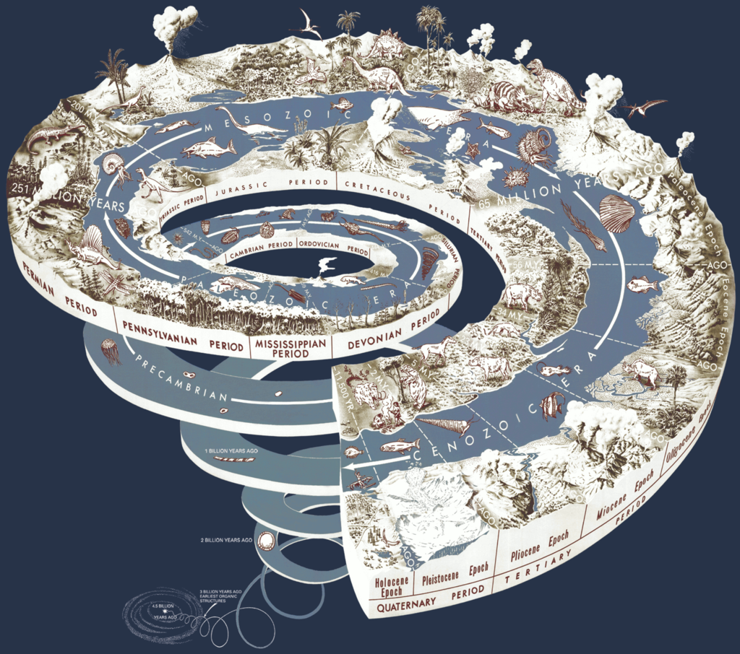
3. TIME

Slide 2
Today we are going to:
practise what we learnt last time (indirect speech + vocabulary + paraphrasing)
talk about geologic time scale and learn some basic terms
practise listening and reading skills
learn how to compare (new phrases + grammar)
talk about the early history of our planet

Slide 3
Paraphrasing
Original
paraphrase
many ways
in order to suit our needs
for millennia
what traditional farming is about
twentieth century
ways of speeding up the proces
Within the past generation
many techniques
with the characteristics we want to see
for thousands of years
the most basic
the last century
more efficient techniques
The latest form of these manipulations

Slide 4
Practise
Fortunately, no harm was done to the village.
We can reduce the negative impact on our environment.
You can learn a lot by watching.
This was an interesting attempt to explore the effects of radiation exposure.
He has shown the genuine interest in the topic.
English exam might be extraordinarily difficult for some students. ☺

Slide 5
Comparison - basic rules
high – higher – the highest (adj)
narrow – narrower – the narrowest
gentle – gentler – the gentlest
clever – cleverer – the cleverest
hard – harder – the hardest (adv)
slowly – more slowly – the most slowly (adv)
boring – more boring – the most boring/less boring – the least boring ☺
seriously – more seriously – the most seriously
big – bigger – the biggest
noisy – noisier – the noisiest
good – better – the best
well – better – the best
bad – worse – the worst
badly – worse – the worst
far – further/farther – the furthest/farthest
common – commoner/more common - the commonest/the most common

Slide 6
Comparison – other structures
Our planet is not as old as other planets.
This organism was too weak to survive.
This organism was not strong enough to survive.
Other planets are older than our planet.
The longer we live, the more we know.
The driest place in the world is in Antarctica.
We have been experiencing the coldest days of the year.
The Niger is one of Africa‘s longest rivers.
Steel is three times heavier than aluminium
The procedure could be carried out twice as quickly.
He conducted the experiment at the same time as you did.
This procedure is the same as the one you showed me.

Slide 7
Homework
Learn and revise the grammar (see the website with exercises in the sources below)
Learn the vocabulary

Slide 8
sources
https://en.wikipedia.org/wiki/geologic_time_scale#/media/file:geological_time_spiral.png (picture)
https://www.youtube.com/watch?v=rWp5ZpJAIAE&t=70s (listening)
https://www.flo-joe.co.uk/teachers/resources/flojoe_free/fce/worksheets/transfrm/print.htm (grammar - self-study)
Paterson, Ken. Oxford Grammar for EAP, Oxford, OUP, 2013 (grammar - the class)
Murphy, Raymond. English Grammar in Use (intermediate), 3rd ed., Cambridge, CUP, 2004 (grammar – in the class)

