Slide 1

Climate change impact on the mountain environment in Peruvian Andes and Tien Shan Mountains in Kyrgyzstan
Prof. Dr. Bohumir Jansky
Charles University in Prague, Faculty of Science,
Department of Physical Geography and Geoecology

Slide 2
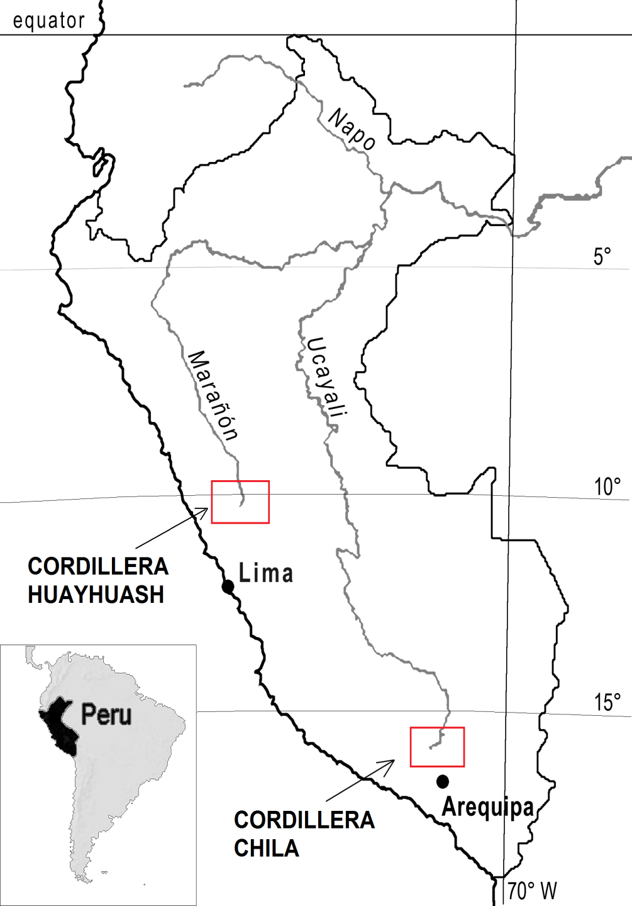
New research project - funded by the Czech Science Foundation
“Natural Hazards of the Amazon
River Sources Territory Caused
by the Global Climate Change”
STUDY AREA
The Peruvian Western Andes (Cordillera Occidental) – altitudes higher than 5000 m
→ The watershed between Pacific and Atlantic Oceans
Cordillera Huayhuash (10° S.)
Cordillera Chila (15° S.)
– distance N-S about 1000 km.

Slide 3
Comparing of two areas:
1. Marañon River headstream area (humid) - mountain steppe páramos
2. Ucayali – Apurímac (Amazon) headstream area (arid)
– mountain steppe puna
Western hillsides:
Costa – zone along the Pacific coast (aridity growth to the south) → desert area and vegetation of type lomas in fog layer garúa.
- periodical effect El Niño (El Niño – Southern Oscillation): temperature increase → heavy rain → natural disaster (increase of glacier melting,
debris flows - huaycos, outburst of glacial lakes, floods, landslides).
Specially strong El Niño in 1982/83, 1997/98 and 2016/2017
Oriental hillsides and the tableland: humidify – under the influence of trade wind from Atlantic ocean
Partnership in Peru:
National Hydrometerological Institute SENAMHI (Servicio Nacional de Meterología e Hidrología)

Slide 4
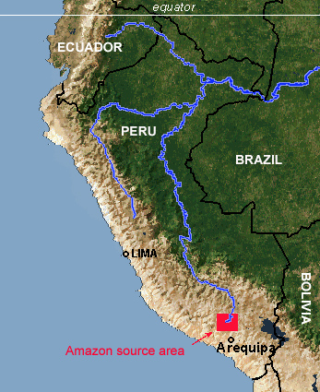
Rio Amazonas
Rio Marañon
Rio Ucayali

Slide 5
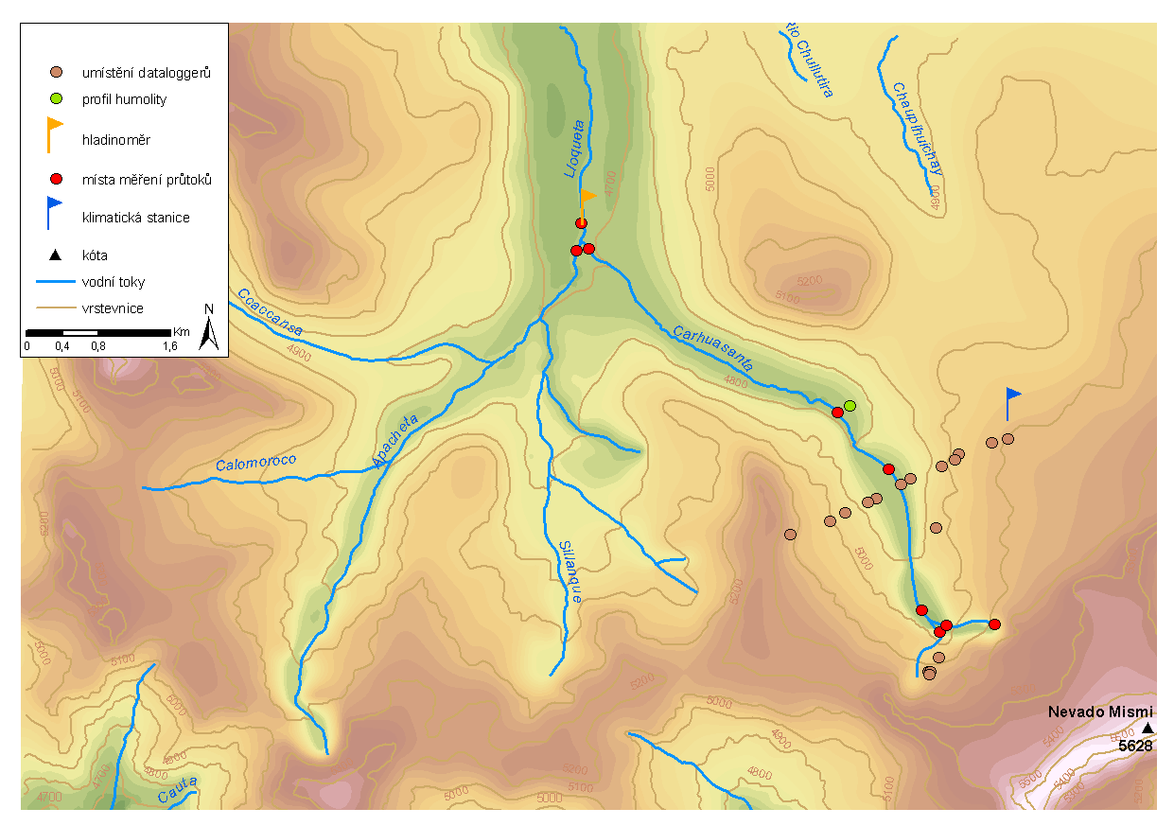
Headwaters territory of the Amazon River

Slide 6
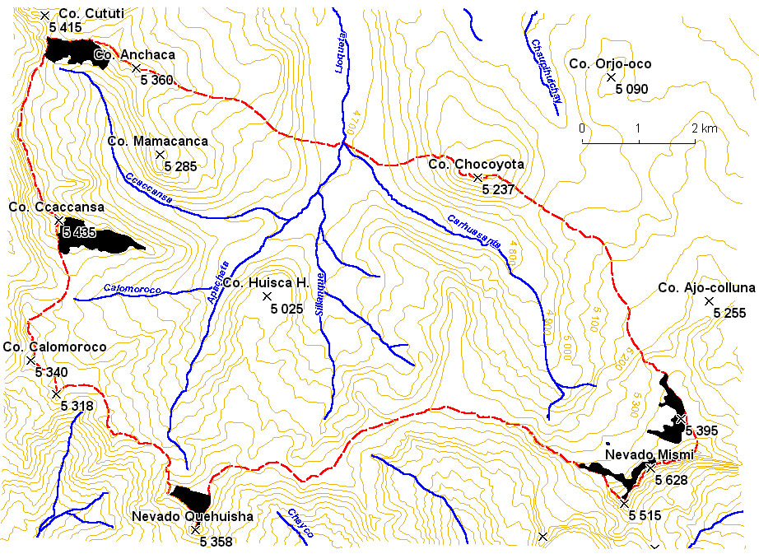
Headwaters territory
of the Amazon River (in 2000)

Slide 7
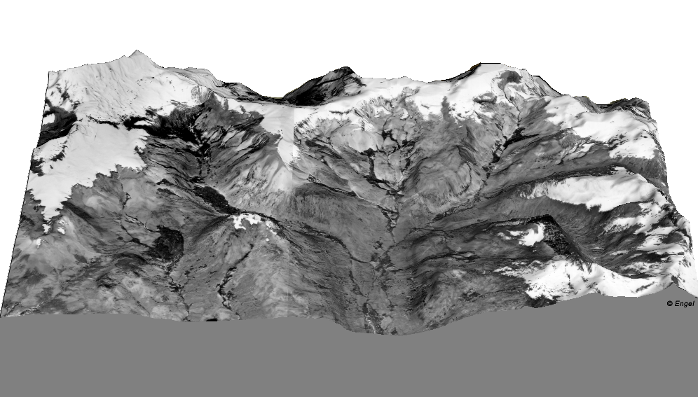
km 0
3D model of the headwater territory of the Amazon river

Slide 8
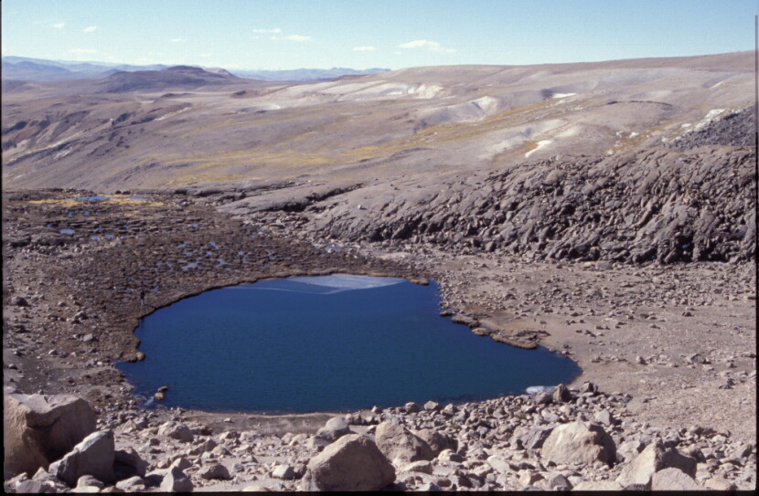
Laguna Bohemia – left source of the Carhuasanta River

Slide 9
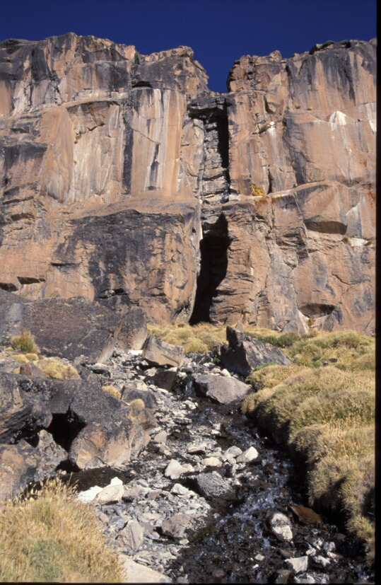
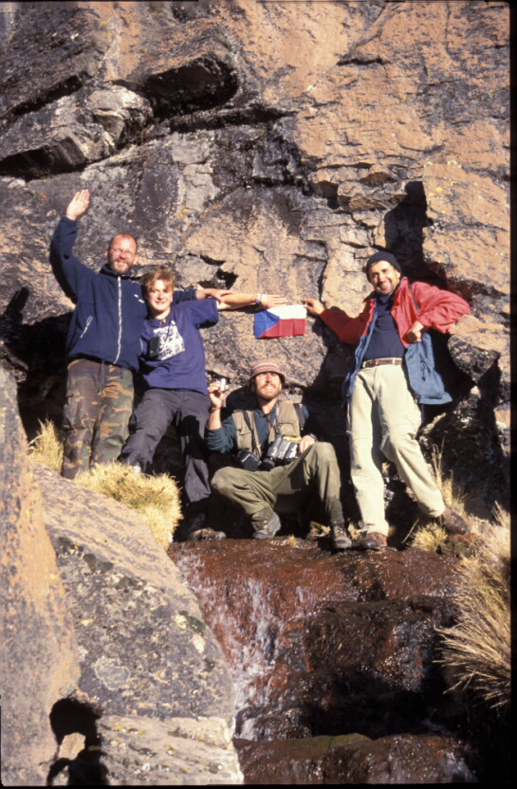
Right headwaters stream of the Carhuasanta River

Slide 10
Glaciation in 2000
The glaciation was restricted to the highest parts of mountain ranges in the eastern part of the Cordillera Chila. There are four glaciers in the catchment area of the Carhuasanta and Apacheta rivers that extend over a surface of 1.54 km² out of total 57.15 km².
The snowline altitude varies from 5250 to 5300 m.
Over the 20th century, the glaciers of an observed area have undergone rapid retreats: glaciers experienced a 60 % decrease in surface area since 1955.
Glaciers disappeared from 2000 to 2007 completely and fields of perennial snow persisted in the highest areas only

Slide 11
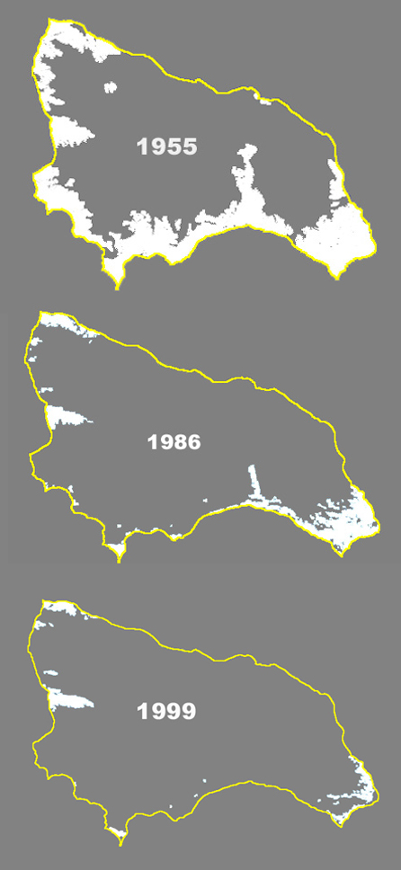
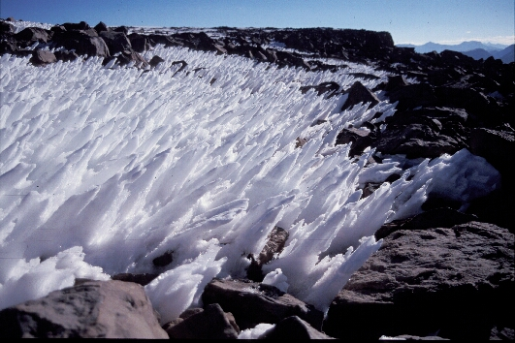
Glacier retreat
since 1955 to 1999

Slide 12
Glaciers dynamic in the Amazon River headwaters territory since 1955 to 2000
Glacier
Area [km²]
Difference
%
Max. alt.
[m]
Min. alt.
[m]
Orientation
1955
2000
Mismi
0.57
0.45
21
5628
5250
NW
Chayco
0.72
-
100
5200
5150
NW
Quehuisha
0.97
0.20
79
5358
5250
N
Calomoroco
0.42
-
100
5340
5200
NE
Ccaccansa
0.66
0.51
23
5435
5250
S
Cututi
0.50*
0.38
24
5360
5200
S
Total
3.84
1.54
60
5628
5150

Slide 13
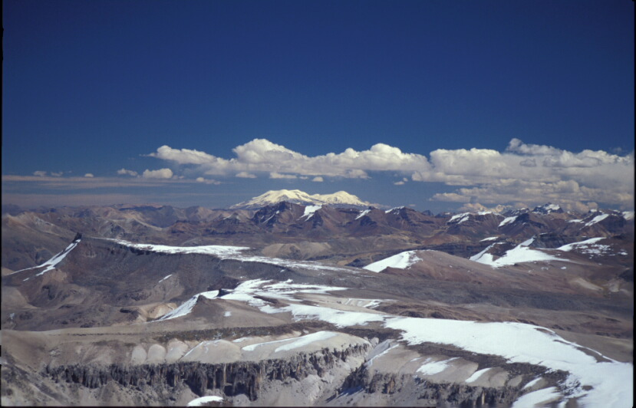
The watershed between Pacific and Atlantic Oceans

Slide 14
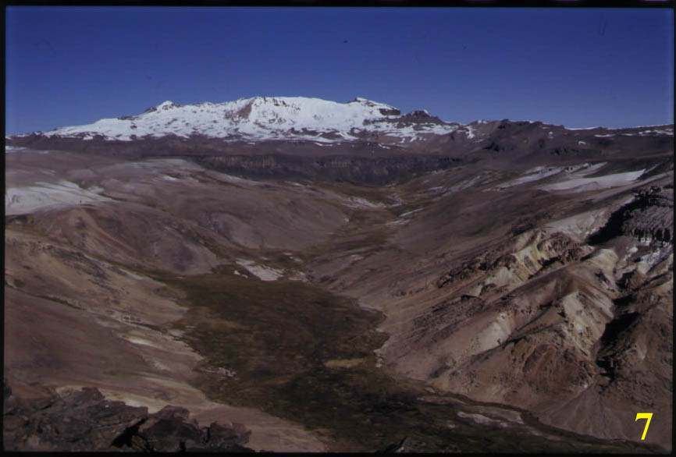
Carhuasanta River and Nevado Mismi (5628 m)

Slide 15
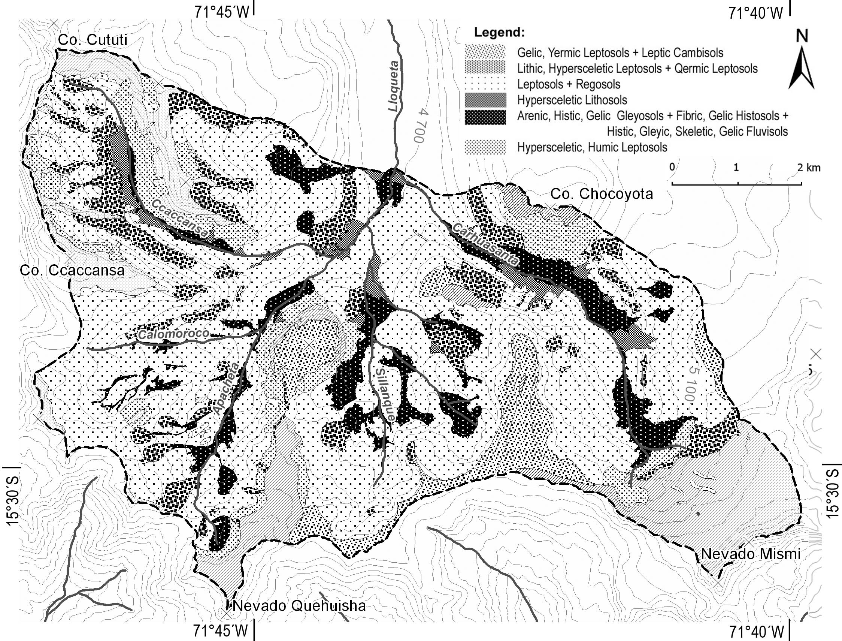
Distribution of soils in the Amazon River headstream area

Slide 16
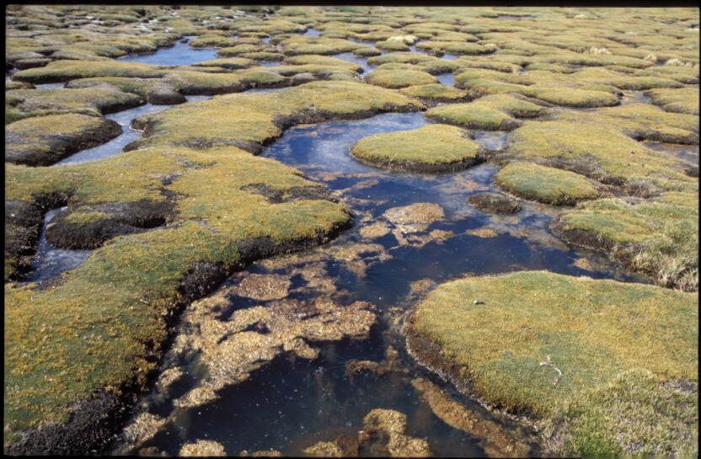
Die Talvegetation „Champa“ (Distichia muscoides)

Slide 17
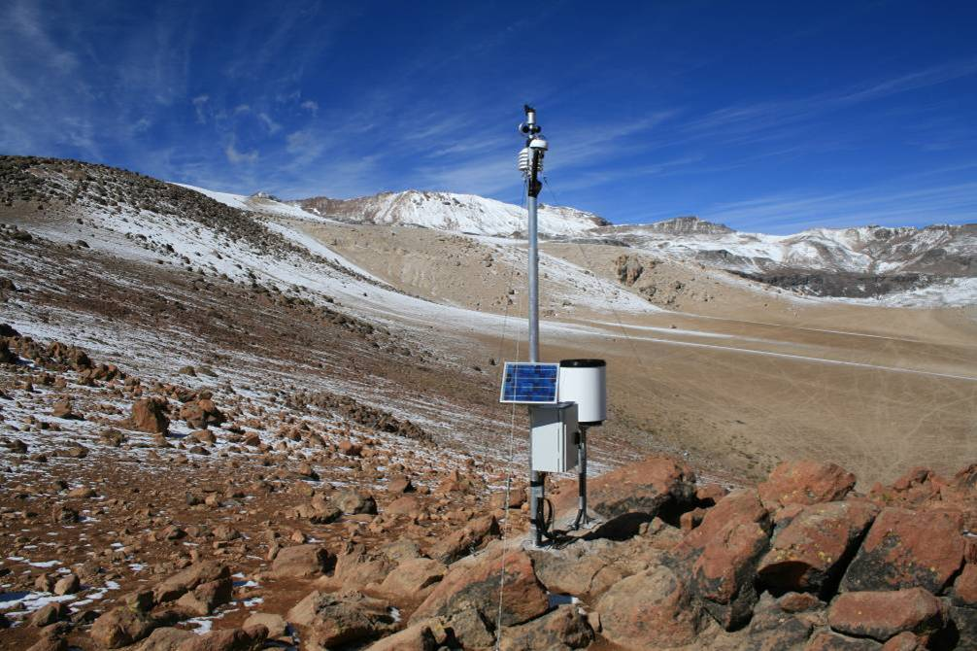
The climatic station at the Amazon’s source, located at 5075 m above sea level: it was the highest located station in Peru. In background Nevado Mismi (5628 m).

Slide 18
air temperature
soil temperature (0.1 m)
radiation
Air temperature, soil temperature and solar radiation at the Amazon’s source. The climatic station of the Charles University in Prague (5075 m a.m.s.l., period 30.7. - 6.8. 2008.

Slide 19
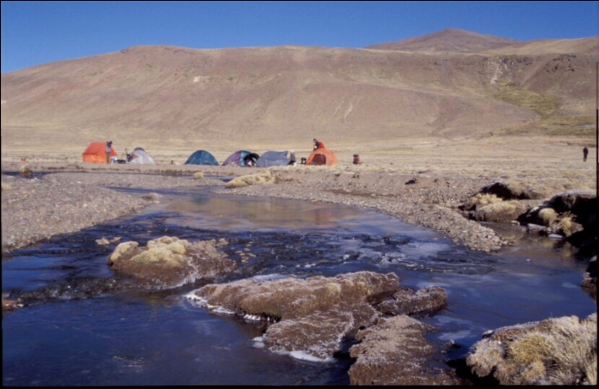
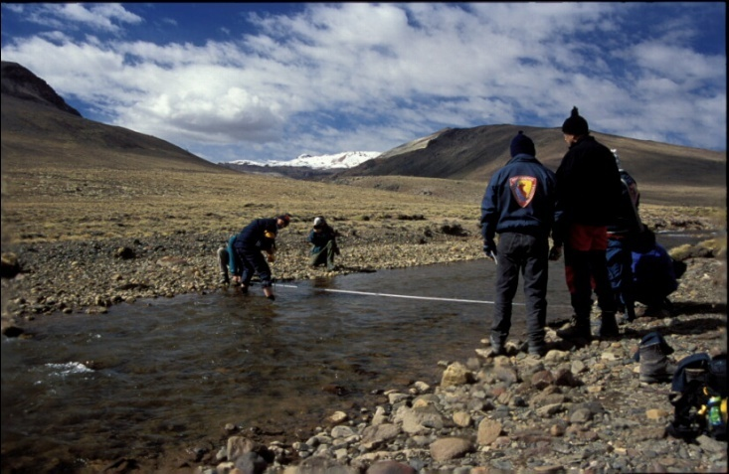
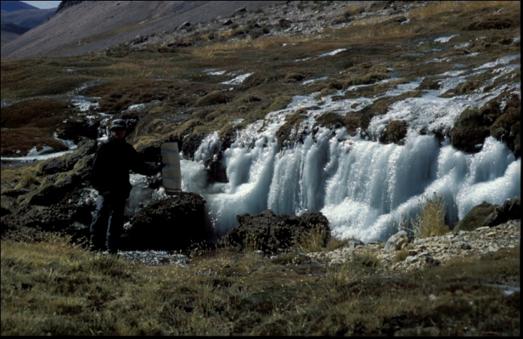

Slide 20
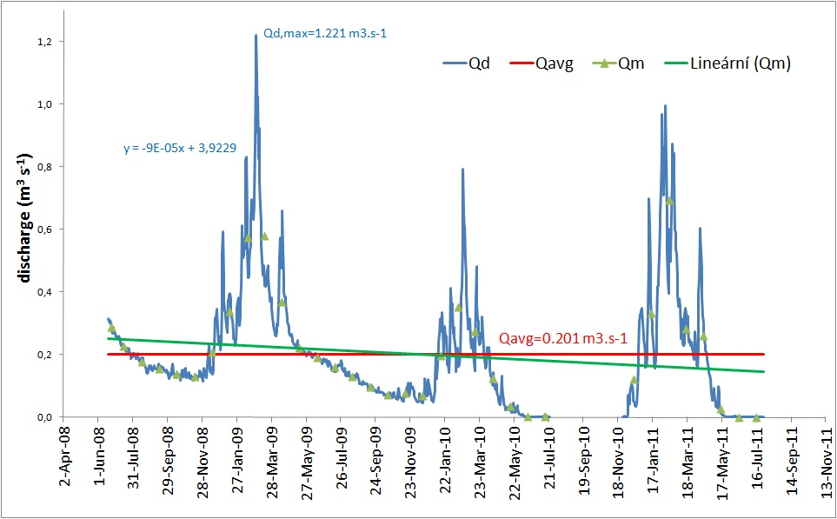
Average daily and monthly discharges in the Lloqueta River (headwaters territory of the Amazon River) and line of trend of monthly discharges. Period: 24.4. 2008 – 16.7. 2011

Slide 21
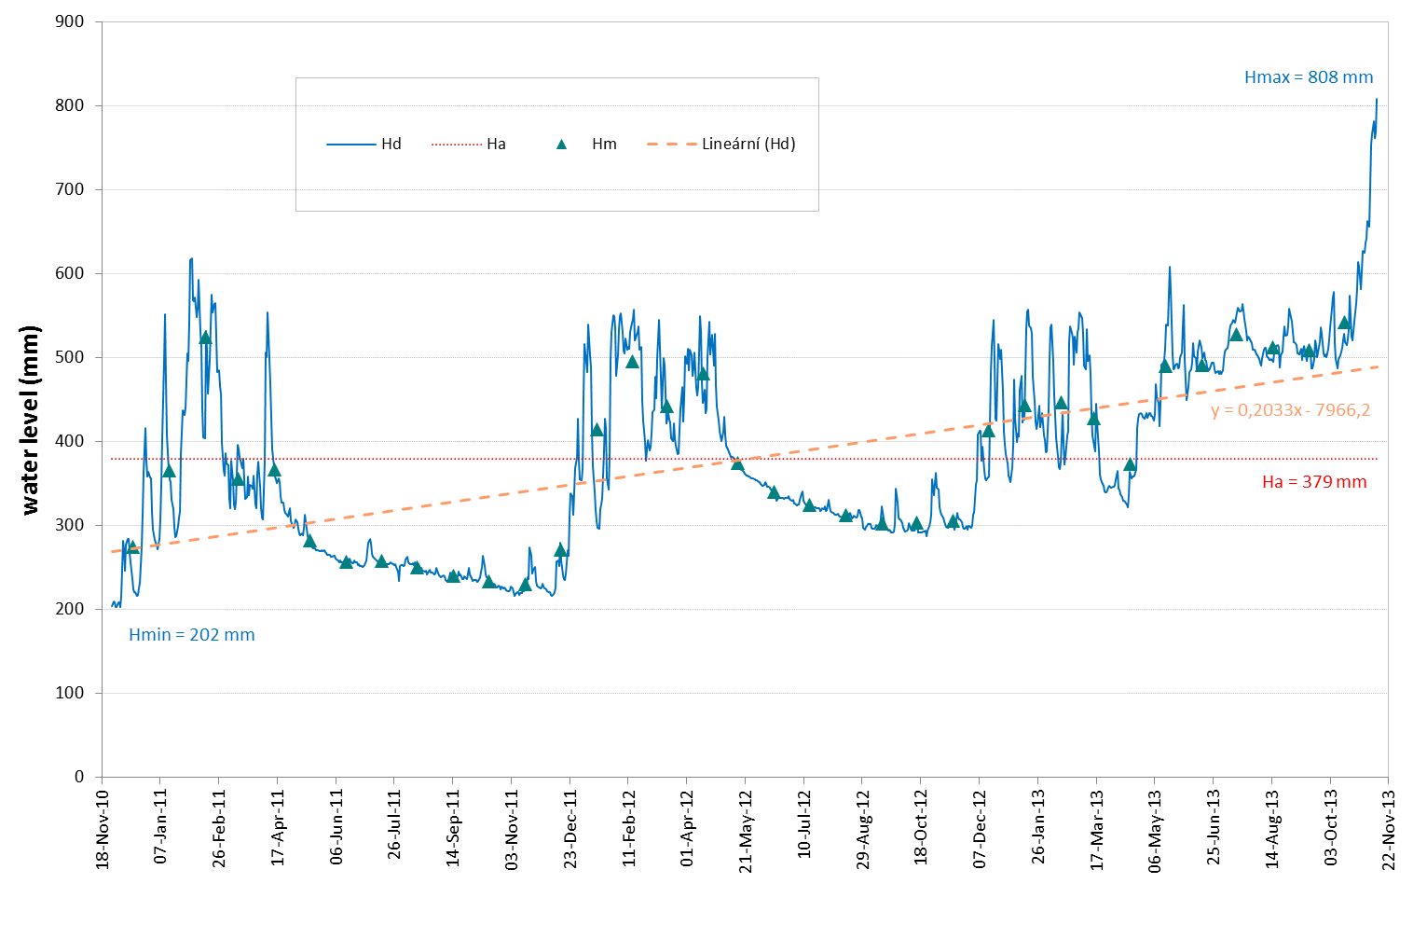

Slide 22
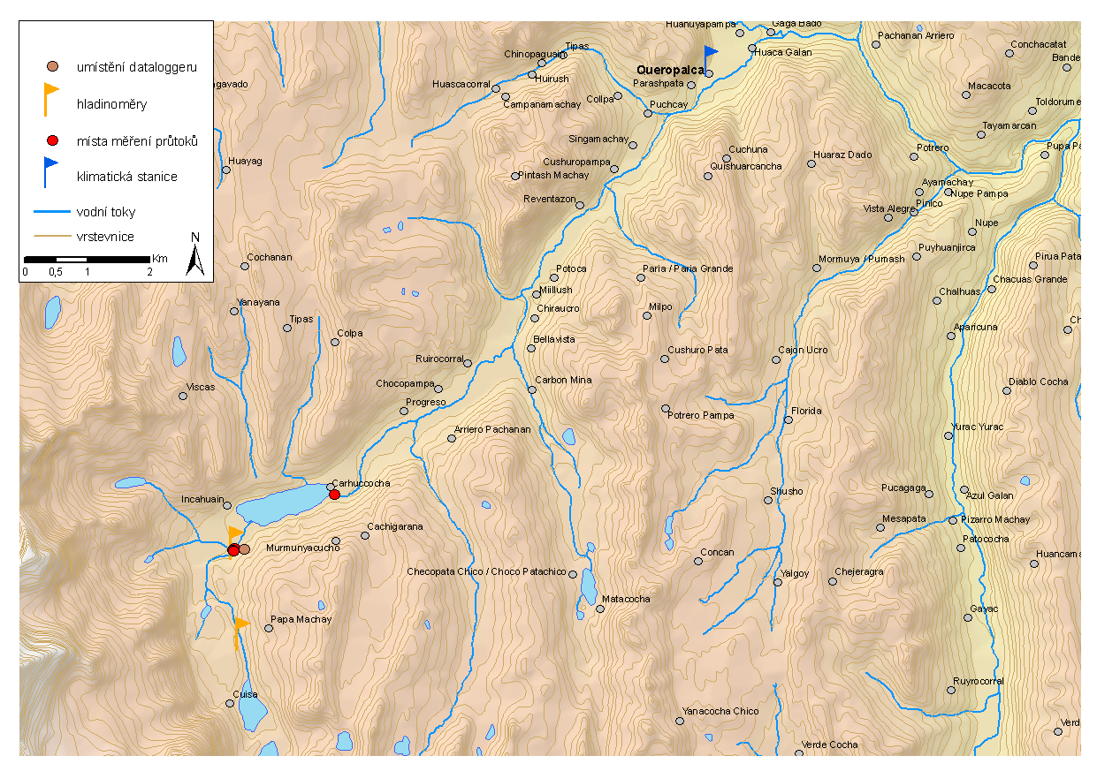
Headwaters territory of the Marañon River

Slide 23
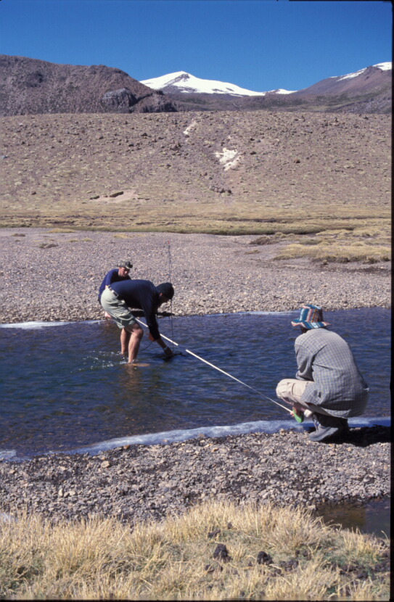
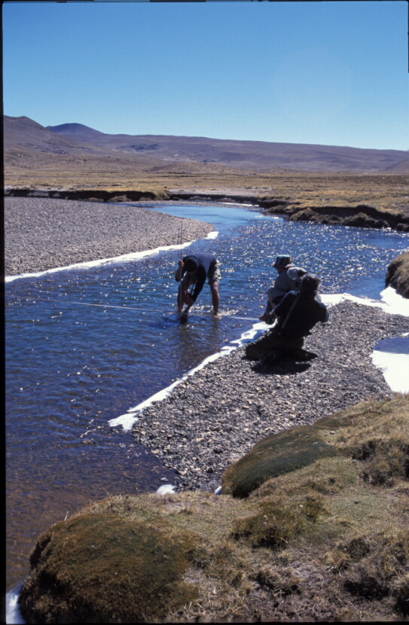
Durchflussmessungen in Rio Lloqueta

Slide 24
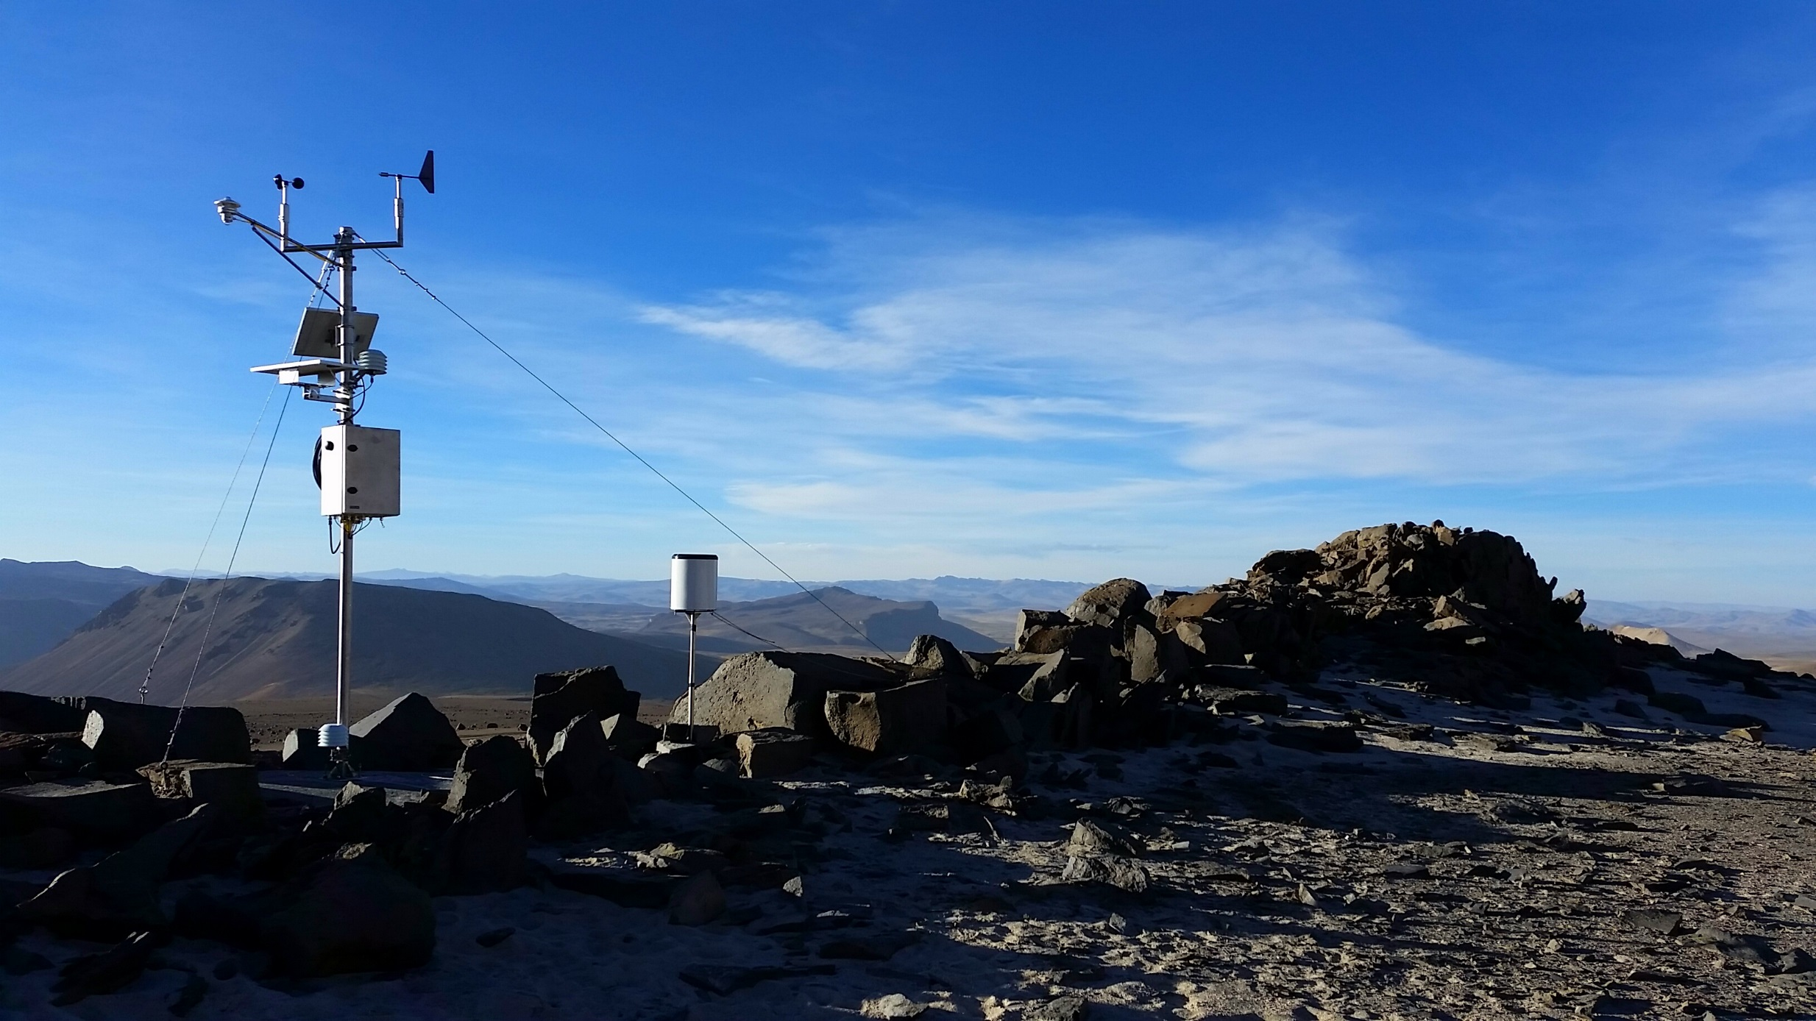
The new climatic station at the Amazon’s source, located at 5280 m a. s. l.
The highest located station in Amerika (5 280 m n.m.), from November 2016.

Slide 25
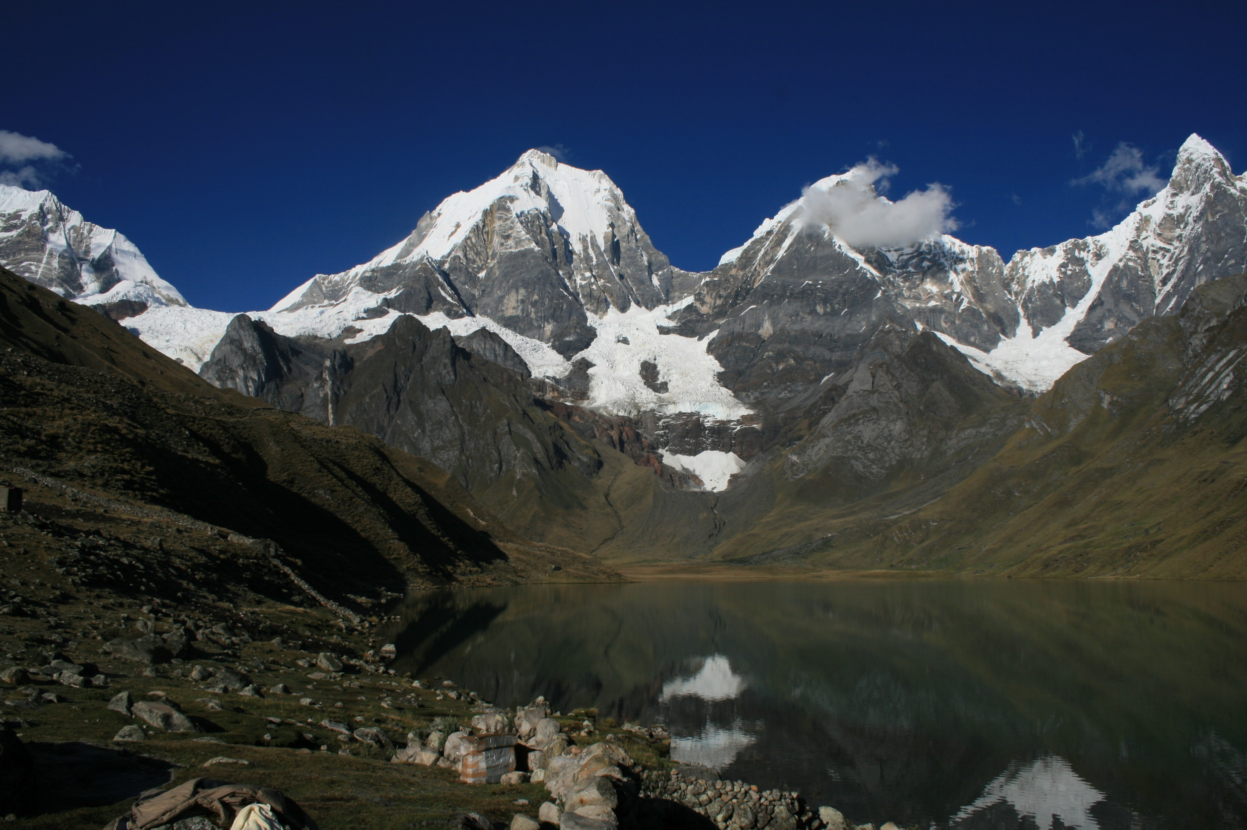
Cordillera Huayhuash, Nevado Yerupaja (6617 m)

Slide 26
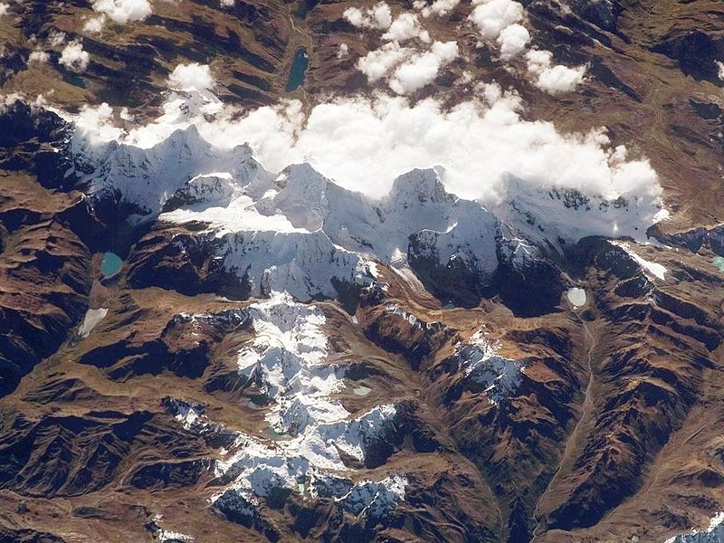
Cordillera Huayhuash
De NASA - http://earthobservatory.nasa.gov/IOTD/view.php?id=8924, Dominio público

Slide 27
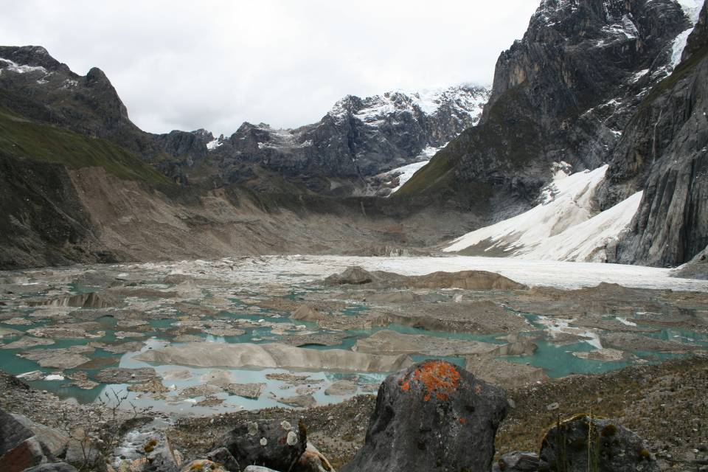
Proglacial Cangrajanca Lake

Slide 28
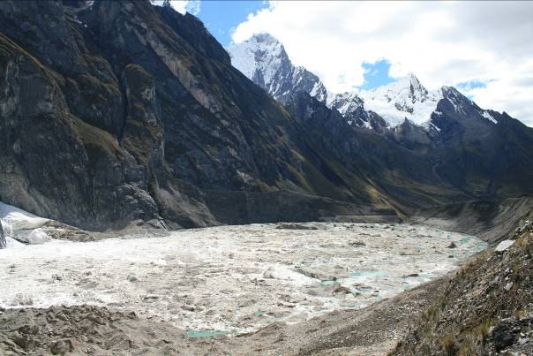
Dangerous Cangrajanca lake with periodical outburst. The lake basin is filled from the Yerupaja glacier.

Slide 29
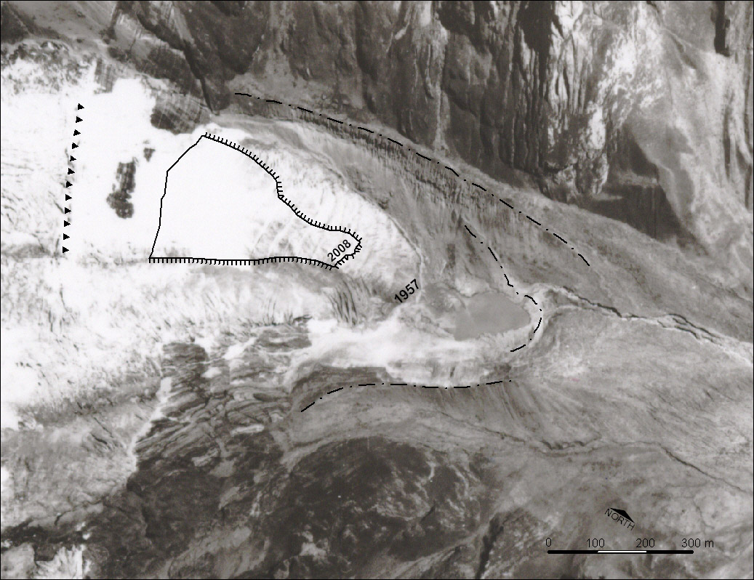
Yerupaja glacier retreat (1957 – 2008)
Total retreat: 230-350 m, annual retreat: 4 – 7 m.

Slide 30
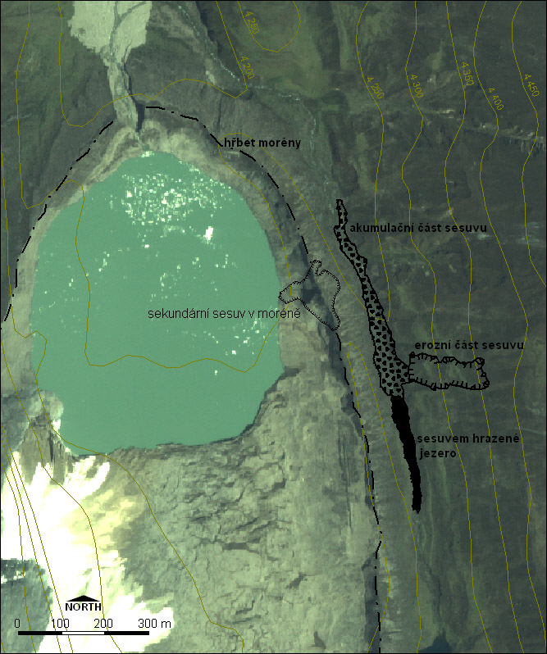
The relief changes
in the valley of Carhuacocha river after lanslide from 8.3. 2009
Lake outflow
Central moraine
Proglacial lake
The new dammed lake

Slide 31
Rainfall-related debris flows in Carhuacocha Valley
The debris flow was triggered by cumulative rainfall combined with an extreme precipitation event:
From the end of January to the beginning of March 2009, the Cordillera Huayhuash experienced abnormally high precipitations at exceeded 270mm.
The annual precipitation at the nearby Cajatambo station
(distance 25 km) is 563 mm.
From January 25 to March 7 – 270 mm
10 days prior to flow – 56,2 mm
24 h prior to flow – 18,4 mm

Slide 32
The new lake (E) damed by the landslide (A,B,C,D)

Slide 33
New hydrographic situation
after landslide:
→ water percolated through the moraine dam of Cangrajanca Lake
→ lateral moraine disturbed by groundwater erosion

Slide 34
Lateral moraine: disturbed by groudwater erosion

Slide 35
Conclusions
The monitoring has confirmed a falling trend in the flow rate, following the retreat of area glaciers.
At present, the Cordillera Chila mountain range no longer has any glaciers. The last of them melted between 2000 and 2007.
The Cordillera Huayhuash mountains show a relatively slow retreat of valley glaciers in comparison with the neighboring Cordillera Blanca range → since 1957, glaciers have retreated at an average annual rate of 4 to 7 m, summary by 230 to 350 m.
Systematic measurements of soil temperatures have shown an absence of long-term frozen soils in locations up to 5150 m above sea level.
The lower boundary of the zone of mountain permafrost is, therefore, located higher than the literature indicates for this area.

Slide 36
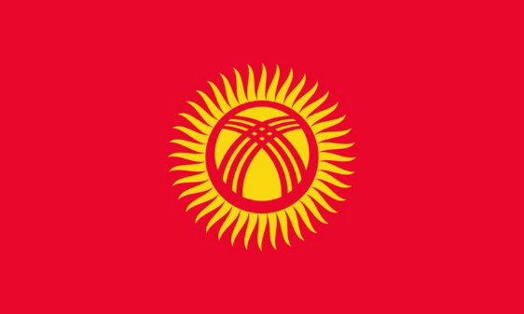

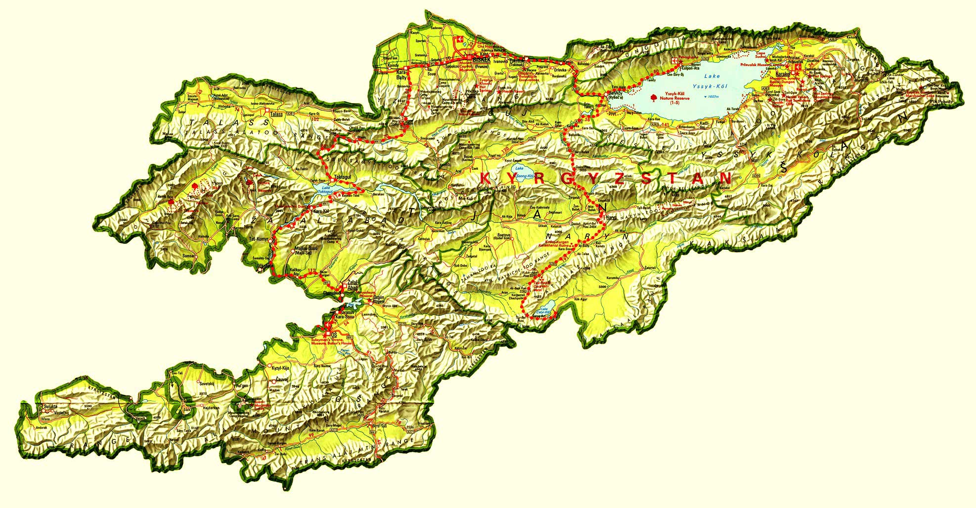
Kyrgyz Republic
Area: 198 500 km²
Average relief altitude is 2 750 m a.s.l.
Population 5,3 millions
94 % of surface at the altitude above 1 000 m
40 % of surface at the altitude above 3 000 m
Highest point: Pik Pobedy 7 439 mts a. s. l.

Slide 37
Projects of the Czech Development Cooperation
Monitoring of high-mountain glacial lakes and protection of population against catastrophic consequences of floods caused by moraine dam failure (2004-2007).
Risk analysis and limiting the consequences of high-mountain lake dam failure (2007-2010).
Project funded by NATO SPS
Glacier hazards in Kyrgyzstan: implications for resource
development and water security in Central Asia
(2012-2013)

Slide 38
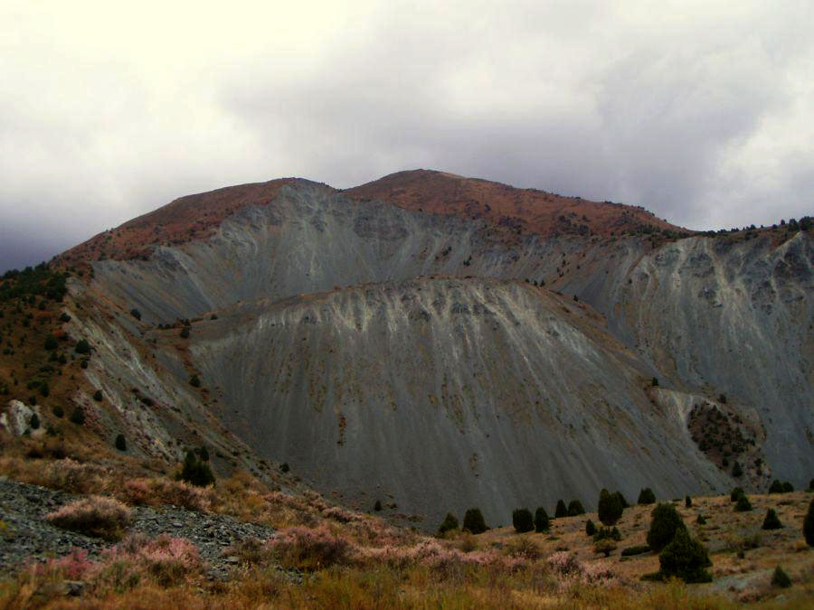
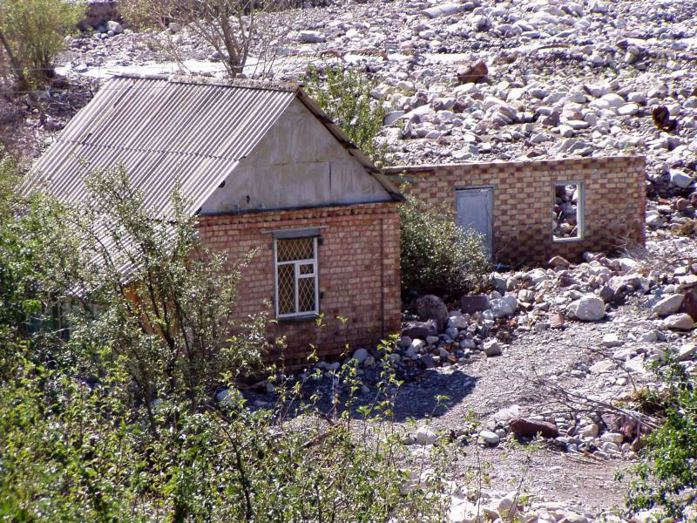
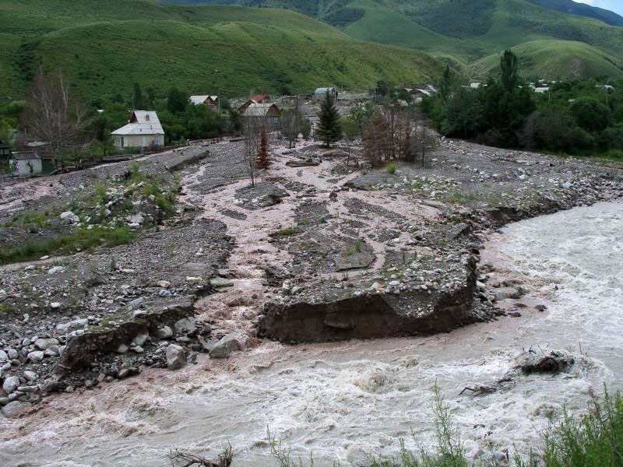
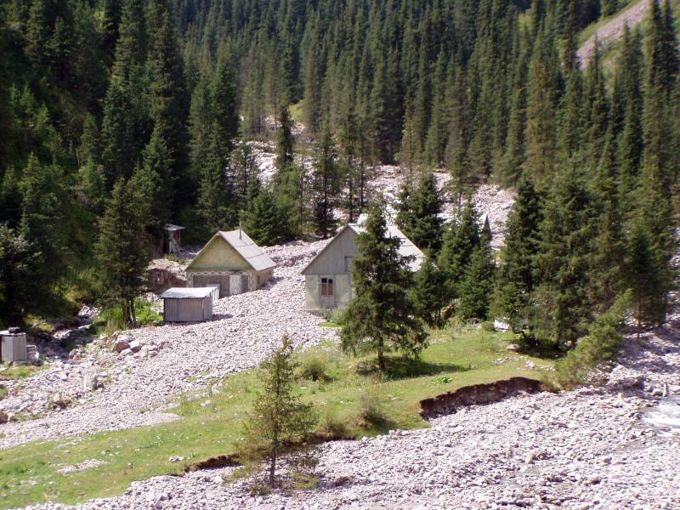
Natural hazards
in Kyrgyzstan
landslides
floods
debris-flows

Slide 39
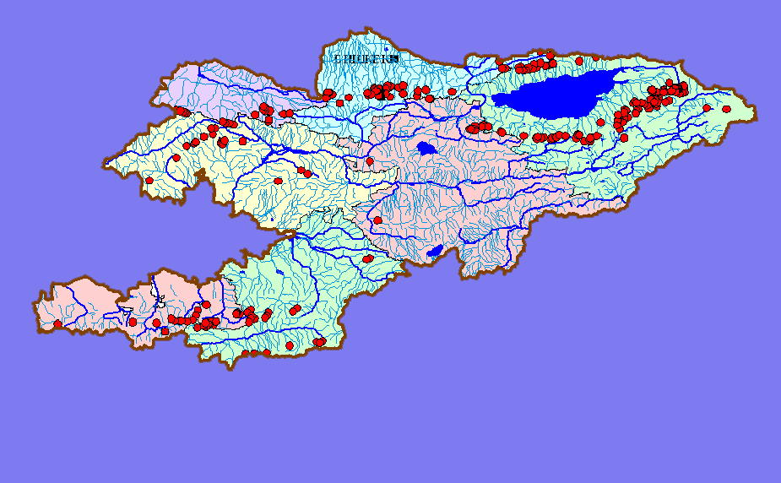
The hazardous alpine lakes in Kyrgyzstan
1923 lakes covering more than 0.1 km²
100 lakes more than 1 km²
328 potentially dangerous lakes
15 actually dangerous lakes
30 of high potential hazard
95 % of population lives in dangerous river valley zones

Slide 40
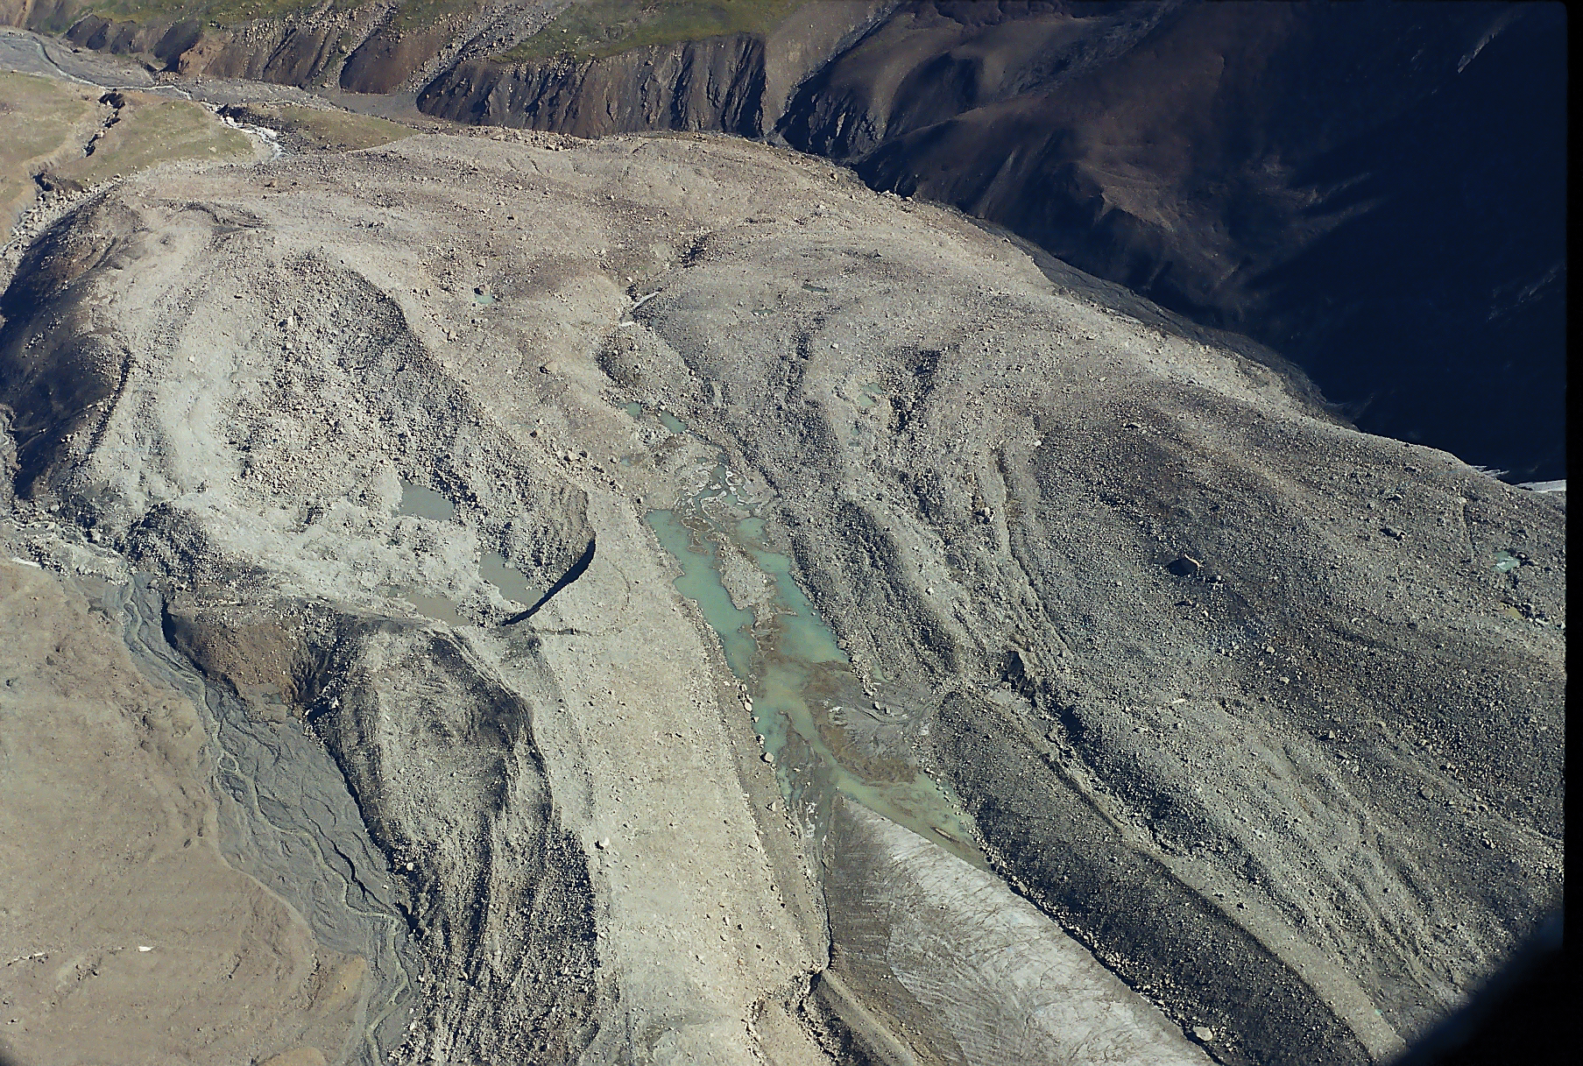
Lakes after outburst
More than 100 victims
Outburst thermokarst lake in Shakhimardan (1998)

Slide 41
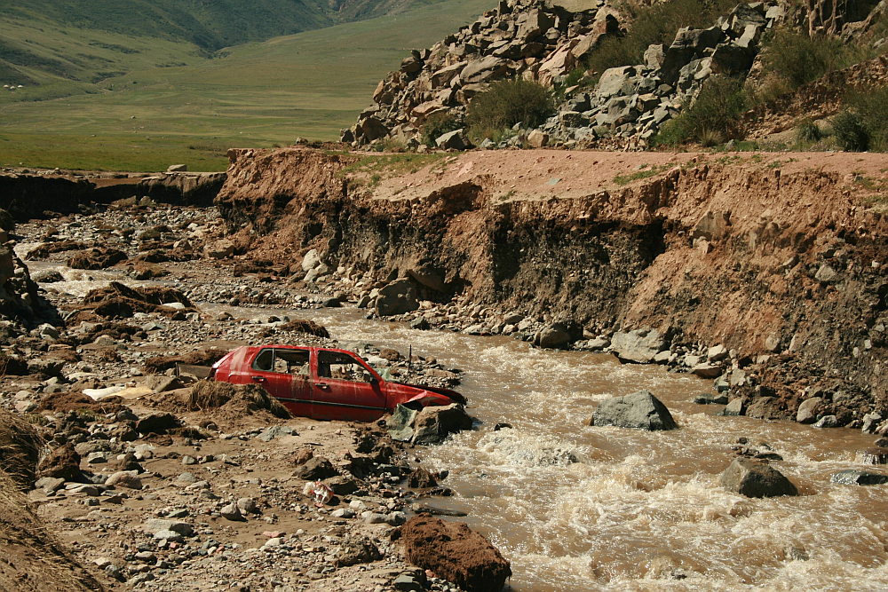
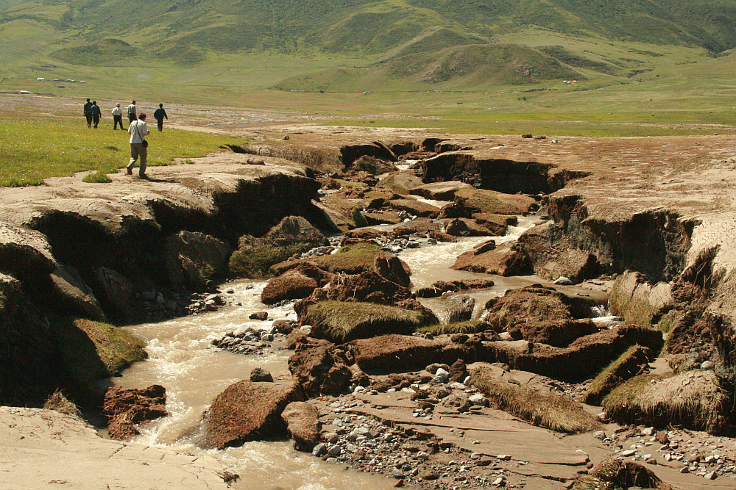
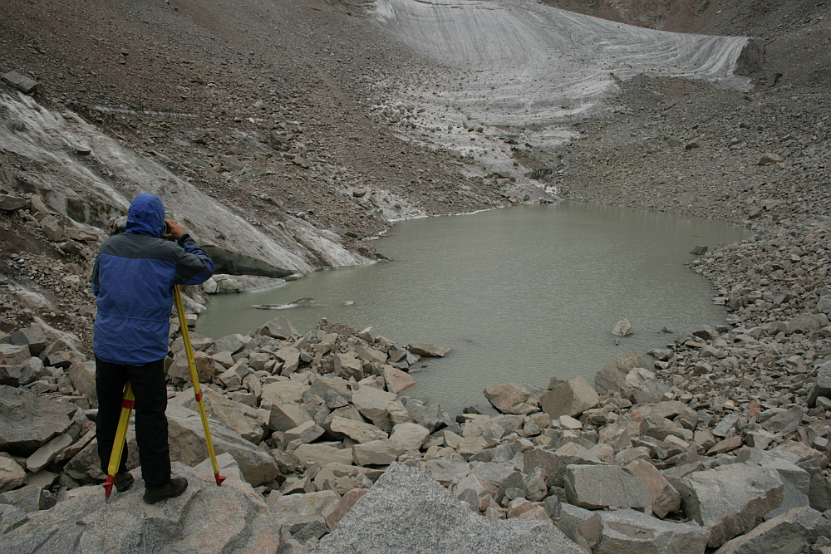
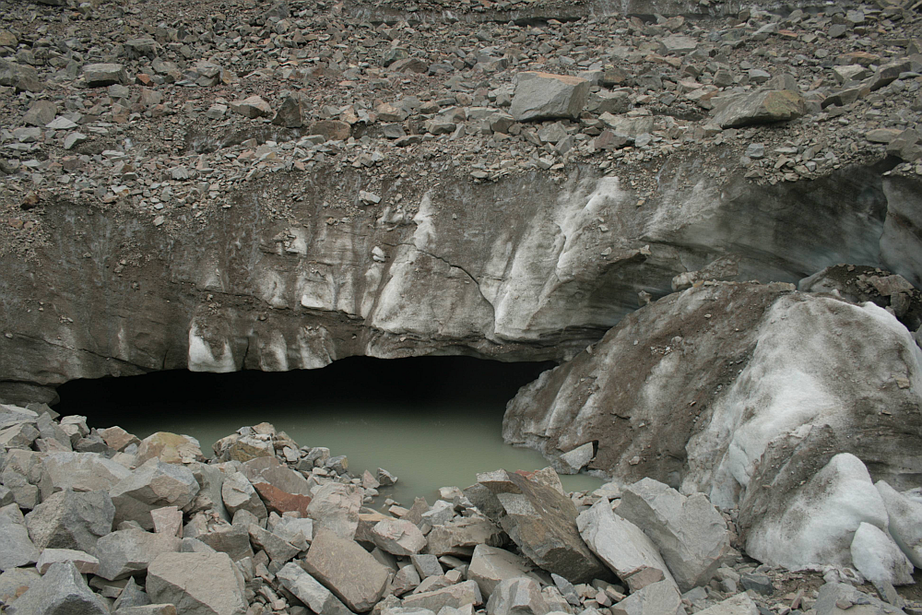
Outburst of Zyndan glacial lake, 24th of 2008

Slide 42
Genetic classification of lakes
Monitoring of the mountain lakes in Kyrgyzstan was aimed mainly at evaluation of dam stability with regard to the risk of lake rupture and consequent occurrence of flood and stone flows ("sels").
Genetic types of lakes in high mountain regions of Kyrgyzstan (according Jansky, Sobr and Yerokhin 2006):
tectonic, glacier, morainic-glacier, morainic, lakes
dammed by a rock step and lakes dammed by a landslides

Slide 43
Typology of alpine lakes
Nonhazardous lakes
Hazardous lakes
Tectonic
Glacial
Moraine-glacial
Moraine
Moraine-riegel
Dammed
Riegel
Dammed by landslide
Dammed by glacier
Interglacial
Intermoraine
Thermokarst
By landslide
By debris-flow

Slide 44
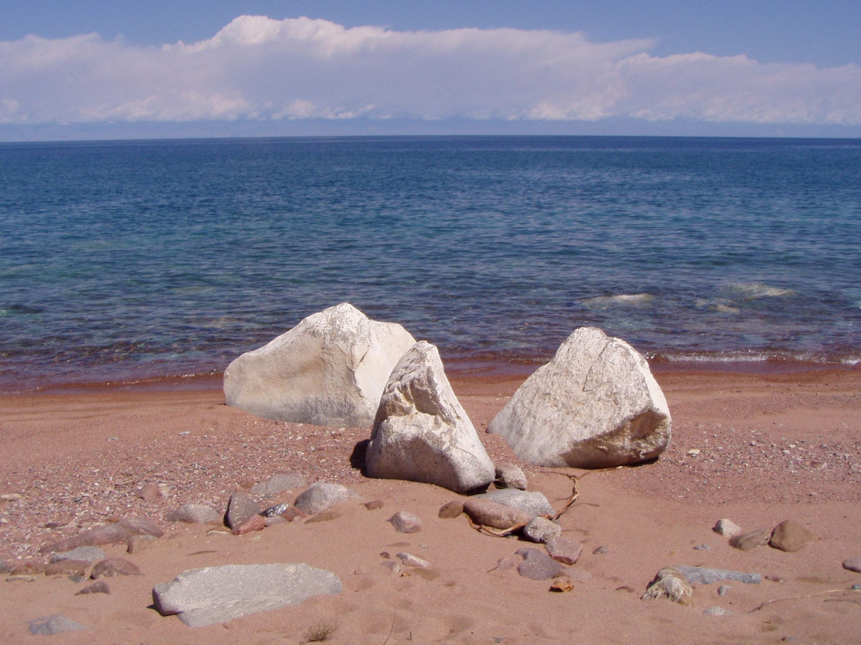
Tectonic lakes
Issyk - Kul

Slide 45
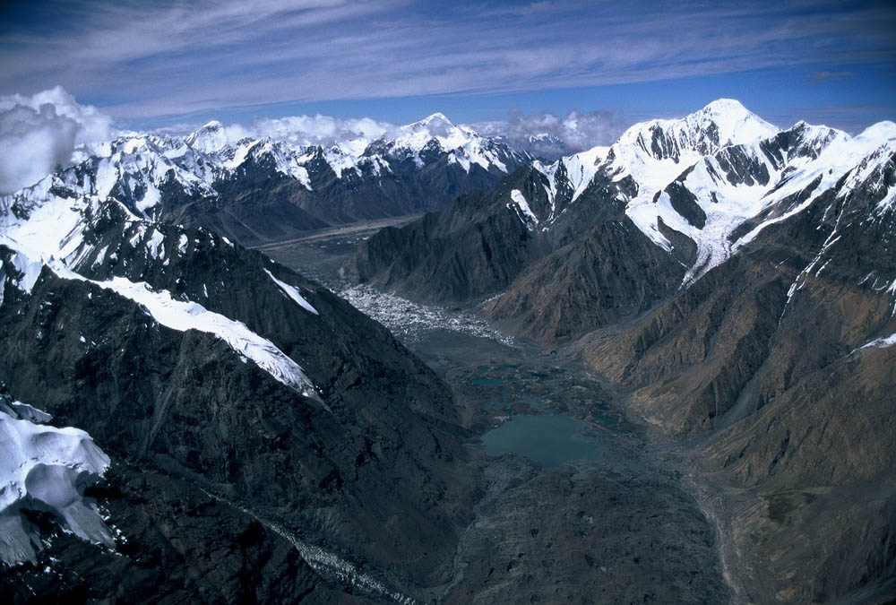
Glacial (proglacial) lakes:
dammed by a glacier, situated directly in the body of a glacier or in the moraine on its contact
Glacier South Inylcek
Merzbacher lake
Glacier North Inylcek

Slide 46
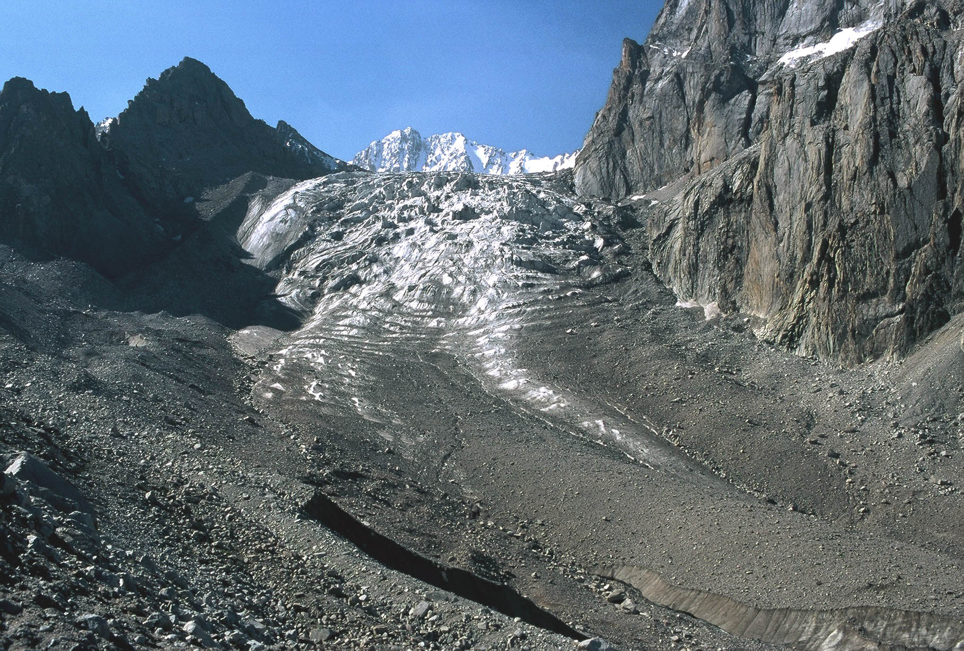
Intraglacier lakes: formed in hollows of glaciers, mostly in places of large icefalls with a complicated system of underground canals
Glacier Ak - Sai

Slide 47
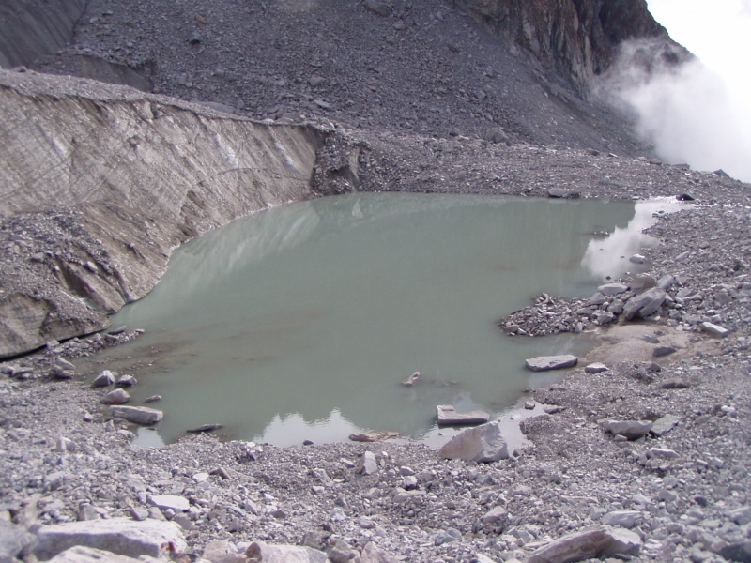
periodical Ak-Sai lake

Slide 48
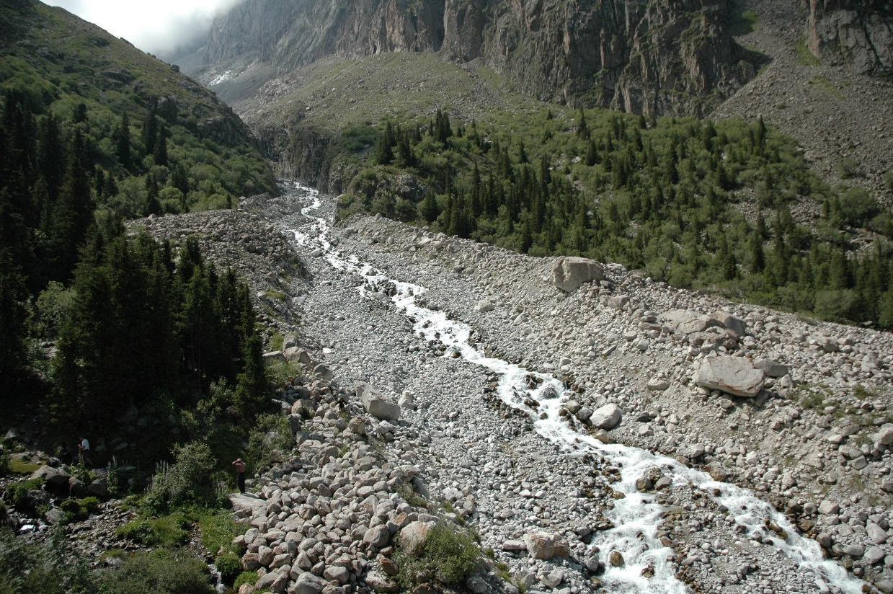
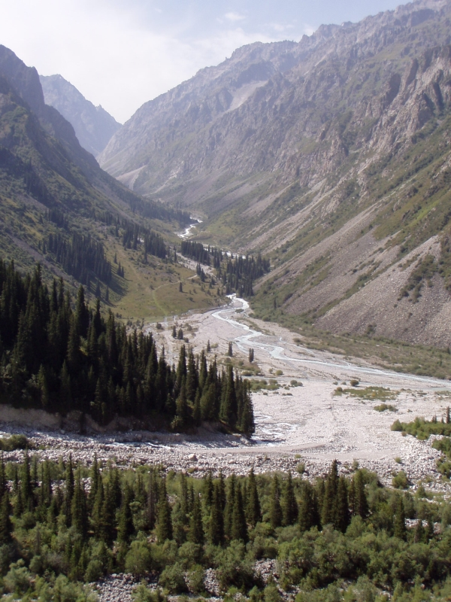
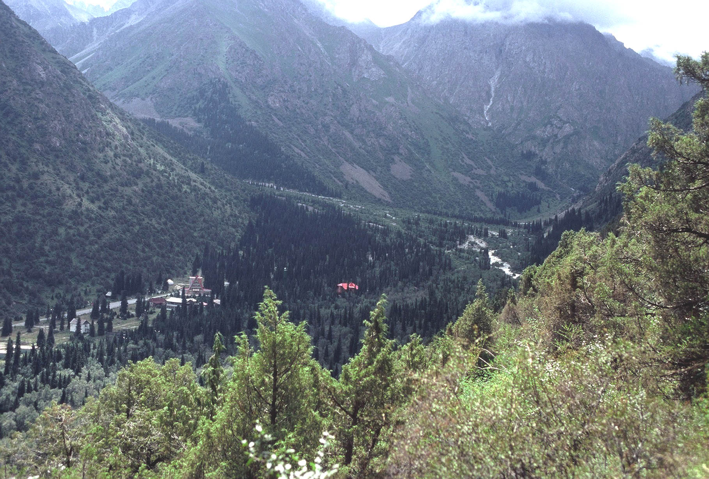
Stone flow (sel) after rupture of Ak–Sai lake in 1985 and 2014
Holiday residence of President of Kyrgzystan

Slide 49
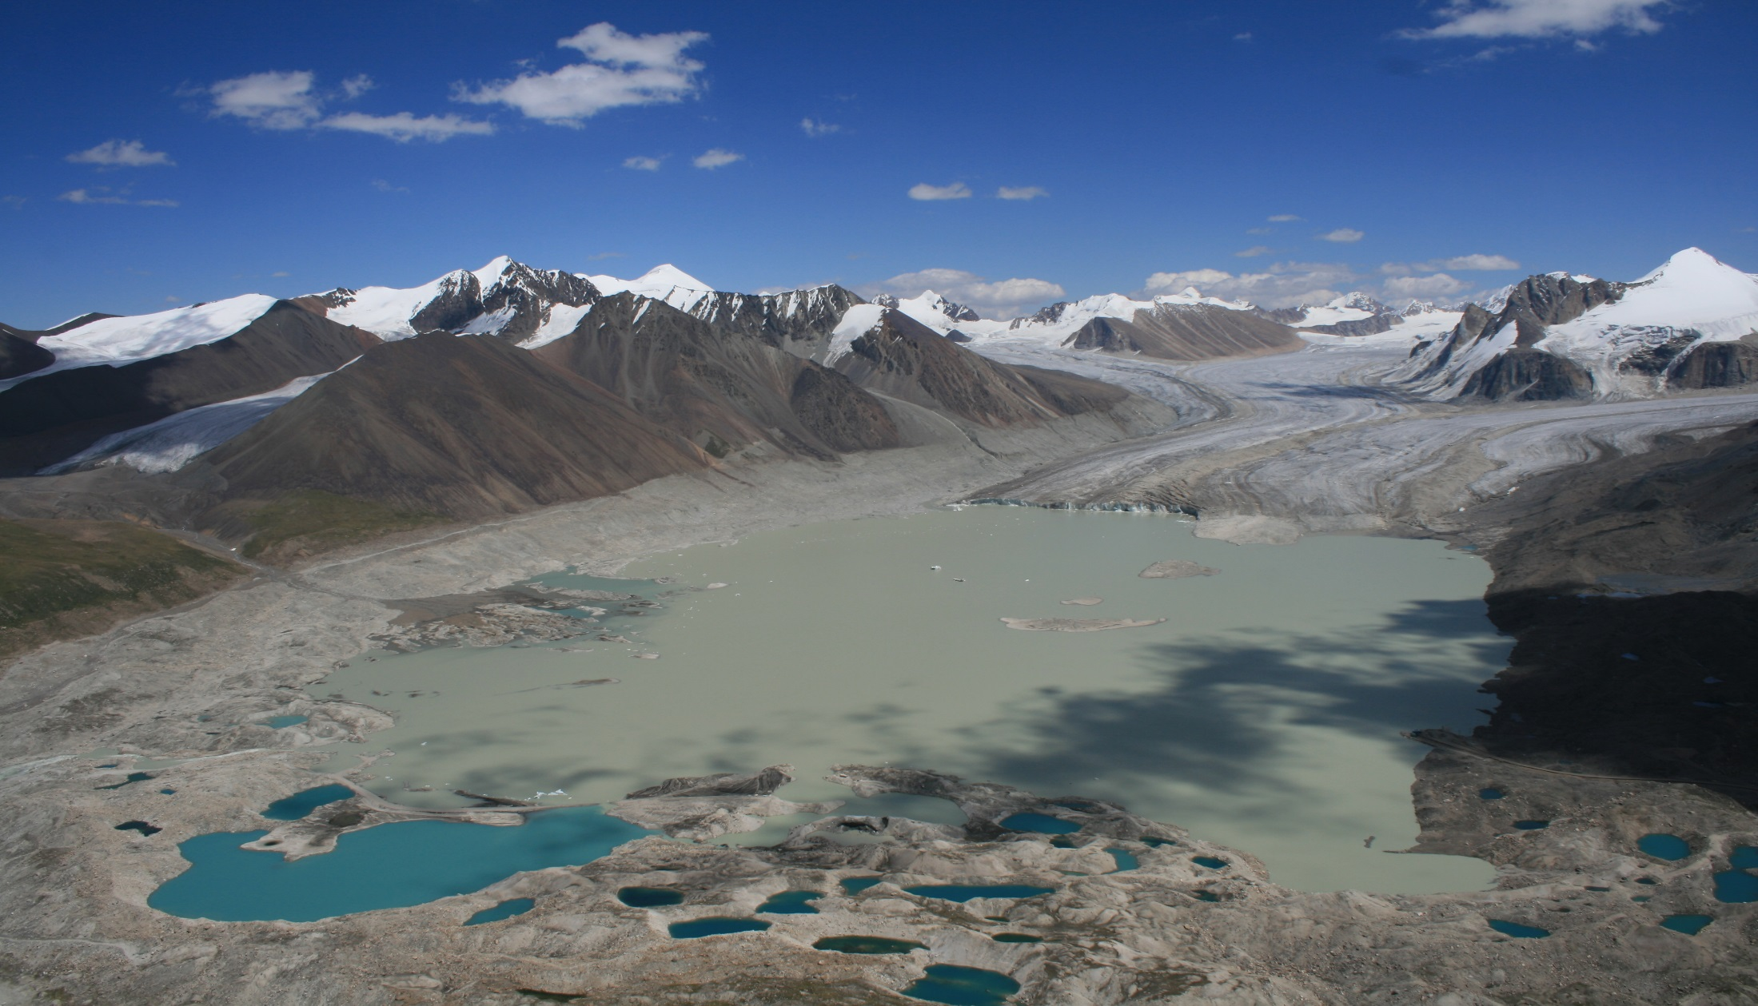
Morainic-glacier lakes: a) subtyp – lakes of intramorainic depressions
This type is developing in basins of intramorainic depressions after retreat of a glacier
Petrov lake

Slide 50



Morainic-glacier lakes: b) subtyp lakes of thermokarstic depressions

Slide 51

Lakes dammed by a landslides: large volume → therefore rupture is very dangerous
landslide
periodical outflow
Koltor lake

Slide 52



Koltor lake: Superficial outflow after intensive precipitation
Overflow 19/ 7/ 2004
Overflow 6/8/2006
Overflow 28/7/2014

Slide 53


Koltor lake – new trouble
Erosion furrow
at outer side of lake dam

Slide 54


Development of precipitations
and temperature
Baytyk station 1 579 mts a.s.l.
Precipitations:
15 years cycle until 1966,
Change to 20 years cycle.
Steep increase since
middle of nineties.
Temperature:
Regular 20 years cycle.
Clear correlation between
precipitations and temperature
In the middle of sixties
and eighties
Highest number of
disastrous outbursts
in 1965-70, 1983-88, 1997-99

Slide 55

Petrov lake: an extremely dangerous evolution

Slide 56
Petrov lake : an extremely dangerous evolution
Moraine-glacial lake: developed in basin of intramorainic depression after retreat of Petrov glacier.
Is located in the foreground of the same-called glacier on the north-western slope of Ak-Sijrak massive in southern Tien-Shan.
The moraine-glacial lakes are considered as the most dangerous type including 47 % of listed lakes.
Petrov glacier is 69.8 km² large and 23 km long.

Slide 57

Tailings dam
Petrov Lake
Petrov Glacier
Gold mine Kumtor
Satelite image of the Petrov Lake area (QuickBird 2003)

Slide 58

Charles University in Prague 2006
Petrov Glacier

Slide 59

bathymetry

Slide 60

Petrov Glacier retreat (1957-2014)
 | Total retreat (m) | Annual retreat (m/y)
1869-1957 | 1330 | 15.1
1957-1980 | 570 | 24.8
1980-1990 | 380 | 38.0
1990-1999 | 390 | 43.3
1999-2014 | 710 | 47.3

Slide 61
Morphology of Petrov glacier

Slide 62


The lakes of thermokarstic depressions

Slide 63

The moraine dam of the Petrov lake
narow part of the dam
superficial outflow

Slide 64


Geophysical survey of Petrov lake dam
Resistivity tomography

Slide 65
Conclusions I
The thermokarst processes caused by melting of
the buried ice in the moraine dam of the Petrov lake
most danger and very dynamic development.
The surface area and volume of the retained water
in the Petrov lake increase considerably.
Enlarging of the lake size and volume together with weakening of moraine stability causes an extremely dangerous situation which could result in a large-scale natural catastrophe.
In the case of the dam rupture the storage facility of highly toxic waste on the territory of the gold mine Kumtor could be washed out.

Slide 66


Glacial complex Adygine
Adygine research station

Slide 67

Adygine research station
3 700 mts a.s.l.

Slide 68








Slide 69

Klimatická stanice Adygine, 3700 m n.m., se satelitním přenosem,
instalace červenec 2017

Slide 70



Research and monitoring station Adygine
The research programme of the station is aimed at:
Monitoring of hazardous lakes
Meteorological observations
Hydrological measurments
Glaciological research
Other researches (geological, botanical etc.)

Slide 71
GENERAL CONCLUSIONS
Retreat of most of glaciers at the heights of
3 500–4 000 mts a. s. l.
Development of new lakes after frontal part of retreated
glacier tongue
Short life-time of recently appeared lakes, few years or
even months
Negative influence of current climatic changes:
- increase of evolution dynamics,
- more chaotic development of glacier complexes,
- decreasing of ice core mass inside the moraine,
- higher water outflow from melting glaciers and
discharge variability of glacial rivers.
Higer risk level due to more intensive exploitation of
mountain valleys

Slide 72
Publications
JANSKÝ, B., ENGEL, Z., ŠOBR, M., YEROKHIN, S., BENEŠ, V., ŠPAČEK, K. (2009): The Evolution of Petrov Lake and Moraine Dam Rupture Risk (Tien-Shan, Kyrgyzstan). Natural Hazards, Springer, 50, No. 1, pp. 83 -96.
JANSKÝ, B., ENGEL, Z., ŠOBR, M. (2010): Outburst flood hazard: Case studies from the Tien - Shan Mountains, Kyrgyzstan. Limnologica, Limnologica-Ecology and Management of Inland Waters, 40(4), 358-364.
ENGEL, Z., ŠOBR, M., EROKHIN, S. A. (2012): Changes of Petrov Glacier and its proglacial lake in Akshiirak massif, central Tien Shan, since 1977. Journal of Glaciology, International Glaciological Society, 58(208), 388-398.
FALATKOVA, K., ŠOBR, M., KOCUM, J., JANSKY, B. (2014): Hydrological regime of Adygine lake, Tien Shan, Kyrgyzstan. Geografie, 119(4), 320–341
In preparation:
JANSKÝ, B., ŠOBR, M. edit.: The Lakes of Kyrgyzstan. Monography, Elsevier, 2019.

Slide 73


The scientists have
a hard live…

Slide 74

THANK YOU FOR YOUR ATTENTION !

