Slide 1
Sparky
NMR Assignment and Integration Software

Slide 2
NMR software
Paid
  TopSpin
    Developed and mainly used for Bruker spectrometers controlling
    Many functions for processing, view and analysis of one- and multi-dimensional spectra
    Basically impossible analysis of multi-dimensional
  Mnova
    Processing, analysis and visualization of 1D and 2D spectra
    Support of different formats of spectra (Bruker, Jeol, Agilent...)
    Free trial version
  ACD/NMR processor
    see Mnova
    Free version for academic purposes with noncomplete functionalities

Slide 3
NMR software
Freeware
  NMRPipe
    Multiplatform
    Processing and analysis of any spectra
    Based on UNIX systems → knowledge of UNIX environment is advantage
  SpinWorks
    For the Windows systems (emulator of Windows are needed for UNIX a Mac)
    Processing and analysis of 1D and 2D spectra
    User very unfriendly
  Sparky

Slide 4
Sparky
NMR Assignment and Integration Software
Originally developed on University of California, San Francisco, currently upgraded on University of Wisconsin–Madison (as NMRFAM-Sparky)
Multiplatform (Windows and Linux OS)
Free for download:
https://nmrfam.wisc.edu/nmrfam-sparky-distribution/
Written in Python language, open source, it is not developed anymore (last version is from the 2008)
Fast and undemanding for hardware
It can handle only multi-dimensional spectra (2D, 3D)

Slide 5
Sparky - spectra
It can work with different formats of spectra, but to work with them is hard and slow (computationaly)
  Conversion of spectra into *.ucsf format
    Unix: bruk2ucsf 2rr name_of_the_spectrum.ucsf
    Windows: on the command line bruk2ucsf.exe 2rr name_of_the_spectrum.ucsf
  Spectrum does not contain any information about acquisition, temperature and so on → it is necessary to give the *.uscf file proper name (colchicine_noesy_800_D2O_25C.ucsf)
It has its own structure of folders
  Lists, Projects, Save
Sparky start
  Windows: /sparky/bin/sparky.bat
Notes:
Prikaz konverzie: bruk2ucsf -> nazov programu, 2rr -> subor s 2D spektrom (obe dimenzie su realne)
1

Slide 6
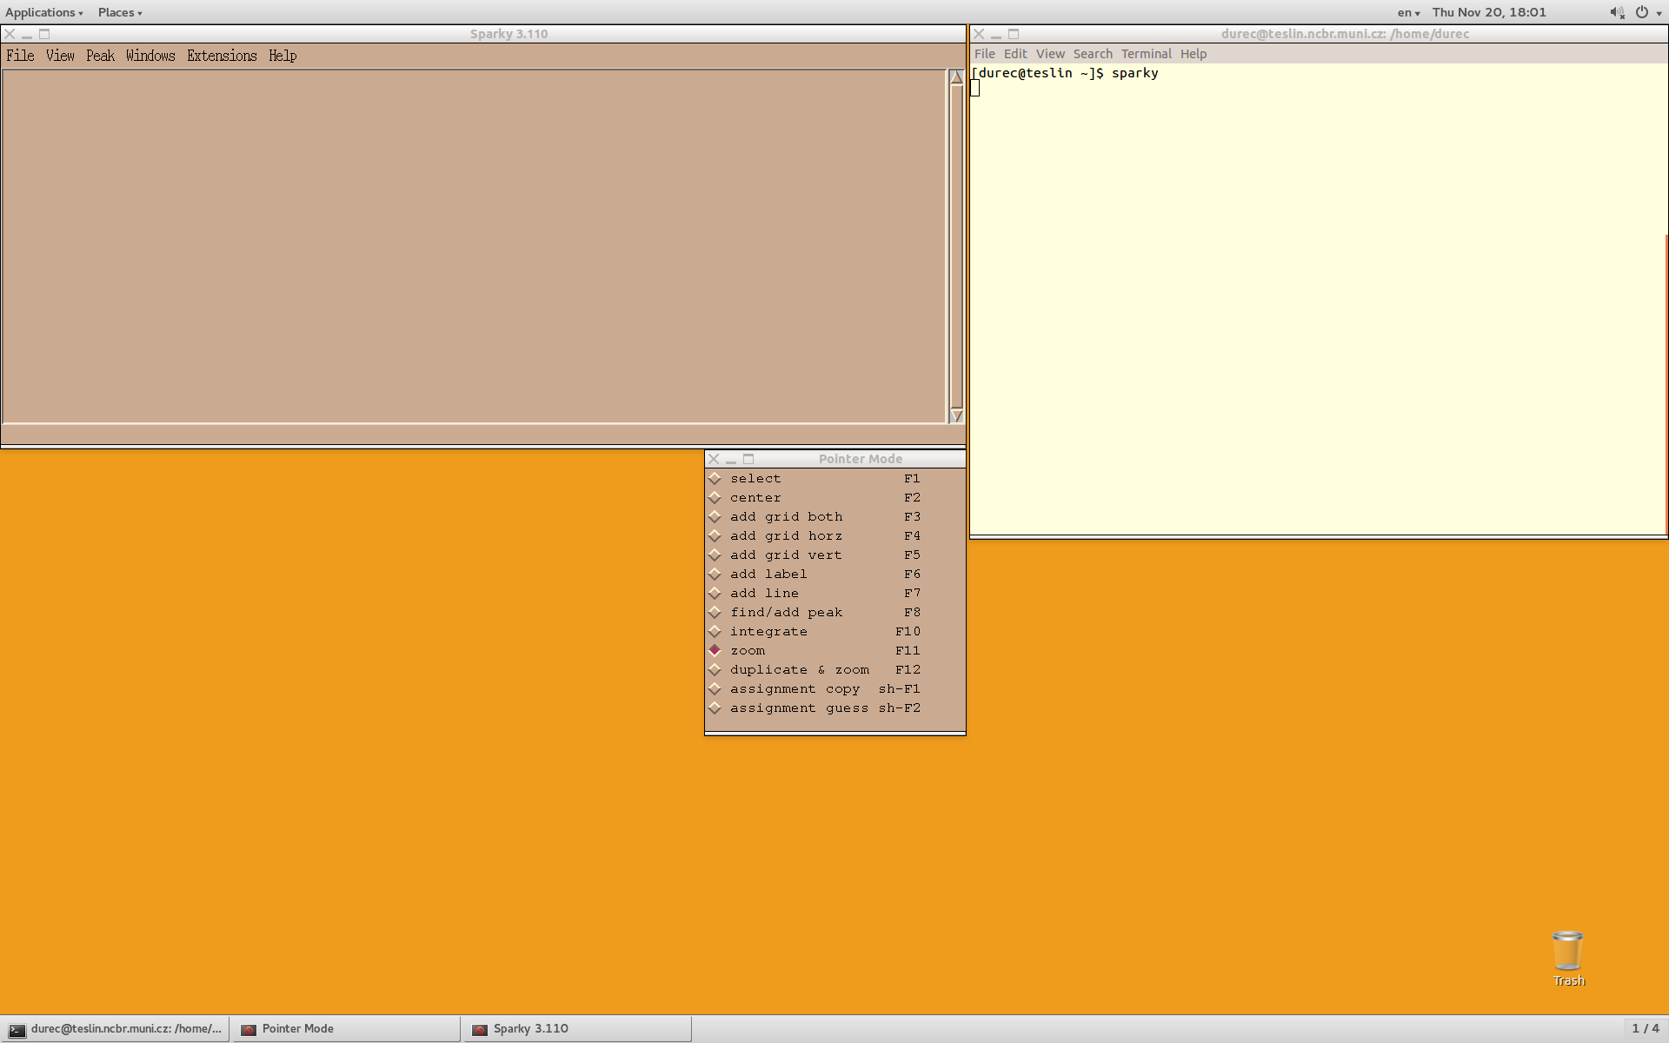
Sparky - start
Windows: batch file – sparky.bat

Slide 7
File open/save spectrum or project
main window
changing the mode of the left mouse button
by using F1-F12 keys

Slide 8
main window
changing the mode of the left mouse button
by using F1-F12 keys

Slide 9
Sparky - control
Control by using
  Two letter shortcuts (case-sensitive)
  Menu in the main window
*.ucsf file - spectral data from a NMR exp
*.save file – Sparky format (plain text) contains all settings, assignment
*.proj file – Sparky project file contains link to multiple *save files
Open spectrum/project: fo/jo
Save spectrum/project as: fa/ja
Save spectrum/project: fs/js
Backup files*.bak are created automatically during the saving of the spectrum

Slide 10
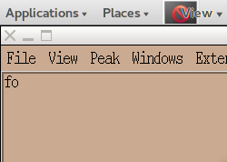
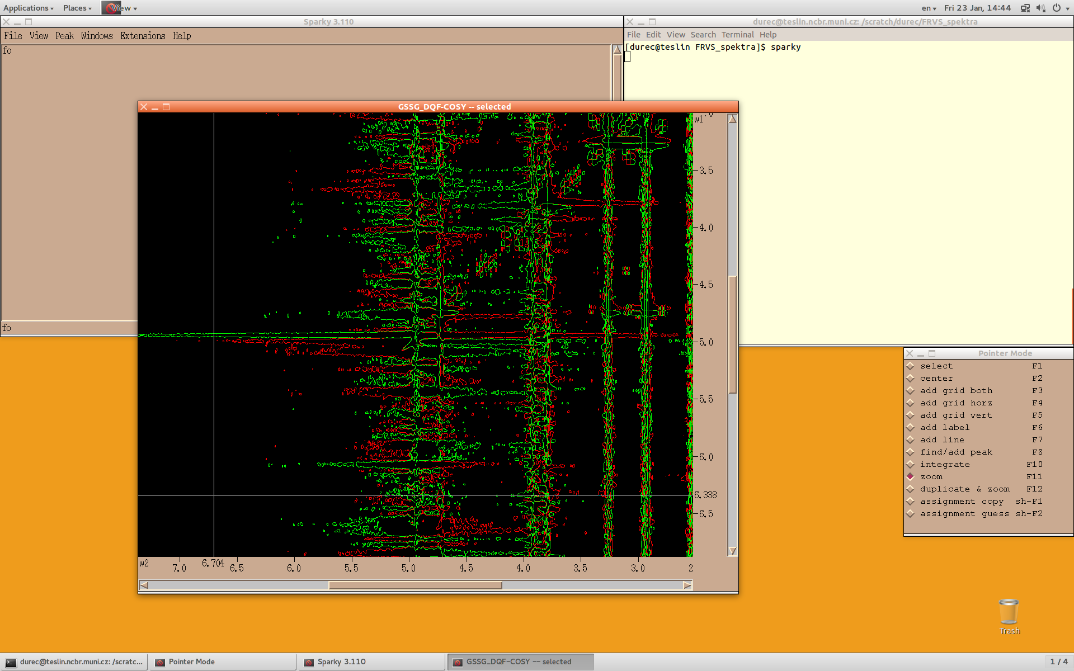
Notes:
Takto to vyzera, ked sa otvori nove spektrum, neulozene
1

Slide 11
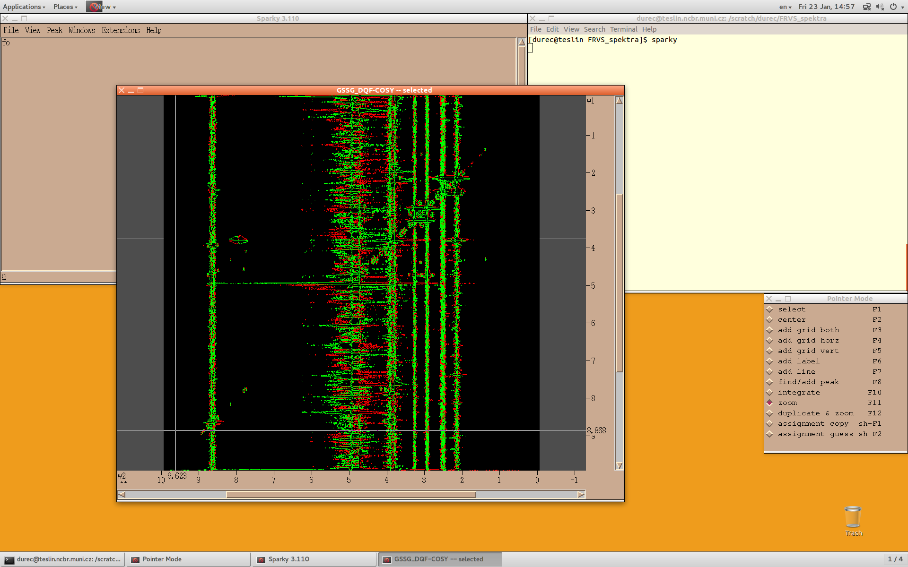
zf – full view
Notes:
zf – odzoomovanie na full view
1

Slide 12
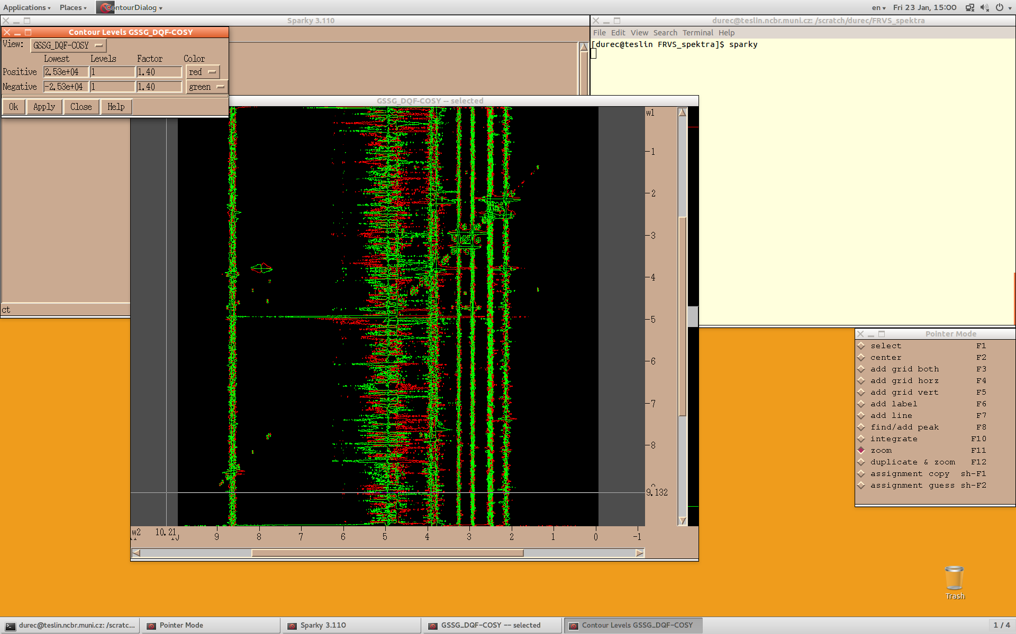
ct – contour levels
vC – contour scale
Notes:
Uprava kontur vC alebo ct
1

Slide 13
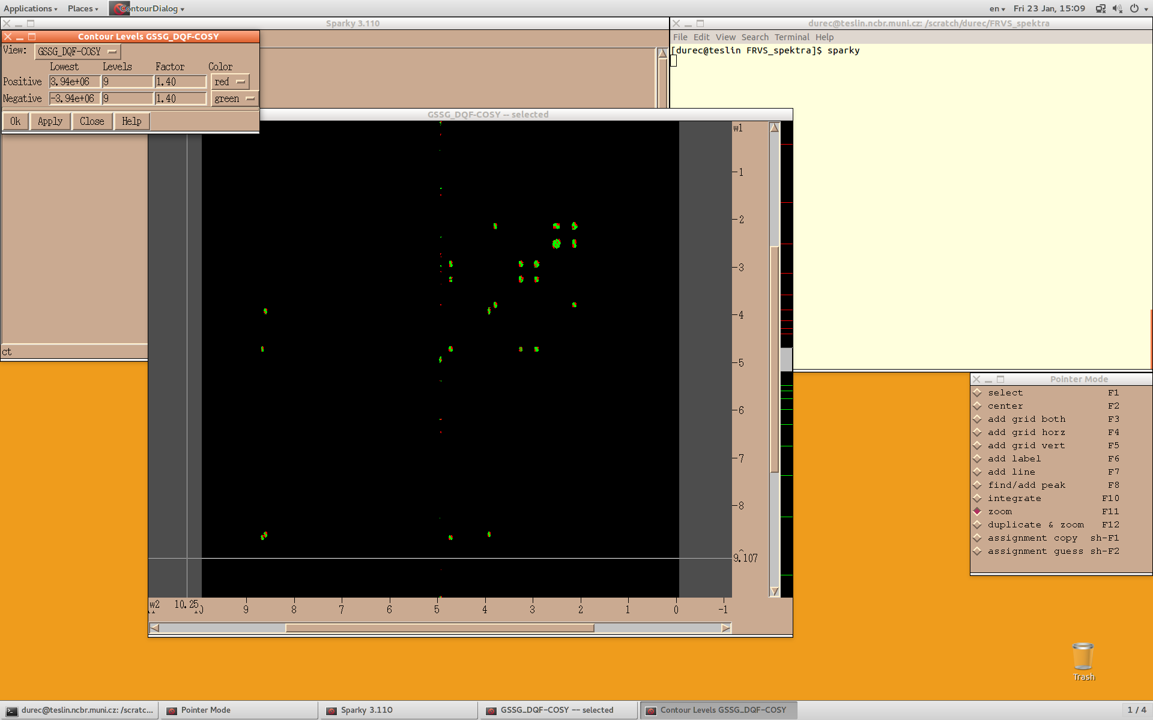
adjustment of the contours:
manually overwrite the values
change by dragging the left mouse button
Notes:
1

Slide 14


adjustment of the contours:
1D
2D
Lowest positive
Levels = 1
Lowest positive
Levels = 3
Lowest positive
Levels = 2

Slide 15
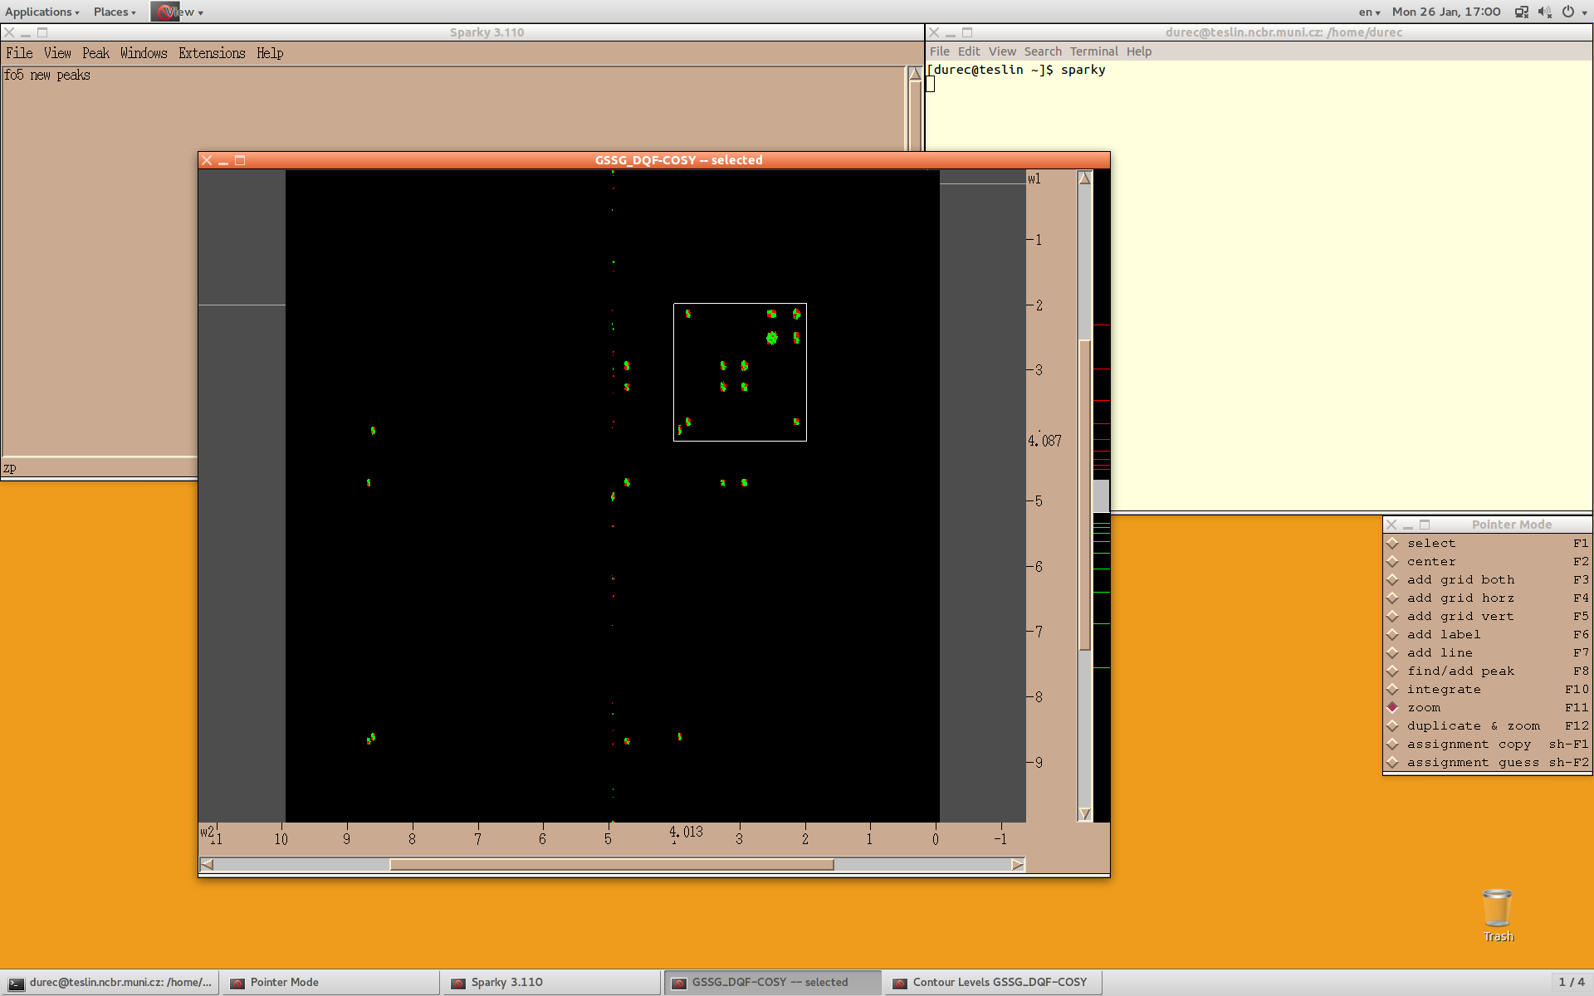

zooming the spectrum:
keyboard shortcut: zi (zoom in)
preset zoom in
alternatively use of middle mouse bottom
pointer mode– zoom: key F11
selected region is zoomed
by clicking and dragging of the mouse
Notes:
1

Slide 16
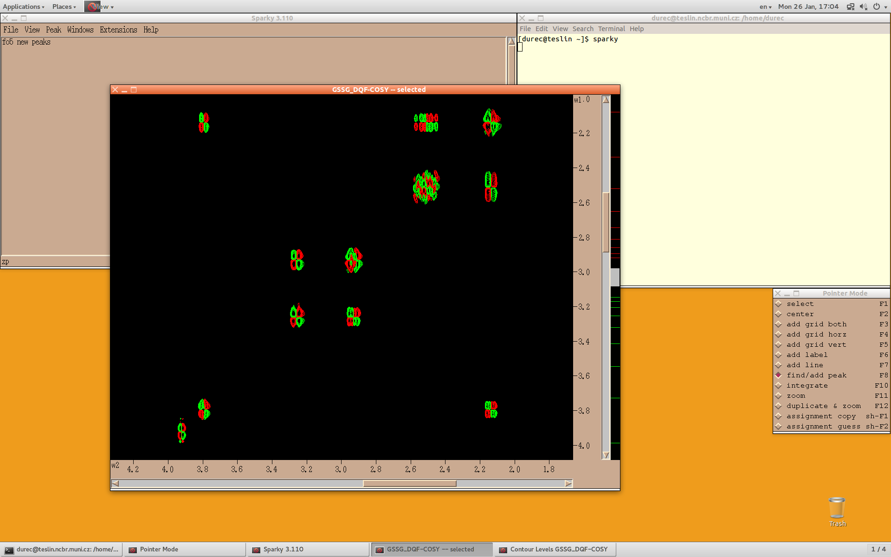
PEAK PICKING:
pointer mode – find/add peak: key F8
one peak is added by one left click,
peaks in every local maximum/minimum are added by selecting the rectangle region
Notes:
1

Slide 17
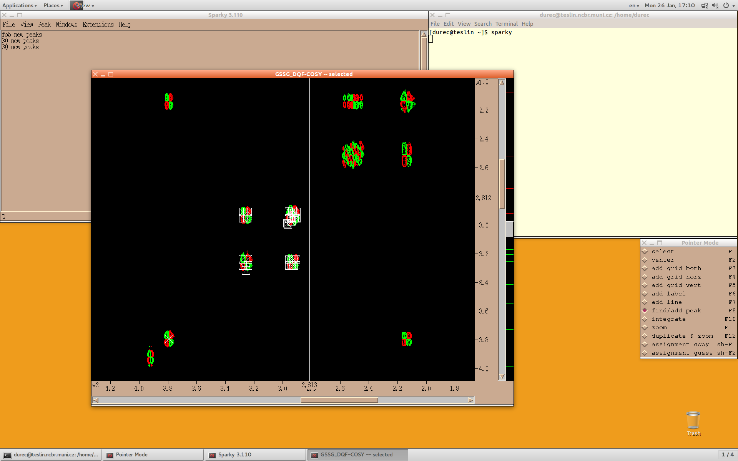
peak picking:
changing the size of ornaments (peaks, labels...): ot → sizes → change the size
as desirable (proper value 0.05) → apply
Notes:
1

Slide 18
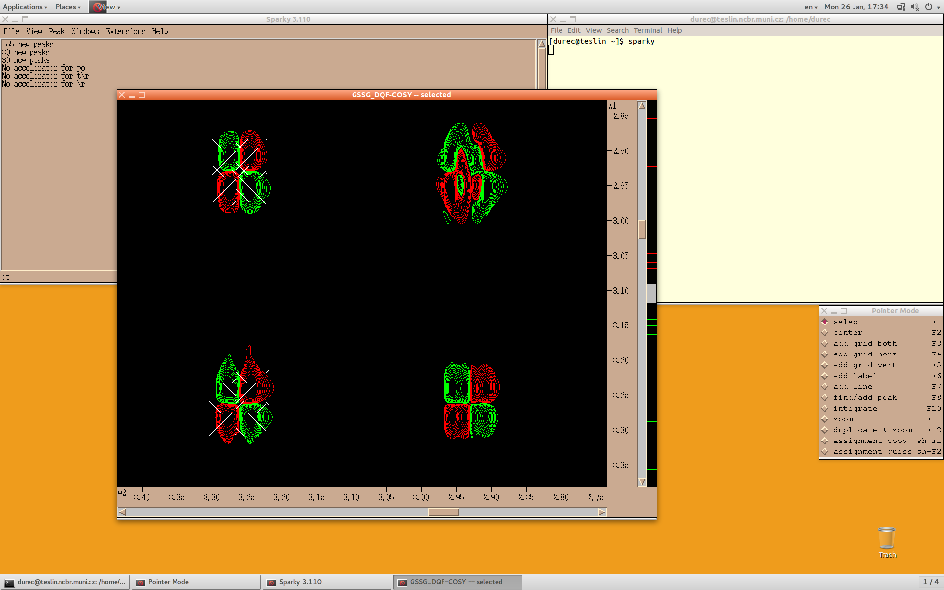
PEAK SELECTION
selection: pointer mode – select: key F1
one object is selected by clicking on it,
more object are selected by dragging the mouse (or Shift+click)
Notes:
1

Slide 19
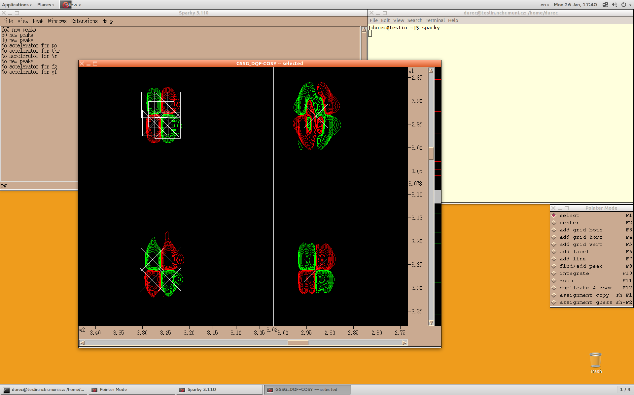
peak picking:
adding of central peak from the selected group of peaks – pg
(useful for multiplets in COSY spectra)
Notes:
Pooznačovať všetky relevantné píky (krospíky len na jednej polovici a diagonálne píky dokopy 16ks)
1

Slide 20
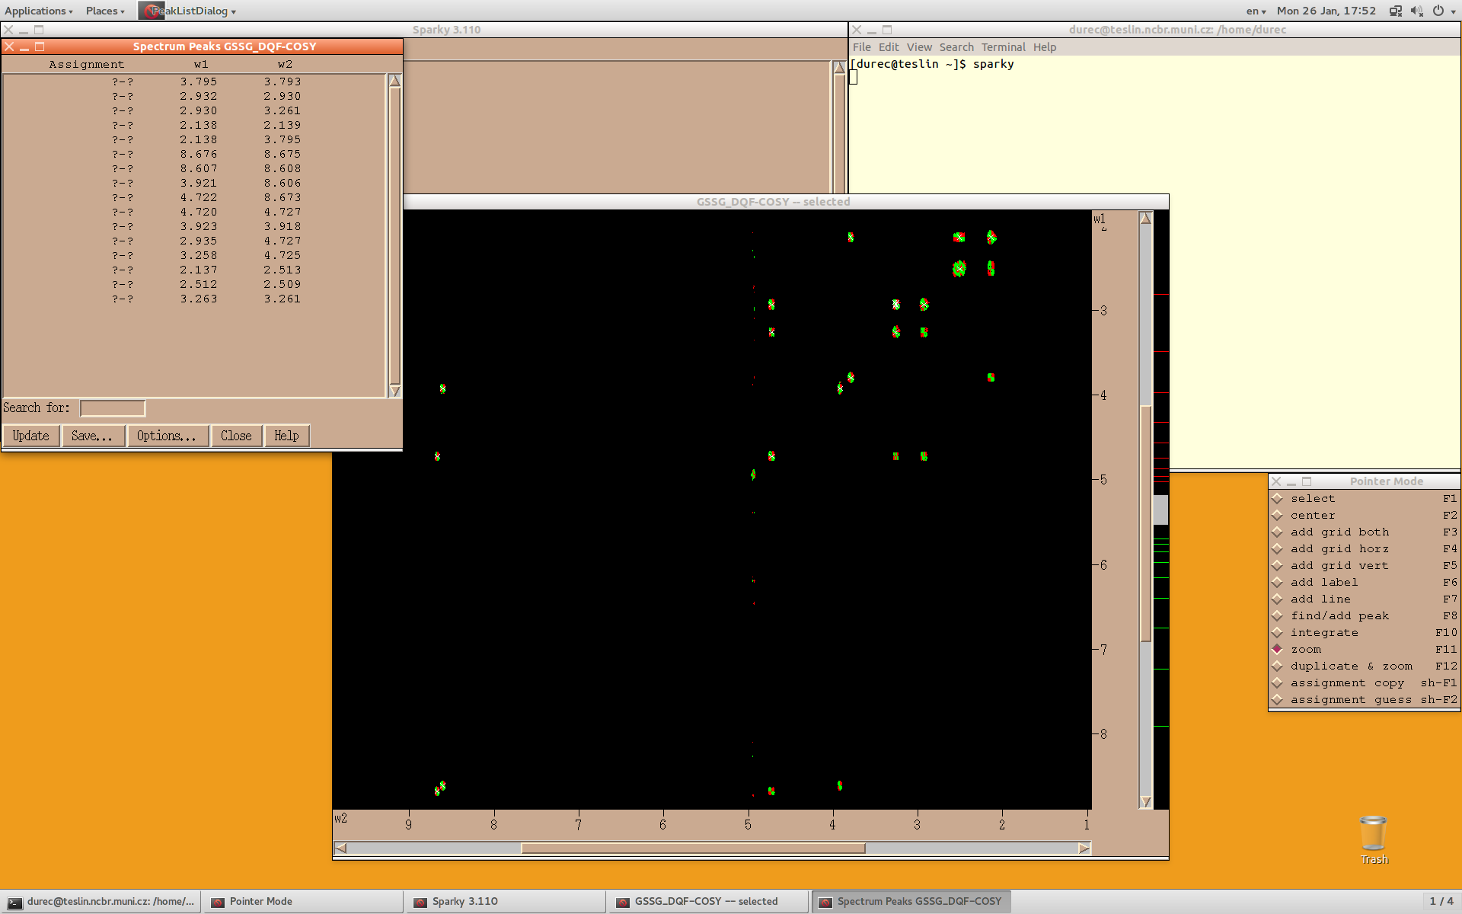
peak picking:
list of the peaks – lt
Notes:
Pooznačovať všetky relevantné píky (krospíky len na jednej polovici a diagonálne píky dokopy 16ks)
1

Slide 21
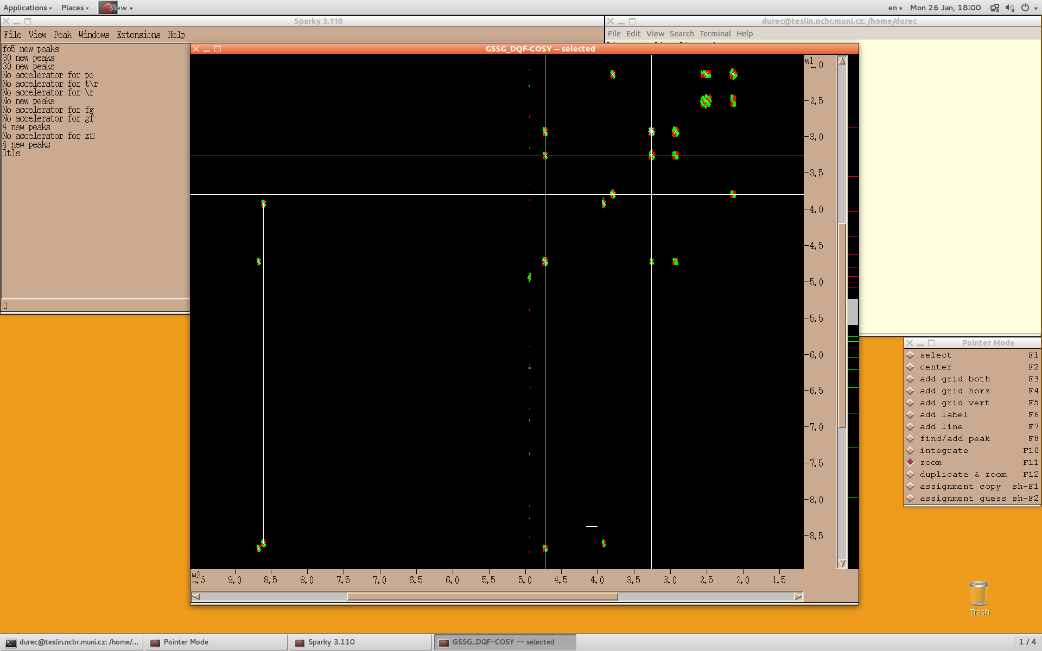
identification of the spin systems:
add vertical and horizontal line: key F3
add horizontal line: key F4
add vertical line: key F5
add a vector: key F7
F3
F4
F7
F5
Notes:
1

Slide 22
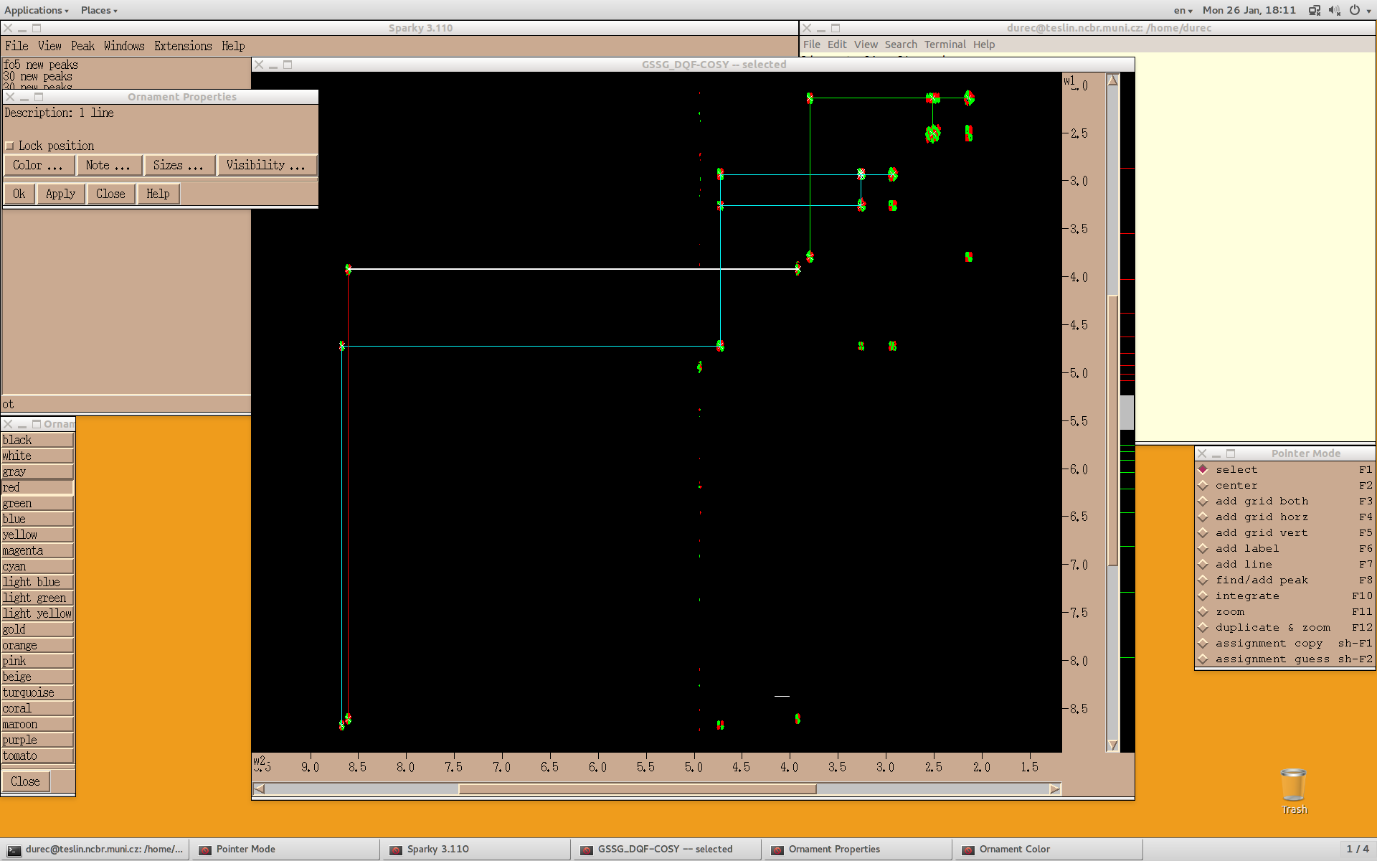
identification of the spin systems:
changing the color of ornaments (lines, labels...): ot → color → select object/s→ choose the color → apply
Notes:
1

Slide 23
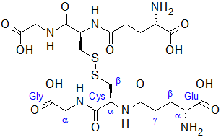

identification of the spin systems:
COSY – correlation through bonds, isolated spin systems
Notes:
Nájsť si spinový systém, odhadnút počet očakávaných signálov a skorelovať to so spektrom
1

Slide 24
identification of the spin systems:
COSY – correlation through bonds, isolated spin systems
expected number of signals:
Gly – 2: Hα, NH
Cys – 4: Hα, NH, Hβ‘, Hβ‘‘
Glu – 3: Hα, Hβ, Hγ
Notes:
Nájsť si spinový systém, odhadnút počet očakávaných signálov a skorelovať to so spektrom (PREMYSLIEŤ POČET OČAKÁVANÝCH SIGNÁLOV)
1

Slide 25
identification of the spin systems:
COSY – correlation through bonds, isolated spin systems
expected number of signals:
Gly – 2: Hα, NH
Cys – 4: Hα, NH, Hβ‘, Hβ‘‘
Glu – 3: Hα, Hβ, Hγ
Notes:
Priradiť nájdené spinové systémy k reziduám podľa odhadu počtu signálov
1

Slide 26
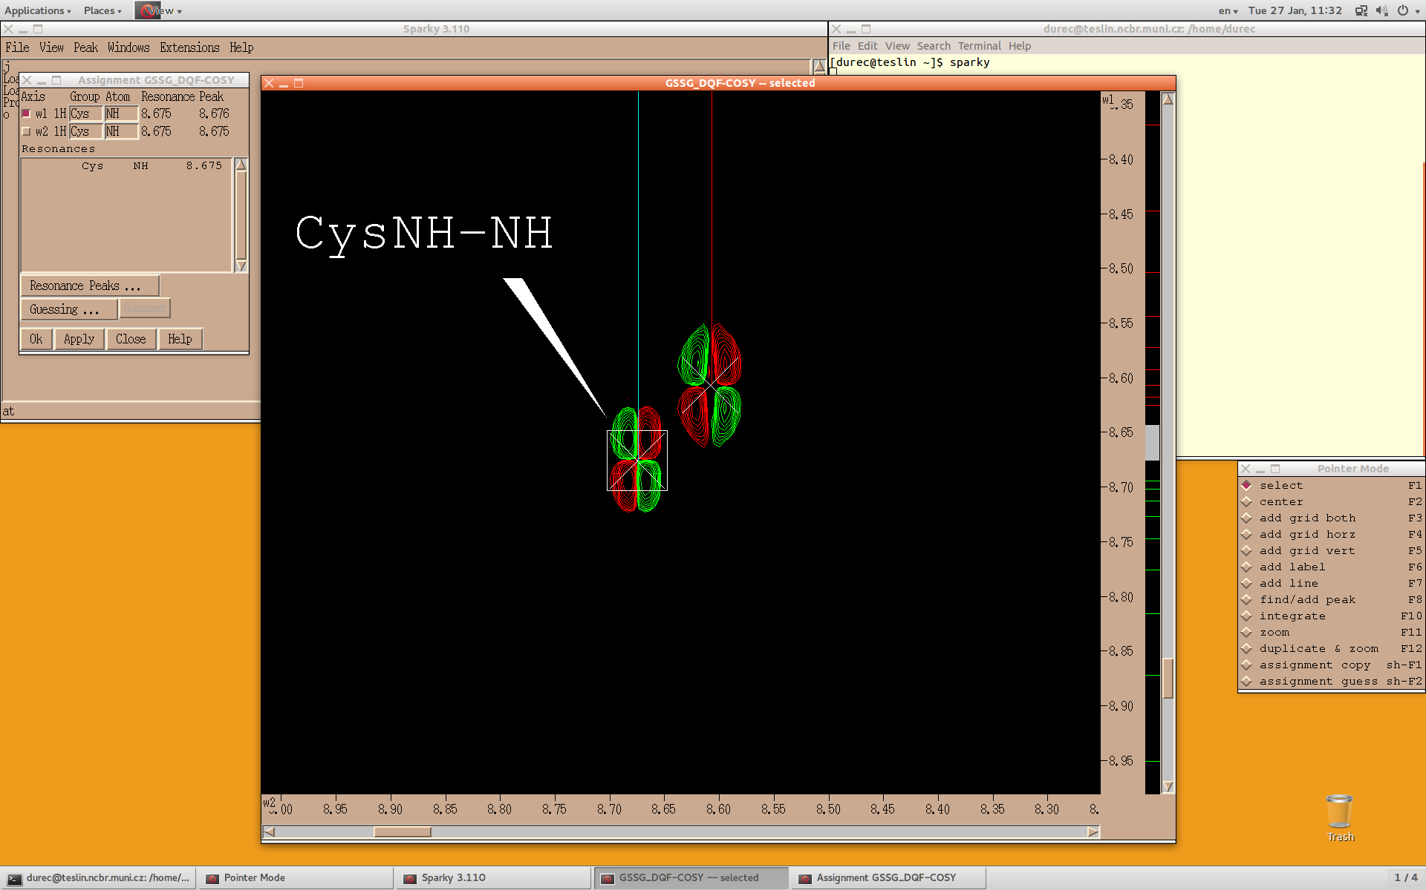
Signal assignment:
select the peak: pointer mode – select: key F1 → shortcut at – assignment → fill in the name of the group (e.g. abbreviation of residuum/molecule) and the name of the atom (eg. NH) according to the resonance in w1 and w2 axis → type apply
Notes:
1

Slide 27
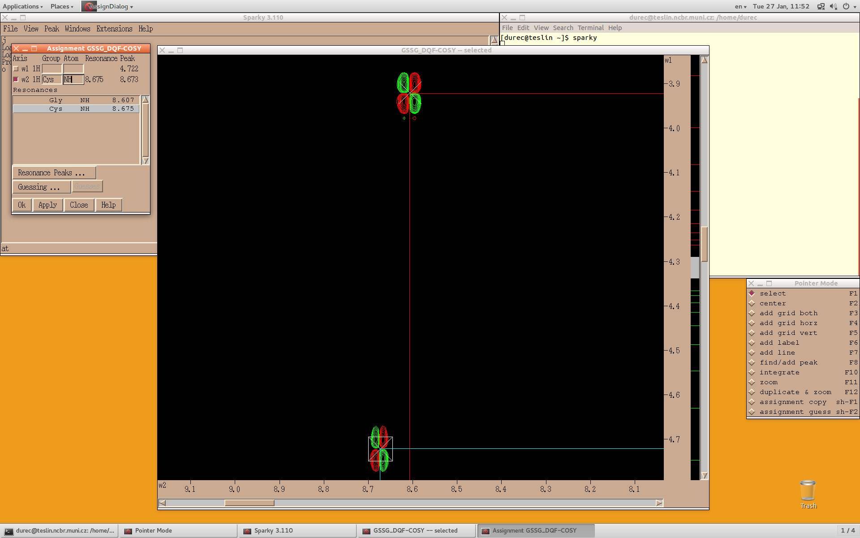
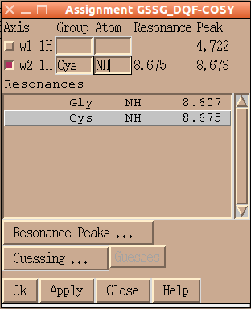

Signal assignment:
the assignment with the closest resonance to the current selected resonance is highlighted when clicking on the name of the axis. (not necessarily correct one!!), double click on the highlighted line adds the name of the group and atom label to currently selected peak. Use unique naming, otherwise resonances will be averaged. Display position of resonance by vR command (view Resonances).
Notes:
Dopriradzovať samostatne!!!
1

Slide 28
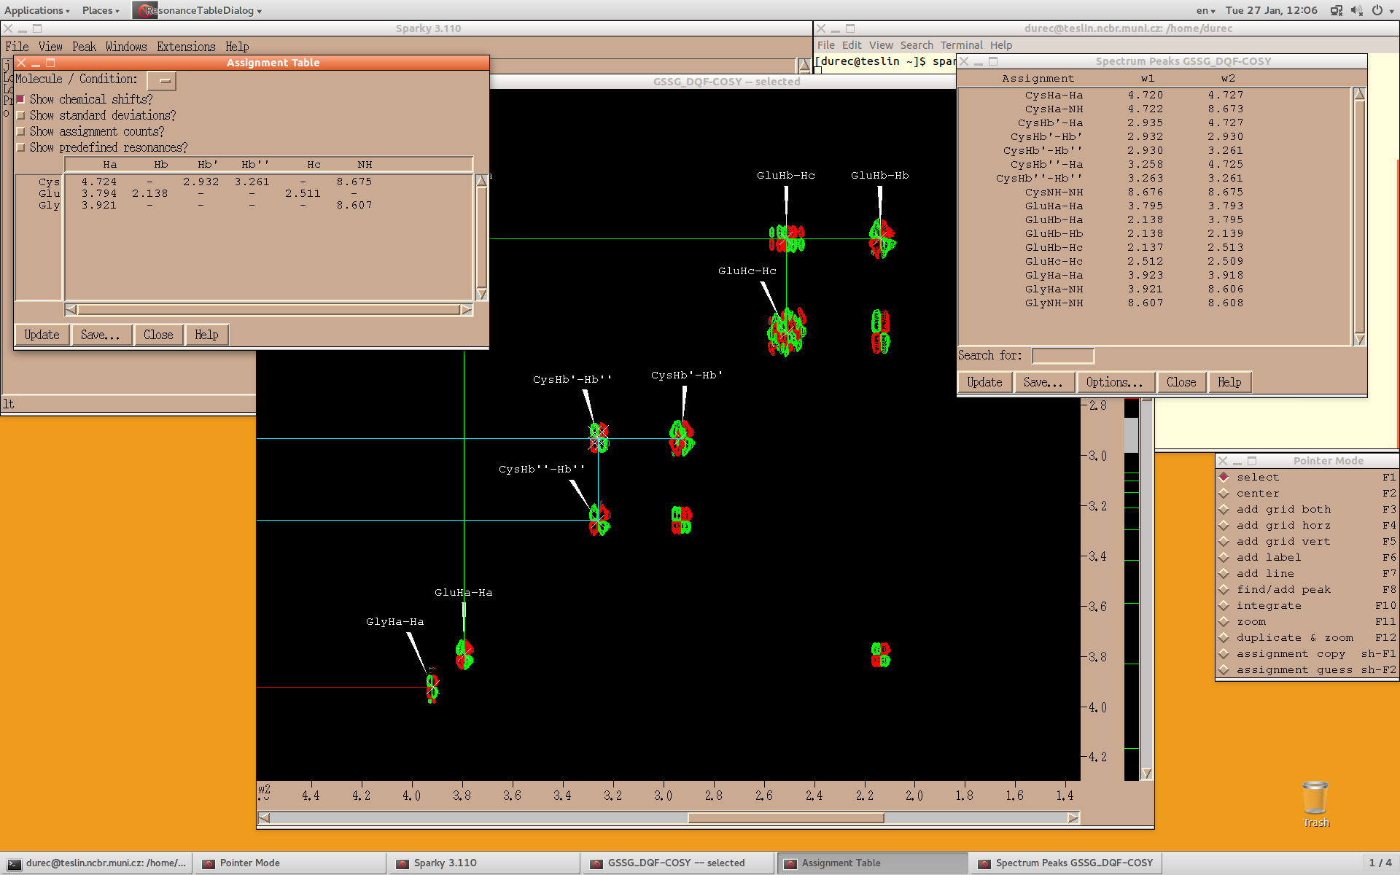
signal assignment:
shortcut lt – list of the peaks already with assignments, or with other information
(→ Options) ! Always check SDev column for consistency of the assignment
shortcut tb – assignment table
residues vs. atoms, statistical data can be shown as well
both can be exported as a plain text file
(→ Save)
Notes:
1

Slide 29
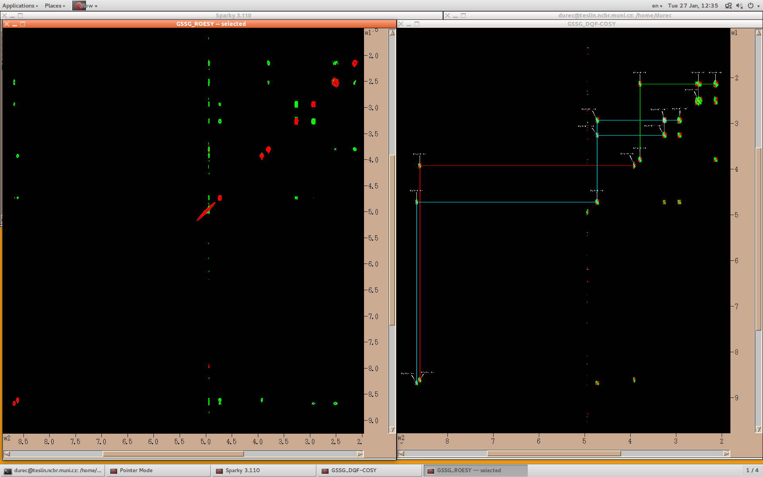
Working with more spectra:
Assignment made in on spectrum is available/shared also for other spectra, peak assignment can be completed using different experiments on condition that experiments were recorded at the same temperature, identical sample etc. During work you may save separately the spectra (file save – experiments of active window) and subsequently save the entire project
Notes:
<number>

Slide 30
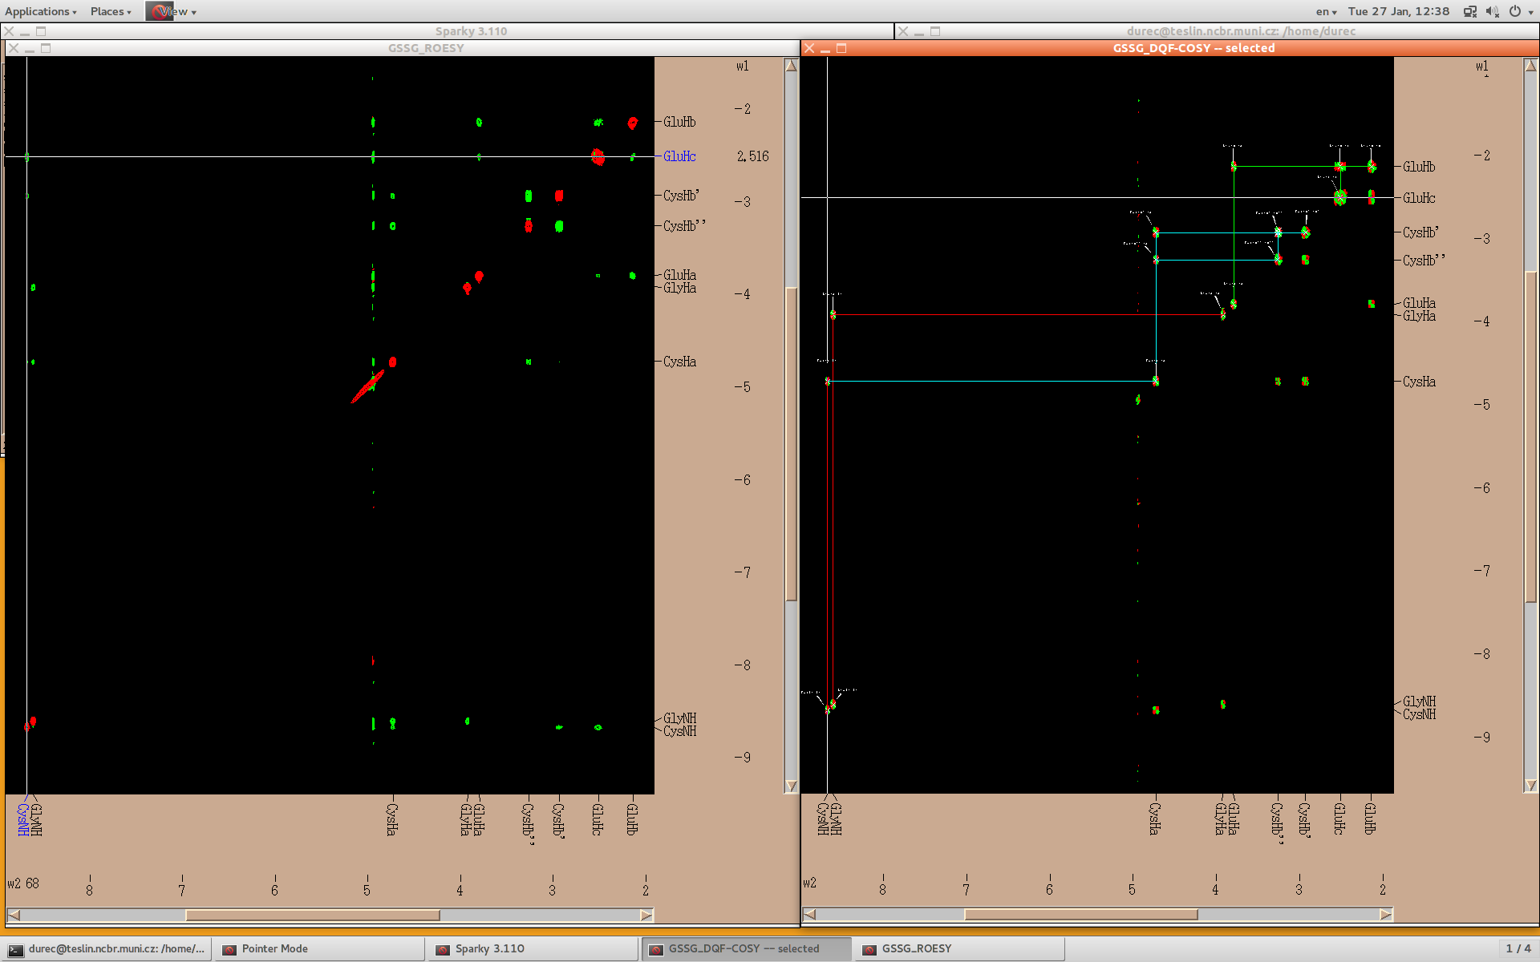
working with more spectra:
view assigned (averaged) resonances on the edge of the spectra - vR
Notes:
<number>

Slide 31
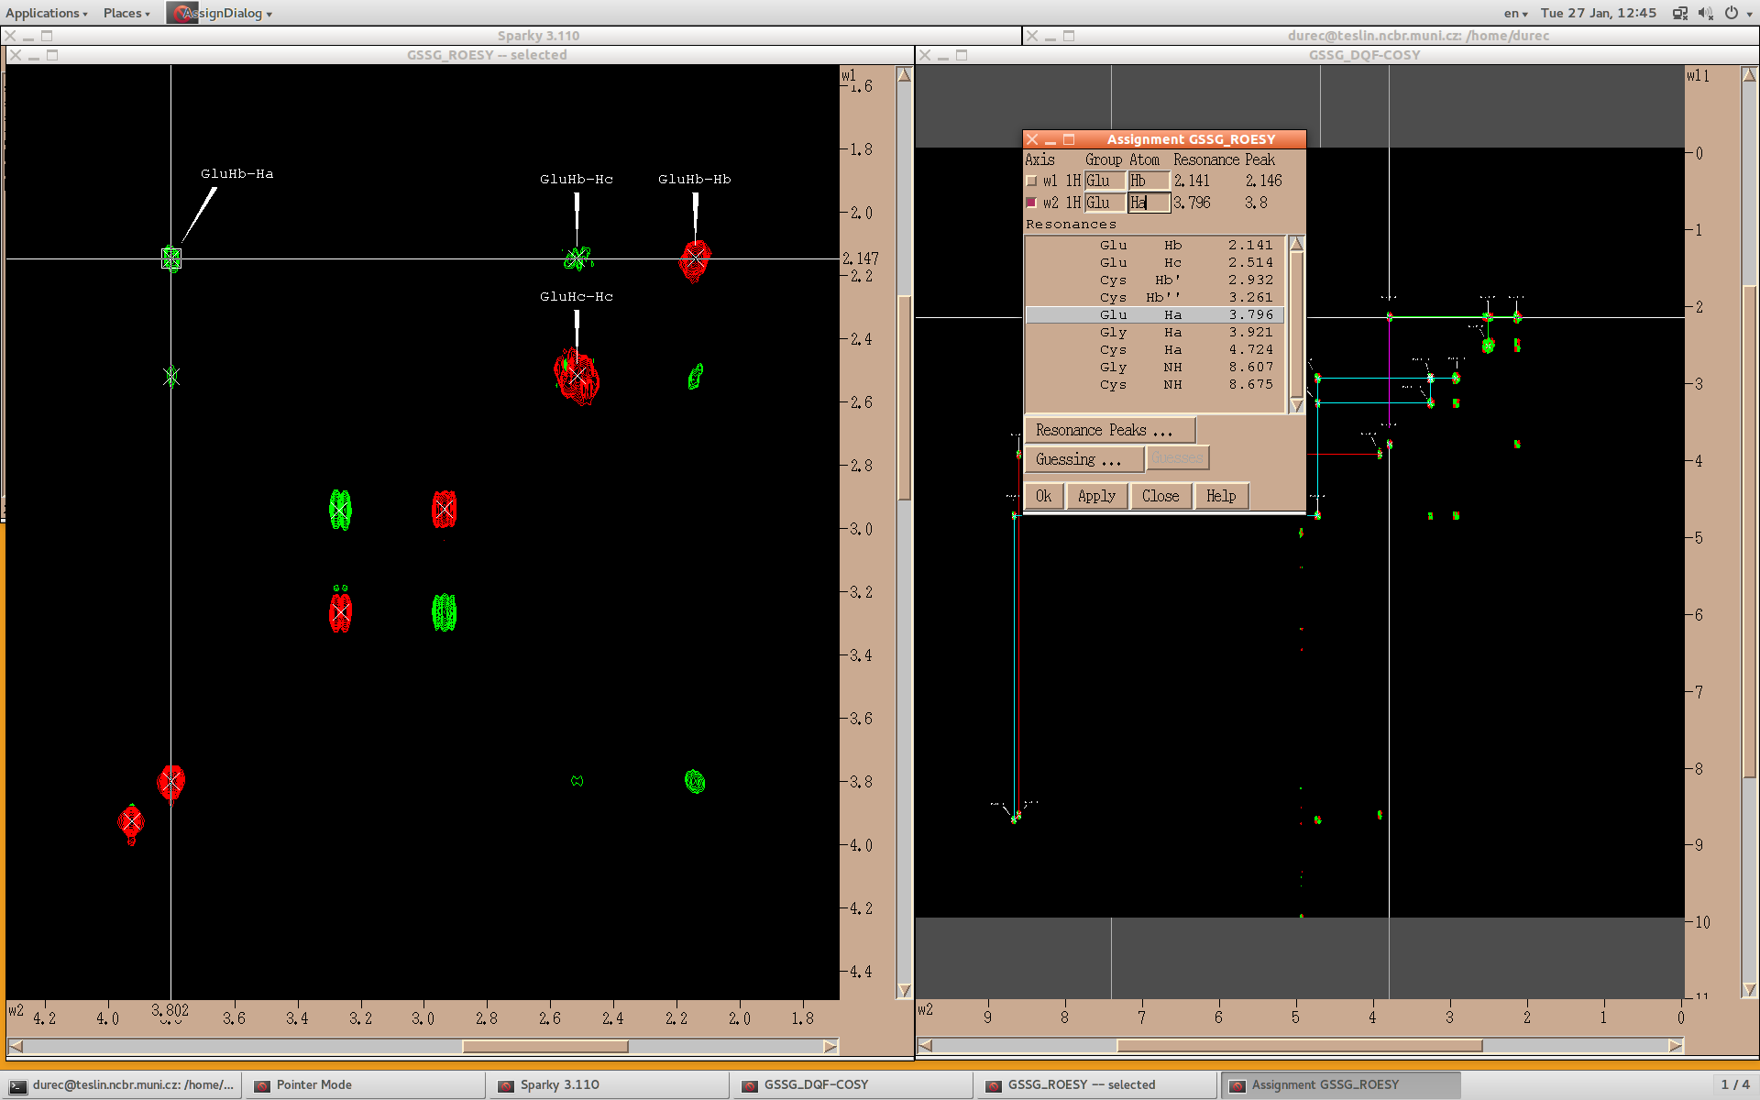
working with more spectra:
assign ROESY spectrum by using at:
Notes:
Opíkovat ROESY a popriradzovať (ideálne pomocou at)
<number>

Slide 32
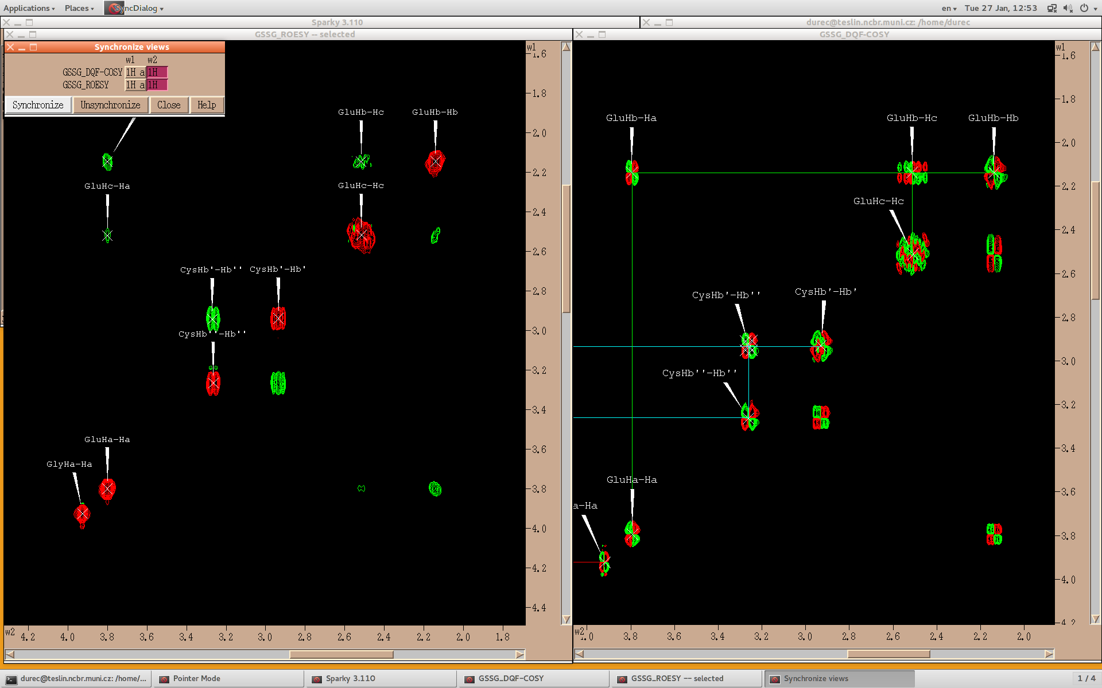
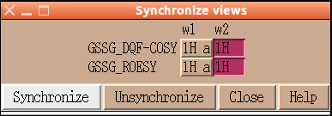

working with more spectra:
synchronize views of spectra: shortcut yt – it allows simultaniously move synchronized axes of spectra when moving one of them,
click on the axes in spectra we want synchronize → Synchronize
Notes:
<number>

