Slide 1
CRYSTALLIZATION
Petr Beňovský

Slide 2
CRYSTALLIZATION – DIFFERENT DEFINITIONS
Crystallization is a phase interconversion of the first order dependent on two parameters – concentration and structure
?

Slide 3

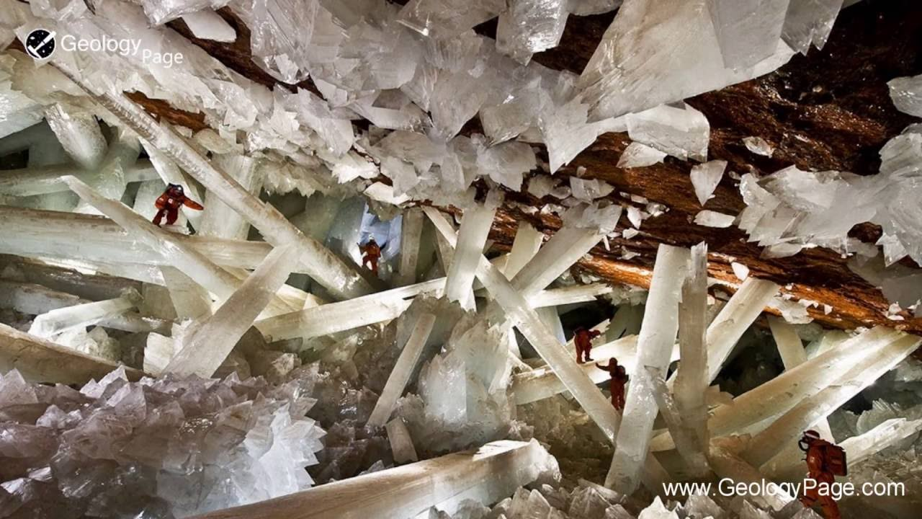
CRYSTALLIZATION – DIFFERENT DEFINITIONS
Crystallization is the natural or artificial process by which a solid forms, where the atoms or molecules are highly organized into a structure known as a crystal.

Slide 4

EQUILIBRIUM STATES
PHASE DIAGRAMS
Can help in the selection of a crystallization method, yield determination and temperature of a crystallization process;
Supersaturation – concentration of a compound in solution is higher than in equilibrium;
Degree of supersaturation – driving force of crystallization, nucleation and crystal growth;
SOLUBILITY CURVES
van’t Hoff equation for ideal solutions:
Unfortunately, the most of solutions differ from ideal solutions and calculated solubilities of the same compounds for different solvents differ a lot
EXPERIMENTALLY OBTAINED SOLUBILITY CURVES

Slide 5
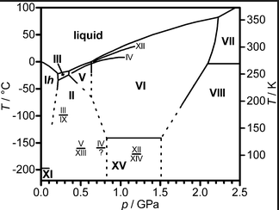
PHASE DIAGRAM OF ICE POLYMORPHS

Slide 6
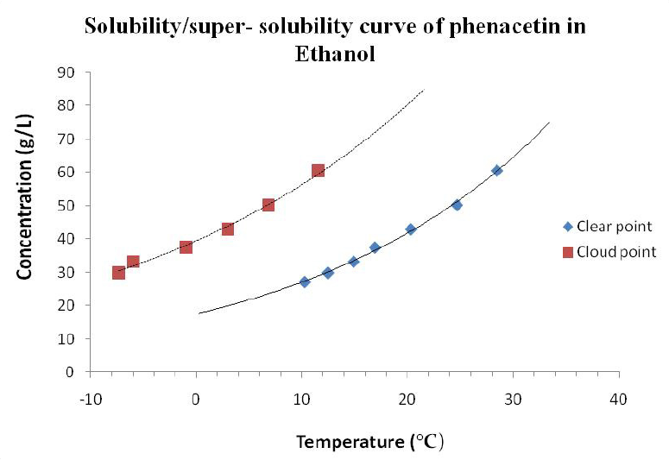
SOLUBILITY CURVE/METASTABILE ZONE FOR PHENACETIN IN ETHANOL

Slide 7
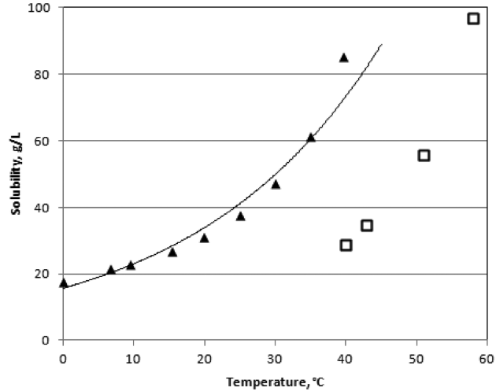
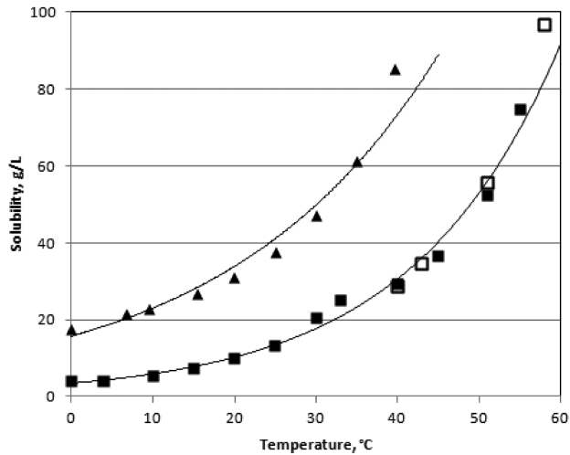
SOLUBILITY MEASUREMENT
Possibility of polymorph interconversion
Black, S.; Dang, L.; Liu, C.; Wei, H. Org. Process Res. Dev. 17, 486 (2013)

Slide 8
THE BLACK’S RULE
Simon Black (Astra Zeneca)
Solubility doubles with every 20 ºC increase
Could be used for the solvent selection after the initial screening of solvents;
In cases, where the prediction according to the Black’s rule significantly differs from experimentally obtained results, always consider possibility of the formation of solvates or different polymorphs;
Muller, F.L.; Fielding, M.; Black, S. Org. Process Res. Dev. 13, 1315 (2009)
Muller, F.L.; Black, S. Org. Process Res. Dev. 14, 661 (2010)

Slide 9
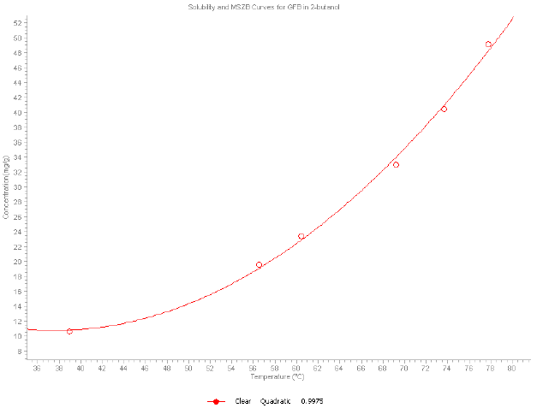
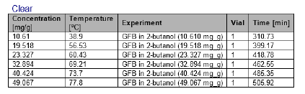
THE BLACK’S RULE

Slide 10
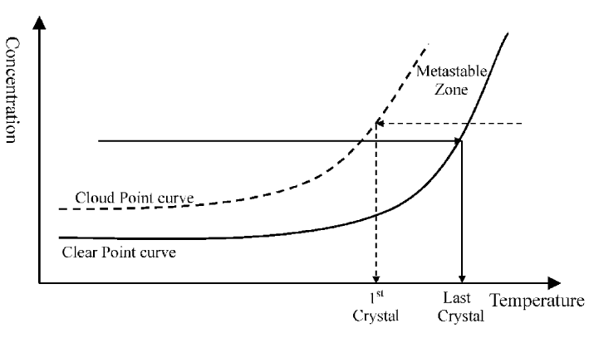
METASTABLE ZONE
Metastability – a term introduced by Ostwald
Parsons, A.R.; Black, S.N.; Colling, R. Trans IChemE 81, Part A, 700 (2003)
Ideal area for the crystal growth on already formed nuclei

Slide 11
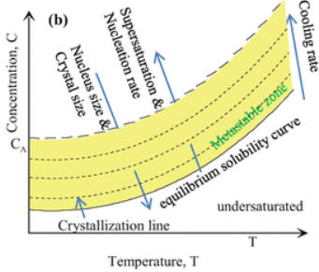
METASTABLE ZONE
Metastable zone width – MZW
Exert influence on probability of nucleation and seeding options
The metastable zone width depends on types of measurement, temperature gradient, presence of impurities, equipment geometry, use of ultrasound, viscosity of solution, stirring mode

Slide 12
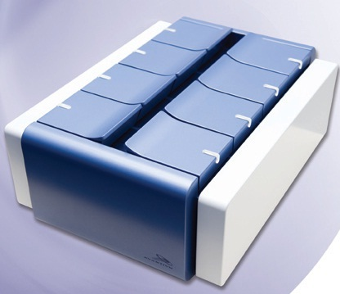
METASTABLE ZONE
Solubility curve and metastable zone determination
CRYSTALLINE (TECHNOBIS)

Slide 13
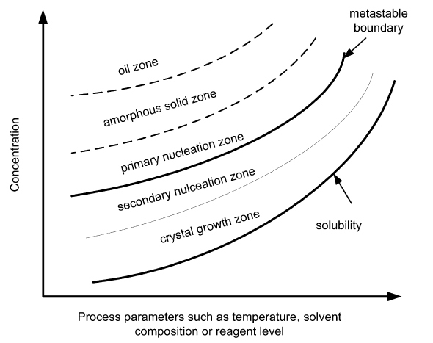
METASTABLE ZONE
Tung, H-H. Org. Process Res. Dev. 17, 445 (2013)

Slide 14
METASTABLE ZONE (AND WHAT NEXT?)
Tung, H-H. Org. Process Res. Dev. 17, 445 (2013)

Slide 15
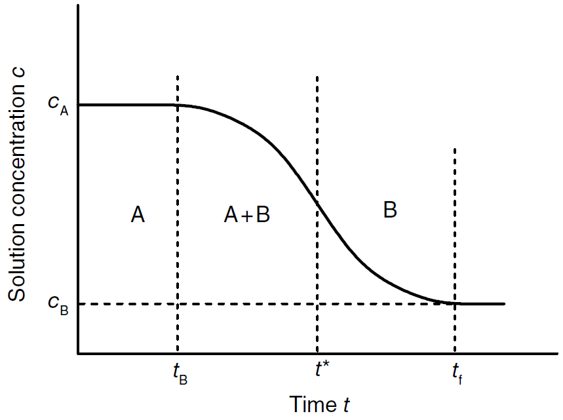
INDUCTION TIME
Could be roughly correlated with the crystallization kinetics
Sangwal, K. Nucleation and Crystal Growth, J.Wiley & Sons, 2018

Slide 16
TYPES OF CRYSTALLIZATION
COOLING CRYSTALLIZATION
Suitable for moderately to high soluble compounds – (100 – 300) g/l;
Positive slope of solubility curve;
Slope of the solubility curve is sufficiently steep;
In the end of crystallization the content of solid product in the reaction mixture should not be higher than 30-35% (vol.);
Product deposits or scaling could be a problem;
Viscosity of solution;
During crystallization, the system is NOT in thermodynamic equilibrium, but actual concentration does not differ much from equilibrium concentration → yields can be calculated using solubility curves;
Yields are limited by solubility of a compound at the lowest temperature used → possibility to reprocess mother liquors.

Slide 17
TYPES OF CRYSTALLIZATION
2. EVAPORATIVE CRYSTALLIZATION
Selected temperature, pressure and concentration of mother liquors are constant;
Solubility is almost independent on pressure, so it can be derived from the solubility curve at atmospheric pressure;
The challenge could be an accumulation of impurities in mother liquors → yield is limited by maximal accepted level of impurities in mother liquors;
100% yield could be accomplished;
Yield could be calculated from mass balance in a solution and it is directly proportional to the mass of evaporated solvent(s);
Could be used for moderately to highly soluble compounds (100 – 300) g/l;
Could be used for the compounds with the flat solubility curve;
Used for compounds not stable at atmospheric boiling

Slide 18
TYPES OF CRYSTALLIZATION
3. PRECIPITATION
Used in the case of compounds with very low solubility ((0.001 – 1) g/l);
Two very soluble compounds form together the product with very low solubility;
Very fast process;
Concentration of a product in solution is very low, so the yield can be determined only from its initial concentration;
Mostly, amorphous material is produced, or different polymorphs obtained using different types of crystallization;

Slide 19
TYPES OF CRYSTALLIZATION
4. ANTI-SOLVENT CRYSTALLIZATION
Solubility of a compound depends on the ratio solvent/antisolvent;
Addition of antisolvent dilutes a reaction mixture → decrease in solubility should have higher impact than dilution effect;
Compounds that form hydrates tend to provide compounds with lower number of water molecule in crystal lattice;

Slide 20
SUPERSATURATION
Situation, where there is more compound in a solution than in equilibrium state under particular conditions;
Nucleation and crystal growth occur in supersaturated solutions;
Degree of supersaturation
Mathematical expressions available – it is difficult and demanding to get corresponding data;
Practical expression of degree of supersaturation based on easily available experimental values;
High supersaturation can lead to agglomeration of formed solid phase.

Slide 21
SUPERSATURATION
Situation, where there is more compound in a solution than in equilibrium state under particular conditions;
Nucleation and crystal growth occur in supersaturated solutions;
Degree of supersaturation
Mathematical expressions available – it is difficult and demanding to get corresponding data;
Practical expression of degree of supersaturation based on easily available experimental values;
High supersaturation can lead to agglomeration of formed solid phase.

Slide 22
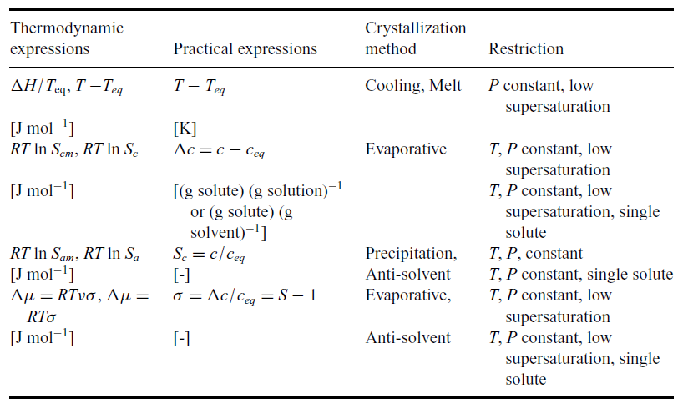
SUPERSATURATION
PRACTICAL EXPRESSIONS

Slide 23
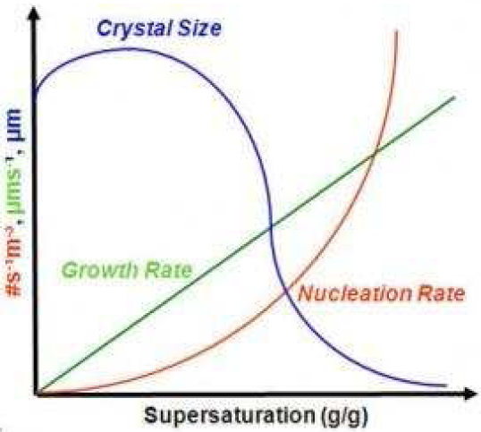


SUPERSATURATION
G = growth rate; k_{g} = growth rate constant; g = growth order (usually 1-2);
∆C = supersaturation; B = nucleation rate; k_{b} = nucleation rate constant;
b = nucleation order(usually 5-10)

Slide 24
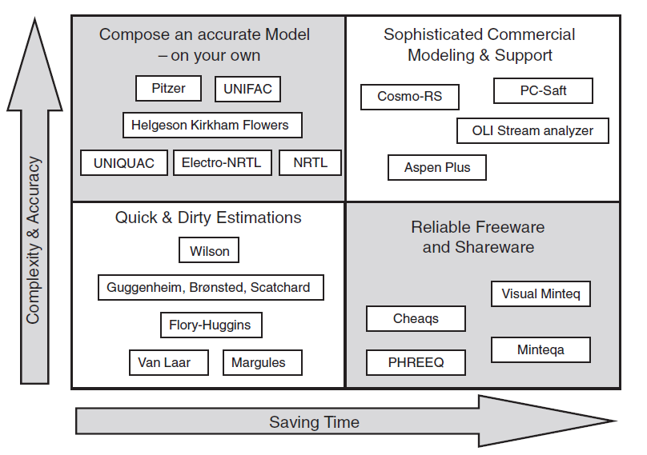
THERMODYNAMIC MODELS

Slide 25
SUPERSATURATION – PRACTICAL EXAMPLE
Malwade, C.R.; Qu, H. Org. Process Res. Dev. 22, 697 (2018)

Slide 26
NUCLEATION
Nucleation control is essential for obtaining of desired polymorph and particle size distribution;
Homogeneous primary nucleation
New phase is formed by a statistical fluctuation of entities of dissolved compound that agglomerate;
Heterogeneous primary nucleation
New phase is formed in the presence of tiny, invisible particles of dust or impurities;
Secondary nucleation
Supersaturated solution already contains crystals of crystallized compound – the only observed mechanism for cooling crystallizations or evaporative crystallizations (already present crystals and their growth decrease the value of supersaturation to the extent that primary nucleation is ruled out);
Cluster formation by combination and detachment of particular entities of a dissolved compound – subsequent combination of clusters – cluster concentration is much lower than concentration of dissolved compound – critical size of clusters

Slide 27
NUCLEATION
Homogeneous nucleation is practically very rare (it is extremely difficult to remove majority of dust particles) – therefore, crystallization mostly starts with heterogeneous nucleation mechanism;
Induction time – can be used as a measure of tendency of the system to remain in metastable state and therefore, can be used to determine the metastability limit ;
Induction time could be used for an estimation of nucleation rates.
Nucleation generally requires relatively large amount of energy and proceeds better in highly oversaturated solution.

Slide 28
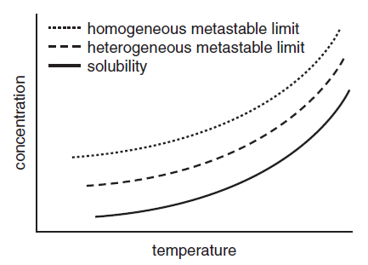
NUCLEATION

Slide 29
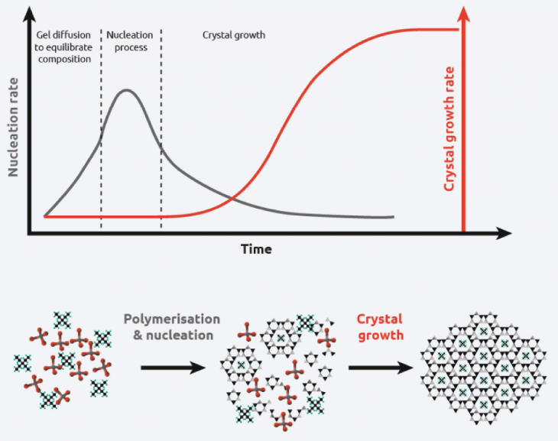
NUCLEATION

Slide 30
CRYSTAL GROWTH
The most important factors influencing crystal growth:
supersaturation
ambient phase (melt or solution?)
interaction energy between dissolved compound and solvent
the presence of impurities
Crystal growth rate depends on the size of crystals – the smaller crystals grow slower to a certain limit size than larger crystals

Slide 31
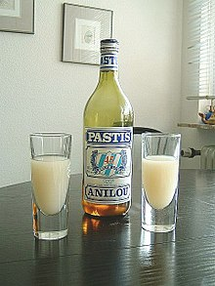
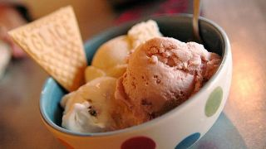
CRYSTAL GROWTH
OSTWALD RIPENING
A phenomenon observed in solid solutions or liquid sols that describes the change of an inhomogeneous structure over time, i.e., small crystals or sol particles dissolve, and redeposit onto larger crystals or sol particles.
Dissolution of small crystals or sol particles and the redeposition of the dissolved species on the surface of larger crystals or sol particles was first described by Wilhelm Ostwald in 1896.

Slide 32
CRYSTAL GROWTH
Example of Ostwald ripening utilization for the modification of particle size distribution:
Problems with the crystallization of the salt (strict control of water content);
Free base and succinic acid dissolved in water/acetone mixture with lower amount of acetone than required for crystallization at 45 ºC, filtered through 1 µm filter, acetone added to required ratio;
Slow stirring and cooling to 43 ºC, seeding with 1% of the product, stirred at43 ºC for 2 h and then cooled to 20 ºC over 1 h.
The mixture was again heated to 38 ºC over 1 h, slowly stirred for 1 h and cooled down to 33 ºC in 3 h and cycles repeated in similar mode three times.
By this approach PSD (100-200) µm instead of original (10-15) µm was obtained.
Brown Ripin, D.H. et al Org. Process Res. Dev. 9, 440 (2005)

Slide 33
CRYSTAL GROWTH
Practical example of crystal healing process:
Codan, L.; Sirota, E.; Cote, A. Org. Process Res. Dev. 22, 1131 (2018)

Slide 34

SEEDING

Slide 35
SEEDING
Main reasons for the seeding during crystallization:
initiation of crystallization in the systems where crystallization is difficult and where the systems tend to oil out;
particle size distribution control with the aim to get larger crystals with narrower particle size distribution;
elimination of encrustation (scaling) caused by spontaneous nucleation, and also the preparation of a desired polymorph;
preparation of a single crystal.

Slide 36
SEEDING
Operation, that could principally influence:
progress of crystallization
product purity
particle size distribution of the product
surface area
orderliness (less disorders in a crystal lattice)
polymorphism
rate of crystallization
Based on many experiments it was observed and verified that without seeding about 30 – 50% of the product quickly precipitate from the solution during spontaneous crystallization. Thus, very large number of tiny crystals is formed with broad particle size distribution. Subsequently, possible crystal growth occurs on the surface of these tiny crystals (depending on concentration).
Ideal crystallization – additon of crystal seeds on which (and only there) the crystal growth occurs – number of crystals thus remains the same as in the beginning of crystallization

Slide 37

SEEDING
Very important operation of the crystallization process that principally influences various attributes of the solid product;
DEVIL IS HIDDEN IN DETAILS
The amount of seed (seed loading), particle size distribution of the seed can dramatically affect the result of crystallization;
Generally, it is close to ideal to seed in the region of lower oversaturation, and thus eliminate primary or secondary nucleation;
Based on the assumption that no primary and secondary nucleation occurs the number of crystals is the same as the number of seed crystals (on every seed crystal additional deposits of solid material is accumulated);
C_{s} = seed loading ratio

Slide 38
SEEDING
Theoretically, for desired particle size of a product, it is possible to calculate seed particle size (direct proporsion);
Practically, there are certain limitations:
In the case C_{s} is too low → insufficient seed loading → small surface area → leads to large oversaturation and primary and secondary nucleation → not robust and small particle size → frequent agglomeration;
In the case C_{s} is too high → excessive seed loading → not economical.
CRITICAL SEED LOADING RATIO C_{S}*
The lowest possible seed loading at which no nucleation occurs
When C_{S}* is used, unimodal particle size distribution is obtained regardless used temperature gradient, yield and volume of a crystallizer (under circumstances that no primary and secondary nucleation occurs – low oversaturation is maintained).

Slide 39
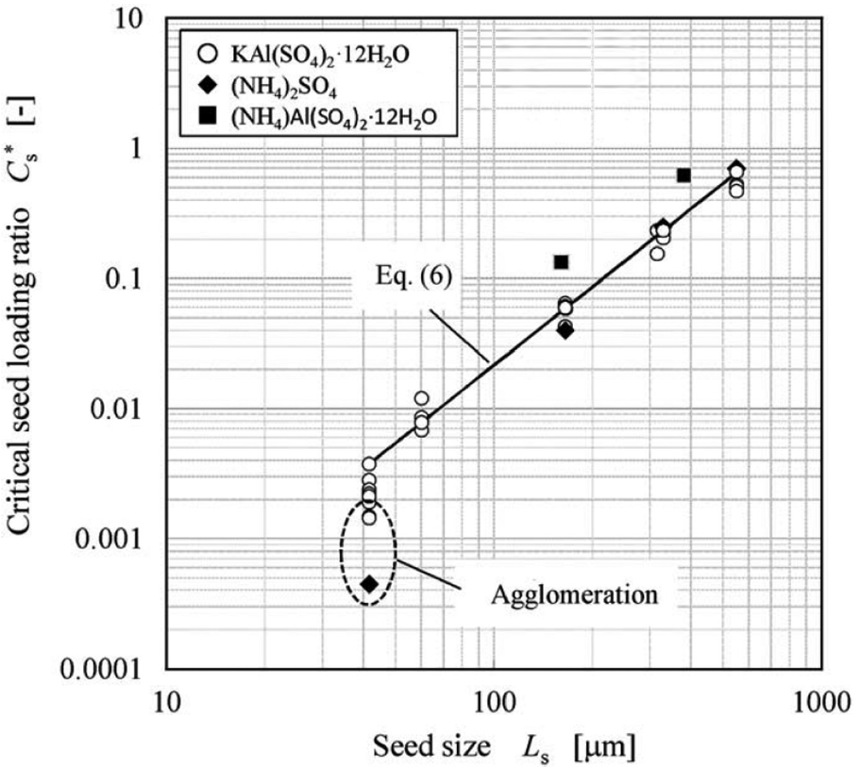
SEEDING
C_{S}* = 2,17 x 10⁻⁶ x L_{SEED}²
$$SEED LOADING=CRYSTAL MASS x {(\frac{SIZE OF SEED}{SIZE OF CRYSTALS})}^{i}$$
i = 1 (needles), 2 (plates) or 3 (cubes)

Slide 40
SEEDING
Timing of seed addition
critical factor for a successful process;
too early → seeds could be dissolved;
too late → spontaneous nucleation might occur
Seed quality
narrow particle size distribution as much as possible;
always add seed as a suspension in slightly undersaturated solution;
always use seed with the highest possible purity.

Slide 41
SEEDING
Seed loading
Paul, E.L.; Tung, H.-H.; Midler, M. Powder Tech, 150, 133 (2005)
„Pinch“ – used mostly in early phase of development on small scale with limited amount of material. Rarely effective or reliable on larger scale.
Small (< 1%) – aid in more controlled crystallization, but not adequate to achieve primarily growth on scale-up.
Large (5-10%) – to improve the probability of growth with the possibility of preventing further nucleation and bimodal distribution.
Massive – mostly used in continuous operations. Provides maximum opportunity for all growth.

Slide 42
SEEDING
Practical example of seeding:
Beckmann, W. Org. Process Res. Dev. 4, 372 (2000)
Beckmann, W.; Nickisch, K.; Budde, U. Org. Process Res. Dev. 2, 298 (1998)

Slide 43
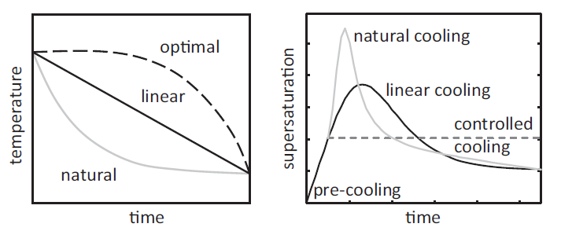
CRYSTALLIZATION TRAJECTORY
Which crystallization trajectory is actually ideal??
- Particular crystallization conditions have significant impact on the yield, size and shape of crystals, polymorphism etc.;
Various ways how to control crystallization
Natural cooling – the simplest, but mostly high degree of supersaturation occur and very small crystals are formed;
Linear cooling – often similar results are obtained as for natural cooling;

Slide 44
CRYSTALLIZATION TRAJECTORY
Constant supersaturation – maintained by a regulated control of cooling/heating, evaporation or antisolvent addition – could bring technical challenges;
Optimal trajectory for a certain purpose – a control system tries to create the best conditions for a certain phase of crystallization, and to get required attributes of crystalline product;
Open loop control – optimal trajectory is calculated by mathematical models and algorithms and is used by a control system – very difficult to control and calculate the impact of various factors and requested attributes (content of impurities, residual solvents, crystal habit etc.);
Closed loop control – the optimal operating policy is continuously updated during a run taking into account in-line process measurements;
Direct design – usually starts with a supersaturation trajectory determined from an open-loop method. The supersaturation is experimentally determined in the course of the process and possibly corrected according to values measured in real time (ATR-FTIR) – can be used to improve for the next batches.

Slide 45
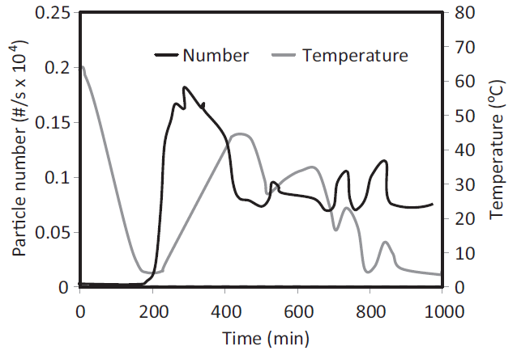
CRYSTALLIZATION TRAJECTORY
Direct nucleation control (DNC)
Formation of crystalline entities/seeds directly in the system without external seeds (very useful for highly toxic compounds);
Does not require any information on the crystallization kinetics;
Overall number and size distribution of formed crystalline entities/seeds is controlled (FBRM) and parameters that influence these attributes are modified in the course of crystallization (temperature, antisolvent addition, solvent evaporation);
Thus, relatively narrow distribution of crystal size can be obtained – by appropriate temperature control fractions of very small crystals are dissolved again;

Slide 46
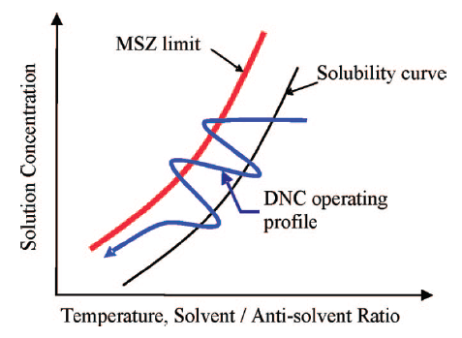
CRYSTALLIZATION TRAJECTORY
Direct nucleation control (DNC)

Slide 47
CRYSTALLIZATION TRAJECTORY
Direct nucleation control (DNC)
Practical example of application:
Abu Bakar, M.R.; Nagy, Z.K.; Saleemi, A.N.; Rielly Ch.D. Crystal Growth Design 9, 1378 (2009)
Liotta, V.; Sabesan, V. Org. Process Res. Dev. 8, 488 (2004)
Saleemi, A.N.; Steele, G.; Pedge, N.I.; Freeman, A.; Nagy, Z.K. Int. J. Pharm. 430, 56 (2012)

Slide 48
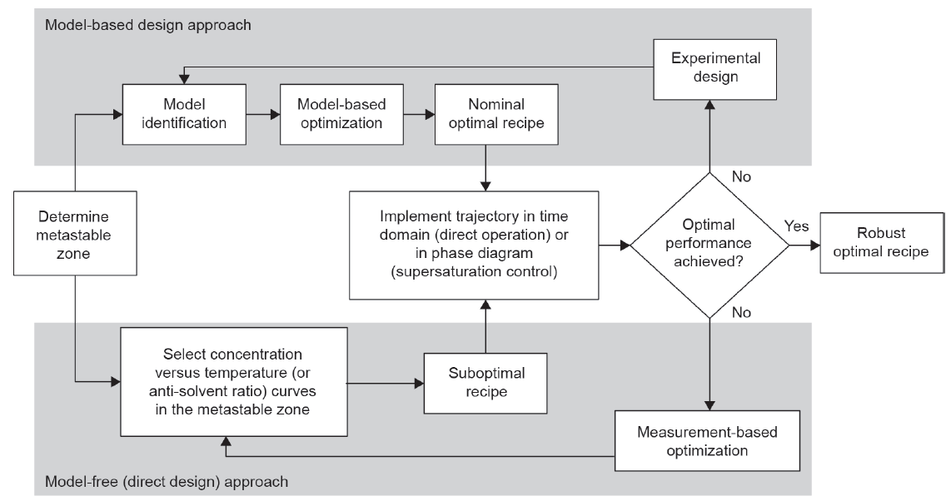
APPROACHES USED IN THE OPTIMIZATION OF CRYSTALLIZATION
Gao, Z.; Rohani, S.; Gong, J.; Wang, J. Engineering 3, 343 (2017)

Slide 49
DUTCH RESOLUTION,
ATTRITION ENHANCED DERACEMIZATION
Petr Beňovský

Slide 50
CRYSTALLIZATION OF ENANTIOMERS FROM RACEMIC MIXTURES
RACEMIC MIXTURE (CONGLOMERATE)
A mechanical mixture of enantiomerically pure crystals of one enantiomer and its opposite;
RACEMIC COMPOUNDS
The crystallographic unit cell contains both enantiomers in ordered 1 : 1 ratio;
RACEMIC SOLID SOLUTIONS
The crystallographic unit contains molecules of each enantiomer in a random order.

Slide 51
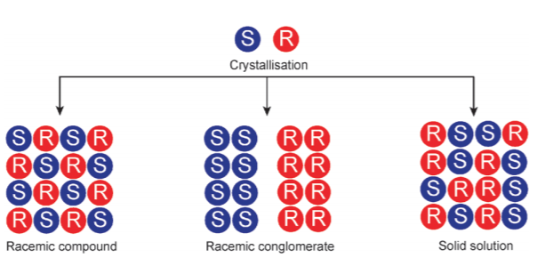
CRYSTALLIZATION OF ENANTIOMERS FROM RACEMIC MIXTURES
Sogutoglu, L.-C. et al Chem. Soc. Rev. 44, 6723 (2015)

Slide 52
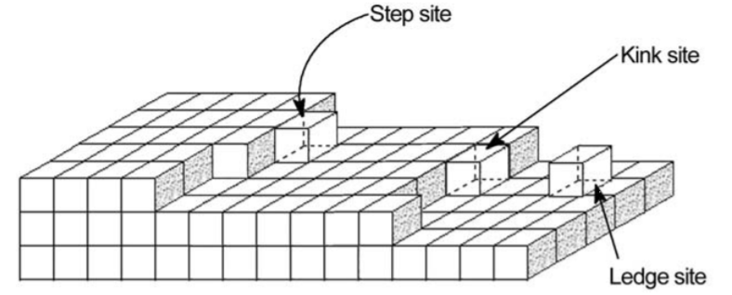
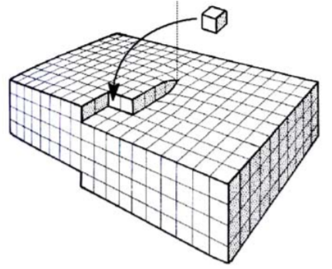
CRYSTALLIZATION OF ENANTIOMERS FROM RACEMIC MIXTURES
CRYSTAL GROWTH
Step-wise growth
Spiral growth

Slide 53
CRYSTALLIZATION OF ENANTIOMERS FROM RACEMIC MIXTURES
CRYSTAL GROWTH
Step-wise growth
Spiral growth

Slide 54
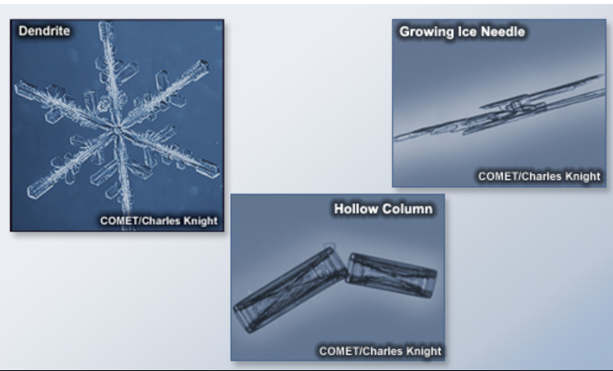
CRYSTALLIZATION OF ENANTIOMERS FROM RACEMIC MIXTURES
CRYSTAL HABITS (ICE CRYSTALS)

Slide 55
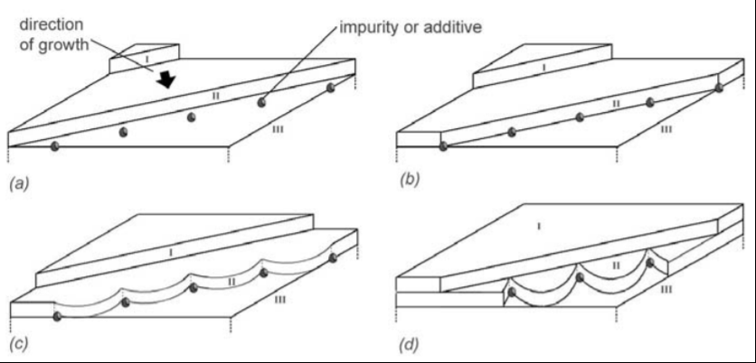
CRYSTALLIZATION OF ENANTIOMERS FROM RACEMIC MIXTURES
CRYSTAL HABIT MODIFIERS
Present impurities or deliberately added compounds that have profound effect on growth rate of one or more faces even at very low concentrations;

Slide 56
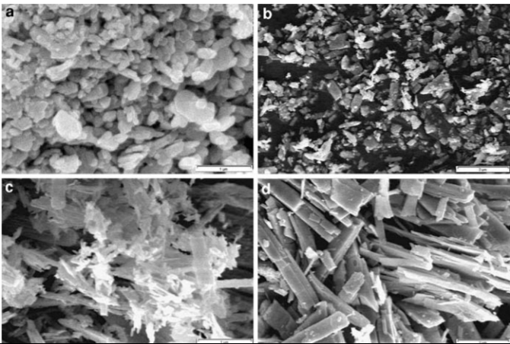
CRYSTALLIZATION OF ENANTIOMERS FROM RACEMIC MIXTURES
CRYSTAL HABIT MODIFIERS
MoO₃ a – urea; b – PEG 200; c – EDTA; d – sorbitol
Parviz, D. et al J. Nanopart. Res. 12, 1509 (2010)

Slide 57
CRYSTALLIZATION OF ENANTIOMERS FROM RACEMIC MIXTURES
NUCLEATION INHIBITORS
Some compounds can efficiently block (or dramatically slow down) crystal growth or nucleation of crystals;
The metastable zone width is thus enlarged;
If we want to crystallize just one enantiomer from a racemic conglomerate we must block nucleation and crystal growth of the opposite one;
Inhibitor in that case must be homochiral;
Inhibitor must be the same enantiomorph

Slide 58
CRYSTALLIZATION OF ENANTIOMERS FROM RACEMIC MIXTURES
OPTICAL RESOLUTION VIA DIASTEREOMERIC SALTS
Single enantiomer drugs - $147 billion worldwide sale (2001)
Optical resolution (besides utilization of chiral pool and asymmetric synthesis) is the most frequent used industrial method for obtaining single enantiomers;
1882 – Louis Pasteur demonstrated that by seeding a supersaturated solution of ammonium sodium tartrate with a d-crystals on one side of the reactor and a l-crystals on the opposite side, crystals of opposite handedness formed on the opposite sides of the reactor.

Slide 59
CRYSTALLIZATION OF ENANTIOMERS FROM RACEMIC MIXTURES
OPTICAL RESOLUTION VIA DIASTEREOMERIC SALTS
Peachey-Pope Resolution
Instead of one equivalent of homochiral resolving agent, only one half equivalent of resolving agent is used and supplemented with one half equivalent of an achiral, low cost acid or base (e.g. HCl, NaOH) to make the system neutral. The achiral supplement should provide very soluble salts with the racemate so this will not crystallize and ruin the resolution. The less soluble (desired) salt will start to crystallize and will consume most of a chiral resolving agent thus leaving only small amount of a chiral resolving agent for the more soluble diastereomer which, in ideal case, will not crystallize.
The solubility difference between two diastereomeric salts can be relatively small.

Slide 60
CRYSTALLIZATION OF ENANTIOMERS FROM RACEMIC MIXTURES
OPTICAL RESOLUTION VIA DIASTEREOMERIC SALTS
Peachey-Pope Resolution
OPRD 1, 72 (1997) – naproxen example

Slide 61
CRYSTALLIZATION OF ENANTIOMERS FROM RACEMIC MIXTURES
OPTICAL RESOLUTION VIA DIASTEREOMERIC SALTS
Dutch Resolution
The use of mixtures of resolving agents (families);
The family members should bear strong structural similarity and are stereochemically momogeneous;
2 or 3 family members are used in a resolution;
Usually, such resolutions proceed rapidly with high diastereomeric excess;
Often, this combination of resolving agents brings better resolution than with just one resolution agent;
Sometimes, all resolution agents are incorporated into the crystal lattice, but sometimes at least one of them serves as a nucleation inhibitor;

Slide 62
CRYSTALLIZATION OF ENANTIOMERS FROM RACEMIC MIXTURES
OPTICAL RESOLUTION VIA DIASTEREOMERIC SALTS
Dutch Resolution
Example

Slide 63
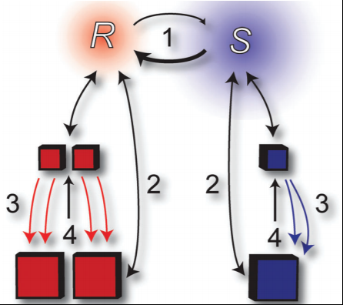
CRYSTALLIZATION OF ENANTIOMERS FROM RACEMIC MIXTURES
ATTRITION ENHANCED DERACEMIZATION
Viedma Ripening
Racemisation in solution
Ostwald ripening
Enantioselective growing
Attrition
Sogutoglu, L.-C. et al Chem. Soc. Rev. 44, 6723 (2015)

Slide 64
CRYSTALLIZATION OF ENANTIOMERS FROM RACEMIC MIXTURES
ATTRITION ENHANCED DERACEMIZATION
Viedma Ripening
Hachiya, S. Chem. Commun. 49, 4776 (2013)

Slide 65
CRYSTALLIZATION OF ENANTIOMERS FROM RACEMIC MIXTURES
ATTRITION ENHANCED DERACEMIZATION
Upscaled synthesis of Clopidogrel (Plavix) using a bead mill
Noorduin, W.L. et al Org. Process Res. Dev. 14, 908 (2010)

Slide 66
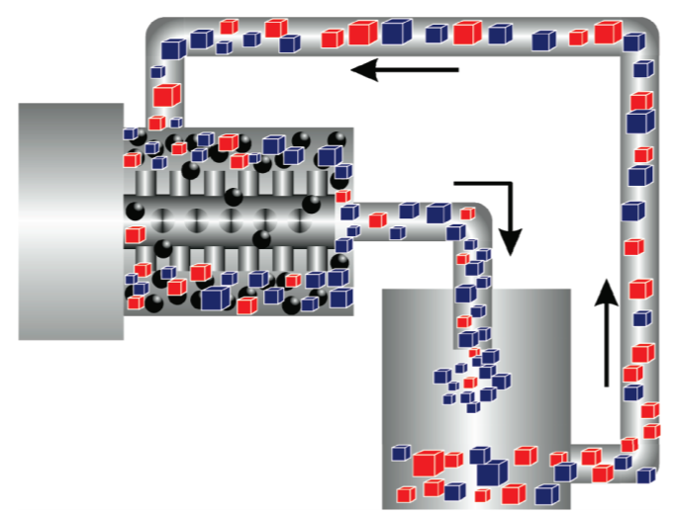
CRYSTALLIZATION OF ENANTIOMERS FROM RACEMIC MIXTURES
ATTRITION ENHANCED DERACEMIZATION
Upscaled synthesis of Clopidogrel (Plavix) using a bead mill
Noorduin, W.L. et al Org. Process Res. Dev. 14, 908 (2010)

Slide 67
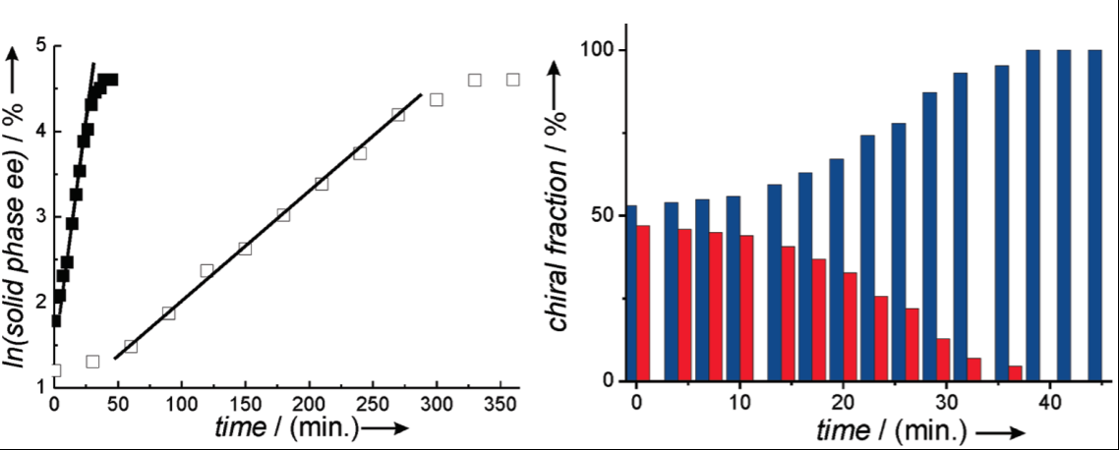
CRYSTALLIZATION OF ENANTIOMERS FROM RACEMIC MIXTURES
ATTRITION ENHANCED DERACEMIZATION
Upscaled synthesis of Clopidogrel (Plavix) intermediate using a bead mill
Noorduin, W.L. et al Org. Process Res. Dev. 14, 908 (2010)

Slide 68
WHAT NEXT??
Solubility determination using very small amounts
Peybernes, G.; Grossier, R.; Villard, F.; Letellier, P.; Lagaize, M.; Candoni, N.; Veesler, S. Org. Process Res. Dev. 22, 1856 (2018)
Membrane crystallizations
Drioli, E.; Di Profio, G.; Curcio, E. Curr. Opinion Chem. Eng. 1, 178 (2012)
Continuous reaction including crystallizations on microscale
Song, H.; Chen, D.L.; Ismagilov, F. Angew. Chem. Int. Ed. 45, 7336 (2006)

Slide 69
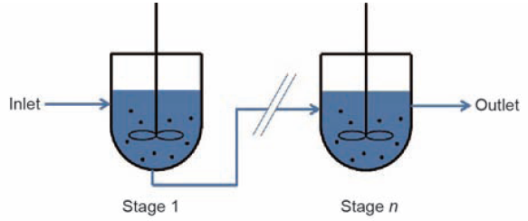
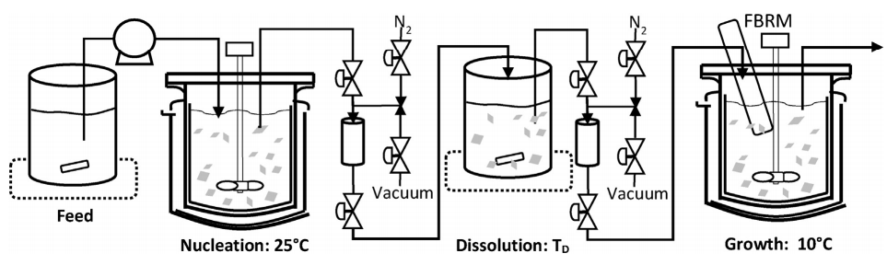
WHAT NEXT??
MSMPR (Mixed Suspension Mixed Product Removal) Crystallization
Zhang, D. et al Engineering 3, 354 (2017)
Nagy, Z.K. et al Chem. Eng. Res. Des. 135, 112 (2018)

Slide 70
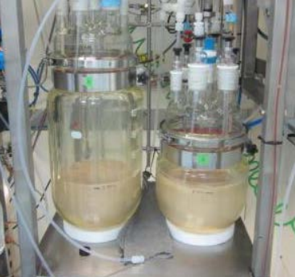
WHAT NEXT??
MSMPR (Mixed Suspension Mixed Product Removal) Crystallization
MSMPR equipment in Eli Lilly;
Crystallization was the most important element of their control strategy for low impurity profile;
Purity of a crystallized compound was higher than 99.8 %.

Slide 71
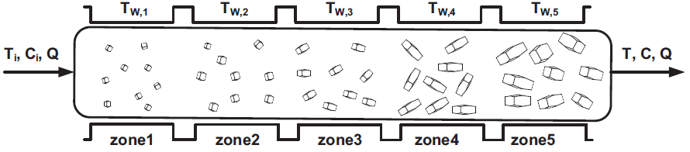
WHAT NEXT??
Plug Flow Crystallization (PFC)
Kwon, J.S. et al Chem. Eng. Sci. 119, 30 (2014)

Slide 72
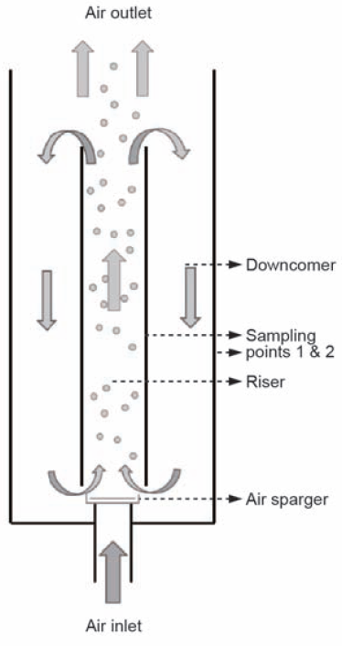
WHAT NEXT??
AIRLIFT CRYSTALLIZERS

Slide 73
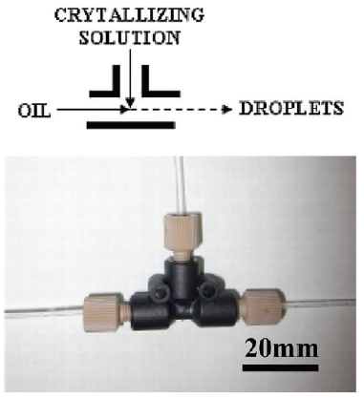
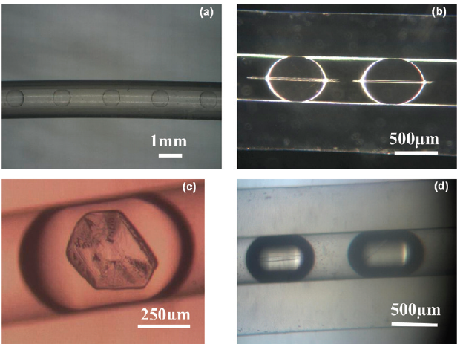
WHAT NEXT??
Microfluid Crystallizations
Crystallization in droplets – every droplet with nanoliter volume is independent crystallizer
Ildefonso, M.; Candoni, N.; Veesler, S. Org. Process Res. Dev. 16, 556 (2012)

Slide 74
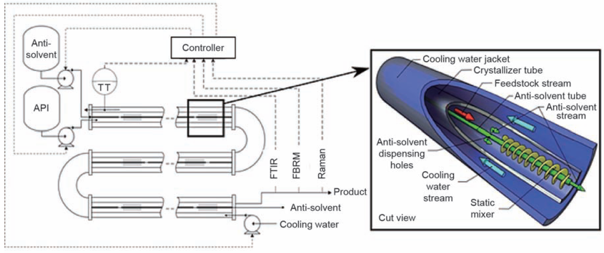
WHAT NEXT??
OSCILLATORY BAFFLED CRYSTALLIZATION
NiTech Solutions

Slide 75
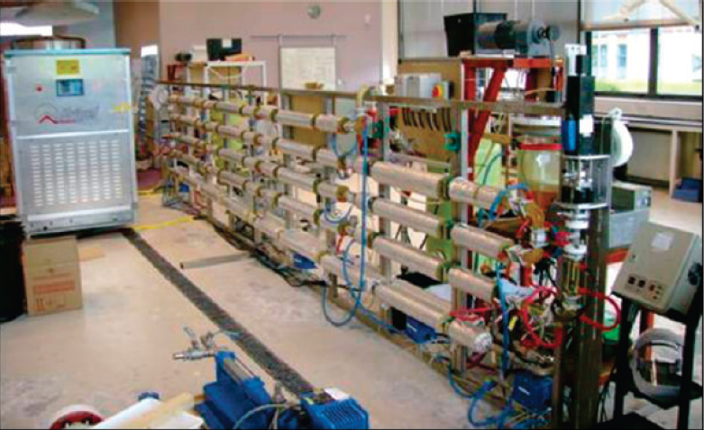
WHAT NEXT??
OSCILLATORY BAFFLED CRYSTALLIZATION
Practical example
NiTech Solutions
Lawton, S.; Shering, P.; Zhao, L.; Laird, I.; Ni, X-W.
Org. Process Res. Dev. 13, 1357 (2009)

