Slide 1
Bi2003 Ecotoxicology
Ecotoxicological bioassays
Jakub Hofman

Slide 2
Content
Introduction – what, why, how, concept
Types of bioassays
Ecotoxicological bioassays’ design and results
Aquatic bioassays - examples
Soil bioassays – examples
Use of bioassays in praxis

Slide 3
Bioassays’ general design

Slide 4
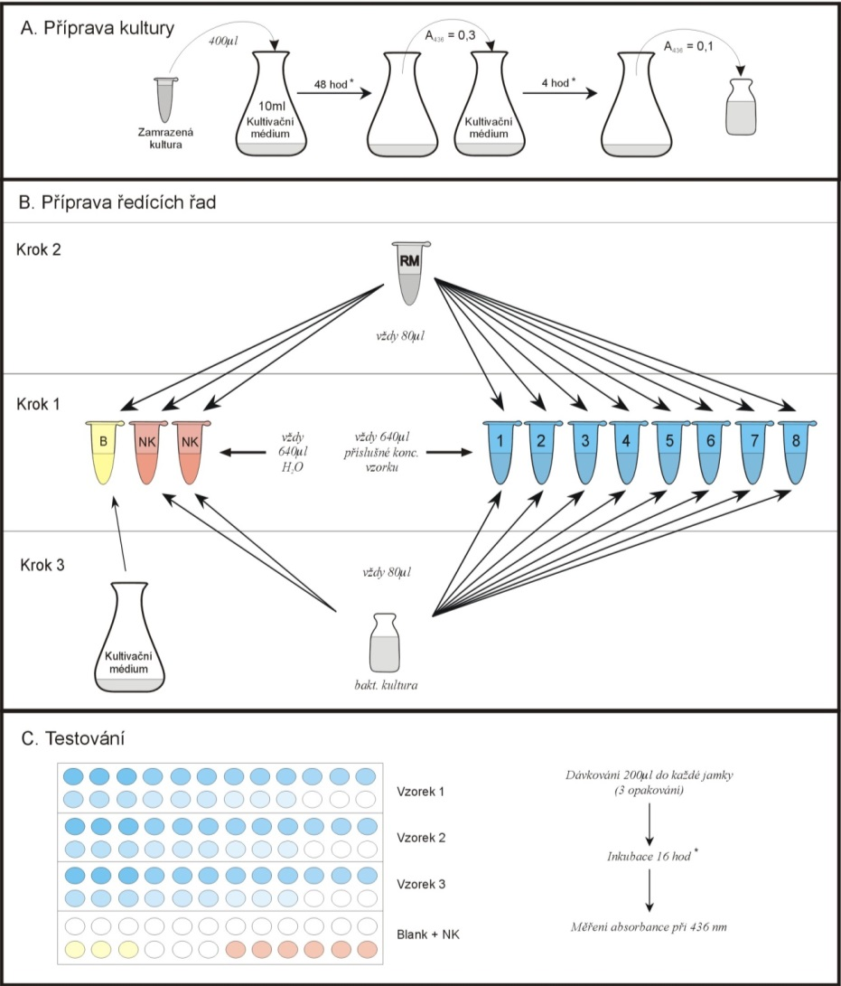
General scheme of bioassay
1) Prepare the organism
  Culture media, standardized numbers, age, etc.
2) Prepare the sample
Dilution series
  water/culture media – direct organism exposure
    Include BLANK (medium only)
  solvent for organic compounds – minimum to be added
    Include SOLVENT CONTROL
  specifics for the SOLID MATRICES
3) Expose of organisms
… for appropriate time, number of repetitions, under specified conditions
0) culture
of organisms
4) Evaluate and report results
    measure the endpoint / count organisms
    validity criteria
    statistical evaluation (means, ANOVA, dose-response …)

Slide 5
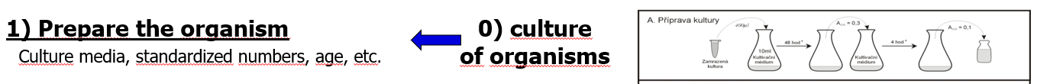
Organisms
Ideally
good availability (laboratory cultures, commercial availability ...)
easy storage and breeding in laboratory conditions in sufficient quantities for experiments
the biology of the species and the genetics of the respective culture are characterized
the relative sensitivities of the species / culture to different classes of toxic substances are studied
the susceptibility of the species should be a good representative of the relevant group of organisms (Daphnia - crustaceans, Danio rerio - freshwater fish)

Slide 6
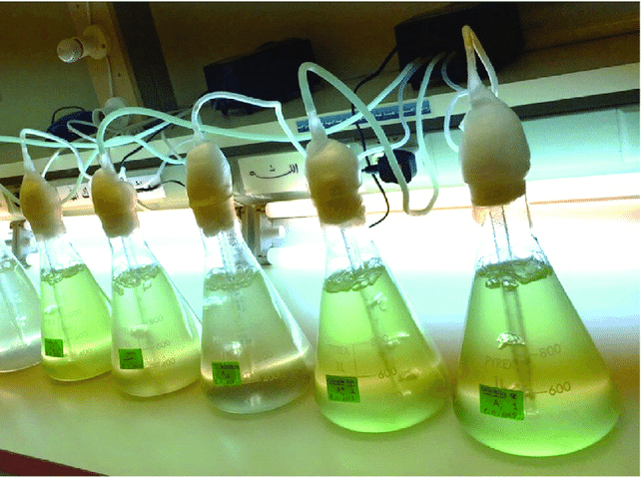
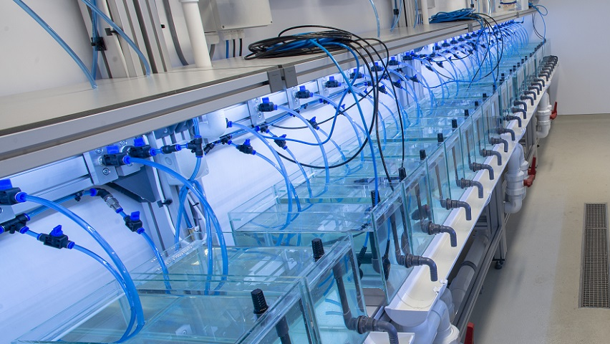
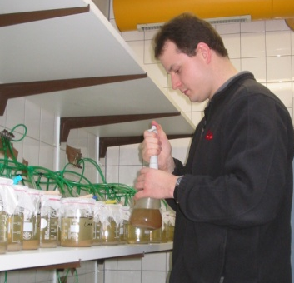
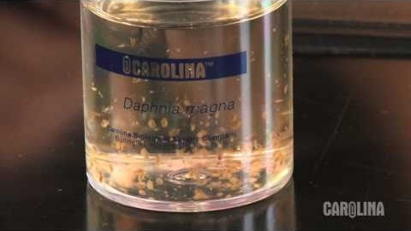
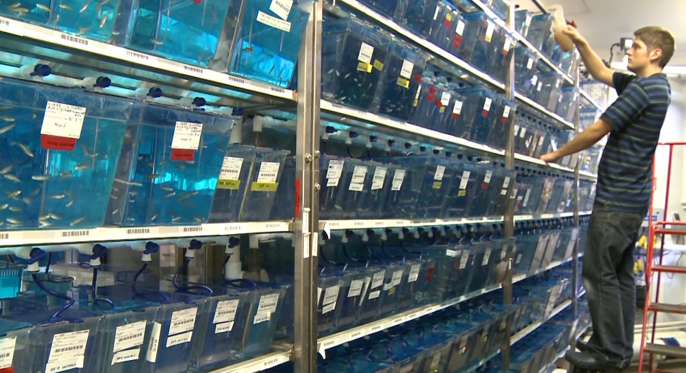
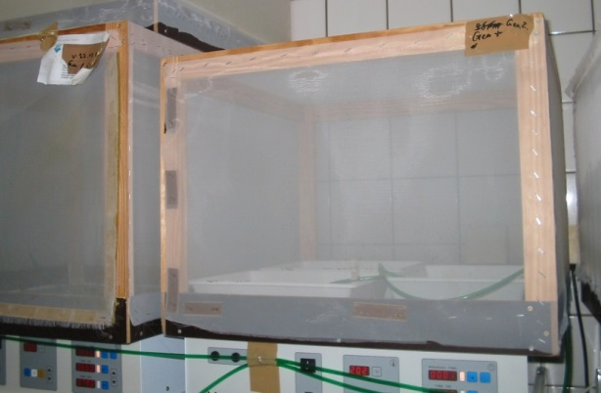

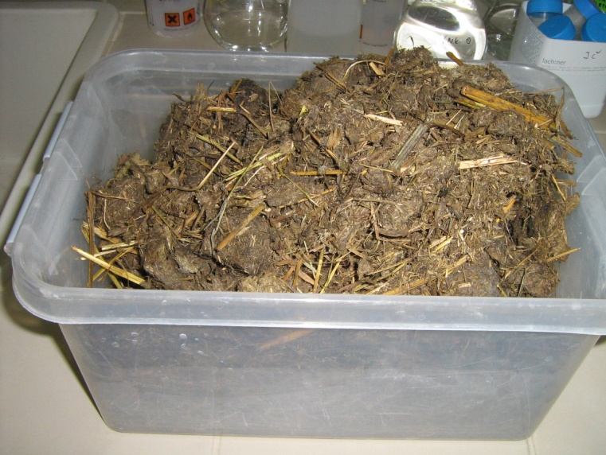
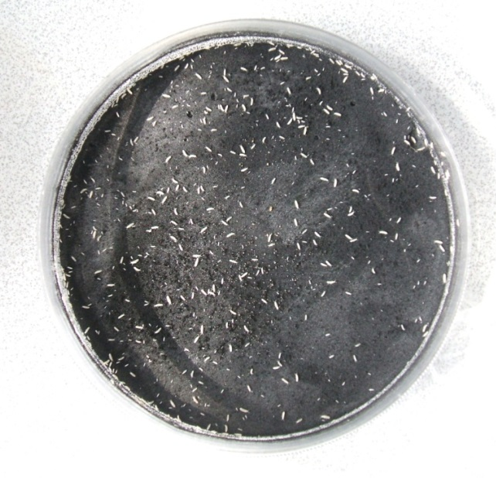
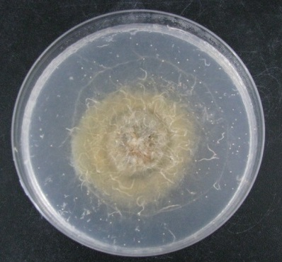
Organisms
Cultures !!!

Slide 7
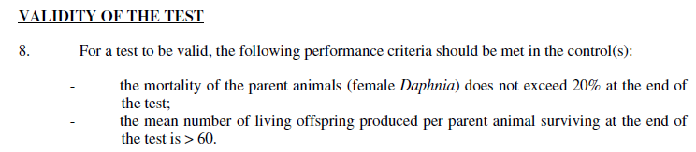
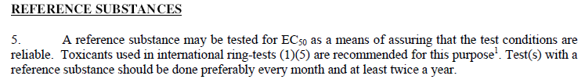
Organisms
the result of toxicity determination and interpretation is influenced by a number of other biological parameters
  genetically determined sensitivity of the respective culture / clone / variety ...
  size and age of individuals
  sex
  developmental stage (eggs, embryos, larvae, adults ...)
  physiological conditions - optimum (diseases, food - antioxidants ...)
in general, the organisms must be in optimal status before the test ➔ this is checked by the test validity criteria and testing reference substances

Slide 8
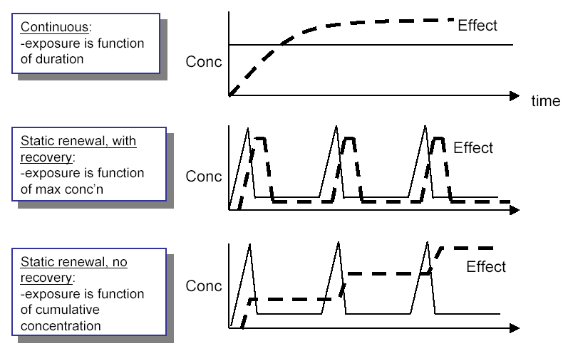
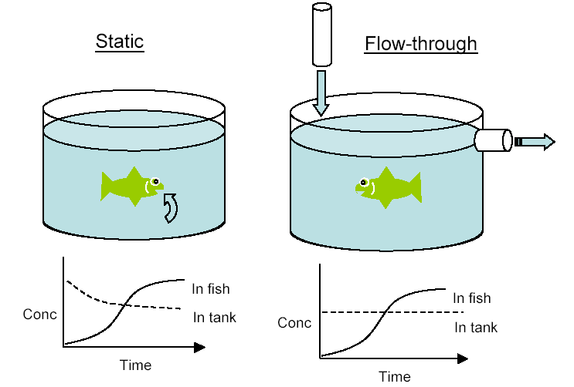
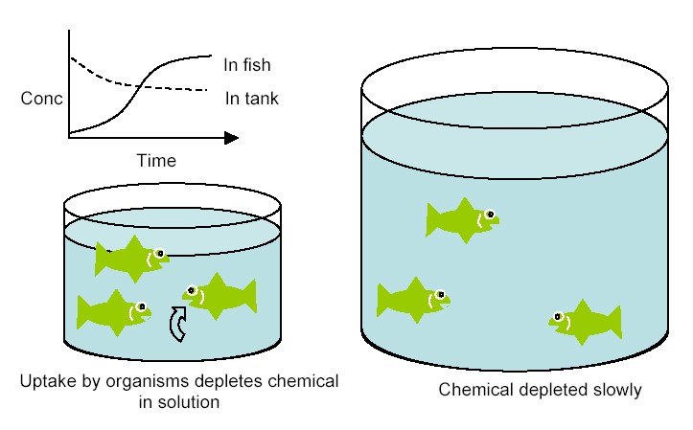
Exposure in aquatic bioassays
Usually exposure of whole organisms (intake by body surface area, respiratory system, food) less often: single injections (fish, input and dose are not affected by the environment)
Distribution according to the arrangement of the exposure
  static (without exchange of solutions - possible changes of concentrations, oxygen)
  static with medium change/renewal (change at defined times, ~24 h)
  recirculation (medium recirculation, more technically demanding ...)
  flow-through (continuous maintenance of concentrations, technically demanding ...)
static
static – large volume
static – medium change
flow-through

Slide 9
Exposure of vertebrate animals in bioassays
vertebrates - laboratory rodents, birds
like in "classical" toxicology:
  injection intramuscular (IM), intraperitoneal (IP), intravenous (IV), subcutaneous (SC)
  oral - dosing in food, application of gauze (tube directly into the stomach) ...
  respiration - air contamination - closed containers / cells, inhalation ...

Slide 10
Exposure in soil bioassays
soil, sediments - bacteria, invertebrates - contact with the whole surface (direct contact tests - solid phase tests)
  real soil / sediment
  artificial soil / sediment
plants - roots - contact with solid or liquid medium, exposure to gaseous pollutants from the air
often several exposure routes can be realistically assumed at the same time

Slide 11
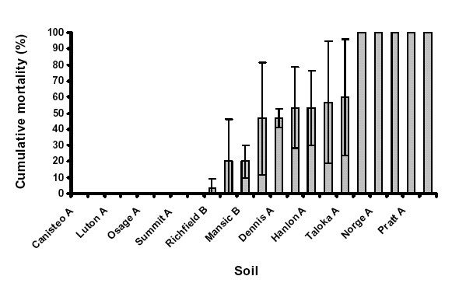
Exposure in soil bioassays
it is specific:
the fate of the contaminant in the soil environment, the influence on the real bioavailability for soil organisms comes into play significantly
Pb: 2 g/kg in soil
mortality of earthworms
Lanno et al. (2004) Ecotoxicology and Environmental Safety 57, 39-47

Slide 12
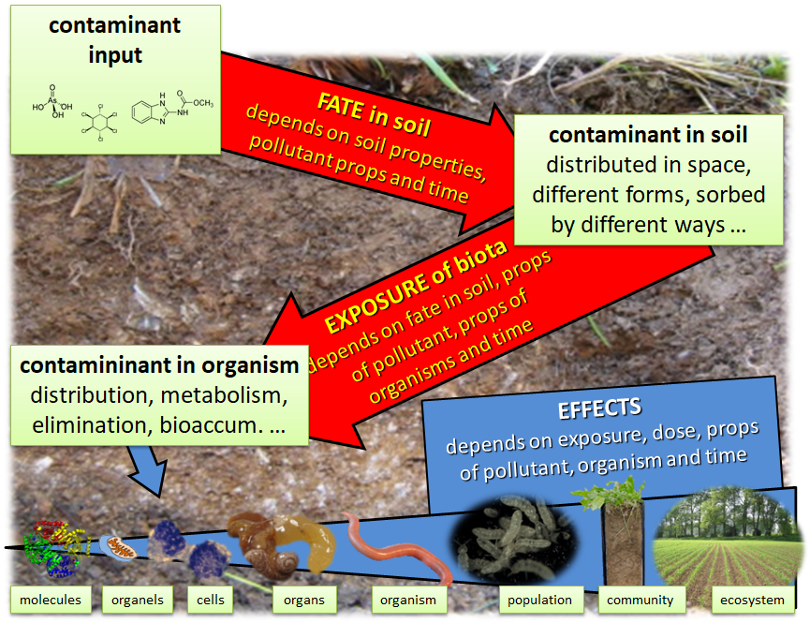
Exposure in soil bioassays
Bioavailability
soil is heterogenous and there is lot of places available for sorption or sequestration of the pollutants ➔ fate, beahviour, distribution affected ➔ exposure, toxicity, risks affected
bioavailability

Slide 13
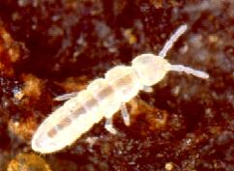
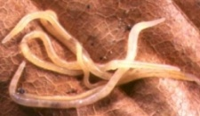
Exposure in soil bioassays
Ingestion and oral
food and soil particles - organisms consume mineral and organic matter - an important route of exposure for sorbed chemicals
contaminants can be biomagnified - for example in fungi that are consumed by sprintails
important path for arthropods
Dermal
from the soil or soil solution - especially organisms drilling in the soil (earthworms and enchytraeids), which have a thin cuticle and are in contact with the soil and pore water
it is also possible to model the results of tests in an aquatic environment by supplementing the model of the distribution of the substance between the soil solution and the sorption on particles = the so-called Equilibrium partitioning theory (EqP)
Breathing
almost no data

Slide 14
Exposure in soil bioassays
ARTIFICIAL SOIL
10% dry fine peat
20% caoline clay, min 30% calolinite
70% quartz sand fine min. 50% of size 0.05 – 0.2 mm
0.3-1% calcium carbonate → pH of 6 ± 0.5

Slide 15
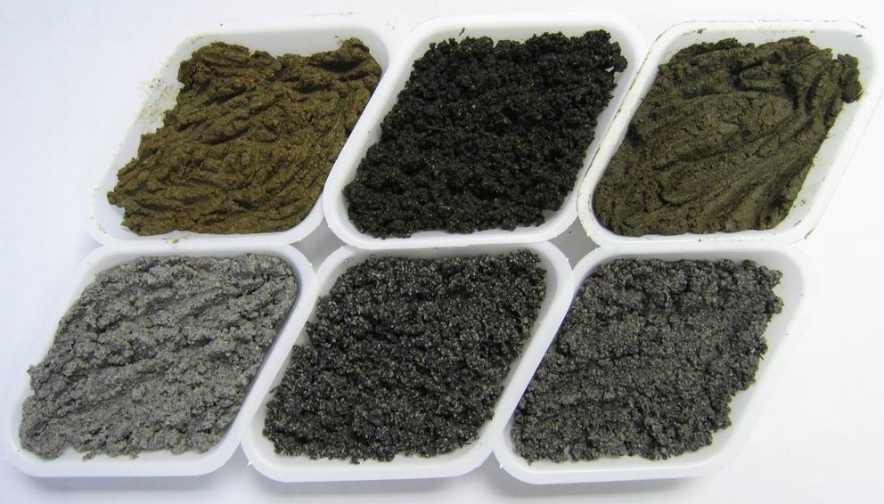
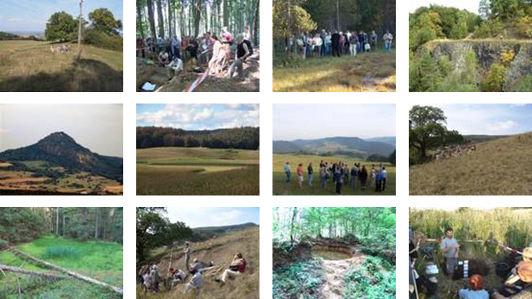
Exposure in soil bioassays
artificial soil is NOT real soil

Slide 16
Exposure in soil bioassays
http://lufa-speyer.de
artificial soil is NOT real soil

Slide 17
Exposure in soil bioassays
the goal is HOMOGENITY of exposure to the test substance
water soluble chemicals
in water which is also used to adjust soil moisture
insoluble in water
using carrier - non-toxic, water soluble/miscible (acetone, ethanol)
using carrier - non-toxic volatile organic solvent and evaporated rapidly
in both cases, solution can be added to:
  small amount (1-10%) of fine quartz sand; after evaporation of solvent, this is added to soil and mixed
  directly into soil (dry or wet) followed by evaporation and mixing
in all carrier cases, it is necessary to include a control for the carrier/solvent
insoluble in water or solvent
mixed directly with quartz sand or whole soil

Slide 18
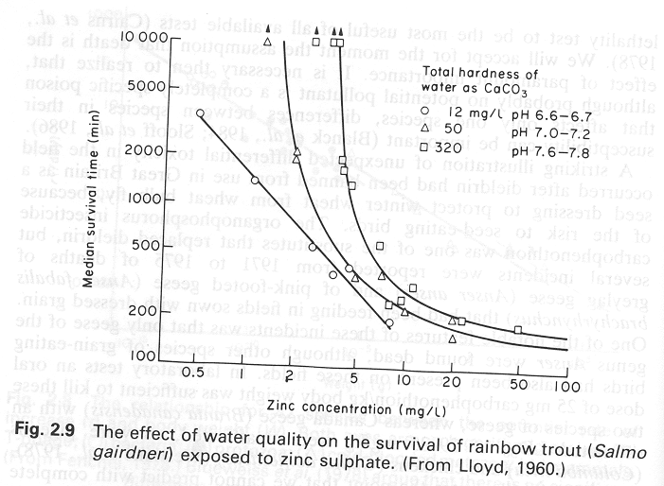
Factors / conditions of the assay
CRUCIAL !!! they affect both the organisms and the tested chemical, they significantly affect the exposure and the final results
must be standardized !!!
  temperature
  light / photoperiod
  oxygen (aquatic consumers)
  pH
  water hardness
  clay and organic matter content in soil
  food added/non-added
  etc.

Slide 19
Results of the bioassays

Slide 20
Parameters of evaluation - endpoints
effects ~ response = result of the exposure to toxic chemical (stressor)
  higher/lower with increasing stressor intenzity (except hormesis)
endpoint = measured (measurable) response / effect
  original units (numbers, weight, enzyme activity etc.) or relative (% of control)
acute effects
  animals – letality/mortality, imobilization in case of Daphnia
  plants – algae: growth, chlorofyl (fluorescnence); vacular: emergence, growth
  destruents – bacteria: growth, activity ...
chronic/sublethal effects
  animals –growth, malformations, reproduction, behavior
  plants – growth, reproduction...

Slide 21
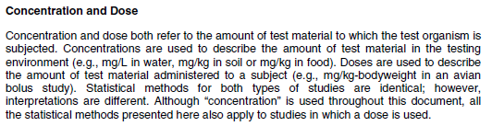
Measures of exposure
DOSE versus CONCENTRATION
  toxicology – dose - mg/kg b.w. - body weight, mg/kg b.w./day
  ecotoxicology – usually the concentration in the medium - mg/L, mg/kg_{soil} etc.
pure chemicals and defined mixtures
  conc. in media - mg/L, mmol/L (= mM), mg/kg etc.
environmental samples
  extracts of the samples and their % dilutions
  % of the sample in the reference material

Slide 22
Data from ecotoxicity bioassays
Error bars in the graphs indicate that regardless of the type of response, it is measured in several replicates and the resulting data have some variability

Slide 23
Data from ecotoxicity bioassays
Tested factor - qualitative, nominal
Contamination (or other stressor tested) in variants (samples) is not quantified, is not quantifiable, or is quantified, but the aim is not to study the influence of its intensity on the effect. Variants (samples) cannot be (or it is not the goal) arranged in any way. It is a comparative test of several variants (samples) each other and / or against the control (e.g. soils from monitoring from different localities, samples of different soil materials - sludge, sediments, waste). The extreme is „the limit test“ - one tested variant (sample) is compared with the control.
Tested factor - kvalitative, ordinal
Contamination (or other stressor tested) in variants (samples) is not fully quantified, but variants (samples) can be ranked based on some criteria. However, it is not possible to determine how many times the variant is larger or smaller than the previous or next one - the intensity of contamination (stress) cannot be plotted on the axis and no relationship between it and the effect can be modeled. It is a comparative test of several variants (samples) each other and / or against the control (e.g. soils little, medium and very far from the source; soils from little, medium and very damaged ecosystem, etc.).
Tested factor – quantitative
Contamination (stressor) is quantified to the extent that it is possible to say how many times or by how much its intensity is greater or less than in the previous or next variant. The contaminant concentration (stressor intensity) can be plotted on an axis and the experiment arranged and evaluated as a test of the relationship between concentration and effect, this relationship can then be graphically expressed, modeled and ecotoxicity parameters calculated. Whether the tested factor is quantified by discrete (integer) or continuous (even decimal) data is not very relevant.

Slide 24
Data from ecotoxicity bioassays
Observed response – qualitative, binary
The answer is not quantifiable, it is only possible to determine whether it has occurred or not - a typical example is mortality / survival of organisms, occurrence of some signs (lesions, swelling, mutations,), immobilization, escape reaction, etc. Finding on a number of organisms (biological systems), the binary result can be converted to the frequency or affected fraction and expressed as a percentage of the effect (e.g. mortality, lethality, survival, leakage) or as an affected fraction with values from 0 to 1. In this form, this type of data can be evaluated similarly to quantitative continuous data (test, model, regressions, etc.), but statistical methods designed for binomial data should be used correctly, including, for example, another formula for calculating variance.
Observed response – qualitative, ordinal
The response is quantified to the extent that the results can be ranked, eg small, medium and large damage. However, it is not possible to determine between the samples (variants) how many times or by how much the result is larger or smaller, and therefore it is not possible to model the relationship between the effect and the concentration. As with binary data, these results can be converted to fraction or frequency and expressed as a percentage in each category.
Observed response – quantitative, continuous
The response is quantified to the extent that it is possible to say how many times or how much is greater or less in one variant (concentration) than in another (eg weight, size, enzyme activity, production, number of juveniles, biomarker concentration…). The results can be plotted and the relationship between concentration and effect evaluated.

Slide 25
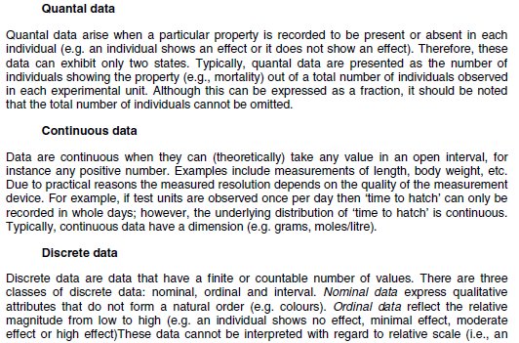
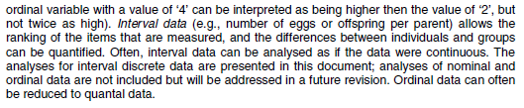
Data from ecotoxicity bioassays
Draft Guidance Document for on the Statistical Analysis of Ecotoxicity Data. OECD Environmental Health and Safety Publications, Series on Testing and Assessment, Environment Directorate, OECD, Paris 2003.

Slide 26
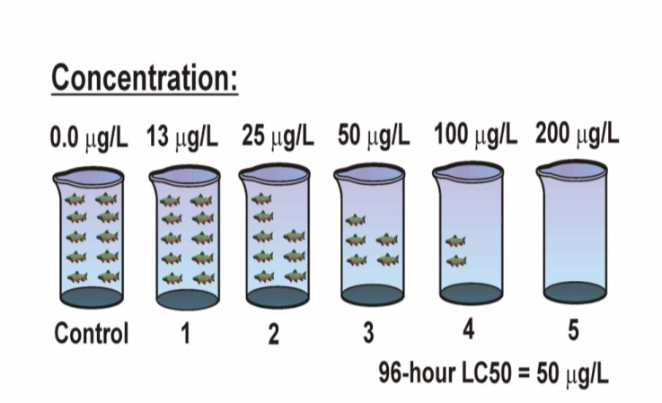
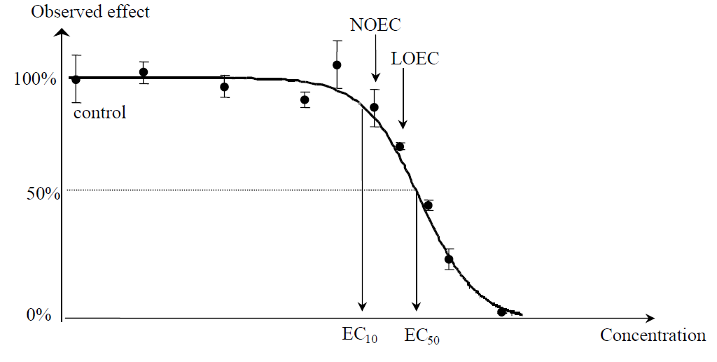
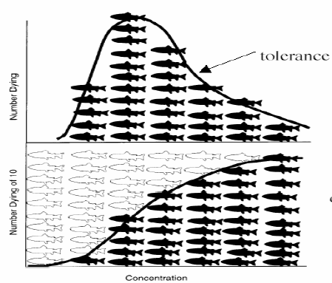
Dose(concentration) - response relationship
each conc./dose is tested in several replicates !!!
No Observed Effect Concentration (NOEC)
Lowest Observed Effect Concentration (LOEC)
ECx ( x % effects concentration)
LCx ( x % lethal concentration)

Slide 28
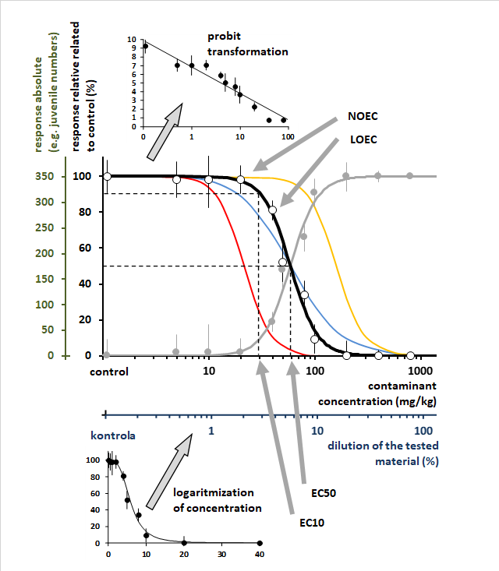
Dose(concentration) - response relationship

