Slide 1
MECHANISMS OF TOXICITY OVERVIEW
Luděk Bláha, PřF MU, RECETOX
www.recetox.cz

Slide 2
Different categorizations of Mechanisms of Action (MoA)
According to target molecules (next slide)
  Mechanisms primarily targeting different
    BIOLOGICAL MACROMOLECULES
      i.e. PROTEINS and/or NUCLEIC ACIDS and/or PHOSPHOLIPIDS
    SMALL BIOLOGICAL (ORGANIC) MOLECULES
      E.g. Antioxidants or scavengers (vit.E, GSH)
According to INTERACTION between toxicant/target (next slide)
  Non-covalent interactions
    Partitioning (v d Waals, H-bonds, hydrophobic interactions) → [1] below
    Partitioning with specific steric fit → [3] below
  Formation of covalent bonds
    ... with proteins / DNA-RNA / P-lipids / small molecules → [2] below
According to “STERIC SPECIFICITY” of the interaction
  NON-SPECIFIC MECHANISMS
    the interaction between the toxicant and the target occurs “generally” with any target of certain general properties (e.g. toxicant is able to bind to ANY protein having e.g. SH- group), it does not require specific steric (structural) properties of the target
      mechanisms [1] and [2] below
  SPECIFIC MECHANISMS
    the toxicant interacts only with certain and specific structural properties (e.g. specific binding of a pesticide into the active site of enzyme acetylcholinesterase)
      mechanism [3]

Slide 3
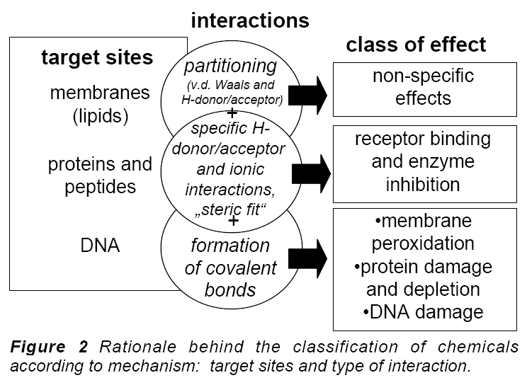
Target (receptor) in MoA / toxicodynamic = BIOMOLECULE
[1]
[3]
[2]

Slide 4
Categorizations of MoAs
[1] non/specific membrane toxicity
  Involves ALL ORGANIC compounds
  Affinity to non-polar environment (membrane phospholipids)
  Two types can be discriminated
    nonpolar basal / narcotic toxicity (
      effects observed at relatively high concentrations, depends on hydrophobicity (Kow)
    polar narcosis
      more polar compounds may affect also membrane proteins (effects at lower concentrations than expected from Kow)
[2] nonspecific reactive toxicity
  some compounds with “reactive” properties may directly modify biological macromolecule (lipids, proteins, nucleic acids) causing thus toxic effects
  reactive chemicals are mostly „electrophiles“ (reacting with „nucleophiles“ in cells – i.e. electrone-rich sites - nucleotides, -NH2, -SH and others)
[3] specific steric interactions
  only certain specific compounds selectively affect specific targets
  E.g. enzyme inhibitions (drugs, insecticides); receptor interactions (e.g. Estrogens)
  Can be non-covalent as well as covalent
  Effects at very low concentrations
All organics
→ membranes
Specific interactions
Reactive

Slide 5
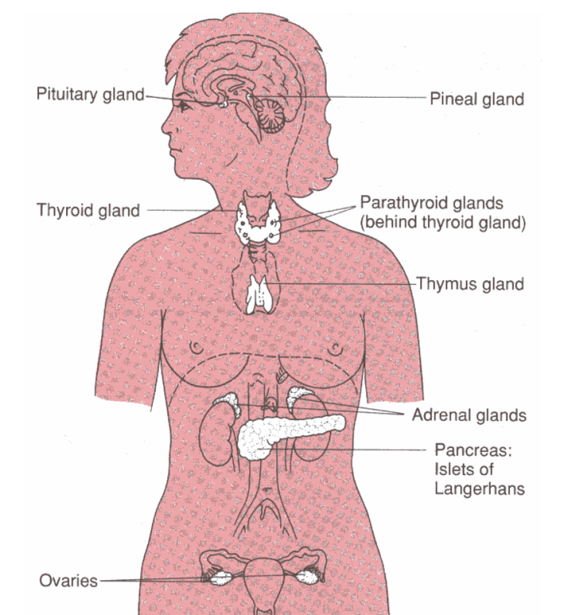
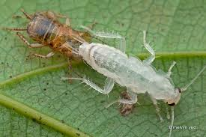
Categorizations of MoA
Species-specific mechanisms, examples
  photosynthetic toxicity (only in plants) vs. teratogenicity (only in vertebrates)
  Endocrine disruption
    different hormonal systems in invertebrates vs vertebrates
    → different toxicity mechanisms
Growth in humans
several hormones
Growth in invertebrates
ecdysis (moulting) - ecdysteroids

Slide 6
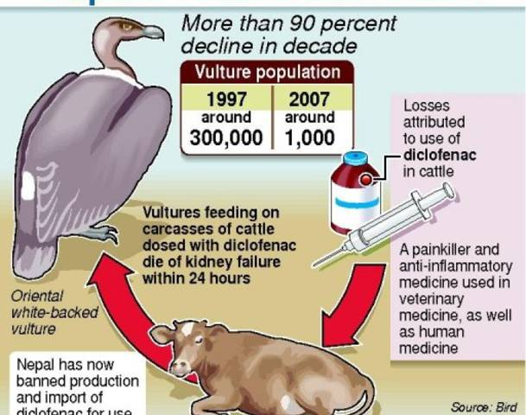
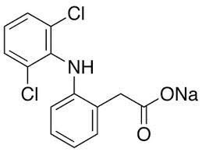
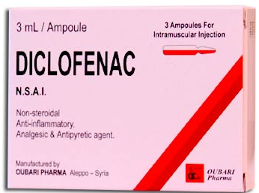
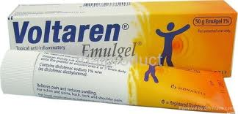
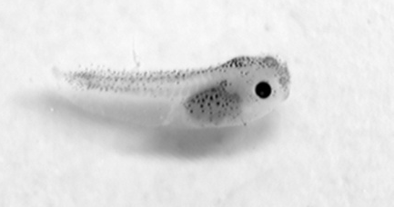
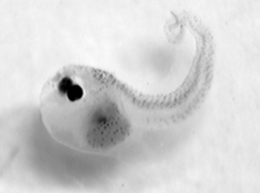
Categorizations of MoA
- Tissue-specific mechanisms (& effects)
- hepatotoxicity; neurotoxicity; nephrotoxicity; haematotoxicity
- toxicity to reproduction organs;
- immunotoxicity
Developmental stage-specific mechanisms
- embryotoxicity/teratogenicity: toxicity to cell differenciation processes
Thalidomide
Cyanobacterial metabolites
Malformations in frog tadpoles

Slide 7
Keywords to remember and understand
What is it MoA?
Can you give examples of species-specific MoA?
What are the biological targets for toxicants? How can they be classified?
What are the possible interactions between toxicants and biological targets?
What is it specific and non-specific toxicity mechanism?
What biological molecules are likely to be affected (usually at relatively high concentrations) by ALL ORGANIC COMPOUNDS?
.... and now let’s look in detail on major MoAs
and their toxic consequences

Slide 8
Toxicity mechanisms - overview
Student is expected to know principles and some examples of the following main types of toxicity mechanisms
Membrane nonspecific toxicity (narcosis)
Proteins and inhibition of enzymatic activities
Ligand competitions – receptor mediated toxicity
DNA toxicity (genotoxicity)
Complex mechanisms
  Oxidative stress – redox toxicity: discussed in the presentation on cell and organismal effects

Slide 9
DNA as target to toxicants

Slide 10
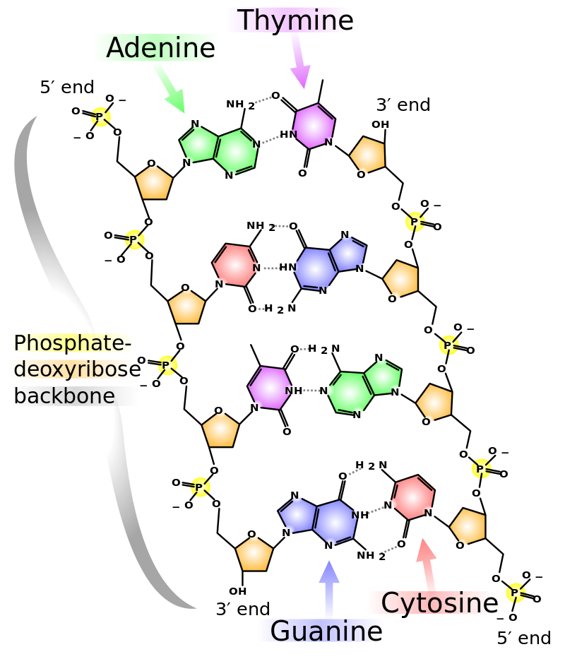
DNA as target to toxicants
principal molecule for life
structure and function carefully checked
changes rapidly repaired
irreversible changes → cell death
(physiologically by apoptosis)
Mutagenesis → MUTATIONS
→ variability and evolution
or → damage to DNA
(structure or coding)
… naturally
billions of nucleotides/day
→ most are repaired
… stress-induced → toxicity

Slide 11
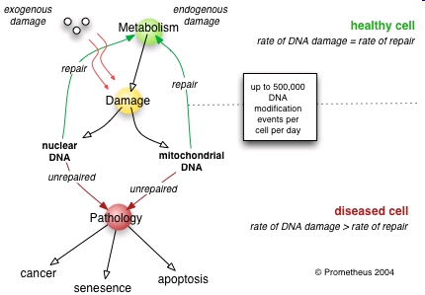
DNA damage and its effects
Cellular changes → Health and evolutionary consequences

Slide 12
DNA repair
Damage of DNA is carefully controlled
constitutively expressed repair systems
Sudden changes in DNA
→ induction of additional repair enzymes
(e.g."SOS-repair“ in bacteria - biomarker of DNA damage)

Slide 13
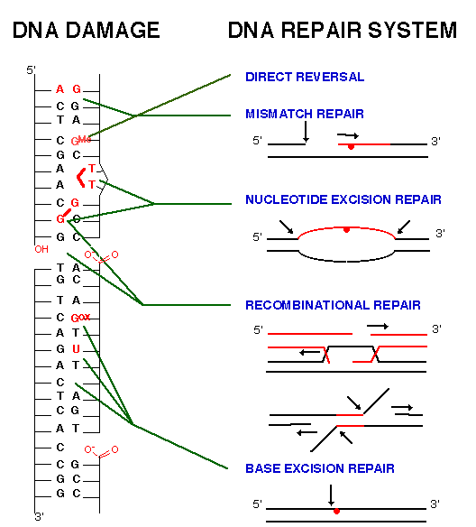
Various types of
molecular changes
in DNA ...
and corresponding
repair systems
Note!
Not all nucleotides
are affected in the
same rate
(mutations occur only at
specific sites due
to physicochemical properties)
Most common patterns:
G - the most frequent target
(highly nucleophilic character)
T=T at the same strand
G=G crosslinks

Slide 14
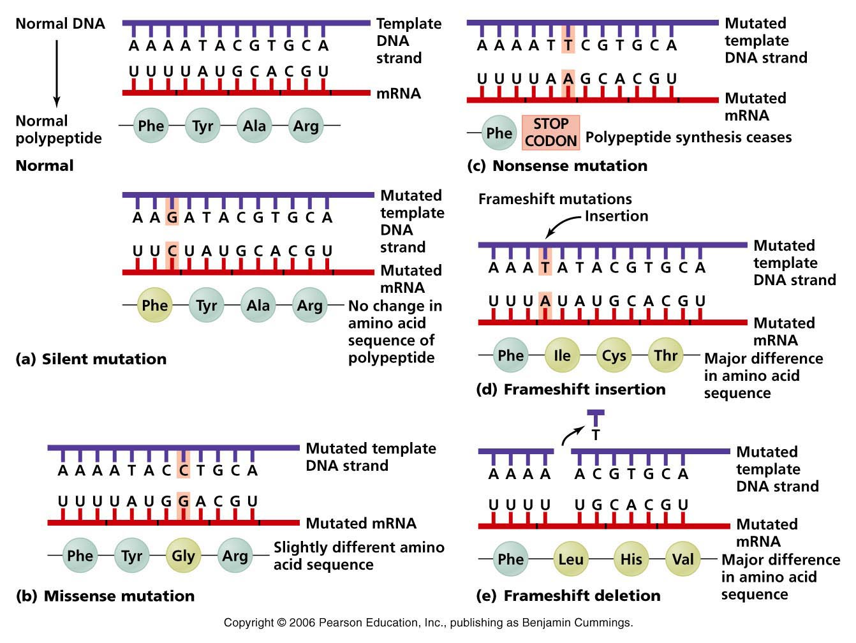
Examples – point mutations and their IMPACT
→ (a) silent, (b) missense, (c) nonsense, (d) frameshift

Slide 15
What are the agents inducing mutations? MUTAGENS
PHYSICAL FACTORS
Ionizating radiation
- direct interactions with NA
- interactions with water
→ formation of OH*
(and other oxygen radical species – ROS)
→ Various impacts on bases and strands
UV radiation
- interaction with aromatic cycles (bases)
→ base dimerization (T=T)

Slide 16
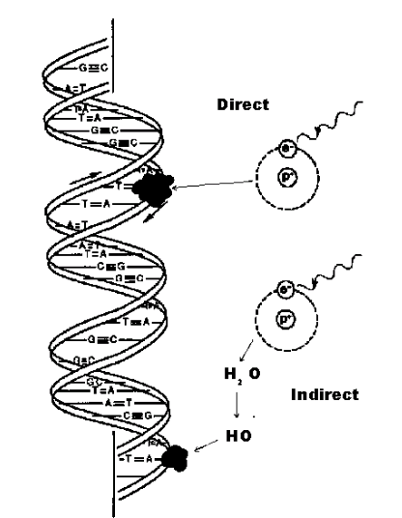
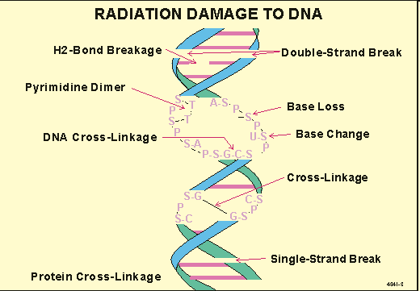
Ionizing radiation effects on DNA

Slide 17
What are the agents inducing mutations? MUTAGENS
CHEMICALS
1) Small electrophilic molecules
(attracted by nucleophilic/basic sites … e.g. in DNA)
2) Other reactive molecules
* alkylating and arylating agents – covalent adducts
* specifically intercalating agents
3) Base analogs
inserted during replication instead of nucleotides
Some compounds may require “activation” by metabolism
pro-mutagen (pro-carcinogen) → mutagen (carcinogen)

Slide 18
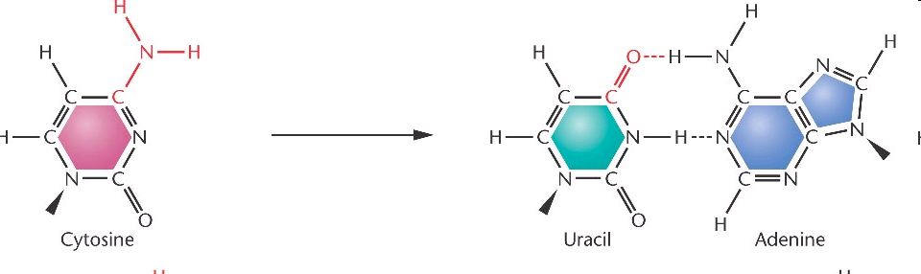
Small molecules → deamination of bases
HNO₂, HSO₃⁻ Hydroxylamine (HO-NH2), Methoxyamine (CH3-O-NH2)
Example: oxidation (deamination)
→ CG to → TA shift

Slide 19
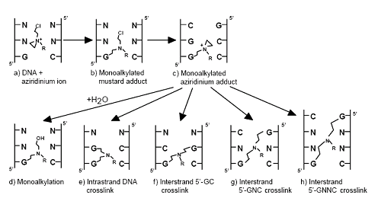

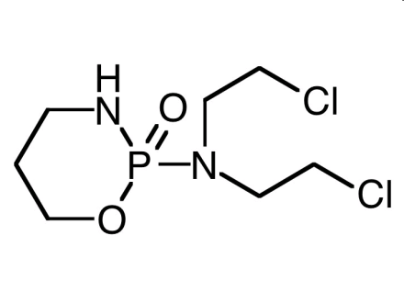
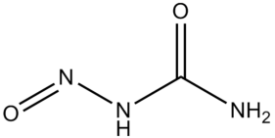
ALKYLating compounds
Covalent binding to NA (alkylation of bases, crosslinks in dsDNA)
Alkylsulphates, Nitro-urea, N-nitroso-alkyles, cis-platinum
cisplatin
cyclophosphamide
Nitrourea

Slide 20
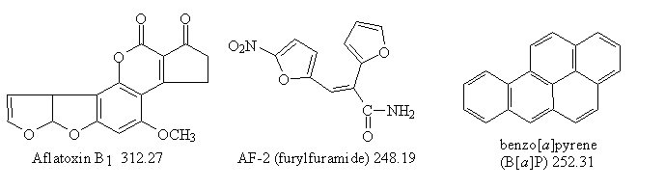
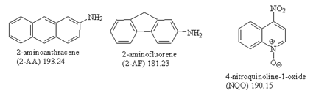
ARYLating compounds
Covalent binding, aromatic „adducts“ with bases
(see also discussion at biomarkers)
Mycotoxins (Aflatoxins) – requires activation
PAHs (benzo[a]pyrene) – requires activation
PAH derivatives
- 2-AA, 2-AF (grill products)
- NQO – model mutagen
in experiments
... many others

Slide 21
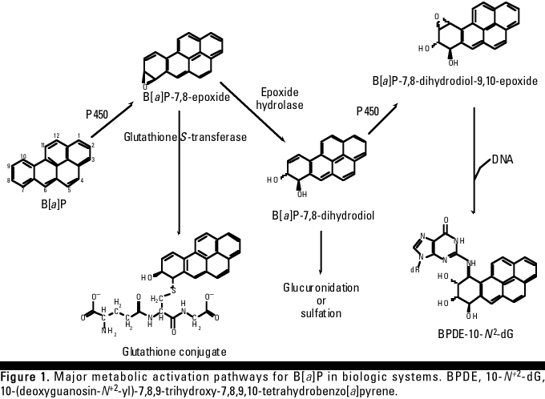
Bioactivation of benzo[a]pyrene → genotoxicity
BaP is oxidized to epoxides and OH-derivatives during detoxification (CYP450)
→ increased reactivity (including binding to bases ... primarily G or A)
(Similar bioactivation e.g. at aflatoxin)

Slide 22
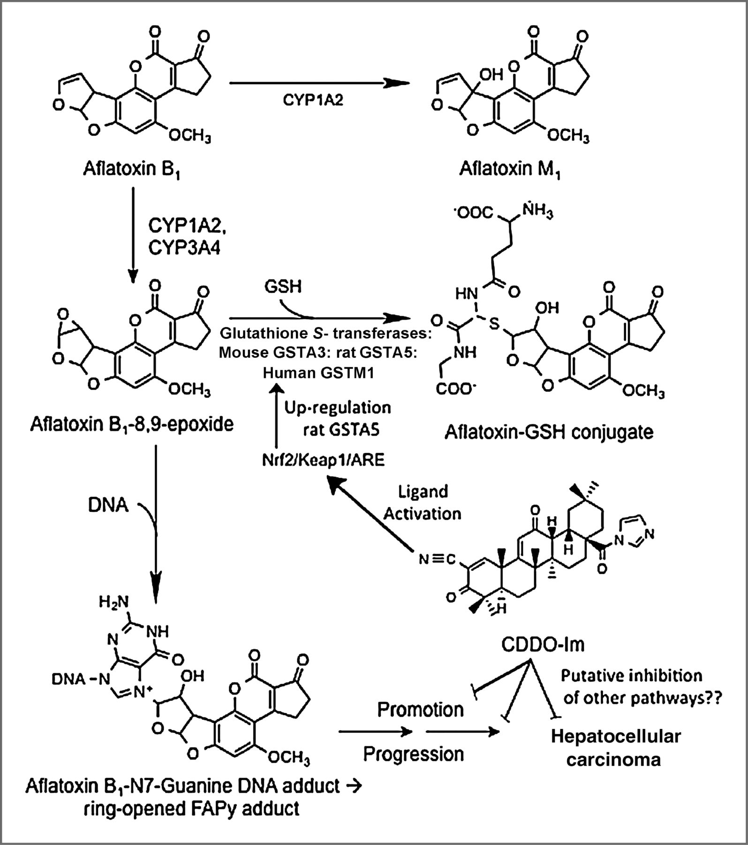
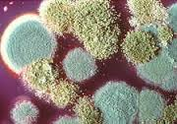
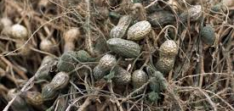
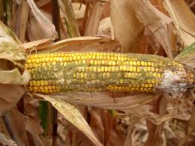
Bioactivation of aflatoxin → genotoxicity
AFLATOXIN sources

Slide 23
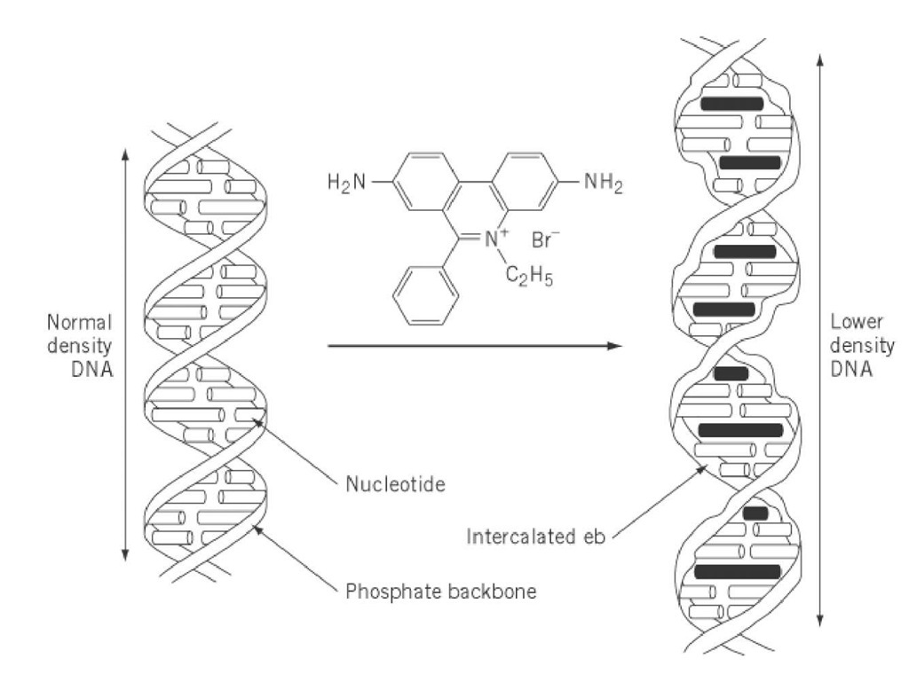
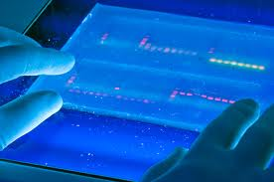
Intercalating agents
INTERCALATORS
Compounds with characteristic structures “fitting” into DNA
→ both noncovalent and covalent intercalation
Example 1 – ETHIDIUMBROMIDE
- experimental dye – visualization of DNA
- intercalation → sharing of electrones with bases → high fluorescence

Slide 24
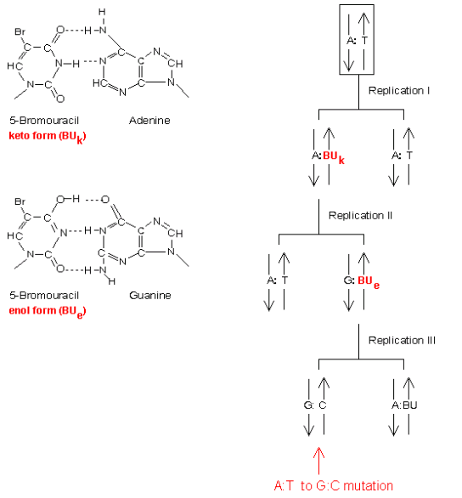
Base analogs
Structure similarity with natural bases
→ Incorporation into DNA during replication
→ Base exchange mutations
Example
5-Br-Uracil (anticancer drug)
  AT → GC shift

Slide 25
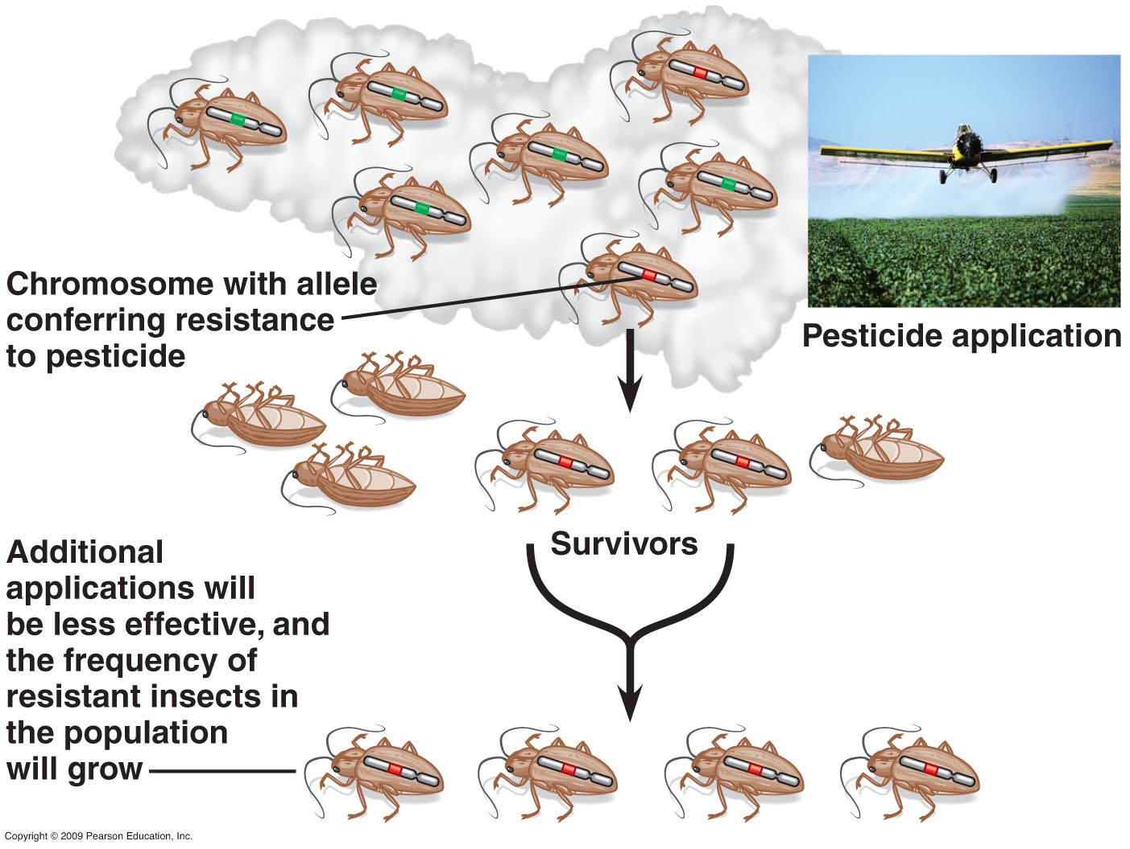
Mutations (alleles) and evolution

Slide 26
MEMBRANES AS TARGETS TO TOXICANTS

Slide 27
Cell membrane
Key functions for life
Primary barrier / separation of „living“ inside from „abiotic“ outside
Semipermeability for nutrients / signals
Reception of chemical signals & regulatory molecules
Keeping gradients necessary for life
  H+ - ATP synthesis(mitochondria / bacterial emambrane)
  K+/Na+ - neuronal signals
Proteosynthesis (ribosomes) depends on membranes
Many other enzymes bound to membranes (e.g. signaling, detoxification, post-translational modifications)
Etc….

Slide 28
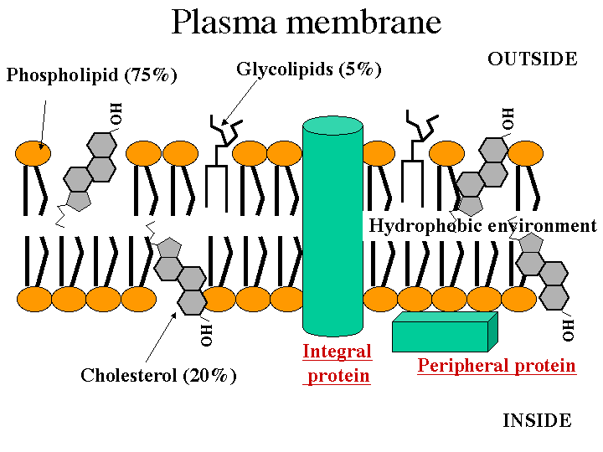
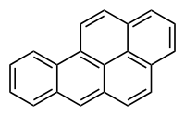
Note: cholesterol – structural/size similarity to toxic
organics e.g. Benzo[a]pyrene

Slide 29
Nonspecific (basal, narcotic) toxicity
- All organic compounds tend to accumulate in membranes, being “narcotic” at relatively "high“ concentrations
- Compounds then affect membranes
→ nonspecific disruption of fluidity
→ and/or disruption of membrane proteins
- Related to lipophilicity (Kow): tendency of compounds to accumulate in body lipids (incl. membranes)
E.g. narcotic toxicity to fish: log (1/LC50) = 0.907 . log Kow - 4.94
- The toxic effects occur at the same "molar volume" of all narcotic compounds (volume of distribution principle)

Slide 30
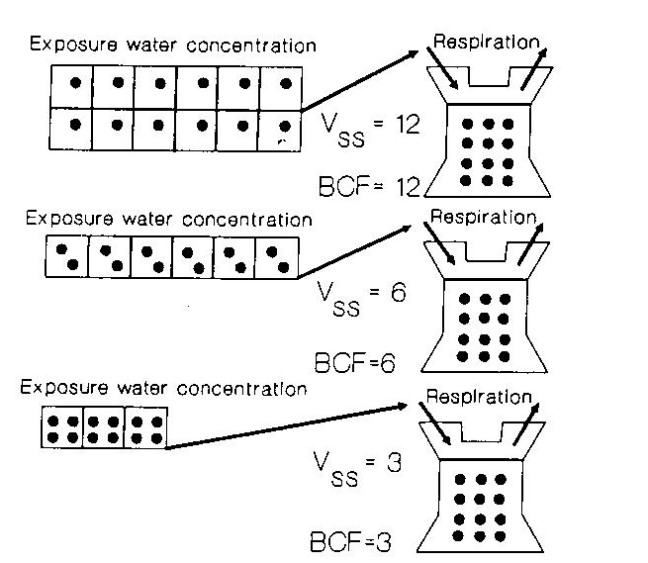
Volume of distribution principle
BCF – bioconcentration factor
* Depends on hydrophobicity
(i.e. Kow)
* Higher BCF
→ lower concentration is
sufficient for bioconcentration
to the same “tissue concentration”
→ lower external concentration
(IC50) will induce toxic effect
* Confirmed by chemical analyses
(same molar concentrations of
different compounds accumulated
in membranes)

Slide 31
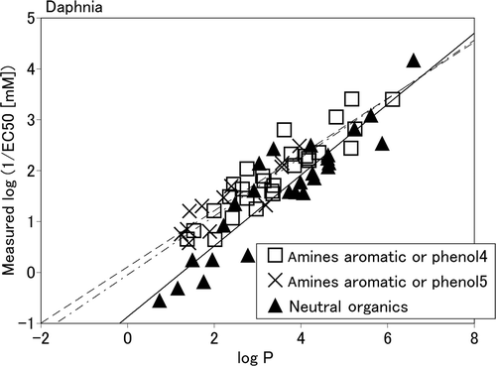
Narcotic toxicity in ecotoxicology
Acute basal toxicity
Direct correlations between logKow (=logP) and EC50 for aquatic organisms (e.g. Daphnia magna)
Example:
Neutral organics
  Nonpolar narcosis
Amines, phenols
  Polar narcosis
  (similar logP → higher toxicity, i.e. higher
  Values of 1/EC50 in comparison to
  neutral organics)
  More specific ... In addition
  to membrane accumulation, direct
  interactions with proteins
  are anticipated

Slide 32
Toxicity to membrane gradients and transport
Semipermeability of membranes and key functions
→ DISRUPTIONS AND RELATED TOXIC EFFECTS
- cytoplasmic membrane:
signalling, neural cells Na+/K+ gradient
- mitochondrial membrane:
electrone flow → ATP synthesis
- endoplasmatic reticulum
Ca²⁺ signalling

Slide 33
PROTEINS AS TARGETS OF ECOTOXICANTS

Slide 34
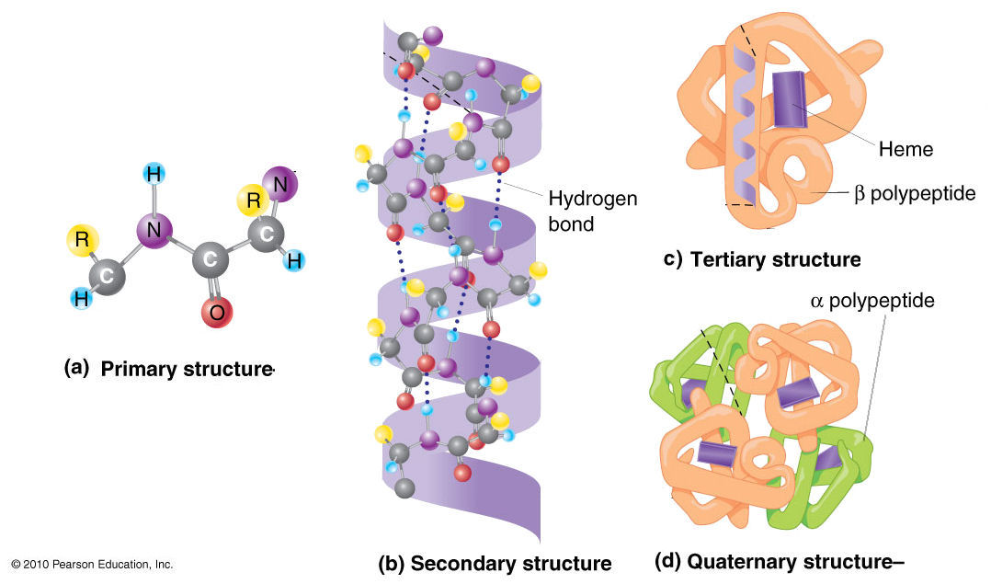
Proteins as targets to toxicants
Structure of proteins
– primary (sequence of aminoacids, AA),
- secondary, tertiary, quarternary (folding – important for functions)
Proteins - large/long – key target for number of toxicants!
= polypeptides - tens to thousands of AA
Peptides (small, “πεπτός, "digested“, 2x AA to e.g. 20x AA)
may have various functions (e.g. protective - glutathione)
Key functions of proteins
STRUCTURE and PROTECTION
CATALYSIS (enzymes)
TRANSFER (information and mass)
- receptors, channels, transporters

Slide 35
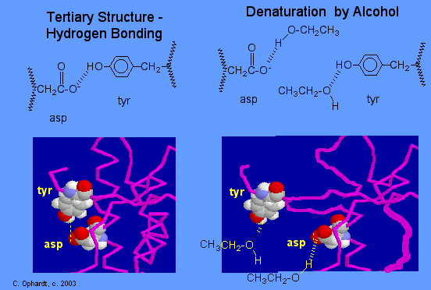
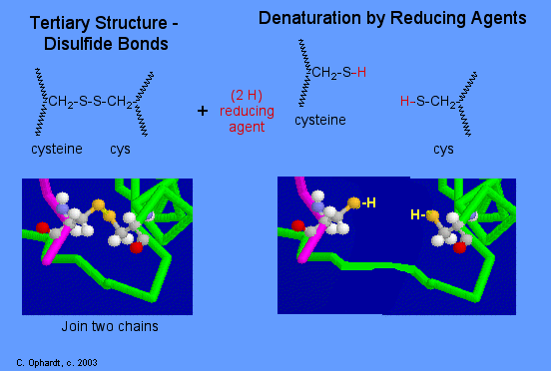
Non-specific interactions & denaturation
Most common interactions (and some examples)
Hydrogen bond disruption alcohols, amines
Ion bonds acids (COOH), alkalic compounds (amines)
toxic metals Hg⁺², Pb⁺², Cd⁺² , Ag⁺¹ Tl⁺¹,
carbonyls
S-S bonds toxic metals
See also http://www.elmhurst.edu/~chm/vchembook/568denaturation.html

Slide 36
Specific effects of environmental toxicants on proteins - examples
ENZYME INHIBITIONS
Acetylcholinesterase (organophosphate pesticides)
Inhibition of hemes – respiratory chains (cyanides)
Glyphosate (roundup) action
EFFECTS ON RECEPTORS
membrane receptors (neurotoxicants)
nuclear receptors (endocrine disrupters)

Slide 37
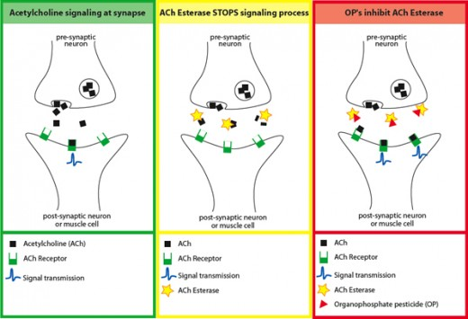
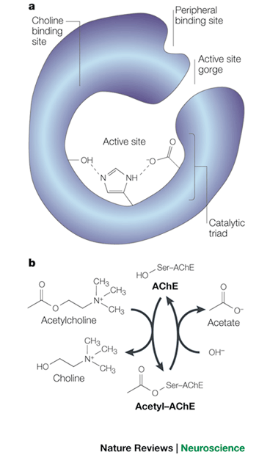
Acetylcholinesterase inhibition by organophosphates

Slide 38
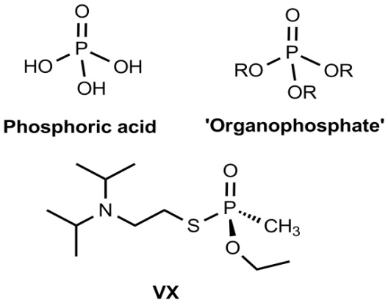
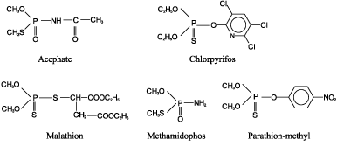
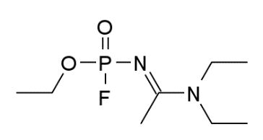
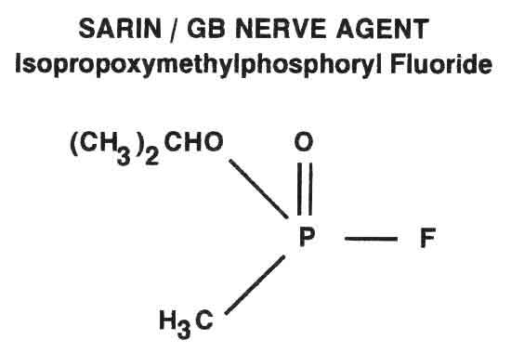
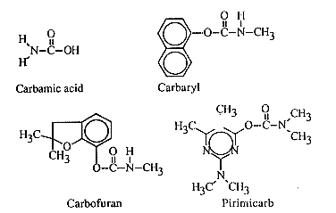
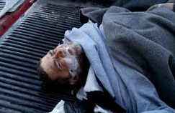
Acetylcholinesterase inhibition by organophosphates (and carbamates)
Insecticides - OPs
Nerve gases
(warfare agents)
Novichok
Insecticides - Carbamates

Slide 39
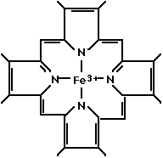
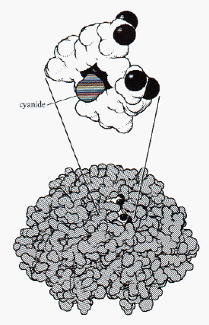
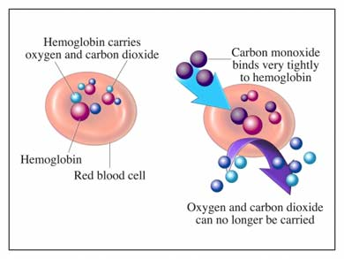
Inhibition of hemes – e.g. Haemoglobin, Mitchochondria, CYP450 etc.
(cyanide HCN, carbon monooxide – CO)

Slide 40
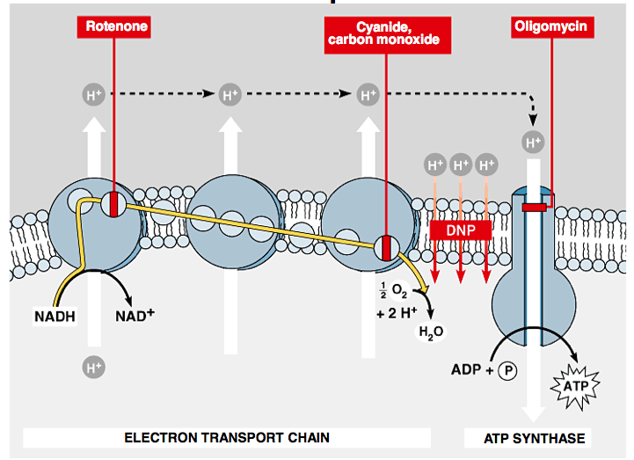
Gradient of H+ → ATP generation & its disruption

Slide 41
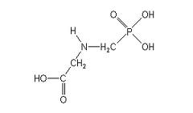



Glyphosate action
N-(phosphonomethyl)glycine
Broad-spectrum herbicide („RoundUp“)
Selective inhibition of ESPs 5-enolpyruvylshikimate-3-phosphate synthase;
(synthesis of aromatic AAs – Tyr, Trp, Phe)
Uptake via leafs - only to growing plants
„Non-toxic“ to other organisms (no ESPs in animals, AA-like chemical - rapid degradation)

Slide 42

EFFECTS on „receptors“ – part 1 / membranes receptors

Slide 43



Environmentally relevant ion channel activators
Neurotoxins (cyanobacterial)

Slide 44



Environmentally relevant ion channel activators
SAXITOXINS
Produced by dinoflagelates and cyanobacteria
(toxic blooms, „red tides“)

Slide 45
EFFECTS OF CHEMICALS on „receptors“ → nuclear receptors

Slide 46

Copyright © The McGraw-Hill Companies, Inc. Permission required for reproduction or display.
Blood
plasma
1. Hormone passes
through plasma
membrane
Lipophilic hormones
Plasma membrane
Cytoplasm
Nucleus
2. Inside target
cell the hormone
binds to a
receptor protein
in the cytoplasm
or nucleus
Receptor
3. Hormone-receptor
complex binds to
hormone response
element on DNA,
regulating gene
transcription
5. Change in protein
synthesis is
cellular response
mRNA
Protein
DNA
4. Protein synthesis
Hormone response element
46
Notes:
46

Slide 47
NUCLEAR (Intracellular) RECEPTORS in summary
Important physiological functions, and
All NRs share similar structure and mechanisms of action
  Act as direct transcription factors on DNA
Natural ligands are small lipophilic hormones (steroids, thyroids, retinoids)
  Role in toxicity – NR are modulated (activated/inhibited) by structurally close xenobiotics
Important roles in pathologies and chemical toxicity
  Endocrine disruption
    → effects on reproduction as well as other hormone-regulated processes (immune-, neuro-, metabolism – obesity etc.)
  Dioxin-like toxicity
    immunosuppression, cancer
The most studied NRs:
ER – estrogenic receptor → xenoestrogens
AhR – Arylhydrocarbon receptor („dioxin“ receptor)

Slide 48

Natural ligands of NR
Small, lipid-soluble molecules
  Diffuse through plasma and nuclear membranes and interact directly with the transcription factors they control.
  STEROID HORMONES:
    sex steroids (estrogen, progesterone, testosterone)
    corticosteroids (glucocorticoids and mineralcorticoids)
  OTHER HORMONES and ligands
  Thyroid hormone, vitamin D3, retinoic acid, ligands of AhR
  Small molecules - gases
  e.g. NO (signaling for immune reactions)

Slide 49




Ligands of ER – ESTROGEN RECEPTOR
Environmental estrogens (xenoestrogens, exoestrogens)
>> Highly diverse group of substances
>> Do not necessarily share structural similarity to the prototypical estrogen 17β-estradiol
>> may act as AGONISTS and/or ANTAGONISTS (depending on situation and concentration!)
Natural products
genistein
naringenin
coumestrol
zearalenone
Industrial chemicals
Bisphenol A
Nonionic surfactants
Pthalate esters (eg. DEHP)
Endosulfan (pesticide)
Various POPs
DDT and its metabolites (DDE)
kepone
PCBs/OH-PCBs
PAHs and dioxins
DEHP
Pharmaceuticals
Ethinyl estradiol
Diethylstilbestrol
gestodene
norgestrel
Consequences
* Toxicity to reproduction

Slide 50
AhR (Arylhydrocarbon receptor)
AhR structure
2,3,7,8-TCDD
(dioxin) bound to AhR

Slide 51

AhR
Ligand-activated transcription factor
  Similar to all NRs
AhR has effects on many different genes
important mediator of toxicity of POPs – primary target of planar aromatic substances
  regulator of xenobiotic metabolism and activation of promutagens
Crossactivation/crosstalk with other NRs
Strongest known ligand - TCDD
  (not endogeneous !)

Slide 52
AhR regulated genes
Many genes contain xenobiotic response elements (XRE) or dioxin responsive elements (DRE) in their promoter region:
  Detoxification genes phase I enzymes (CYP 1A1, CYP 1A2, CYP 1B1) and phase II enzymes (UDP-glucuronosyltransferase, GST-Ya, NADP(H):oxidoreductase)
    → Detoxification after toxicant exposure
    … also with possible toxic consequences (oxidative stress, activation of promutagens accelerated clearance of hormones)
  Other genes - regulation of cell cycle and apoptosis
    Bax (apoptosis control), p27Kip1, Jun B (MAP-kinase), TGF-b (tumor growth factor)
    → Various adverse toxic effects

Slide 53


Classical and “non-classical” AhR ligands
Classical = planar structures → direct binding to AhR
“Non-classical”
Diverse compounds known
to activate AhR
Denison & Nagy, Annu.
Rev. Pharmacol. Toxicol. 43:309

Slide 54
Biological responses to TCDD (via AhR)
Schmidt & Bradfield, Annu. Rev. Cell Dev. Biol. 12:55

