Slide 1

Ecotoxicology
Current issues in
Research vs Regulation
Ludek Blaha + ecotox colleagues

Slide 2
Take home messages from this presentation
Approaches and intentions of ecotoxicology researchers (freedom) and ecotoxicity-results users = regulators (bound by laws) are completely different
Examples of current hot topics and gaps that are slowly reaching sufficient coverage by regulation
  Nanomaterials
  Pharmaceuticals
  Individual chemicals (limits) vs mixture effects
  Complex contaminated matrices: Analyses of priority chemicals according to law – vs - Effects of mixtures determined in bioassays

Slide 3
When
Where
the assessment of toxicity is needed?
What
to assess for toxicity?

Slide 4


When & where the toxicity assessment is needed?
View of the researcher
View of the regulator
Anytime!
… depending on researcher’s
budget
As the law says!
… what are the
law(s)? →

Slide 5
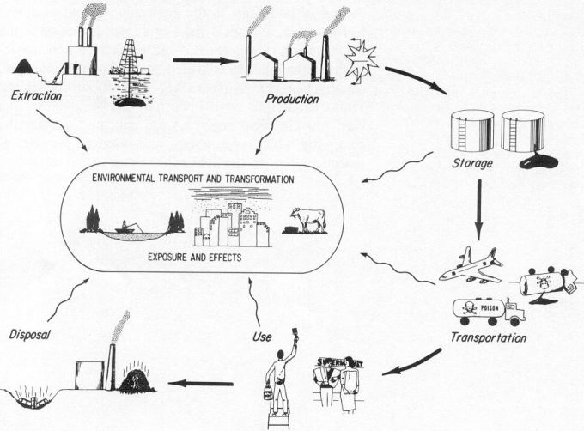

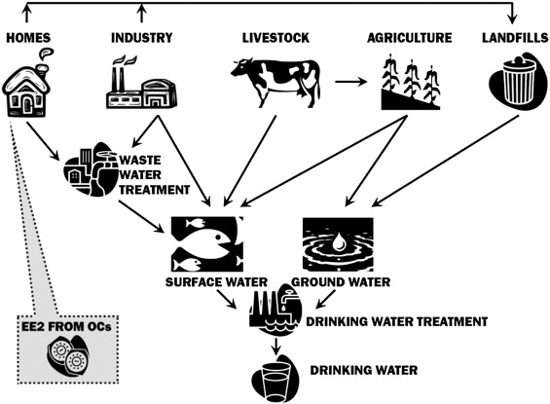
Chemical laws („bulk“)
§§
Industrial chemicals
Cosmetics
PPP (pesticides)
Biocides
Human
pharmaceuticals
Veterinary
pharmaceuticals
REACH
(ECHA)
PPP
(EFSA)
nano nano nano nano
MPs
(EMA)
MIXTURES!
§§
AIR
Two §§ approaches:
Prospective
(chemicals…)
Retrospective
(mixtures …)
WFD – surface w.
GWD – ground w.
Air quality
Food and feed
Soil & Sediments
Wastes
SOIL
WATER

Slide 6
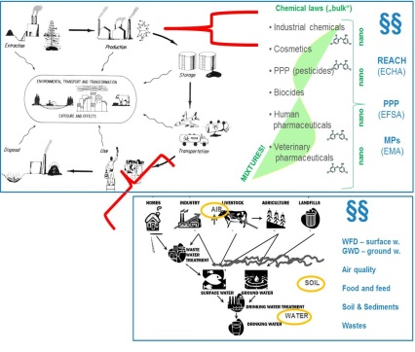




What to assess for toxicity?
 | Current research topics | As required by law
Individual chemicals (prospective) | Engineered nanomaterials/particles Ecological effects (e.g. of pharmaceuticals) Endocrine disruption & chronic diseases | Industry & biocides (REACH) PPPs = pesticides Pharmaceuticals Cosmetics
Mixtures (prospective) | Multistressors +T°C, salinity, pathogens, irradiation, food Exposome
Contaminated samples (retrospective) | Can analyzed chemicals explain observed effects ? | Chemical analyses & limits Effect testing rare: Remediation, dredged sediments (CZ), effluents (DE)

Slide 7
What to assess for toxicity?
 | Current research topics | As required by law
Individual chemicals (prospective) | Engineered nanomaterials/particles Ecological effects (e.g. of pharmaceuticals) Endocrine disruption & chronic diseases | Industry & biocides (REACH) PPPs = pesticides Pharmaceuticals Cosmetics
Mixtures (prospective) | Multistressors +T°C, salinity, pathogens, irradiation, food Exposome
Contaminated samples (retrospective) | Can analyzed chemicals explain observed effects ? | Chemical analyses & limits Effect testing rare: Remediation, dredged sediments (CZ), effluents (DE)

Slide 8
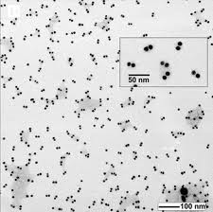
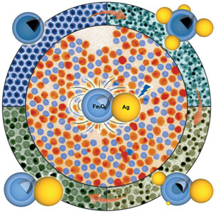
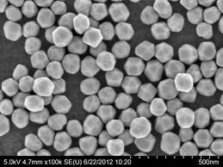
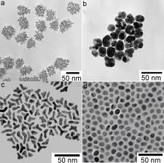
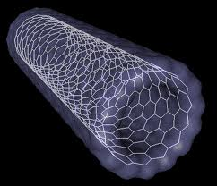
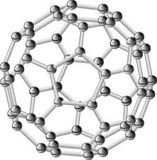
Nanoparticles - examples

Slide 9
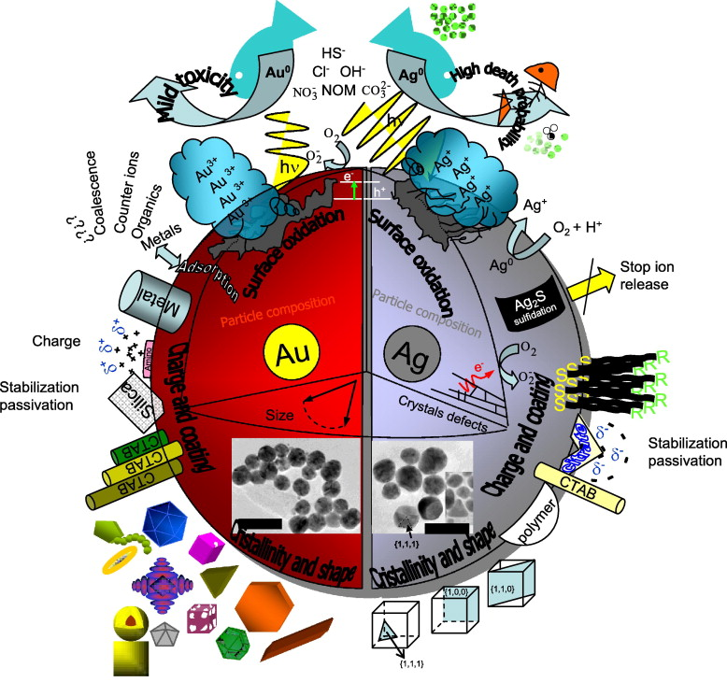
Toxicity of nanoparticles …
(Mostly unknown)
Parameters may
Affect ecotoxicity
Composition (chemical)
Surface (size, area)
Charge
Reactivity
Interactions with ions,
other chemicals…
➔ Effects on
environmental Fate
and toxicity

Slide 10
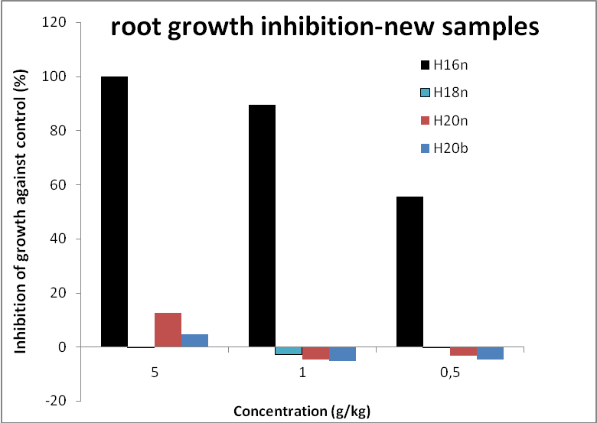
Ecotoxicity of nanoparticles – RECETOX example
Comparison of toxicity - 4 „appeared to be the same“ particles
(one producer – 4 different lots)
(zerovalent iron – ZVI – Fe⁰)
?? Why is H16 so toxic ??
… despite of detailed investigation never revealed

Slide 11
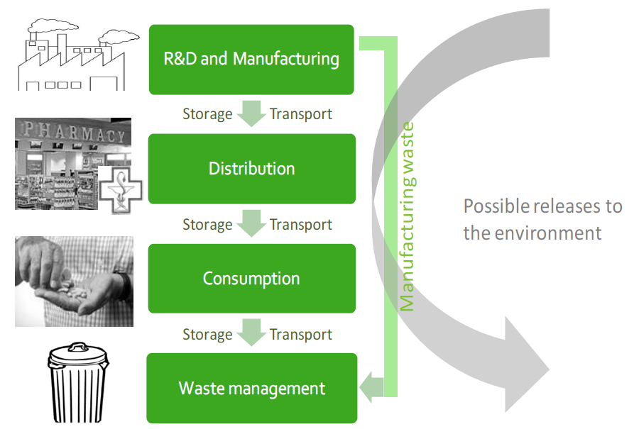
PHARMACEUTICALS

Slide 12
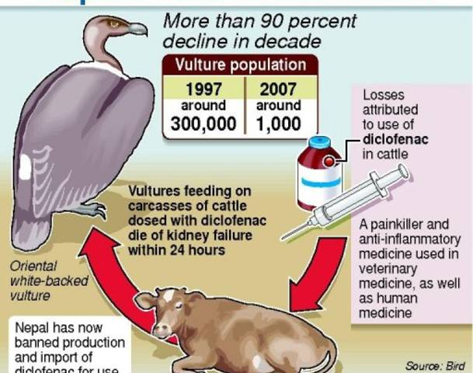
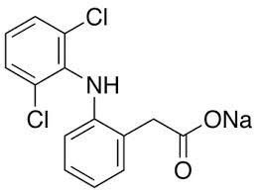
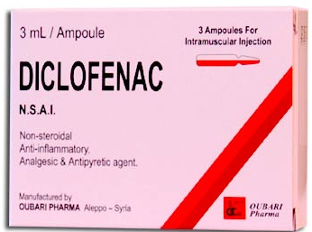
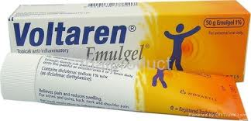
Example 1 - DICLOFENAC
Unexpected effects at NON-TARGET species
- nephrotoxicity at vultures
- Relevant also in EU
(ESP, EL,CY)

Slide 13
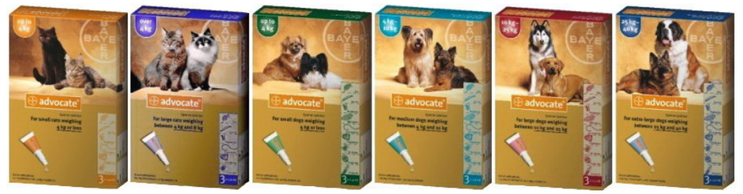
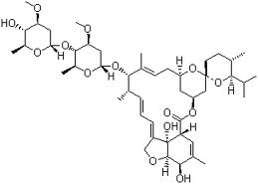
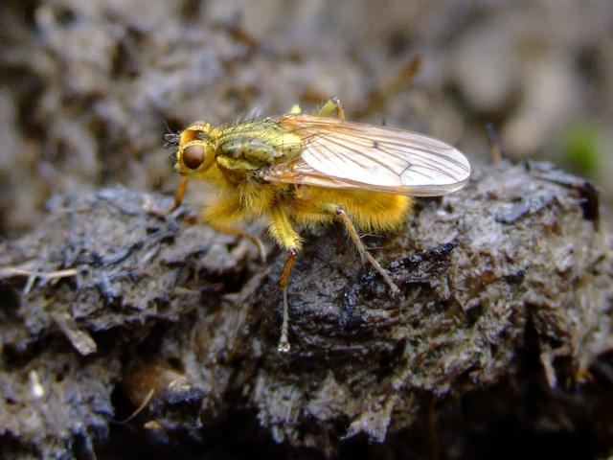

Example 2 – AVERMEKTIN-like antiparasitics
Moxidectin – used e.g. in home
„spot on” products
Ivermectin – antiparasitics in large herds
    Used 2-times per season per sheep/cow
    Kills 100% parasites in sheep
    Released in dung - kills 80-90% larvae of dung flies
    High concentrations in dung (released 2 days post application)
    Persistent in the soil (half-life 30 days)
    Can be washed into adjacent streams (highly toxic to water insects)
?

Slide 14
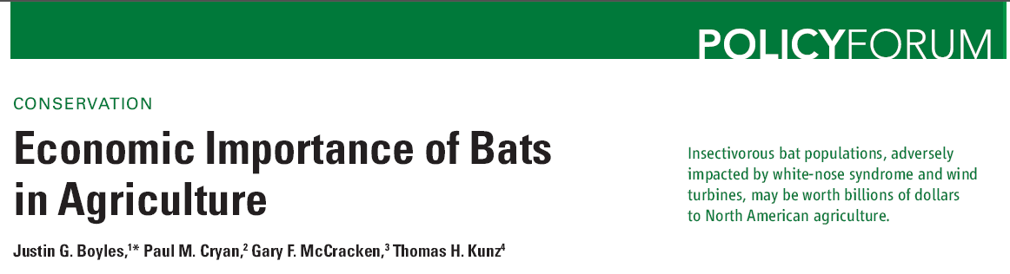

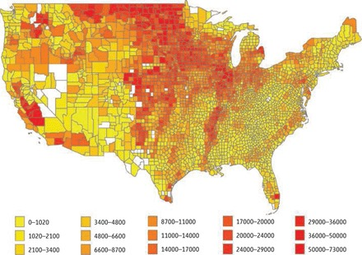
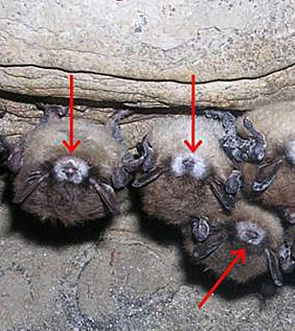
Boyles et al. (2011) Science 332 (60251) 41-42

Slide 15

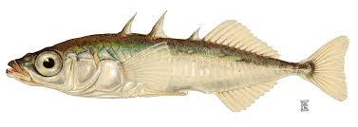
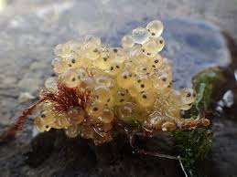
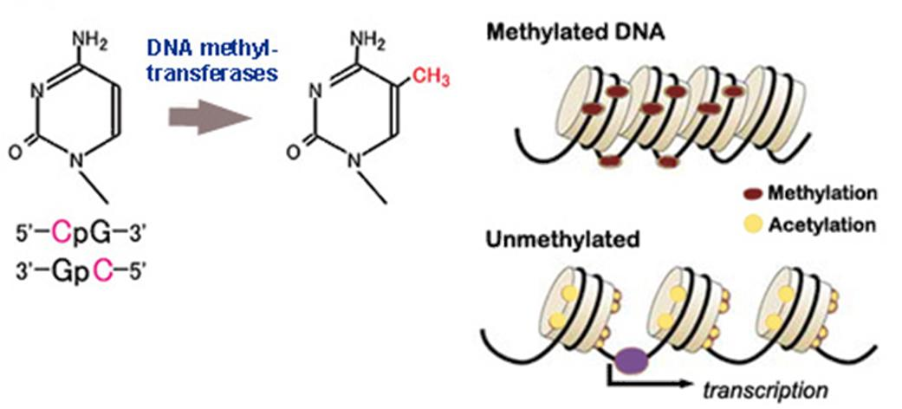
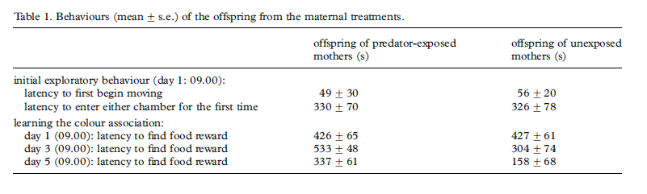
Stress → multigeneration effects
Epigenetics → DNA methylations
2x difference

Slide 16
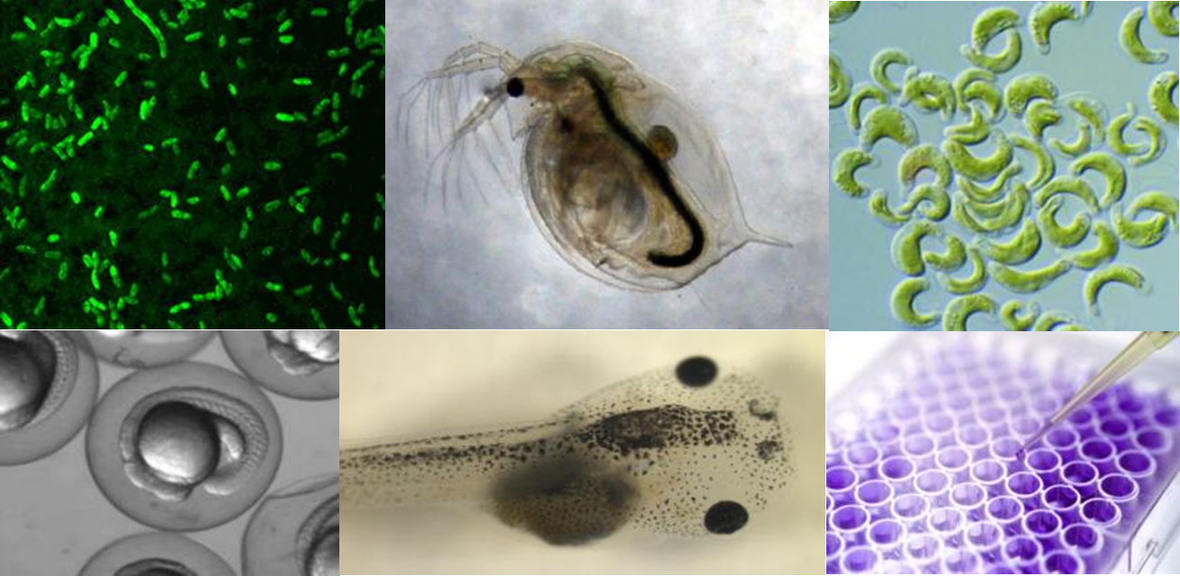
MIXTURE TOXICITY EU interlaboratory test
Testing comparability of existing and innovative bioassays for water quality assessment
Main questions:
Are current limits (for individual compounds) safe?
Relevance of “Something from Nothing” phenomenon ?
3 samples
→ 12 European laboratories – different bioassays
→ ČR – RECETOX: 11 bioassays
Carvalho, R. et al. (2014) Mixtures of chemical pollutants at European legislation safety concentrations: how safe are they? Toxicol Sci 141(1): 218-233

Slide 17
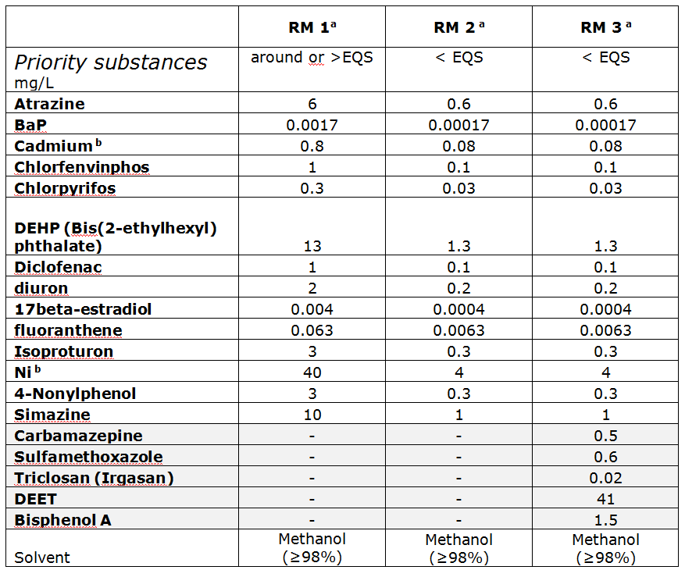
MIXTURE TOXICITY EU interlaboratory test
Testing comparability of existing and innovative bioassays for water quality assessment
EU WFD
priority
substances
Different
concentrations
EQS
= limit
(Environmental
Quality
Standard)

Slide 18
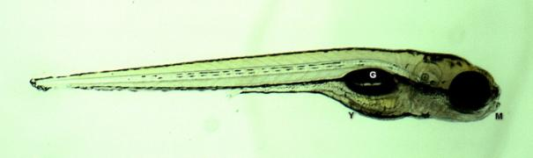
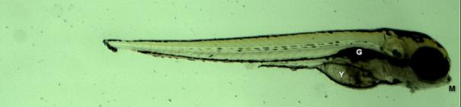
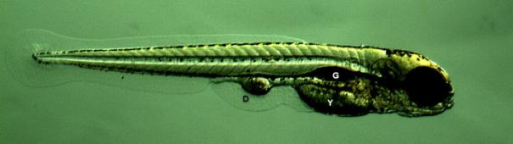
MIXTURE TOXICITY EU interlaboratory test
Testing comparability of existing and innovative bioassays for water quality assessment
Example: Effects of mixtures on D. rerio fish embryos
Control
Effects of RM 3 (i.e. safe)
mixtures
Carvalho, R. et al. (2014) Mixtures of chemical pollutants at European legislation safety concentrations: how safe are they? Toxicol Sci 141(1): 218-233

Slide 19
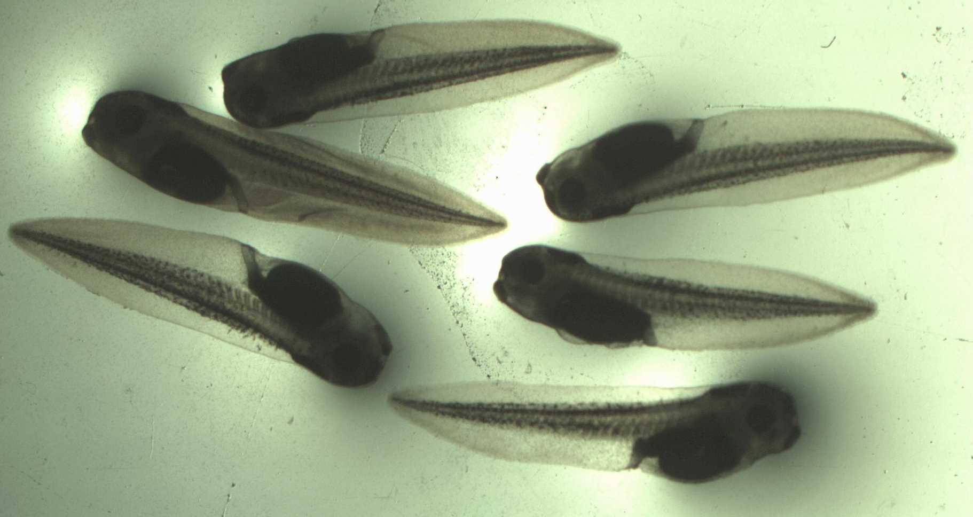
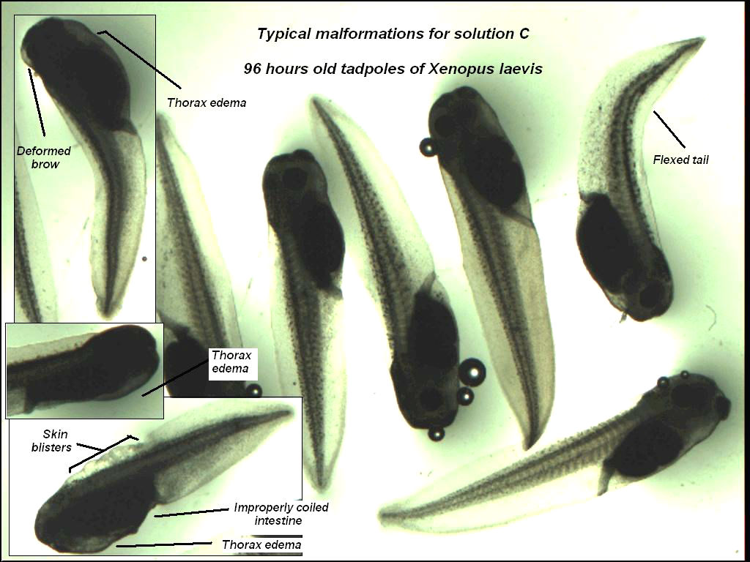
MIXTURE TOXICITY EU interlaboratory test
Testing comparability of existing and innovative bioassays for water quality assessment
Example: Effects of mixtures on X. laevis frog embryos
Effects of RM 3 (i.e. safe)
mixtures
Controls
Carvalho, R. et al. (2014) Mixtures of chemical pollutants at European legislation safety concentrations: how safe are they? Toxicol Sci 141(1): 218-233

Slide 21
What to assess for toxicity?
 | Current research topics | As required by law
Individual chemicals (prospective) | Engineered nanomaterials/particles Ecological effects (e.g. of pharmaceuticals) Endocrine disruption & chronic diseases | Industry & biocides (REACH) PPPs = pesticides Pharmaceuticals Cosmetics
Mixtures (prospective) | Multistressors +T°C, salinity, pathogens, irradiation, food Exposome
Contaminated samples (retrospective) | Can analyzed chemicals explain observed effects ? | Chemical analyses & limits Effect testing rare: Remediation, dredged sediments (CZ), effluents (DE)

Slide 22
What to assess for toxicity?
 | Current research topics | As required by law
Individual chemicals (prospective) | Engineered nanomaterials/particles Ecological effects (e.g. of pharmaceuticals) Endocrine disruption & chronic diseases | Industry & biocides (REACH) PPPs = pesticides Pharmaceuticals Cosmetics
Mixtures (prospective) | Multistressors +T°C, salinity, pathogens, irradiation, food Exposome
Contaminated samples (retrospective) | Can analyzed chemicals explain observed effects ? | Chemical analyses & limits (see lectures: RISK ASSESSMENT part) Effect testing rare: Remediation, dredged sediments (CZ), effluents (DE)

Slide 23
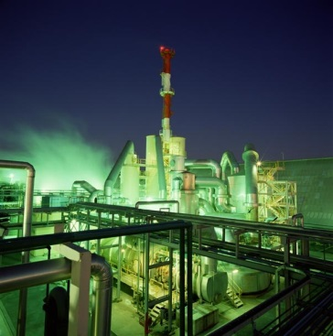
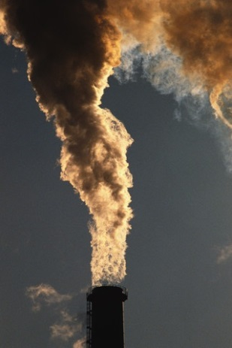
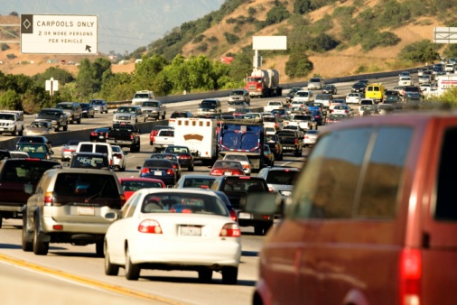
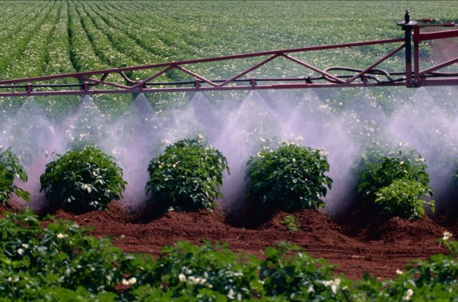
Contaminated samples? Case study “air“
Active sampling
particles vs gaseous phase
Reference locality – agriculture (Košetice observatory)
Region A – industrial
(historically OCPs production)
Region B – combined: industry, agriculture, traffic
Novák et al. (2009) Environment International

Slide 24
Chemical
analyses

Slide 25
Dioxin-like effects
Difference B>A
Difference B vs A – particles vs gas

Slide 26
Antiandrogenic effects
    Quantitative – comparable
    Clear differences in patterns … no effects on particles in „B“ (?)

Slide 27

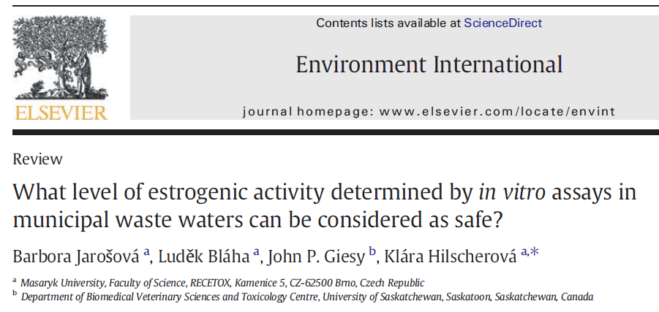
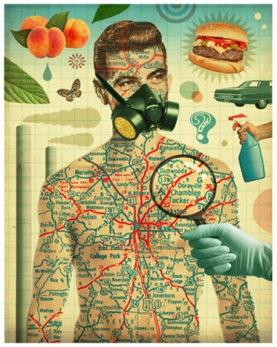
Summary on When, Where, What
Regulatory world
  Assessment of „chemicals“!
Contaminated samples
- effects rarely tested
  Great value of bioassays
  in assessment of contaminated samples
      Effects observed (!)
      How to set the „limits“?
Research issues and questions
  Nanomaterials, Pharmaceuticals, EDCs
  Mixtures!
  Exposome

