Slide 1
CONTINUOUS PROCESSES,
FLOW CHEMISTRY
Petr Beňovský

Slide 2


CONTINUOUS PROCESSES
BATCH PRODUCTION CONTINUOUS PRODUCTION

Slide 3
CONTINUOUS PROCESSES
Typical Signals of Potential Problems on Scale-up
Change of mixing speed changes product yield;
Different mode of addition changes product yield;
The position of a feed stream changes product yield;
Scale up to a vessel with different geometry;
Different holding time before work up;
Poor heat transfer;
Stability of intermediates;
Different stirring

Slide 4
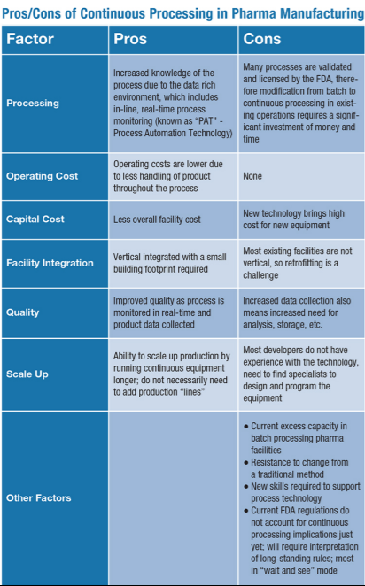
CONTINUOUS PROCESSES

Slide 5
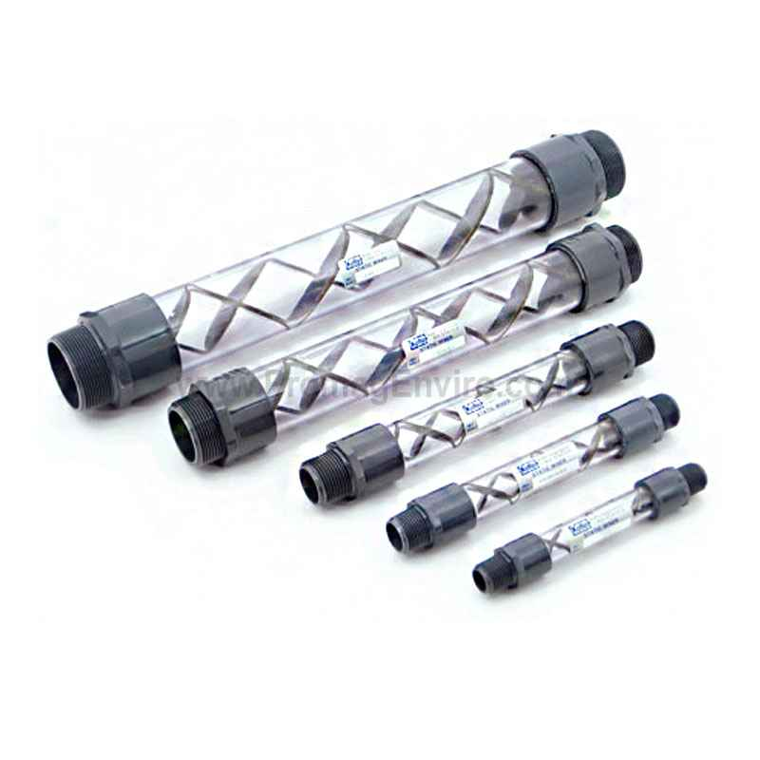
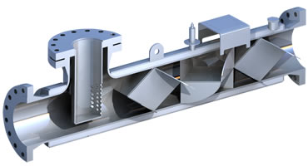
CONTINUOUS PROCESSES
Typical Elements of a Continuous process:
Efficient mixing enables fine control of reaction temperature within the whole reactor
Static mixers
High Surface area / Volume Ratio

Slide 6
CONTINUOUS PROCESSES
Typical Elements of a Continuous process:
Continuous operations can be applied for both cryogenic and high temperature processes;
Much broader range of temperatures;
Effective with respect to energy;

Slide 7
CONTINUOUS PROCESSES
Typical Elements of a Continuous process:
Reactive species can be separated thus minimizing side products (and raising yields);

Slide 8
CONTINUOUS PROCESSES
Typical Elements of a Continuous process:
Utilization of nontraditional techniques (photochemistry, sonochemical reactions, passing through a bed of a catalyst or immobilized enzyme)

Slide 9
CONTINUOUS PROCESSES
Typical Elements of a Continuous process:
Enables much safer processes;
Only tiny portion of the reaction mixture is exposed to high temperature or exothermic reaction occurs only with very small amount of reactants;
Advantage working with highly toxic compounds (cyanides, phosgene, diazomethane, ozone)

Slide 10
CONTINUOUS PROCESSES
Typical Elements of a Continuous process:
Opportunity in the field of intellectual property;
Relatively easy monitoring in real time (PAT);
Variability according to a purpose;
Supported by authorities;
Fitting well into Quality by Design concept;
Sometimes untypically milder reaction conditions;
Increasing of productivity (scaling out, numbering up);

Slide 11
CONTINUOUS PROCESSES
Typical Elements of a Continuous process:
Need for efficient and robust pumps, inert tubings, vessels to collect products and store starting components, fittings, pressure gauges, pressure relief valves, static mixers, heat exchangers, separators
Residence time (average time needed for a molecule to pass through a reactor);
Flow rate (ml per min.);

Slide 12

FLOW CHEMISTRY
Artemisinin continuous production
Used in the treatment of malaria
2015 – Nobel prize for its discovery (1972)
Extracted from plant Artemisia annua (sweet wormwood)

Slide 13
FLOW CHEMISTRY
Artemisinin continuous production
Lévesque, F.; Seeberger, P.H. Angew.Chem. Int. Ed. 51, 1706 (2012)

Slide 14
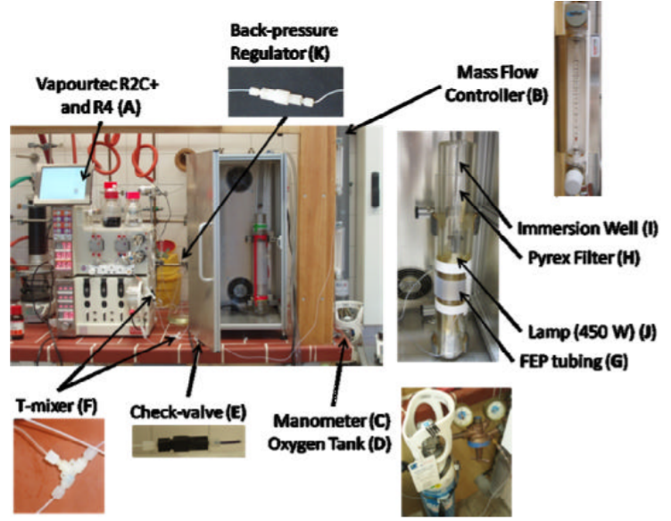
FLOW CHEMISTRY
Artemisinin continuous production
Lévesque, F.; Seeberger, P.H. Angew.Chem. Int. Ed. 51, 1706 (2012)

Slide 15
FLOW CHEMISTRY
Artemisinin continuous production
1500 simple photoreactors (each 200 g of artemisinin a day) would be sufficient to cover demand for roughly 225 million doses necessary for the malaria treatment (2009 WHO estimate)
Lévesque, F.; Seeberger, P.H. Angew.Chem. Int. Ed. 51, 1706 (2012)

Slide 16
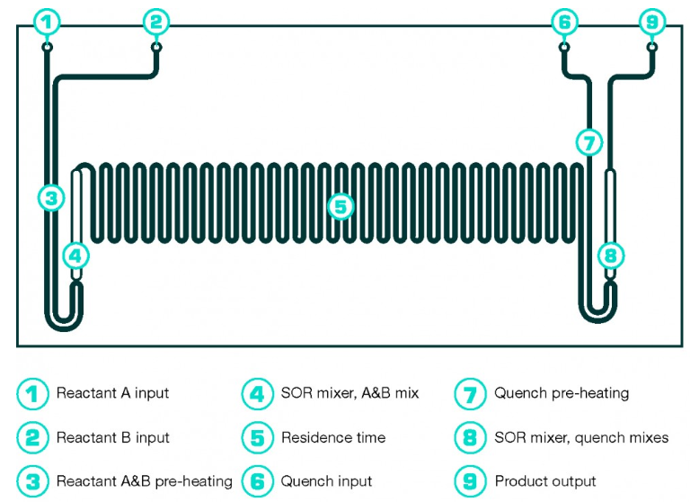
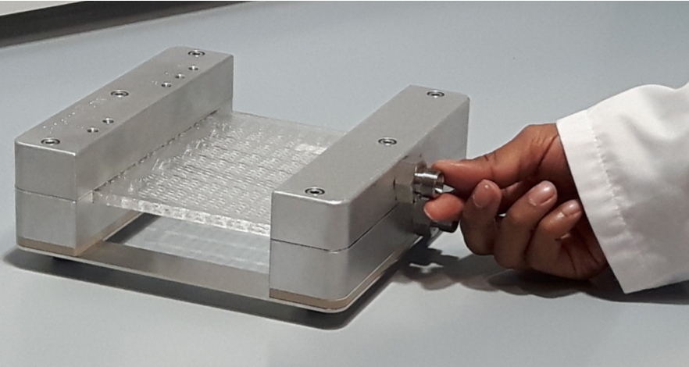
FLOW CHEMISTRY
Microreactors
Chemtrix company microreactor

Slide 17
FLOW CHEMISTRY
Microreactors
DSM company, control of the exothermic Ritter reaction on very large scale (40 tons a day);
Decreased decomposition
Yield was increased by 15%
Waste was decreased by 15%
Ondrey, G. Chem. Eng. 118, 17 (2011)

Slide 18
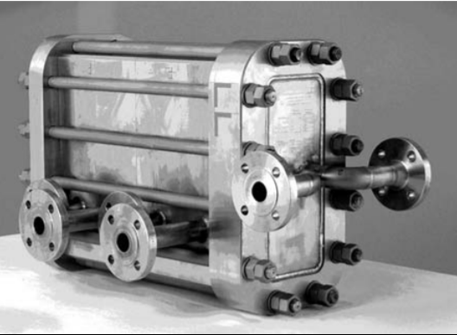
FLOW CHEMISTRY
DSM company
The microstructured flow reactor for throughput at 1700 kg per hour

Slide 19
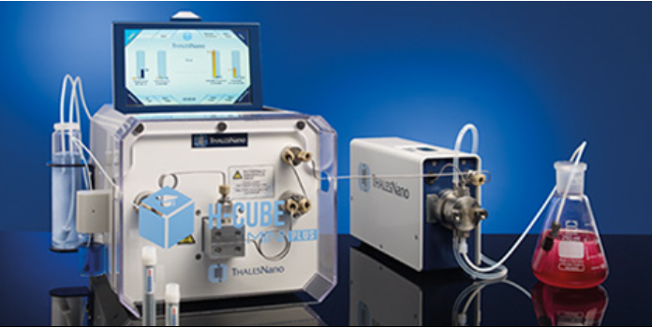
FLOW CHEMISTRY
Microreactors
ThalesNano company
Spadoni, C. et al Chim. Oggi 38 (2006)

Slide 20
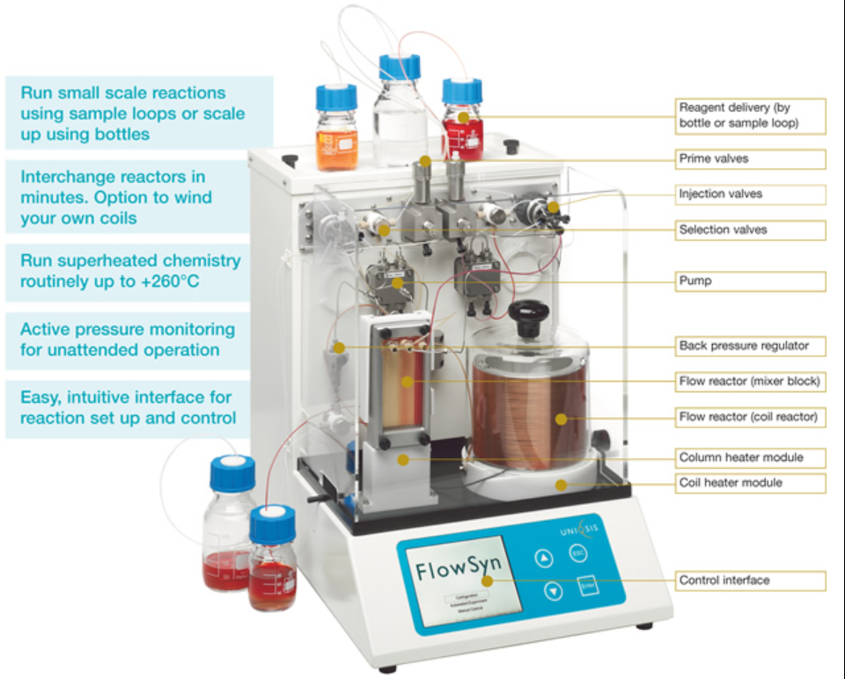
FLOW CHEMISTRY
Microreactors
Uniqsys (GB)

Slide 21
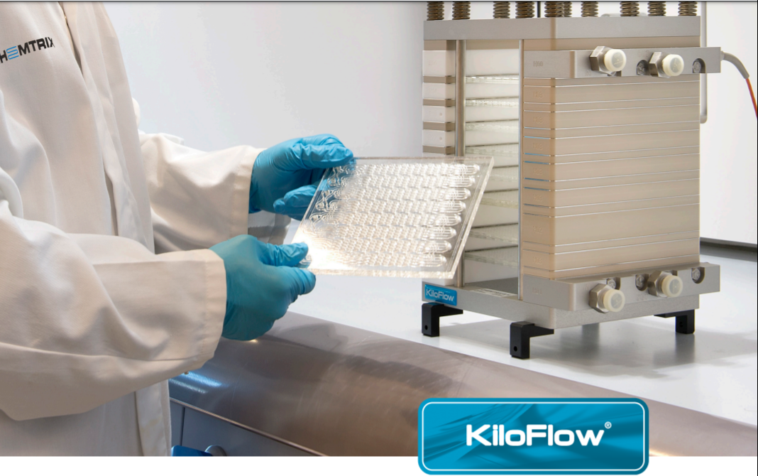
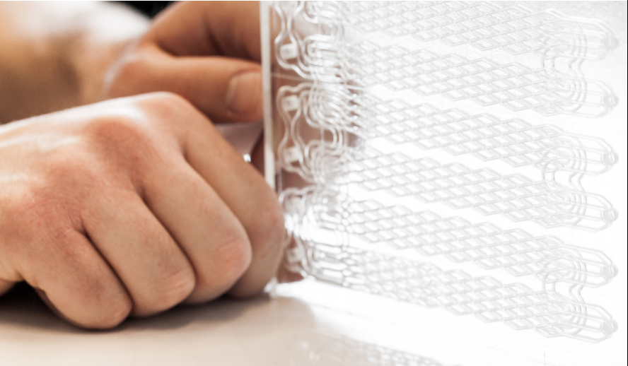
FLOW CHEMISTRY
Microreactors
Chemtrix

Slide 22
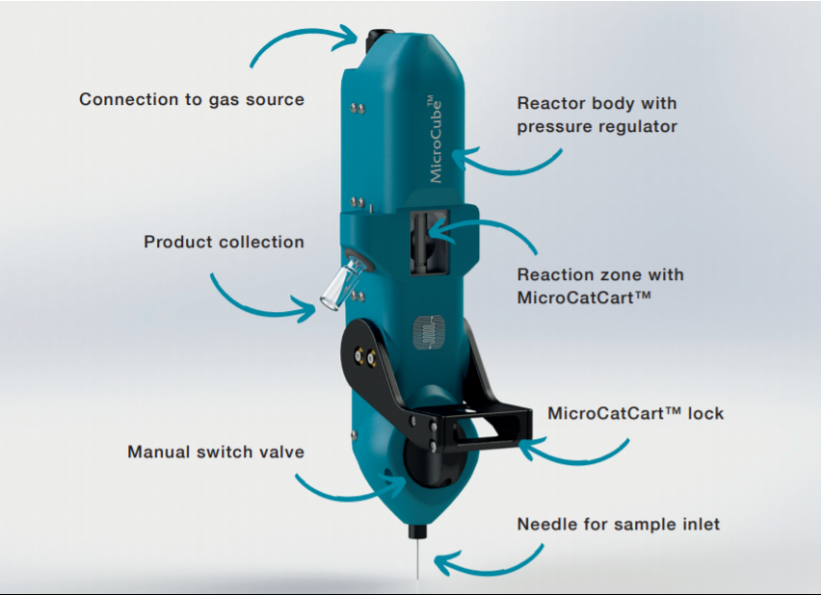
FLOW CHEMISTRY
Microreactors
ThalesNano
1.Q 2020
MicroCubeTM

Slide 23
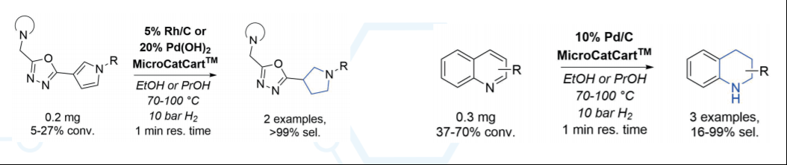
FLOW CHEMISTRY
Microreactors
ThalesNano product brochure

Slide 24
CONTINUOUS PROCESSING
Eli Lilly, new production unit utilizing continuous processes in Kinsale, Ireland;
Prexasertib monolactate monohydrate
8 continuous process step, including using hydrazine;
Designated production unit, the product is cytotoxic → extensive cleaning measures, only 24 kg needed;
Small flow set up could be after each lot discarded;
Halford, B. C&EN Global Enterprise 95, 23 (2017)

Slide 25
CONTINUOUS PROCESSING
Continuous Operations Using Larger Reactors
Spinning Disk Reactor
Thin films of reactant solution permitting rapid heat exchange;
Solutions applied to the center of a spinning disk are driven to the edges by centrifugal forces;
The contact time with the disk is inversly proportional to the angular velocity;
Preferred for fast reactions;
Org. Process Res. Dev. 15, 997 (2011)
https://www.youtube.com/watch?v=p42pCoOJ5sc

Slide 26
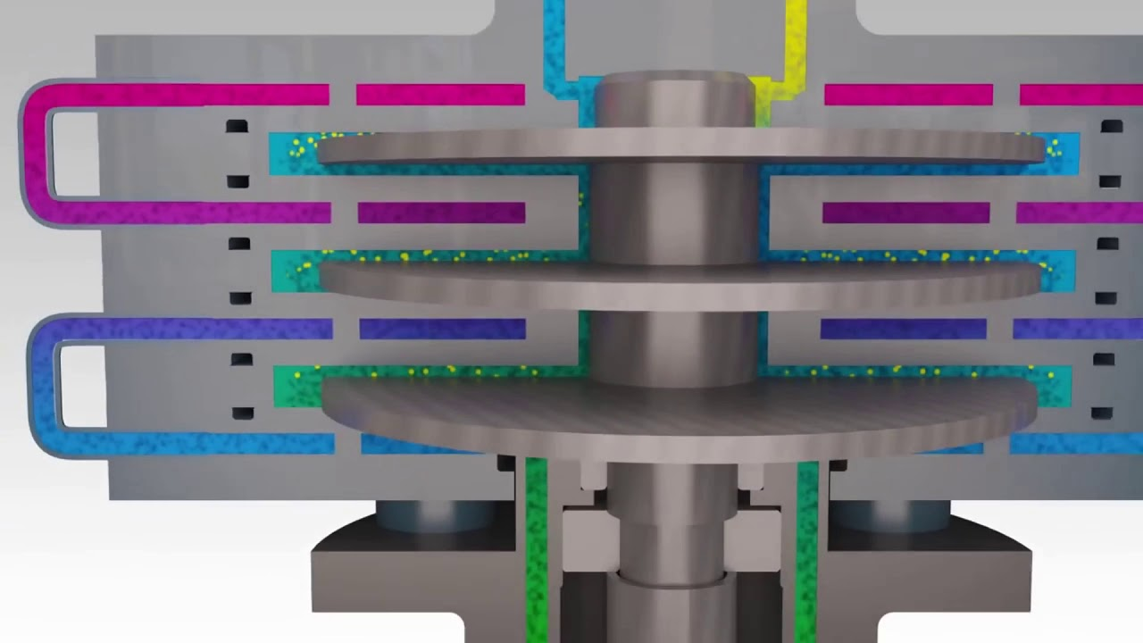
CONTINUOUS PROCESSING
Continuous Operations Using Larger Reactors
Spinning Disk Reactor

Slide 27
CONTINUOUS PROCESSING
Continuous Operations Using Larger Reactors
Spinning Tube-in-Tube Reactor
Reactor of this type increases reaction rates by improving mixing through high shear rate, which is independent of the residence time and dependent upon the angular velocity and the gap between the spinning internal tube and the stationary external tube
Gonzales, M.A. et al Org. Process Res. Dev. 13, 64 (2009)
OPRD 12, 946 (2008)

Slide 28
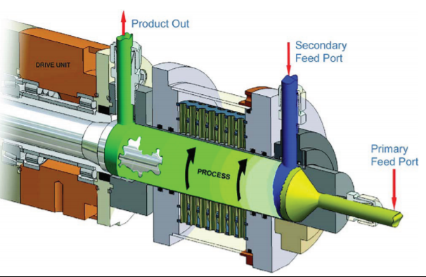
CONTINUOUS PROCESSING
Continuous Operations Using Larger Reactors
Spinning Tube-in-Tube Reactor

Slide 29
CONTINUOUS PROCESSING
Continuous Operations Using Larger Reactors
Plug Flow Reactors
Reactants mix in thin discs (plugs) moving away from the entry point (theoretical assumption);
Mixing in radial direction, no mixing in axial direction;
The composition changes until a plug of product emerges from the reactor;
Turbulence can be amplified by the presence of static mixers

Slide 30
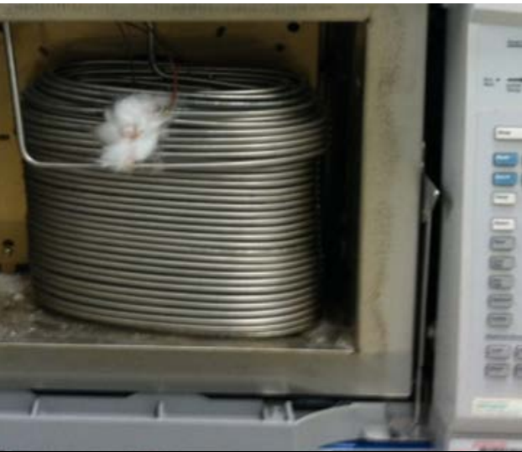
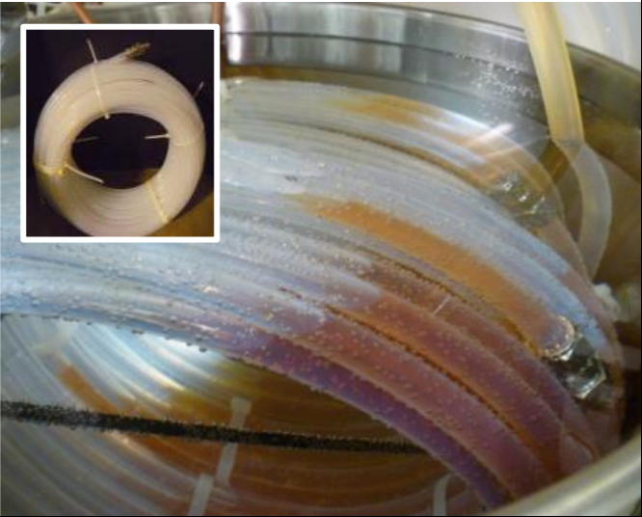
CONTINUOUS PROCESSING
Continuous Operations Using Larger Reactors
Plug Flow Reactors

Slide 31
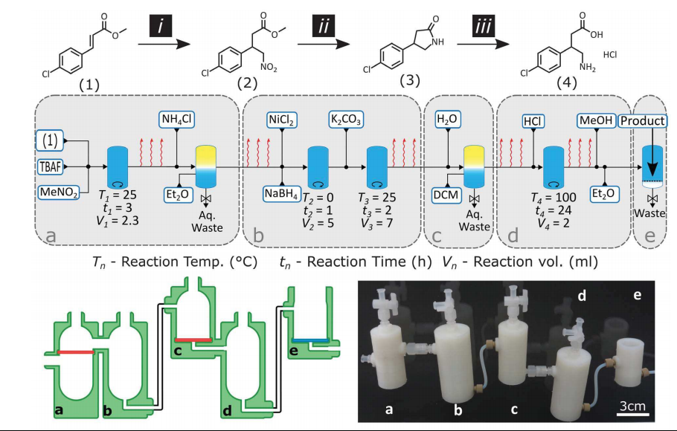
CONTINUOUS PROCESSING
Kitson, P.J. et al Science 359, 314 (2018)

Slide 32
CONTINUOUS PROCESSING AND
FLOW CHEMISTRY
Summary
Used for decades in petrochemical and food industry;
Start to attract attention even in conservative pharmaceutical industry;
Going commercial – new already established companies offering service, expertise, solutions and products;
Boom of new materials – microreactors (glass, ceramic, metal), pumps, tubings, mixers, fittings, valves, prepacked columns);
Disadvantage – clogging, corrosion,
Lack of common experience and expertise;
Continuous processes are not suitable for all reactions

