Slide 1
PROCESS ANALYTICAL TECHNOLOGY (pat)
Petr Beňovský

Slide 2
PROCESS ANALYTICAL TECHNOLOGY
WHAT IS PAT?
FDA’s vision:
A system for designing, analyzing, and controlling manufacturing through timely measurements (during processing) of critical quality and performance attributes of raw, and in-process materials and processes with the goal of ensuring final product quality for a significant number of products on the market or in development

Slide 3
PROCESS ANALYTICAL TECHNOLOGY
WHAT IS PAT?
Any in-situ measurement that participate in control or gathering data for understanding of the process;
E.g. FTIR, Raman, ATR-UV, NIR probes, MS, HPLC, FBRM, PVM, NMR;
PAT probe can measure either chemical or phaysical aspects (flow, temperature, pressure, pH value);
PAT role in development is process understanding;
PAT role in manufacturing is a control strategy tool;

Slide 4
PROCESS ANALYTICAL TECHNOLOGY
WHY USE PAT?
The use of PAT can improve R&D efficiency and minimize personnel hazard;
Speeds up processes → sampling, analyses
Reliable, rapid analyses of a process
Significant data for developing process chemistry inderstanding (detection of reaction intermediates, mechanisms, relationship between process variables);
Reduction of the number of critical parameters;
Results in set of controls (off-line or in-line);
Fully supported by authorities;
More frequent data collection;
Automated measurement;
Real time process control;
Eliminates difficult and hazardous sampling

Slide 5
PROCESS ANALYTICAL TECHNOLOGY
WHEN TO USE PAT?
Depends on many factors throughout the product life cycle:
Development
Manufacturing (e.g. heterogeneous reaction sampling)
Troubleshooting
Capacity of PAT tools
Sensitivity of a PAT tool
Especially useful during continuous processes

Slide 6
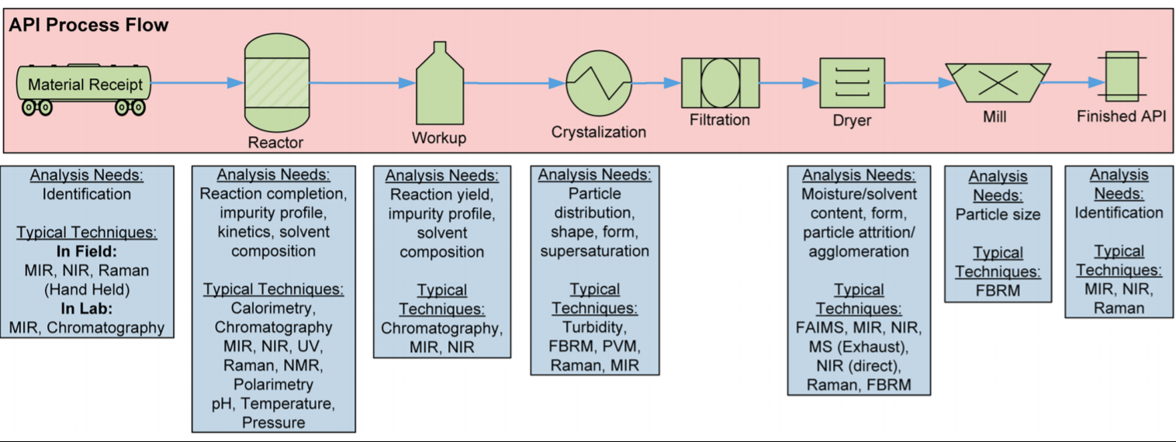
PROCESS ANALYTICAL TECHNOLOGY
WHEN TO USE PAT?

Slide 7
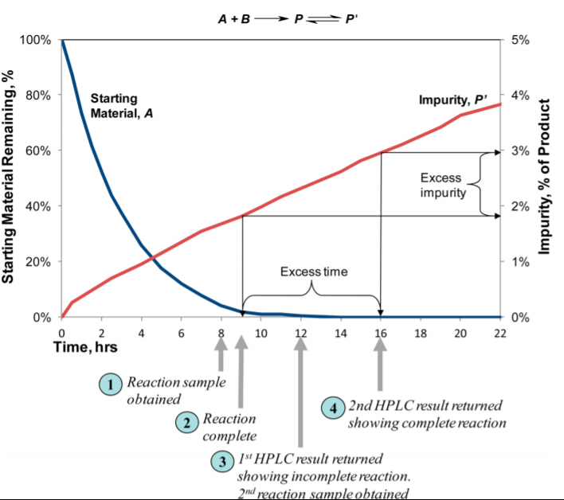
PROCESS ANALYTICAL TECHNOLOGY

Slide 8
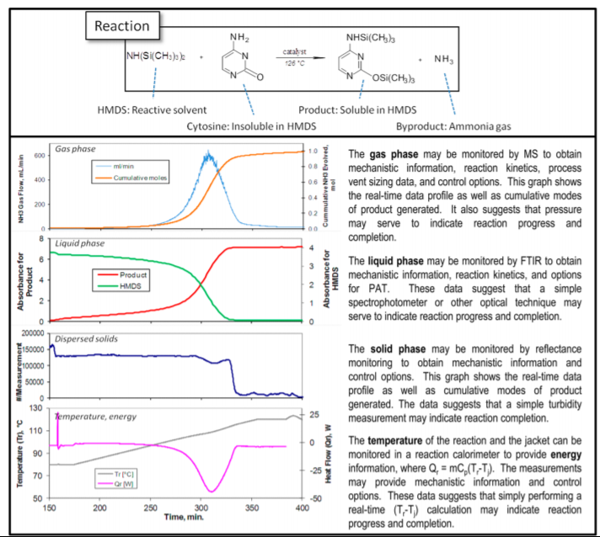
PROCESS ANALYTICAL TECHNOLOGY
Chanda, A. et al Org.Process Res.Dev. 19, 63 (2015)

Slide 9
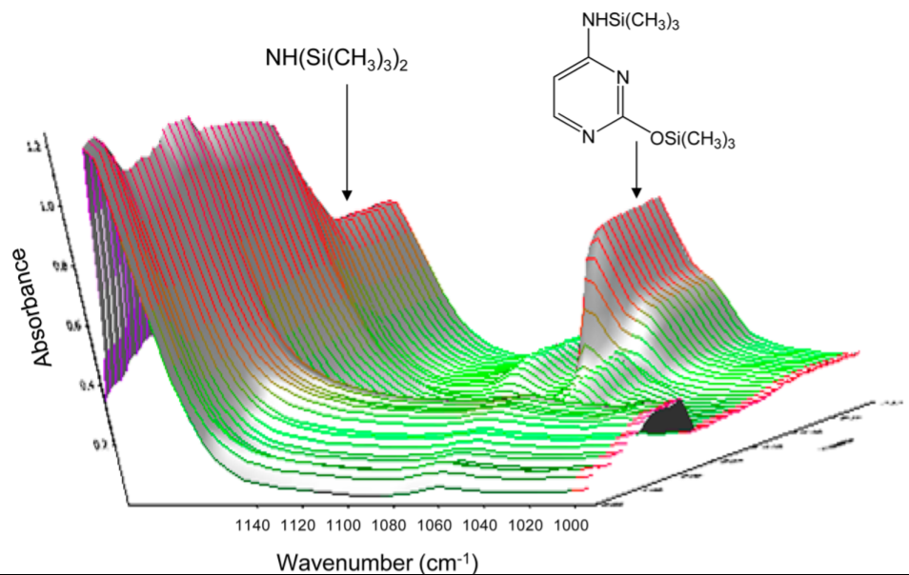
PROCESS ANALYTICAL TECHNOLOGY
Chanda, A. et al Org.Process Res.Dev. 19, 63 (2015)

