Slide 1
POLYMORPHISM
Petr Beňovský

Slide 2
POLYMORPHISM
The ability of a solid material to exist in multiple forms or crystal structures known as polymorphs;
Polymorphs have different energy of their crystal lattices, and consequently different melting points, solubilities etc.
Do not mix up polymorphism with crystal morphology – a compound under different conditions crystallizes in different shapes – habits, but a polymorph is still the same;
Pseudopolymorphs – the crystal lattice contains some amount of solvent (solvates, hydrates)

Slide 3
POLYMORPHISM
Polymorphs are crystalline materials that have the same chemical composition, but different molecular packing

Slide 4
POLYMORPHISM VS. ALLOTROPY
ALLOTROPY – the existence of two or more different physical forms of a chemical element;
Example – graphite, diamond, fullerene
DOES IT MATTER?
When Napoleon invaded Russia, the soldiers’ tin buttons disintegrated in the cold. They had to survive the Russian winter with open jackets!! (tin pest)
Some say it is only a legend

Slide 5
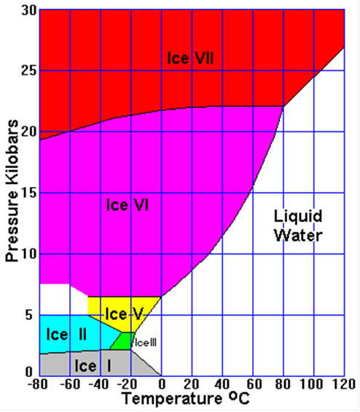
POLYMORPHISM
Some polymorphs of ice
Kurt Vonnegut – Cat’s Cradle - New water modification - Ice Nine – supposedly inspired by Irving Langmuir (General Electric Co.)
Ice IX really exists, it is stable at T below 140 K and pressure between 200 – 400 MPa;
Ice IX fortunately does not have properties described in the novel!

Slide 6
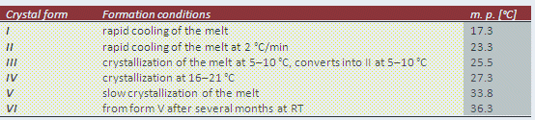
POLYMORPHISM
McCrone criterion – Polymorphs differ in crystalline structure, but molecules are identical in liquid and gaseous states;
McCrone’s statement – every compound has different polymorphs, and that, in general, the number of forms known for a given compound is proportional to the time and money spent in research on that compound.
Polymorphs of cocoa butter

Slide 7
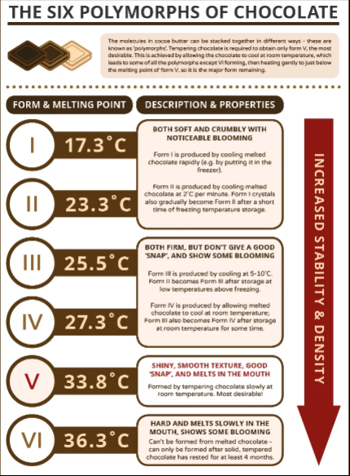
POLYMORPHISM

Slide 8
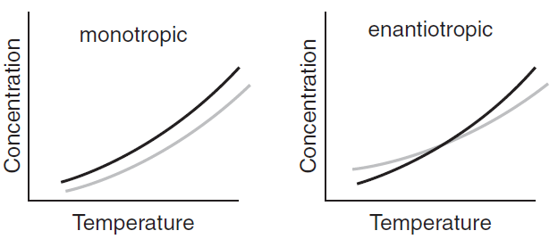
POLYMORPHISM
Monotropic polymorphs
Enantiotropic polymorphs – more stable form depends on temperature

Slide 9
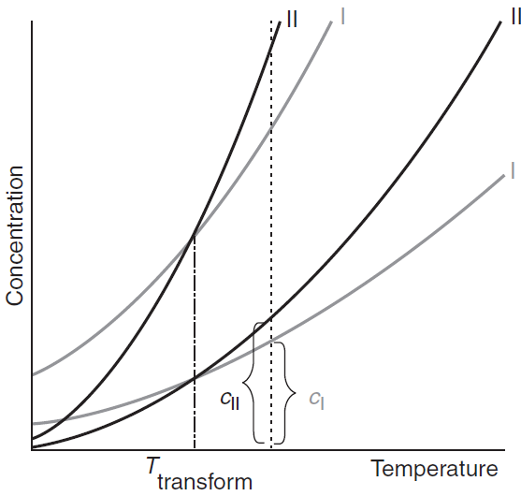
POLYMORPHISM
Transition temperature for enantiotropic polymorphs is independent on a solvent;

Slide 10
POLYMORPHISM
At the transition point of a dimorphic enantiotropic system both polymorphs have the same thermodynamic potential and the same solubility;
The transition temperature is only related to the solid lattice structures and therefore independent of the solvent from which the polymorphs are crystallized.

Slide 11
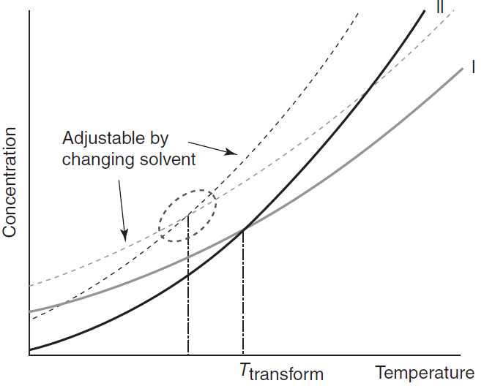
POLYMORPHISM
Metastable zone width is however strongly influenced by selected solvent;
Ostwald’s step rule – for several possible polymorphs (in metastable zone) less stable polymorph is formed preferentially;
Possible formation of different polymorphs in different solvents;
Concomitant polymorphism

Slide 12
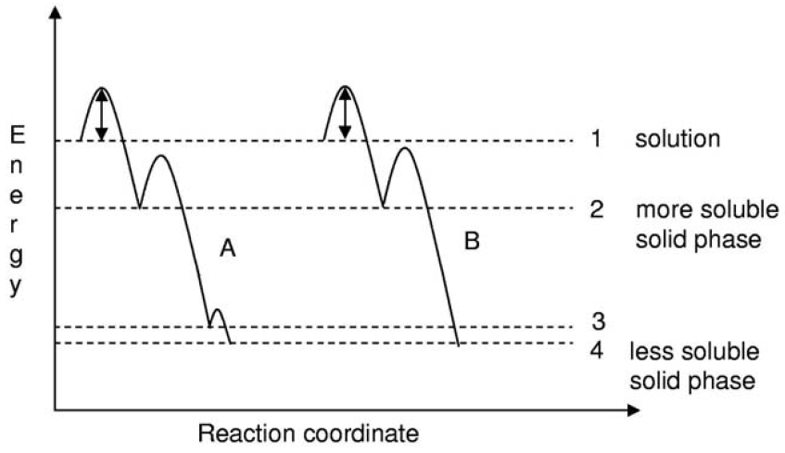
POLYMORPHISM
Ostwald’s step rule – graphical description

Slide 13
POLYMORPHISM
Burger (Ramberg) rules
Heat of Transition rule
Polymorphs are enantiotropically related if endothermic heat of transition from a lower melting form to a higher melting form is observed;
Heat of Fusion rule
Polymorphic pairs are enantiotropically related if the low melting form has the higher heat of fusion, otherwise they are monotropically related;
Entropy of Fusion rule
Polymorphs are enantiotropically related if the high melting form has the lower entropy of fusion, otherwise they are monotropes;
It is recommended to confirm DSC results with experimental microscopic observations, solubility determination or slyrrying;

Slide 14
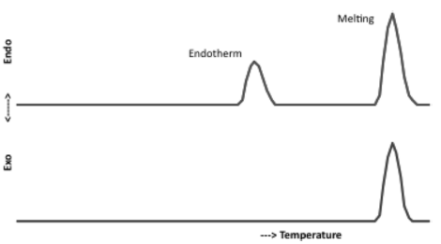
POLYMORPHISM
Burger (Ramberg) rules
Heat of Transition rule

Slide 15
POLYMORPHISM
Disappearing polymorph
Ritonavir Case
Protease inhibitor for HIV (Abbott, NorvirTM)
Chemburkar, S.R. et al Org. Process Res. Dev. 4, 413 (2000)

Slide 16
POLYMORPHISM
Disappearing polymorph
Ritonavir Case
NDA (New Drug Application) filed in December 1995;
Two years after some lots of the product (semisolid gel capsules with Form I) failed a dissolution specification;
The new crystal form (Form II) was found;
Form II is thermodynamically more stable than Form I
Samples of Form II brought to a laboratory to study – within a few days all of the lots of ritonavir turned to Form II;
Form I manufacturing failed from this point and “disappeared“

Slide 17
POLYMORPHISM
Disappearing polymorph
Ritonavir Case
Causes:
Small amounts of impurity
Residual solvent
Solutions:
Develop new manufacturing process for the preparation of Form I and also Form II;
Develop new formulations with either Form.

Slide 18
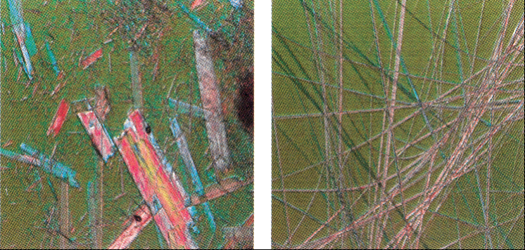
POLYMORPHISM
Disappearing polymorph
Ritonavir Case
Form I Form II

Slide 19
POLYMORPHISM
Disappearing polymorph
Ritonavir Case

Slide 20
POLYMORPHISM
Disappearing polymorph
Dunitz, J.D. et al Acc. Chem. Res. 28, 193 (1995)
Bučar, D.-K. et al Angew. Chem. Int. Ed. Engl. 54, 6972 (2015)

