Slide 1
SAFETY
Thermal Risk Assessment
Petr Beňovský

Slide 2
SAFETY

Slide 3
SAFETY
Seveso, Bhopal terrible accidents;
Risk analysis to advocate benefits of chemical industry;
Toxicity (in silico studies), environmental aspects (including waste disposal), process safety, contamination, elimination of human errors, property protection;
Material and Safety Data Sheets (MSDS) accompaning products
Risk Perception – comparing fatalities in different activities – the Fatal Accident Rate Index (FAR) that gives the number of fatalities per 10⁸ hours of exposure to the hazard.
Francis Stoessel Thermal Safety of Chemical Processes: Risk Assessment and Process Design, Wiley VCH 2008

Slide 4
SAFETY
Risk – according to a definition of the European Federation of Chemical Engineering (EFCE) it is a measure of loss potential, or damage to the environment or persons in terms of probability and severity
RISK = probability x severity ( x occurence)
Risk tools – e.g. Failure Mode and Effect Analysis (FMEA)
Francis Stoessel Thermal Safety of Chemical Processes: Risk Assessment and Process Design, Wiley VCH 2008

Slide 5
SAFETY
The Hazard and Operatibility Study (HAZOP) developed in early 1970s in ICI after the Flixborough incident. It is derived from FMEA concept, but specially adopted for the process industry;
Essentially oriented towards the identification of risks stemming from the process equipment using the proces and instruments design and the process flow diagram.
Francis Stoessel Thermal Safety of Chemical Processes: Risk Assessment and Process Design, Wiley VCH 2008

Slide 6
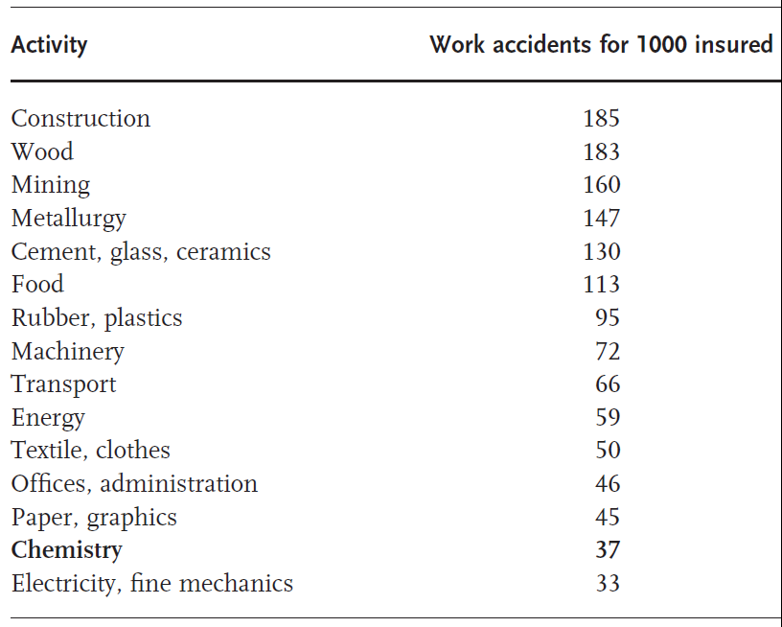
SAFETY

Slide 7
SAFETY
Fatal Accident Rate Index (FAR) - the number of fatalities per 10⁸ hours of exposure to the hazard.

Slide 8
SAFETY
A quiet situation resulting from the real absence of any hazard
But, is it attainable??
The risk is always there, a hazard should be minimized or eliminated as much as possible

Slide 9
THERMAL SAFETY
Molar enthalpy of a reaction – is the heat released (or absorbed) in a chemical reaction at constant pressure when simple substances combine into complex product;
Δ H_{R} [kJ mol⁻¹];
Specific heat of a reaction – the amount of heat energy required to raise the temperature of a body per unit of mass (standard – in J by 1 K for 1 g; e.g. water has 4.18 J);
Q_{R}’ [kJ kg⁻¹];
Heat capacity – the amount of energy required to raise the energy of the given mass of the system by 1 K;
C_{p} [J K⁻¹];

Slide 10
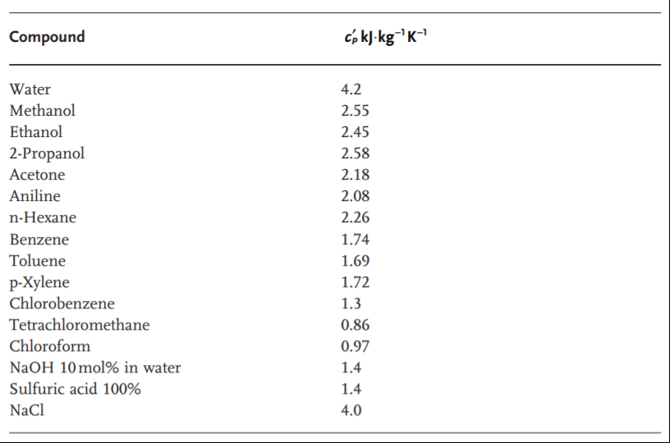
TYPICAL VALUES OF SPECIFIC HEAT CAPACITIES

Slide 11
THERMAL SAFETY
Time to Maximum Rate (under Adiabatic Conditions) (TMR_{ad}) – the higher the temperature the faster the reaction and the shorter TMR_{ad}, can be determined by the DSC measurement;
Time of No Return (TNR)
MTSR … Maximum Temperature of the Synthesis Reaction

Slide 12
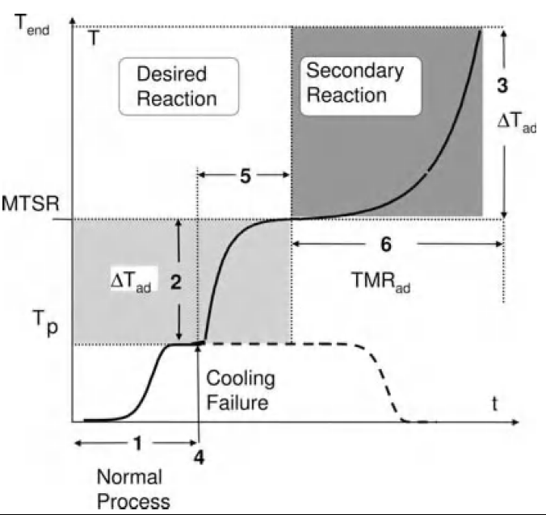
COOLING FAILURE SCENARIO

Slide 13
COOLING FAILURE SCENARIO
SIX PRINCIPAL QUESTIONS
Can the proces temperature be controlled by the cooling system?
Sufficient cooling of the system depends on e.g. viscosity of the mixture, power of a cooling system, possible fouling of the reactor walls, an area for heat exchange, efficient stirring;
Heat release rate of the reaction is relatively easily obtained from reaction calorimetry measurement.

Slide 14
COOLING FAILURE SCENARIO
SIX PRINCIPAL QUESTIONS
2. What temperature can be attained after runaway of the desired reaction?
After the cooling failure unconverted reactants will react in an uncontrolled way and it leads to an adiabatic temperature increase;
The available energy is proportional to the accumulated fraction;
At higher temperature even (desired) products can further react providing additional heat increase.

Slide 15
COOLING FAILURE SCENARIO
SIX PRINCIPAL QUESTIONS
2. What temperature can be attained after runaway of the desired reaction?
The Concept of Maximum Temperature of the Synthesis Reaction (MTSR)
MTSR = T_{p} + X_{ac} x ΔT_{ad}
T_{p} … desired reaction temperature
X_{ac} … degree of accumulation of unconverted reactants
ΔT_{ad} … the adiabatic temperature raise

Slide 16
COOLING FAILURE SCENARIO
SIX PRINCIPAL QUESTIONS
3. What temperature can be attained after runaway of the secondary reaction?
At higher temperature the secondary reactions might be triggered – it leads to further runaway;
At higher temperature even (desired) products can further react providing additional heat increase;
Data can be obtained from the DSC and adiabatic calorimetry measurement.

Slide 17
COOLING FAILURE SCENARIO
SIX PRINCIPAL QUESTIONS
4. At which moment does the cooling failure have the worst consequences?
The time where the accumulation is at a maximum and/or the thermal stability of the reaction mixture is critical;
In order to answer this question both the synthesis reaction and secondary reactions must be known;
Data obtained from the reaction and adiabatic calorimetry, and the DSC measurements can help to answer this question.

Slide 18
COOLING FAILURE SCENARIO
SIX PRINCIPAL QUESTIONS
5. How fast is the runaway of the desired reaction?
Usually, the industrial reactors are operated at temperature where the desired reaction is relatively fast;
A temperature increase above the normal proces temperature thus will cause a significant acceleration of the reaction rate (the van’t Hoff criterion);
Duration of the main reaction runaway may be estimated using the initial heat release rate of the reaction and the concept of the Time to Maximum Rate (TMR).

Slide 19
COOLING FAILURE SCENARIO
SIX PRINCIPAL QUESTIONS
How fast is the runaway of the decomposition reaction starting at MTSR?
The dynamics of the secondary reactions plays an important role in the determination of the probability of an incident;
Again, the concept of the Time to Maximum Rate (TMR) is useful.
The answers to all six questions represent a systematic way of analysing the thermal safety of a proces and building the cooling failure scenario.
Thermal risk assessment based on severity and probability of the event.

Slide 20
SEVERITY OF COOLING FAILURE SCENARIO
Δ T_{ad}$=\frac{Q′}{cp′}$
Δ T_{ad} … increase of temperature under adiabatic conditions
Q’ … specific energy of the reaction
c_{p}’ … specific heat capacity (water 4.2 kJ kg⁻¹ K⁻¹; organic solvents around 1.8 kJ kg⁻¹ K⁻¹; inorganic acids around 1.3 kJ kg⁻¹ K⁻¹⁾

Slide 21
PROBABILITY OF COOLING FAILURE SCENARIO
The probability can be evaluated using the time scale.
If, after the cooling failure, there is enough time left to take emergency measures before the runaway becomes too fast, the probability of the runaway will remain low.

Slide 22
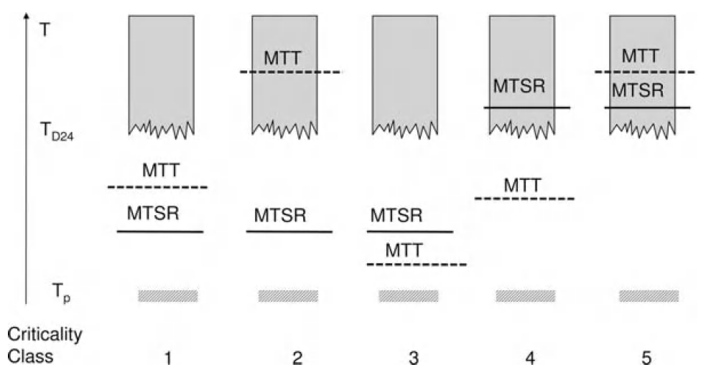
COOLING FAILURE SCENARIO
CRITICALITY CLASSES
T_{p} … proces temperature; MTSR … Maximum Temperature of the Synthesis Reaction; T_{D24} … temperature at which the Time to Maximum Rate is 24 h; MTT … Maximum Technical Temperature (e.g. boiling point)

Slide 23
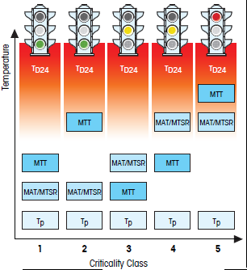
COOLING FAILURE SCENARIO
CRITICALITY CLASSES
Mettler Toledo

Slide 24
COOLING FAILURE SCENARIO
CRITICALITY CLASSES
Criticality Class 1
MTSR < MTT
Very safe
Evaporative cooling serves as an additional safety barrier
Reaction mass should not be held for a very long time under heat accumulation conditions

Slide 25
COOLING FAILURE SCENARIO
CRITICALITY CLASSES
Criticality Class 2
MTSR < MTT;
but MTT > T_{D24} , the decomposition reaction can be triggered if the reaction mass is maintained for a long time under heat accumulation conditions;
Still low risk scenario

Slide 26
COOLING FAILURE SCENARIO
CRITICALITY CLASSES
Criticality Class 3
MTSR > MTT;
Safety of the process depends on the heat release rate of the synthesis reaction at MTT;
Get ready to do pressure release;
Decomposition reaction should not be triggered in 24 hours

Slide 27
COOLING FAILURE SCENARIO
CRITICALITY CLASSES
Criticality Class 4
MTSR > MTT;
Moreover, MTSR > T_{D24};
Safety of the proces depends on the heat release rate of both the synthesis reaction and the decomposition reaction;

Slide 28
COOLING FAILURE SCENARIO
CRITICALITY CLASSES
Criticality Class 5
MTSR > T_{D24}; after loss of control of the reaction the decomposition will be triggered;
It is very unlikely that evaporative cooling or the pressure relief can serve as a safety barrier;
This is very dangerous and unacceptable scenario;

Slide 29
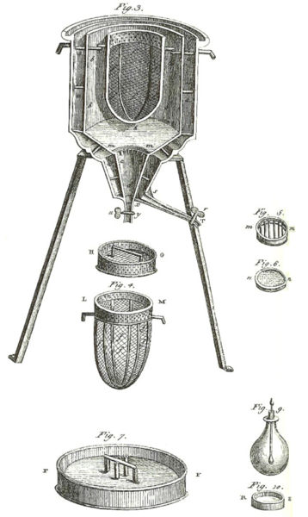
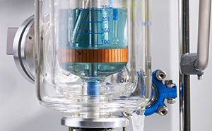
CALORIMETRY
Antoine Lavoisier
Pierre-Simon Laplace
Mettler RC-1

Slide 30
PRACTICAL EXAMPLE
Grimm, J.S. et al Org.Process Res. Dev. 6, 938 (2002)
Original conditions:
3 mol eq. of SOCl₂ as reaction solvent
upon completion rxn becomes thick, unstirrable
added MTBE, filtered
Problems:
large amounts of unused SOCl₂ to be disposed
although MTBE meets all requirements at higher temp it could decompose should be OK at RT
Decision:
Run rxn with 1.6 eq of SOCl₂ in MTBE as rxn solvent at RT
This was OK up to 2.0 mol scale, then sluggish
Concern – prolonged exposure of MTBE to acidic conditions

Slide 31
PRACTICAL EXAMPLE
Adiabatic temperature rise – temp.rise when all the heat generated stays in the RM (cooling, stirring failure)
conversion
specific weight (kg/m³)
specific heat capacity (kJ/kg.K)
MTSR – maximum temperature of synthesis reaction
MTSR = T_{p} + ΔT_{ad}
process temperature

Slide 32
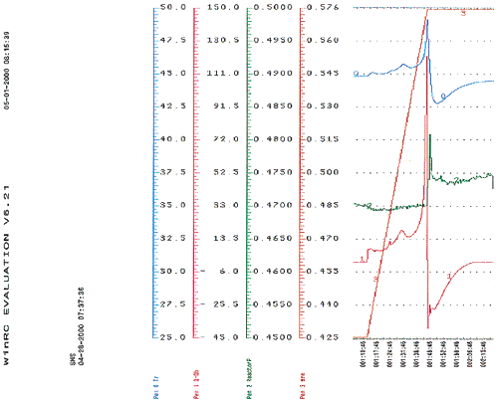
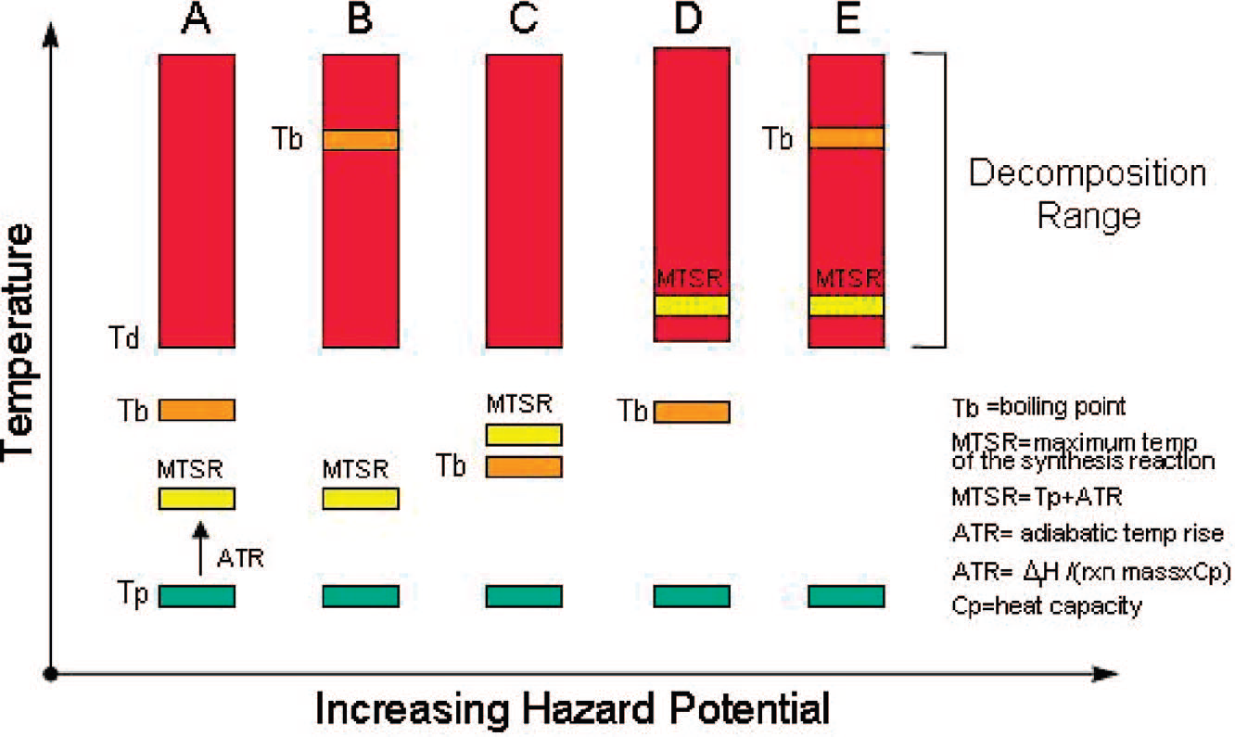
Calorimetric measurement at 40-45°C (RC-1)
Problems:
rxn not „feed controlled“ (sudden delayed heat release)
sudden uncontrolled outgassing
gas contained isobutylene as well (separate exp. showed decomp. at 40ºC)
ΔT_{ad} is 25ºC, MTSR=65ºC, b.p. of MTBE 55ºC

Slide 33
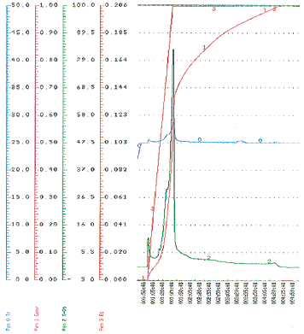
Calorimetric measurement at RT
Again:
rxn not „feed controlled“ (sudden delayed heat release)
2 exotherms observed
ΔT_{ad} is 53ºC, MTSR=78ºC, b.p. of MTBE 55ºC
Still hazardous !!!
Decision:
abandon MTBE in favor of toluene

Slide 34
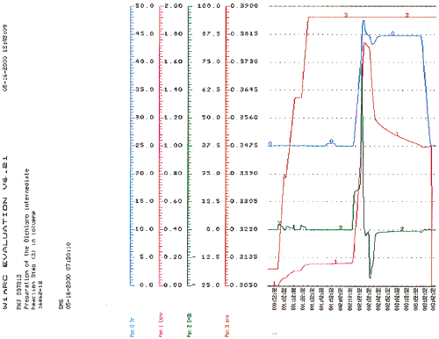
Calorimetric measurement in toluene at RT
Problems:
delay even worse (entire charge)
uncontrolled outgassing
Still hazardous !!!

Slide 35
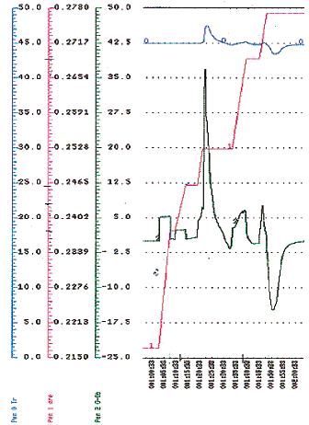
Calorimetric measurement in toluene at 45 ºC
Problems:
Still the same problem – delay of massive outgassing
ΔT_{ad} is 23ºC, MTSR=68ºC, b.p. of toluene 111ºC
Still somewhat hazardous due to uncontrolled outgassing

Slide 36
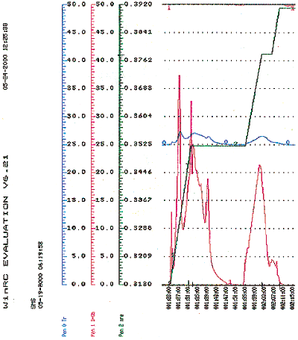
Measurement in toluene/DMF at 25ºC
Finally:
Rxn is more or less feed controlled
Outgassing is also under control
ΔT_{ad} is 20ºC, MTSR=45ºC, b.p. of toluene 111ºC
Not ideal but safe within reason

