Slide 1

Stochastic thermostats
Sushmita Pal
Problems in molecular simulations (FB810)

Slide 2
NVE ensemble gives the correct dynamics
Experiments work at constant temp so NVT ensemble has to be incorporated
For NVT, we alter the newtons motion to reach the target temperature

Slide 3
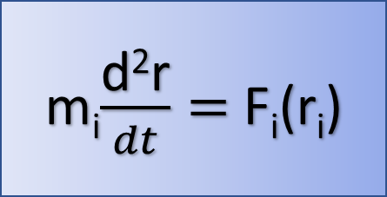
The velocity is altered in the system, it changes the dynamic properties and does not give the true result
Thermostat
Constant Temperature
Kinetic energy
Equation of motion
Velocity
m_{i}$\frac{\text{d}\text{2}\text{r}}{dt}=$ F_{i}(r_{i})
Changing the equation of motion

Slide 4
PROBLEM
Changes in velocity by altering the newton’s equation of motion
Dampening of dynamic properties
Deviation from “true” dynamics

Slide 5
Types of thermostats
Velocity Randomizing
Velocity rescaling

Slide 6
COUPLING CONSTANT
Ƭ_{t} (coupling constant) determines how strongly the system is coupled to heat bath
More strongly coupled, Ƭ_{t} 0
Less strongly coupled, Ƭ_{t} ∞

Slide 7
Velocity randomizing thermostat
Andersen
Massive Andersen
Langevin Dynamics
randomly reassigning new velocities to a group of molecules
randomly reassigning new velocities to all the molecules
changing the Newtonian equation of motion by adding a frictional term and a random term for collision of molecules

Slide 8
Velocity rescaling thermostat
Berendsen
Stochastic rescaling
Nośe-Hoover
Temperature relaxation is exponential
Temperature relaxation in oscillatory manner
Temperature relaxation is exponential with correct energy distribution by addition of properly chosen stochastic factor that rescales the kinetic energy

Slide 9
Some dynamical properties
Short time scale dynamical properties
Diffusivity
Rotational correlation time
Viscosity
Long time scale dynamical properties
Dynamic structure factor using Dynamic light scattering experiments

Slide 10
SOLUTIONS
Use of velocity rescaling thermostats than velocity rescaling

Slide 11
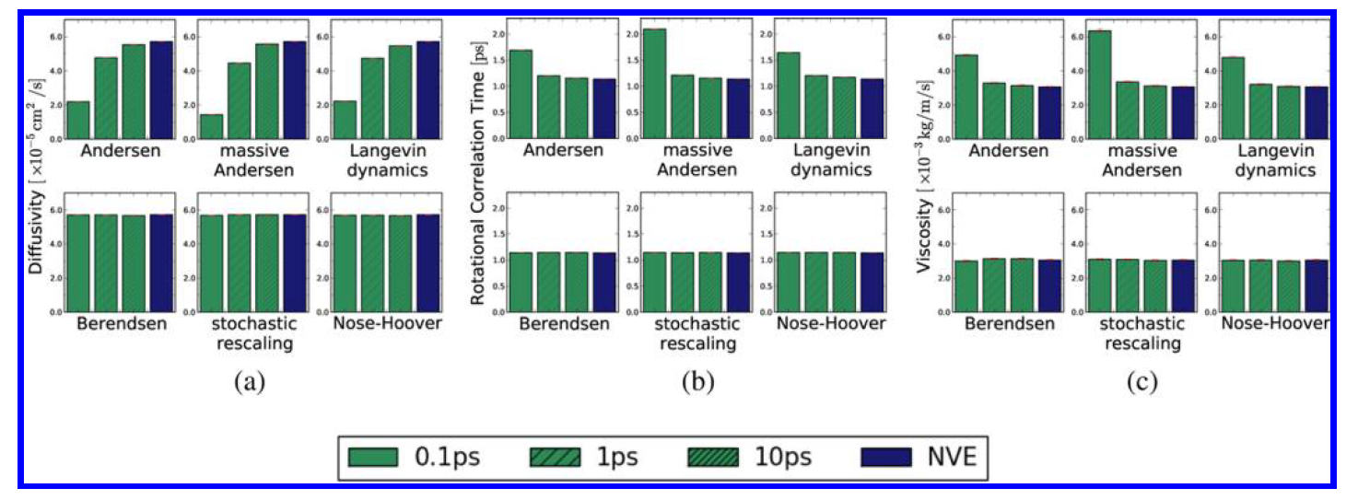
Various thermostats with different Ƭ_{t}
Simulations of TIP3P water model

Slide 12
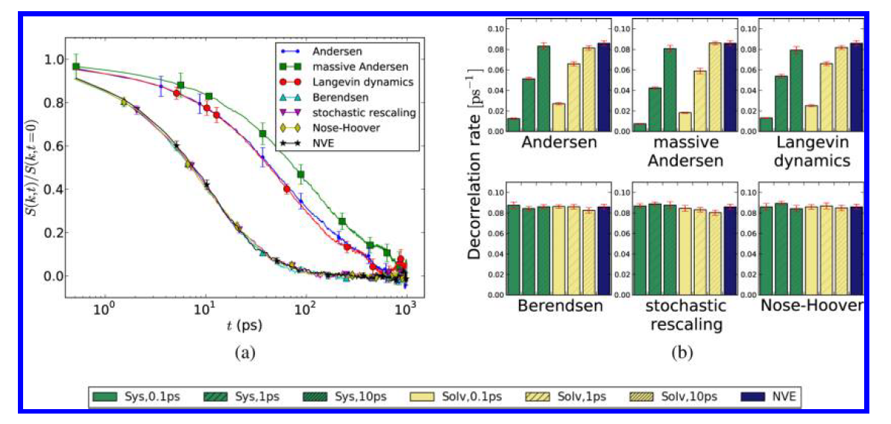
Simulations of solvated polymer chain

Slide 13
SOLUTIONS
Use of Non-invasive scheme ( only solvent is thermostatted and solute is connected to heat bath i.e, solvent)

Slide 14
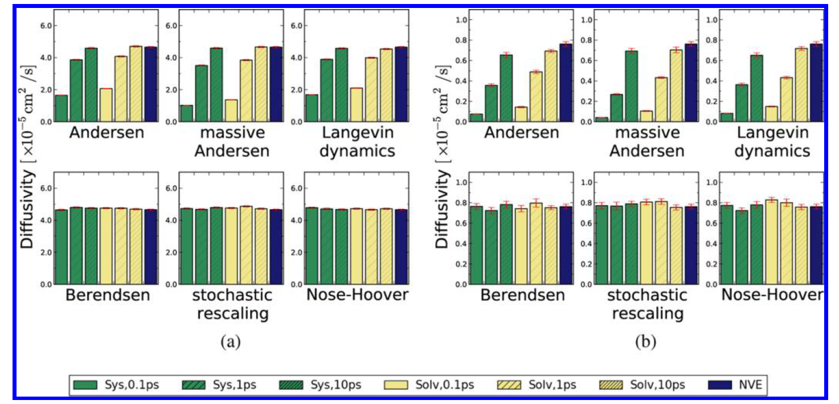
a) Simulations of solvated united-atom methane b) a solvated polymer chain

Slide 15
SOLUTIONS
Use of Global velocity rescaling thermostat rather than massive velocity rescaling thermostat
Global approach – the coupling constant is coupled to ensembled average Kinetic energy of the system
Massive approach- the coupling constant is coupled to individual kinetic energy of the particle

Slide 16
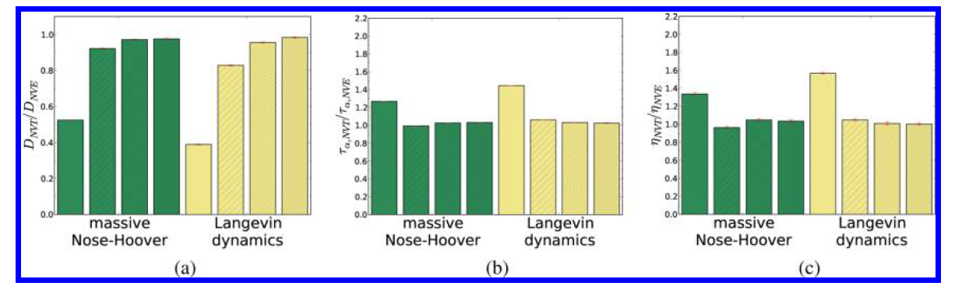
Simulations of TIP3P water with coupling constants 0.1 ps, 1 ps, 10 ps and 100 ps respectively

Slide 17
THANK YOU!!

