Slide 1
HUNTER-GATHERER STUDIES
A FRAMEWORK

Slide 2
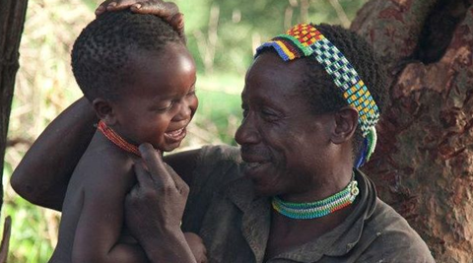

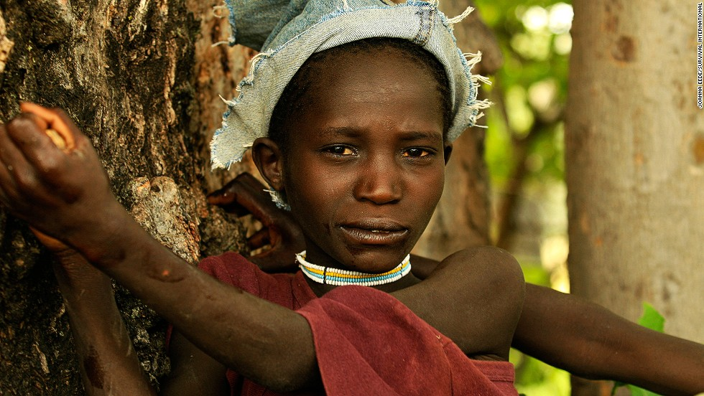
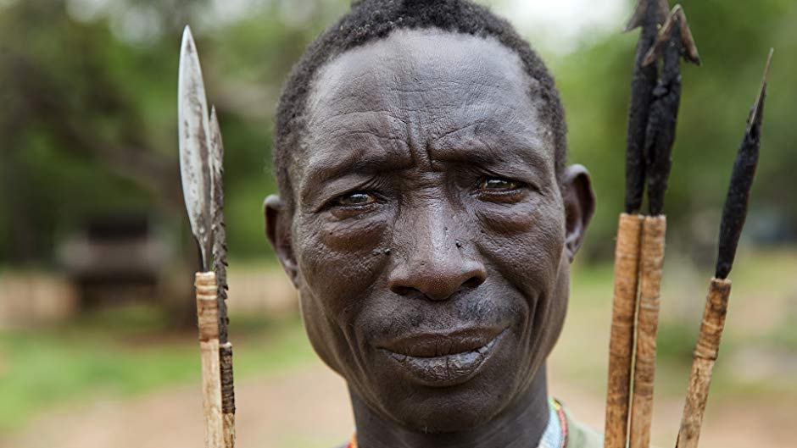

Slide 3
WHAT ARE COMMON MISCONCEPTIONS OF HGS
Kramer & Codding

Slide 4
A FRAMEWORK
Historical aspects and approaches to studying hunter-gatherers
How those approaches have shaped our understandings of 21st century HG communities.

Slide 5
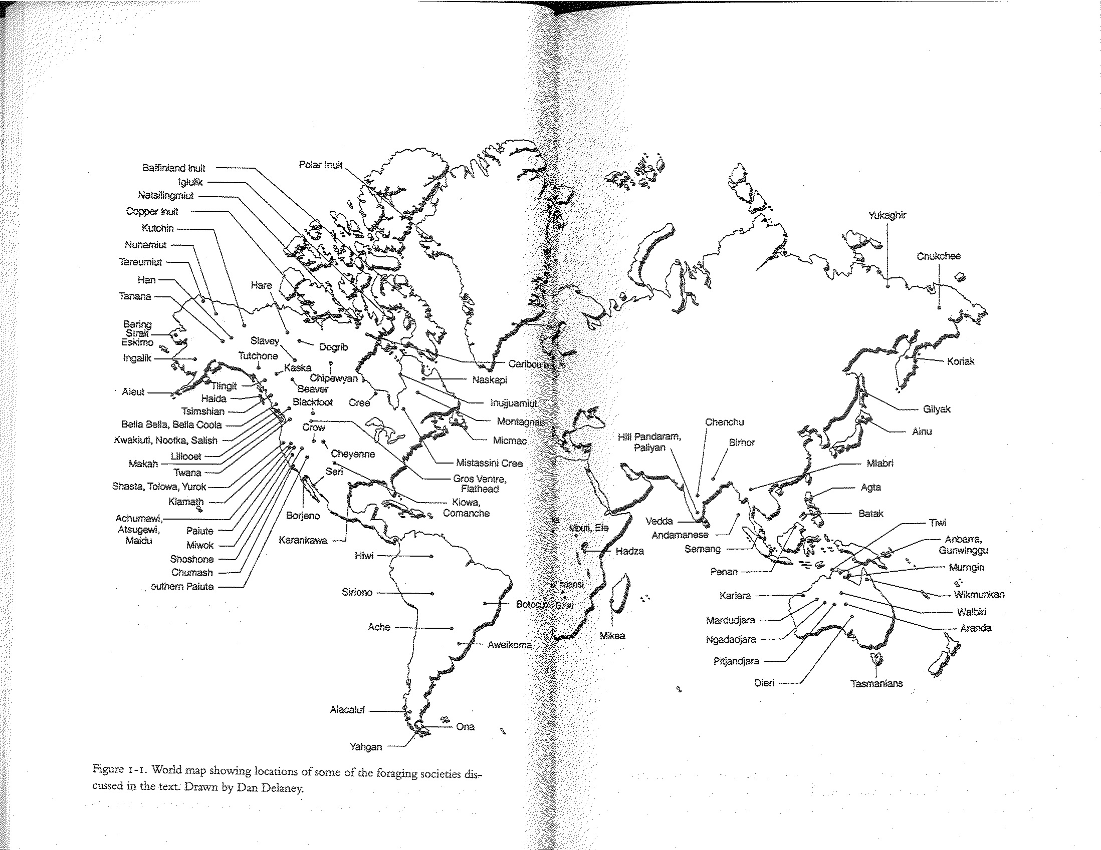
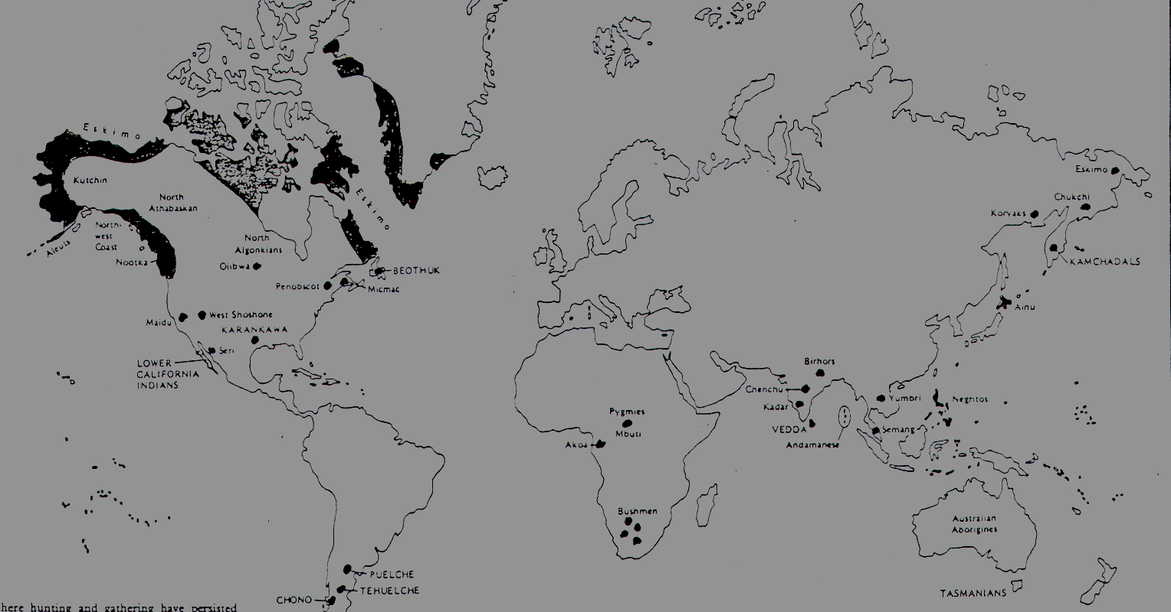
HGS TODAY

Slide 6
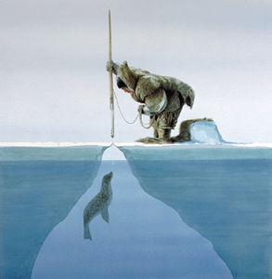
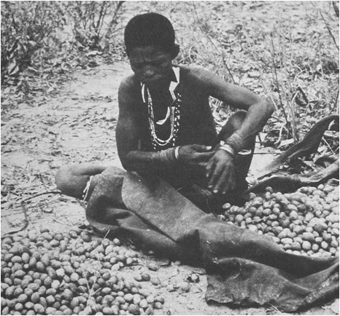
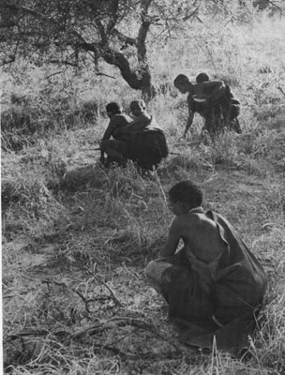
HUNTER-GATHERERS (FORAGERS) DEFINED
Economically – mode of subsistence.
  reliance on hunting wild animals, gathering wild plant foods, and fishing
  no domesticated plants and animals (except dogs)

Slide 7
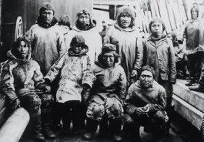
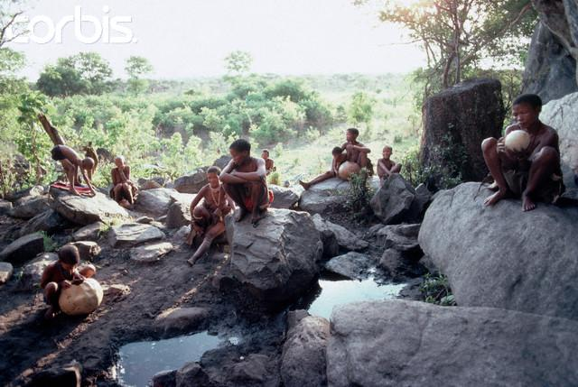
HUNTER-GATHERERS (FORAGERS) DEFINED
Socially – band level societies, live in small groups where membership is flexible and relations are generally egalitarian (Kelly 1995).

Slide 8
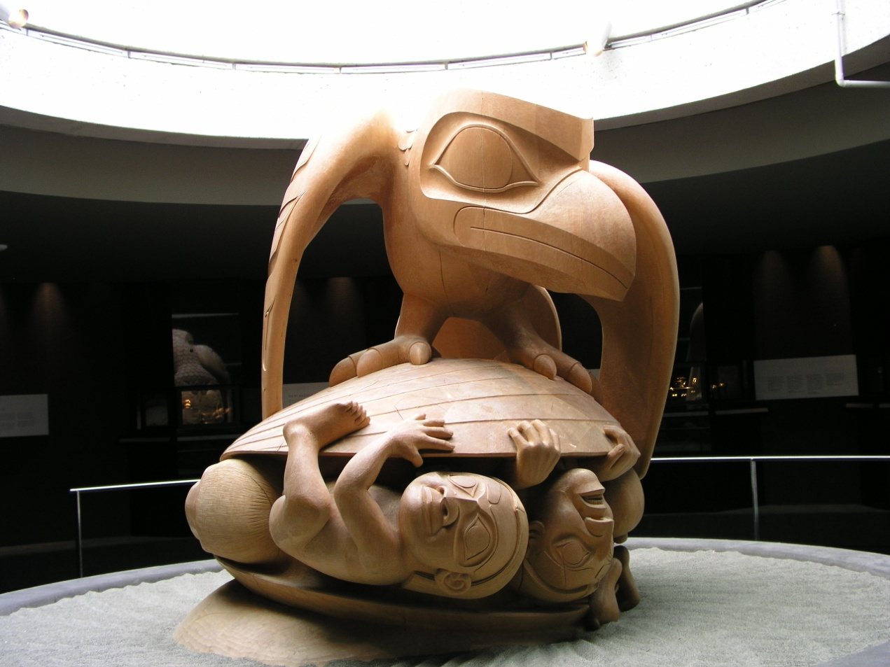
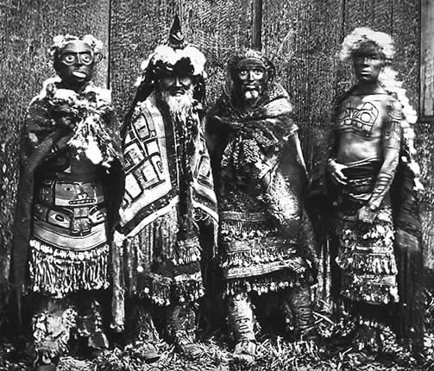
HUNTER-GATHERERS (FORAGERS) DEFINED
Cosmology and world-view (Lee and Daly 1999)

Slide 9
ETHOS AND WORLD-VIEW
Sharing – “central rule of social interaction among HGs” (Lee and Daly 1999:4)
  Morgan – “primitive communism”
  Generalized reciprocity
Giving Environment?
A Trickster
Shamanism

Slide 10
IMAGES OF HGS IN EUROPEAN SOCIAL THOUGHT
Barnard 1999

Slide 11
19TH CENTURY

Slide 12
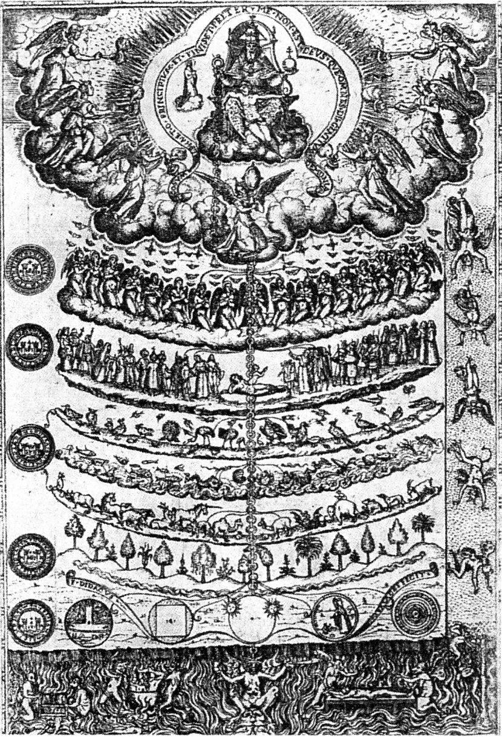
GREAT CHAIN
OF BEING

Slide 13
RISE OF EVOLUTIONISM

Slide 14
Unilineal Evolution
  Developed by Lewis Henry Morgan
    Concept of Cultural Evolution
Do not need to seek causes for the present state/activities of a group’s “culture” in biology or climate, or any other factor outside of culture itself.

Slide 15
LEWIS HENRY MORGAN (1818-1881)
Civilization – use of phonetic alphabet
Barbarism – herding and agriculture
Savagery – hunting and gathering
  3 stages
    Lower
    Middle
    Upper

Slide 16
RECAP
Hunter-gatherers at the bottom of the social evolutionary scale B/C:
  Few material possessions
  No private property
  Moral limitations (lazy, brutish etc.)
Initially a search for the archetypal HG turned into a quest to figure out why there is diversity

Slide 17
20TH CENTURY MODELS

Slide 18
THINGS TO KEEP IN MIND
Disappearance is not due to technological inefficiency
  Political factors – European expansion
Importance of early human history
  Contemporary H&G are not relics from the past
  But participants in the modern world system
Forced into marginal areas

Slide 19
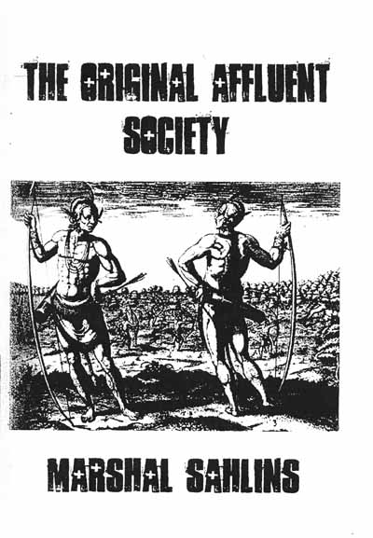
THE ORIGINAL AFFLUENT SOCIETY

Slide 20
HOW DO WE DEFINE HUNTER-GATHERER?
Do we define it in…
  Evolutionary terms?
  Organizational terms?
  Subsistence terms?

Slide 21
PATRILINEAL/PATRILOCAL

Slide 22
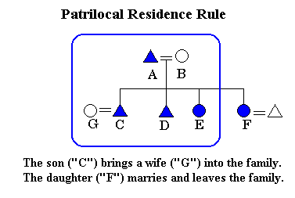

PATRILINEAL/PATRILOCAL
Definition of patrilineal: relating to, based on, or tracing descent through the paternal line a patrilineal society, : patrilocal: located at or centered around the residence of the husband's family or tribe
Radcliffe Brown = description of Australian Aboriginal social organization, first mention of the patrilineal band

Slide 23
GENERALIZED FORAGING MODEL

Slide 24
THE ORIGINAL AFFLUENT SOCIETY

Slide 25
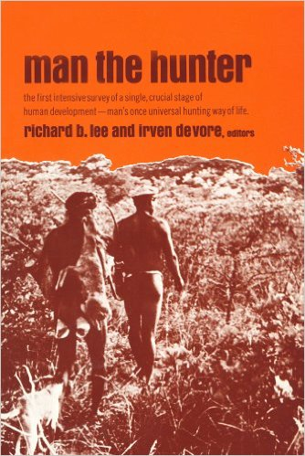
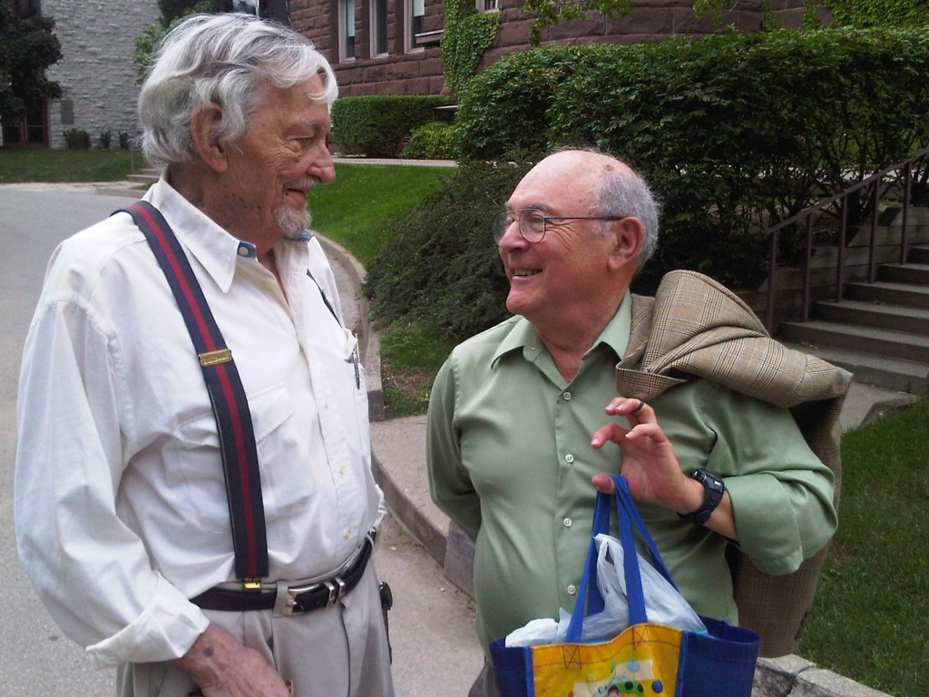
MAN THE HUNTER (1968)

Slide 26
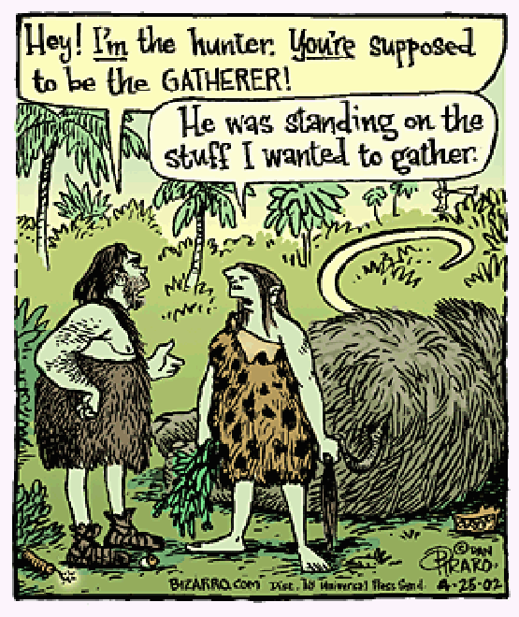
MAN THE HUNTER CONF.
Surprise! A result of the the “Man the Hunter” conference
Marriage, demography, territoriality, social and political organization and evolution from a variety of contexts
Despite name they claim to have discussed the importance of women…

Slide 27
GENERALIZED FORAGING MODEL
“NOMADIC STYLE”
Egalitarianism
Low population density
Lack of territoriality
Minimum of food storage
Flux in band composition

Slide 28
As read in Kramer and Codding, what other questions/conclusions came from the 1968 ”Man the Hunter” conference?

Slide 29
THE INDEPENDENT MODEL

Slide 30
OR PROFESSIONAL PRIMITIVE
HGs are not isolated or outside of history
A history of contact has resulted in dramatic changes in HG livelihoods
2 main issues
  Are sociocultural trends associated with Hging itself or as a product of interactions with other nonHG groups
  The increased concern with political economy
    Modes of production

Slide 31
MARXISM
Developed by Marx and Engels
Civilization followed the invention of private property (result of internal conflict)
  Some individuals became wealthy and needed to protect wealth ->Social classes and specialization followed

Slide 32
EXCHANGE SYSTEMS
Market Principle
  Capitalism
  Supply and demand
Reciprocity – exchange between social equals
  Generalized
  Balanced
  Negative
Redistribution – movement of goods and services to a center and then flow back out.

Slide 33
RECIPROCITY (SAHLINS 1972)
Generalized
  giving without expecting a concrete or immediate return
  Less about economic exchange, more about relationships
  Between kin or fellow house or band members
Balanced
  Exchange with those distantly related, or not related
  Cousins, trading partner, fictive kin
Negative – deceit, cheating, theft, raiding

