Slide 1
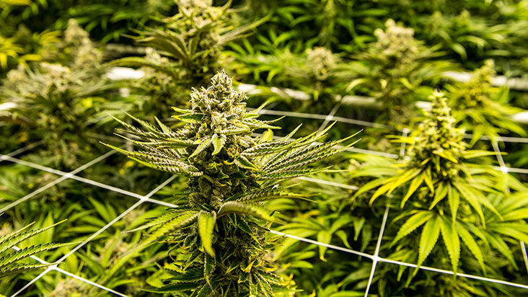
Group A
Hřebíčková, Sau

Slide 2
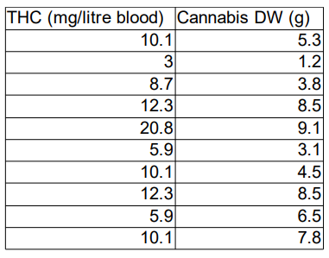
A. Dependence of THC concentration in blood on the amount of cannabis smoked was analyzed in one person who smoked different amounts of dried cannabis of the same source. The intervals between measurements were long enough to decrease of THC concentration to 0 before each trial.

Slide 3
Analysis
0 hypothesis: THC concentration in blood does not depend on the amount of cannabis smoked.
thc <- read.delim2("clipboard")
summary(thc)
View(thc)
lm.thc <- lm(THC~DW,data=thc)
plot(lm.thc)
anova(lm.thc)

Slide 4
Results
summary(lm.thc)
Call:
lm(formula = THC ~ DW, data = thc)
Residuals:
Min 1Q Median 3Q Max
-4.9687 -1.4006 -0.2593 1.4734 6.2498
Coefficients:
Estimate Std. Error t value Pr(>|t|)
(Intercept) 1.6650 2.5453 0.654 0.53138
DW 1.4160 0.4003 3.537 0.00765 **
---
Signif. codes:
0 ‘***’ 0.001 ‘**’ 0.01 ‘*’ 0.05 ‘.’ 0.1 ‘ ’ 1
Residual standard error: 3.211 on 8 degrees of freedom
Multiple R-squared: 0.6099, Adjusted R-squared: 0.5612
F-statistic: 12.51 on 1 and 8 DF, p-value: 0.007655
Analysis of Variance Table
Response: THC
Df Sum Sq Mean Sq F value Pr(>F)
DW 1 128.999 128.999 12.509 0.007655 **
Residuals 8 82.497 10.312
---
Signif. codes:
0 ‘***’ 0.001 ‘**’ 0.01 ‘*’ 0.05 ‘.’ 0.1 ‘ ’ 1

Slide 5
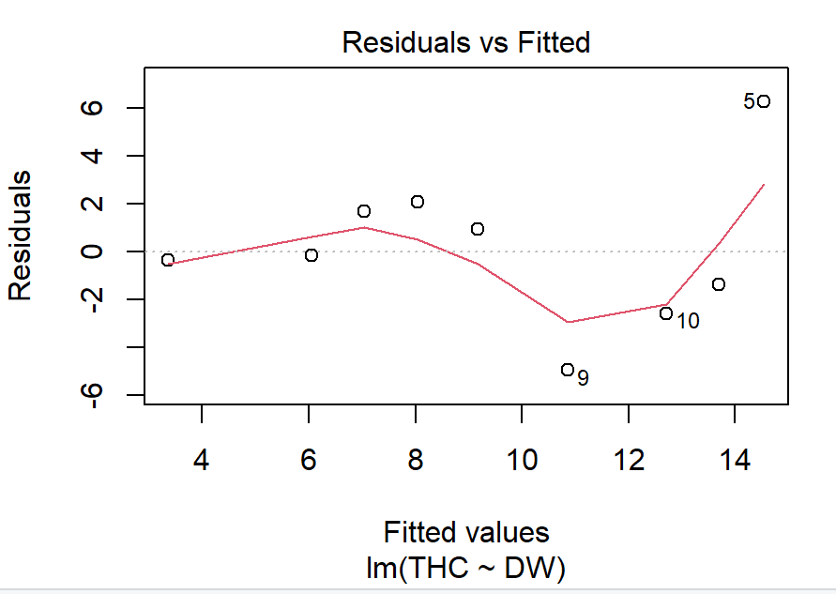
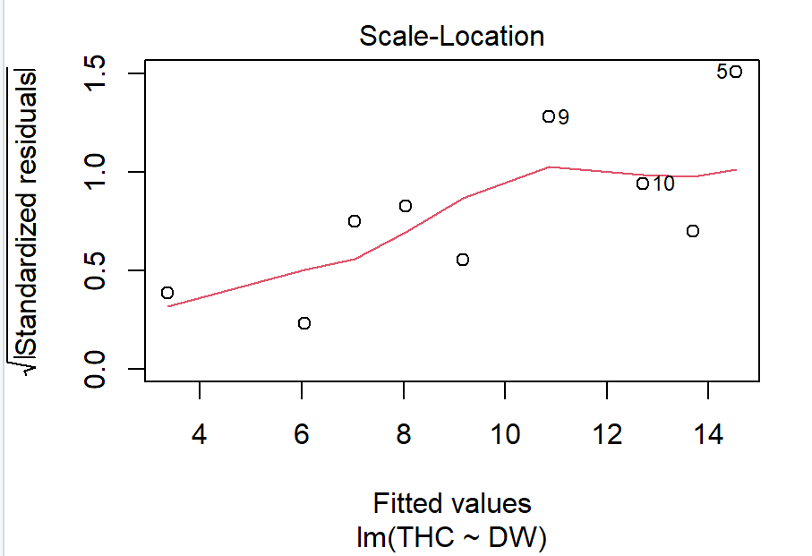

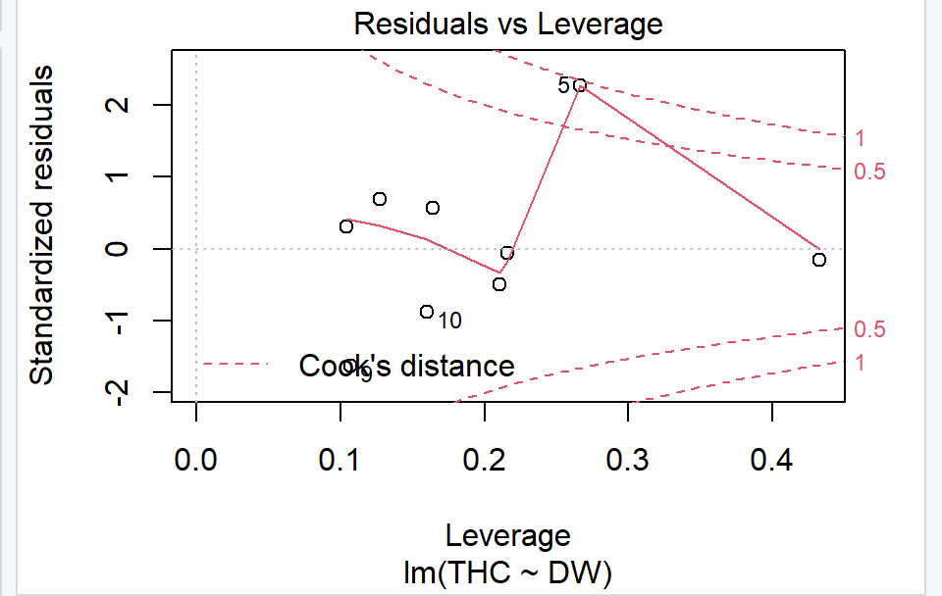

Slide 6
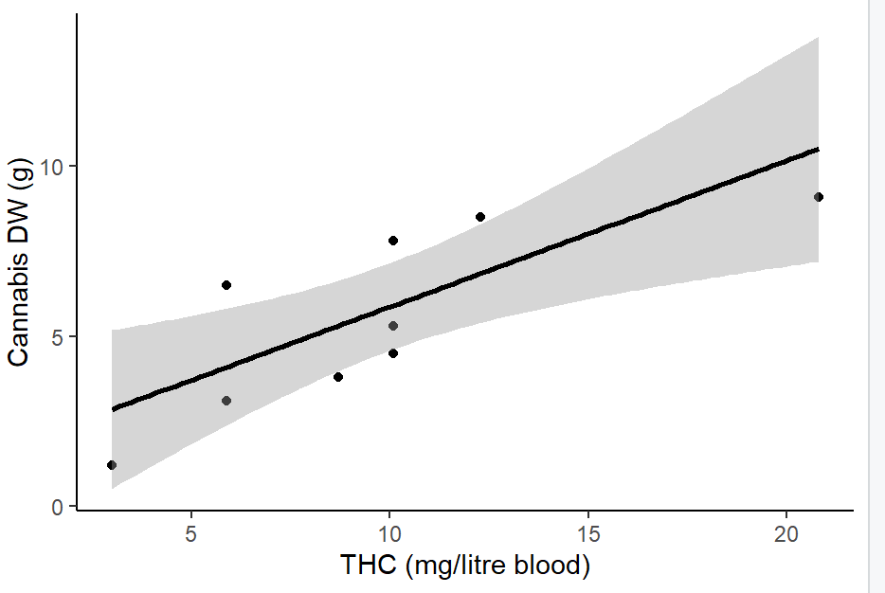

Slide 7

Conclusion
We reject the null hypothesis, there is a significant relationship between the THC concentration in blood and the amount of cannabis smoked

Slide 8
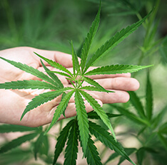
Thanks for
your attention

