Slide 1
Task C

Slide 2
Relationship between mean age of children in a family and height of Christmas tree was studied. The resulting data were following:
Does the age of children in family affect the height of the Christmas tree bought by the parents?
Tree height | Age
2,2 | 3,5
3,1 | 4,2
0,8 | 15,8
2,5 | 7,6
1,4 | 12,8
1,7 | 16,4
1,2 | 15,3
2,8 | 6,5
0,9 | 19,5
1,6 | 5,6

Slide 3
Null hypothesis
There is no correlation between the height of Christmas tree and the age of the children.

Slide 4
R script
tree<-read.delim2("clipboard")
cor.test(tree$tree.height, tree$age)
lm.c<-lm(tree$tree.height~tree$age)
summary(lm.c)
ggplot(data=tree, aes(x=age, y=tree.height))+geom_point()+
geom_smooth(method="lm", color=1)+
labs(x="Age", y="Tree height")+theme_classic()

Slide 5
Results
Pearson's product-moment correlation
data: tree$tree.height and tree$age
t = -3.8541, df = 8, p-value = 0.004849
alternative hypothesis: true correlation is not equal to 0
95 percent confidence interval:
-0.9523889 -0.3585995
sample estimates:
cor
-0.8061992

Slide 6
Results
Call:
lm(formula = tree$tree.height ~ tree$age)
Residuals:
Min 1Q Median 3Q Max
-0.78154 -0.35686 -0.03737 0.46167 0.56491
Coefficients:
Estimate Std. Error t value Pr(>|t|)
(Intercept) 2.99572 0.34361 8.718 2.34e-05 ***
tree$age -0.10968 0.02846 -3.854 0.00485 **
---
Signif. codes: 0 ‘***’ 0.001 ‘**’ 0.01 ‘*’ 0.05 ‘.’ 0.1 ‘ ’ 1
Residual standard error: 0.5001 on 8 degrees of freedom
Multiple R-squared: 0.65, Adjusted R-squared: 0.6062
F-statistic: 14.85 on 1 and 8 DF, p-value: 0.004849

Slide 7
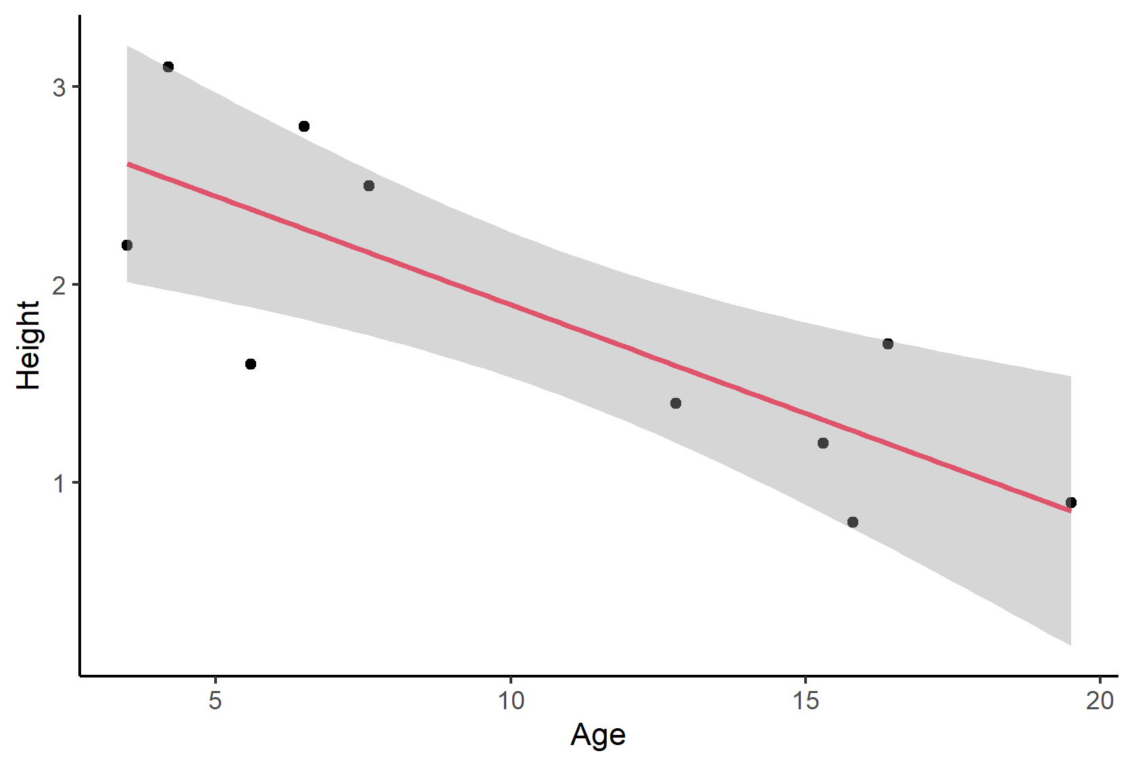

Slide 8
Conclusion
There is a negative linear regression between the age of children and the tree height.

