Slide 1
Visit to IVF Center www.reprofit.cz Theoretical Introduction
Helena Nejezchlebová
2022, ApriL 14th
Bi6140c Embryologie-cvičení

Slide 2
Important:
Please read this presentation before visiting the IVF laboratories of the Reprofit International clinic (Hlinky street) on April, 14th at 5 pm (our meeting point = the reception desk at the ground floor of the clinic)
Take with you: white coats, slippers, respirators/face masks (everything perfectly clean), printed worksheet (uploaded to the IS system together with this presentation)
ATTENTION: there are IVF centers with similar names in Brno, our students traditionally wait for the start of the excursion at the reception desks of these clinics, so please do not repeat this ☺ ☺ ☺
Bi6140c Embryologie-cvičení

Slide 3
Infertility
WHO: „Infertility is a disease of the male or female reproductive system defined by the failure to achieve a pregnancy after 12 months or more of regular unprotected sexual intercourse.(1) Infertility affects millions of people of reproductive age worldwide – and has an impact on their families and communities.“
it is not a permanent, unsolvable condition, although the path to pregnancy may not always be easy.
if pregnancy is to occur, the sperm must fertilize the eggs between 6-24 hours after ovulation
the probability of achieving pregnancy in one monthly cycle is max. 25%. And what if there is an extra problem ???
Types of infertility:
a) primary: the couple never managed to conceive (despite well-timed, regular, unprotected intercourse)
b) secondary: pregnancy has occurred in the past
Bi6140c Embryologie-cvičení

Slide 4
Causes
40 % male factor
40 % female factor
20 % - the cause remains unrevealed
In women, infertility may be caused by life style factors, increasing maternal age, genetic and immunologic factors, infections, oncological treatment, a range of abnormalities of the ovaries, uterus, fallopian tubes, endocrine system disorders, etc.
In men, infertility is caused by life style factors, genetic factors, oncological treatment, anatomical obstructions, infections, problems in the ejection of semen, absence or low levels of sperm, or abnormal morphology and movement of the sperm, etc.
WHO: „ For both women and men, however, environmental and lifestyle factors such as smoking, excessive alcohol intake, obesity and exposure to environmental pollutants have been associated with lower fertility rates.“
Bi6140c Embryologie-cvičení

Slide 5
Examination of infertile couple
interview with a doctor
physical examination of reproductive organs,
ultrasound examination
semen examination
ovulation examination
blood tests (hormones, immunology)
genetic tests
etc.
Bi6140c Embryologie-cvičení

Slide 6
Treatment
lifestyle changes: reduce smoking, alcohol, increase physical activity, reduce stress, put emphasis on a quality and balanced diet,…
rehabilitation and spa treatment (method of Ludmila Mojžíšová)
drug treatment (infection treatment, correction of hormonal imbalance,…)
surgical solutions (removal of anatomical defects, removal of obstructions,…)
assisted reproduction techniques: utmost possibility, suitable only for certain diagnoses
Bi6140c Embryologie-cvičení

Slide 7
Indications for assisted reproduction methods
the female and male factors apply 1: 1
immunological sterility (a woman makes antibodies against her partner's sperm,…)
endometriosis, obstructed fallopian tubes, ovulation disorders,…
sperm production disorders
obstruction of the excretory tract
infections,…
sterility requiring surgery or gamete donation (sperm, oocytes, embryos)
genetic factor (Turner syndrome X0, Klinefelter's syndrome XXY,…)
psychological aspects
Bi6140c Embryologie-cvičení

Slide 8
Man treatment
sperm count evaluation: after 3-4 days of sexual abstinence abnormality → repeat the examination at intervals of 2 to 3 months, if the abnormalities are still present, visit a urologist / andrologist; this is a basic examination of male fertility
it is also possible to proceed to: genetic testing in men 45+ years, in the absence of sperm in ejaculate + in repeated miscarriages of the partner, in the risk of hereditary defect.
microdeletion on the Y chromosome: 10 – 20 % of patients with less than 2 million sperm / ml, but a normal karyotype → loss of genes responsible for sperm production and development, the disorder is hereditary
chromosome abnormalities: 5 - 15% of men with severe spermiogram disorders have chromosome abnormalities that can be diagnosed from the blood by karyotype determination
cystic fibrosis (CF) and congenital vas deferens atresia (CAVD): only in men with complete absence of sperm in the ejaculate. Men with CAVD are highly likely to carry the cystic fibrosis (CF) gene. Therefore, genetic testing for CF must be performed on men in whom no sperm have been found.
hormonal examination of a man for men with low sperm quality: FSH, LH and testosterone, which inform about the hormonal background of sperm production (in men, limited importance in diagnosis)
Bi6140c Embryologie-cvičení

Slide 9
Women treatment
Gynecological examination, ultrasound of the uterus and ovaries
Examination of hormone levels (blood tests): 1.-3. day of menstruation → information on function of the ovaries, their ability to form mature eggs and possible responses to stimulation treatment; FSH, LH, AMH, PRL, TSH.
Normal blood hormone levels: FSH 1.9 - 12 IU / ml, LH 0.9 - 12 IU / ml, prolactin: less than 25 ng / ml, TSH 1.0 - 4.0 IU / ml, AMH (anti-Müllerian hormone) 0.5 - 30 IU / ml (low level = low ovarian reserve)
Examination of the uterus and fallopian tubes - hysterosalpingography (HSG) using a contrast agent: shows the patency of the fallopian tubes, the shape of the uterine cavity under ultrasound control (sono HSG) or under X-ray control (X-ray HSG). Sono HSG is preferred due to the wide availability, painless examination, no X-ray exposure.
Reproductive tract surgery - hysteroscopy and laparoscopy: direct view into the uterine cavity (hysteroscopy → adhesions, polyps, septa, etc.) and view into the abdominal cavity on the uterus, ovaries and fallopian tubes (laparoscopy → endometriosis, adhesions, the patency of the fallopian tubes,… ).
Genetic testing for female infertility: in case in repeated miscarriages and failed IVF cycles; determination of karyotype (number of chromosomes)
Immunological examination: it is not one of the basic fertility examinations, for patients with repeated IUI failures, when the spermiogram of the partner is normal repeatedly; for patients in whom high-quality embryo transfer has been performed repeatedly without success; antibodies against sperm, against trophoblast (placenta) and against embryo envelope (ZP) are examined
Bi6140c Embryologie-cvičení

Slide 10
Asisted reproduction (ART, „artificial fertilization):
medical procedures and methods in which gametes (sperm and oocytes) and embryos are manipulated in laboratory (in vitro) to achieve pregnancy
if necessary, ART procedures may involve donor oocytes, donor sperm, donor embryos or a surrogate/ gestational carrier. A surrogate is a person who becomes pregnant with sperm from one partner of the couple. A gestational carrier becomes pregnant with an egg from one partner and sperm from the other partner.
a very most common complication of ART is a multiple pregnancy: prevented or minimized by limiting the number of embryos that are put into the parent's body.
Bi6140c Embryologie-cvičení

Slide 11
ART techniques
Ovarian stimulation and planned intercourse: this procedure is suitable for patients where a problem with cycle regularity and ovulation has been identified. In these cases, patients take antiestrogens from the 3rd to the 7th day of the menstrual cycle. The whole cycle is monitored by ultrasound, measuring the height of the uterine lining and the size of the growing follicles („small bladders" in the ovary, from which the egg is released at the time of ovulation). At an suitable moment, ovulation is induced by hormonal injection and thus the optimal time for a natural pregnancy.
Bi6140c Embryologie-cvičení

Slide 12
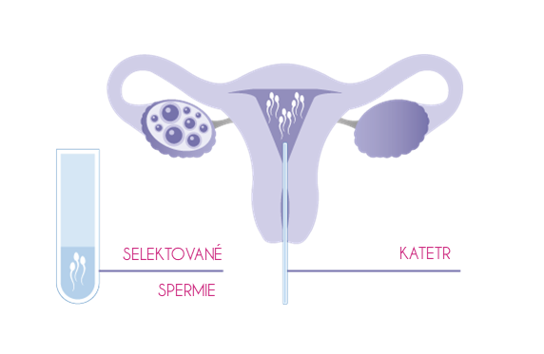
ART techniques
Intrauterine insemination (IUI): this procedure is suitable for mild sperm quality disorders, which can be overcome by performing intrauterine insemination. In this type of treatment, the partner's sperm (if necessary, the donor) is processed in the laboratory and then introduced through a special catheter directly into the patient's uterus.
Bi6140c Embryologie-cvičení

Slide 13
ART techniques
In vitro fertilization (IVF): fertilization of a woman's oocyte(s), taken directly from the ovary (OPU = oocyte pick up, see: https://www.youtube.com/watch?v=tmy3Z-TfZ5I), by the sperm of a man outside the woman's body (in-vitro fertilization, IVF).
In order to increase the probability of success and obtain more oocytes for the needs of this method, hormonal stimulation is performed on the woman in order to induce so-called superovulation and obtain more oocytes.
Fertilization (fertilization) is carried out either by „easy" mixing of sperm and the oocytes followed by cultivation, or by injecting sperm into the egg (ICSI method, see: https://www.youtube.com/watch?v=GTiKFCkPaUE). The procedure is intended, for example, for women with ovulation disorders, fallopian tube obstruction or endometriosis. Another indication is male sterility factor and idiopathic conditions. Depending on the diagnosis, donated eggs or sperm or embryos can be used.
Bi6140c Embryologie-cvičení

Slide 14
ART techniques
Cryoembryotransfer (CET): use of frozen embryos obtained during previous treatment. It is used in couples whose IVF treatment and transfer of 'fresh' embryos have not been successful, or in couples who already have an IVF child and want another. Fully donated embryos can also be used in indicated cases. The success of this technique has increased significantly in recent years thanks to the introduction of the vitrification technique (the most modern method of freezing embryos).
Bi6140c Embryologie-cvičení

Slide 15
ART techniques
Fertility / social freezing programs:
sperm: freezing postponing parenthood to a later age, before oncological treatment,…
vitrification of oocytes in case a woman postpones pregnancy, before starting cancer treatment; in case of unexpected absence of partner sperm in the treatment cycle, etc.
Explanation - vitrification: from Latin vitreum = glass, extremely fast freezing using media with a high dose of cryoprotectants (protects cells from damage) to the temperature of liquid nitrogen, which is then used to store vitrified material (-196 degrees Celsius). Vitrification makes it possible to avoid the formation of ice crystals, which are formed in a controlled manner during the traditional so-called "slow freezing".
Bi6140c Embryologie-cvičení

Slide 16
IVF fertilization – step by ster
WOMEN'S HORMONAL STIMULATION, SUPEROVULATION INTRODUCTION: ultrasound monitoring of follicular development; gonadoliberin analogues or antagonists + gonadotropins (FSH, HMG = FSH + LH) + preovulatory hCG (similar to LH) are used.
Alternatives: native (= natural) cycle, minimal stimulation (→ 2-5 eggs, economic reasons, for fear of hormonal stimulation, in women with polycystic ovaries, due to previous IVF treatment failure,…)
Bi6140c Embryologie-cvičení

Slide 17
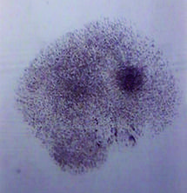
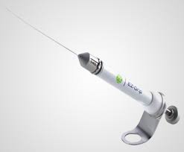
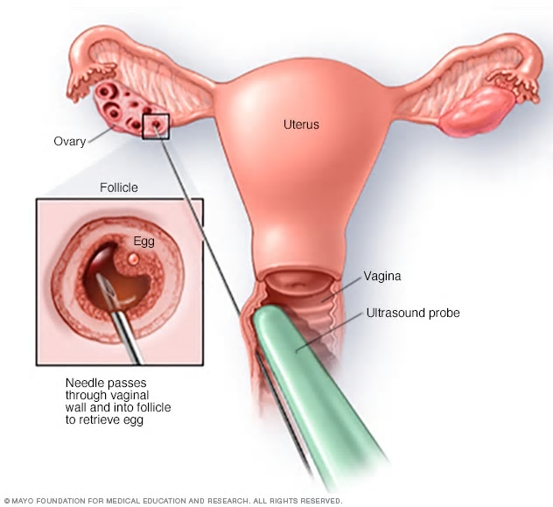
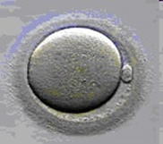
IVF fertilization - step by step
COLLECTION OF MATURE EGGS (OPU, oocyte pick-up): under general anesthesia (picture 1+2)
EVALUATION OF THEIR QUALITY AND MATURITY, denudation (removal of follicular cells from oocytes by pipette, see last 3 pictures in the top row) is required to evaluate the quality of oocytes: https://www.youtube.com/watch?v=zgBicQq4QIU)
1
2
collected oocyte with follicle cells aroung
denudation pipette
denudation process
mature oocytes
Bi6140c Embryologie-cvičení

Slide 18
IVF fertilization - step by ster
SPERM COLLECTION AND QUALITY EVALUATION OF TAKES PLACE ON THE DAY OF EGG COLLECTION:
basic values of native semen in men (WHO):
total sperm count (mil./ejaculate) | 39 mil.
liquefaction | do 60 minut
pH of liquefied sample | 7,2-7,8
sperm concentration | 15 mil./ml
vitality (eosin staining) | 58 %
total motility | 40 % (progressive + non progressive)
progressive motility (linear) | 32 %
normal morphology (head, neck and tail morphology) | 4 %
presence of white blood cells, prokaryotic cells
Bi6140c Embryologie-cvičení

Slide 19
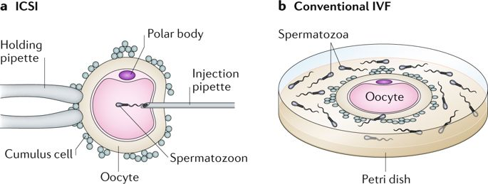
IVF fertilization - step by step
FERTILIZATION: ICSI (intracytoplazmic sperm injection, left) or “classical fertilization“ (right)
https://www.youtube.com/watch?v=lvLwU9G1Oug
Bi6140c Embryologie-cvičení

Slide 20
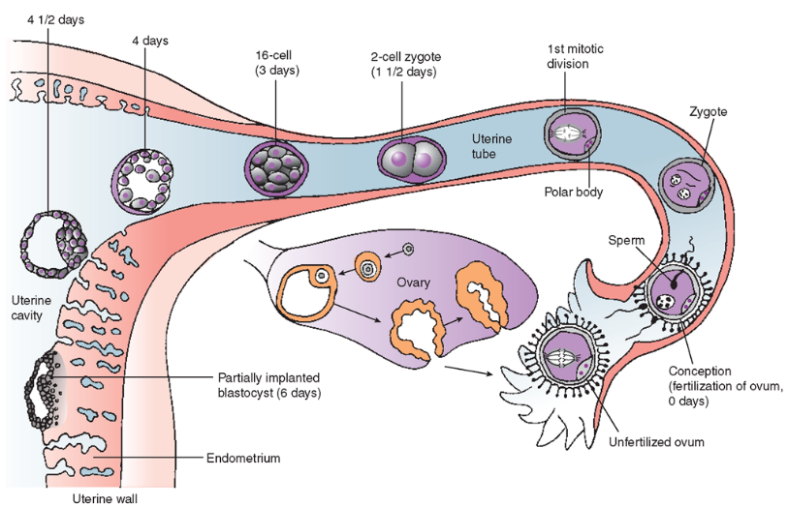
IVF fertilization - step by step
CULTIVATION OF EMBRYOS IN VITRO (IMITATION OF PHYSIOLOGICAL CONDITIONS(: 37 ° C, 6% CO2, 5% O2)
MORPHOLOGY EVALUATION (EMBRYA METABOLOMIC PROFILE, O2 CONSUMPTION)
Human embryos under IVF conditions compared with human embryos under natural conditions
Bi6140c Embryologie-cvičení

Slide 21
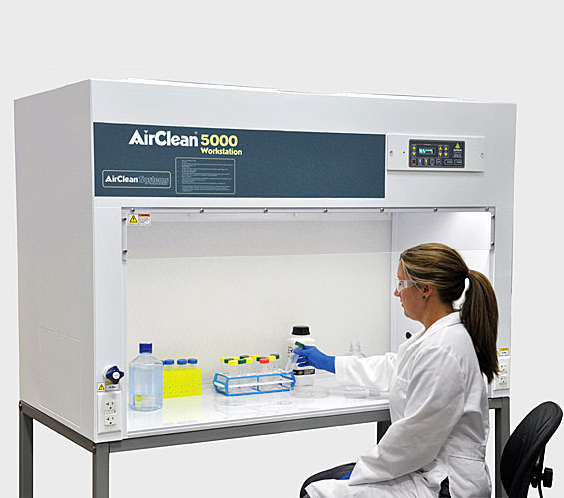
IVF fertilization - step by step
Dr. Pipettte says ☺: „Laminar box is a relatively expensive device in the price of a new lower-class car, but a skilled handyman will make it for about several thousand Czech crowns. All you need is a box, a strong fan and a HEPA filter. But don't show such a piece to State institute of drug control and do not show it during the inspection„
Note: State institute of drug control is the control authority for assisted reproduction clinics.
Bi6140c Embryologie-cvičení

Slide 22
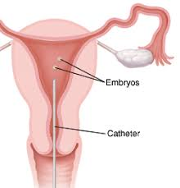
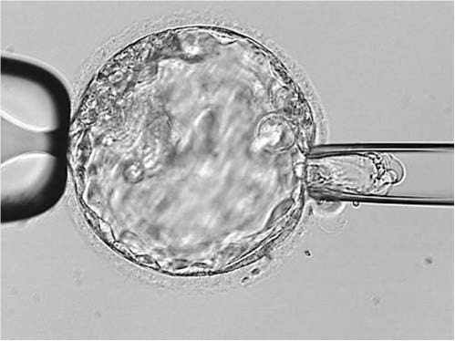
IVF fertilizace
EMBRYOTRANSFER, see: https://www.youtube.com/watch?v=GeigYib39Rs
Note 1: Currently, just one embryo is usually transferred to the uterine cavity on day 5 (= single embryo transfer)
Note 2: In the case of trophoblast cell removal (in the case of a blastocyst) for genetic testing, the blastocysts are "frozen" and the transfer takes place only on the basis of the results of this testing
trophoblast cell removal for genetic testing
Bi6140c Embryologie-cvičení

Slide 23
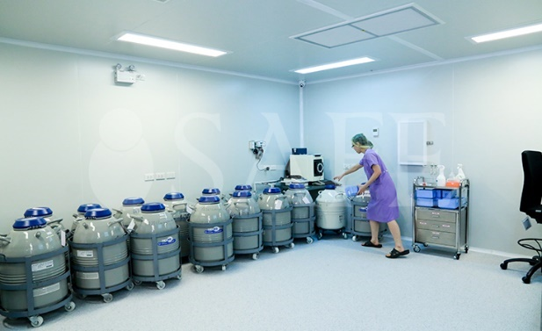
IVF fertilizace – step by step
CRYOCONSERVATION
SLOW FREEZING: older approach, embryo freezing techniques using special media for storage in liquid nitrogen (-196 ° C). Reproductive cells and embryos can be stored for decades.
VITRIFICATION: modern technique, the embryos are freezed to a temperature of -196 ° C in the order of seconds. Media with high doses of cryoprotectants are used. Due to its high success rate, this technique replaced the previously used so-called slow freezing and, among other things, enabled the preservation of oocytes.
Bi6140c Embryologie-cvičení

Slide 24
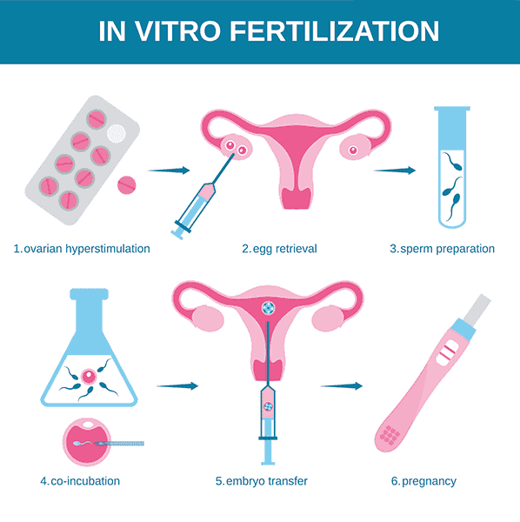
Summary of in vitro fertilization (IVF)
ovarian stimulation: gonadoliberin analogues or antagonists + gonadotropins (FSH, HMG = FSH + LH) + preovulatory hCG (similar to LH)
oocyte collection (oocyte pick-up = OPU)
evaluation of oocyte quality and maturity
fertilization: classical insemination or ICSI
in vitro cultivation (imitation of physiological conditions: 37 ° C, 6% CO2, 5% O2) and morphology evaluation ("time-lapse„ automated monitoring)
embryo transfer (SET, DET)
cryopreservation of quality embryos, which were not chosen for embryotransfer, and subsequently cryo-embryo transfer (25% of children born after ART) = transfer of a healthy thawed embryo into the uterus
further reading: www.reprofit.cz
Bi6140c Embryologie-cvičení

Slide 25
Rules
The Czech Republic belongs to the liberal countries (together with, for example, the UK), the Czech legislation of the ART is very complex and "What is not prohibited, that is is allowed",
In the Czech Republic, all ART methods including gametes donations should be performed according to the recommendations of ESHRE (European Society of Human Reproduction and Embryology),
Strict regulation: e.g. Italy (Roman Church influence): ART is available only for heterosexual couples in reproductive age, only their own gametes, no donor program, infertile couples are obliged to have all embryos created in the process of IVF transfered, ban on cryopreservation of embryos and genetic testing of embryos (subsequent abortion allowed), ban on research on human embryonic stem cells, limitation of the number of embryos implanted in the uterus within one cycle, ban on gamete donation, couples with hereditary genetic diseases do not have access to infertility treatment
Oocyte donation is prohibited in Germany (due to the prevention of health complications for the donor associated with hormonal stimulation and subsequent oocyte collection) → "reproductive tourism" to the Czech Republic
Bi6140c Embryologie-cvičení

Slide 26
Rules in the Czech Republic
Czech legislation allows infertility treatment for a woman only at her fertile age (up to 49 years, reimbursement from the public health insurance system is possible up to 39 years)
Only a couple can apply for ART (man and woman, they do not have to be married); in the UK, ART is also available for homosexual couples
The request for IVF is in writing (in
gamete donation is anonymous
the mother of the child = the woman who gave birth to the child (problem with surrogacy)
gender selection (exception: genetic causes), cloning, transfer of human embryo to the uterus of another animal species is prohibited,…
Bi6140c Embryologie-cvičení

Slide 27
Literature
Carlson BM: Human embryology and developmental biology. 2009.
Junqueira LC, Carneiro J, Kelly R. Základy histologie. 1997, 502 s.
Lajkep T. Status lidského embrya z hlediska filozofické antropologie. Scripta bioethica. http://www.volny.cz/bioetika.
Moore KL, Persaud TVN: The developing human. Clinically oriented embryology. 2008.
Pařízek A. Kniha o těhotenství, porodu a dítěti. 2015
Roztočil A a kolektiv. Moderní gynekologie. 2011.
Slack JMW: Essential developmental biology. 2006.
http://bioetika.cz/clanky/2008-1-2-uvod.pdf
http://old.lf3.cuni.cz/farmakologie/pregnancy/sld002.htm
https://embryology.med.unsw.edu.au/embryology/index.php/Main_Page
https://theses.cz/id/yz61e4/Bakalsk_Prce_CS_finln_verze.pdf
https://uprps.pedf.cuni.cz/UPRPS-353-version1-prehled_didaktiky_biologie.pdf
www.embryology.ch/anglais/bvueEmbr/vueembryo.html
www.histology.leeds.ac.uk/index.php
https://www.northcyprusivf.com/treatments/ivf-icsi/
www.pf.jcu.cz/education/department/czv/archiv_zp/ns/2018/Tvorba_pomucek_a_her_zacinajiciho_ucitele.pdf
www.reprofit.cz
www.sanquis.cz/index1.php?linkID=art760
www.sci.muni.cz/ptacek
https://www.who.int/news-room/fact-sheets/detail/infertility
www.zakonyprolidi.cz
Bi6140c Embryologie-cvičení

