Slide 1
P4/0290 klinické studie

Slide 2
Medicína založená na důkazech
Úkolem zdravotního systému je zajistit dostupnými prostředky nejlepší možný zdravotní a psychický stav národa.
K naplňování tohoto úkolu by měl pomoci princip nazvaný medicína založená na důkazech („evidence based medicine“).
Medicína založená na důkazech je proces zabývající se systematickým hledáním, hodnocením a hlavně využitím současných výsledků klinického výzkumu při poskytování péče jednotlivým pacientům.
  Poskytování důkazů pomocí klinického výzkumu a vědecké literatury.
  Vytváření klinických doporučení (založených na důkazech) a jejich distribuce.
  Implementace účinných a efektivních postupů pomocí výuky a řízení kvality.
  Hodnocení dodržování doporučených postupů pomocí klinických auditů, indikátorů kvality a výsledků léčebné péče.

Slide 3

The Cochrane collaboration
Cochrane Database of Systematic Reviews (CDSR) obsahuje systematické přehledy (systematic reviews, Cochrane reviews) o účinnosti zdravotní péče.
Jedná se o metaanalýzy, ve kterých jsou shrnuty a statisticky zpracovány (re-analyzovány) výsledky z více studií. Metaanalýzy jsou připravovány a pravidelně aktualizovány členy mezinárodní sítě odborníků.
http://www.cochrane.org/
Mulrow CD. Rationale for systematic reviews. BMJ. 1994 Sep 3; 309(6954):597–9.

Slide 4
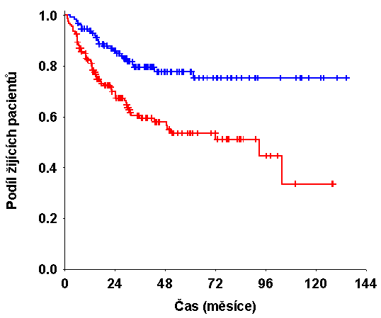
Cíl klinických studií
Primární cíl:
Ověření účinnosti nebo bezpečnosti nového léčebného postupu nebo intervence.
Otázka:
Jsou dosažené výsledky reálné nebo náhodné?
?

Slide 5
Prospektivní a retrospektivní studie
Prospektivní studie
U některých subjektů je rizikový faktor přítomen a u jiných ne → sledujeme v čase, zda se vyskytne událost.
Retrospektivní studie
U některých subjektů se událost vyskytla a u jiných ne → zpětně hodnotíme, zda se liší s ohledem na nějaký rizikový faktor.

Slide 6
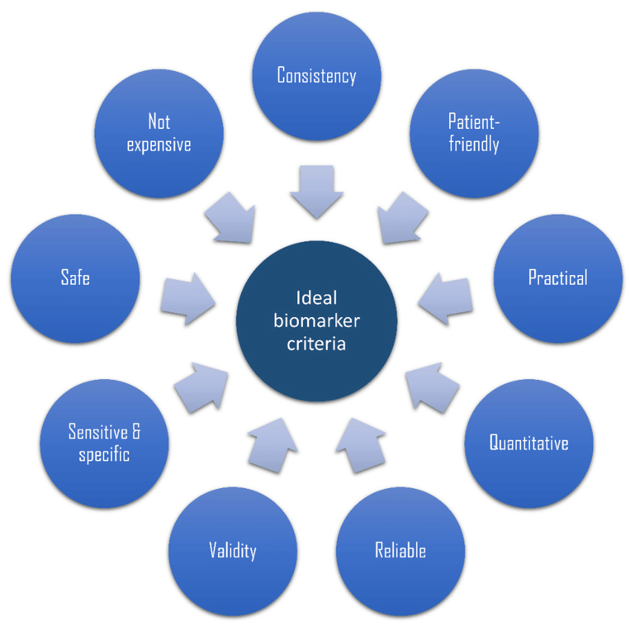
IDEAL BIOMARKER

Slide 7
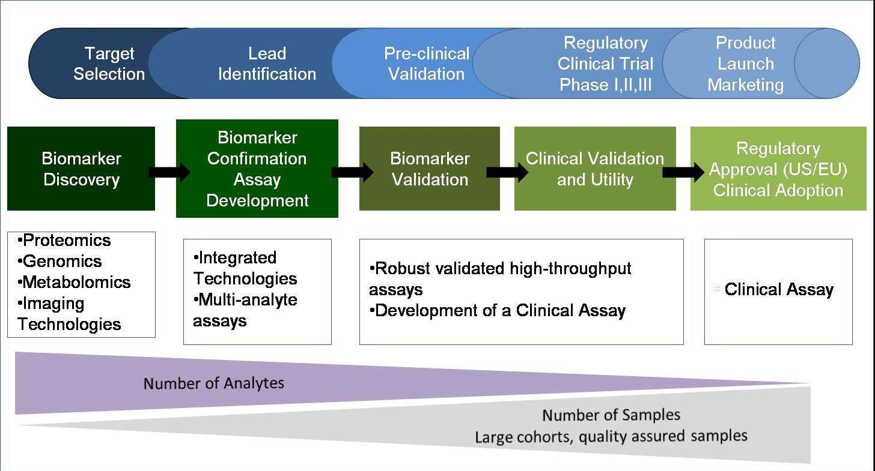
Biomarker Discovery and Evaluation

Slide 8
BIOMARKER IDENTIFICATION TECHNOLOGIES
4.Metabolomics
NMR
Mass spectrometry
5. Other technologies-
Fluorescent indicators
Lab-on-chip
Nuclear magnetic resonance
Mass spectrometry/liquid chromatography
Nanobiotechnology
6. Imaging
1.Genomics
Genome sequencing
Genome variation
Genome annotation
2.Transcriptomics
Microarrays
Gene expression data
3.Proteomics
Y2H method
Mass spectrometry
Protein chips

Slide 9
Validní biomarker
„Biomarker, který se měří v analytickém testovacím systému s dobře zavedeným výkonem a pro který je stanoven vědecký rámec nebo soubor důkazů, které objasňují fyziologický, toxikologický, farmakologický nebo klinický význam výsledku testu“

Slide 10







CLASSIFICATION OF BIOMARKERS
TYPE 0
Natural history of a disease
Eg. symptoms of disease.
Intervention/Drug activity markers
Eg.radioactive isotope(rubidium chloride ) to evaluate perfusion of heart muscle.
Eg. Blood glucose lowering after antidiabetic drugs
TYPE 1
Surrogate markers:- as a change in that marker predicts clinical benefit .
Ex: LDL-C
Eg. "Death from heart disease" is the endpoint of
interest, but "cholesterol" is the surrogate marker.
TYPE 2

Slide 11
CLASSES OF BIOMARKERS IN CLINICAL TRIALS
Safety biomarkers
Efficacy biomarkers
Biomarkers include imaging (CT, MRI, PET, x-ray) or clinical laboratory testing.

Slide 12
SAFETY BIOMARKERS
Constantly monitored safety lab biomarkers can act as common vital organ function tests applied across different therapeutic areas or as specialized testing applied to detect unique toxicities.
Thus, at phases 1 and 2, careful selection of the correct tests is essential, and the selection of those tests should be based on the compound profile and pre-clinical toxicology data.

Slide 13

Safety testing can be classified as follows:
Liver safety tests: AST , ALT , ALP, GGT, Bilirubin
Renal safety tests: BUN, Sr Creatinine, GFR
Haematology safety biomarkers: Complete bloo_{A}d _{d}co_{d}un_{a}t _{Slide Title -}
Bone safety biomarkers: Calcium, Inorganic pho⁵sphates
Basic metabolic safety biomarkers: Glucose , Cholesterol, Uric acid

Slide 14
EFFICACY BIOMARKERS
Efficacy biomarkers are used to demonstrate a change in all, or at least a good proportion of treated subjects.
The more positive the biomarker, the higher the efficacy of a drug.
Efficacy biomarkers can be classified into the following groups:
  Surrogate Biomarkers/Endpoints
  Predictive Biomarkers
  Pharmacodynamic Biomarkers
  Prognostic Biomarkers

Slide 15
SURROGATE BIOMARKER/ENDPOINTS.
A surrogate endpoint is a laboratory or physical measurement used in clinical trials to indicate a drug’s response and can be used in place of a clinical endpoint, which is usually acceptable as evidence of efficacy for regulatory purposes.
It can be used to assess the benefit of or harm from a therapeutic agent.
Even if evidence for surrogacy is not enough, such types of biomarkers are useful in proving the concept for which a candidate drug is to be used.

Slide 16
Examples of surrogate biomarkers are:
Disease | Surrogate endpoints | Clinical endpoints
HYPERTENSION | Blood pressure | Stroke
DYSLIPIDEMIA | Cholesterol, LDL | Coronary artery disease
DIABETES | HBA1C | Retinopathy, Nephropathy, Neuropathy and Heart diseases
GLAUCOMA | Intraocular pressure | Loss of vision
CANCER | Biomarkers of tumour shrinkage, Response rates | Progression-Free survival , Overall survival

Slide 17
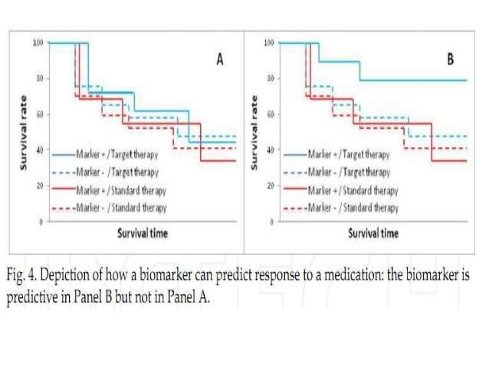

Slide 18
DRUG | INDICATION | BIOMARKER
Imatinib | CML | BCR-ABL(PCR) , c-Kit
Erlotinib | NSCLC ,pancreatic | EGFR and KRAS mutation
Gefitinib | NSCLC | EGFR and KRAS mutation
Trastuzumab | Breast cancer | HERE2

Slide 19
PHARMACODYNAMIC BIOMARKERS
These are the biomarkers which demonstrate that a drug hits its target and impacts its biochemical pathway.
Such types of biomarkers are necessary to demonstrate proof of the drug’s mechanism of action.
This class of biomarkers:
  Constitute the majority of biomarkers in early phases of drug discovery (preclinical, phase I, and phase II).
  Can help to determine effective dose and dose schedule.
The non-imaging biomarkers include proteins, cytokines, and enzyme activity in serum, CSF, or tissue lysates, proteins by immunohistochemistry (IHC), and DNA and RNA gene expression. Ex: Ki67 in Ca Prostate

Slide 20
PHARMACOGENOMIC BIOMARKERS
Clinically significant polymorphisms are found in the genetic coding for proteins (exon), promoter regions or the cofactors that drive transcription of that protein, or in post- translational modifications of that protein.
These can be used not only to identify patients at risk of disease, but also those most likely to benefit from a particular therapy, or most at risk of adverse effects.
Genotypes , Single nucleotide polymorphism and haplotypes can serve as biomarkers of
clinical phenotypes .
Phenotypic variation can result from the effect of single gene, Eg. Tangier’s disease or can be multigenic and multifactorial as in diabetes.

Slide 21
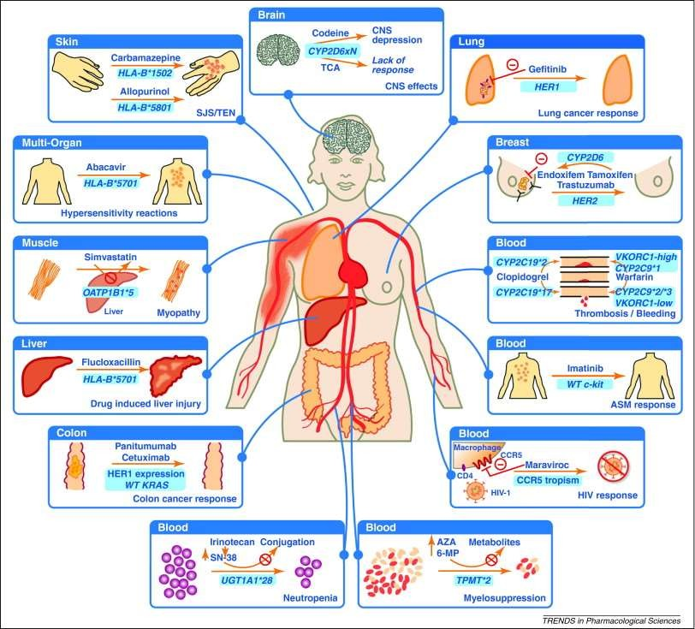

Slide 22
76 genetic and genomic biomarkers (CYP2D6,CYP2C19):- on FDA labels of 70 approved drugs – oncology, psychiatry, antiviral and cardiovascular drugs
Drug label information on genomic biomarkers :-
  Describe drug exposure and clinical response variability
  Risk for adverse events
  Genotype specific dosing
  Mechanisms of drug action
  Polymorphic drug target and disposition genes
  Precautions- interactions, contraindications, patient management.
counselling,
nutritional

Slide 23
PHASES OF EVALUATION OF BIOMARKER
The identiﬁcation of biomarkers should proceed in a systematic manner.
In 2002, the National Cancer Institute’s ‘Early Detection Research Network’ developed a ﬁve-phase approach to systematic discovery and evaluation of biomarkers.
In Phase 1, the identified markers are prioritized based on their diagnostic/prognostic/therapeutic value that could suggest their evolution into routine clinical use.
Phase 2 involves establishing an assay with a clear intended clinical use. The assays need to be validated for reproducibility and shown to be portable among diﬀerent laboratories.

Slide 24
During Phase III, an investigator evaluates the sensitivity and speciﬁcity of the test for the detection of diseases that have yet to be detected clinically.
Phase IV evaluates the sensitivity and speciﬁcity of the test on a prospective cohort. An investigator can estimate the false referral rate based on tested biomarkers and describe the extent and characteristics of the disease detected.
Phase V evaluates the overall beneﬁts and risks of the new diagnostic test on the screened population.

Slide 25
BIOMARKERS IN PHASE I TRIALS
In phase I studies, pharmacodynamic biomarkers are often of interest based on assumptions that modulation of these markers may provide proof of drug target inhibition and support the selection of drug and dose for further evaluation.
These are almost always exploratory biomarkers.
The goal in these pharmacodynamic marker studies in phase I trials is to provide evidence that the agent reaches or modulates the putative target.
These studies can be conducted by analysis of samples and/or images obtained prior to and after treatment, or by comparison to an untreated control.

Slide 26
BIOMARKERS IN PHASE II TRIALS
In phase II trials biomarkers can be used to:
  Provide evidence that the agent modulates the putative target or pathway in a pharmacodynamic assessment similar to the phase I setting.
  Evaluate the association between the biomarker and clinical outcome.
  Determine patient eligibility (for example, HER2 status for trastuzumab trials).
  Determine the dose-response relationship of a pharmacodynamic marker across a narrow set of dose cohorts (generally one or two) and more homogenous patient population.

Slide 27
VALIDATION OF BIOMARKER
Once a biomarker candidate has been selected on the basis of biological plausibility and
technical feasibility, statistical validation is required to justify its use in a clinical trial.
Validation of a biomarker begins with an initial demonstration that a correlation exists between the marker and the clinical endpoint of interest, followed by independent statistical validation of this relationship.
Type 0 markers can be characterized in phase 0 clinical studies, in which a reliable assay
is used in a well defined patient population for a specified period of time.
Ideally, a linear (+ve or -ve) relationship is established with the gold standard clinical assessor.

Slide 28
VALIDATION OF BIOMARKER
A prior validation of type I biomarkers is impossible for truly novel targets without an effective positive control treatment. So, for novel targets the biomarker will be validated in parallel with the drug candidate.
  Ex:- A battery of cognition markers validated with the scopolamine were used to confirm the pharmacological effect of a novel agonist directed against the alfa 7 nicotinic acetylcholine receptor.
Type 2 biomarkers (or surrogate endpoints) must be relevant both to the MOA of the drug & to the pathophysiology of the disease.
Changes in these biomarkers should reflect treatment benefit & so effective therapy is necessary for their validation.
Hence, a phase-3 study supporting claims of effectiveness for the innovator drug is sufficient to validate type 2 biomarkers.

Slide 29
FIT-FOR-PURPOSE METHOD VALIDATION
Practical approach of validating biomarkers.
Fit-for-purpose method validation provides for efficient drug development by conserving resources in the exploratory stages of biomarker characterization.
It is used to describe distinct stages of the validation process including pre-validation, exploratory and advanced method validation, and in-study method validation.

Slide 30
FIT-FOR-PURPOSE METHOD VALIDATION
Practical approach of validating biomarkers. Fit
  Biomarker data must be reliable and accurate.
Purpose
  Decision making during drug development.
Fit-for-Purpose
  Analytical validation requirements are specific to the stage of drug development.
Consideration is given to
  the intended use of the biomarker data .
  the regulatory requirements associated with that use.

Slide 31
DESIGN CONSIDERATIONS FOR BIOMARKER STUDIES
The choice of an appropriate design for a trial will largely depend on:
  The strength of existing evidence for a biomarker.
  The nature of conclusions to be drawn.
  The strength of evidence desired at the trial’s conclusion.
  The available resources.
For prognostic biomarkers, which offer information about the likely course of a disease if there is no change in treatment of an individual, retrospective studies using data from well- conducted clinical trials will be sufficient.

Slide 32
In the case of predictive biomarkers, more rigorous standards must be met to justify their use in a clinical setting.
Since predictive biomarkers seek to prospectively identify patients likely to have a favorable clinical outcome in response to targeted therapies, validation often may require comparing outcomes between biomarker-positive and biomarker-negative patients.
Thus, prospective, randomized controlled trials (RCTs) remain the best approach for
establishing the clinical utility of predictive biomarkers.
Yet traditional RCTs only allow for the estimation of the average treatment effect in the overall study population rather than in marker-defined subpopulations.

Slide 33
Thus, alternative trial designs like adaptive clinical trials need to be considered for the evaluation and application of biomarker-based therapies.
If evidence suggests that the benefits of a treatment are limited to the biomarker-positive subpopulation, an enrichment design strategy, in which only biomarker-positive patients are enrolled, may be the appropriate choice.
Because they require relatively small sample sizes to demonstrate safety and efficacy, enrichment strategies may improve trial efficiency.
However, such designs only allow for partial evaluation of the clinical validity of biomarkers since they do not provide information on the effects of treatment in biomarker-negative patients.

Slide 34
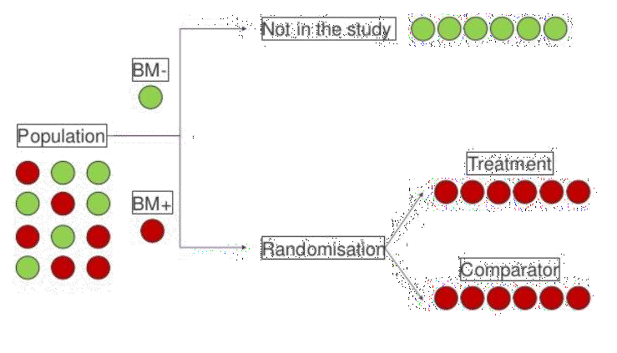
ENRICHMENT DESIGN

Slide 35
If there is sufficient reason to suggest that a biomarker can predict that a therapy will be more effective in biomarker- positive patients, but the evidence is not compelling enough to rule out clinical efficacy in biomarker-negative patients, a biomarker-stratified trial design or an adaptive enrichment trial design may be more appropriate.
In the biomarker-stratified trial design, biomarkers are used to guide analysis but not treatment assignment.
In the adaptive enrichment trial design, biomarkers are used to guide the enrollment and not treatment assignment.

Slide 36
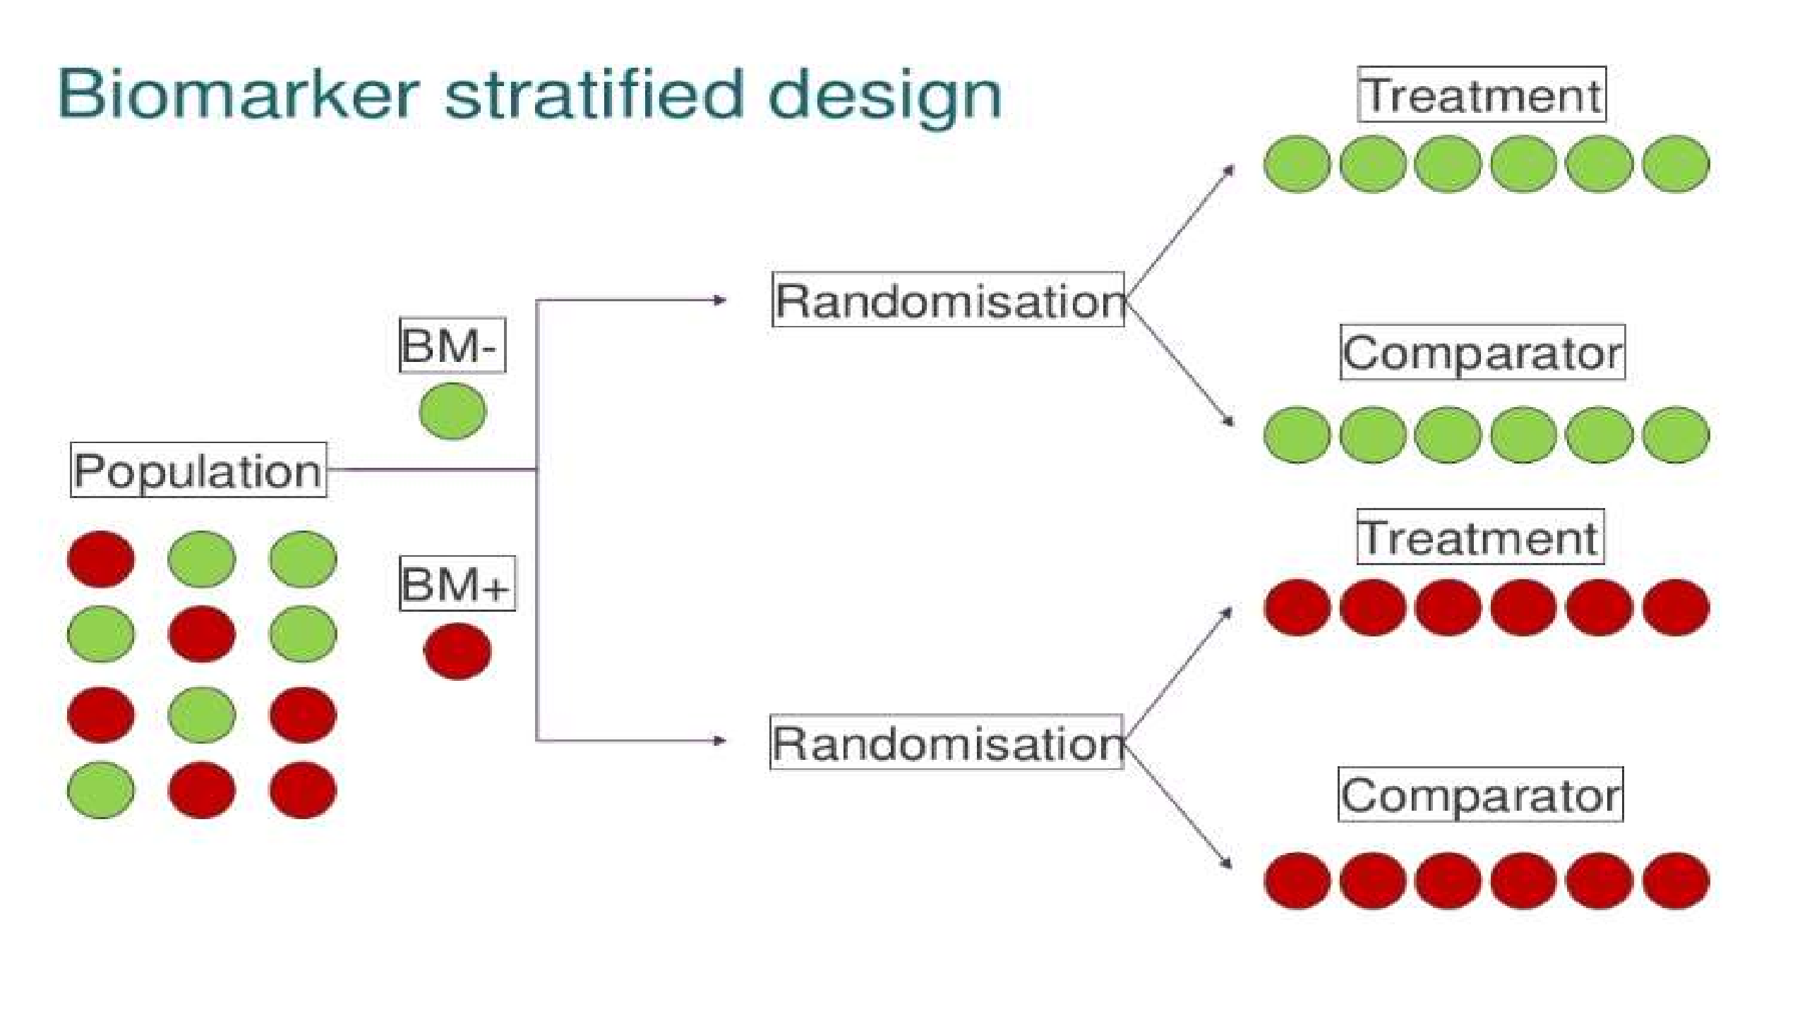

Slide 37
By assigning biomarker-positive and - negative patients to both experimental and control
groups, the biomarker- stratified trial design provides more information on the effects of
treatment in both subpopulations, as well as more definitive evidence for the clinical utility of the biomarker.

Slide 38
BIOMARKERS AS SURROGATE ENDPOPINTS
Evaluation of biomarkers as surrogate endpoints is a challenging task.
It has been proposed that for a biomarker to be considered a surrogate, it must be
  Correlate of the true clinical outcome and that.
  The treatment effect on the surrogate should capture the full effect of treatment on the clinical endpoint.
While the first criterion is relatively simple to demonstrate, the second is not.
For example, although the risk that human immunodeficiency virus (HIV)-infected pregnant women will transmit the infection to their infants is strongly correlated with maternal CD4 counts, the provision of therapy to increase maternal CD4 counts has not been found to impact transmission risk because the CD4 count is not in the causal pathway of the disease processes that are responsible for transmission.

Slide 39
SOME CONCERNS WITH BMS/SEPS
Use of SEP assume that the treatment effect is mediated by the pathway represented by the SEP. However, multiple pathways may exist.
SEP may be influenced by physiological or pathological properties of the outcome,
e.g. patients with inherited QT abnormalities.
SEP may reflect on one aspect (i.e., clinical benefit) while ignoring other effects (i.e., adverse reactions).

Slide 40
CASE EXAMPLE: CAST TRIAL
Cardiac Arrhythmia Suppression Trial (CAST) evaluated effect of encainide, flecainide and moricizine on survival of patients who had MI and had >10 premature ventricular beats per hour.
Reduction in ventricular ectopic contraction used as a SEP for decreased mortality
Primary endpoint was death or cardiac arrest with resuscitation, either of which due to arrhythmia.

Slide 41
CAST TRIAL RESULTS
Unexpected results: encainide and flecainide arms stopped early : 63 patients died in
encainide or flecainide arm compared to 26 in the placebo arm (p=0.0001).
After continuing the trial with moricizine as the only active arm (CASTII), there was excess mortality in moricizine arm alone (17 deaths in 665 patients) as compared to no therapy or placebo group (3 deaths in 660 patients). This study had to be terminated early also.
Surrogate markers may not always be a good predictor and have to be validated
extensively before being used in a regulatory setting.

Slide 42
Reasons why surrogates may fail to capture the effect of an intervention on clinical outcomes include cases:
  Where a disease has multiple pathways and the intervention affects only one pathway
mediated through the surrogate.
  When a surrogate is not affected by the intervention’s effects .
  When the intervention has mechanisms of action independent of the disease process.
Hence, a particular biomarker’s status as a surrogate is context-specific and cannot be assumed to be a general surrogate endpoint separate from its designated use.

Slide 43
POTENTIAL USES OF BIOMARKERS IN DRUG DEVELOPMENT PROCESS
PHASE POTENTIAL USE
TARGET DISCOVERY & VALIDATION
To identify and Justify targets for therapy.
Eg. Use of Her-2 protooncogene as a marker of poor prognosis of breast cancer.
LEAD DISCOVERY & OPTIMIZATION
To identify leads and evaluate the effects of molecular targeted drugs in preclinical development.
PRECLINICAL STUDIES
Development and validation of new animal models.
To assess the toxicity and safety of drug.
disease
CLINICAL TRIALS
For early evaluation of success and failure of drugs.
Rational selection of drug combinations
Optimization of dose and schedule
To identify responders in subpopulations
Development of new surrogate endpoints of clinical benefit
To predict clinical outcomes.

Slide 44
USE OF BIOMARKERS IN POSTMARKETING
Information obtained from post marketing studies has resulted in recent labeling changes.
Ex: 1)Finding of strong association of HLA-B*5701 to abacavir- induced hypersensitivity reaction in HIV-infected patients.
  Carbamazepine-induced SJS & the presence of HLA-B*1502 allele.
  Genetic variants of CYP2C9 & VKORC1 leading to PK/PD variations in patients on warfarin therapy.

Slide 45
ROLE OF FDA IN PROMOTING USE OF BIOMARKERS IN DRUG DEVELOPMENT
To facilitate the use of biomarkers in drug development & clinical practice, the FDA has
  Established a voluntary submission process
  Developed online educational tools
  Strived to ensure the integration of genetic/genomic biomarkers information into drug labels.

Slide 46
BIOMARKERS FOR PERSONALIZED PREVENTION STRATEGIES
Medicines that target the genetic signatures of diseases are making inroads into modern medicine. Health experts see this therapeutic approach as the beginning of a new era in medicine.
In the treatment of diseases especially cancer, there is a shift from the traditional clinical practices to novel approaches.
Traditionally, cancer patients were treated with drugs of low toxicity or of high tolerance.
Novel approaches are intended to identify individualized patient benefits of therapies, minimize the risk of toxicity and reduce the cost of treatment.
The chemotherapy drug irinotecan is one example of personalized medicine,(used to treat advanced colorectal cancer).

Slide 47
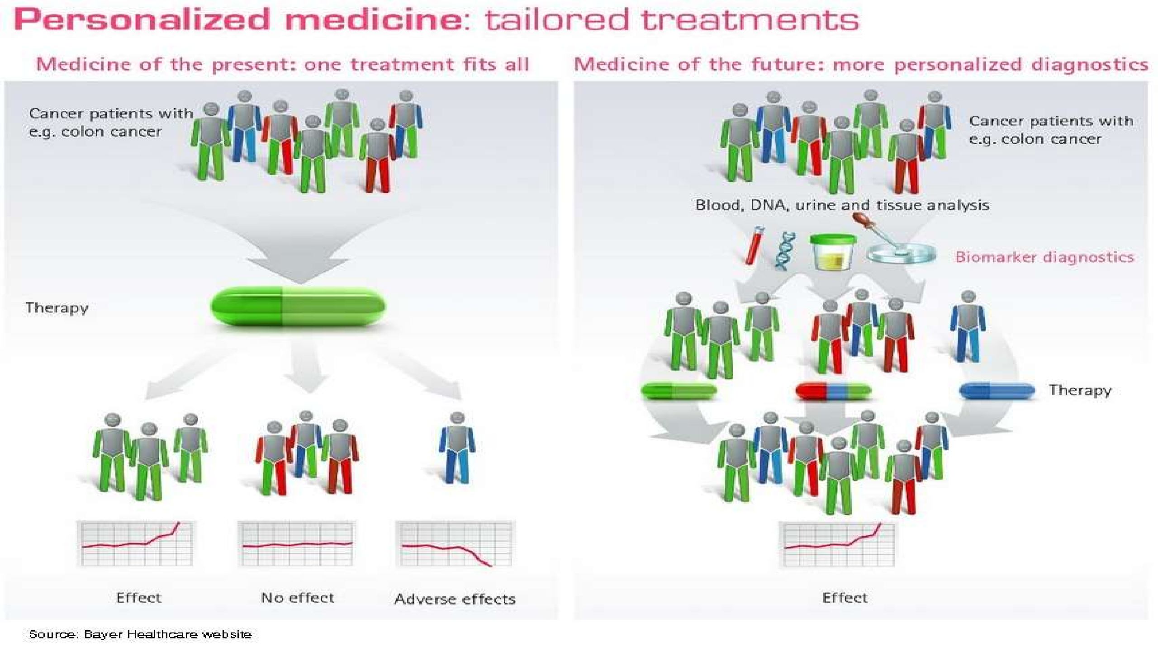

Slide 48
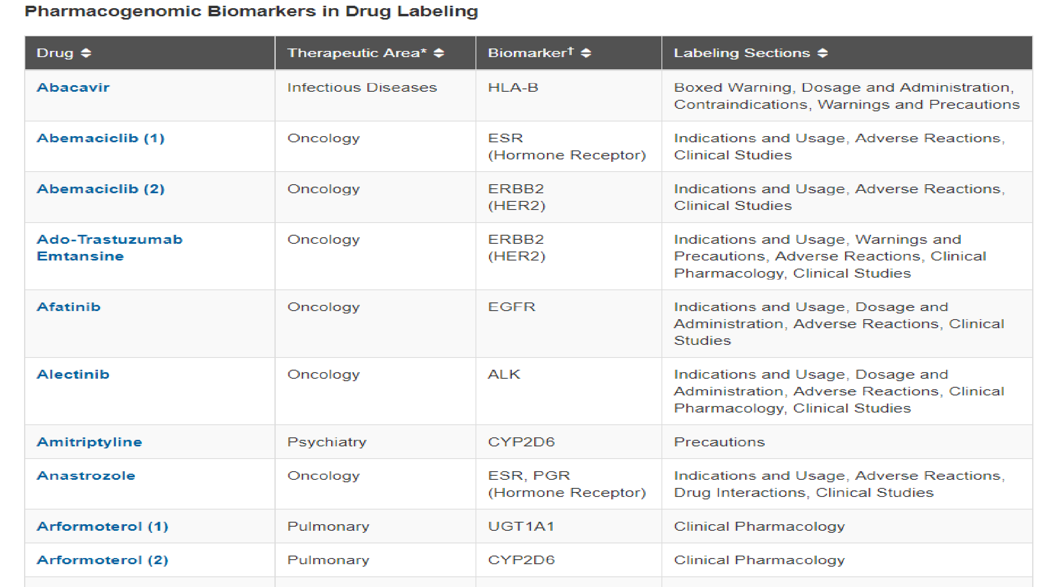

Slide 49
LIMITATIONS
Expensive (cost for analyses) .
Storage (longevity of samples) .
Laboratory errors.
Normal range is difficult to establish.
The following are the major pitfalls in the translation from biomarker discovery to clinical utility:
  Lack of making different selections before initiating the discovery phase.
  Lack in biomarker characterization/validation strategies.
  Robustness of analysis techniques used in clinical trials.

Slide 50
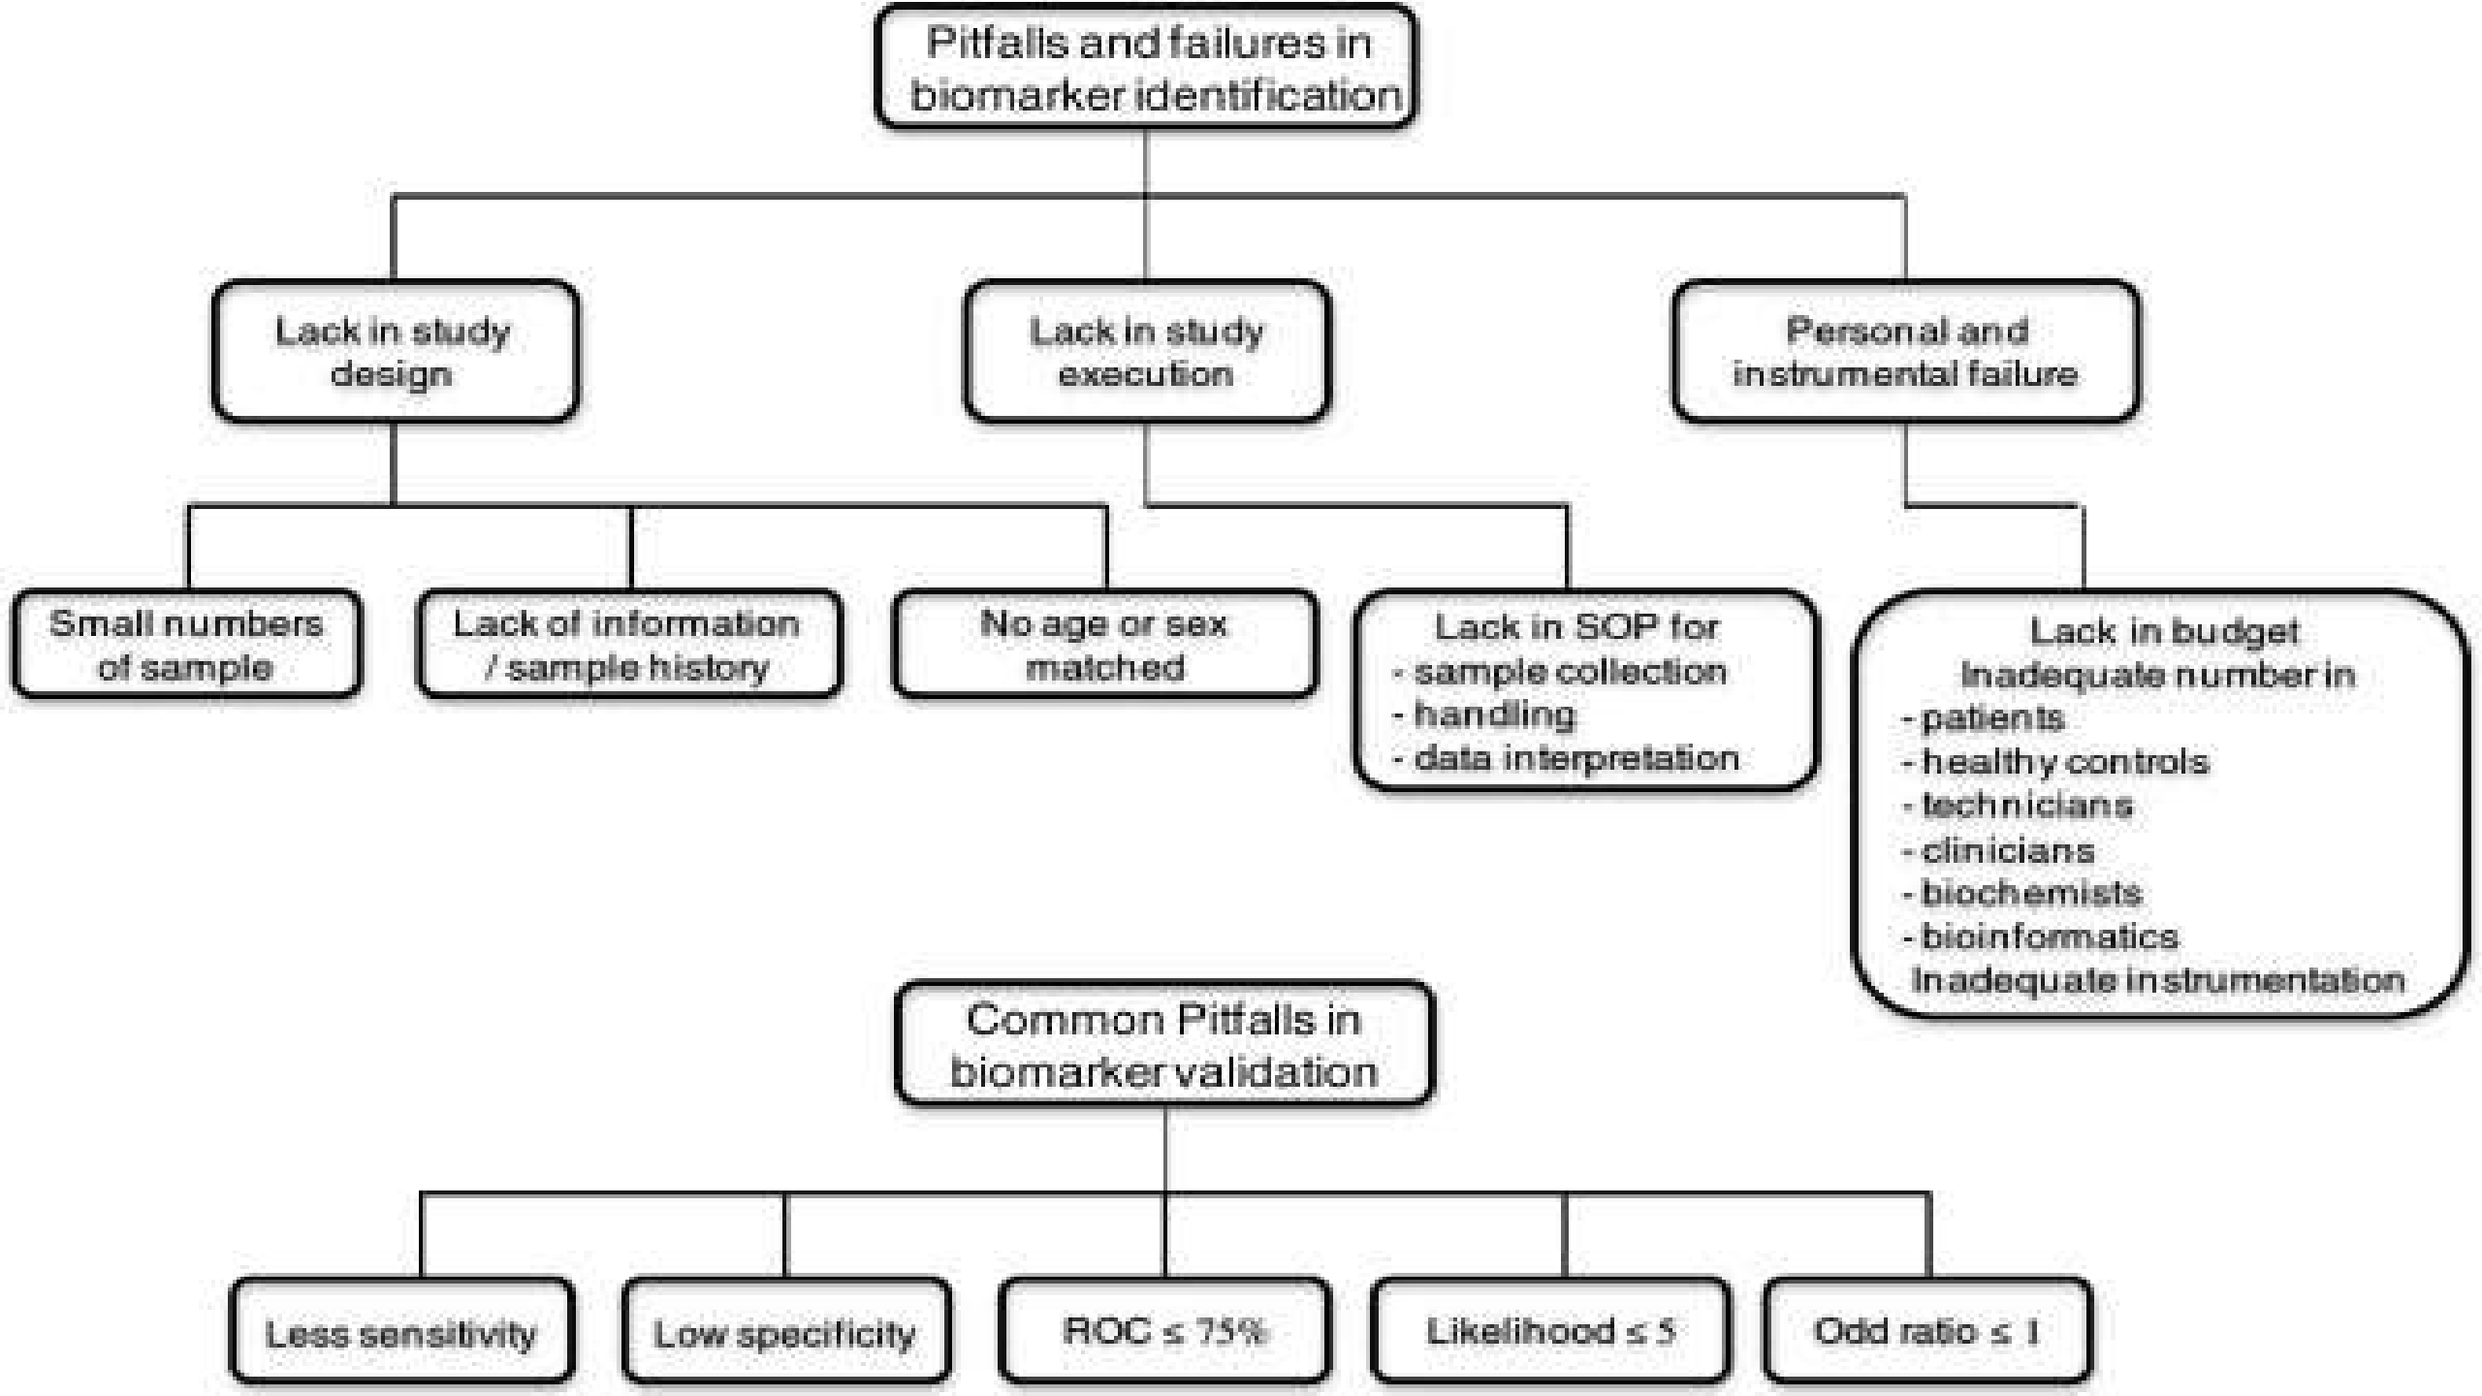

Slide 51
CONCLUSION
Patients expect approved drugs that work, are safe and are “right” for them.
Biomarkers can help drug development focus more on defined subgroups of patients, thereby
potentially increasing treatment efficacy and safety.
Helps to make a decision to move to the next phase.
Offer strong supporting evidence and in the future will be the key data in certain programs.
Offer an objective, biological indicator, rather than just seeing whether the patients feel better.

Slide 52
Biomarker enabled R&D is maturing into a new discipline that is addressing these goals with more precision.
However, the science is outpacing widespread acceptance.
The path toward acceptance by regulators and the medical community is through discovery and consistent validation of genomic, proteomic, in vitro and imaging biomarkers.
Further collaborative efforts and powerful technology approaches can increase public
confidence.

Slide 53

Zkreslení v klinických studiích
V hodnocení klinických studií se snažíme vyhnout zkreslení výsledků, tzv. „bias“.
V případě klinických studií se jedná o zkreslení výsledků jinými faktory než těmi, které jsou cíli studie.
  Statistické srovnání není nikdy 100% spolehlivé, existuje náhoda a tedy i pravděpodobnost chybného úsudku – to nelze ovlivnit.
  My však chceme použít adekvátní metody pro odstranění vlivů, které by zkreslily výsledky a nebyly přitom náhodné (např. zastoupení pohlaví).

Slide 54

Chyby a zkreslení v metodice klinických studií
1) Podvod
Padělání dat
2 % respondentů připustilo – úpravu, pozměnění, zfalšování dat
14 % - u kolegů
1/3 připustila pochybné výzkumné praktiky
70 % u kolegů
…

Slide 55


Chyby a zkreslení v metodice klinických studií
2) Testování na „ideálních“ pacientech
- nadsazují se přínosy a snižují rizika NÚ
179 reprezentativních pacientů s astmatem – pouze 6 % pacientů by bylo vhodných do konkrétní studie s lékem na astma
Travers, J. et al., 2007. External validity of randomised controlled trials in asthma: to whom do the results of the trials apply? Th orax, 62(3), str. 219 –223

Slide 56
Chyby a zkreslení v metodice klinických studií
3) Porovnávat svůj lék s brakem
- placebo
- konkurenční lék – obsoletní – méně účinný, v nevhodných dávkách
Paroxetin vs amytriptilin – srovnání NÚ ospalosti

Slide 57
Chyby a zkreslení v metodice klinických studií
4) Příliš krátké výzkumy
- co nejrychleji získat data a uvést lék na trh
- použití náhradních výsledků (změny v krevních testech) oproti výsledků z reálného světa (výskyt infarktu)
- „operace mitrálních chlopní – Operační riziko úmrtí při chlopenních srdečních operacích v mimotělním oběhu se pohybuje mezi 2 – 4 %“
... 1 .den …
- Lék na snížení hmotnosti – výsledky publikované za období 3 měsíců…

Slide 58
Chyby a zkreslení v metodice klinických studií
5) Předčasně ukončené výzkumy
- při nahlížení do výsledků výzkumu příliš brzy či pozdě, zvýšíte tím pravděpodobnost, že získáte příznivé výsledky
- zneužití náhodné variace
Celecoxib – srovnání se 2 staršími léky – vyhodnocení po půl roku - méně GIT komplikací – publikováno, po roce žádný rozdíl – nepublikováno
Silverstein FE¹Gastrointestinal toxicity with celecoxib vs nonsteroidal anti-inflammatory drugs for osteoarthritis and rheumatoid arthritis: the CLASS study: A randomized controlled trial. Celecoxib Long-term Arthritis Safety Study. JAMA. 2000 Sep 13;284(10):1247-55.

Slide 59
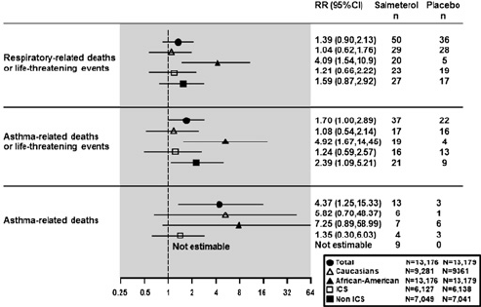
Chyby a zkreslení v metodice klinických studií
6) Příliš pozdě ukončené výzkumy
- potřeba přesné nadefinování pravidel, za kterých je možné výzkum předčasně ukončit ještě před samotným zahájením
Salmeterol – zprávy o pardoxním bronchospasmus
GSK provedlo nový randomizovaný výzkum s cílem „respirační úmrtí a život ohrožující stavy“, sekundární cíle – úmrtí spojená s astmatem
Lurie P, Wolfe SM. Misleading data analyses in salmeterol (SMART) study. Th e Lancet. 2005 Oct; 366(9493):1261–2.

Slide 60
Chyby a zkreslení v metodice klinických studií
7) Příliš malé výzkumy
- malý výzkum u léku, který zachraňuje život u stavu, který je konzistentně smrtelný – OK – ale
Velký výzkum pro odhalení malého rozdílu mezi dvěma léky
Obrovský výzkum ke zhodnocení, že 2 léky jsou stejně účinné
Power analýza – odhalit rozdíl mezi 2 skupinami pacientů a 2 různými léky – informace, kolik budete potřebovat pacientů, máte-li mít 80 % šanci na odhalení 20 % rozdílu v úmrtnosti mezi těmito 2 léky
Pokud je výsledek negativní, neznamená to, že jeden lék je lepší než druhý.
Pro zjištění, zda jsou léky stejné, potřeba mnohem většího počtu pacientů

Slide 61

Chyby a zkreslení v metodice klinických studií
8) Výzkumy, které měří nic neříkající výsledky
- krevní testy vs bolest/úmrtí ….

Slide 62
Proč?
0. Správná formulace klinické hypotézy
Je nutné definovat, co vlastně hodnotíme, neboť od hypotézy se odvíjí nejen uspořádání celé studie, ale i forma jejího vyhodnocení.
1. Použití souběžné kontrolní skupiny
Účinnost i bezpečnost léčby musí být hodnoceny v kontextu kontrolní skupiny pacientů, kteří nebyli exponováni experimentální léčbě, ale jsou srovnatelní v ostatních klinických faktorech.
2. Randomizace
Přiřazování subjektů do skupin musí být náhodné, protože pouze přiřazování, které není zatíženo subjektivitou, může umožnit relevantní srovnání primárních cílů studie.
3. Zaslepení
Cílem zaslepení studie je vyhnout se subjektivnímu hodnocení výsledků léčby nebo experimentu při vědomí pacienta a/nebo lékaře, do které léčebné skupiny pacient patří.
4. Optimalizace velikosti vzorku
Počet subjektů zapojených do klinické studie musí být optimalizován, aby nedošlo k ovlivnění statistického testu, případně aby tento test měl vůbec smysl.

Slide 63

Validita klinické studie
Medicína založená na důkazech – zajímají nás pouze „kvalitní“ důkazy.
Hlavním aspektem kvality je validita získaných výsledků.
Interní validita studie: odráží, jak moc lze rozdíly v účinnosti a bezpečnosti pozorované u srovnávaných skupin přisuzovat sledované intervenci. Chceme minimalizovat nenáhodnou chybu (zkreslení).
Externí validita studie: odráží zobecnitelnost (z hlediska korektnosti) výsledků na jiné populace a experimentální podmínky.

Slide 64
Interní validita studie
Interní validita studie jednoznačně souvisí se zkreslením výsledků (bias):
„Bias is any process at any stage of inference tending to produce results
that differ systematically from the true values.”
V klinických studiích rozlišujeme čtyři typy zkreslení:
  Výběrové zkreslení (selection bias)
  Prováděcí zkreslení (performance bias)
  Detekční zkreslení (detection bias)
  Úbytkové zkreslení (attrition bias)

Slide 65
Interní validita studie
Výběrové zkreslení (selection bias): vzniká ve chvíli, kdy srovnávané skupiny nejsou srovnatelné stran nějakého faktoru, který ovlivňuje výsledek. Vznik výběrového zkreslení se snažíme minimalizovat použitím randomizace.
Prováděcí zkreslení (performance bias): vzniká ve chvíli, kdy srovnávané skupiny mají různé experimentální podmínky (samozřejmě kromě sledované intervence) – např. dostávají jinou léčbu/péči.
Detekční zkreslení (detection bias): vzniká ve chvíli, kdy je u srovnávaných skupin různě hodnocena cílová proměnná. Vznik prováděcího a detekčního zkreslení se snažíme minimalizovat použitím zaslepení.
Úbytkové zkreslení (attrition bias): vzniká ve chvíli, kdy srovnávané skupiny nejsou srovnatelné stran subjektů, které předčasně opustily studii a nelze u nich hodnotit cílovou proměnnou. Vznik úbytkového zkreslení se snažíme minimalizovat použitím intention-to treat analýzy.

Slide 66
Externí validita studie
Externí validita studie souvisí s možností zobecnění jejích výsledků na jinou populaci subjektů v jiném prostředí a za jiných podmínek.
Jiná populace subjektů: vliv věku, pohlaví, tíže onemocnění, rizikových faktorů, komorbidit
Jiné prostředí: systém zdravotnictví (USA⨯EU), organizace léčebné péče, specializace a zkušenosti lékařů
Jiné podmínky – léčba: dávkování, podání, pravidelné sledování, další léčebné modality, souběžná léčba
Jiné podmínky – měření výsledků léčby: definice cílové proměnné a její měřitelnost v daném prostředí

Slide 67
Interní a externí validita studie
Interní validita studie je nutným předpokladem externí validity.
Klinická studie
Interní validita?
Výsledky nelze zobecnit na žádnou populaci
Ne
Ano
Externí validita?
Ne
Výsledky lze zobecnit pouze na populaci danou vstupními kritérii studie
Ano
Výsledky lze zobecnit i na širší populaci subjektů

Slide 68
Cílové parametry testování hypotéz v klinických studiích
Klinický parametr: Většinou je hodnocena změna v daném parametru nebo dosažení určité hladiny.
Léčebná odpověď a odvozené parametry: Hodnocení ústupu nádoru jako odpovědi na léčbu a délky času trvání této redukce. Tento endpoint je nejčastěji používaný ve studiích fáze II ale i v ostatních typech studií.
Time-to-event: Hodnotí délku času, po kterou je subjekt bez sledované události, např. bez zhoršení primárního onemocnění. Často používaný endpoint pro studie fáze III. OS, PFS, DFS.
Kvalita života: Parametr založený na subjektivním zhodnocení celkového zdravotního stavu pacienta a ovlivnění jednotlivých aspektů jeho života. Jedná se o současné zhodnocení přínosů léčby a negativního vlivu nežádoucích účinků.

Slide 69
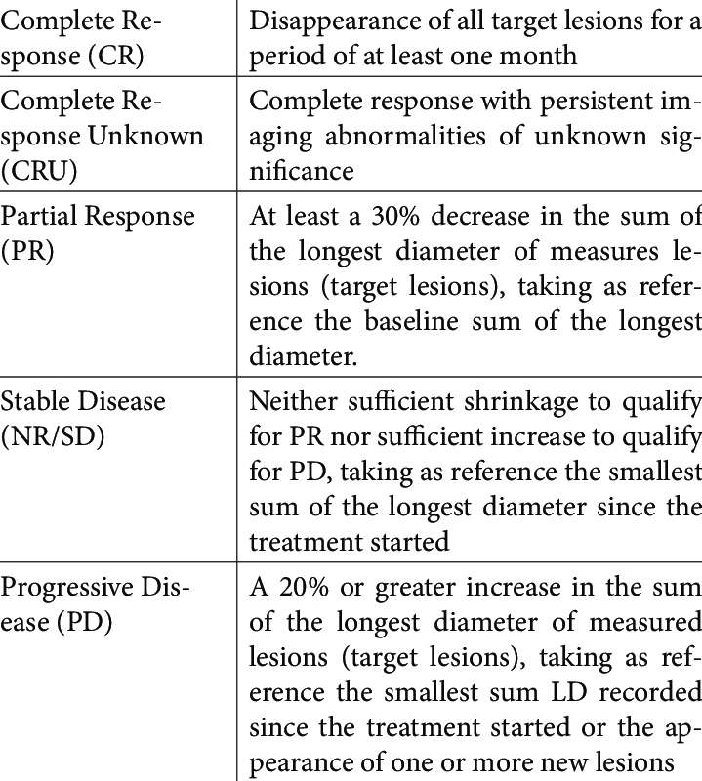
Př.: Hodnocení léčebné odpovědi na základě RECIST kritérií

Slide 70
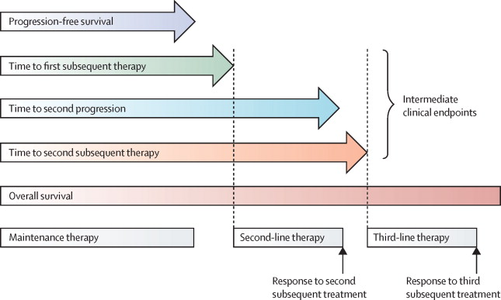
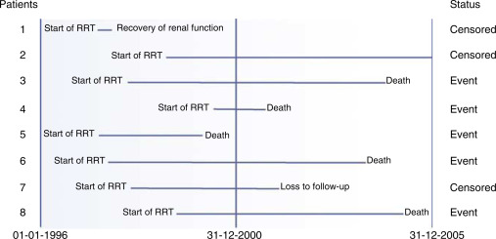
Přežití, cenzorování
Studujeme čas předcházející události, která nás zajímá
Na rozdíl od mortality nechceme pouze počty událostí
(událost = smrt, progrese nemoci, relaps …)
Musí být jasně časově definován počátek (je většinou individuální) i konec sledování.
Cenzorování je typické pro analýzu přežití (kompletní čas přežití nemusí být pozorován u všech subjektů)

Slide 71
Case-control (případ-kontrola) studie
Retrospektivní sledování souboru osob, u nichž došlo ke sledovanému jevu (např. vzniku onkologického onemocnění). Tuto skutečnost vztahujeme k výskytu určitého faktoru (rizikového nebo ochranného) v minulosti.
Exponovaní jedinci
Jedinci bez expozice
Případy (s událostí)
Případy (s událostí)
Exponovaní jedinci
Jedinci bez expozice
Kontroly (bez události)
Kontroly (bez události)
Historie
Začátek studie
Čas

Slide 72
Kohortní studie
Prospektivní sledování souboru osob, z nichž část byla vystavena působení určitého faktoru. Po adekvátní době sledování je zhodnocen výskyt sledovaného jevu ve skupině ovlivněné definovaným faktorem a ve skupinu bez něj.
Exponovaní jedinci
S událostí
Bez události
Kohorta
subjektů
(náhodně vybraná ze studované populace)
S událostí
Bez události
Jedinci bez expozice
Začátek studie
Průběh studie
Čas

Slide 73
Paralelní design randomizované studie
Tento typ uspořádání je charakteristický pro studie fáze III kde je srovnávána účinnost a bezpečnost dvou nebo více terapeutických postupů. Základním prvkem designu je randomizace subjektů do jednotlivých léčebných skupin. V průběhu celé studie je zachováno jedinečné přiřazení subjektů do léčebných skupin.
R
A
N
D
O
M
I
Z
A
C
E
Rameno 1
Vstup
Rameno 2
Rameno n

Slide 74
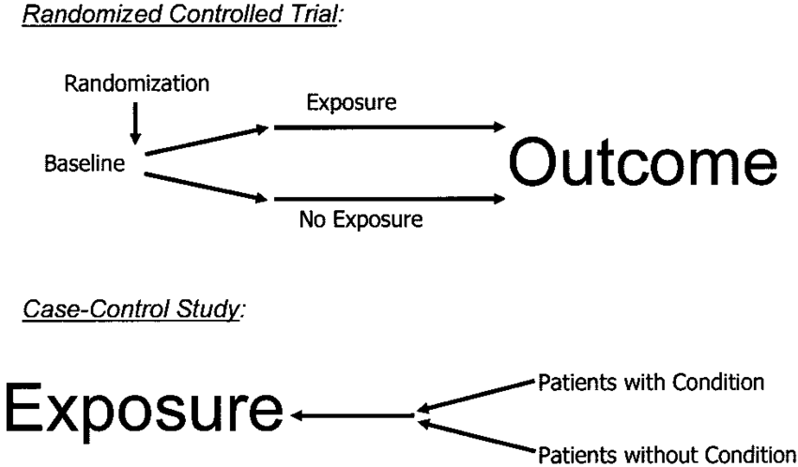
Randomizace
Metodika a proces náhodného (pseudonáhodného) rozdělování subjektů hodnocení (pacientů) do dvou nebo více léčebných skupin.

Slide 75
Cíle a smysl randomizační procedury
Zamezit subjektivnímu a selektivnímu rozdělování pacientů (subjektů) do léčebných skupin.
Zamezit systematické chybě, zkreslení
Splnit základní předpoklad validního použití statistických testů - náhodný výběr z populace
Zabezpečit požadovaný poměr počtu pacientů v jednotlivých léčebných skupinách
Možnost kontroly rovnoměrné distribuce prognostických faktorů v léčebných skupinách
Randomizace však není zárukou rovnoměrné distribuce prognostických faktorů – i při minimálním rozdílu v klíčovém parametru mezi jednotlivými skupinami je nutné tento rozdíl brát při statistickém hodnocení v potaz

Slide 76
Blinding - zaslepení
Zaslepení studie je proces, kdy pacient a/nebo investigátor nevědí, jakou léčbu pacient dostává (při paralelním uspořádání studie není znám podaný lék, při change-over uspořádání studie není známo pořadí podaných léků).
To ovšem neznamená, že by pacienti nevěděli, jaké léky jsou ve studii použity!
Cílem zaslepení je vyhnout se úmyslnému i neúmyslnému zkreslení výsledků studie.
  Pacient jinak hodnotí svůj zdravotní stav, když ví, je-li mu podávána nová léčba nebo placebo.
  Lékař může být tímto vědomím také ovlivněn, např. při použití kategoriálního hodnocení.

Slide 77
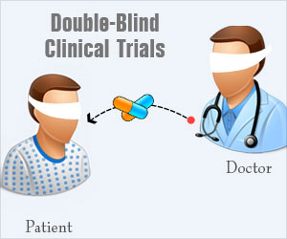
Blind (zaslepené) studie
  Single blind (jednoduše slepá) studie
  - pacient neví jaký lék dostává, zatímco lékař jej zná
  - téměř se nepoužívají, pouze v případech, kdy nelze jinak
  - např. v chirurgii (lékař musí vědět, jak pacienta operovat)
  Double blind (dvojitě slepá) studie
  - pacient ani lékař neznají léčbu přidělenou pacientovi
  - drtivá většina studií je dvojitě zaslepená
  - např. v onkologii při testování nových modalit léčby rakoviny
  Triple blind (trojitě slepá) studie
  - pacient, lékař ani statistik studie neznají léčbu přidělenou pacientovi
  - modifikace dvojitě zaslepené studie
  - z hlediska objektivity studie je to další zlepšení

Slide 78
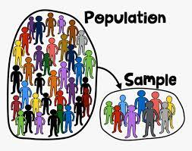
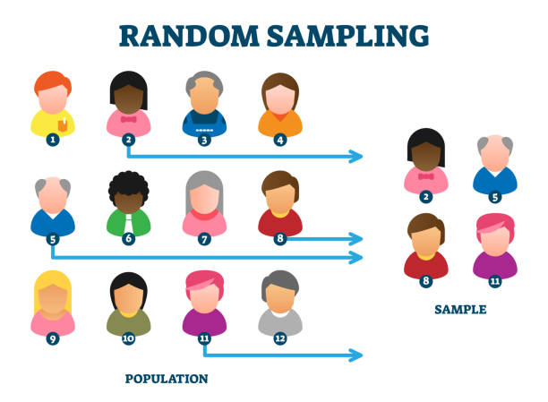
Power analýza a optimalizace velikosti vzorku
Power analýza (analýza síly testu) a optimalizace velikosti vzorku (sample size estimation) jsou dvě strany téže mince.
Obě vycházejí z testování hypotéz, tedy hypotézy a příslušné testové statistiky, jednou však máme jako předpoklad požadovanou sílu testu a chceme optimalizovat N, podruhé jsme limitováni N a ptáme se, jaké jsme v našich podmínkách schopni dosáhnout síly testu.
Optimalizace velikosti vzorku může také souviset s dosažením určité přesnosti v odhadu cílového parametru.

Slide 79
Odhad velikosti vzorku – srovnání dvou výběrů I
Cílem je ověřit klinickou hypotézu o nenulovém rozdílu ve sledovaném parametru mezi dvěma skupinami pacientů:
H₀: X₁ = X₂ + k
Klinicky významný rozdíl
Spojité proměnné
nabývající hodnot v určitém intervalu
tlak,
hladina cholesterolu
počet leukocytů
Binomické proměnné
nabývající jedné z možností úspěch/neúspěch
snížení hladiny cholesterolu
incidence zlomeniny

Slide 80
Odhad velikosti vzorku – shrnutí
Optimalizace velikosti vzorku je nutná z hlediska korektního statistického zpracování výsledků a dostatečné síle studie prokázat klinicky zajímavý rozdíl.
Optimalizace velikosti vzorku je založena na principu testování klinických hypotéz.
Každou hypotézu je nutné vyjádřit ve smyslu testové statistiky, která zahrnuje parametry nutné pro ověření hypotézy.
Parametry nezbytné pro výpočet optimální velikosti vzorku závisí na typu studovaného problému, pokud o nich nemáme apriorní informaci, lze je odhadnout na základě předchozích studií nebo expertní znalosti.

Slide 81

GCP v České republice
Legislativa:
Zákon č. 378/2007 Sb., o léčivech a o změnách některých souvisejících zákonů (zákon o léčivech), ve znění pozdějších předpisů (poslední aktualizace duben 2013)
Vyhláška č. 226/2008 Sb., o správné klinické praxi a bližších podmínkách klinického hodnocení léčivých přípravků
Pokyny SÚKL – KLHy:
  KLH-8 až KLH-21
  KLH-EK-001
  SPK-1
  VYR 32, Doplněk 13
Notes:
Paragraf 51-59
Pokyny SÚKL – jsou doplněním legislativy – vycházejí z guidelines, směrnic ICH, často jejich překlady

Slide 82
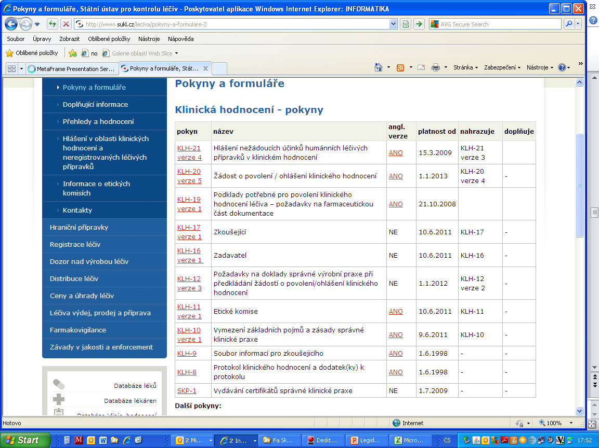
Klinické studie - zdravotnické prostředky
Notes:
KLH-8, Protokol; KLH-IB; KLH-16 v platné verzi Zadavatel
KLH-17 v platné verzi Zkoušející, KLH- 19
KLH-EK-001 Žádost o stanovisko etické komise k provedení klinického hodnocení v České republice - požadavky na předkládanou dokumentaci
KLH-10 verze 1 Vymezení základních pojmů a zásady správné klinické praxe

