Slide 1
TENSES

Slide 3
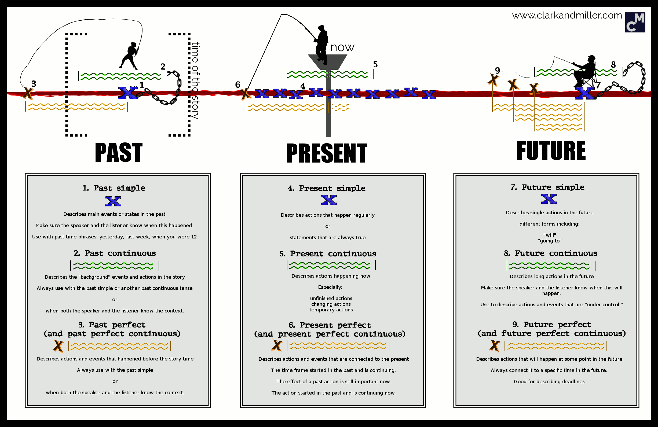
Tenses and their use
Make sentences about the fisherman Jim.

Slide 4
Kahoot – various tenses exercise
Play at home with the Kahoot app
https://kahoot.it/challenge/0331760
PIN: 0331760

Slide 5
Kahoot: past simple X present perfect
Play at home with the Kahoot app
https://kahoot.it/challenge/0878412
PIN: 0878412

Slide 6
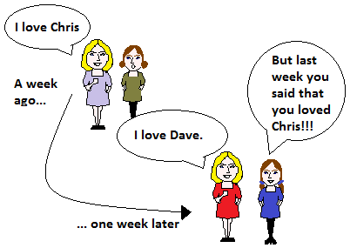
Reported Speech

Slide 7
Reported Speech
Present
Past
Present perfect
Will
Can
Tom said: “I have been to England twice.“
Tom said (that) he had been to England twice.
He told me: “I will join you.“
He told me (that) he would join me.
Past
Past perfect
Past perfect
Would
Could

Slide 8
Reported Speech - Questions
John asked me: “Do you speak English?“
John asked me whether/if I spoke English.
Mike asked: “Where is my umbrella?“
Mike asked where his umbrella was.

Slide 9
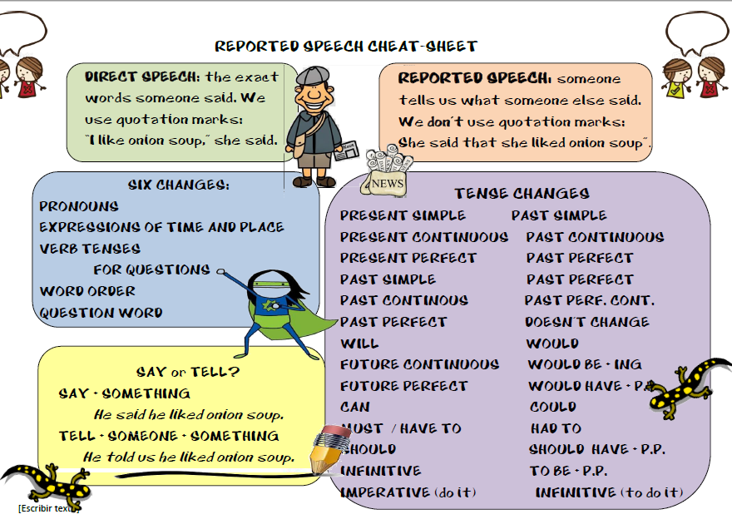

Slide 10
He said (that) he would reply to his email the following day.
He said (that) they were going to England the following week.
He asked if/whether he could borrow some money for a cab.

Slide 11
He said (that) they had gone to Starbuck’s the previous day and that the coffee had been really good.
He said (that) he didn’t/doesn’t fancy horror films, because they were/are too scary.
He said (that) he had never been to the United States before.

