Slide 1



What NMR can tell about proteins
Core Technologies for Education and Innovation in Life Sciences
For Application to Protein Characterization
by
Radovan Fiala, Karel Kubicek, and Pavel Kaderavek
CEITEC, Masaryk University
innocore-project@unitn.it
www.innocore-project.eu
This project received funding by the European Commission under the GA n° 2019-1-IT02-KA203-063391

Slide 2
How to prepare and what to expect from NMR spectroscopy
A] Scientific question / I’d like to obtain:
  Structure
  Relaxation properties
  Interaction at atomic level resolution
  Analysis (NMR is also analytical method)
  Image (MRI)
B] What do I need to provide / prepare?
C] How much would it cost?
D] How long would it take?
E] Can I do it on my own (or a sudent/colleague of mine)

Slide 3
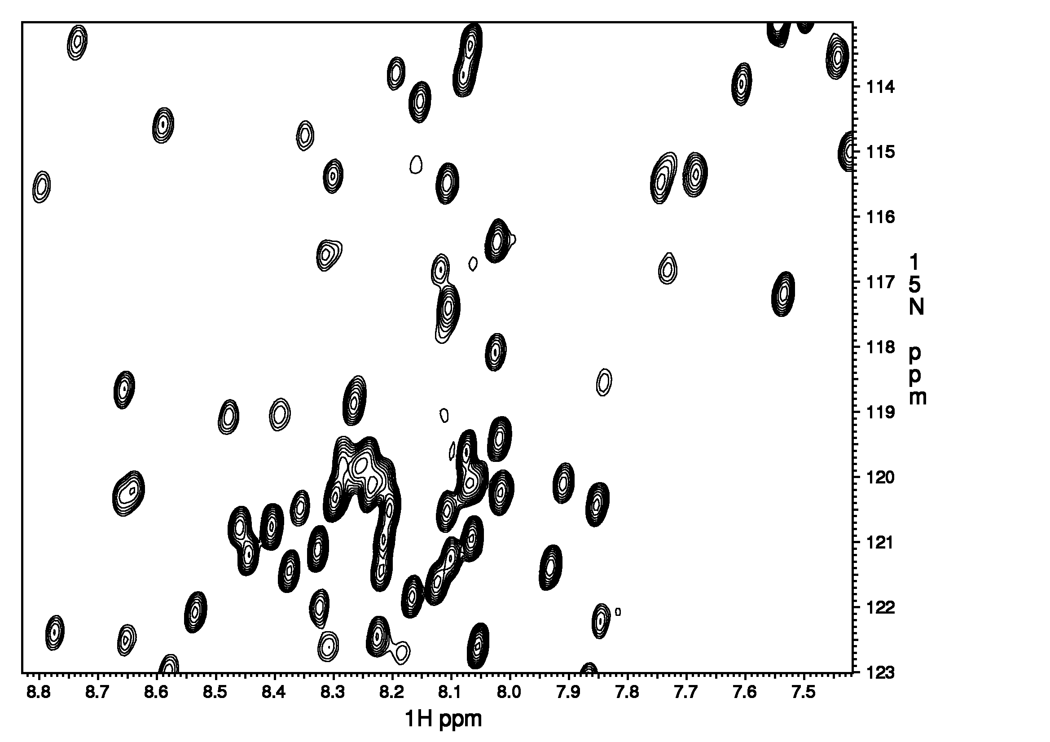
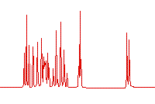
200-500 μl of
100-1000 μM compound
Method of choice
Data to be analyzed
Results
Structure
Relaxation properties
Interaction at atomic level resolution
Analysis
Image
sample
NMR
spectrum

Slide 4
PDB Data Distribution by Experimental Method and Molecular Type
Exp. Method | Proteins | NA | Protein/NA Complex | Other | Total
X-Ray | 133461 | 2098 | 7091 | 8082 | 150732
NMR | 11493 | 1309 | 267 | 92 | 13161
EM | 4181 | 47 | 1478 | 501 | 6207
Other | 32 | 1 | 0 | 4 | 37
Multi Method | 162 | 6 | 3 | 6 | 177
Source: http://www.rcsb.org as of 03Nov2020

Slide 8
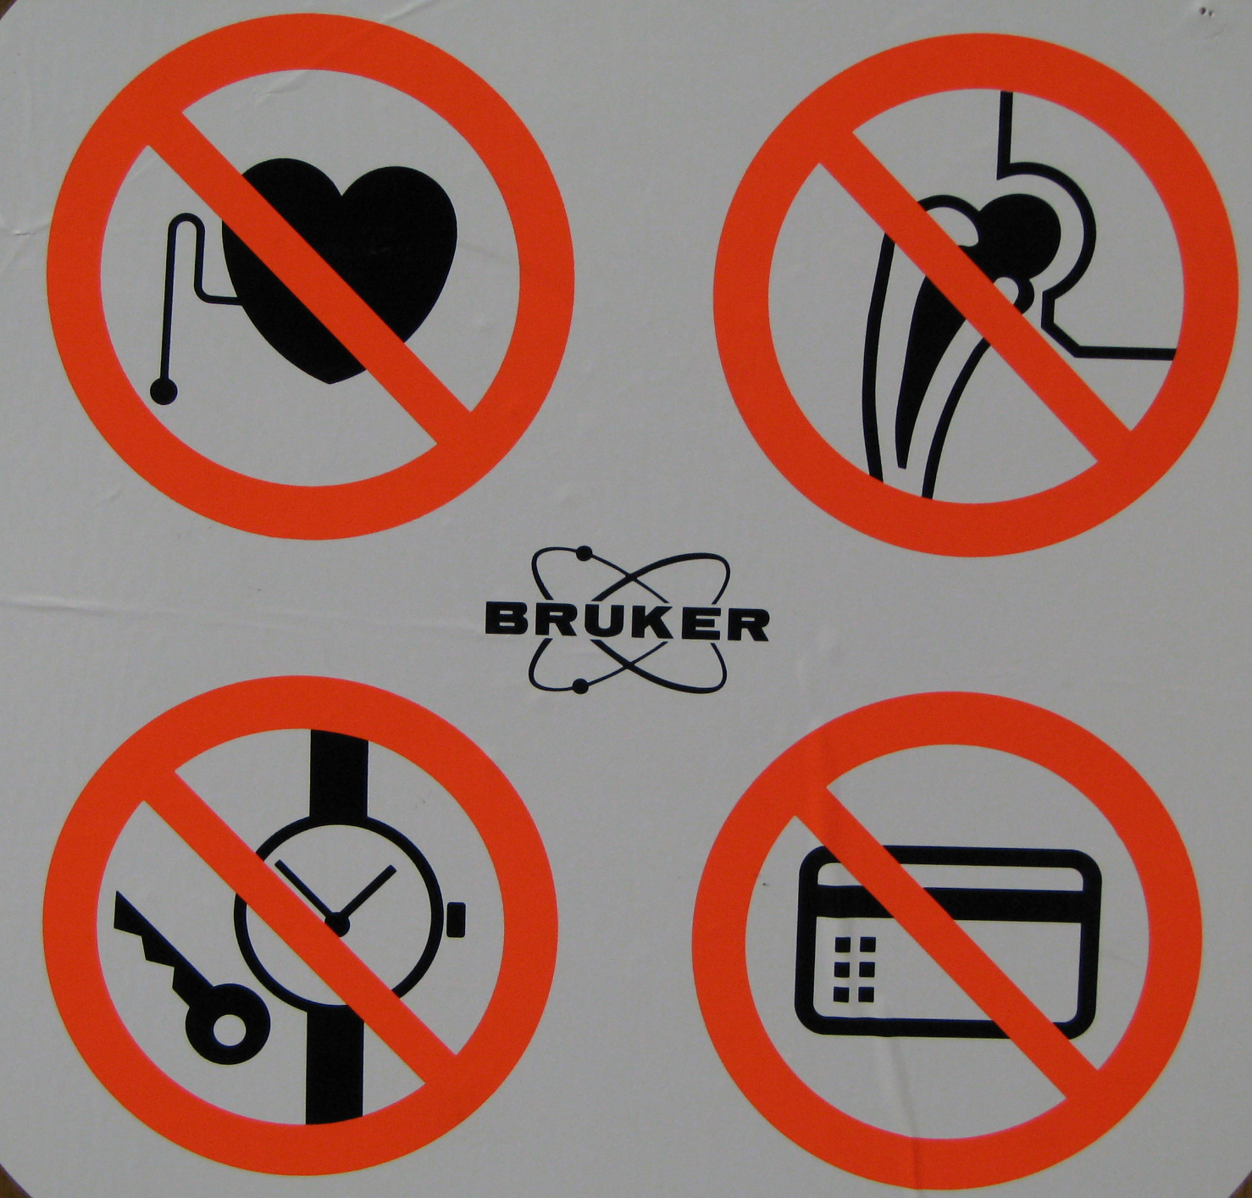
NMR
Safety First

Slide 9
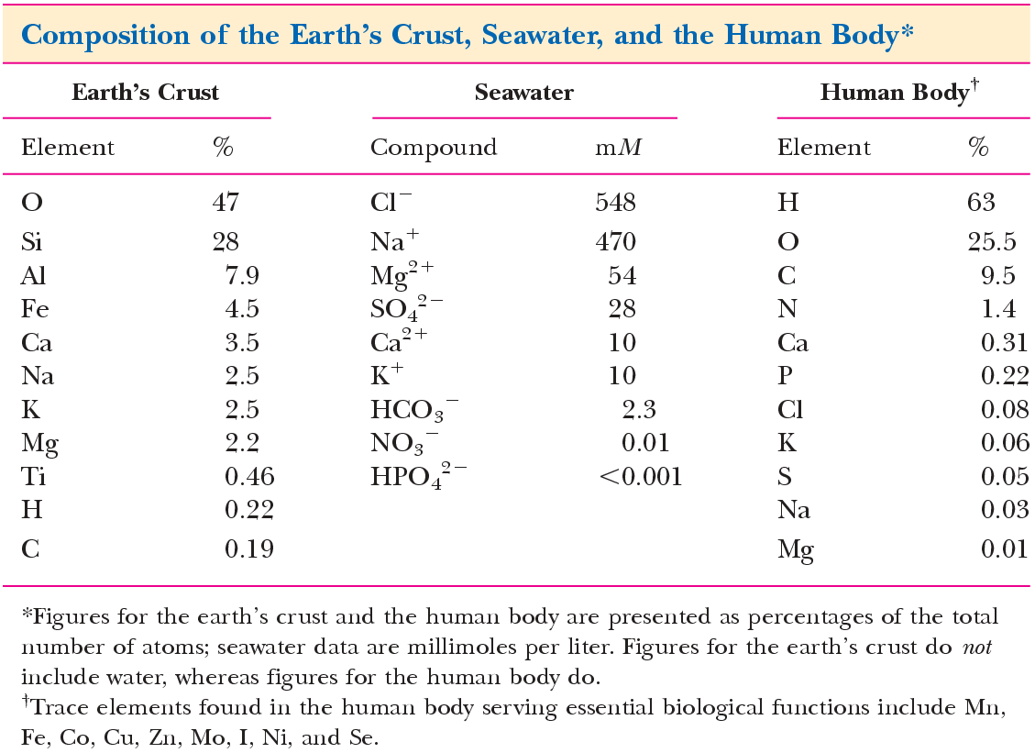

Slide 10
For most of modern NMR applications,
¹³C, ¹⁵N, and often ²H needed
Isotope | Ground state spin | Natural abundance [%] |  | Rel. Sensitivity
¹H | ½ | ~100__ |  | 1.00x10⁺⁰
¹³C | ½ | 1.10 |  | 1.59x10⁻²
¹⁵N | ½ | 0.37 |  | 1.04x10⁻³
¹⁹F | ½ | 100__ |  | 8.30x10⁻¹
³¹P | ½ | ~100__ |  | 6.63x10⁻²
¹²C | 0 | 98.90 |  | -
¹⁶O | 0 | ~100__ |  | -

Slide 11
Samples:
  Small organic molecules - synthesis
  Peptides (10-40 aa) - synthesis
  Proteins (40-200 aa) - ¹³C/¹⁵N enriched media
  Large proteins > 200 aa - ²H/¹³C/¹⁵N enriched media
If high concentrations (>1 mM) multidimensional spectra in natural abundance can be performed

Slide 12
NMR as a tool for structure determination of proteins and biological complexes:
From single proteins to large systems

Slide 13
Conventional scheme for structure determination by NMR
Sample preparation / protein expression
NMR data acquisition and processing
Backbone chemical shifts assignment
Assignment of side-chain chemical shifts
Peak-picking of NOESY spectra
Structure calculation
(iterative improvement of 5 and 6)

Slide 14
Before we start with assignment of backbone chemical shifts we need to know:
1) Protein primary sequence
MQQDDDFQNF VATLESFKDL KSGISGSRIK KLTTYALDHI DIESKIISLI IDYSRLCPDS HKLGSLYIID SIGRAYLDET RSNSNSSSNK PGTCAHAINT LGEVIQELLS DAIAKSNQDH KEKIRMLLDI WDRSGLFQKS YLNAIRSKCF AMDLEHHHHHH
2) Standard chemical shifts of Cα and Cβ (vide infra)
3) Secondary structure prediction (values of 2) will be affected accordingly)
4) Precise peak-picking (manually or semi-automatically)
5) ¹³C/¹⁵N uniformly labeled protein (6-30kDa)

Slide 15
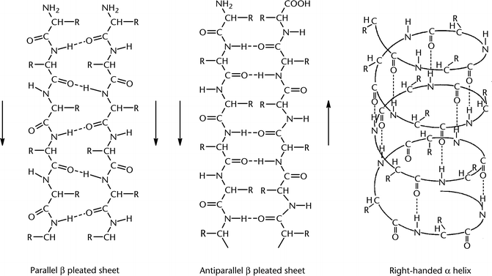
Protein backbone and secondary structure
β-strand α-helix
parallel antiparallel
N- C-terminus
Hydrogen bond

Slide 16
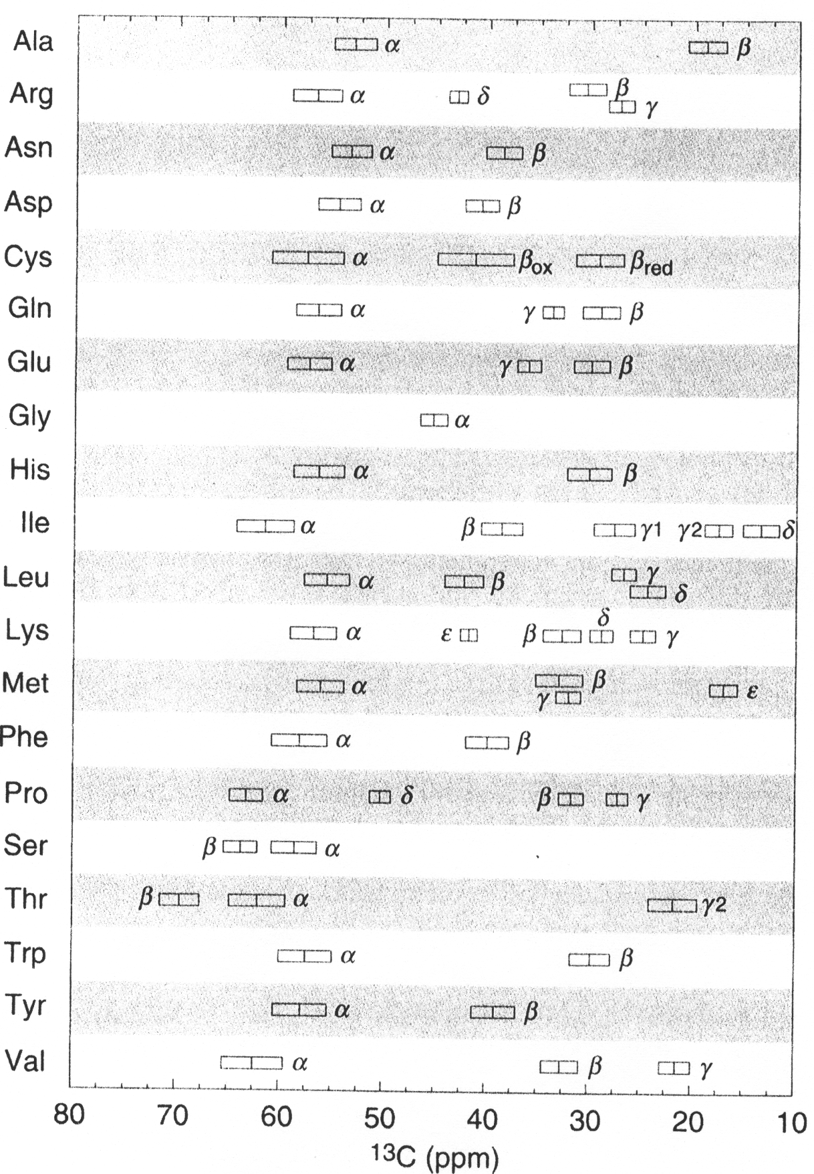
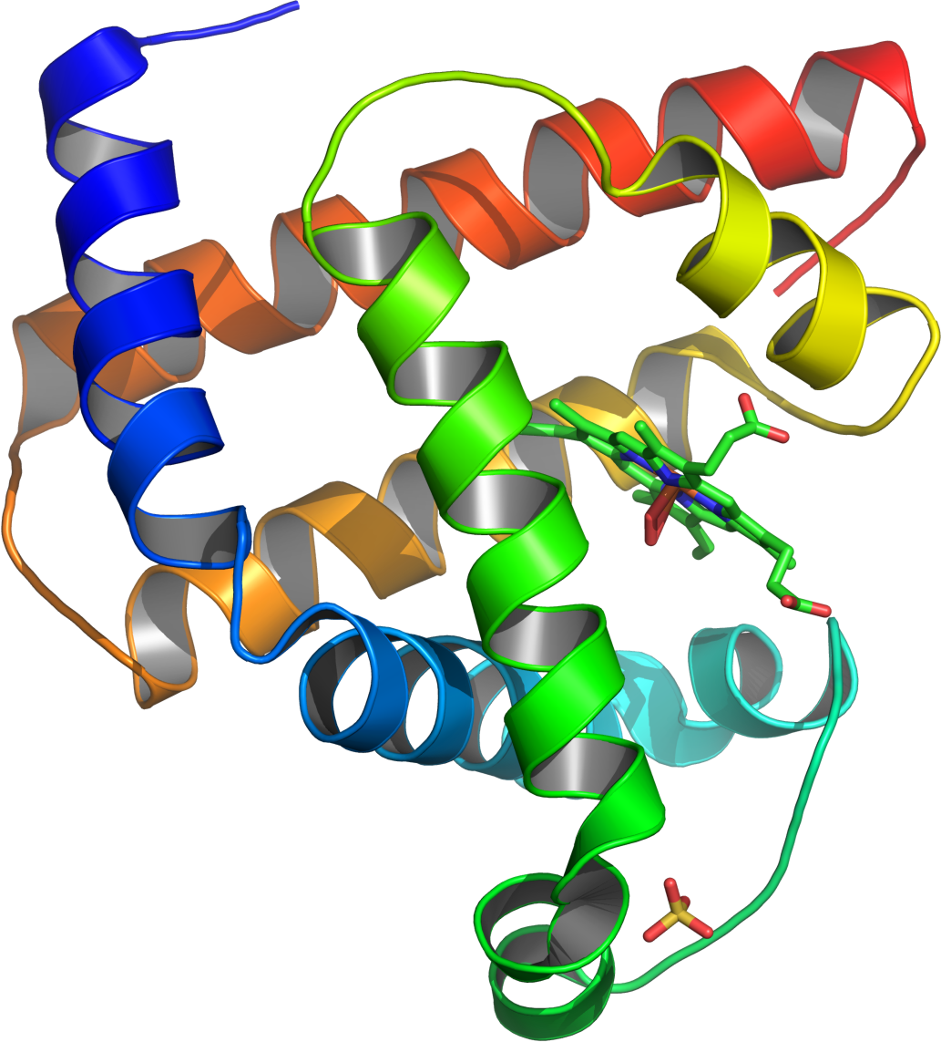
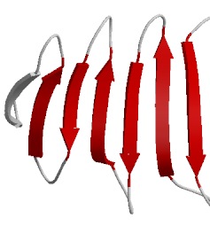
α-helix
¹³C chem. shift in proteins
β-strand
Cavanagh et al. Protein NMR Spectroscopy 2nd ed.

Slide 17
In a ¹³C/¹⁵N uniformly labeled protein, correlation spectra can be measured through single- and double-bond couplings
¹³C_{γ}
35Hz
¹³C_{β}
H_{β}
¹³C_{β}
130Hz
H_{β}
35Hz
35Hz
¹³C_{α}
55Hz
¹³C’
-15Hz
¹⁵N
-11Hz
¹³C_{α}
55Hz
¹³C’
140Hz
7Hz
-92Hz
< 1Hz
H_{α}
H^{Ν}
H_{α}
Sattler et al. Prog. NMR Spectrosc. (1999) 34, 93-158

Slide 18
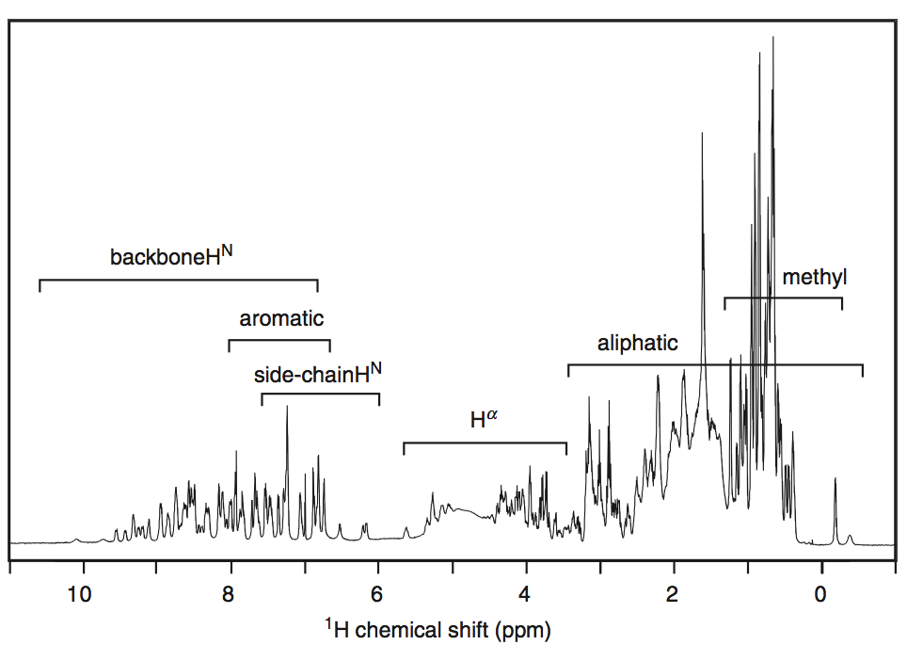
¹H 1D, Cavanagh et al., 2007
water

Slide 19
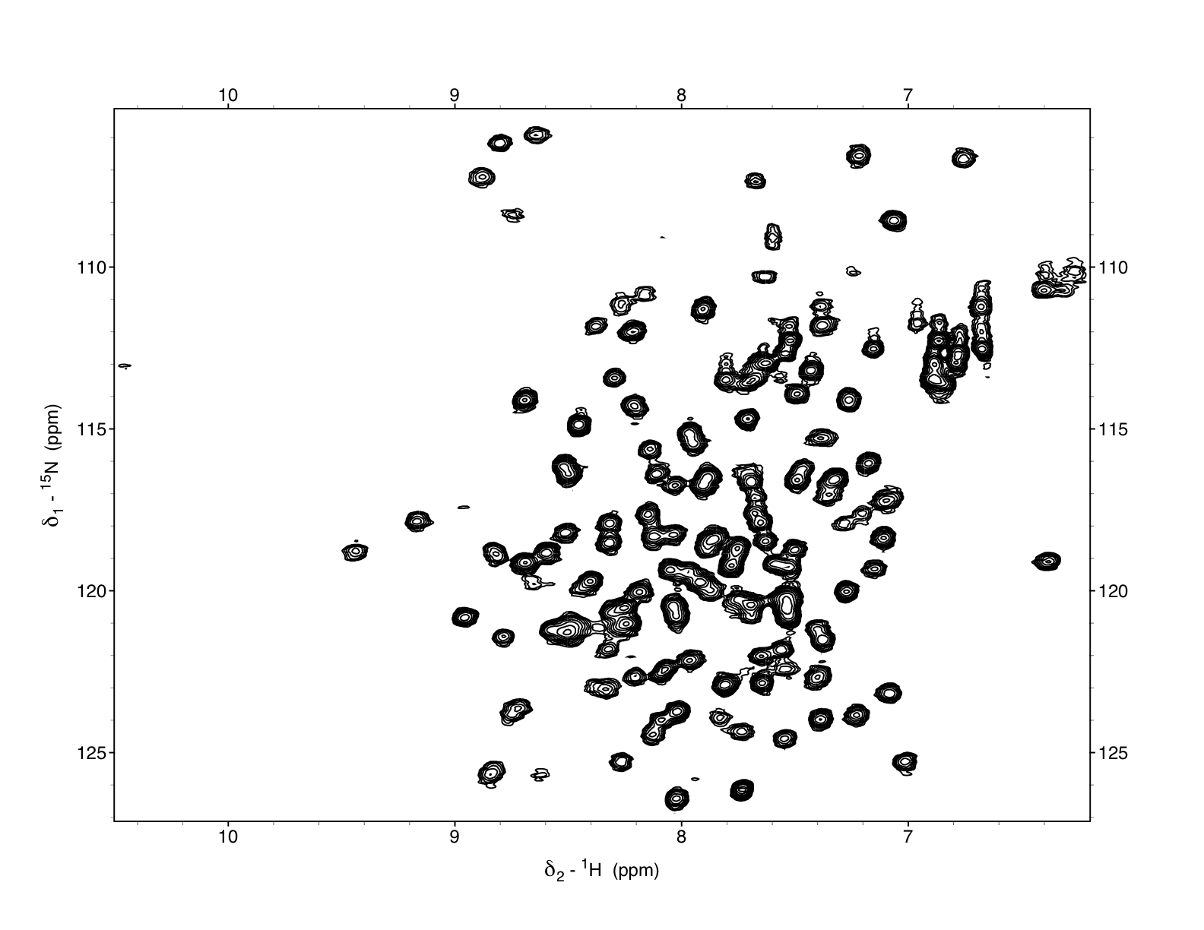
¹H 1D, Cavanagh et al., 2007
water
¹H-¹⁵N HSQC, cca 155 aa, well folded, 600MHz, 293K

Slide 20
¹⁵N-¹H HSQC – Heteronuclear SingleQuantum Correlation
1 peak ≅ 1 amino acid
Excellent info about the protein fold
No info about primary sequence

Slide 21
Traditional triple resonance NMR spectra for protein backbone assignment
HNCO – chem. shifts of C=O
HNCA – chem. shifts of C_{α,i}, C_{α,i-1}
HNCOCA – chem. shifts of C_{α,i-1}
HNCACB – chem. shifts of C_{α,i}, C_{α,i-1}, C_{β,i}, C_{β,i-1}
HNCOCACB – chem. shifts of C_{α,i-1}, C_{β,i-1}
¹⁵N-¹H HSQC rovina
¹⁵N
¹³C
¹H
Two of the above spectra needed

Slide 22
¹H_{i}/ ¹⁵N_{i}
¹H_{i}/ ¹⁵N_{i}
¹H_{i}/ ¹⁵N_{i}
Cβ_{i-1}, Cα_{i-1}
Cβ_{i, i-1}
Cα_{i, i-1}
¹³C 10 20 30 40 50 60 ppm
Alanine Glycine Serine
i-1 i i+1

Slide 23
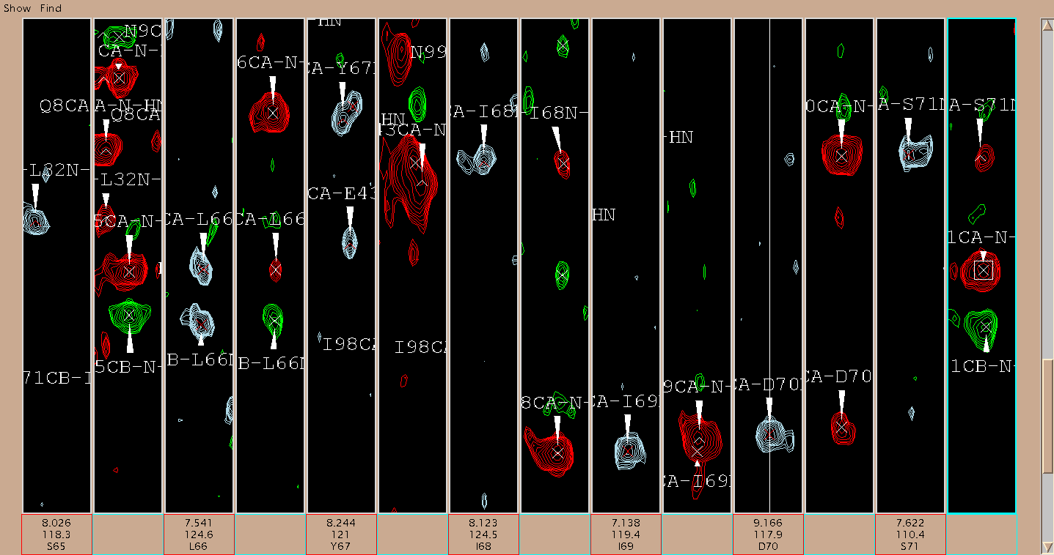
Backbone chemical shifts assignment example:
- fragment S65-S71 (50-66ppm v ¹³C)

Slide 24
Automatic chemical shifts assignment
With a known 3D protein structure (e.g. X-ray, Modeller)
Without prior knowledge of a structure
e.g. Automated Projection SpectroscopY APSY (S. Hiller, F. Fiorito, K. Wüthrich & G. Wider, PNAS (2005) 102, 10876-81)
Advantages
Time
Disadavantages
1) With increasing size of the protein (increasing spectral overlap) the reliability is decreasing

Slide 25
How to prepare and what to expect from NMR spectroscopy
A] Scientific question / I’d like to obtain:
  Structure
  Relaxation properties
  Interaction at atomic level resolution
  Analysis (NMR is also analytical method)
  Image (MRI)
B] What do I need to provide / prepare?
C] How much would it cost?
D] How long would it take?
E] Can I do it on my own (or a sudent/colleague of mine)

Slide 26
Thank you for your attention
Core Technologies for Education and Innovation in Life Sciences
For Application to Protein Characterization
by
Radovan Fiala, Karel Kubicek, and Pavel Kaderavek
CEITEC, Masaryk University
innocore-project@unitn.it
www.innocore-project.eu
This project received funding by the European Commission under the GA n° 2019-1-IT02-KA203-063391

