Slide 1
Development of nervous system and sensoric organs

Slide 2
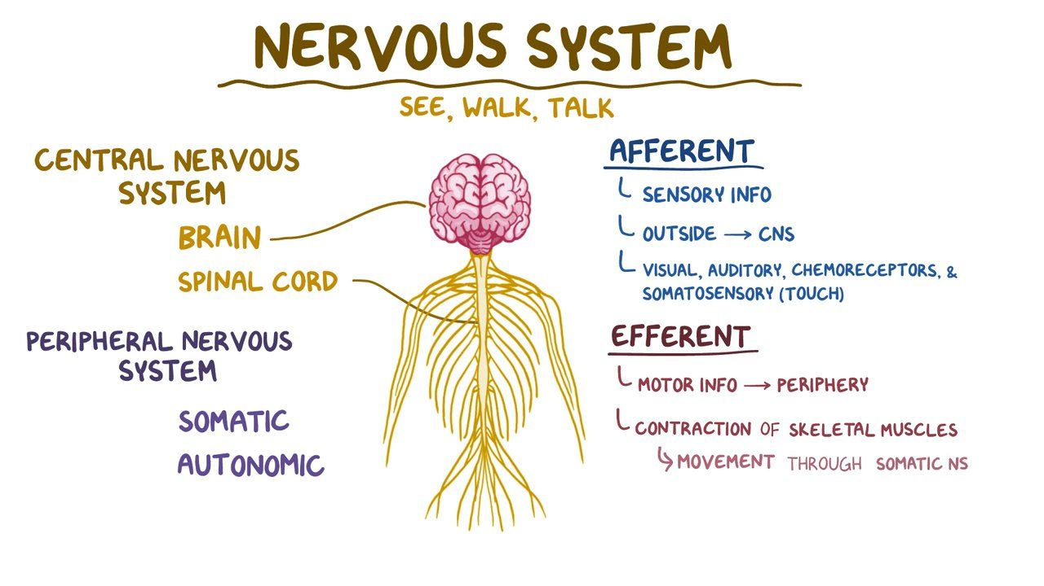
Functions of nervous system
Control of other body tissues and organs
Perception of body and limb positition
Perception of stimuli from the environment and reactions
Perception of stimuli from body and reactions
https://www.osmosis.org/learn/Nervous_system_anatomy_and_physiology
Ability to learn and memory creation

Slide 3
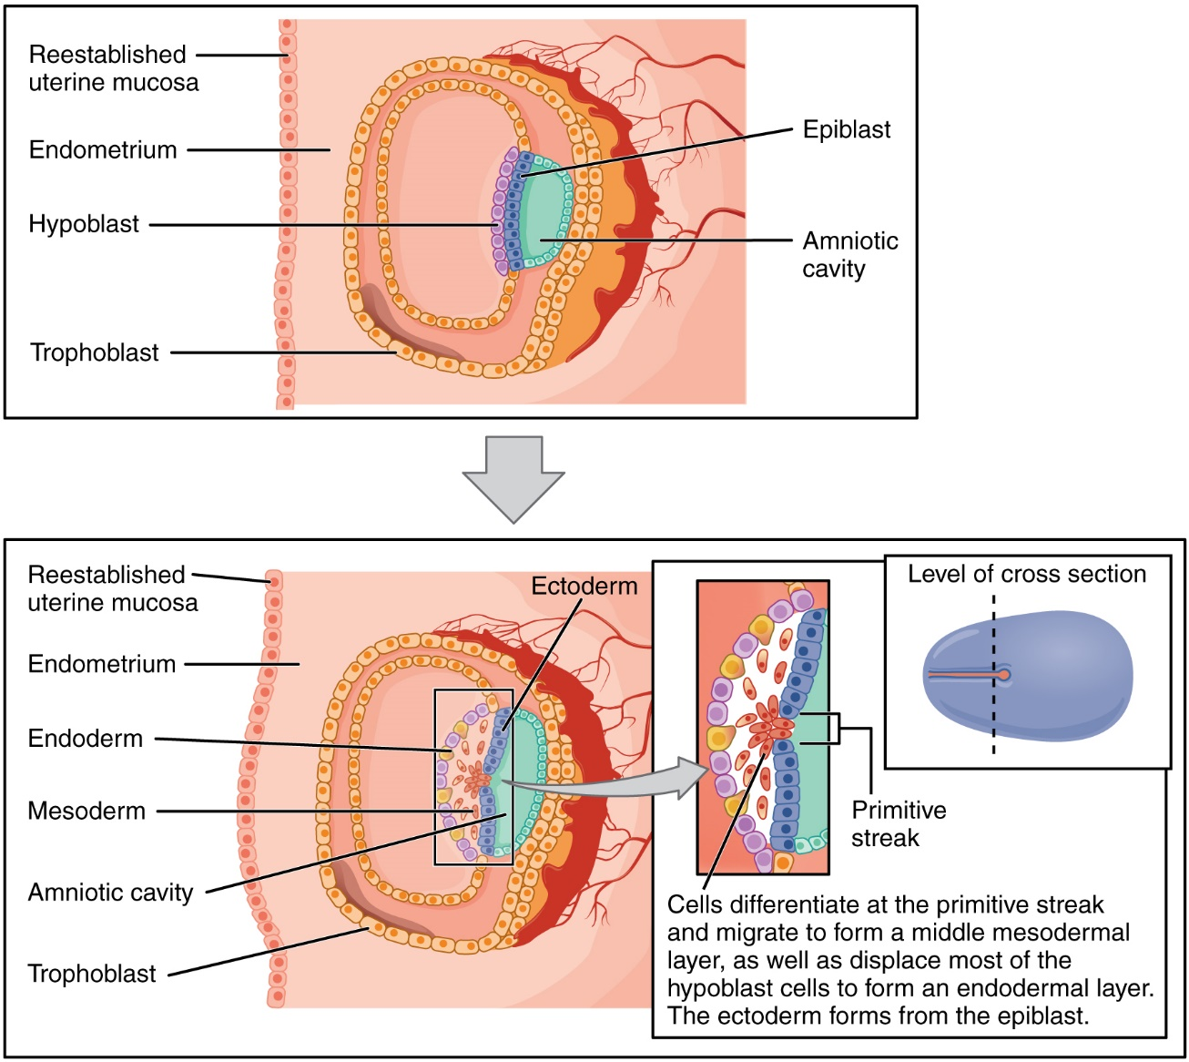
Embryonic origin of nervous system
Primitive streak formation in epiblast layer of bilaminar disc
Epiblast layer cells migrate through primitive streak to space between epiblast and hypoblast, replacement of hypoblast cells
Formation of trilaminar disc:
  Endoderm – inner layer
  Mesoderm – middle layer
  Ectoderm – outer layer
Nervous system forms from ectoderm, originally epiblast
Teach Me Anatomy

Slide 4
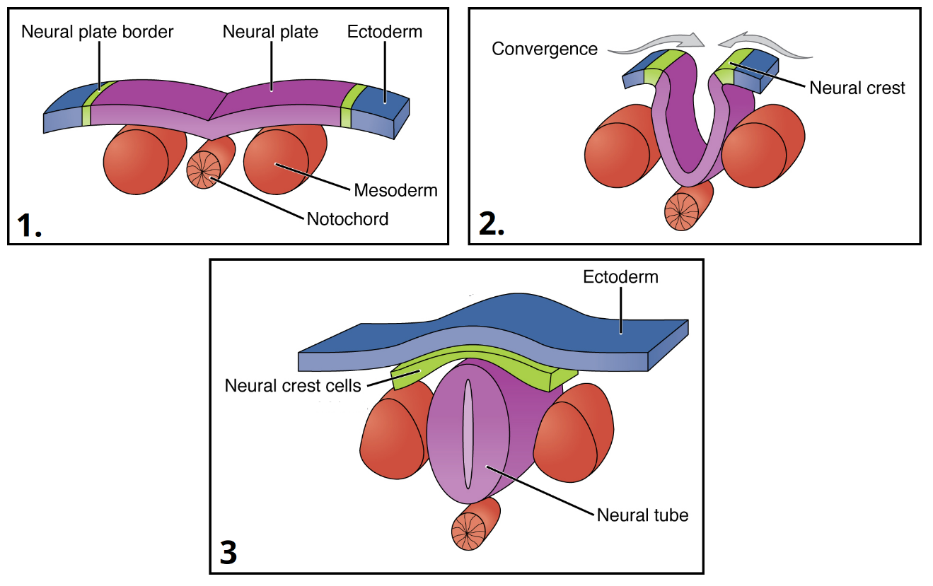
Neurulation
Ectoderm influenced by factors produced by notochord
Convergence of neural ridges
adjacent ectoderm differentiate into neuroectoderm
formation of thickened neuroectoderm layer – neural plate
Neural groove
lateraly in neural plate – neural ridges, neural groove between them → neural ridges move towards each other, fusion along midline – formation of neural tube (basis for central nervous system)
interface between ectoderm and neuroectoderm – region of neural tube fusion – formation of neural crest cells population (basis for peripheral nervous system)
Teach Me Anatomy

Slide 5
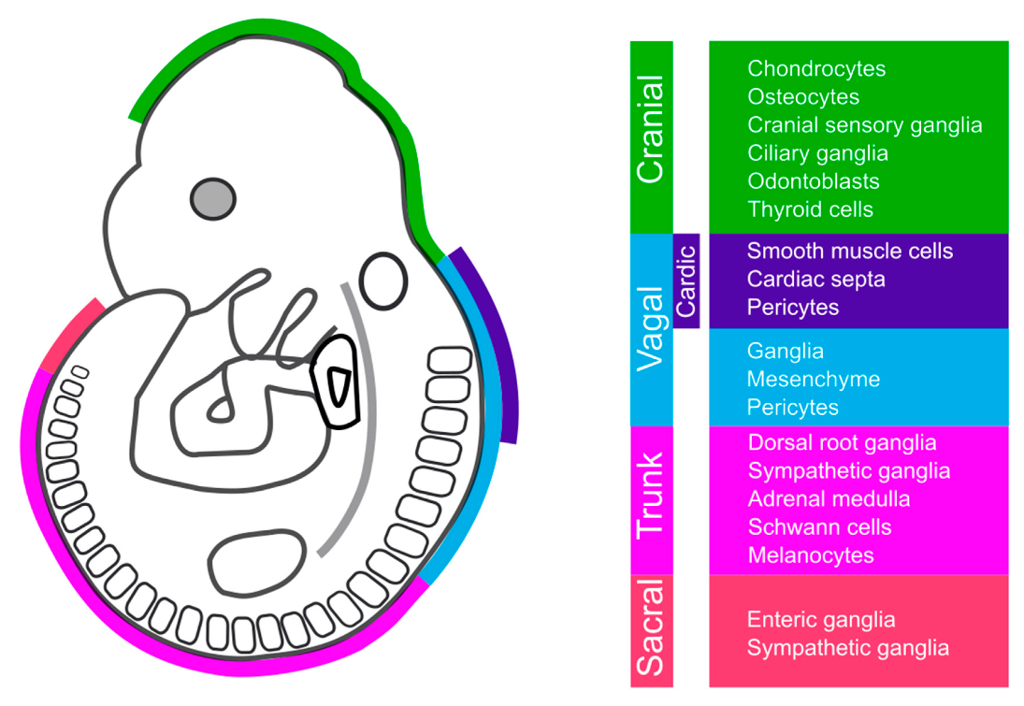
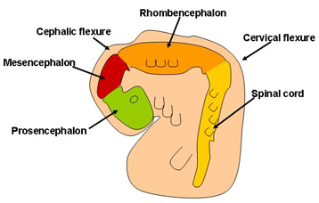
Nervous system
Structures formed during neurulation:
  Neural tube – basis for development of central nervous system
  Neural crest – basis for development of peripheral nervous system
Neural tube:
  brain
  Spinal cord
Neural crest:
  Peripheral neurons
  Enteric neurons
  Glial cells

Slide 6
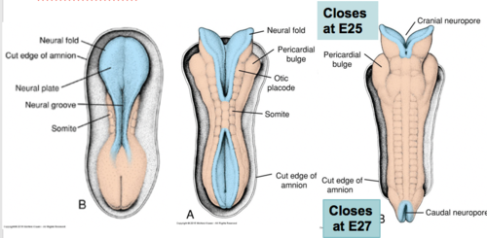
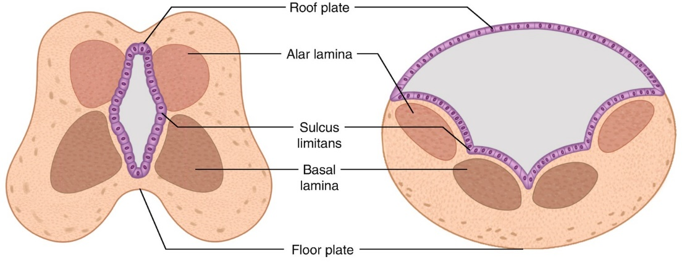
Development of neural tube
brain forms from cranial neural tube, spinal cord from caudal
Cranial neuropore
closing neural tube from cranial region (4. somite) to caudal – cranial and caudal parts stay temporarily open, formation of cranial and caudal neuropores (communication of neural tube with amnion)
first closure of cranial neuropore, later caudal neuropore
Caudal neuropore
Spinal cord
brain
Enclosed neural tube divided along dorsoventral axis:
  Ventral – floor plate, development influenced by notochord
  ventrolateral – basal lamina/plate – motor neurons
  dorsolateral – alar lamina/plate – sensory neurons
  dorsal – roof plate, development influenced by surface ectoderm (epidermis)
  Sulcus limitans – divide basal and alar lamina
O`Kane and Begg. Clinical Embryology

Slide 7
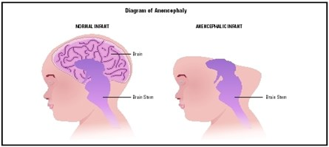
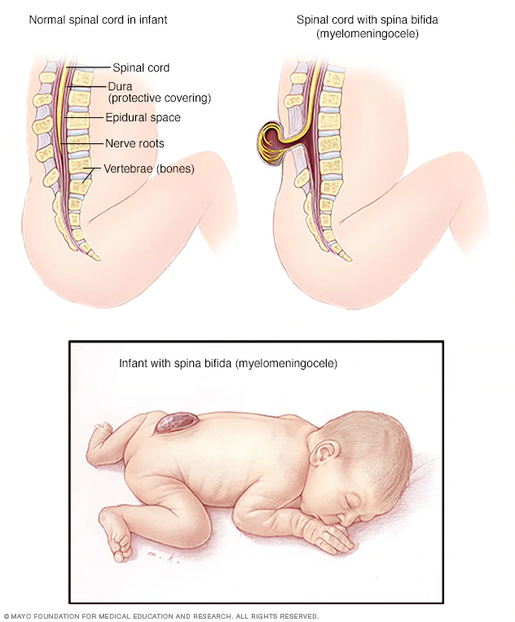
Developmental defects of neural tube closure
Anencephaly
  Cranial neuropore closure defect
  Reduced formation of brain, or its part (telencephalon)
  Often lethal
Spina bifida
  Defect of caudal neuropore closure
  Cleft, prolapse of spinal cord
  surgery

Slide 8
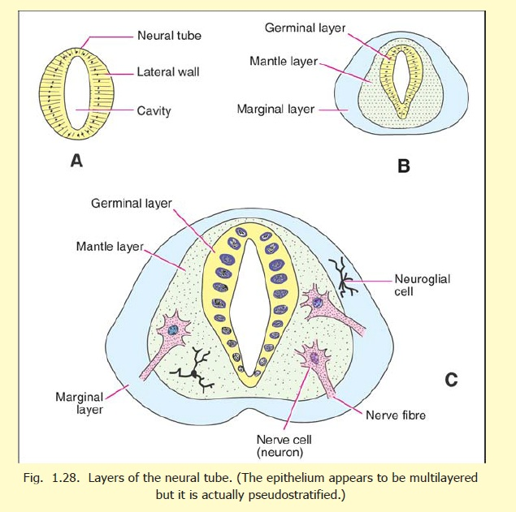
Initial differentiation of neural tube cells
Neural tube lined by pseudostratified cylindrical epithelium
Neuroepithelium differentiate into two major types of progenitors:
  neuronal progenitors (neuroblasts) – formation of central nervous system cells
  glial progenitors (glioblasts) – formation of CNS supporting cells
Germinal (ependymal) layer
Neural tube neuroepithelium differentiate into 3 basic layers:
  Inner (germinal/ventricular) layer – neural tube cavity lining epithelium
  Mantle layer – spinal cord grey matter
  Marginal layer - periphery

Slide 9
Formation of neural tube layers
neuroblasts migrate from gerrminal inner layer to mantle layer
Inner germinal layer
neuroblasts form protrusions from mantle layer lateraly – formation of marginal layer
Mantle layer
Glial cell
(astrocyte, oligodendroglia)
Cells formed from glioblasts:
  astrocytes – formed in mantle and marginal layer
  oligodendroglia – especially in marginal layer
Neuroepithelial cells lining cavity differentiate to ependymal cells – future lining of brain ventricles and spinal cold canal
Marginal layer
Neuronal protrusion
Glial cell (astrocyte)
neuroblast

Slide 10
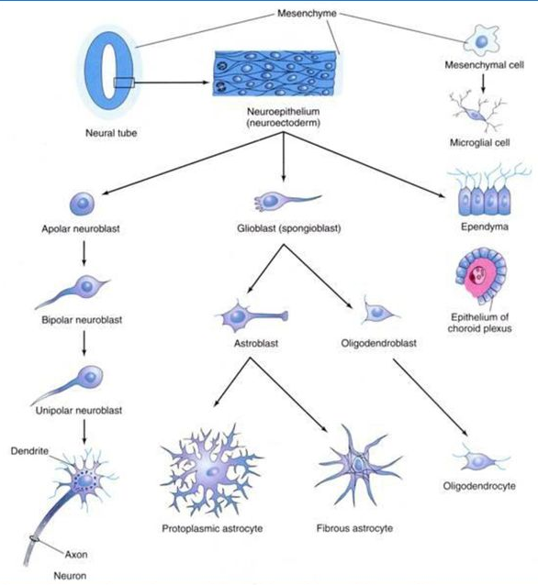
Neural tube wall histogenesis
Differentiation of neural tube cells – from germinal neuroepithelium
Neuroblast lineage – development of neurons
  Apolar neuroblast – progenitor without protrusions
  Bipolar neuroblast – formation of two protrusions
  Unipolar neuroblast – one protrusion
  Neuron – formation of one axon, development of dendrites
Glioblast lineage – development of supporting cells
  Spongioblast – glial cells progenitor
  Astroblast – astrocytic progenitor (blood-brain barrier)
  Oligodendroblast – progenitor of oligodendroglia (CNS neurons myelination)
ependyma – epithelial cells forming neural tube lining → important for development of choroid plexus
mesenchyme – microglia development (nervous system monocytic cells)

Slide 11
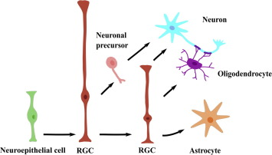
Radial glia
specialized neural cells (bipolar morphology – similiarly to neuroepithelial cells
Long protrusions from ventricular zone (germinal epithelium) to marginal layer
supporting cells for migration of immature neurons from germinal epithelium to marginal layers of developing epithelium
progenitor cell for development of:
  neurons
  Glial cells
important for differentiation of cells in specific CNS regions

Slide 12
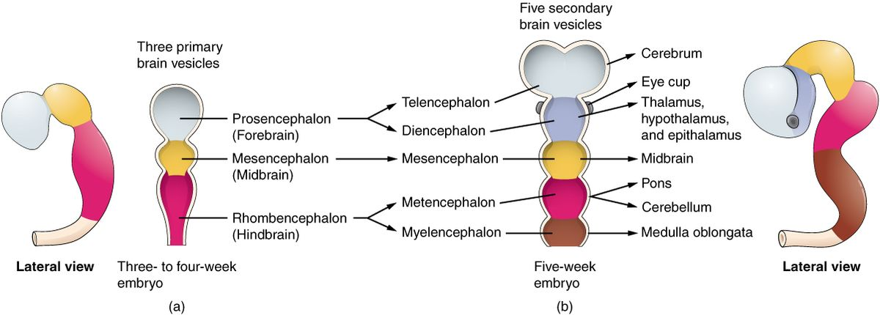
Brain development – primary brain vesicles
Brain development in cranial region – region of neural plate extension
From neural plate extension, 3 primary brain vesicles formed:
  prosencephalon – forebrain
  mesencephalon – midbrain
  rhombencephalon – hindbrain
Brain compactness and small space for its development →
Formation of 2 flexures of neural tube:
  Cervical – flexure between hindbrain and spinal cord
  Cephalic – ventral flexure in the midbrain region
Cephalic flexure
Cervical flexure

Slide 13
Brain development – secondary brain vesicles
3 primary vesicles transform to 5 secondary brain vesicles
Prosencephalon:
  Telencephalon – cranial part; brain hemispheres, olfactory lobe
  Diencephalon – caudal part; eye cups, thalamus, neurohypophysis, epiphysis
hemispheres
Mesencephalon – no division
Rhombencephalon
  Metencephalon – cranial part; pons Varoli, Cerebellum
  Myelencephalon – caudal part; Medulla oblongata

Slide 14
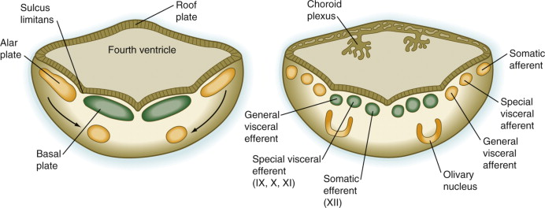
Rhombencephalon
after neuropore closure – expansion of lateral rhombencephalic walls dorsally
dorsal
roof plates extend laterally and dorsally – formation of diamond-shaped structure – fourth ventricle
Brain ventricle covered by thin ependymal cell layer
cranialy – formation of metencephalon
caudally – formation of myelencephalon
ventral
Sadler, 1990. Langman`s medical embryology

Slide 15
Myelencephalon
myelencephalon – caudal rhombencephalon
myelencephalon – connection of spinal cord and brain → Medulla oblongata
dorsal
Extension of walls laterally – alar plates localized laterally, basal plates medially
Formation of dorsal (roof) and ventral (floor) plates
roof plate compose of one layer of ependymal cells covered by cells of developing vessels (mesoderm) – pia mater (vascular cover closely attached to brain)
ependyma and pia mater of 4. ventricle → tela choroidea, invagination to 4. ventricle – formation of choroid plexus (production of cerebrospinal fluid)
ventral
9., 10., 11.
development of cranial nerves - VI. abducens, VII. facial, VIII. vestibulocochlear, IX. glossopharyngeal, X. vagus, XI. accessory, XII. hypoglossal
12.
Sadler, 1990. Langman`s medical embryology

Slide 16
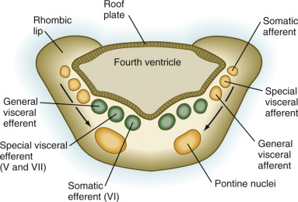
Metencephalon
metencephalon – cranial rhombencephalon
metencefalon – development of dorsally localized Cerebellum and ventrally localized pons Varoli
dorsal
develops similarly to myelencephalon – extension of walls laterally – alar plates laterally, basal plates medially
dorsolaterally – formation of rhombic lips (basis for Cerebellum)
5., 7.
Development of V. cranial nerve - trigeminal
6.
ventral
Sadler, 1990. Langman`s medical embryology

Slide 17
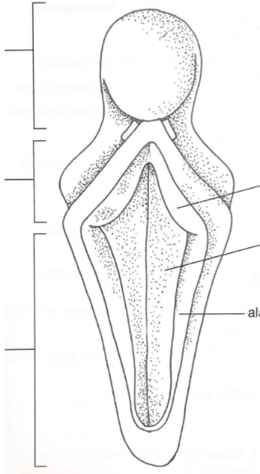
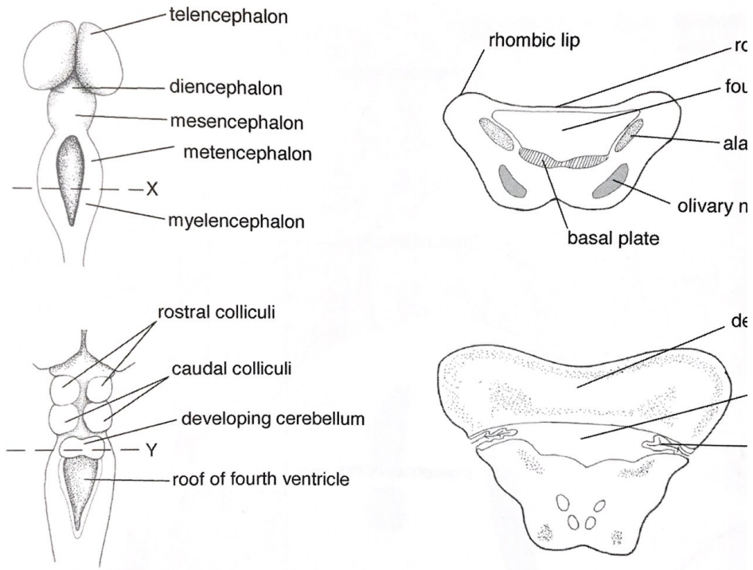
Cerebellum development
originates in dorsolateral parts of alar plate of rhombencephalon – rhombic lips
mesencephalon
diencefalon
Roof plate
4. ventricle
Rhombic lip
Alar plate
metencephalon
Rhombic lips come together in mesencephalon region – proliferation of rhombic lip cells – formation of precursors of cerebellar hemispheres
Basal plate
Floor plate
Alar plate
Cerebellum
myelencephalon
Choroid plexus
Further proliferation results in connection and fusion medially – one cerebellum formed covering 4. ventricle
Edited: McGeady et al. Veterinary Embryology. 2009

Slide 18
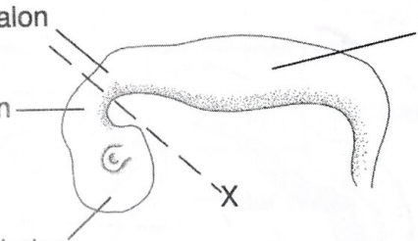
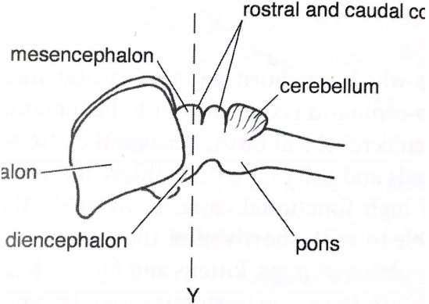
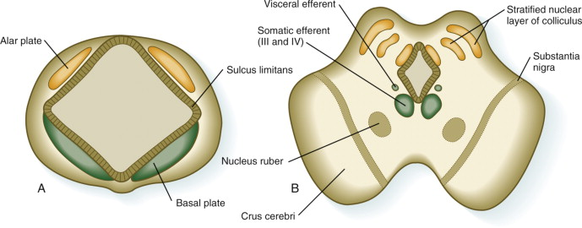
Mesencephalon
slight developmental changes compared to other parts
rostral and caudal colliculi
medial expansion of alar and basal plates – reduction of neural canal – formation of mesencephalic aquaduct
Basal plate – formation of motoric nuclei of cranial nerves (III. oculomotor, IV. trochlear)
crura cerebri – expansion of peripheral parts of basal plate – roots for descending nerves from cereberal cortex to pons and spinal cord
neuroblasts from alar plates settle tectum (dorsal part of mesencephalon) – formation of 4 nuclei (colliculi) with visual and auditory function
substancia nigra – migration of alar cells ventrally (dopamine production), motoric function
Sadler, 1990. Langman`s medical embryology

Slide 19
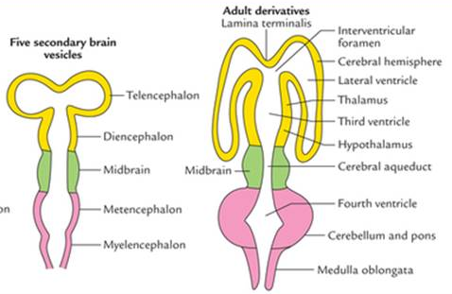
Prosencephalon
rostral part of brain – telencephalon rostrally, diencephalon caudally
Prosencephalon:
  Telencephalon – cranial part; hemispheres, olfactory lobe
  Diencephalon – caudal part; eye cups, thalamus, hypothalamus, neurohypophysis, epiphysis
Cavity of diencephalon – 3. brain ventricle
Cavity of telencephalon – paired lateral ventricles

Slide 20
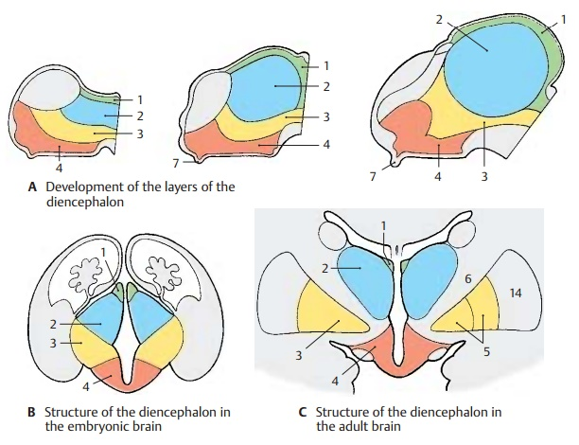
Diencephalon
Caudal part of forebrain
Does not form basal plates – formation from alar and roof plates
Formation of 3 medial protrusions from lateral walls:
  dorsally – epithalamus (1)
  middle – dorsal thalamus (2), subthalamus (3)
  ventrally – hypothalamus (4)
Growth of thalamus (sensoric center of brain) medially to ventricle – reduction of cavity
hypothalamus – center for sleep, digestions, termoregulation, behaviour
ventrally – formation of neurohypophyseal infundibulum
Caudal part of epithalamus – epiphysis cerebri – endocrine gland (melatonin)
https://www.brainkart.com/article/Subdivision-of-Diencephalon-s-Structure_14831/

Slide 21
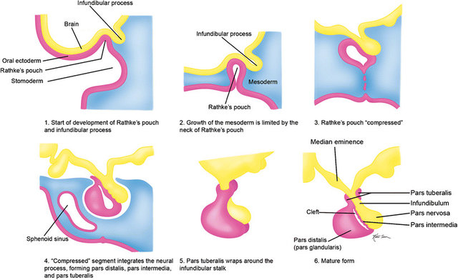
Hypothalamo-hypophysal system
HYPOTHALAMUS
Ventral part of diencephalon (tuberal hypothalamus with the pituitary stalk, mammilary bodies)
+ caudal part of telencephalon (preoptical area)
Symmetrically duplicated parts divided
by the 3rd ventricle
HYPOPHYSIS
Diencephalon – infundibulum
- Neurohypophysis (pars nervosa)
Oral cavity endoderm – Rathke´s pouch
- Adenohypophysis (pars distalis)
https://www.researchgate.net/publication/273833506_Magnetic_resonance_imaging_of_sellar_and_juxtasellar_abnormalities_in_the_paediatric_population_an_imaging_review/figures?lo=1

Slide 22
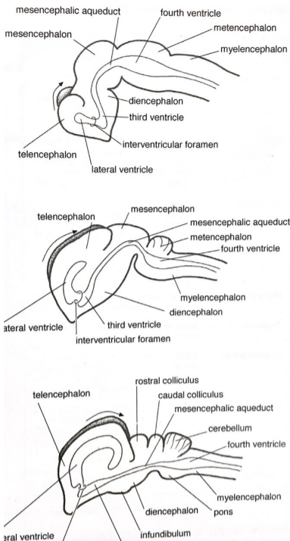
Telencephalon
The most rostral brain region – central part lamina terminalis, 2 lateral diverticles – formation of hemispheres
telencephalon
Cavities of lateral diverticles communicate with 3. ventricle of diencephalon
expansion of hemispheres – reduction of lateral ventricles and 3. ventricle
telencephalon
Development of telencephalon – first rostral expansion, further dorsal expansion, subsequent caudal expansion, finally ventral expansion – formation of C-shaped hemispheres
telencephalon
Hemispheres cover diencephalon, mesencephalon and rostral rhombencephalon – formation of brain cortex
Biggest region – development of centers for learning and memory, intellect and emotions
Edited: McGeady et al. Veterinary Embryology. 2009

Slide 23
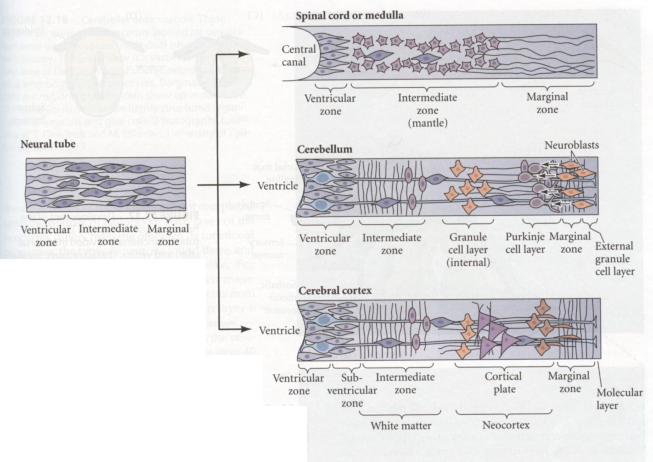
Differentiation of cells in brain cortex
3 basic zones – ventricular, intermediate, marginal
Onset of cortex formation – asymmetric division of radial glial cells – formation of radial glia and neurons
Intermediate progenitors (IP) migrate from ventricular to subventricular zone – symetric division of IPs – formation of identical neurons
migration of IPs to cortical zone through intermediate zone (future white matter)
Cortical layer formed of (from inner to outer regions):
  Fusiform – smaller pyramidal cells, interneurons
  Inner pyramidal layer – bigger pyramidal neurons
  Inner granular – dense small granular cells
  Outer pyramidal – pyramidal cells, short protrusions
  Outer granular – dense small granular cells
  molecular – stelate and basket cells
Scott Gilbert. Developmental Biology 10th edition

Slide 24
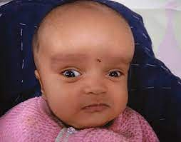
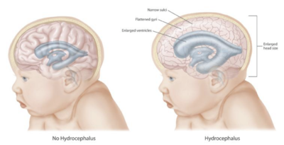
Developmental defects of brain
Macrocephaly
  Expansion of individual brain regions
  Major cause – enhanced proliferation of neurons and glial cells
Hydrocephaly
  Higher production and accumulation of cerebrospinal fluid in brain, often caused by altered connection between ventricles
  Enlarged ventricles cause higher pressure in brain
  lead to headache, problems with balance, double vision, mental changes

Slide 25
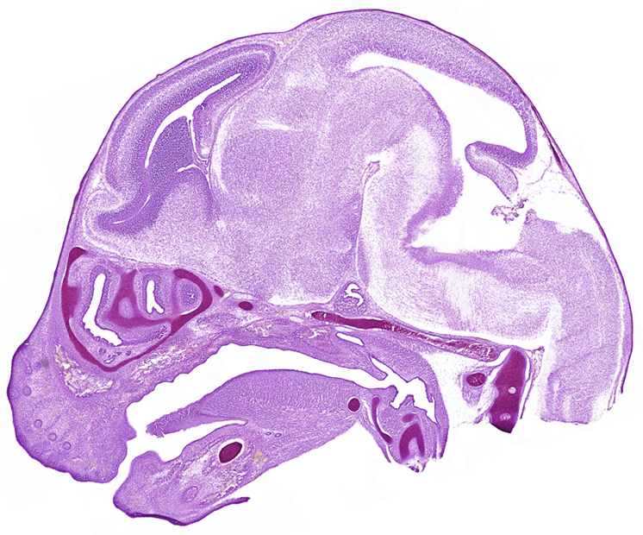
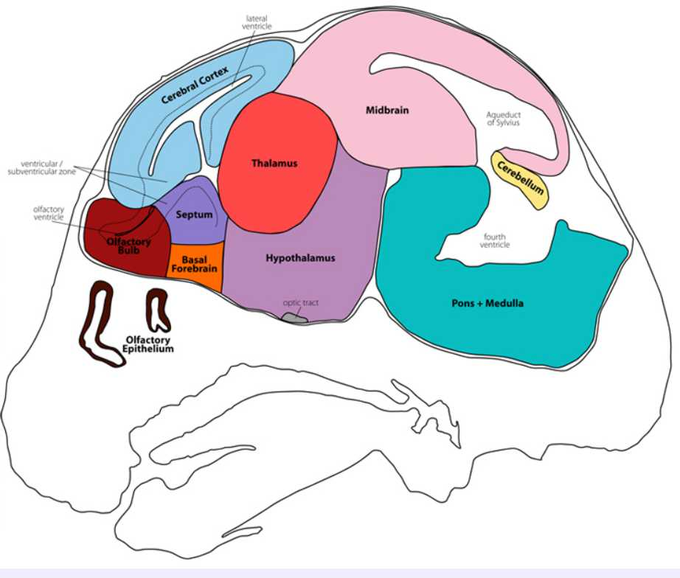
mouse
E12

Slide 26
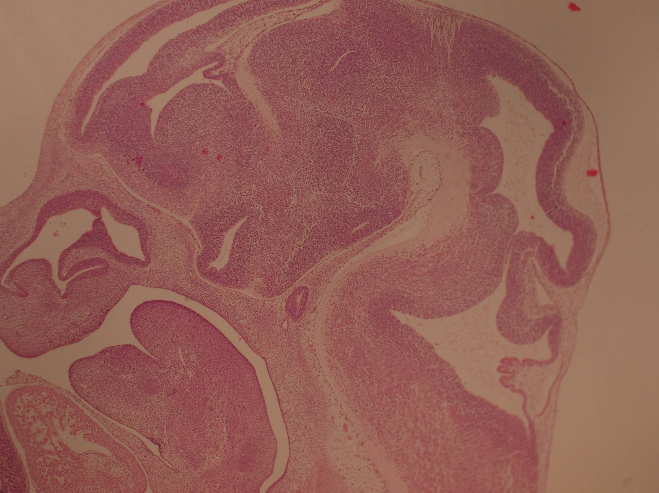
mouse
E12
Hypothalamus Thalamus Midbrain Aquaduct of sylvii
Rathke pouch
Cerebral
cortex
Lateral
Ventricle
Septum
Olfactory
bulb
Pons
Nasal cavity
Cerebellum
Fourth
Ventricle
Choroid plex
Myelenceph.

Slide 27
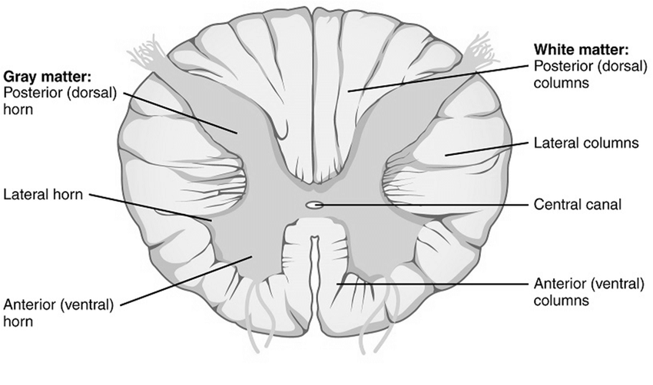
Development of spinal cord
development of spinal cord from neural tube caudally from rhombencephalon
Spinal cord
brain
Enclosed neural tube divided along dorsoventral axis:
  Ventral – floor plate, development influenced by notochord
  ventrolateral – basal plate – motor neurons
  dorsolateral – alar plate – sensory neurons and interneurons
  dorsal – roof plate, development influenced by surface ectoderm (epidermis)
  Sulcus limitans – divide basal and lateral plates
alar and basal plates – formed by proliferation of neuroblasts in mantle layer
O`Kane and Begg. Clinical Embryology
alar – formation of sensory and interneurons
basal – formation of motoric neurons
intensive proliferation, fusion of plates – typical butterfly shape of grey matter

Slide 28
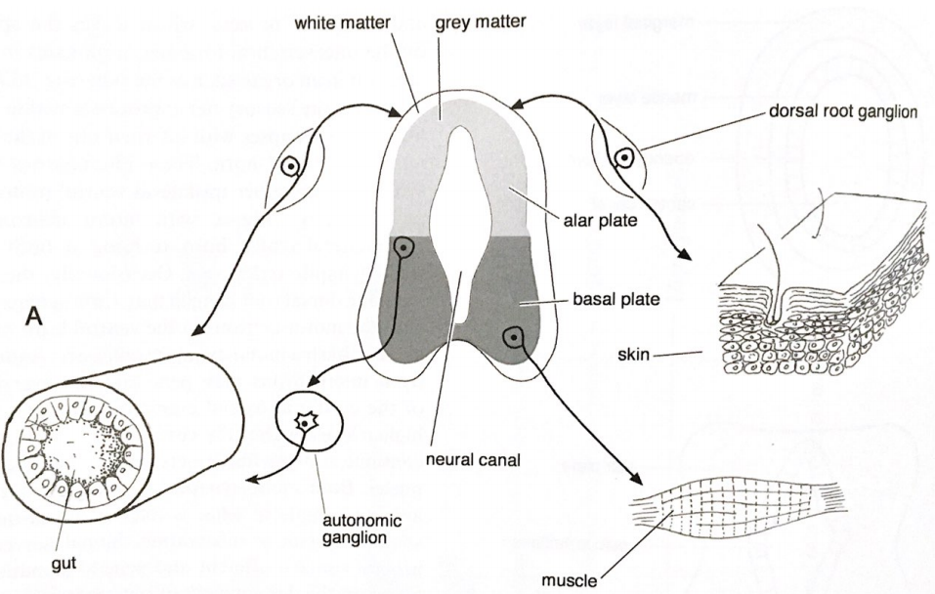
Development of ventral and dorsal spinal cords
Formation of motor neurons (basal plate):
Ventral cord – motor axon outgrows from neuroblast – inervation of effector organ (muscle)
Lateral cord – motoric axon outgrows from neuroblast to autonomic ganglion, axons outgrows from axons of autonomic ganglion – inervation of autonomic organ (gut)
Formation of sensory neurons (neural crest):
somatic neuroblast of dorsal ganglion – one protrusion outgrows towards dorsal spinal cord, other protrusion terminates in somatic sensory receptor (skin)
viscelar neuroblast of dorsal ganglion - one protrusion outgrows towards dorsal spinal cord, other protrusion terminates in visceral sensory receptor (gut)
Edited: McGeady et al. Veterinary Embryology. 2009

Slide 29
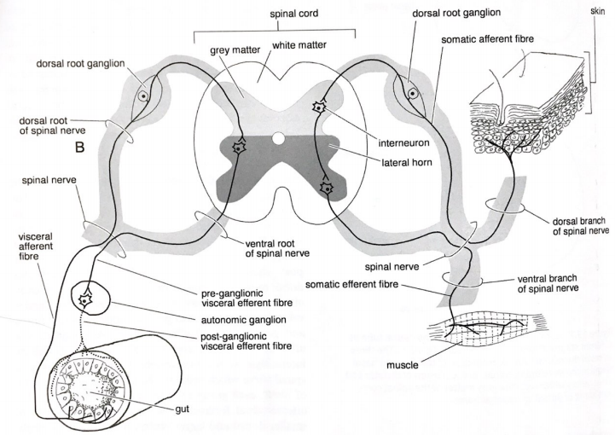
Development of spinal nerves
interneurons – connection between CNS neurons
  Receive information from sensory neurons or interneurons
  Transmission of information to motor neurons or interneurons
efferent fibers – lead signals from CNS to tissues and organs, formed from basal plates
afferent fibers – lead signals from periphery to CNS, formed from neural crest cells
together – spinal nerve, formed of dorsal (afferent) and ventral (efferent) fibers
Edited: McGeady et al. Veterinary Embryology. 2009

Slide 30
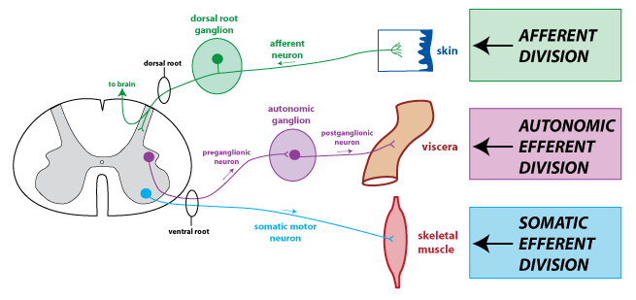
Development of peripheral nervous system
Nervous system outside the brain and spinal cord:
  Cranial and spinal nerves
  Sensory and autonomic ganglia
  Supporting cells
CNS – efferent somatic and autonomic fibers from basal plates
Neural crest:
  Afferent nerve fibers
  Postganglionic neurons
  Spinal, head and autonomic ganglia
  Glial cells
Placodal tissues (ectodermal placodes of sensory system):
  part of cranial neurons and ganglia

Slide 31
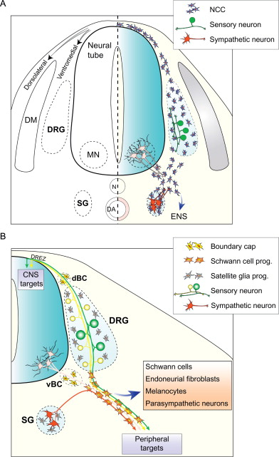
Development of dorsal root ganglia (DRG)
Bodies of neurons responsible for transmission of sensory information from receptors (termoreceptors, nociceptors, proprioreceptors, chemoreceptors) to CNS
Bodies of neurons separated by satellite glial cells – preventing transmission of signals between bodies
Trunk neural crest cells migrate ventrally
migration terminated medially from somites
formation of two cell populations:
  Sensory neurons
  Glial cells (Satellite glia, Schwann cells)
neuron:
  Dorsomedial outgrowth (neural tube)
  Ventrolateral outgrowth (connected to developing spinal nerve)

Slide 32
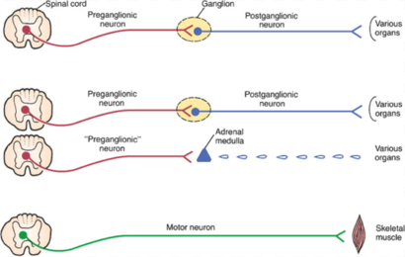
Autonomic nervous system
General visceral efferent system – involuntary regulation of systems (smooth and cardiac muscles, exocrine and endocrine glands)
Divided to:
  sympathetic
  parasympathetic
in contrast with somatic efferent system (one neuron), autonomic system formed of two neurons
connection takes place in autonomic ganglion (neural crest)
Delloye-Bourgeois and Castellani, 2019. Front Mol Neurosci

Slide 33
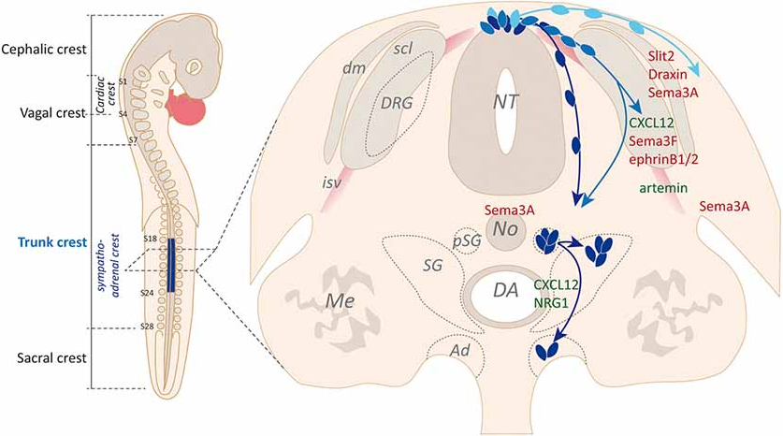
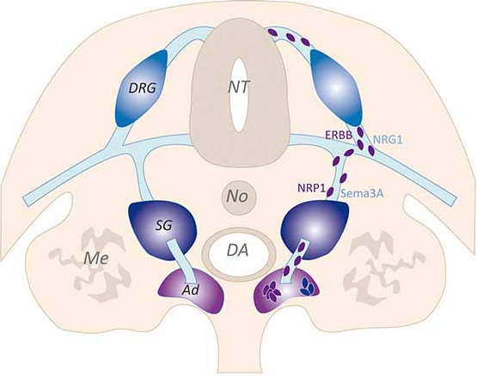
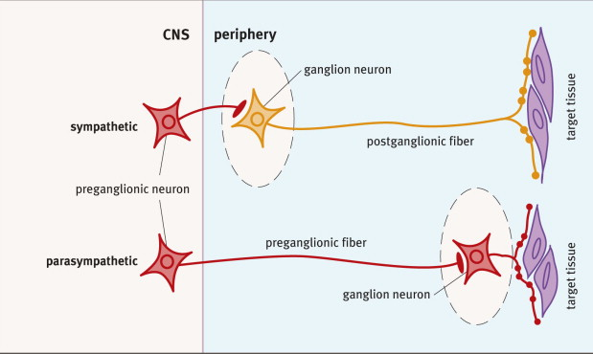
Sympathetic nervous system
Sympathetic system develops:
  preganglionic neurons – trunk and lumbar spinal cord
  postganglionic neurons and ganglion - sympatoadrenal population of trunk neural crest
Sympathetic fibers:
  preganglionic - short
  postganglionic - long
  Ganglia formed close to neural tube
Myelination:
  Myeline sheet formed from Schwann cells
  Postganlionic axon not myelinated
Delloye-Bourgeois and Castellani, 2019. Front Mol Neurosci

Slide 34
Parasympathetic nervous system
Parasympathetic system develops:
  Preganglionic axons – brain stem (part of cranial nerves – Oculomotor, Facial, Glossopharyngeal, Vagus)
  Ganglia and postganglionic neurons – from cranial, vagal and lumbosacral neural crest
Parasympathetic ganglia formed close to or directly in innervated tissue
Parasympathetic fibers:
  Preganglionic – long
  Postganglionic – short
Myelination:
  Formation of myeline sheet from Schwann cells
  Post-ganglionic axon not myelinated

Slide 35
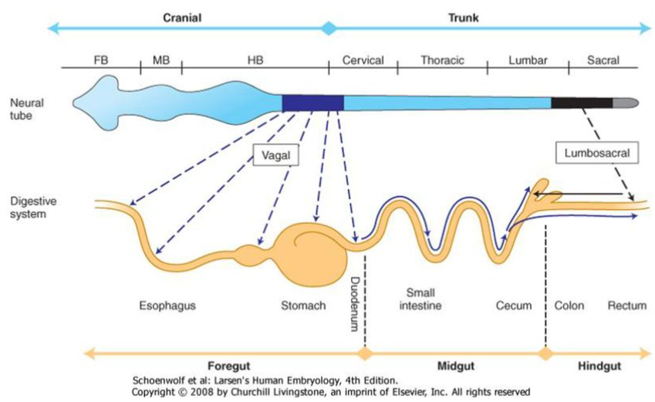
Enteric nervous system
Control of gut motility, secretion, transport of water and electrolytes, vascularization of mucosa
Formed from 2 sources:
  Vagal neural crest (hind brain), inervation of almost the whole gut – including first 2/3 of colon
  Lumbosacral neural crest, inervation of last 1/3 of colon and rectum
Neural crest cells migrate to wall of developing gut, formation of nerve plexus:
  submucosa – Meissner`s plexus
  External muscle layer – Auerbach`s plexus
Larsen Human Embryology, 2008

Slide 36
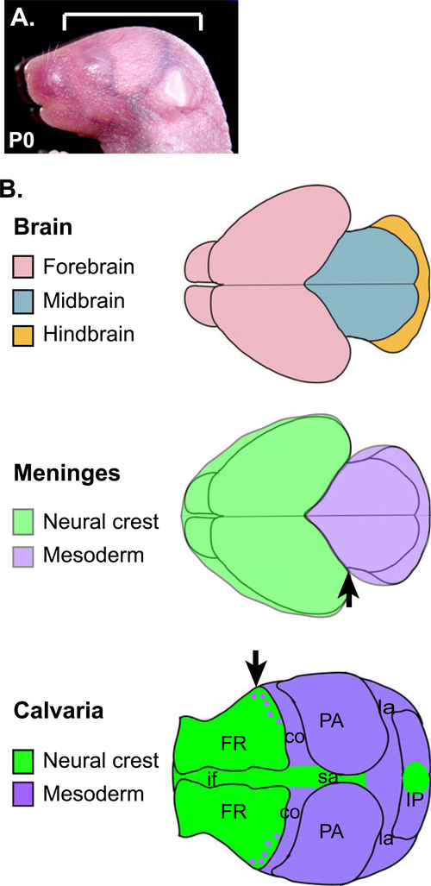
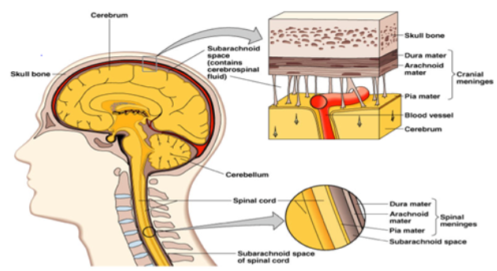
Development of CNS meninges
neural tissue protection, attachement to bones (cranium, backbone), flow of cerebrospinal fluid
Origin of meninges – different for brain and spinal cord
  Cranial brain – neural crest (forebrain)
  Caudal brain and spinal cord – paraxial mesoderm
CNS meninges:
  Outer layer – dura mater
  Middle layer – arachnoidea
  Inner layer – pia mater
Development from mesenchymal sheath - primary meninx
Differentiation of primary meninx:
  Pachymeninx – dura mater
  Leptomeninges – arachnoidea and pia mater
Dasgubta and Jeong, 2019. Genesis

Slide 37
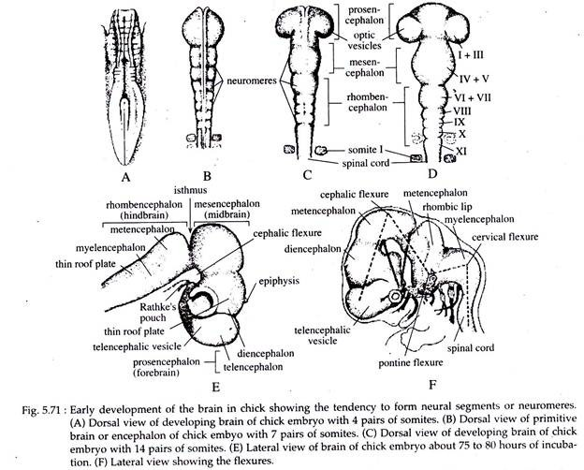
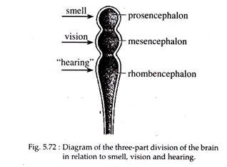
https://www.notesonzoology.com/zoology/development-of-brain-in-chick/2697
Notes:
For years it was assumed that the avian brain was limited in function because it lacked a neocortex.
he mammalian cortex is organized into six layers containing vertical columns of neurons that communicate with one another both horizontally and vertically. The avian brain, on the other hand, was thought to be arranged into discrete collections of neurons called nuclei, including a region called the dorsal ventricular ridge, or DVR, and a single nucleus named the wulst.

Slide 38
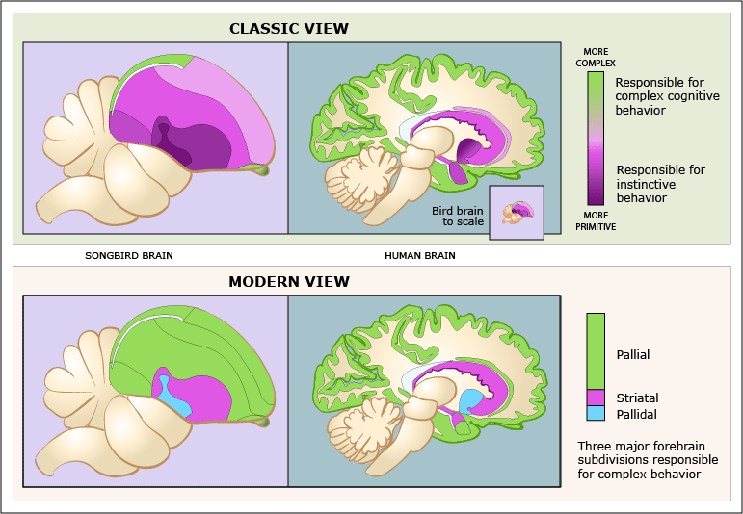
Avian brain
Early development resembles
the mammal brain
Main difference – lack of neocortex
In mammals - information flow among the
brain's layers
In birds - interconnected nuclei
with bands of neurons
Both microcircuits of info are analogic
Increased optic region
https://medicalxpress.com/news/2015-02-mammalian-avian-brains-corticosensory-microcircuit.html

Slide 39
Development of sensory organs

Slide 40
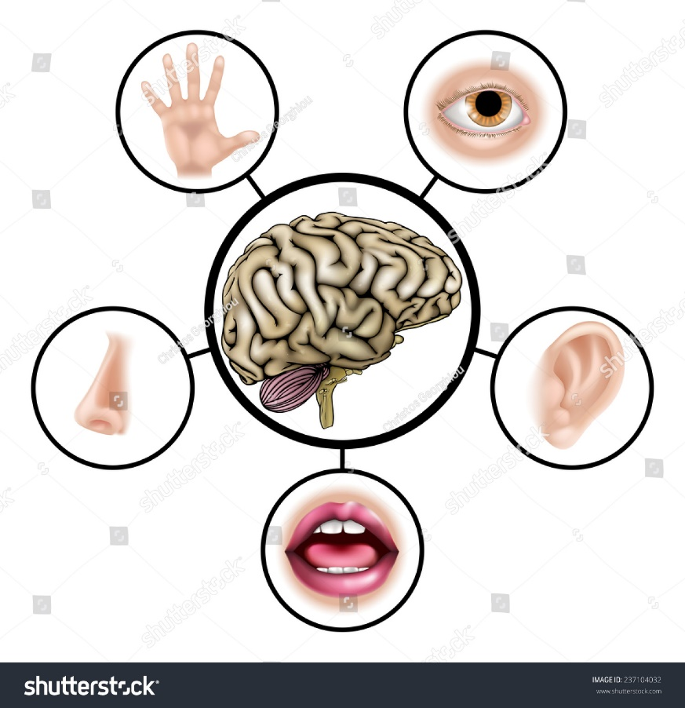
Functions of sensory organs
Development of structures specific for perception of stimuli
Tastes and smells perception
Sounds perception
Optical perception
Water flow perception and electric field perception
Structures for perceving body position and balancing

Slide 41
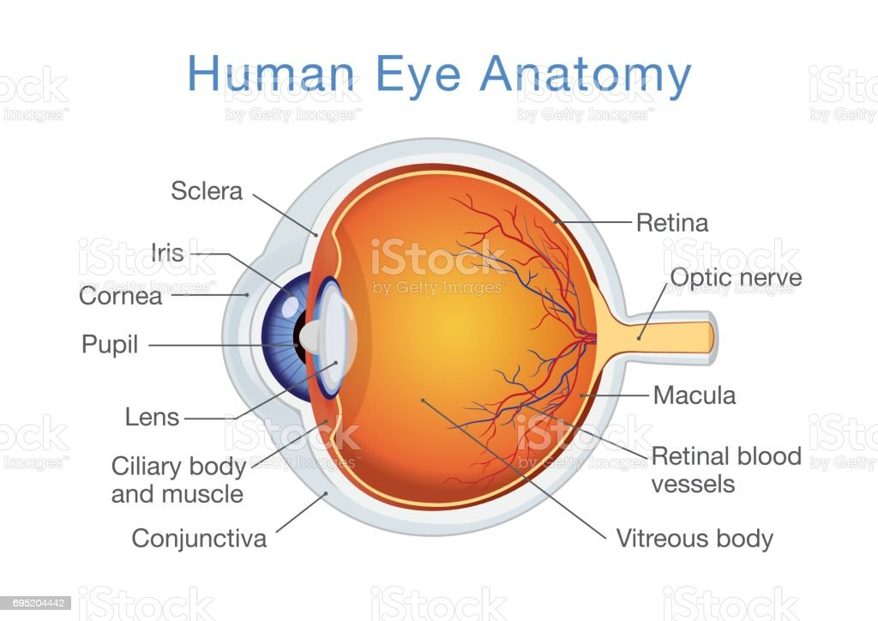
Eye

Slide 42
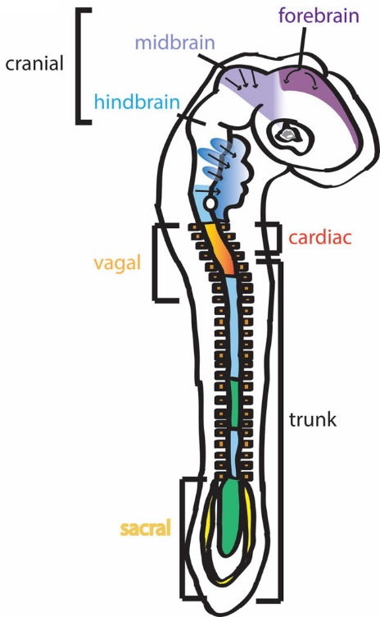
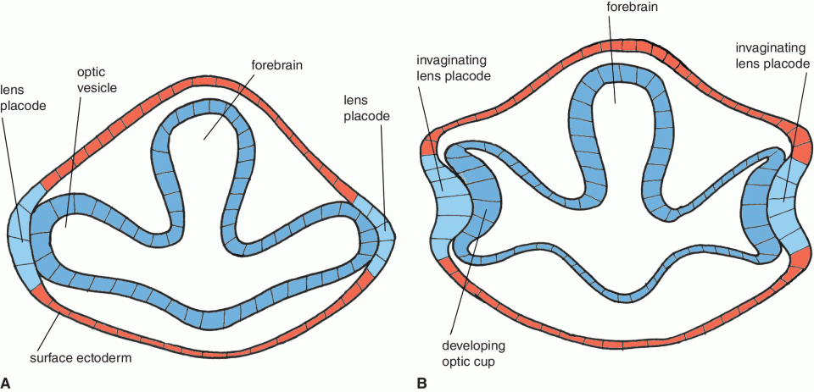
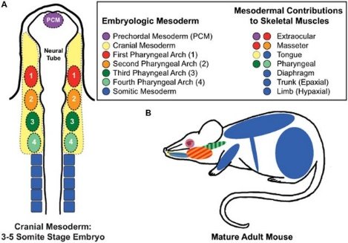
Embryonic origins of individual eye parts
Neural epithelium of diencephalon – retina, iris including smooth muscles, optic nerve, part of vitreous body
Surface ectoderm – lens, cornea, conjunctiva, eyelids, lacrimal duct
Prechordal mesoderm (preotic mesoderm) – external occulomotor muscles
Neural crest (prosencephalon a mesencephalon) – part of epithelium and stroma of cornea, stroma of iris, stroma and muscles of ciliary body, sclera
Randolph and Pavlath, 2015
Williams and Bohnsack, 2015.
Birth Defects Res C Embryo Today
Veterian Key

Slide 43


Development of optic groove and optic vesicle
formation of optic grooves on both sides of forebrain (neural ridges)
Optic groove
Optic grooves
Enclosure of neural tube – formation of sacs from grooves – optic vesicles
Neural ridge
Neural groove
Neural groove
Optic vesicles grow from forebrain through mesenchyme towards the surface ectoderm
During growth – connection between forebrain and optic vesicle is prolonged – optic stalk (basis for optic nerve)
Optic vesicle
Optic vesicle
forebrain
Lens placode
Lens placode
interaction between optic vesicle and surface ectoderm – induction of epithelial thickening (lens placode) in ectoderm (lens precursor)
ectoderm
ectoderm
Optic stalk
Veterian Key

Slide 44

Development of eye basis
induction of invagination epithelium of lens placode – formation of lens depression
forebrain
Optic cup
Invaginating lens placode
Surface ectoderm
mesenchyme
stalk
from lens placode is formed circular structure – further invagination – separation of structure from surface ectoderm – formation of lens vesicle
Lens placode
Optic vesicle
concurrently invagination of optic vesicle epithelium – formation of doublelayered epithelial structure – optic cup
Epithelial double layer of cup
Surface ectoderm
Surface ectoderm
epithelial double layer of optic cup – basis for development of retina
Lens vesicle
Developing lens
Veterian Key

Slide 45

Development of retina
basis – epithelial double layer (outer thinner, inner thicker) of optic cup
Undifferentiated mesenchyme
Pigmented retina layer
Neural layer of retina
ectoderm
smaller anterior (A) part – iris and ciliary body
larger posterior (B) part - retina
A
B
Developing eyelid
Optic nerve
Posterior part:
  Inner epithelial layer – neural layer of retina (photosensory)
  Outer epithelial layer – pigmented retina layer
  separated by intraretinal space
vessels
lens
Intra-retinal space
Veterian Key

Slide 46


Neural retina histogenesis
layer adjacent to intraretinal space – photoreceptors (rods and cones)
Outer nuclear layer – bodies of receptor cells
Outer plexiform layer – formation of synapses between photoreceptors and bipolar neurons, horizontal cells (signal integration)
Inner nuclear layer – bipolar, horizontal and amacrine cell bodies (signal transmission to ganglion cells)
Inner plexiform layer – synapses between bipolar, amacrine and ganglion cells
Ganglion cell layer – ganglion cell bodies
Nerve fiber layer – ganglion cell axons
Müllerian cell (M) – glial cell, supporting retinal cell

Slide 47

Origin of extraocular muscles
Extraocular muscles develop from 2 sources:
  nonsegmented cranial mesoderm
  cranial neural crest
Nonsegmented cranial mesoderm
  Muscle cells
Cranial mesoderm
Cranial neural crest
  Muscle connective tissue (muscle coat)
Extraocular muscles
Randolph and Pavlath, 2015
Sefton and Kardon, 2019. Curr Top Dev Biol

Slide 48


Developmental defects of eye
Microphthalmia
  Congenital eye defect
  Small and insufficiently developed eye
  Defect in formation of optic vesicle
  Unilateral or bilateral
Anophthalmia
  Congenital eye defect
  Missing eye, ultrasound often reveals rest of the eye basis inside the head
  Defective formation of optic vesicle
  Unilateral or bilateral

Slide 49

EAR

Slide 50


Development of ear
Ear formed of 3 parts:
  external – auricle, external canal
  middle – middle ear cavity, Eustachian tube, bones and muscles
  inner – saccule, cochlea, organ of Corti
Anthwal and Thompson, 2015. J Anat
Ear basis develops:
  in region of pharyngeal arches and hindbrain
  formation of ectodermal thickening (ear placode)
  placode – basis for development of inner ear
Otic placode
Invaginating neural tube
Pharyngeal arches
Otic placode
Lens
placode

Slide 51

Development of inner ear
formation of ectodermal thickening in the hindbrain region – otic placode
Optic groove
Otic placode
Neural ridge
hindbrain
section
Surface ectoderm
epithelial cells of otic placode start to invaginate to mesenchyme around hindbrain – formation of otic pit
Otic placode
mesenchyme
Otic pit
section
Otic placode
Otic pit separates from surface ectoderm – formation of hollow structure lined by cylindrical epithelium – otic vesicle, cavity filled with endolymph
Otic placode
Neural tube
Otic vesicle
Otic vesicle localized in region between surface ectoderm covered by mesenchymal cells – ear capsule
section
Formation of otic vesicle
Surface ectoderm
some epithelial cells – leave vesicle and form sensory ganglia of VIII. cranial nerve (vestibulocochlear)
Otic vesicle
Moore and Persaud. The developing Human 8e

Slide 52


Differentiation of otic vesicle
from otic vesicle – formation of membranous labyrinth lined with epithelium
Utricular part (developing semicicular duct)
epithelium differentiation – regions with different thickness of epithelium
Otic vesicle divides into 2 parts:
  dorsal – utricular (vestibular basis – vestibular/balancing system)
  ventral – saccular (inner ear basis – hearing)
saccule
dorsomedial – evagination leads to formation of endolymphatic duct, with terminal extension – endolymphatic vesicle (regulation of volume and pressure of endolymph)
Cochlear canal
Edited: McGeady et al. Veterinary Embryology. 2009

Slide 53


Development of vestibular system
from dorsal utricle - semicircular ducts
Formation of 3 semicircular ducts:
  2 vertically oriented
  1 oriented under 90 ^{O} angle to vertical ducts
Semicircular ducts
at the end of each canal - extension called ampullae containing sensory organs
Edited: McGeady et al. Veterinary Embryology. 2009

Slide 54


Development of cochlear system
from ventraly oriented saccule formation of evagination – cochlear duct
duct first prolongates and narrows and later convolutes
narrow duct connecting saccule and cochlear duct – ductus reuniens
ductus reuniens
adjacent mesenchyme – differentiation to auditory cartilage
Edited: McGeady et al. Veterinary Embryology. 2009

Slide 55




Development of cochlear system
part of cartilage adjacent to basillary membrane is vacuolated
Endolymphatic vesicle
Semicircular canal
cartilage
formation of cavity between outer cartilaginous layer and membranous labyrinth – perilymphatic space filled with perilymph
Basilar membrane
ampullae
saccule
Perilymphatic space divided to:
  Scala vestibuli – cochlear duct separated by vestibular membrane
  Scala tympani – cochlear duct separated by basilar membrane
ductus reuniens
Cochlear duct
Cochlear duct
Vestibular membrane
scala vestibuli
differentiation of basal cells in cochlear duct – formation of organ of Corti
scala vestibuli
Cochlear duct
Cochlear duct
Nerve fibers
cartilaginous labyrinth ossify – formation of bony labyrinth
migration of cells from medial sac wall medialy – formation of statoacoustic ganglion (together with neural crest cells)
scala tympani
ganglion
developing organ of Corti
Organ of Corti
scala vestibuli
Edited: McGeady et al. Veterinary Embryology. 2009

Slide 56

Development of middle ear
Tympanic cavity, Eustachian tube, bones and muscles
Basis of malleus and incus
Basis of stapes
epithelium of 1. pharyngeal cleft
Epithelium of 1. pharyngeal arch pouch (endoderm)
  Tympanic cavity
  Eustachian tube
epitel 1. faryngeální výchlipky
Epithelium of 1. pharyngeal pouch
middle ear ossicles – mesenchyme of pharyngeal arches
Tympanic cavity
Eustachian tube

Slide 57

Development of middle ear ossicles
Malleus, incus and stapes develop from 1. and 2. pharyngeal arches
1. pharyngeal arch – endochondral ossification of Meckel`s cartilage:
  Malleus
  incus
malleus
incus
2. pharyngeal arch – endochondral ossification of Reichert cartilage:
  stapes
stapes
Meckel`s cartilage
Reichert cartilage
Scott Gilbert. Developmental Biology 10th edition

Slide 58




Development of external ear
external canal, auricle, tympanic membrane
epithelium of 1. pharyngeal arch cleft (ectoderm)
  External auditory canal
  partly tympanic membrane and auricle
Developing external auditory canal
Developing external auditory canal
meatal plug
proliferation of pharyngeal cleft cells – formation of transitional epithelial plug of ear canal - meatal plug
ectodermal wall get to contact with endodermal wall, separated by thin mesenchymal layer – basis for formation of tympanic membrane
in human – external ear (auricle) develops from mesenchyme of 1. and 2. pharyngeal arch covered by ectoderm – basis for 6 auricular swellings
Edited: McGeady et al. Veterinary Embryology. 2009

Slide 59


Developmental defects of ear
Anotia/microtia
  Insufficient development of auricle and external auditory canal
  Anotia – complete missing of external ear (rare)
  Microtia – small insufficiently developed ear
Cochlear aplasia/hypoplasia
  Altered development of middle ear labyrinth and adjacent structures
  Aplasia – complete absence of cochlear and vestibular apparatus
  Hypoplasia – smaller cochlear and vestibular apparatus

Slide 60

NoSE

Slide 61


Development of nasal cavity
formation of nasal placodes – ectodermal thickening, epithelium growth and mesenchymal proliferation around placodes
Medial nasal processes
Placode deepening – formation of nasal pit, lateral nasal processes on sides, medial nasal processes are formed later
deepening and extension of nasal pit – nasal groove
deepening of nasal groove, approaching stomodeum – formation of nasal sac
Som and Naidich, 2013. Am J Neurorad

Slide 62


Separation of primitive nasal and oral cavities
maxillary prominences grow medially – nasal sacs are pushed medially
medial nasal prominence form intermaxillary segment
closing space between maxillary and medial nasal prominences – buconasal groove disappears → closing of the nasal sac lower part
primitive nasal and oral cavities separated
Som and Naidich, 2013. Am J Neurorad

Slide 63

Formation of nasal and oral cavities
primitive nasal cavity epithelium grows to underlying mesenchyme – formation of oronasal membrane (connection of primitive nasal and oral epithelium)
differentiation of the olfactory epithelium dorsally
brain epithelium
oral cavity
oronasal membrane breakdown
communication between oral and nasal cavitites through primitive choana
secondary palate formed from maxillary prominences, definitive choana formed caudally
McGraw-Hill, 2006

Slide 64

Differentiation of olfactory epithelium
dorsal part of nasal cavity – differentiation of olfactory epithelium
2 sources:
  ectoderm – sensory bipolar neurons, basal epithelial cells
  neural crest – ensheathing supporting cells
Sensory bipolar neurons:
  1. outgrowth – nasal cavity
  2. outgrowth – axon leading to olfactory lobe in brain
basal epithelial cells – stem cells of sensory olfactory neurons (basis for recovery of sensory neurons)
Supporting cells – glial cells of sensory olfactory neurons

Slide 65

Developmental defects of olfactory epithelium
Anosmia/hyposmia
  Altered development of olfactory epithelium
  Mostly no differentiation of olfactory epithelium
  Defective communication between epithelium and brain
  Can be also caused by infections – ability to regenerate
  Anosmia – complete absence of olfactory epithelium
  Hyposmia – partial defect in olfactory epithelium differentiation

Slide 66

Taste

Slide 67


Development of taste system
formation of taste placodes – cylindrical cells in cubic tongue epithelium – invagination to underlying mesenchyme – taste papilla
taste papilla – mesenchymal basis covered by epithelium
cells in placode and adjacent epithelial cells undergo morphogenesis which give rise to morphologically diverse taste papilla:
  circumvallate – posterior tongue
  foliate – lateral tongue
  fungiform – anterior tongue
Kramer et al. 2019
epithelial placodal cells in papilla differentiate to sensory cells and form taste buds
Chandrashekar et al. 2016. Nature

Slide 68

Cells forming taste bud
taste buds localized in multilayered epithelium, taste bud connected with oral cavity through taste pore
Receptor cells – individual types of receptor taste cells, connected to afferent sensory nerve fibers, differentiate from ectoderm
Support cells – glia-like cells covering receptor cells
  most numerous
  develops from precursors originating in neural crest
Basal cells – stem cells of taste buds – ability to recover taste cells
Pagella et al. 2014. Cell Mol Life Sci

Slide 69

Integument

Slide 70
Functions of skin
formation of outer layer of individuals body and other structures (hair, fingernails, feathers)
Formation of protective layer with multiple functions:
  barrier against physical, chemical, mechanical and biological factors
  termoregulation
  secretion
  immune response
  pigmentation

Slide 71


Origin and development of skin and its derivatives
main source for development of external surface:
  epidermis - ectoderm
  dermis
    paraxial mesoderm – trunk
    somatic part of lateral plate mesoderm – trunk, limbs
    cranial neural crest - head
Introduction to Anatomy and Development, University College London
Green et al. 2015. Nature

Slide 72


Epidermis development
epidermis – outer layer of skin
cuboidal epithelium, basal membrane in contact with mesenchyme
after neurulation – 2 layers:
  Basal layer – cuboidal epithelium, mitotically active
  periderm – flat cells on surface, first differentiation of basal cells, cover developing body
Periderm detachment
Basal cells proliferate – formation of intermediate layer – onset of multilayered epidermis formation
Basal layer cells differentiate into cells specific for individual layers
during differentiation – peridermal cells detach from epidermis surface
Edited: McGeady et al. Veterinary Embryology. 2009

Slide 73

Epidermis development
differentiation of basal cell layer below the periderm – formation of epidermis layers:
  stratum basale
  stratum spinosum
  stratum granulosum
  stratum corneum
Keratinizing layer
Intermediate layer
differentiation of basal cells induced by factors produced in underlying mesenchyme (mesoderm) – formation of keratinocytes in epidermis (keratin production)
Basal layer
Basal lamina
formation of keratinizing multilayered squamous epithelium
dermis
melanoblasts migration (neural crest) to forming epidermis – formation of melanocytes (pigment production), or migration of Schwann cell precursors (also formation of melanocytes)
Edited: McGeady et al. Veterinary Embryology. 2009

Slide 74

Migration – important mechanism for development of diverse tissues and organs
free migration – small body size (earlier then E12 stage), cells migrate efficiently
perineural migration – large body size (later then E12 stage), cells do not migrate efficiently – participation of nerves
Schwan cell precursors (SCPs) – migrating precursors for different cell types
Furlan and Adameyko, 2018

Slide 75

Epidermal layers
Stratum basale – cuboidal to cylindrical cells, stem cells and keratinocytes, melanocytes, proliferating cell layer - regeneration of epidermis
Stratum spinosum – the thickest layer formed of kerytinocytes, in deeper layers proliferating cells, cells produce keratin fibers and flatten
Stratum granulosum – multiple layers of flat keratinocytes, contain keratohylian granules
Stratum lucidum – tightly connected keratinocytes without nuclei and organeles
Stratum corneum – multiple layers of dead keratinizing cells, formation of durable and strong surface

Slide 76

Dermis development
dermis – layer underlying the epidermis
Formed from different sources:
  paraxial mesoderm – basis for dermis formation in trunk region
  somatic lateral plate mesoderm – basis for dermis development in trunk and limbs
  Cranial neural crest – basis for dermis in head region
mesenchymal cells of dermis differentiate to fibroblasts (connective tissue cells)
fibroblasts produce collagen and elastic fibers
surface papillary layer – loose connective tissue
underlying reticular layer – dense connective tissue, large amount of collagen and elastic fibers
localization of nerves, vessels, glands and hair follicles

Slide 77



Developmental defects of skin
Congenital skin aplasia (aplasia cutis congenita)
  congenitally missing skin
  local or the whole surface
  The most often - missing skin on head
  patogenesis not clear – caused by drug use and other substances during pregnancy
  insufficient closure of surface ectoderm
Cephalocele
  permeation of intracranial structures through opening in the skull
  caused by insufficient separation of neuroectoderm from surface ectoderm
  formation of sac filled with neural tissue covered by skin

Slide 78

Origin and development of hair follicle
Origin of hair follicle:
  basal layer of epidermis (ectoderm) grows through the underlying mesenchyme (dermis - mesoderm or neural crest)
  formation of hair follicle
stages:
  epidermal placode
  hair bud
  hair bulb
  hair cone
  hair

Slide 79


Developmental stages of hair
formation of epidermal thickening - placode in epidermis
epidermal placode cells rearrange, proliferate and invaginate to underlying mesenchyme – formation of hair bud
Epidermis proliferation
Epidermis proliferation
mesenchymal cells condensate around the bud region – bud prolongation, mesenchymal cells surrounded by epithelial (hair papilla) – formation of hair bulb
Hair papilla – germ cells, matrix cells, melanocytes
mesenchyme
Hair papilla
Hair papila induces formation of inner epidermal cells – formation of germinal matrix:
  Hair fiber
  epithelial root sheet
Root of hair
Germinal matrix
formation of cavity in hair bulb – connection of germinal matrix and surface
Hair papilla
Edited: McGeady et al. Veterinary Embryology. 2009

Slide 80


Developmental stages of hair
outer epidermal cells line the cavity – outer hair sheet, localization of Bulge – hair follicle stem cells
germinal matrix cells – proliferate and transfer to cavity in outer hair sheet – keratinization of cells and formation of hair fiber
continuous proliferation of basal cells in matrix cause pushing of the hair fiber towards the surface
epidermis
B
surrounding mesenchyme:
  connective tissue
  smooth muscles – arrector hair fiber muscle
invagination of basal epidermal layer in hair region:
  sebaceous glands
  sweat glands
Hair papilla
Edited: McGeady et al. Veterinary Embryology. 2009

Slide 81

Hair life cycle
postnatal – changing proliferation and resting phases:
anagen
  Active growth
  Proliferation of papillary cells
katagen
  regression stage (recess)
  proliferation in papilla is inhibited
  hair root changed – club-shape
telogen
  outer epidermal cells constriction in hair root region
  hair follicle attached by strands of epithelial cells to recessing papilla
renewed anagen
  formation of replacement hair
  epithelial strands – formation of renewed hair bulb surrounding new hair papilla
  old hair pushed out by replacement hair
anagen
katagen
telogen
renewed anagen
Edited: McGeady et al. Veterinary Embryology. 2009

Slide 82



Developmental defects of hair
Congenital hypotrichosis
  hair absence during fetal period – often during whole life
  isolated defect, no other skin defects
  caused by mutations in genes important for growth, proliferation and differentiation of hair bulb cells
Romero and Grimalt, 2014.
Congenital hypertrichosis
  also called Werewolf syndrome
  overproduction of hair due to formation of more hair follicles
  often fetal hair preserved
  caused by mutation in genes responsible for formation and growth of hair follicles
  mutations often caused by drug use during pregnancy (antibiotics, anti-inflammatory drugs, immunosuppressive drugs)
Shah et al. 2018. Ind J Dermatol Vener Leprol

Slide 83




Origin and development of feathers
interaction of epithelial thickening (epidermis – ectoderm) with condensing dermal cells (mesoderm, neural crest)
epidermis
formation of conical papilla – epidermal surface, underlying dermal papilla
Dermal condensation
dermal papilla continuously push out covering epidermis – formation of basic feather bud
invagination of epidermal cells at the base of feather bud into dermis – formation of follicles covered with epidermis (ectoderm)
Dermal papilla
Early fibers (barbs)
Fibers (barbs) basis
Feather sheat
follicle prolongation – feather bud tips start to form protrusions of follicles (fibers/barbs basis)
Medullar cavity
Broken feather sheat
Down feathers – basal cells in papilla proliferate – formation of epithelial colar, formation of cellular protrusions to medullary cavity
separation of protrusions and keratinization – formation of individual fibers
Dermal medulla
Basis of follicle
Edited: McGeady et al. Veterinary Embryology. 2009

Slide 84



Origin and development of feathers
contour feathers – early development identical with down
epidermis
bud
barbs
formation of epidermal collar at the base of developing bud
crown of barbs
epidermal colar
shaft (main axis)
proliferation in the surface collar region – formation of basis for shaft (axis) of feather – prolongation towards distal part of bud
epidermal sheath
developing barbs
developing shaft
epidermal collar
smaller barbs outgrow from main shaft on both sides – basis for vane
barb ridges
epidermal collar
Edited: McGeady et al. Veterinary Embryology. 2009

Slide 85


Development of fingernail
formation of thickened epidermal region (ectoderm) in dorsal region of last (distal) phalanx – nail field
lateral nail folds
proximal nail fold
both sides from the nail field – lateral nail folds – overgrow nail field, connected to proximal nail fold
under the proximal nail fold – formation of nail matrix – production of nail-forming material
nail matrix cells are keratinizing – formation of nail plate
nail plate grows distally over the nail bed towards the end of finger
Cui et al. 2013. J Investig Derm

Slide 86


Developmental defects of fingernail
Congenital anonychia
  partial or total absence of fingernails on feet and/or hands
  caused by defects in nail matrix formation or inability to produce material for nail formation
Etensel et al. 2002. Eur J Plast Surg
Khan et al. 2015. Br J Dermatol

Slide 87

Origin and development of scales in bony fish
zebrafish (Danio rerio) – formation of leptoid scales – the most often scale type
leptoid/elasmoid scales – concentrically shaped scales formed of 4 layers:
elasmodin – deepest layer, not completely mineralized, formed of collagen fibers in layers (plywood look)
External layer – thin well mineralized layer formed of collagen fibers
Limiting layer – highly mineralized layer with no collagen fibers
surface layer – formed of epidermis, almost the whole surface
Sire and Akimenko, 2004. In J Dev Biol

Slide 88

Origin and development of scales in bony fish
Interaction of epithelial epidermal cells (ectoderm) with mesenchymal dermal cells (paraxial mesoderm) – accumulation of mesenchymal cells under the basal epidermal layer (early morphogenesis)
late morphogenesis – accumulation (condensation) of mesenchymal cells in scale papilla
early differentiation – upper layers of papilla differentiate to scale-forming cells, accumulation of first scale parts between papilla-forming cells – external layer
Scale papilla
late differentiation – deeper layers of papilla under the external layer differentiate to elasmoblasts – production and accumulation of elasmodin
External layer
bending and invagination – epidermis bends around posterior part of developing scale – formation of overlay over the next scale, in anterior part invagination of scale to dermis
elasmoblasts
elasmodin
Sire and Akimenko, 2004. In J Dev Biol

Slide 89
Fun facts
How quick is the transfer of infos in the brain?
How many watts can brain generate?
If eye would be a camera, what woudl be its resolution?
When ear lobe stop growing?
Notes:
7000 m/s
23W
576 mega pixels

