Slide 1
Development of urogenital system
Excretory system
Reproductive system

Slide 2
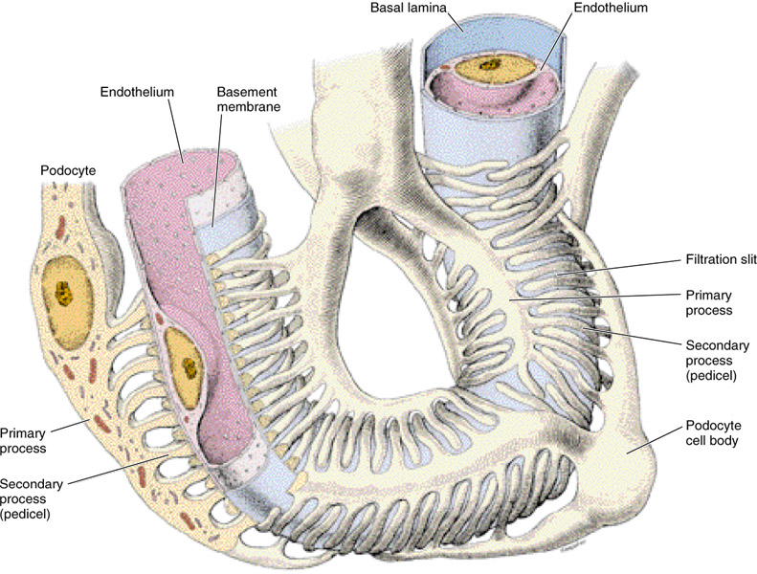
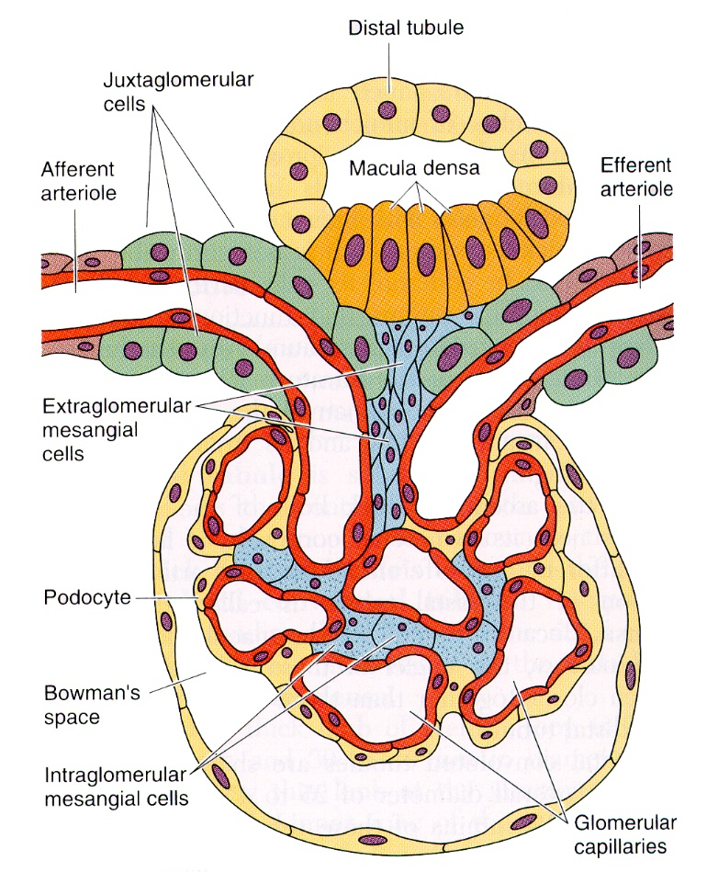
Excretory system functions
Excretion of metabolites via filtration
Regulation of electrolyte amounts in body
Water reabsorption
Renin production by juxtaglomerulac cells – regulation of blood pressure
Production of erytropoetin by kidney intersticial fibroblasts – regulation of erytrocytes number

Slide 3
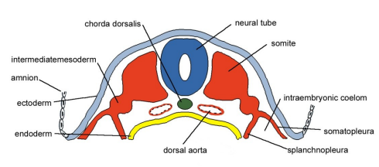
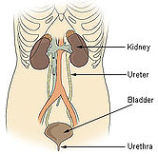
Origin and development of excretory system in vertebrates
notochord
Neural tube
Main source for excretory system – intermediate mesoderm
endoderm – epithelial basis of bladder and urethra
splanchnic mesoderm – vessels, connective tissue, muscle cells
Ectoderm – distal part of urethra (males)
Paraxial mesoderm
Intermediate mesoderm
amnion
ectoderm
endoderm
somatopleura
Dorsal aorta
splanchnopleura
development of excretory system tightly connected with development of reproductive system (intermediate mesoderm)
Excretory system developes earlier than reproductive
kidney
ureter
Excretory system is composed of:
kidney
ureter
bladder
urethra
bladder
urethra

Slide 4
Development of intermediate mesoderm
mesoderm localized intermediary – between paraxial mesoderm and lateral plate mesoderm
notochord
Neural tube
Paraxial mesoderm
Intermediate mesoderm
amnion
epiblast cells invaginate to space between newly formed endoderm (originally hypoblast) and forming ectoderm (originally epiblast)
ectoderm
endoderm
somatopleura
Dorsal aorta
splanchnopleura
migration of mesodermal cells cranialy, caudaly, lateraly
Three mesodermal zones:
Paraxial mesoderm – closest to developing neural tube
Lateral plate mesoderm – mesoderm localized on sides
Intermediate mesoderm – between paraxial m. and lateral plate m.

Slide 5
Formation of nephrogenic cords
from intermediate mesoderm differentiate pairs of nephrotomes – nephrogenic cords
Cords formed by migration of cells from mesoderm lateraly from developing dorsal aorta
Paraxial mesoderm
Dorsal aorta
Cranial part
Intermediate mesoderm
somites
Cells of nephrogenic cords migrate and form three nephrogenic segments along craniocaudal body axis:
Pronephric region
Somatic mesoderm
Splanchnic mesoderm
Mesonephric
region
pronephric region - cranially
mesonephric region - caudally from pronephric region
metanephric region - caudally
cloaca
Metanephric region
Caudal part
Three paired basis of „kidney“ developmental stages
Duke embryology

Slide 6
Development of kidney
Kidney develop in two transitional stages, third stage is definitive:
Transitional – pronephros a mesonephros
Definitive - metanephros
pronephros
Degenerating pronephros
cranial
Degenerating mesonephros
Pronephros (pre-kidney) – first kidney tissue, gradual degradation
mesonephros
mesonephros
Mesonephros (primary kidney) – second developmental stage, partial degradation, part is transformed
developing metanephros
Metanephros (definitive kidney) – last stage, definitive kidney
caudal
Teach Me Anatomy

Slide 7
Development of pronephros
Rudimentary, non-functional kidney
degeneration
formed ventraly from developing cranial somites
cranial
pronephros
Mesodermal cells form pronephric duct (tube) lateraly
dorsal
somites
Cells of ducts migrate caudaly, cranial part of ducts induce formation of pronephric tubules from surrounding nephrogenic mesenchyme
Pronephric tubule
Pronephric duct
Pronephric duct
Pronephric tubules functional only in fish and larva of amphibians, non-functional in reptiles, birds and mammals
Nephrogenic mesenchyme
Cranial part of ducts and tubules degenerate
Wolffian duct
caudal
caudal part of pronephric ducts preserve excretory function during development - formation of Wolffian duct from caudal part of pronephric duct
ventral
Edited: McGeady et al. Veterinary Embryology. 2009

Slide 8
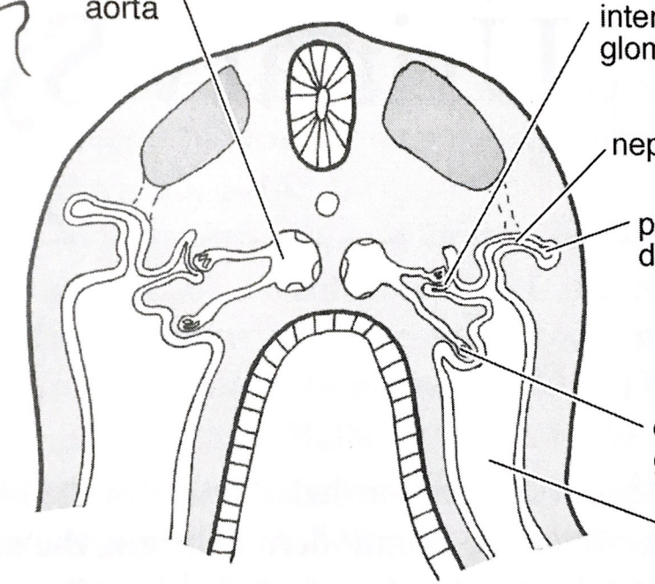
Development of pronephric body
Pronephric tubules formed on level of each cranial somite
Dorsal aorta
Inner glomerulus
Each developing tubule is connected with nephrocoel cavity which opens to coelomic cavity through nephrostome
Pronephric tubule
branching of capillary loops (glomerulus) from dorsal aorta, invaginate to:
Epithelium of coelom – outer glomeruli, filtration from coelom
Walls of tubule – inner glomeruli, separated from coelom
Pronephric duct
epithelium forming around loop of capillaries forms Bowmans capsule
Outer glomerulus
Outer glomeruli
Formation in lower vertebrates, less effective filtration
Filtration of fluid is allowed thanks to activity of ciliated cells from coelomic cavity to pronephric tubules close to nephrostome
coelom
Edited: McGeady et al. Veterinary Embryology. 2009

Slide 9
Development of mesonephros
degeneration
Wolffian duct induces development of tubules from adjacent nephrogenic mesenchyme
Degenerating pronephros
Formation of mesonephros – in some mammals (human) filtration is functional
cranial
Induction of tubule formation more caudaly
mesonephros
degeneration of pronephros cranialy
Wd
male – Wolffian duct as basis for epididymis and ductus deferens development
Nephrogenic mesenchyme
caudal
cloaca
Teach Me Anatomy

Slide 10
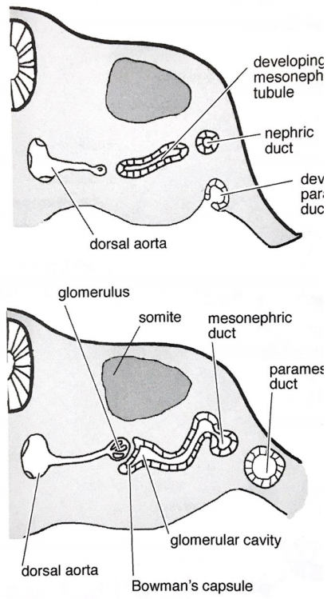
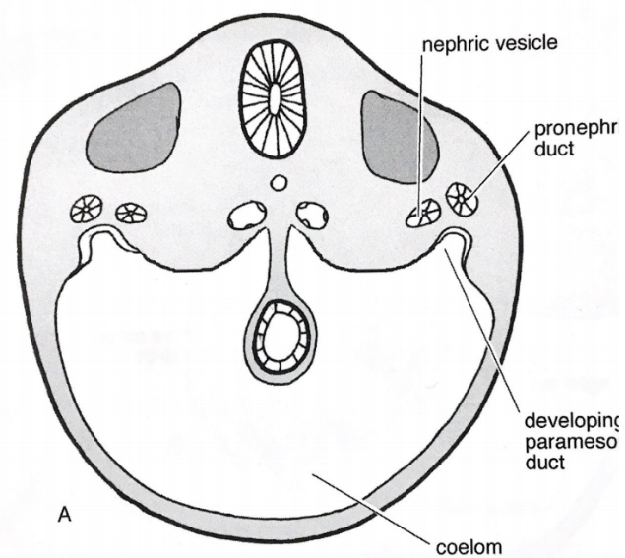
Development of mesonephric bodies
lateral
lateraly development of mesonephric ducts
Mesonephric tubule
Induction of mesonephric tubule formation medialy from nephrogenic mesenchyme
Basis of tubule
Mesonephric duct
medial
mesonephric duct
Forming paramesonephric duct
mesonephric tubules connect laterally to mesonephric (Wolffian) duct
Dorsal aorta
glomerulus
Mesonephric duct
tubules grow medialy and start to form Bowmans capsule
somite
Forming paramesonephric duct
Paramesonephric duct
Bowmans capsule enclose developing capillary loops of glomerulus from mesonephric arteries
coelom
mesonephric arteries develop through branching directly from dorsal aorta
Glomerular cavity
Dorsal aorta
Bowmans capsule
Edited: McGeady et al. Veterinary Embryology. 2009

Slide 11
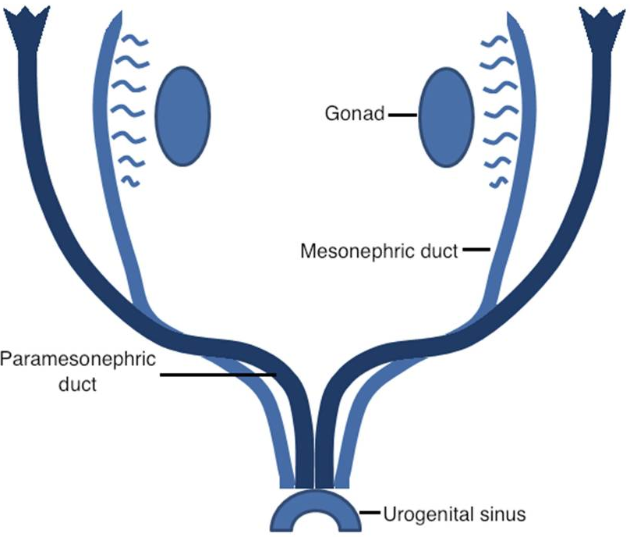
Development of paramesonephric ducts
lateral
basis for Müllerian duct development
females – basis for development of fallopian tubes, uterus, cervix and upper third of vagina
males - atrophies
cranial
gonads
medial
Mesonephric duct (Wolffian)
Develop lateraly of Wolffian duct from coelomic epithelium, so called Müllerian ridge
Paramesonephric duct (Müllerian)
parallel development with Wolffian ducts in cranial region
transition of Müllerian ducts to ventral side in caudal region
caudal
Corsoginho et al. 2016. ECR

Slide 12
Development of metanephros
Formation of definitive kidney (metanephros) caudaly from mesonephros
degeneration
mesenchyme:
medulla
cortex
Formed from paired primordial structures – ureteral buds – outgrowths of mesonephric ducts
cranial
Degenerating mesonephros
Buds grow into nephrogenic mesenchyme (caudal region of nephrogenic basis)
bud:
renal pelvis
collecting tubules
mesonephros
from buds are developed:
renal pelvis
collecting tubules
Metanephric nephrogenic mesenchyme
collecting tubules induce formation of mesenchymal structures:
medulla
cortex
Ureteral bud
caudal
Nephric duct

Slide 13
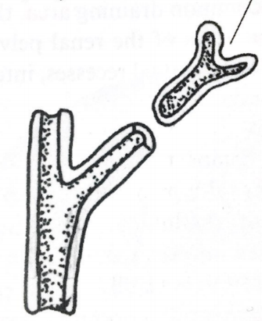
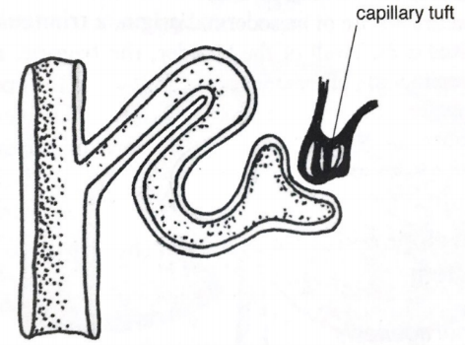
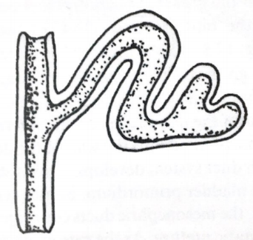
Development of kidney
branching of renal pelvis – formation of collecting tubules
Primitive tubule
developing tubule
Collecting tubule
collecting tubules induce formation of primitive tubules from metanephric mesenchyme
straight tubule
Primitive tubules connect with collecting tubules and change their shape from straight to S-shaped (basis for proximal, medial and distal segment of nephron)
Capillary loops (glomerulus)
the other side of tubule forms cup (Bowmans capsule) surrounding capillary loops (glomerulus) – together form renal body
Bowmans capsule
S-shaped tubule
Edited: McGeady et al. Veterinary Embryology. 2009

Slide 14
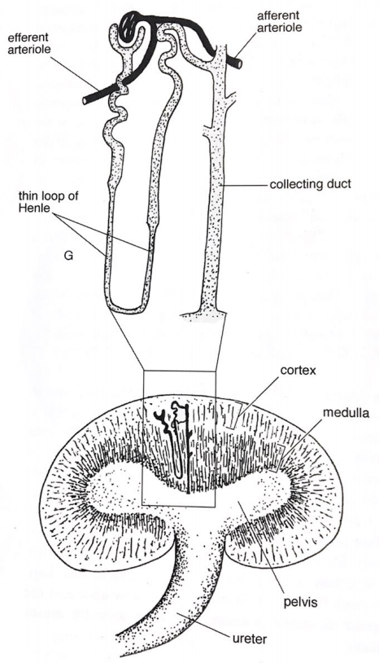
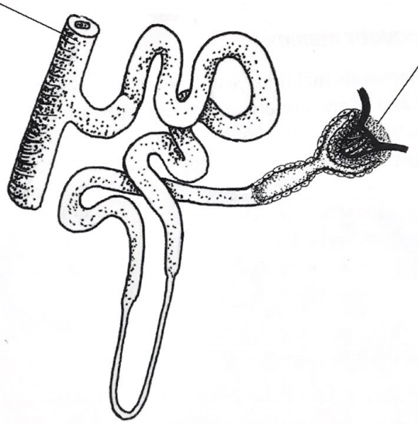
Development of kidney
tubules develop, U-shaped prolongation – formation of Loop of Henle (passage towards renal pelvis)
efferent arteriole
afferent arteriole
Tubules withdrawing from Bowmans capsule – proximal convoluted tubules
Distal tubule
Collecting tubule
Loop of Henle
Collecting tubule
Bowmans capsule
collecting tubules connects to distal convoluted tubules
cortex
renal body, Loop of Henle, proximal and distal convoluted tubules - nephron
medulla
glomerulus
Proximal tubule
cortex – renal bodies, proximal and distal tubules
medulla – Loops of Henle, collecting tubules
Loop of Henle
renal pelvis
ureter
Edited: McGeady et al. Veterinary Embryology. 2009

Slide 15
Cells forming Renal body
fenestrated endothelium – endothelium of glomerular capillaries with pores for filtration of bigger molecules
Parietal epithelium
Glomerular capillaries surrounded by podocytes – formation of glomerular membrane
Mesangial myofibroblasts
Mesangial myofibroblasts – smooth muscle cells of vessels, induce invagination and thus segmentation of capillary loops
Parietal epithelium of Bowmans capsule – epithelial cells form capsule of glomerulus, potential role in regeneration (not clear yet)
Fenestrated endothelium
Podocyte protrusions
Glomerular basal membrane
podocyte
Trends in Genetics

Slide 16
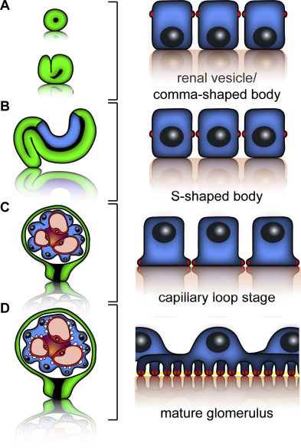
Development of slit membrane
comma-shaped (straight) tubules – pre-podocytes with cylindrical shape, apical intercellular connections
S-shaped tubules – extension of apical sides of podocytes, intercellular connections moved to basal sides
Formation of capillary loops – induction of apical side expansion of podocytes around capillaries, formation of intercellular connections on basal side
mature glumeruli – intercellular connections moved to spaces between podocytes protrusions and basal membrane, fusion of podocytes and endothelial cells basal membranes, formation of one glomerulal basal membrane
Schell et al. 2014. Sem Cell Dev Biol

Slide 17
Larsen Human embryology 2001
Branching
Of ureteral
bud

Slide 18
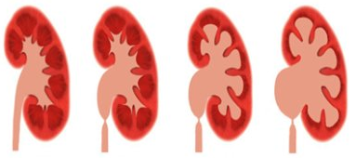
Developmental defects of kidneys
Renal agenesis/dysgenesis
Development of metanephric bud is altered or not developed at all, on one or both sides
Patients can live without one kidney
Missing both kidneys lethal perinataly
Multicystic kidney dysplasia
Nephron not developed, ureteral bud is not branched
Renal tubules surrounded by non differentiated cells
Often bifid (cleft) ureter
Hydronephrosis
narrowed connection between renal pelvic and ureter (stenosis) – altered drainage
Extension of renal pelvis
Higher preasure in cortex – loss of function
surgery

Slide 19
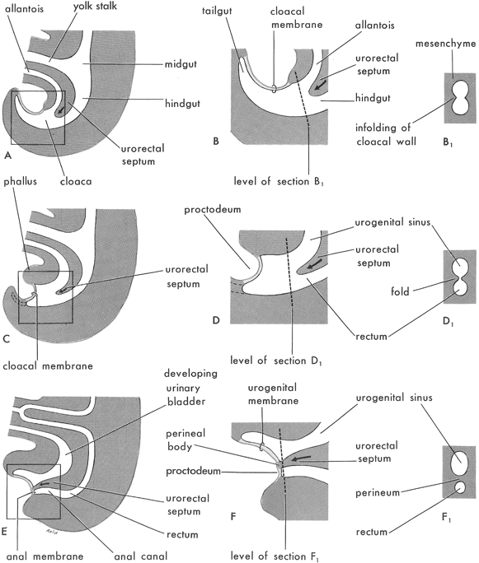
Cloaca development
origin – hindgut endoderm
alantois
Yolk stalk
tailgut
Cloacal membrane
alantois
mesenchyme
midgut
Urorectal septum
Later divided by urorectal septum into:
dorsal – part of colon, rectum
ventral – urogenital sinus (ureter, bladder)
hindgut
hindgut
Cloacal wall strangulation
Urorectal septum
cloaca
proctodeum
Urogenital sinus
Caudal part connected with external environment by cloacal membrane, ventraly connected to alantois
Urorectal septum
Urorectal septum
rectum
Cloacal membrane
Dev. bladder
Urogenital membrane
Urogenital sinus
mammals – transitional structure
reptiles, birds – permanent structure
perineum
Urorectal septum
proctodeum
uror. septum
perineum
rectum
Lewis and Kaplan, 2009. Cambridge University Press
Anal membrane
Anal canal
rectum

Slide 20
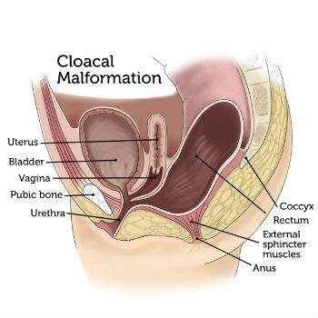
Developmental defects of cloaca
Persistent cloaca
Cloaca is not divided
rectum, vagina and urethra connected into one canal
Mostly in place of developing urethra
surgery
Boston Children`s Hospital

Slide 21
Urogenital sinus
Ventral part of cloaca – urogenital sinus – divided into:
cranial
vesicular segment – cranial part, development of urinary bladder
vesicular
pelvic segment – middle narrower part
males – main part of urethra
females – whole urethra
pelvic
phallic
phallic segment – caudal wider part
males – part of urethra in penis
females – vaginal vestible
caudal
rectum

Slide 22
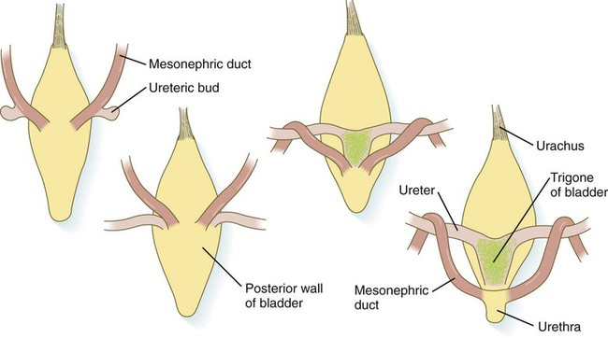
Development of ureters
Muscular tube important for active drainage of filtrate from kidney
ureters form by invagination of wall of Wolffian duct (ureteral bud) towards the nephrogenic mesenchyme (kidney development)
Mesonephric (Wolffian) duct
Ureteral bud
Wolffian duct and developing ureter connect to developing bladder from cloaca
urachus
ureter
trigonum
Kidney migrate cranially, prolongation of developing ureters
formation of bladder trigonum
Posterior wall of bladder
Mesonephric (Wolffian) duct
urethra
Ureters connected to cranial regions of bladder
males – Wolffian duct moved caudally, connected to urethra
females – Wolffian duct degrades
Liaw et al. 2018. Differentiation

Slide 23
Development of urinary bladder
origin – ventral side of hindgut endoderm, so called urogenital sinus
Mesonephric duct
mesonephros
Ventral side of cloaca – divided by urorectal septum
metanephros
bladder
ureter
Urogenital sinus connected to allantois cranially, later degrades
rectum
Urorectal septum
urachus
Rest is connected to allantois – bladder - urachus (bladder mesentery on ventral side)
Fallopian tube
kidney
Developing ovary
Bladder develops from vesicular segments (cranial part) of urogenital sinus cranially from ureters connection
Developing uterus
clitoris
vagina

Slide 24
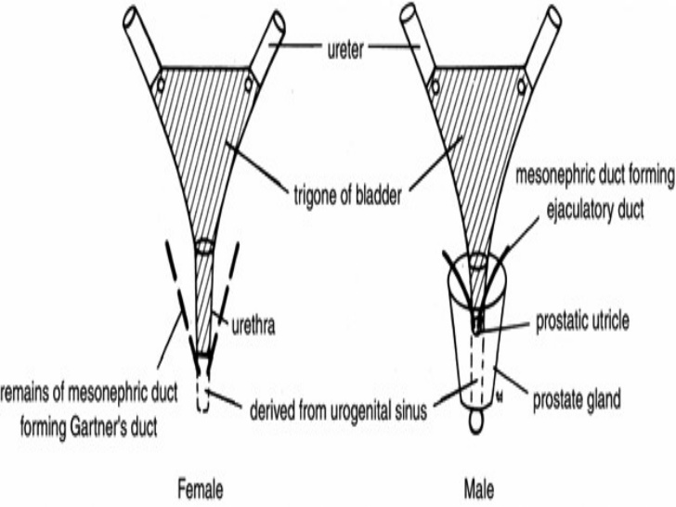
Formation of urinary bladder trigonum
region of connection between ureter and Wolffian duct (future deferens duct in males)
ureter
region of connection – urinary bladder trigonum
trigonum
Basis of ductus deferens (mesonephric duct)
trigonum formed of urinary bladder smooth muscles, partly of smooth muscles from ureters
urethra
Prostate sac
basis for formation of valves preventing return of urine back from bladder through ureters to kidneys – kidney damage
Mesonephric duct residue (Gartners canal)
Urogenital sinus
prostate
female
male

Slide 25
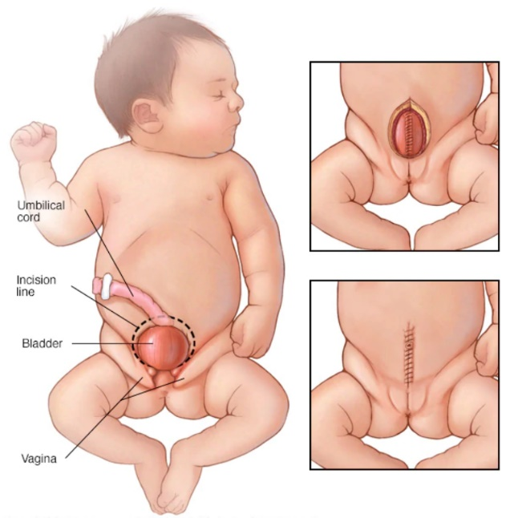
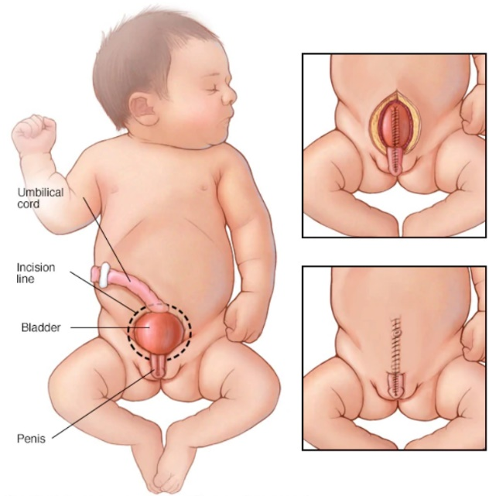
Developmental defects of urinary bladder
Urinary bladder extrophy
Urinary bladder develops outside the body
bladder cant keep urine inside - incontinence
surgery
Mayo Foundation for Medical Education and Research

Slide 26
Development of urethra
origin – hindgut endoderm, forms together with urinary bladder by division of urogenital sinus from ventral side of cloaca
cloaca
Primitive urogenital sinus
Primitive rectum
Primitive urogenital sinus
Primitive rectum
urethra develops from pelvic and phallic parts of urogenital sinus
Primitive urogenital sinus
males – pelvic and phallic regions of sinus, distal part of phallic region formed from ectoderm, connection of Wolffian duct (deferens duct) to urethra, connection of excretory and reproductive systems
Primitive urogenital sinus
Urinary bladder
Vesico-urethral canal
upper and lower parts of vesico-urethral canal
urethra
pelvic (males, females) and phallic (males) part of urogenital sinus
Definitive urogenital sinus
females – pelvic region of sinus, Wolffian ducts degrade, ducts of excretory and reproductive systems separated

Slide 27
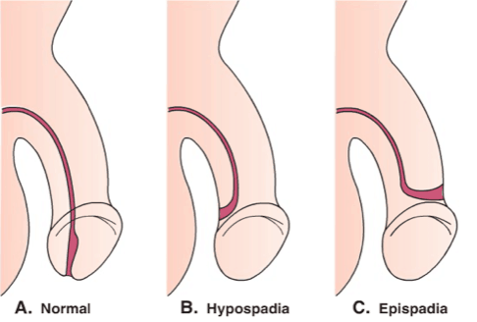
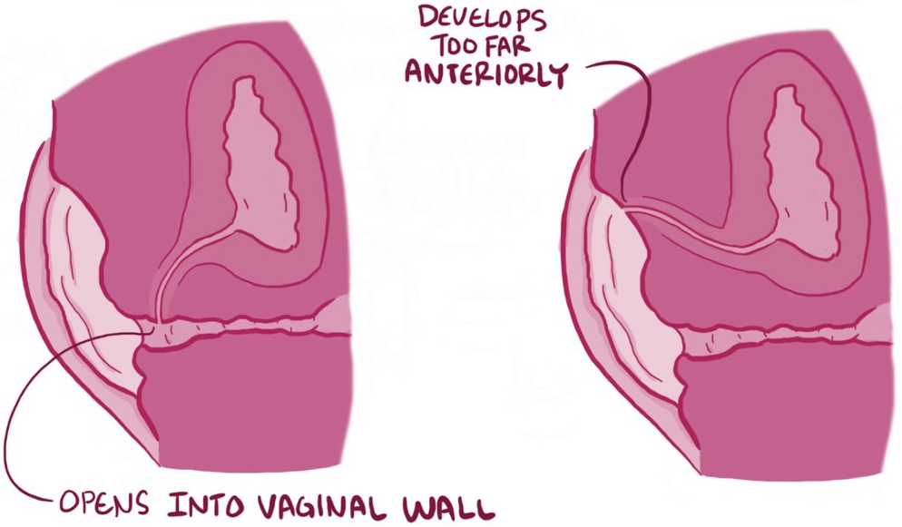
Developmental defects of urethra
Epispadia
Displaced opening of urethra
Opening on dorsal side of genitals
More often in males
Hypospadia
Displaced opening of urethra
Opening on ventral side of genitals
More often in males
epispadia (cranialy)
hypospadia (caudaly, connection with vagina)

Slide 28
Development of adrenal glands
Adrenal cortex develops from intermediate mesoderm
Adrenal medulla develops from neural crest cells
Adrenal medulla precursors
dorsal
cortex – develops from epithelium of coelom in urogenital cord region
medulla –neural crest cells migrate to urogenital cord region
ventral
Adrenal cortex precursors
medullary cells covered by cortical cells
cortex (intermediate mesoderm)
medulla (neural crest)
Pansky. Review of Medical Embryology

Slide 29
Development of adrenal glands
Adrenal cortex develops from intermediate mesoderm
Adrenal medulla develops from neural crest cells
medulla
Neural crest cells migrate to the region of developing cortex, cortical cells cover medullary cells
cortex
Cortical cells differentiate and form layers:
Zona reticularis (androgens)
Zona fasciculata (glucocorticoids – cortisol, corticosterone)
Zona glomerulosa (mineralcorticoids - aldosterone)
Adrenal medulla
Chromaffin cells (catecholamines – adrenaline, noradrenaline)
Pansky. Review of Medical Embryology

Slide 30
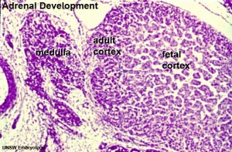
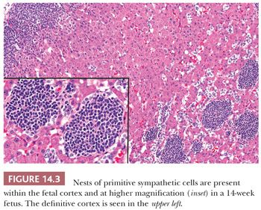
Double origin of Adrenals
Medulla – neuroectoderm
Neural crest cells form sympathetic ganglion in solar plexus = chromafinne cells + primitive sympathetic cells (noduli)
Travel to cortex (7th week iud) and along main vein get to its center
Cortex - intermediate mezoderm
Cluster of cells in urogenital ridge (5th week iud) – primitive cortex
Second wave of differentiation of mesotel cells (6th w iud) – definitive cortex
8th w iud – separaconnective tissue
Zona reticulata appears after 3rd year of life
Proliferation and apopttion from other organs by osis reshape primitive cortex in definitive c.
8 w iud
14 w iud

Slide 31
Developmental defects of adrenal glands
Congenital adrenal hyperplasia
altered production of cortisol in zona fasciculata
higher production of adrenocorticotropic hormone
hyperstimulation of adrenal cortex to produce hormone precursors
hyperplasia caused by storage of more precursors
overproduction of androgens – formation of male sexual characteristics in females

Slide 32
Development of reproductive system

Slide 33
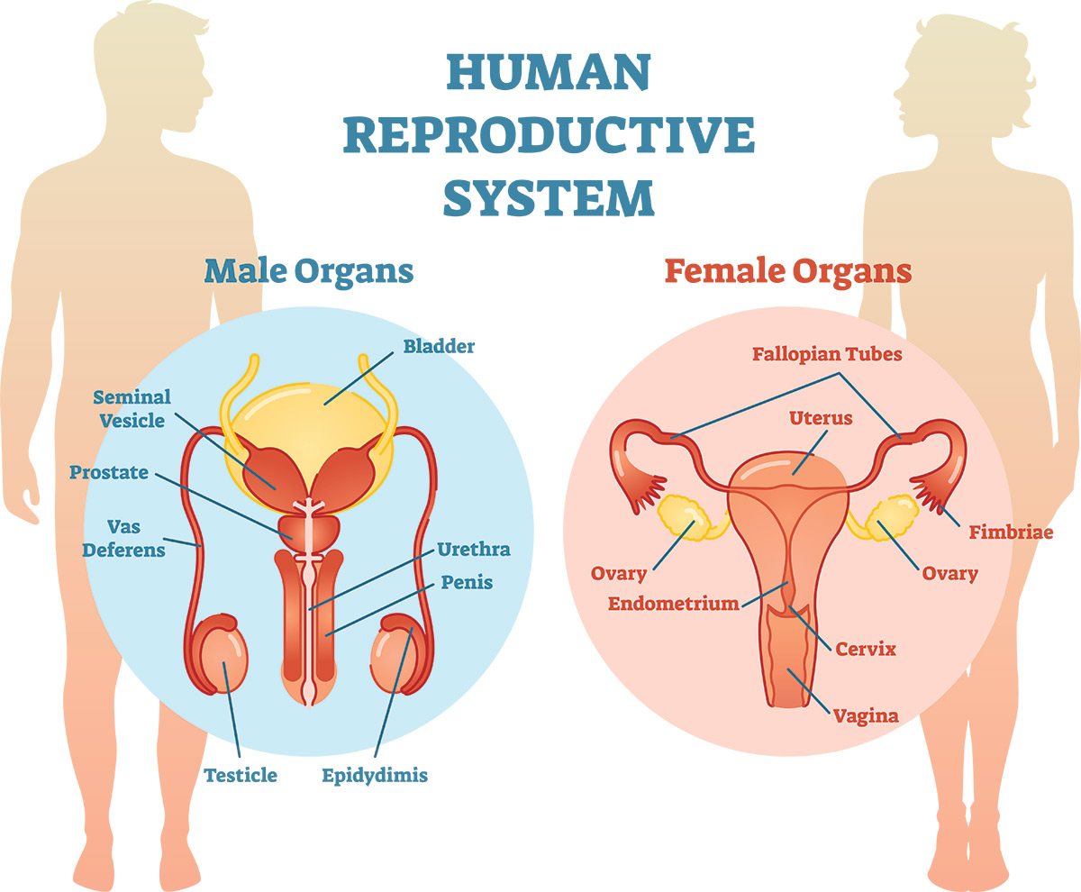
Function of reproductive system
production of germ cells (oocytes, sperms)
storage, maturation and transport of germ cells
fertilization and development of new individuals of a given species

Slide 34
Origin and development of reproductive system in vertebrates
Main source for reproductive system – intermediate mesoderm
endoderm – urethra and prostate males, vagina females
splanchnic mesoderm – vessels, connective tissue, muscles
somatic mesoderm – stroma of external genitals
notochord
Neural tube
Paraxial mesoderm
Intermediate mesoderm
amnion
ectoderm
endoderm
somatopleura
Dorsal aorta
splanchnopleura
Reproductive system:
female – ovaries, oviducts, uterus, vagina
male – testes, epididymis, ductus deferens, glands, urethra, penis

Slide 35
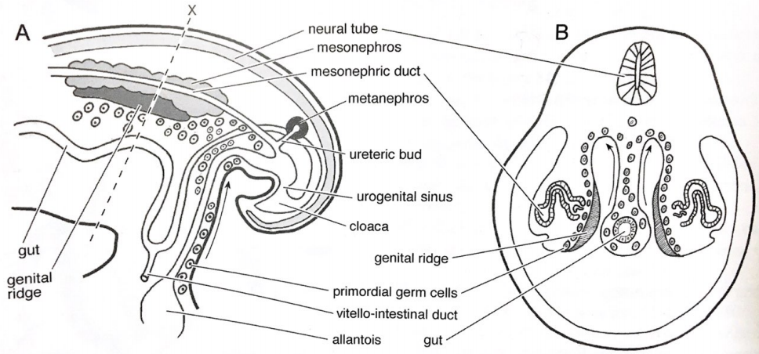
Formation and development of primordial germ cells
epiblast cells migrate through primitive streak to yolk sac and alantois region
Neural tube
mesonefros
Mesonephric duct
Cells further migrate along the hindgut wall to genital ridge – region of developing gonads
metanefros
Ureteral bud
Primordial germ cells settle undifferentiated gonads (testes, ovaries)
Urogenital sinus
gut
cloaca
Genital ridge
mammals – active migration of cells through surrounding tissues
birds – germ cells migrate via bloodstream
Genital ridge
Primordial germ cells
viteline-intestinal duct
allantois
gut
maturation in gonads – cells outside gonads die, preserved germ cells outside gonads can form teratomas
Edited: McGeady et al. Veterinary Embryology. 2009

Slide 36
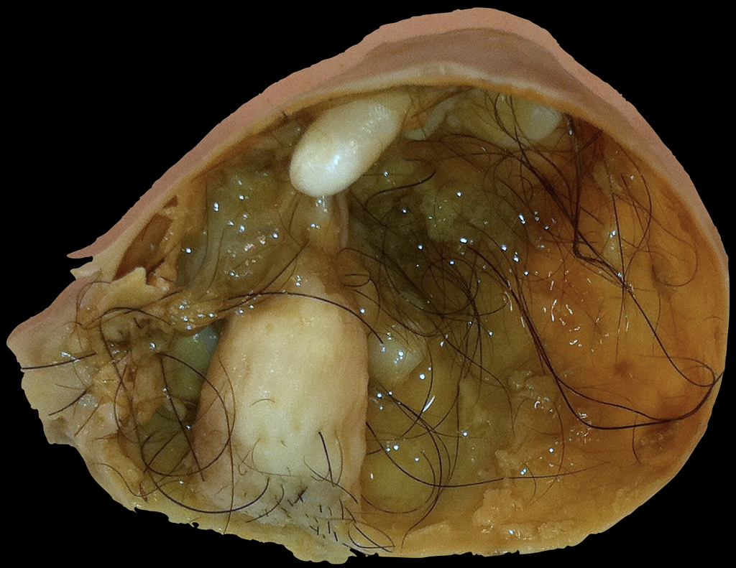
Formation of teratomas
tumors developed from germ cells
formed from germ cells that did not reach gonads but did not die
originates in epiblast → tumor formed of tissues of all germ layers (ectoderm, endoderm, mesoderm)

Slide 37
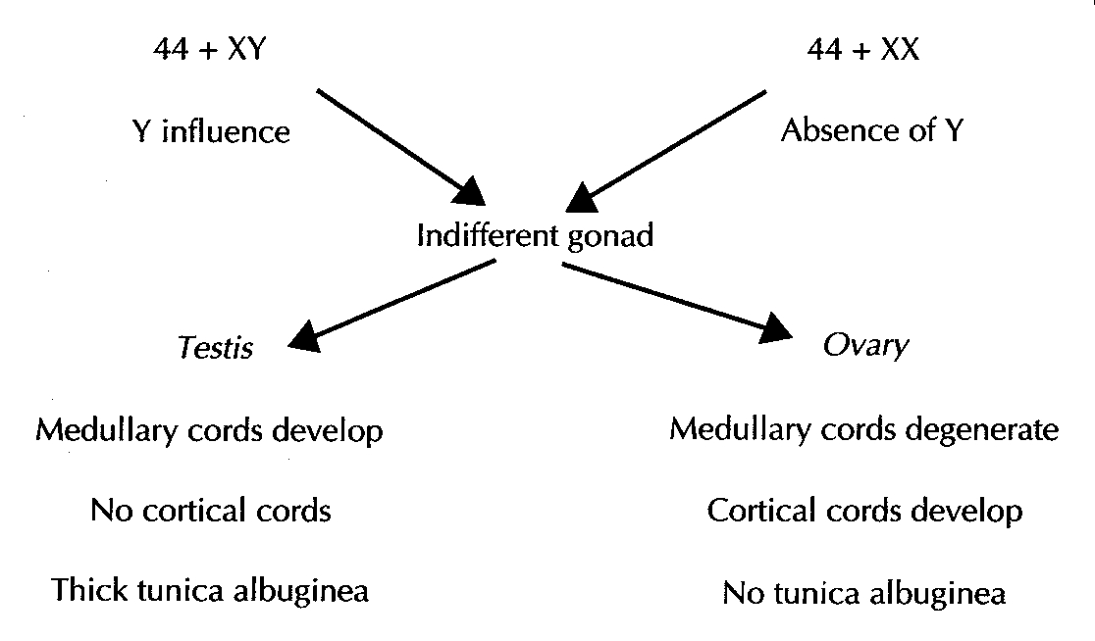
(SRY gene – TDF)
Primary female sexual differentiation is not hormone dependent – it occurs even if the ovaries are absent.

Slide 38
Role of SRY gene
Larsen Human embryology 2001

Slide 39
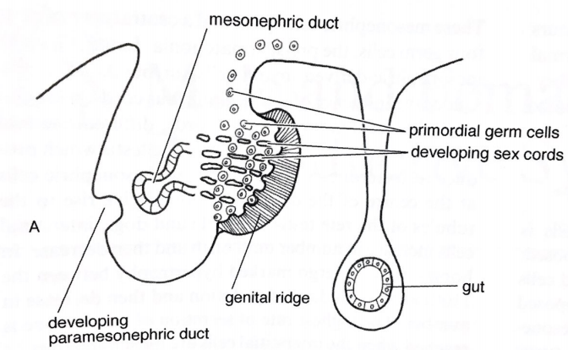
Development of gonads and ducts
development of undifferentiated stage of gonads from 3 sources::
Intermediate mesoderm mesenchymal cells
Epithelium of coelom
Cells of mesonephric tubules
Mesonephric duct
development – genital ridges – on both sides medially from mesonephros
Protrusions into coelom covered by coelom epithelium
Primordial germ cells
Developing tubular system
Prolongation along craniocaudal axis (from thoracic to lumbar region)
Undifferentiated gonads settled by primordial germ cells
Genital ridge
gut
Developing paramesonephric duct
cells of mesonephros and mesonephric tubules – formation of rete tubular system
Edited: McGeady et al. Veterinary Embryology. 2009

Slide 40
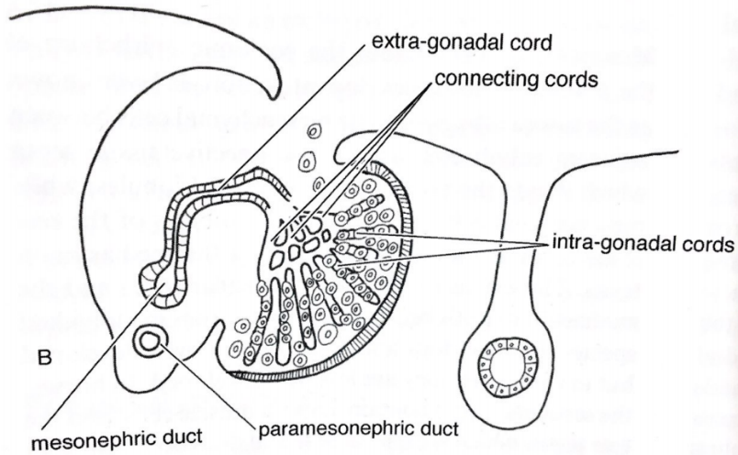
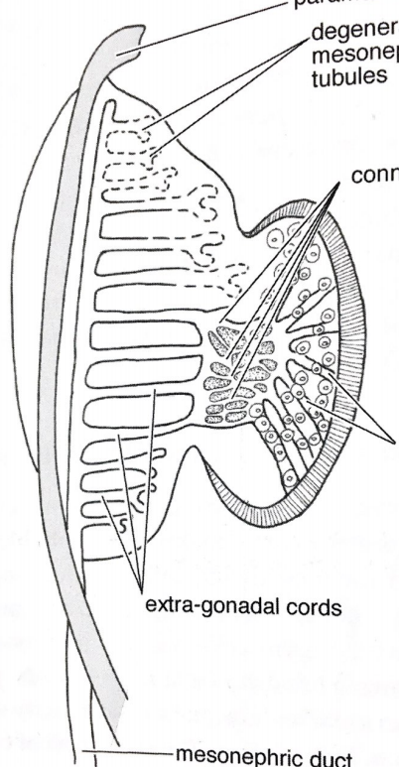
Development of gonads and ducts
Tubular rete system divided to 3 parts:
extra-gonadal cords
connecting cords
intra-gonadal cords
Paramesonephric duct
Extra-gonadal cords
Degenerating mesonephric tubules
Connecting cords
Connecting cords
Intra-gonadal cords
proliferation of inner part of gonads – genital ridge getting rounded
connection with adjacent mesonephros preserved
Mesonephric duct
Paramesonephric ducts
Intra-gonadal cords
Formation of ducts:
Wolffian ducts – from mesonephric ducts (male ducts)
Mullerian ducts – from paramesonephric ducts (female ducts)
Extra-gonadal cords
Mesonephric duct
Edited: McGeady et al. Veterinary Embryology. 2009

Slide 41
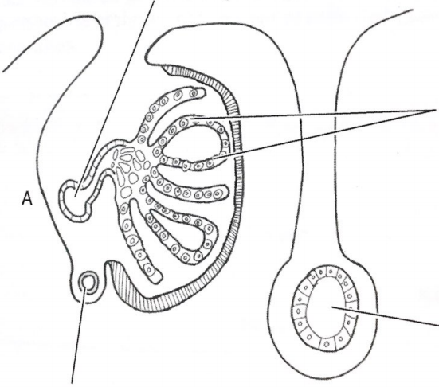
Development and maturation of testes
Formation of seminal cords from mesonephric cells on periphery → incorporation of germ cells
Mesonephric duct
Seminal cords connect with mesonephric cells in center of gonads – onset of convolution of seminal cords – formation of seminiferous tubules
Seminal cords
Seminal cords – solid (not hollow) structures formed of 2 cell types:
periphery – precursors of Sertoli cells
centraly –precursors of sperms (pre-spermatogonial cells)
gut
Paramesonephric duct
Edited: McGeady et al. Veterinary Embryology. 2009

Slide 42
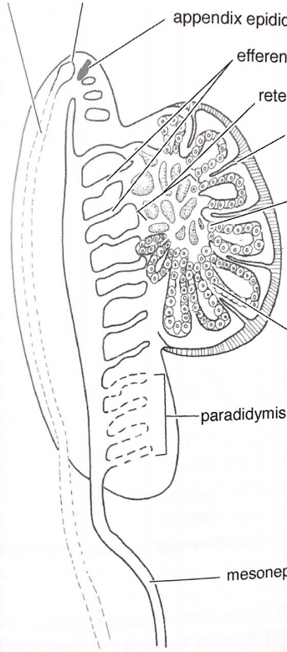
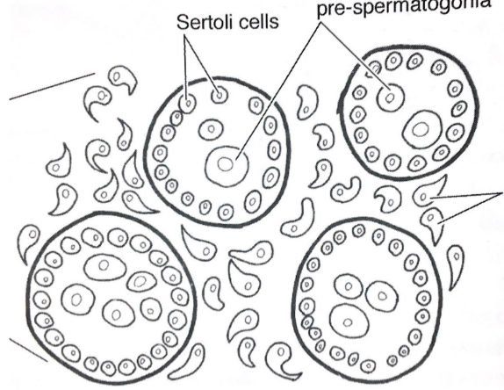
Development and maturation of testes
Seminiferous parts finally formed of:
wall – Sertoli cells (support sperms development)
center – development of sperm precursors
Degenerating paramesonephric ducts
appendix testis
appendix epididymis
Efferent ducts
rete testis
Sertoli cells
pre-spermatogonial cells
Intersticial cells between seminiferous tubules parts:
Intersticial (Leydig) cells – mesodermal cells differentiate under influence of seminiferous tubules, testosterone production
septum
lobe
mesonephric cells in the center – formation of rete testis canals (web of tubules between seminiferous tubules and efferent ducts)
Mesenchymal cells under the epithelium of coelom – formation of connective tissue - tunica albuginea
tunica albuginea
paradidymis
intersticial (Leydig) cells
subsequent septa connected to tunica albuginea from mesenchymal cells between developing canals – lobe formation
Mesonephric duct
canalization – formation of tubules from seminiferous cords (adolescence)
Edited: McGeady et al. Veterinary Embryology. 2009

Slide 43
Development of male ducts
Pronephros form ventraly from developing cranial somites
degeneration
mesodermal cells form pronephric ducts lateraly
cranial
pronephros
dorsal
cranial part of ducts and tubules degenerate
somites
Pronephric tubule
Pronephric duct
caudal part of pronephric ducts preserve its excretory function during development, formation of Wolffian (mesonephric) duct from caudal part of pronephric duct
Pronephric duct
Nephrogenic mesenchyme
males – Wolffian ducts serve for formation of epididymis, ductus deferens, ejaculatory ducts and seminal vesicles
Wolffian duct
caudal
ventral
females – Wolffian ducts gradually degrade (no production of testosterone)
Edited: McGeady et al. Veterinary Embryology. 2009

Slide 44
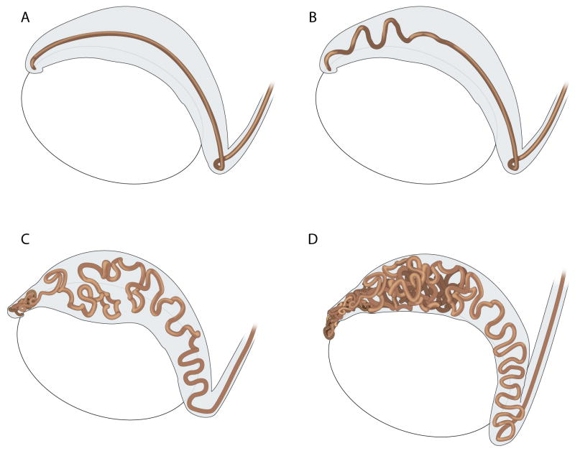
Development of epididymis
Wolffian ducts grow towards cloaca, formation of mesonephric tubules from nephrogenic mesenchyme
Luminization of Wolffian ducts, development of efferent ducts from mesonephric tubules (MT – connection between rete testis with epididymis)
Intensive cell proliferation leads to prolongation and formation of loops – onset of convoluting in proximal region, onset of convoluting efferent ducts
proximal
distal
Efferent ducts
distal starts to convolute later – formation of loops in whole epididymis
Ductus deferens is not convoluted
Ductus deferens
Joseph et al. 2010. Dev Biol

Slide 45
Development of ductus deferens
basis – middle part of Wolffian duct
connection of epididymis (EpD) and ejaculatory ducts (EjD)
prolongation of duct, formation of cells with cilia and development of thick smooth muscle layer – active transport of sperms
from distal part of Wolffian duct ejaculatory ducts develops - connected to urethra
Ductus deferens – ejaculatory ducts interface region - development of seminal vesicles
Bieth et al. 2021. Hum Genet

Slide 46
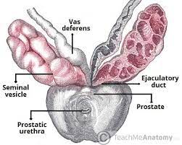
Formation of seminal vesicles
Seminal vesicles – supporting glands of male reproductive system
Formation of paired evaginations (buds) from distal Wolffian duct into surrounding mesenchyme regulated by testosterone production
Ductus deferens
Further growth and development – formation of prolonged vesicular structures
Ejaculatory duct
Seminal vesicles
prostate
Secretory cells porduce supporting components of ejaculate:
fructose, proteins, enzymes, vitamine C
semenogelin – protein forming gell matrix

Slide 47
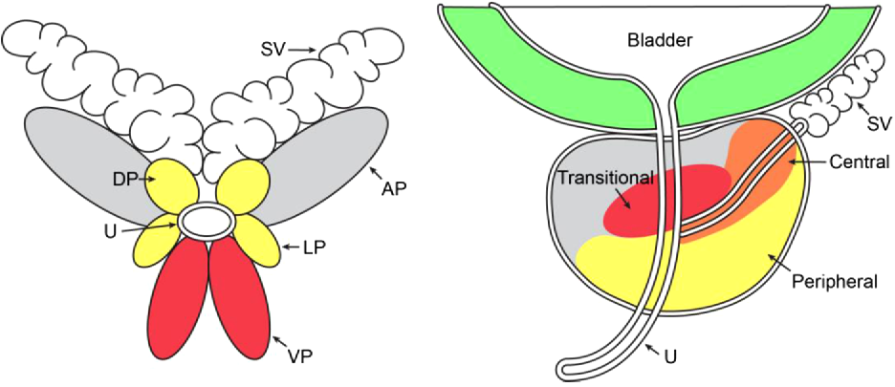
Development of prostate
Develops from urogenital sinus – ventral part after splitting cloaca
Branching of buds
Basal cells
Solid buds, no lumen
Formation of prostatic epithelial buds (4 pairs in mouse, compact gland in human) from urogenital sinus
Prostatic buds
cavitation
Luminal cells
Proliferation cause growth and branching of buds, differentiation of epithelial cells to luminal (production and secretion of supporting components, part of seminal fluid) and basal cells (keep integrity and diferentiation of luminal cells)
Kumari and Sinha, 2021.
mouse
bladder
human
transitional
central
Canalization from proximal part of bud - formation of ductal cavity
peripheral
Urogenital mesenchyme – stroma formation – smooth muscle and connective tissue cells
urethra
Peng and Joyner, 2015.

Slide 48
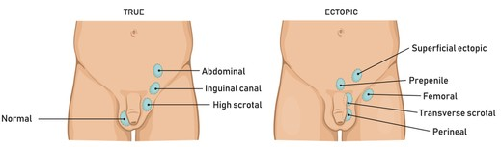
Developmental defects of testes
Cryptorchidism (undescended testiscle)
The most often congenital defect of male reproductive system (25 %)
Absence of at least one testes in scrotum
Testicle ofeten descend after the born (within 3 months)
Surgery if not
Anorchia
Complete missing of one or both testicles
Rare (1:20000)
unknown origin

Slide 49
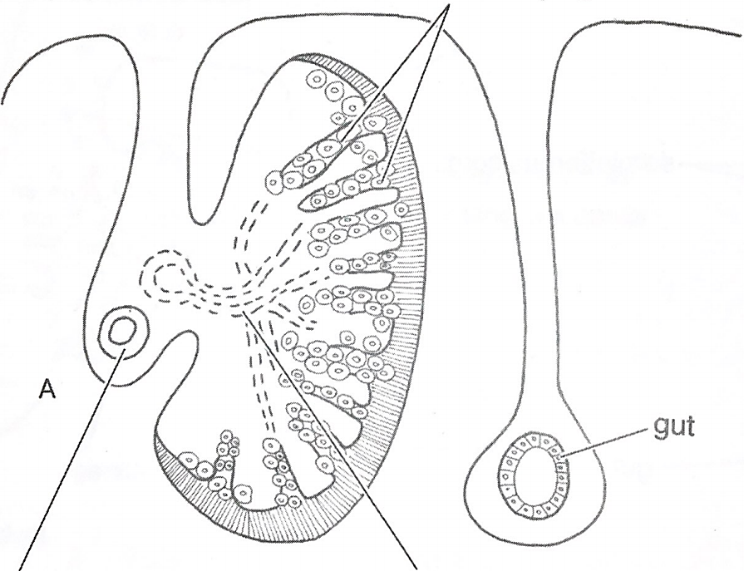
Development and maturation of ovaries
genital cords form from epithelium of coelom – incorporation of germ cells
Developing genital cords
mesonephric tubules start to degenerate and disintegrate
genital cords then degenerate – followed by intensive mitotic activity of germ cells
gut
Paramesonephric duct
Degenerating mesonephric tubules
Edited: McGeady et al. Veterinary Embryology. 2009

Slide 50
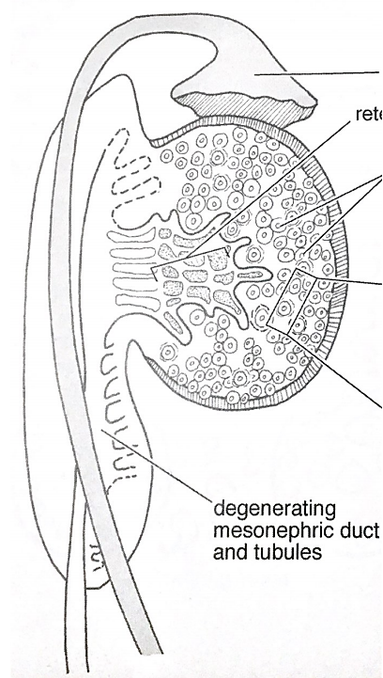
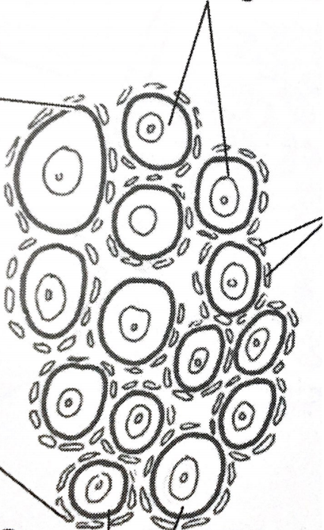
Development and maturation of ovaries
Mitotic activity of oocytes precursor cells terminated (perinataly in mammals)
Developing oviducts
rete ovarii
oogonia
Primordial follicle
Primordial oocytes after the last mitosis – oogonia – surrounded by cells originated in epithelium of coelom – follicular cells
Follicular cells
formation of primordial folicles – germ cell enclosed with basal membrane surrounded by follicular cells
Degenerating mesonephric ducts and tubules
Primordial follicles
Edited: McGeady et al. Veterinary Embryology. 2009

Slide 51
Development of female ducts
Mesonephric ducts formed lateraly, gradual degradation in females
Mesonephric tubules
Tubule vesicle
Nephric duct
Mesonephric duct
Forming paramesonephric ducts
Lateraly from mesonephric ducts fortmation of paramesonephric ducts
Dorsal aorta
glomerulus
Mesonephric duct
somite
Forming paramesonephric ducts
Paramesonephric duct
coelom
Paramezonephric duct – future Müllerian duct
Glomerular cavity
Dorsal aorta
Bowmans capsule
Edited: McGeady et al. Veterinary Embryology. 2009

Slide 52
Development of paramesonephric duct
lateral
Basis for Müllerian duct formation
females – formation of oviducts, uterus and upper third of vagina
Male – atrophies (Antimüllerian hormone, Sertoli cells)
cranial
gonads
medial
Mesonephric duct (Wolffian)
development lateraly from Wolffian duct, develop from epithelium of coelom, so called Müllerian ridge
Paramesonephric duct (Müllerian)
In cranial region, parallel development with Wolffian duct
In caudal region, transition of Müllerian ducts ventrally
caudal
Corsoginho et al. 2016. ECR

Slide 53
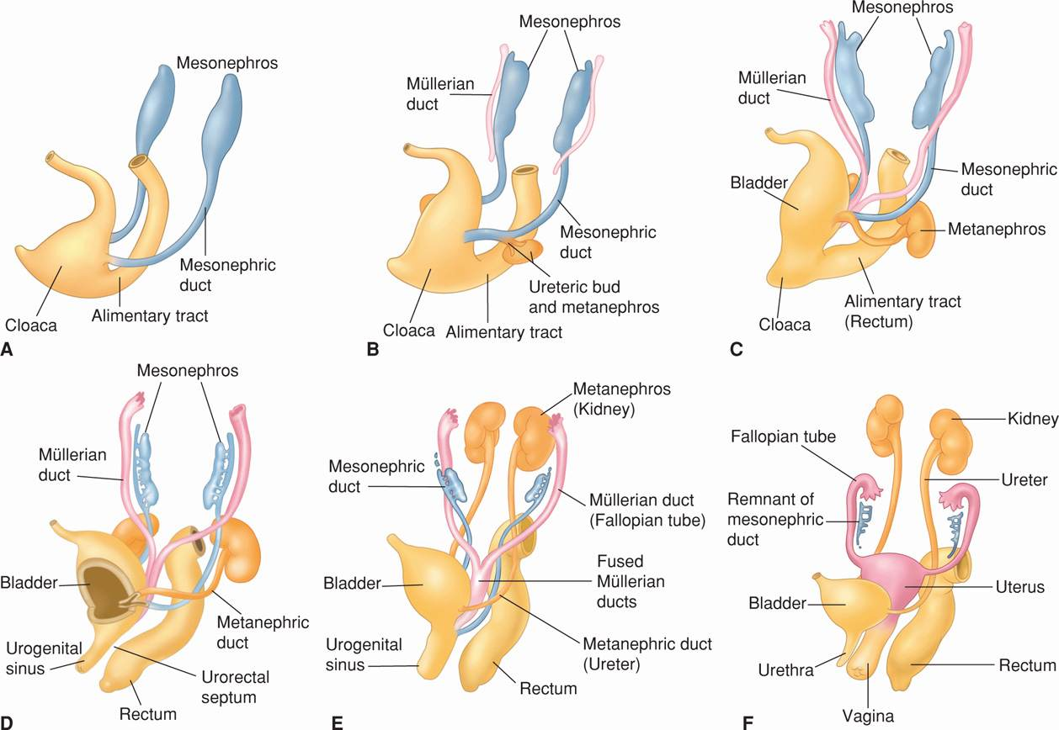
Development of oviducts and uterus
develop from Müllerian duct, grow caudaly
development of paired oviducts cranialy, oviducts connected caudaly – basis of uterus (proliferation in cranial region, extension)
Connection of oviducts – formation of uterine septum – degradation of septum results in cavity of uterus
Oviducts: cranialy open to peritoneal cavity (contact with ovaries), caudaly connect to uterine horns
Developing uterus caudaly connected to endodermal sinovaginal bulbs – part of urogenital sinus close to uterus (originaly ventral side of cloaca)
Ventral part of urogenital sinus divided into:
ventral - urethra and bladder
dorsal - vagina
Bradshaw, 2012.

Slide 54
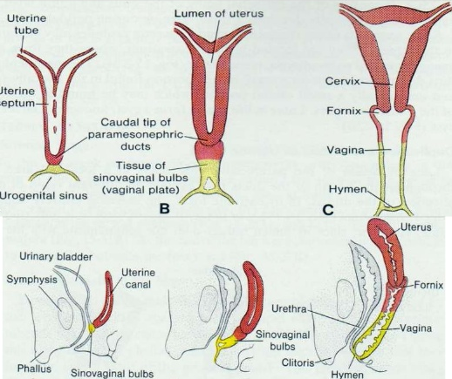
Development of vagina
2 sources:
Upper 1/3 – Müllerian duct (mesoderm)
Lower 2/3 – Urogenital sinus (endoderm)
Uterine cavity
oviduct
Separation of ventral urogenital sinus:
ventral – urethra and bladder
dorsal - vagina
cervix
Caudal part of paramesonephric ducts
Uterine vault
vagina
Connection between uterus and sinovaginal bulbs (vaginal plate), proliferation and fusion → formation of compact structure (no cavity)
Sinovaginal bulbs (vaginal plate)
UG sinus
hymen
uterus
bladder
later resorption of vaginal plate and canalization (apoptosis) – formation of vaginal cavity
Uterine vault
urethra
Vaginal plate
vagina
vaginal cavity separated from urogenital sinus cavity by transversal membrane - hymen
Sahar Hafeez

Slide 55
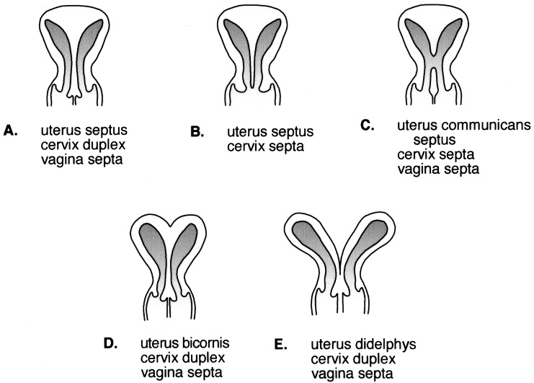
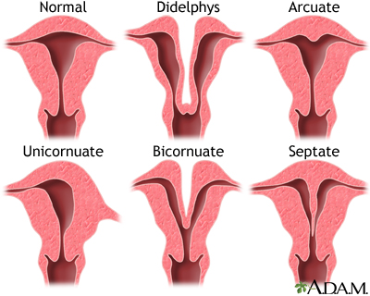
developmental defects of female ducts
developmental defects of uterus
Altered fusion of Müllerian ducts
Defects caused by insufficient degradation of septum
Often connected with defects of oviducts
Can lead to infertility and problems during pregnancy
Developmental defects of vagina
Often connected with defects of uterus and cervix
Vaginal septum – no fusion, split vagina

Slide 56
Development of external genitals
basis – indifferent stage composed of 3 parts:
Genital (phallic) tubercle (penis, clitoris)
urogenital (cloacal) folds (urethra, labia minora)
labioscrotal swelling (scrotum, labia majora)
Genital tubercle
Dorsal limb bud
Ventral limb bud
Urogenital folds
Genital tubercle
Labioscrotal swelling
Development External Genitalia, 2011.
External genitals form from all 3 germinal layers:
Lateral plate mesoderm – stroma (clitoris, penis)
endoderm – urethra
ectoderm – external cover by skin and its derivatives (hair)
Ventral limb bud
Dorsal limb bud
Genital tubercle
Herrera and Cohn, 2014. Sci Rep

Slide 57
Development of male external genitals
Genital tubercle
glans penis
Genital tubercle
Development of penis
Urethral fold
Urogenital folds
Urethral groove
Labioscrotal swelling
Scrotal swelling
Urogenital folds
Fusion along the midline
Formation of enclosed urethra
anus
Urethra opening
foreskin
Glans penis
penis
Labioscrotal swelling
Grow towards the midline
Fusion in along the midline
Formation of scrotum
Scrotal swelling
scrotum
anus
Development External Genitalia, 2011.

Slide 58
Developmental defects of male external genitals
Hypospadia/Epispadia
Displaced opening of urethra
Opening on ventral/dorsal sides
More often in boys
scrotum bifidum
Labioscrotal swellings not fused along the midline
Testicles placed in two scrota

Slide 59
Development of female external genitals
Genital tubercle
Slow growth
Formation of clitoris
Genital tubercle
glans clitoris
Urogenital folds
Urethral fold
Urethral groove
Labioscrotal swelling
Labial swelling
Urogenital folds
No fusion in the medial plane
Paired labia minora
anus
clitoris
Labia majora
Labioscrotal swelling
No fusion in the medial plane
Paired labia majora
Opening of urethra
Opening of vagina
Labia minora
anus
Development External Genitalia, 2011.

Slide 60
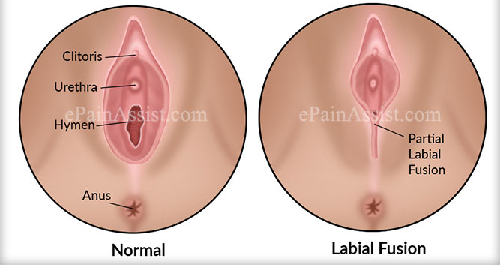
Developmental defects of female external genitals
Labial fusion
Abnormal labial fusion
Vaginal opening is blocked
Hypertrophy of labia majora
Abnormally enlarged labia majora
Cause – congenital adrenal hyperplasia
Clitoral defects
Very rare
Bifid or duplex clitoris
Hypertrophy – caused by adrenal hyperplasia

Slide 61
Summary
1) Degenerating pronephros
2) Wolffian duct
3) Degrading mesonephros
4) Metanephros
5) Urogenital sinus
6) Urinal Bladder anlage
7) Müller´s duct
7

Slide 62
Development of cardiovascular and lymphatic systems

Slide 63
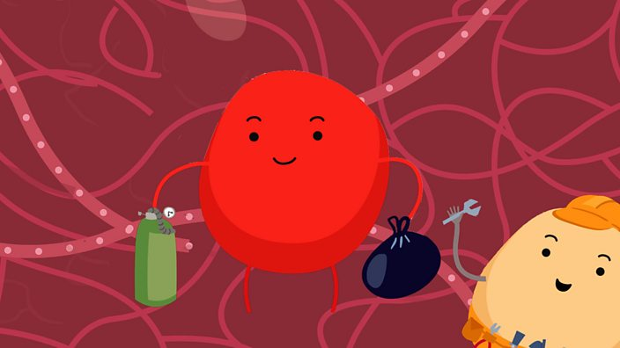
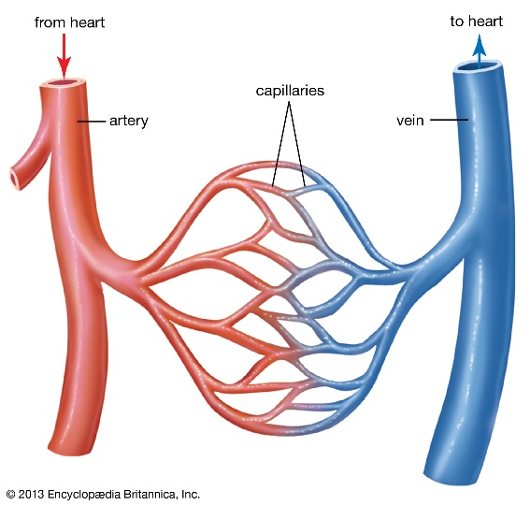
What is the reason of developing cardiovascular and lymphatic systems?
supply tissues with neccesary molecules
disposal of waste products
one of the first functional systems during development:
embryo is growing →
Exchange of nutrients and metabolites on long distances is no more effective →
development of heart and vessels

Slide 64
Cardiovascular system - comparison
Open cardiovascular system
blood and tissue fluids are not separated - hemolymph
Not involved in gas exchange
energetically less demanding
invertebrates
Enclosed cardiovascular system
blood and lymph separated in vessels
blood is separated from tissue fluids
gas and nutrients exchange
transport of nutrients and metabolites on long distances
vertebrates

Slide 65
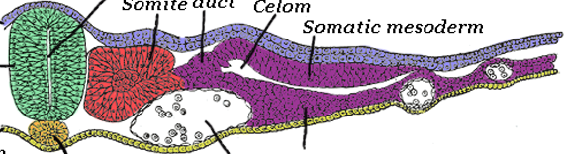
Development of heart and vessels
Develop from 3 sources:
Lateral plate mesoderm – splanchnic part
Paraxial mesoderm - somites
Cardial neural crest
somites
Dorsal aorta development
Heart development
Development of vessels
Lymphatic organs and vessels development
Splanchnic mesoderm
Rothstein et al. 2018. Dev Biol

Slide 66
Dorsal aorta development
agregation of endothelial precursor cells from lateral plate mesoderm - endothelium
somites – endothelium, smooth muscle cells
paired basis in cranial part of embryo, lateral from embryonic midline
Lateral embryo bending – paired aorta basis approach in the midline and fuse
endothelial cells transit into hematopoietic cells
mammals, birds, reptiles – paired dorsal aorta basis
fish – single dorsal aorta basis
Sato et al. 2012. Dev Gr Dif

Slide 67
Heart development in vertebrates
Heart develops from 2 sources:
Neural crest
Lateral plate mesoderm – splanchnic part
Cardiac neural crest
splanchnic mesoderm
Dorsal aorta
Santini et al. 2016. Dev

Slide 68
Formation of heart fields
Progenitor cells in epiblast – invaginate through primitive streak, formation of two groups of cells in splanchnic lateral plate mesoderm
Migration in cranial and lateral direction → cardiogenic mesoderm
lateral cardiogenic mesoderm →
primary heart field
Primary heart field
medial cardiogenic mesoderm →
secondary heart field
Cardiogenic mesoderm
Secondary heart field
Kloesel et al. 2016. Anesthesia and Analgesia

Slide 69
Derivatives of heart field mesoderm
Primary heart field
partly ventricles
left atrium
part of right atrium
cranial
Cranial part of secondary heart field
part of right atrium
region of the receding heart vessels
Caudal part of secondary heart field
atrial myocytes
myocardium between atriums
myocardium of the venous heart side
caudal

Slide 70
Heart tubes development - transversal
paired heart tube basis – formation from cells of the primary heart field mesoderm
Lateral embryo bending – paired endocardial primordia approach each other
primordia fuse in the embryonic midline
formation of left ventricle, parts of atria and parts of right ventricle
Heart tube
myocardium forms from cells of the secondary heart field mesoderm
Scott Gilbert. Developmental Biology 10th edition

Slide 71
Heart tubes development – lateral
paired heart tube basis – formation from cells of the primary heart field mesoderm
Dorsal aorta
Heart tube primordium
Craniocaudal embryo bending – forming heart tubes (endocardium) translocates from cranial part of embryo to ventral
tubes contact dorsal aorta and vitelline veins (from yolk sac)
Lateral embryo bending – medial approach of paired endocardial primordia, beginning of fusion
after the fusion – segmentation of heart tube
McGaedy et al. 2006

Slide 72
Heart tube segmentation
Formation of first segments:
single chamber heart connects with vitelline veins (blood enters the heart) caudally and aortic sac cranially (blood exits the heart)
cranial
aorta
Pulmonary artery
Right atrium
Left atrium
Tube bending:
originally - cranio-caudal direction
now – right-left polarity
Segmentation into two parts:
atrium (blood enters the heart)
ventricle (blood exits the heart)
Right ventricle
Left ventricle
Vitelline veins
caudal
Bending completion:
cranially – atria
caudally - ventricles
septation of atria and ventricles – formation of septa from heart walls
Scott Gilbert. Developmental Biology 10th edition

Slide 73
Cardiac neural crest
Caudal region of the cranial neural crest
localized between otic placode and 3. somite
endothelium of the aortic arch arteries
Neural crest cells migrate into 3., 4., 6. pharyngeal arches → migration to region of the developing aortic-pulmonary septum
Scott Gilbert. Developmental Biology 10th edition

Slide 74
Developmental heart defects
Foramen ovale patens
permanent opening in septum between atria
very often defect, people are mostly not even diagnosed – functional problems are not common
Truncus arteriosus persistens
failure in division of pulmonary trunk and aorta
mixing of oxygenated and deoxygenated blood
manifests as blue skin (insufficient blood oxygenation) and heart failure
surgery is necessary

Slide 75
Blood vessels development
Vessels develop by two different processes:
vasculogenesis – vessels develop from blood islands - splanchnic lateral plate mesoderm
embryonic development only
splanchnic mesoderm
dorsal aorta
angiogenesis – „budding“ and development of new vessels from existing vessels
both embryonic and postnatal development

Slide 76
Vasculogenesis
Differentiation of mesodermal cells into hemangioblast precursors:
blood cells (hematopoietic precursors)
vascular cells (endothelial precursors)
Splanchnic mesoderm
hemangioblasts condensate forming blood islands
Blood islands have two parts:
inner – blood cells precursors
outer – angioblasts, vascular cells precursors
intraembryonic and extraembryonic mesoderm
Scott Gilbert. Developmental Biology 10th edition

Slide 77
Vasculogenesis
extraembryonic vasculogenesis
blood islands of the yolk sac
important for embryo nourishment
embryonic vessels formation
formation of hematopoietic cells for early embryonic stages
Primitive blood cells
Extraembryonic mesoderm
Endothelial cells
intraembryonic vasculogenesis
formation of dorsal aorta
mesoderm of individual organs
vessels form from mesodermal angioblasts in organs
Intraembryonic mesoderm
outer layers of vessels (smooth muscle cells) partly formed from neural crest
Organ-specific mesenchyme
DeSesso, 2017. Rep Tox

Slide 78
Hollowing of blood vessels
endothelial cells aggregation
small vacuoles are formed in individual cells
small vacuoles fuse and form larger vacuoles
large vacuoles fuse with cellular membrane
formation of lumen
Scott Gilbert. Developmental Biology 10th edition

Slide 79
Hollowing of blood vessels
formation of intracellular vacuoles
formation of cavity/channel within one cell
fusion of cells on their ends
wall of vessel is formed by membrane of one cell
Scott Gilbert. Developmental Biology 10th edition

Slide 80
Angiogenesis – budding and longitudinal splitting
Budding:
formation of tip cell from endothelial cell
migration of tip cell into surrounding mesenchyme
another endothelial cells follow, cavity of vessel is maintained
Tip cell
Proliferating and migrating endothelial cells
Longitudinal splitting:
formation of the intraluminal pillar (walls of vessels invaginate into cavity), migration of the opposite endothelial cells into center of cavity
enlargement and fusion of pillars
splitting vessel into two vessels
Intraluminal pillar formation
DeSesso, 2017. Rep Tox

Slide 81
Artery, vein, or lymphatic vessel?
precursors of arteries – endothelium formation dependent on vascular endothelial growth factor (VEGF)
specification – Ephrin B2
arteries are formed earlier than veins
VEGF/
EphB2
precursors of veins – artery specification is blocked by presence of COUP-TFII receptor
specification – Ephrin B4
veins are formed later
artery
COUP-TFII/
EphB4
vein
Prox1
lymphatic vessel
lymphatic precursors – from venous endothelial cells
specification – Prox1

Slide 82
Hematopoiesis – production of blood cells
Depends on existence of hematopoietic stem cells (HSC)
HSC are able to:
selfrenew (stem cells production)
differentiate (production of hematopoietic precursors)
Differentiate into myeloid and lymphoid progenitors
production of specific blood cell types
Where and how are hematopoietic stem cells formed?
Caocci and La Nasa, 2017. Med J Hem Inf Dis

Slide 83
Places of embryonic hematopoiesis
Hematopoietic precursors are embryonically formed in:
yolk sac
aorta-gonad-mesonefros
vessels of placenta, umbilical cord, liver, spleen, thymus, bone marrow

Slide 84
Yolk sac
Extraembryonic hematopoiesis phase
develops from splanchnic lateral plate mesoderm
blood islands are formed in yolk sac wall
Yolk sac

Slide 85
Aorta-gonad-mesonefros
intraembryonic development of hemetopoietic precursors
mesoderm surrounding aorta, developing urogenital system and adrenal cortex
hematopoietic precursors differentiate from endothelium of developing vessels
Sugimura et al., 2019. Biomed Microdev

Slide 86
How are hematopoietic stem cells formed?
More than one theory:
Hemangioblast theory
Hemogenic endothelium theory
Mesodermal prehematopoietic precursor theory

Slide 87
Hemangioblast theory
hemangioblast is formed from mesoderm
hemangioblast derivatives:
hematopoietic precursors
endothelial precursors
hemagioblast precursors differentiate in yolk sac
applicable theory for early hematopoiesis phases
Hemogenic endothelium theory
Mesodermal prehematopoietic precursor theory
Rossmann et al., 2016. Curr Biol

Slide 88
Hemogenic endothelium theory
Hemogenic endothelium forms from endothelial cells in aorta-gonad-mesonephros region
Mesoderm from regions around developing aorta, urogenital system and adrenal cortex
Hemogenic endothelium can differentiate into lymphoid and myeloid precursors
applicable theory also for definitive phases of hematopoiesis
Hemangioblast theory
Mesodermal prehematopoietic precursor theory
Entothelial progenitors
Hemogenic endothelium
Primitive erytroid cells
Endothelial cells
Rossmann et al., 2016. Curr Biol

Slide 89
Mesodermal prehematopoietic precursor theory
Theory combining previous theories:
both theories are valid – consecutive parts of hematopoietic and endothelial cells development
hemangioblast derivatives:
endothelial precursors
hematopoietic precursors
hematopoietic precursors develop from endothelial cells
Hemangioblast theory
Hemogenic endothelium theory
Endothelial-hematopoietic transition:
endothelial cells loose their epithelial character
releasing from vessel walls
migration to lumen of vessel
Rossmann et al., 2016. Curr Biol

Slide 90
Developmental defects of vessels
Hereditary hemorrhagic telangiectasia
arterial-venous malformation
missing connecting cappilaries between arteries and veins
nose bleeding, bloody spots on skin
Cerebral autosomal dominant arteriopathy with subcortical infarctions and leukoencephalopathy (CADASIL)
defects in skin and brain arteries
degeneration of smooth muscle cells in vessels
accumulation of fibrous tissues around arteries
narrowed artery transit
migrains, dementia, stroke
Alagile syndrome
narrowing of big arteries including aorta
connected with defects in skeletogenesis and formation of face

Slide 91
Lymphatic system development
blindly-terminated system of tissue vessels
absorbtion and drainage of tissue fluid
enters venous system through lymphatic vessels
transporting antigens and antigen-presenting cells to lymphatic nodes → immune response
lymphatic vessels develop from veins
development of lymphatic organs:
lymphatic nodes
spleen
thymus
Alderfer et al., 2018. J Biol Eng

Slide 92
Development of lymph nodes
Lymph nodes:
vessels in lymphatic sac
stroma and capsule
Lymphoid tissue inducer cells (LTiC)
initiation:
lymphatic vessels branching – lymph sac is produced
lymph sac is settled by mesemchymal precursors of stroma
Lymphocyte migration
Lymphatic vessels
mesenchyme originates in mesoderm – from vascular endothelium
migration
induction
induction
stroma:
mesenchyme originates in mesoderm
mesenchyme induces migration of LTiC to sac surrounding – basis of node (LTiC originate in hemogenic endothelium)
LTiC induces mesenchyme in developing node – formation of LToC
LToC differentiation – formation of all stromal cell types of node
node induces migration of lymphocytes into node
reverse activation
mesenchymal cells
Lymphoid tissue organising cells (LToC)
Edited. Nosenko et al., 2016. Acta Natur

Slide 93
Spleen development
embryonically – production of hematopoietic cells
Immune organ, erythrocyte degradation
Develops from splanchnic lateral plate mesoderm (mesenchyme surrounding stomach and pancreas)
Spleen vessels – branching from dorsal aorta
stroma:
ventral from aorta – bilateral splanchnic mesodermal plate (cylindrical epithelium), surrounded with splanchnic mesoderm
right – plate replaced by splanchnic mesoderm
left – plate cells proliferate, growth
mesenchymal cells under the plate proliferate and differentiate
Formation of spleen, mesothelial sheath on surface
Brendolan et al. 2007. BioEssays

Slide 94
Thymus development
development of T-lymphocytes
develops from 3 sources:
Foregut endoderm
Neural crest
mesoderm - vessels
Foregut endoderm – 3. pharyngeal pouch of pharyngeal arch (gut epithelium)
Endodermal evagination – formation of epithelial sac surrounded by mesenchymal capsule
formation of primordial thymus and parathyroid gland
Thymus detaches from endoderm and migrate
Neural crest – mesenchymal capsule, partly vessels
till 6th week iud – epithelial tissue
from 7th week – formation of mesenchymal septa
after 9th week – population with blood cells (T cell)
Gordon and Manley, 2011. Dev

Slide 95
Thymus
Ectoderm (neural crest)
Mezoderm
Endoderm (pouches)
Mandibular arch
Hyoid
Foramen caecum
Thyreoid
3rd pouch
4th pouch
Phrayngeal cleft
Thymus (from 3rd pouch)
Parathyroid and ultimobrachial body
(from 4th pouch)
Neural crest – mezenchyme capsula, partially veins
till 6th week iud – epithelial tissue
from 7th week – formation of mesenchymal septa
after 9th week – population with blood cells (T cell)
http://www.embryology.ch/anglais/qblood/lymphat03.html

Slide 96
Thymus - Child
Maximal aktivity – puberty
T lymphocytes fate???
Cytokin
TSLP
Thymic
Stromal
Lympho
poietin

Slide 97
Thymus - adult
Functional Involution

Slide 98
Development of Thyroid gland
24th day of iud the endoderm on the floor of pharynx swells
Formation of bud and its prolongation around the hyoid bone
The anlage migrates toward the base of trachea
Co-migration of superior parathyroid (dorsal part of 3rd pouch)
thymus (ventral part of 3rd pouch)
inferior parathyroid (dorsal part of 4th pouch)
ultimobrachial body (ventral part of 4th pouch)
7th week – definitive location and shape
https://basicmedicalkey.com/embryology-and-developmental-lesions/

Slide 99
Developmental defects of lymphatic system
Lymphedema – enlarged lymphatic vessels in tissues results in insufficient lymph drainage
Spleen defects:
Lobular spleen – „clefts“ as remnants of defective development, no functional defects
Wandering spleen – missing fibrous spleen attachments in the abdominal cavity
Cystic hygroma – cystic neck lymphangioma
polycystic
formation of cysts in lymphatic regions, endothelial lining
contains clear liquid
neck region – causing respiration problems and food intake problems

