Slide 1
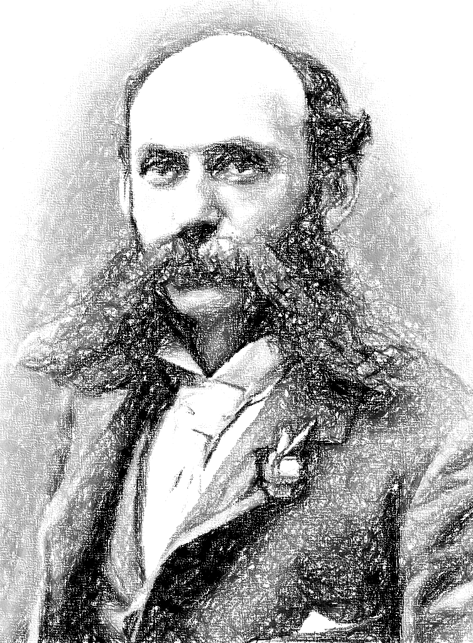
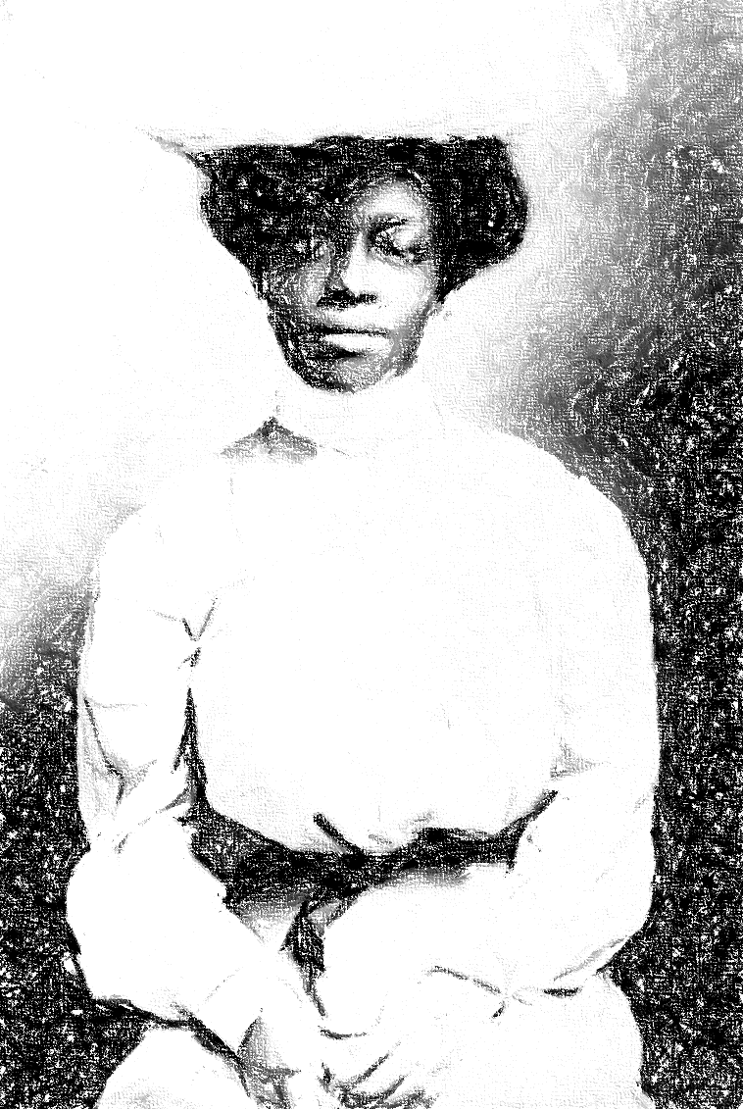
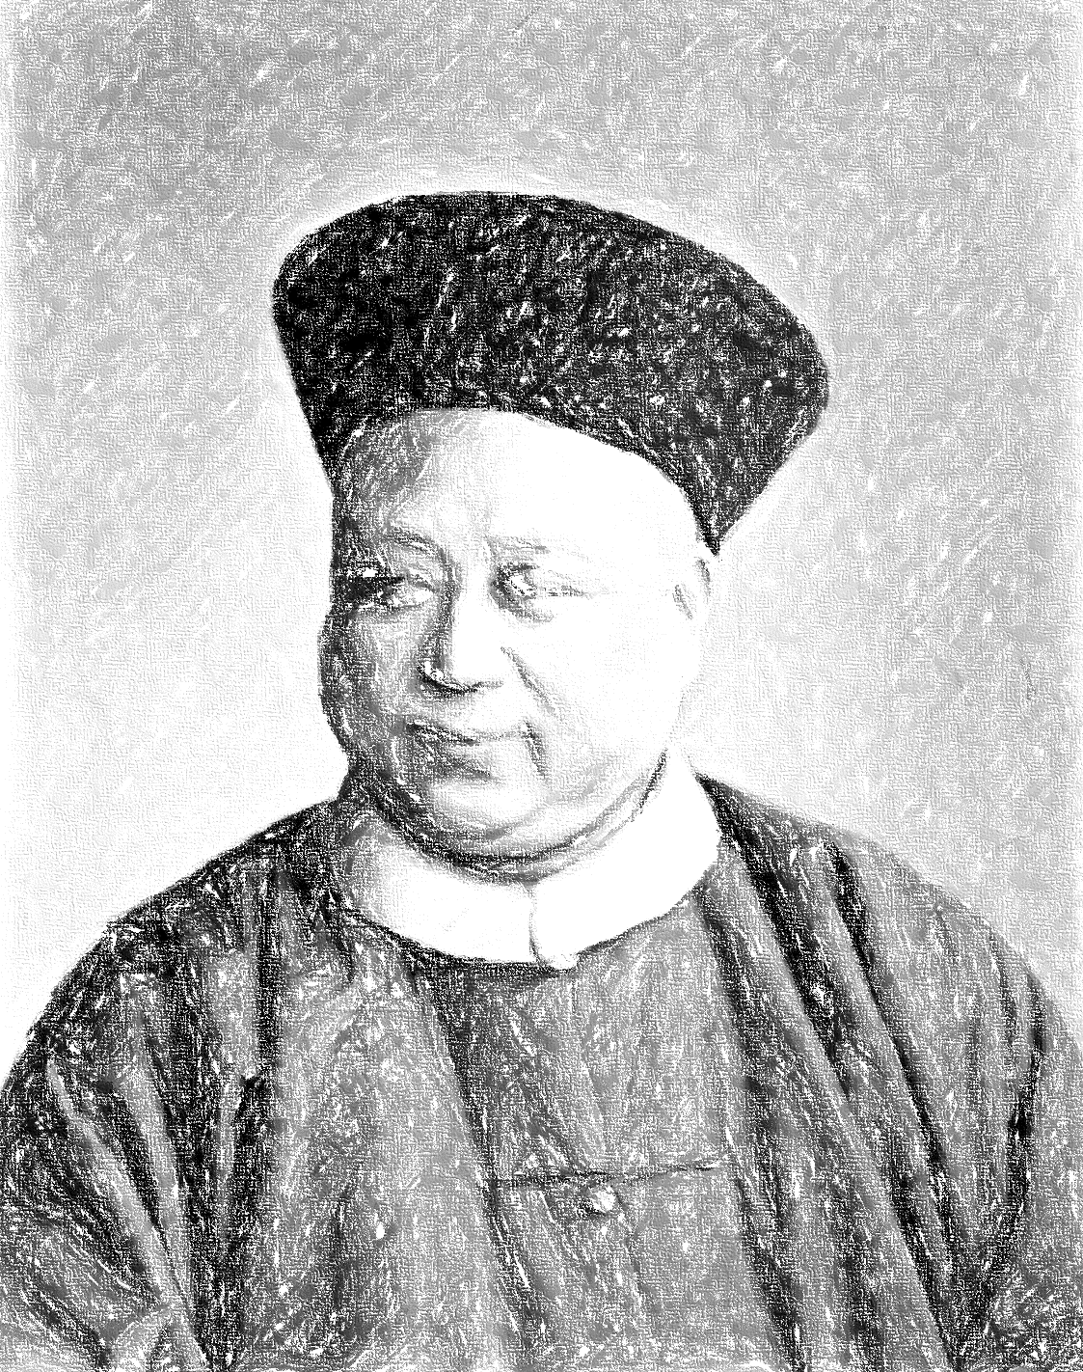
Tracing lost narratives:
unlocking secrets through isotope analysis of ashes

Slide 2
A human being
This metaphysical question of identity is one we've all asked ourselves at some point in our lives
Obviously, today we won't delve into the countless layers of responses that exist for this question.
Considering my slight bias, I will narrow down my focus to specific aspects.
Who are you

Slide 3
According to nutritionists
“You are what you eat”
Lindlahr, nutritionist, The Bridgeport Telegraph, 1923
As per nutritionists, there is a correlation between your nutrition and your state of health

Slide 4
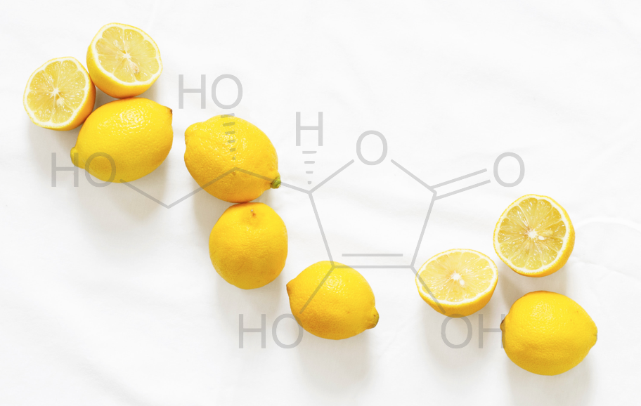
According to biologists
“You are what you eat”
As per biologists, there is a correlation between the nutrients you ingest and your metabolism
VS
Macronutrients
Micronutrients
Carbohydrates
Proteins
Fats
Alcohol
Water
Fiber
Dietary minerals
Vitamins
Energy

Slide 5
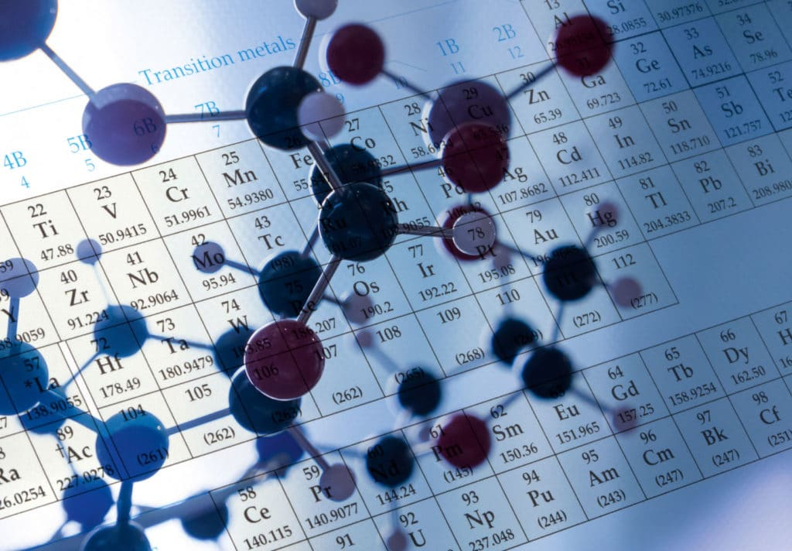
According to nutritionists
“You are what you eat (plus a few per ‰):
the carbon isotope cycle in food chains.”
DeNiro M.J. and Epstein S. (1976)
Geological Society of America Abstracts with Programs 8: 834-835.
As per chemists, there is a correlation between your diet and the isotopic composition in your body
But wait,
what’s an isotope?

Slide 6
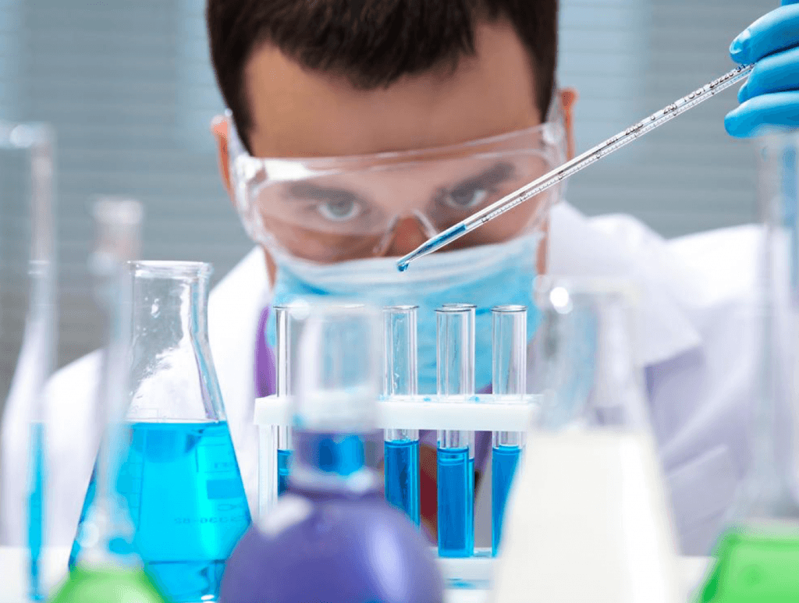
Basics of chemistry:
a reminder

Slide 7
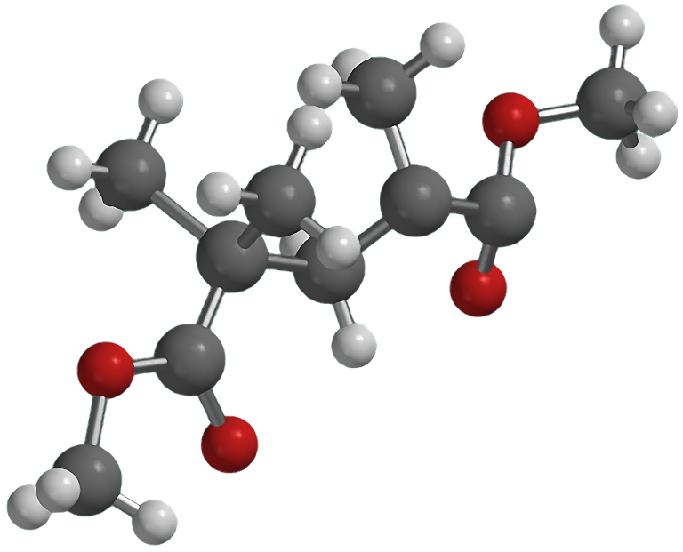
What’s an atom?
Atoms are the fundamental building blocks of chemistry
Molecule

Slide 8
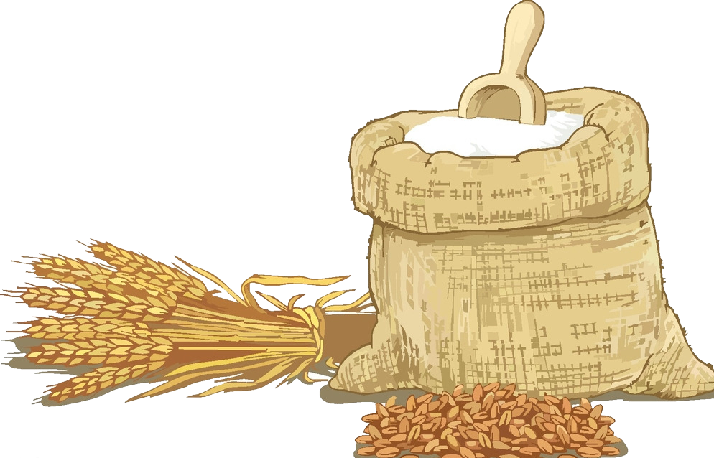
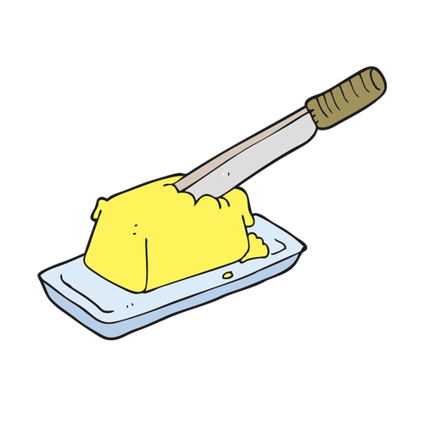
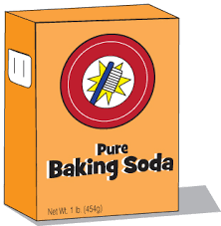
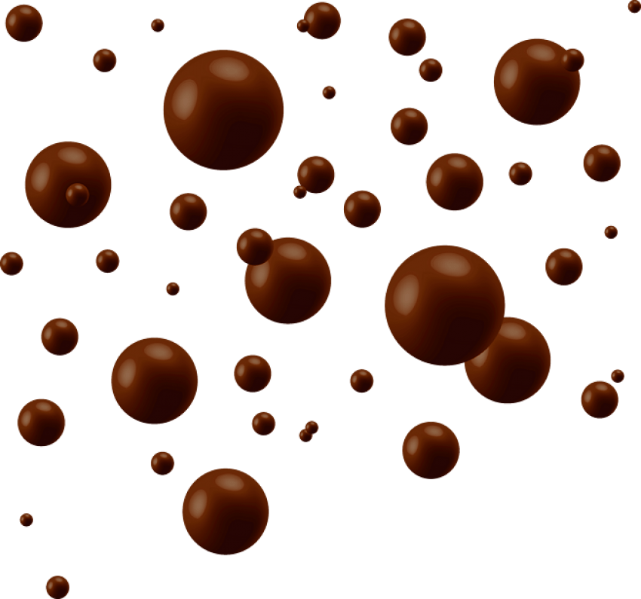
What’s an atom?
Just like baked goods are made of a collection of different types of ingredients
Flour
Butter
Sugar
Baking soda
Chocolate chips

Slide 9
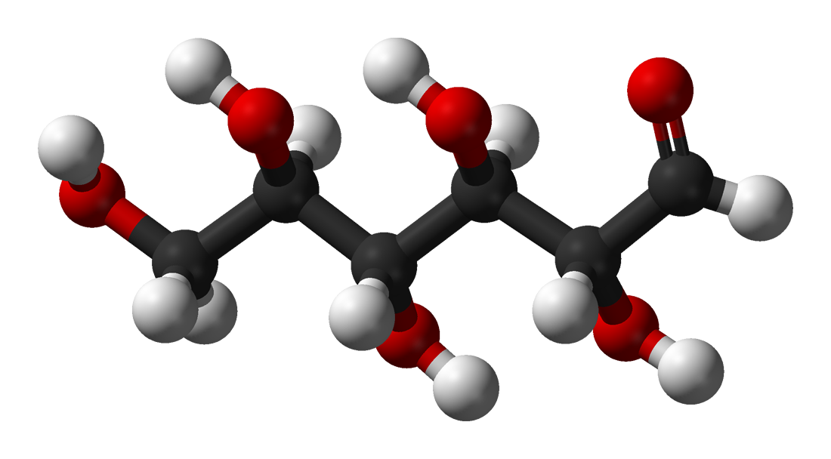
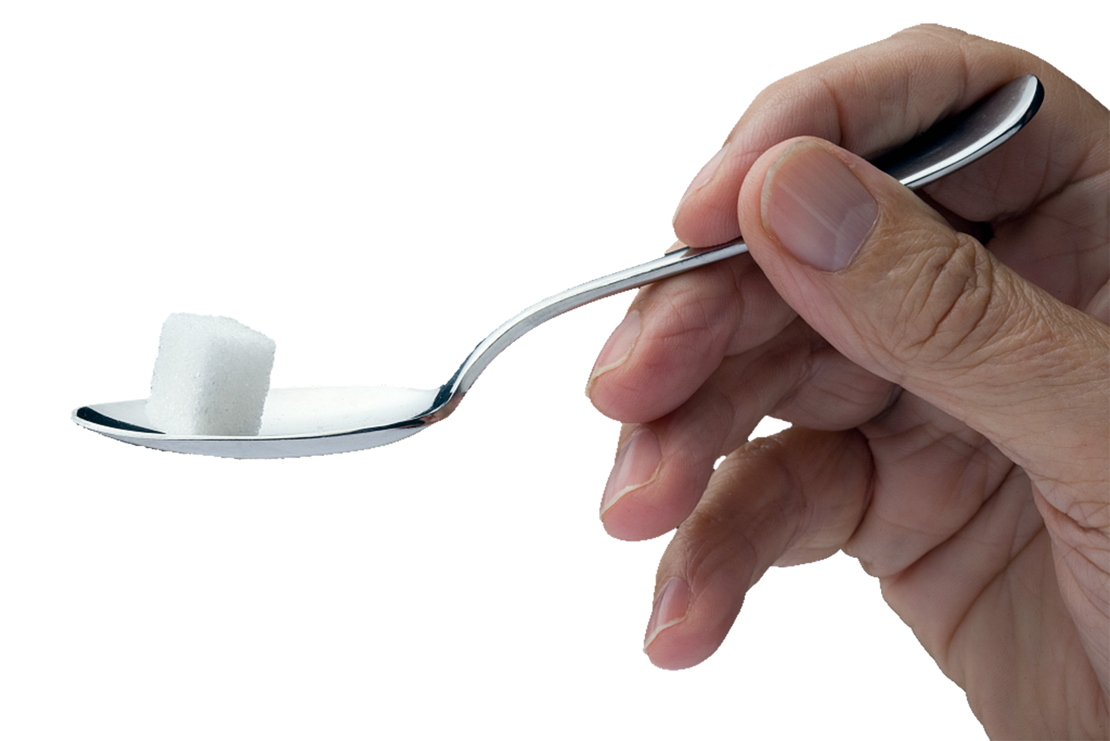
What’s an atom?
Glucose molecule – C₆H₁₂O₆
Matter itself is made of a collection of different types of atoms
Carbon atoms
Hydrogen atoms
Oxygen atoms

Slide 10
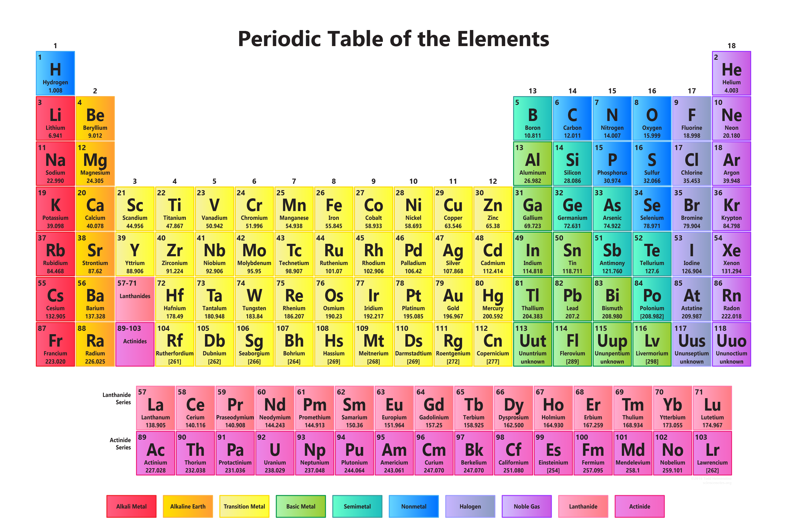
What’s an atom?
Fact: Only 94 occur naturally on Earth
118 kinds of atoms which we call elements
Elements have very different properties. They don’t look or act the same
Periodic table (Mendeleïev)
Why?
Hydrogen atoms
Carbon atoms
It comes down to what is inside their atoms
Oxygen atoms

Slide 11
What’s an atom?
Mass number
Symbol A
Total number of nucleons in an atomic nucleus
Protons + neutrons
Atomic number
Symbol Z
Charge number of an atomic nucleus
Number of protons
Define a chemical element
Number of neutrons
Sometimes symbol N
N = A – Z
Number of electrons
Equal to the number of protons
Determine the chemical properties of an element
A
Z
X
N
Sr
H
O
C
S

Slide 12
What’s inside an atom?
Particle | Symbol | Electric charge | Mass
Proton | p | 1,602*10⁻¹⁹ | 1,6726*10⁻²⁷
Neutron | n | 0 | 1,6749*10⁻²⁷
Électron | e⁻ | -1,602*10⁻¹⁹ | 9,1094*10⁻³¹
Let’s take the theoretical example
(-) Electron
Proton (+)
+
Nucleus
Neutron (/)

Slide 13
What’s inside an atom?
Take a look!
+
+
+
+
+
+
+
+
+
+
+
+
+
+
+
+
+
+
The nucleus!
What is different?

Slide 14
What’s inside an atom?
Number of neutrons in atoms of the same element can vary
+
+
+
+
+
+
+
+
+
+
+
+
+
+
+
+
+
+
+
+
+
Protons = 6
Neutrons = 6
Protons = 6
Neutrons = 7
Protons = 6
Neutrons = 8

Slide 15
What’s inside an atom?
Mass number = Number of protons + Number of neutrons
+
+
12
6
+
+
+
C
+
+
=>
6 +
6 = 12
+
+
+
+
+
+
+
13
6
+
+
C
+
=>
+
6 +
7 = 13
+
+
+
+
+
+
+
+
14
6
+
C
+
+
+
=>
+
6 +
8 = 14
+
+
+
+
+

Slide 16
What’s an isotope?
12
6
C
13
6
C
14
6
C
Isotopes:
Atoms of the same elements with the same atomic numbers but different mass numbers
Same chemical properties (number of electrons) but different physical properties (number of neutrons; mass)
Here we are!

Slide 17
What’s an isotope?
Isotopic ratio
Notion δ
Variation of a heavy isotope from a light isotope
Expressed according to a standard
There are some exception (e.g. Sr)
⁸⁷Sr/ ⁸⁶Sr
δ³⁴S
δ¹⁵N
δ¹³C
δ¹⁸O

Slide 18
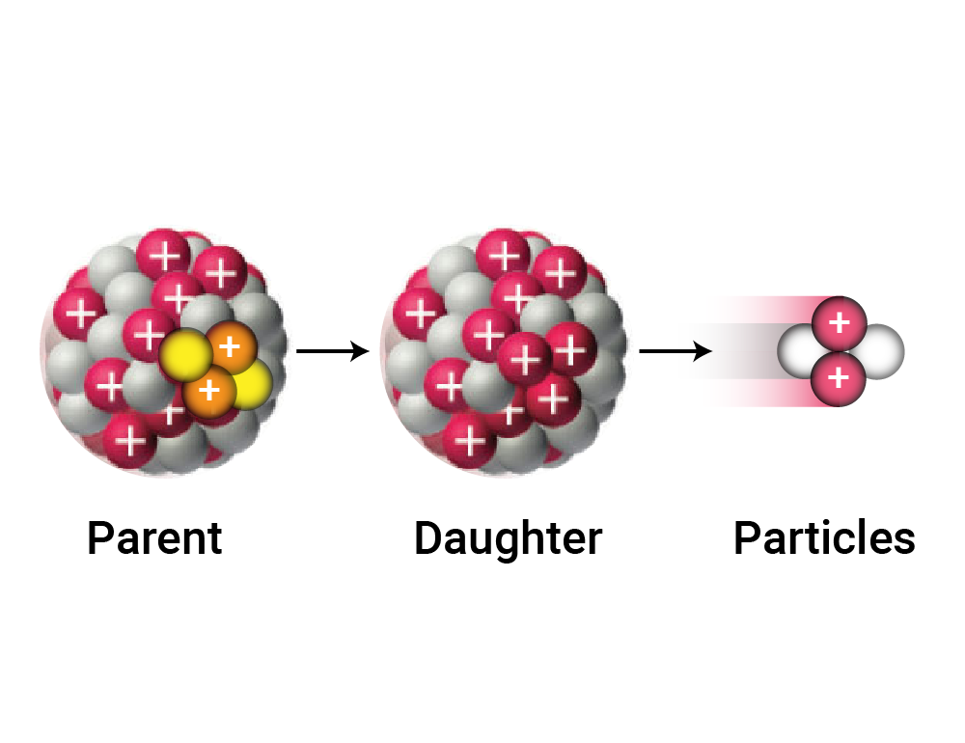
What’s an isotope?
Fact: all the elements with an atomic number greater than 82 have only unstable isotopes.
If an isotope is stable, it will stay as it is. There is no reason to change!
If an isotope is unstable, it will undergo a nuclear reaction in order to become stable.
Unstable isotopes emit energy in the form of a radiation when they break down (decay).

Slide 19
What’s in your body?
Lots of atoms, in almost every possible form.
All deriving from your diet

Slide 20
What’s in your body?
12
11.4 kg
+Sr and others
13
137 g
Negligible
Mister CHON :
Body mass: 50 kg
Heavy isotopes: 225 g
17
18
16
12.3 g
68.6 g
30.4 kg
Simple, isn’t it?
15
14
N
N
5.1 g
1.3 kg
Through isotope analyses, it becomes possible to unveil the substances that enter your body, and where they are coming from.
2
H
1
H
1.5 g
5 kg

Slide 21
What’s in your body?
Breasfeeding patterns
Dietary habits
Social status
Mortuary practices
Demography
DIET
Spatial organization
Cultural specificities
Regional diversity
Migration
Mobility
Population particularities
+Drinks
Population dynamics

Slide 22
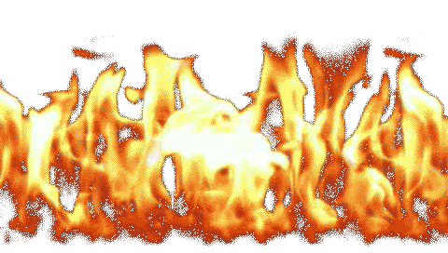
What’s in your body?
12
11.4 kg
+Sr and others
13
137 g
Negligible
Mister CHON :
Body mass: 50 kg
Heavy isotopes: 225 g
17
18
16
12.3 g
68.6 g
30.4 kg
But what’s happen when the body is set on fire?
15
14
N
N
5.1 g
1.3 kg
Well, things begin to get complex!
2
H
1
H
1.5 g
5 kg

Slide 23
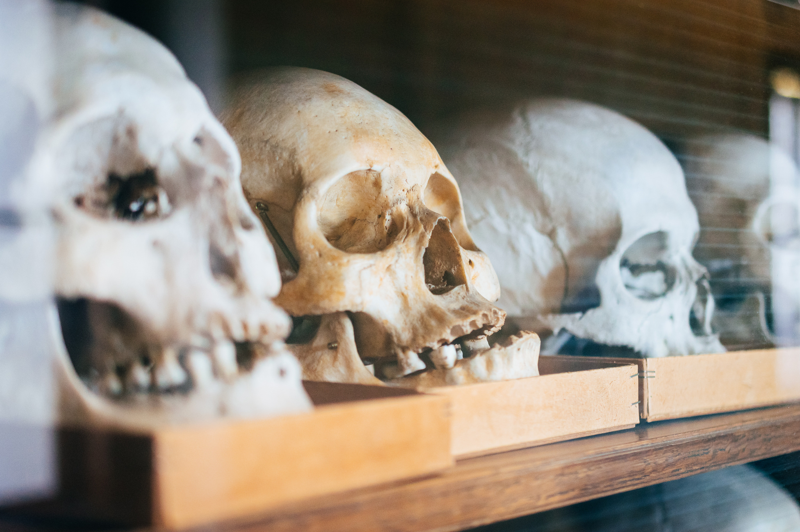
Basics in bioanthropology:
Very basic!

Slide 24
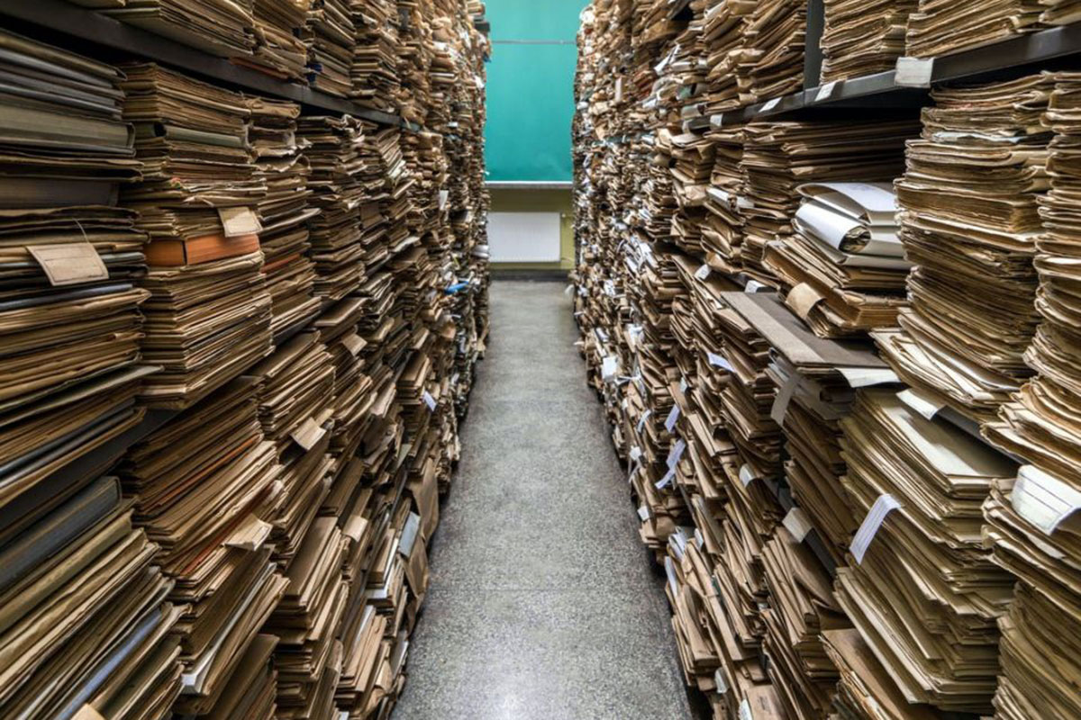
The skeleton: An archive
Human remains
Time capsules
Diachronic investigation at the level of the individuals

Slide 25
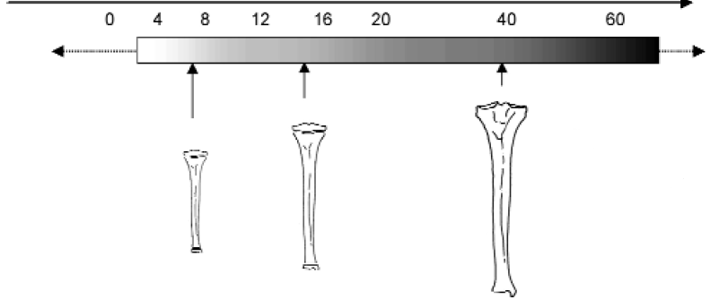
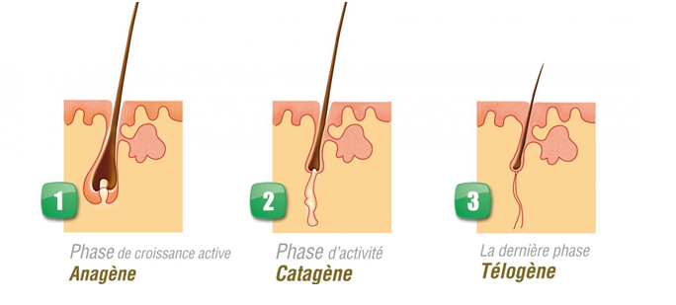
Signal recording
Turnover
Growth
1st years of life
Permanent dentition
Last years of life
Mixed dentition
Specific case: last months of life

Slide 26
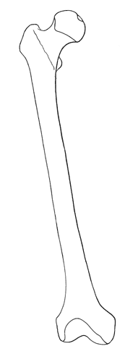
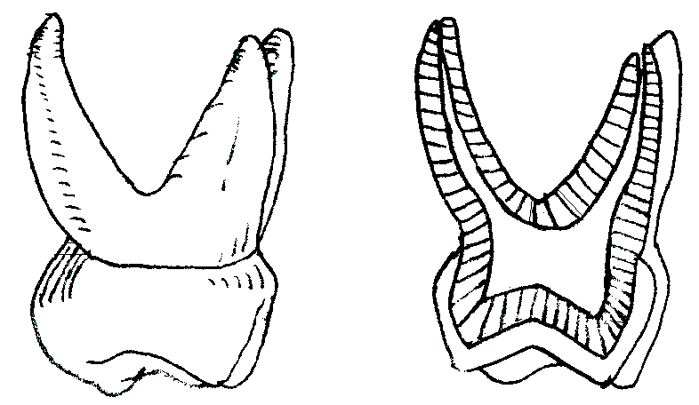
Tissue composition
Mineral fraction
Organic fraction
Bone
70% carbonated hydroxyapatite
Bone
30% : collagen
& other proteins
Dentine
70 % carbonated hydroxyapatite
Dentine
30% : collagen
& other proteins
Enamel
97% carbonated hydroxyapatite
Enamel
3% :
Enamelin, amelogenin
Hair, nails
100% keratin

Slide 27
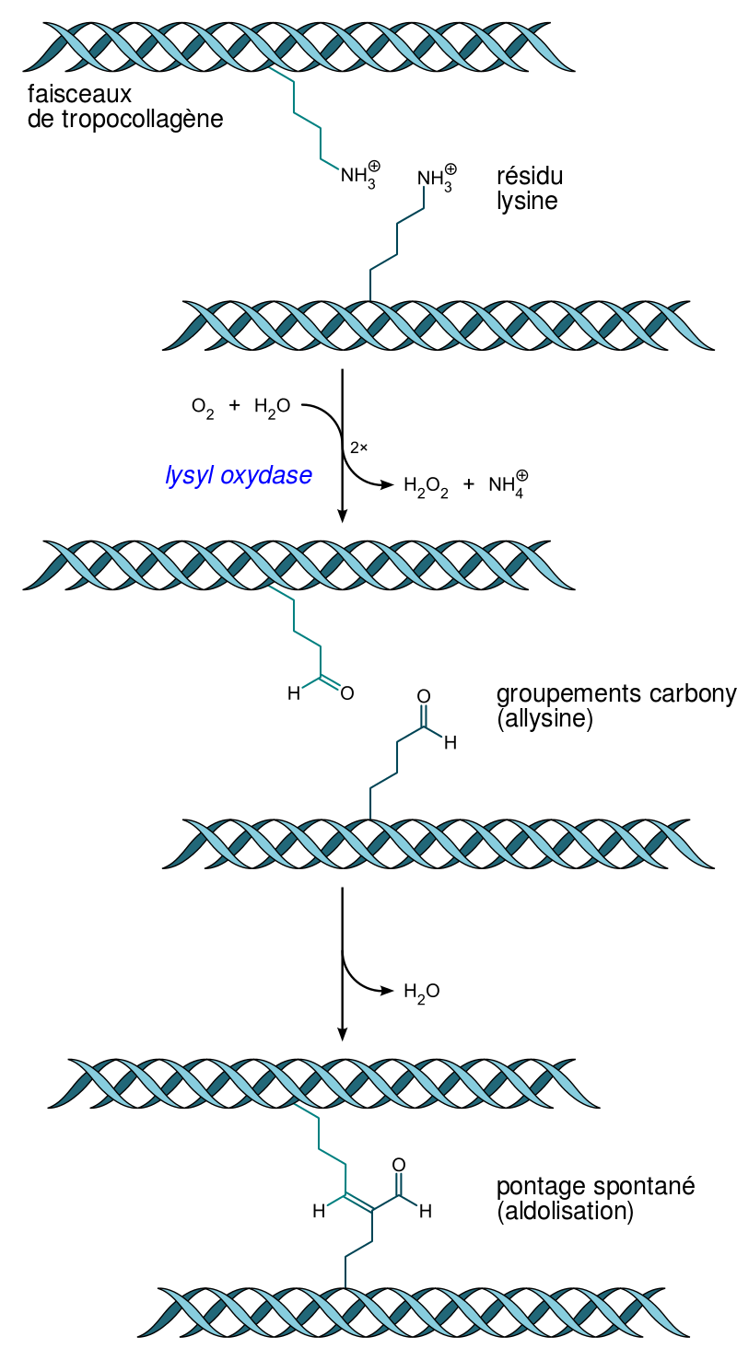
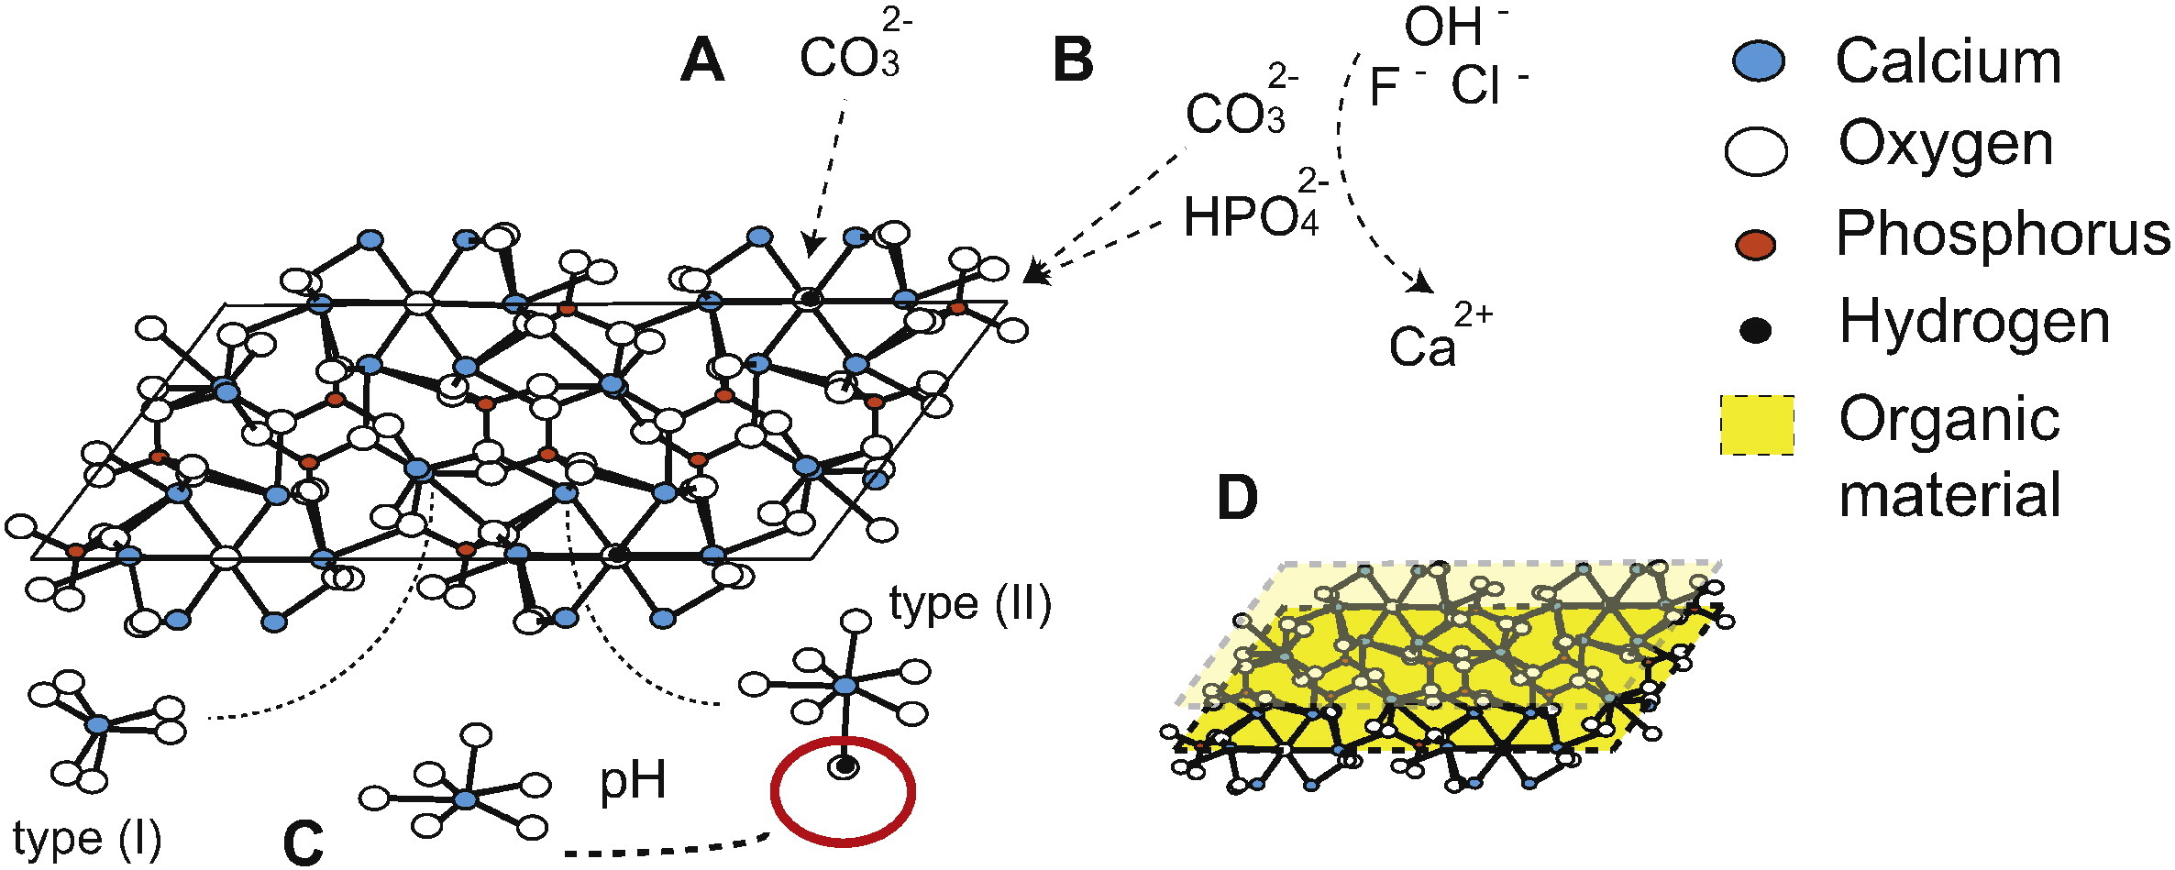
Structures
$$Collagen:$$
Rich in C et N
$Bioapatite$:
$${\left(Ca, Na, Mg, Ba, Sr, Zn, Pb,[ ]\right)}_{10}$$
$${\left({PO}_{4},{HPO}_{4},{CO}_{3},{SO}_{4}\right)}_{6}$$
$${\left(OH, F, Cl, {CO}_{3},O,H_{2}O,[ ]\right)}_{2}$$

Slide 28
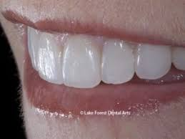
Organic matter
Crystal thickness and length
Intercrystallite space
And fire…
Isotopic changes (C/N/O/etc. but no Sr)
Isotopic alteration
H₂O
https://doi.org/10.1038/s41598-018-34376-w
https://doi.org/10.1080/05704928.2017.1400442

Slide 29
Why isotopes matter?
Convoluted but promising!
Awesome!
Forget about it!

Slide 30
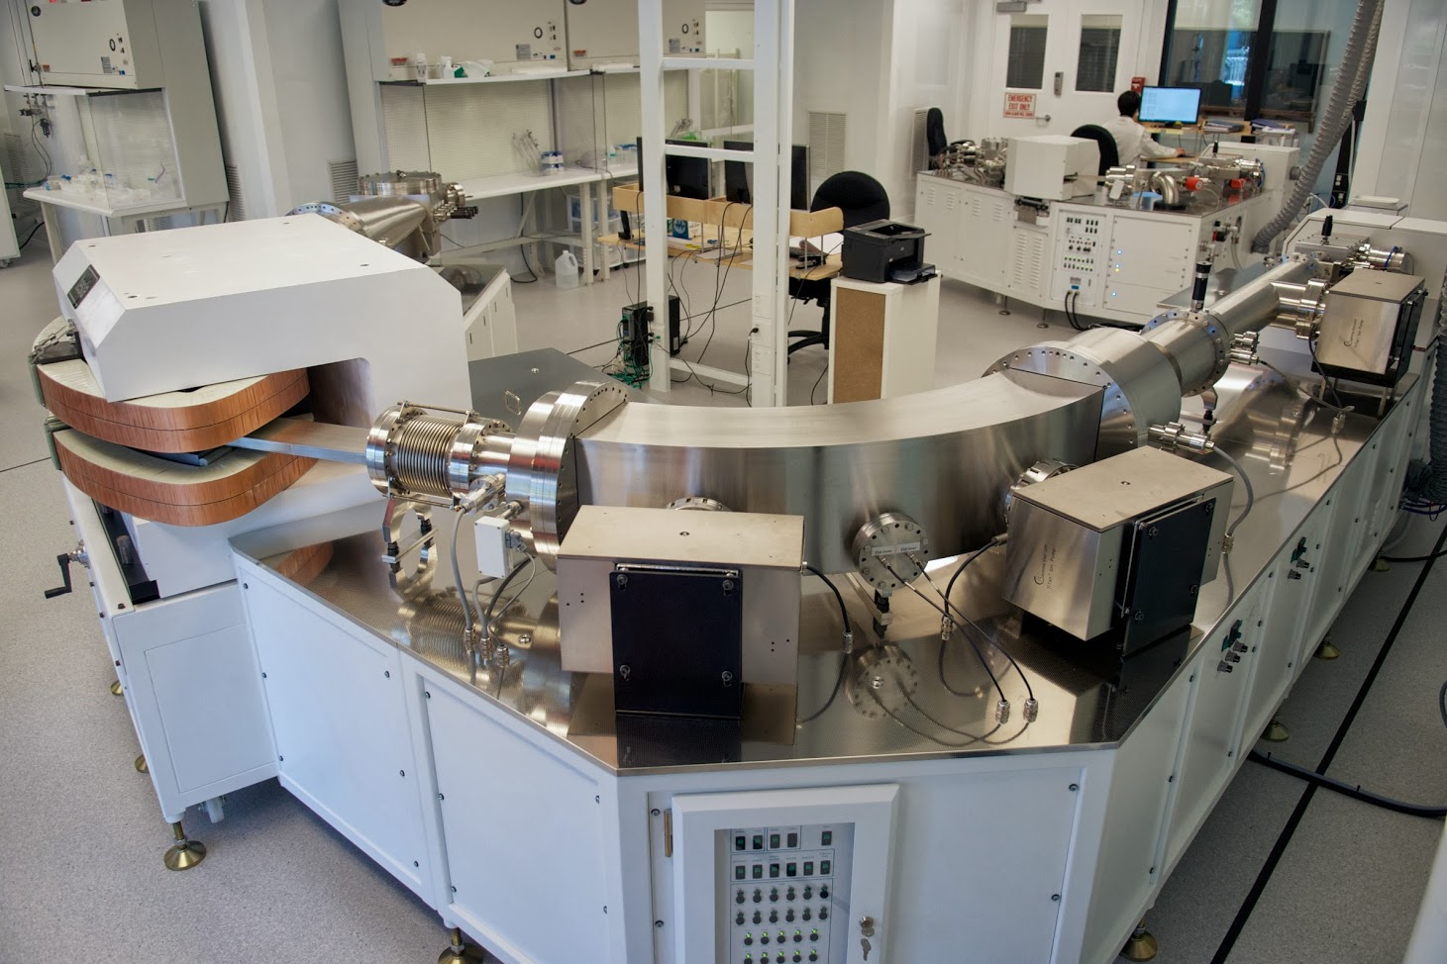
Strontium:
the unaffected isotope

Slide 31
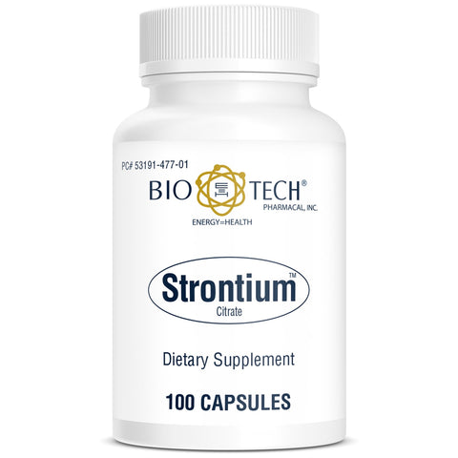
Not so strong-tium
Strontium (or Sr) has chemical similarity to calcium, which enables the replacement of calcium by strontium in biomineralization processes
About 99% of Sr in the human body is concentrated in the bones
Sr concentrations are relatively low in skeletal tissues (bone and tooth) and are expressed in ppm (parts per million).
Does supplemental strontium strengthen weak bone? The jury is in: and the answer is, it does not!
Strontium salts

Slide 32
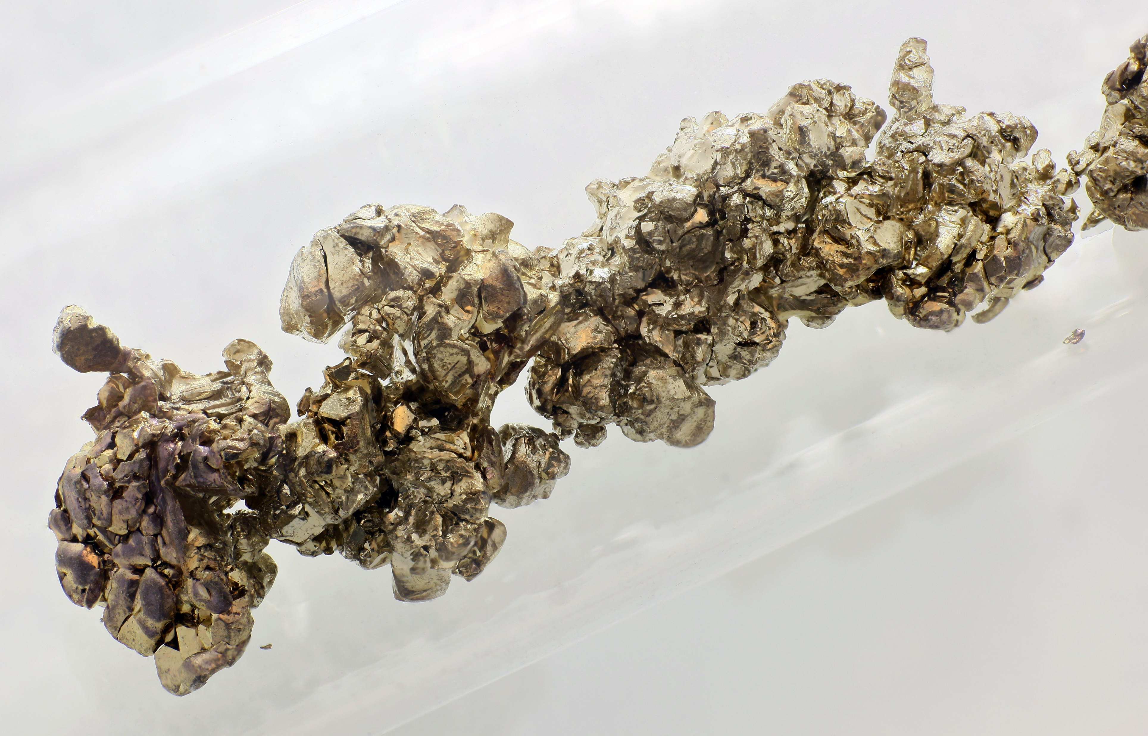
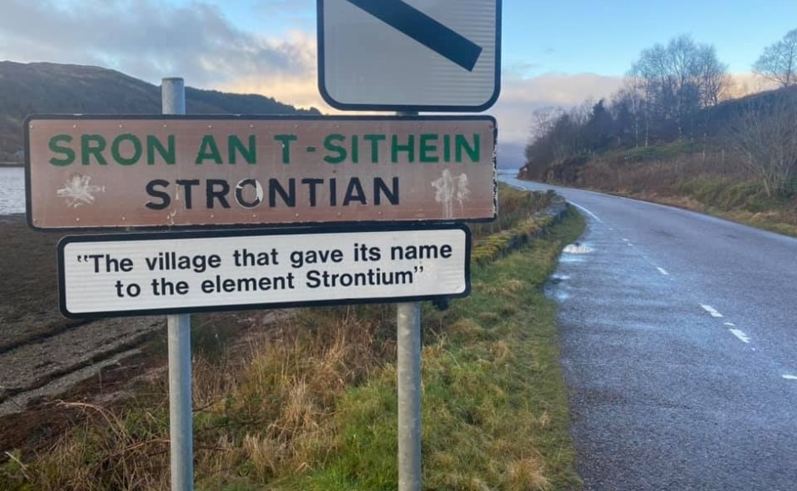
What’s strontium?
Sr is a soft silver-white yellowish metallic element that is highly chemically reactive.
Let’s start with strontium (Sr)!
Natural stable strontium is not hazardous to health.
Because strontium has an electron configuration similar to that of calcium, it readily substitutes for calcium in minerals.
Sr are named after Strontian, a village in Scotland near which the mineral was discovered in 1790 by Adair Crawford and William Cruickshank.

Slide 33
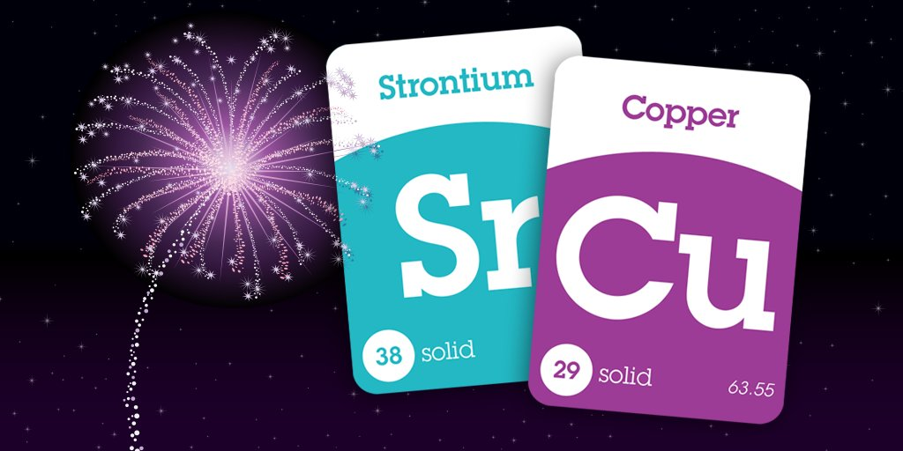
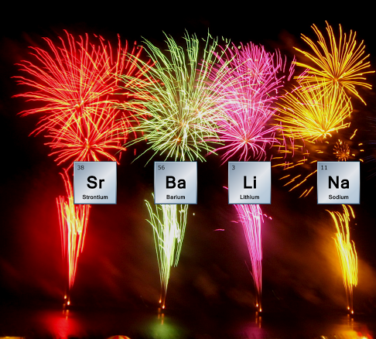
What’s strontium?
Sr has four stable, naturally occurring isotopes:
⁸⁴Sr = 0.56%
⁸⁶Sr = 9.87%
⁸⁷Sr = 7.04%
⁸⁸Sr = 82.53%
Only ⁸⁷Sr is radiogenic
A radiogenic nuclide is a nuclide that is produced by a process of radioactive decay. It may itself be radioactive or stable.
How colors in fireworks are produced. Purple = Mixture of Sr and Cu compounds. Red = Sr salts.
⁸⁷Sr derived from ⁸⁷Rb, which has a half-life of 4.88 × 10¹⁰ years (i.e. more than three times longer than the current age of the universe).
The ratio of ⁸⁷Sr to the other isotopes is therefore a function of the variable abundance of ⁸⁷Sr.

Slide 34
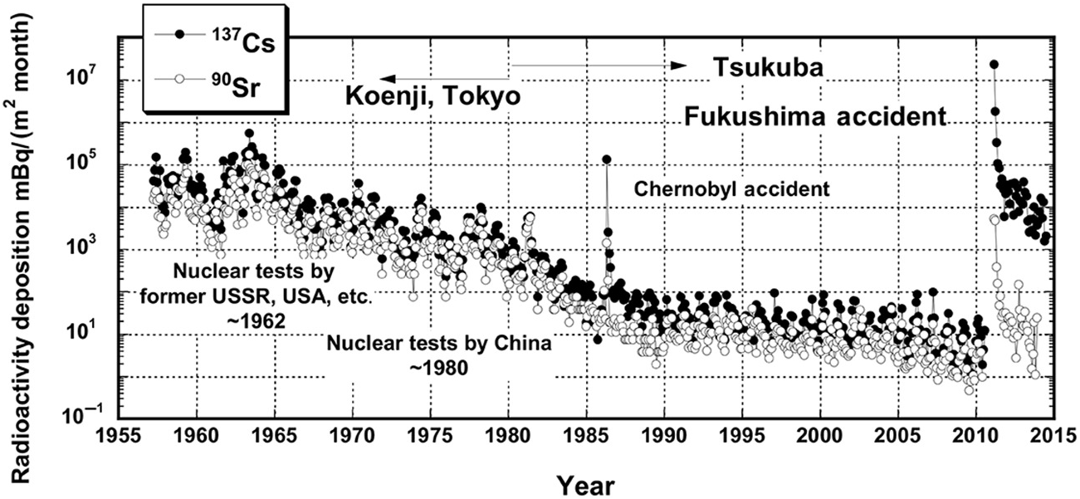
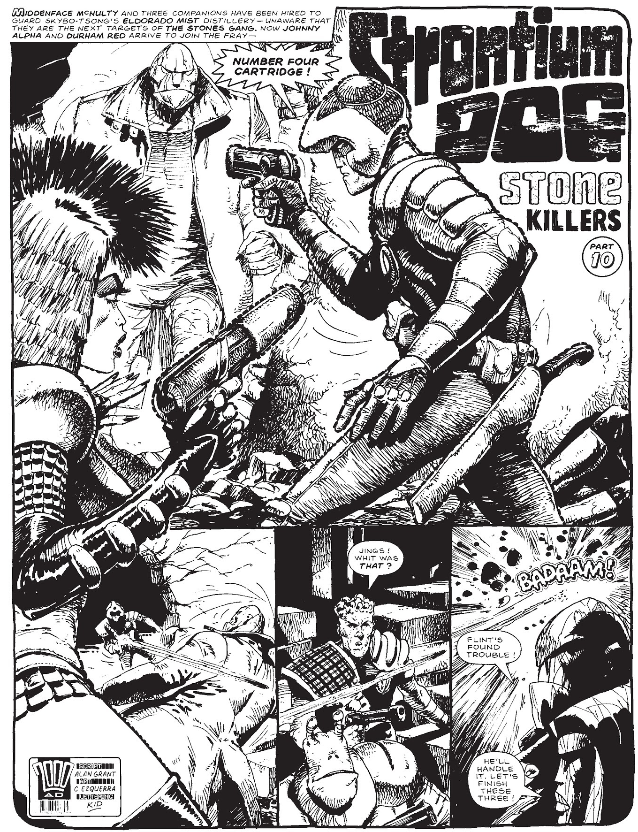
What’s strontium?
32 unstable isotopes of strontium are known to exist, ranging from ⁷³Sr to ¹⁰⁸Sr.
The longest-lived of these isotopes, and the most relevantly studied, are:
⁹⁰Sr with a half-life of 28.9 years,
⁸⁵Sr with a half-life of 64.853 days,
⁸⁹Sr with a half-life of 50.57 days.
Monthly deposition of ⁹⁰Sr and ¹³⁷Cs observed at the MRI, Japan since 1954.
Nakajima et al. 2019, https://doi.org/10.1017/9781108574273
One neutron away:
⁸⁹Sr = used in treatment of bone cancer
⁹⁰Sr = causes health problems (cancer of bone, marrow, nearby soft tissues and leukemia)
⁹⁰Sr is present in dust from nuclear fission after detonation of nuclear weapons or a nuclear power plant accident.
Strontium Dog was a long-running British comics series. Due to nuclear fallout of ⁹⁰Sr, humanity has an increased number of mutant births, most of whom have physical abnormalities but some of whom possess superhuman abilities.

Slide 35
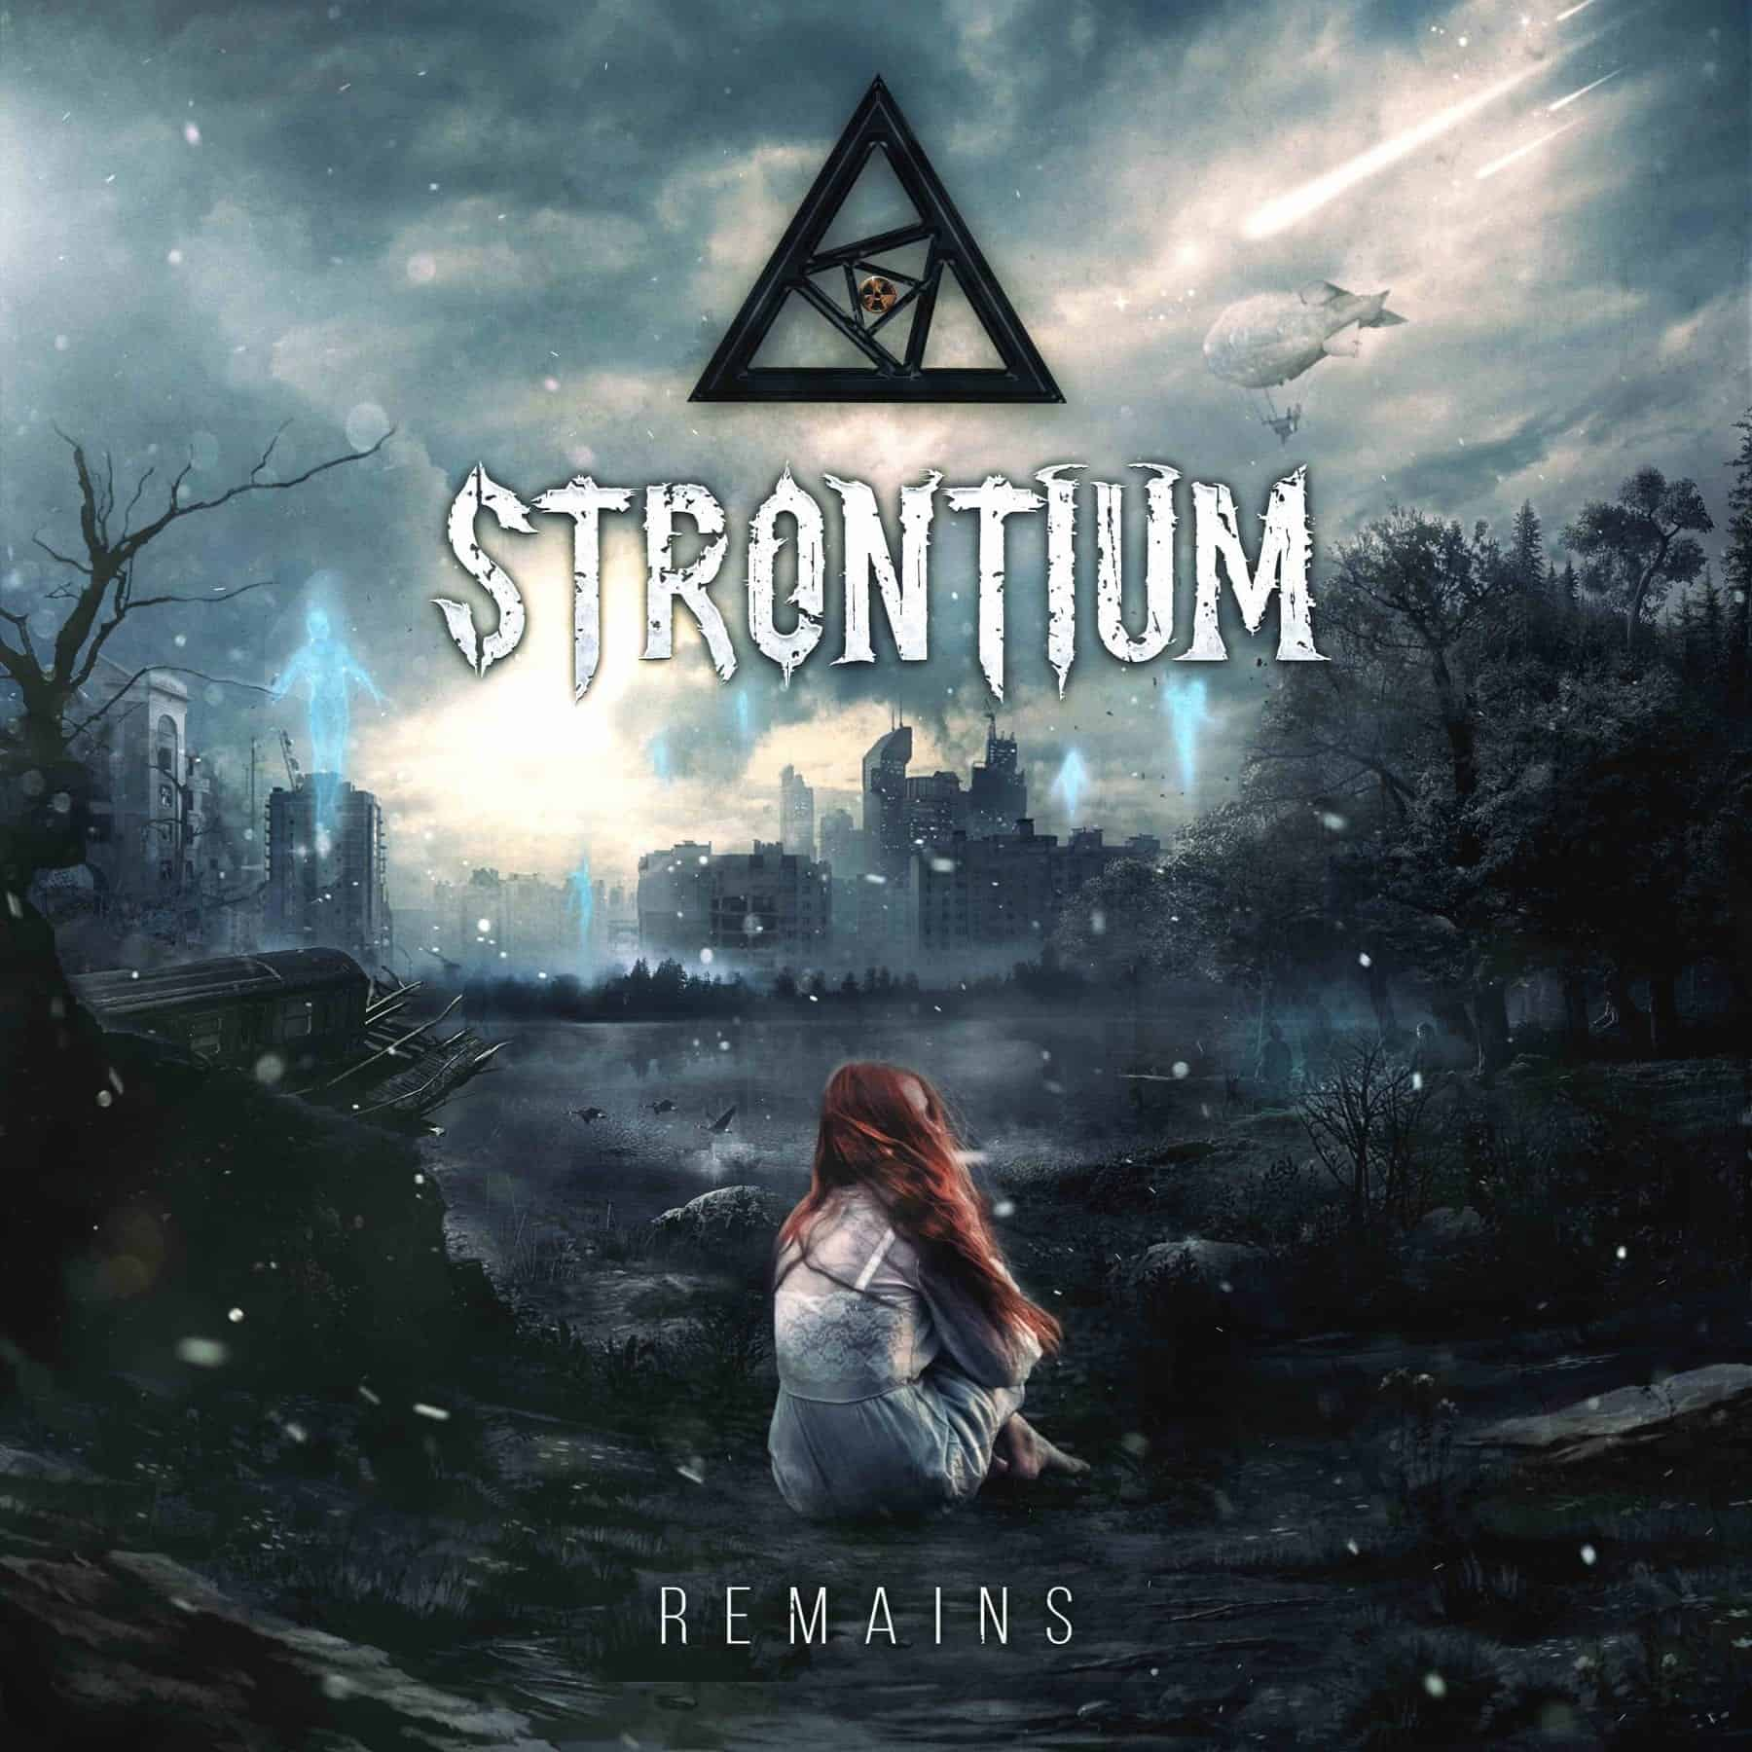
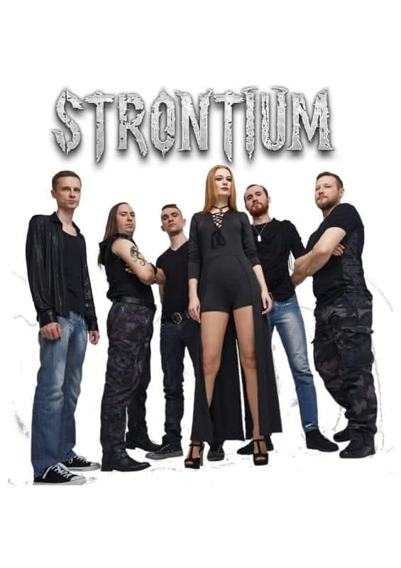
What’s strontium?
Sr is a heavy element with a standard atomic mass of 87.62 u.
⁸⁷Sr has 49 neutrons.
In provenance studies, Sr isotope variations are typically represented using the ratio of ⁸⁷Sr relative to ⁸⁶Sr (⁸⁷Sr/⁸⁶Sr).
Mass differences between Sr isotopes are very small and isotopic fractionations in biochemical reactions are undetected so far.
Strontium is inspiring…

Slide 36
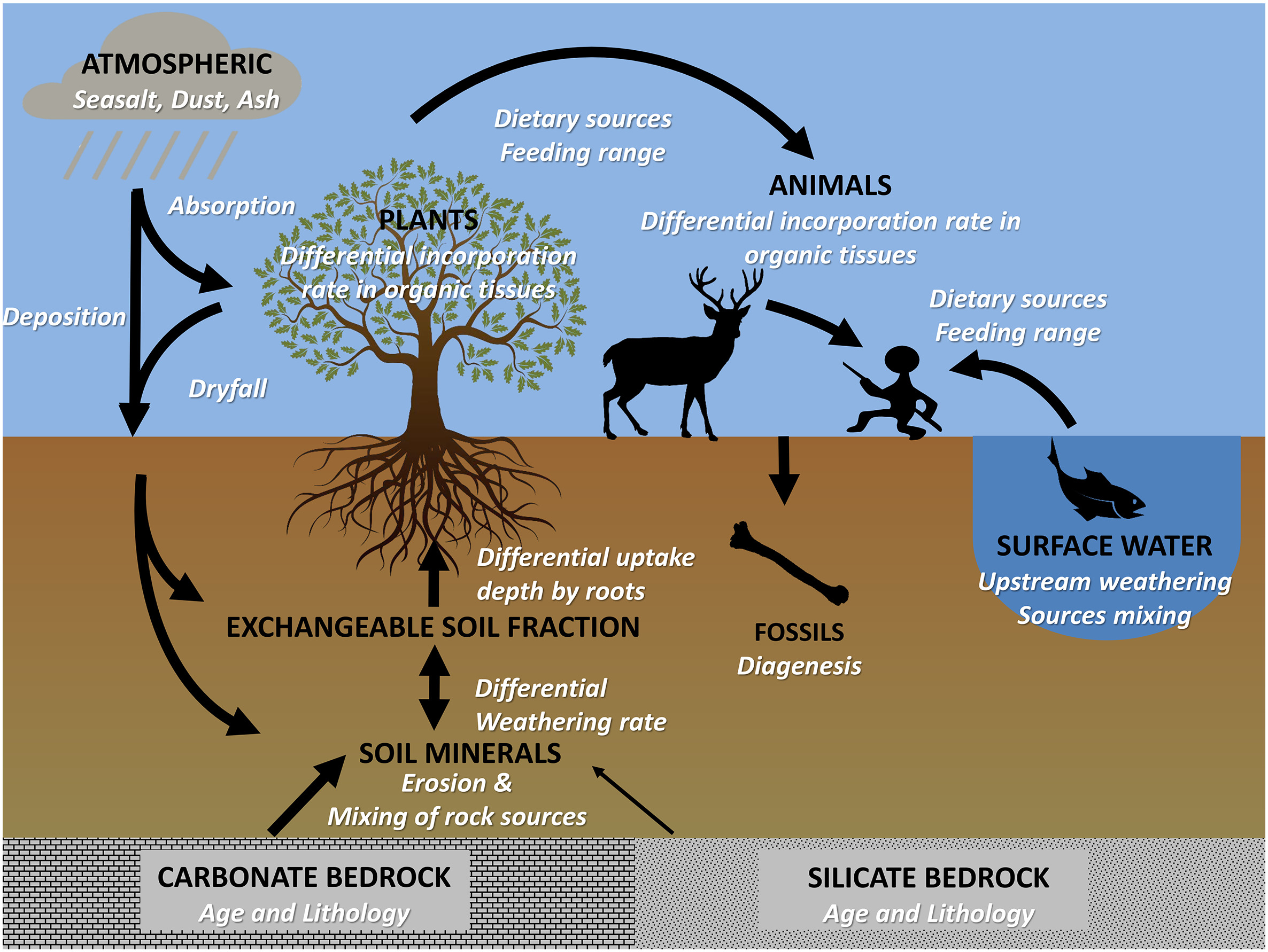
Strontium cycle
Simplified sketch of strontium isotope cycling from rocks to ecosystems.
Capitalized black words correspond to Sr reservoirs and italicized white words correspond to process modifying 87Sr/86Sr. Bataille et al. 2020, https://doi.org/10.1016/j.palaeo.2020.109849.

Slide 37
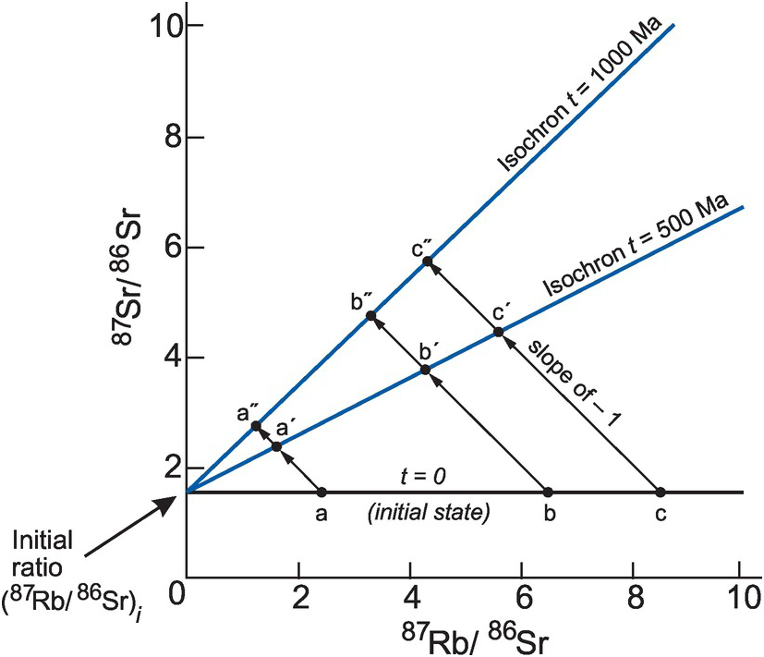
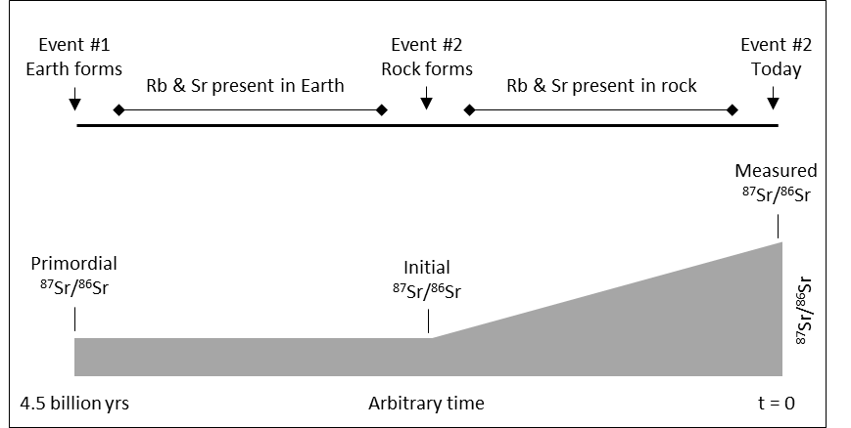
Schematic isochron diagram used in Rb-Sr dating methods. Rollinson and Pease 2021, https://doi.org/10.1017/9781108777834.004.
Sr in the geosphere
The ⁸⁷Sr/⁸⁶Sr in rocks and minerals is:
mineral-dependent
(initial ⁸⁷Rb, ⁸⁷Sr, and ⁸⁶Sr abundances)
time-dependent
(radioactive decay of ⁸⁷Rb to ⁸⁷Sr).
At the time of our planet's formation, the bulk Earth reservoir had a ⁸⁷Sr/⁸⁶Sr signature of 0.699.
As geochemical differentiation progressed, Sr and Rb concentrated in melts that preferentially contributed to the crusts.
This partitioning resulted in increased ⁸⁷Rb/⁸⁶Sr in the continental crust relative to the mantle, and over time, this led to differences in ⁸⁷Sr/⁸⁶Sr among geologic pools with the progressive decay of ⁸⁷Rb into ⁸⁷Sr.
Timeline of a simple event sequence from Earth's origin (event 1) until today (event 3). Event 2 created a new reservoir with higher Rb/Sr, causing ⁸⁷Sr/⁸⁶Sr to grow more rapidly thereafter until today.
After Long 1998, https://doi.org/10.1007/1-4020-4496-8_279.

Slide 38
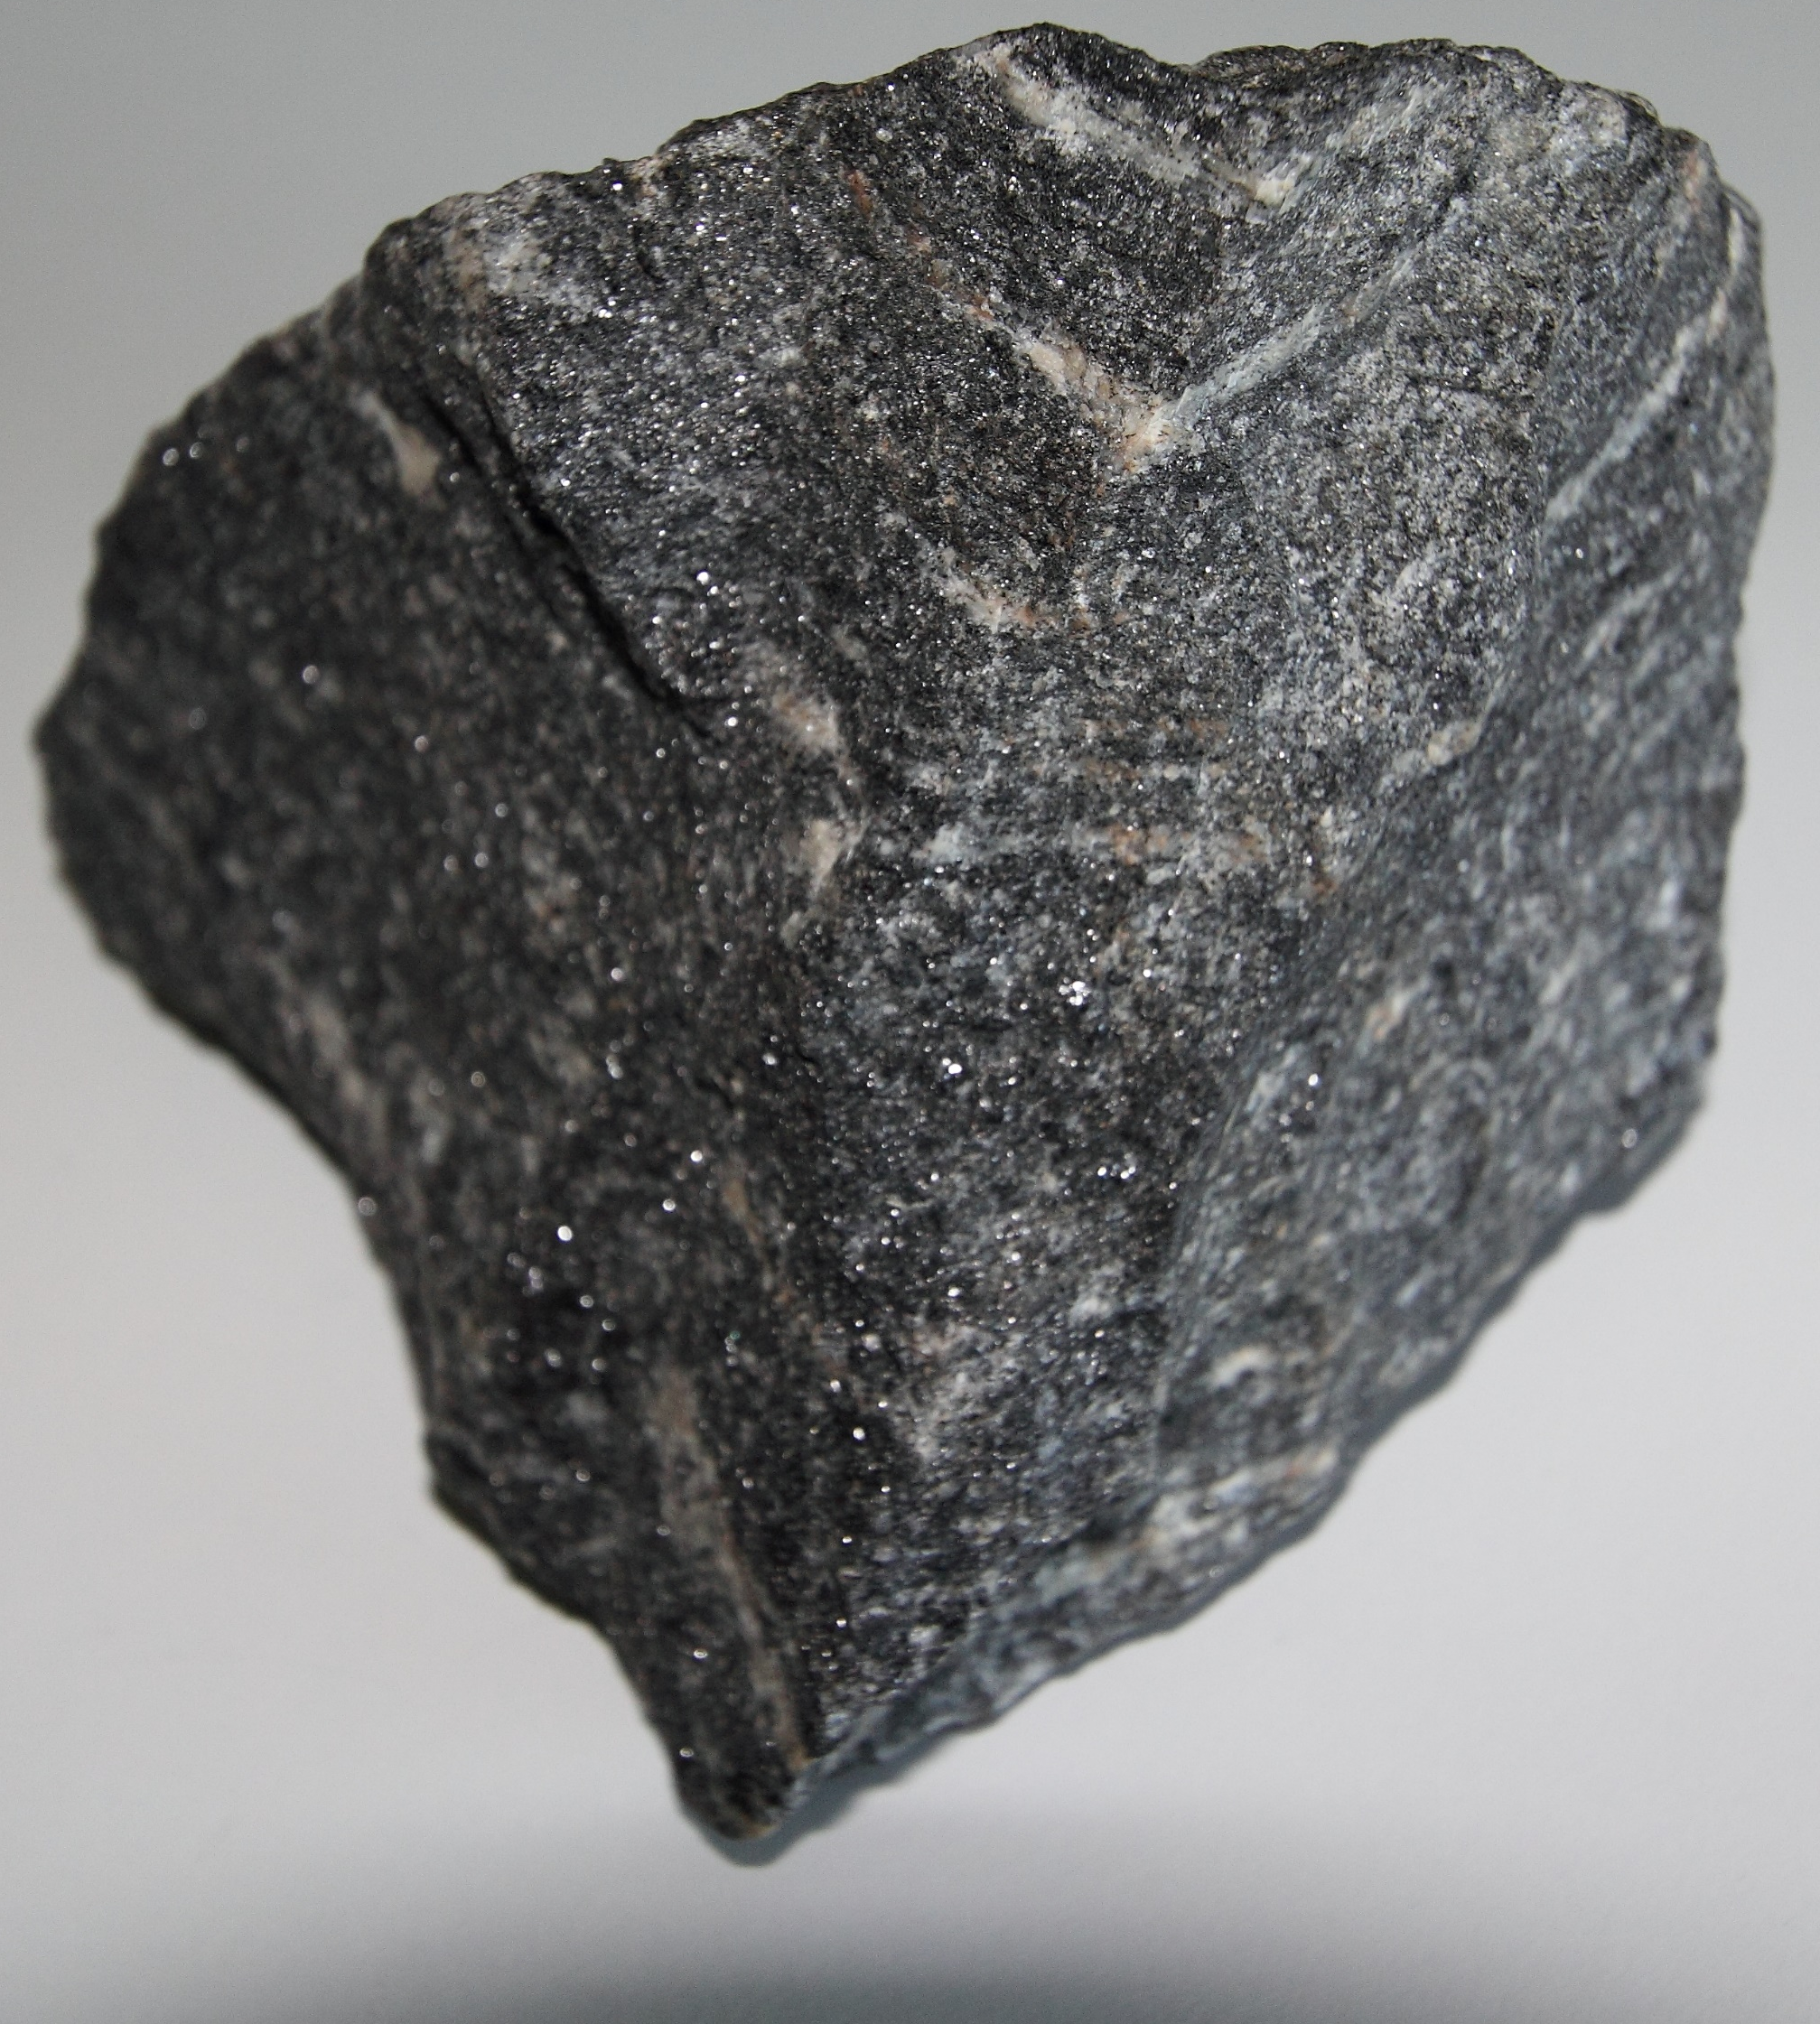
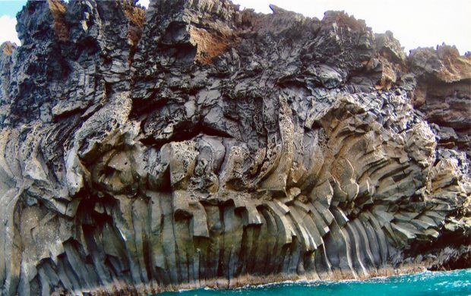
Sr in the geosphere
The combined effects of geochemical partitioning of Rb and Sr and radioactive decay explain the large range of ⁸⁷Sr/⁸⁶Sr in igneous, sedimentary, and metamorphic rocks.
With equal initial ⁸⁷Rb/⁸⁶Sr, older igneous rocks have higher ⁸⁷Sr/⁸⁶Sr than younger rocks because ⁸⁷Rb has had more time to decay in the older reservoir.
The Acasta Gneiss from Canada is considered as the oldest rock on Earth. It is composed of the Archaean igneous and gneissic cores of ancient mountain chains (4.031 ±0.003 Ga).
At equal age, more felsic rocks (with higher ⁸⁷Rb/⁸⁶Sr) have higher ⁸⁷Sr/⁸⁶Sr than mafic rocks (with lower ⁸⁷Rb/⁸⁶Sr) because more ⁸⁷Rb is available to decay into ⁸⁷Sr.
Old felsic igneous rock units (e.g., cratonic shields) have the highest measured ⁸⁷Sr/⁸⁶Sr (>0.720), while newly formed mafic igneous rock units (e.g., basalts, volcanic arcs) have the lowest ⁸⁷Sr/⁸⁶Sr (c. 0.703).
A cooled lava flow along the Kanaio coast in Hawaii dated from the 18 c. AD.

Slide 39
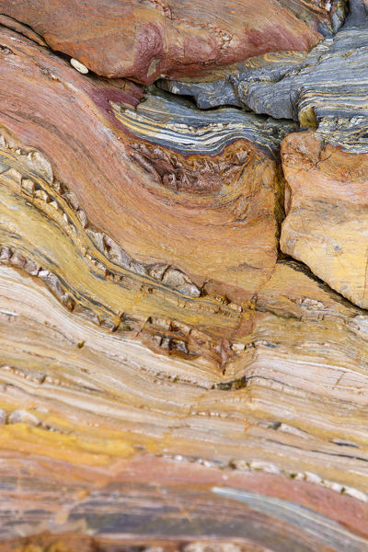
Sr in the geosphere
Siliciclastic sediments inherit ⁸⁷Sr/⁸⁶Sr from their parent rocks but are usually composed of a mixture of minerals with distinct parent rock, and thus different isotopic ratios.
Because local bedrock sources dominate the ⁸⁷Sr/⁸⁶Sr, recently deposited siliciclastic sediments from young igneous rocks (e.g., volcanic arcs) tend to have lower ⁸⁷Sr/⁸⁶Sr than those forming in older felsic environments.
However, it becomes challenging to assess the original parent rock for older sediments due to tectonic and geomorphological evolution of the surface.
Rock formation El Silencio, Spain.
Siliciclastic rocks are clastic non-carbonate sedimentary rocks that are composed primarily of silicate minerals, such as quartz or clay minerals. They include mudrock, sandstone, and conglomerate.

Slide 40
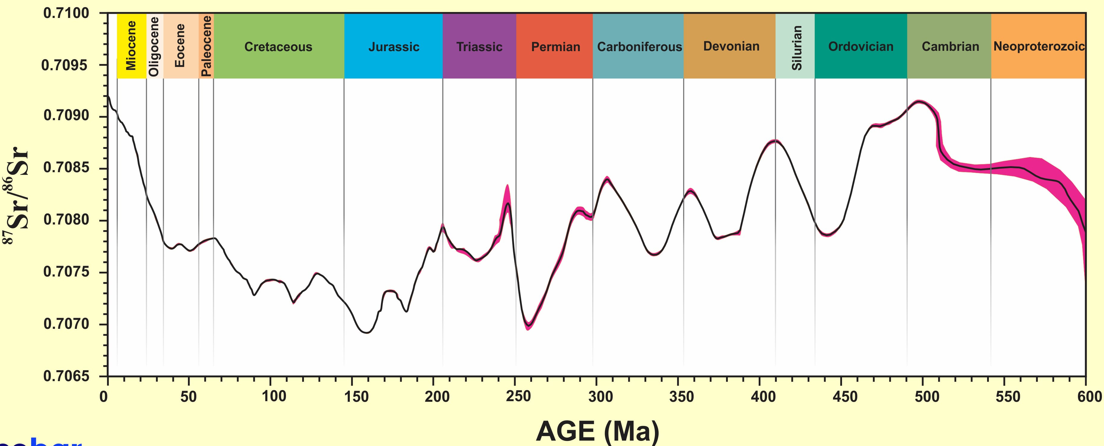
Sr in the geosphere
They have a narrow range in ⁸⁷Sr/⁸⁶Sr because:
Seawater ⁸⁷Sr/⁸⁶Sr has remained within a tight range throughout the Phanerozoic (0.707-0.709)
Carbonates have small amounts of Rb but large amounts of Sr (Sr readily substitutes for calcium), which means their ⁸⁷Sr/⁸⁶Sr does not evolve significantly through time.
Carbonate rocks, on the other hand, primarily inherit their ⁸⁷Sr/⁸⁶Sr from seawater.
Strontium isotopic ratio of seawater during geological time based on analyses of bulk sediment, unaltered brachiopods, belemnites, conodonts and foraminifera samples from various locations around the world. Red area denotes the 95% confidence interval. Adapted from McArthur et al., 2001.

Slide 41
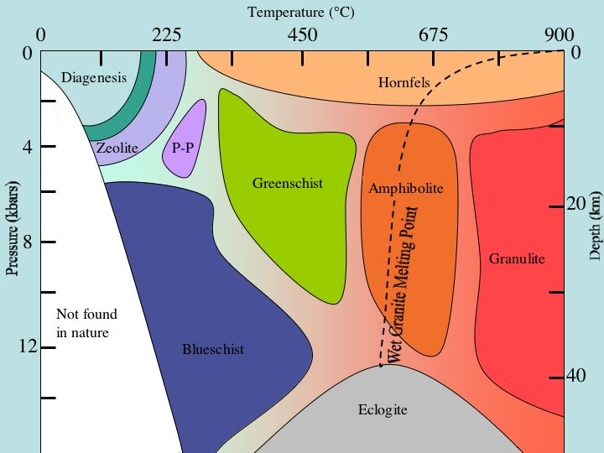
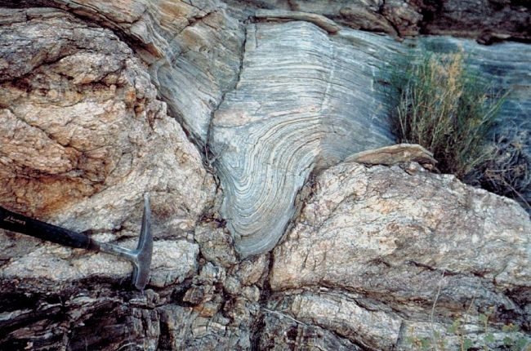
Sr in the geosphere
Metamorphism is the transformation of existing rock to rock with a different mineral composition or texture. Various forms of metamorphism exist.
Metamorphism can alter the ⁸⁷Sr/⁸⁶Sr of igneous and sedimentary rock units, which can lead to highly variable ⁸⁷Sr/⁸⁶Sr in metamorphic rocks.
Temperatures and pressures of metamorphic facies
Ultimately, the combination of igneous, sedimentary and metamorphic processes leads to considerable variability of ⁸⁷Sr/⁸⁶Sr in the geosphere.
Example of a metamorphic rock.

Slide 42
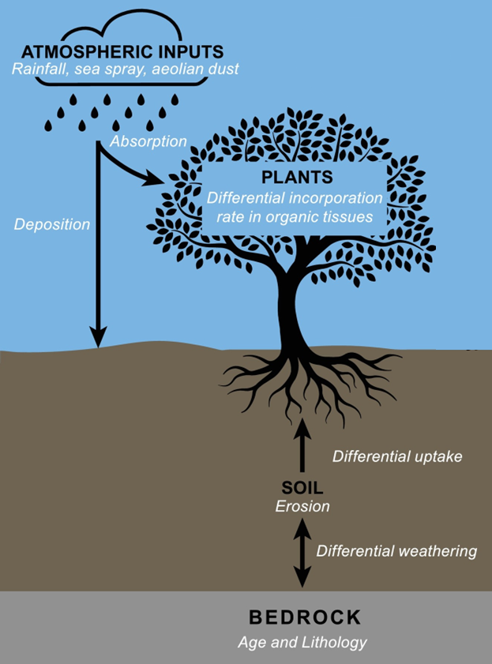
Sr in the geosphere
Soils primarily inherit their ⁸⁷Sr/⁸⁶Sr composition from parent rock, and consequently ⁸⁷Sr/⁸⁶Sr patterns in soils follow those of the underlying geology.
However, the observed relationship between soil and local bedrock ⁸⁷Sr/⁸⁶Sr is rarely 1:1.
Exogenous sources can drastically affect the ⁸⁷Sr/⁸⁶Sr of soil, such as:
Unconsolidated sediments (e.g., loess)
Aeolian dust from desert zones
Volcanic tephra (e.g., ash)
Sea salt aerosols (= seaspray)
Strontium pathways in soil. After Holt et al. 2021, https://doi.org/10.1016/j.earscirev.2021.103593.

Slide 43
Sr in the geosphere
Different soil fractions can also have distinct ⁸⁷Sr/⁸⁶Sr compositions due to differential weathering and soil mixing processes.
The soil exchangeable Sr corresponds primarily to Sr dissolved in soil water and available to plants.
⁸⁷Sr/⁸⁶Sr of this soil exchangeable Sr is strongly influenced by soil age.
As soils become more and more weathered, fewer primary minerals are available, and other sources increasingly contribute to the exchangeable Sr budget.
Strontium pathways in soil. After Bataille et al. 2020, https://doi.org/10.1016/j.palaeo.2020.109849.

Slide 44
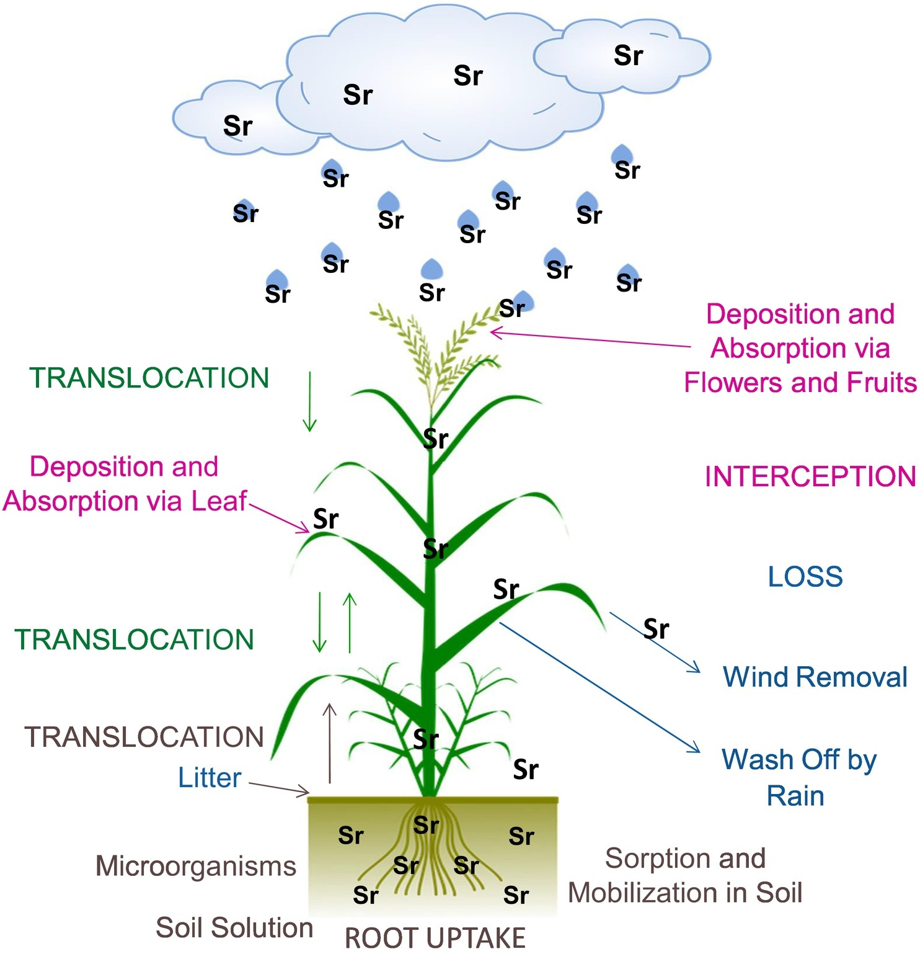
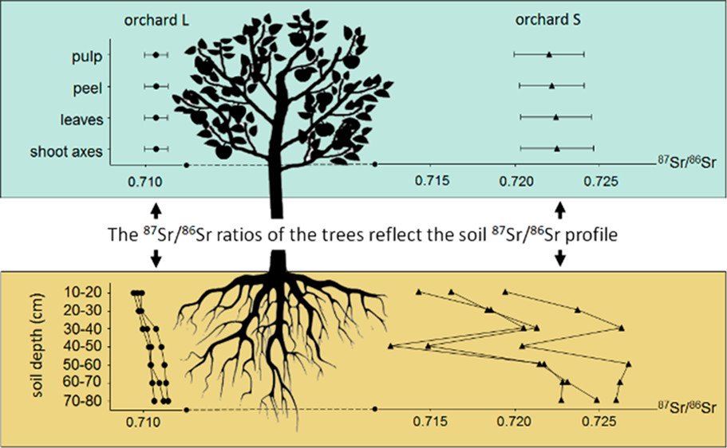
Uptake of strontium by the plant. Burger & Lichtscheidl 2019, https://doi.org/10.1016/j.scitotenv.2018.10.312.
Sr in plants
Plants take up Sr from the exchangeable soil fraction.
However, differences between ⁸⁷Sr/⁸⁶Sr in plants and the exchangeable Sr fraction can occur.
Differential weathering and soil mixing processes can lead to variable ⁸⁷Sr/⁸⁶Sr along the soil profile.
This variability is propagated among plants with different rooting depth.
A moderate homogeneity of the ⁸⁷Sr/⁸⁶Sr was observed among subsamples of the same tree part. The variability of the ⁸⁷Sr/⁸⁶Sr of the apple trees is explained by the ⁸⁷Sr/⁸⁶Sr of the soil. Aguzzoni et al 2019, https://doi.org/10.1021/acs.jafc.9b01082.

Slide 45
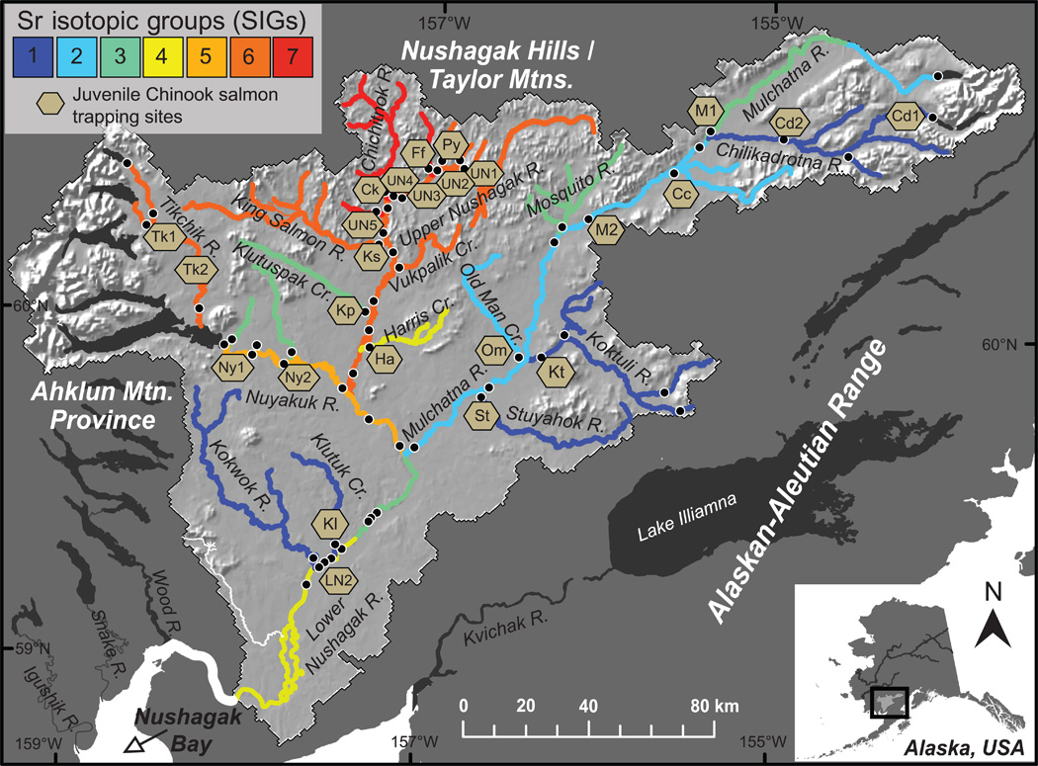
Sr in surface waters
Water inherits ⁸⁷Sr/⁸⁶Sr from rock weathering.
Consequently, spatial patterning of ⁸⁷Sr/⁸⁶Sr in the hydrosphere reflects that of rocks exposed on the surface and in aquifers.
Mixed Stock Analysis model built using water data from throughout the Nushagak River (Alaska, USA), producing seven strontium isotopic groups. Brennan et al. 2015 https://www.science.org/doi/10.1126/sciadv.1400124.
However, the contributions of different minerals and rock units to the dissolved Sr pool vary broadly based on their weathering rate and Sr content, which in turn leads to distinct ⁸⁷Sr/⁸⁶Sr between the hydrosphere and geosphere.
At the scale of a catchment, the flux of Sr from isotopically distinct rock units is also modulated by geomorphological, climatic and environmental conditions.
Caution: Sr-rich and easily weatherable carbonates and evaporites contribute disproportionately to the dissolved Sr in the hydrosphere.

Slide 46
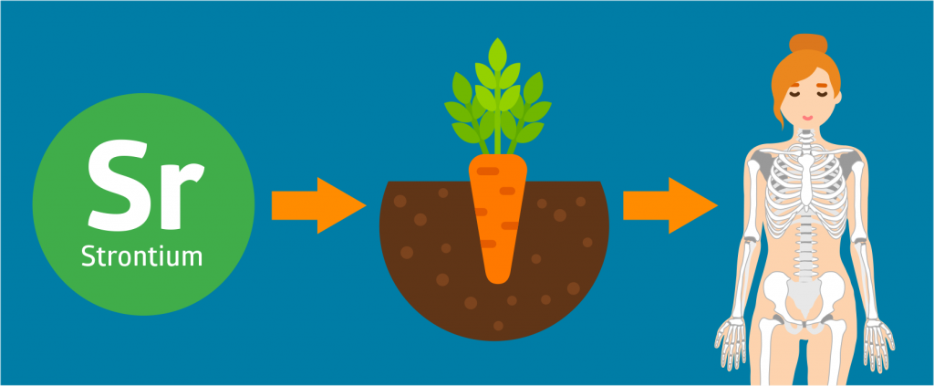
Sr in animals & humans
Primary terrestrial consumers obtain the majority of their Sr from diet.
As plants are at the base of many terrestrial food chains, ⁸⁷Sr/⁸⁶Sr for animals usually reflects that of local plants.
Tooth preserve a snapshot of a specific period in the organism's life, while bone integrate Sr over longer time periods. They can therefore provide information about dietary signatures at different stages of an individual's life.
Reminder: no fractionation!
Humans can eat local terrestrial resources, hunt migratory mammals, harvest marine resources, inheriting a potentially very complex mixture of ⁸⁷Sr/⁸⁶Sr sources.
In some contexts, drinking water can contribute significantly to the Sr inputs when (1) water is Sr-rich (e.g., carbonate landscapes), or (2) animals drink frequently.
Different taxa sample Sr differently on the landscape depending on their feeding habits and feeding ranges (small rodents vs large herbivores).
Humans can also obtain resources from distant localities via trade.

Slide 47
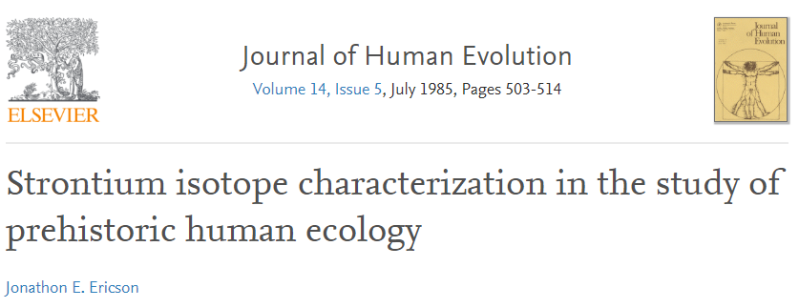
Sr in the skeleton
The application of strontium isotope analysis in archaeology arose from the realization that migrant individuals moving from one geological region to another could be identified by comparing the ⁸⁷Sr/⁸⁶Sr of different skeletal elements.
In theory, if the teeth and bones of a skeleton have different signatures, then the person spent his/her last years in a different geochemical province than during his/her youth.
First publication in archaeology using ⁸⁷Sr/⁸⁶Sr. Ericson 1985 https://doi.org/10.1016/S0047-2484(85)80029-4.

Slide 48
Sr in the skeleton
Unfortunately, archaeological bone is often contaminated during burial.
Soil water Sr can penetrate the bone after burial and overwhelm or even sometimes completely replace the biogenic Sr.
⁸⁷Sr/⁸⁶Sr vs. age diagram of archaeological teeth from Switzerland, analyzed by Chiaradia et al. (2003). From Bentley 2006 https://doi.org/10.1007/s10816-006-9009-x.
Post-burial contamination is the reason why it may not be reliable to define the local ⁸⁷Sr/⁸⁶Sr range based on the average ⁸⁷Sr/⁸⁶Sr of samples of human bones from the site.
Like bone, tooth dentine is also highly susceptible to contamination.
The ⁸⁷Sr/⁸⁶Sr ratios from sequential acid leaching of bone and enamel samples from a Holocene California fur seal. Hoppe et al. 2003, https://doi.org/10.1002/oa.663.

Slide 49
Sr in the skeleton
Micro X-Ray Fluorescence scanning reveals trace element variability in archaeological tooth enamel.
De Winter et al. 2017, https://doi.org/10.1016/j.palaeo.2019.109260.
Repeated studies prove that tooth enamel is less sensible to diagenetic Sr than bone or dentine.
Outer enamel and enamel-dentine junction should be avoided or removed when sampling enamel for palaeo-reconstructions.

Slide 50
Teeth and cremation
Unfortunately, the recovery of burnt human teeth is relatively low.
They tend to become brittle and fracture either during the cremation process or upon excavation. Additionally, due to their small size, they are not always recovered after the cremation process.

Slide 51
Bone and cremation
https://doi.org/10.1002/rcm.7078
Bones work!

Slide 52
Sr analysis

Slide 53
Where people come from?
https://www.bbc.com/news/uk-england-wiltshire-35461309
http://www.thehistoryblog.com/archives/date/2008/05
https://doi.org/10.1038/s41598-018-28969-8

Slide 54
What people ate?
https://doi.org/10.1038/s41598-022-12880-4
Comparison of ⁸⁷Sr/⁸⁶Sr and [Sr] between the Metal Ages and Gallo-Roman buried individuals of Destelbergen, Blicquy, Herstal and Fize-le-Marsal. The available ⁸⁷Sr/⁸⁶Sr baselines are indicated in grey.

Slide 55
Carbon & Oxygen:
the underexplored isotopes

Slide 56
Background
The current state of research shows that palaeodietary analyses in burnt bone are not possible
Isotope signatures of δ¹³C, δ¹⁵N and δ¹⁸O preserve their original values only up to 200°C
Changes occurring above this threshold were identified experimentally, with varying degrees of influence on the final isotopic composition.

Slide 57
Background
A comparison of the results of δ¹³C and δ¹⁸O isotope analysis of remains from a single cemetery allows the pinpointing of those individuals who were cremated in different circumstances than others (i.e. their isotopic values do not correlate with the cemetery “baseline”).
https://doi.org/10.1016/j.jas.2015.10.013
It has recently been pointed out that stable light isotopes may be used in studies oriented at reconstructing the cremation ritual, serving as proxies of the conditions in the funeral pyre during the burning of the deceased

Slide 58
Background
Sources of CO₂ that probably affect the isotopic composition of the carbonate fraction of bone apatite during heating/burning:
the atmosphere,
the burnt fuel,
the burnt organic matter, i.e. skin, muscle, fat, marrow
the burnt collagen,
the burnt carbonate fraction of bone apatite.
Wolska et al. 2020
10.15584/anarres.2020.15.1

Slide 59
A step forward
Reviewer #2 stated:
“I feel that the paper is certainly a seminal work on cremated remains.”

Slide 60
Objective
This study aims at detecting the presence of garments worn by the deceased during cremations.
We are investigating whether the deceased worn shoes or not, as the latter is likely one of the most resistant clothing items to fire and might represent a proxy to discuss whether an individual was dressed with other clothing pieces or not.
Targeted anatomical section => Feet
Targeted clothing items => Shoes
It is not possible to answer such a question so far by classic archeological methods.

Slide 61
Research design
Working Hypothesis:
Foot bones encased in unventilated shoes may experience heating conditions characteristic to confined-space cremation (low availability of oxygen, poorly ventilated, etc.).
Archaeological early modern footwear
Archaeological Roman boots

Slide 62
Research design
Scientific approaches:
Experimental archaeology &
cremations (outdoor & lab) in Belgium
During 2 sessions
Scientific tool:
Stable isotope analysis (δ¹³C, δ¹⁸O) and other complementary approaches at AMGC lab in VUB (Brussels)

Slide 63
Experimentations
Leather Shoes:
Vegetable-tanned leather (Switzerland) to approximate leather used by past populations
Already used in experimental archaeology to make Roman boots (Trans Alp Journey, Volken 2004)
Cattle hides (3mm) & goat hide (1.5mm)
Shoes laced with leather strips (same hides)
2 types of shoes: fully closed vs. one-side open
Handmade leather footwears

Slide 64
Experimentations
Pig Feet:
8 pigs from the same farm (Belgium)
Per pig: 1 unburnt foot, 3 burnt feet
(2 shoed & 1 unshoed)
Per pyre: feet deposited at the same level
Feet placed at the top, in the middle or at the bottom of the pyre
x 3

Slide 65
Experimentations
Sampling:
Excavation of pyres
Pig tissues (burnt & unburnt),
leather pieces, and wood logs
Overview of the different steps during our experimental cremations

Slide 69
Archaeological application
https://doi.org/10.1016/j.jas.2021.105509

Slide 70
What next?
Using donated body for direct test
https://www.dailymail.co.uk/news/article-2512694/Stuntman-Joe-Toedtling-sets-human-torch-record-set-6-minutes.html

Slide 71
Setting up the experiments
Launching the experiments

Slide 72
Burning phase

Slide 73
Burning phase

Slide 74
What next?
Stay tuned!

Slide 75
What’s an isotope?
Thank
you

