Slide 1


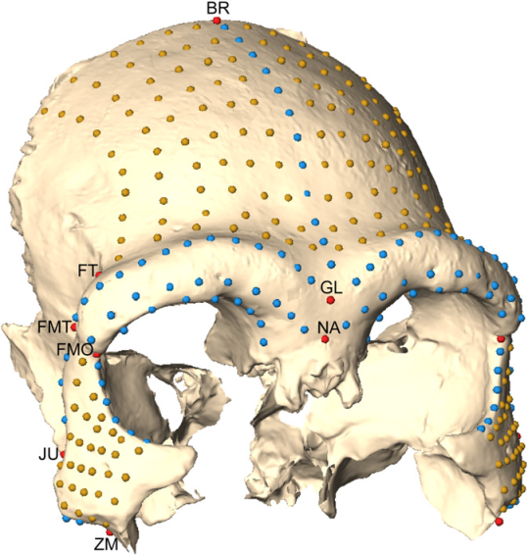
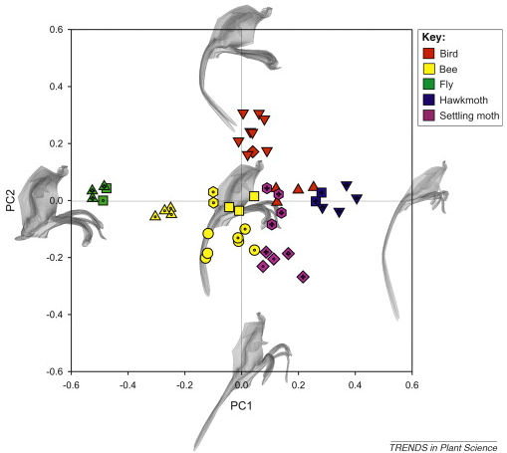
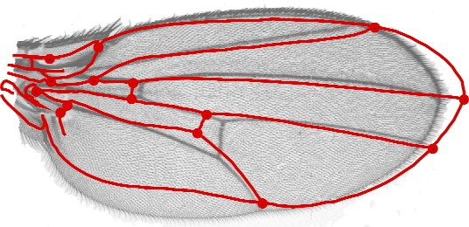
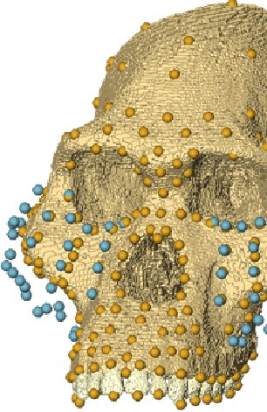
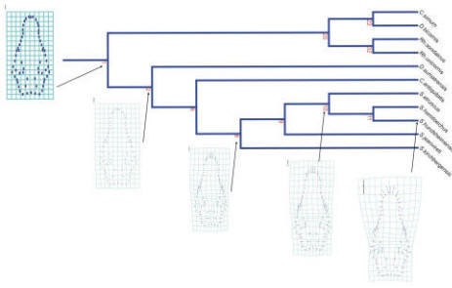
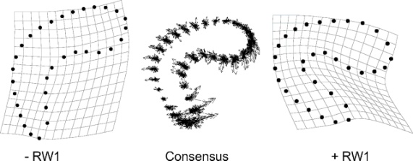

MODULARIZACE VÝUKY EVOLUČNÍ A EKOLOGICKÉ BIOLOGIE
CZ.1.07/2.2.00/15.0204
ANALYSIS OF PHENOTYPE

Slide 2
Genetic methods and morphology
What is the genetic basis of a morphological trait?
(quantitative trait loci = QTL)
Trait variation in time (phylogenesis)
Trait variation depending on other factors
Some methods are shared (e.g. PCA)

Slide 3
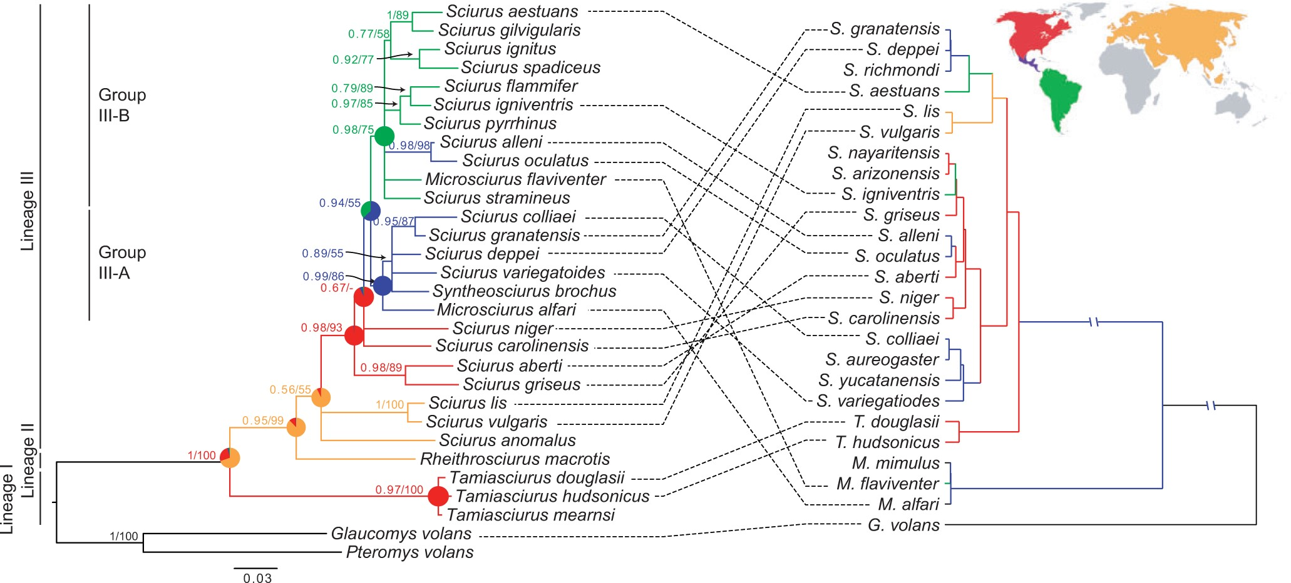
DNA
morfometrie
Pečnerová et al. Syst. Biol. (2015)

Slide 4
Molecular vs. morphological traits
amount (10³ - >10⁶ vs. 10²)
independence
phylogenetic scale
(with mol. traits we can compare e.g. bacteria and vertebrates)
larger number of taxa
usually represent many genes
(vs. e.g. mtDNA, cpDNA)
we can also study museum/fossil material

Slide 5
traits | variation |  | genetic determination
qualitative | discrete |  | one to a few genes of large effects
quantitative – plastic | continuous |  | many genes of small effects + non-genetic influence
quantitative – meristic | continuous scale of discrete traits |  | many genes of small effects + non-genetic influence (threshold traits)
Many so-called qualitative traits have, in fact, quantitative basis!

Slide 6
Analysis of phenotype
qualitative traits
epigenetic traits
traditional morphometrics
geometric morphometrics

Slide 7
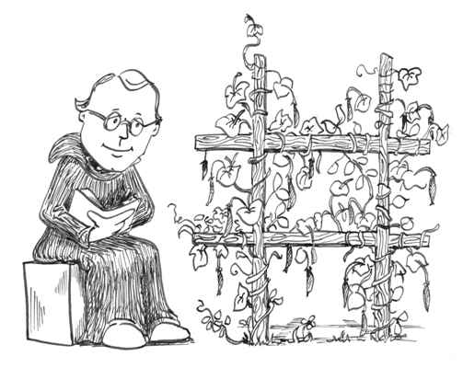
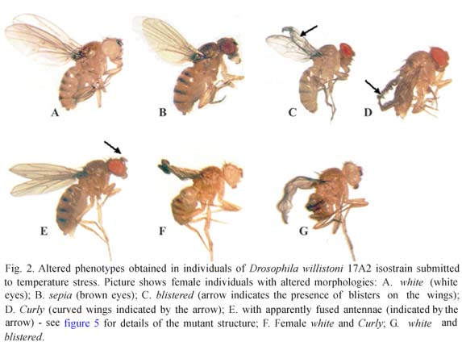
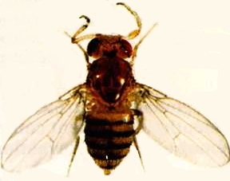
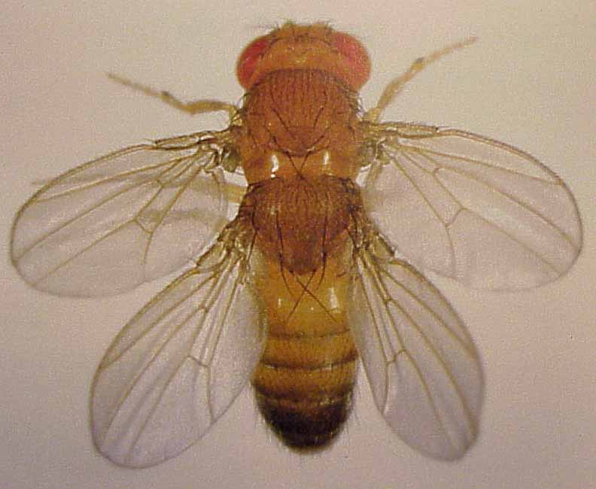
Qualitative trais
Mendelian inheritance, 1 − a few genes
mutations in D. melanogaster
mutations of Hox genes:
Antennapedia, Ultrabithorax

Slide 8
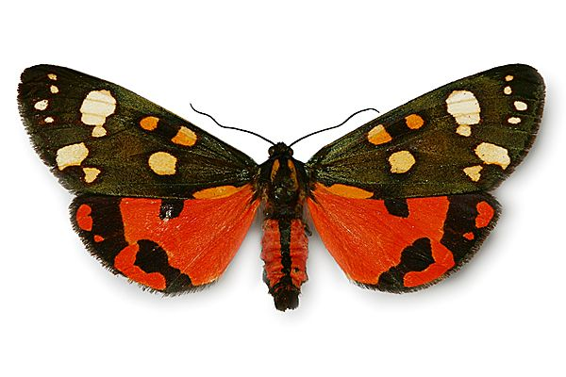
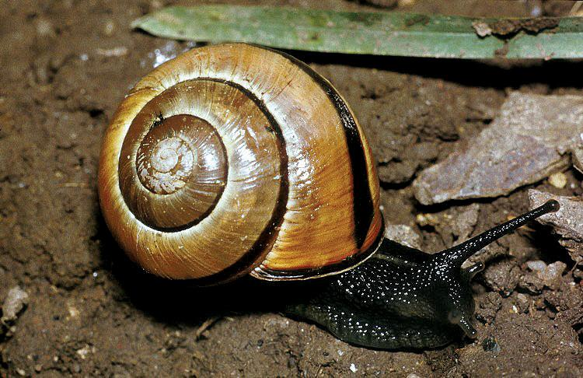
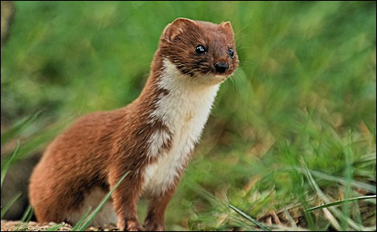
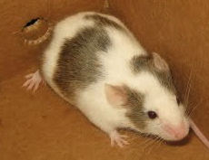
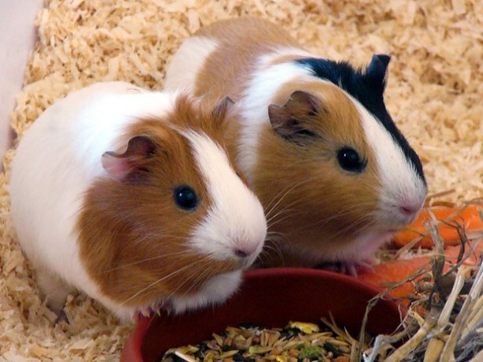
Qualitative trais
colouration:
scarlet tiger moth (přástevník hluchavkový, Callimorpha dominula), grove snail (páskovka hajní, Cepaea nemoralis), beetle elytrons
mammals: ∼15 domestic and laboratory species - cat, mouse, guinea pig, weasel, leopard, mink, horse
pigments:
eumelanin, phaeomelanin, carotens,
haemoglobin, trichosiderin

Slide 9
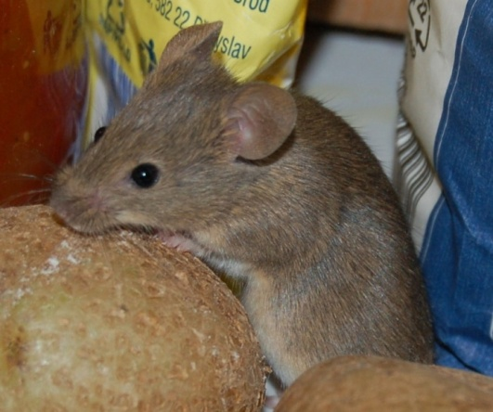
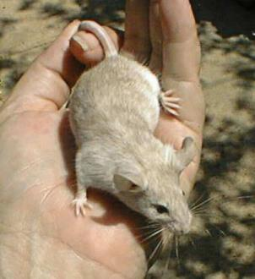
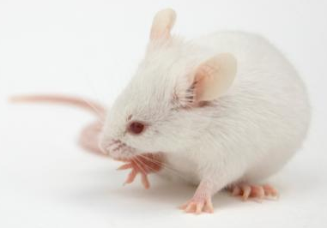
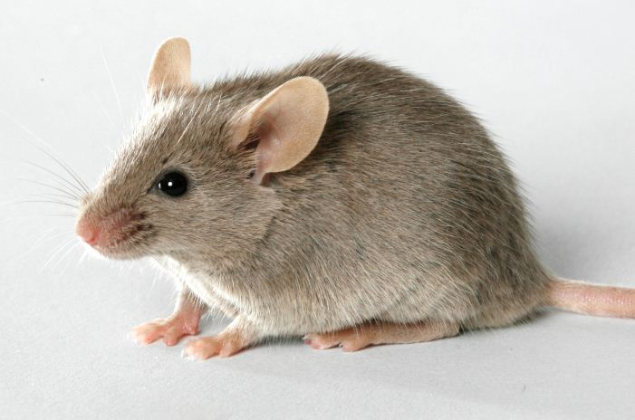
Qualitative trais
main allelic series – mouse:
  A = agouti (colour structure along hair)
  B = brown (protein component of pigment granules)
  C = albino (reduction of number of pigmented lesion)
  D = dilute (aggregation of pigmented lesions)
  E = extension (changes in amount of eumelanin)
agouti
albino
dilute
DBA = dilute–brown–non-agouti

Slide 10
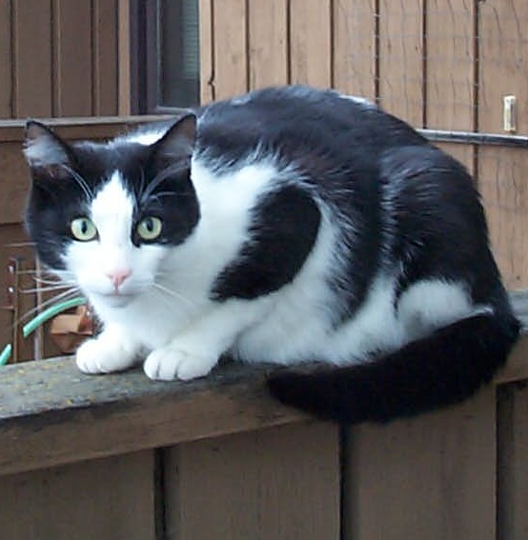



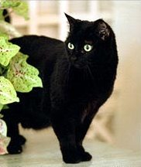
Qualitative trais
main allelic series – cat:
A-agouti, T-tabby, B-brown, O-orange,
S-white spotting, W-white, L-long hairs

Slide 11
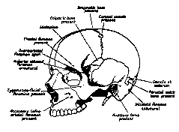
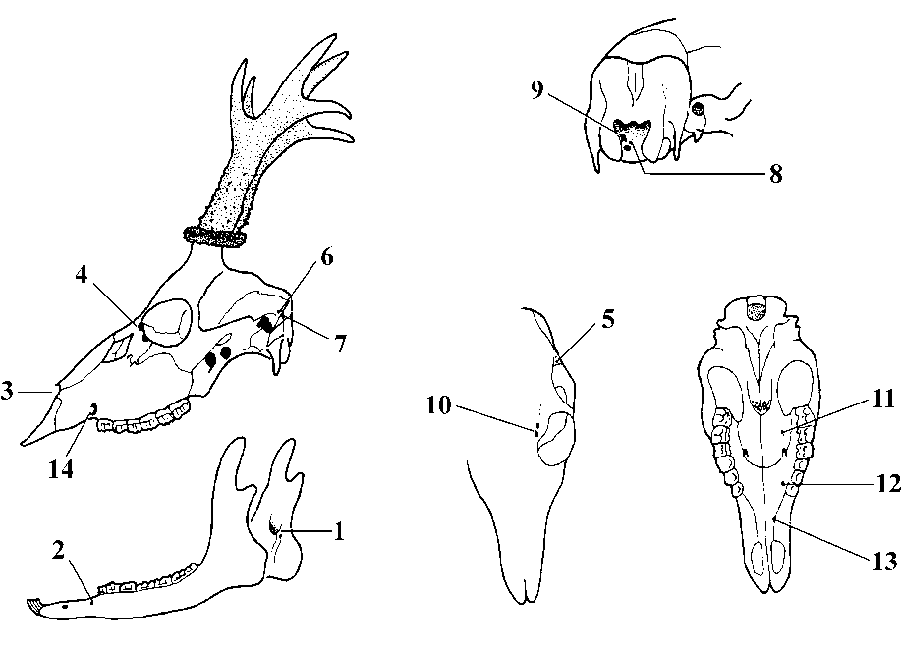
Epigenetic traits
Epigenesis = developmental interactions over/outside of alteration of genes
basic criterion = absence of correlation between the trait and its size

Slide 12
Quantitative traits
Relationship of genotype and phenotype:
V_{P} = V_{G} + V_{E}
  V_{P} = total phenotype variance
  V_{G} = genotype variance
  V_{E} = variance caused by environment
  V_{G} = V_{A} + V_{D} + V_{I}
  A = additivity; D = dominance; I = epistasis

Slide 13
Quantitative traits
Heritability, h²:
= measure of heritable part of phenotypic variability
says, to what extent phenotypic variance has genetic basis
True heritability:
in narrow sense h² = V_{A} / V_{P}
in broad sense h² = V_{G} / V_{P}

Slide 14
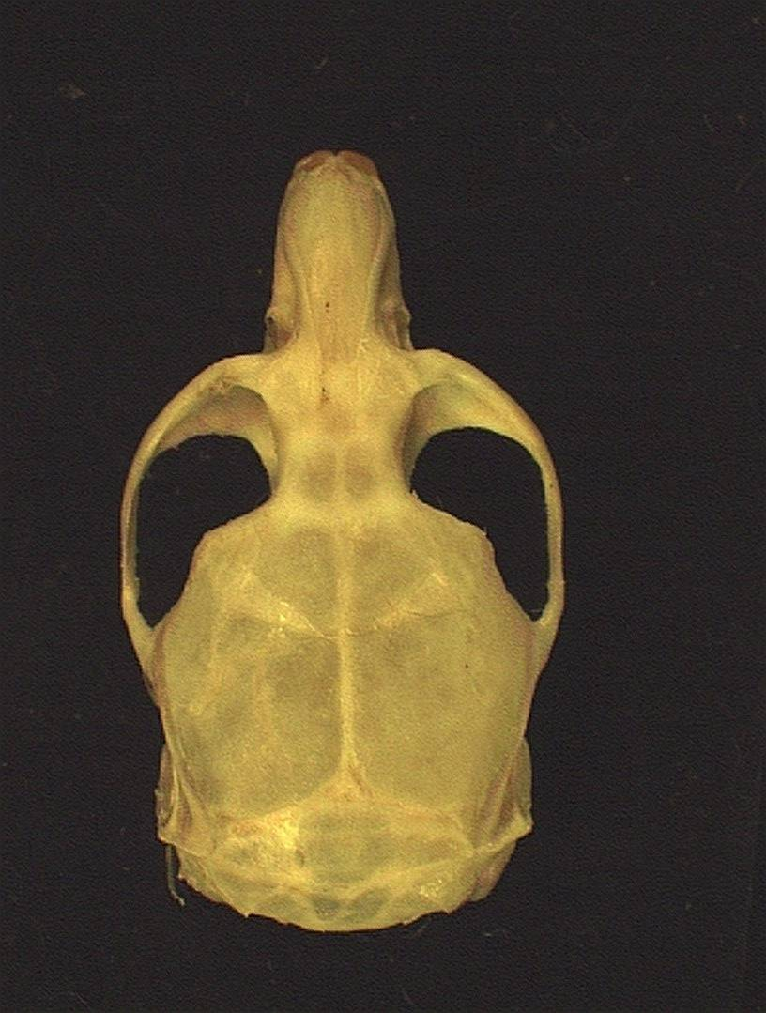
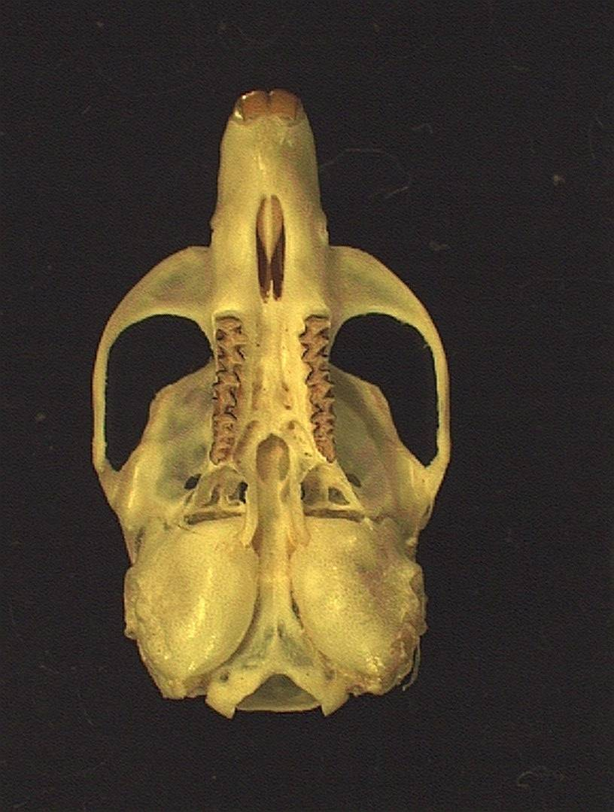
Traditional morphometrics
RW
IW
FIL
IOCW
M1L
OL
UTL
CBL
BCW
ZW

Slide 15
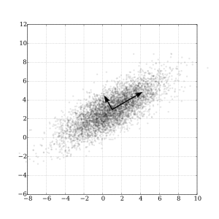
Principal components analysis (PCA)
reduction of data dimensionality with as low information loss
as possible
exploratory data analysis
making predictive models

Slide 16
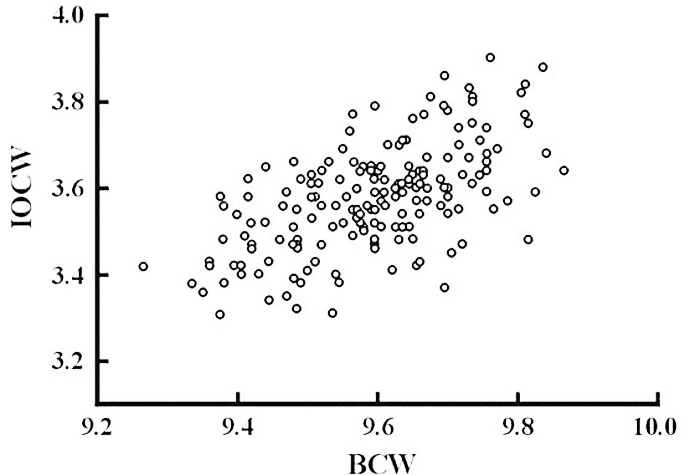

Slide 17
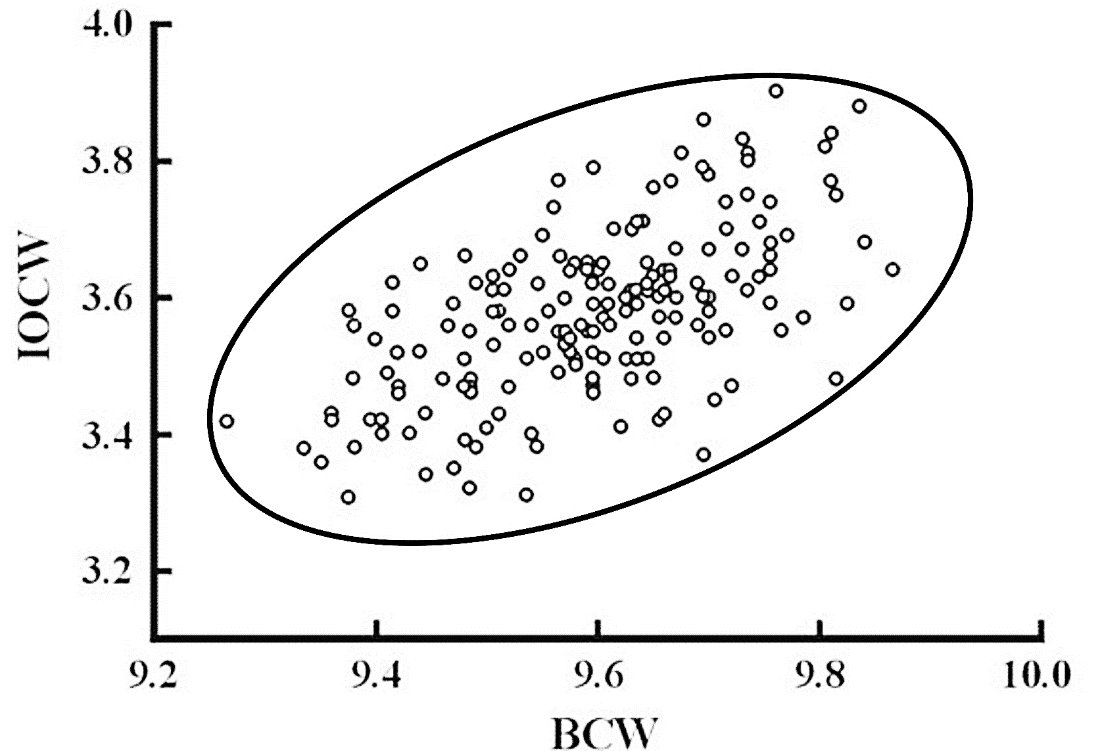

Slide 18
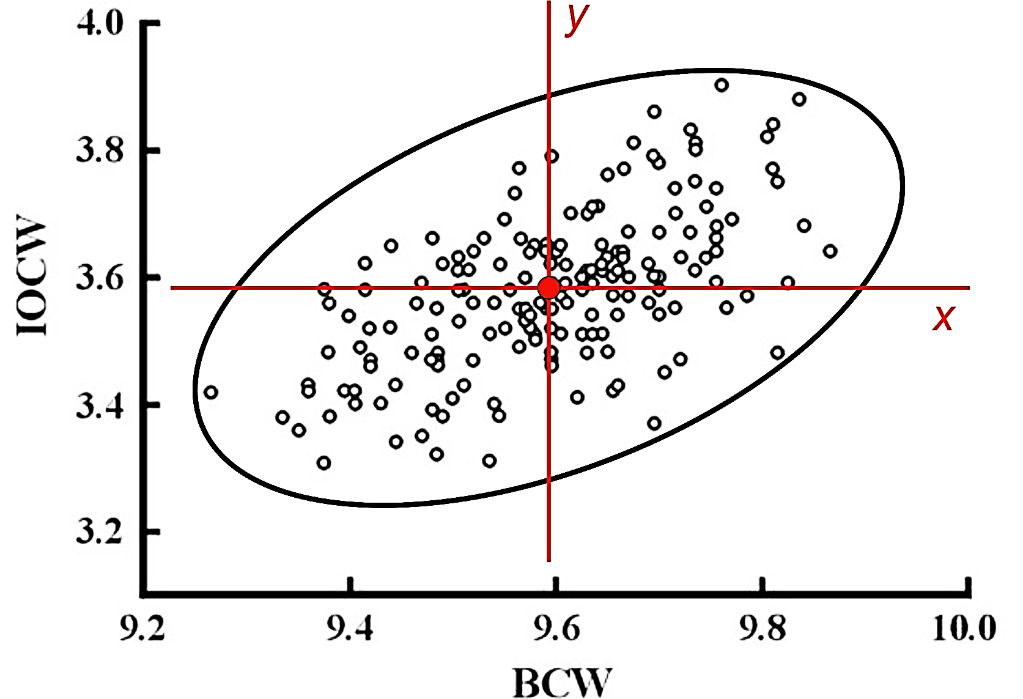

Slide 19
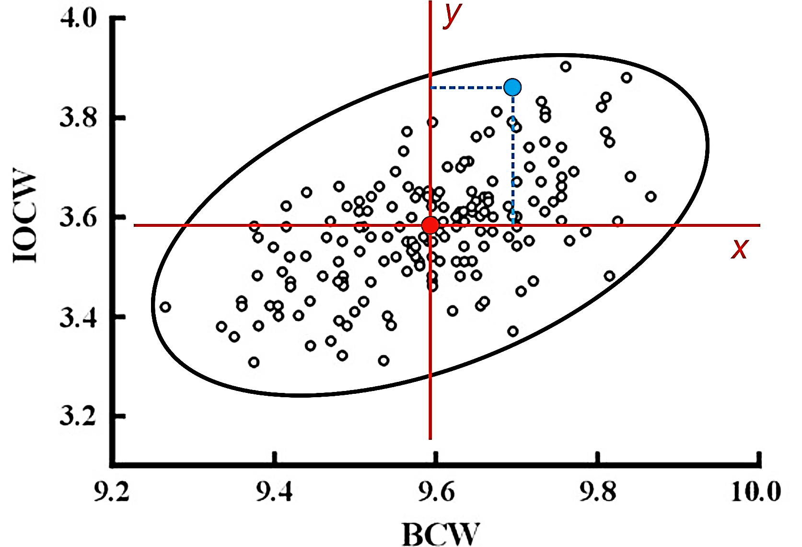

Slide 20
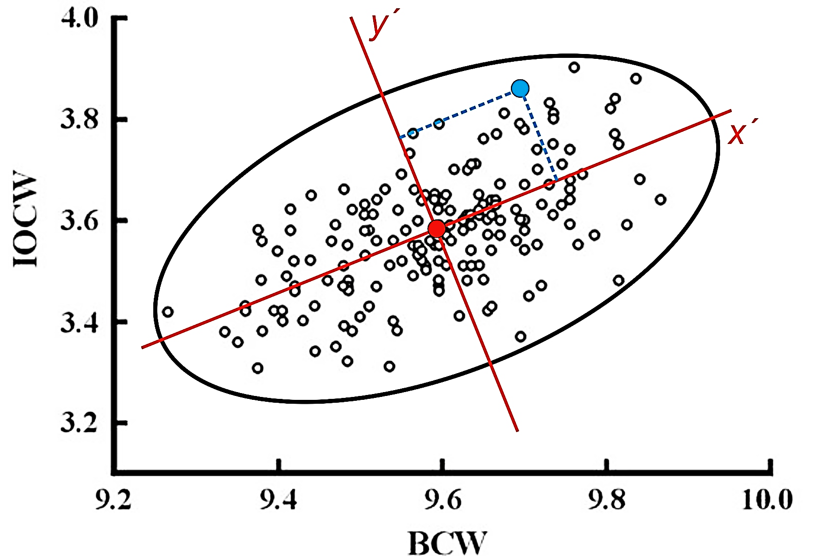

Slide 21
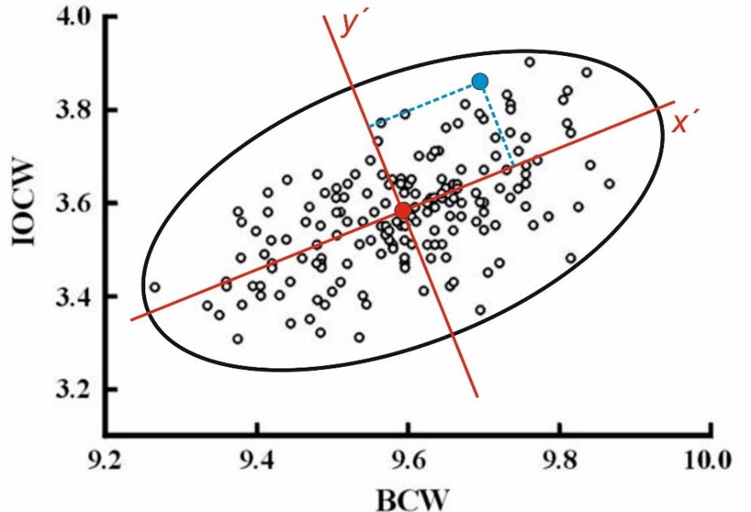
n individuals
p variables
correlation or covariance matrix
eigenvalue = latent root (latentní kořen)
eigenvector = latent vector (latentní vektor)
PC1: vysvětluje největší podíl variability
PC2: druhý největší podíl variability atd.

Slide 22
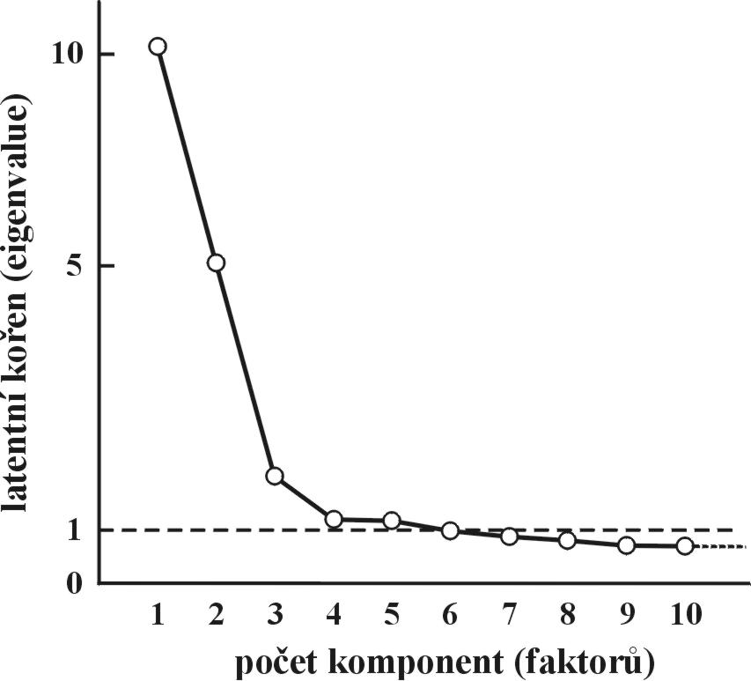
size vector
loadings (zátěže)
PC scores
how many components?
PC2
Kaiser’s criterion: 5 PCs
scree graph: 3–4 PCs
PC1

Slide 23
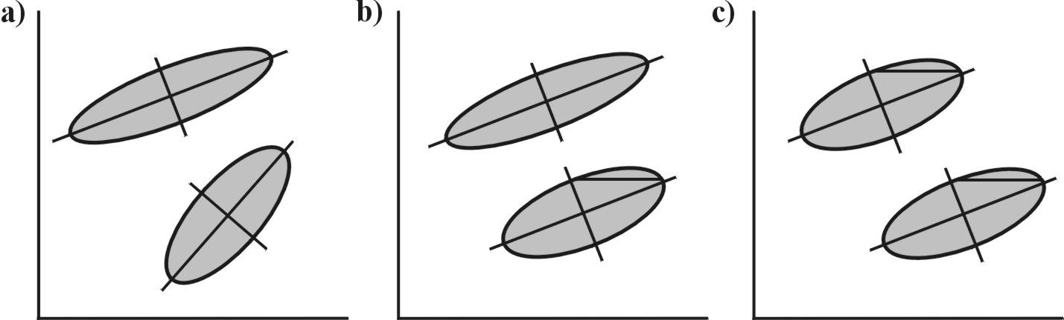
Problem of multiple groups:
CPCA (common PCA)
MGPCA (multiple-group PCA)
PC2
PC1
different variation
different direction
different variation
same direction
same variation
same direction
CPCA
MGPCA

Slide 24
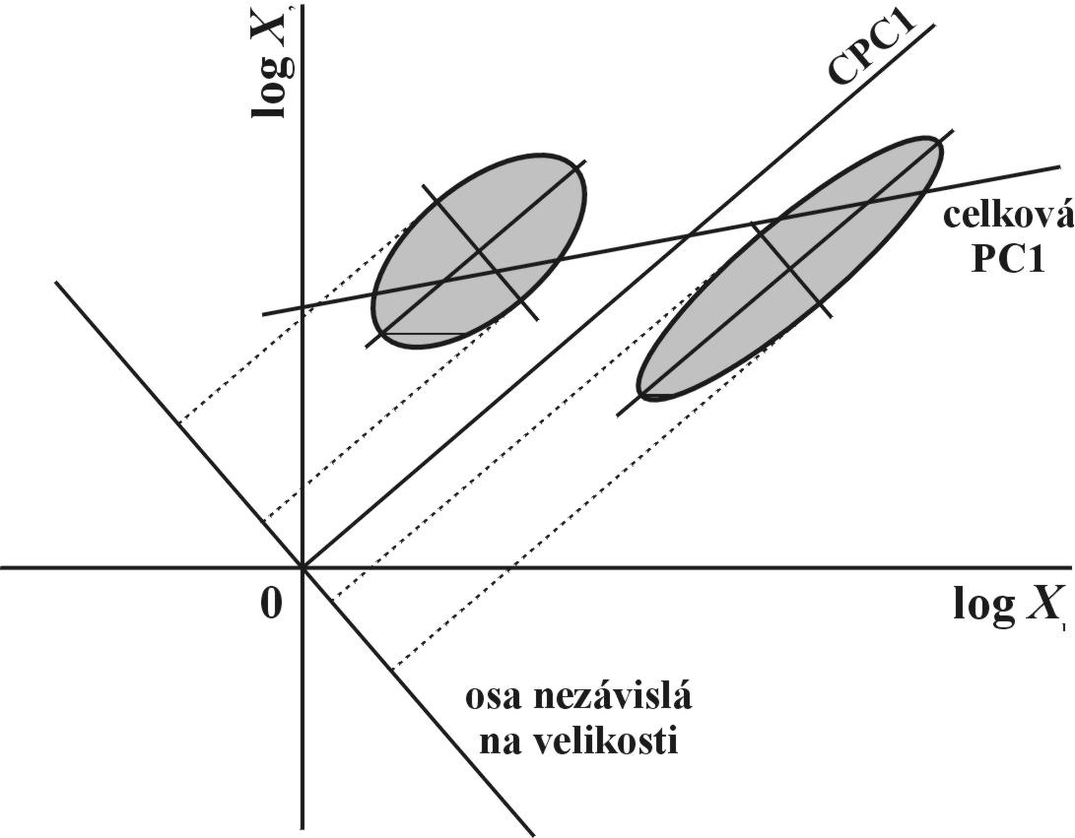
Problem of size:
omitting PC1
Burnaby’s adjustment

Slide 25
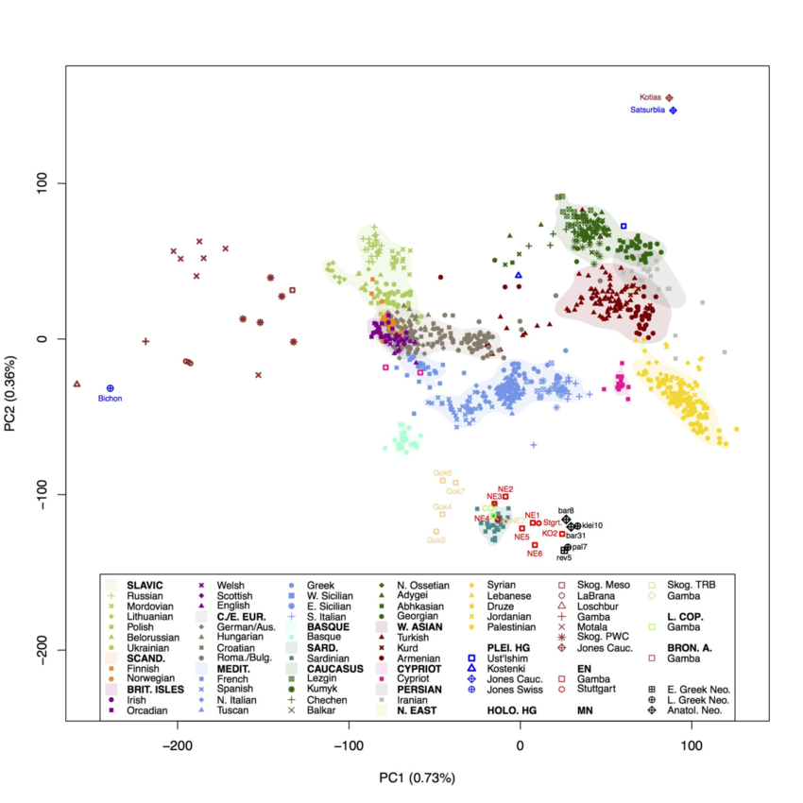
Kavkaz
Slované
Írán
Z Asie
Blízký
východ
Britské
ostrovy
Středomoří
Baskové
aDNA

Slide 26
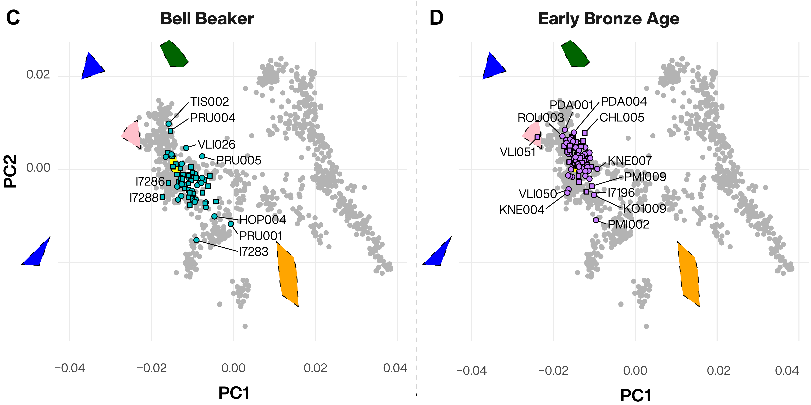
současní lidé
aDNA
kultura zvoncovitých pohárů

Slide 27
Multidimensional scaling (MDS):
not only correlation/covariation matrix, all types of matrix, e.g. similarity/dissimilarity matrix
Classical MDS = principal coordinates analysis (PCoA)
Metric MDS
Non-metric MDS
Generalized MDS

Slide 28
Discriminant function analysis (DFA) and canonical analysis (CVA):
a priori groups
minimization of within-group variation
maximization of among-group variation
Mahalanobis (generalized) distances
MANOVA (Wilk’s Lambda, Pilai’s trace)
Hotelling T² test
stepwise DFA
Cluster analysis

Slide 29
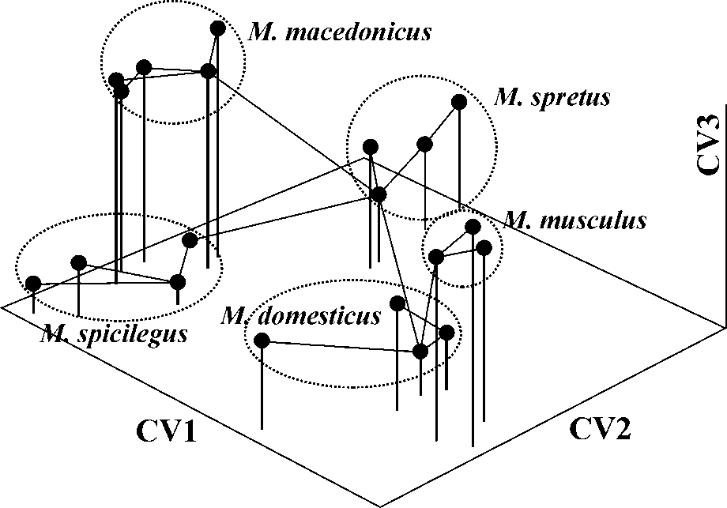
Minimum spanning tree (MST)
6
1
4
7
2
CV1
3
5
8
CV2

Slide 30
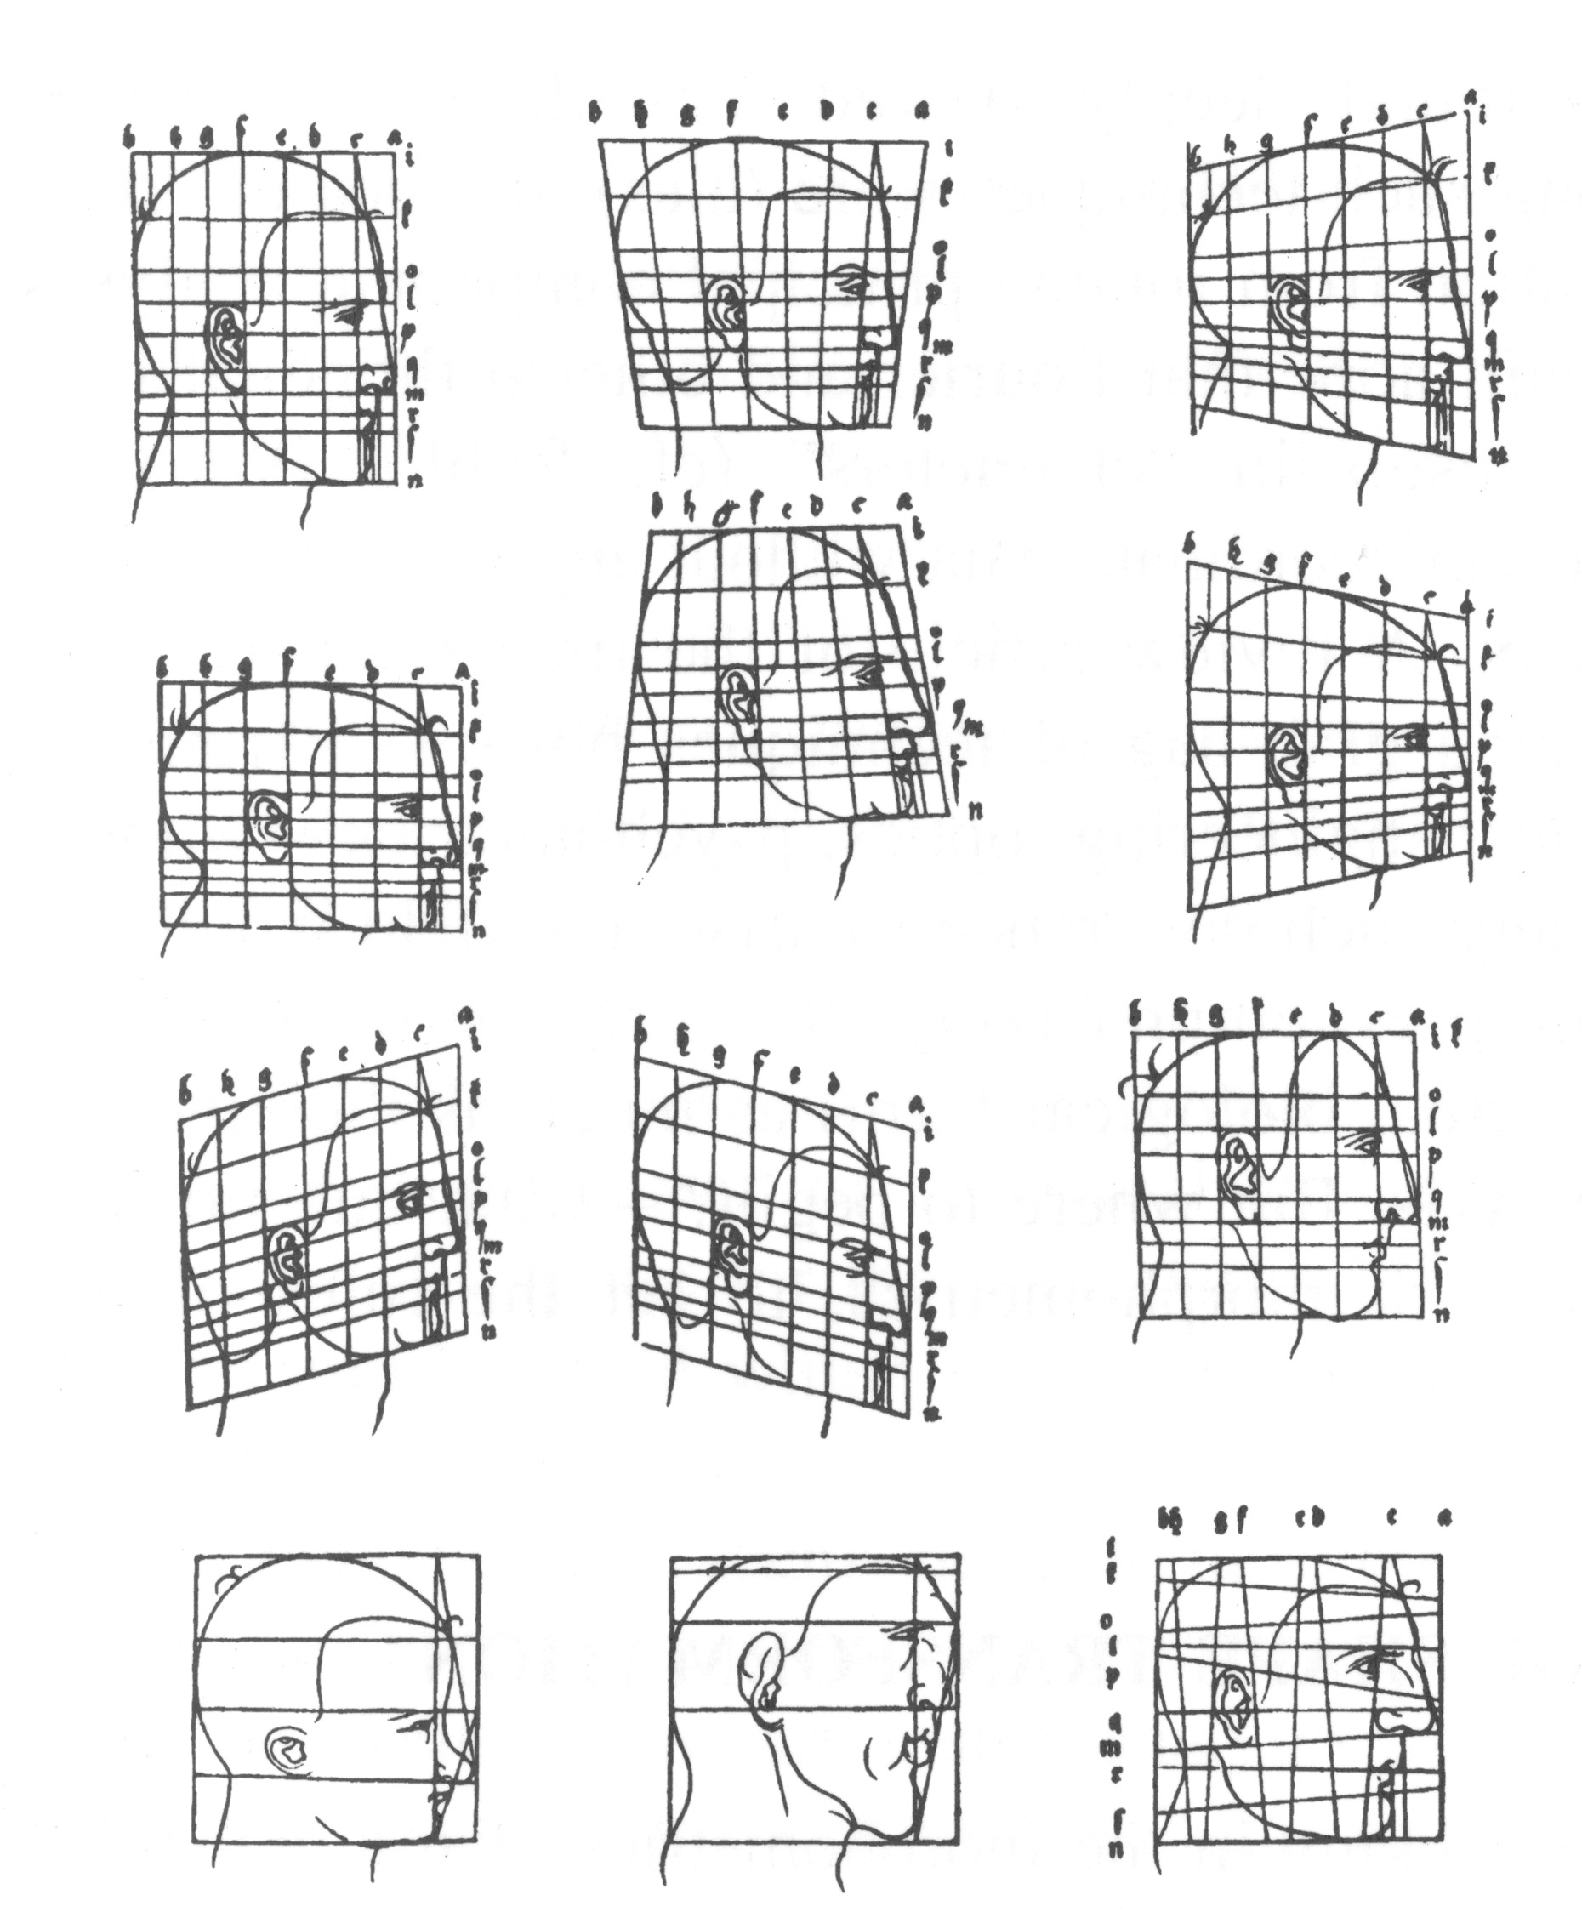
Geometric morphometrics
A. Dürer (1524): Vier Bücher von Menlicher Proportion.

Slide 31
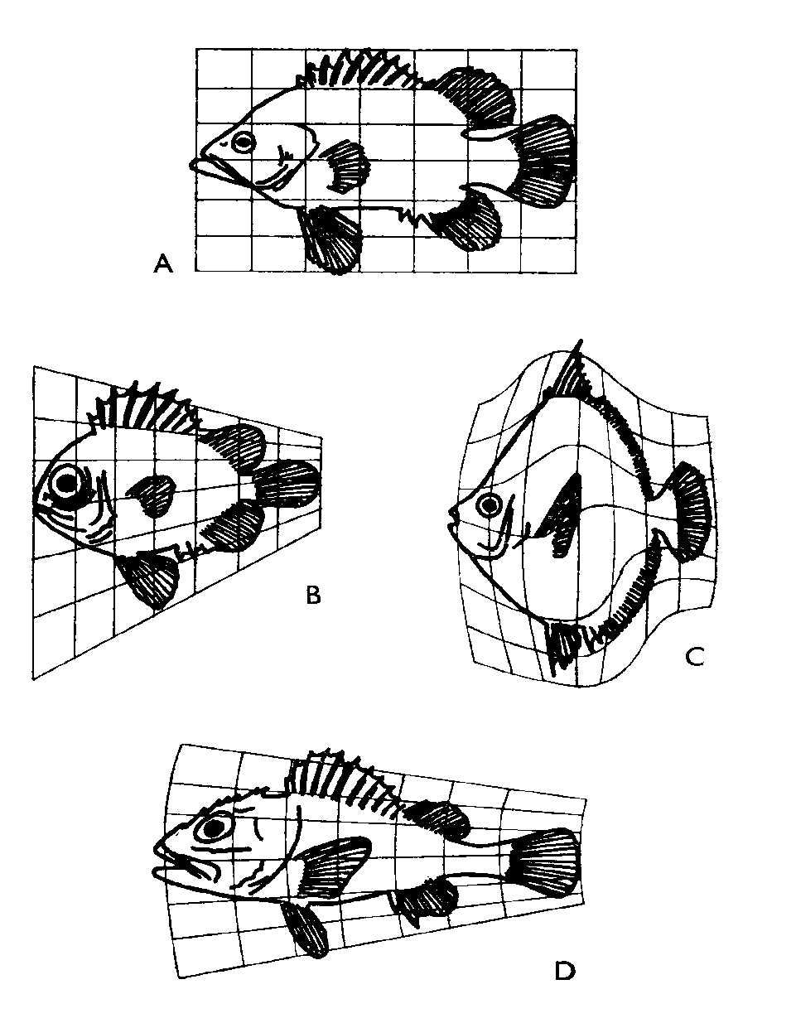
In the past, there were two different strategies in study of shape
of biological objects:
1. W. D’Arcy Thompson
Absence of quantification
of shape changes!
W. A. Thompson (1917): On Growth and Form

Slide 32
In the past, there were two different strategies in study of shape
of biological objects:
2. Traditional morfometrics:
F. Galton, K. Pearson, R.A. Fisher, S. Wright, H. Hotelling...
linear measurements, weights, angles, surfaces...
PCA, DFA, CVA, FA, PCoA, cluster a.
Absence of any information on shape (morphometrics)!

Slide 33
Geometric morphometrics I.
Analysis of closed curves

Slide 34
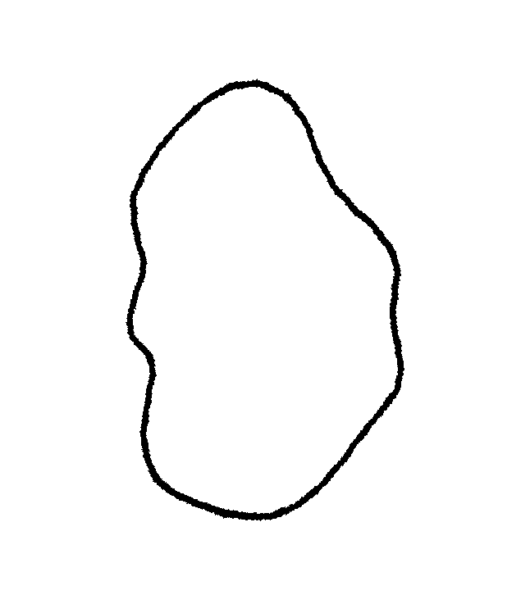

Slide 35
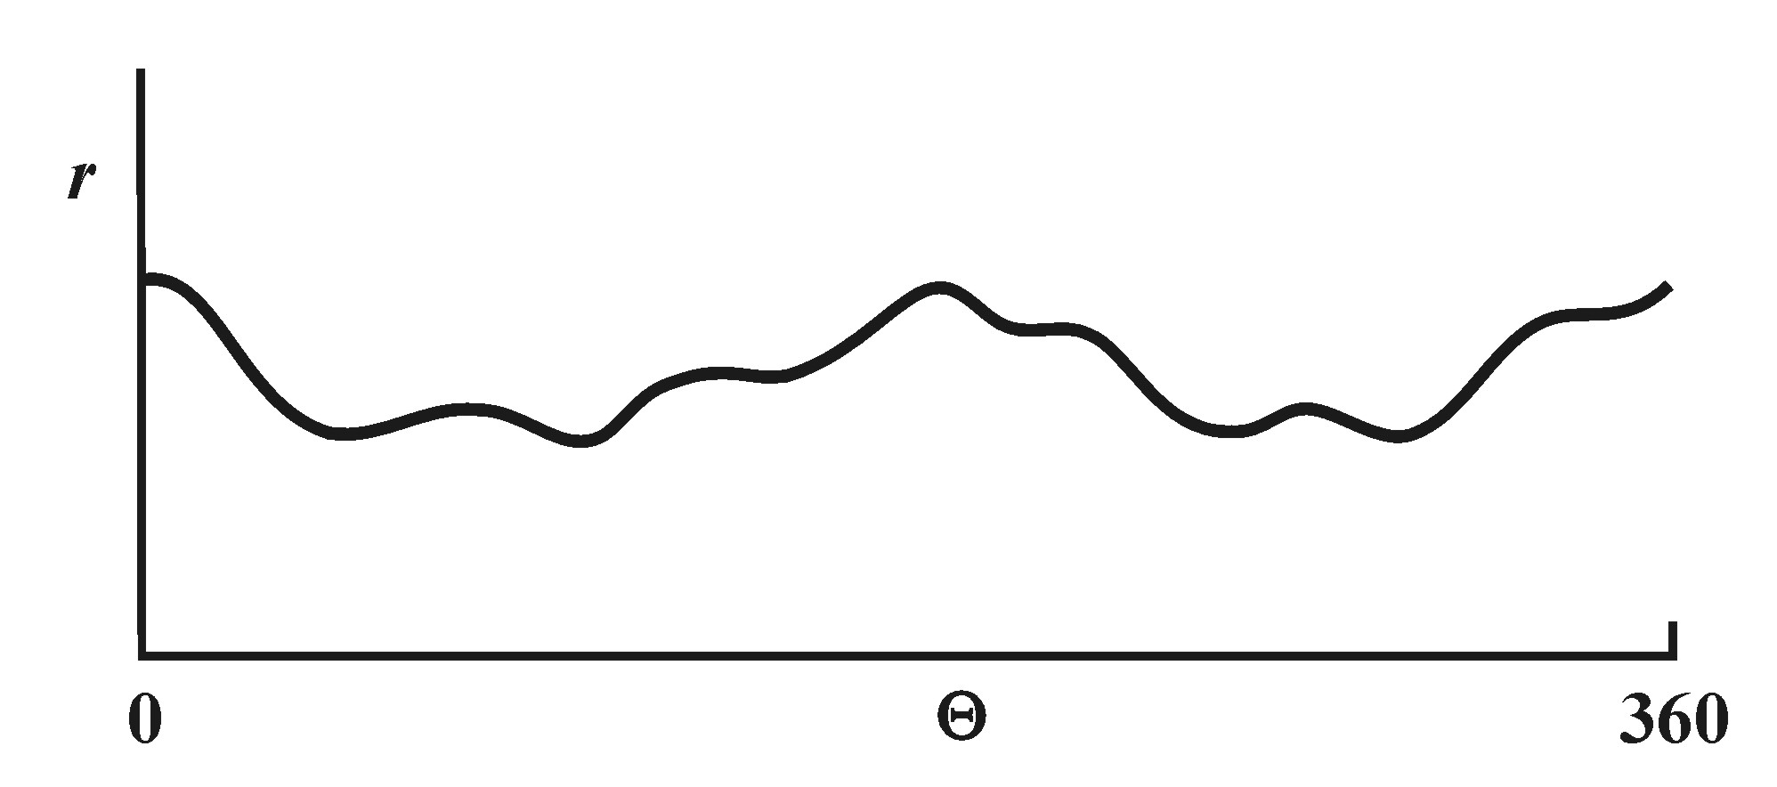
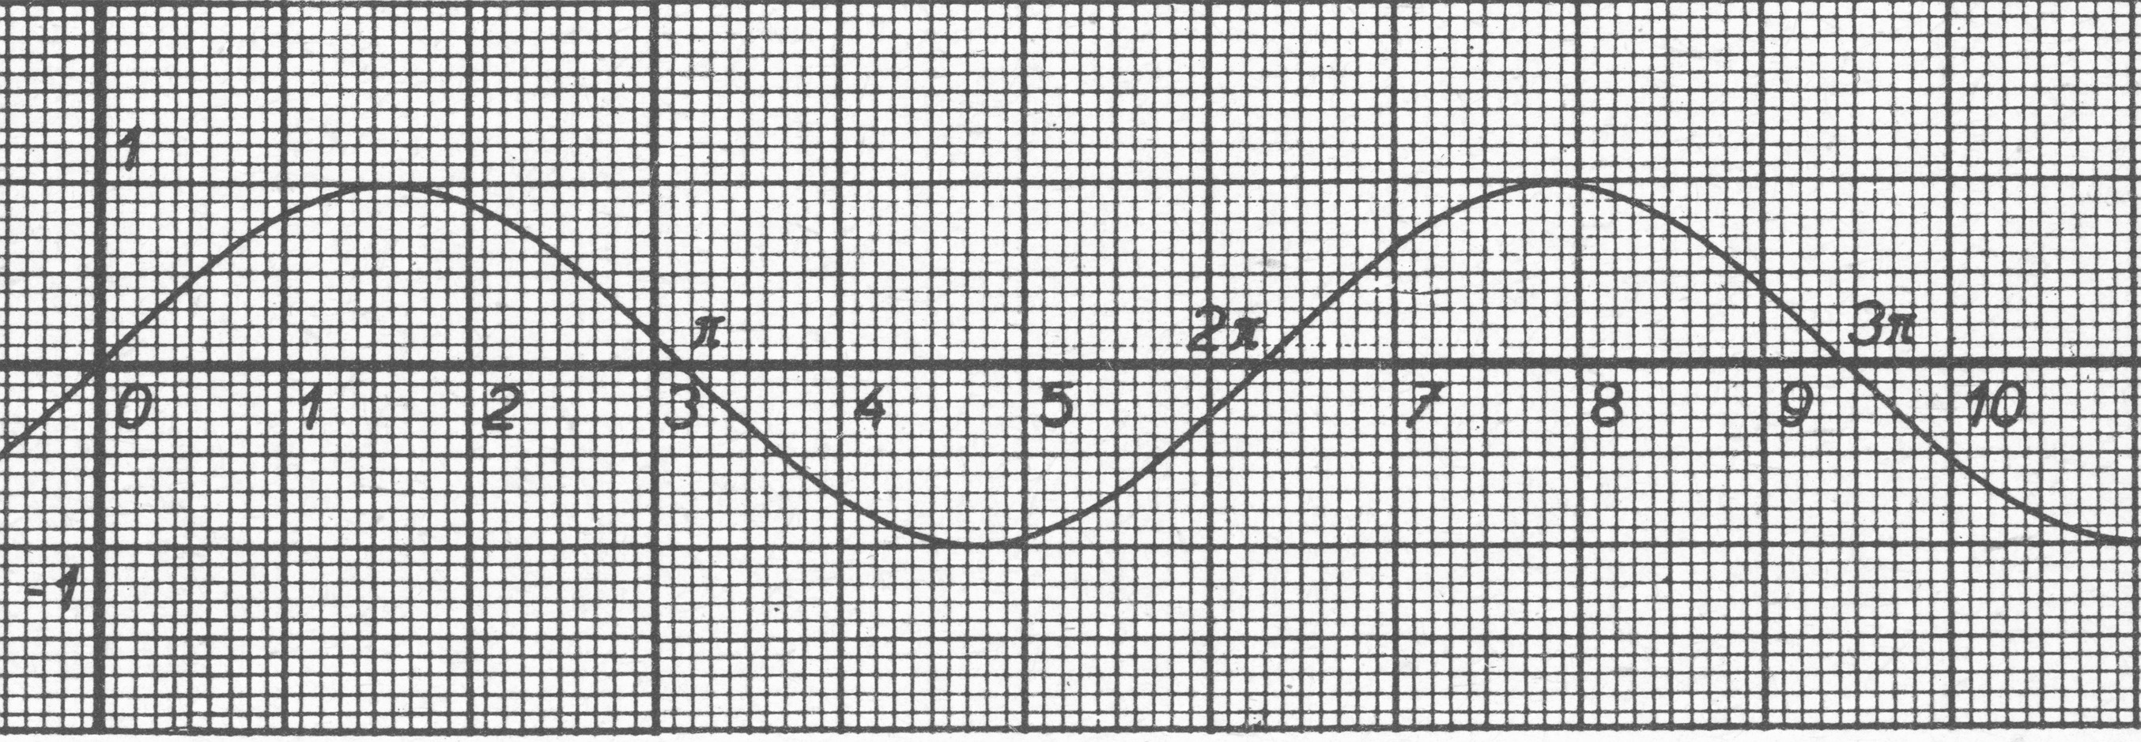
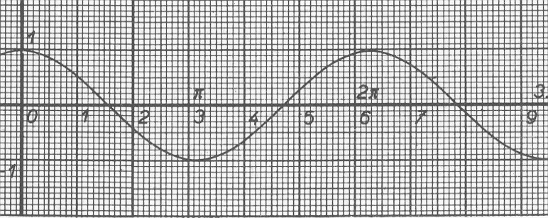
Fourier analysis
sin
harmonics, coefficients
cos

Slide 36
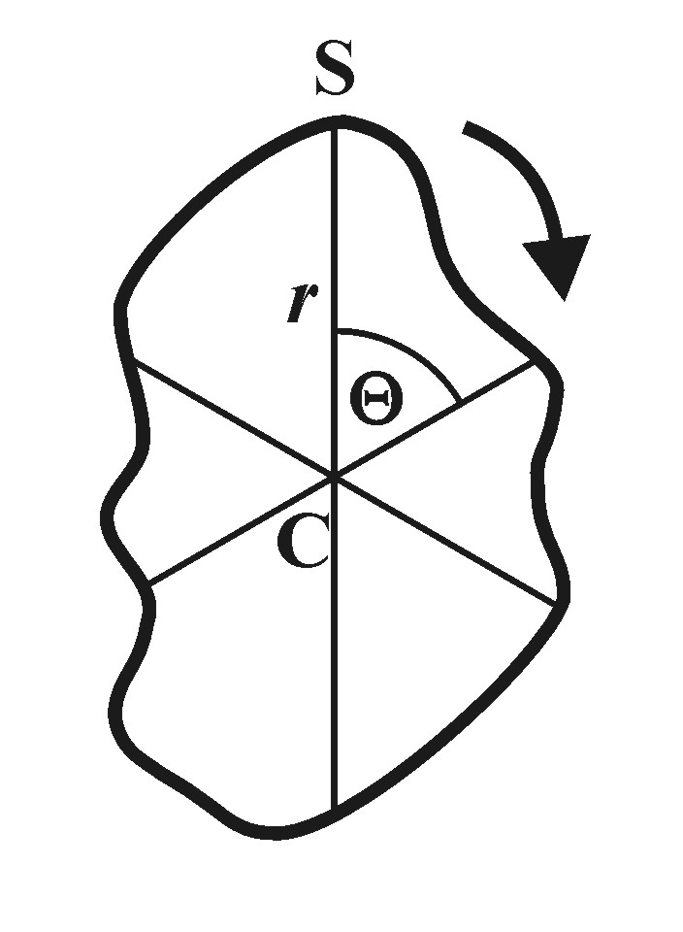
Traditional Fourier a.

Slide 37
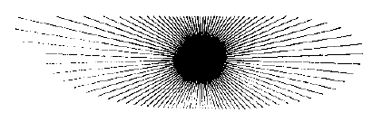

Slide 38
Elliptic Fourier a.
x
y

Slide 39
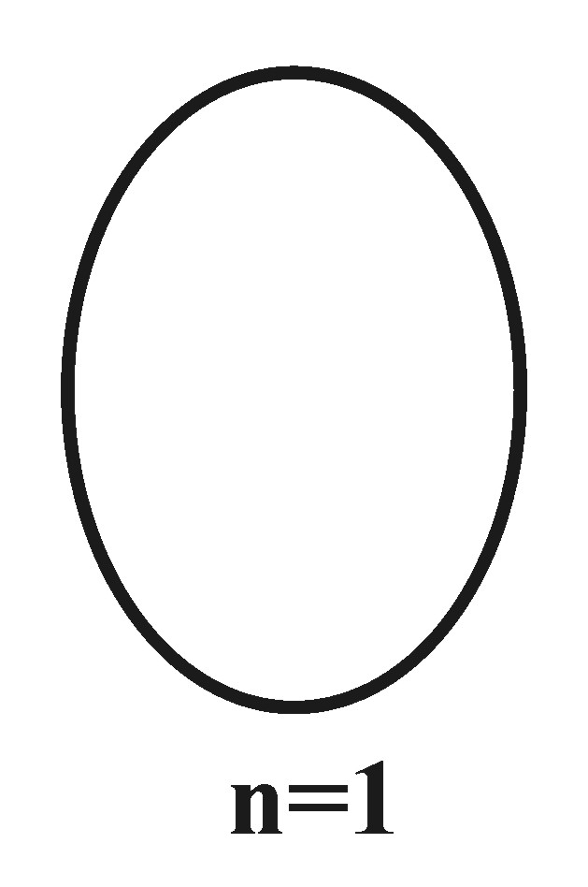
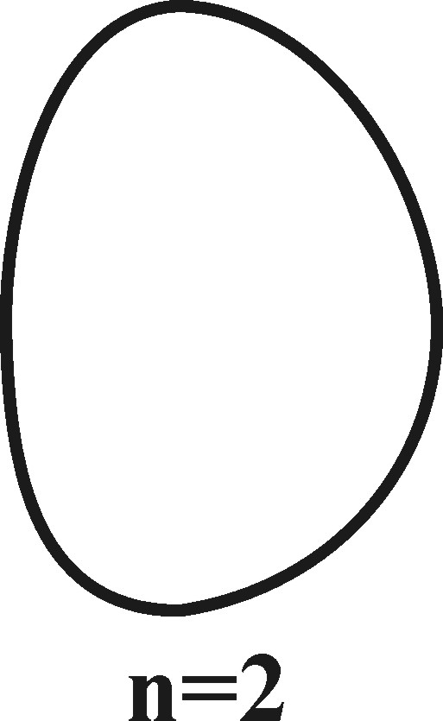
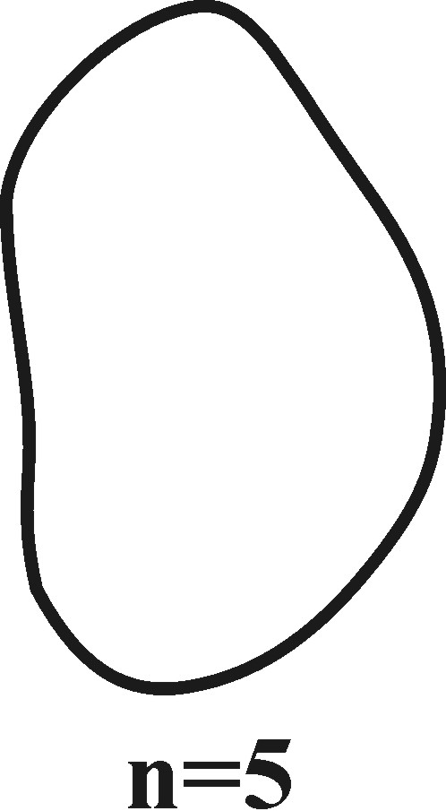



Slide 40


Slide 41
Geometric morphometrics II.
Analysis of landmarks
landmarks
quantification of shape using shape coordinates, distinction
between different shape components
information on shape maintained during the whole analysis
size standardization and ability to work independently with
the size vector
data processing with traditional morphometric methodology

Slide 42




landmarks = points that can be accurately localized and
which are – at least in a geometric sense – homologous
among the objects

Slide 43

Procrustes superposition
= GLS (Generalized Least Squares)
shape = everything except information on size, position,
and orientation of objects

Slide 44
Procrustes superposition
= GLS (Generalized Least Squares)
IMAGE SPACE: p – dimensions, k – landmarks; n = pk

Slide 45
1) Size adjustment: unit centroid size

Slide 46
1) Size adjustment: unit centroid size

Slide 47
2) Transformation: same centroid position

Slide 48
3) Rotation: minimization of distances
between homologous landmarks

Slide 49
3) Rotation: minimization of distances
between homologous landmarks
shape coordinates
SHAPE SPACE: n = pk – k – k(k–1)/2 – 1

Slide 50
Extracting shape information:
Procrustes superposition
Original landmark configurations
1. Change scale so that all configurations
have the same size
2. Superposition of the centers
of gravity on a single point
3. Rotation to minimize the
dispersion of corresponding
points

Slide 51
tangent space
A´
T
A
tangent (reference,
consensual) configuration
shape space
C

Slide 52


Slide 53

Thin-Plate Spline (TPS)
metaphor of infinitely large and infinitely thin metal plate

Slide 54

+

Slide 55


Slide 56
+

Slide 57


Slide 58
Thin-Plate Spline (TPS)
energy necessary for plate deformation = bending energy
differentiating between afine and nonafine shape changes
projection of latent roots of bending energy into components
= partial warps
partial warp 0 ~ afine component

Slide 59

Afine shape change

Slide 60

Afine shape change

Slide 61
Afine shape change

Slide 62

Afine shape change
parallel lines are still parallel

Slide 63
Nonafine shape change

Slide 64

Nonafine shape change
parallel lines are not parallel any more

Slide 65

Homo

Slide 66

reference object

Slide 67

Pan

Slide 68

reference object = Homo

Slide 69

reference object = Pan

Slide 70


>2 samples: Thin-Plate Spline Relative Warps (TPSRW)
RW 1
RW 2
∼ PCA

Slide 71


RW 1
RW 2

Slide 72

RW 1
RW 2

Slide 73

Software:
tpsDig: úprava obrázků, digitalizace bodů, měření rozměrů
tpsSplin: TPS
tpsRelw: TPS Relative Warps
tpsRegr: regrese na nezávislou proměnnou
tpsPLS: metoda parciálních nejmenších čtverců
(např. korelace 2 sad bodů)
tpsSuper: deformace obrázků („unwarping“)
tpsTree: analýza tvarových změn podél větví fylogenetického
MorphoJ
http://life.bio.sunysb.edu/morph/

Slide 74


Morfometrics and phylogenesis
tpsTree
mapping of shape changes

Slide 75
Landmark based methods without landmarks –
„sliding semilandmarks“

Slide 76


Slide 77


Bookstein et al.,
Anat. Record (1999)

Slide 78


Slide 79


Slide 80




Slide 81
Velemínská, Dupej, Živa 5/2016

Slide 82
Velemínská, Dupej, Živa 5/2016

Slide 83
Velemínská, Dupej, Živa 5/2016

Slide 84

Example: knockout of gene Sprouty

Slide 85

Program Checkpoint (Stratovan):

Slide 86

Problem of symmetric objects

Slide 87
Problem of symmetric objects

Slide 88
Problem of symmetric objects

Slide 89

matching symmetry
Klingenberg et al., Evolution (2002)

Slide 90
matching symmetry
Klingenberg et al., Evolution (2002)

Slide 91
object
symmetry

Slide 92
object
symmetry

Slide 94
Comparison of wild-type and mutant mouse, 5 weeks
blue = wild-type
red = mutant
Stratovan Checkpoint

Slide 95
MorphoJ

Slide 97



Comparative analysis

Slide 98

Independent contrasts
assumption: Brownian motion!
Alternatives: phylogenetic generalized least squares (PGLS)
possibility of also applying other models than Brownian motion

Slide 99


Brownian motion model

Slide 100

Ornstein-Uhlenbeck model

