Slide 1
QUALITY BY DESIGN,
DESIGN OF EXPERIMENTS,
PROCESS ANALYTICAL TECHNOLOGY
Petr Beňovský

Slide 2


Slide 3
QUALITY BY DESIGN AND DESIGN OF EXPERIMENTS CONCEPT
Definition of Quality by Design:
Systematic approach to development and manufacturing;
The concept of QbD is to determine the critical quality attributes of a product resulting in a target product profile;
Begins with predefined objectives;
Emphasizes product and process understanding and process control;
Based on sound science and quality risk management.

Slide 4
QUALITY BY DESIGN AND DESIGN OF EXPERIMENTS CONCEPT
Definition of Design of Experiment:
Strategy to gather empirical knowledge, i.e. knowledge based on the analysis of experimental data and not on theoretical models. It can be applied when investigating a phenomenon in order to gain understanding or improve performance.

Slide 5
QUALITY BY DESIGN AND DESIGN OF EXPERIMENTS CONCEPT
Approach to Process Validation (FDA Guideline excerpt):
Stage 1 – Process Design
The commercial manufacturing process is defined during this stage based on knowledge gained through development and scale-up activities;
Stage 2 – Process Qualification
During this stage, the process design is evaluated to determine if the process is capable of reproducible commercial manufacturing;
Stage 3 – Continued Process Verification
Ongoing assurance is gained during routine production that the process remains in a state of control.

Slide 6
Quality by Design and Design of Experiments
Concept
QbD = Process Understanding
A process is considered well understood from the physico-chemical perspective when
All key (critical) sources of variability are explained;
Quality attributes can be predicted based on key (critical) inputs;
Process capability of “Key (Critical) Quality Attributes“ meets acceptance levels.
A well understood process is by definition a process with a low risk of delivering of a poor quality product.

Slide 7
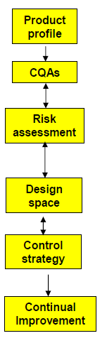
Quality by Design and Design of Experiments
Concept
Target the product profile
Determine critical quality attributes (CQAs)
Link raw material attributes and process parameters to CQAs and perform risk assessment
Develop a design space
Design and implement a control strategy
Manage product lifecycle, including continual improvement

Slide 8
Quality by Design and Design of Experiments
Concept
Target the product profile
Determine critical quality attributes (CQAs)
Link raw material attributes and process parameters to CQAs and perform risk assessment
Develop a design space
Design and implement a control strategy
Manage product lifecycle, including continual improvement

Slide 9


Quality by Design and Design of Experiments
Concept
Target the product profile
I want a flower !
But I wanted something different !!

Slide 10
Quality by Design and Design of Experiments
Concept
Target the product profile
Dosage Form
Characteristics – appearance, shape, form, size
Strength
Assay
Purity/impurity
Stability
Others
cQAs

Slide 11
Quality by Design and Design of Experiments
Concept
Target the product profile
Determine critical quality attributes (CQAs)
Link raw material attributes and process parameters to CQAs and perform risk assessment
Develop a design space
Design and implement a control strategy
Manage product lifecycle, including continual improvement

Slide 12
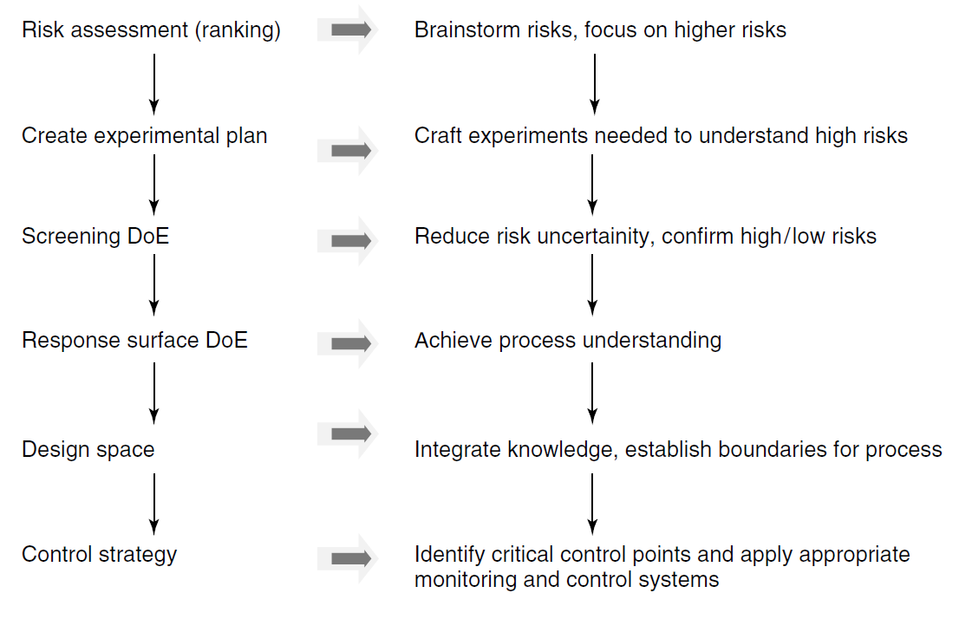
Quality by Design and Design of Experiments
Concept

Slide 13
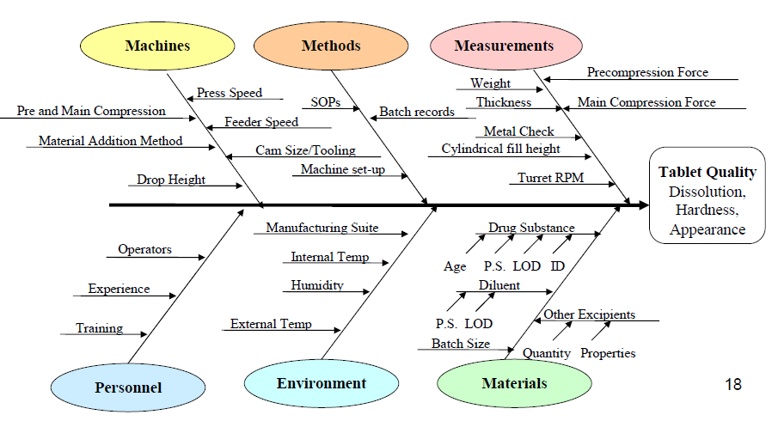

Quality by Design and Design of Experiments
Concept
Risk assessment – Ishikawa (fishbone) diagram

Slide 14
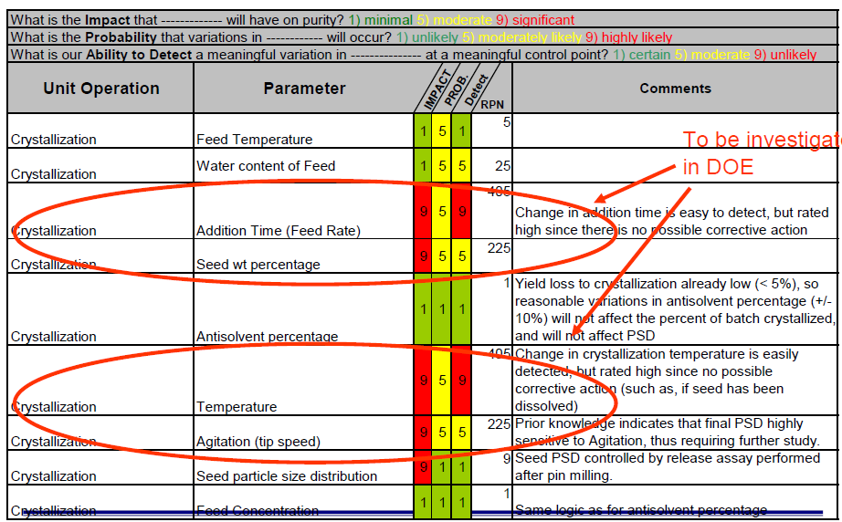
Quality by Design and Design of Experiments
Concept

Slide 15
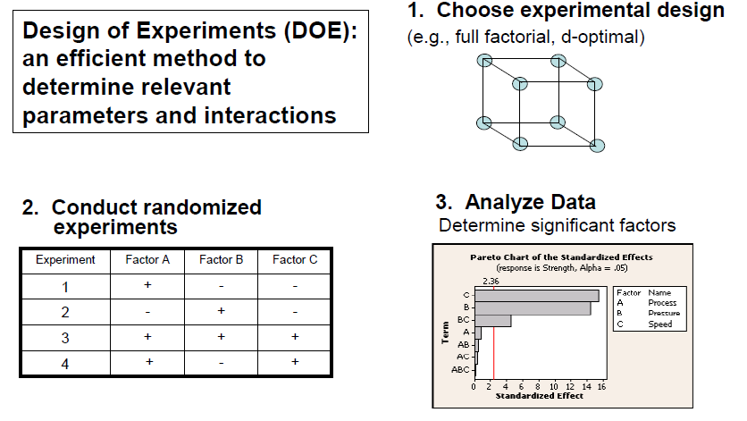
Quality by Design and Design of Experiments
Concept

Slide 16
Quality by Design and Design of Experiments Concept
▪ DOE results in a set of experiments.
▪ All factors are varied, systematically and independently.
▪ The number and type of factors and regression model specify the prerequisites.
▪ The DOE defines the optimal number of runs and the best factor combinations for the runs.
▪ DOE is used for three primary experimental objectives screening:
which factors are important and what are their appropriate ranges?
optimization: what are the optimal factor settings?
robustness testing: how sensitive is a response to small factor changes?
▪ Advantages with DOE compared to OVAT:
factor interactions are estimable;
reliable maps of the systems;
seen effects and noise are separable and estimable;
probability analysis.
Carlson, R. Design and Optimization in Organic Synthesis, Elsevier 1992

Slide 17
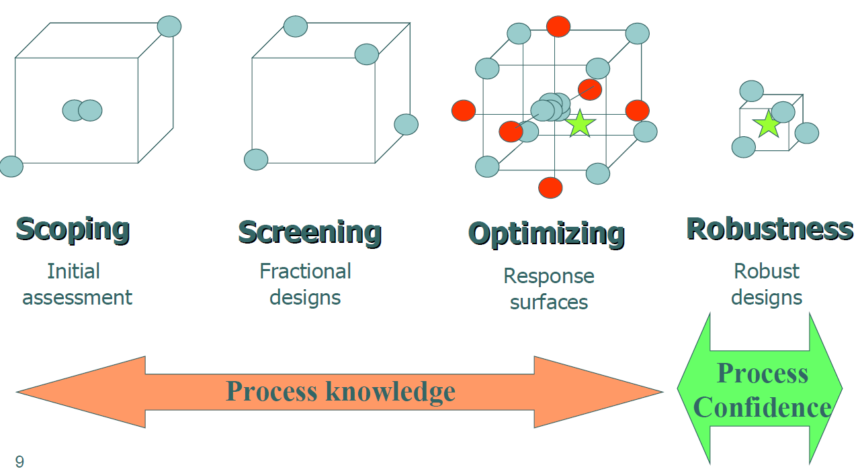
Quality by Design and Design of Experiments
Concept

Slide 18
Quality by Design and Design of Experiments
Concept
Target the product profile
Determine critical quality attributes (CQAs)
Link raw material attributes and process parameters to CQAs and perform risk assessment
Develop a design space
Design and implement a control strategy
Manage product lifecycle, including continual improvement

Slide 19
Quality by Design and Design of Experiments
Concept
Design Space
The process design space is a multidimensional combination and interaction of input variables, i.e. material attributes and process parameters, that have been demonstrated to provide adequate quality.

Slide 20
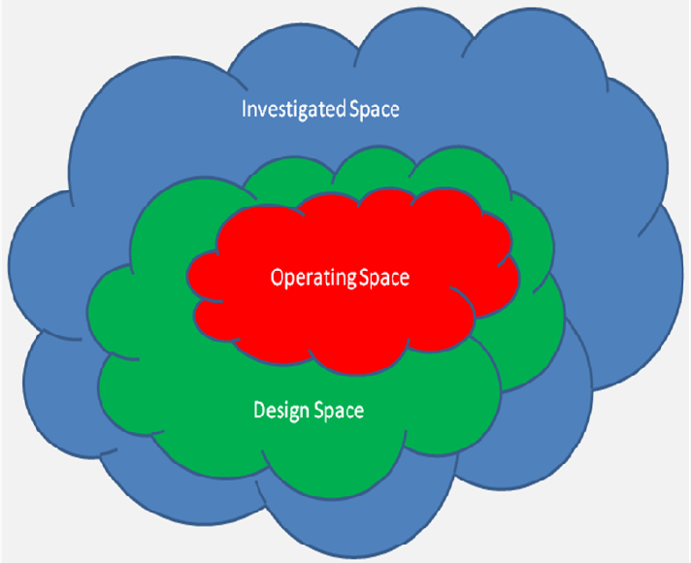
Quality by Design and Design of Experiments
Concept

Slide 21
Quality by Design and Design of Experiments
Concept
Target the product profile
Determine critical quality attributes (CQAs)
Link raw material attributes and process parameters to CQAs and perform risk assessment
Develop a design space
Design and implement a control strategy
Manage product lifecycle, including continual improvement

Slide 22
Quality by Design and Design of Experiments
Concept
The Control Strategy must include CQAs and CPPs that are included in the Design Space
Examples:
Raw material purchase specification
API characteristics
Operating ranges for process parameters
In-process controls
Acceptance criteria
Release testing
API and drug product specifications and their acceptance criteria

Slide 23
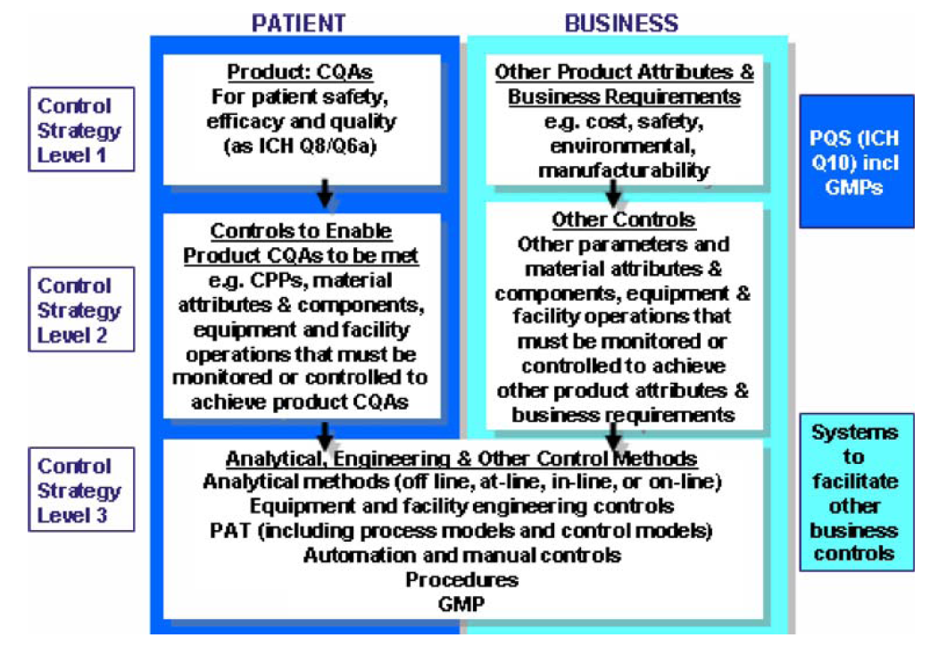
Quality by Design and Design of Experiments
Concept

Slide 24
Quality by Design and Design of Experiments
Concept
When fully implemented, QbD means that all critical sources of process variability have been identified, measured and understood so that they can be controlled by the manufacturing process itself. The resulting business benefits are significant:
Reduced batch failure rates;
Lower operating cost;
Increased predictability of manufacturing output and quality;
Faster tech transfer between development and manufacturing;
Faster regulatory approval of new product applications and process changes;
Fewer and shorter regulatory inspections of manufacturing sites;
Significant reductions in working capital requirements, resource costs and time to value.

Slide 25


Quality by Design and Design of Experiments
Concept

Slide 26
Quality by Design and Design of Experiments
Concept
Mohammed, A.Q. Org.Process Res.Dev. 19, 1634 (2015) –
Quality by Design in Action 1
Mohammed, A.Q. Org.Process Res.Dev. 19, 1645 (2015) –
Quality by Design in Action 2
Murray, P.M. et al Org.Biomol.Chem. 14, 2373 (2016) – the application of design of experiments in reaction optimization and solvent selection

