Slide 1
Heterotrophic protists:
What and how do they eat
Martin Kolisko

Slide 2
Autotrophy – form organic compounds from anorganic. In the case of eukaryotes only photoautotrofy, i.e. with the use of light energy. The light is used for ATP production. Often it is auxotrophy – uptake vitamins.
Heterotrophy – organic compounds forms only from other organic compounds. In the case of eukaryotes only chemoorganoheterotrothy, i. e. from organic compounds obtain both organic compounds and ATP.
Mixotrophy – heterotrophy combined with autotrophy (very frequent situation in unicellular algae)

Slide 3
Autotrophy – form organic compounds from anorganic. In the case of eukaryotes only photoautotrofy, i.e. with the use of light energy. The light is used for ATP production. Often it is auxotrophy – uptake vitamins.
Heterotrophy – organic compounds forms only from other organic compounds. In the case of eukaryotes only chemoorganoheterotrothy, i. e. from organic compounds obtain both organic compounds and ATP.
Mixotrophy – heterotrophy combined with autotrophy (very frequent situation in unicellular algae)

Slide 4
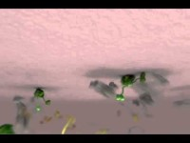

Slide 5
Cortical vesicles of giardia
Zumthor 2016, PLoS Pathogens

Slide 6
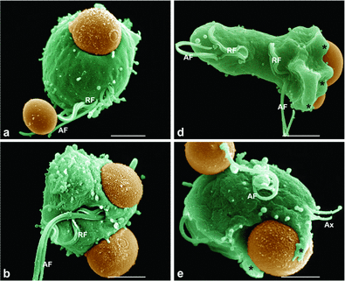
Feeding by solid food particles with the active help of cytoskeleton
Heterotrophy - phagotrophy
Most significan phagotrophic groups:
Cilliates
Dinoflagellates
Haptophytes
Chrysophytes
Euglenids
Bodonids
Choanoflagellates
Bicoecids
various amoebae

Slide 7
Heterotrophy - phagotrophy

Slide 8
Heterotrophy - phagotrophy

Slide 9
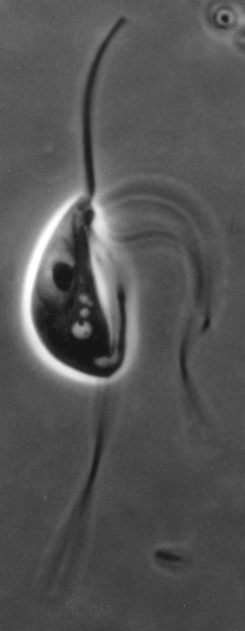
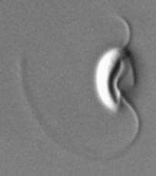
Hunting – suspension feeding
Catches pray that “falls in” or creates stream that delivers the pray
Feeding current
Generated by Posterior
Flagellum
Carpediemonas
Trimastix

Slide 10
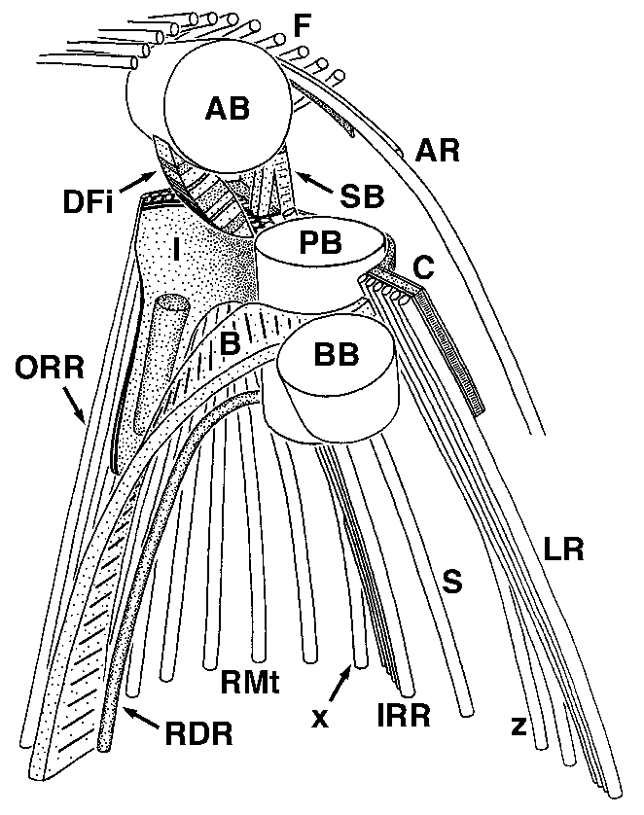
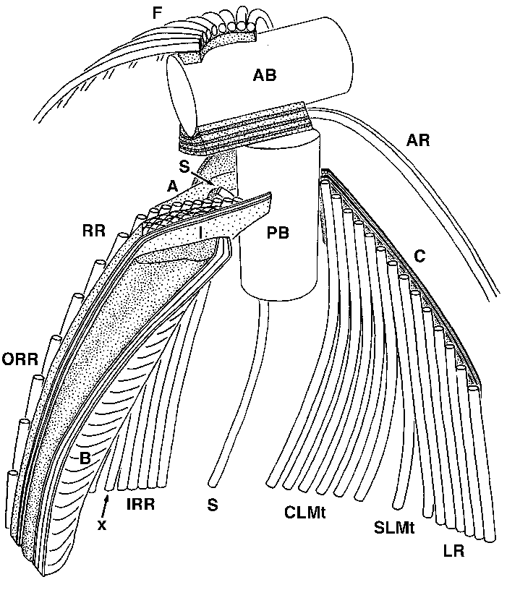
Evolutionary note
Most groove-bearing flagellates have very similar cytoskeletal morphologies
Carpediemonas
Andalucia

Slide 11
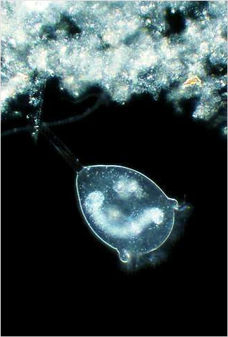
Filtering
The particles are catched or even engulfed in and area of a filter.
Stramenopila (pedinelids, dictyocha), many ciliates.
It can engulf multiple particles at once.
Filtering is an effective strategy especially for catching relatively small particles smaller than 1/10 of a cell. Filtering is therefore advantageous especially for large protozoa, for which direct interception is ineffective (the particles are small for them and they would still have to deal with swallowing one particle after another for a relatively long time).
Notes:
In this system, phagocytosis involves GP40 as a molecule which binds to both prey and Actinophrys. So, we may conclude that the function of GP40 is similar to that of immunoglobulins or complements in animal immune systems. In other words, a specialized protein molecule is present between the foreign substance and the cell surface that is used for food recognition.
This is the first demonstration that a kind of recognition system that is equivalent to the innate immune system is present in Protozoa, and in this respect, phagocytosis in Actinophrys is assumed to be evolutionally related to the immune systems of multicellular organisms.

Slide 12
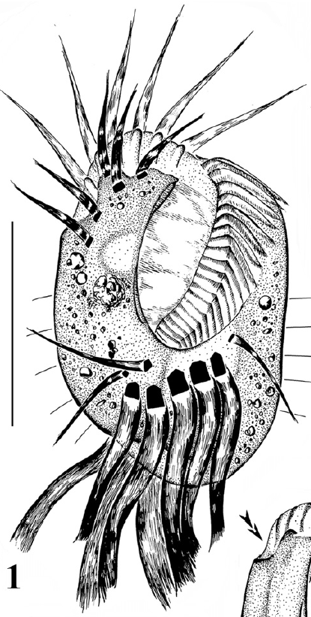
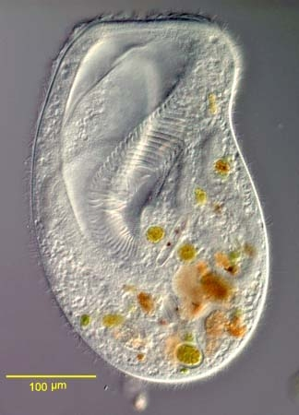
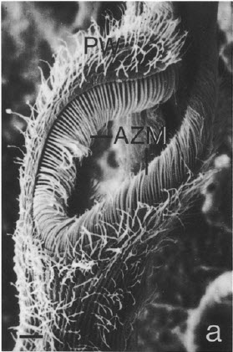
Membranelles
Membranelles act as a filter while creating a stream. The pore size is determined by the gaps between them.
Eufolliculina
Diophrys
apoligothrix
Bursaria truncatella

Slide 13
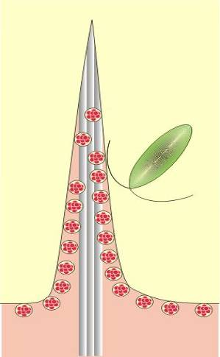
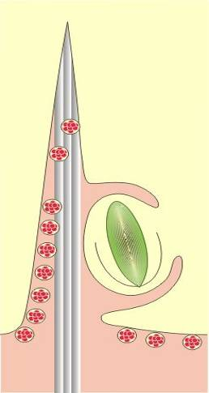
Molecular weapons
axopodium
kořist
extrusomy
mikrotubuly
Notes:
Prey uptake in Actinophrys is carried out by the feeding tentacles called axopodia. The prey is trapped by the surface of axopodium and finally engulfed by the pseudopodia surrounding the prey. During the process of feeding, the cortical granules called extrusomes are known to secrete their contents toward the prey.

Slide 14
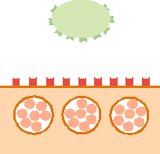
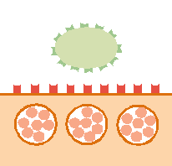
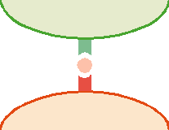
Molecular weapons
Extrusomes contain glycoprotein (gp40).
Actinophrys secretes gp40, when the prey touches the surface. Gp40 molecules then bind to the surface.
Evolutionary note – immune system
Heliozoan recognises cells covered by gp40 as the prey, which is destined to engufment and digestion.
prey
Prey
gp40
gp40
Actinophrys
extruzome
Notes:
From these observations, GP40 was found to be the key molecule that can recognize and bind to both the prey and the cell surface of the heliozoan. The results show that 1, extrusomes contain the Con A-binding glycoproteins GP40, 2) The heliozoan secretes GP40 when a prey is attached to the cell surface, and gp40 are adhered to the prey, and 3, The heliozoan recognizes the GP40-coated cell as a "prey" and capture it by phagocytosis.
In this system, phagocytosis involves GP40 as a molecule which binds to both prey and Actinophrys. So, we may conclude that the function of GP40 is similar to that of immunoglobulins or complements in animal immune systems. In other words, a specialized protein molecule is present between the foreign substance and the cell surface that is used for food recognition.
This is the first demonstration that a kind of recognition system that is equivalent to the innate immune system is present in Protozoa, and in this respect, phagocytosis in Actinophrys is assumed to be evolutionally related to the immune systems of multicellular organisms.

Slide 15
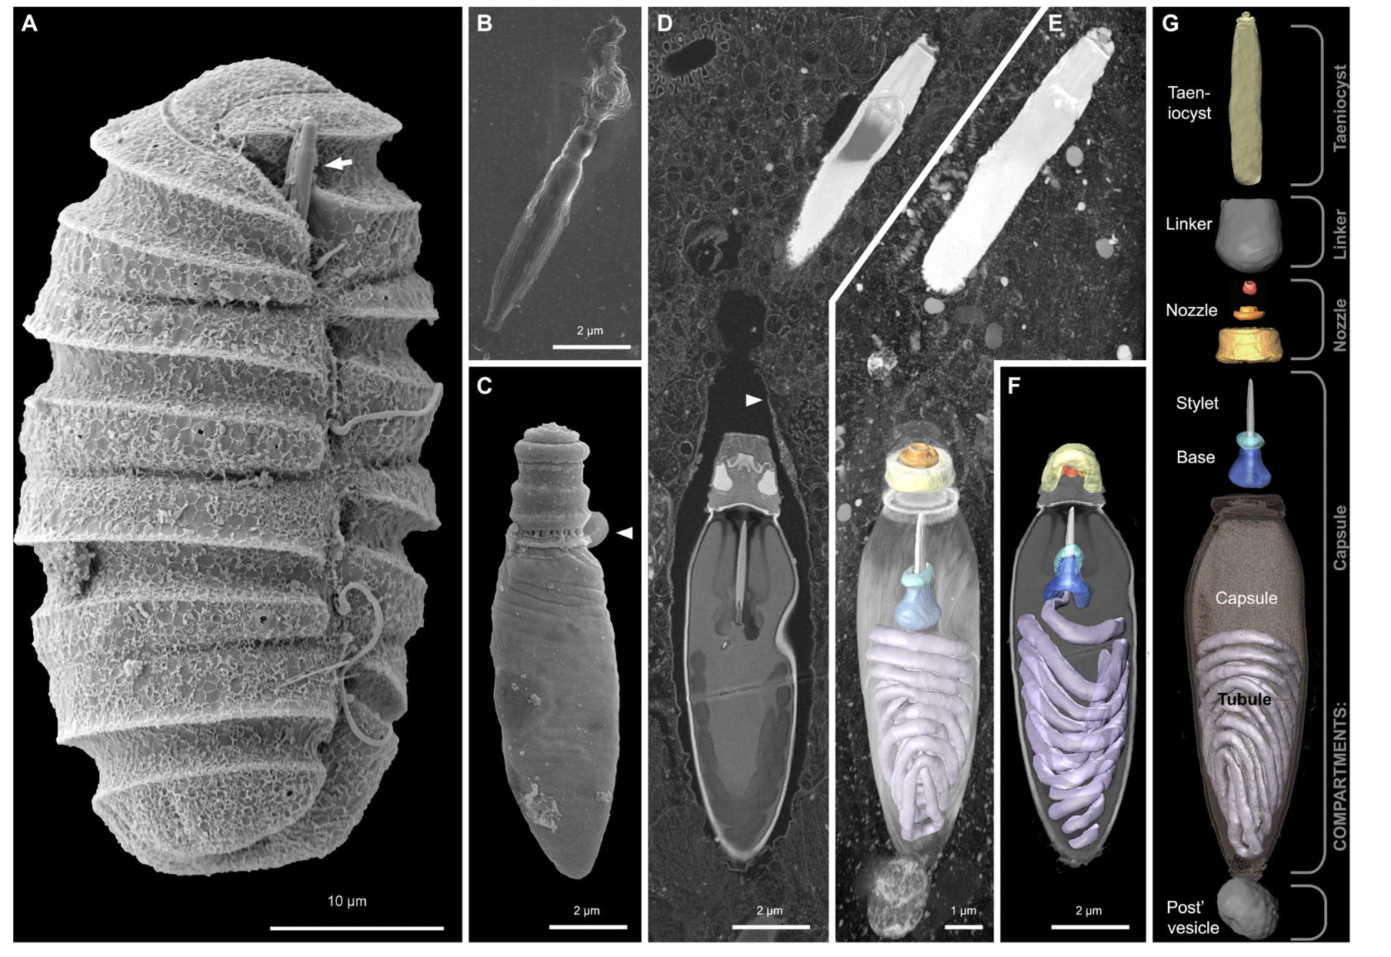

Slide 16
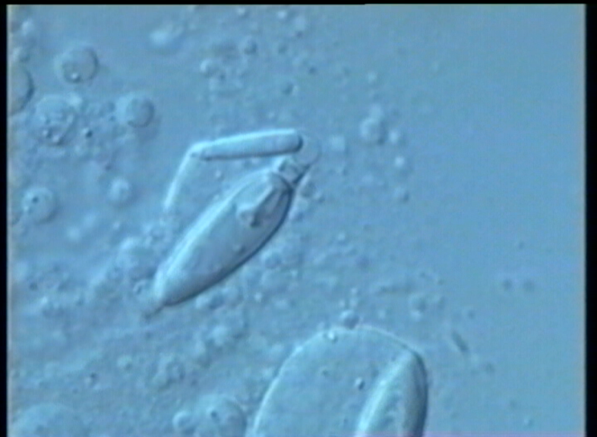

Slide 17


Slide 18
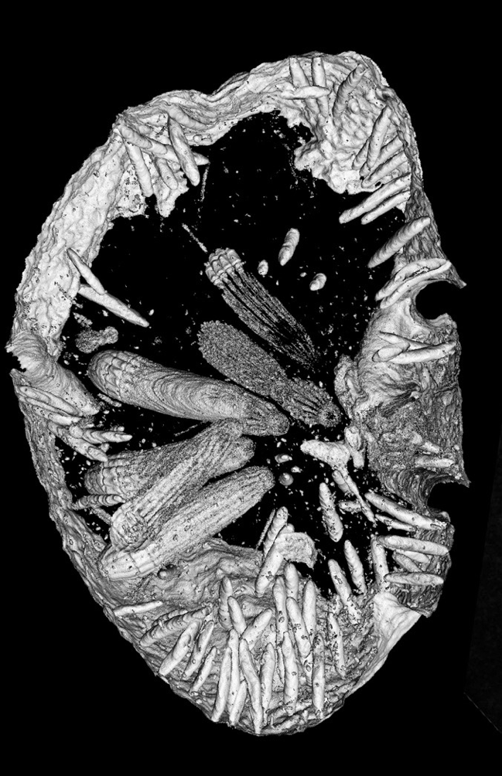
Molecular weapons -- gatling gun
Nematodinium

Slide 19
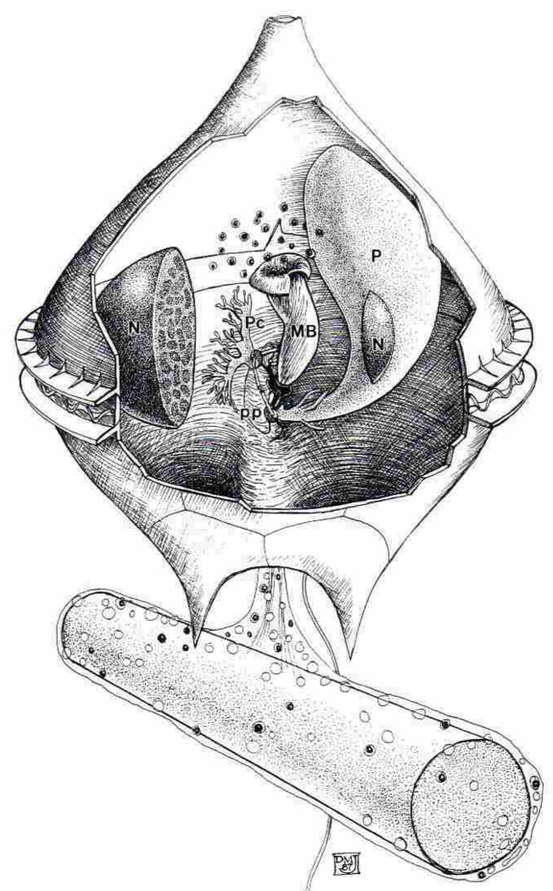
Molecular weapons -- trap
Jacobson and Anderson, 1992
Notes:
Here, we use new genomic data from over 1,000 uncultivated and little known organisms, together with published sequences, to infer a dramatically expanded version of the tree of life, with Bacteria, Archaea and Eukarya included. The results reveal the dominance of bacterial diversification and underline the importance of organisms lacking isolated representatives, with substantial evolution concentrated in a major radiation of such organisms.
Metagenomics is a shotgun sequencing-based method in which DNA isolated directly from the environment is sequenced, and the reconstructed genome fragments are assigned to draft genomes New bioinformatics methods yield complete and near-complete genome sequences, without a reliance on cultivation or reference genomes. To render this tree of life, we aligned and concatenated a set of 16 ribosomal protein sequences from each organism.

Slide 20
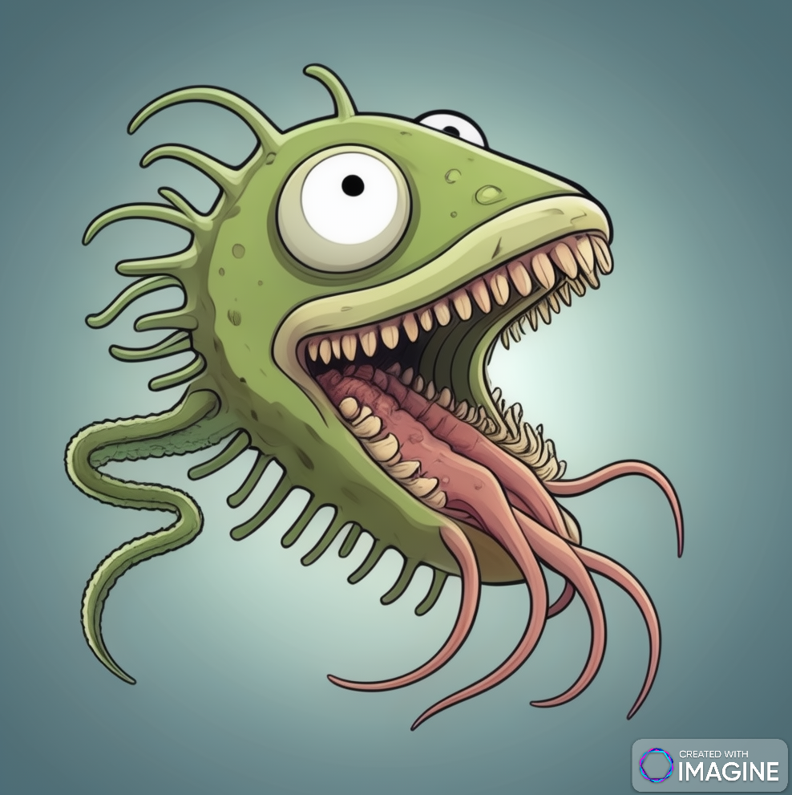
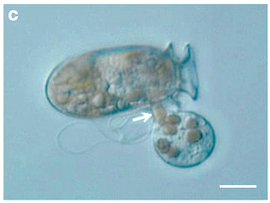
Protistan Raptors
Dinophysis
ProtiRaptor?

Slide 21
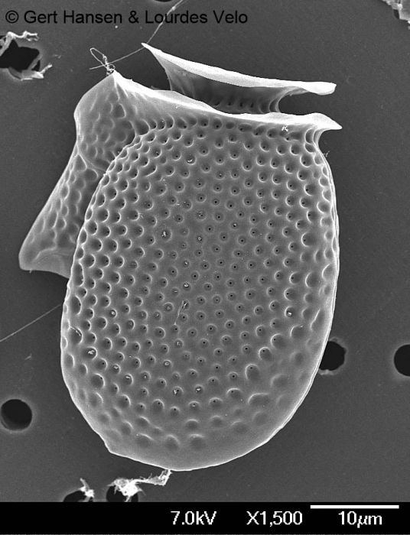
Protistan Raptors: Myzocytosis
Dinophysis

Slide 22
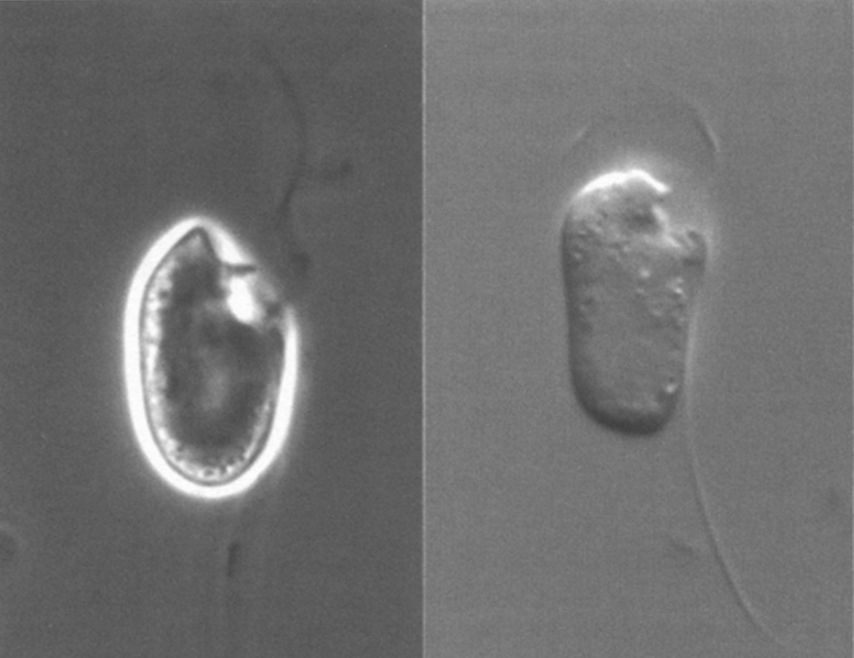
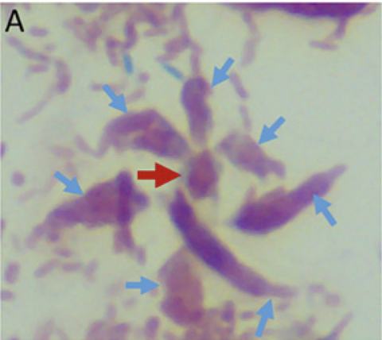
Colpodellids

Slide 23
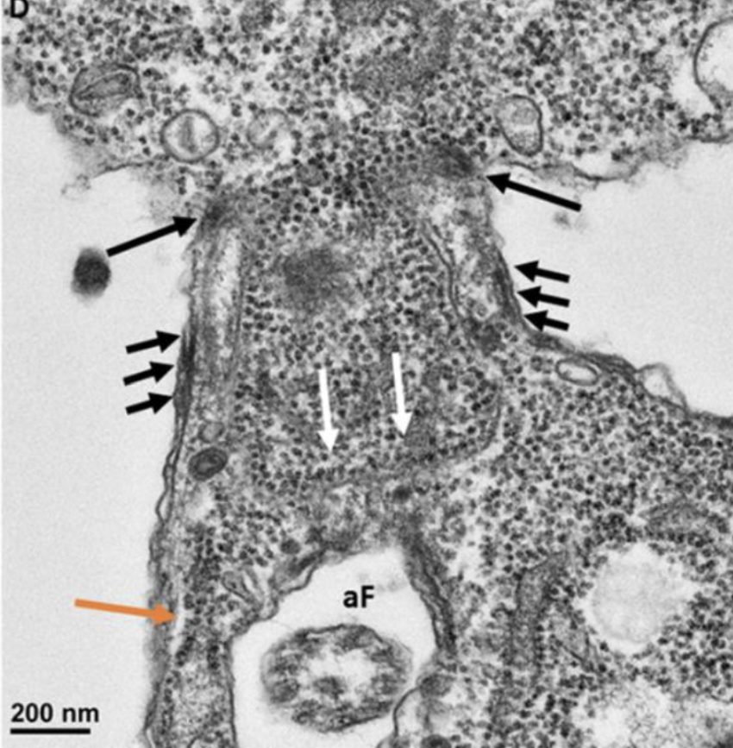
Colpodellids

Slide 24
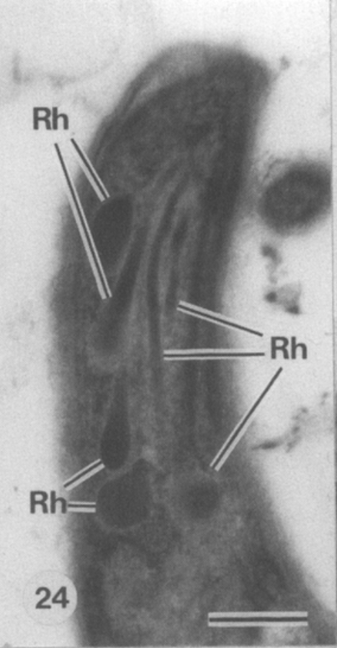
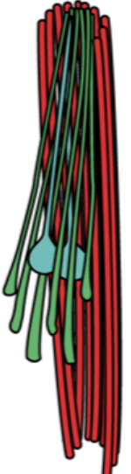
Colpodellids

Slide 25
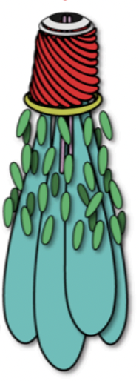
Evolutionary note: Evolution of parasitism
Colpodellids
Apicomplexa

Slide 26
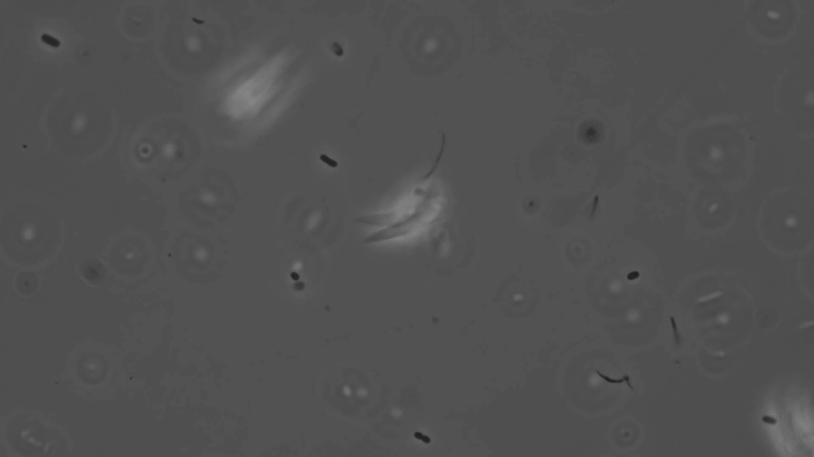

Slide 27
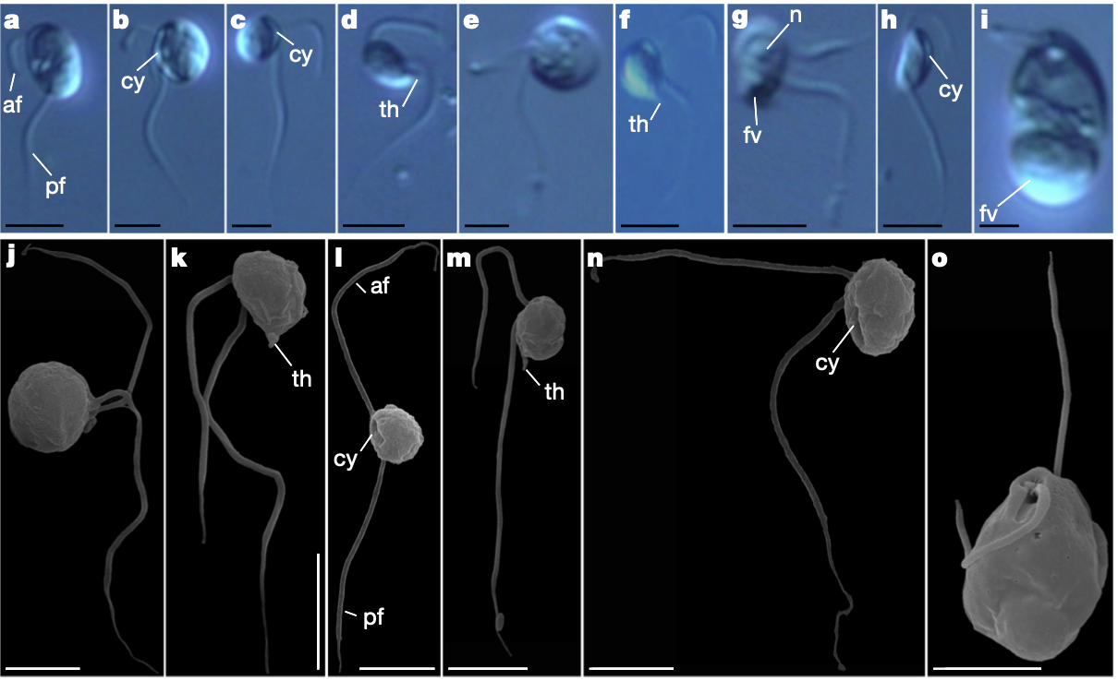
Protistan Raptors: Biters
Dinophysis

Slide 28
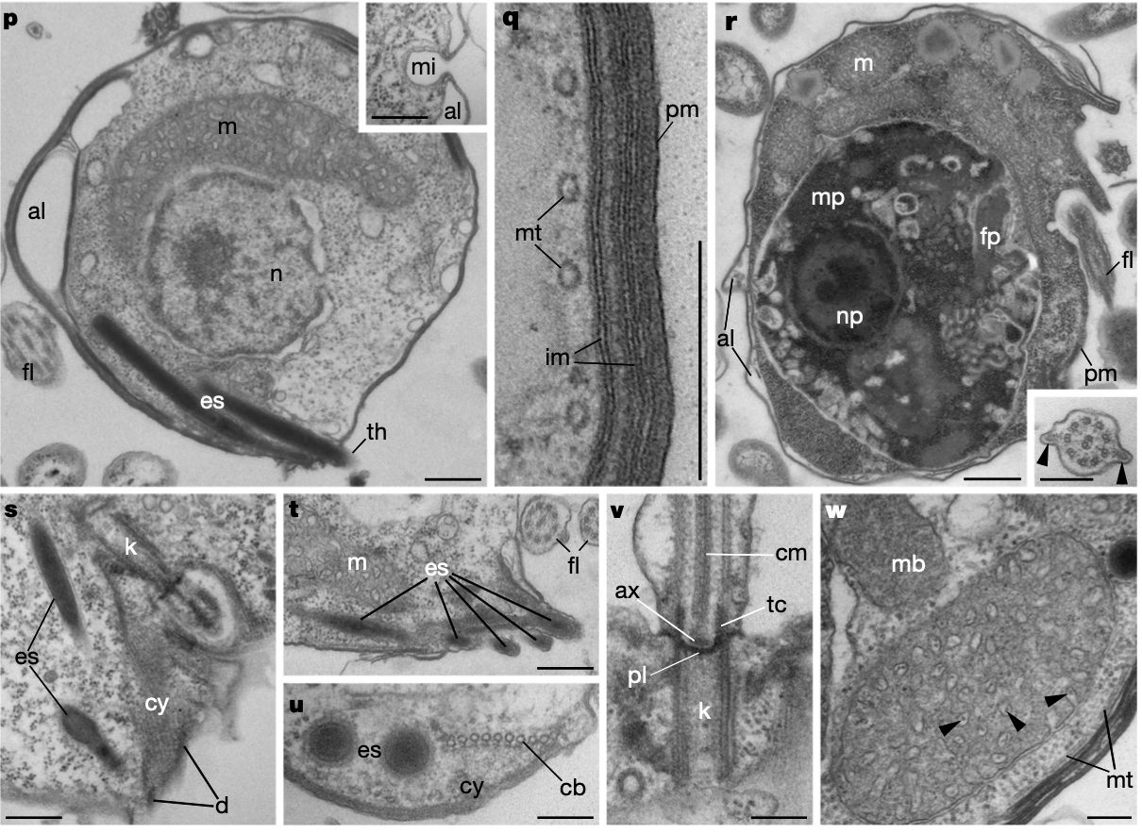
Protistan Raptors: Biters
Dinophysis

