Slide 1
Evolution of Mitochondria and anaerobic lifestyle
Martin Kolisko

Slide 2
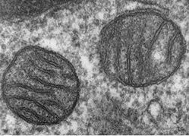
Mitochondria
Often Considered “The Powerhouse of the Cell”
Contains its own genome – “semi-autonomous organelle”
Double membrane bound
Cristae – formed by the folding of the inner membrane
One of signature characteristics of Eukaryotic cell

Slide 3
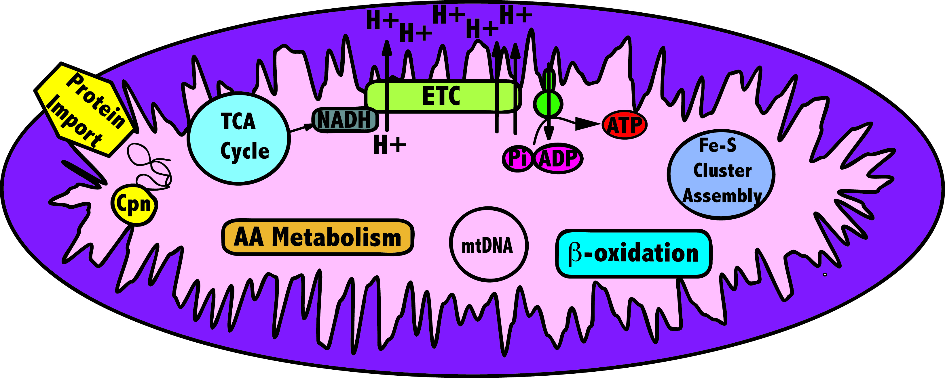
Mitochondria – functions
Oxidative phosphorylation ➔ Pyruvate – Acetyl-CoA – Proton Gradient – ATP synthesis
Also called cellular respiration

Slide 4
Mitochondria – more functions….
Energy generation
Fe-S cluster assembly
Fatty acid metabolism
Amino acid metabolism
Protein import

Slide 5
Mitochondria – more functions….
Energy generation
Fe-S cluster assembly
Fatty acid metabolism
Amino acid metabolism
Protein import

Slide 6
Mitochondria
Often Considered “The Powerhouse of the Cell”
Contains its own genome – “semi-autonomous organelle”
Double membrane bound
Cristae – formed by the folding of the inner membrane
One of signature characteristics of Eukaryotic cell

Slide 7
Mitochondria – evolutionary origins

Slide 8
Endosymbiosis
Unknown host:
Bacterium?
Primitive Eukaryote?
Eukaryotic cell
Mitochondrion
α-Proteobacterium

Slide 9
Endosymbiosis
Internalization of one single cell organism by another single-cell organism
The internalized organisms is eventually transformed into an organelle (e.g. mitochondrion/ chloroplast)
Organellar genome is slowly reduced and genes are transferred to the host nucleus
EVIDENCE for endosymbiotic origin of mitochondria?

Slide 10
Mitochondria – evolutionary origins
Circular genome – bacterial-like
Different mitochondrial genome reduction. Different organisms possess different number of genes and vary in sizes:
  genes: 5 genes in Plasmodium vs. 94 genes in Reclinomonas
  size: ~5Kb in Plasmodium vs. ~100Kb in Jakoba
Translational (mRNA into protein) machinery similar to bacteria
Some Bacterial-like biochemical pathways and functions
Phylogenetic evidence

Slide 11
Endosymbiosis
Unknown host:
Bacterium?
Primitive Eukaryote?
Eukaryotic cell
Mitochondrion
α-Proteobacterium
Gene transfer – This means that there are genes in the eukaryotic genomes that originated
from the mitochondria.
Making phylogenies based on these genes may help understand the origin of mitochondria

Slide 12
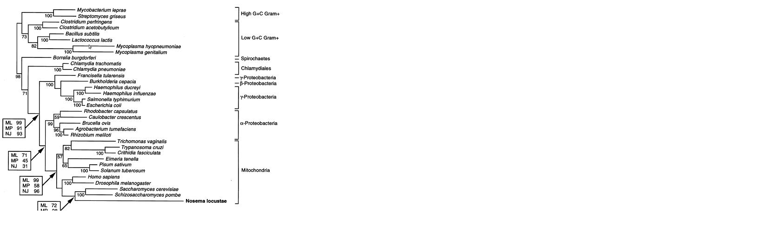
α-proteobacterial origin

Slide 13
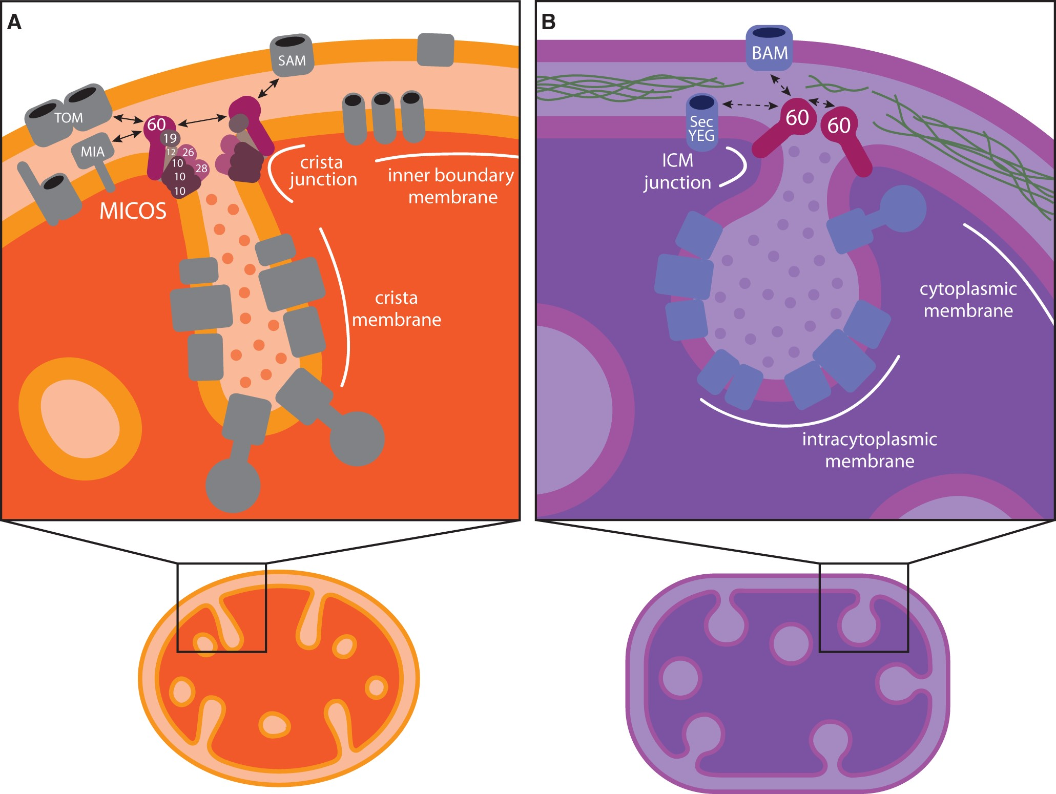

Cristae origins
Notes:
Fig. 1. The function of MICOS is probably conserved between mitochondria and alphaproteobacteria. (A) In the mitochondrion of Saccharomyces cerevisiae, MICOS forms CSs and CJs to maintain and stabilize cristae (Harner et al. 2011; Hoppins et al. 2011; von der Malsburg et al. 2011; Körner et al. 2012; Ott et al. 2012; Zerbes et al. 2012). MICOS is composed of the Mic60–Mic19 subcomplex which establishes CSs with the MOM and marks the sites of CJ formation, and the Mic12–Mic10–Mic26–Mic28 subcomplex which differentiates and bends the MIM at CJs (Pfanner et al. 2014; Friedman et al. 2015; Muñoz-Gómez, Slamovits, Dacks, Baier, et al. 2015; Zerbes et al. 2016). The central MICOS subunit, Mic60, contacts the outer membrane through its interactions with the TOM and SAM complexes (additional interactions have also been reported with the MOM proteins porin and Ugo1), and further interacts with Mia40 to aid in the oxidative import of mitochondrial proteins (von der Malsburg et al. 2011; Körner et al. 2012; Ott et al. 2012; Zerbes et al. 2012). (B) In alphaproteobacteria, alphaMic60 is presumably involved in the formation of ICMJs and CSs to stabilize bioenergetic ICMs. alphaMic60 likely uses its conserved mitofilin domain to interact with the BAM complex, the bacterial homologue of SAM. alphaMICOS might therefore mark the sites of ICM invagination and keep ICMs anchored to the alphaproteobacterial envelope at CSs. Alternatively, alphaMic60 might bring together protein translocases (e.g., SecYEG and BAM) for proper envelope biogenesis (the so called Bayer’s junctions) at sites of murein hypotrophy. The compartmentalization of both mitochondrial cristae and alphaproteobacterial ICMs is achieved by narrow tubules (i.e., CJS and ICMJs) likely made and stabilized by Mic60. Mitochondrial cristae and alphaproteobacterial ICMs are therefore functionally analogous. They both constitute specialized sub-compartments that optimize the efficiency of energy transduction by concentrating bioenergetic metabolism. Thick arrows indicate physical interactions between protein partners. Dashed arrows indicate hypothesized physical interactions between protein partners based on the known function of their homologues.
Unless provided in the caption above, the following copyright applies to the content of this slide: © The Author 2017. Published by Oxford University Press on behalf of the Society for Molecular Biology and Evolution. All rights reserved. For permissions, please e-mail: journals.permissions@oup.com

Slide 14
Targeting of proteins into Mitochondria

Slide 15
Targeting of proteins into the Mitochondria
Mitochondrial genome codes for only a fraction of proteins that function in mitochondrion (1 – 2%).
Most of the mitochondrial proteins are imported into the mitochondrion.
Targeting of the proteins into the mitochondrion is therefore crucial for the function.

Slide 16
Targeting peptide
Proteins are mostly imported to mitochondrion through
targeting peptide
Targeting peptide:
usually 10-80 amino acids long
rich in positively charged residues
forms amphipathic helix - all charged residues on one site – this is recognized by the translocating proteins

Slide 17
Targeting of proteins into the Mitochondria
Cytosol
Targeting peptide
SAM complex
TOM
Intramembrane
space
TIM23
PAM
TIM22
17
HSP70
MPP
Mitochodrial
matrix
CPN60
CPN10

Slide 18
Targeting of proteins into the Mitochondria
Inner membrane protein with integral targeting peptide
Cytosol
SAM complex
TOM
Intramembrane
space
TIM23
PAM
TIM22
HSP70
Mitochodrial
matrix

Slide 19
Mitochondria – functions
Targeting of proteins into the Mitochondria
Cytosol
SAM complex
TOM
Intramembrane
space
TIM23
PAM
TIM22
HSP70
Mitochondrial
matrix

Slide 20
Targeting of proteins into the Mitochondria
Cytosol
Either a stop signal or signal for re-translocation from matrix to inner membrane space
SAM complex
TOM
Intramembrane
space
TIM23
PAM
TIM22
HSP70
Mitochondrial
matrix

Slide 21
Targeting of proteins into the Mitochondria
Cytosol
SAM complex
TOM
Either a stop signal or signal for re-translocation from matrix to inner membrane space
Intramembrane
space
TIM23
PAM
TIM22
HSP70
Mitochondrial
matrix

Slide 22
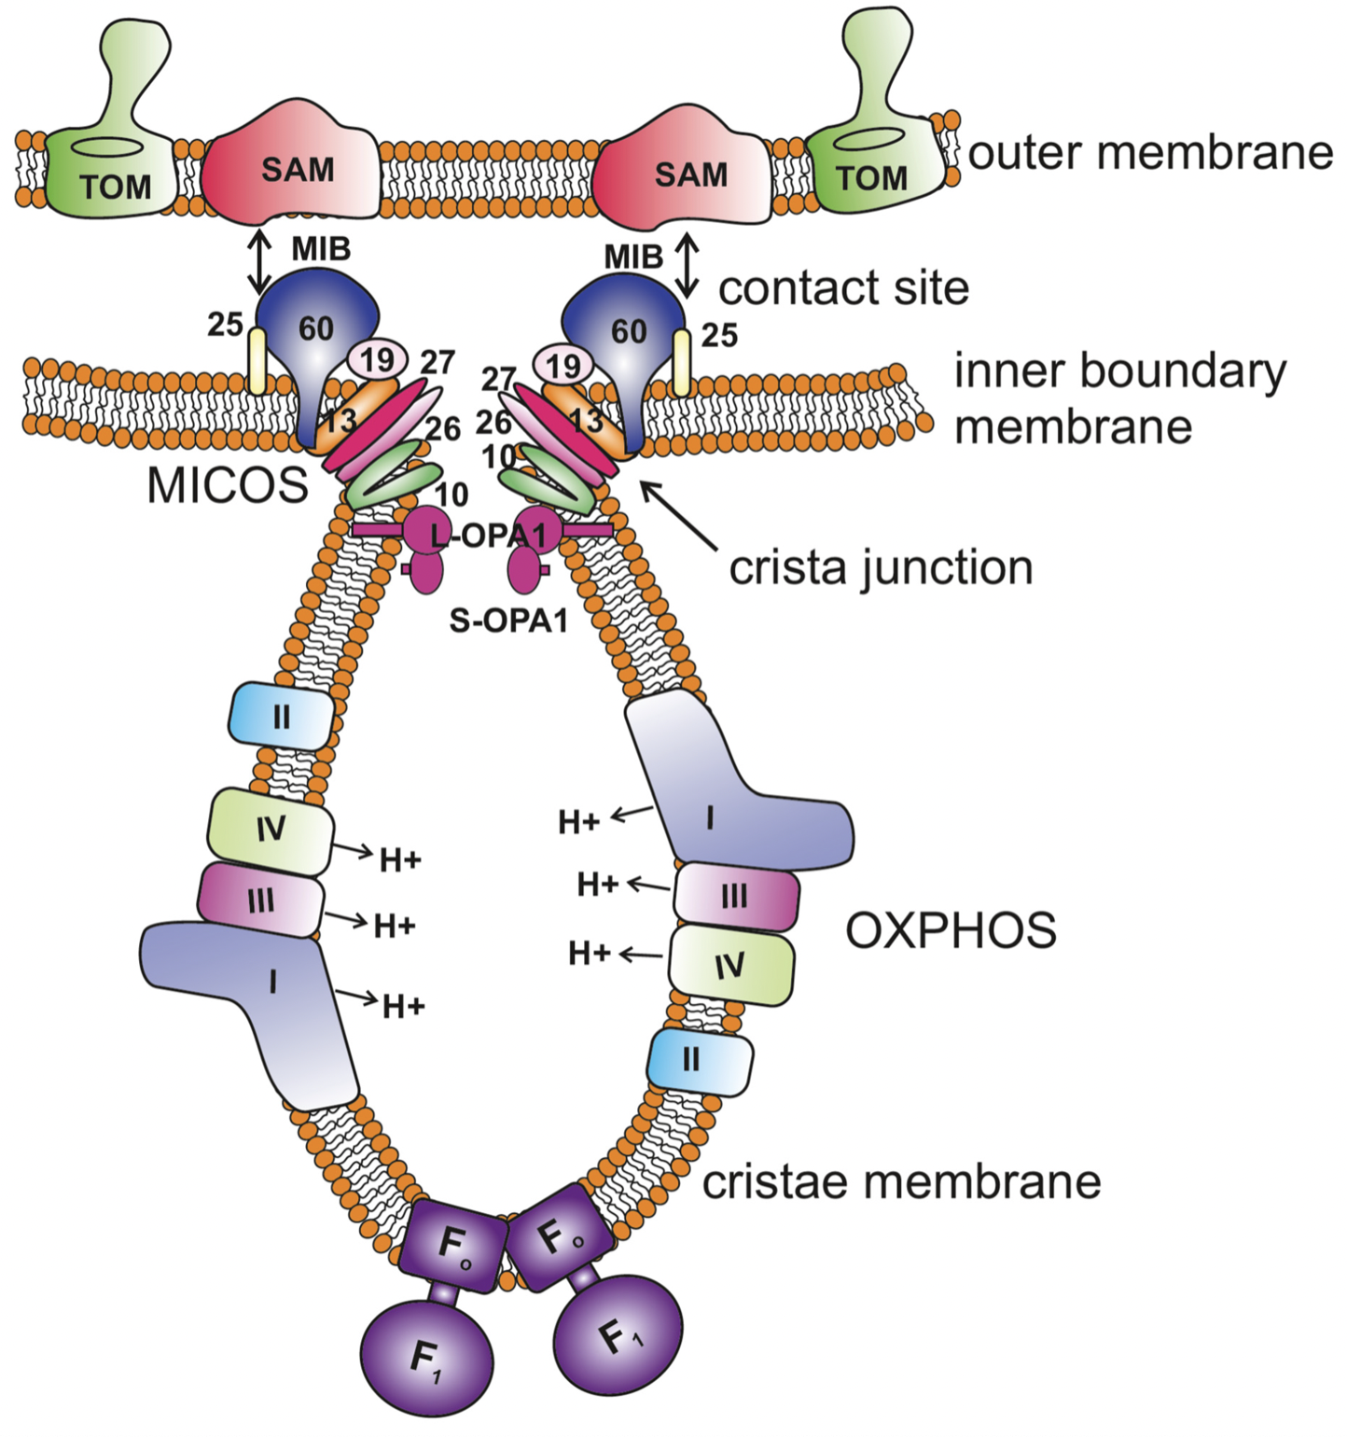
Micos
Mitochondrila Cristae Organization:
MIC proteins, that ficiliate flding of the inner membrane.
Notes:
Fig. 1. The function of MICOS is probably conserved between mitochondria and alphaproteobacteria. (A) In the mitochondrion of Saccharomyces cerevisiae, MICOS forms CSs and CJs to maintain and stabilize cristae (Harner et al. 2011; Hoppins et al. 2011; von der Malsburg et al. 2011; Körner et al. 2012; Ott et al. 2012; Zerbes et al. 2012). MICOS is composed of the Mic60–Mic19 subcomplex which establishes CSs with the MOM and marks the sites of CJ formation, and the Mic12–Mic10–Mic26–Mic28 subcomplex which differentiates and bends the MIM at CJs (Pfanner et al. 2014; Friedman et al. 2015; Muñoz-Gómez, Slamovits, Dacks, Baier, et al. 2015; Zerbes et al. 2016). The central MICOS subunit, Mic60, contacts the outer membrane through its interactions with the TOM and SAM complexes (additional interactions have also been reported with the MOM proteins porin and Ugo1), and further interacts with Mia40 to aid in the oxidative import of mitochondrial proteins (von der Malsburg et al. 2011; Körner et al. 2012; Ott et al. 2012; Zerbes et al. 2012). (B) In alphaproteobacteria, alphaMic60 is presumably involved in the formation of ICMJs and CSs to stabilize bioenergetic ICMs. alphaMic60 likely uses its conserved mitofilin domain to interact with the BAM complex, the bacterial homologue of SAM. alphaMICOS might therefore mark the sites of ICM invagination and keep ICMs anchored to the alphaproteobacterial envelope at CSs. Alternatively, alphaMic60 might bring together protein translocases (e.g., SecYEG and BAM) for proper envelope biogenesis (the so called Bayer’s junctions) at sites of murein hypotrophy. The compartmentalization of both mitochondrial cristae and alphaproteobacterial ICMs is achieved by narrow tubules (i.e., CJS and ICMJs) likely made and stabilized by Mic60. Mitochondrial cristae and alphaproteobacterial ICMs are therefore functionally analogous. They both constitute specialized sub-compartments that optimize the efficiency of energy transduction by concentrating bioenergetic metabolism. Thick arrows indicate physical interactions between protein partners. Dashed arrows indicate hypothesized physical interactions between protein partners based on the known function of their homologues.
Unless provided in the caption above, the following copyright applies to the content of this slide: © The Author 2017. Published by Oxford University Press on behalf of the Society for Molecular Biology and Evolution. All rights reserved. For permissions, please e-mail: journals.permissions@oup.com

Slide 23
Targeting of proteins into the Mitochondria
Quick repeat:
Targeting peptide – rich in charged residues
TOM complex transports across outer membrane – cytosolic HSP70 are used to deliver the protein to the TOM complex
TIM complex transports across inner membrane – mtHSP70 facilitates the transport
Tim22 complex – transports inner membrane proteins
Tim23 complex – transports into the matrix

Slide 24
Mitochondrion – Iron-Sulfur cluster assembly
Iron-Sulfur clusters are part of Iron-Sulfur cluster proteins
There are vital part of …
For example:
Ferredoxins
aconitase

Slide 25
Several Fe-S assembly systems
Fe-S cluster assembly system | Cytosolic | Mitochondrial | Plastid | Prokaryotes
Cytosolic Iron Sulfur Cluster Assembly (CIA) | +
Iron sulfur cluster (ISC) |  | + |  | +
Sulfur Mobilization (SUF) |  |  | + | +
Nitrogen fixation (NIF) |  |  |  | +

Slide 26
Mitochondrion – Iron-Sulfur cluster assembly
CIA machinery – cytosolic Fe-S cluster assembly
Fe
X - factor
Atm1
IS
Mrs?
Cytosolic mature proteins
IscU
IscU
Scaffold
protein
IscS
Cystein
desulfurase
Cys
Mitochondrial
mature proteins

Slide 27
Quick rep.
Mitochondria originated through endosymbiosis
Most of mitochondrial genes were transferred to nucleus and are imported to mitochondria post-translationaly
Proteins are imported into mitochondria through TOM and TIM complexes
Iron-Sulfur assembly is an obligatory function of mitochondria and is done through bacterial type ISC system

Slide 28
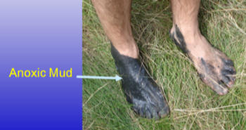
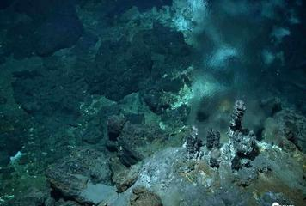
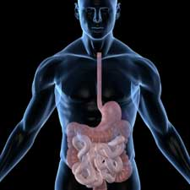
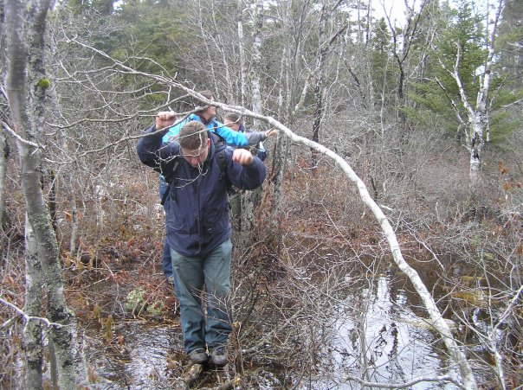
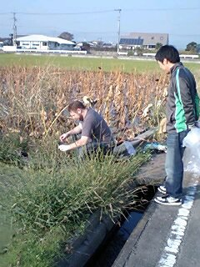
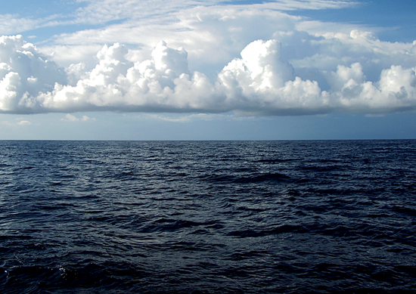
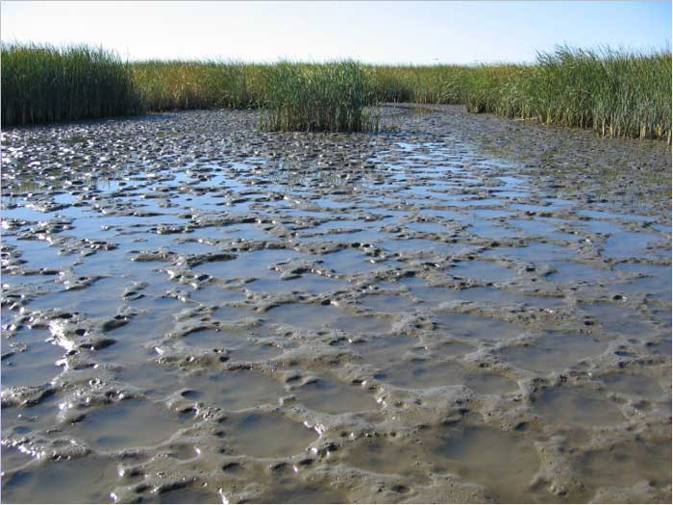
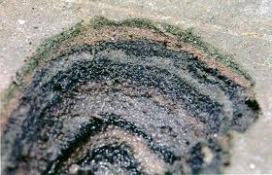
Anaerobic lifestyle
Anoxic mud
Deep sea
Gut
Bacterial mat
Ocean
marshes

Slide 29
Anaerobic life-style
Few terms:
Facultative anaerobes: tolerate oxygen
Strict anaerobes: oxygen is toxic
Microaerophiles: live in an environment with low-level of oxygen

Slide 30
What happens to mitochondria?
Anaerobic mitochondria
Electron transport/oxidative phosphorylation
use alternate electron acceptor, not O₂
However many organisms seemed not to contain any mitochondrion
In past they were considered primarily amitochondriate
However,…

Slide 31
Amitochondriate organisms
Organisms that do not possess mitochondria
Primarily amitochondirate – originated before the acquisition of mitochondria

Slide 32
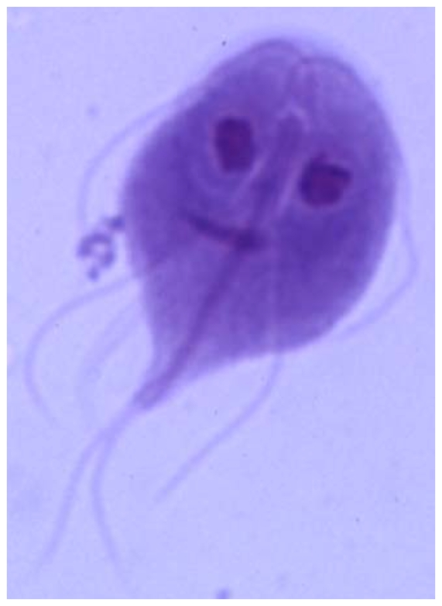
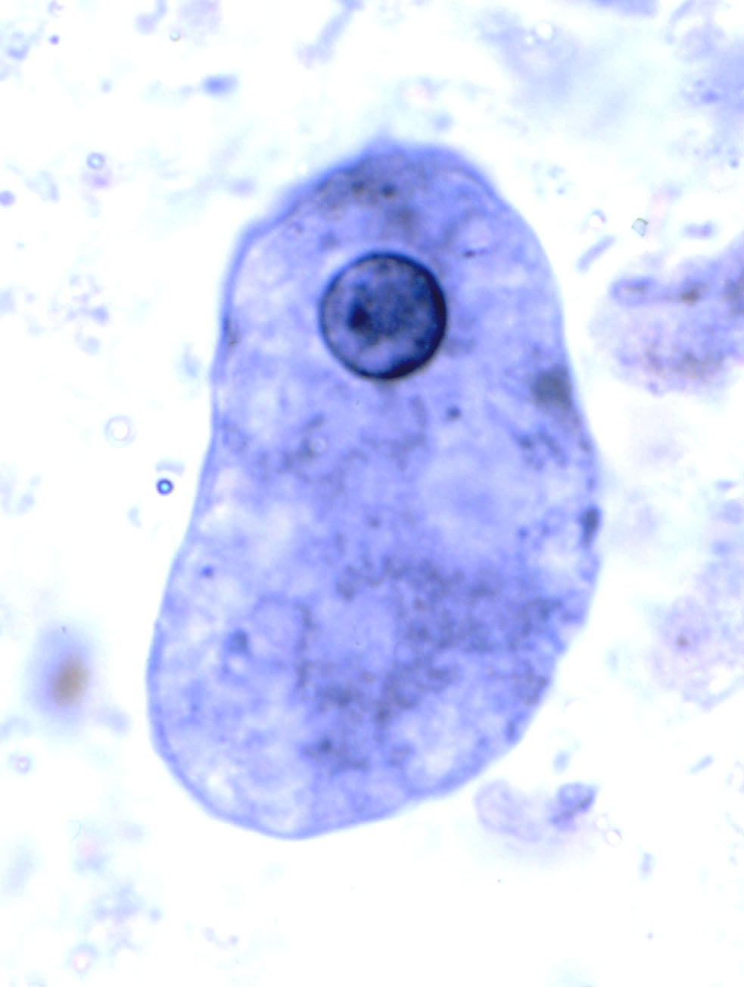
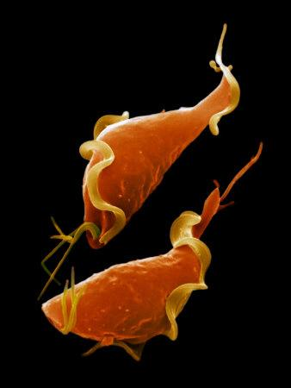
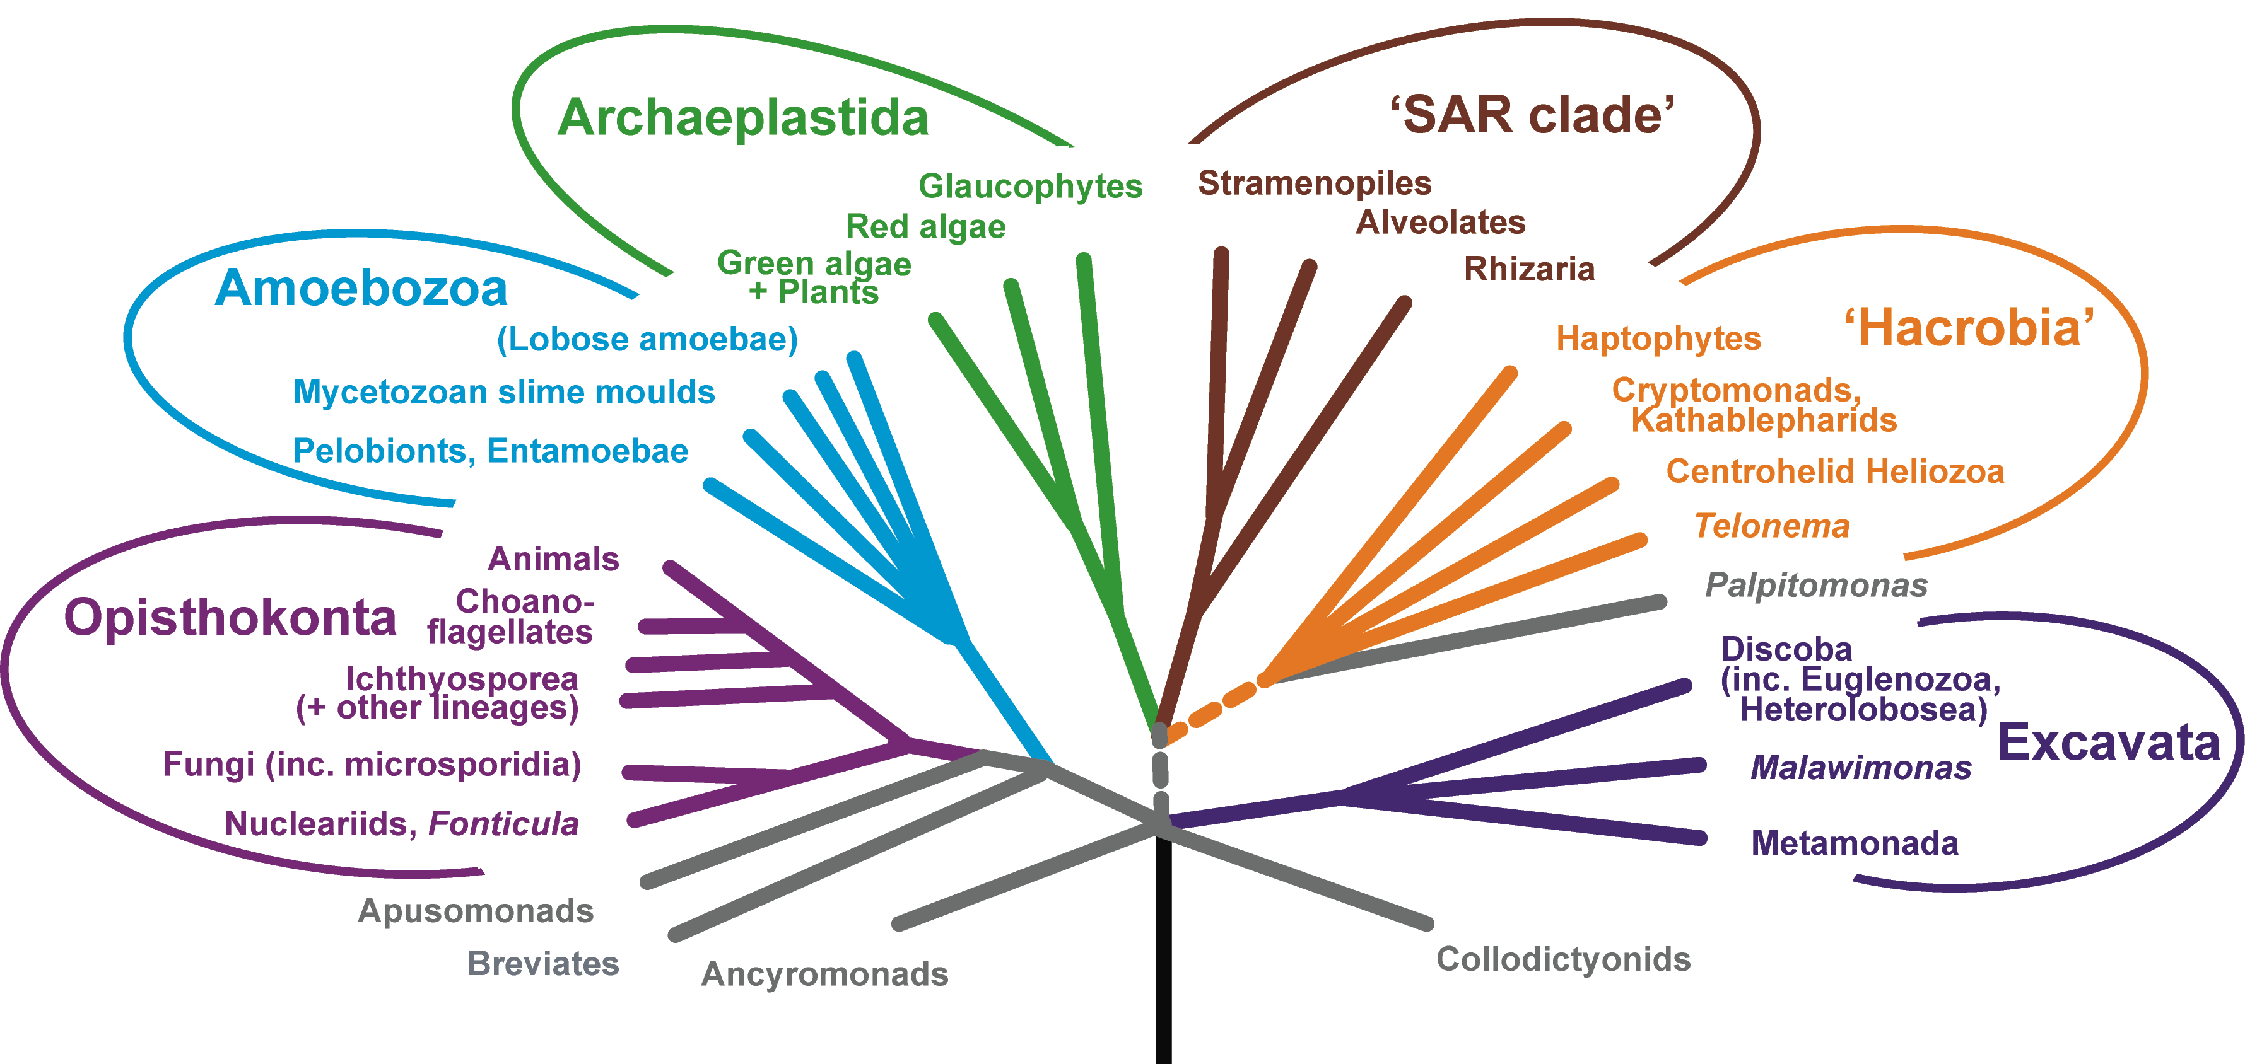
Amitochondriate organisms
Giardia
Entamoeba
Trichomonas

Slide 33
How are they generating
energy?

Slide 34

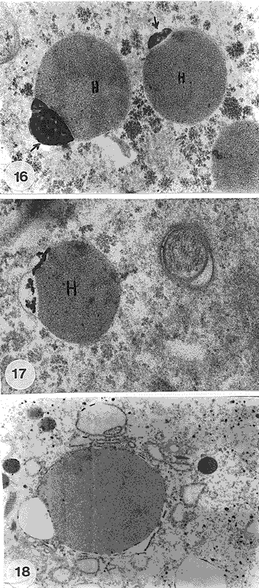
Trichomonas vaginalis
Parasite of men – STD trichomoniasis
Posses Hydrogenosomes:
Double membrane bound organelle
no DNA
no cristae

Slide 35
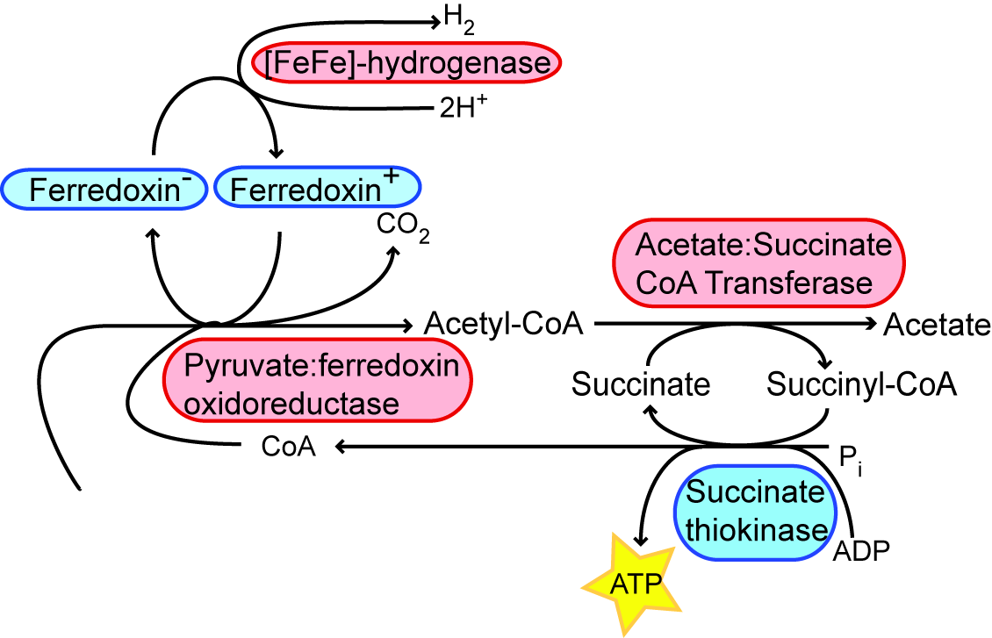
Hydrogenosomes
ASCT
pyruvate
STK

Slide 36
Hydrogenosomes
ASCT
pyruvate
STK

Slide 37
Hydrogenosomes
Fe-Hyd
ASCT
PFO
pyruvate
STK

Slide 38
Hydrogenosomes
ASCT
pyruvate
STK

Slide 39
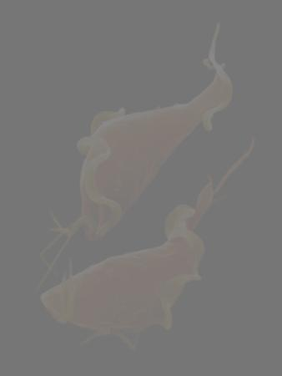
Amitochondriate organisms
Giardia
Entamoeba
Trichomonas

Slide 40
Amitochondriate organisms
Intestinal parasite
Beaver fever
No organelle
Giardia
Intestinal parasite
dysentery
No organelle
Entamoeba

Slide 41
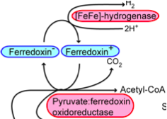
In cytosol
Acetyl-CoA Synthetase
acetate
ADP
ATP
pyruvate
Alcohol dehydrogenase E
ethanol

Slide 42
In cytosol
?
Acetyl-CoA Synthetase
acetate
ADP
ATP
pyruvate
Alcohol dehydrogenase E
ethanol

Slide 43
In cytosol
?
Acetyl-CoA Synthetase
acetate
ADP
ATP
pyruvate
Alcohol dehydrogenase E
ethanol

Slide 44
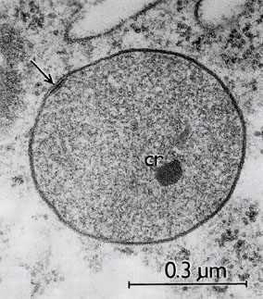
Amitochondriate organisms
At this point of the lecture we still think they are truly amitochondriate…
Do we?

Slide 45
Genes of mitochondrial origin
Giardia
Entamoeba
Trichomonas

Slide 46
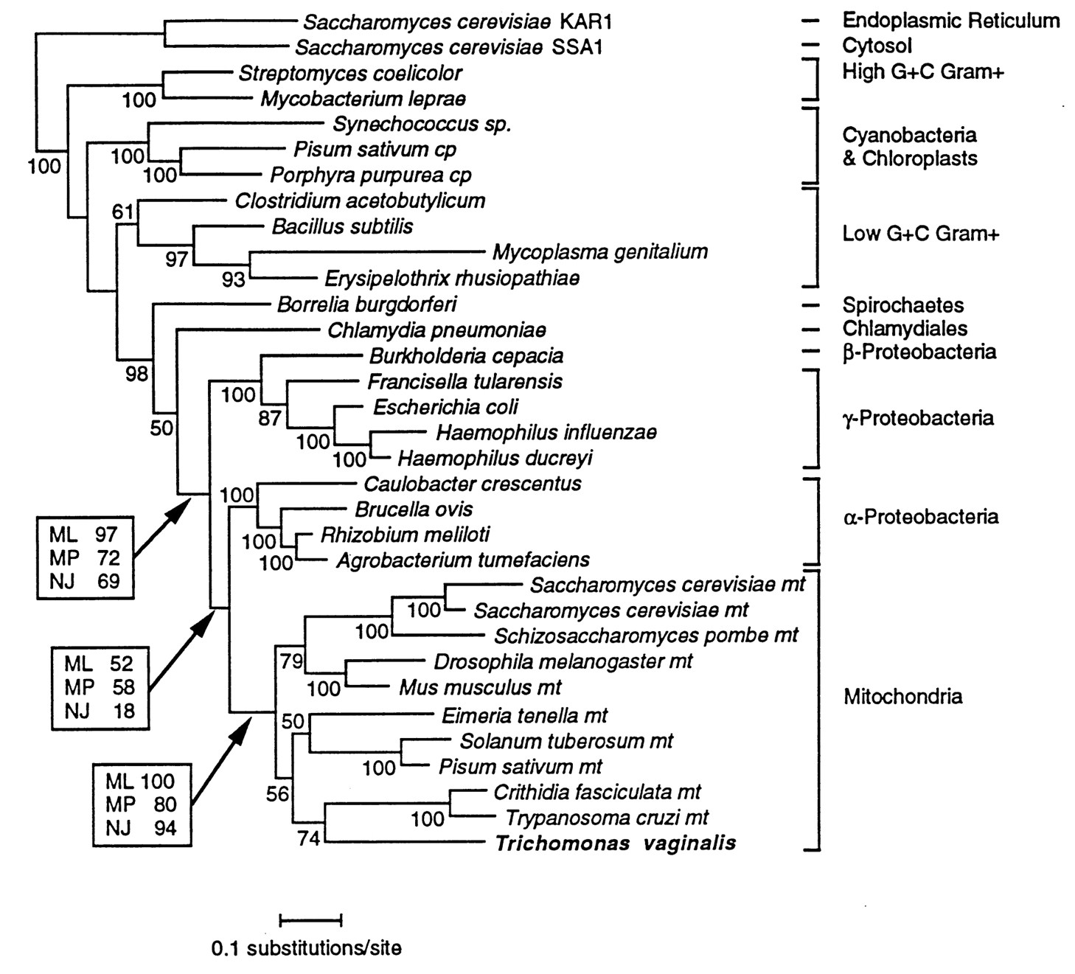
Genes of mitochondrial origin
Germot A et al. PNAS 1996;93:14614-14617

Slide 47
Hydrogenosome = mitochondrion
CIA machinery – cytosolic Fe-S cluster assembly
Fe
X - factor
Atm1
IS
Mrs?
Cytosolic mature proteins
IscU
IscU
Scaffold
protein
IscS
Cystein
desulfurase
Cys
Mitochondrial
mature proteins

Slide 48
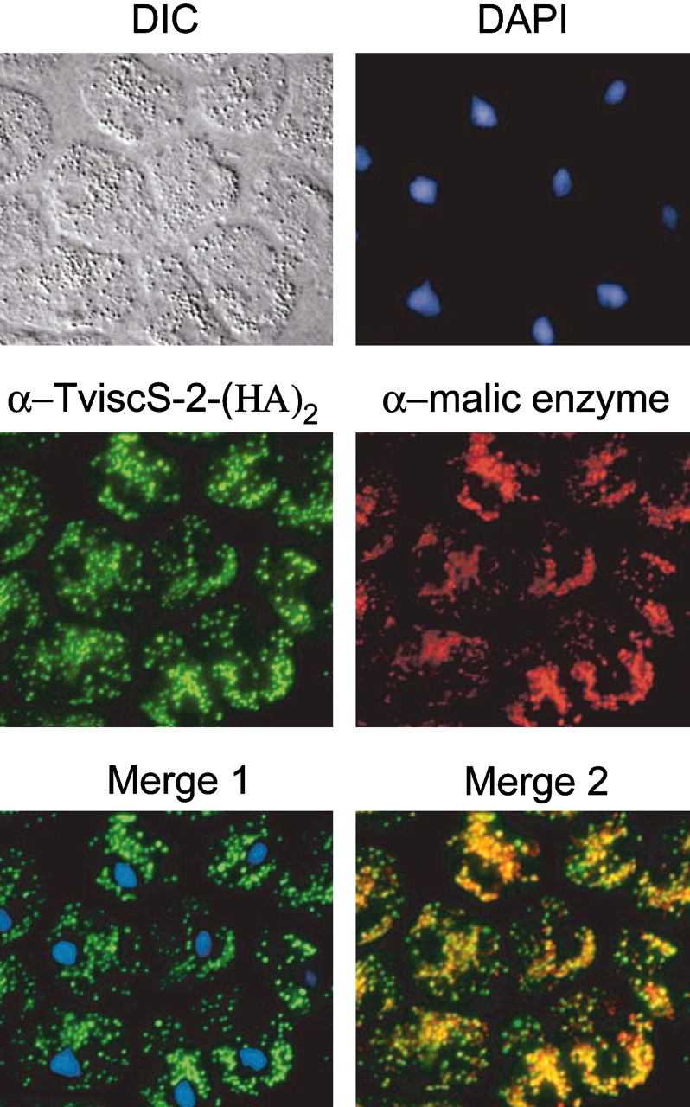
Hydrogenosome = mitochondrion
Other evidence:
Other proteins of mitochondrial origin targeted to hydrogenosome
Similar targeting machinery
Sutak R et al. PNAS 2004;101:10368-10373

Slide 49
How about Giardia and Entamoeba
Giardia
Entamoeba
Trichomonas

Slide 50
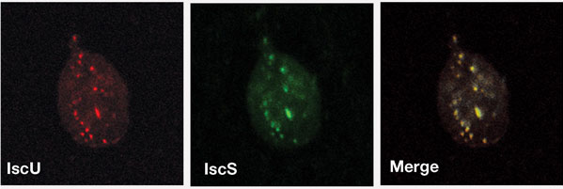
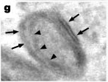
Giardia intestinalis
CPN60 gene discovered in Giardia genome
Subsequently Isc system (Fe-S cluster assembly system) was discovered and localized in Giardia
This organelle was called Mitosome

Slide 51
Giardia mitosomes
Shown to have common targeting system with Hydrogenosomes and Mitochondria
TOM complex proteins have been identified
However, TIM pore complex proteins have not yet been identified
The only known function is Fe-S cluster assembly
ATP is being imported into mitosome rather than made

Slide 52
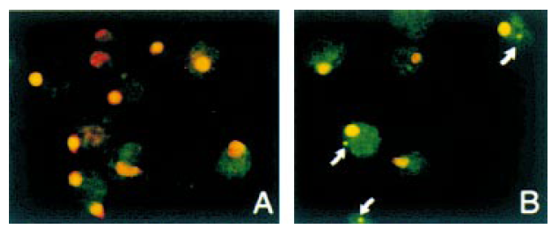
Entamoeba mitosomes
CPN60 gene of mitochondrial origin
Iron-Sulfur cluster assembly
Does not have Ics system but Nif system instead
Does not localize into the organelle

Slide 53
Entamoeba mitosomes
CPN60 gene of mitochondrial origin
Does not have Ics system but Suf system instead
Also functions in cyst formation – again crucial function

Slide 54
To summarize…
Three basic categories of organelles:
Mitochondrion – genome, electron transport chain, Import machinery, Fe-S cluster synthesis
Hydrogenosome – no genome, PFO/Hydrogenase – genrates energy, Import machinery, Fe-S cluster synthesis
Mitosomes – tiny, no genome, does not generate energy, highly reduced import machinery, Fe-S cluster synthesis (usually)

Slide 55
5 minutes break….

Slide 56
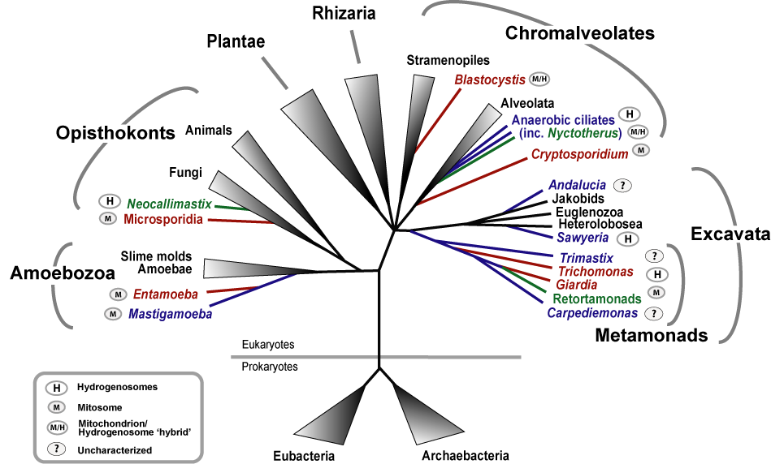
To make it more complicated

Slide 57
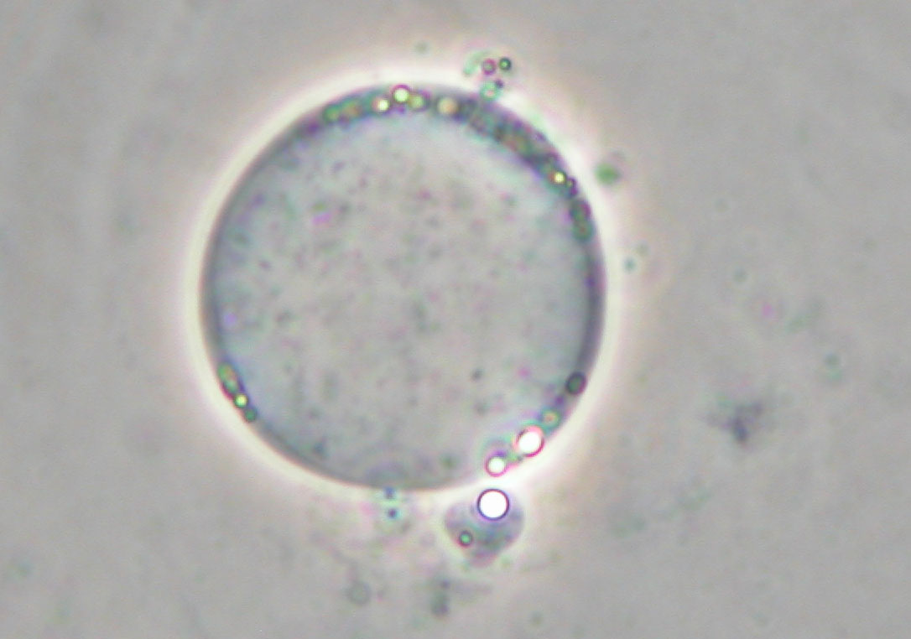
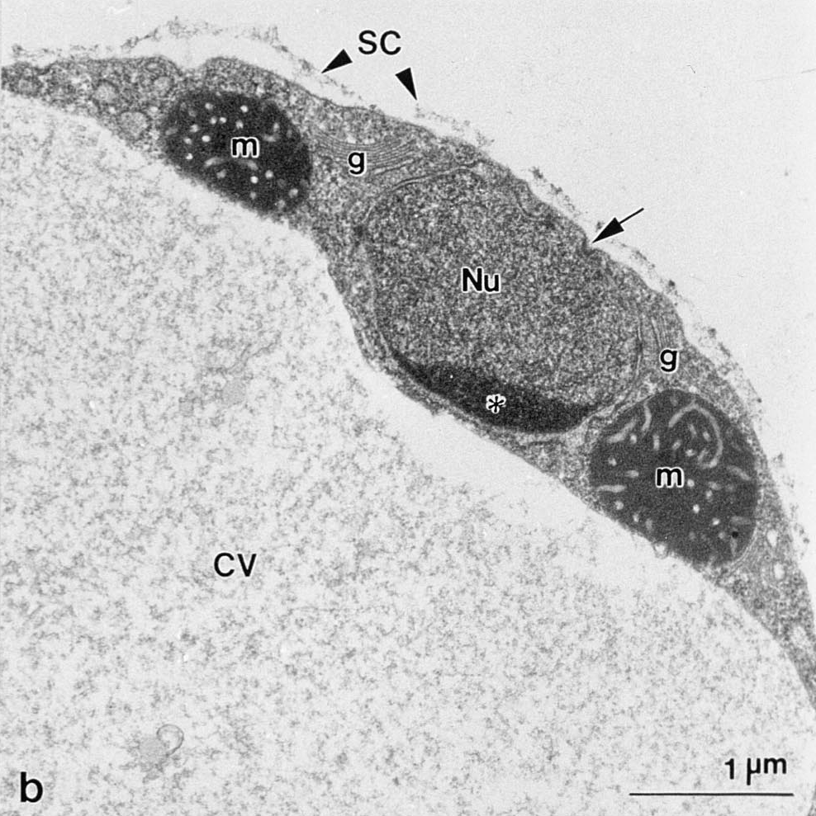
Blastocystis
Infects gastro-intestinal tract of humans and animals.
9 species of Blastocystis that infect humans.
Strict anaerobe
Stramenopile
Notes:
57

Slide 58
Blastocystis organelle
Possess PFO and Fe-Hydrogenase ➔ Therefore it is Hydrogenosome
But also has genome
And partial TCA cycle, and classical mitochondrial pyruvate dehydrogenase
So it is Hydrogenosome/Mitochondria?
There is several organisms whose organelle are bluring the bouindaries
Extremely dynamic system
Notes:
58

Slide 59
What happens to mitochondria?
Classical mitochondria
Anaerobic mitochondria
Electron transport/oxidative phosphorylation
use alternate electron acceptor, not O₂
Continuum
loss of
genome
Hydrogenosomes
No oxidative phosphorylation (usually)
Anaerobic ATP generation producing H₂ gas
Mitosomes
No electron transport, oxidative phosphorylation
Some mitochondrial-derived proteins
Protein import apparatus and Fe-S cluster biogenesis
Unknown functions

Slide 60
To make it more complicated

Slide 61
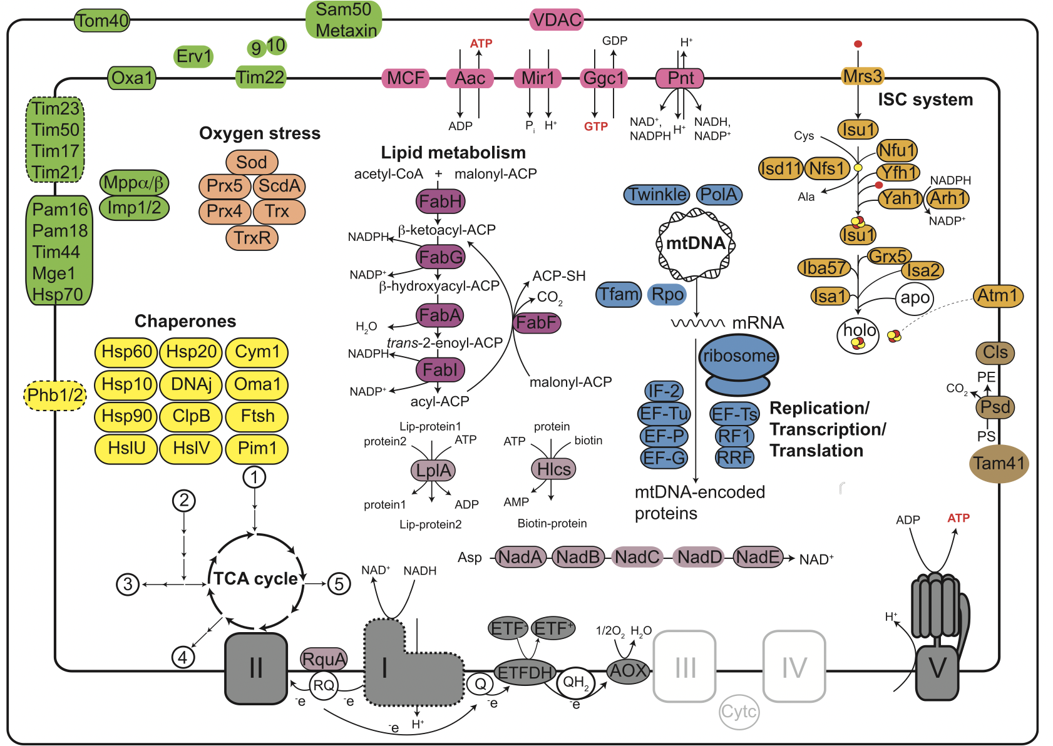
Brevimastigomonas motovehiculus

Slide 62
What happens to mitochondria?
Classical mitochondria
Anaerobic mitochondria
Electron transport/oxidative phosphorylation
use alternate electron acceptor, not O₂
loss of
genome
Hydrogenosomes
No oxidative phosphorylation (usually)
Anaerobic ATP generation producing H₂ gas
Mitosomes
No electron transport, oxidative phosphorylation
Some mitochondrial-derived proteins
Protein import apparatus and Fe-S cluster biogenesis
Unknown functions

Slide 63
Metopid Ciliates

Slide 64
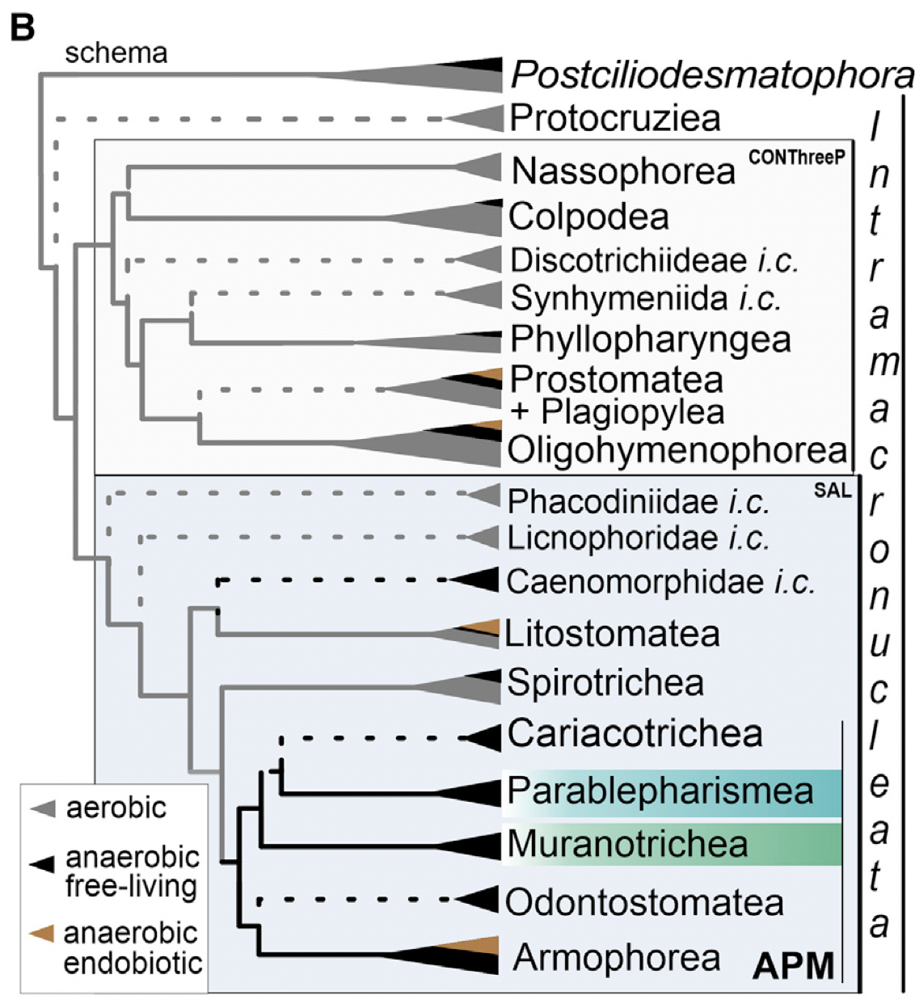
Metopid Ciliates

Slide 65
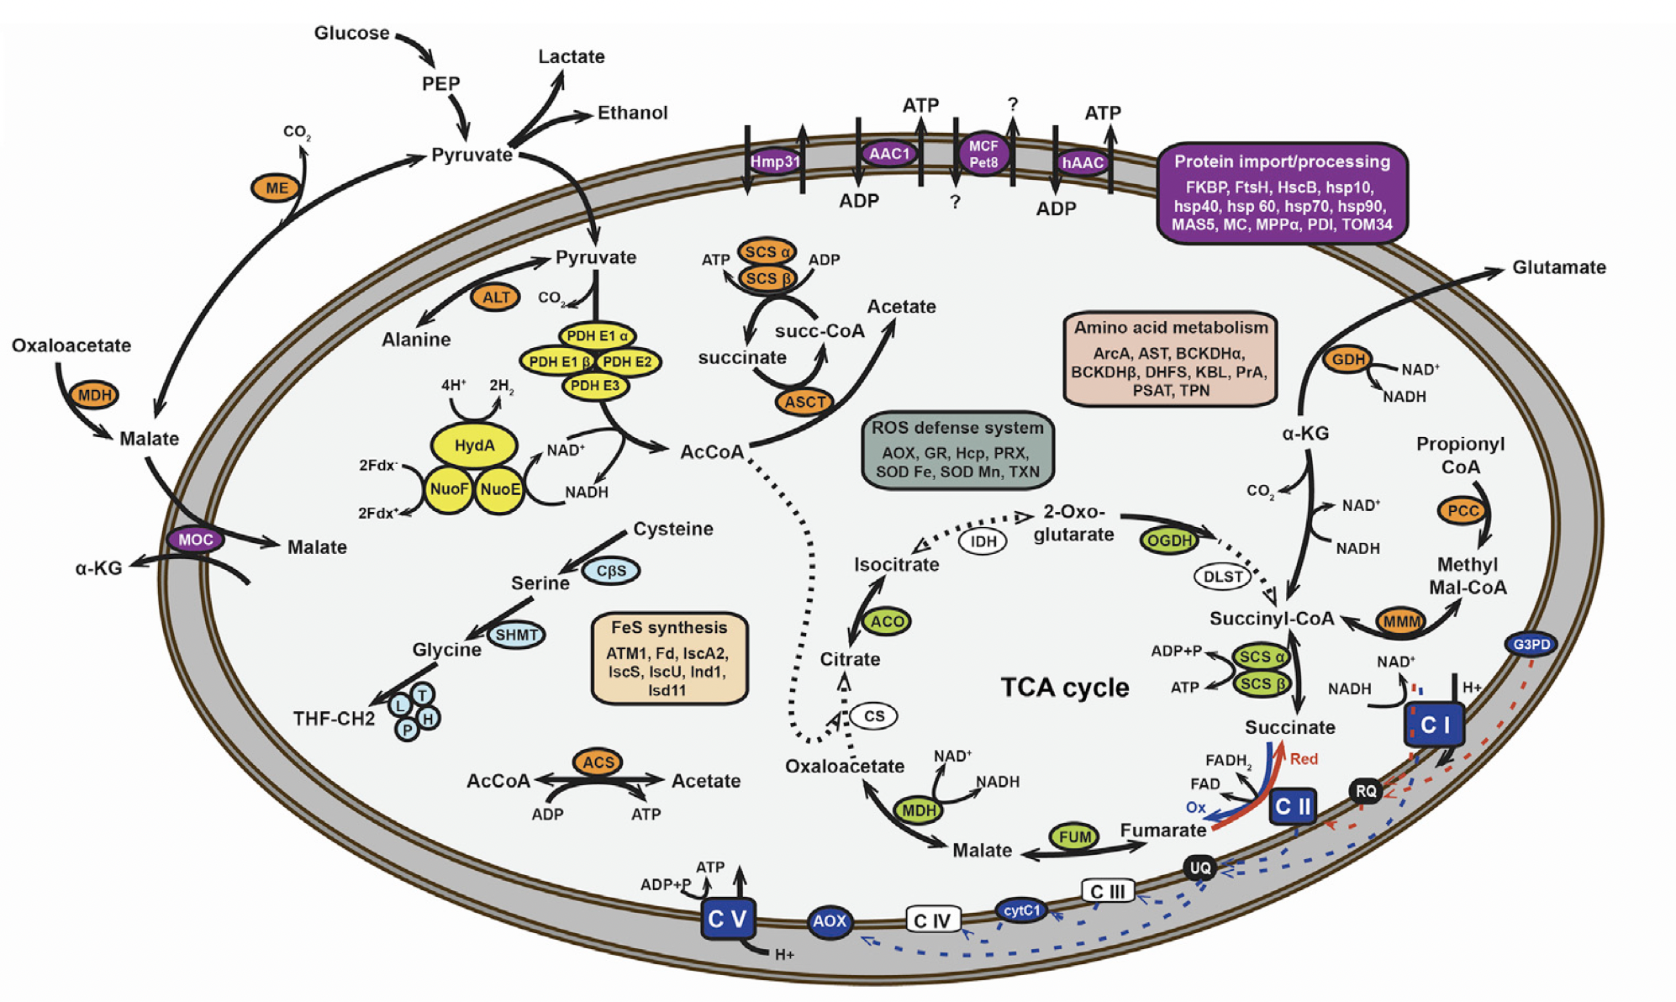
Metopid Ciliates

Slide 66
What happens to mitochondria?
Classical mitochondria
Anaerobic mitochondria
Electron transport/oxidative phosphorylation
use alternate electron acceptor, not O₂
loss of
genome
Hydrogenosomes
No oxidative phosphorylation (usually)
Anaerobic ATP generation producing H₂ gas
Mitosomes
No electron transport, oxidative phosphorylation
Some mitochondrial-derived proteins
Protein import apparatus and Fe-S cluster biogenesis
Unknown functions

Slide 67
Metamonada
Trimastix PCT
Monocercomonoides sp.
Trimastix + Oxymonads
Trimastix pyriformis
Tritrichomonas foetus
Pentatrichomonas hominis
Trichomonads
Trichomonas vaginalis
Carpediemonas membranifera
Ergobibamus cyprinoides
CLO NY0171
Chilomastix cuspidata
Carpediemonas-like organisms
Chilomastix caulleri
Kipferlia bialata
Dysnectes brevis
Giardia intestinalis
Spironucleus barkhanus
Spironucleus salmonicida
Diplomonads
Spironucleus vortens
Trepomonas PC1

Slide 68
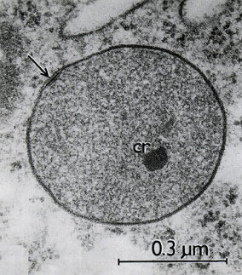
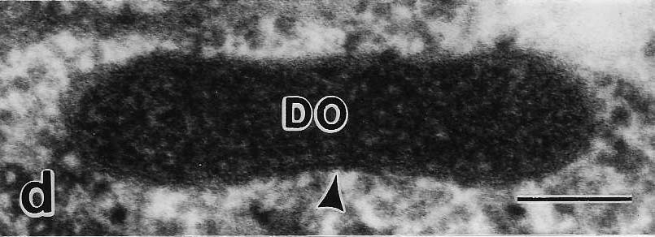
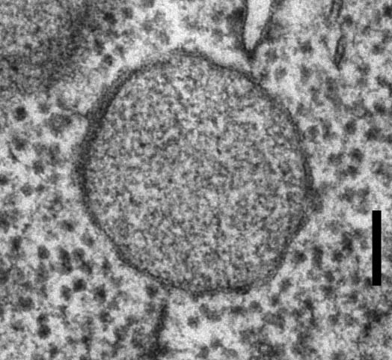
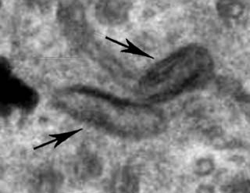
MROs of metamonada
Trimastix PCT
Monocercomonoides sp.
Trimastix pyriformis
Tritrichomonas foetus
Pentatrichomonas hominis
Trichomonas vaginalis
Carpediemonas membranifera
Ergobibamus cyprinoides
CLO NY0171
Chilomastix cuspidata
Chilomastix caulleri
Kipferlia bialata
Dysnectes brevis
Reductive evolution?
Giardia intestinalis
Spironucleus barkhanus
Spironucleus salmonicida
Spironucleus vortens
Trepomonas PC1

Slide 69
ATP generation
2 enzymes:
PFO
PFL
2 enzyme systems:
ASCT_SCS
ACS
Pyruvate
Acetyl-CoA
Acetate
ADP
ATP
Trichomonas
PFO
ASCT + SCS
Pyruvate
Acetyl-CoA
Acetate
ADP
ATP
Giardia
PFO
ACS
Pyruvate
Acetyl-CoA
Acetate
ADP
ATP

Slide 70
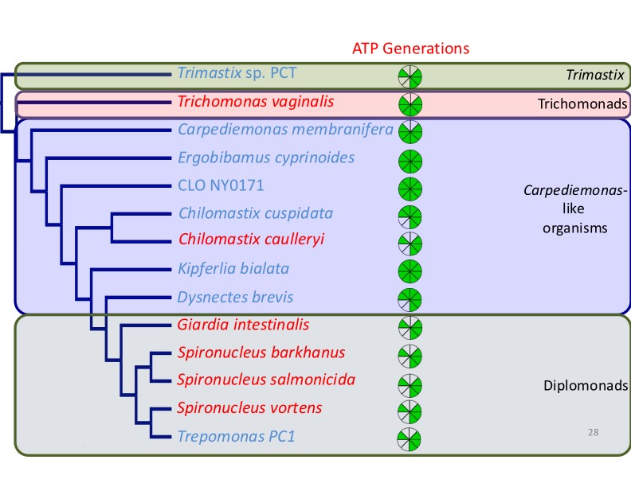
ATP generation
2 enzymes:
PFO
PFL
2 enzyme systems:
ASCT_SCS
ACS
Pyruvate
Acetyl-CoA
Acetate
ADP
ATP
Trichomonas
PFO
ASCT + SCS
Pyruvate
Acetyl-CoA
Acetate
ADP
ATP
Giardia
PFO
ACS
Pyruvate
Acetyl-CoA
Acetate
ADP
ATP

Slide 71
Glycine Cleavage system
Important part of amino acid metabolism
Synthesize or degrades glycine
In eukaryotes present in mitochondria
4 component complex:
    T_protein
    P_protein
    H_protein
    L_protein

Slide 72
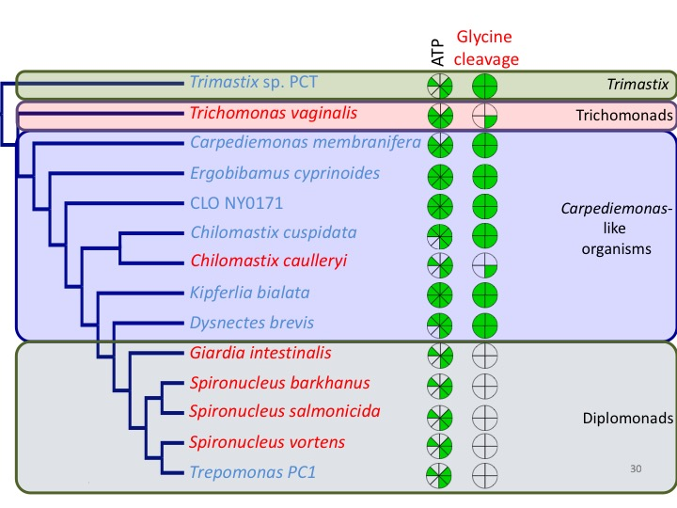
Glycine
cleavage
ATP
Trimastix
Trichomonads
Carpediemonas-
like
organisms
Diplomonads
72

Slide 73
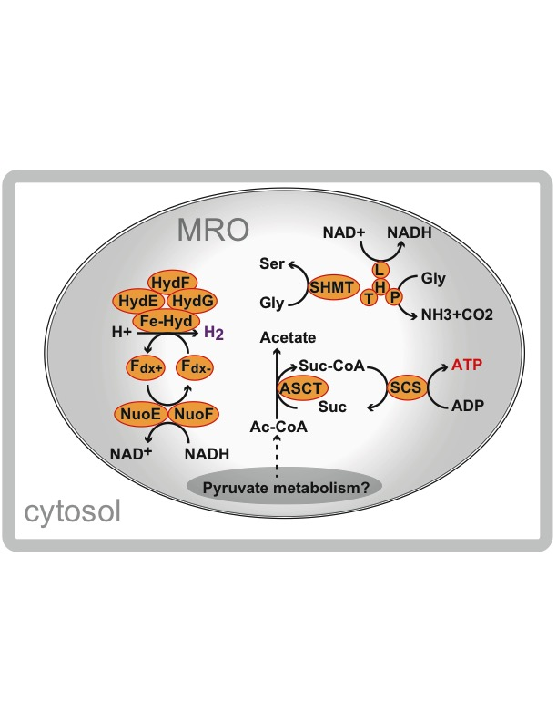
Diplomonads
Trichomonads

Slide 74
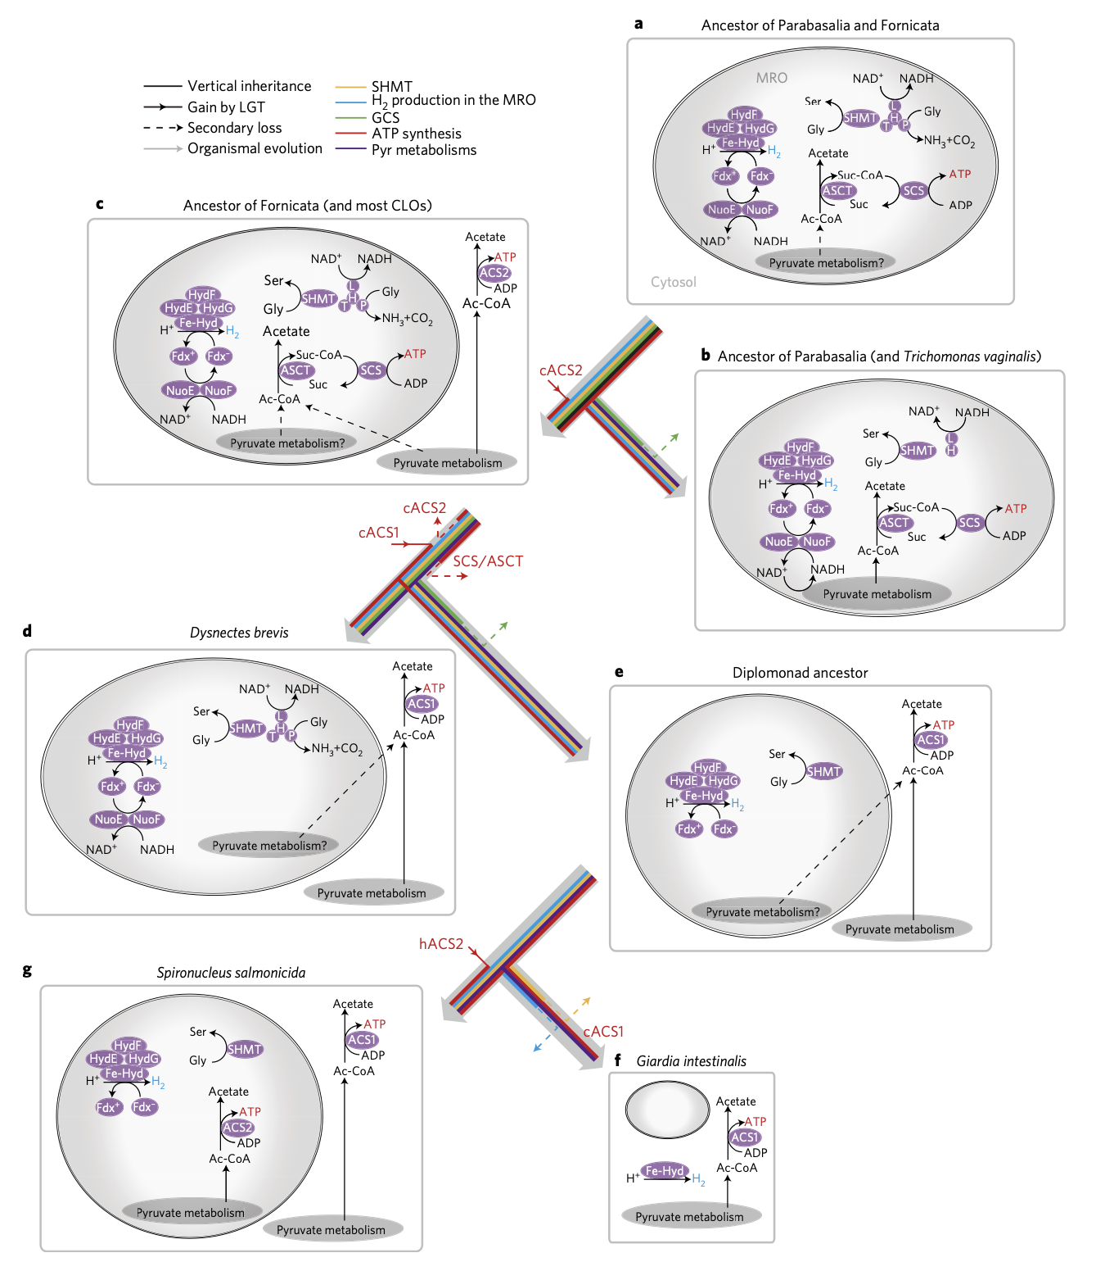
Metamonada
Notes:
74

Slide 75
Diplomonads
Trichomonads
Reduction Step By Step
Trichomonas
Other CLOs
Dysnectes brevis
Gain of Acetyl-CoA synthetase -> Cytosolic ATP generation
Loss of SCS/ASCT -> Organellar ATP generation
Spironucleus salmonicida
Loss of Glycine
Cleavage System
Transfer of ACS into hydrogenosome -> regain of ATP production
Loss of Hydrogen Production, only ISC assembly and associated pathways remain
Giardia

Slide 76
What happens to mitochondria?
Classical mitochondria
Anaerobic mitochondria
Electron transport/oxidative phosphorylation
use alternate electron acceptor, not O₂
loss of
genome
Hydrogenosomes
No oxidative phosphorylation (usually)
Anaerobic ATP generation producing H₂ gas
Mitosomes
No electron transport, oxidative phosphorylation
Some mitochondrial-derived proteins
Protein import apparatus and Fe-S cluster biogenesis
Unknown functions

Slide 77
Monocercomonoides

Slide 78
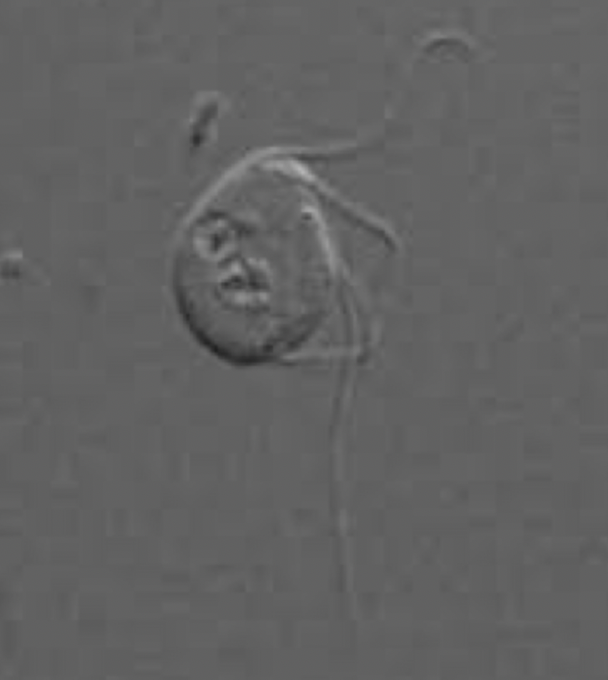
Monocercomonoides
Trimastix PCT
Monocercomonoides sp.
Trimastix pyriformis
Tritrichomonas foetus
Pentatrichomonas hominis
Trichomonas vaginalis
Carpediemonas membranifera
Ergobibamus cyprinoides
CLO NY0171
Chilomastix cuspidata
Chilomastix caulleri
Kipferlia bialata
Dysnectes brevis
Giardia intestinalis
Spironucleus barkhanus
Spironucleus salmonicida
Spironucleus vortens
Trepomonas PC1

Slide 79
Monocercomonoides
Trimastix PCT
Monocercomonoides sp.
Trimastix pyriformis
Tritrichomonas foetus
Pentatrichomonas hominis
Trichomonas vaginalis
Carpediemonas membranifera
Ergobibamus cyprinoides
CLO NY0171
Chilomastix cuspidata
Chilomastix caulleri
Kipferlia bialata
Dysnectes brevis
Giardia intestinalis
Spironucleus barkhanus
Spironucleus salmonicida
Spironucleus vortens
Trepomonas PC1

Slide 80
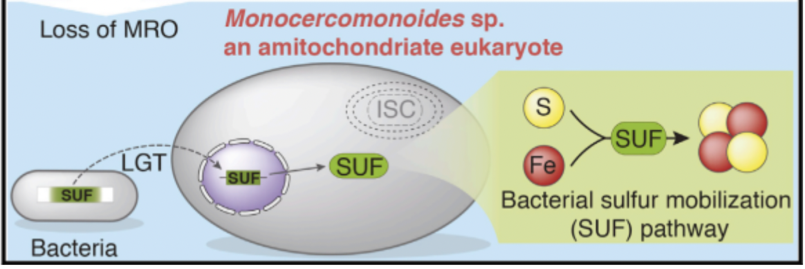
Monocercomonoides

Slide 81
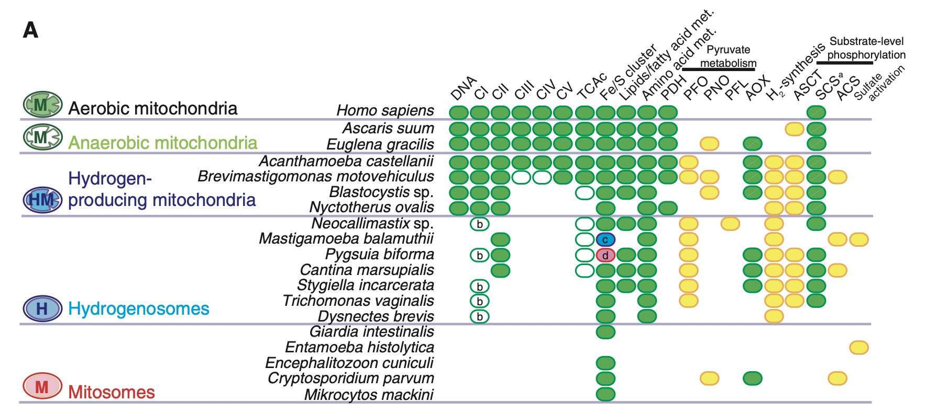
What happens to mitochondria?

