Slide 1
History of malaria and sleeping sickness
Treatment development

Slide 2
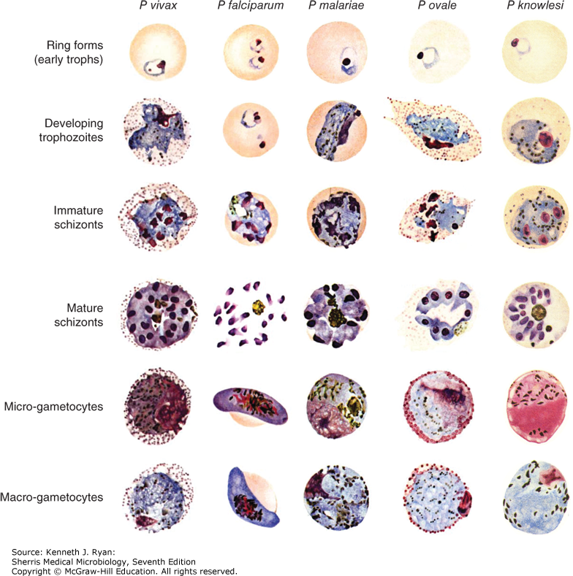


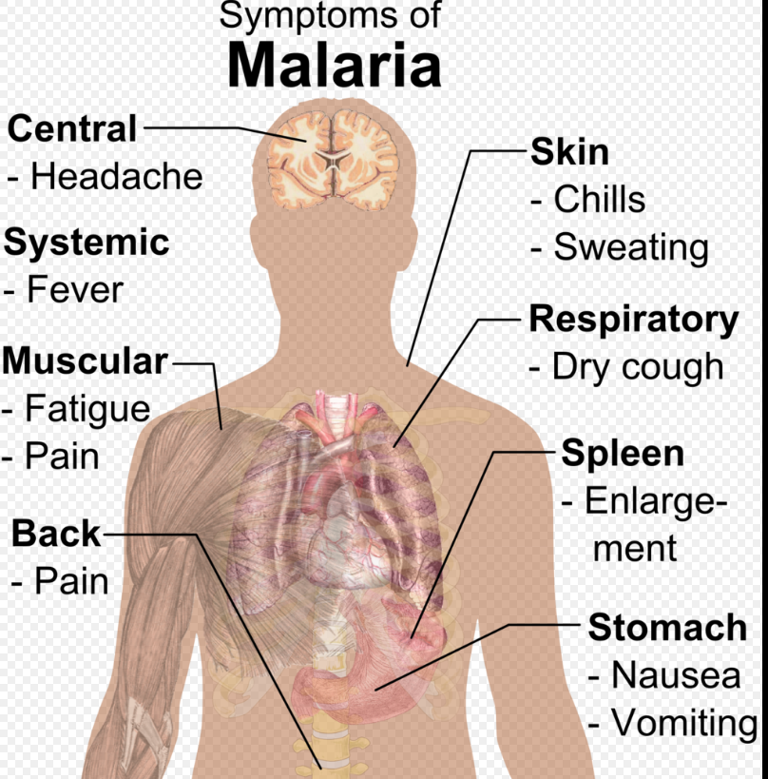
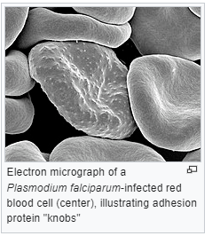
Plasmodium
Hematozoa
many species were discovered in various hosts and classified
mammals ~ 50 species; birds ~ 40 species; reptiles ~ 60 species
five species that regularly infect human
  P. vivax, P. falciparum, P. malariae, P. ovale, and P. knowlesi
Malaria
249 millions cases worldwide (2022)
608 000 deaths (80% of being five and under)
Mainly in sub-Saharan Africa
Every minute a child dies
Associated with poverty
Negative effect on economic development
12 billions USD loss

Slide 3
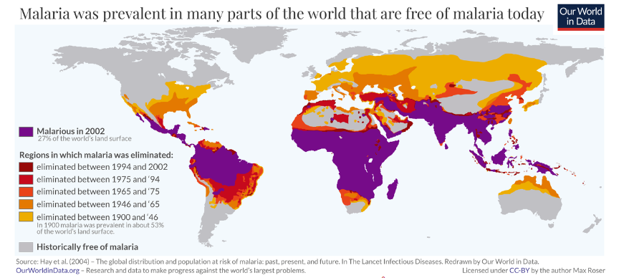
Plasmodium
Hematozoa
many species were discovered in various hosts and classified
mammals ~ 50 species; birds ~ 40 species; reptiles ~ 60 species
five species that regularly infect human
  P. vivax, P. falciparum, P. malariae, P. ovale, and P. knowlesi
Malaria
249 millions cases worldwide (2022)
608 000 deaths (80% of being five and under)
Mainly in sub-Saharan Africa
Every minute a child dies
Associated with poverty
Negative effect on economic development
12 billions USD loss

Slide 4
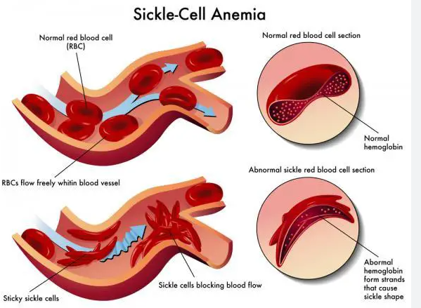
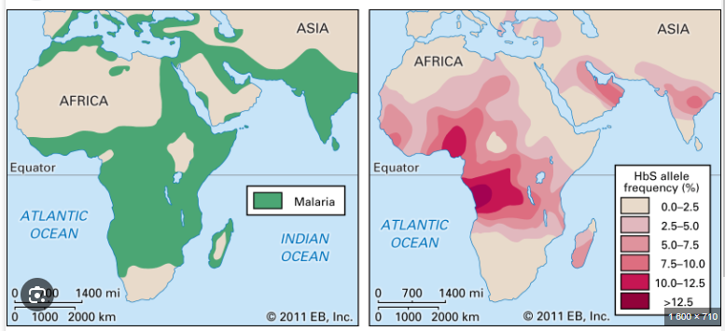
History of malaria
P. falciparum – very ancient human parasites, co-evolved with humans (host cospecication)
  The others parasites species transferred to humans from primates
  Sickle cell anemia (srpkovitá)
    Point mutation in beta-globing chain
    Hetezygotes children – 10 times less likely to dies from malaria
    Thalassemias
      Anemia, loss of alpha- or beta globin chains
      Binds less oxygen
      50 less chance to get infected

Slide 5
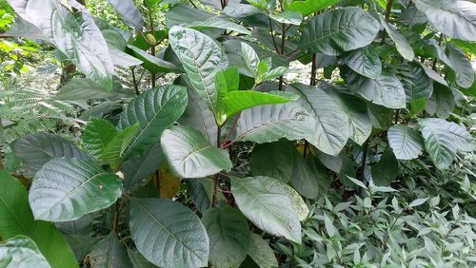
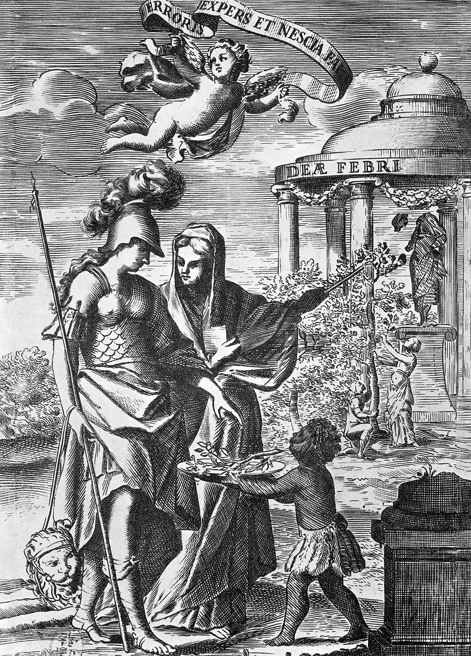
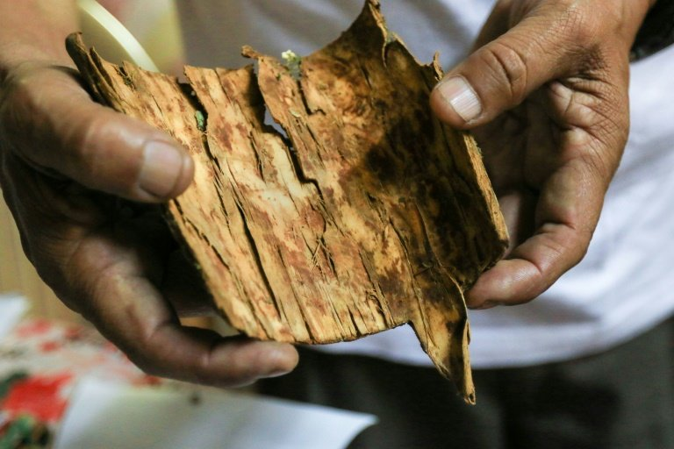
History of malaria
Huge effect on human population
  Barrier to social and economic development (detrimental and mental effects of repeated malarial infections)
First effective treatment for malaria, South America
  17th century
  Jesuit´s bark
  Powdered bark of cinchona tree (tropical Andes) contains chinin
  trade, variable content, religious reasons (Oliver Cromwell)
  Only for wealthy (alternatives failed – willow bark)
  19st century – isolation of quinine (Caventou and Pelletier)
    Procedure not patented
    Rapid establishment of factories (modern pharmaceutical industry)
    1826 – Pelletier produced 3600 kg annually
  Huge pressure on import of cinchona tree
    European plant hunters
    Finally smuggled – plantations in Brittish and Dutch colonies in Asia
    Cinchona ledgeriana – plantations in Java (Dutch) 13% of quinine content, 97% world`s supply (monopoly until 1942)
  Resistance to quinine reported in 1910
Peru offers a branch of cinchona to Science (from a 17th-century engraving).

Slide 6
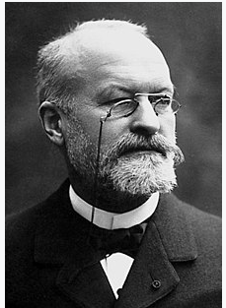
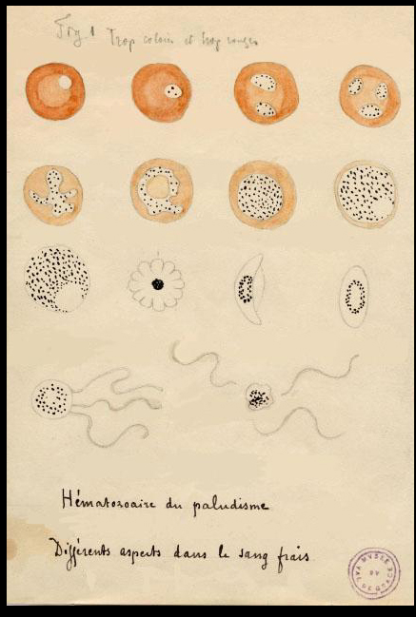
Discovery of the parasite
Charles Louis Alphonse Laveran (1848-1922)
  1878 – Algiers, military hospitals
  Detected pigment, “crescents” in patients
  Oscillaria malariae (1880)
  First protozoan parasite detected in man
  1884 finally accepted (Pasteur and Koch)
  1889 – report on a possibility that mosquitos play role in malaria transmission
  1907 – Nobel Prize in Physiology
  “in recognition of his work on the role played by protozoa in causing diseases”

Slide 7
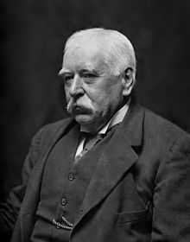
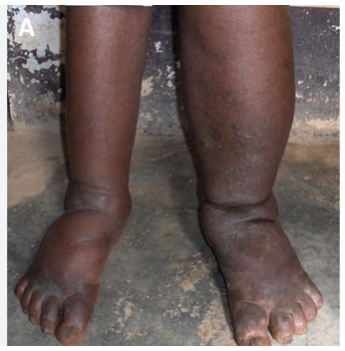
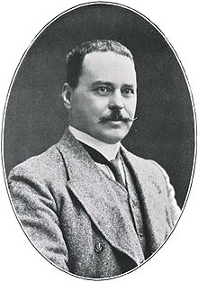
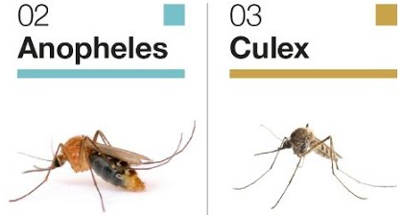
Mosquito-malaria hypothesis
Patrick Manson (1844 – 1922)
  Scottish physician
  Filariosis is transmitted by mosquitoes
  Suggested that malaria can be also transmitted with mosquitoes
  Maintain fruitful collaboration with Ross
  Introduced preventive measures to reduce exposure to mosquitoes
Sir Ronald Ross (1857 – 1932)
  Brittish medical doctor
  1894 - search for malaria transmission in Secunderabad, he examinated wrong mosquitoes!
  Finally in 1897 he looked at different mosquito (dapple-winged) that fed on the malaria patient and described a stage in the mosquito gut
  Transferred to Calcutta (no malaria), upon Manson advice he studied bird malaria
    Life cycle of P. relictum
  1899 –sent to Sierra Leone and implied first measures to
    control transmission (draining puddles, rivers straightened)
  1902 – Nobel prize for his work on the transmission of malaria
    Battista Grassi (infections of healthy volunteers)

Slide 8

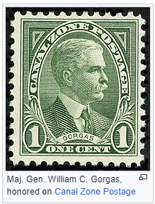
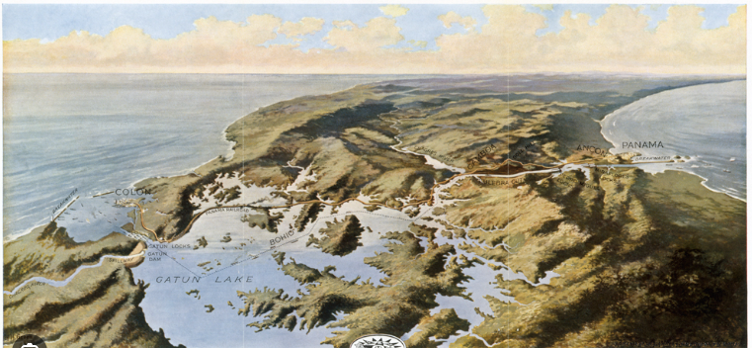
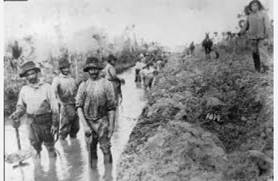
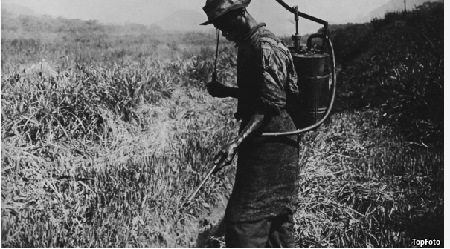
Malaria control - The Case of Panama Canal
1882 – 1889 – bankruptcy of the French company (F. de Lesseps)
    Mosquitoes did not recognize as a problem
    30 000 deaths
1904 – major William Gorgas appointed as a advisor (experienced from Cuba)
1914 – funds to control malaria in US
1939 – DDT (Nobel prize in 1948)
1951 – USA malaria free

Slide 9
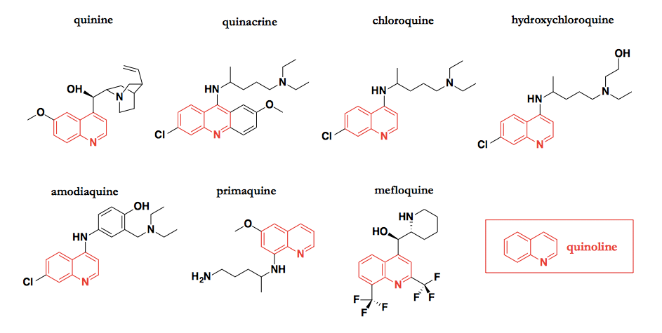
QUININE and its derivates
derivatives are some of the oldest drugs around
all stem ultimately from quinine
  a natural product isolated from the bark of the Andean cinchona tree
  the first antimalarial drug by the early 1800s

Slide 10
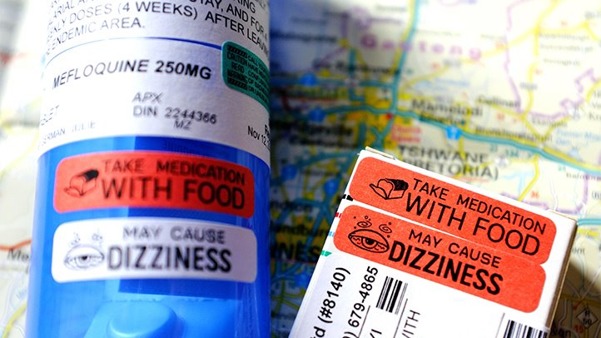
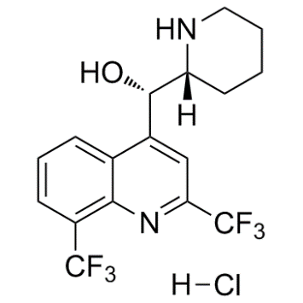
MALARIA TREATMENT
types of drugs and the length of treatment will vary, depending on:
  species of malaria parasite
  the severity of symptoms
  age of patient
  pregnancy
mefloquine (prophylaxis)
  results of a huge effort Walter Reed Inst (Vietnam war), screen of 250 thousands compounds
  trials in prison populations
chloroquine phosphate = the preferred treatment for any malaria parasite
  in many parts of the world the parasites are resistant to chloroquine
combination of atovaquone and proguanil (Malarone)
quinine sulfate (Qualaquin) with doxycycline (Vibramycin, Monodox, others)
artemisinin-based combination therapies (ACTs) = the first line treatment
demonstrated resistance to nearly all of the available antimalarial drugs

Slide 11
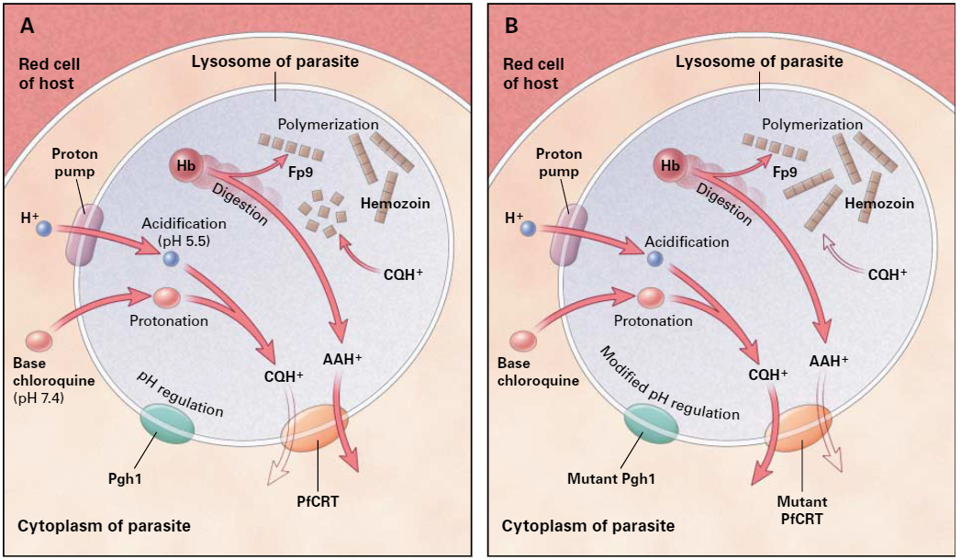
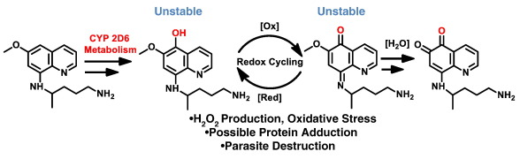
CHLOROQUINE
1950s
primarily used to prevent and treat malaria (Korean war)
inhibit parasite's ability to digest haemoglobin
  the drug concentrates in the acidic food vacuole of the parasite and interferes with essential processes
  caps hemozoin molecules to prevent biocrystallization of heme (hemozoin)
  binds to heme (or ferriprotoporphyrin‐IX, FP) to form the FP-chloroquine complex
  this complex is highly toxic to the cell and disrupts membrane function
resistance
PRIMAQUINE
1952
to treat and prevent malaria and to treat Pneumocystis pneumonia
to prevent relapse of malaria → eliminates hypnozoites, the dormant liver form
the exact mechanism of action is not fully understood
oxidative damage to the cell interfering with the electron
transport
effective against the gametocytes
→ prevents spread to the mosquito
Notes:
Figure 1. The Effect of Chloroquine on Heme Detoxification in the Lysosome of a Chloroquine-Sensitive Plasmodium falciparum Malaria Parasite (Panel A) and a Chloroquine-Resistant Malaria Parasite (Panel B).In Panel A, in the lysosome of a chloroquine-sensitive parasite, hydrogen ions enter through the proton pump, acidifying the lyso-somal environment (pH 5.5). This process is probably regulated by the Pgh1 protein, which releases anions into the lysosome tooptimize the difference in the transmembrane charge. During the digestion of hemoglobin (Hb), protonated basic amino acids(AAH+) are released together with toxic ferriprotoporphyrin IX (Fp9). Ferriprotoporphyrin IX is detoxified by polymerization to crys-talline hemozoin. The weak base chloroquine, present in the cytoplasm (pH 7.4), dissolves in the lysosomal membrane and entersthe acidic environment, undergoing protonation to a form (CQH+) that is insoluble in the membrane and that quickly becomes con-centrated. CQH+ binds to ferriprotoporphyrin IX and thus inhibits its polymerization, which leads to the accumulation of ferripro-toporphyrin IX, causing membrane damage. The protonated basic amino acids exit the lysosome by means of the transmembraneprotein PfCRT. The PfCRT protein probably has a limited affinity for CQH+ and exports some of the drug from chloroquine-sensitiveparasites.Panel B shows the lysosome of a parasite with mutations in pfcrt and pfmdr 1 related to chloroquine resistance. The mutant PfCRTprobably has an increased affinity for CQH+ and exports large amounts of the drug, enabling the polymerization of ferriprotopor-phyrin IX to proceed normally. Concomitantly, the mutant PfCRT would have a reduced affinity for AAH+, which may reduce theefficiency of the export of AAH+ and, in the absence of chloroquine, result in the accumulation of more protons (H+) in the lyso-some. The presence of mutant Pgh1 may partially prevent this accumulation of protons, increasing the fitness of parasites withpfcrt and pfmdr 1 mutations. The mutation in pfmdr 1 also increases the sensitivity of the parasite to mefloquine and artemisinin,probably as a result of the partial inactivation of the ability of mutant Pgh1 to export these drugs
(3) (PDF) A Molecular Marker for Chloroquine-Resistant Falciparum Malaria. Available from: https://www.researchgate.net/publication/12158530_A_Molecular_Marker_for_Chloroquine-Resistant_Falciparum_Malaria [accessed Apr 24 2024].

Slide 12
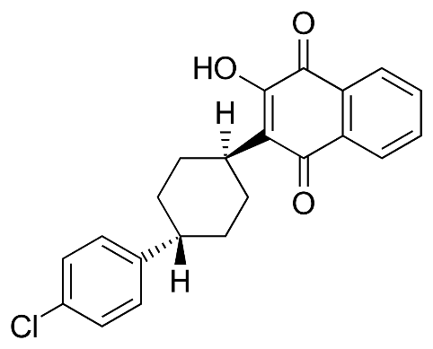
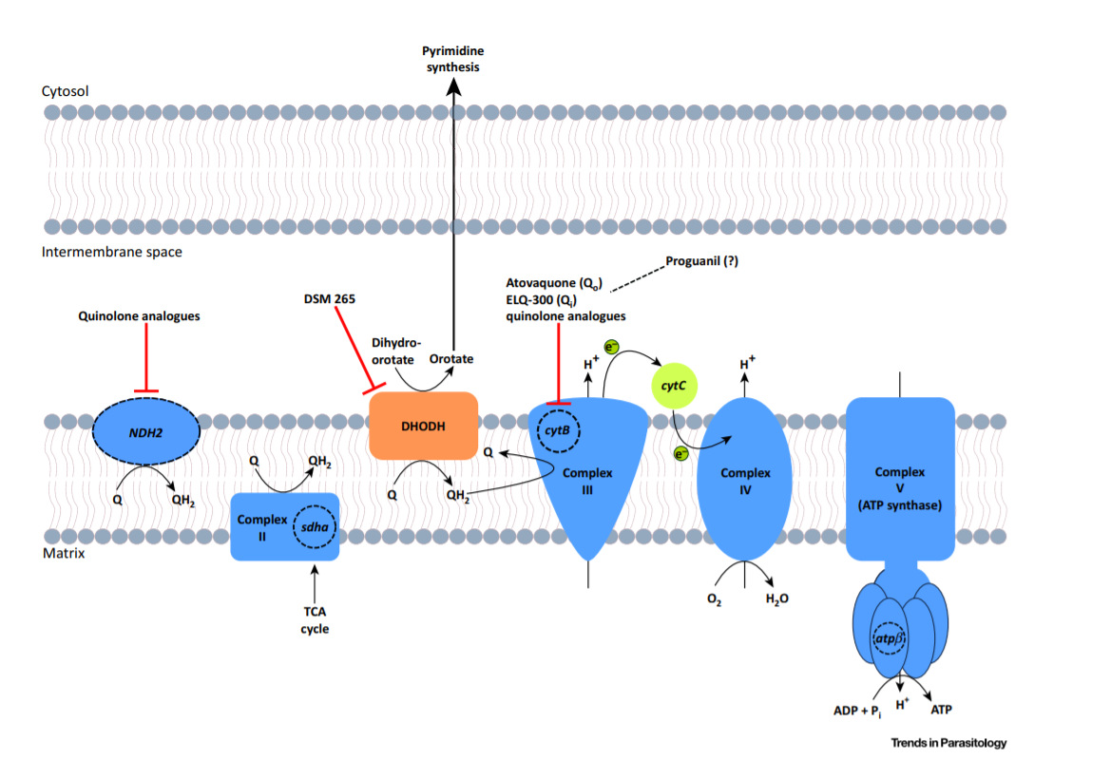
Atovaquone
broad-spectrum activity against Plasmodium, Babesia, Toxoplasma and Pneumocystis
collapse of the mitochondrial membrane potential
structurally similar to the inner mitochondrial protein ubiquinone (ubiquinol) = coenzyme Q
  an integral component of electron flow in aerobic respiration
  ubiquinone accepts electrons from dehydrogenase enzymes and passes them to electron transport cytochromes → electrons from ubiquinone to cytochrome bc1 (complex III) requires binding of coenzyme Q-complex III at the Qo cytochrome domain
  this step which is inhibited by atovaquone
the structure of the Qo cytochrome binding site has been defined and explains the selective toxicity of atovaquone to parasitic mitochondria
collapse of the mitochondrial membrane potential
  inhibition of dihydroorotate dehydrogenase that is required
  in the biosynthesis of pyrimidines
  inhibition of ATP production
„competitive inhibitor of ubiquinol“
Notes:
Inhibitors of the Plasmodium Mitochondrial Electron Transport Chain. Schematic diagram of the enzymes involved in electron transport across the inner mitochondrial membrane in Plasmodium. Atovaquone, the only mitochondrial electron transport chain inhibitor in clinical use, specifically inhibit cytB. Abbreviations: cytB, cytochrome b; DHODH, dihydroorotate dehydrogenase; NDH2, type II NADH:ubiquinone oxidoreductase; Q, ubiquinone; QH2, ubiquinol; Qi , ubiquinol reductase site of cytochrome b; Qo, ubiquinone oxidase site of cytochrome b; sadh, flavoprotein subunit of succinyl dehydrogenase.

Slide 13
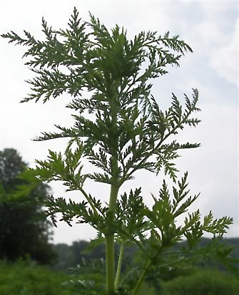

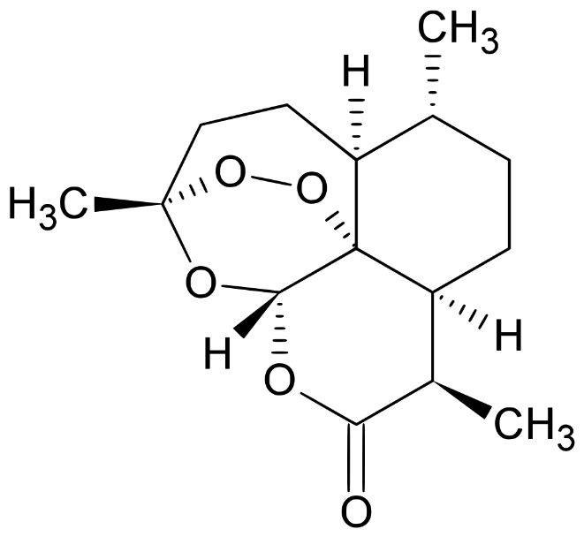
Artemisinin
  Vietnam war – P. falciparum chloroquine resistant parasites
  People´s Liberation Army Research Institute
    1967 – huge research program called Project 523 (500 scientists, 60 institutions)
    Search for antimalarial by screening as well using traditional Chinese herbal medicines
    Military secret
    1969 – prof. Youyou Tu
            ancient literature
            640 recipes, tested against P. berghei
            Sweet warmwood Artemisia annua
            Extraction under low-temperature yielded the active compound
            1971 – 100% active against parasitemia
            1977 – X-ray structure
            1979 – artemisinin published in ENG journal
            2015 – Nobel prize in physiology and medicine
            Artemisinin used in combination therapies
Artemisia annua

Slide 14
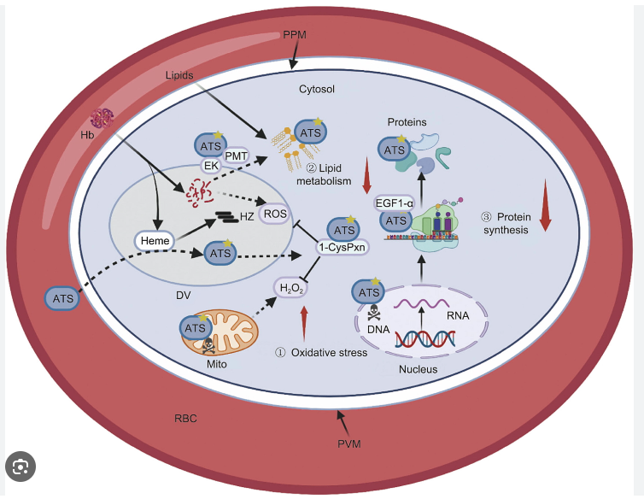
Artemisinin
ART reacts with accessible heme and as a result, generate ROS, which is a potentially damaging agent. A portion of ART gets into mitochondria, where mitochondrial dysfunctions occur.
ATS simultaneously interferes with ① redox homeostasis, ② lipid metabolism,
and ③ protein synthesis in P. falciparum to exert antimalarial effects by targeting
several essential proteins. DV: digestive vacuole; HZ: hemozoin; Mito: mitochondrion
Artesunate ← the most widely used derivate of artemisinin, hydrophylic
Notes:
Digestion of hemoglobin (Hb) releases ferriprotoporphyrin‐IX (FP). Normally FP polymerizes to hemozoin but some unpolymerized FP can react with O2 to form ROS, superoxide radical that can be reduced to H2O2 by superoxide dismutase (SOD) in the cytosol.
Artemisinins react with the FP iron (FP‐Fe2+) to form activated drugs and ROS that then attack hemoglobin digesting proteases, mitochondrial transport chain, and the mitochondrial membrane, and many cytosolic targets including the cysteine‐containing redox system of the parasite destroying them and exacerbating ROS formation and eventually death of the parasite.

Slide 15
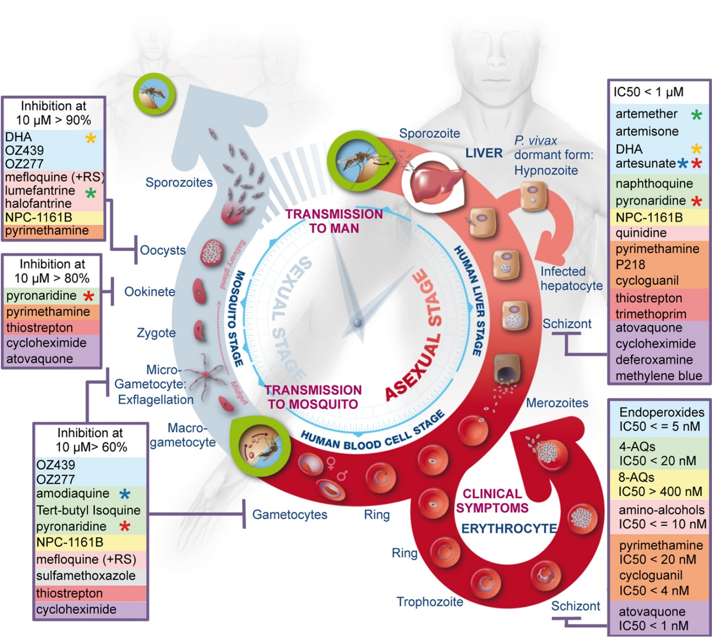
Malaria treatment

Slide 16
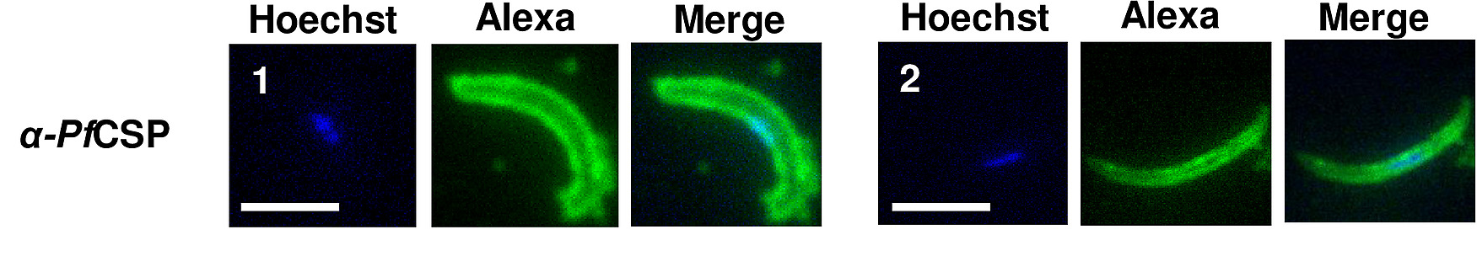
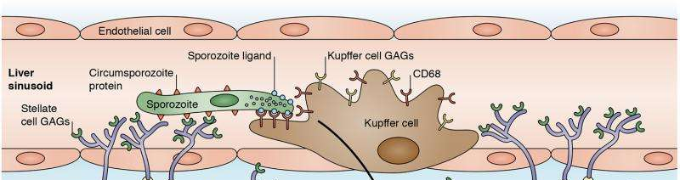
VACCINE AGAINST MALARIA
the only approved vaccine as of 2015 is RTS,S (trade name Mosquirix)
requires four injections, and has a relatively low efficacy
consists of the P. falciparum circumsporozoite protein (CSP)
PfSPZ Vaccine is a candidate malaria vaccine
non-replicating irradiated whole sporozoites
PfSPZ is the acronym: Plasmodium falciparum (Pf) and sporozoites (SPZ)

Slide 17
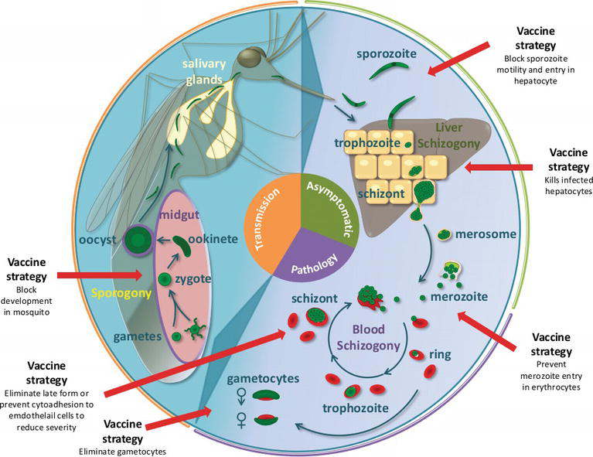
VACCINE AGAINST MALARIA
transmission-blocking vaccine
anti-infection vaccine
  (RTS,S and pfSPZ)
anti-disease vaccine

Slide 18
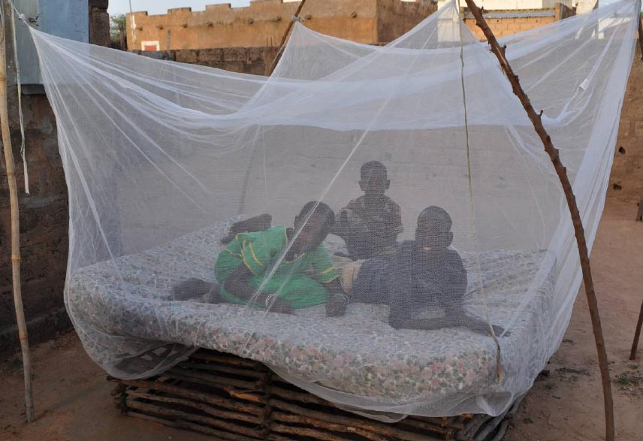
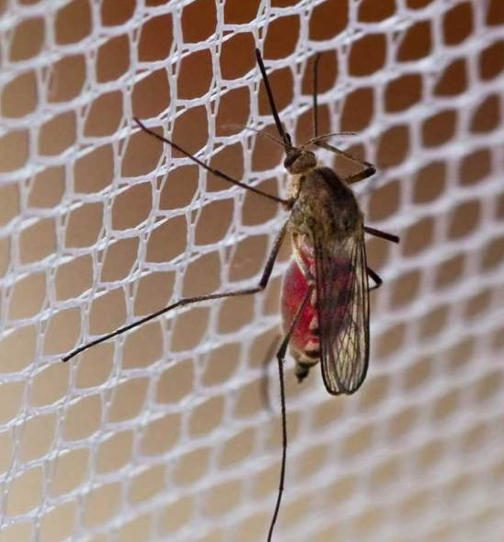
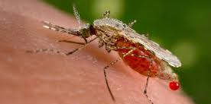
Treating bed nets with antimalarial compound blocks parasite from developing in mosquitoes (atovaquone)
Anopheles gambiae
+ treatment with insecticides

Slide 19
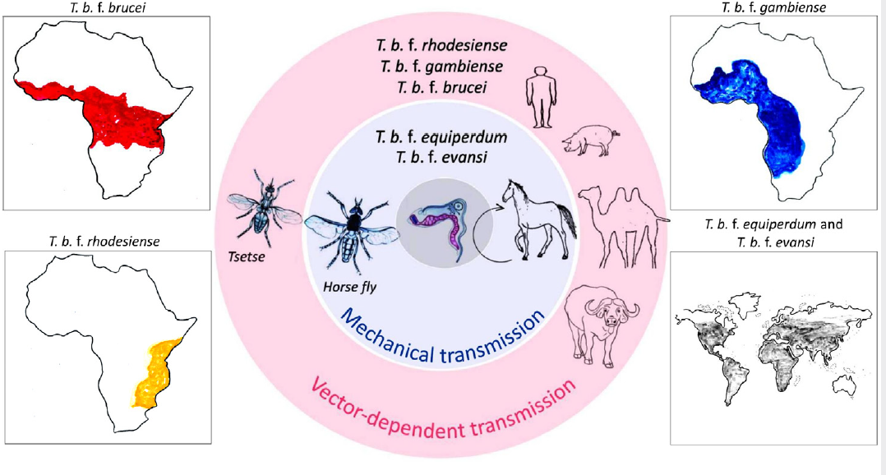
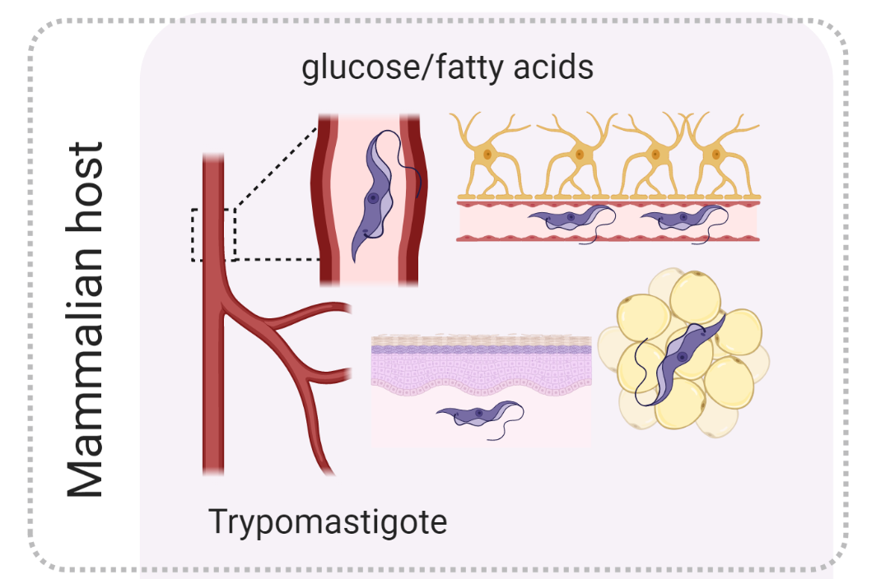
African Trypanosomes
Trypanosoma brucei (T. b. brucei, T. b. gambiense, T. b. rhodesiense, T. b. evansi, T. b. equiperdum)
T. congolense, T. vivax
Human African Trypanosomiasis (HAT)
  36 African states
  50 millions in affected areas
  Always lethal if untreated
Animal African Trypanosomiasis (AAT)
  Direct loos of livestock products
  Loss of crop productivity due to loss
  of the anmals draught power
Adapted from Lukeš et al., 2022. Trends in Parasitol.

Slide 20

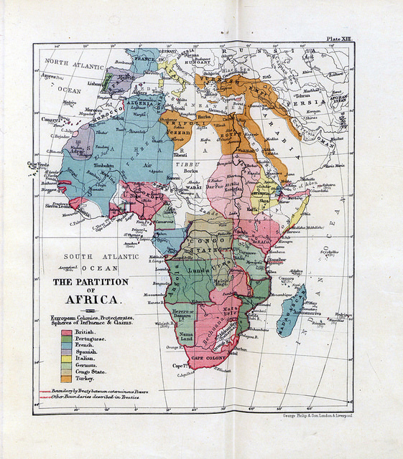
First accounts of sleeping sickness
Slave trade
Colonization of Africa
Winterbottom syndrom
THE SLEEPING SICKNESS: Cutting a continent out from under him.
- political cartoon made by Gordon Ross (''Puck'' magazine), United States, October 1911
Notes:
HE SLEEPING SICKNESS: Cutting a continent out from under him'' - political cartoon made by Gordon Ross (''Puck'' magazine), United States, October 1911
Trypanosomes are very ancient parasites that emerged 380 millions years ago, they are ubiquitous, some salivarian forms began to transmit to mammalas when tsetse flies emerged some 35 millions years ago
The relative late arrival of humans may explain why African game animals are tolearnt towards most species of trypanosomes , btu humans and domestic animals are more susceptible
HAT beamce very impactful when slaves traders emerged and later colonial forces arrived to Africa
First accounts of sleeping sickness came from ship doctors who worked for slave-trade companies 1775 – first accurate medica report on HAR by English naval surgeion John Atkins - only the second stage
Thomas Winterbottom in 1803 - report on a characteristics swolled lymph nodes

Slide 21
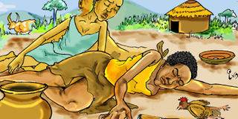
First accounts of sleeping sickness
Slave trade
Colonization of Africa
1st epidemic killed 250,000 Ugandans
Winterbottom syndrom
ILLUSTRATIONS BY IVAN SENYONJO
Notes:
HE SLEEPING SICKNESS: Cutting a continent out from under him'' - political cartoon made by Gordon Ross (''Puck'' magazine), United States, October 1911
Trypanosomes are very ancient parasites that emerged 380 millions years ago, they are ubiquitous, some salivarian forms began to transmit to mammalas when tsetse flies emerged some 35 millions years ago
The relative late arrival of humans may explain why African game animals are tolearnt towards most species of trypanosomes , btu humans and domestic animals are more susceptible
HAT beamce very impactful when slaves traders emerged and later colonial forces arrived to Africa
First accounts of sleeping sickness came from ship doctors who worked for slave-trade companies 1775 – first accurate medica report on HAR by English naval surgeion John Atkins - only the second stage
Thomas Winterbottom in 1803 - report on a characteristics swolled lymph nodes

Slide 22
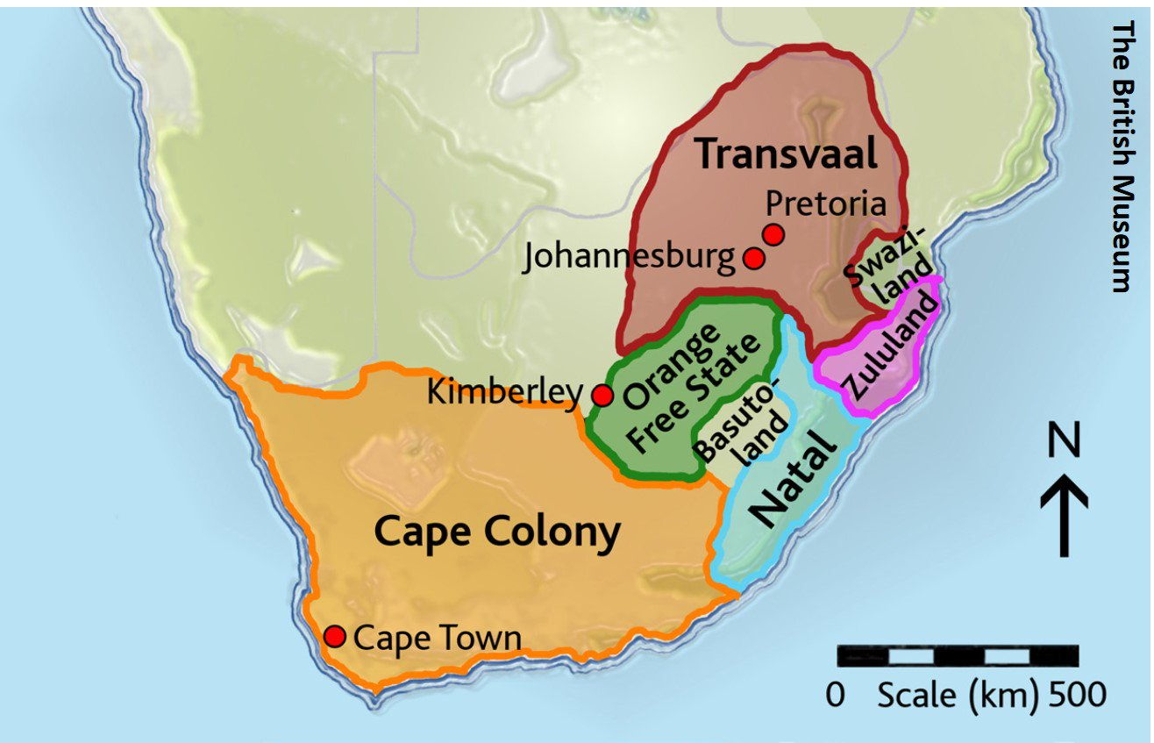
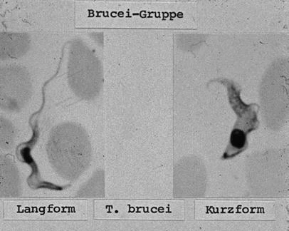


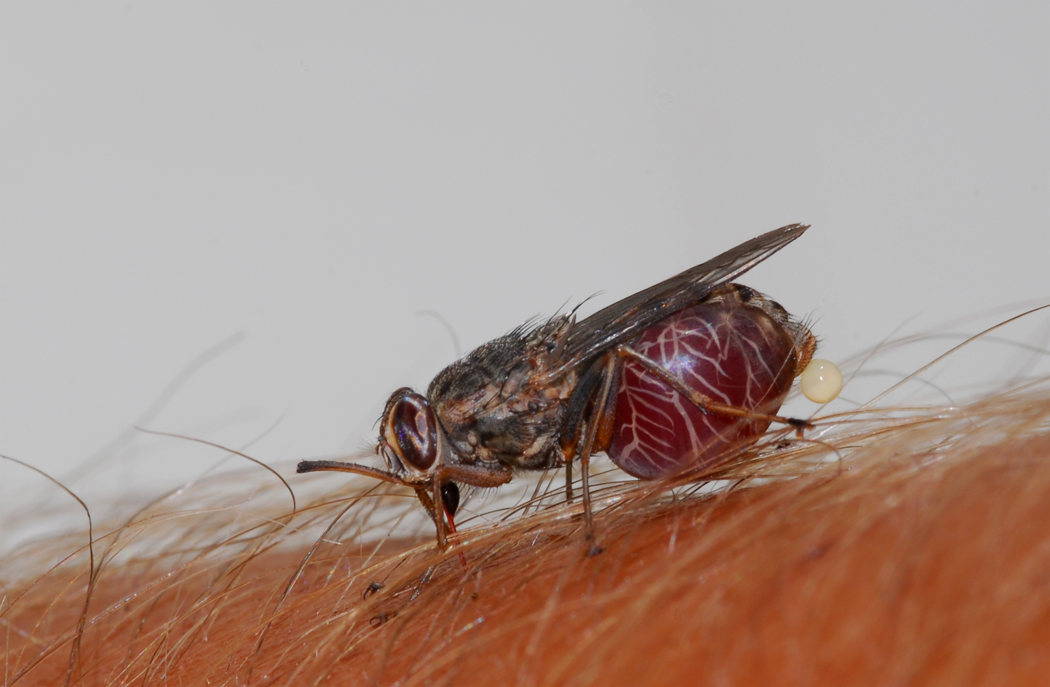
The discovery of Trypanosoma brucei
David and Mary Bruce (1855 – 1931]
Scottish pathologist and microbiologist
1894 – sent to Zululand to investigate an outbreak of nagana (the fly disease)
T. b. brucei
Notes:
Human African trypanosomiases HAT is a disease with a truly historic dimensions
Its maximum possible distribution corresponds to the rande of tsetse flies, which covers an area of 8 km2
1895 – David Bruce reported that the tsetse fly was linked to cattle trypanosomiases
Dutton in 1902 – West Africa – t gambiense
Castellani I 1903 – east Africa t rhodesiense –trypanosomes in cerebrospinal fluid
1852 – Scottish missionary and explorer Livingstone – magana is transmitted by tsetse
1895 – scottish microbiologist and pathologist David brucediscovered Tb as the cause of cattle trypanosomiases
The first observation of trypanosomes in human blood was made bh brittish colonial surgeon Robert Michael Forde in 1901 – he though it was a worm
(steamboat captain in Gambia)
But Everette Dutton identified them as trypnaosomes and proposed the name Gambiense
1902 – Bruce provided comclusive evidence that HAT s transmitted by stsetse fly, but he thought ot was mechanical,
German mlitary surgeon Friedrich Karl Kleine who showed cyclical transmission in tsetse flies
Bruce then described the full life cycle
T. congo and T. vivax doscivered in 1904 and 1905

Slide 23
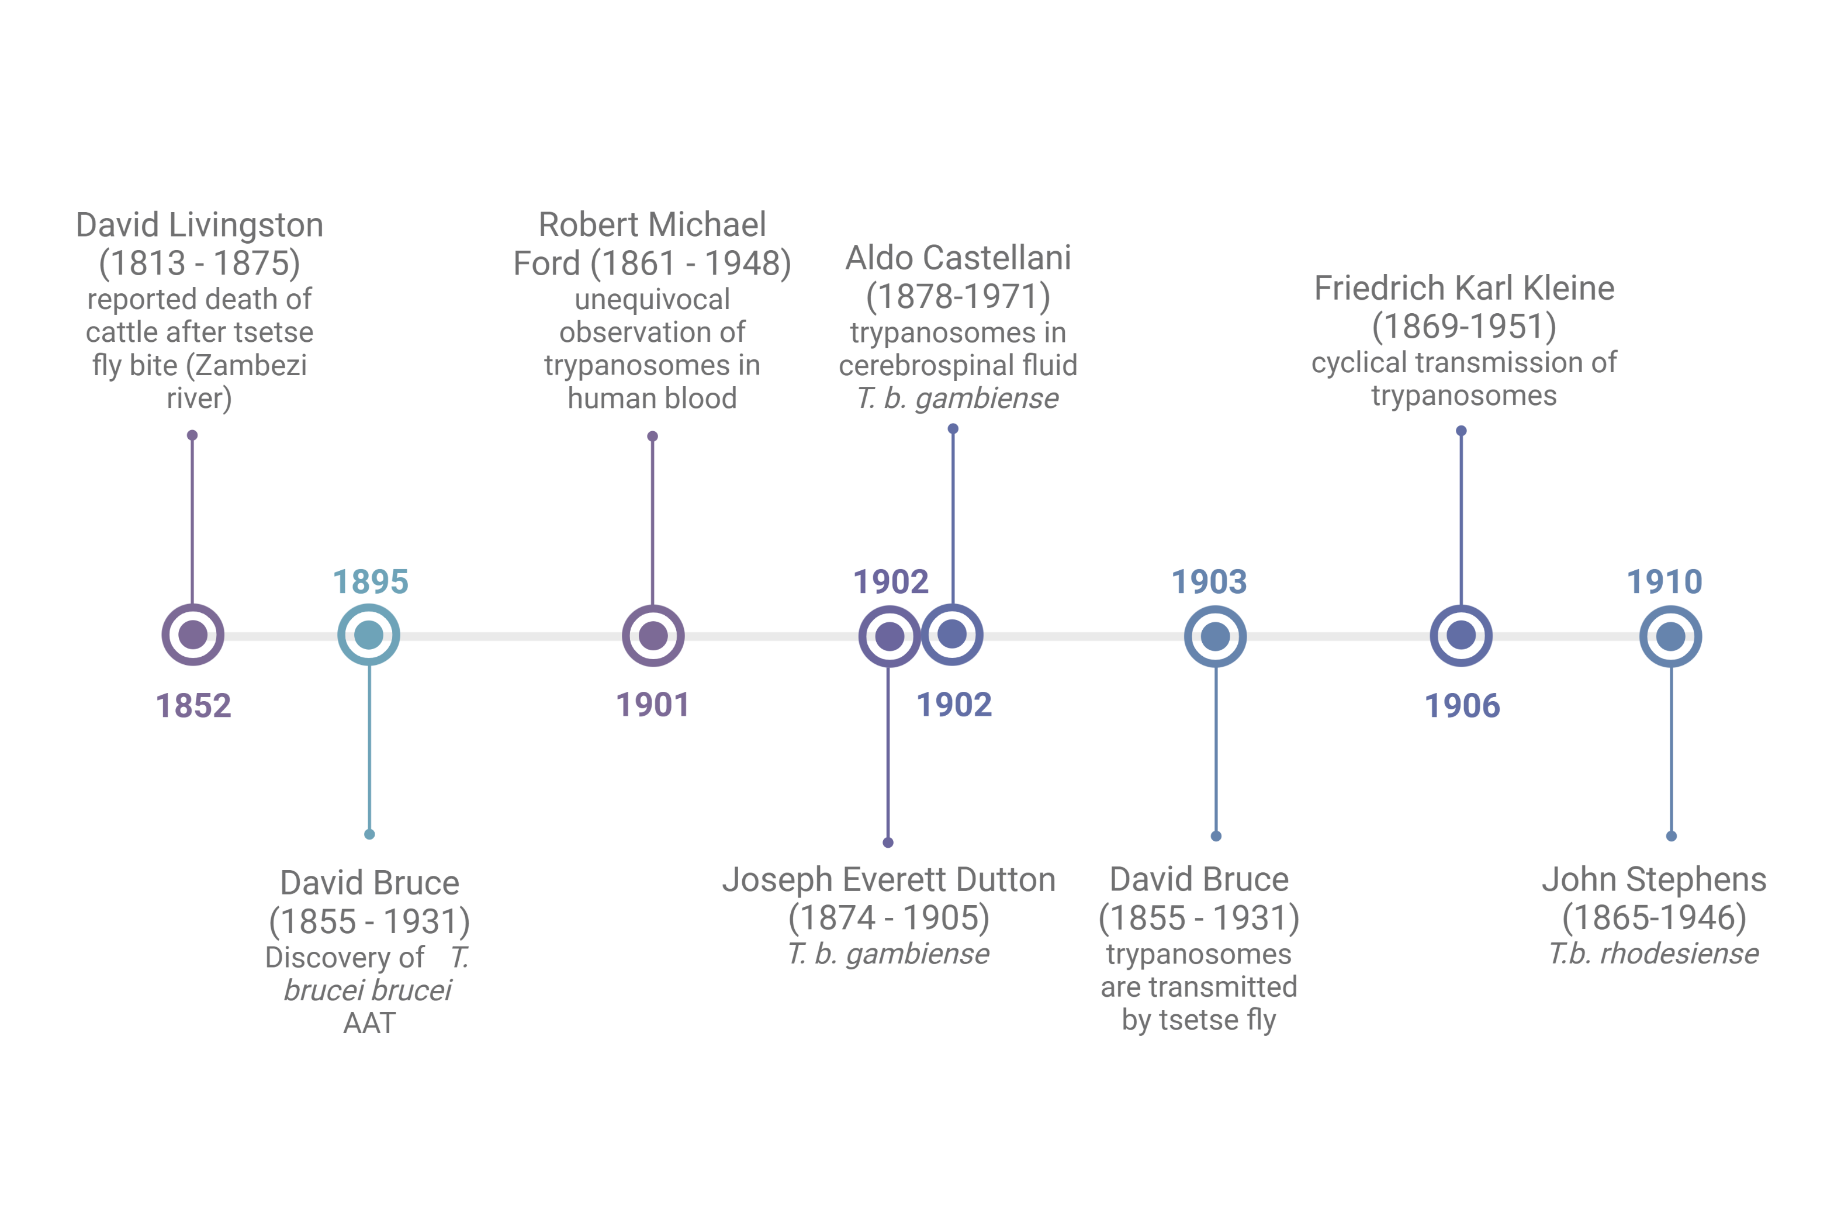
The discovery of Trypanosoma brucei

Slide 24
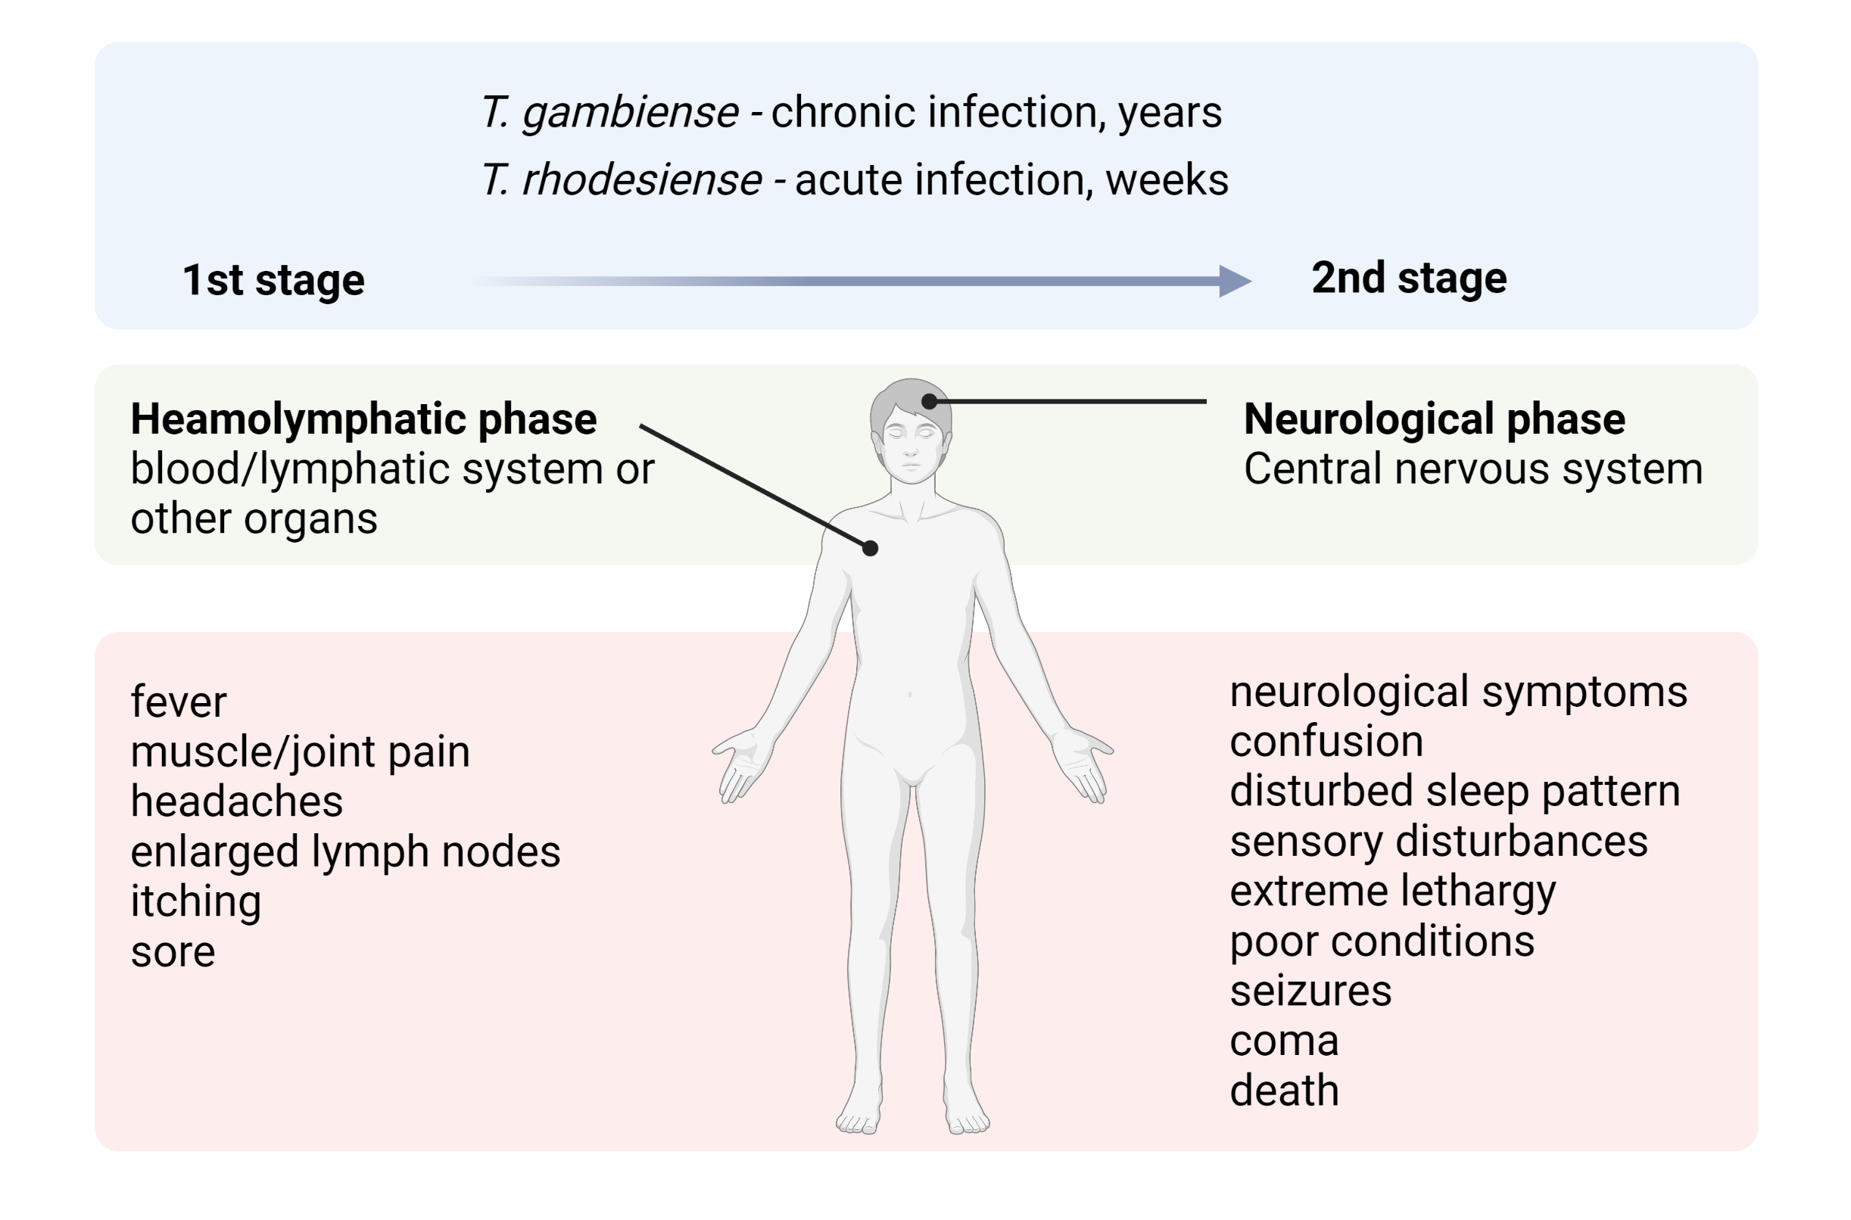
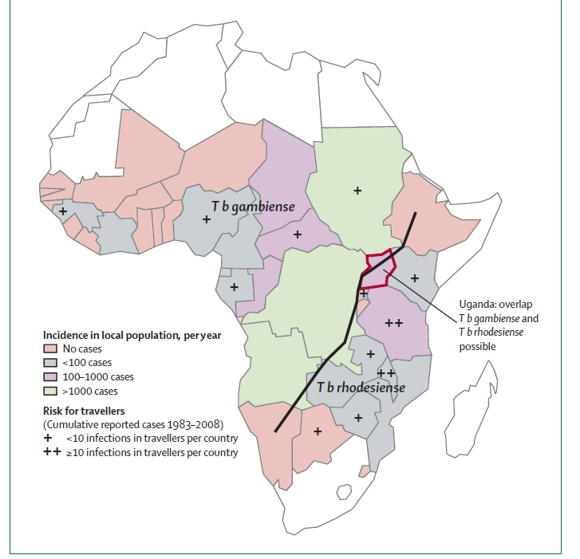
Two species, two diseases
Brun et al., Lancet 2010, 375:148-159
Notes:
Tbg is responsible for chronic form of HAT in West and cetrnal Africa
Tbr give rise to acute form in East and Southers Africa
There are two distinctstages also known as heamolymphatic pahse is defined bt the restrictions of trypanosomes to the blood and lymph system, the sympotoms are fever, headches, joiny pains, itchign
The second late phase also known as a neurologival phase is characterized by the presence of trpanosomes in the cerebrospinal fluid, typical signs: confusion, disturbed sleep pattern, sensory disturbances, extreme lethargy, poor conditions, seizrues, comaco

Slide 25
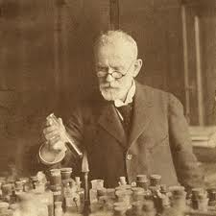
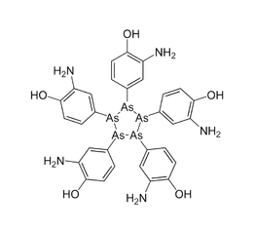
Drug discovery for treating sleeping sickness
Paul Ehrlich (1854 – 1915)
the so-called father of the modern chemotherapy
original proponent of the “magic bullet”
1900s - first synthetic drug
1905 – Atoxyl (toxic side effects – blindness)
1922 – Suramin (1st stage, T.b. rhodesiense, IV)
1937 – Pentamidine (1st stage, T. b. gambiense, IM)
1949 – Melarsoprol (2nd stage of the disease, highly toxic, IV)
Nobel prize for medicine 1908
Notes:
The detection of the causative agent the mode of transmisison and the first documnted major epidemics coincided with the advent of moder pharmacology – there was a interest in finding drugs
1908 colonial powers geva drug debelopmed the highest priority
Paul Erlich - Atoxyl – arsenic based compund – toxic , damaging a optic nerve, active only againts the 1 stage

Slide 26
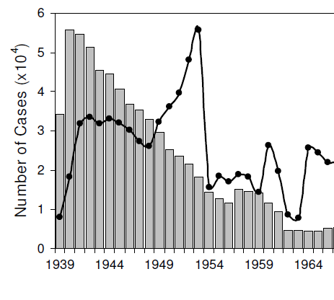
Epidemics and control of the disease
Francophone colonies
T. gambiense
Humans are only reservoir
Approach:
focused on medical problems
mobile team (E. Jamot)
1926 – atoxylisation
1950s – pentaminidiasation (2 mill. people)
Anglophone colonies
T. rhodesiense
Wild and domestic animals are reservoir
Approach:
vector control (spraying, traps)
bush clearing
game destruction
chemopreventive use of veterinary drugs
C.B. Marcondes (ed.), Arthropod Borne Diseases, DOI 10.1007/978-3-319-13884-8_18
Notes:
HAT had a tremendous impact on population HAT hampered the colonization , all invaders in africa were challenged by logistics sicne horses were very suscptionel to trypanosomes
It is not difficult to understand the manifold early attenpts to control the disease
The finding of trypanosomes coincide with the first hhuge epidemics - Kenya and Uganda - left 500 thousands peope dead (most like Tbr)
Belgian congo
The colonial powers were horrifed by the speed at which their working force was dying
The response of Anglophone and Francophone colonial powers differed signicinatly
Francophone – chose to concetrate directly on modeical problems, introduction of mobile teams actively searching and screenign populations, systematic case detection and treatment with the aim of elimination of the patrasite reservoir . atoxysilation and pentamidization prevalce of HAT decreased from as high as 60% in 1919 to 0.2 - 4.1 % in 1930, Beligian Congo . massive adminitartion of penatmidine to 2 mil people in 1950
Anglophone - Tbr, they were confronted with more widepsread proble of ideases in domectis animals, which also presneted a reservoir for humans. Their approach included tsetse traps, spraying bush cclearing, and game destrction and later chempreventive ise of veterinary drugs

Slide 27
First turning point and a colloisal failure
Notes:
Suramin – Bayer – arsenic based compound 1st stage
Melarsoprol – 2nd stage, - 10% patienst diy from encelopathy (50% dead), 35 days treatments
Eflronithine, Nifurtimox – drawbakcs – potential for resistance
Another line of reaseach – diamidines (1930), discover ny serendepity pentamidine, ver effective, 1st stage,
Lumbar puncture – painful - to determine the stage and decide treatment, source of distressm stigma and technical difficutires
The drugs available were commercilized during the first half of 20th century, the pharmaceutical industry had no financial motivationto seek new products fir a dusease with a market representing a few ten thousands of cases per year, living I rural and impoverished regions of central Africa.
Eflornithine was developed as a potnetial anti-cancer drug,
The control measures were very succesful, progresively controlled disease, reaching a very low generailied transmisison by mid 1960 with w minimum of 4000 cases decalred in Africa in 1964

Slide 28
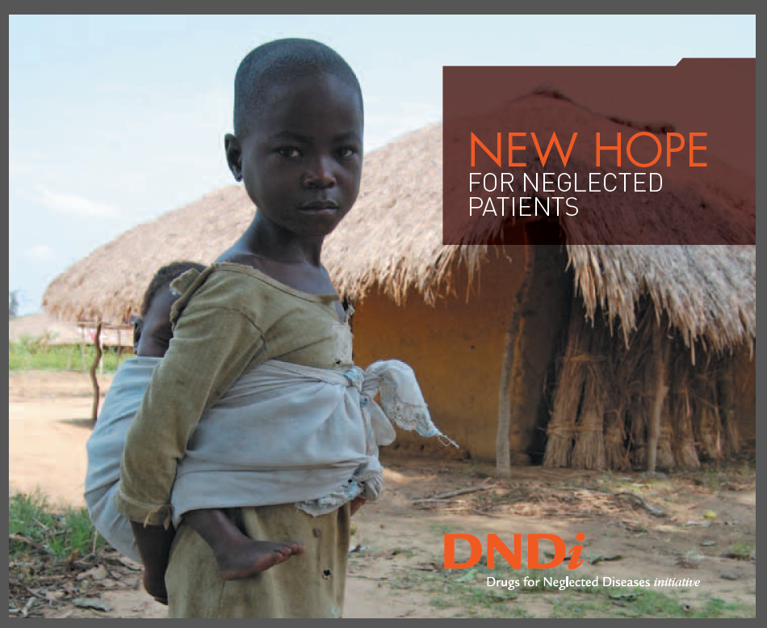

DNDi - Drugs for Neglected Diseases Initiative
MISSION:
Developing drugs on a not-to-profit bases
Needs-driven portfolio
Raises awareness about lack of R&D for NTDs
Strengthen R&D activities in endemic countries
Notes:
With the colonial powers withdrawing, between 1960 – 1975 - new era began.
The young countries created national institutons to continue to fight HAT, but decreaseing funds, different health priorities, expenditures for HAT was reduced, awarness and survaillence decreased, no mobility teams, social instability, conflicts, insecuiruty – significant resurgence of Tbg in 1980 and 1990 mainly affectign Angola, COngo, Sudan and Uganda, situation again was reminisncet to that in 1920
Melarsoprol still the only opiton to the 2nd stage,
Drug develpoment was dormant for 50 years
Commitment of Sanofi 20 years ago – the company decided to provide the exisiting trypanocides free of charge (melarsoprol, eflornithne, pentamidine))
Supplied financial assisatnce to national cotrnol programes,
Bayer provided Suramin and nifurtimox,
Bill and amelinda Gates gace millions of dollars
And Drugs for negelected diseases initiative coordinated clinical testing of new candidates
Eflornithine as a failed anti-cancer drug was shown to be active for 2md stage
NECT – reduced the number of eflortnithine infusion from 56 to 14, amount of eflo by half and hospitalization by 1/3
Fexinidazole
Acoziborole (oral, long half life, good penetration to CNS)
Extraoridnary achievement
Interuption of transmission soon
DNDI initiataed a major compoudn minign effort in 2005 to explore old and new nitroimidazoles as drug leads againts HAT
Out of 830 drugs, fexinidazole proved to be orally active against Tbg and Tbr, had an excellent safety profile
2018 – approved
Has limitations - its absorption depends on food intake, lowered efficacy for patinets with advanced symptoms
Hence the search for magic bullet still on

Slide 29



Treatment
the first line treatment:
Pentamidine (1941) resistance, ineffective against late stage
Suramin (1921) – severe side effects
the second line treatment:
eflornithine
nifurtimox-eflornithine combination treatment (NECT)
Melarsoprol (1949) arsenic anti-freeze, sometimes fatal, only in severe cases
Notes:
DNDi, Swiss tropical Insitute, MSF
56 slow dripping infusion every six houra

Slide 30





Second turning point – the change for a better
New treatment:
NECT – combinatory therapy, IV
Fexinidazole – 10 tables, orally, active for the 2nd stage
Acoziboroles – 1 tablet
Putting sleeping sickness to sleep forever
Diagnostics
Surveillance
Treatment
Vector control

Slide 31




Pentamidine and Melarsoprol
-cross resistance
Pentamidine
Diamidines, accumulate in mt
Binds DNA
Pleiotrophic effect on various cell fce
Melarsoprol
Generates a toxic adduct with trypanothione (MelT)
Notes:
Injekce do svalu, 7 dnu
Pentamidin puvodne protoze snizuje glukozu v krvi – vyhladoveni trypek
Accumulate in the mit. mM concentration
DK cells sensitive
Antitrypanosomal aktivita – vysledek akumulace vedouci k multiple deleterious effetxts
Melarsoprol – IV
Figure 2. Schematic model of melarsoprol and pentamidine transport in
Trypanosoma brucei. The schematic shows known and putative mechanisms.
Both drugs are thought to enter trypanosomes via the P2 and AQP2 transporters;
the weight of the arrows reflects their relative contributions to uptake. The
presence of the AQP2 gene appears to correlate with HAPT1 activity but it is not yet
certain that AQP2 codes for this activity. The P-type H+ ATPases (HA1–3) may
provide a proton motive force that drives pentamidine uptake. Melarsen oxide
forms a toxic adduct with trypanothione (TSH/TS), known as Mel T, which inhibits
TSH synthesis and is also removed from the cell via the ABC transporter, MRPA.
An additional low-affinity pentamidine transport activity (not shown) may
contribute to transport of pentamidine at concentrations above 0.1, 10 days

Slide 32


Eflornithine
Nifurtimox-eflornithine combination treatment (NECT)
Eflornithine
Failed cancer drug
polyamine synthesis disruption
irreversibly binding to ornithine decarboxylase
preventing the natural substrate ornithine from accessing the active site
Nifurtimox
Originally for T. cruzi
forms a nitro-anion radical metabolite
causing significant breakdown of DNA
mechanism is similar to action of metronidazole
Notes:
ODC is the key enzyme in the cellular production of polyamines (spermine,
spermidine, putrescine), which are essential for cell division and as such eflornithine was developed
to inhibit cancer cell proliferation
ODC in mammals – 20 minutes
ODC in tryps 18 hours
NECT - The overall conclusions were that the combination is non-inferior to eflornithine monotherapy and
has considerable advantages such as protection against resistance, lower cost, easier and shorter
administration as well as a reduction in adverse eects by 50%

Slide 33

WHO bold targets
Elimination of transmission of gambiense HAT
Elimination as a public health problem of rhodesiense HAT
by 2030
https://doi.org/10.1371/journal.pntd.0010047
Notes:
Acoziboroles – combines all three desired qualities - well abosped, oral, penetration to CNS, long half life
Migth be a ley to interruption of transmission
Positive serology negative parasitological tests
Fewer than 1000 cases I Africa
The very eand of eradication process areextremelu challenging,
contr
Cotrnol measuers will have to be maintained, for a long time obver a vast teritory
Sustained funding despite of low incidents
Screening activities enagenment of local populations
The political isntabiity is worrying
The animal reservoir is another problem,
Wild animals are vector, reservoies that can sustained human infections
Acoziboroles for anmimals,
HAT can be a first disease to be eradciated thanks to tretment and not vaccine , Lets dream a little
Towards elimination of dreadful comeback
Several challenges still have to be overcome
WHO set the goal fpr the elimination of HAT asued vby Tbg as aoublic heath problem for 2020 and for the total interruption of transmission tohumasn by 2030.
First of all – donor fatigue must be avoided
HAT is stigmatized, linked to many spirits and believes
Doctor will recognize it?
Tbr . Zoonotic!
We celebrate several marvellous achievements – toole were improved, patienst bńumber down, but tor each the set goals
The goal must now be maintain tge momentum and even bigger effrot of the research sicentists field workers developments agenices companies will fail if they are no parraleled by achievemnts in the political filed bringing piece, stability and minimal standard fo living people in remote regions most affected.

Slide 34

Notes:
https://www.youtube.com/watch?v=J2eqP7sMoAY

