Slide 1
E0410 Fundamentals of Statistics for Scientific Data Using R
by Daria Sapunova, PhD student, RECETOX
daria.sapunova@recetox.muni.cz
Bohunice, D29, room 123

Slide 2
Repetition
Notes:
Mentimeter.com

Slide 3
Association between multiple variables:
quantification
We have: multiple numerical and categorical variables
Height Gender Smoker
Weight
Salary Education Urbanization
Productivity
QUANTIFY association
QUANTIFY association

Slide 4
Association between multiple variables:
quantification

Slide 5
Association between multiple variables:
quantification
Male
Height (cm)
Gender
Gender
Height (cm)
Female
One-unit shift
One-unit shift
?
Weight (kg)
?
Weight (kg)
How much will change?
How much will change?
+1 cm
0.87 kg
2.14 kg

Slide 6
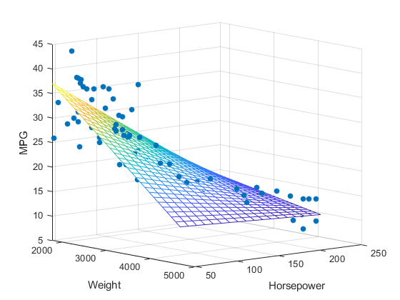
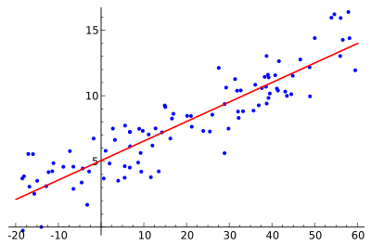
Multiple linear regression
The basic format of a multiple linear regression is:
Y = α + β1*X1 + β2*X2
Where:
Y = outcome (i.e. dependent) variable.
X1 = first predictor (i.e. independent) variable.
X2 = second predictor (i.e. independent) variable.
α = intercept (average Y when X1=X2=0). Note: α is unit specific.
β1 = slope of the line (change in Y for a 1 unit increase in X1 when X2 is held constant). Note: β1 is unit specific.
β2 = slope of the line (change in Y for a 1 unit increase in X2 when X1 is held constant). Note: β2 is unit specific.
https://www.coursera.org/learn/linear-regression-r-public-health; https://towardsdatascience.com/graphs-and-ml-multiple-linear-regression-c6920a1f2e70

Slide 7
Association between multiple variables:
quantification
We have: multiple numerical and categorical variables
Fruit consumption; veggie consumption; fish consumption; meat consumption
Mercury level
Be aware: collinearity as an assumption in case of multiple numerical variables!

Slide 9
Practical part

