Slide 1
Plasma Physics 2
Adam Obrusník, obrusnik@plasmasolve.com
Tomáš Hoder, hoder@plasmasolve.com

Slide 2
Introduction and context (CZ)
Předcházející povinné a volitelné kurzy
F5170 Úvod do fyziky plazmatu / dr. Z. Bonaventura
(definice plazmatu, pohyb častic v el-mag poli, Transportneí rovnice v plazmatu)
F7241 Fyzika plazmatu 1 / doc. Zajíčková
(rozdělovací funkce, teorie stěnové vrstvy)
F3180 Výboje v plynech / prof. Černák + Dr. Krumpolec
(klasifikace výbojů a teoorie formování jednotlivých výbojů)
F4280 Technologie depozice tenkých vrstev a povrchových úprav / prof. Vašina + doc. Zajíčková (plazmochemie, plazmové zdroje pro PVD a PECVD)

Slide 3
Course requirements
Understanding the presented topics, especially:
  Definitions of different discharge modes and types.
  Transition mechanisms between discharge modes.
  Conditions and properties of different discharge types.
  Analytical calculations, estimating plasma properties at various conditions.
  … (see details below)
Oral exam
Individual consultations available:
Adam Obrusník
Tomáš Hoder

Slide 4
Literature
RAIZER, Y.P. Gas discharge physics, Springer, 1991
COBINE, J.D. Gaseous conductors, Dover Publications, New York, 1958
CHEN, Francis F. Introduction to plasma physics and controlled fusion. 2nd ed. New York: Plenum Press, 1984. xv, 421. ISBN 0306413329.
BITTENCOURT, J. A. Fundamentals of plasma physics. 3rd ed. Sao José dos Campos: National Institute for Space Research, 2003. xxiii, 678. ISBN 85-900100-3-1.
BAZELYAN E.M., Raizer Y.P. Spark discharge, CRC Press, Taylor&Francis, 1998

Slide 5
Lecture series contents
Townsend breakdown theory, Paschen‘s law
Glow discharge
Electric arc at low and high pressures
Magnetized low-pressure plasmas and their role in material deposition methods.
Brief introduction to high-frequency discharges
Streamer breakdown theory, corona discharge, spark discharge
Barrier discharges
Leader discharge mechanism, ionization and discharges in planetary atmospherres
Discharges in liquids, complex and quantum plasmas
Thermonuclear fusion, Lawson criterion, magnetic confinement systems, plasma heating and intertial confinement fusion.

Slide 6
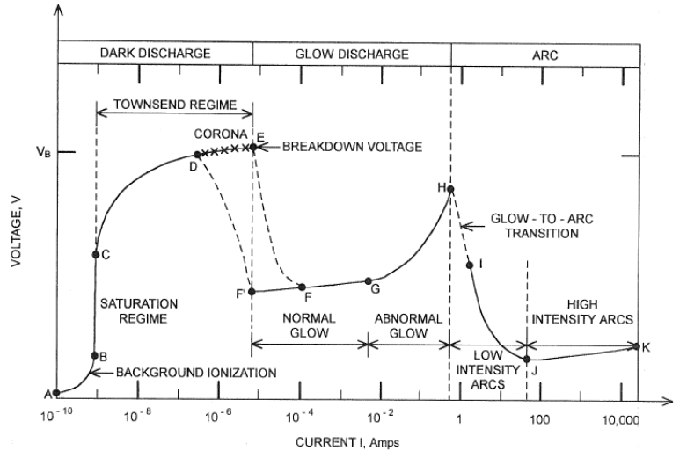
Discharges – what this Lesson covers?

Slide 7
Electron avalanche, Townsend criterion, discharge breakdown

Slide 8
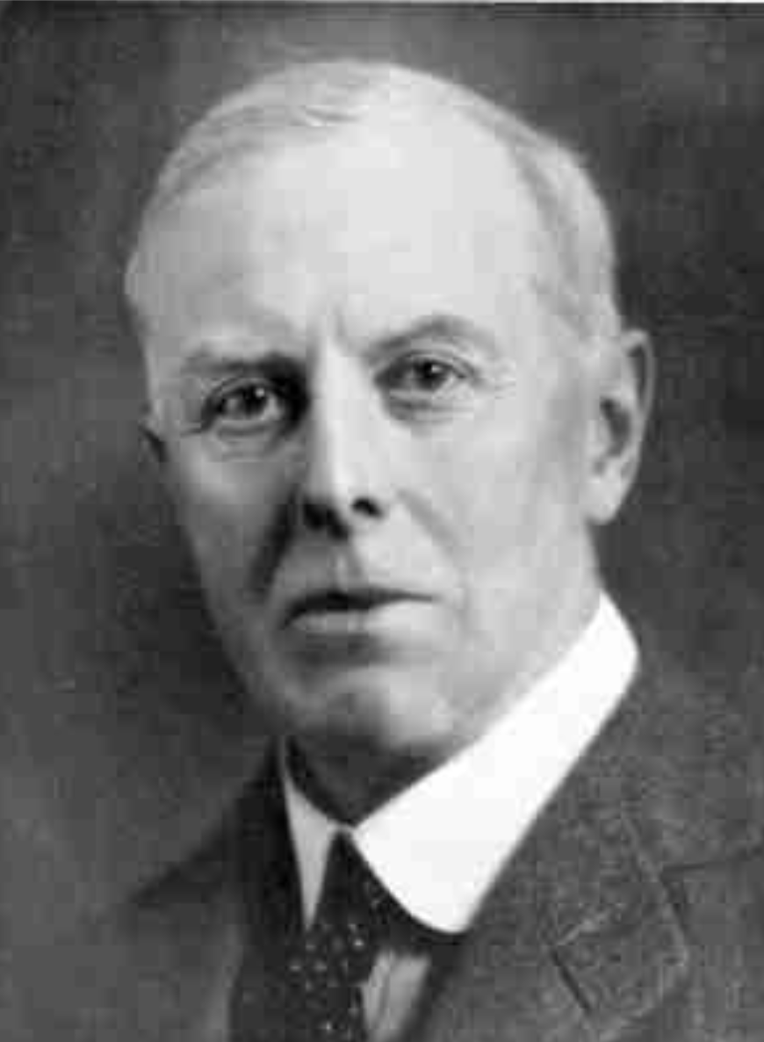
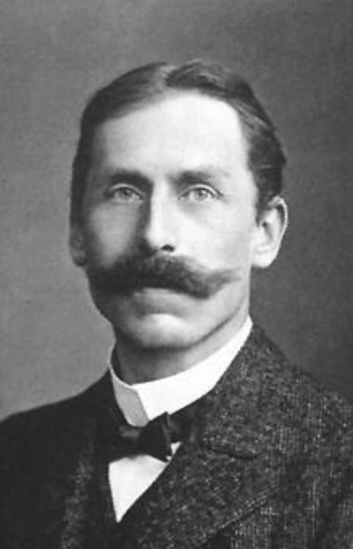
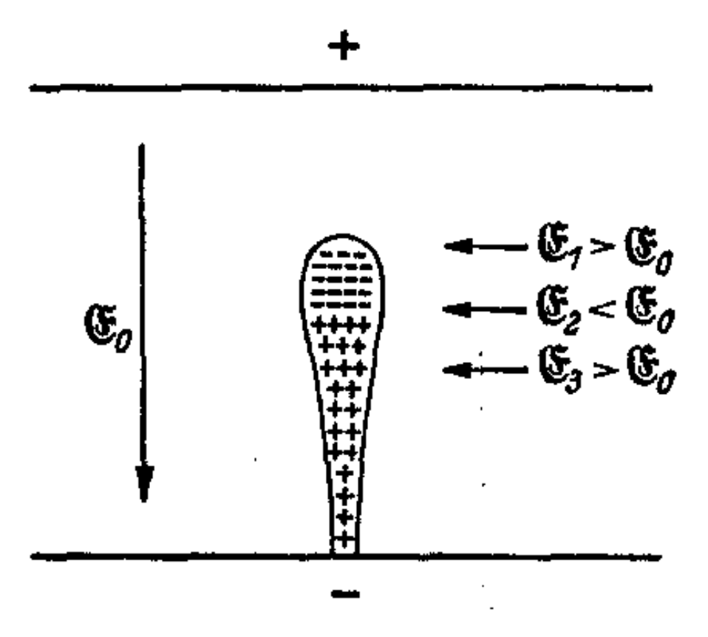
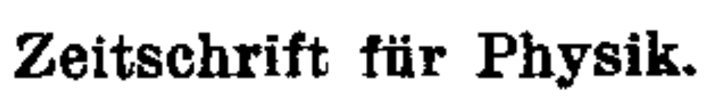
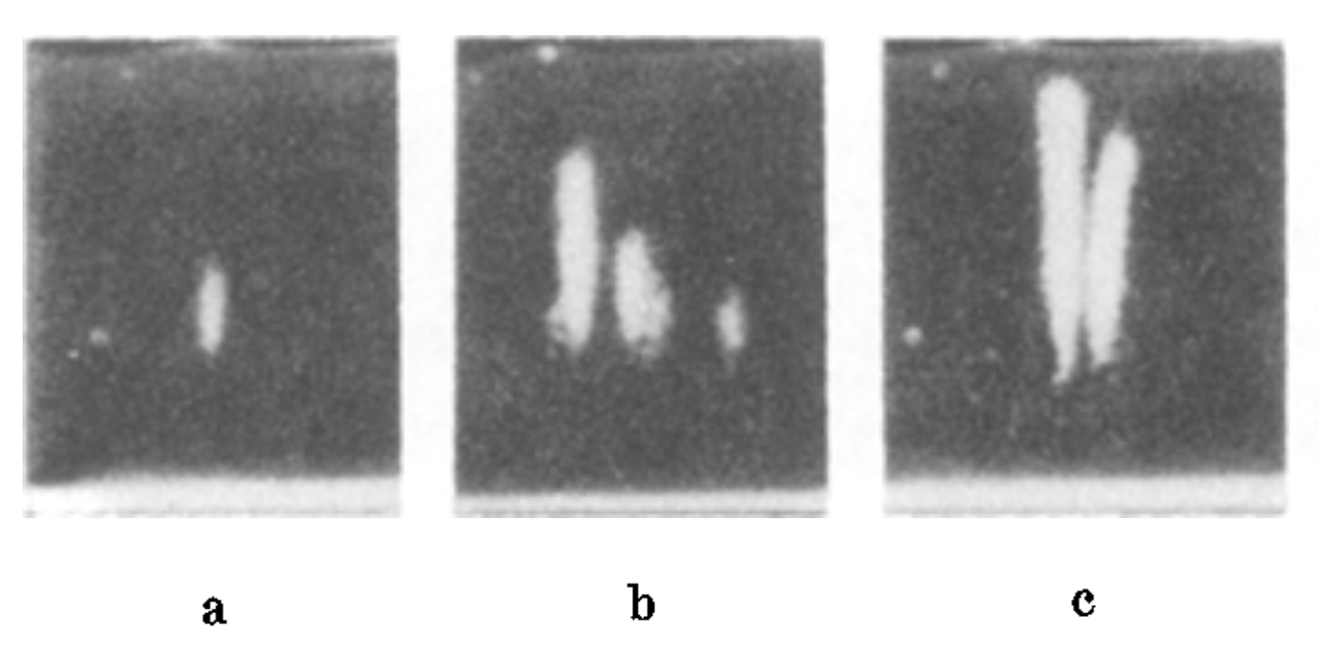
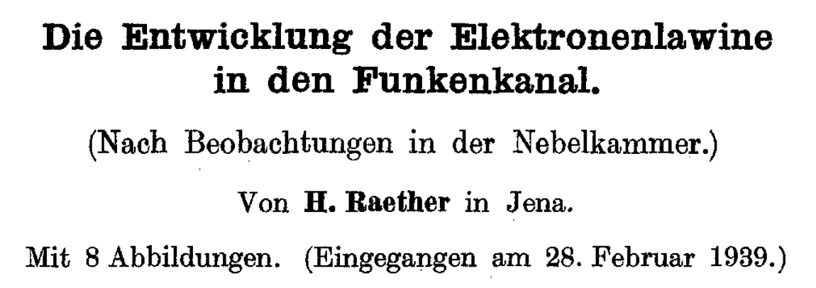
Electron avalanche
At the turn of 19th and 20th century: Townsend a Paschen formulate the basics of gaseous discharges / gas discharges
1930s: Experimental observation of electron avalanches in vapor chambers and later in vacuum chambers
Luminous structures between the cathode and the anode – more luminous for higher voltages.
John S.Townsend
Friedrich Paschen
rostoucí počáteční napětí

Slide 9
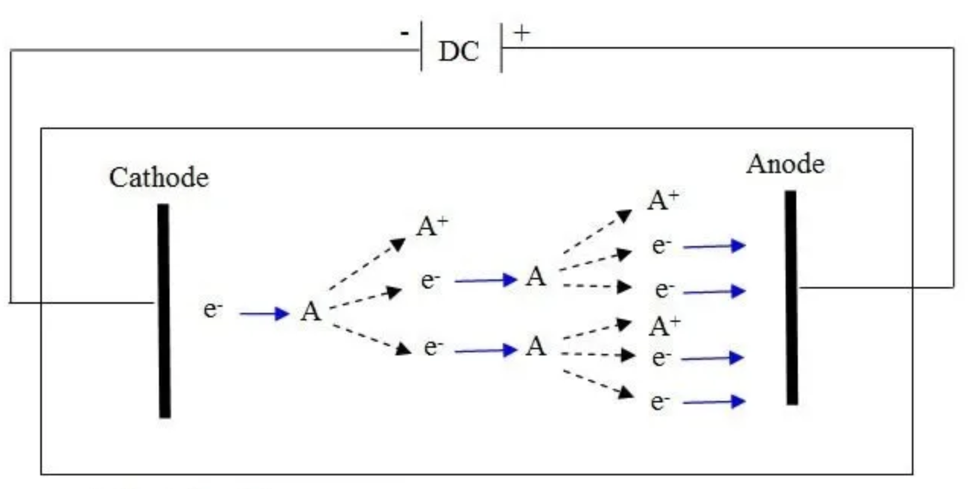
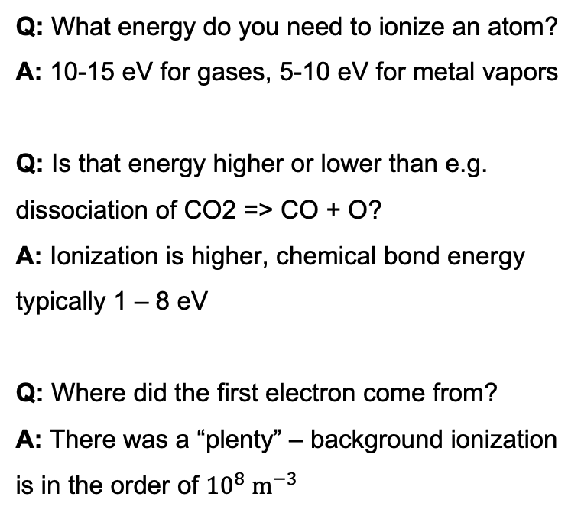
Electron avalanche – the principle
Q: What energy do you need to ionize an atom?
A: 10-15 eV for gases, 5-10 eV for metal vapors
Q: Is that energy higher or lower than e.g. dissociation of CO2 => CO + O?
A: Ionization is higher, chemical bond energy typically 1 – 8 eV
Q: Where did the first electron come from?
A: There was a “plenty” – background ionization is in the order of ${10}^{8} m^{−3}$

Slide 10
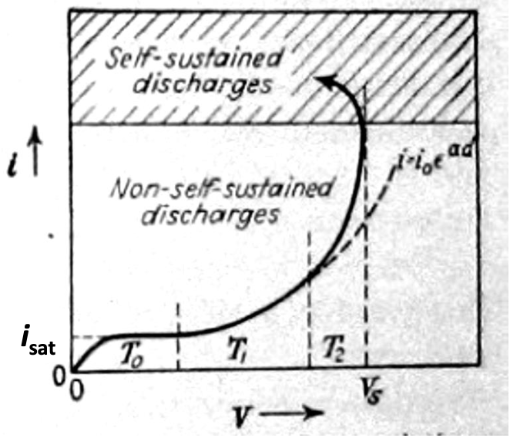
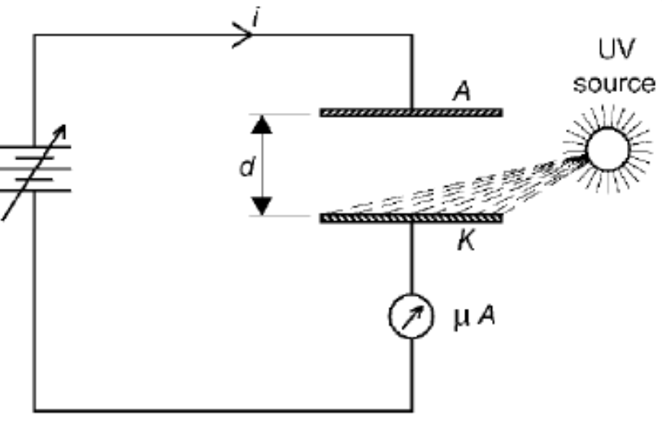
Electron avalanche – empirical summary
Plane-parallel electrodes with constant E field
Volume filled with primary electrons (cosmic radiation, radioactivity or external UV)
When voltage is applied, charged particles move towards the electrodes where they are lost. Volume recombination can be neglected in the first approximation.
Electrons are accelerated to energies over the ionization threshold
In such an experiment, one can observe 3 scenarios:
  After turning off the external source of ionization, current disappears = non self-sustaining discharge, see range T₀
  Further voltage increase leads to ionization and creation of avalanches, external ionization source not needed = Townsend discharge (range T₁), described very well by the electron avalanche theory
  Further voltage increase leads to range T₂ = additional phenomena (e.g. recombination), no longer described by the simple electron avalanche theory.

Slide 11
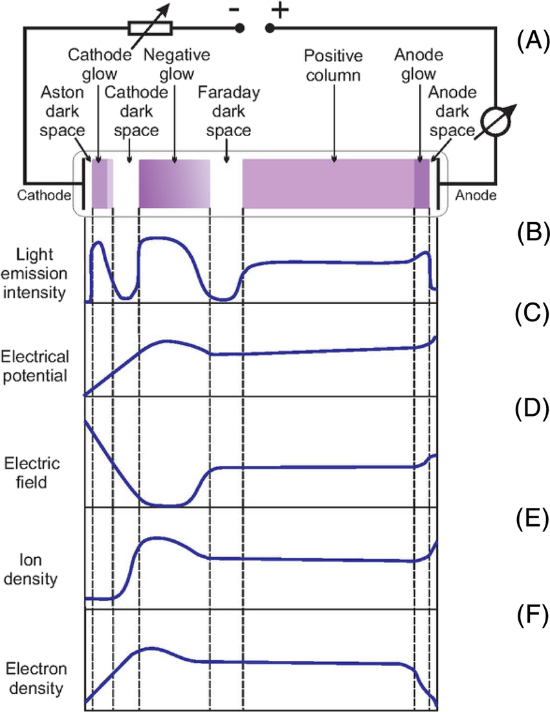
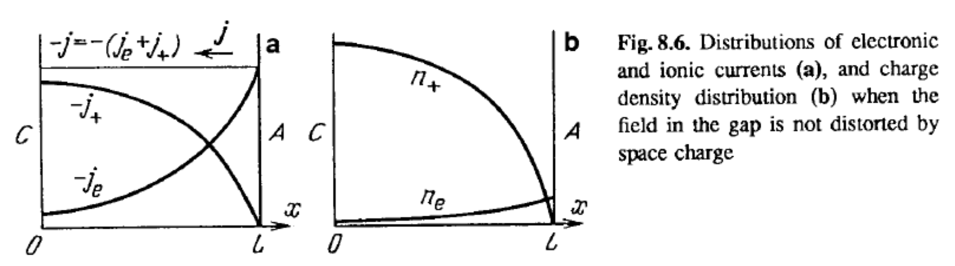

Important assumption of further slides
In the derivations below, we assume Townsend dark discharge, i.e. we maintain plasma densities low enough that they do not affect the electric field
$$ΔV=−\frac{ρ}{ε_{0}}≈0$$
This holds only before discharge ignition, so the slides below describe how discharges are initiated but not how they operate once they are ignited.

Slide 12


The first Townsend coefficient ⍺
Q: How do we mathematically describe the growth of electron density in an electric field?
Q: What does the coefficient depend on?
Type of gas
Pressure
E field magnitude
Energy distribution of electrons
Anoda (+)
$$dn_{e}=αn_{e}dx$$
+
-
$$n_{e}=n_{e,0}e^{αx}$$
E
N
-
Katoda (-)

Slide 13
The third Townsend coefficient Ɣ
When an ion hits the surface, so-called secondary electron emission can occur.
The probability of such effect is described by a factor Ɣ (or ISEE = ion-induced secondary electron emission).
Values of Ɣ:
  0.1 – 0.2 in laboratory plasmas (ion energy 100s of eV)
  0.1 – 10 by ion milling (ion energy 1 – 10 keV)
Anoda (+)
+
-
E
N
-
-
Katoda (-)

Slide 14
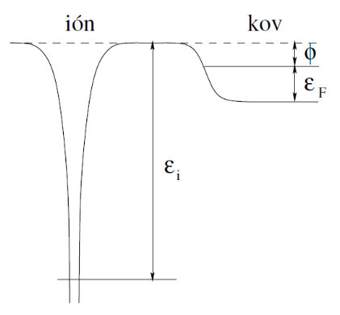
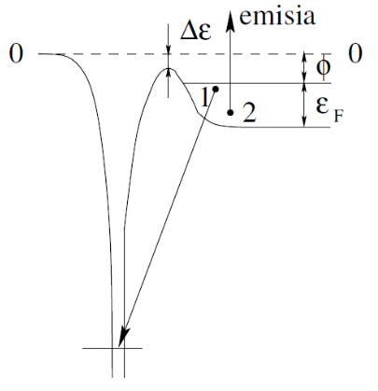
The third Townsend coefficient Ɣ
At voltages below 500 eV, potential emission is the main mechanism of ISEE
Electron no.1 from the conduction band of the metal tunnels through the potential barrier and recombines with the positive ion. The energy gain can be used for releasing electron 2
Above ca 500 eV, kinetic energy of the ion starts to make a contribution
Anoda (+)
+
-
E
N
výstupní práce
kovu
Fermiho
energie
-
-
Katoda (-)
ionizační
energie atomu

Slide 15
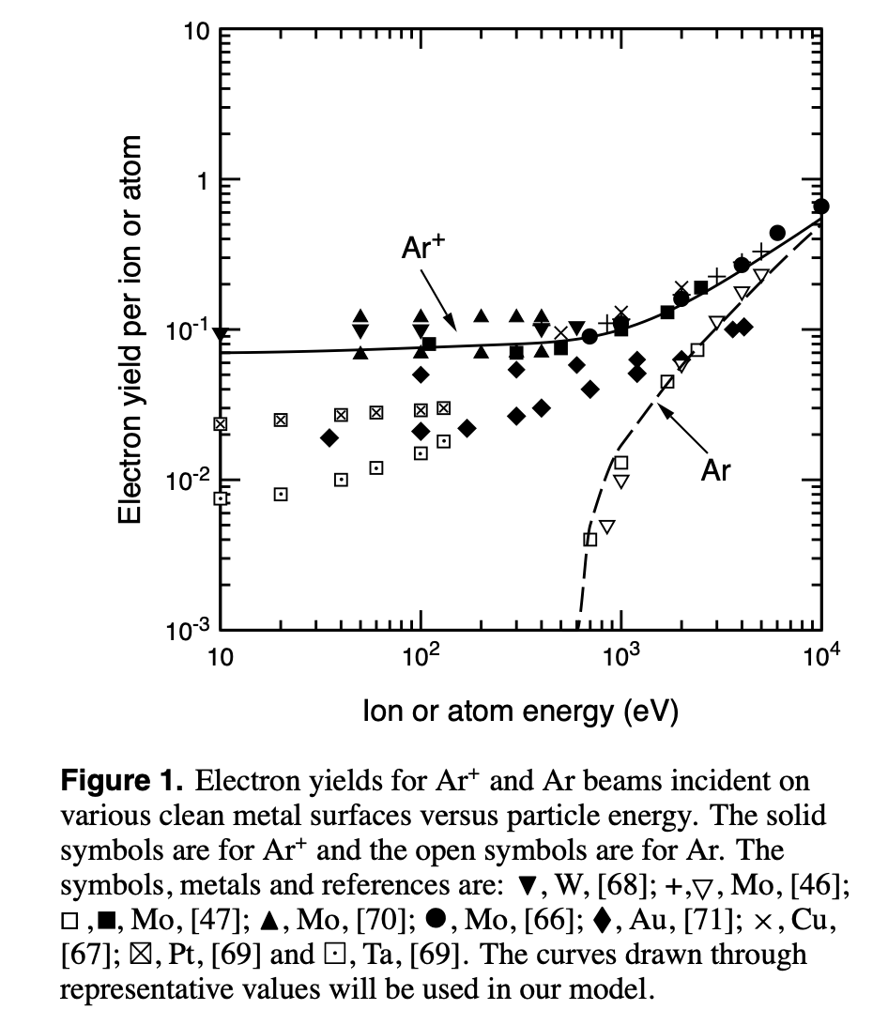
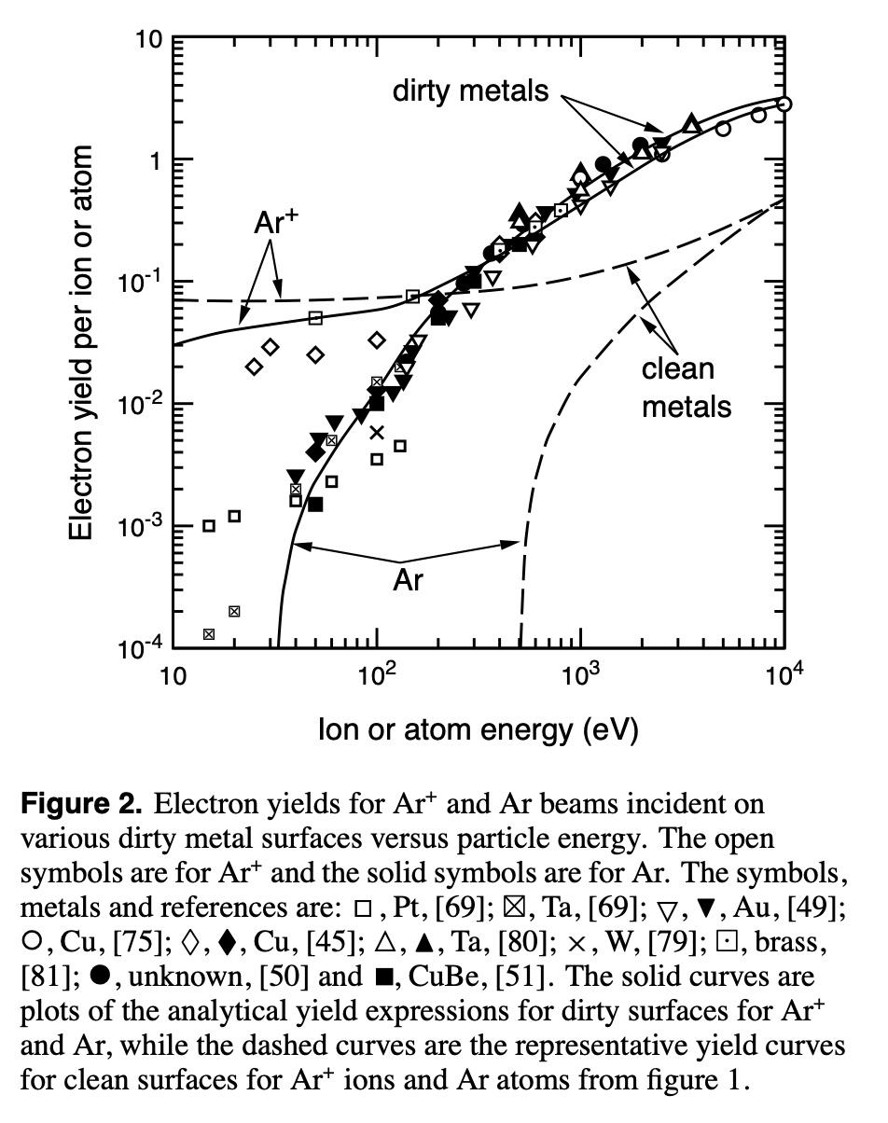
The third Townsend coefficient Ɣ
In “clean metals”, which are very smooth , ISEE depends on the material work function W_{f} – ion energy must be at least 2W_{f} for ISEE to occur.
In real life, ISEE is surprisingly quite material-independent and depends more on surface micro-roughness
[Phelps, A. V., & Petrovic, Z. L. (1999). PSST, 8(3), R21–R44.doi:10.1088/0963-0252/8/3/201]
Anoda (+)
+
-
E
N
-
-
Katoda (-)

Slide 16

What about the second coefficient?
The second Townsend coefficient $β$ was supposed to better describe the region T2, where glow discharge starts to form.
It never really caught on because it was way too simplistic a treatment.
As a plasma-physicist, you can sometimes be wrong. The world will still appreciate that you are trying to tackle this beast ☺

Slide 17
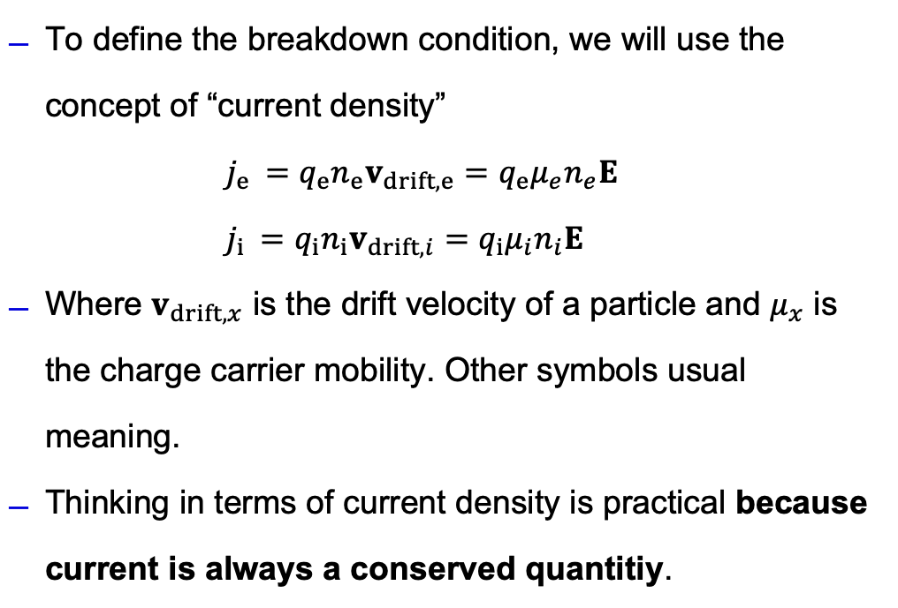
Discharge breakdown condition
To define the breakdown condition, we will use the concept of “current density”
$j_{e }=q_{e}n_{e}v_{drift,e}=q_{e}μ_{e}n_{e}E$
$j_{i }=q_{i}n_{i}v_{drift,i}=q_{i}μ_{i}n_{i}E$
Where $v_{drift,x}$ is the drift velocity of a particle and $μ_{x}$ is the charge carrier mobility. Other symbols usual meaning.
Thinking in terms of current density is practical because current is always a conserved quantitiy.
Anoda (+)
+
-
E
N
-
-
Katoda (-)

Slide 18
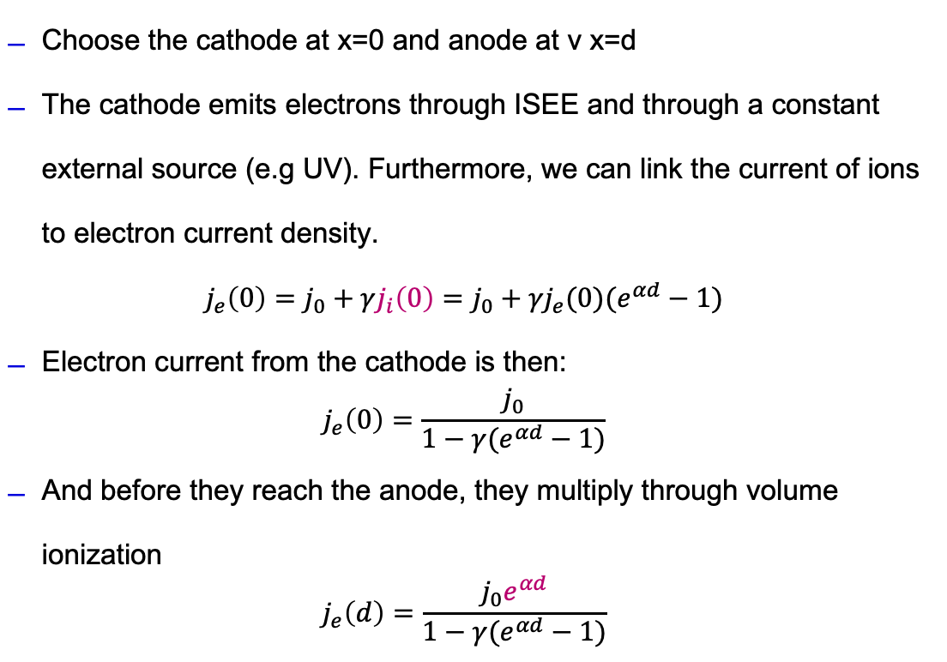
Discharge breakdown condition
Choose the cathode at x=0 and anode at v x=d
The cathode emits electrons through ISEE and through a constant external source (e.g UV). Furthermore, we can link the current of ions to electron current density.
$$j_{e}\left(0\right)=j_{0}+γj_{i}\left(0\right)=j_{0}+{γj}_{e}(0)(e^{αd}−1)$$
Electron current from the cathode is then:
$$j_{e}\left(0\right)=\frac{j_{0}}{1−γ(e^{αd}−1)}$$
And before they reach the anode, they multiply through volume ionization
$$j_{e}\left(d\right)=\frac{j_{0}e^{αd}}{1−γ(e^{αd}−1)}$$
Anoda (+)
+
-
E
N
UV
-
-
Katoda (-)

Slide 19
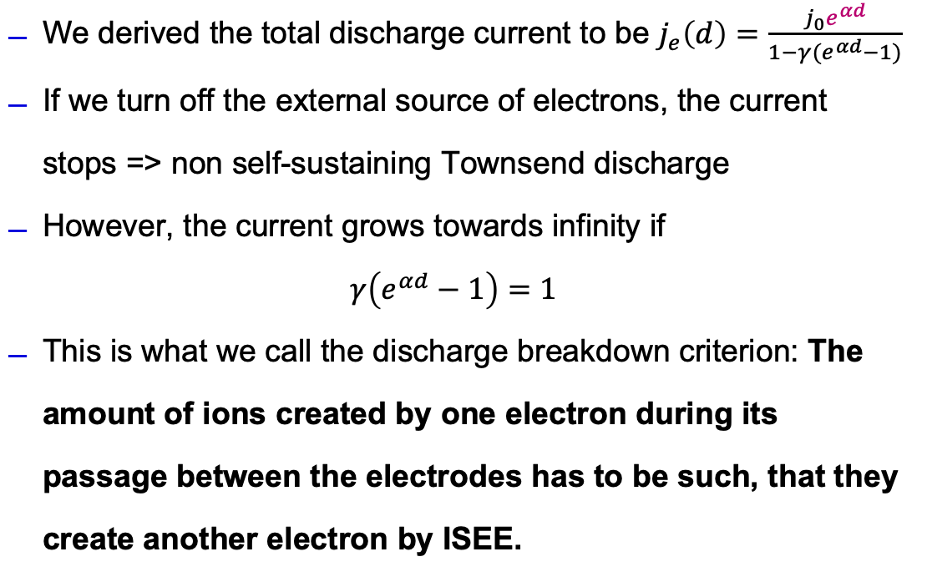
Discharge breakdown condition
We derived the total discharge current to be $j_{e}\left(d\right)=\frac{j_{0}e^{αd}}{1−γ(e^{αd}−1)}$
If we turn off the external source of electrons, the current stops => non self-sustaining Townsend discharge
However, the current grows towards infinity if
$$γ\left(e^{αd}−1\right)=1$$
This is what we call the discharge breakdown criterion: The amount of ions created by one electron during its passage between the electrodes has to be such, that they create another electron by ISEE.
Anoda (+)
+
-
E
N
UV
-
-
Katoda (-)

Slide 20
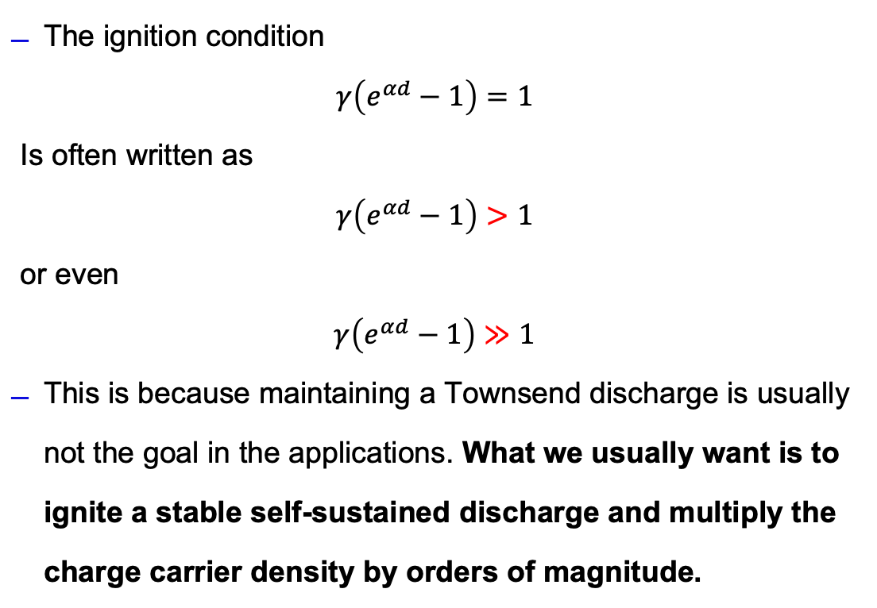
Discharge breakdown condition
The ignition condition
$$γ\left(e^{αd}−1\right)=1$$
Is often written as
$$γ\left(e^{αd}−1\right)>1$$
or even
$$γ\left(e^{αd}−1\right)≫1$$
This is because maintaining a Townsend discharge is usually not the goal in the applications. What we usually want is to ignite a stable self-sustained discharge and multiply the charge carrier density by orders of magnitude.
Anoda (+)
+
-
E
N
UV
-
-
Katoda (-)

Slide 21
Breakdown voltage, Paschen law

Slide 22
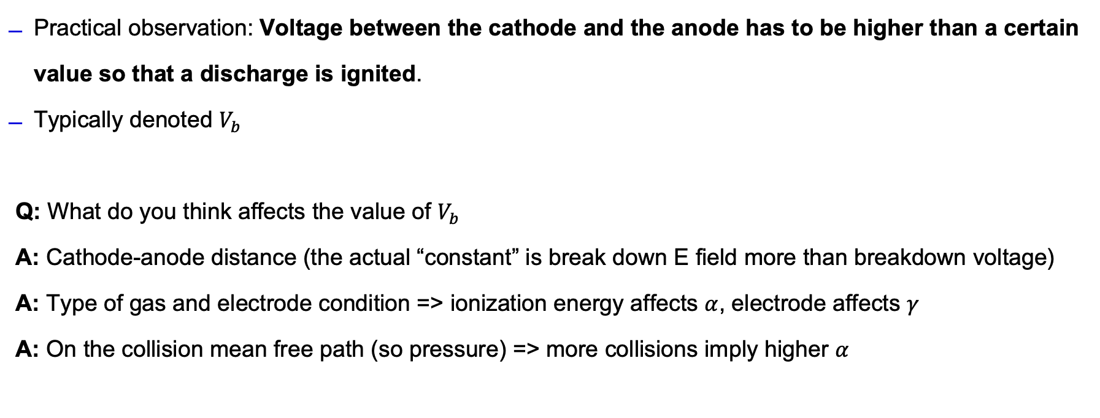
Breakdown voltage
Practical observation: Voltage between the cathode and the anode has to be higher than a certain value so that a discharge is ignited.
Typically denoted $V_{b}$
Q: What do you think affects the value of $V_{b}$
A: Cathode-anode distance (the actual “constant” is break down E field more than breakdown voltage)
A: Type of gas and electrode condition => ionization energy affects $α$, electrode affects $γ$
A: On the collision mean free path (so pressure) => more collisions imply higher $α$

Slide 23
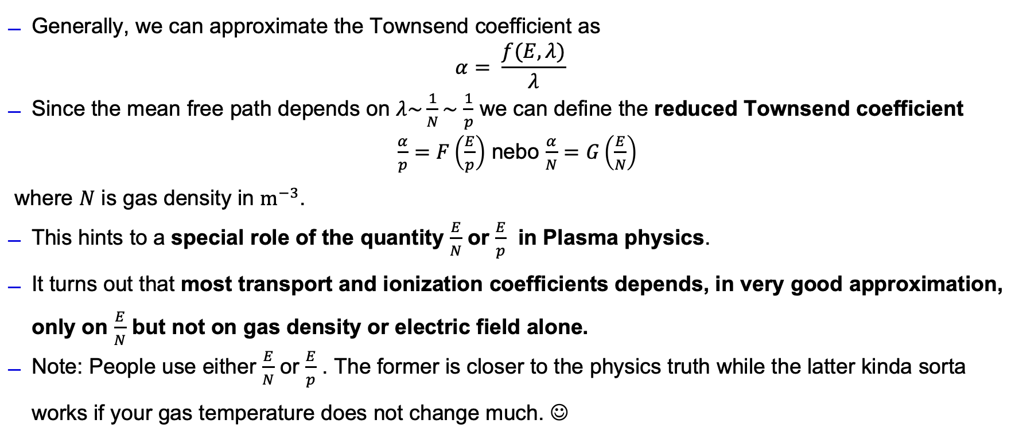
Breakdown voltage
Generally, we can approximate the Townsend coefficient as
$$α= \frac{f(E, λ)}{λ}$$
Since the mean free path depends on $λ\sim \frac{1}{N}\sim$ $\frac{1}{p}$ we can define the reduced Townsend coefficient
$\frac{α}{p}=F\left(\frac{E}{p}\right)$ nebo $\frac{α}{N}=G\left(\frac{E}{N}\right)$
where $N$ is gas density in $m^{−3}$.
This hints to a special role of the quantity $\frac{E}{N}$ or $\frac{E}{p}$ in Plasma physics.
It turns out that most transport and ionization coefficients depends, in very good approximation, only on $\frac{E}{N}$ but not on gas density or electric field alone.
Note: People use either $\frac{E}{N}$ or $\frac{E}{p}$ . The former is closer to the physics truth while the latter kinda sorta works if your gas temperature does not change much. ☺

Slide 24
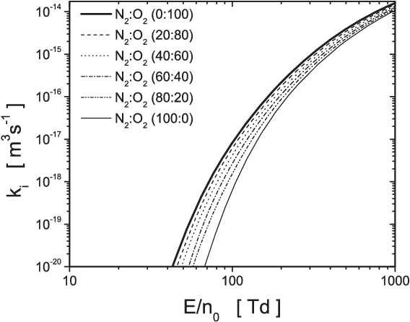
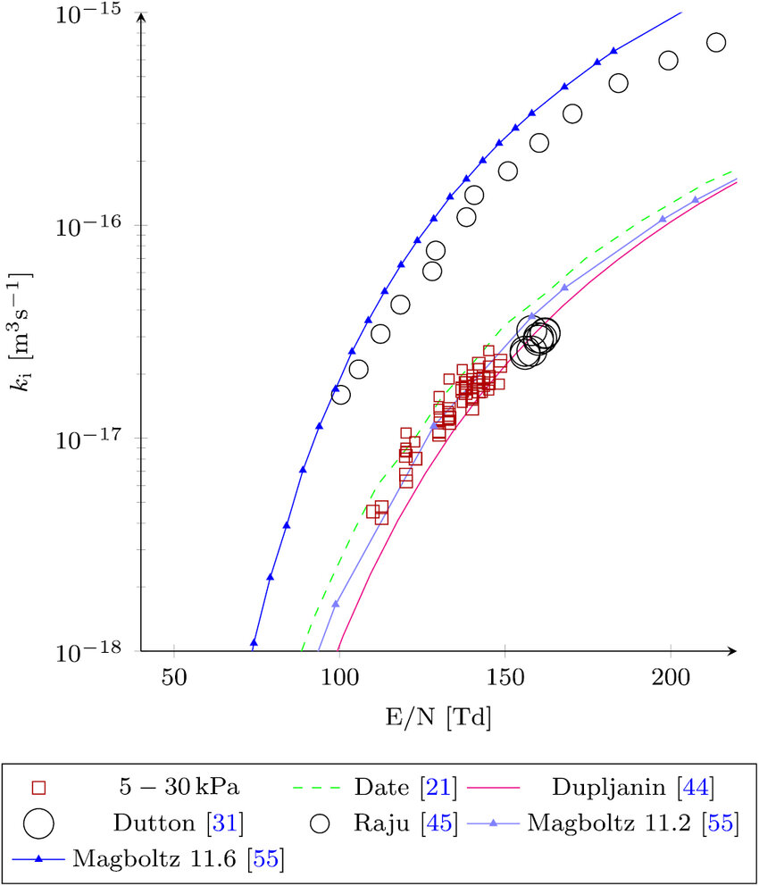
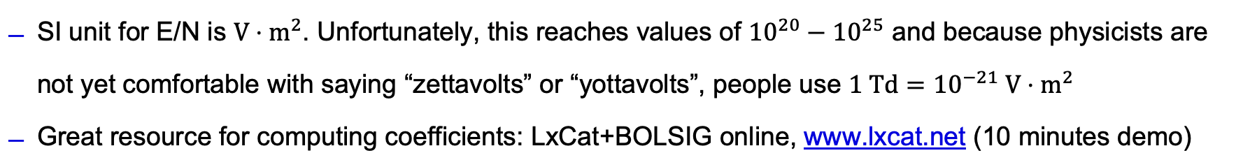
E/N in plasma science
SI unit for E/N is $V⋅m^{2}$. Unfortunately, this reaches values of ${10}^{20}−{10}^{25}$ and because physicists are not yet comfortable with saying “zettavolts” or “yottavolts”, people use $1 Td={10}^{−21} V⋅m^{2}$
Great resource for computing coefficients: LxCat+BOLSIG online, www.lxcat.net (10 minutes demo)

Slide 25
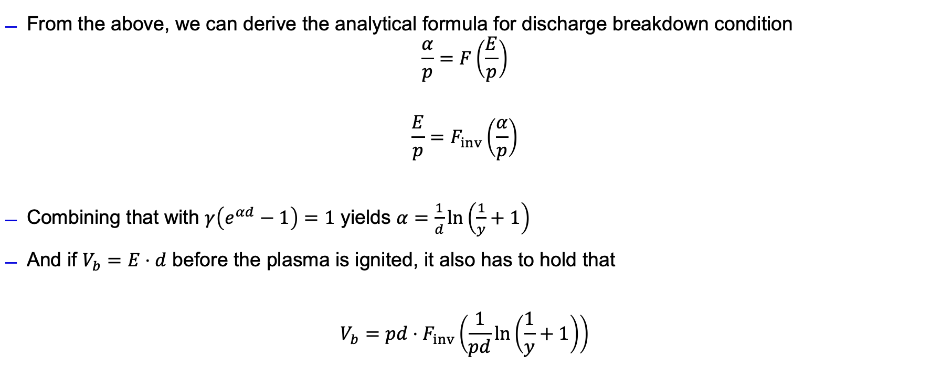
Paschen law
From the above, we can derive the analytical formula for discharge breakdown condition
$$\frac{α}{p}=F\left(\frac{E}{p}\right)$$
$$\frac{E}{p}=F_{inv}\left(\frac{α}{p}\right)$$
Combining that with $γ\left(e^{αd}−1\right)=1$ yields $α=\frac{1}{d}\ln\left(\frac{1}{y}+1\right)$
And if $V_{b}=E⋅d$ before the plasma is ignited, it also has to hold that
$$V_{b}=pd⋅F_{inv}\left(\frac{1}{pd}\ln\left(\frac{1}{y}+1\right)\right)$$

Slide 26
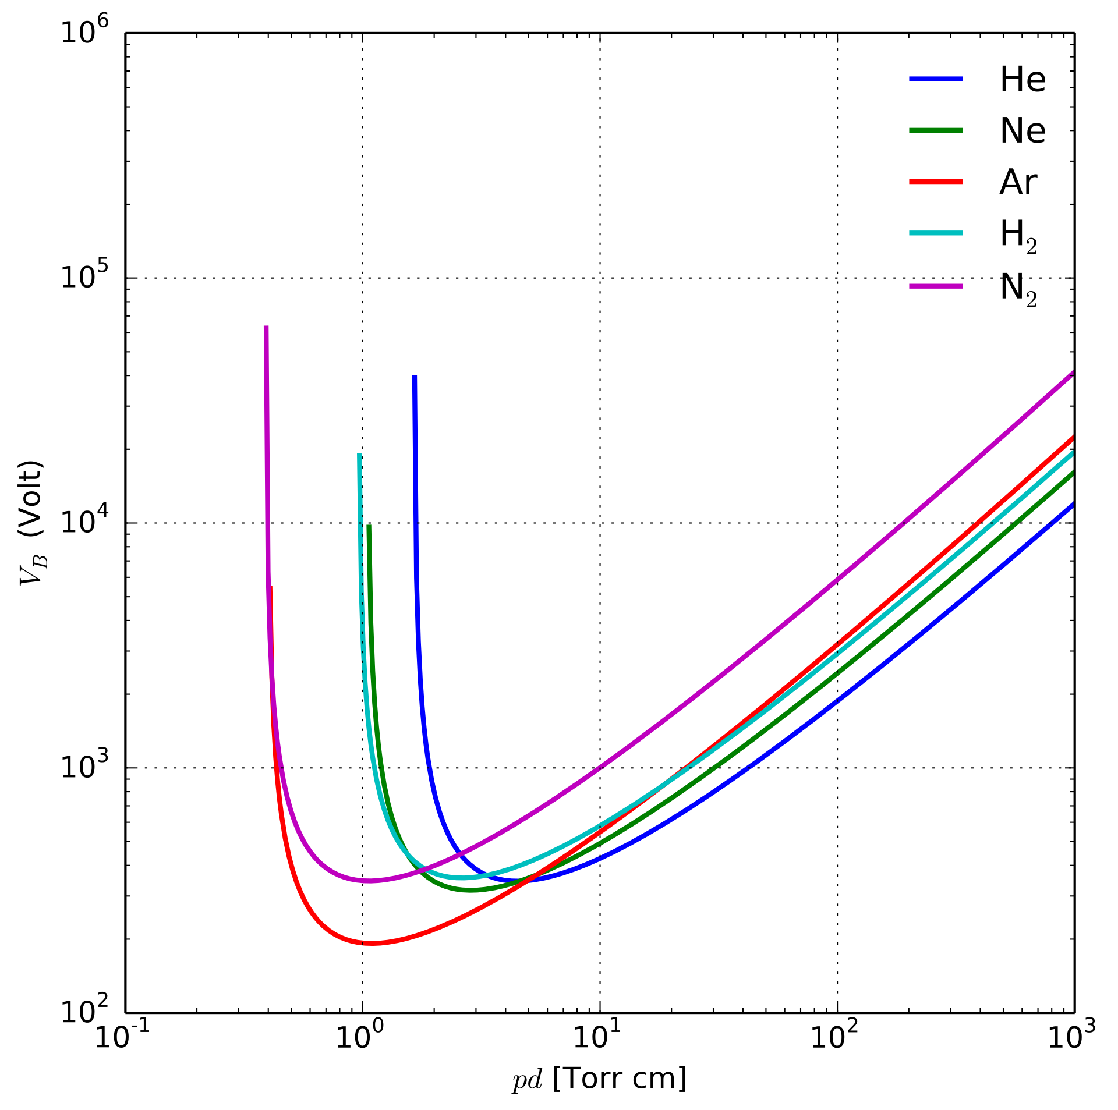
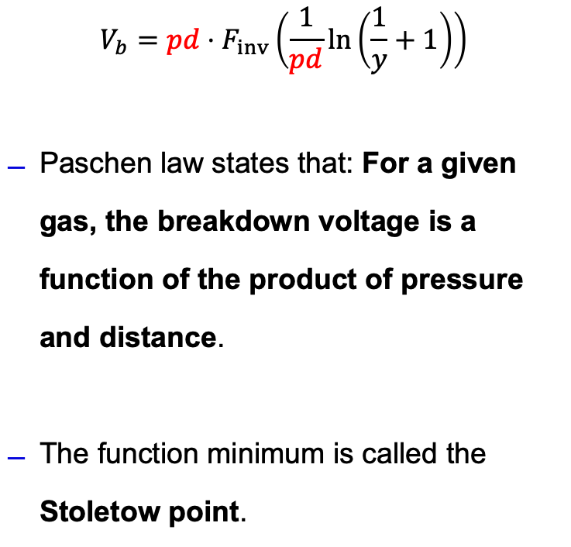
Paschen law
$$V_{b}=pd⋅F_{inv}\left(\frac{1}{pd}\ln\left(\frac{1}{y}+1\right)\right)$$
Paschen law states that: For a given gas, the breakdown voltage is a function of the product of pressure and distance.
The function minimum is called the Stoletow point.

Slide 27
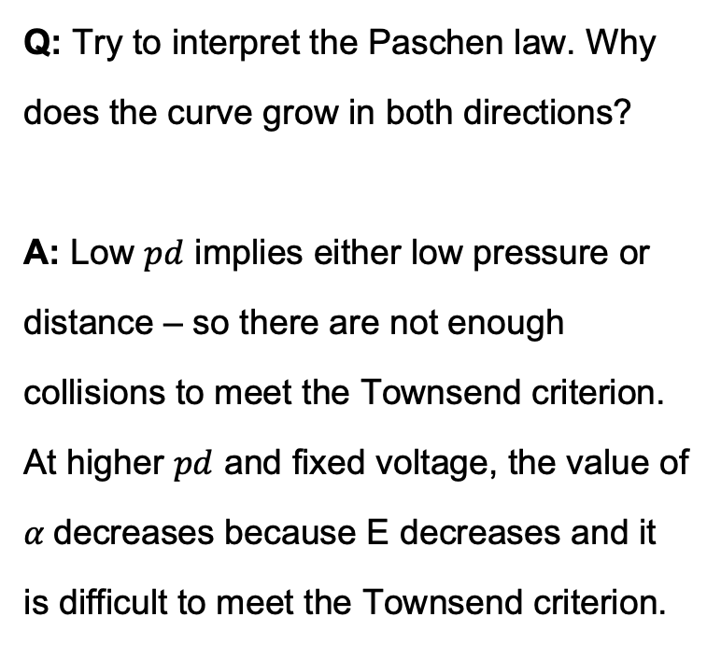
Paschen law
Q: Try to interpret the Paschen law. Why does the curve grow in both directions?
A: Low $pd$ implies either low pressure or distance – so there are not enough collisions to meet the Townsend criterion. At higher $pd$ and fixed voltage, the value of $α$decreases because E decreases and it is difficult to meet the Townsend criterion.

Slide 28
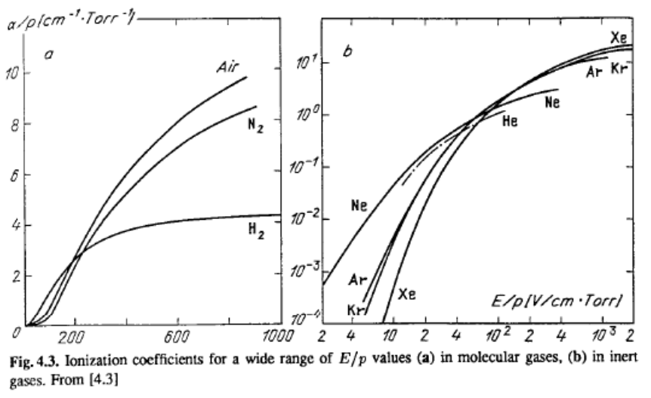
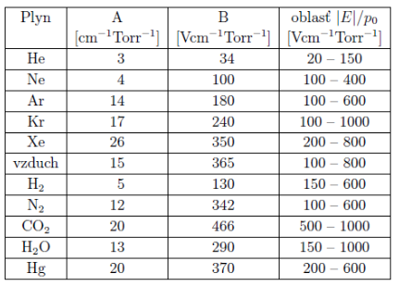

Paschen law - quantitatively
We can obtain $α$ by solving BKE and somehow fit $\frac{α}{p}≈A⋅\exp\left(−\frac{Bp}{E}\right)$

Slide 29
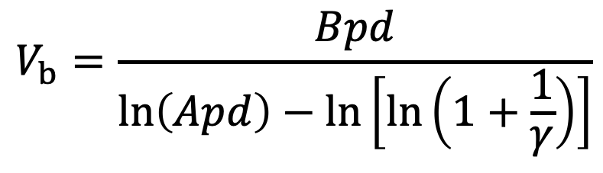
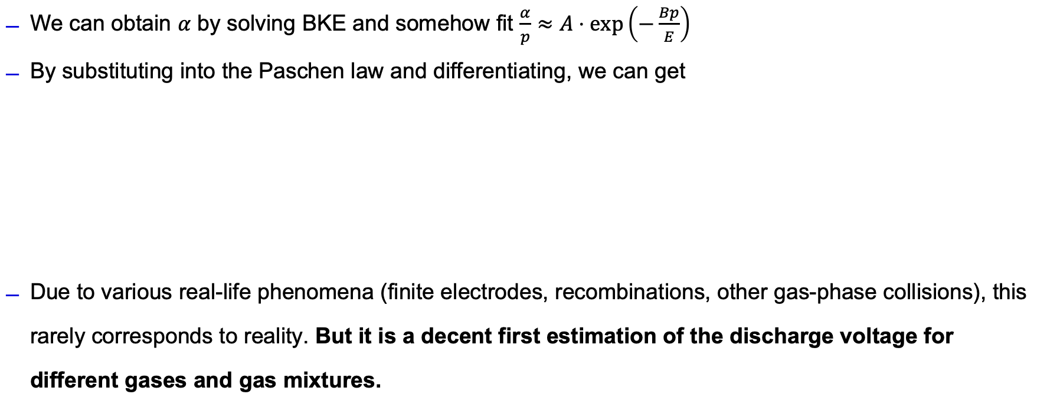
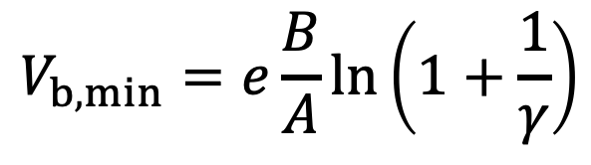
Paschen law - quantitatively
We can obtain $α$ by solving BKE and somehow fit $\frac{α}{p}≈A⋅\exp\left(−\frac{Bp}{E}\right)$
By substituting into the Paschen law and differentiating, we can get
Due to various real-life phenomena (finite electrodes, recombinations, other gas-phase collisions), this rarely corresponds to reality. But it is a decent first estimation of the discharge voltage for different gases and gas mixtures.
$$V_{b}=\frac{Bpd}{\ln\left(Apd\right)−\ln\left[\ln\left(1+\frac{1}{γ}\right)\right]}$$
$$V_{b, min}=e\frac{B}{A}\ln\left(1+\frac{1}{γ}\right)$$

Slide 30
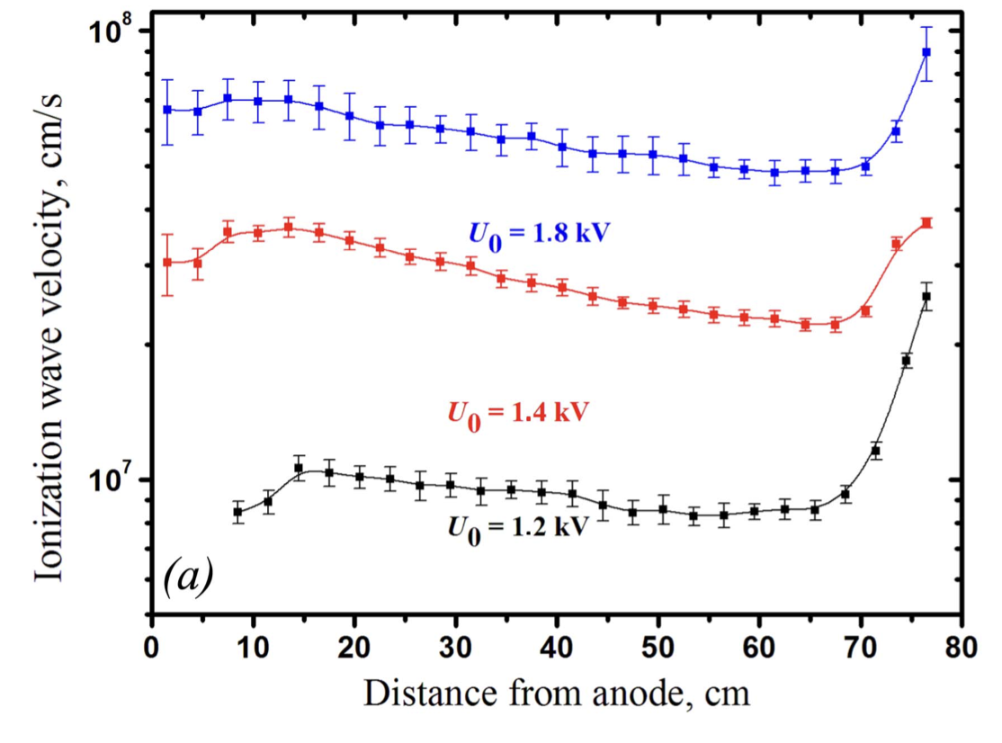
Actual discharge ignition
Nice overview of the problematics:
[Shishpanov, A. I., Meshchanov, A. V., Kalinin, S. A., & Ionikh, Y. Z. (2017). Processes of discharge ignition in long tubes at low gas pressure. Plasma Sources Science and Technology, 26(6), 065017. doi:10.1088/1361-6595/aa6f7c ]
The ionization does not happen instantaneously, it proceeds with a certain ionization wave velocity.
This causes a delay in discharge breakdown w.r.t voltage application.

Slide 31
A short note on actual discharge ignition

Slide 32
Actual discharge ignition
Nice overview of the problematics:
[Shishpanov, A. I., Meshchanov, A. V., Kalinin, S. A., & Ionikh, Y. Z. (2017). Processes of discharge ignition in long tubes at low gas pressure. Plasma Sources Science and Technology, 26(6), 065017. doi:10.1088/1361-6595/aa6f7c ]
The ionization does not happen instantaneously, it proceeds with a certain ionization wave velocity.
This causes a delay in discharge breakdown w.r.t voltage application.

Slide 33
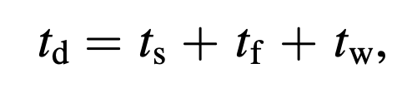
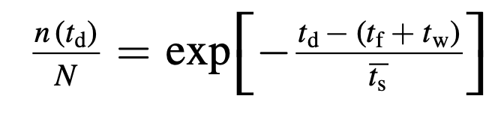
Actual discharge ignition
The time after which the discharge is ignited is expressed as
where the symbols ts and tf correspond to random phenomena.
Based on that, we can express the Laue distribution
number of breakdowns with larger breakdown time than td
total number of breakdowns

Slide 34
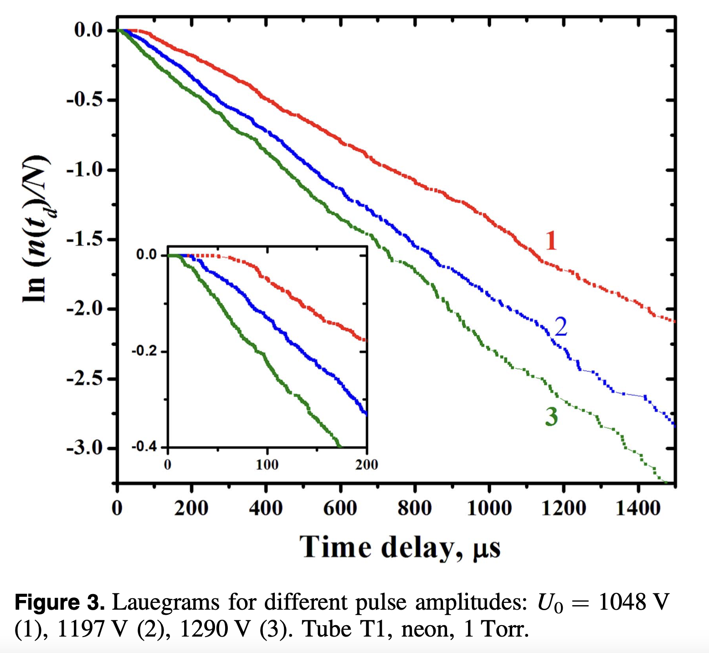
Actual discharge ignition
This expression produces “Lauegrams”, from which we can read out the probability of discharge ignition and time delay at various voltages

Slide 35
Main take-aways

Slide 36
Take-aways from lesson 1
Be able to formulate and derive Townsend breakdown criterion, be aware of the underlying assumptions and limitations.
Be able to accurately and exactly describe Paschen law.
Be aware of the special role of E/N in plasma science and where it comes from.
General awareness of actual breakdown mechanisms – there is a time delay, Lauegrams exist.

