Slide 1
Plasma Physics 2
Adam Obrusník, adamobrusnik@physics.muni.cz
Tomáš Hoder, hoder@physics.muni.cz

Slide 2
Lecture series contents
Townsend breakdown theory, Paschen‘s law
Glow discharge
Electric arc at low and high pressures
Magnetized low-pressure plasmas and their role in material deposition methods.
Brief introduction to high-frequency discharges
Streamer breakdown theory, corona discharge, spark discharge
Barrier discharges
Leader discharge mechanism, ionization and discharges in planetary atmospherres
Discharges in liquids, complex and quantum plasmas
Thermonuclear fusion, Lawson criterion, magnetic confinement systems, plasma heating and intertial confinement fusion.

Slide 3
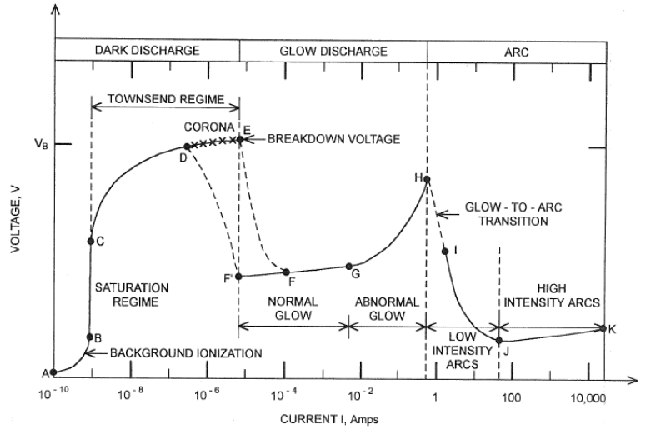
Discharges – what this Lesson covers?

Slide 4
Contents of this lesson
Transition from glow to arc, mechanisms, fundamental properties of arcs.
Physics of arc plasmas, analytical models for high power LTE arcs.
A short but important note on vacuum arcs
Applications of arc plasmas

Slide 5
Observation of the transition between Glow Dischage and Arc Discharge

Slide 6
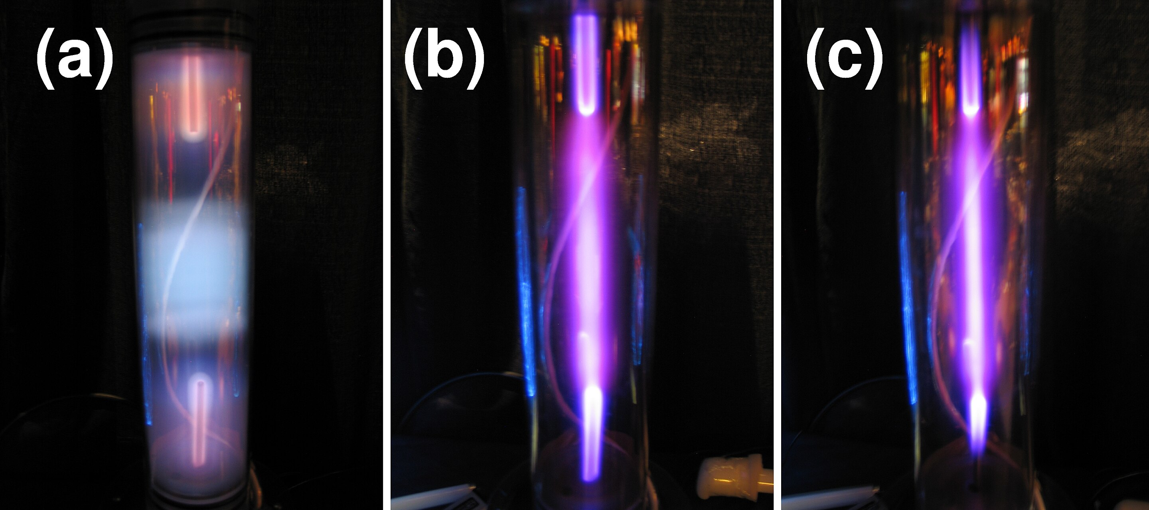
Glow > Arc transition mechanics
Visuals first: https://www.youtube.com/watch?v=VAwnxIc0-6E
Pressure increase or power increase

Slide 7
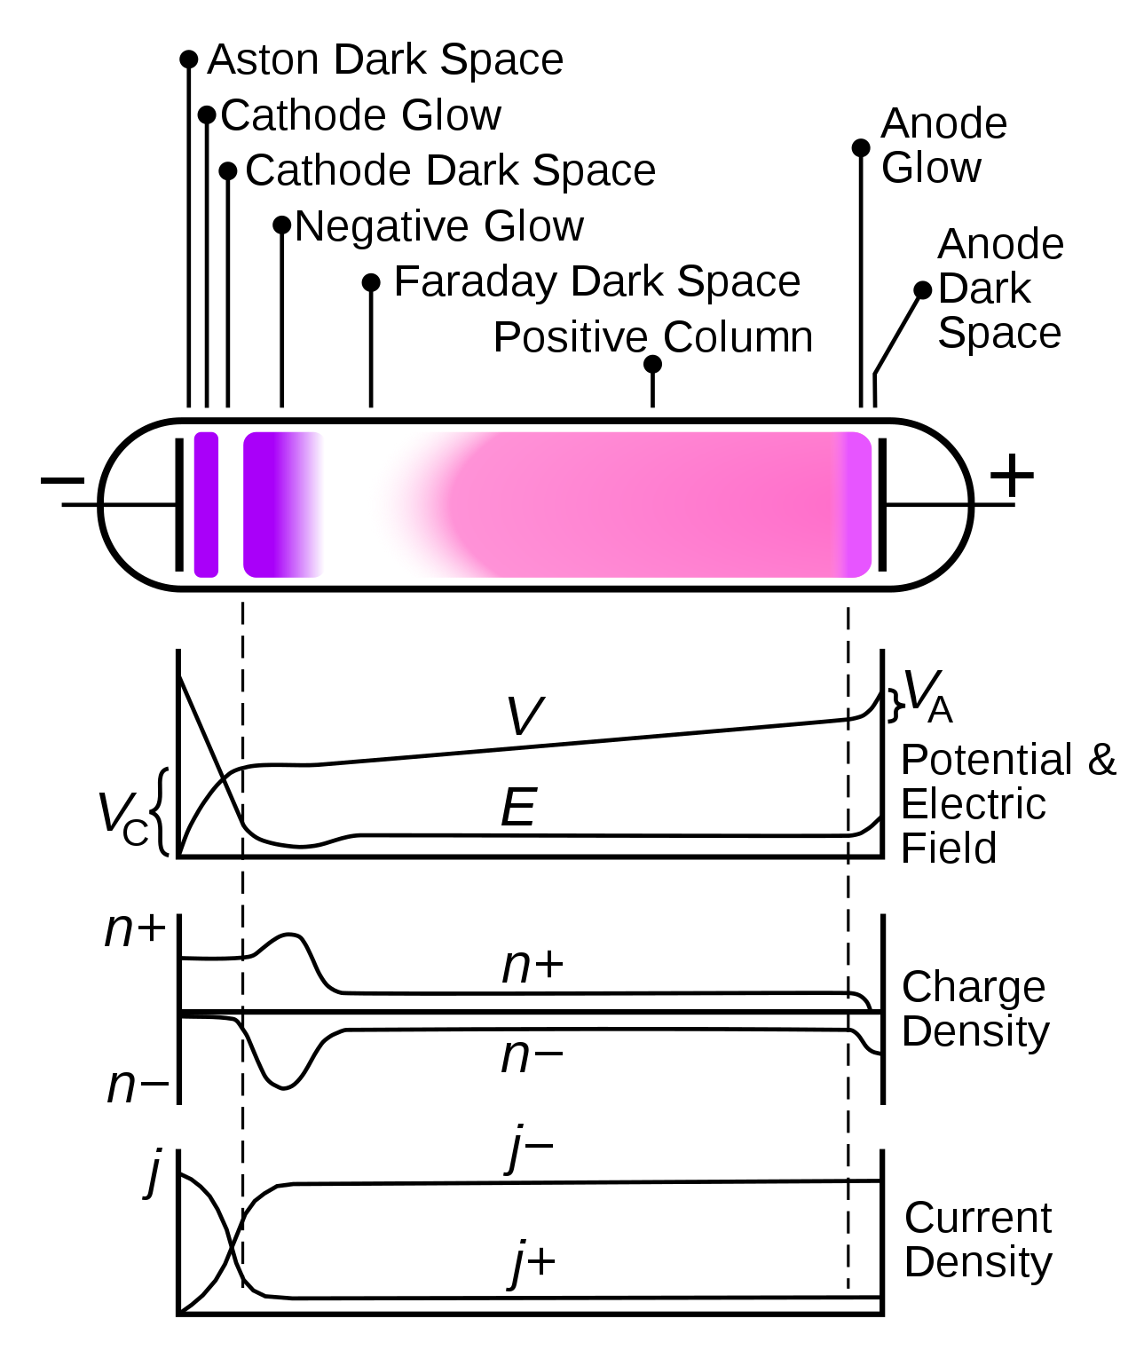
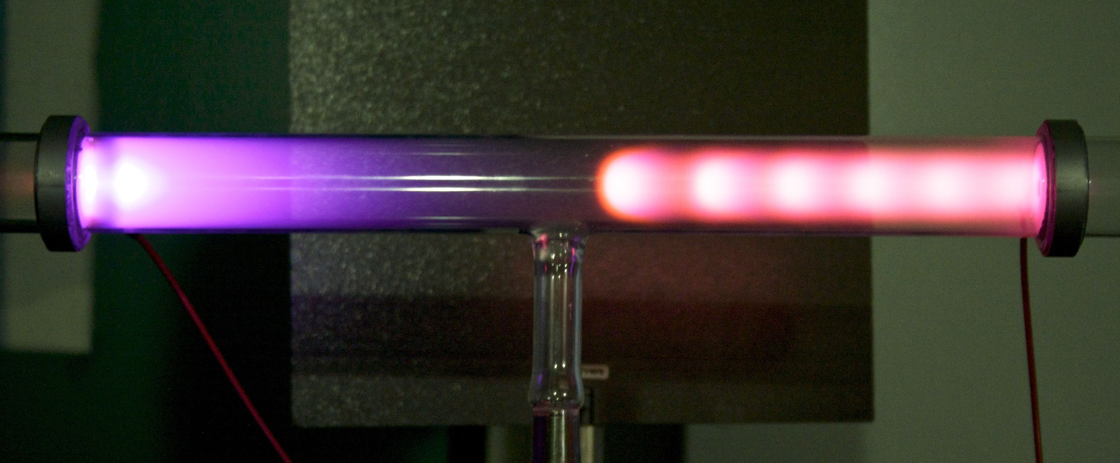
Glow > Arc transition mechanics
Q: What happens if you start increasing plasma power in glow discharge?
A1: Plasma gets generally more dense
A2: Cathode sheath gets thinner even though voltage keeps growing.
A3: Electric field in the cathode drop increases.
A4: More ions bombard the cathode surface.

Slide 8
Glow > Arc transition mechanics
Q: When will this stop? What do you think happens to the cathode?
A1: It gets hot (more ions) => thermoemission of electrons
A2: It is subject to locally strong electric field => field emission
We get 2 new effects that further boost the plasma density!

Slide 9
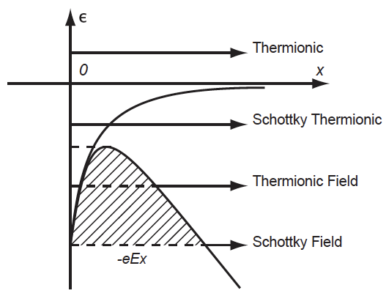
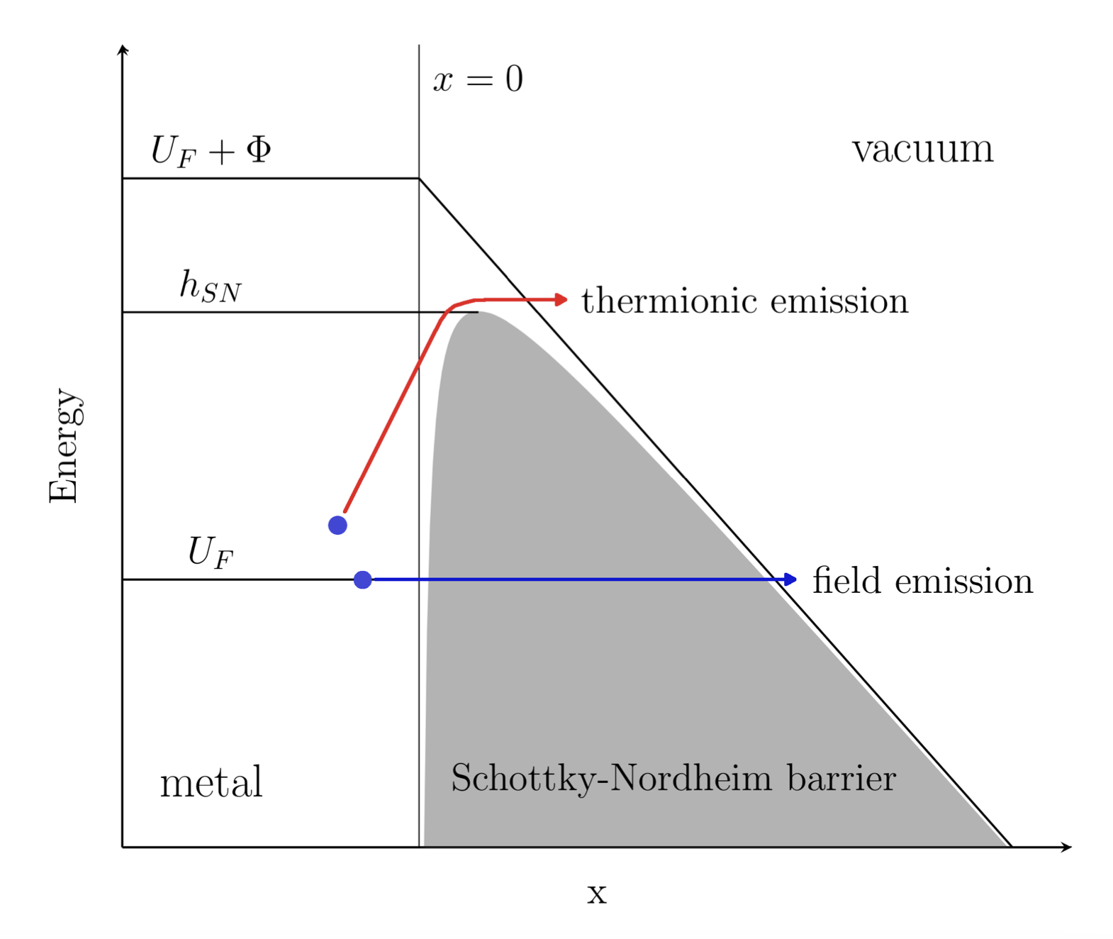
Glow > Arc transition mechanics
First, let’s qualitatively assess this on the quantum mechanics level.
Heating up the metal ensures that there are more and more electrons getting over the work function barrier.
Electric field close to the metal surface further reduces the energy barrier for electrons to get out.
Interesting Q: what is the plasma density in metals?
A: About 10²⁹ m⁻³, so there is enough electrons ☺.

Slide 10
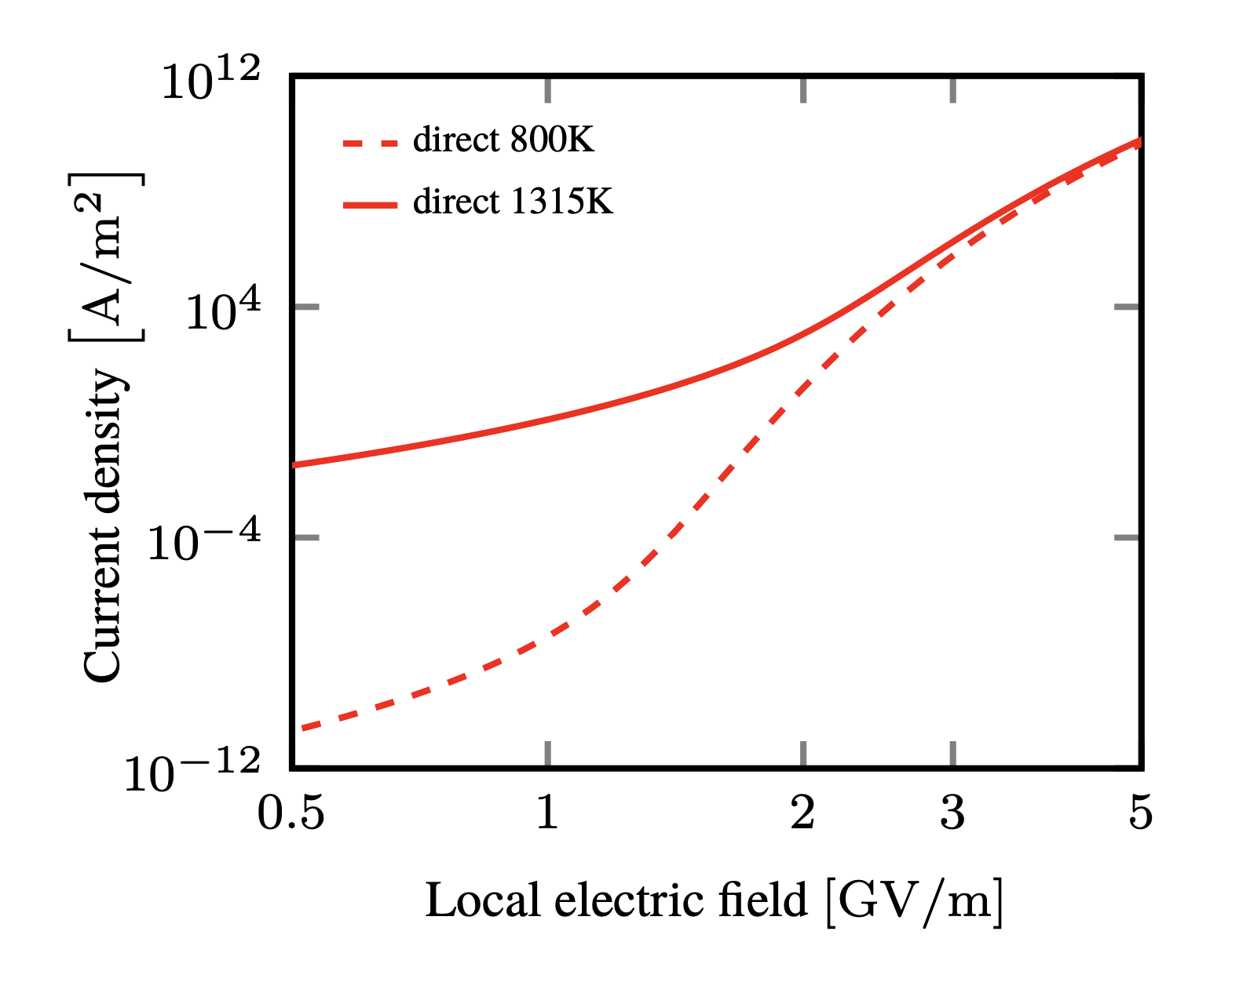
Glow > Arc transition mechanics
At high E fields, the field emission effect lowers the barrier to such extent, that electron emission becomes mostly insensitive to metal temperature.
Current densities in an arc discharge actually can and do reach MA/m² (that is mega-Amperes)

Slide 11
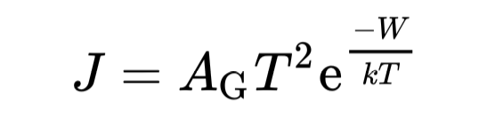
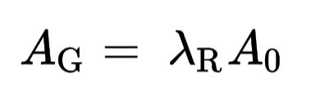
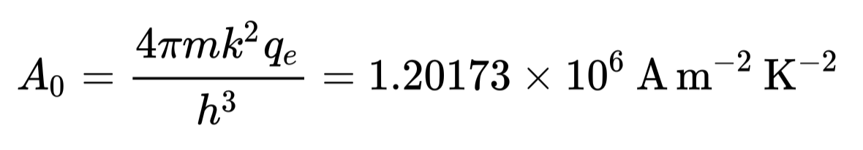

Macroscopic treatment of electrode processes
The aforementioned processes at the cathode are very important for sustaining an arc plasma.
Thermionic emission is well described by so-called Richardson’s law, which connects emitted current density with surface temperature and work function as:
Where A_{G} is a material-specific constant (tabulated) and W is the work-function of the material.
Interestingly, the AG constant is only mildly sensitive to the material
$$λ_{R}≈0.3−0.8$$

Slide 12
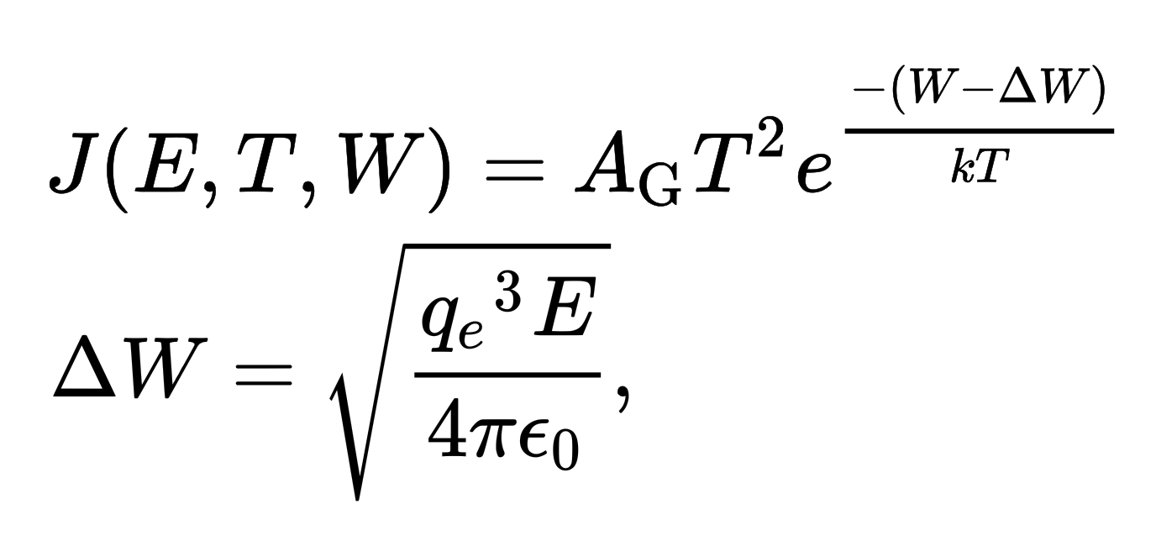
Macroscopic treatment of electrode processes
The aforementioned processes at the cathode are very important for sustaining an arc plasma.
To account for the fact that the electric field at the electrode facilitates easier emission (also known as Schottky effect/Schottky emission), the Richardson law can be modified as:
Where we see that the electric field is effectively reducing the work function of the material, as expected from the QM perspective.

Slide 13
Structure and properties of an arc plasma, z-pinch effect

Slide 14
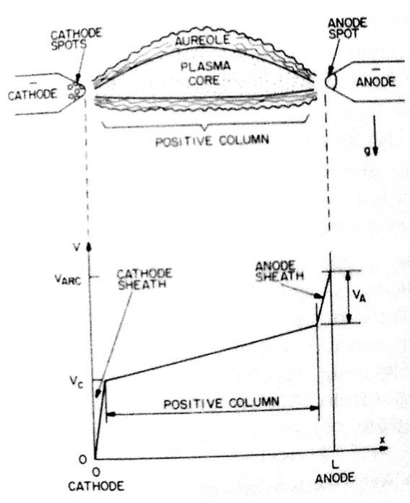
Structure and parameters of an arc
An arc plasma is mostly the positive column
Anode and cathode falls are typically highly constricted to the surface (10s of micrometers – milimeter)
At the electrode, an arc imprint can be either constricted to spot(s) or diffuse
Voltage drop in the cathode sheath is very small – 10-50 V

Slide 15
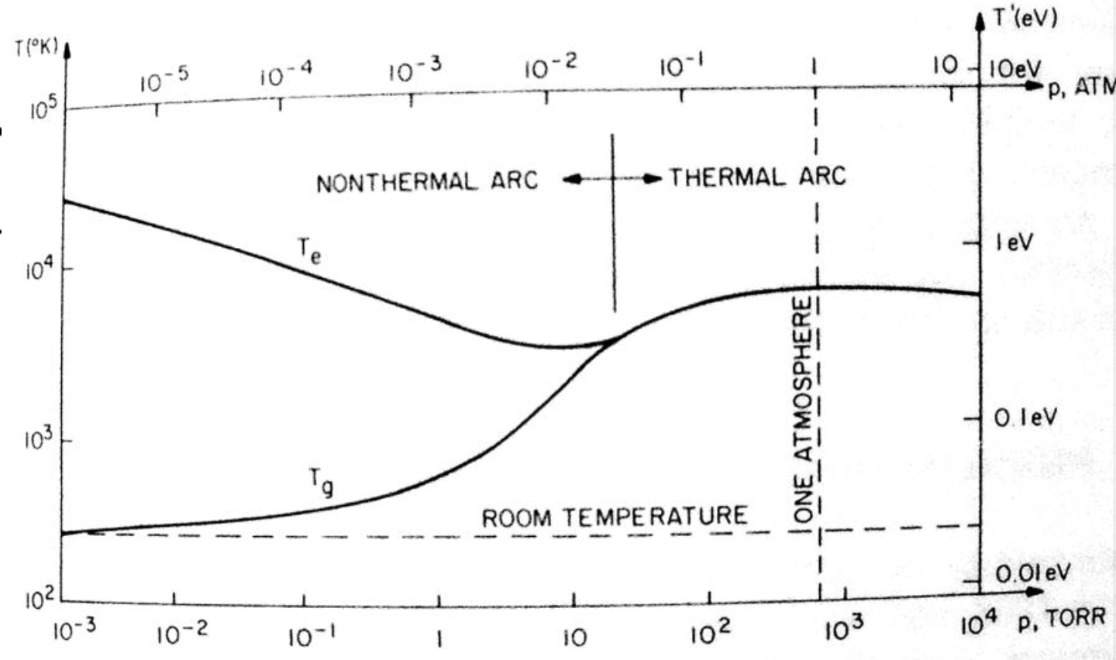
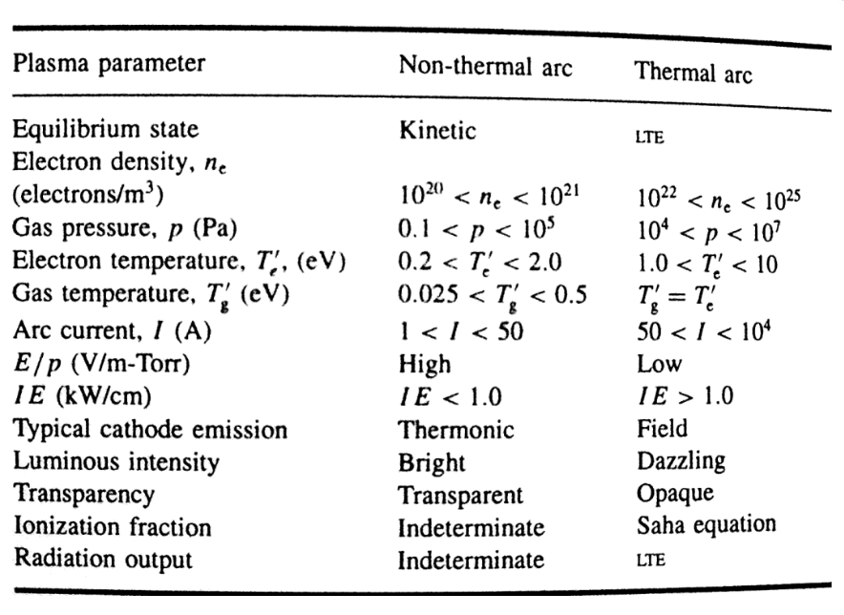
Structure and parameters of an arc
There are generally two types of arc plasmas – equilibrium and non-equilibrium
The type depends on current but also on the pressure
Thermal arcs have been operated up to 1 MW of plasma power.

Slide 16
Structure and parameters of an arc
There are generally two types of arc plasmas – equilibrium and non-equilibrium
The type depends on current but also on the pressure
Thermal arcs have been operated up to 1 MW of plasma power.

Slide 17
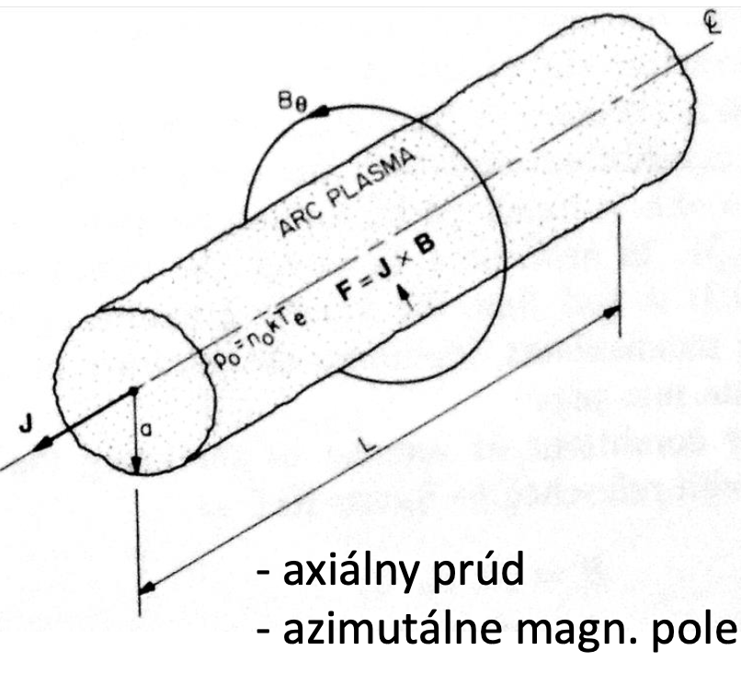
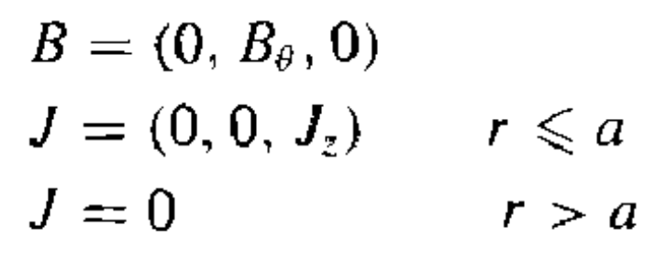
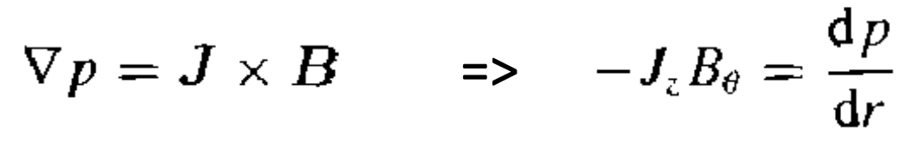
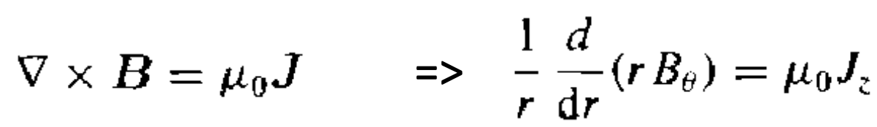
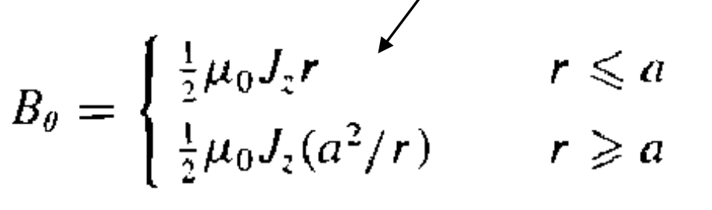
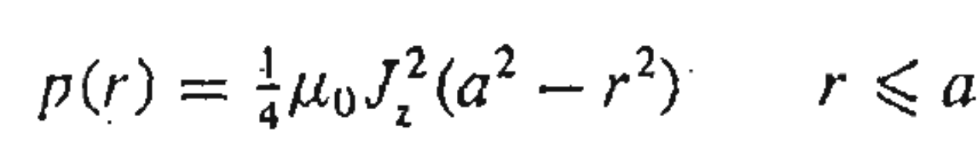
Pinch effect in arc plasmas
The high currents in arc plasmas generate substantial magnetic fields
These fields lead to further constriction of the discharge channel – Benett’s z-pinch
balance of forces:
Apparent pressure which constricts the arc channel is proportional to the quare root of the current density

Slide 18
Arc plasma as a conductive fluid, Saha equation, Ellenbaas-Heller equation

Slide 19
Arc as a conductive fluid
In the 20th century, various applications for high-power arcs have appeared (t.b.d. later)
Coincidentally, it turns out that high power arc plasma is much easier to model than e.g. glow discharge plasmas due to several simplifying factors:
  The sheath is thin (micrometers)
  Voltage drop in sheath is small (10 V) => kinetic effects simpler
  Gas and electron temperatures are equal (local Thermodynamic equilibrium)
  Ionization degree is high and electron energy distribution function is Maxwellian
This allows us to compute some plasma properties analytically, which is much more difficult for the glow discharge and other non-LTE discharges.

Slide 20
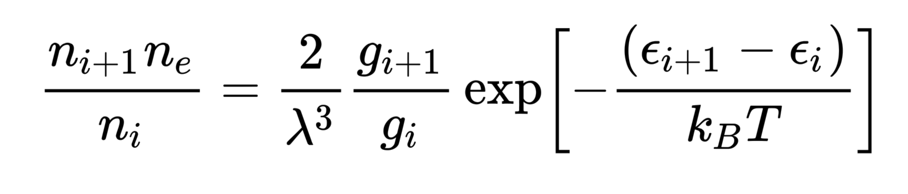
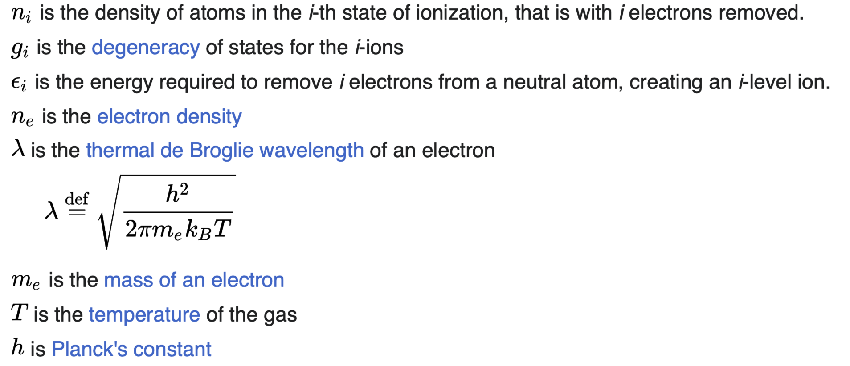
Saha ionization equation
Describes ionization degree for an LTE plasma
Connects the density of the (i+1)-th ionization state ions with i-th state ions => we can calculate ionization degree only based on the local temperature.

Slide 21
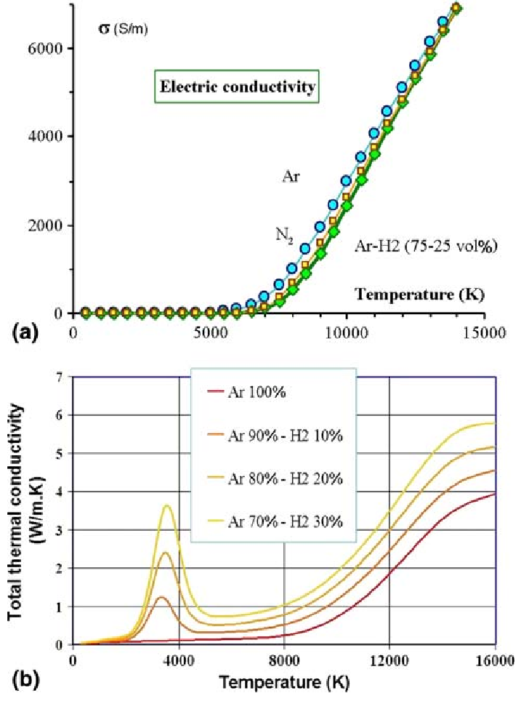


Ellenbaas-Heller Equation
Simplest possible model for describing an arc plasma
Assumes that the energy is absorbed only through Joule heating and lost through heat conduction
$σE^{2}=−∇⋅(k∇T)$
We have to consider that thermodynamic properties of highly ionized gas are non-trivial!
for a gas
for a plasma
$$σ≈0$$
$$k=a⋅T+b$$

Slide 22
Plasma as a conductive fluid
If the plasma is in LTE, it is actually easier to simulate and model than a milder non-LTE plasma.
You do not have to worry about electron mobilities, ion mobilities.
You do not have to worry about kinetic processes because they are already included in the thermodynamic properties‘ variations
You do not have to solve the problematic Poisson equation because n_{e}=n_{i}.

Slide 23
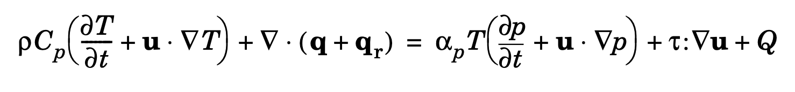
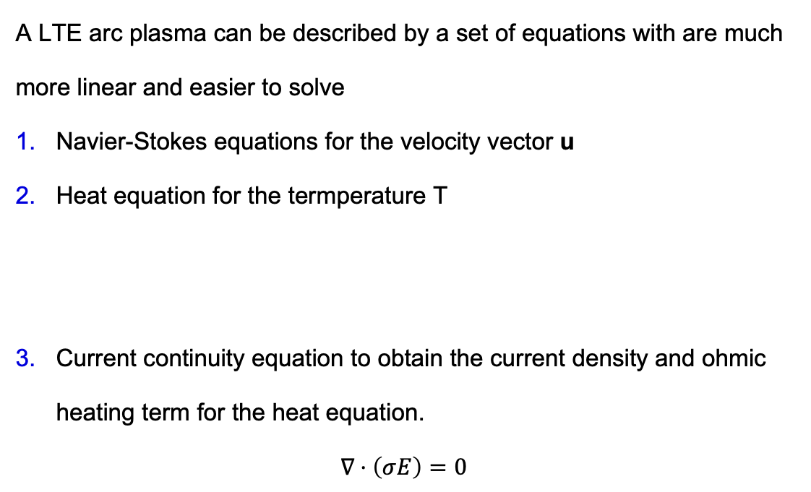

Plasma as a conductive fluid
A LTE arc plasma can be described by a set of equations with are much more linear and easier to solve
Navier-Stokes equations for the velocity vector u
Heat equation for the termperature T
Current continuity equation to obtain the current density and ohmic heating term for the heat equation.
$$∇⋅\left(σE\right)=0$$
$$=σE^{2}$$

Slide 24
A short but important note on vacuum arcs

Slide 25
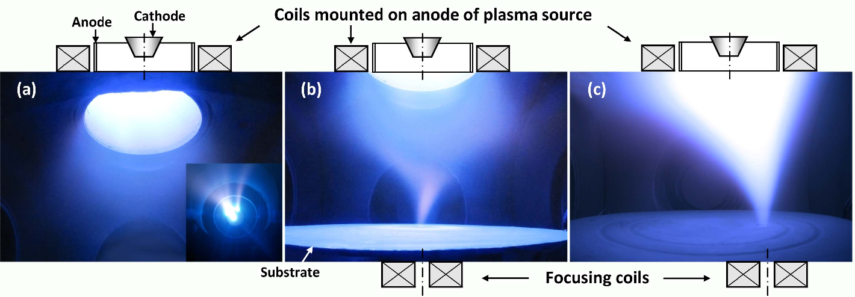
Vacuum arcs
It turns out that arc plasma does not need gas background to operate.
The plasma is ignited in the metal vapors that are emitted from the cathode
Vacuum arcs have been ignited at pressures of 10⁻⁴ or even 10⁻⁶ Pa

Slide 26
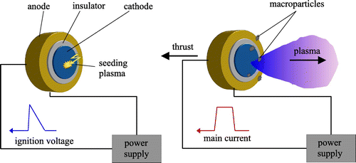
Vacuum arcs
Vacuum arcs are very different from conventional arcs that operate at 1000 Pa – 1 atm.
In the cathode spot, the plasma density can reach 10²⁵-10²⁶ m⁻³ (yes, over 1 atm of plasma) even if it is surrounded by high vacuum
The remarkable gradient in plasma properties causes hypersonic expansion of the plasma plume, which attains the drift velocity of
10 – 50 km/s (Mach 20 – Mach 120)
It has been extensively researched for
satellite electric propulsion, but the main
applications are PVD coatings.

Slide 27
Applications of arc plasmas

Slide 28
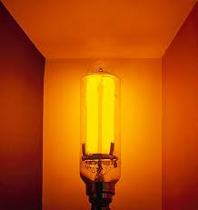
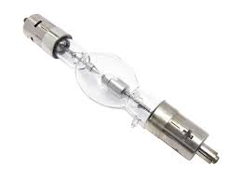
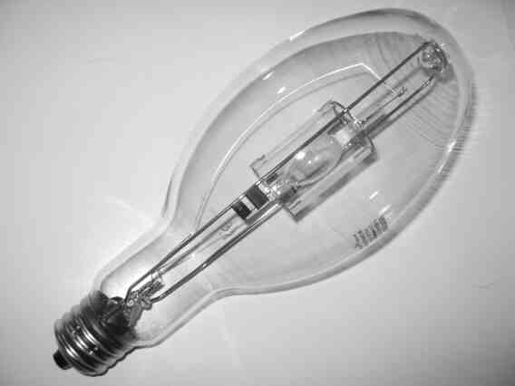
Application – Lighting
Sodium arc lamps – only scalable source of large-area lighting before the recent scaling of LEDs. Low ionization potential of sodium and pleasant emission current made them the most energy efficient source of lighting until ca 2020
Xenon arc lamps for automotive applications – also surpassed by LEDs.
HID lamps (high-intensity discharge) – typically operated in mercury vapors with dopants. But mercury does not produce UV, it emits through blackbody radiation.

Slide 29
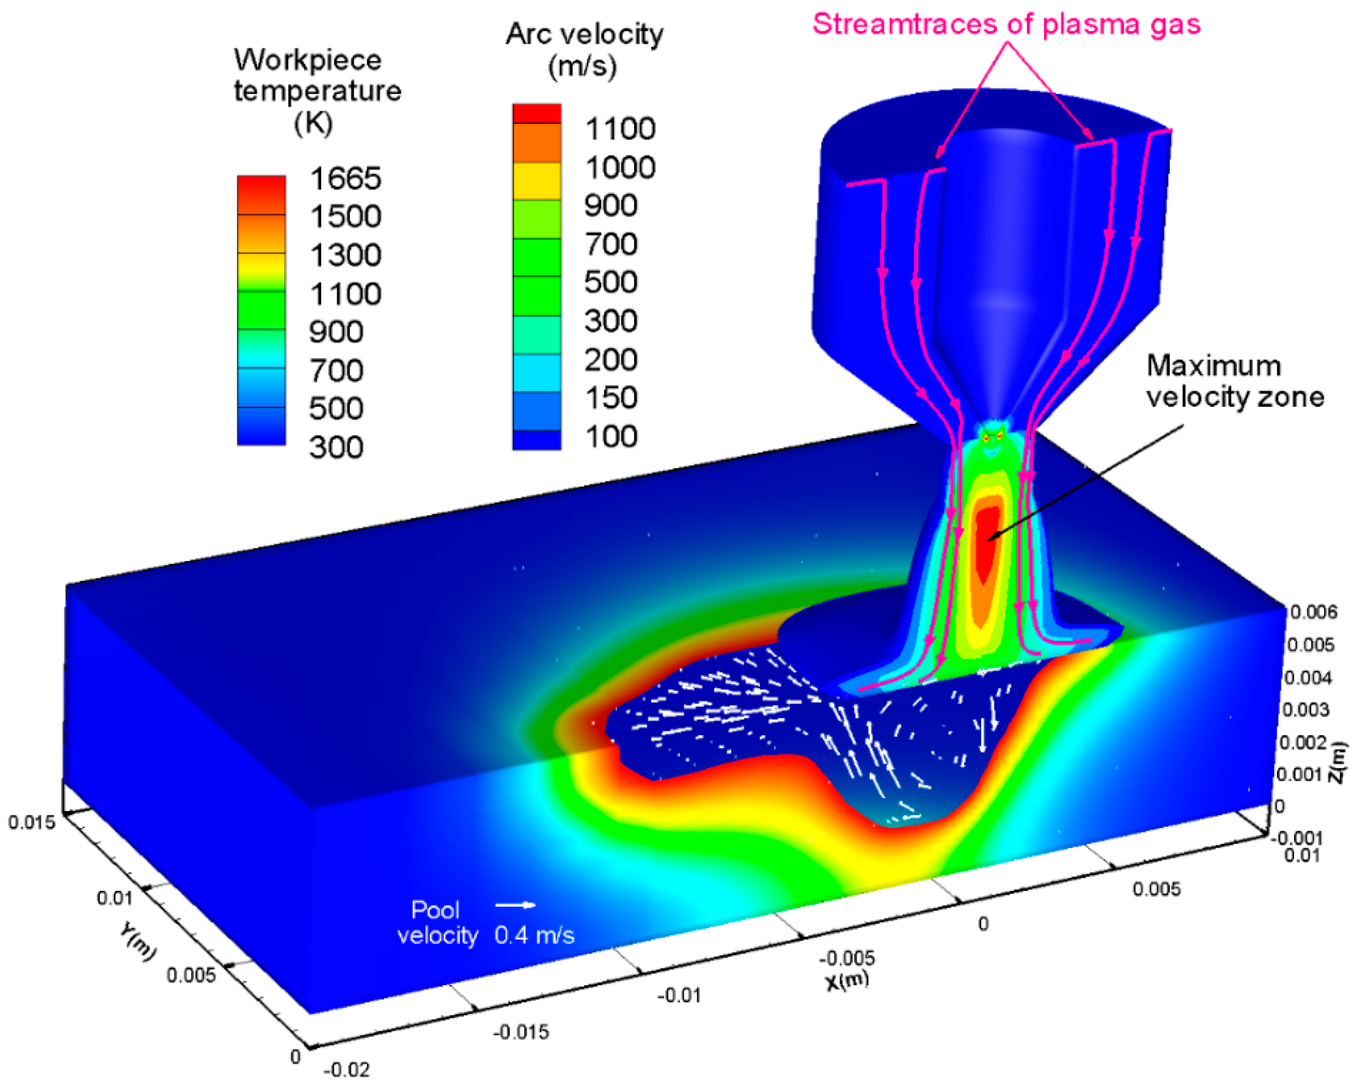
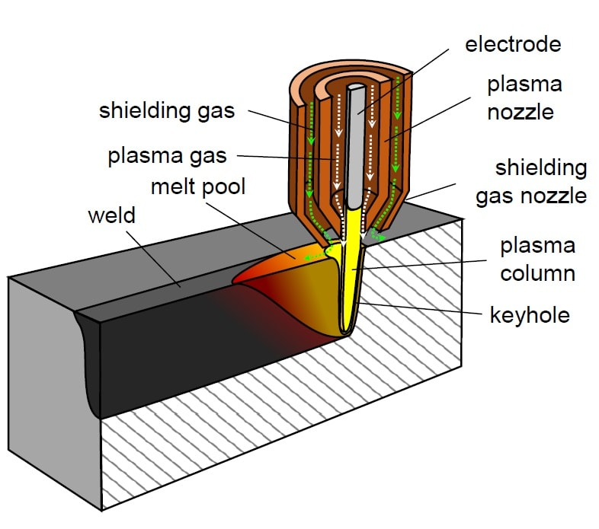
Application – Welding
Plasma welding is probably the most widely used application of arcs.
Apart from regular welding machines that you can find in every dad’s garage, there are highly specialized devices for industrial use.
These devices typically combine arc cathode with the welded piece as an anode and there is active gas flow through the cathode.
Enables high-precision welding and joining.

Slide 30
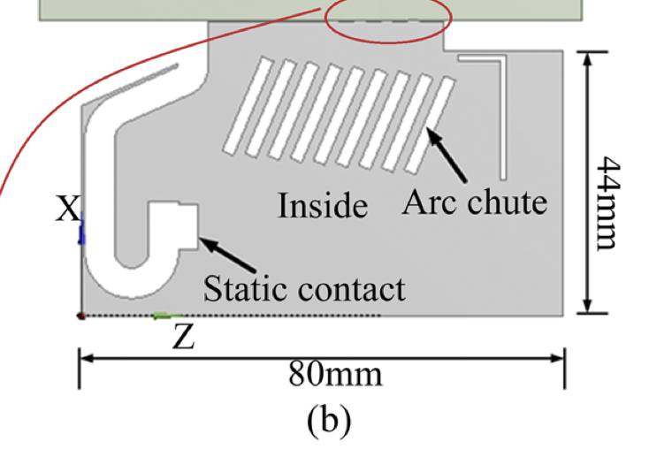
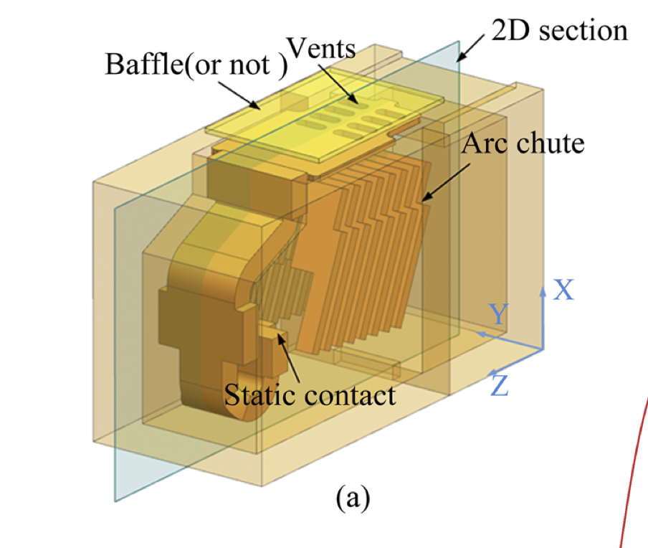
Application – Circuit breakers
If a high-power circuit is disconnected, there is a lot of energy that needs to be dissipated.
That energy can be dissipated into forming a plasma discharge.
Obviously, the discharge is parasitic, unwanted => people use gases which are really bad for generating plasma. Typically SF6
These gases are called “electronegative” gases, because they prefer to form negative ions rather than positive.
In Prague, there is a big research centre of EATON working on these – job opprotunity.

Slide 31
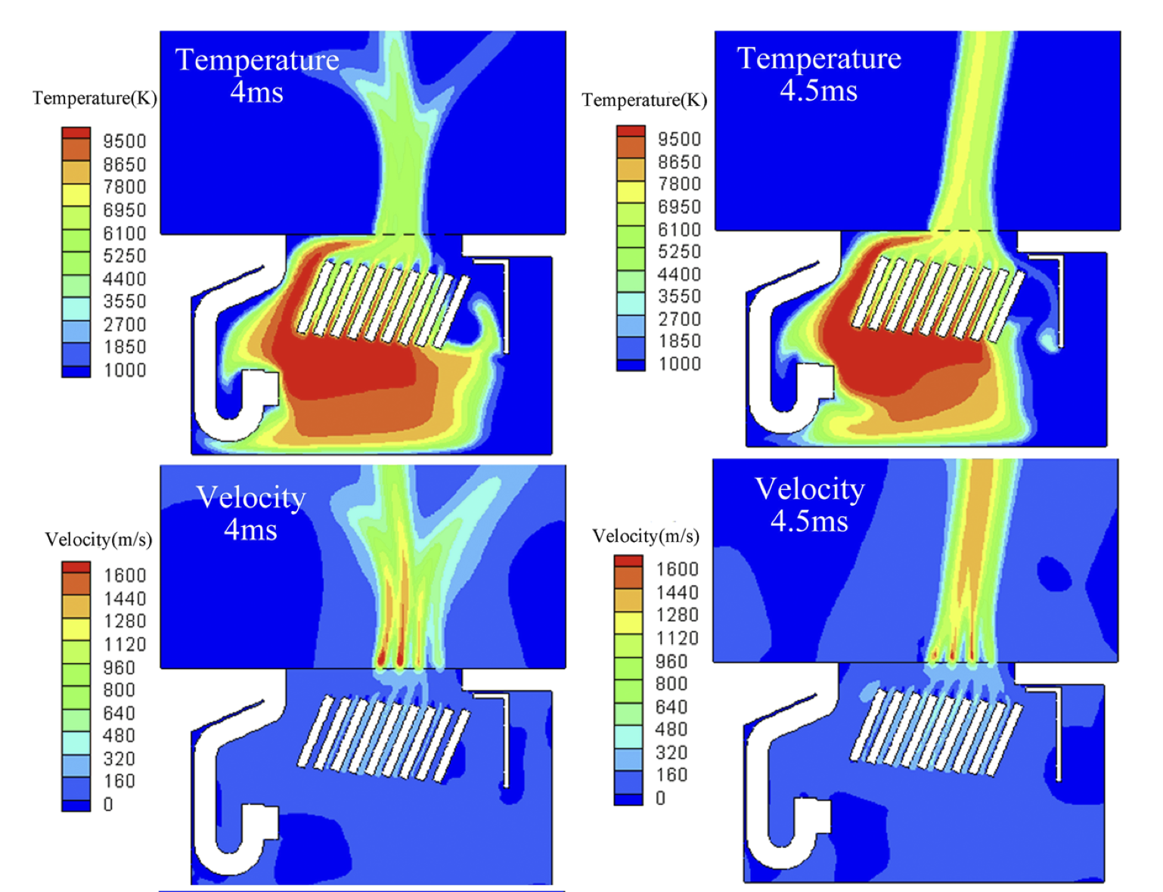
Application – Circuit breakers
If a high-power circuit is disconnected, there is a lot of energy that needs to be dissipated.
That energy can be dissipated into forming a plasma discharge.
Obviously, the discharge is parasitic, unwanted => people use gases which are really bad for generating plasma. Typically SF6

Slide 32
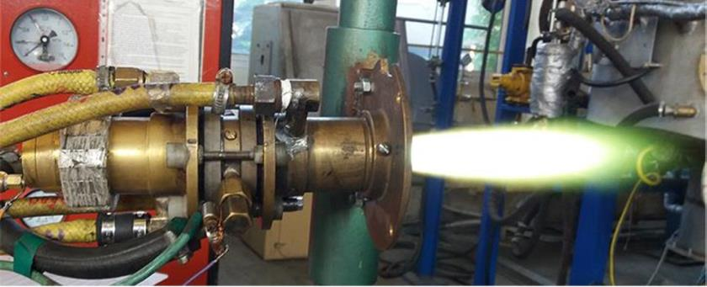
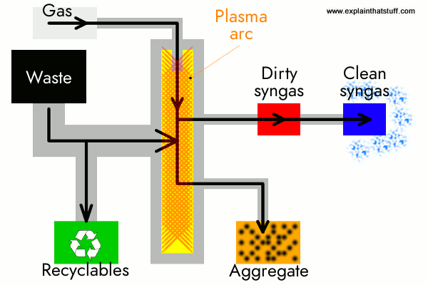
Application – Plasma Catalysis
Plasma catalysis is an emerging “green” application. Where not only arc plasmas ar used.
The idea is converting waste gases to value-added chemicals, e.g. converting CH₄ from biomass to H₂ or converting CO₂ to syngas, that can be re-used as fuel.
Arc plasmas are used rather often in this type of projects because of their scalability, fast switching times, robustness, and off-the-shelf availability.

Slide 33
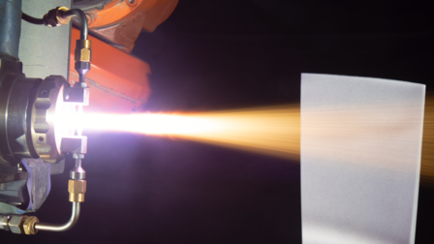
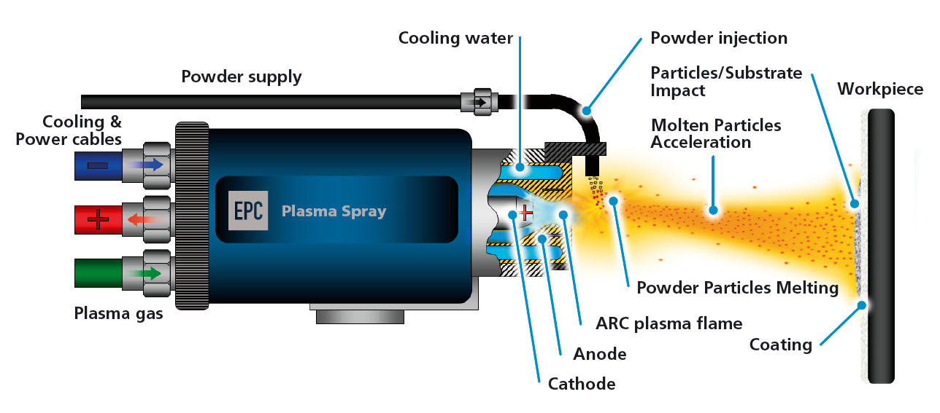
Application – Plasma Spraying
Extremely important in all mechanical industries
Solid microparticles melted or evaporated in the plasma and deposited onto substrates to form hard / low friction / thermal barrier coatings.
This is used especially for jet engine turbine blades or for mechanically stressed components in power generation applications.
Alternative/parallel to low pressure PVD – plasma
spraying is much faster but produces much
“dirtier” and rougher materials.

Slide 34
Take aways
Mechanisms of arc plasma formation
Surface phenomena – thermoemission and field emission and what they depend on.
Properties of an arc discharge
Modeling strategies for high power LTE arcs – Saha, Ellenbaas-Heller, non-linear thermodynamic properties.
Overview of applications

