Slide 1
Plasma Physics 2
Adam Obrusník, adamobrusnik@physics.muni.cz
Tomáš Hoder, hoder@physics.muni.cz

Slide 2
Lecture series contents
Townsend breakdown theory, Paschen‘s law
Glow discharge
Electric arc at low and high pressures
Magnetized low-pressure plasmas and their role in material deposition methods.
Brief introduction to high-frequency discharges
Streamer breakdown theory, corona discharge, spark discharge
Barrier discharges
Leader discharge mechanism, ionization and discharges in planetary atmospherres
Discharges in liquids, complex and quantum plasmas
Thermonuclear fusion, Lawson criterion, magnetic confinement systems, plasma heating and intertial confinement fusion.

Slide 3
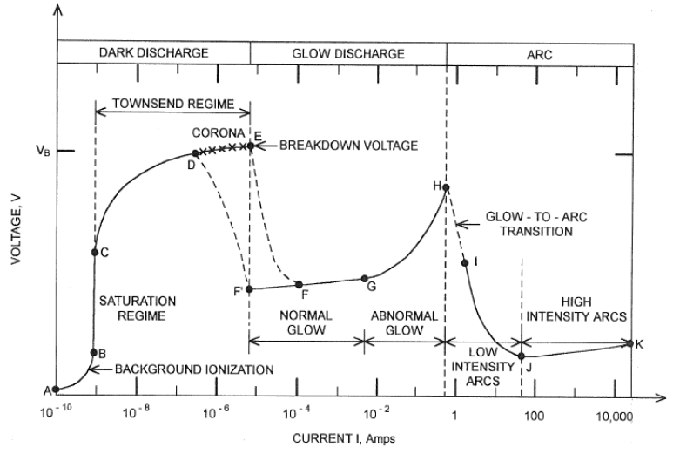
Discharges – what this Lesson covers?

Slide 4
Contents of this lesson
The diffusivity tensor – why do we magnetize plasma?
Estimating when the magnetic confinement makes sense – numerical assessment and intro to BOLSIG+
Important applications of magnetized plasmas:
  Magnetron sputtering PVD and its broad applications.
  Vacuum arc PVD
  ECR particle generators
  Hall thrusters

Slide 5
The diffusivity tensor – why do we magnetize plasma

Slide 6
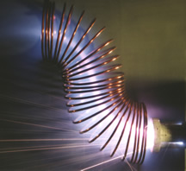
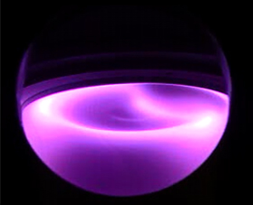
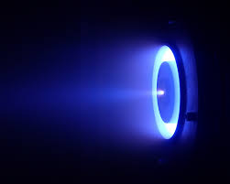
Why do we magnetize plasma?
To control its spatial distribution or to provide ExB acceleration…
Magnetron sputtering plasma (likely a wafer processing setup)
Filtered vacuum arc
Hall thruster for satellites

Slide 7
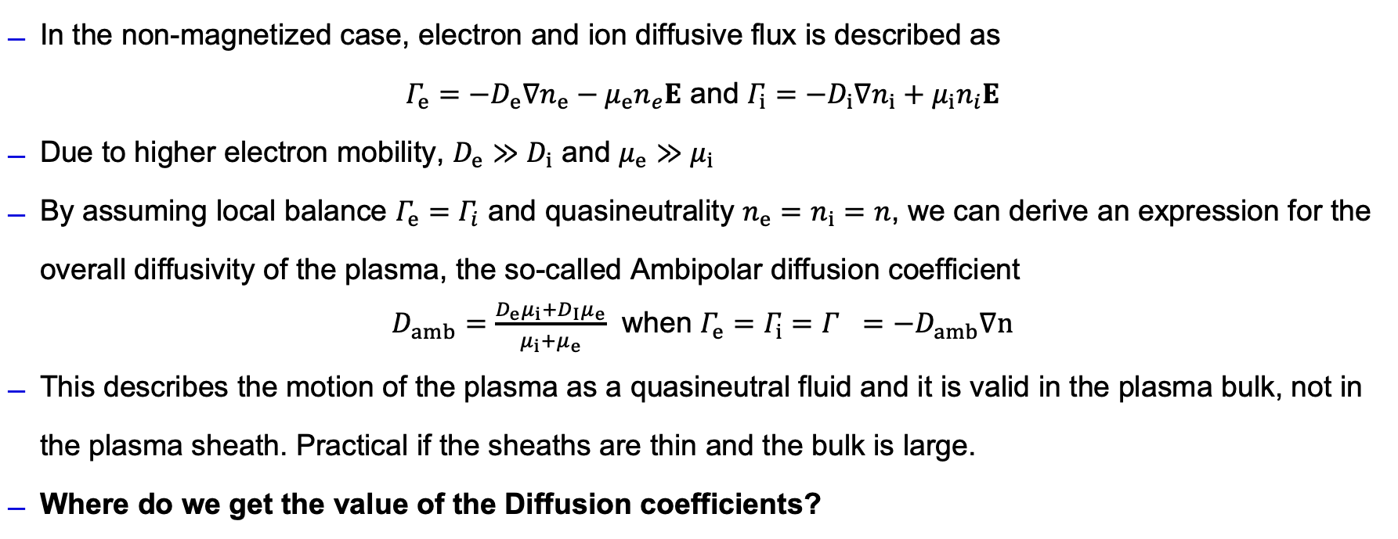
Why do we magnetize plasma?
In the non-magnetized case, electron and ion diffusive flux is described as
$Γ_{e}=−D_{e}∇n_{e}−μ_{e}n_{e}E$ and $Γ_{i}=−D_{i}∇n_{i}+μ_{i}n_{i}E$
Due to higher electron mobility, $D_{e}≫D_{i}$ and $μ_{e}≫μ_{i}$
By assuming local balance $Γ_{e}=Γ_{i}$ and quasineutrality $n_{e}=n_{i}=n$, we can derive an expression for the overall diffusivity of the plasma, the so-called Ambipolar diffusion coefficient
$D_{amb}=\frac{D_{e}μ_{i}+D_{I}μ_{e}}{μ_{i}+μ_{e}}$ when $Γ_{e}=Γ_{i}=Γ_{}=−D_{amb}∇n$
This describes the motion of the plasma as a quasineutral fluid and it is valid in the plasma bulk, not in the plasma sheath. Practical if the sheaths are thin and the bulk is large.
Where do we get the value of the Diffusion coefficients?
AO’s favourite reference for all the derivations mentioned here is the Liebermann book

Slide 8
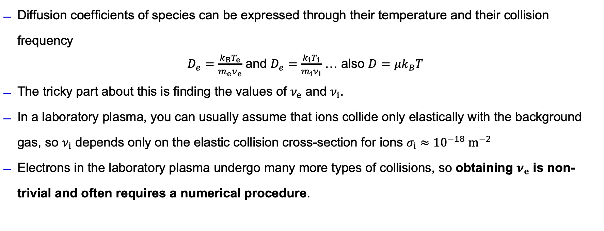
Values of diffusion coefficients
Diffusion coefficients of species can be expressed through their temperature and their collision frequency
$D_{e}=\frac{k_{B}T_{e}}{m_{e}ν_{e}}$ and $D_{e}=\frac{k_{i}T_{i}}{m_{i}ν_{i}}$ … also $D=μk_{B}T$
The tricky part about this is finding the values of $ν_{e}$ and $ν_{i}$.
In a laboratory plasma, you can usually assume that ions collide only elastically with the background gas, so $ν_{i}$ depends only on the elastic collision cross-section for ions $σ_{i}≈{10}^{−18} m^{−2}$
Electrons in the laboratory plasma undergo many more types of collisions, so obtaining $ν_{e}$ is non-trivial and often requires a numerical procedure.
AO’s favourite reference for all the derivations mentioned here is the Liebermann book

Slide 9
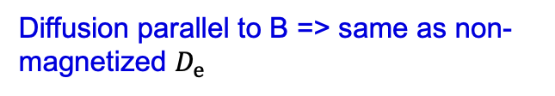
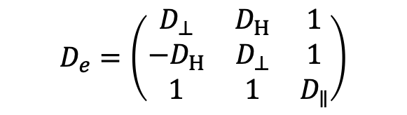

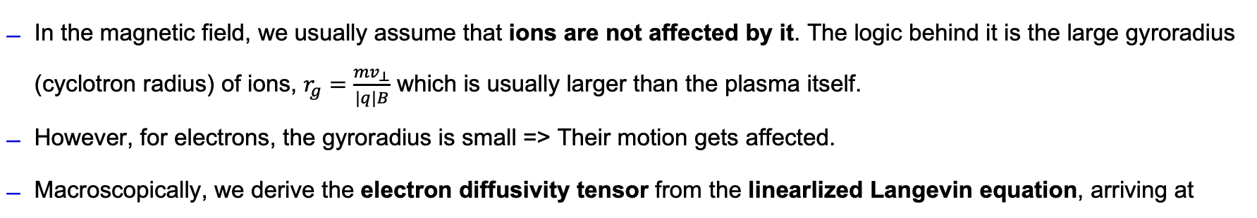
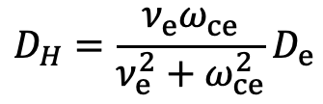
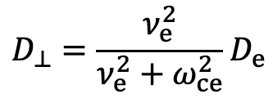

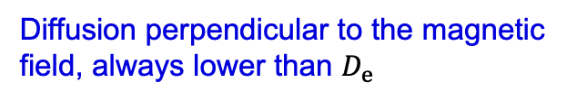
Magnetized diffusion
In the magnetic field, we usually assume that ions are not affected by it. The logic behind it is the large gyroradius (cyclotron radius) of ions, $r_{g}=\frac{mv_{⊥}}{|q|B}$ which is usually larger than the plasma itself.
However, for electrons, the gyroradius is small => Their motion gets affected.
Macroscopically, we derive the electron diffusivity tensor from the linearlized Langevin equation, arriving at
$$Γ_{e}=−D_{e}⋅∇n_{e}$$
$$D_{⊥}=\frac{ν_{e}^{2}}{ν_{e}^{2}+ω_{ce}^{2}}D_{e}$$
Diffusion perpendicular to the magnetic field, always lower than $D_{e}$
$$D_{e}=\left(\begin{matrix}D_{⊥} & D_{H} & 1 \\ −D_{H} & D_{⊥} & 1 \\ 1 & 1 & D_{∥}\end{matrix}\right)$$
$$D_{H}=\frac{ν_{e}ω_{ce}}{ν_{e}^{2}+ω_{ce}^{2}}D_{e}$$
Hall diffusion (e.g. gradient in X causes diffusion in Y direction)
$$D_{∥}=D_{e}$$
Diffusion parallel to B => same as non-magnetized $D_{e}$
AO’s favourite reference for all the derivations mentioned here is the Liebermann book

Slide 10
Magnetized diffusion
Magnetic field hinders diffusion of electrons in the direction perpendicular to it => electrons get more confined
Due to the plasma space charge, ions get confined as well
There is then something like „magnetized ambipolar diffusion“, but it cannot be expressed analytically.
$$Γ_{e}=−D_{e}⋅∇n_{e}$$
$$D_{⊥}=\frac{ν_{e}^{2}}{ν_{e}^{2}+ω_{ce}^{2}}D_{e}$$
Diffusion perpendicular to the magnetic field, always lower than $D_{e}$
$$D_{e}=\left(\begin{matrix}D_{⊥} & D_{H} & 1 \\ −D_{H} & D_{⊥} & 1 \\ 1 & 1 & D_{∥}\end{matrix}\right)$$
$$D_{H}=\frac{ν_{e}ω_{ce}}{ν_{e}^{2}+ω_{ce}^{2}}D_{e}$$
Hall diffusion (e.g. gradient in X causes diffusion in Y direction)
$$D_{∥}=D_{e}$$
Diffusion parallel to B => same as non-magnetized $D_{e}$
AO’s favourite reference for all the derivations mentioned here is the Liebermann book

Slide 11
Why do we magnetize plasma?
Just by looking at these plasmas, we can sometimes guess the direction of B fields
Magnetron sputtering plasma (likely a wafer processing setup)
Filtered vacuum arc
Hall thruster for satellites

Slide 12
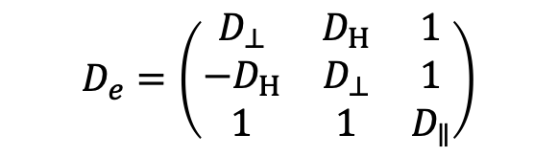
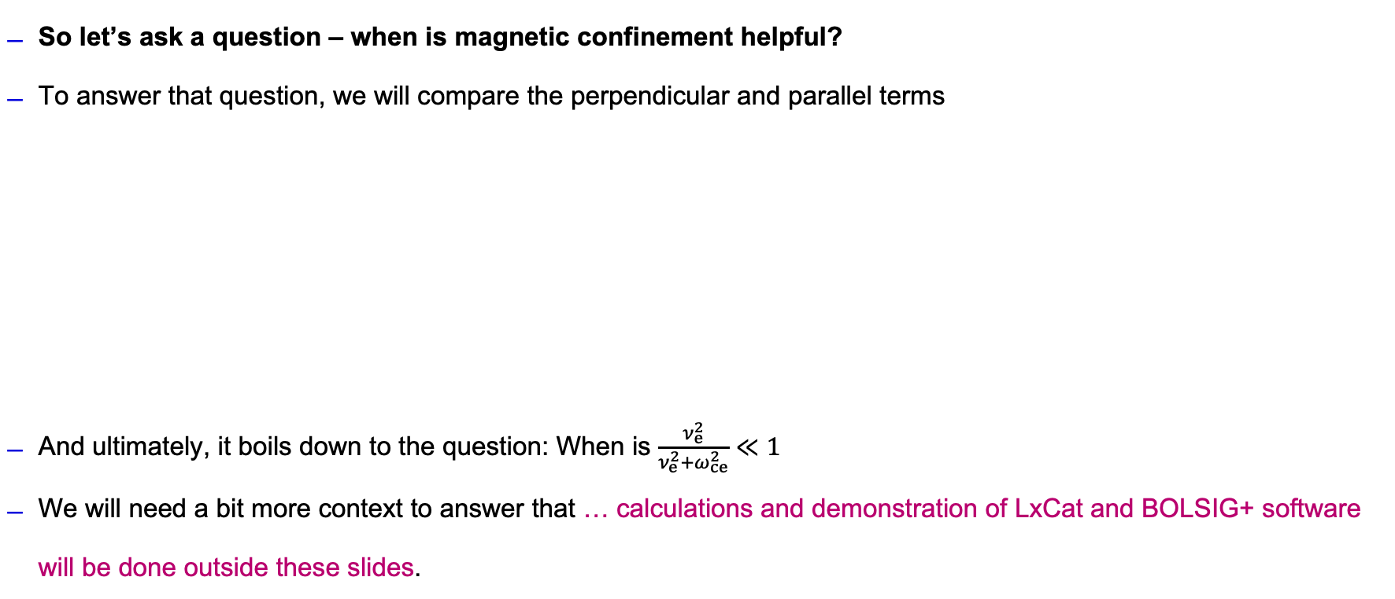

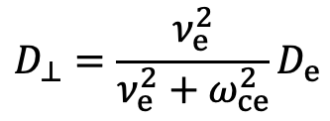
Magnetized diffusion - quantifying
So let’s ask a question – when is magnetic confinement helpful?
To answer that question, we will compare the perpendicular and parallel terms
And ultimately, it boils down to the question: When is $\frac{ν_{e}^{2}}{ν_{e}^{2}+ω_{ce}^{2}}≪1$
We will need a bit more context to answer that … calculations and demonstration of LxCat and BOLSIG+ software will be done outside these slides.
$$D_{e}=\left(\begin{matrix}D_{⊥} & D_{H} & 1 \\ −D_{H} & D_{⊥} & 1 \\ 1 & 1 & D_{∥}\end{matrix}\right)$$
$$D_{⊥}=\frac{ν_{e}^{2}}{ν_{e}^{2}+ω_{ce}^{2}}D_{e}$$
$$D_{∥}=D_{e}$$

Slide 13
Magnetized diffusion - quantifying
We learned a few things:
With permanent magnets, we can only confine plasma at the low pressures
At higher pressures or even atm. pressure, extremely high B field would be required for the confinement, attainable only by coils, ideally superconducting ☺
At high pressures, the high collisionality breaks the confinement
On a microscopic level, we can imagine that the gyrating electron undergoes too many collisions during one gyration.

Slide 14
Applications of magnetized plasma

Slide 15
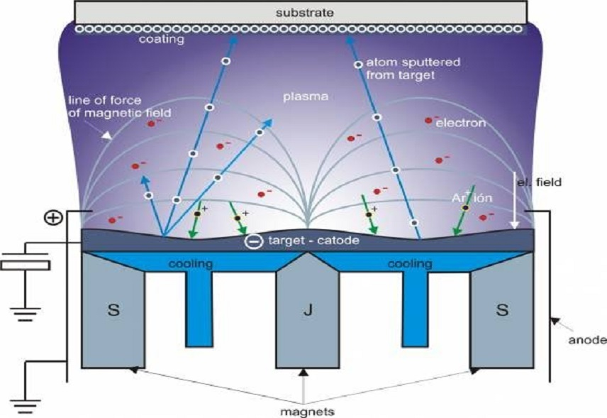
Applications – magnetron sputtering
Magnetron sputtering is a so called PVD (physical vapor deposition) technique for converting solids to gases at the low temperature.
On the plasma physics level, it is a magnetized glow discharge.

Slide 16
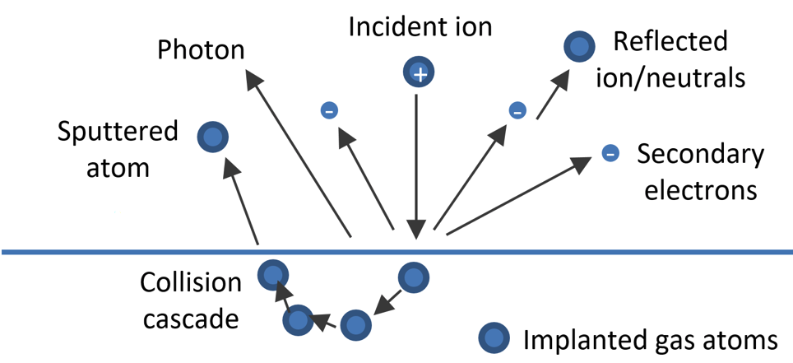
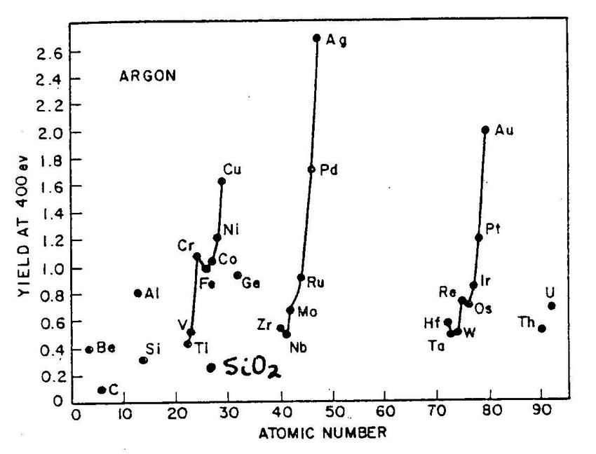
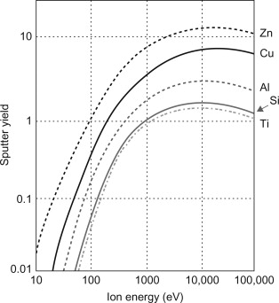
Applications – magnetron sputtering
On the surface, the the so-called collision cascade can occur, whereby a neutral atom is knocked off the solid phase by an incoming ion at high kinetic energy https://www.youtube.com/watch?v=TyYBIj-A9tY
This effect occurs if the ion energy is significantly above the suface binding energy (10-20 eV).
The probability of this effect is called the sputtering yield and depends highly on material

Slide 17
Applications – magnetron sputtering
Why cannot we sputter without B field, e.g. by increasing the pressure?
Our primary objective is depositing metal atoms onto the surface. The higher the pressure, the more they will scatter and the larger the material loss.
We want to have plasma at as low pressure as possible but still as dense as possible => This is usually the argument for magnetizing plasmas ☺
Magnetic field ensures that the plasma is dense where we want it – at the surface of the sacrificial cathode.

Slide 18
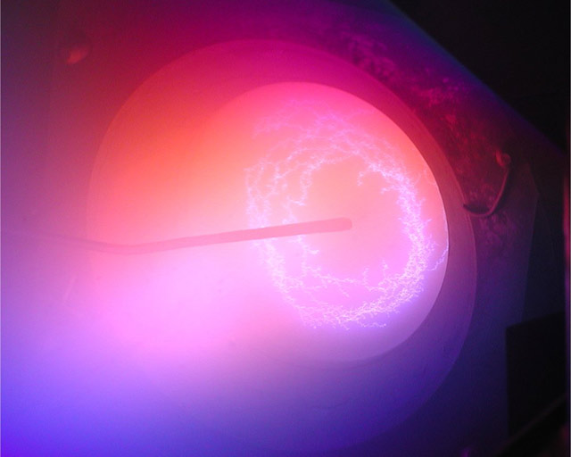
Applications – low pressure vacuum arc
In a vacuum arc PVD, almost an identical B field setup is used but for different reasons!
Also, gas pressure in vacuum arcs is higher, about 1-3 Pa.
The plasma is not a nice and stable glow discharge but a rather stochastic arc discharge. https://www.youtube.com/shorts/rx6uX3g1Ss8

Slide 19
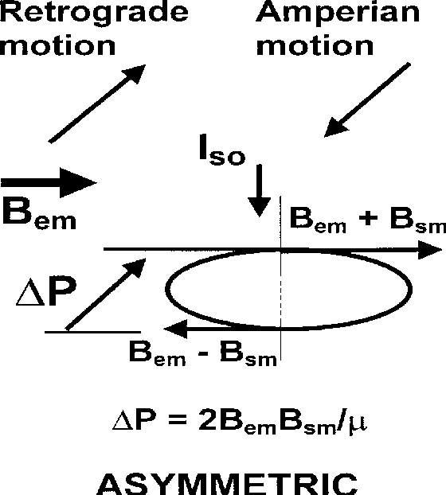
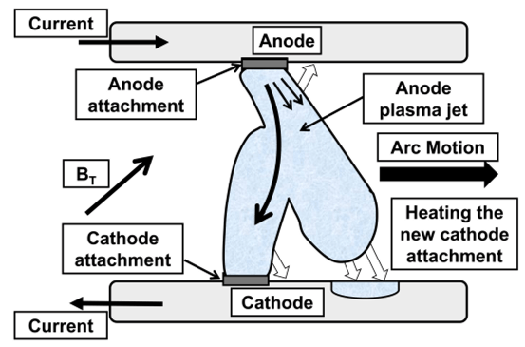
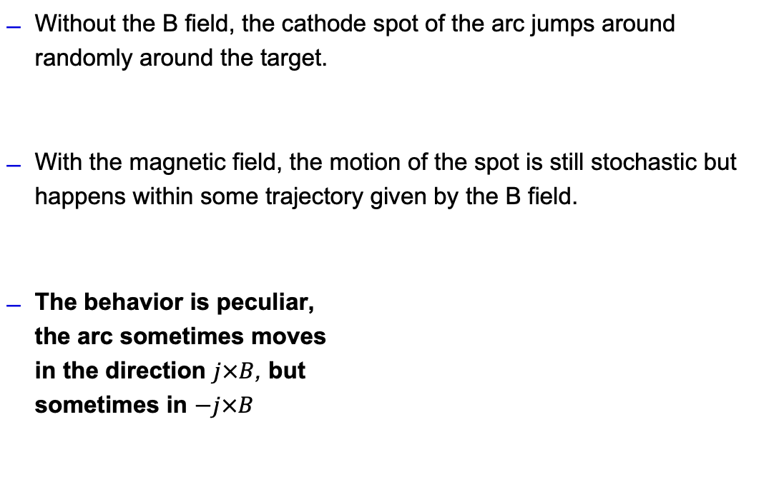
Applications – low pressure vacuum arc
Without the B field, the cathode spot of the arc jumps around randomly around the target.
With the magnetic field, the motion of the spot is still stochastic but happens within some trajectory given by the B field.
The behavior is peculiar,
the arc sometimes moves
in the direction $j×B$, but
sometimes in $−j×B$

Slide 20
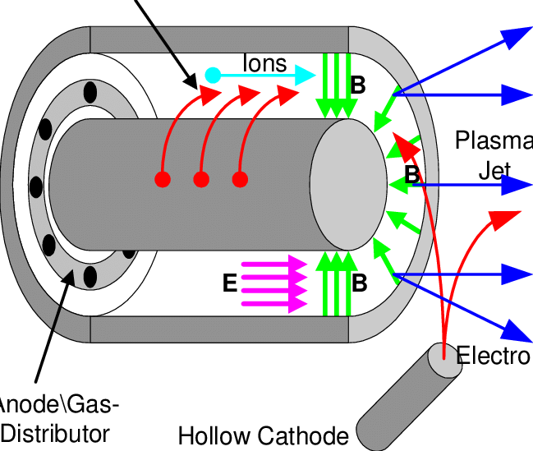
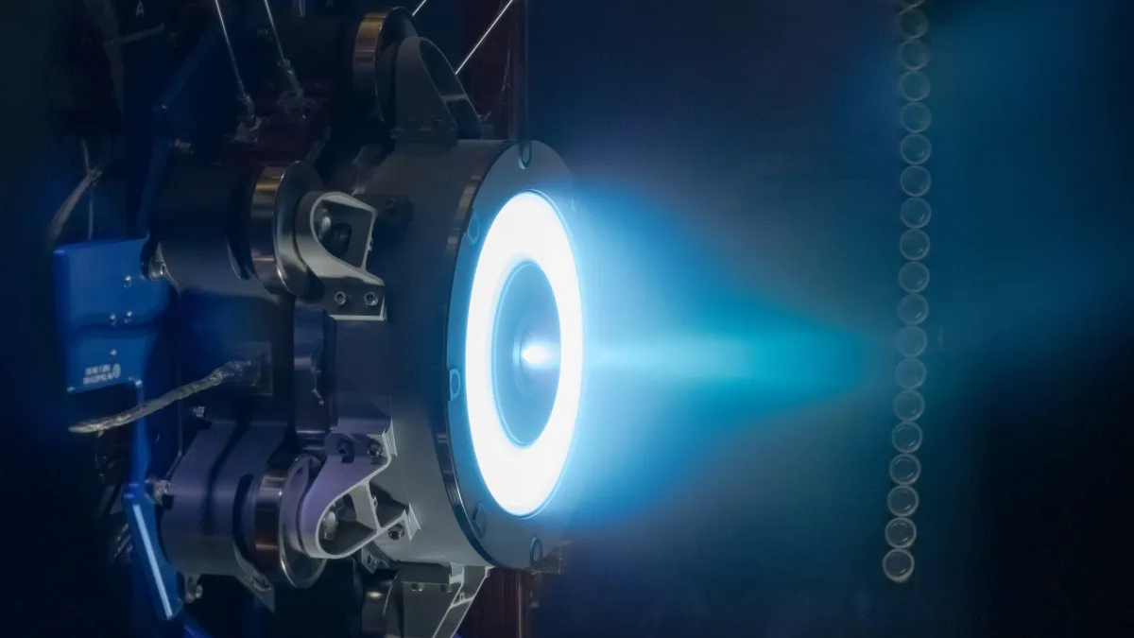
Application – Hall thrusters
One of the most established methods of satellite electric propulsion.
Plasma is accelerated through ExB drift and the extracted plasma is quasineutral

Slide 21
Take aways
Why use magnetic field in a plasma?
How to quantify when magnetizing the plasma is going to have some effect?
Applications of magnetized plasma discharges and difference between the magnetic field role in arc PVD and sputter PVD

