Slide 1
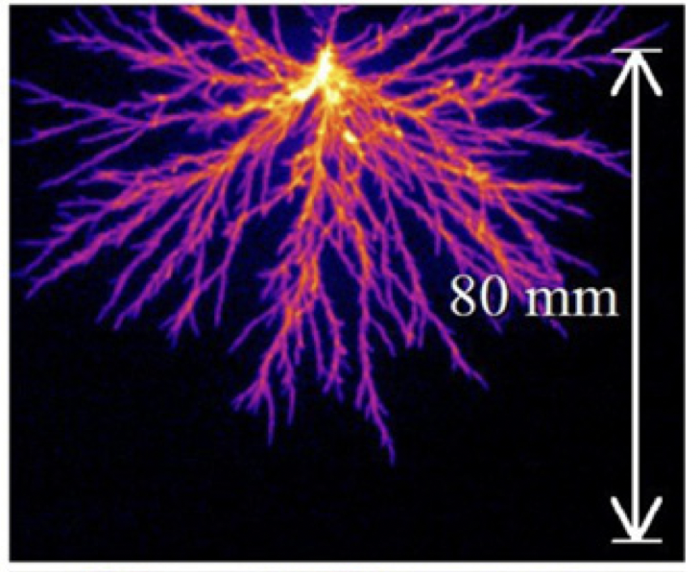

Plasma Physics 2
5. 5. Streamer breakdown mechanism
Korona discharge
Spark discharge
TU Eindhoven
Notes:
Vylepsit …

Slide 2
Lecture series contents
Townsend breakdown theory, Paschen‘s law
Glow discharge
Electric arc at low and high pressures
Magnetized low-pressure plasmas and their role in material deposition methods.
Brief introduction to high-frequency discharges
Streamer breakdown theory, corona discharge, spark discharge
Barrier discharges
Leader discharge mechanism, ionization and discharges in planetary atmospherres
Discharges in liquids, complex and quantum plasmas
Thermonuclear fusion, Lawson criterion, magnetic confinement systems, plasma heating and intertial confinement fusion.
1
Notes:
Pozor je to pro verejnost … jednoduseji, schemata nazorna, ne moc analyz, jen par rovnic

Slide 3
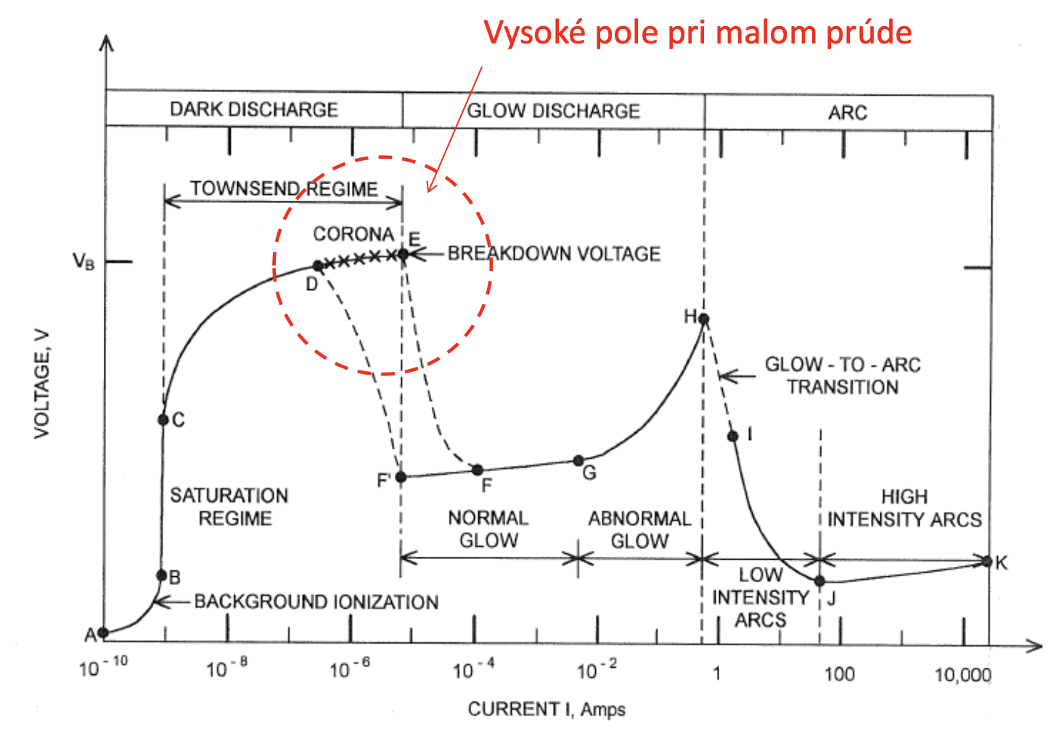
Where are we on the IV chart
At some conditions, the transition from Townsend to glow si not as „smooth“ and gradual as we explained.
At high fields, low currents and typically higher pressures, a filamentary structure typically called a „Streamer“ starts to form
https://en.wikipedia.org/wiki/Streamer_discharge Explore video of streamer formation
2
Notes:
Pozor je to pro verejnost … jednoduseji, schemata nazorna, ne moc analyz, jen par rovnic

Slide 4
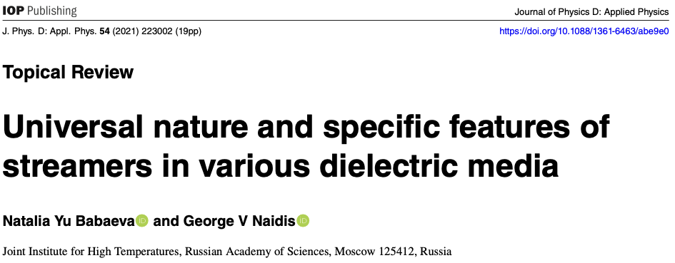
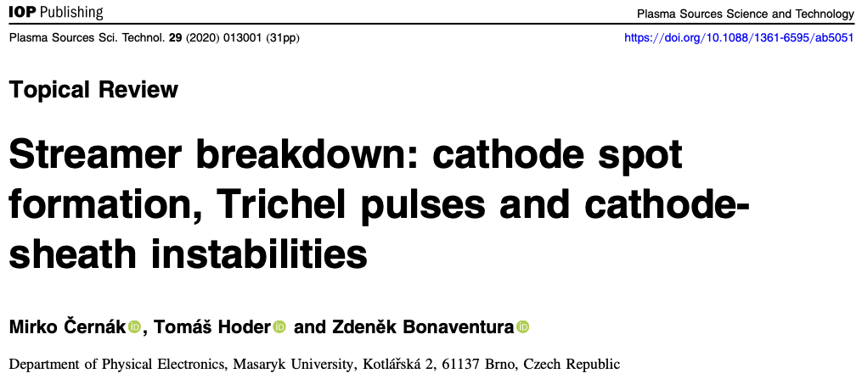
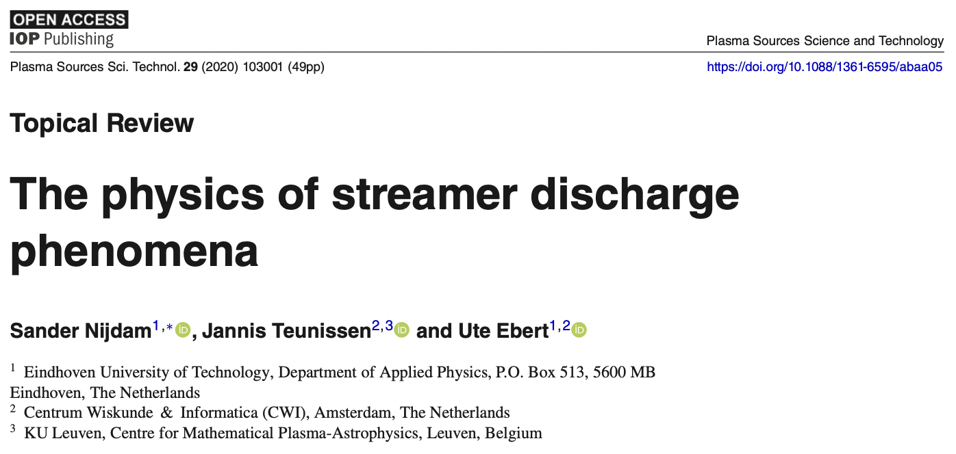
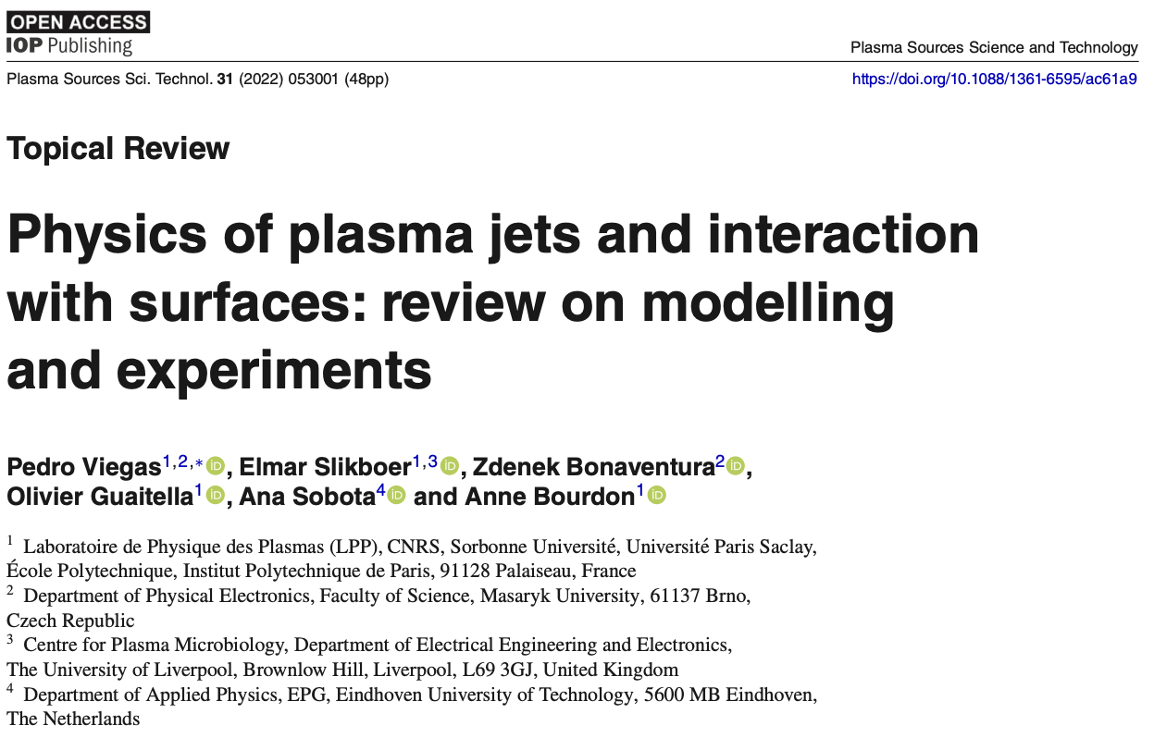
Streamer physics is a living topic
Even though the interest peaked around the mid 2010s, it is still of interest
There are no „definitive answers“, so whatever we are teaching here is an attempt to capture the best current theory for streamer formation that will likely be improved in future.
3
Notes:
Pozor je to pro verejnost … jednoduseji, schemata nazorna, ne moc analyz, jen par rovnic

Slide 5
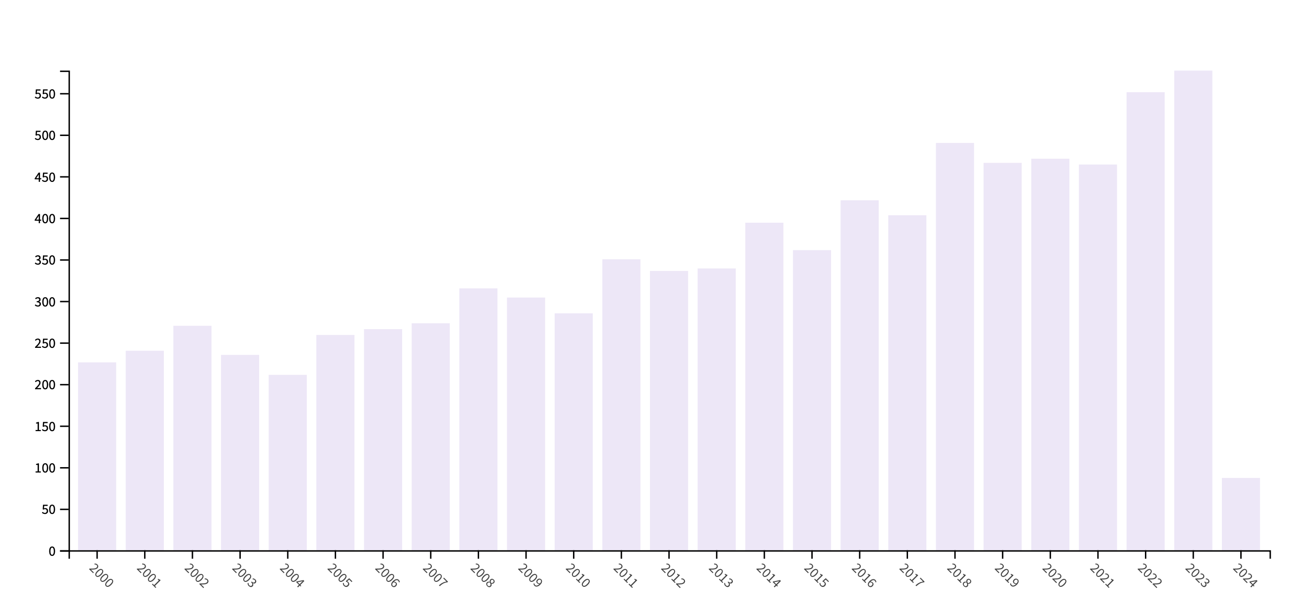
Streamer physics is a living topic
Even though the interest peaked around the mid 2010s, it is still of interest
There are no „definitive answers“, so whatever we are teaching here is an attempt to capture the best current theory for streamer formation that will likely be improved in future.
3
Notes:
Pozor je to pro verejnost … jednoduseji, schemata nazorna, ne moc analyz, jen par rovnic

Slide 6
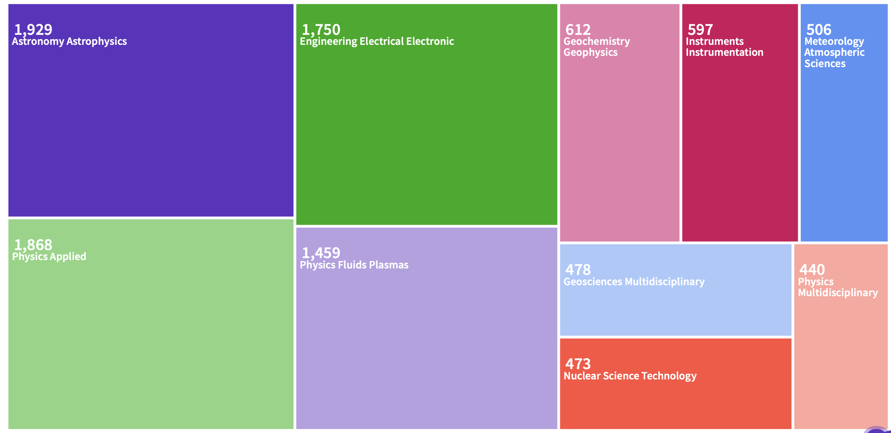
Streamer physics is a living topic
Even though the interest peaked around the mid 2010s, it is still of interest
There are no „definitive answers“, so whatever we are teaching here is an attempt to capture the best current theory for streamer formation that will likely be improved in future.
Streamers are important in geophysics, biophysics, and in planetary plasma research, as well as on-ground uses
3
Notes:
Pozor je to pro verejnost … jednoduseji, schemata nazorna, ne moc analyz, jen par rovnic

Slide 7
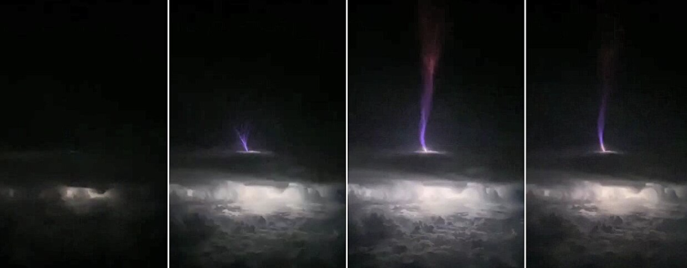

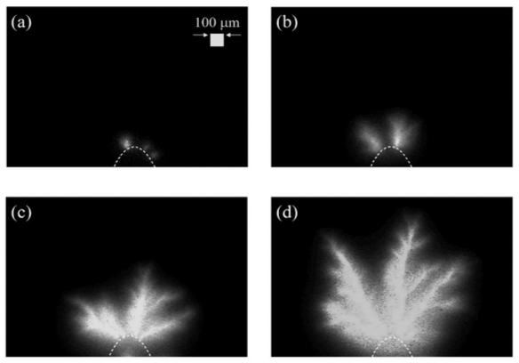
Examples of streamers
There are no „definitive answers“, so whatever we are teaching here is an attempt to capture the best current theory for streamer formation that will likely be improved in future.
Upper atmospheric lightning
Nanosecond discharge in liquid water
(M.Šimek, CAS, Praha)
4
Notes:
Pozor je to pro verejnost … jednoduseji, schemata nazorna, ne moc analyz, jen par rovnic

Slide 8
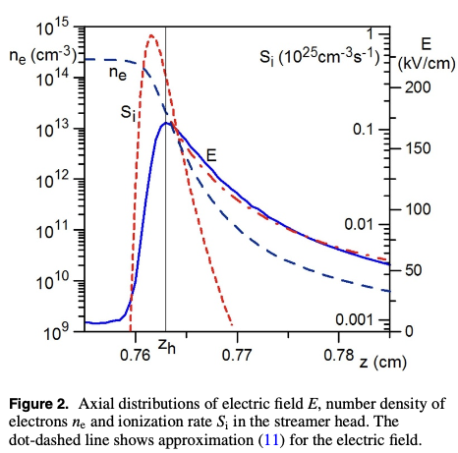
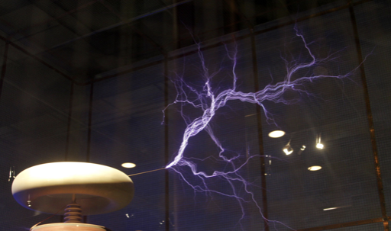
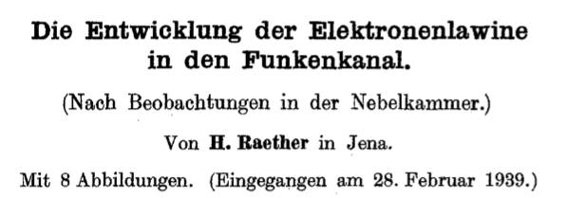
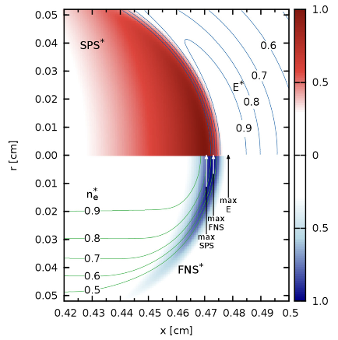
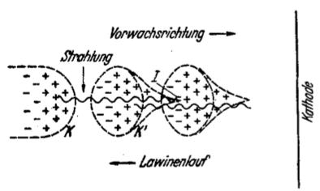
Terminology associated with streamers
Engineering / historical understanding of streamer = filamentary discharge
Physics description of a ”streamer head”
5
Notes:
Pozor je to pro verejnost … jednoduseji, schemata nazorna, ne moc analyz, jen par rovnic

Slide 9
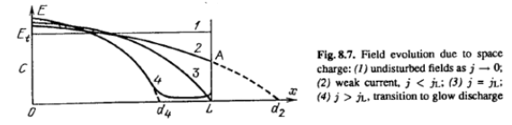
Streamer formation and its similarities with Townsend > Arc transition
In the previous description of glow discharge ignition, we have always assumed that the electron avalanche creates charge carriers and these move around between the electrodes, forming a diffuse discharge
But it can occur that electron avalanche itself forms sufficient space charge and turns into a plasma?
6
Notes:
Pozor je to pro verejnost … jednoduseji, schemata nazorna, ne moc analyz, jen par rovnic

Slide 10



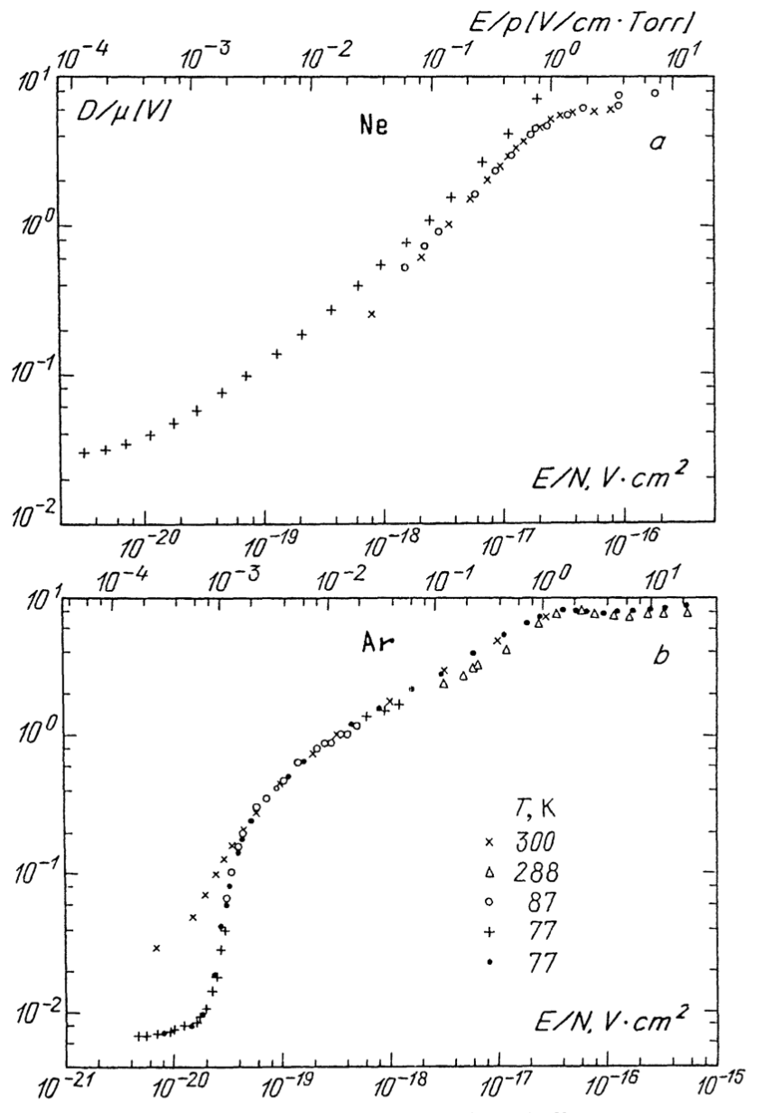
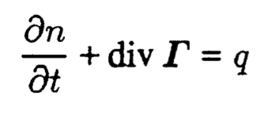
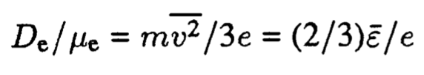
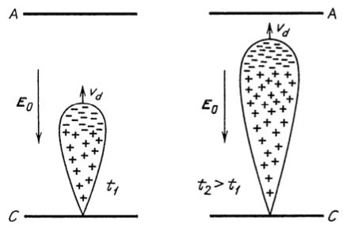
Electron avalanche and its transition to quasineutral plasma
Take the expression for the drift-diffusion flux of charge carriers
Approximate the diffusion coefficient as
And substitute to
a analogií Einsteinova vztahu pro elektrony:
šířící se elektronová lavina:
7
Notes:
Pozor je to pro verejnost … jednoduseji, schemata nazorna, ne moc analyz, jen par rovnic

Slide 11






Rostoucí a expandující elektronová lavina
započítáme-li ionizaci a elektronový záchyt pak pro celkové počty elektronů a pozitivních i kladných iontů platí:
elektrony se šíří k anodě driftovou rychlostí:
a difůze hraje také svou roli při expanzi laviny kolem její axiální osy:
pro lokální elektronovou hustotu pak platí (z rovnice kontinuity):
platí při tom, jak už bylo naznačeno:
kde je střední energie elektronů
pozitivní ionty (díky své asi sto krát nižší pohyblivosti) zůstávají vůči elektronům stabilní a platí:
pokud zanedbáme záchyt elektronů a pro oblasti nedaleké od axiální osy pak:
čili hustota iontů roste exponenciálně směrem k anodě a klesá radiálně od axiální osy dle Gaussova rozdělení
8
Notes:
Pozor je to pro verejnost … jednoduseji, schemata nazorna, ne moc analyz, jen par rovnic

Slide 12
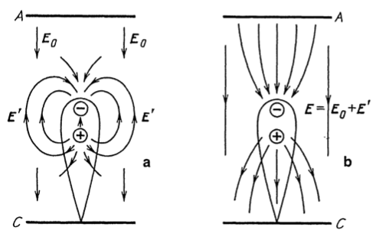


Electron avalanche and its transition to quasineutral plasma
If the avalanche has enough space and the external field E₀ is large enough, the space charge field E‘ becomes non-negligible
Electrons accumulate in the “head” of the streamer and the electric field drives further ionization and causes expansion.
The expansion rate of the approx. spherical ”streamer head” is driven by the electric field of the electrons themselves.
The field E‘ is proportional to R but the electron density is independent of E‘:
If the space-charge field becomes non-negligible compared to the external field, typically E‘ > 0.03 E₀, the effects of space charge become dominant and the avalanche transforms into a “negative streamer” – a filamentary type of plasma (quasineutral, collective)
9
Notes:
Pozor je to pro verejnost … jednoduseji, schemata nazorna, ne moc analyz, jen par rovnic

Slide 13
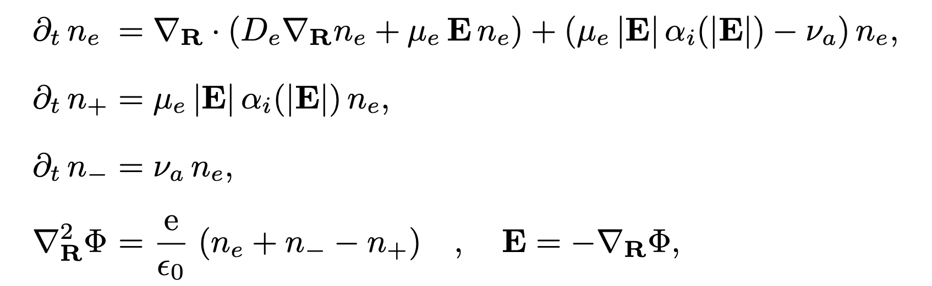
Electron avalanche and its transition to quasineutral plasma
We can have a look at the (minimum) streamer physics through equations https://arxiv.org/pdf/physics/0508109.pdf
Electrons are created in ionization collisions and lost through attachment
Positive are created through collisions and depend only on local electron density => streamers are so fast, that positive ions do not have time to be transported.
Same for negative ions, which are formed by attachment
9
Notes:
Pozor je to pro verejnost … jednoduseji, schemata nazorna, ne moc analyz, jen par rovnic

Slide 14
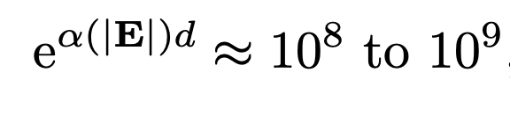
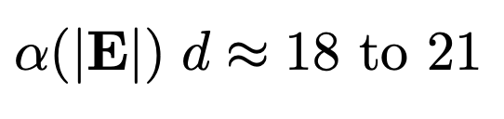
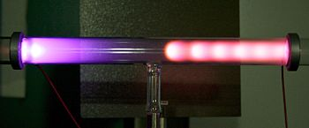
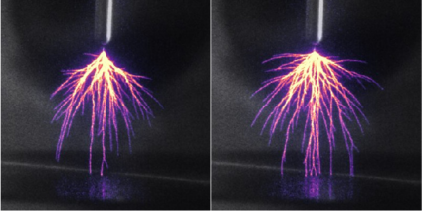
Raether-Meek criterion
The Raether-Meek criterion states the condition for streamer breakdown.
If the space charge field is E‘ > 0.03 E₀, the streamer forms.
Through numerical modeling, this can be translated to „Townsend terminology“ arriving at
This can be understood as a criterion describing at what conditions will an avalanche transition to a streamer, as opposed to a situation when an avalanche serves as a “seed” of charge carriers for igniting glow discharge plasma
10

Slide 15
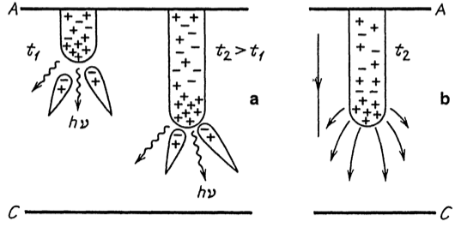
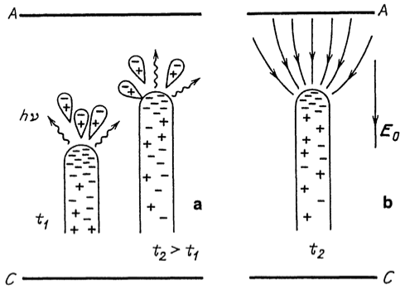
Positive vs negative streamers
Experience shows that there are two types of streamers – those propagating from a cathode and those propagating from an anode.
In positive streamers, the dominant ionization mechanism is photoionization.
In negative streamers, the dominant ionization mechanism is direct electron-impact ionization.
In both cases, the ionization occurs mostly in the streamer head, because the electric field is strong there.
Cathode streamer = positive streamer
Anode streamer = negative streamer
10

Slide 16

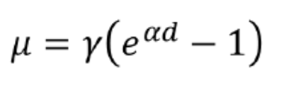
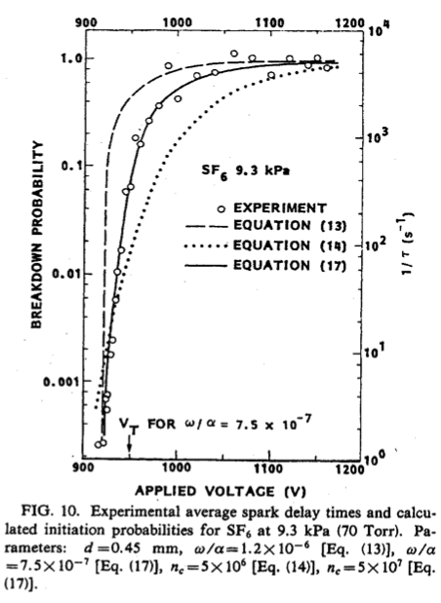
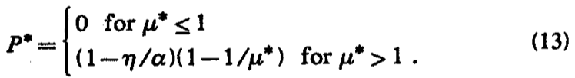

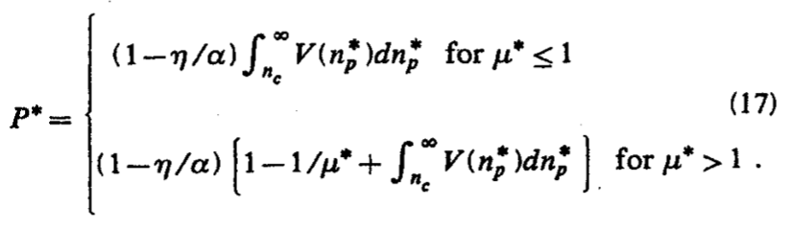
Statistical nature of breakdown in gases
Same as with Townsend breakdown, the streamer breakdown is also a statistical/random phenomenon!
After Wijsman (1943) and his work on statistical breakdown through Townsend mechanism, other theories have emerged which could also capture the transition from a Townsend mechanism to a streamer mechanism , e.g.Hodges (1985):
Breakdown probability for Townsend breakdown:
[Wijsman]
Breakdown probability for streamer breakdown:
Including attachment in Wijsman theory
Purely streamer breakdown with avalanches transitioning
into streamers
Unified ignition probability, considering both Townsend
breakdown and Streamer breakdown
11
Notes:
Pozor je to pro verejnost … jednoduseji, schemata nazorna, ne moc analyz, jen par rovnic

Slide 17
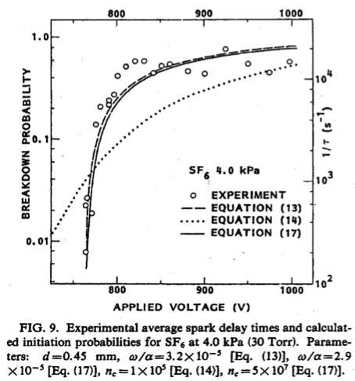
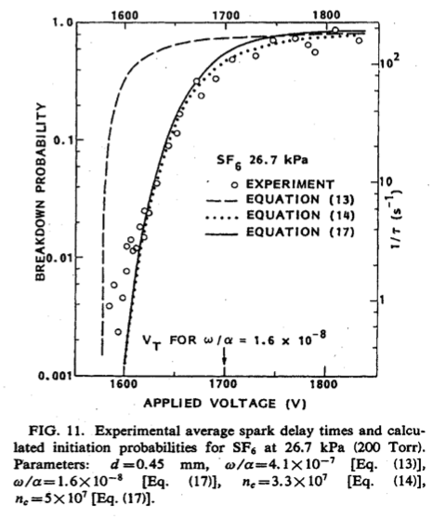
Statistical nature of breakdown in gases
With increasing pressure, the ignition probaibility curve is shifting towards higher E and its shape is changing too
Qualitatively, this is similar to Townsend breakdown but the physics behind is a bit more complex ☺
4 kPa
9.3 kPa
26.7 kPa
12
Notes:
Pozor je to pro verejnost … jednoduseji, schemata nazorna, ne moc analyz, jen par rovnic

Slide 18
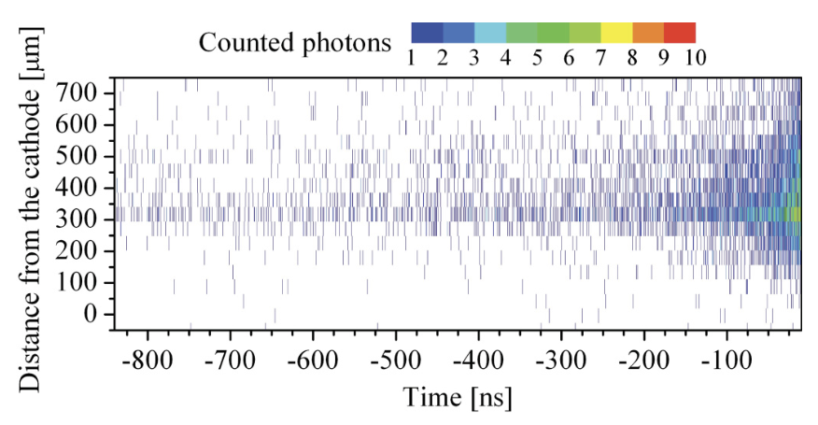
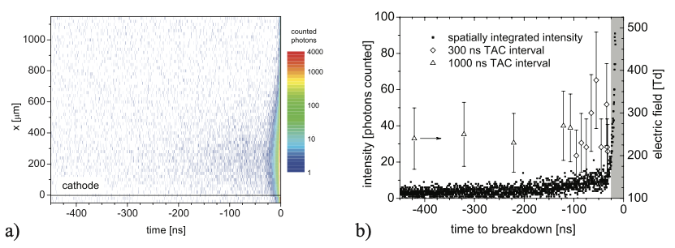
The Brno trace in streamer research ☺
Not-so-historically (1980s-2000s), streamers were researched y prof Mirko Cernak.
An important technique for quantifying streamers is TCSPC = time-correlated single-photon counting pioneered a.o. by Tomas Hoder
By time-correlating the origin of individual photons, light was emitted with the exponential spatial resolution up to 1 microsecond before the streamer, which suggested the Townsend mechanism
14
Notes:
Pozor je to pro verejnost … jednoduseji, schemata nazorna, ne moc analyz, jen par rovnic

Slide 19
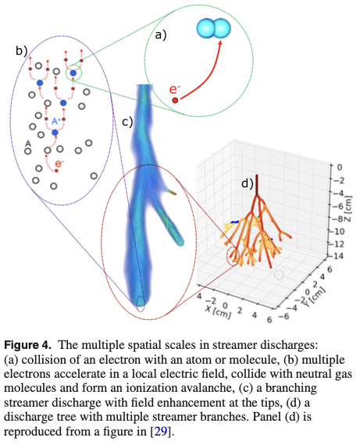
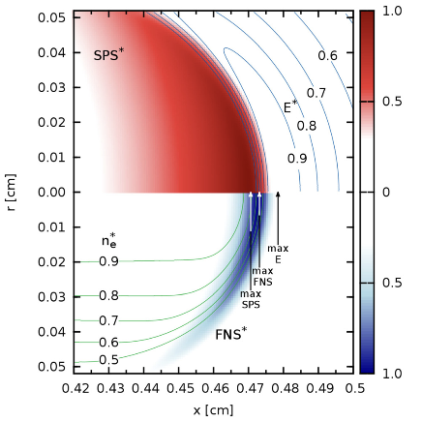
The Brno trace in streamer research ☺
Explaining the fundamentals through simulations – Zdeněk Bonaventura and team.
Bonaventura, Bourdon:
Ebert, Teunissen:
15
Notes:
Pozor je to pro verejnost … jednoduseji, schemata nazorna, ne moc analyz, jen par rovnic

Slide 20
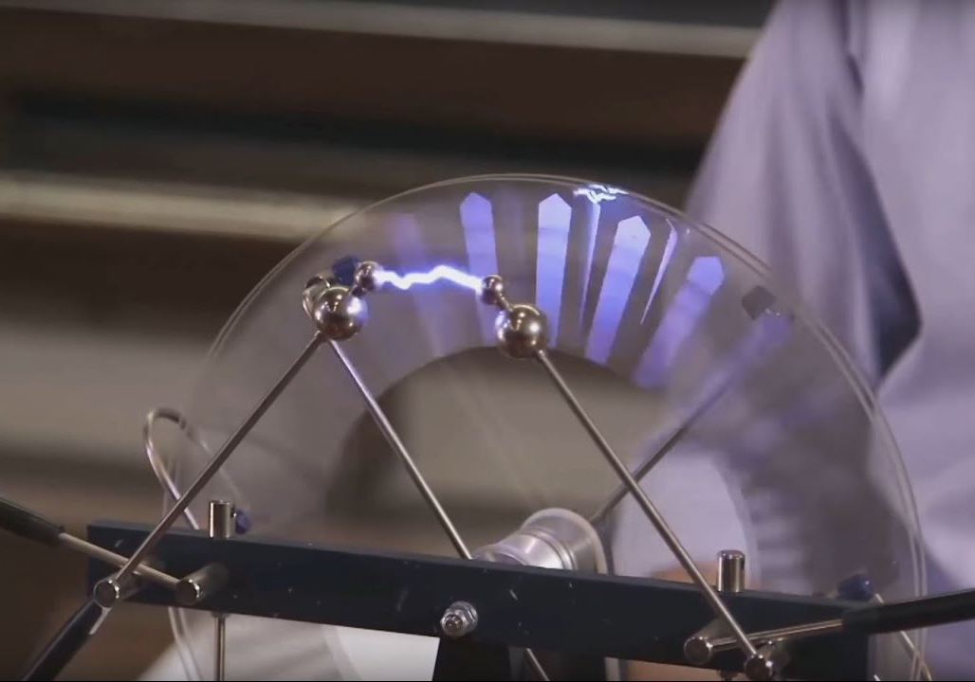
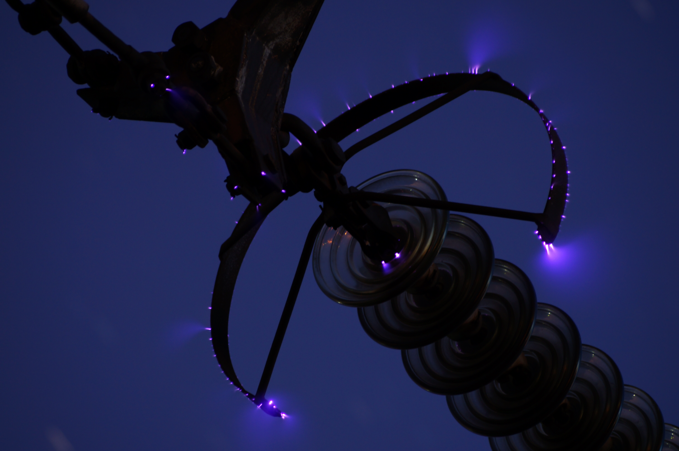
But what happens next with the streamers?
Q: What do you think could happen when we have such a propagating plasma structure?
A1: Streamer reaches a counter-electrode
Conductive channel is formed
Electric field drops significantly
We see an arc plasma forming if the power supply can support it.
We see a spark plasma forming if the power supply cannot support an arc
A2: Streamer does not reach a counter-electrode
The counter electrode is large and far
Ionization stops to increase and ultimately starts to decrease in space because the plasma is expanding to a large volume.
Streamers can exist as semi-stable structures in time, called corona discharge
13
Notes:
Pozor je to pro verejnost … jednoduseji, schemata nazorna, ne moc analyz, jen par rovnic

Slide 21
Corona discharge

Slide 22
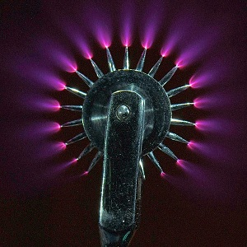
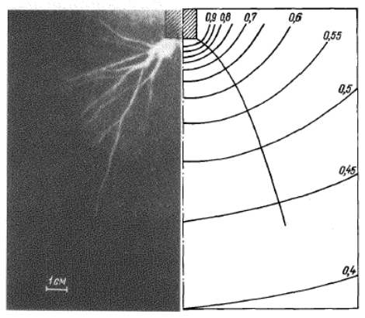
Corona discharge
If the field is highly non-uniform, e.g. close to sharp tips surrounded by ground, a corona discharge can appear
There is no counter-electrode to reach but streamers still form and consume some energy
Sometimes referred to as partial discharge
positive corona at 125 kV
in atmosphere
16
Notes:
Pozor je to pro verejnost … jednoduseji, schemata nazorna, ne moc analyz, jen par rovnic

Slide 23
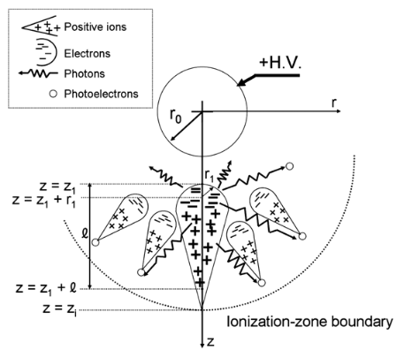
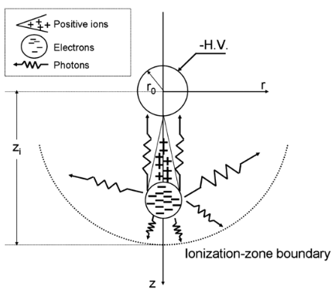
Corona discharge
Corona can form in the proximity of both a positive and negative tip
Positive corona – tip is extended by a positive streamer
Negative corona – negative streamers propagate towards the tip
Photoionization important
Appears as diffuse glow around a wire.
Stable in all gases.
Secondary emission and volume ionization important
Has a glow discharge structure.
Appears as a series of luminous spots.
Stable only in electronegative gases.
17
Notes:
Pozor je to pro verejnost … jednoduseji, schemata nazorna, ne moc analyz, jen par rovnic

Slide 24
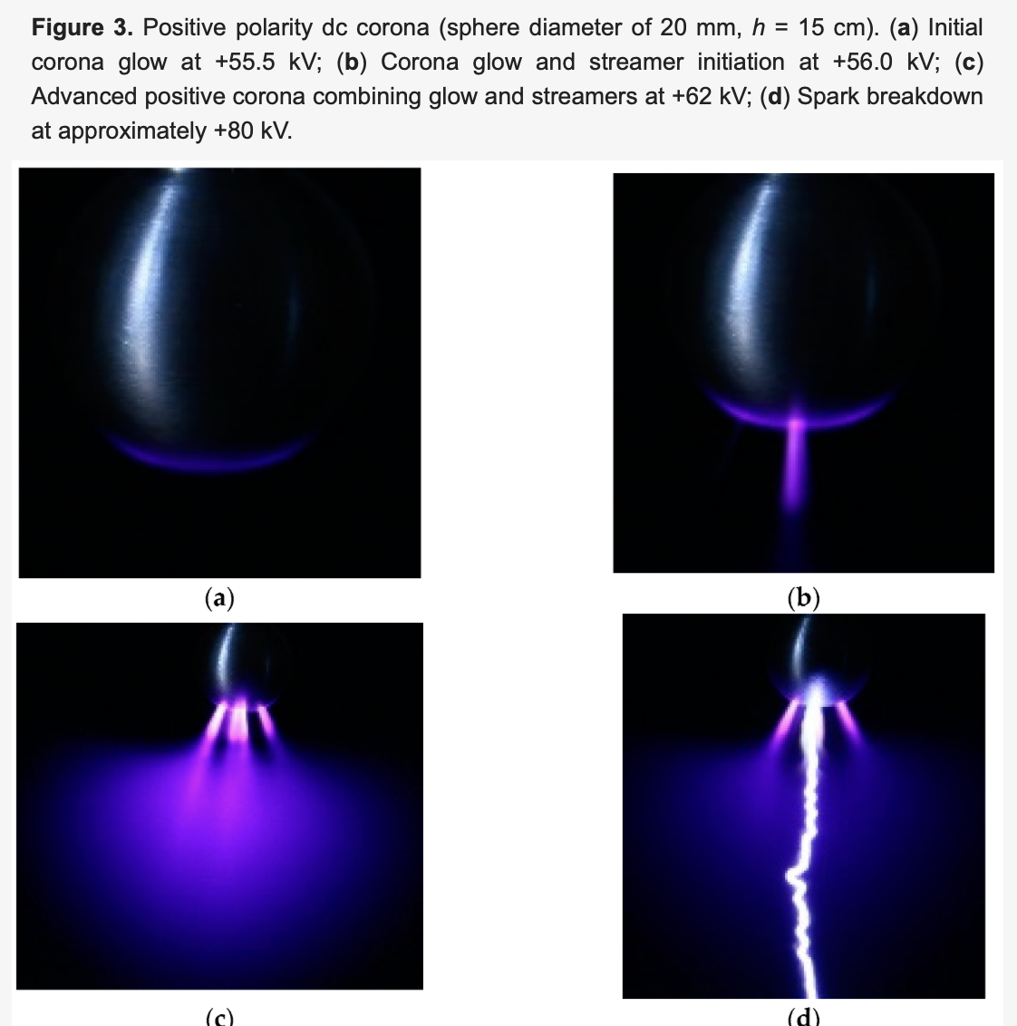
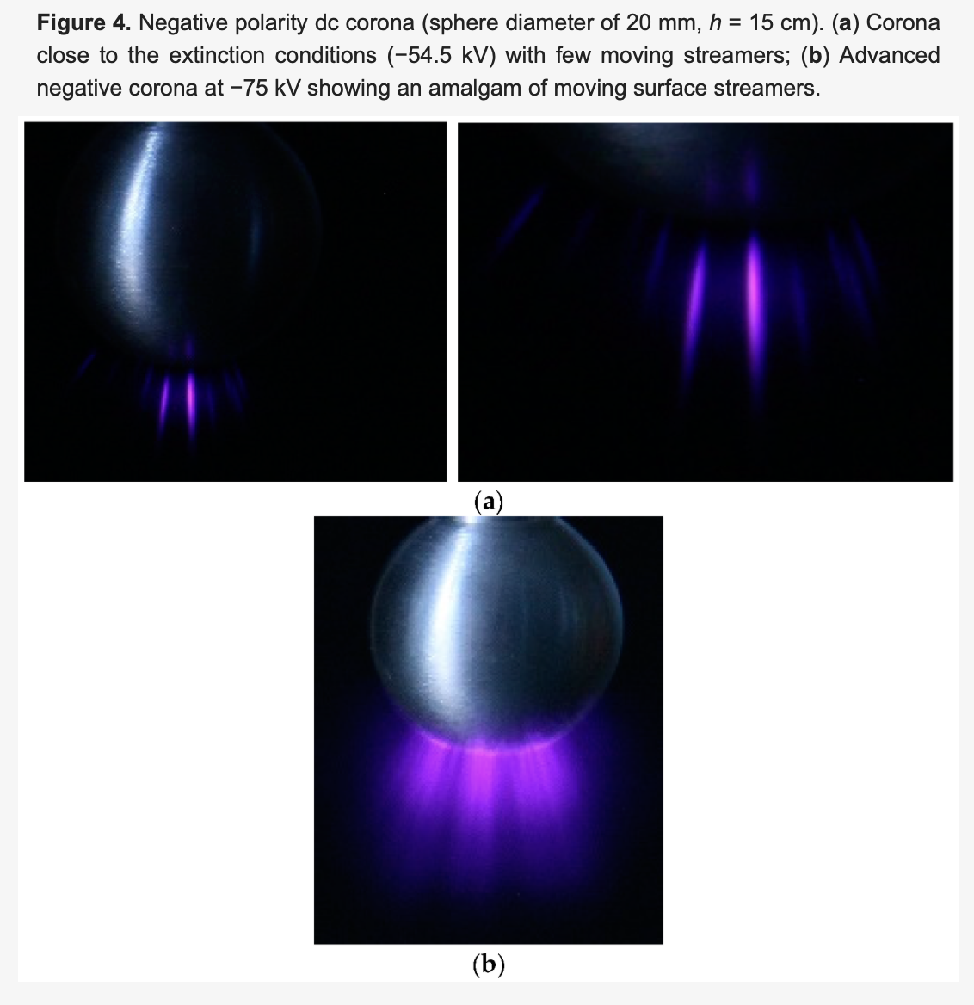
Corona discharge
Corona can form in the proximity of both a positive and negative tip
Positive corona – tip is extended by a positive streamer
Negative corona – negative streamers propagate towards the tip
17
Notes:
Pozor je to pro verejnost … jednoduseji, schemata nazorna, ne moc analyz, jen par rovnic

Slide 25
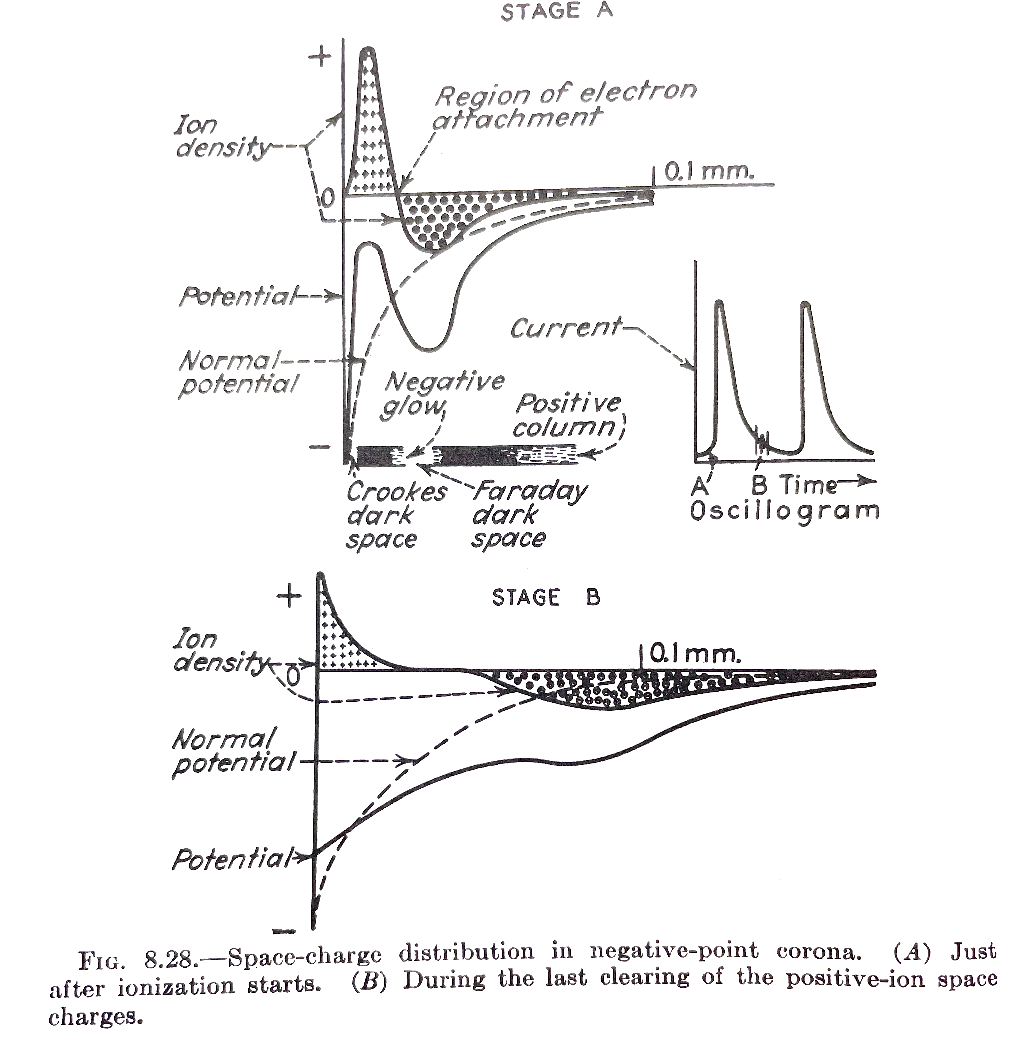
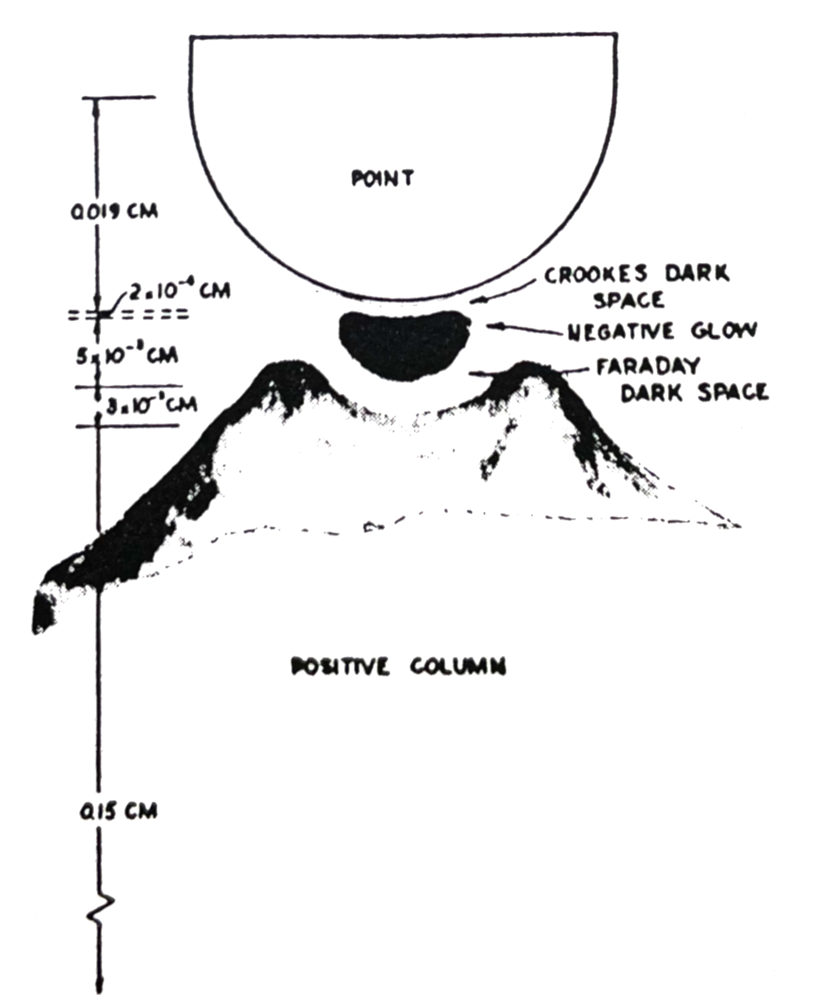
Negative corona structure
The negative corona has a structure similar to a glow discharge with highly asymmetrical electrodes
pozitivní
ionty
negativní
ionty
struktura doutnavého výboje
v případě Trichelova pulzu v
negativní koróně
21
Notes:
Pozor je to pro verejnost … jednoduseji, schemata nazorna, ne moc analyz, jen par rovnic

Slide 26
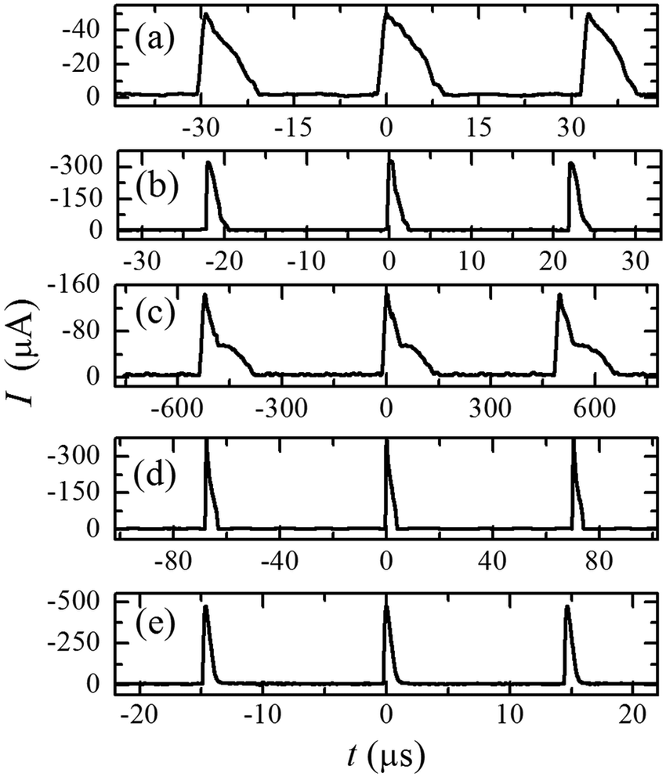
Trichel pulses in negative corona
Trichel pulses are kHz – MHz oscillations inherent to negative corona discharges.
The fundamental physics is driven by the nature of the plasma:
A negative streamer starts to form
Ionization grows exponentially
Formed charge carriers start to shield the external E field.
At some point, the external field is shielded perfectly by the discharges => no more corona
Plasma takes some characteristic time to “dissipate” – that time scale is typically microseconds, determined by the plasma ambipolar diffusion time scale.
As the plasma dissipates, external field starts to dominate again
A negative streamer starts to form …
17
Notes:
Pozor je to pro verejnost … jednoduseji, schemata nazorna, ne moc analyz, jen par rovnic

Slide 27
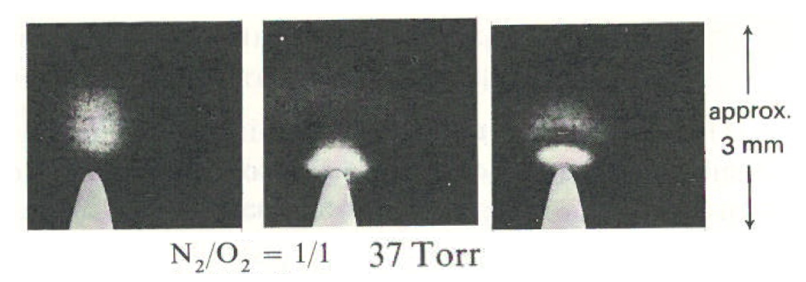
Trichel pulses in negative corona
Time recording of a Trichel pulse (Sigmond 1973):
We see electron multiplication, space charge formation and ultimately a glow discharge structure – but what is the dynamics behind it?
23
Notes:
Pozor je to pro verejnost … jednoduseji, schemata nazorna, ne moc analyz, jen par rovnic

Slide 28


Trichel pulses in negative corona – current measurement
First current peak sensitive to material, second current
peak is not!
streamer initiation and generation of energetic photons.
First peak is probably the impact of the streamer
onto the cathode – probably the first Trichel pulse
for repeated Trichel pulses, it is likely that transient glow
discharge starts to form, as qualitatively outlined
a few slides back.
Photoemission coefficient
p-CuI > p-brass
Has no effect on the maximum but it affects the rise time!
23c
Notes:
Pozor je to pro verejnost … jednoduseji, schemata nazorna, ne moc analyz, jen par rovnic

Slide 29



Trichel pulses in negative corona – emission measurement
Nitrogen emission in time and space before the Trichel pulse:
Nitrogen emission, current and E field in time and space during the Trichel pulse:
23d
Notes:
Pozor je to pro verejnost … jednoduseji, schemata nazorna, ne moc analyz, jen par rovnic

Slide 30
Spark discharge

Slide 31

Spark discharge
If a sufficient amount of current is available and the streamer reaches a counter-electrode, what we call a spark discharge starts to form.
This can be understood as an. early stage of an arc discharge but arc itself will operate only if the power supply can provide ample current.
27
Notes:
Pozor je to pro verejnost … jednoduseji, schemata nazorna, ne moc analyz, jen par rovnic

Slide 32


Spark discharge (Janda, Machala 2010)
If the voltage is pulsed at the right frequency and duty cycle, the spark can be transient.
Interesting special case of this plasma source, used at UK Bratislava.
28
Notes:
Pozor je to pro verejnost … jednoduseji, schemata nazorna, ne moc analyz, jen par rovnic

Slide 33


Spark discharge formation (Janda, Machala 2016)
The IV measurements of a pulsed spark discharge shed more lithght onto how it is formed.
We see around 1.2 us, that if the discharge would not be stopped, the current would run away exponentially and an arc discharge would be formed.
We also see the voltage decreasing, as the plasma is becoming ore conductive.
29
Notes:
Pozor je to pro verejnost … jednoduseji, schemata nazorna, ne moc analyz, jen par rovnic

Slide 34


Spark discharge formation (Janda, Machala 2016)
Measurements of electron density in spark plasma suggest that the plasma densities reach full ionization
If the supply of power is not interrupted by the power supply at microsecond scales, the plasma will thermalize and an arc discharge will form.
30
Notes:
Pozor je to pro verejnost … jednoduseji, schemata nazorna, ne moc analyz, jen par rovnic

Slide 35
Application overview

Slide 36







Corona discharge applications
Corona discharge is often unwanted, appearing on high voltage components where it induces loss power.
One major application are electrostatic precipitators. In these devices, corona discharge softly charges microparticles of combustion products so that they can be captured and not contaminate the environment.
Deutch-Anderson efficiency:
flow rate
Drift of a charged microparticle
Loss power on HV lines
24
Notes:
Pozor je to pro verejnost … jednoduseji, schemata nazorna, ne moc analyz, jen par rovnic

Slide 37


Spark discharge applications
Historically spark plugs… we all know where that is going ☺
Understanding of sparks, Trichel pulses, etc.. is still super important in circuit breakers because it affects how fast you are able to switch current on/off in the grid.
24
Notes:
Pozor je to pro verejnost … jednoduseji, schemata nazorna, ne moc analyz, jen par rovnic

Slide 38


Streamer „applications“
Understanding streamers is absolutely crucial in geophysics, biophysics and planetary plasmas.
Thanks to the, we can understand upper atmospheric lighting
They also help to elucidate how life started to form – plasma was one of the “activation channels” converting inorganic molecules to organic ones.
24
Notes:
Pozor je to pro verejnost … jednoduseji, schemata nazorna, ne moc analyz, jen par rovnic

Slide 39
Takeaways
What is a streamer, positive and negative
What are the main physics phenomena
What happens when a streamer reaches a counter-electrode
The few applications of streamers and their importance for fundamental science.

