Slide 1
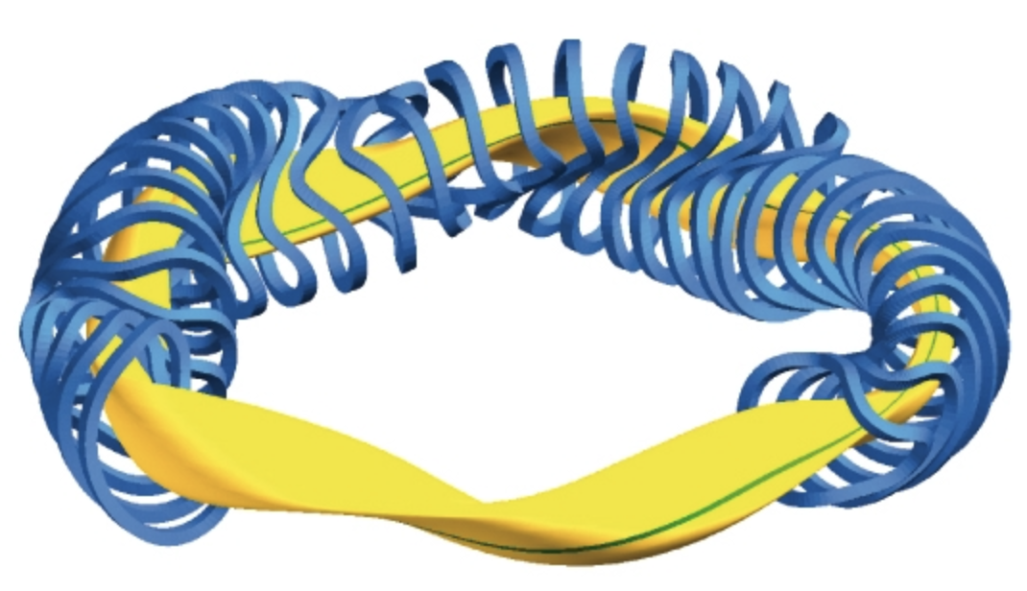


Plasma Physics 2
9. Thermonuclear fusion
Notes:
Vylepsit …

Slide 2
Lecture series contents
Townsend breakdown theory, Paschen‘s law
Glow discharge
Electric arc at low and high pressures
Magnetized low-pressure plasmas and their role in material deposition methods.
Brief introduction to high-frequency discharges
Streamer breakdown theory, corona discharge, spark discharge
Barrier discharges
Leader discharge mechanism, ionization and discharges in planetary atmospherres
Discharges in liquids, complex and quantum plasmas
Thermonuclear fusion, Lawson criterion, magnetic confinement systems, plasma heating and intertial confinement fusion.
1
Notes:
Pozor je to pro verejnost … jednoduseji, schemata nazorna, ne moc analyz, jen par rovnic

Slide 3
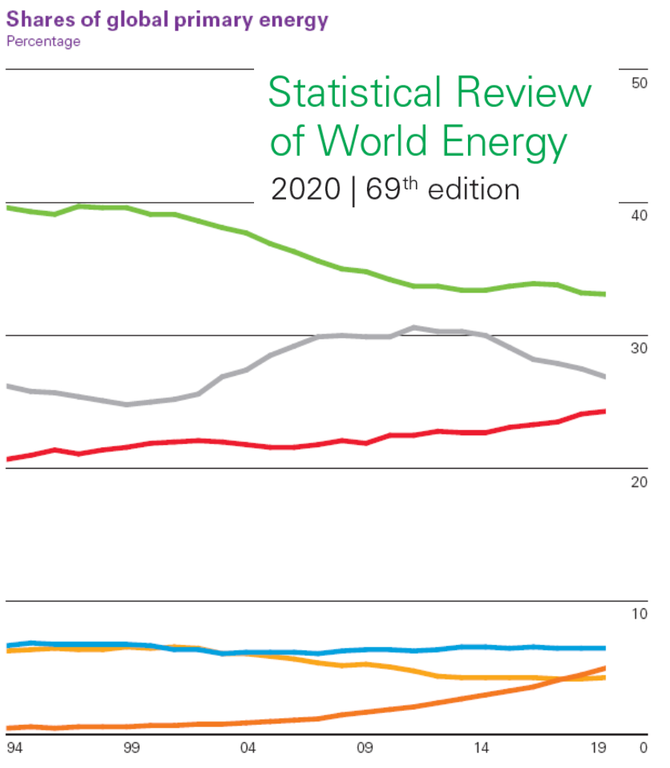
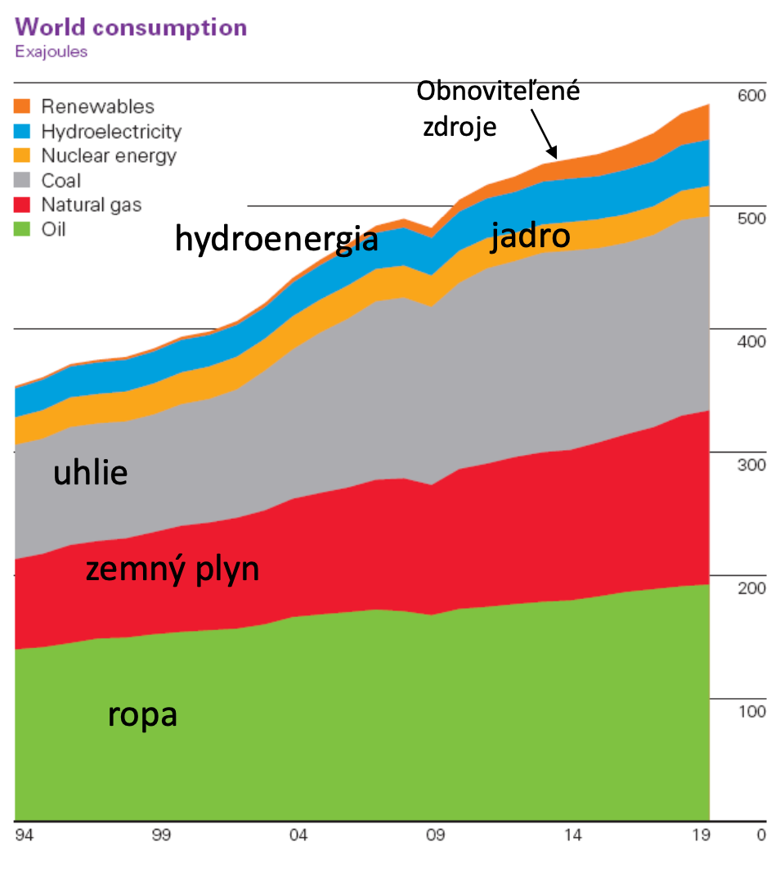
Evolution of world‘s primary energy
meziroční nárůst spotřeby energie v roce 2019: +7.67E18 J (celkem 2019: 583.9 EJ – exa Joul)
meziroční nárůst energie z obnovitelných zdrojů 2019: +3.15 EJ (celkem 2019: 28.98 EJ)
1
Notes:
Pozor je to pro verejnost … jednoduseji, schemata nazorna, ne moc analyz, jen par rovnic

Slide 4
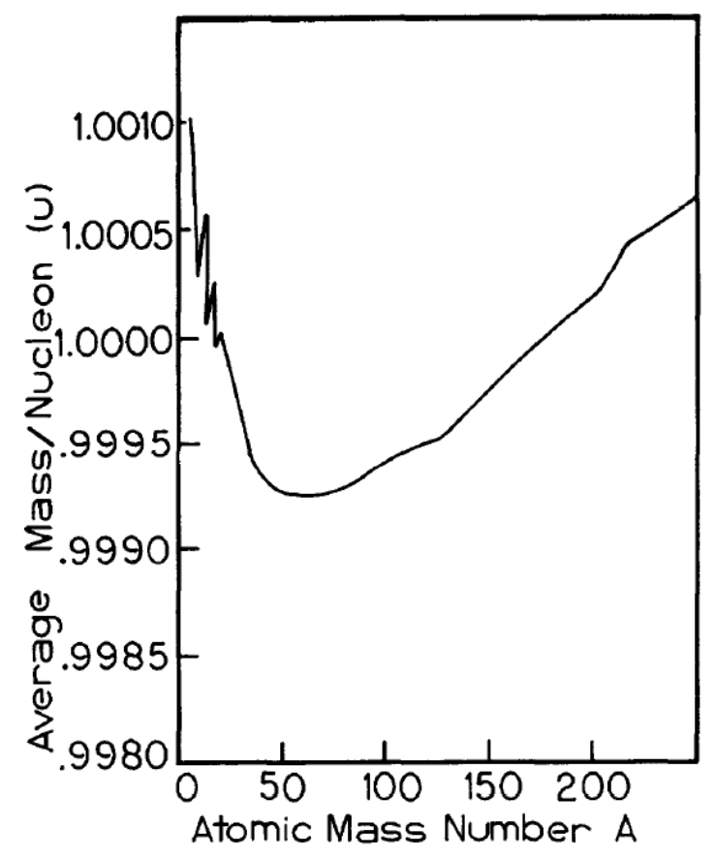
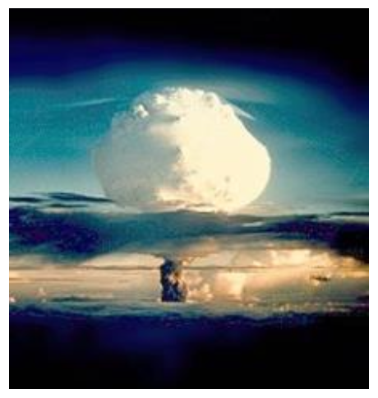
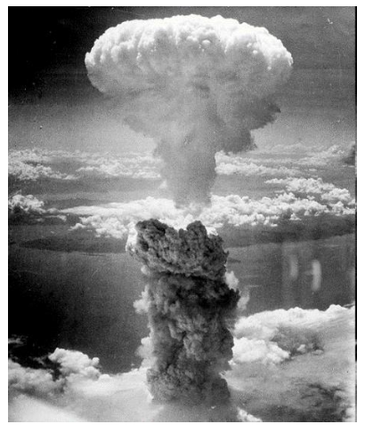
Energy consumption by humanity (converted to energy)
The total consumption from primary energy sources for the year 2019 is 583.9 EJ (exa = 1E18).
If we convert this to power for the year and with over 40% efficiency of converting thermal energy to electricity, we get 7.4 TW (1E12), which is an annual increase of 0.1 TW.
For comparison, the power from the Sun hitting Earth is about 40,000 TW, and Earth’s thermal radiation is about 32 TW.
The Temelín power plant has a capacity of 1 GW, meaning that the global energy consumption in 2019 increased by the equivalent of 100 Temelín nuclear power plants.
… This is a staggering increase in energy consumption! And of course, thermonuclear fusion is one of the possible solutions, but why?
The difference between the mass of an atom and the sum of the masses of its nucleons is the source of atomic energy (binding energy), as given by Einstein's equation E = mc².
Deuterium from 1 liter of seawater (0.15 per mille) is energetically equivalent to 300 liters of gasoline
olovo
A = 82
2
Notes:
Pozor je to pro verejnost … jednoduseji, schemata nazorna, ne moc analyz, jen par rovnic

Slide 5
main fusion pathways, lawson criterion, TRIPLE PRODUCT

Slide 6
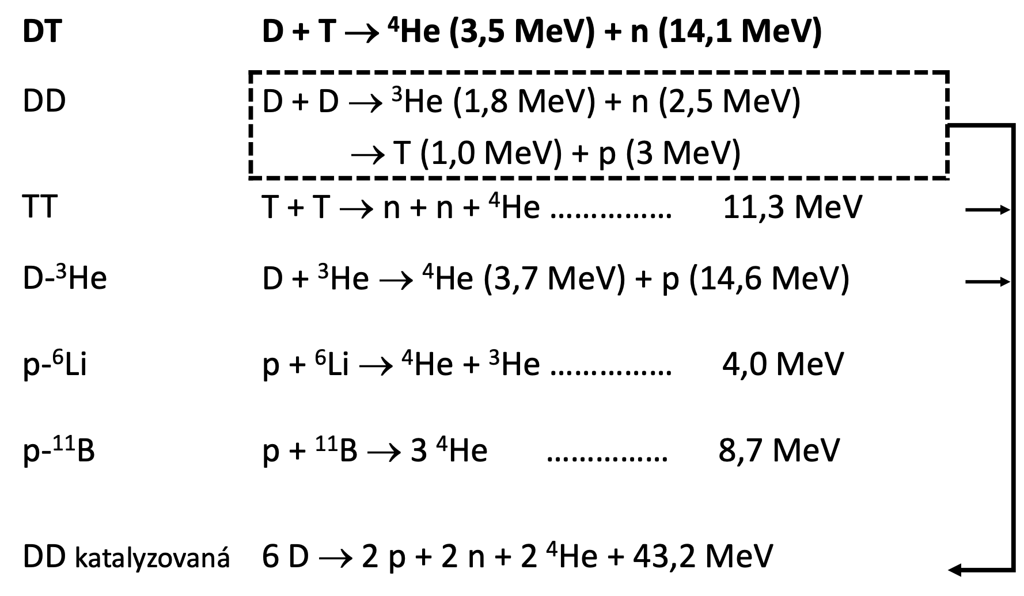
Main fusion pathways
Possible fusion reactions for a potential energy source:
3
Notes:
Pozor je to pro verejnost … jednoduseji, schemata nazorna, ne moc analyz, jen par rovnic

Slide 7
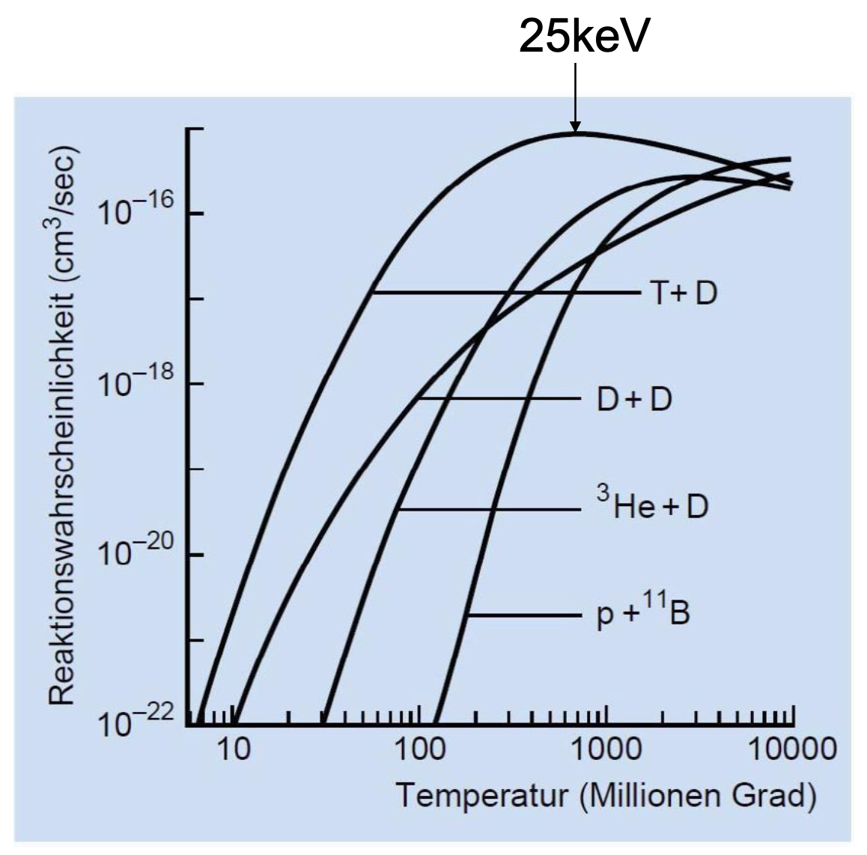
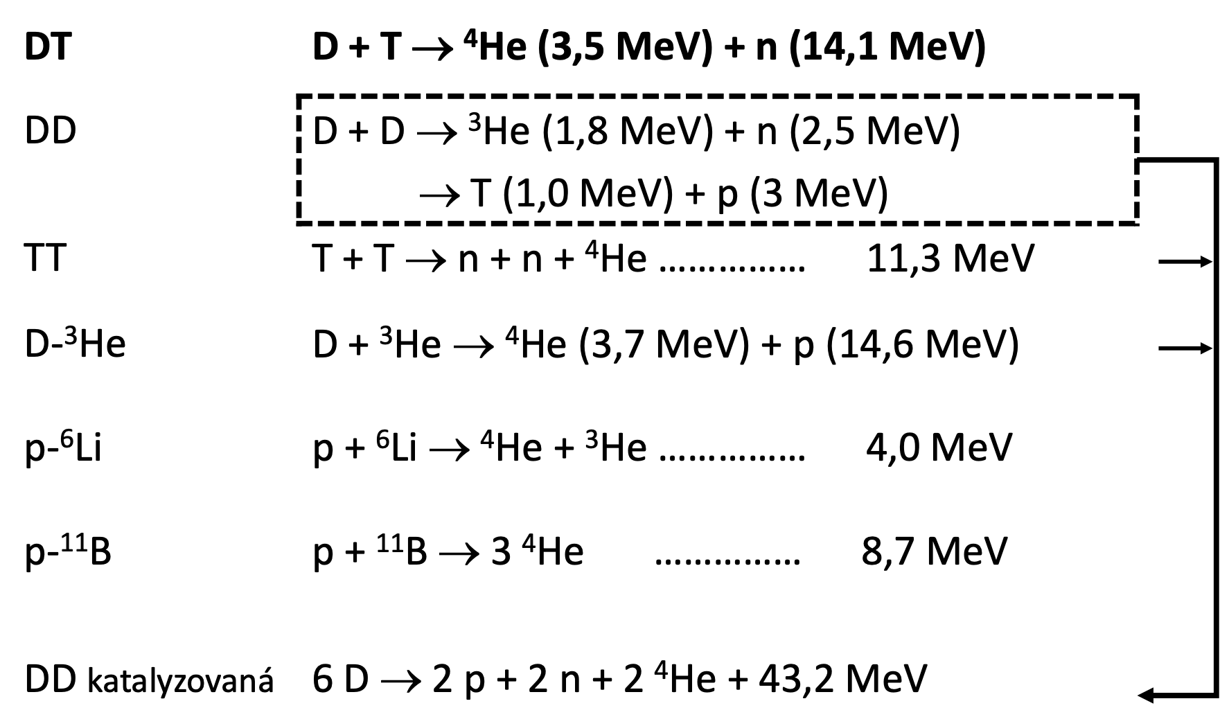
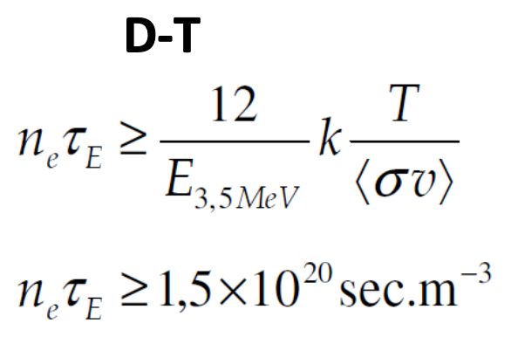
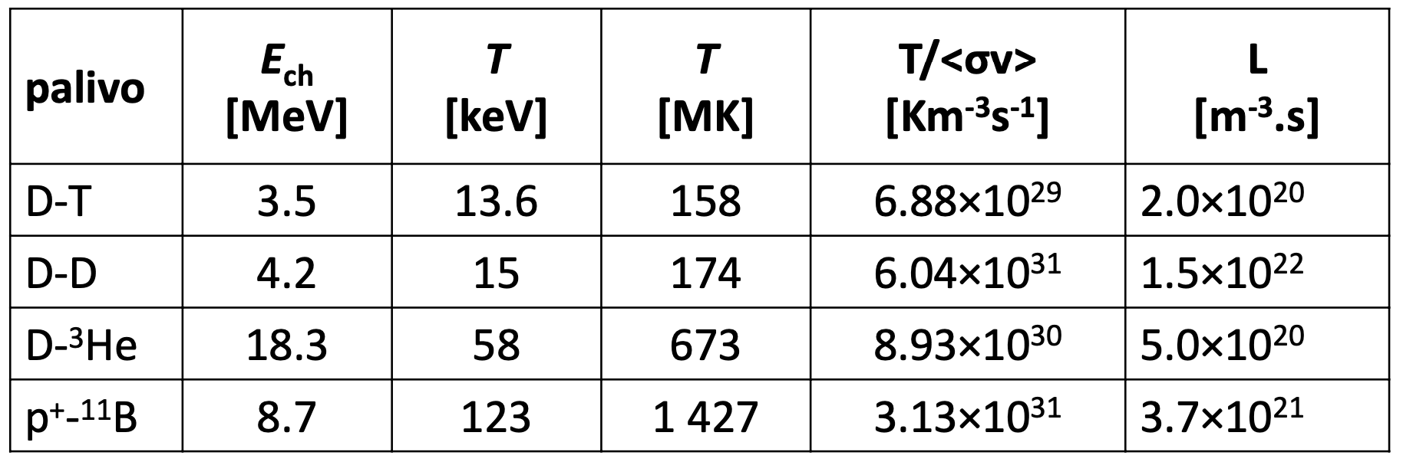
Rate constants of fusion reactions
Computed optimal values
5
Notes:
Pozor je to pro verejnost … jednoduseji, schemata nazorna, ne moc analyz, jen par rovnic

Slide 8
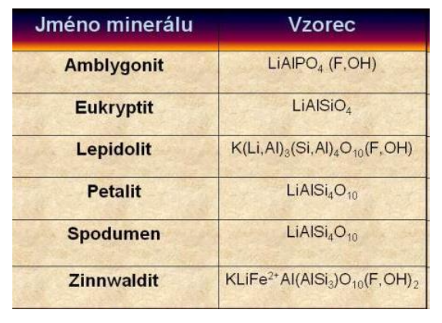
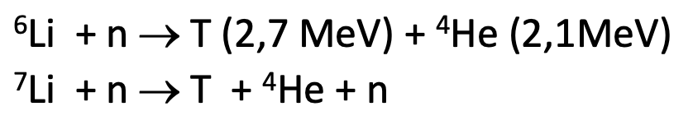
Fuel considerations
The DT reaction has approximately twice the effective cross-section compared to the DD reaction, but:
It also generates fast neutrons, which initiate fission reactions in the reactor that must then be carefully shielded/stored.
Only 20% of the energy goes into charged particles.
Tritium (T) is reactive and must be produced from lithium; lithium supplies are limited and are also used in battery production.
Tritium production (with a half-life of 12 years) occurs through reactions of slow neutrons with lithium isotopes.
Reserves: Hydrogen on Earth contains 15 per mille of deuterium, lithium in minerals is about 14 million tons, and in seawater about 0.2 ppm, totaling 230 billion tons.
7
Notes:
Pozor je to pro verejnost … jednoduseji, schemata nazorna, ne moc analyz, jen par rovnic

Slide 9
Main fusion pathways
Necessary physical conditions for the synthesis/fusion of light nuclei:
Nuclei repel each other, therefore approximately 100 keV is needed for heavy hydrogen isotopes to come within 1 fm
To achieve these energies/particle speeds, accelerators are very inefficient.
Therefore, it is necessary to heat the matter and use particles from the tail of the Maxwellian distribution function for speeds (10 keV = 10⁸ K) – hence thermonuclear fusion
Plasma (ionization) is primarily not needed. The fact that the matter at such temperatures will be in plasma state follows from the Saha equation
Controllability of the reaction:
  Is it possible to isolate hot plasma? – by gravity (the Sun), inertially (explosions), electrostatically, and by magnetic fields;
  How to heat the plasma to such a temperature?
  How to design a reactor so that its energy balance is positive?
3
Notes:
Pozor je to pro verejnost … jednoduseji, schemata nazorna, ne moc analyz, jen par rovnic

Slide 10

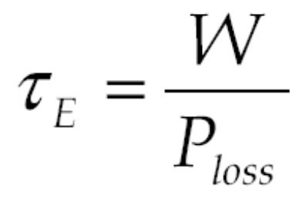
Lawson criterion
This is a necessary condition for the occurrence of self-sustaining fusion in a thermonuclear reactor, derived by John D. Lawson in 1955.
It is based on the following reasoning: the power input from nuclear synthesis must be greater than the loss power, which the plasma loses through various paths (radiation, conduction, etc.). Therefore:
When considering this equation, it is useful to introduce the concept of confinement time.
This time is necessary for the escape of the entire thermal energy W from the plasma, and therefore:
Naturally, to obtain quantitative value of the confinement time, we need to know the system as such and be able to quantify P_{loss} based on its geometry, volume, etc…
4
Notes:
Pozor je to pro verejnost … jednoduseji, schemata nazorna, ne moc analyz, jen par rovnic

Slide 11
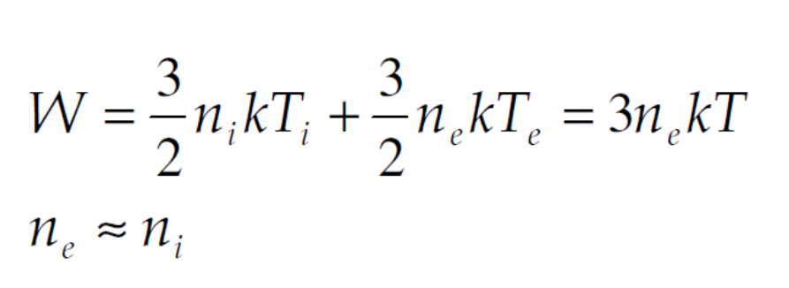
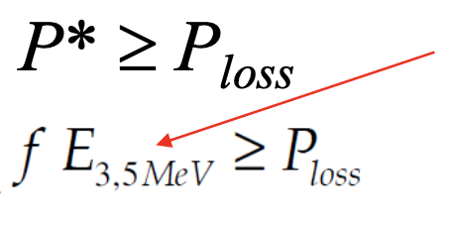
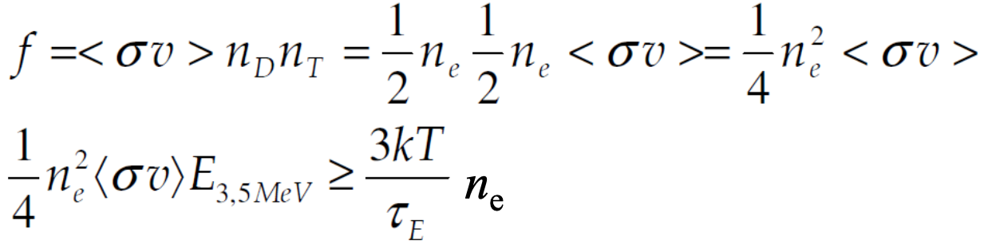
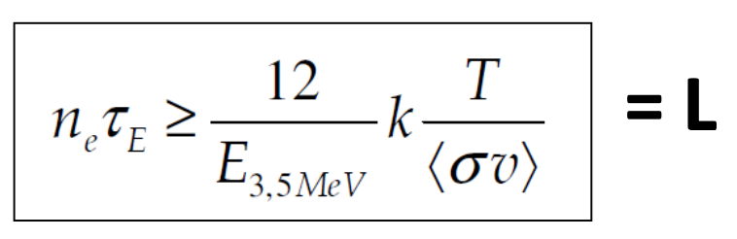

Lawson criterion – derivation outline
Assuming thermal quasineutral plasma the total energy is:
Next, we utilize the condition for positive energy balance of the fusion reaction
Finally, we arrive at the Lawson criterion
Which for the D-T system gives:
number of reactions per unit time
(reaction frequency)
kinetic energy of charged particles
4
Notes:
Pozor je to pro verejnost … jednoduseji, schemata nazorna, ne moc analyz, jen par rovnic

Slide 12
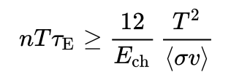
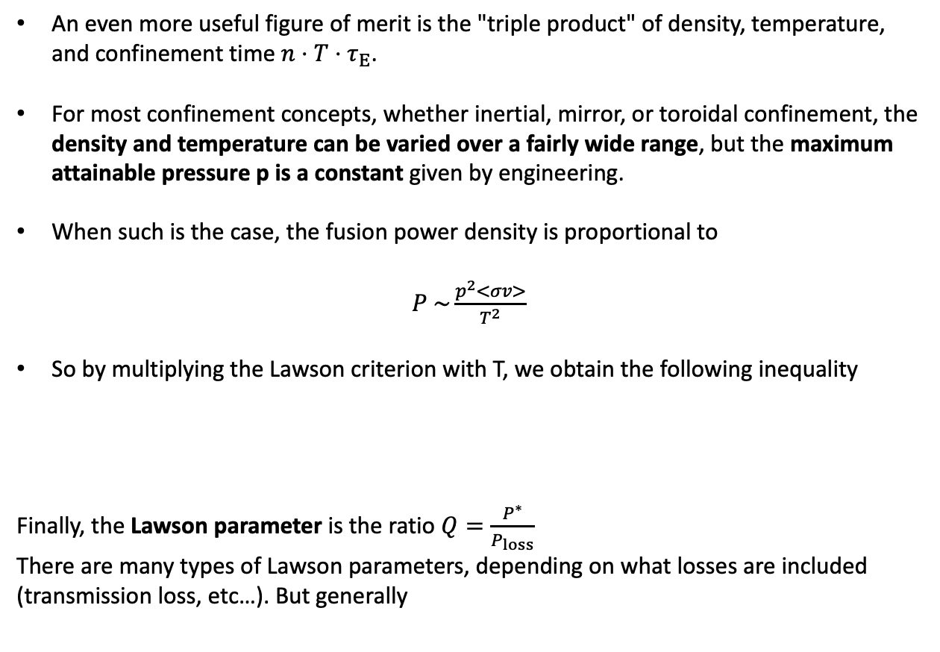
Triple product
An even more useful figure of merit is the "triple product" of density, temperature, and confinement time $n⋅T⋅τ_{E}$.
For most confinement concepts, whether inertial, mirror, or toroidal confinement, the density and temperature can be varied over a fairly wide range, but the maximum attainable pressure p is a constant given by engineering.
When such is the case, the fusion power density is proportional to
$P \sim \frac{p^{2}<σv>}{T^{2}}$
So by multiplying the Lawson criterion with T, we obtain the following inequality
Finally, the Lawson parameter is the ratio $Q=\frac{P^{∗}}{P_{loss}}$
There are many types of Lawson parameters, depending on what losses are included (transmission loss, etc…). But generally
5
Notes:
Pozor je to pro verejnost … jednoduseji, schemata nazorna, ne moc analyz, jen par rovnic

Slide 13
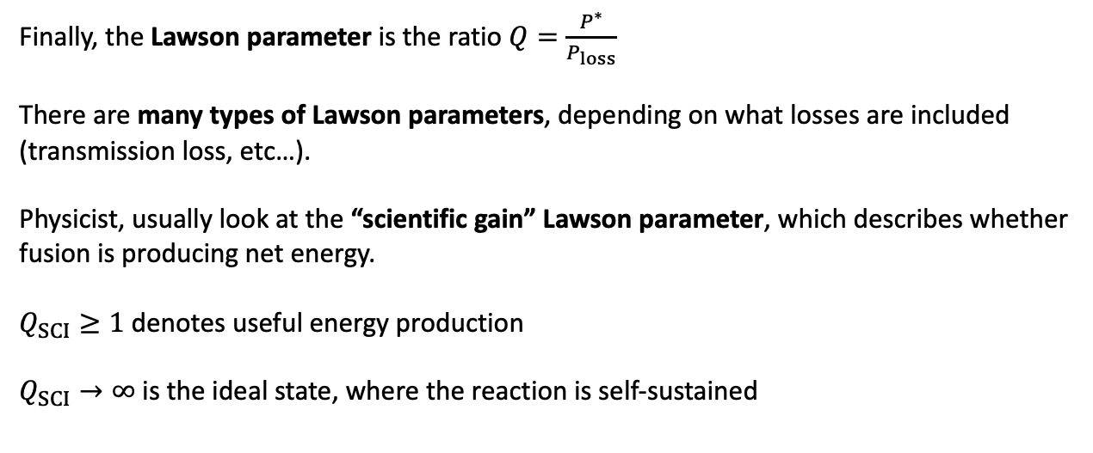
Lawson parameter
Finally, the Lawson parameter is the ratio $Q=\frac{P^{∗}}{P_{loss}}$
There are many types of Lawson parameters, depending on what losses are included (transmission loss, etc…).
Physicist, usually look at the “scientific gain” Lawson parameter, which describes whether fusion is producing net energy.
$Q_{SCI}≥1$ denotes useful energy production
$Q_{SCI}→∞$ is the ideal state, where the reaction is self-sustained
5
Notes:
Pozor je to pro verejnost … jednoduseji, schemata nazorna, ne moc analyz, jen par rovnic

Slide 14
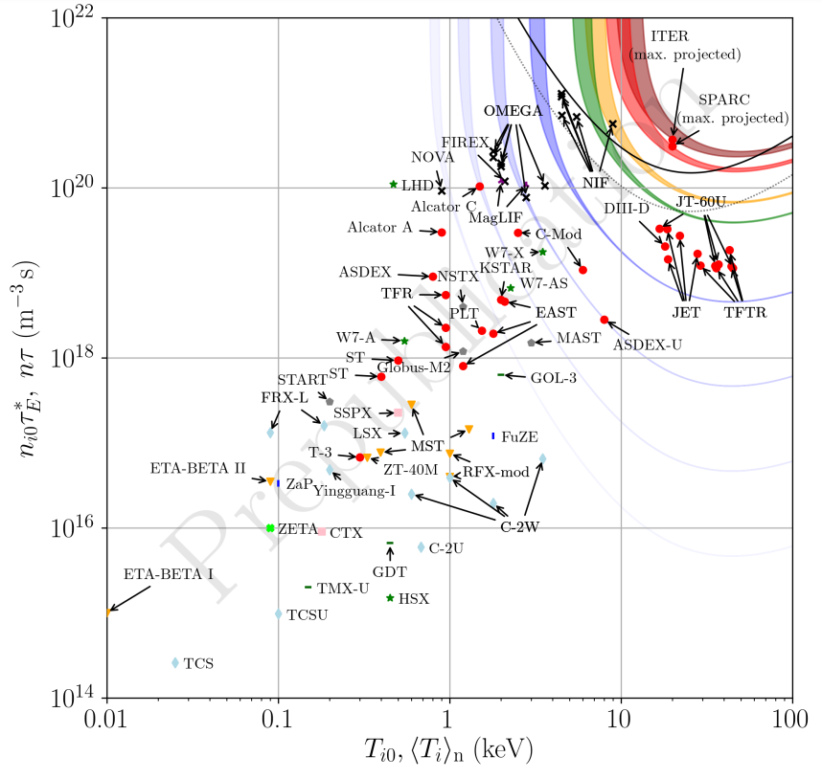
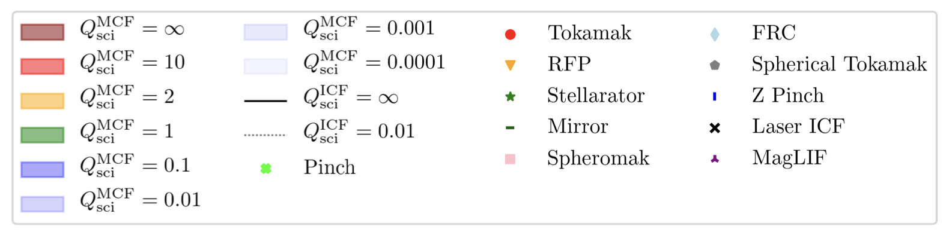
Fusion devices built to date
13
Notes:
Pozor je to pro verejnost … jednoduseji, schemata nazorna, ne moc analyz, jen par rovnic

Slide 15
fusion setups

Slide 16
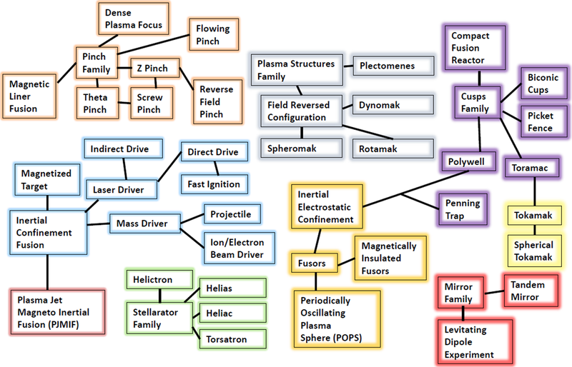
Fusion setups
11
Notes:
Pozor je to pro verejnost … jednoduseji, schemata nazorna, ne moc analyz, jen par rovnic

Slide 17
fusion setups – Pinches

Slide 18
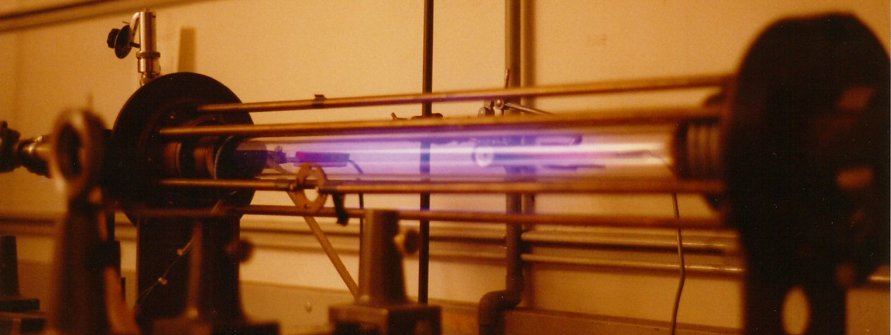
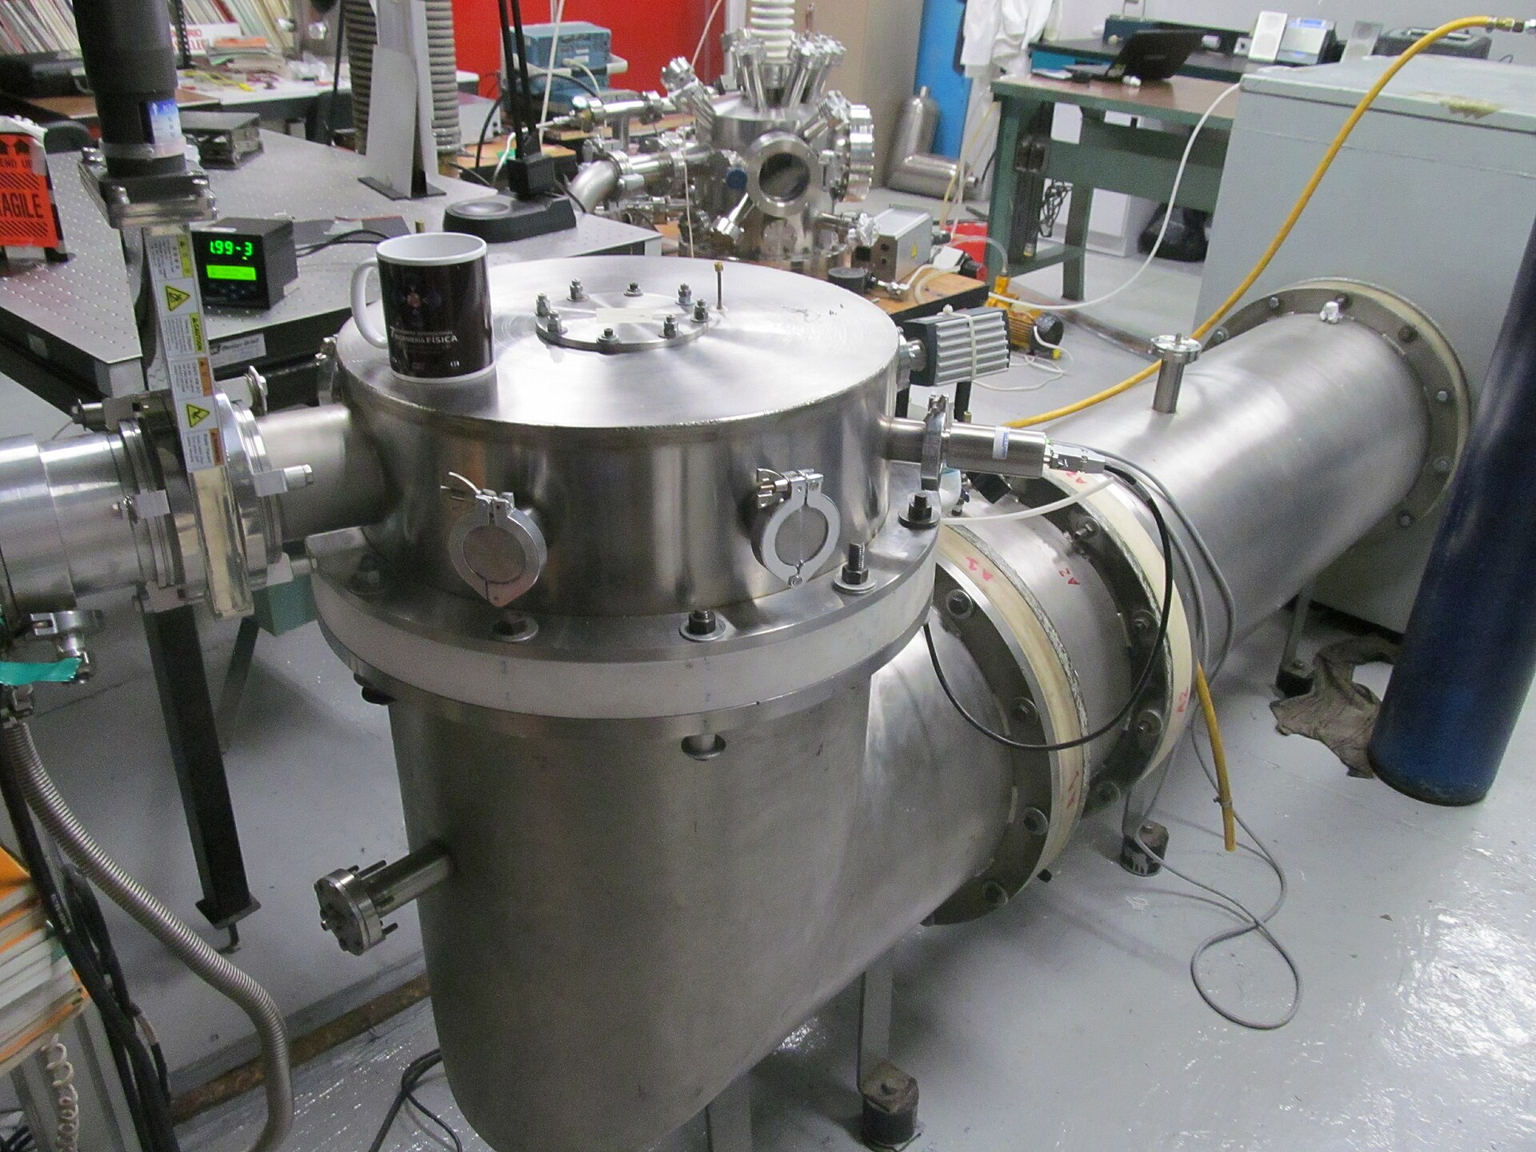
Fusion in pinch systems
In z-pinch and theta-pinch systems (see arc lecture), plasma density can be high enough to observe measurable fusion in H2 plasmas.
As you can imagine, Q factor here is nearly zero, good for research purposes only.
11
Notes:
Pozor je to pro verejnost … jednoduseji, schemata nazorna, ne moc analyz, jen par rovnic

Slide 19
fusion setups – magnetic confinement FUSION (MCF)

Slide 20
Drifts in B fields
Summary of charged particle drifts you should already know
grad B drift, caused by a change in the density of magnetic field lines, the force is directly proportional to grad B
drift caused by a general force and gravitational drift, perpendicular to the gravitational and magnetic field
drift caused by the curvature of the B field lines, centrifugal force
polarization drift, caused by a slow change in the electric field over time, induced force
ExB drift
9
Notes:
Pozor je to pro verejnost … jednoduseji, schemata nazorna, ne moc analyz, jen par rovnic

Slide 21
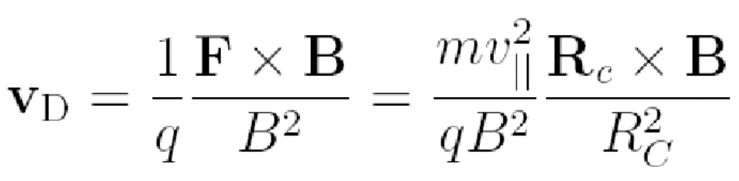
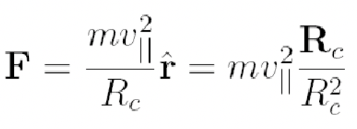
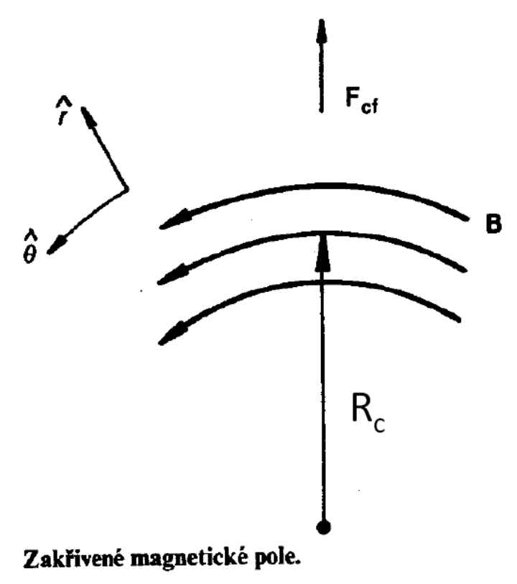
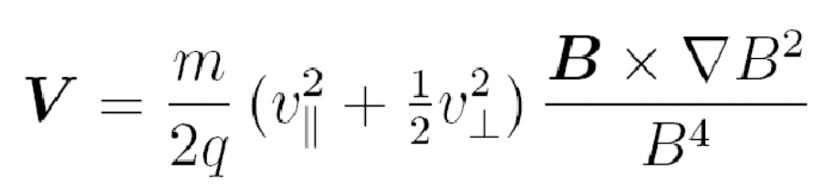
Drifts in B fields
Curvature drift is a consequence of centrifugal force due to varying B field strength
Practically, when you curve magnetic field (e.g. from a solenoid), the magnitude goes down
as well, so there is gradB field.
As a consequence, in toroidal B fields, particles always escape via the torus OD
because there is always a gradient B there.
11
Notes:
Pozor je to pro verejnost … jednoduseji, schemata nazorna, ne moc analyz, jen par rovnic

Slide 22
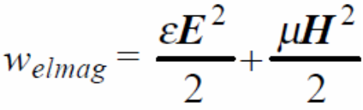
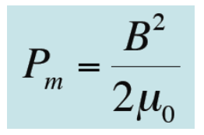
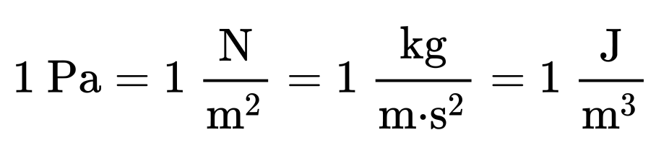
Isolation through B field
The condition for the balance between the kinetic pressure of the plasma and the magnetic pressure P_{m}​ of the external confinement field, the volumetric density of electromagnetic energy:
However, magnetic confinement systems have a limited mechanical strength at ca p=10 Mpa
For a temperature T=200 MK gives a fuel concentration at the level of 10 Pa, or a density of 2.10²¹ m⁻³
According to the Lawson's criterion, this gives a confinement time of 0.1 s for D-T or 10 s for D-D.
At the same time, this also means that a magnetic thermonuclear reactor must be constructed as a vacuum vessel, which implicitly ensures resistance to accidents that would disrupt the vacuum and thus automatically stop the reaction.
6
Notes:
Pozor je to pro verejnost … jednoduseji, schemata nazorna, ne moc analyz, jen par rovnic

Slide 23
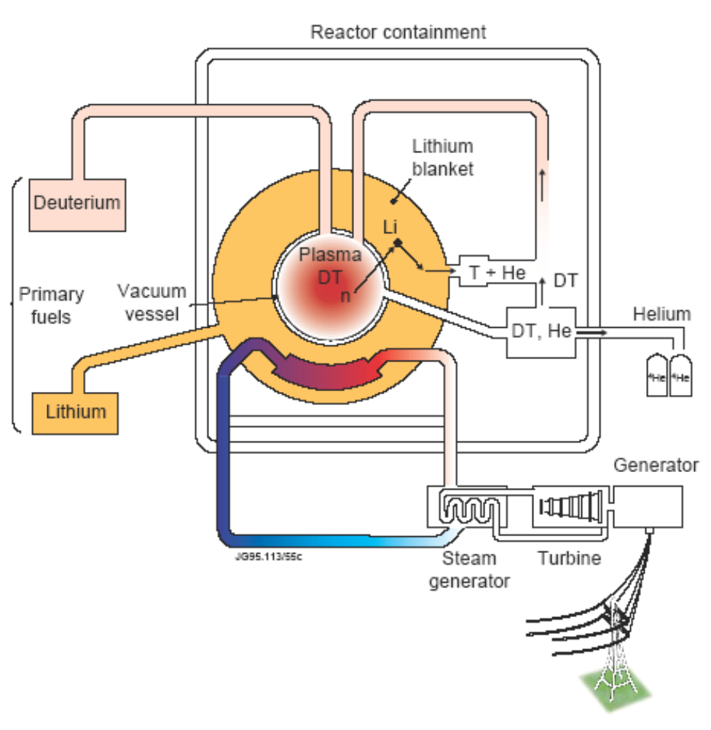


Isolation through B field
The energy production scheme could then look as follows:
A fusion reactor mixes D (deuterium) and T (tritium) isotopes at the center of the reactor and the heat from the released neutrons is captured by a mantle of molten Li (lithium).
This heat then generates steam in a heat exchanger, which will drive a turbine that delivers electrical energy to the grid.
Meanwhile, lithium reacts with slow neutrons to produce T (tritium), which can be used as new fuel.
The charged alpha particles (He) can be used for direct electricity production through so-called magnetohydrodynamic (MHD) generators.
6
Notes:
Pozor je to pro verejnost … jednoduseji, schemata nazorna, ne moc analyz, jen par rovnic

Slide 24
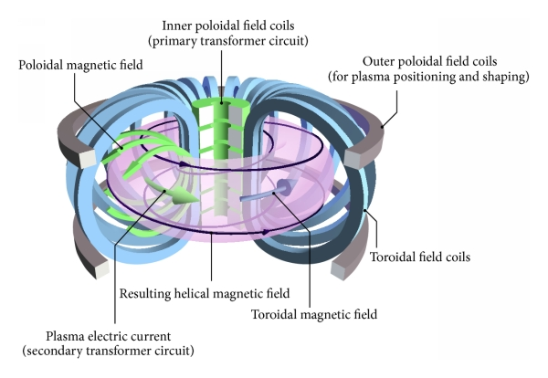
Magnetic confinement fusion - Tokamak
6
Notes:
Pozor je to pro verejnost … jednoduseji, schemata nazorna, ne moc analyz, jen par rovnic

Slide 25
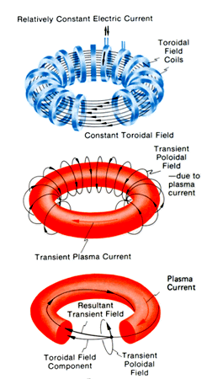
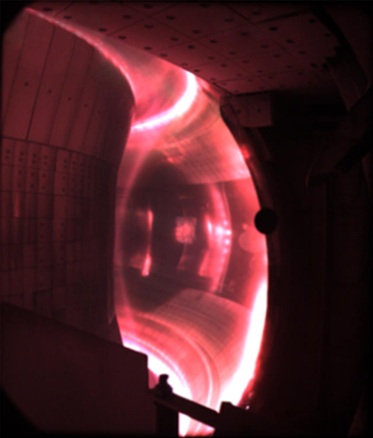
Magnetic confinement fusion - Tokamak
6
Notes:
Pozor je to pro verejnost … jednoduseji, schemata nazorna, ne moc analyz, jen par rovnic

Slide 26
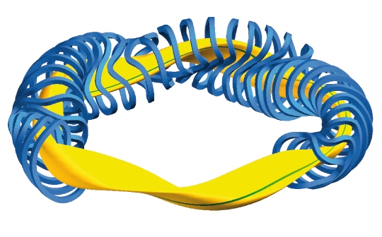
Magnetic confinement fusion - Stellarator
Highly tailored B field reduces gradB drift lossess
6
Notes:
Pozor je to pro verejnost … jednoduseji, schemata nazorna, ne moc analyz, jen par rovnic

Slide 27
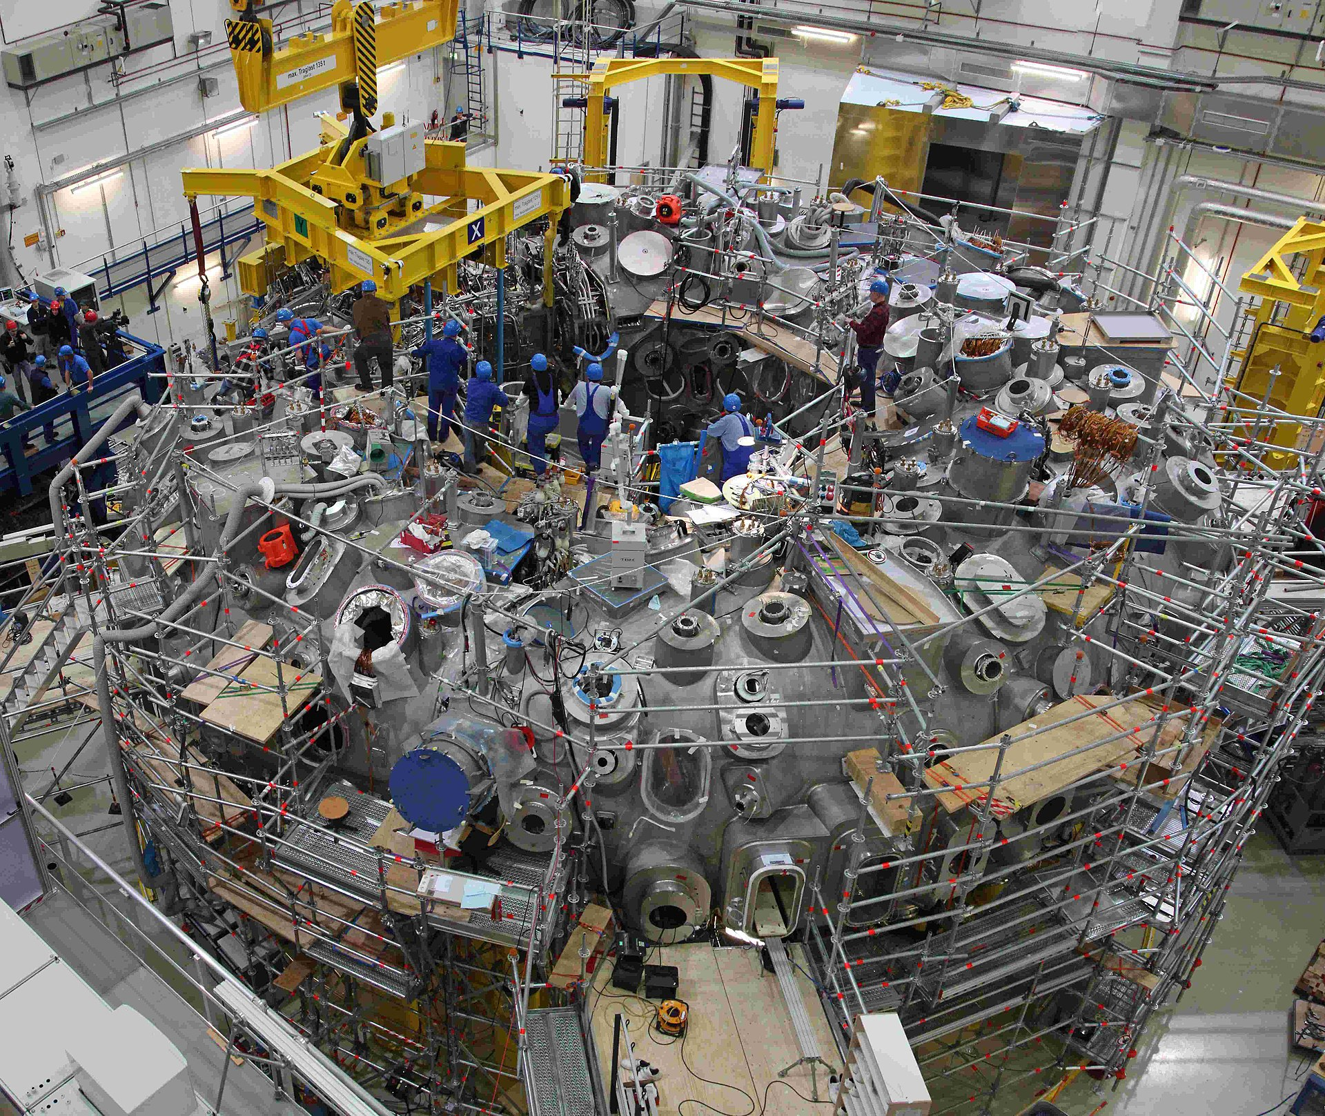
Magnetic confinement fusion - Stellarator
Wendelstein-7X in Greifswald is a very succesful testbed for high power levels (even though steady-state demonstrations done with He, no fuel)
6
Notes:
Pozor je to pro verejnost … jednoduseji, schemata nazorna, ne moc analyz, jen par rovnic

Slide 28
fusion setups – inertial confinement fusion (ICF)

Slide 29
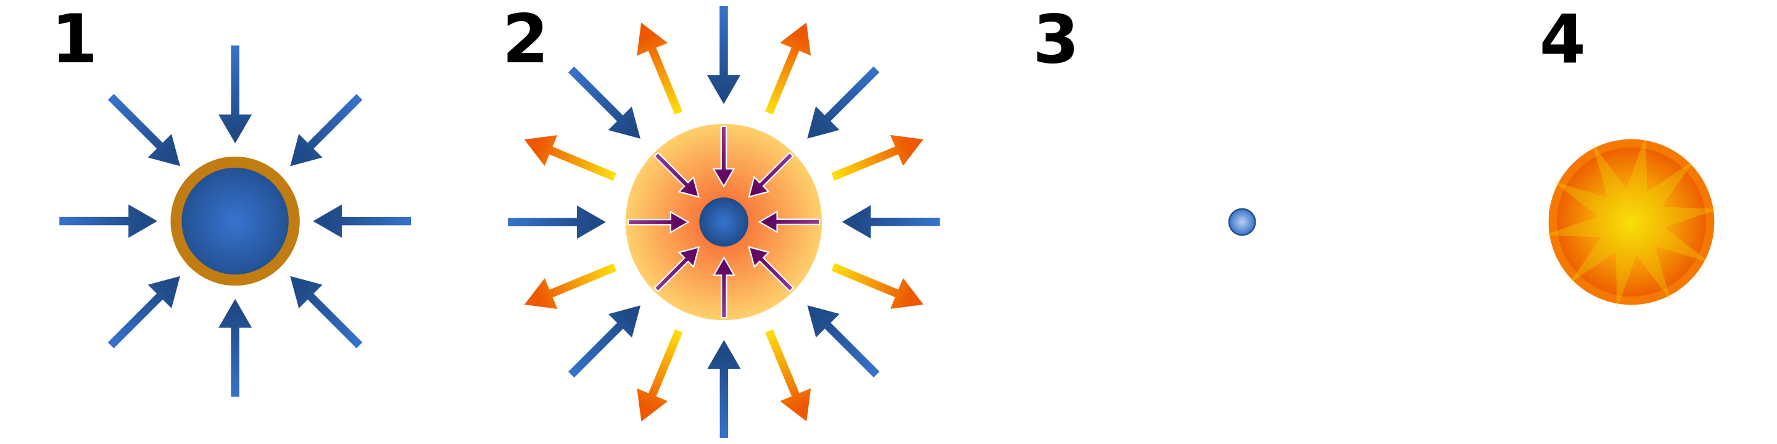
Inertial confinement fusion
Schematic of the stages of inertial confinement fusion using lasers. The blue arrows represent radiation; orange is blowoff; yellow is inwardly transported thermal energy.
Laser beams or laser-produced X-rays rapidly heat the surface of the fusion target, forming a surrounding plasma envelope.
Fuel is compressed by the rocket-like blowoff of the hot surface material.
During the final part of the capsule implosion, the fuel core reaches 20 times the density of lead and ignites at 100 MK.
Thermonuclear burn spreads rapidly through the compressed fuel, yielding many times the input energy.
6
Notes:
Pozor je to pro verejnost … jednoduseji, schemata nazorna, ne moc analyz, jen par rovnic

Slide 30
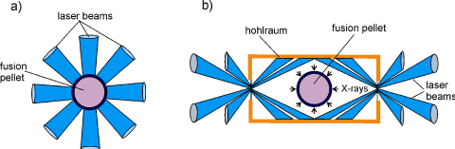
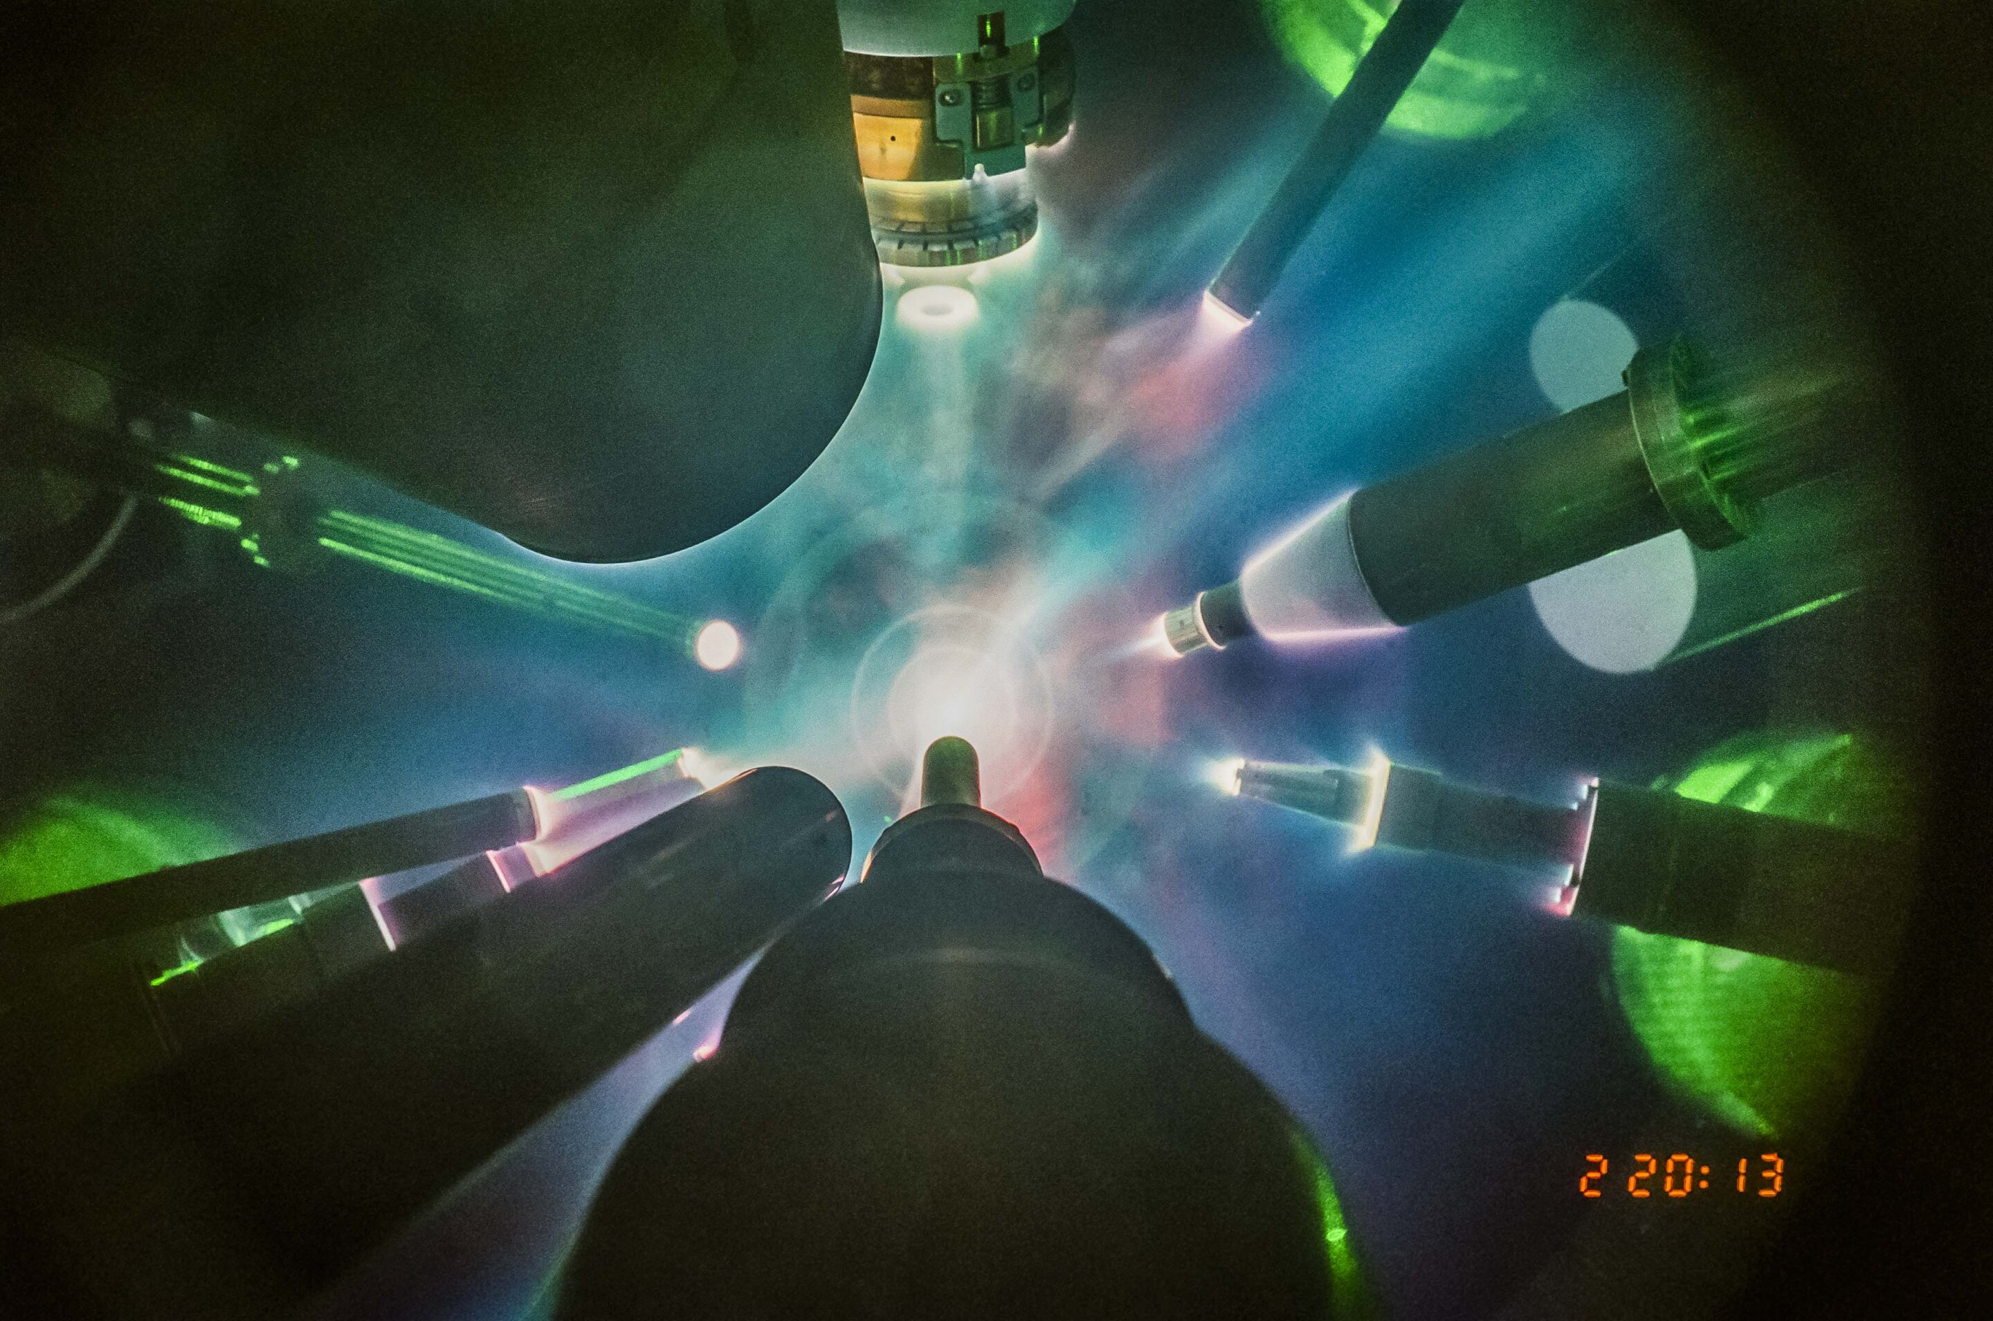
Inertial confinement fusion – direct vs indirect drive
6
Notes:
Pozor je to pro verejnost … jednoduseji, schemata nazorna, ne moc analyz, jen par rovnic

Slide 31
fusion setups – inertial electrostatic confinement (IEC)

Slide 32
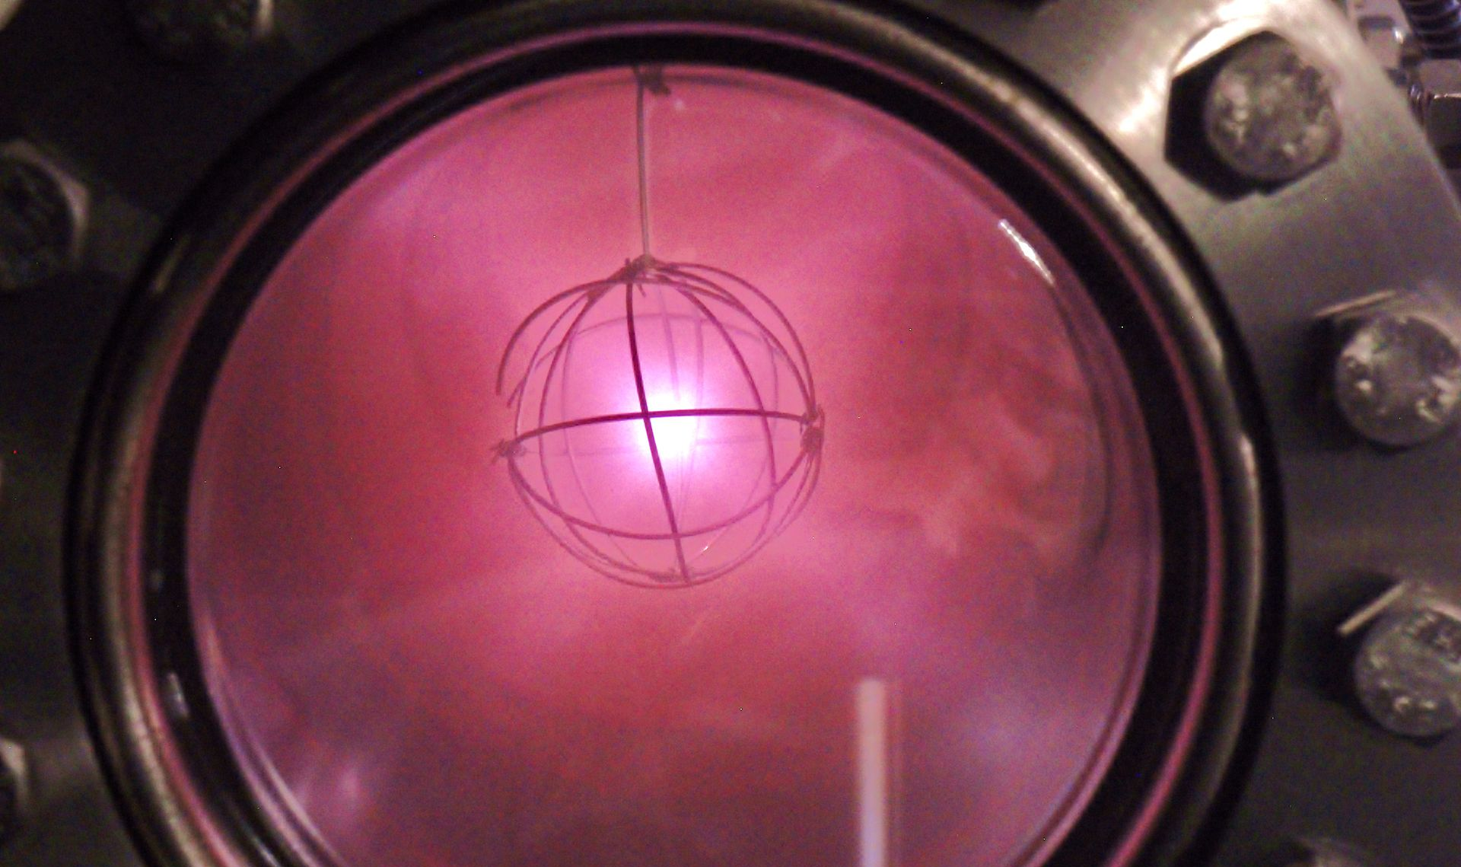
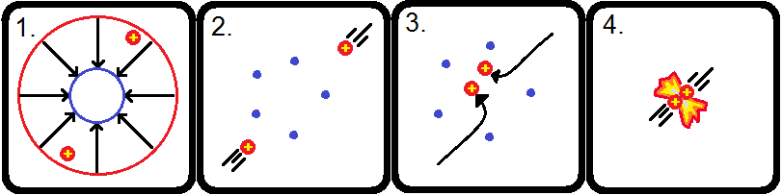
Inertial electrostatic confinement
6
Notes:
Pozor je to pro verejnost … jednoduseji, schemata nazorna, ne moc analyz, jen par rovnic

Slide 33
take aways

Slide 34
Take aways
Main fusion reactions, optimum in the cross section.
Lawson criterion and parameter, triple product.
Different fusion setups with emphasis on MCF as the most widespread concept.

