Slide 1
English for Physicists 2 Week 5
Black holes and speculating

Slide 2
Black holes and related concepts
Hawking paradox
Very long baseline interferometry
Conditionals and speculating

Slide 3
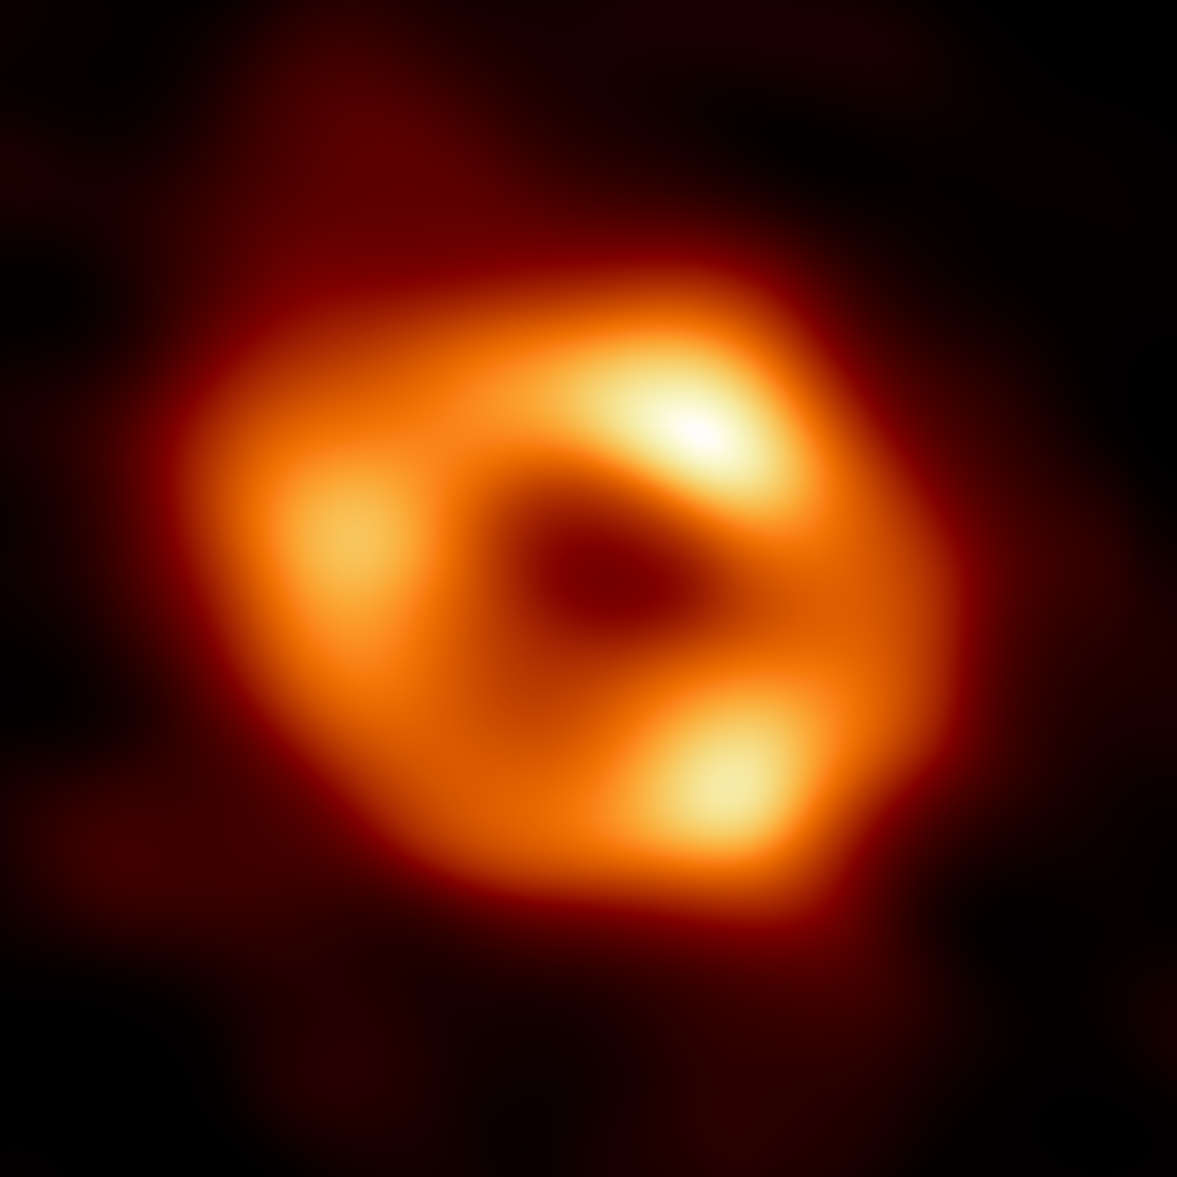

Slide 4
How are these items related?
quantum hair stars quasars Karl Schwarzschild
galaxy event horizon gravity
very long baseline interferometry
accretion disc singularity

Slide 5
True or false?
1 A black hole is an empty space
2 Black holes are the most fascinating objects in space
3 Black holes were predicted by Einstein's theory of general relativity
4 Black holes can be directly observed with telescopes
5 Black holes are passages to another universe
6 The existence of black holes cannot be explained by the quantum-mechanical laws
7 Most black holes form from the remnants of a large star
8 A black hole can destroy the Earth

Slide 6
Listening – sorting out information
Things I knew about black holes before watching the video | Things I learned in the video | Things I want to know about black holes and I hope I will one day

Slide 7
Reading
1 What seems to be the answer to Hawking’s paradox according to the latest articles?
2 What did Hawking suggest about black holes in 1976 and why is it against laws of quantum mechanics?
3 What is Hawking radiation and what does it depend on?
4 Who is the author of the no-hair theorem and what does it say?
5 Why do scientists find it important to merge Einstein's theory of general relativity with quantum mechanics?
6 What was the purpose of the experiment?

Slide 8
Listening
1. The pictures of black holes were not made with ___________, they were made with __________________ with a wavelength of 1.3 mm.
2. When a radio telescope is pointed directly at a radio source, it produces _________________.
3. Being in phase means that ____________________ and ________________ line up.
4. The telescope produces peak intensity only when aimed directly ______________________.
5. The angular resolution of a telescope is its ability to _________________________________.
6. The angular resolution is ____________________________ to the diameter of the telescope.
7. The angular resolution is too _____________ for any individual radio telescope on the Earth.
8. Instead of increasing the dish diameter of the telescope, it is easier to ___________________.
9. _________________________ is a global network of radio observatories.
10. Each telescope records the signal at its location and ________________________________.

Slide 9
Listening
1. The pictures of black holes were not made with ___________, they were made with __________________ with a wavelength of 1.3 mm.
2. When a radio telescope is pointed directly at a radio source, it produces _________________.
3. Being in phase means that ____________________ and ________________ line up.
4. The telescope produces peak intensity only when aimed directly ______________________.
5. The angular resolution of a telescope is its ability to _________________________________.
6. The angular resolution is ____________________________ to the diameter of the telescope.
7. The angular resolution is too _____________ for any individual radio telescope on the Earth.
8. Instead of increasing the dish diameter of the telescope, it is easier to ___________________.
9. _________________________ is a global network of radio observatories.
10. Each telescope records the signal at its location and ________________________________.

Slide 10
Listening
1. The pictures of black holes were not made with visible light, they were made with radio waves with a wavelength of 1.3 mm.
2. When a radio telescope is pointed directly at a radio source, it produces a bright spot.
3. Being in phase means that peaks and troughs line up.
4. The telescope produces peak intensity only when aimed directly at the source.
5. The angular resolution of a telescope is its ability to identify the source of the waves.
6. The angular resolution is inversely proportional to the diameter of the telescope.
7. The angular resolution is too large for any individual radio telescope on the Earth.
8. Instead of increasing the dish diameter of the telescope, it is easier to have a network of devices.
9. The Event Horizon Telescope is a global network of radio observatories.
10. Each telescope records the signal at its location and the exact time in femtoseconds.

Slide 11
Speculating and conditionals
A If you jump in the water, you will get wet.
B If we constructed spacecraft moving at 64 000 kph, it would take us 77 000 years to get to the nearest star.
C If I didn't have a computer, my work would be much more difficult.
D I will use my phone, if there isn’t any computer in the classroom.
Sentences ____ and _______ express a real possibility.
Sentences ____ and ______ express an imaginary situation.

Slide 12
Speculating and conditionals
A If you jump in the water, you will get wet.
B If we constructed spacecraft moving at 64 000 kph, it would take us 77 000 years to get to the nearest star.
C If I didn't have a computer, my work would be much more difficult.
D I will use my phone, if there isn’t any computer in the classroom.
Sentences A and D express a real possibility.
Sentences B and C express an imaginary situation.

Slide 13
Possibility or imaginary situation?
What would happen if you ________ (fall) into a black hole?
If he ________ (come) tomorrow, I will let you know.
If he had more money, he ________ (travel) around the world.
If you don’t hurry, you __________ (miss) the bus.
If she ______ (have) time, she’ll write the paper.
If I ________ (know) the correct answer, I’d tell you.
If I __________ (be) an astronaut, I would live aboard the ISS.
Nobody _________ (notice), if you make a mistake.
If I won the lottery, I __________ (buy) a new car.
If I _________ (be) you, I’d study more.

Slide 14
Possibility or imaginary situation?
What would happen if you fell into a black hole?
If he comes tomorrow, I will let you know.
If he had more money, he would travel around the world.
If you don’t hurry, you ´II miss the bus.
If she has time, she’ll write the paper.
If I knew the correct answer, I’d tell you.
If I was (were) an astronaut, I would live aboard the ISS.
Nobody will notice, if you make a mistake.
If I won the lottery, I would buy a new car.
If I were you, I’d study more.

Slide 15
Complete sentences with yout ideas
If I could study abroad, I would study in _______ because ...
If I were a millionaire, the area of research I would support financially would be ______ because …
If I met Albert Einstein, the question I’d ask him would be __________ because ...
If I met Stephen Hawking, the topic I’d like to speak with him about would be ______ because …
If I didn’t study physics, I’d like to study _______ because ….
If I could be a superhero, I’d be _______ because ….
If I could travel back in time, I’d go to ______ because ..

Slide 16
Speculation: What would happen if you fell into a black hole?
a As you start being pulled toward a black hole, you would be moving__________________ because_________________.
b When you cross the event horizon, your body would _________________________________.
c You would be squashed in the centre and become____________________________________.
d A person observing you from the outside of the event horizon would see _________________.

Slide 17
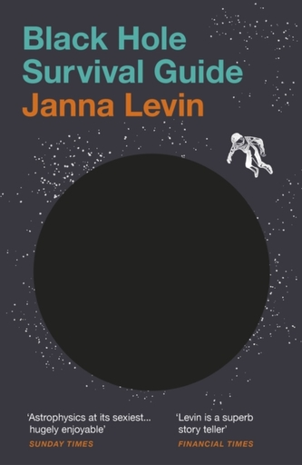

Slide 18
Cloze test
Black holes can come in a range of sizes, but there are three main 1________ of black holes. The black hole's 2________ and size 3__________ what kind it is.
The smallest ones are 4__________ as primordial black holes. Scientists believe this type of black hole is as small as a 5_________ atom but with the mass of a large mountain.
The most 6__________ type of medium-sized black holes is called "stellar." The mass of a stellar black hole can be up 7________ 20 times greater than the mass of the sun and can fit inside a ball with a diameter of about 10 miles. Dozens of stellar mass black holes may exist within the Milky Way galaxy.
The largest black holes are called "supermassive." These black holes have masses greater than 1 million suns combined and would fit inside a ball with a diameter about the size of the solar system. Scientific 8__________ suggests that every large galaxy 9__________ a supermassive black hole at its center. The supermassive black hole at the center of the Milky Way galaxy is called Sagittarius A. It has a mass 10________ to about 4 million suns and would fit inside a ball with a diameter about the size of the sun.

Slide 19
Cloze test
Black holes can come in a range of sizes, but there are three main 1 types of black holes. The black hole‘s 2 mass and size 3 determine what kind it is.
The smallest ones are 4 known as primordial black holes. Scientists believe this type of black hole is as small as a 5 single atom but with the mass of a large mountain.
The most 6 common type of medium-sized black holes is called "stellar." The mass of a stellar black hole can be up 7 to 20 times greater than the mass of the sun and can fit inside a ball with a diameter of about 10 miles. Dozens of stellar mass black holes may exist within the Milky Way galaxy.
The largest black holes are called "supermassive." These black holes have masses greater than 1 million suns combined and would fit inside a ball with a diameter about the size of the solar system. Scientific 8 evidence suggests that every large galaxy 9 contains a supermassive black hole at its center. The supermassive black hole at the center of the Milky Way galaxy is called Sagittarius A. It has a mass 10 equal to about 4 million suns and would fit inside a ball with a diameter about the size of the sun.

Slide 20
HW
Prepare a monologue – Speculate on an issue from your field of study (approximate length – 2-3 mins).
Concentrate mainly on two requirements:
The monologue is clearly structured into an introduction, main body, and a conclusion.
The monologue unfolds logically from one point to another and is effectively connected with appropriate signalling language (conditionals).

