Slide 1
Plasma Physics 2
Adam Obrusník, adamobrusnik@physics.muni.cz
Tomáš Hoder, hoder@physics.muni.cz

Slide 2
Lecture series contents
Townsend breakdown theory, Paschen‘s law
Glow discharge
Electric arc at low and high pressures
Magnetized low-pressure plasmas and their role in material deposition methods.
Brief introduction to high-frequency discharges
Streamer breakdown theory, corona discharge, spark discharge
Barrier discharges
Leader discharge mechanism, ionization and discharges in planetary atmospherres
Discharges in liquids, complex and quantum plasmas
Thermonuclear fusion, Lawson criterion, magnetic confinement systems, plasma heating and intertial confinement fusion.

Slide 3
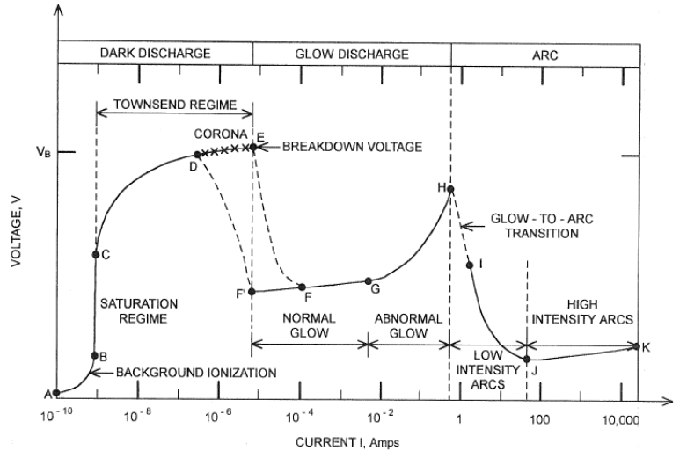
Discharges – what this Lesson covers?

Slide 4
Contents of this lesson
Transition between Townsend and Glow discharge modes – what we observe and what is the physics behind it.
Typical glow discharge structure and how it changes with conditions.
Glow discharge scaling laws
Glow discharge applications

Slide 5
Observation of the transition between Townsend and Glow Dischage

Slide 6
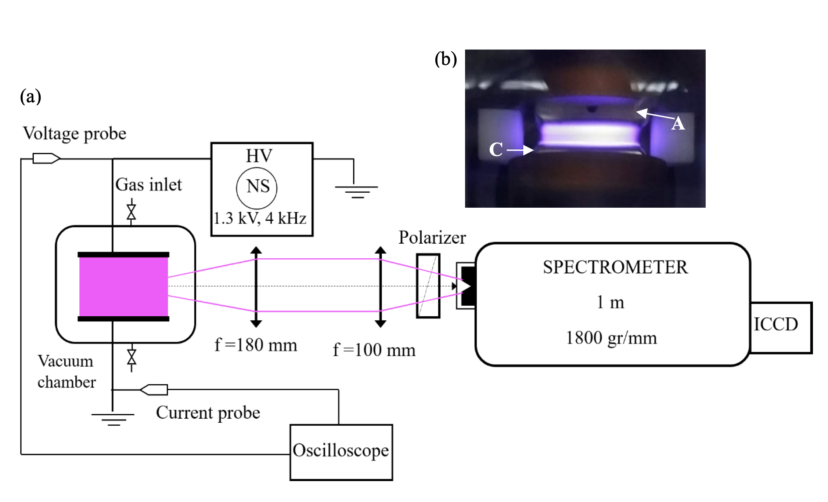
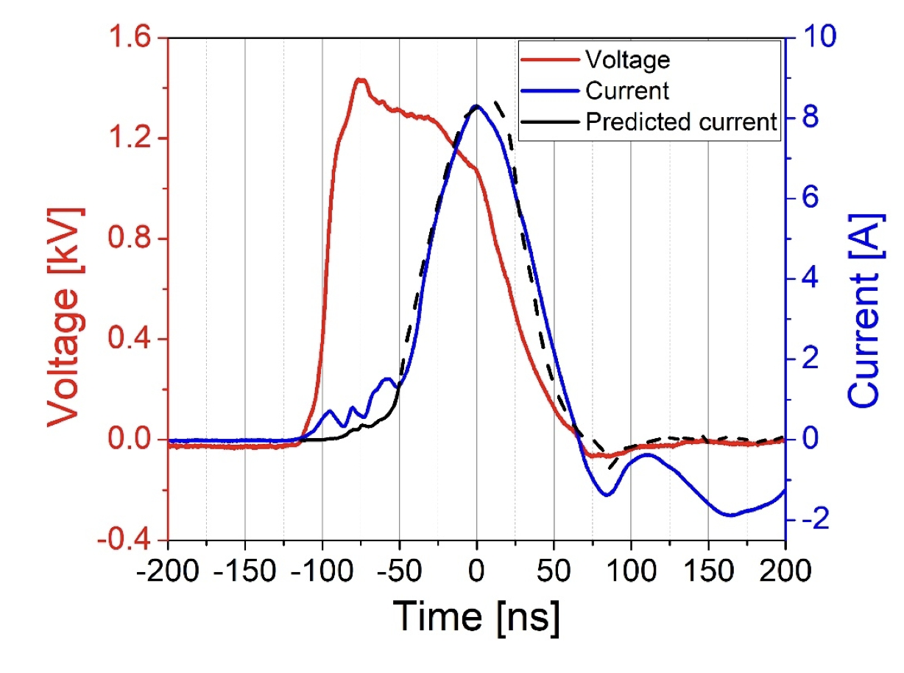
Observation: Townsend > Glow transition
The relevant phenomena take place at the time scale of single ns.
Light or electrical signals travel ca 30 cm in 1 ns => very high demands on instrumentation and triggering.
ns-plasmas and processes are in focus of fundamental plasma reaseach in the past decade.
[M. S. Simeni, Y. Zheng, E. V. Barnat, and P. J. Bruggeman, “Townsend to glow discharge transition for a nanosecond pulse plasma in helium: space charge formation and resulting electric field dynamics,” Plasma Sources Science and Technology, vol. 30, no. 5. IOP Publishing, p. 055004, May 01, 2021. doi: 10.1088/1361-6595/abf320]

Slide 7
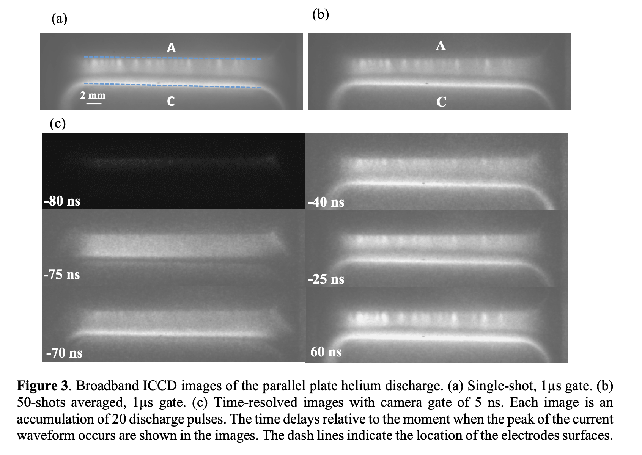
Observation: Townsend > Glow transition
The relevant phenomena take place at the time scale of single ns.
Light or electrical signals travel ca 30 cm in 1 ns => very high demands on instrumentation and triggering.
ns-plasmas and processes are in focus of fundamental plasma reaseach in the past decade.
[Reference see previous slide]

Slide 8
Mechanics behind the transition

Slide 9
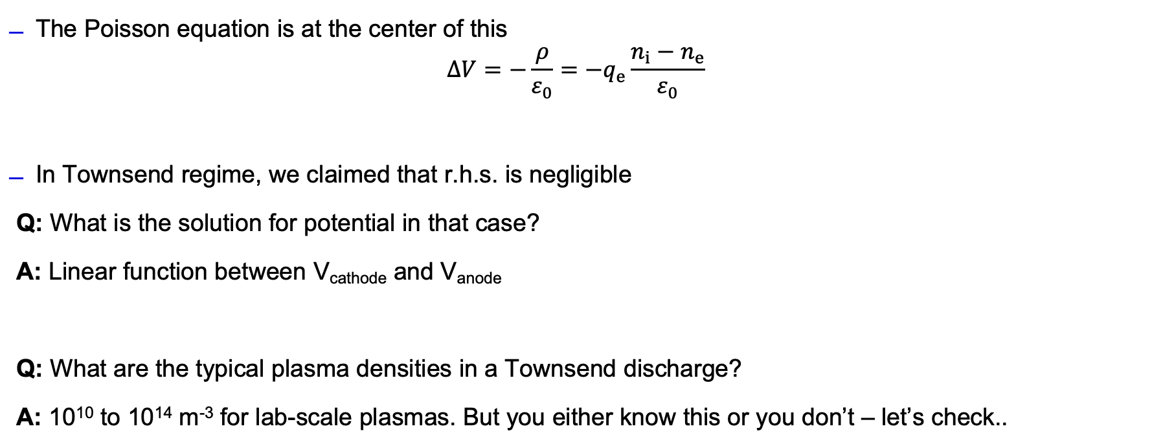
Townsend > Glow transition mechanics
The Poisson equation is at the center of this
$$ΔV=−\frac{ρ}{ε_{0}}=−q_{e}\frac{n_{i}−n_{e}}{ε_{0}}$$
In Townsend regime, we claimed that r.h.s. is negligible
Q: What is the solution for potential in that case?
A: Linear function between V_{cathode} and V_{anode}
Q: What are the typical plasma densities in a Townsend discharge?
A: 10¹⁰ to 10¹⁴ m⁻³ for lab-scale plasmas. But you either know this or you don’t – let’s check..

Slide 10
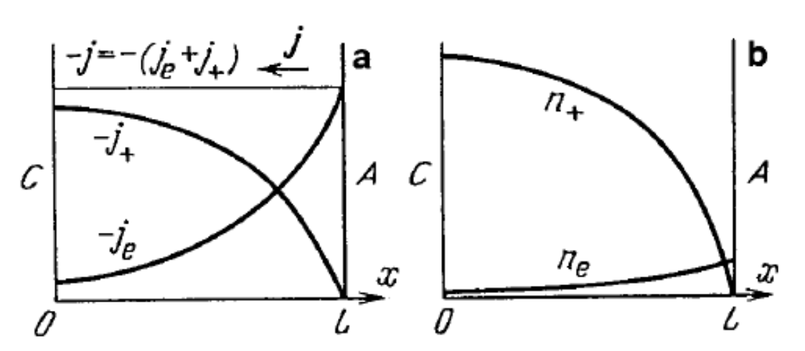
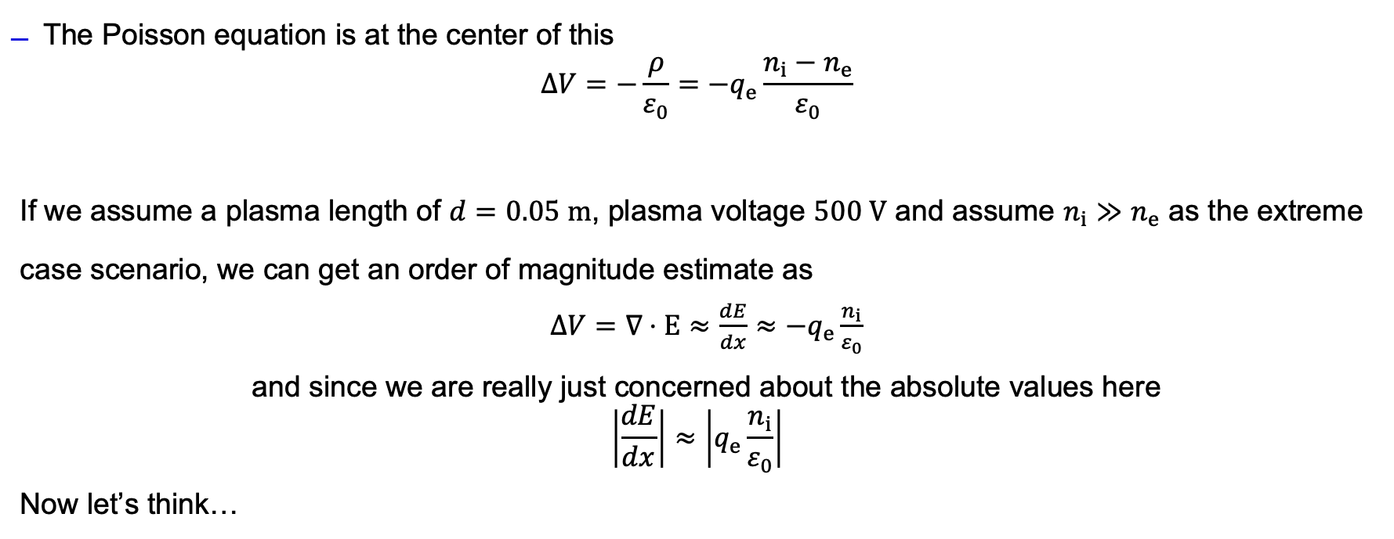
Townsend > Glow transition mechanics
The Poisson equation is at the center of this
$$ΔV=−\frac{ρ}{ε_{0}}=−q_{e}\frac{n_{i}−n_{e}}{ε_{0}}$$
If we assume a plasma length of $d=0.05 m$, plasma voltage $500 V$ and assume $n_{i}≫n_{e}$ as the extreme case scenario, we can get an order of magnitude estimate as
$ΔV=∇⋅E≈\frac{dE}{dx}≈$ $−q_{e}\frac{n_{i}}{ε_{0}}$
and since we are really just $\text{concerned} \text{about} \text{the} \text{absolute} \text{values} \text{here}$
$$\left|\frac{dE}{dx}\right|≈\left|q_{e}\frac{n_{i}}{ε_{0}}\right|$$
Now let’s think…

Slide 11
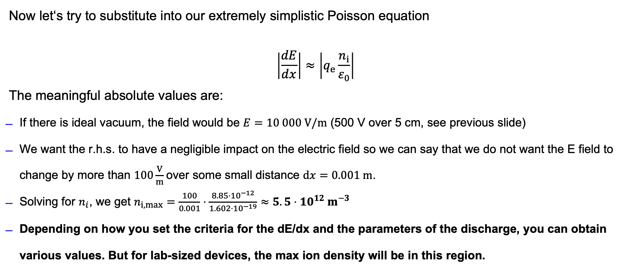
Townsend > Glow transition mechanics
Now let‘s try to substitute into our extremely simplistic Poisson equation
$$\left|\frac{dE}{dx}\right|≈\left|q_{e}\frac{n_{i}}{ε_{0}}\right|$$
The meaningful absolute values are:
If there is ideal vacuum, the field would be $E=10 000 V/m$ (500 V over 5 cm, see previous slide)
We want the r.h.s. to have a negligible impact on the electric field so we can say that we do not want the E field to change by more than $100\frac{V}{m}$over some small distance $dx=0.001 m$.
Solving for $n_{i}$, we get $n_{i, max}=\frac{100}{0.001}⋅\frac{8.85⋅{10}^{−12}}{1.602⋅{10}^{−19}}≈5.5⋅{10}^{12} m^{−3}$
Depending on how you set the criteria for the dE/dx and the parameters of the discharge, you can obtain various values. But for lab-sized devices, the max ion density will be in this region.

Slide 12
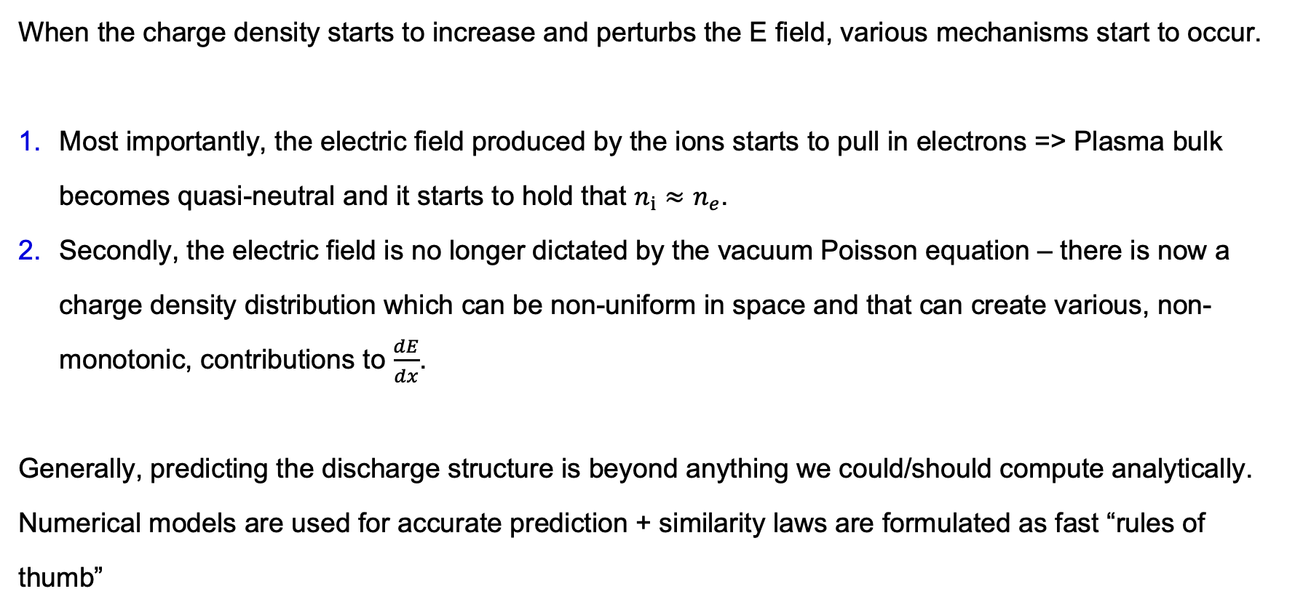
Townsend > Glow transition mechanics
When the charge density starts to increase and perturbs the E field, various mechanisms start to occur.
Most importantly, the electric field produced by the ions starts to pull in electrons => Plasma bulk becomes quasi-neutral and it starts to hold that $n_{i}≈n_{e}$.
Secondly, the electric field is no longer dictated by the vacuum Poisson equation – there is now a charge density distribution which can be non-uniform in space and that can create various, non-monotonic, contributions to $\frac{dE}{dx}$.
Generally, predicting the discharge structure is beyond anything we could/should compute analytically. Numerical models are used for accurate prediction + similarity laws are formulated as fast “rules of thumb”

Slide 13
Glow discharge structure, typical conditions and similarity laws

Slide 14
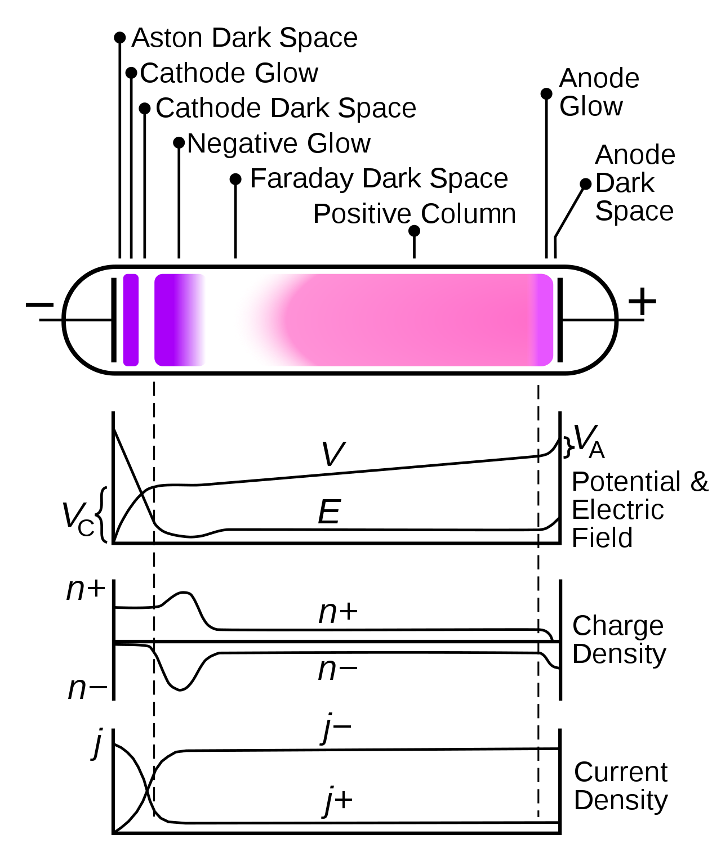
Townsend > Glow transition mechanics
The structures below have been observed.
Depending on the layout, many of them may not form.
d is the thickness of the cathode voltage drop
V_{C} is the cathode potential
Aston space immediately close to the cathode, the electrons do not have enough energy to ionize or excite.
Cathode light – accelerated electrons start to excite neutral species, which de-excite while emitting a photon.
Cathode dark space – the mean energy exceeds a certain threshold, beyond which they can ionize. This leads to a decrease in the absolute count of excitations.
Negative glow – Electrons have lost some energy due to ionizations, light emission may increase again.
Faraday dark space – electrons have now passed the crazy sheath region and entered the region with a rather low energy, so the emission is reduced again.
Positive column – always exists, this is the bulk plasma with small but consistent E field. Electrons are in equilibrium with the field and continuously excite.
Anode light – slight acceleration of electrons by the anode voltage bump.

Slide 15
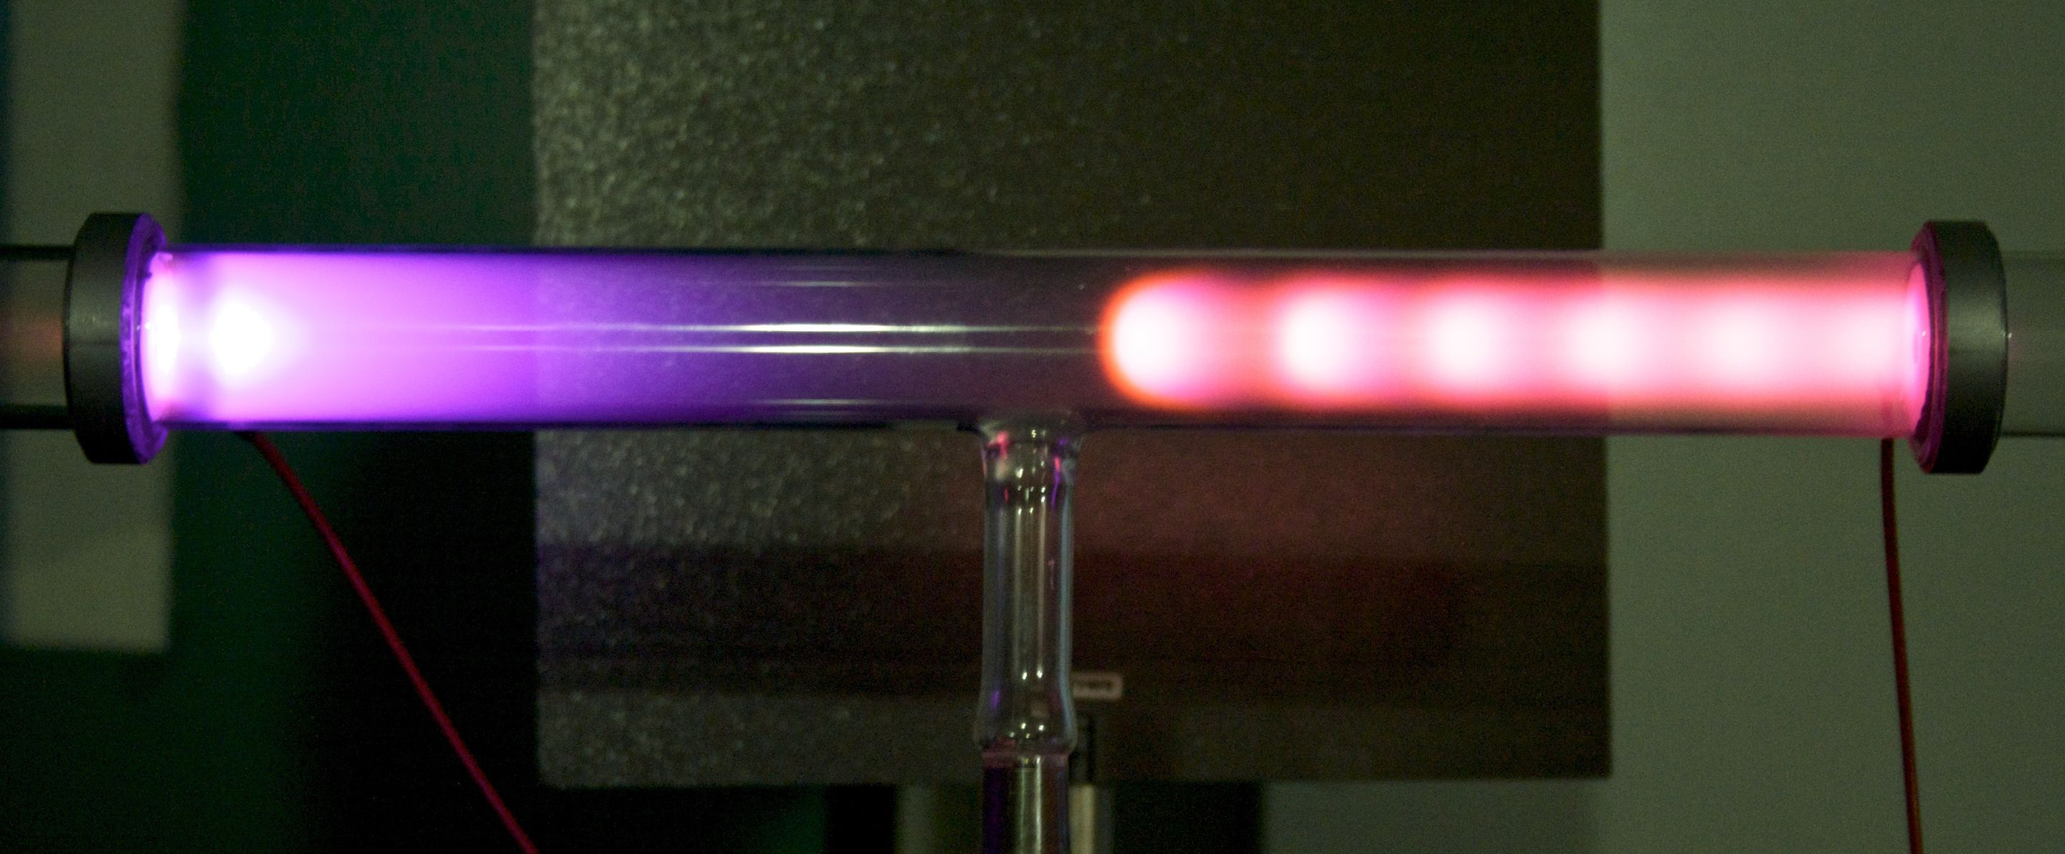
Townsend > Glow transition mechanics
The structures below have been observed.
Depending on the layout, many of them may not form.

Slide 16
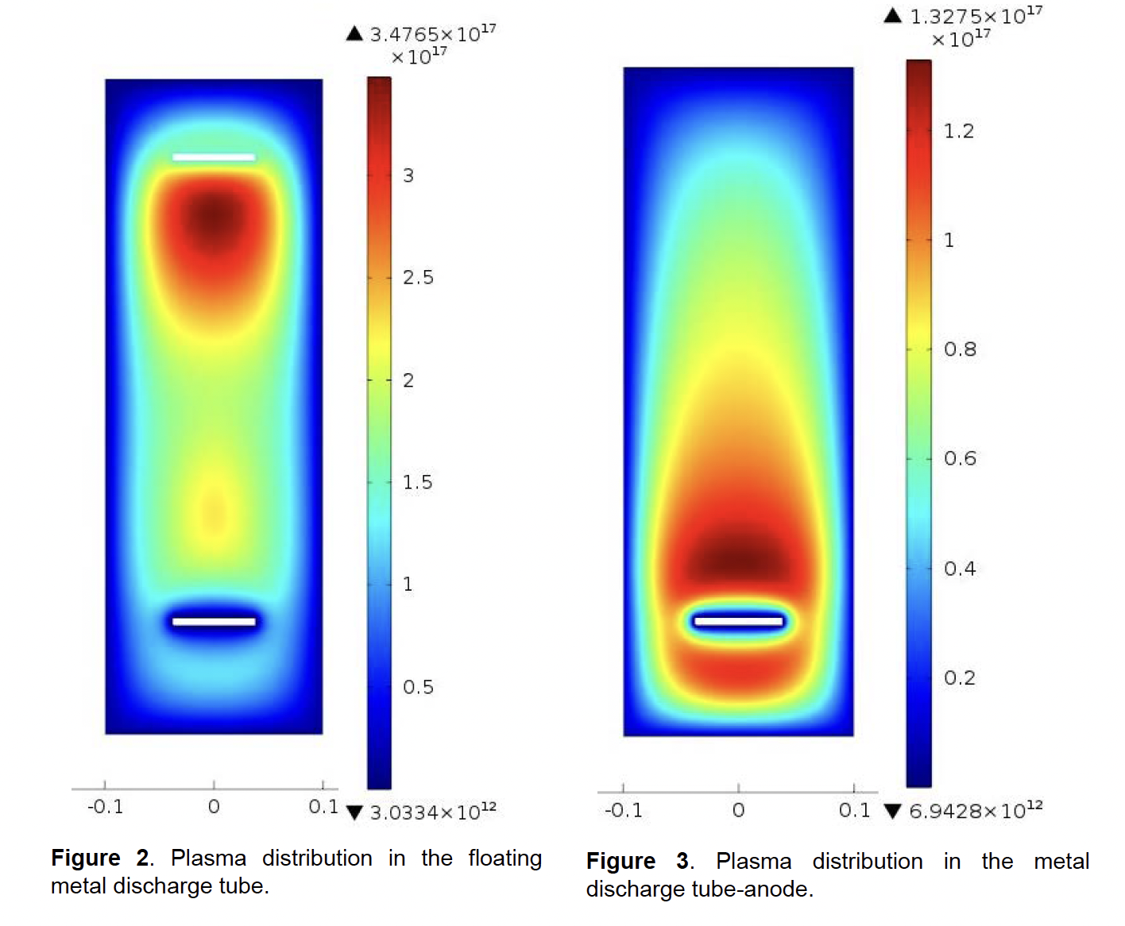
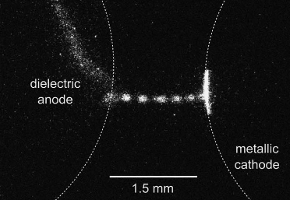
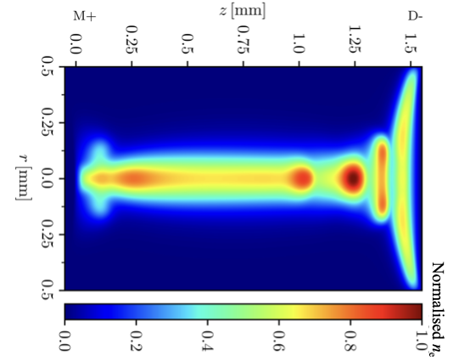
Townsend > Glow transition mechanics
The structures in the previous slide have been observed. Depending on the conditions, many of them may not form.
[V. Gorokhovsky Modeling of DC Discharges in Argon at Low Pressures. COMSOL Conference 2012]
[T. Hoder and team]

Slide 17
Pressure/geometry vs discharge strucure
If we are decreasing the pressure at fixed other conditions OR increase voltage at fixed pressure: The negative glow and Faraday space start to increase, positive column shortens, until it disappears completely. https://www.youtube.com/shorts/nn8796OnTsk
If we reduce the cathode-anode distance: Positive glow again starts to shorten while the negative glow and Faraday space remain the same. Ultimately, there is a minimum distance at which the plasma will still operate.

Slide 18
Plasma properties in glow discharge
Theoretically, you can construct arbitrarily large glow discharges, but the typical reasonable conditions are as follows:
Quantity | Usual range | Comment
Gas pressure | 0.1 – 1000 Pa *APGD up to 1 atm | No ignition for too low pressures, development of plasma instabilities for high pressures. APGD = atmpospheric-pressure glow discharge, requires tiny gaps and very high electrode precision.
Plasma density | 10¹⁵ – 10¹⁹ m⁻³ | At higher densities, conductivity is too high and plasma collapses into arc discharge.
Electron mean energy | 1– 2.5 eV in positive column | In the positive column, electrons reach some type of equilibirum (especially at higher pressures). In the near-electron regions, the EEDF is highly non-Maxwellian
Gas temperature | 300 – 500 K * up to 2000 K in hollow cathode configs
Input power | 10 W – 1 kW *up to 20 kW in hollow chathode configs

Slide 19
Similarity laws
There have been various attempts to identify similarity laws for glow discharges – essentially attempting to answer the question “at what two conditions do I get the same discharge structure?”
This is quite important for practical applications of plasmas – in many cases, we want to make a small-scale prototype for testing and then upscale it. But the plasma behaves in a highly non-linear manner!

Slide 20
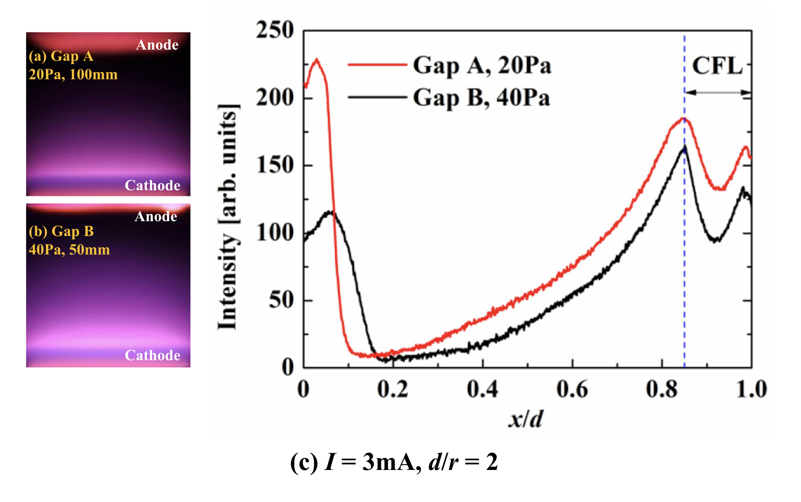
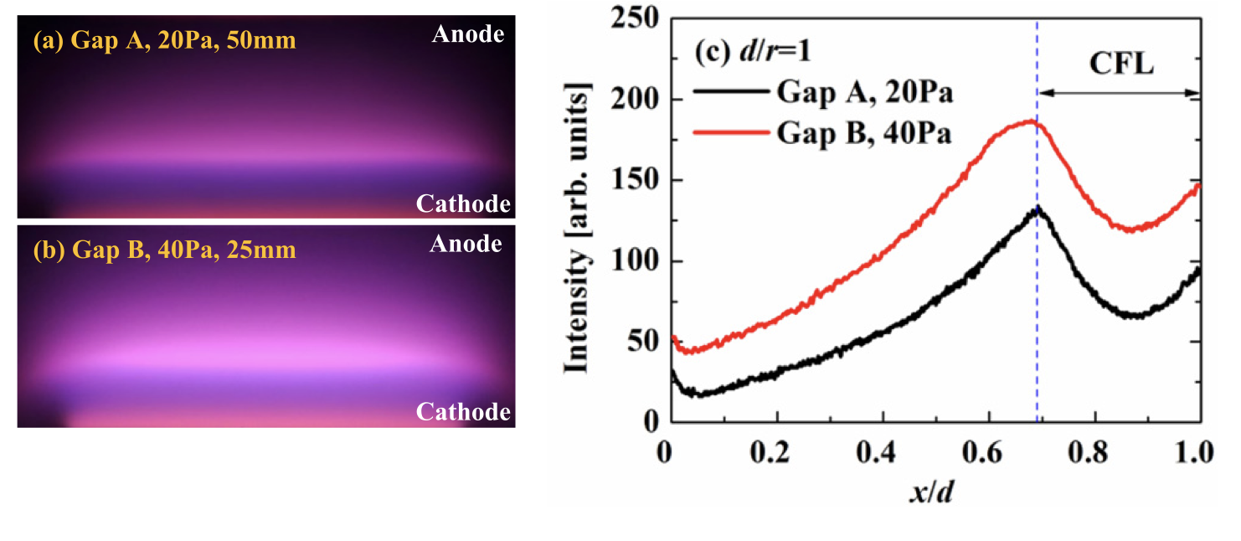

Similarity laws
Example 1: Y Fu et al. Physics of Plasmas 24, 083510 (2017); doi: 10.1063/1.4997425
The correlation metric is the discharge emission.
Demonstrates that in glow discharge, not only $pd$ is important but also $\frac{d}{r}$ has to be the same to maintain the same emission.

Slide 21
Similarity laws
Example 1: Y Fu et al. Physics of Plasmas 24, 083510 (2017); doi: 10.1063/1.4997425
The correlation metric is the discharge emission.
Demonstrates that in glow discharge, not only $pd$ is important but also $\frac{d}{r}$ has to be the same to maintain the same emission.

Slide 22
Similarity laws
Example 2: Deriving a similarity law for normal glow discharge
As we have seen, most of the voltage drop occurs in the cathode region and indeed, in most glow discharge conditions, majority of energy is dissipated in the cathode fall.
So let’s see if we can derive a useful expression for the current conducted through the cathode fall.

Slide 23
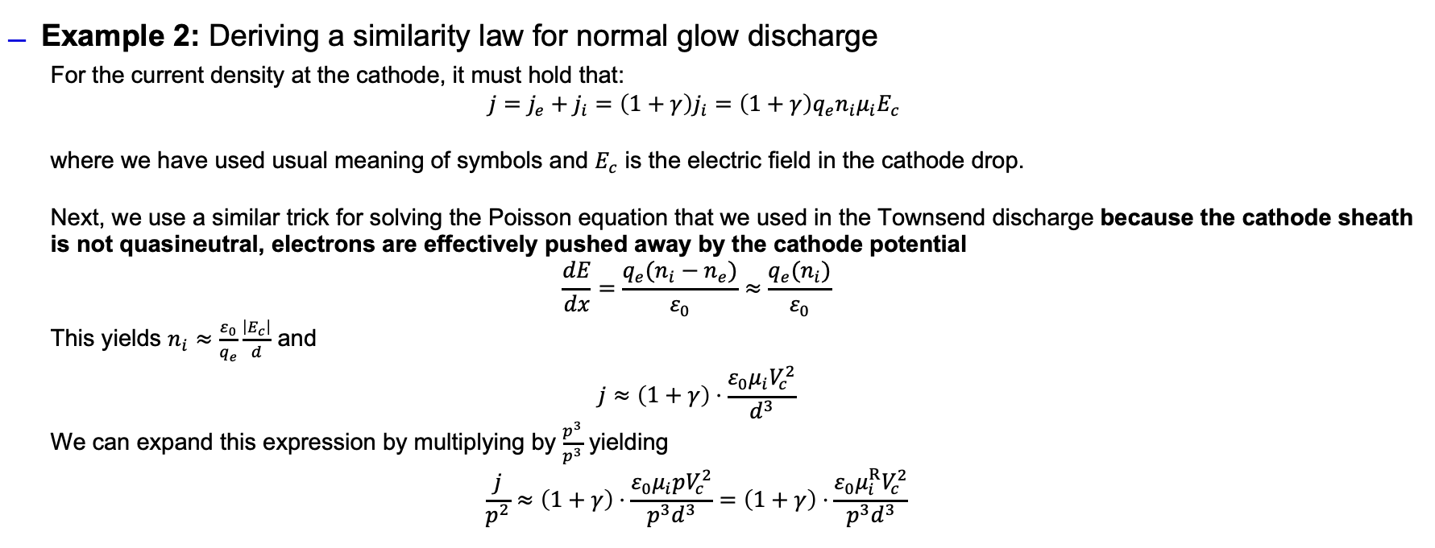
Similarity laws
Example 2: Deriving a similarity law for normal glow discharge
  For the current density at the cathode, it must hold that:
  $$j=j_{e}+j_{i}=\left(1+γ\right)j_{i}=\left(1+γ\right)q_{e}n_{i}μ_{i}E_{c}$$
  where we have used usual meaning of symbols and $E_{c}$ is the electric field in the cathode drop.
  Next, we use a similar trick for solving the Poisson equation that we used in the Townsend discharge because the cathode sheath is not quasineutral, electrons are effectively pushed away by the cathode potential
  $$\frac{dE}{dx}=\frac{q_{e}(n_{i}−n_{e})}{ε_{0}}≈\frac{q_{e}(n_{i})}{ε_{0}}$$
  This yields $n_{i}≈\frac{ε_{0}}{q_{e}}\frac{\left|E_{c}\right|}{d}$ and
  $$j≈\left(1+γ\right)⋅\frac{ε_{0}μ_{i}V_{c}^{2}}{d^{3}}$$
  We can expand this expression by multiplying by $\frac{p^{3}}{p^{3}}$ yielding
  $$\frac{j}{p^{2}}≈\left(1+γ\right)⋅\frac{ε_{0}μ_{i}pV_{c}^{2}}{{p^{3}d}^{3}}=\left(1+γ\right)⋅\frac{ε_{0}μ_{i}^{R}V_{c}^{2}}{{p^{3}d}^{3}}$$

Slide 24
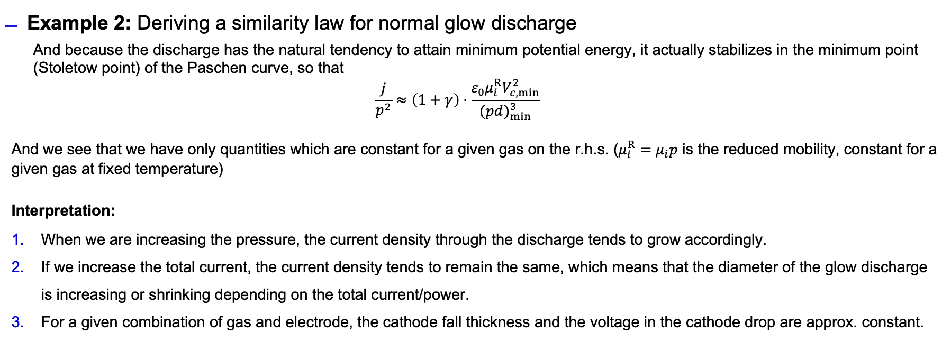
Similarity laws
Example 2: Deriving a similarity law for normal glow discharge
  And because the discharge has the natural tendency to attain minimum potential energy, it actually stabilizes in the minimum point (Stoletow point) of the Paschen curve, so that
  $$\frac{j}{p^{2}}≈\left(1+γ\right)⋅\frac{ε_{0}μ_{i}^{R}V_{c, min}^{2}}{{(pd)}_{min}^{3}}$$
And we see that we have only quantities which are constant for a given gas on the r.h.s. ($μ_{i}^{R}=μ_{i}p$ is the reduced mobility, constant for a given gas at fixed temperature)
Interpretation:
When we are increasing the pressure, the current density through the discharge tends to grow accordingly.
If we increase the total current, the current density tends to remain the same, which means that the diameter of the glow discharge is increasing or shrinking depending on the total current/power.
For a given combination of gas and electrode, the cathode fall thickness and the voltage in the cathode drop are approx. constant.

Slide 25
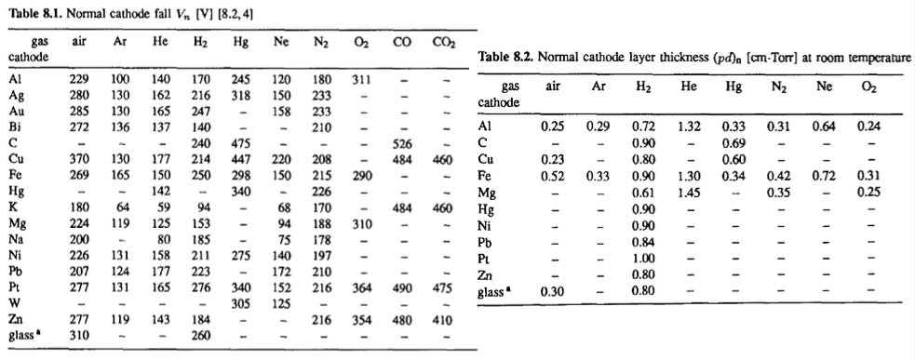
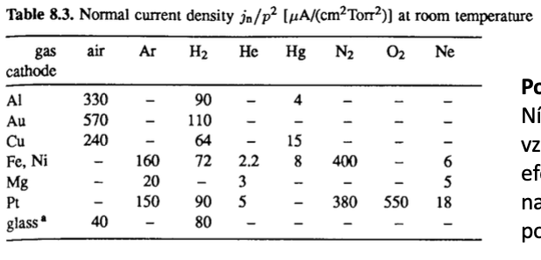
Similarity laws
Interpretation:
When we are increasing the pressure, the current density through the discharge tends to grow accordingly.
If we increase the total current, the current density tends to remain the same, which means that the diameter of the glow discharge is increasing or shrinking depending on the total current/power.
For a given combination of gas and electrode, the cathode fall thickness and the voltage in the cathode drop are approx. constant – you can find tables for various gasses that tell you with which parameters will the discharge stabilize.

Slide 26
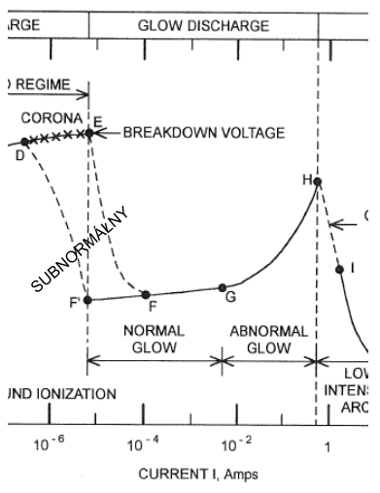
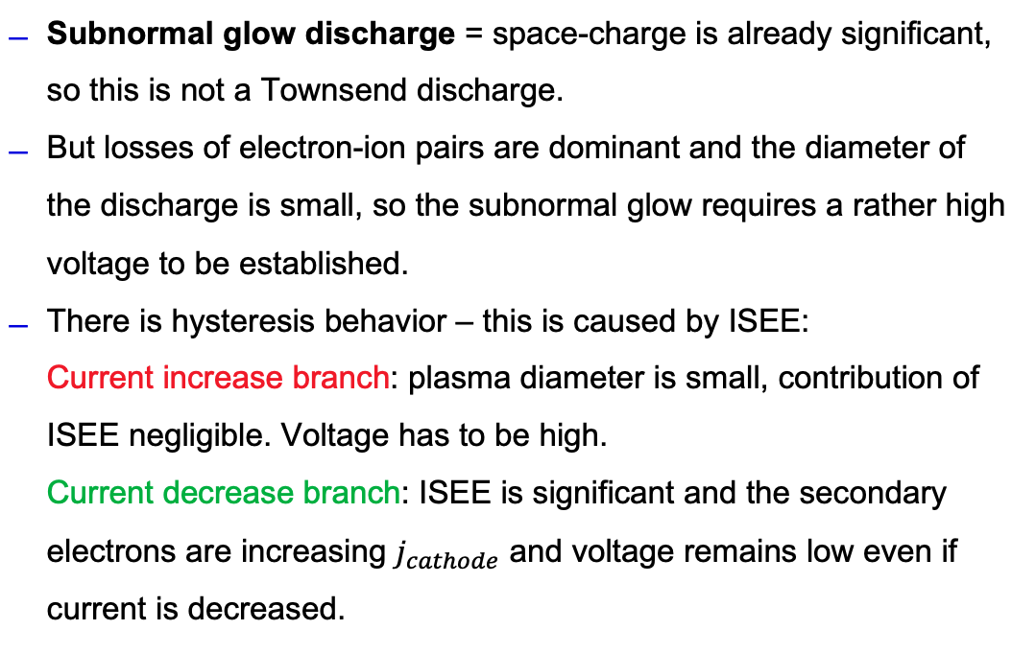
Subnormal / normal / abnormal glow discharge
Subnormal glow discharge = space-charge is already significant, so this is not a Townsend discharge.
But losses of electron-ion pairs are dominant and the diameter of the discharge is small, so the subnormal glow requires a rather high voltage to be established.
There is hysteresis behavior – this is caused by ISEE:
Current increase branch: plasma diameter is small, contribution of ISEE negligible. Voltage has to be high.
Current decrease branch: ISEE is significant and the secondary electrons are increasing $j_{cathode}$ and voltage remains low even if current is decreased.

Slide 27
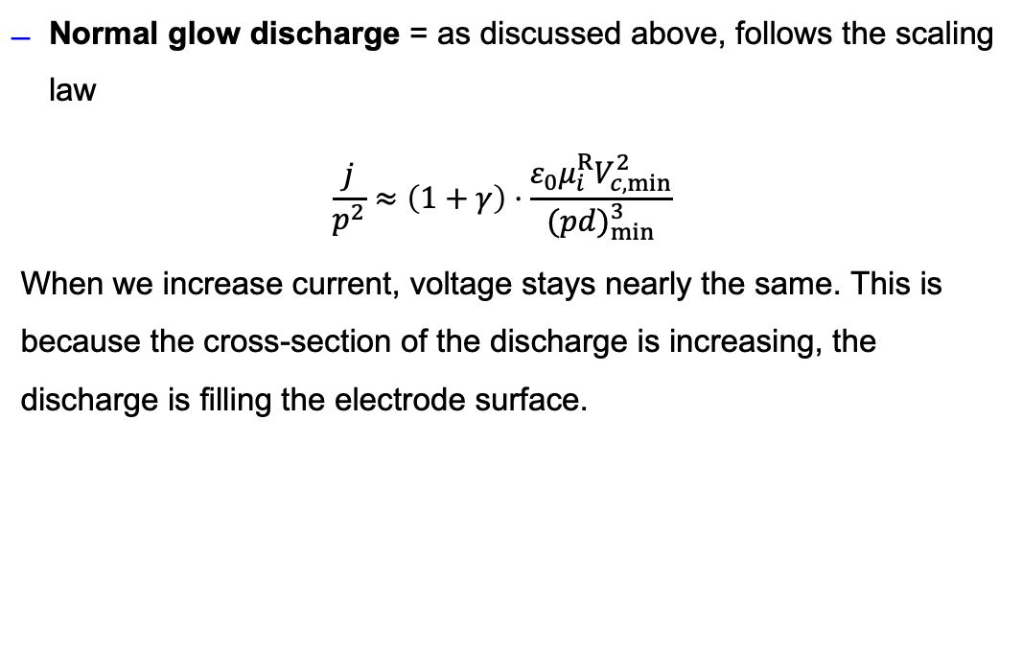
Subnormal / normal / abnormal glow discharge
Normal glow discharge = as discussed above, follows the scaling law
$$\frac{j}{p^{2}}≈\left(1+γ\right)⋅\frac{ε_{0}μ_{i}^{R}V_{c, min}^{2}}{{(pd)}_{min}^{3}}$$
When we increase current, voltage stays nearly the same. This is because the cross-section of the discharge is increasing, the discharge is filling the electrode surface.

Slide 28
Subnormal / normal / abnormal glow discharge
Abnormal glow discharge = when the discharge has filled the entire electrode surface, the scaling law stops to work.
Simply put, the plasma starts to behave like a resistor – to force more current through it, you need a higher voltage.
In reality, it is a slightly non-linear resistor, conductivity changes due to the change in voltage and current.

Slide 29
Applications of glow discharge
(today we cover only plain non-magnetized glow discharge in DC or slow AC < 1 kHz)

Slide 30
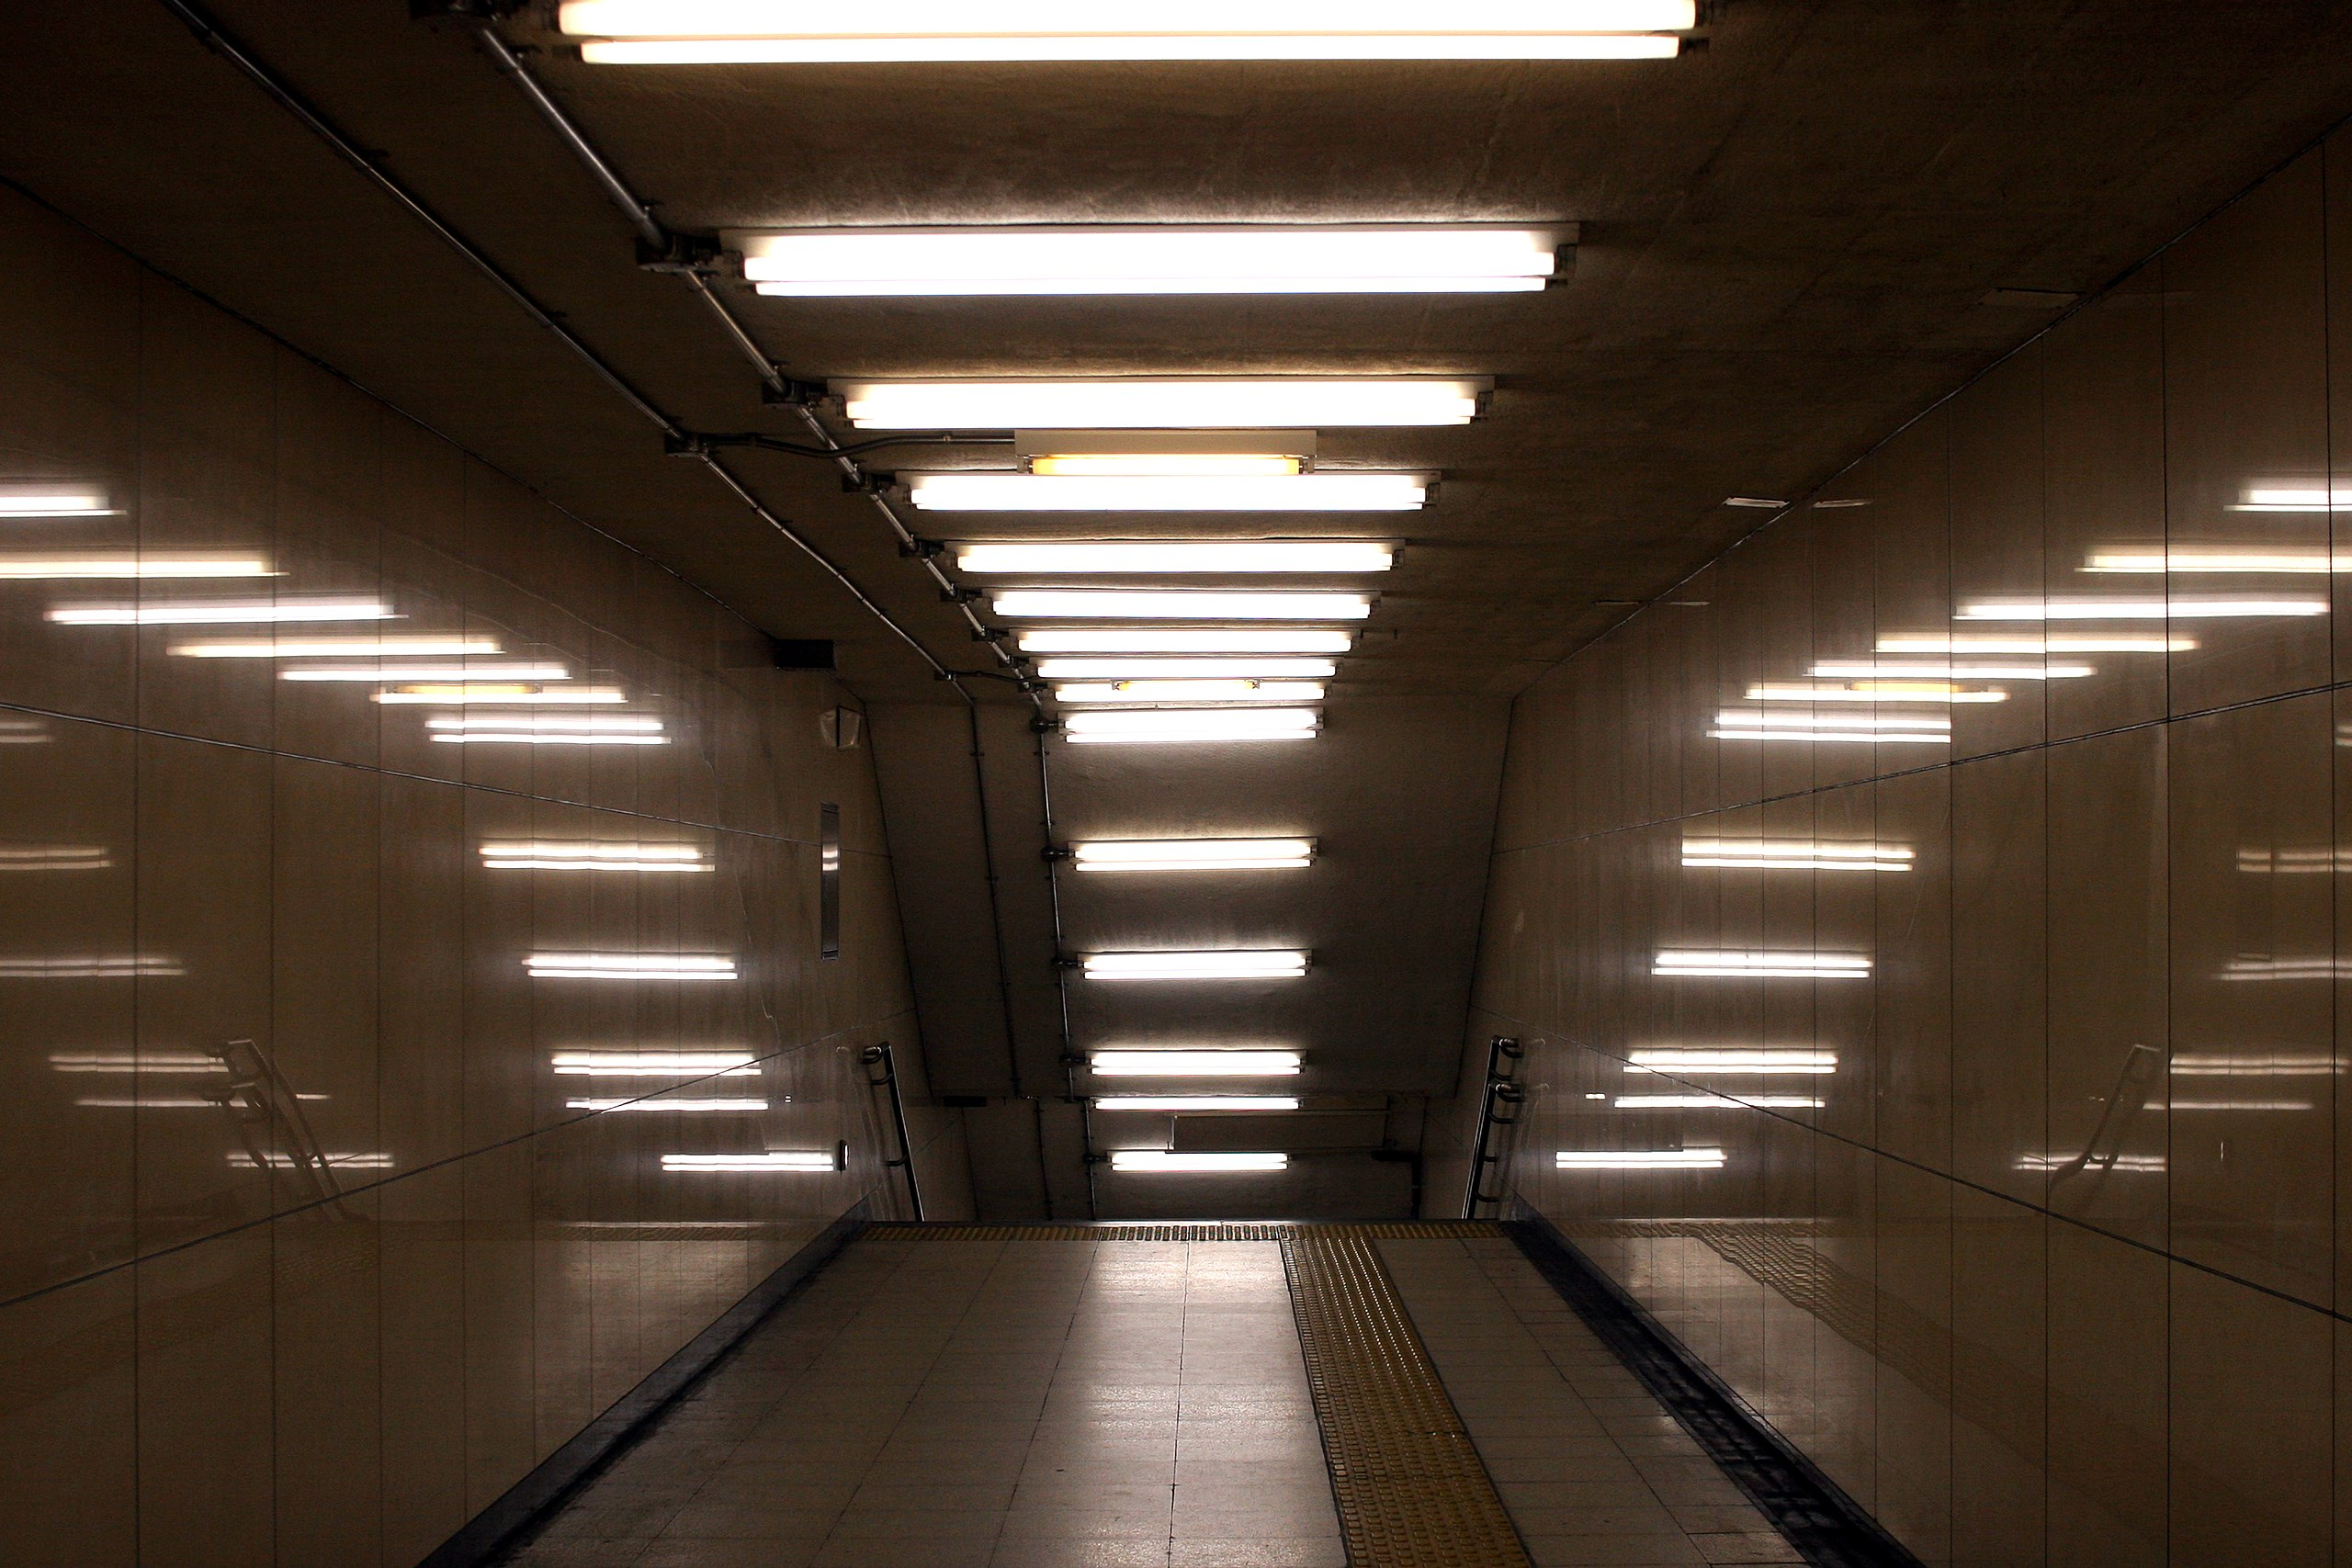
Application: Fluorescent lamps
Nowadays an obsolete device, mostly surpassed by LEDs.
Plasma ignited in mercury vapors producing UV
UV causes fluorescence on a photofluorescent layer
Still the go-to method for producing large-scale UV e.g. for disinfection

Slide 31
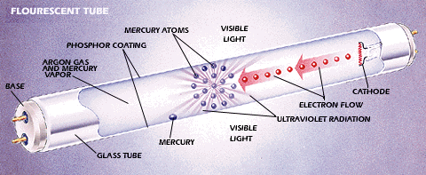
Application: Fluorescent lamps
Nowadays an obsolete device, mostly surpassed by LEDs.
Plasma ignited in mercury vapors producing UV
UV causes fluorescence on a photofluorescent layer
Still the go-to method for producing large-scale UV e.g. for disinfection

Slide 32
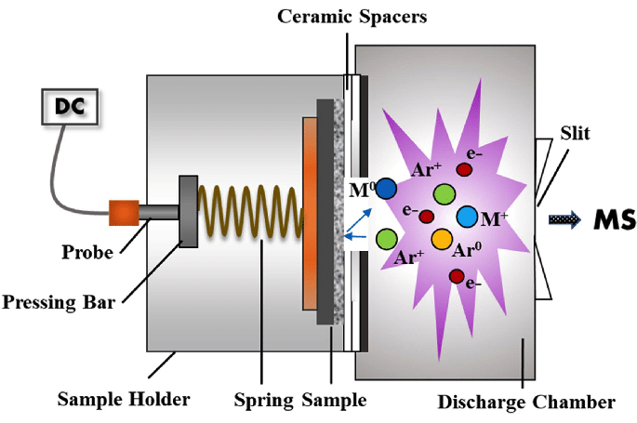
Application: GDMS
Glow discharge mass spectrometry = glow discharge acts as a source of ionization of samples which cannot be ionized chemically or by photons
Q: Why are M atoms emitted from the surface?
A: This is due to the effect of “sputtering” – low temperature removal of solid material by energetic ions (more on that next lecture)

Slide 33
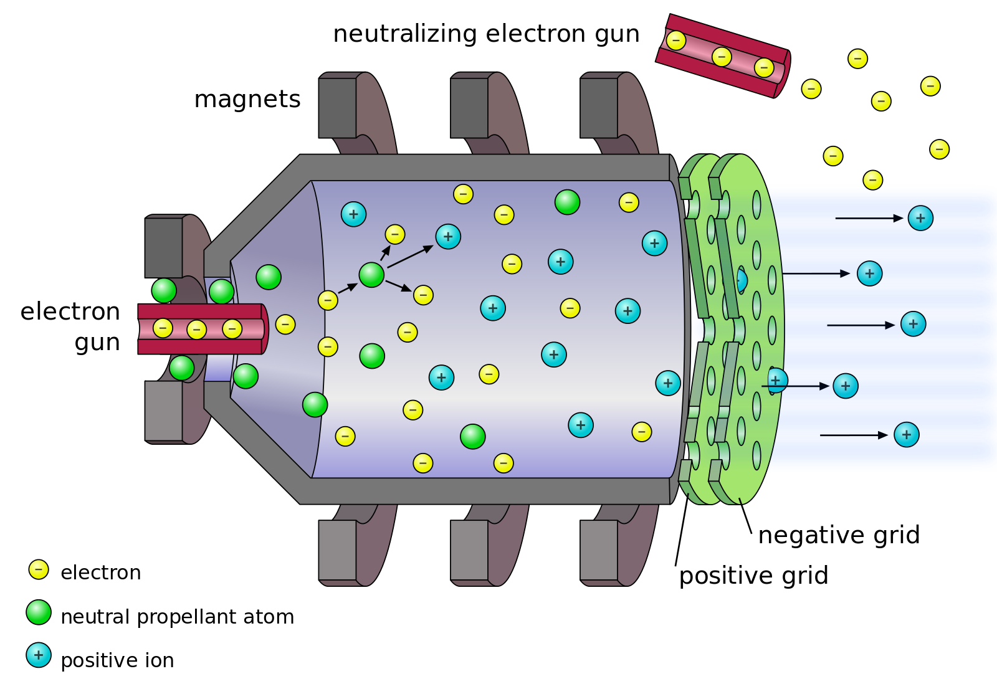
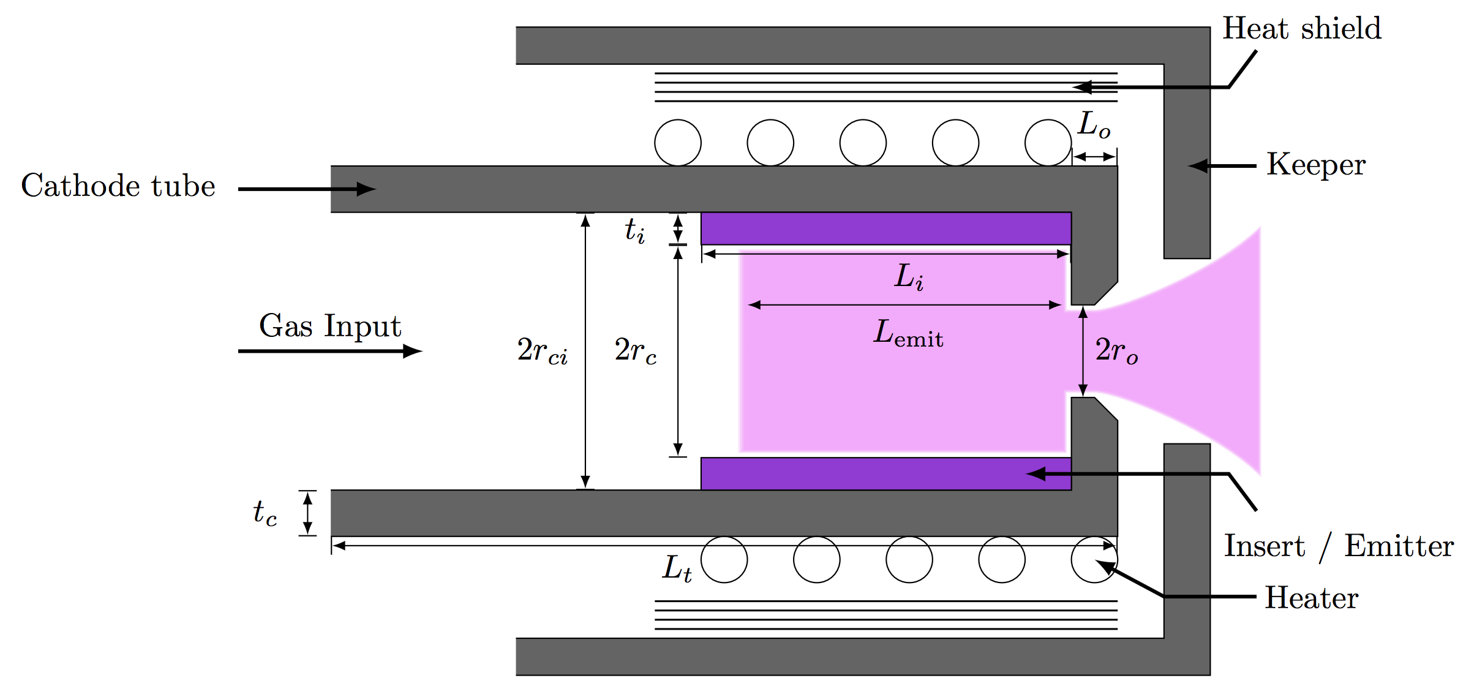
Application: Hollow cathode GD in satellite propulsion
In a very special arrangement called the “hollow cathode”, glow discharge can generage very dense but stable plasma at 10-100 A of current.
Q: Why do you think a HC plasma can get much more dense than the typical glow discharge?
A: Due to secondary emission and thermoemission being confined in the volume – it is largely a geometrical effect.

Slide 34
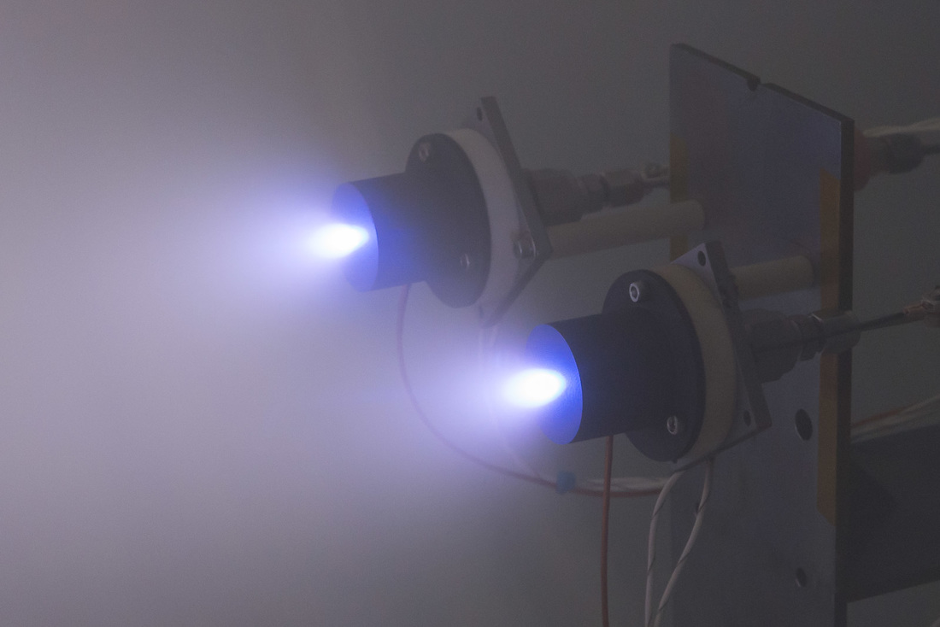
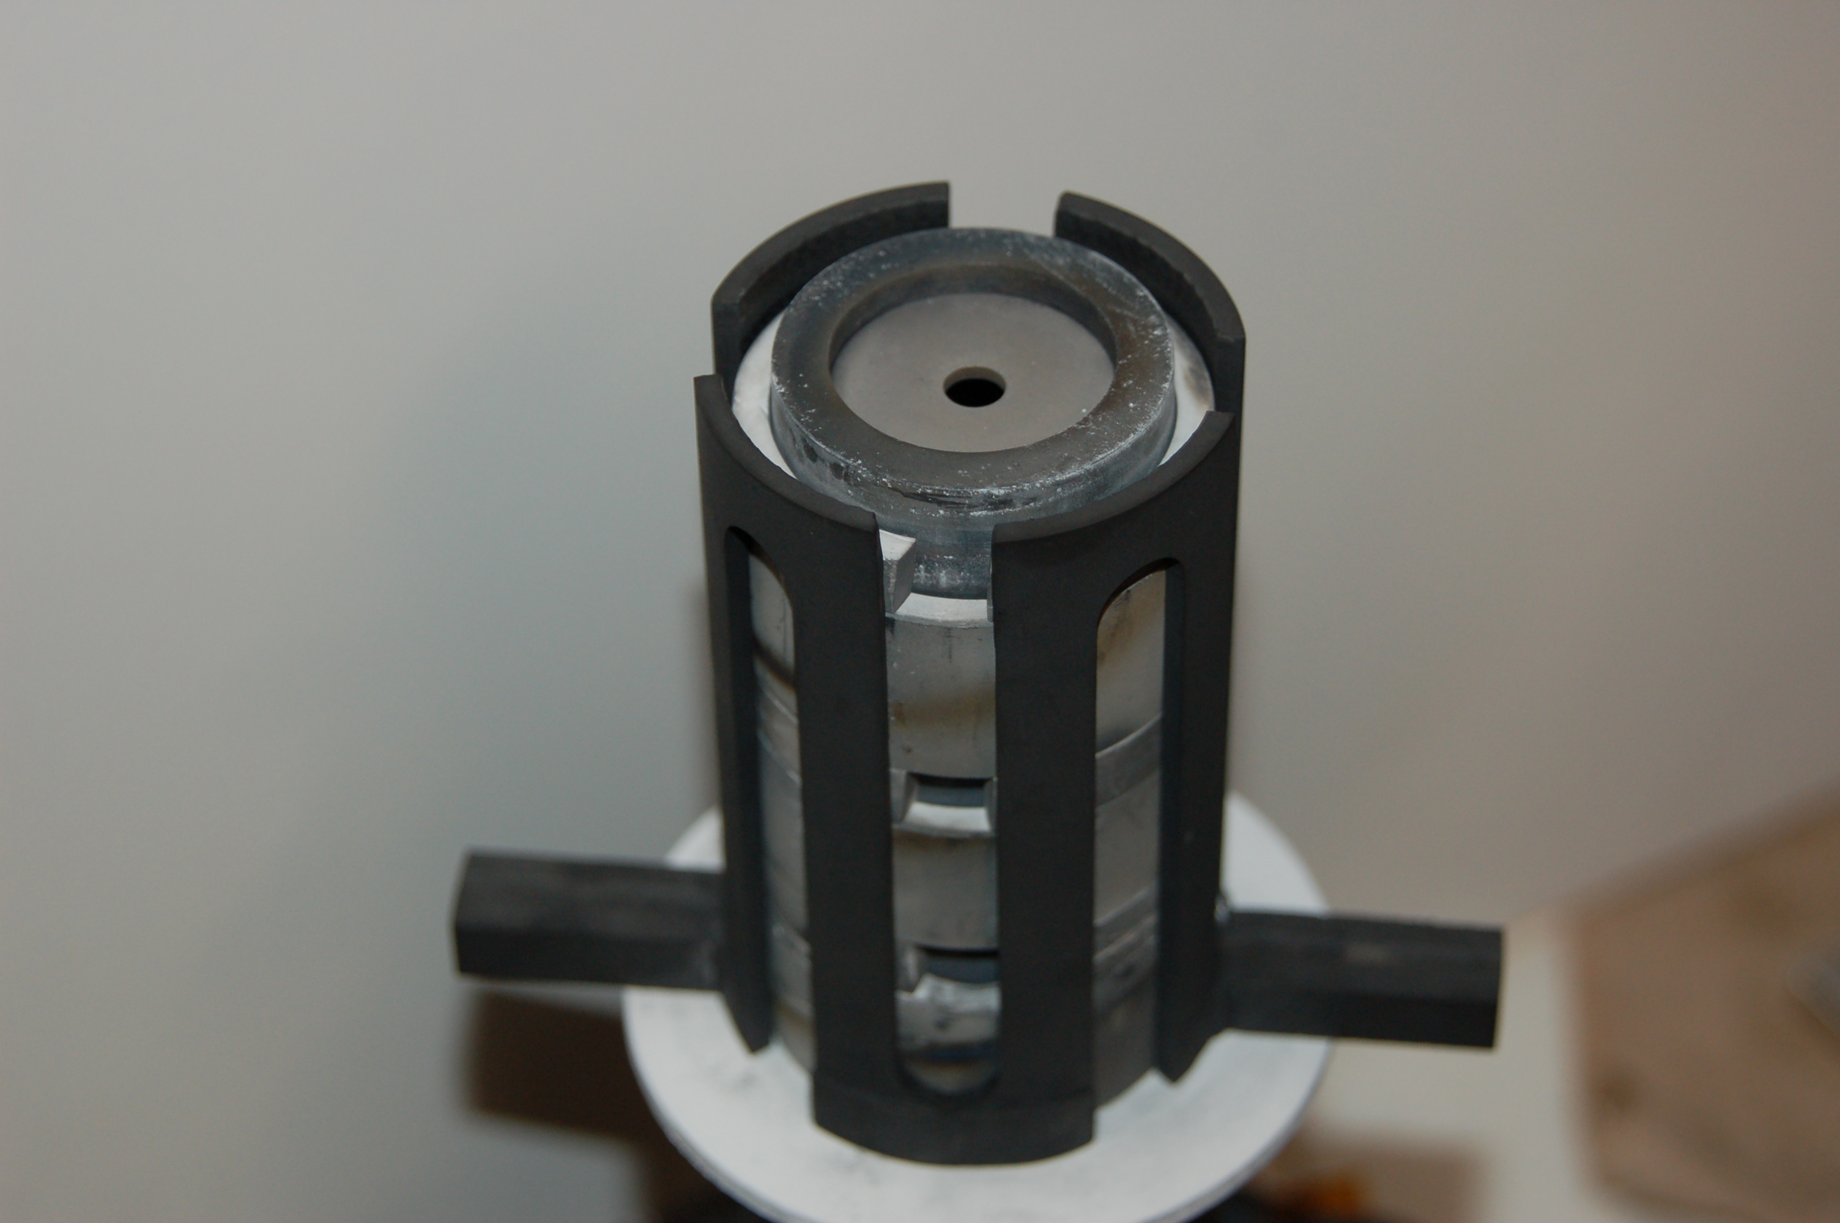
Application: Hollow cathode GD in satellite propulsion
In a very special arrangement called the “hollow cathode”, glow discharge can generage very dense but stable plasma at 10-100 A of current.

Slide 35
Main take-aways

Slide 36
Take-aways from lesson 2
Mechanisms of Townsend to Glow transition
Similarity laws
Subnormal, normal and abnormal discharge
Application overview

