Slide 1
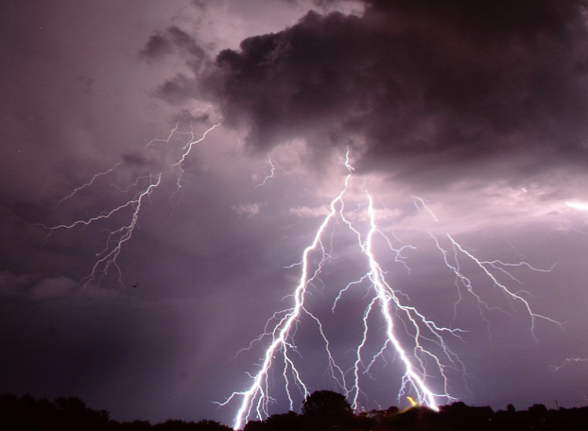

Plasma physics 2
8. Leader mechanisms, discharges and plasmas in planetary atmospheres
Notes:
Vylepsit …

Slide 2
Lecture series contents
Townsend breakdown theory, Paschen‘s law
Glow discharge
Electric arc at low and high pressures
Magnetized low-pressure plasmas and their role in material deposition methods.
Brief introduction to high-frequency discharges
Streamer breakdown theory, corona discharge, spark discharge
Barrier discharges
Leader discharge mechanism, ionization and discharges in planetary atmospherres
Discharges in liquids, complex and quantum plasmas
Thermonuclear fusion, Lawson criterion, magnetic confinement systems, plasma heating and intertial confinement fusion.
1
Notes:
Pozor je to pro verejnost … jednoduseji, schemata nazorna, ne moc analyz, jen par rovnic

Slide 3
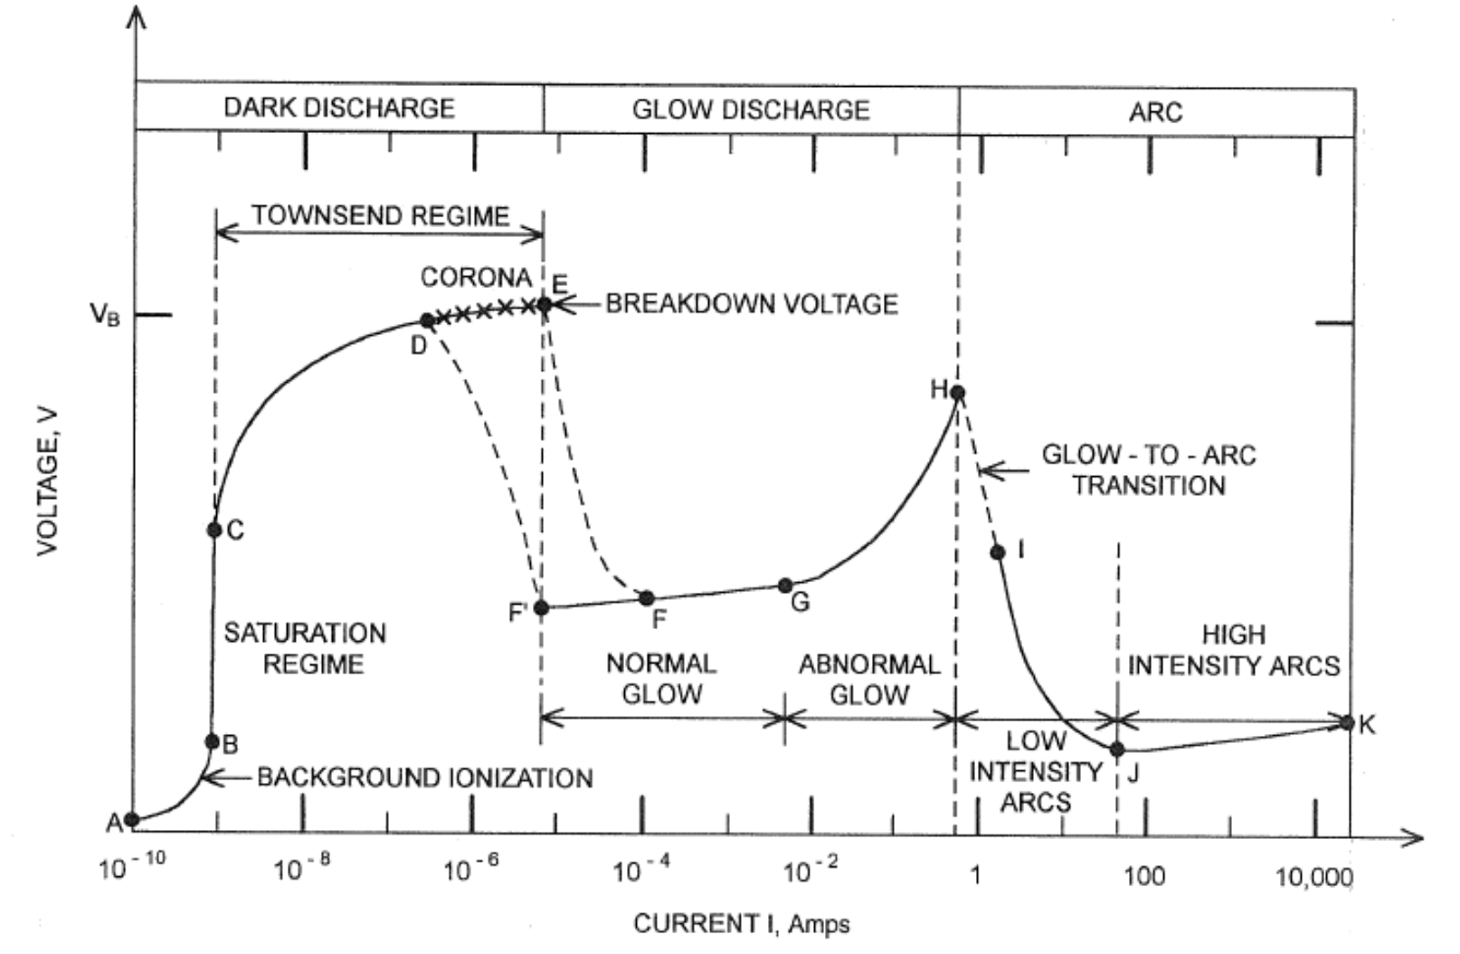
Opakování
We know that E-field deformations lead to different ignition mechanisms / structures
We talked about filaments, streamers, etc…
But on what distances does this work? How far can a streamer travel?
Key reference for this talk: Beroual a Fofana 2016 Discharge in long air gaps: modelling and applications, IOP Publishing, Bristol UK
1
Notes:
Pozor je to pro verejnost … jednoduseji, schemata nazorna, ne moc analyz, jen par rovnic

Slide 4
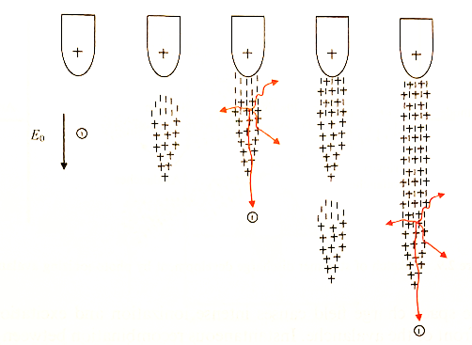
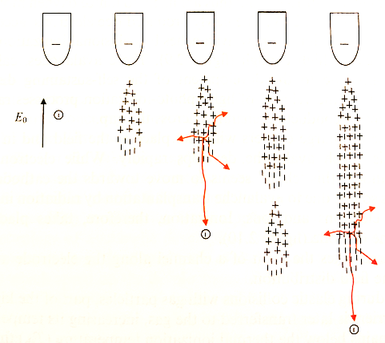
Streamers - review
Let us remind ourselves about the existence and mechanism of the positive and negative streamers
Secondary electron avalanches and photo-ionization are important
Positive streamer
Negative streamer
2
Notes:
Pozor je to pro verejnost … jednoduseji, schemata nazorna, ne moc analyz, jen par rovnic

Slide 5
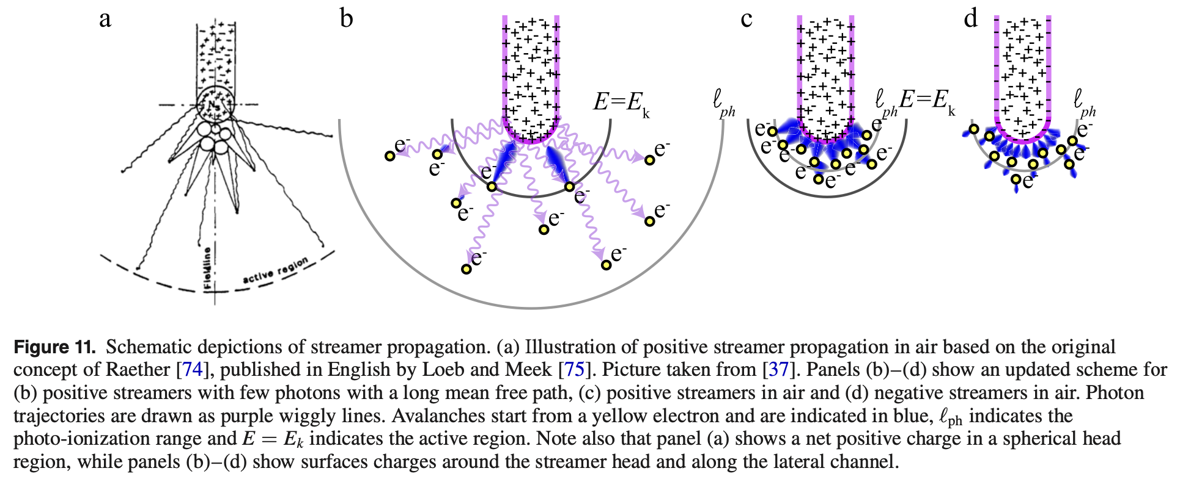
Streamers - review
Let us remind ourselves about the existence and mechanism of the positive and negative streamers
Secondary electron avalanches and photo-ionization are important
Positive streamer
Negative streamer
3
Nijdam et al. 2020 PSST
Notes:
Pozor je to pro verejnost … jednoduseji, schemata nazorna, ne moc analyz, jen par rovnic

Slide 6
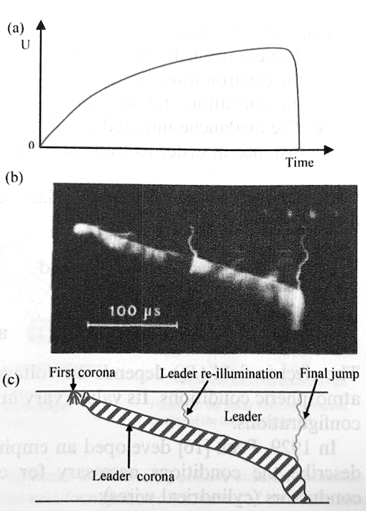
Leader mechanism
„Leader discharges“ appear in atmospheric-pressure air over distances longer than 1 m.
The new mechanism appears because the streamer is not conductive enough and as it gets very long, it does not maintain a sufficient E field in its head.
It is not entirely clear why the streamer transitions into leader discharge but their macroscopic properties and qualitative mechanisms are generally well known.
Leader mechnism proposed by Meeke a Loeb and helped to understand lightning propagation.
Experimentally, researches use the so-called lighting pulse: for 10m electrode distance, V_{max} = 2.5 MV, t = 500 us
Just like with streamers, we know positive and negative leaders – positive originate from the positive electrode (anode) and negative originate from the negative one (cathode).
4
Notes:
Pozor je to pro verejnost … jednoduseji, schemata nazorna, ne moc analyz, jen par rovnic

Slide 7
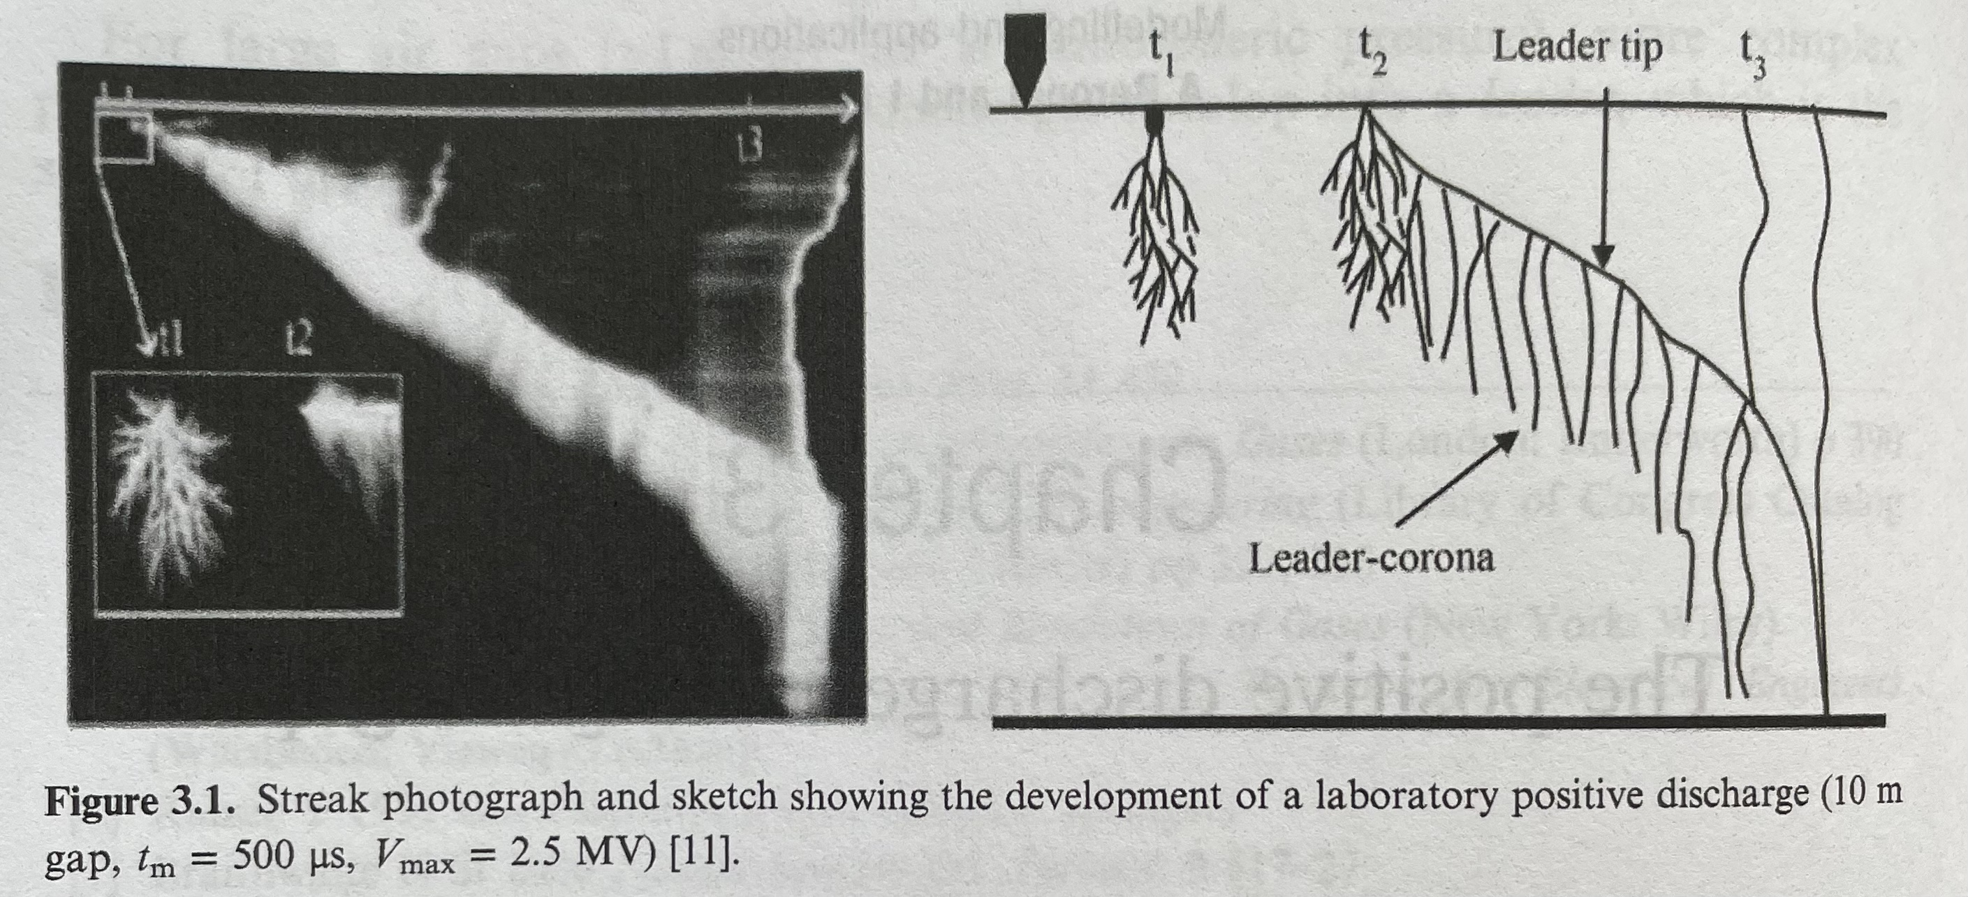
Positive leader - overview
Starts at the positive tip
Typical leader discharge on the left:
a) voltage, b) streak camera recording, c) mechanism
Mechanism
The discharge beings with corona discharges near the tip
The corona ionizes the gas which extends the anode and ignites a new corona at its end.
The leader corona (consisting of streamers) is more luminous than the leader body.
After the final jump, arc discharge is ignited because a conductive channel is formed.
čas
5
Notes:
Pozor je to pro verejnost … jednoduseji, schemata nazorna, ne moc analyz, jen par rovnic

Slide 8
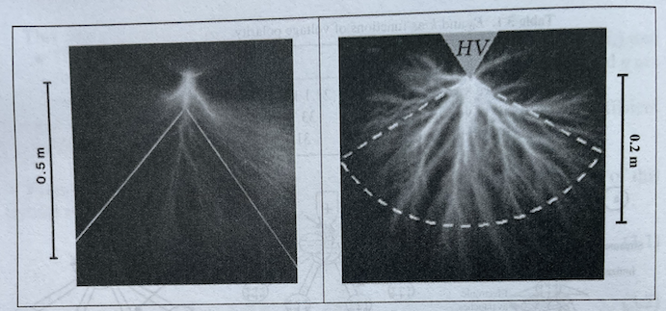
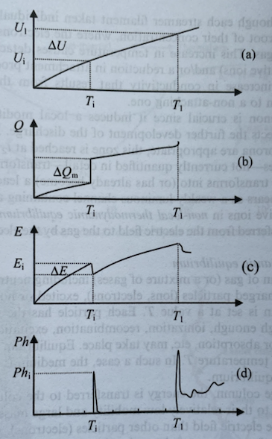
Positive leader – the initial corona (1+2)
The positive leader is initiated by intense corona discharges in the so-called active zone.
The leader mechanism follows the ignition of the first corona but often, there is a delay (dark phase), which depends on the rise time of the voltage pulse.
5
Notes:
Pozor je to pro verejnost … jednoduseji, schemata nazorna, ne moc analyz, jen par rovnic

Slide 9
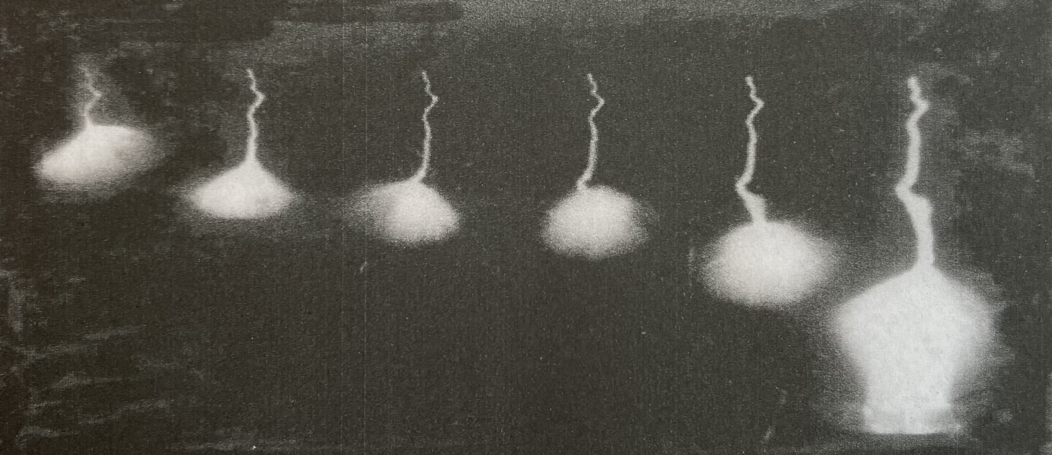
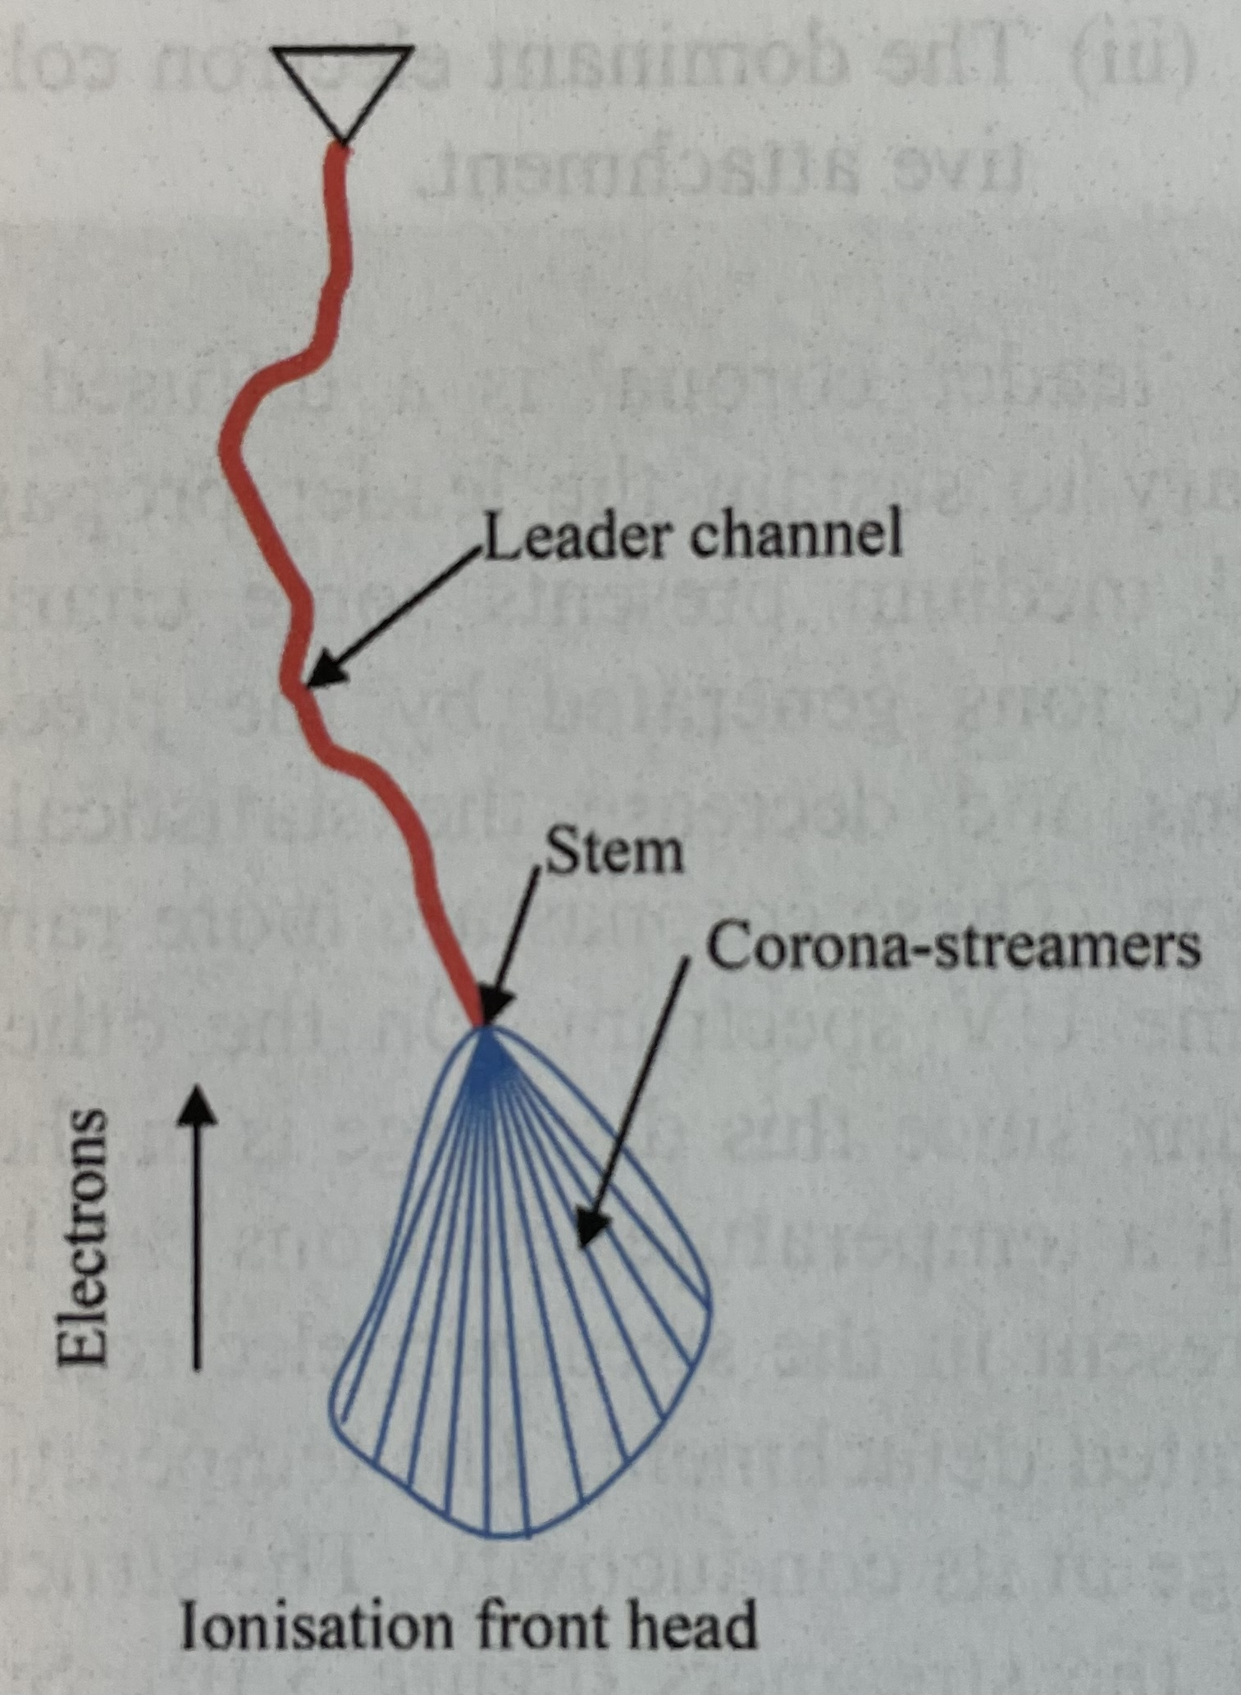
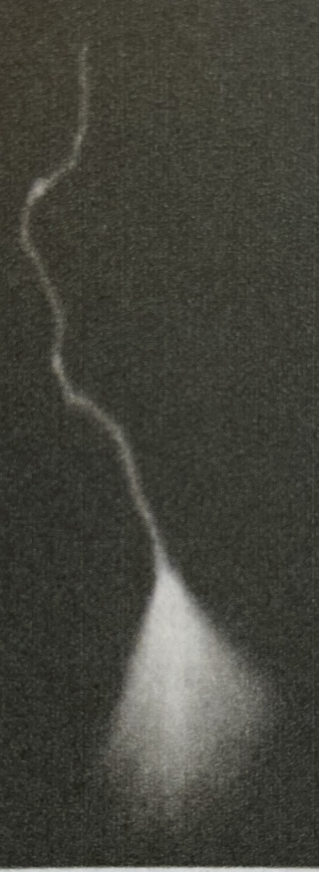
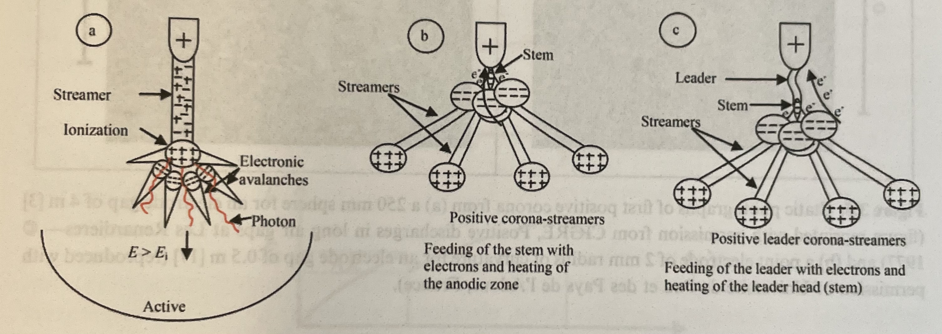
Positive leader – stochastic propagation (3)
The discharge beings with corona discharges near the tip
The corona ionizes the gas which extends the anode and ignites a new corona at its end.
The leader corona (consisting of streamers) is more luminous than the leader body.
=> This is a stochastic phenomena because streamers ignite in all directions but the plasma ignites through only one of them => hence the clasical zig-zag pattern.
After the final jump, arc discharge is ignited because a conductive channel is formed.
6
Notes:
Pozor je to pro verejnost … jednoduseji, schemata nazorna, ne moc analyz, jen par rovnic

Slide 10
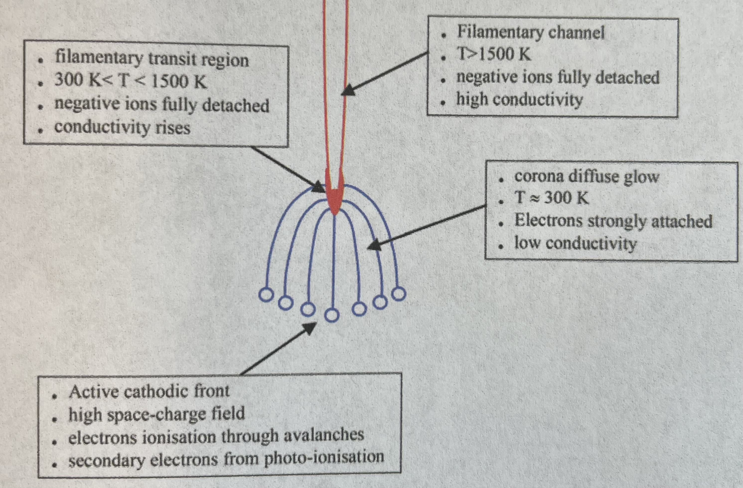
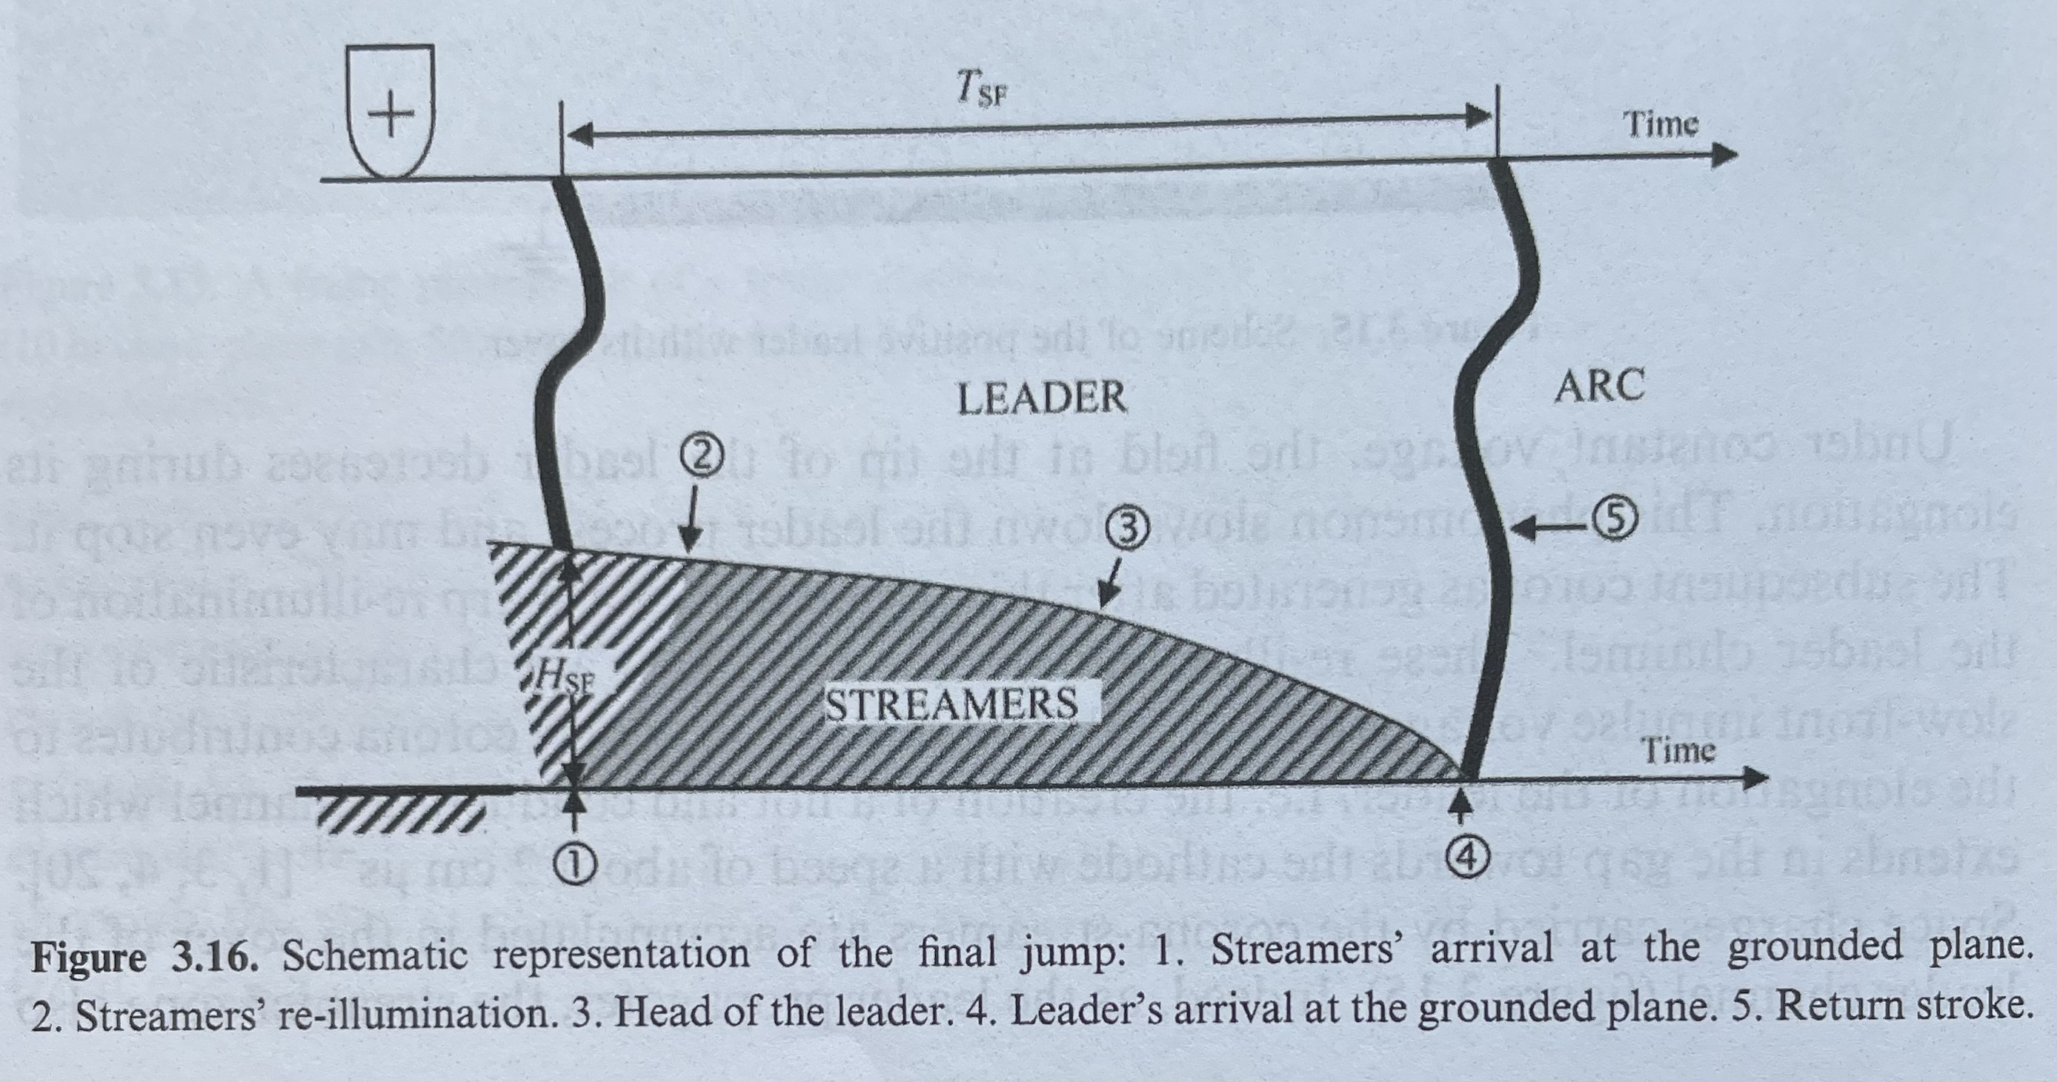
Positive leader – transition to arc (4)
Parameters of a leader discharge shown on the right
The discharge beings with corona discharges near the tip
The corona ionizes the gas which extends the anode and ignites a new corona at its end.
The leader corona (consisting of streamers) is more luminous than the leader body.
After the final jump, arc discharge is ignited because a conductive channel is formed.
  Streamers reach the cathode surface
  Rapid secondary emission occurs on the cathode
  Cathode and anode are connected and a „return stroke“ follows – intense current pulse that ionizes the entire pre-ionized channel and discharges all the available charge.
  The discharging takes tens of microseconds and current reaches kA-range
7
Notes:
Pozor je to pro verejnost … jednoduseji, schemata nazorna, ne moc analyz, jen par rovnic

Slide 11
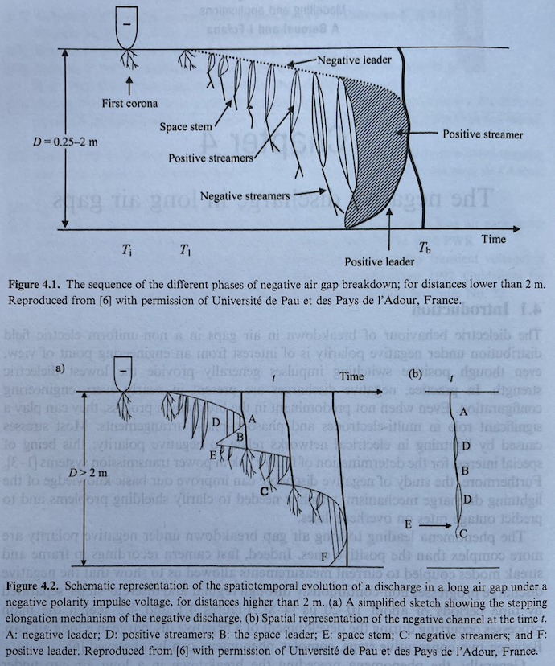
Negative leader
Propagates from the negative electrode?
Typical development shown in the figure
More complex physics compared to positive leader…
What is the mechanism?
8
Notes:
Pozor je to pro verejnost … jednoduseji, schemata nazorna, ne moc analyz, jen par rovnic

Slide 12
Negative leader - overview
Propagates from the negative electrode?
Typical development shown in the figure
More complex than a positive leader – it is not simply about prolonging the electrode.
The negative leader has to be „fed“ by positive streamers originating from the anode and increasing the plasma density there.
This gradually increases the length of the conductive volume in front of the cathode. The positive „super-streamers“ feeding the negative leader are called „stems“
Negative and positive streamers are moving towards each other.
When this structure approaches the anode, streamers – and possibly also the positive leader – start propagating towads it.
After both leaders connect and a conductive channel is established, system goes to arc.
9
Notes:
Pozor je to pro verejnost … jednoduseji, schemata nazorna, ne moc analyz, jen par rovnic

Slide 13
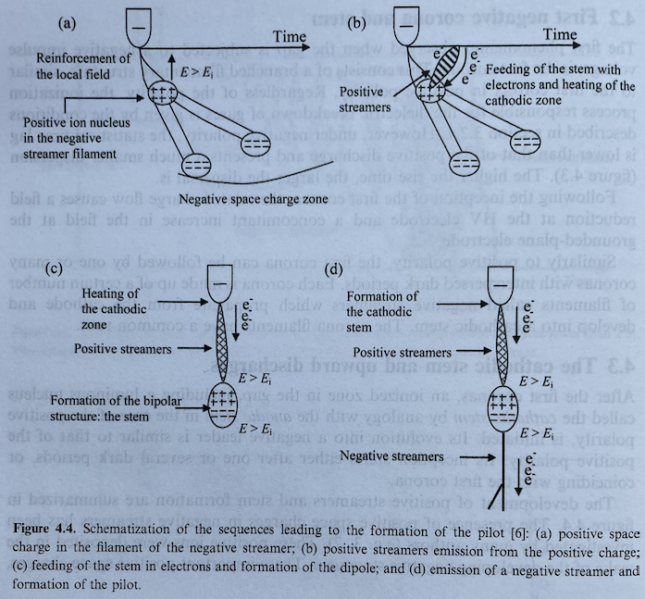
Negative leader – mechanism of a stem, pilot system
Charge separation in space
Positive streamer propagates between positive space charge areas and negative tip
Negative streamers propagate the other way
10
Notes:
Pozor je to pro verejnost … jednoduseji, schemata nazorna, ne moc analyz, jen par rovnic

Slide 14
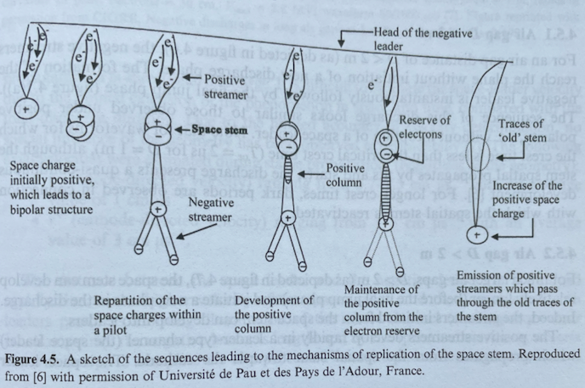
Negative leader – mechanism of a stem, pilot system
The “stem” structure replicates in individual steps.
11
Notes:
Pozor je to pro verejnost … jednoduseji, schemata nazorna, ne moc analyz, jen par rovnic

Slide 15
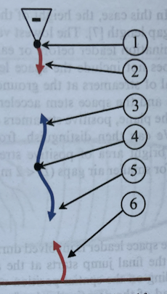
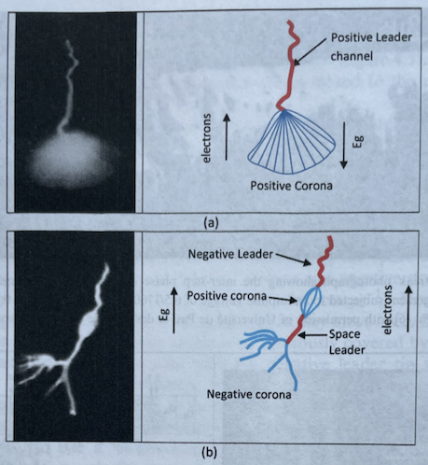
Negative and positive leaders - comparison
Figure shows the negative leader (2) issued from the stem (1), the space leader (3,4,5) elongating towards the cathode (3) and the anode (5) and the upward positive leader (6)
12
Notes:
Pozor je to pro verejnost … jednoduseji, schemata nazorna, ne moc analyz, jen par rovnic

Slide 16
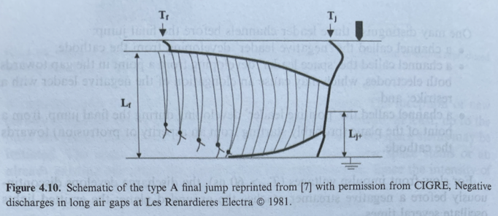
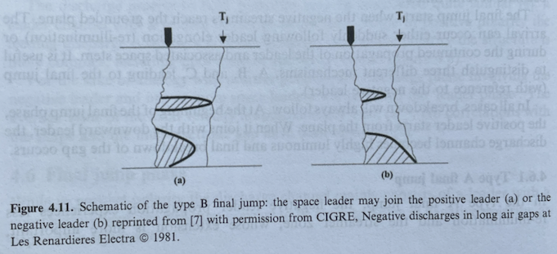
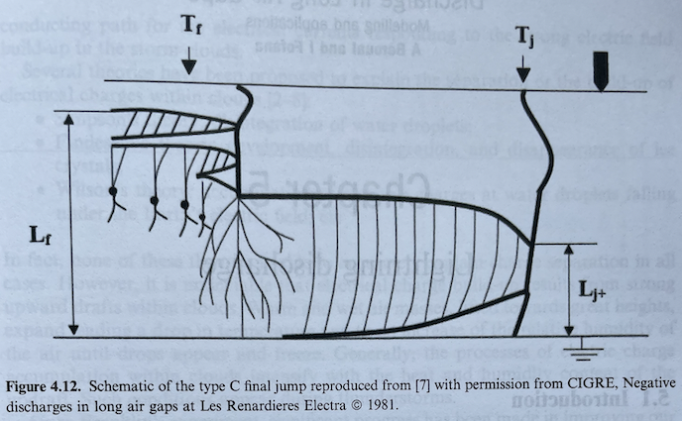
Negative leader – final jump phase
There are three ways how the final leader can be shorted / terminated
For inter-electrode distances below 2m, the final jump is 70-90% of the entire distance. The positive leader is observed as well.
For larger distances, there is usually a spatial leader that connects with the positive or negative leader before the final jump.
Finally, it can happen that the spatial stem does not transfer to a spatial leader and you get very long and branching streamers.
13
Notes:
Pozor je to pro verejnost … jednoduseji, schemata nazorna, ne moc analyz, jen par rovnic

Slide 17
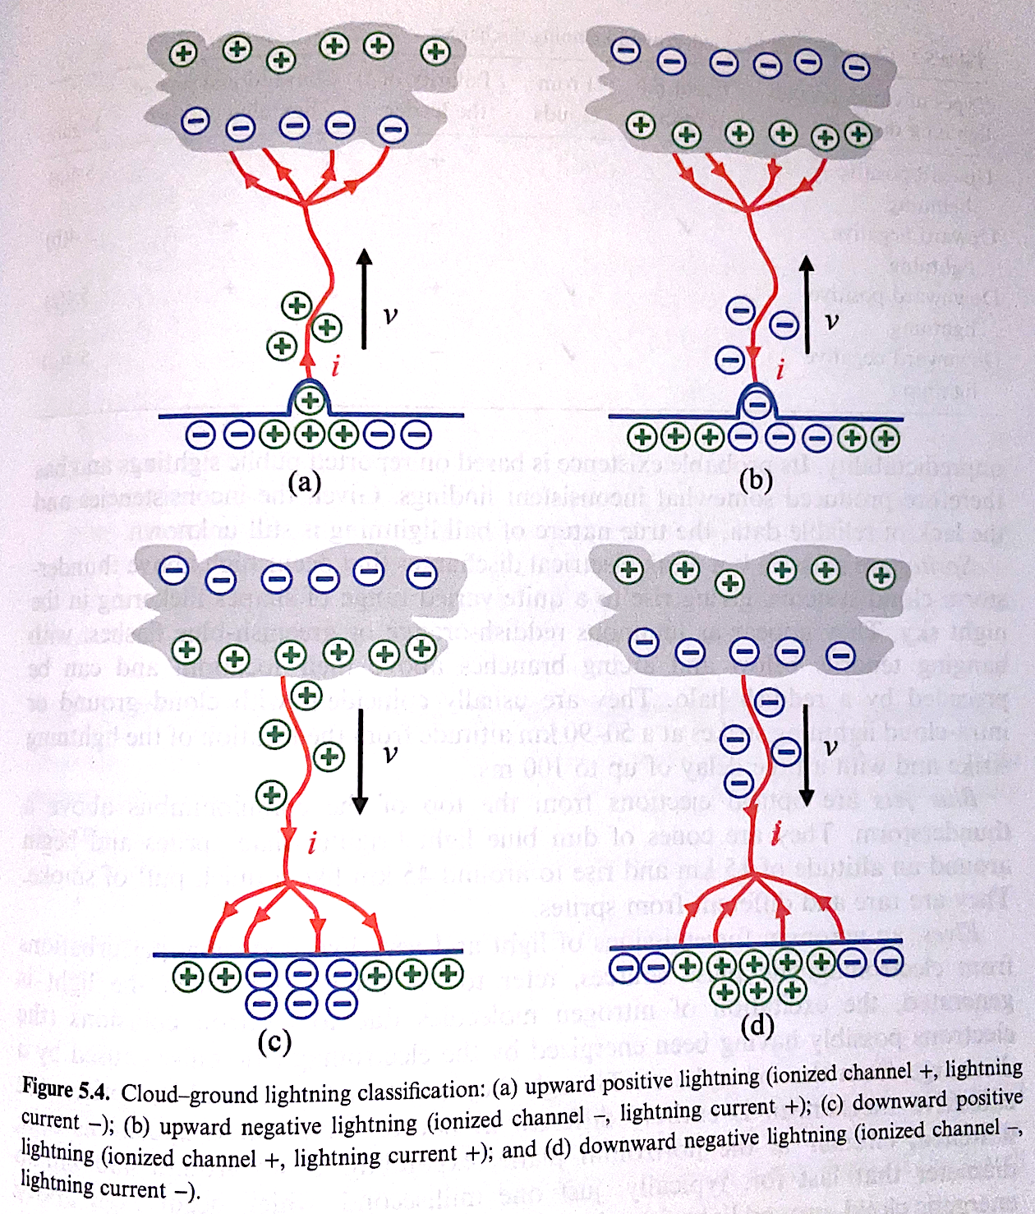
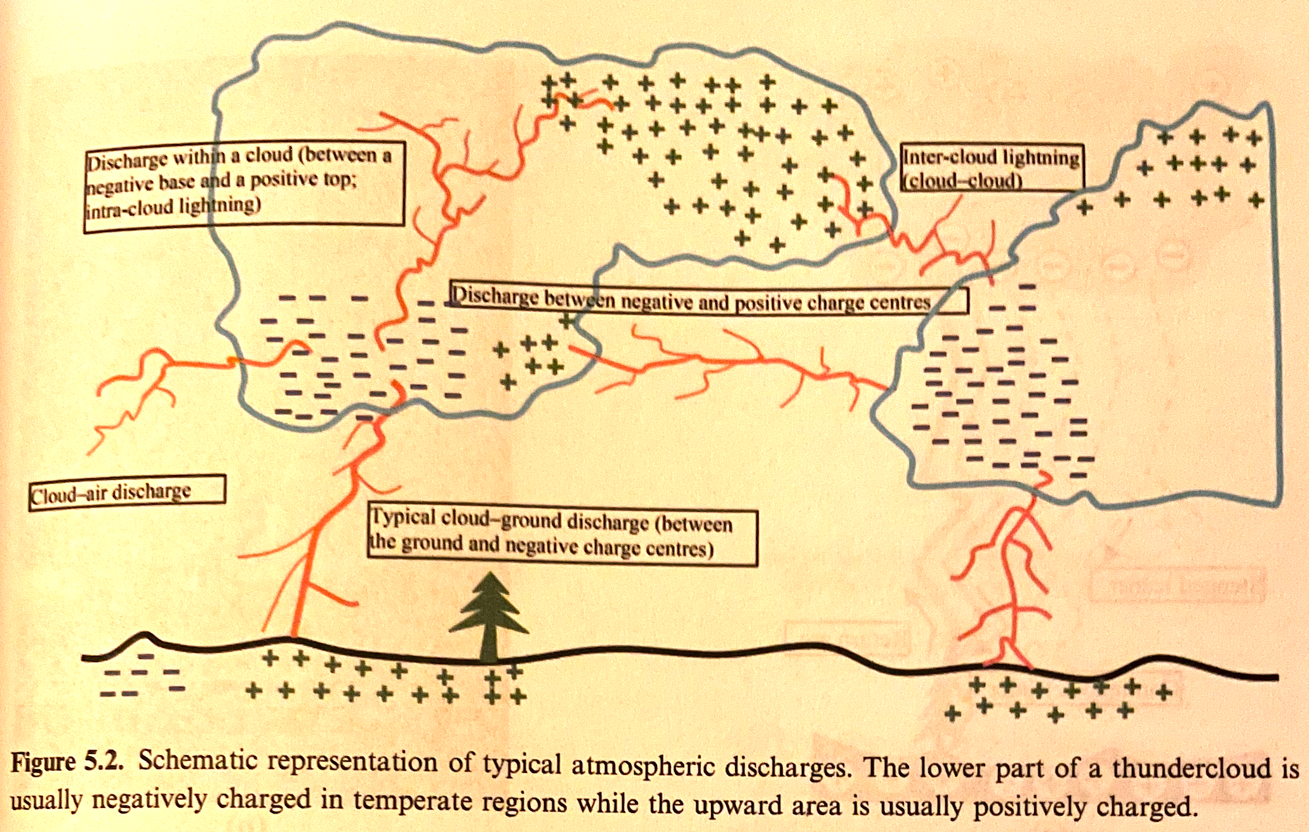
Classical lightning
One of the most well-known manifestations of electrical activity in Earth's atmosphere is lightning; there are various types of lightning, see the images below ('v' is the direction of discharge spread, and 'i' is the direction of current, that is, opposite to the direction of electron drift).
The polarity of lightning is determined according to the polarity
of the leader mechanism leading to the breakdown.
In temperate climates, the majority of lightning (up to 80%) is
negative, carrying negative charge to the ground. Positive
lightning is more common on winter days. In tropical climates,
up to 90% of lightning is positive.
most common
14
Notes:
Pozor je to pro verejnost … jednoduseji, schemata nazorna, ne moc analyz, jen par rovnic

Slide 18
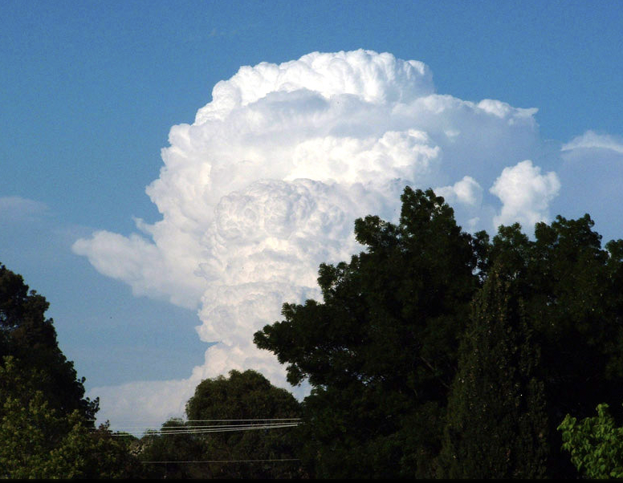
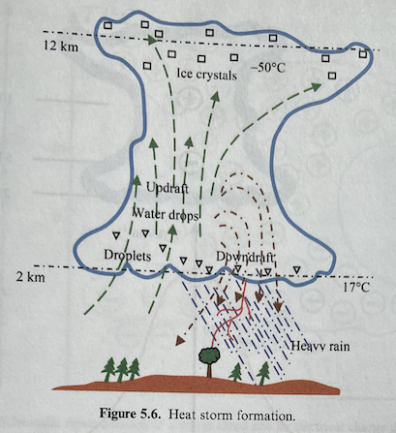
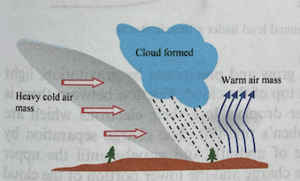
Stages of lighting evolution
Lightning has the following typical phases:
Formation of a thundercloud
Generation of free charge in the thundercloud
Initial corona and leader spread
Return stroke and arc discharge phase
Dart (continuous) leader
Subsequent additional return strokes
Formation of a thundercloud:
This refers to the so-called cumulonimbus cloud (also known in Czech as 'dešťová kupa'), which grows vertically due to the upward flow of air heated by the sun-warmed Earth's surface (heat storm), or by a so-called front storm, where a flow of cold air and warm/moist air collide.
A heat storm (thermal storm) is typical for tropical regions; thermally driven rising air lifts moist air which condenses at about 2km, forming the cloud, first as droplets and at higher altitudes then as ice crystals. The formation of a thundercloud by this mechanism can be very rapid, from one to three hours. The conditions for the creation of such a storm depend much on the properties of the Earth's surface – for example, its ability to heat up.
A front storm (storm created by an atmospheric front) is dominant in milder climates, typically reaching larger dimensions than the former, up to 23km. The creation of thunderclouds by this mechanism can take several days.
heat storm
front storm
15
Notes:
Pozor je to pro verejnost … jednoduseji, schemata nazorna, ne moc analyz, jen par rovnic

Slide 19
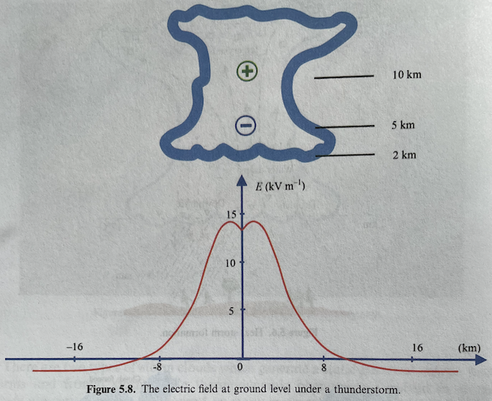
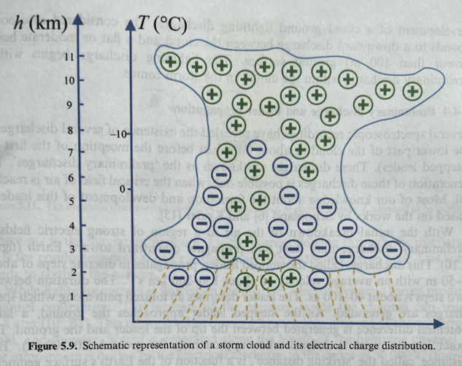
Origin of free space charge during cloud charge-up
The exact mechanism of charge separation and the formation of high electric fields in thunderclouds is not precisely known.
Various hypotheses exist, which do not always apply (such as the breakup of raindrops, formation of ice crystals, etc.). But it is known that ice crystals become positively charged, and raindrops carry a negative charge – this imbalance arises from the friction of water particles in the cloud, these particles are referred to as hydrometeors. The friction is a result of the turbulent movement of air in the cloud, up to 20m/s.
During friction in the cloud, water droplets lose their electrons in favor of frozen
droplets of water. The result of the charging in the cloud is a charge separation
such that the top of the cloud is positive and its bottom part is negative.
The potential between these areas can then be up to millions of volts.
Here is a possible E field of a cloud
If the average electric field between the cloud and the ground reaches values between 15 and 20 kV/m (elsewhere values above 100 kV/m are reported), lightning occurs.
16
Notes:
Pozor je to pro verejnost … jednoduseji, schemata nazorna, ne moc analyz, jen par rovnic

Slide 20
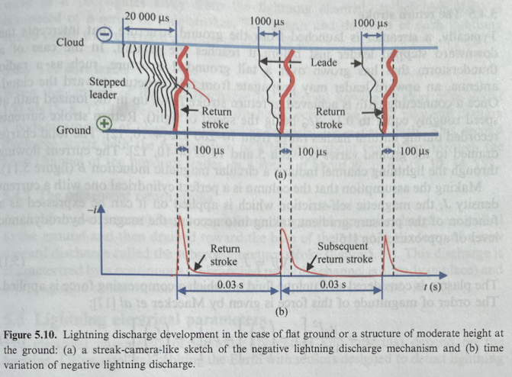
Lightning discharge time sequence, frequency of ocurrence
The sequence of a lightning discharge for a distance of up to 100 m, negative cloud-to-ground lightning:
In the first few milliseconds, the initial corona discharges occur, even among different domains of free charge in the cloud, akin to the corona before the leader.
After the initiation of the leader discharge, it moves towards the ground at speeds of up to 200 km/s with the length of individual jumps ranging from 4 to 50 m.
The pause between individual jumps (necessary to create another segment of the leader) is 40 to 100 microseconds.
When the leader reaches a distance of 20 to 200 m from the ground, the "selection" of the impact site occurs, which depends on the geometry of the surface and the size of the charge in the leader.
The return stroke propagates at speeds of up to a tenth of the speed of light, its currents reach 10 to 200 kA, and it transfers a charge of 5 to 15 C, with the dissipated energy reaching up to 500 MJ. As the current passes, pinching of the ionized channel occurs (remember arc lecture).
17
Notes:
Pozor je to pro verejnost … jednoduseji, schemata nazorna, ne moc analyz, jen par rovnic

Slide 21
Lightning discharge time sequence, frequency of ocurrence
The sequence of a lightning discharge for a distance of up to 100 m, negative cloud-to-ground lightning:
In the first few milliseconds, the initial corona discharges occur, even among different domains of free charge in the cloud, akin to the corona before the leader.
After the initiation of the leader discharge, it moves towards the ground at speeds of up to 200 km/s with the length of individual jumps ranging from 4 to 50 m.
The pause between individual jumps (necessary to create another segment of the leader) is 40 to 100 microseconds.
When the leader reaches a distance of 20 to 200 m from the ground, the "selection" of the impact site occurs, which depends on the geometry of the surface and the size of the charge in the leader.
The return stroke propagates at speeds of up to a tenth of the speed of light, its currents reach 10 to 200 kA, and it transfers a charge of 5 to 15 C, with the dissipated energy reaching up to 500 MJ. As the current passes, pinching of the ionized channel occurs (remember arc lecture).
Details of the discharging:
During the pinch, the pressure in the channel increases to 2 to 8 atm. The temperature rapidly reaches up to 30,000 °C, and due to the expansion of the gas, pressure sound waves are created, resulting in thunder.
After typically four return strokes, a substantial part of the cloud's charge is discharged, with each stroke lasting up to 30 microseconds.
Even after another 100 ms, there can be further discharging of the cloud's charge through what is known as a dart leader (continuous leader), which is almost an entirely new discharge without a branched structure but propagates along the pre-ionized path of previous strokes at speeds of up to 10⁷ m/s. The return strokes following the dart leader propagate at speeds of up to 10⁸ m/s.
Positive lightning often occurs in the form of a single strike without return strokes and typically lasts one to two tenths of a second.
18
Notes:
Pozor je to pro verejnost … jednoduseji, schemata nazorna, ne moc analyz, jen par rovnic

Slide 22
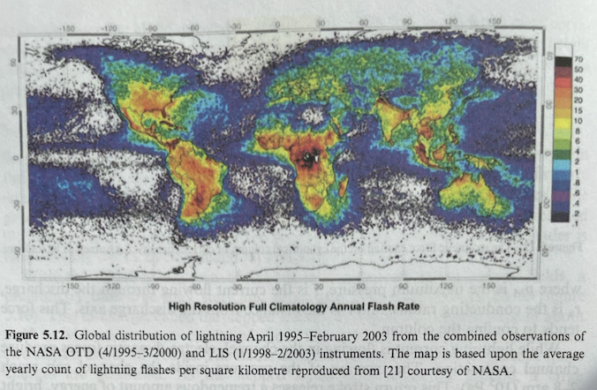
Frequency of lightning, measured currents
19
Notes:
Pozor je to pro verejnost … jednoduseji, schemata nazorna, ne moc analyz, jen par rovnic

Slide 23
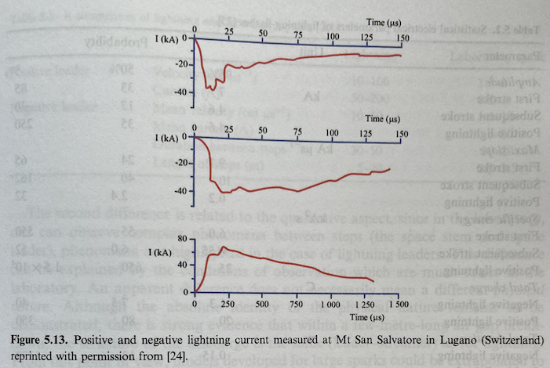
Frequency of lightning, measured currents
19
Notes:
Pozor je to pro verejnost … jednoduseji, schemata nazorna, ne moc analyz, jen par rovnic

Slide 24
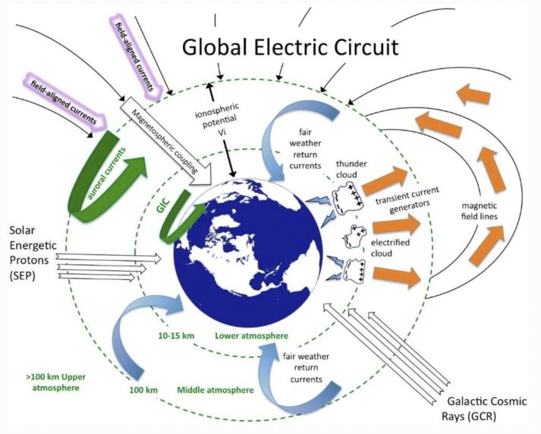
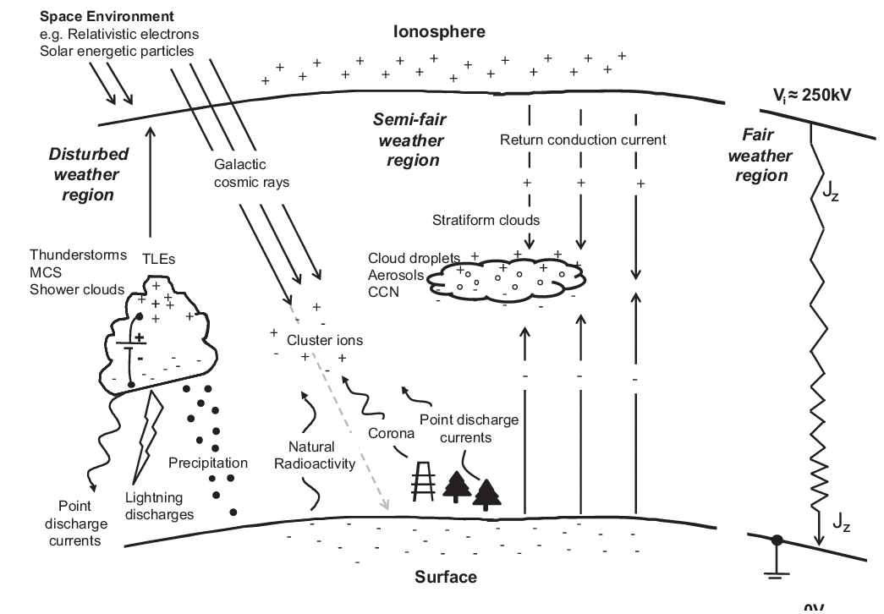
Global electrical circuit
Atmospheric electrical activity is not limited solely to classic lightning.
Other components include: continuous picoampere current, TLE or transient luminous events, current caused by cosmic radiation, solar proton showers, relativistic electrons, gamma-ray bursts, terrestrial radioactivity and probably other, yet undocumented, phenomena
20
Notes:
Pozor je to pro verejnost … jednoduseji, schemata nazorna, ne moc analyz, jen par rovnic

Slide 25
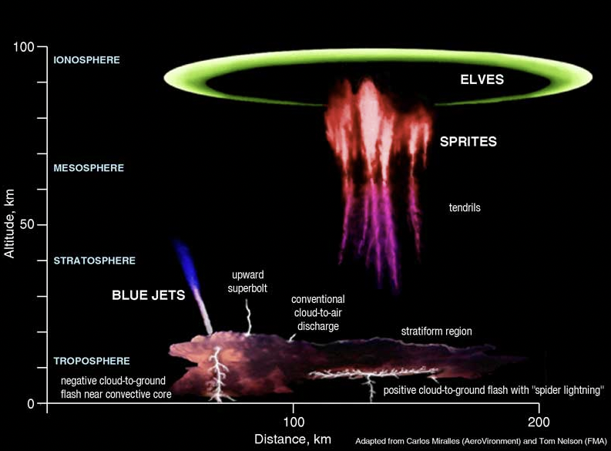
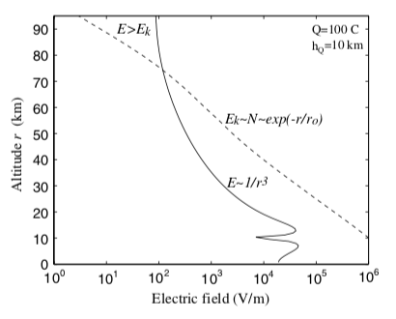
TLE – transient luminous events
This refers to lightning activity above the clouds, that is, from the cloud to the ionosphere.
In the case of a discharge from a portion of a large thundercloud towards the ground, part of the cloud remains undischarged and thus reorganizes the electric field direction towards the ionosphere. Under various pressure, thermal, and ionization conditions, this then leads to above-cloud lightning.
These are known as: elves, sprites, blue jets, tendrils, halos...
ozonová
vrstva
21
Notes:
Pozor je to pro verejnost … jednoduseji, schemata nazorna, ne moc analyz, jen par rovnic

Slide 26
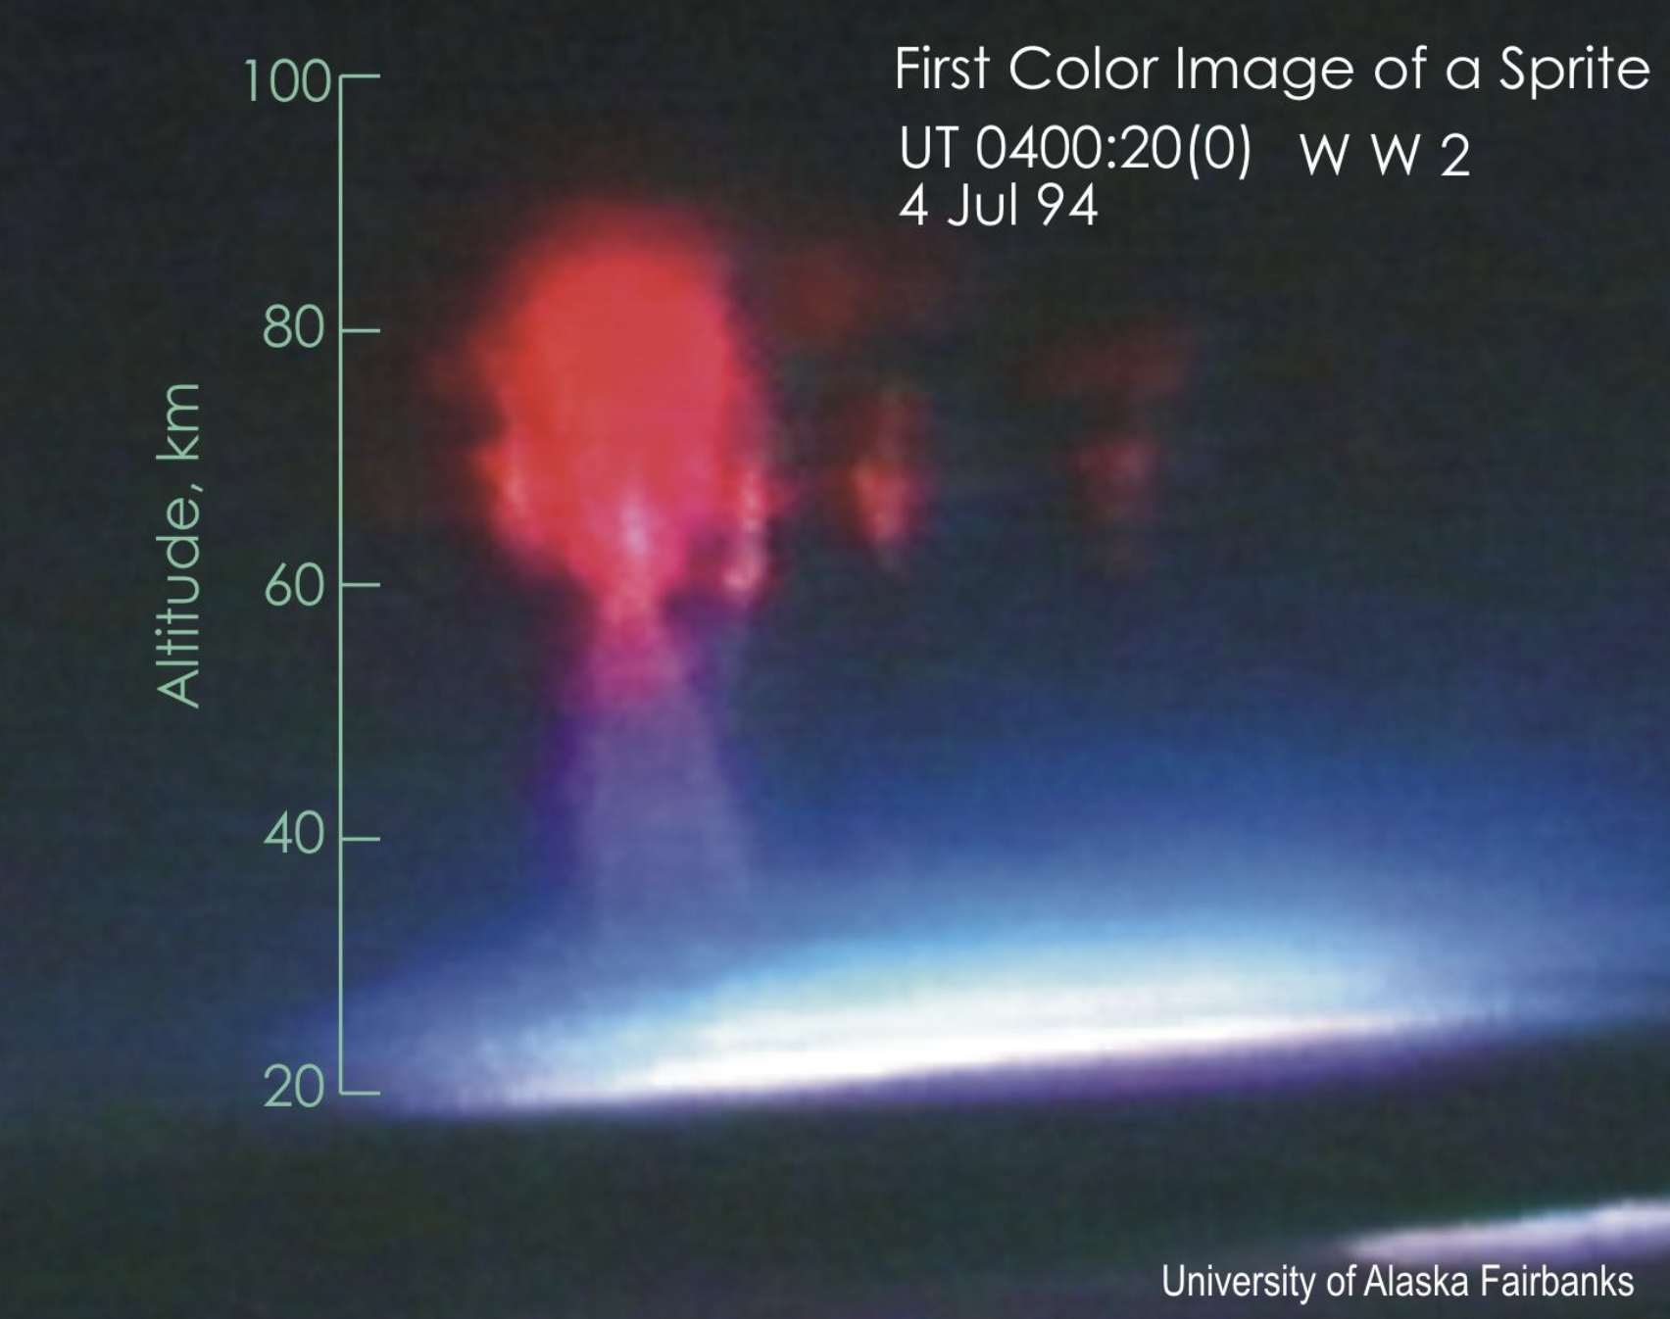
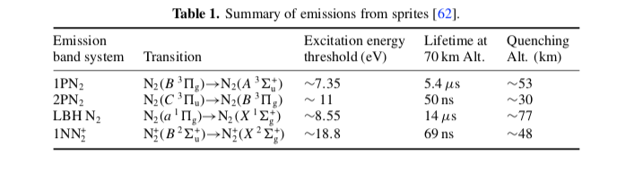
TLE – transient luminous events
This refers to lightning activity above the clouds, that is, from the cloud to the ionosphere.
In the case of a discharge from a portion of a large thundercloud towards the ground, part of the cloud remains undischarged and thus reorganizes the electric field direction towards the ionosphere. Under various pressure, thermal, and ionization conditions, this then leads to above-cloud lightning.
These are known as: elves, sprites, blue jets, tendrils, halos...
22
Notes:
Pozor je to pro verejnost … jednoduseji, schemata nazorna, ne moc analyz, jen par rovnic

Slide 27
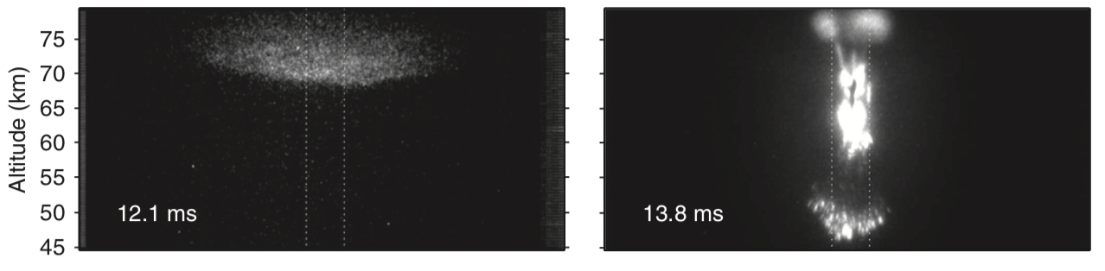
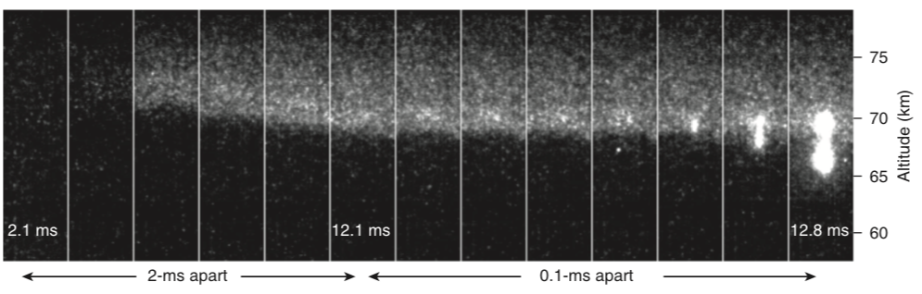
Origin of a sprite from a halo
The record of the birth of a Sprite from Halo on July 6, 2011, at 73 km.
The transition hypothesis is a perturbation in the surrounding electron density in the upper mesosphere.
23
Liu et al. 2014 Nature Com.
Notes:
Pozor je to pro verejnost … jednoduseji, schemata nazorna, ne moc analyz, jen par rovnic

Slide 28
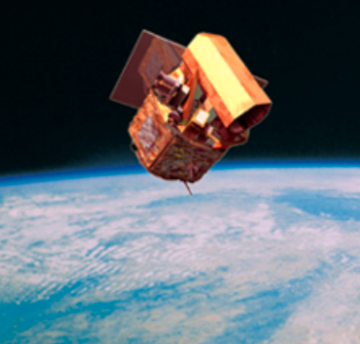
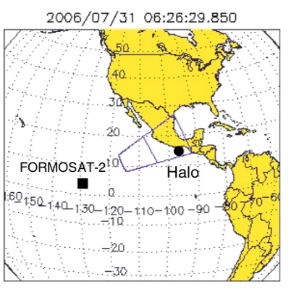
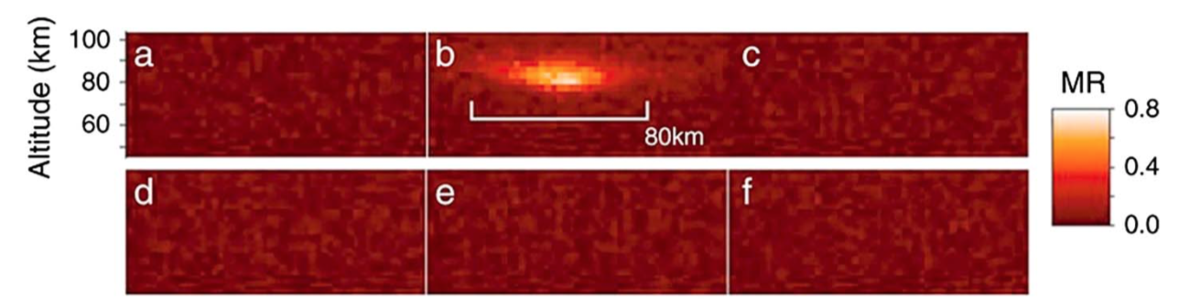
Other observations
Observation of Halo on July 31, 2006, above Mexico.
Record from the ISUAL module of the FORMOSAT-2 satellite of the Taiwan Space Agency.
30 ms
exposure
24
Kuo et al. 2013 JGR
Notes:
Pozor je to pro verejnost … jednoduseji, schemata nazorna, ne moc analyz, jen par rovnic

Slide 29
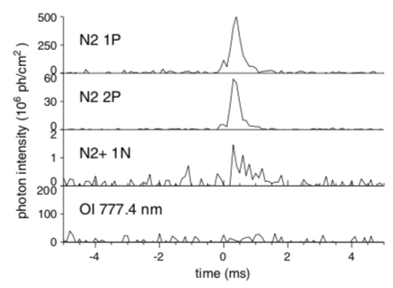
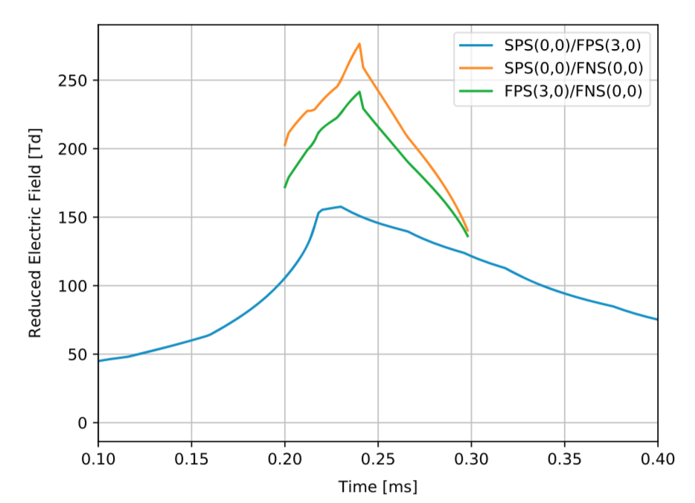
Plasma diagnostics from a satellite
Measuring electric field based on a spectrometer mounted on a satellite
25
Pérez-Invernón et al. 2018 JGR
Notes:
Pozor je to pro verejnost … jednoduseji, schemata nazorna, ne moc analyz, jen par rovnic

Slide 30
Take aways
Understand the difference between streamer and leader, positive and negative.
Be able to qualitatively describe lightning formation – from the cloud formation all the way to discharge
Be aware of the main plasma properties of lightning plasmas (current, temperature, pressure, propagation speeds etc.)
Know of the existence of TLE and their characteristic dimensions.

