Slide 1
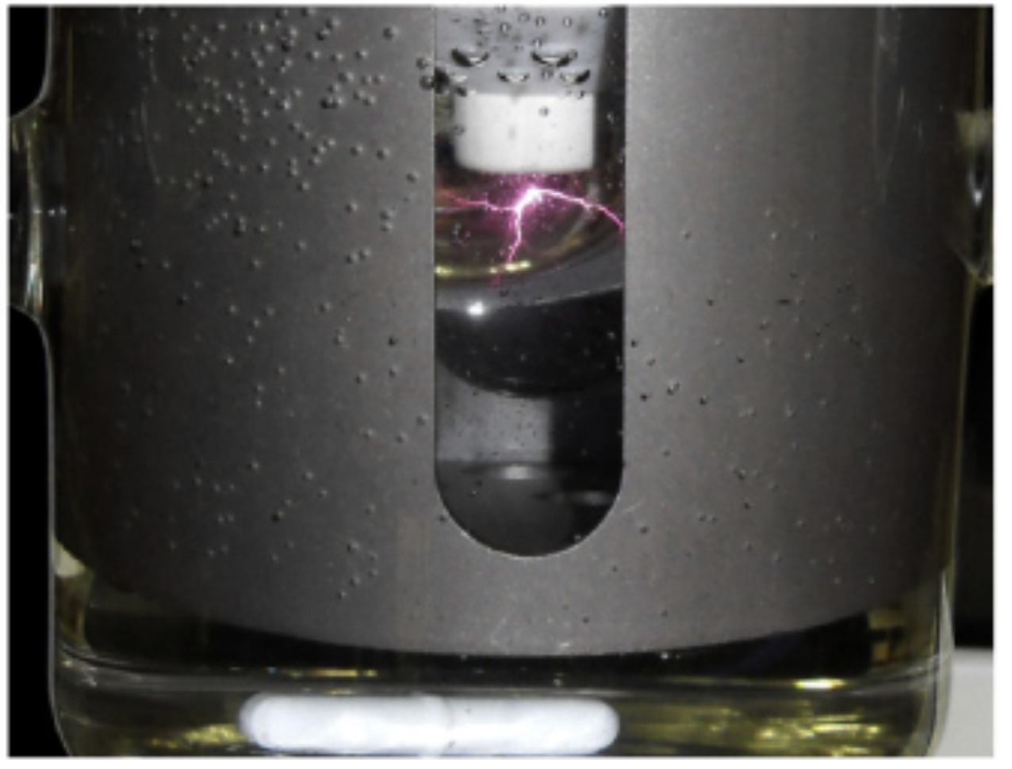

Fyzika plazmatu 2
9. Discharges in liquids, complex and quantum plasmas
Šimek et al. AV ČR
Notes:
Vylepsit …

Slide 2
Lecture series contents
Townsend breakdown theory, Paschen‘s law
Glow discharge
Electric arc at low and high pressures
Magnetized low-pressure plasmas and their role in material deposition methods.
Brief introduction to high-frequency discharges
Streamer breakdown theory, corona discharge, spark discharge
Barrier discharges
Leader discharge mechanism, ionization and discharges in planetary atmospherres
Discharges in liquids, complex and quantum plasmas
Thermonuclear fusion, Lawson criterion, magnetic confinement systems, plasma heating and intertial confinement fusion.
1
Notes:
Pozor je to pro verejnost … jednoduseji, schemata nazorna, ne moc analyz, jen par rovnic

Slide 3
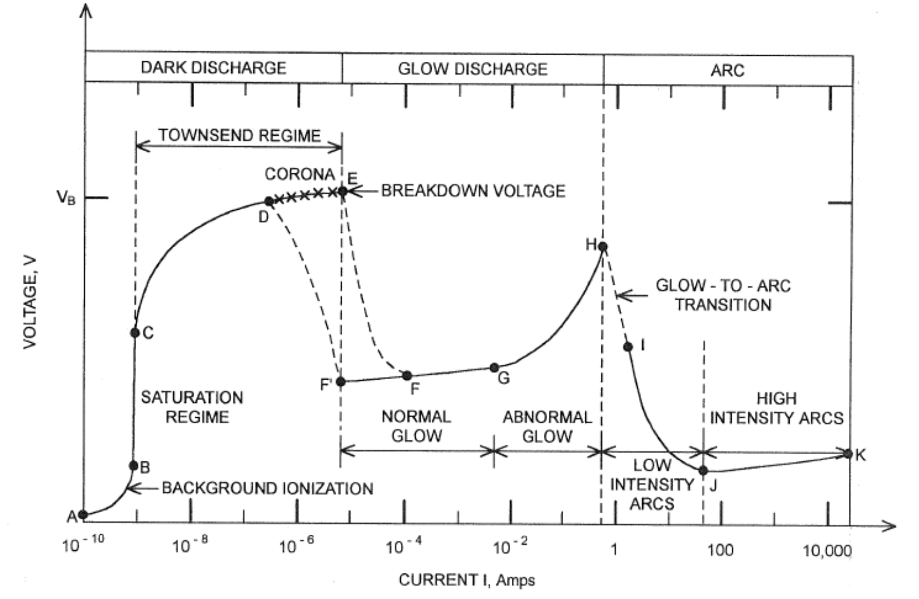
Opakování
We know that E-field deformations lead to different ignition mechanisms / structures
We talked about filaments, streamers, etc…
What happens at temperatures and pressures which are significantly higher?
1
Notes:
Pozor je to pro verejnost … jednoduseji, schemata nazorna, ne moc analyz, jen par rovnic

Slide 4
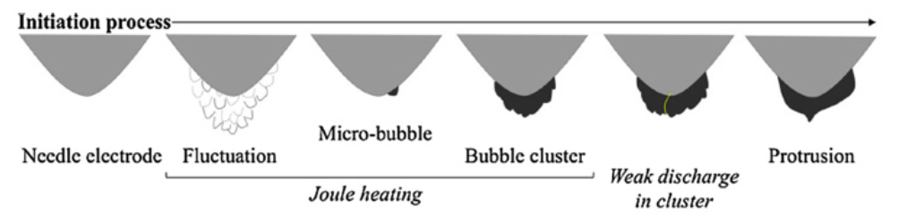
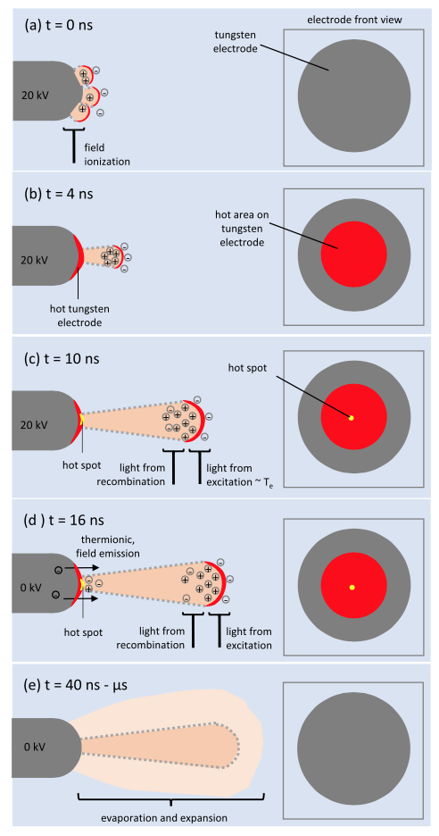
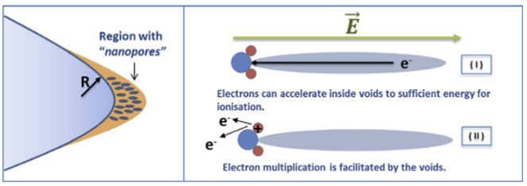
Electric breakdown in a dielectric liquid
We distinguish two mechanisms that occur with varying dominance for differently steep leading edges of the applied voltage:
MICROSECOND BREAKDOWN: A slowly changing (microseconds and longer) electric field mobilizes ions, polarizes polar molecules, or causes oscillatory motion (like heating food in a microwave), and through interaction with the surroundings, it leads to collisions with nearby molecules and the transfer of kinetic energy into vibrational and thus thermal energy...
NANOSECOND BREAKDOWN: A rapidly changing (nanoseconds) electric field generates negative pressure through the nonlinear response of a polar/dielectric liquid, creating nanoscopic "cracks" in the liquid—a phenomenon known as electrostriction. Alternatively, strong heating at the contact between plasma and electrode is associated with the Zener model of ionization.
3
Sun et al. 2016 High Volt.
Notes:
Pozor je to pro verejnost … jednoduseji, schemata nazorna, ne moc analyz, jen par rovnic

Slide 5
Nanosecond electric breakdown in a dielectric liquid
1) A rapidly changing (nanoseconds) electric field generates negative pressure through the nonlinear response of a polar/dielectric liquid, resulting in nanoscopic "cracks" in the liquid—a phenomenon known as electrostriction.
A rapidly changing high electric field at the electrode =>
Creation of negative pressure =>
Generation of nanoscopic vacancies (literally nano-cracks in water) =>
Multiplication of electrons in the nanovacancy similar to a photomultiplier =>
Generation and accumulation of free charge =>
Strengthening of the electric field, etc.
2) Alternatively, the Zener model of ionization involves strong heating at the contact between the plasma and the electrode.
A rapidly changing high electric field at the electrode =>
Ionization of molecules via the Zener mechanism =>
Multiplication of electrons =>
Generation of high current =>
Rapid heating of the electrode
Sun et al. 2016 High Volt.
Von Keudell et al. 2020 PSST
4
Notes:
Pozor je to pro verejnost … jednoduseji, schemata nazorna, ne moc analyz, jen par rovnic

Slide 6
Nanosecond electric breakdown in a dielectric liquid – scheme 1
1) A rapidly changing (nanoseconds) electric field generates negative pressure through the nonlinear response of a polar/dielectric liquid, resulting in nanoscopic "cracks" in the liquid—a phenomenon known as electrostriction.
A rapidly changing high electric field at the electrode =>
Creation of negative pressure =>
Generation of nanoscopic vacancies (literally nano-cracks in water) =>
Multiplication of electrons in the nanovacancy similar to a photomultiplier =>
Generation and accumulation of free charge =>
Strengthening of the electric field, etc.
Nanovacancies are not bubbles, but literally nanometer-sized structures in the direction of the E field
Seepersad et al. 2013 JPD
Shneider et al. 2013 PRE
5
Notes:
Pozor je to pro verejnost … jednoduseji, schemata nazorna, ne moc analyz, jen par rovnic

Slide 7
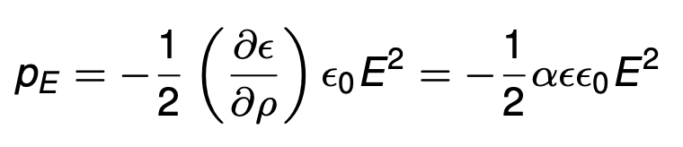
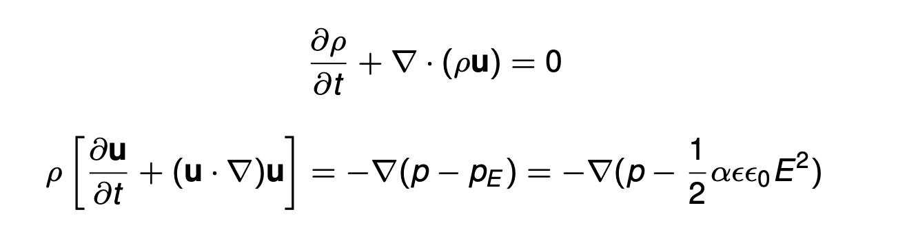
Modeling liquid water with electrostriction
pressure in the liquid created by the electrostrictive force:
We can describe a compressible liquid using equations for the conservation of momentum and mass:
dielectric permittivity
empirical factor for the fluid
density
velocity
hydrodynamic pressure
electrostriction pressure
Bonaventura et al. 2019 GEC
Shneider et al. 2013 PRE
6
Notes:
Pozor je to pro verejnost … jednoduseji, schemata nazorna, ne moc analyz, jen par rovnic

Slide 8
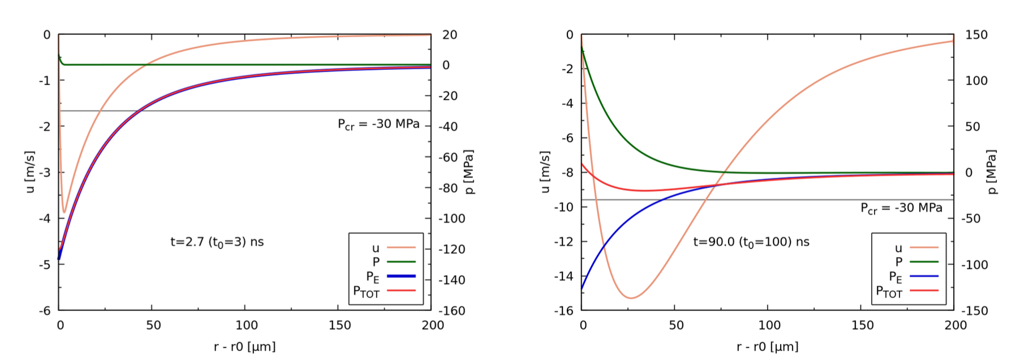
Electrostriction and the formation of nanovacancies through cavitation
Cavitation for a 3ns leading edge of the applied voltage
Without cavitation for a 100ns leading edge of the applied voltage
The resulting total pressure arises from the balance/competition between hydrodynamic and electrostrictive pressure for two differently rapid leading edges of the applied voltage
7
Bonaventura et al. 2019 GEC
Notes:
Pozor je to pro verejnost … jednoduseji, schemata nazorna, ne moc analyz, jen par rovnic

Slide 9






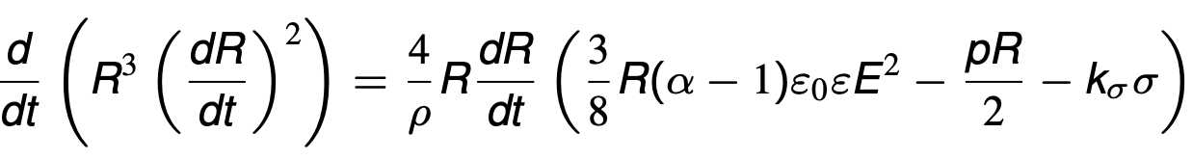



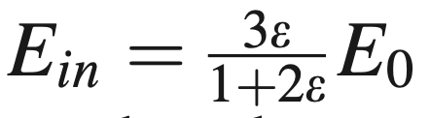
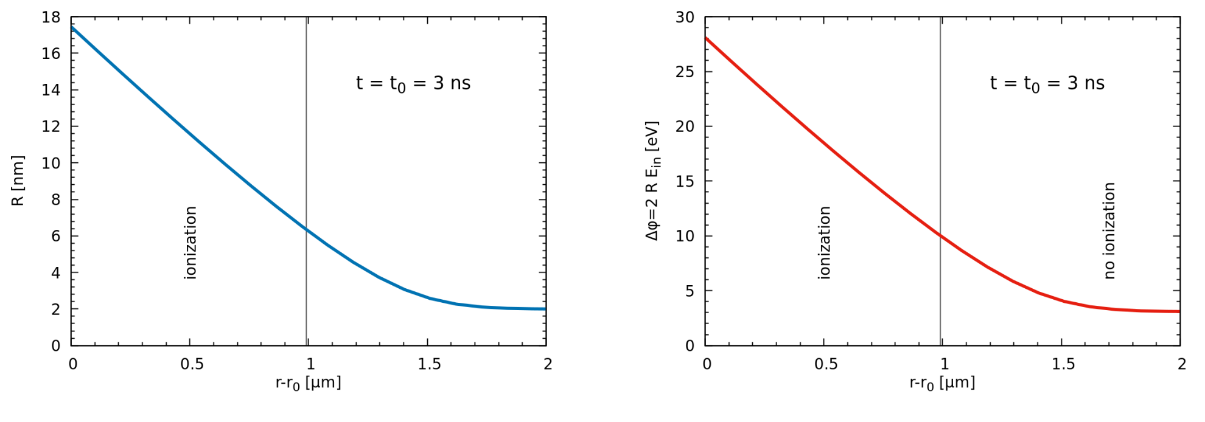
Growth of nano vacancies and ionization inside
Electrostrictive, surface tension, and hydrodynamic pressure on the surface of a nanovacancy
experimental Tolman coeff.
nanovacancy collapses
nanovacancy expands
Equilibrium of kinetic energy of the expanding liquid and pressure forces
coeff. of equilibrium between tensile forces
Electron kinetic energy in a nanovacancy
nanovacancy radius
water ionization energy, 10 eV
Simulation for r₀ = 100 μm, ε = 81, α = 1.5, U₀ = 54 kV, t₀ = 3 ns, σ = 0.072 N/m, R₀ = 2 nm and k_{σ} = 1
Bonaventura et al. 2019 GEC
Shneider et al. JAP 2015
8
Notes:
Pozor je to pro verejnost … jednoduseji, schemata nazorna, ne moc analyz, jen par rovnic

Slide 10
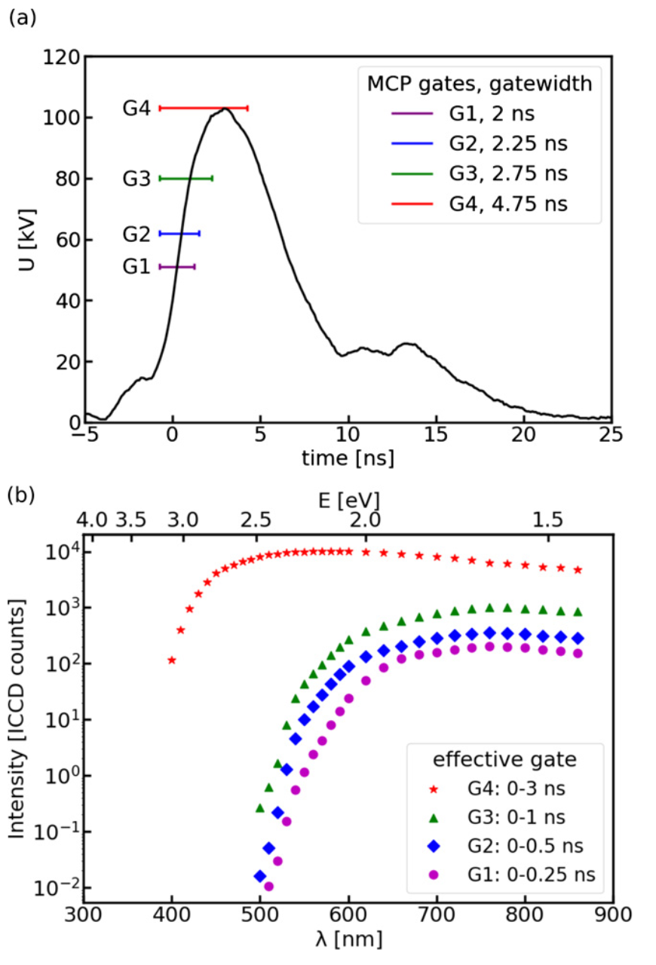
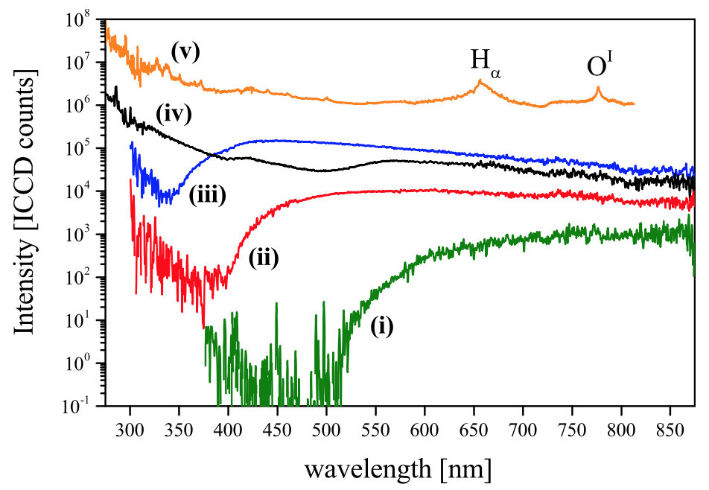

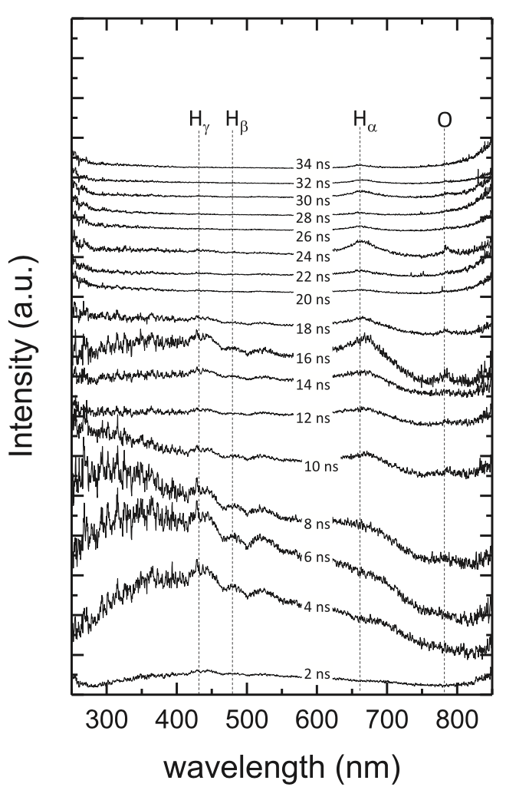
Optical emission spectrum at the start of an ns-pulse of high voltage
Experiment Bilek et al. 2021 PSST
Experiment Šimek et al. 2017 PSST
Deionized water, tip-to-plane geometry, curvature of the anode tip ~50 μm, high voltage amplitude ~20 kV, FWHM ~15 ns, 15 Hz
Deionized water, tip-to-plane geometry, curvature of the anode tip ~50 μm, high voltage amplitude ~100 kV, FWHM ~7 ns, < 1Hz
von Keudell et al. 2020 PSST
9
Notes:
Pozor je to pro verejnost … jednoduseji, schemata nazorna, ne moc analyz, jen par rovnic

Slide 11
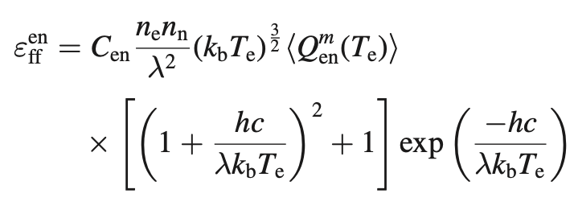
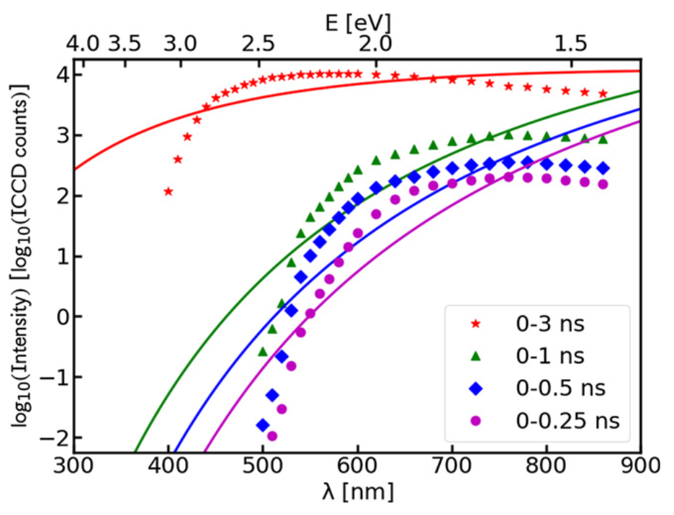
Optical emission spectrum - interpretation by bremsstrahlung radiation
Experimental result
Interaction of electrons with neutral particles and the generation of bremsstrahlung radiation, described by a Maxwell-Boltzmann distribution:
Deionized water, tip-to-plane geometry, curvature of the anode tip ~50 μm, high voltage amplitude ~100 kV, FWHM ~7 ns, < 1Hz
10
Bilek et al. 2021 PSST
Notes:
Pozor je to pro verejnost … jednoduseji, schemata nazorna, ne moc analyz, jen par rovnic

Slide 12
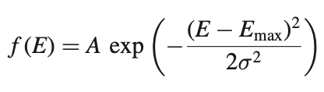
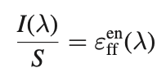
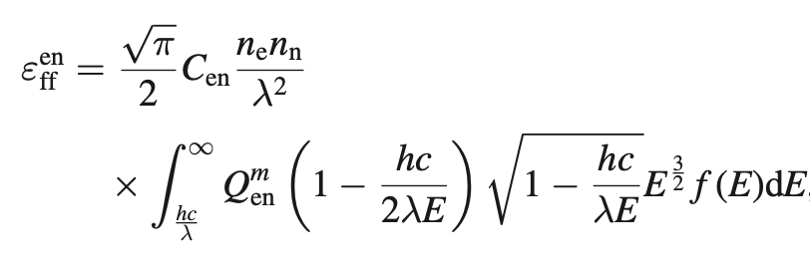
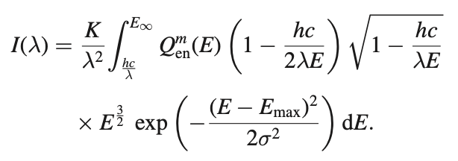
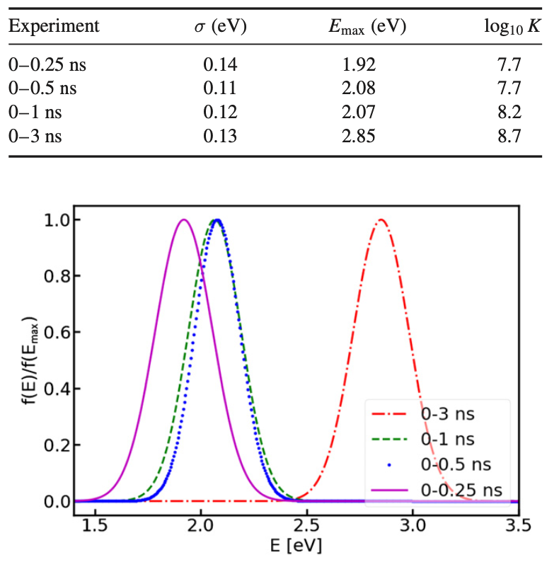
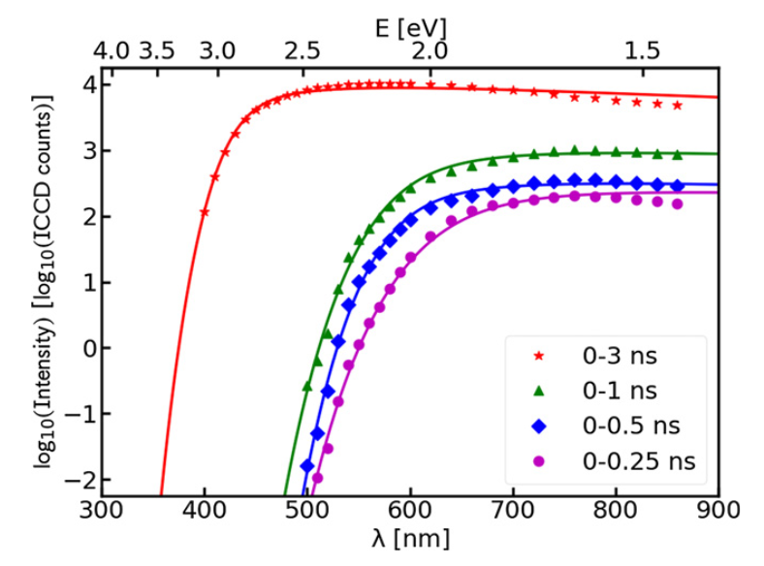
Bremsstrahlung radiation generated by electrons with a Gaussian distribution function.
EEDF (Electron Energy Distribution Function) and expression of intensity using the emission coefficient.
A Gaussian-shaped EEDF is characteristic for electrons produced by field emission.
11
Bilek et al. 2021 PSST
Notes:
Pozor je to pro verejnost … jednoduseji, schemata nazorna, ne moc analyz, jen par rovnic

Slide 13
Nanosecond electric breakdown in a dielectric liquid – scheme 1
1) A rapidly changing (nanoseconds) electric field generates negative pressure through the nonlinear response of a polar/dielectric liquid, resulting in nanoscopic "cracks" in the liquid—a phenomenon known as electrostriction.
A rapidly changing high electric field at the electrode =>
Creation of negative pressure =>
Generation of nanoscopic vacancies (literally nano-cracks in water) =>
Multiplication of electrons in the nanovacancy similar to a photomultiplier =>
Generation and accumulation of free charge =>
Strengthening of the electric field, etc.
The generation of bremsstrahlung radiation in this type of discharge was successfully interpreted using the proposed model with a specific distribution function for electrons, and under the given conditions, it meets the cavitation requirements. The obtained distribution function also provides clues on how primary electrons are formed—namely by field emission from water molecules in nanovacancies.
Seepersad et al. 2013 JPD
Shneider et al. 2013 PRE
5
Notes:
Pozor je to pro verejnost … jednoduseji, schemata nazorna, ne moc analyz, jen par rovnic

Slide 14
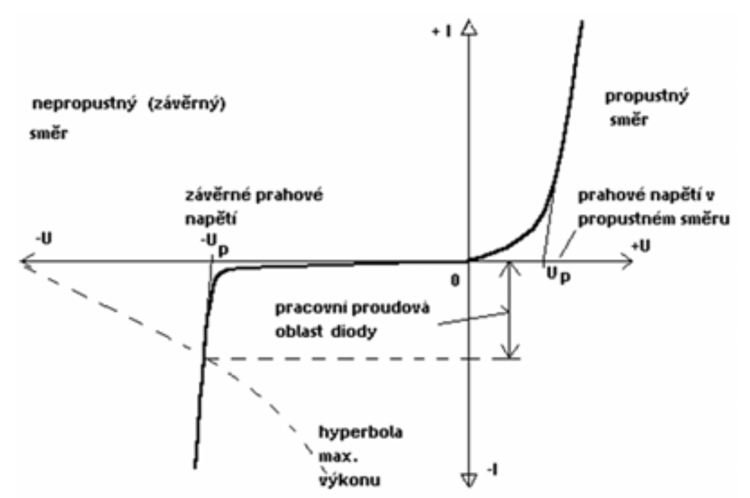

Nanosecond electric breakdown in a dielectric liquid – scheme 2
2) Alternatively, the Zener model of ionization involves strong heating at the contact between the plasma and the electrode.
A rapidly changing high electric field at the electrode =>
Ionization of molecules via the Zener mechanism =>
Multiplication of electrons =>
Generation of high current =>
Rapid heating of the electrode, thermoemission
Sun et al. 2016 High Volt.
Von Keudell et al. 2020 PSST
13
Notes:
Pozor je to pro verejnost … jednoduseji, schemata nazorna, ne moc analyz, jen par rovnic

Slide 15
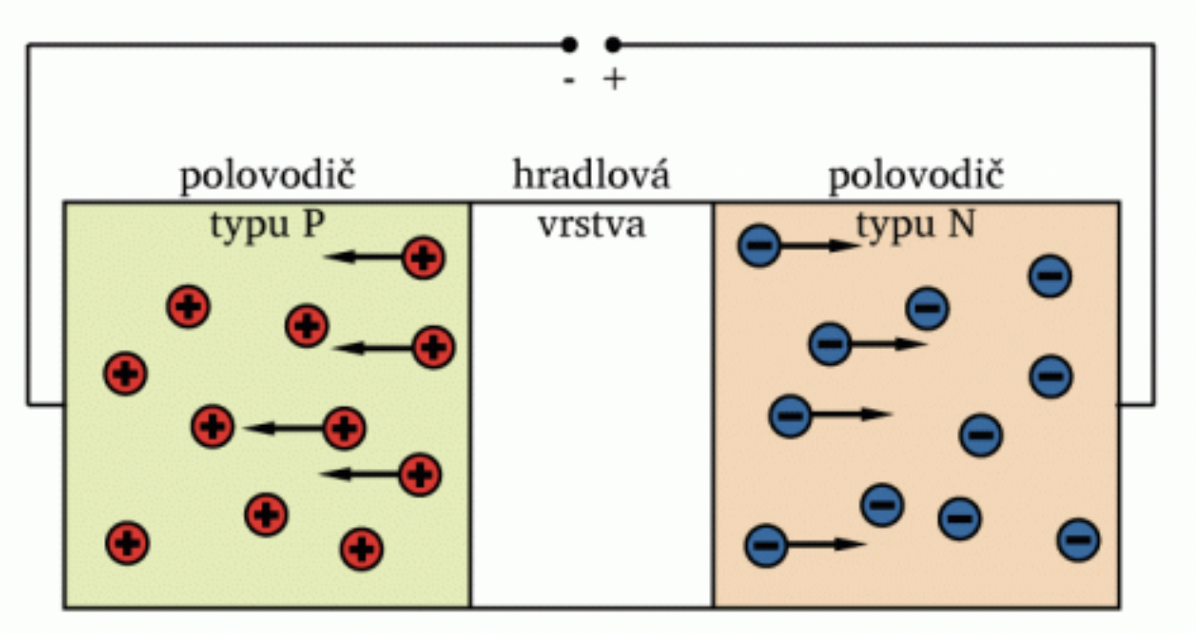
Nanosecond electric breakdown in a dielectric liquid – scheme 2
The Zener model of ionization, adopted from semiconductor physics for the reverse/blocked direction
If we increase the voltage in the reverse direction, it leads to the separation of charges from the gate layer, and at low voltages, it does not conduct any current. If the voltage is further increased beyond a certain threshold, the electric field intensifies until the electrons at material impurities begin to ionize through tunneling where the electric field enhancement is highest.
Electron emission by this mechanism is called the Zener model and is described by the following equation:
where G denotes the rate of field ionization, q is the electric charge, h is the Planck constant, ∣E∣ is the magnitude of the electric field, n0​ is the number of impurities, that is, molecules/atoms, on which ionization can occur through the tunnel effect, a is the distance between individual molecules, Δ is the ionization energy of the molecule, and m∗ is the effective mass of the electron in the liquid.
14
Notes:
Pozor je to pro verejnost … jednoduseji, schemata nazorna, ne moc analyz, jen par rovnic

Slide 16
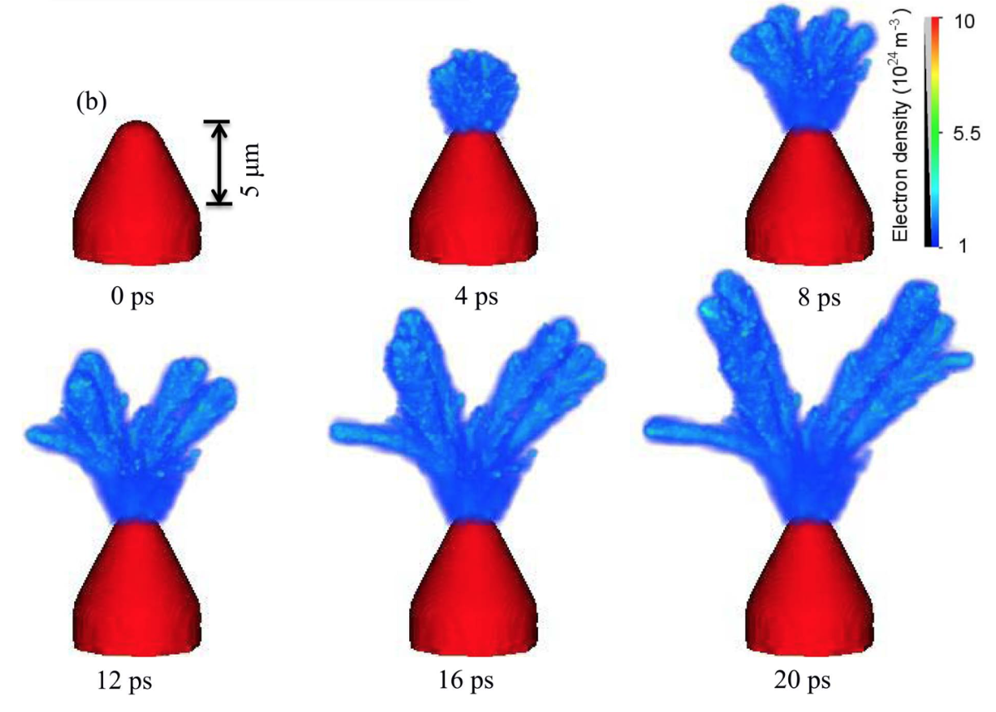

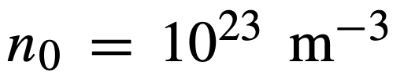



Nanosecond electric breakdown in a dielectric liquid – scheme 2
  The Zener model of electron tunneling applied to the simulation of streamer discharge in supercritical liquid nitrogen at 80 bars and 290 K.
ionization rate
intermolecular distance
impurity density (50ppm)
effective electron mass
streamer speed
density of ionized matter
15
Sun et al. 2014 IEEE TPS
Notes:
Pozor je to pro verejnost … jednoduseji, schemata nazorna, ne moc analyz, jen par rovnic

Slide 17
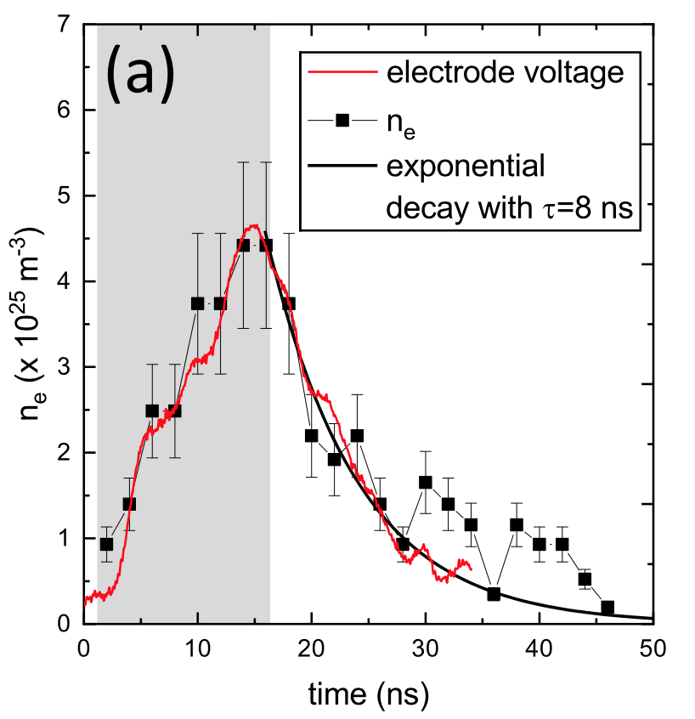
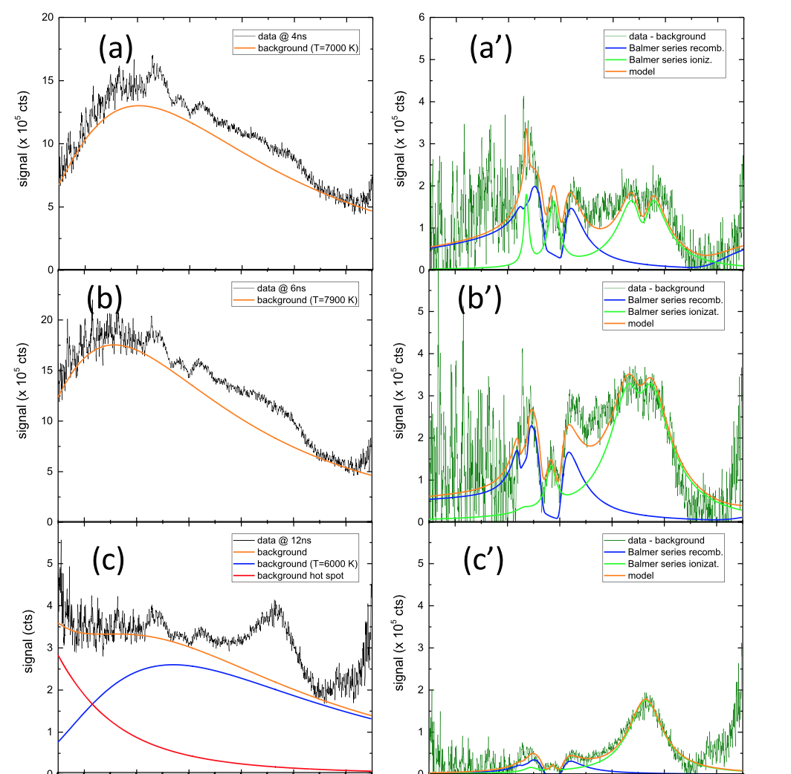
Nanosecond electric breakdown in a dielectric liquid – scheme 2
navrhovaný model
Optical emission spectrum and its interpretation: superposition of two blackbody emissions.
čas
Interpretation of the spectrum with nanosecond resolution using a physical model and determination of the electron density in the initial phases of the discharge from the broadened emission of hydrogen spectral lines.
von Keudell et al. 2020 PSST
Marinov et al. 2014 JPDAP
16
Notes:
Pozor je to pro verejnost … jednoduseji, schemata nazorna, ne moc analyz, jen par rovnic

Slide 18
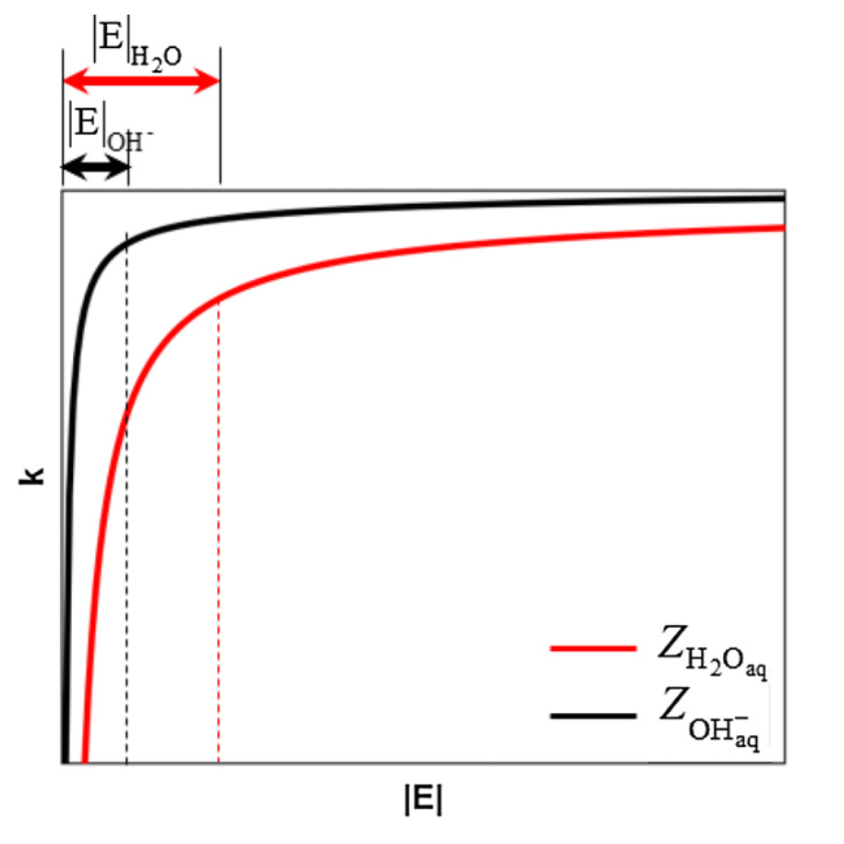
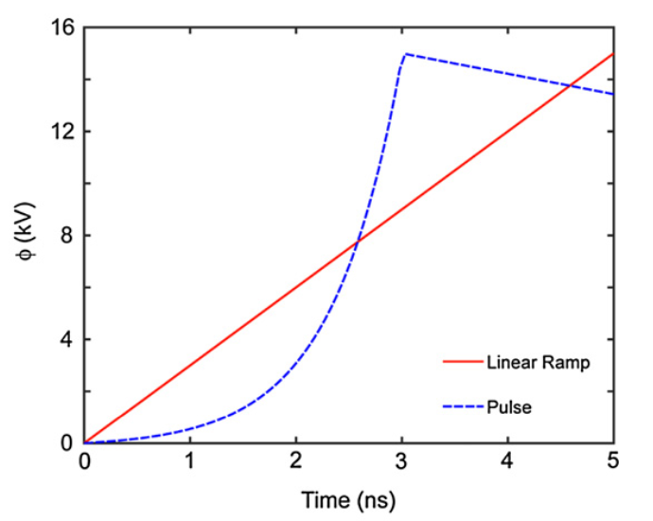
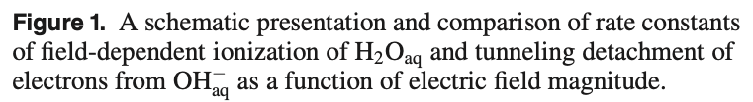
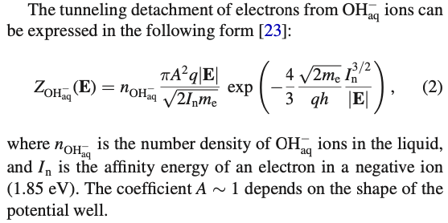
Nanosecond electric breakdown in a dielectric liquid – unified scheme
Simulations taking into account both the electrostriction mechanism and the Zener ionization model (Aghdam et al. 2020 and 2021 PSST)
Theory did not confirm the formation of sufficiently large vacancies for the acceleration of electrons to ionize surrounding water molecules by direct impact.
Fluid model results
Different electron generation mechanisms
Electrons separated from the OH negative ion provide a current of electrons even at lower voltages during the initial increase of the applied voltage.
The local electric field is not large enough to allow for ionization by direct electron impact on a water molecule; simulations indicate that this cannot be a dominant or significant mechanism.
Both exponential and linear voltage increases were tested, and both yield essentially the same results.
But this was only a fluid model
17
Notes:
Pozor je to pro verejnost … jednoduseji, schemata nazorna, ne moc analyz, jen par rovnic

Slide 19
Nanosecond electric breakdown in a dielectric liquid – what do we know?
A detailed local model of cavitation provides an explanation for experimental results (optical emission spectra) through a suitable fit, which also gives additional information about the source of primary electrons.
3D simulation, in an extreme case, describes with the Zener model a streamer discharge in liquid nitrogen, which likely cannot be experimentally confirmed directly and under relatively extreme conditions unrelated to water in a laboratory setting.
The generation of hot spots and relatively hot plasma is jointly described by optical emissions through the radiation of an absolutely black body, supplemented by the Zener ionization model—however, the presence of hot spots has not been confirmed.
Fluid simulation considering both electrostriction and the Zener model explains the stratification of pressure in front of the high-voltage electrode, but is not capable of detailing the experiment.
Moreover, neither model completely describes the breakdown in liquids; there is always a missing transition from the generation of free charges by primary mechanisms in streamer or spark-like processes... but the most consistent experimental and theoretical works are on the trail of this (for example, collaborations like that of colleague Bonaventura and the Academy of Sciences of the Czech Republic in Prague).
... so we are still waiting for the complete uncovering of the mechanism.
18
Notes:
Pozor je to pro verejnost … jednoduseji, schemata nazorna, ne moc analyz, jen par rovnic

Slide 20
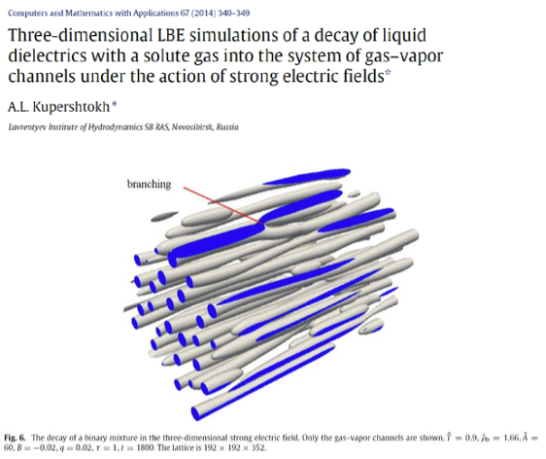
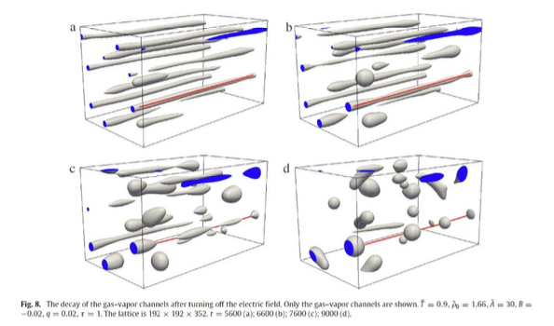
Nanosecond electric breakdown in a dielectric liquid – what do we know?
podrobný lokální model kavitace dává vysvětlení experimentálním výsledkům (optickým emisním spektrům)
>>> skrze vyhovující fit (vzpomeňme na Plancka), který ale dává další informace o zdroji primárních elektronů
3D simulace v extrémním případě popisuje Zenerovým modelem streamerový výboj v kapalném dusíku
>>> patrně experimentálně nepotvrditelná přímo a v poměrně extrémních podmínkách bez vztahu k vodě v laboratoři
generace hot-spotů a relativně horkého plazmatu společně popisuje optické emise skrze záření absolutně černého tělesa, model doplněn Zenerovým ionizačním modelem
>>> ovšem přítomnost hot-spotů nebyla potvrzena
fluidní simulace beroucí v úvahu elektrostrikci i Zenerův model
>>> vysvětluje stratifikaci tlaku před vysokonapěťovou elektrodou, ovšem není schopna podrobně popsat experiment
Moreover, all models do not completely describe breakdown in liquids; there is always a missing transition from the generation of free charges by primary mechanisms in streamer or spark-like processes... but the most consistent experimental and theoretical works are on the trail of this (for example, collaborations like that of colleague Bonaventura and the Academy of Sciences of the Czech Republic in Prague).
... so we are still waiting for the complete uncovering of the mechanism.
18b
Notes:
Pozor je to pro verejnost … jednoduseji, schemata nazorna, ne moc analyz, jen par rovnic

Slide 21
Microsecond electric breakdown in liquids
A slowly changing (microseconds and longer) electric field mobilizes ions, polarizes polar molecules, or causes oscillatory motion (like heating food in a microwave), and through interaction with the surroundings, it leads to collisions with nearby molecules and the transfer of kinetic energy into vibrational and thus thermal energy...
19
Sun et al. 2016 High Volt.
Notes:
Pozor je to pro verejnost … jednoduseji, schemata nazorna, ne moc analyz, jen par rovnic

Slide 22
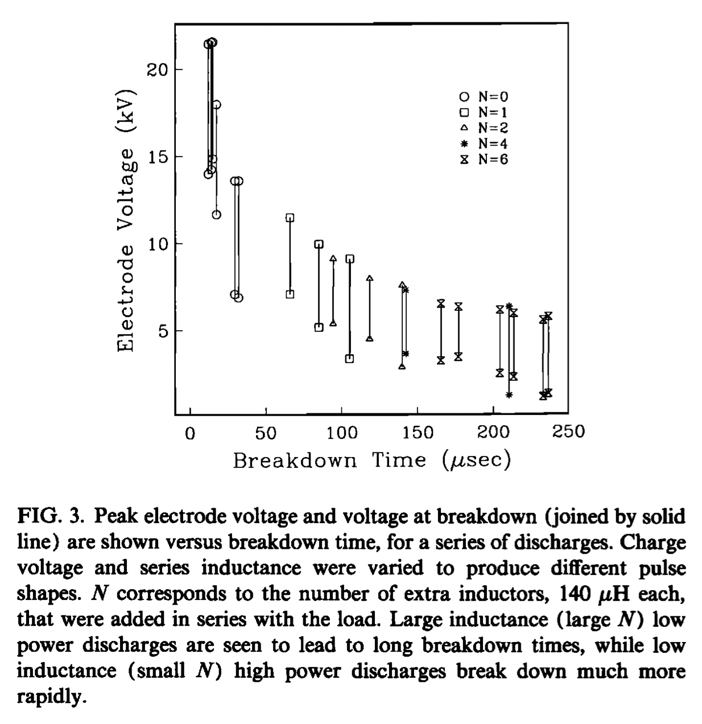
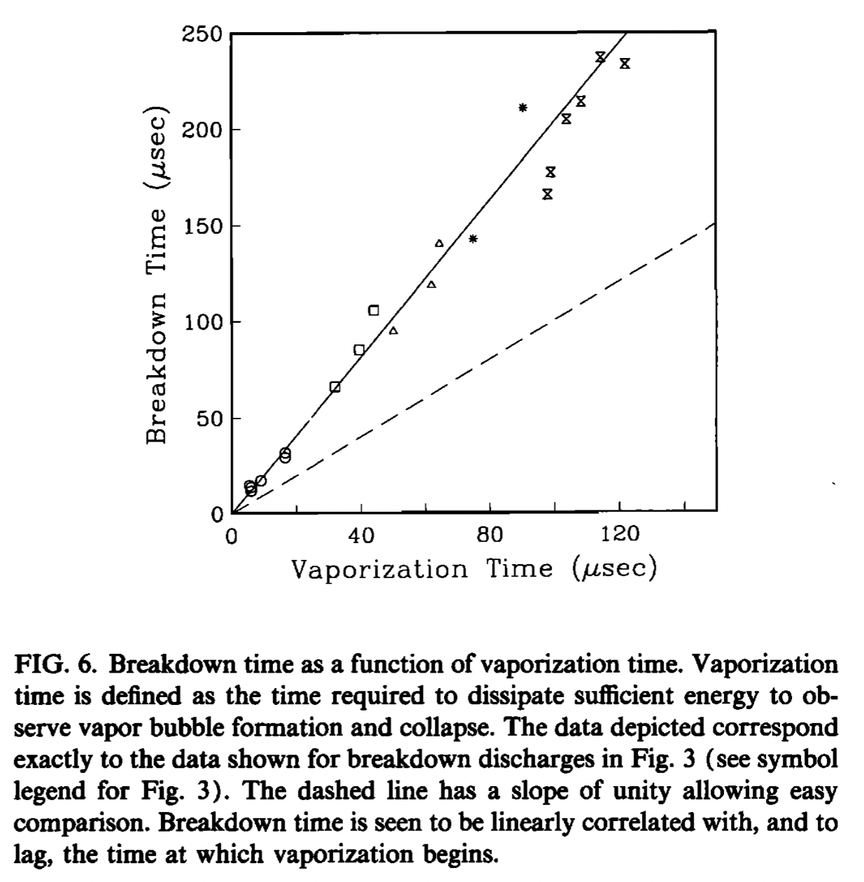
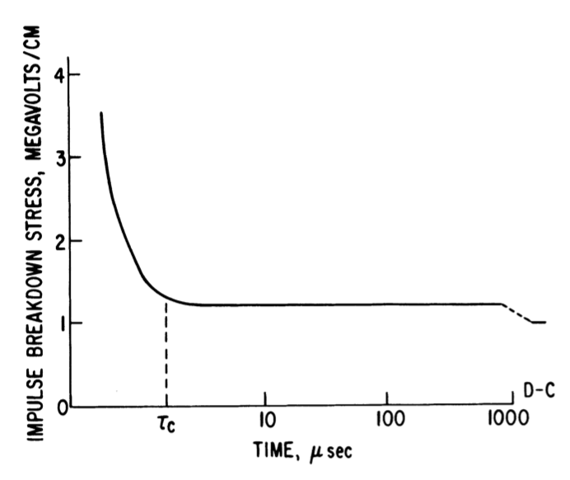
Microsecond electric breakdown in liquids
A slowly changing (microseconds and longer) electric field mobilizes ions, polarizes polar molecules, or causes oscillatory motion (like heating food in a microwave), and through interaction with the surroundings, it leads to collisions with nearby molecules and the transfer of kinetic energy into vibrational and thus thermal energy...
Electric breakdown in liquid hydrocarbons
Breakdown in sea water
Joule heating, microbubbles formation
Harbaugh et al. 1978 IEEE TEI
20
Olson et al. 1993 JASA
Notes:
Pozor je to pro verejnost … jednoduseji, schemata nazorna, ne moc analyz, jen par rovnic

Slide 23
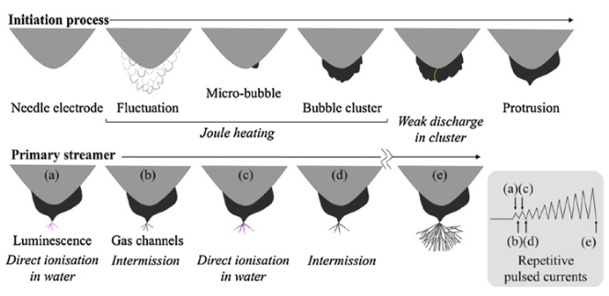
Microsecond electric breakdown in liquids
A slowly changing (microseconds and longer) electric field mobilizes ions, polarizes polar molecules, or causes oscillatory motion (like heating food in a microwave), and through interaction with the surroundings, it leads to collisions with nearby molecules and the transfer of kinetic energy into vibrational and thus thermal energy...
After the formation of the first streamer discharges in a microbubble (note, these are no longer nano-vacancies but real bubbles!), there occurs a rapidly fast transfer of a large amount of electric charge, leading to cavitation in the water wall of the bubble, and the situation (not) explained in the previous parts of the lecture repeats itself.
21
Notes:
Pozor je to pro verejnost … jednoduseji, schemata nazorna, ne moc analyz, jen par rovnic

Slide 24
quantum plasmas /complex plasmas / dusty plasmas
22
Notes:
Pozor je to pro verejnost … jednoduseji, schemata nazorna, ne moc analyz, jen par rovnic

Slide 25
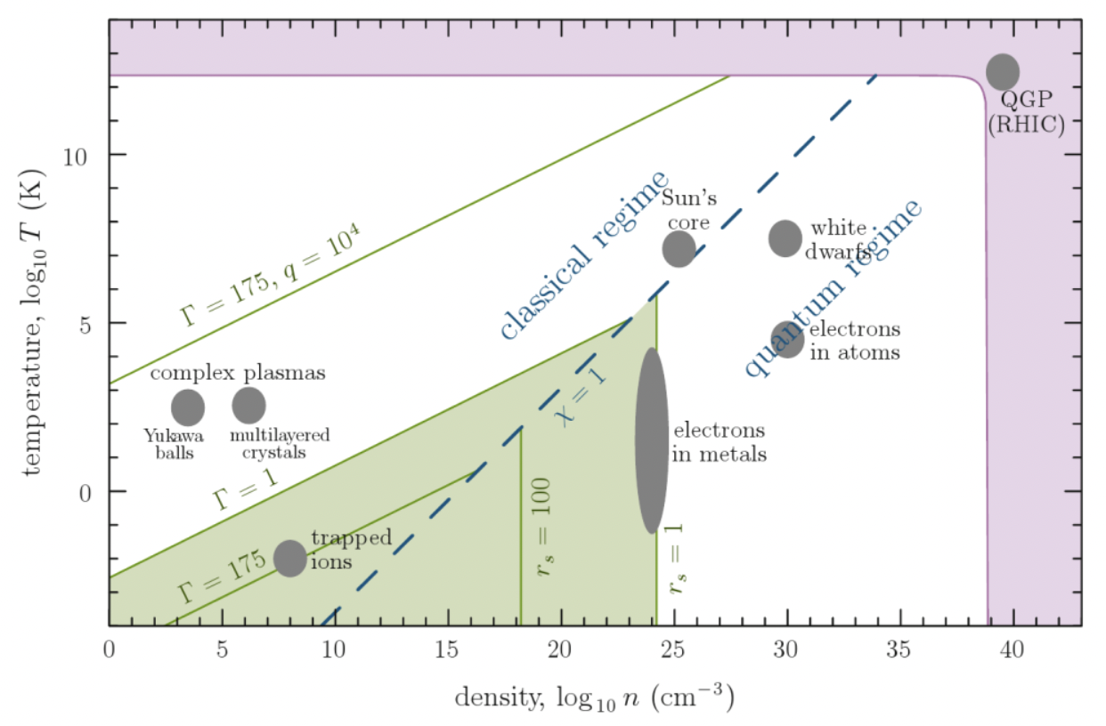
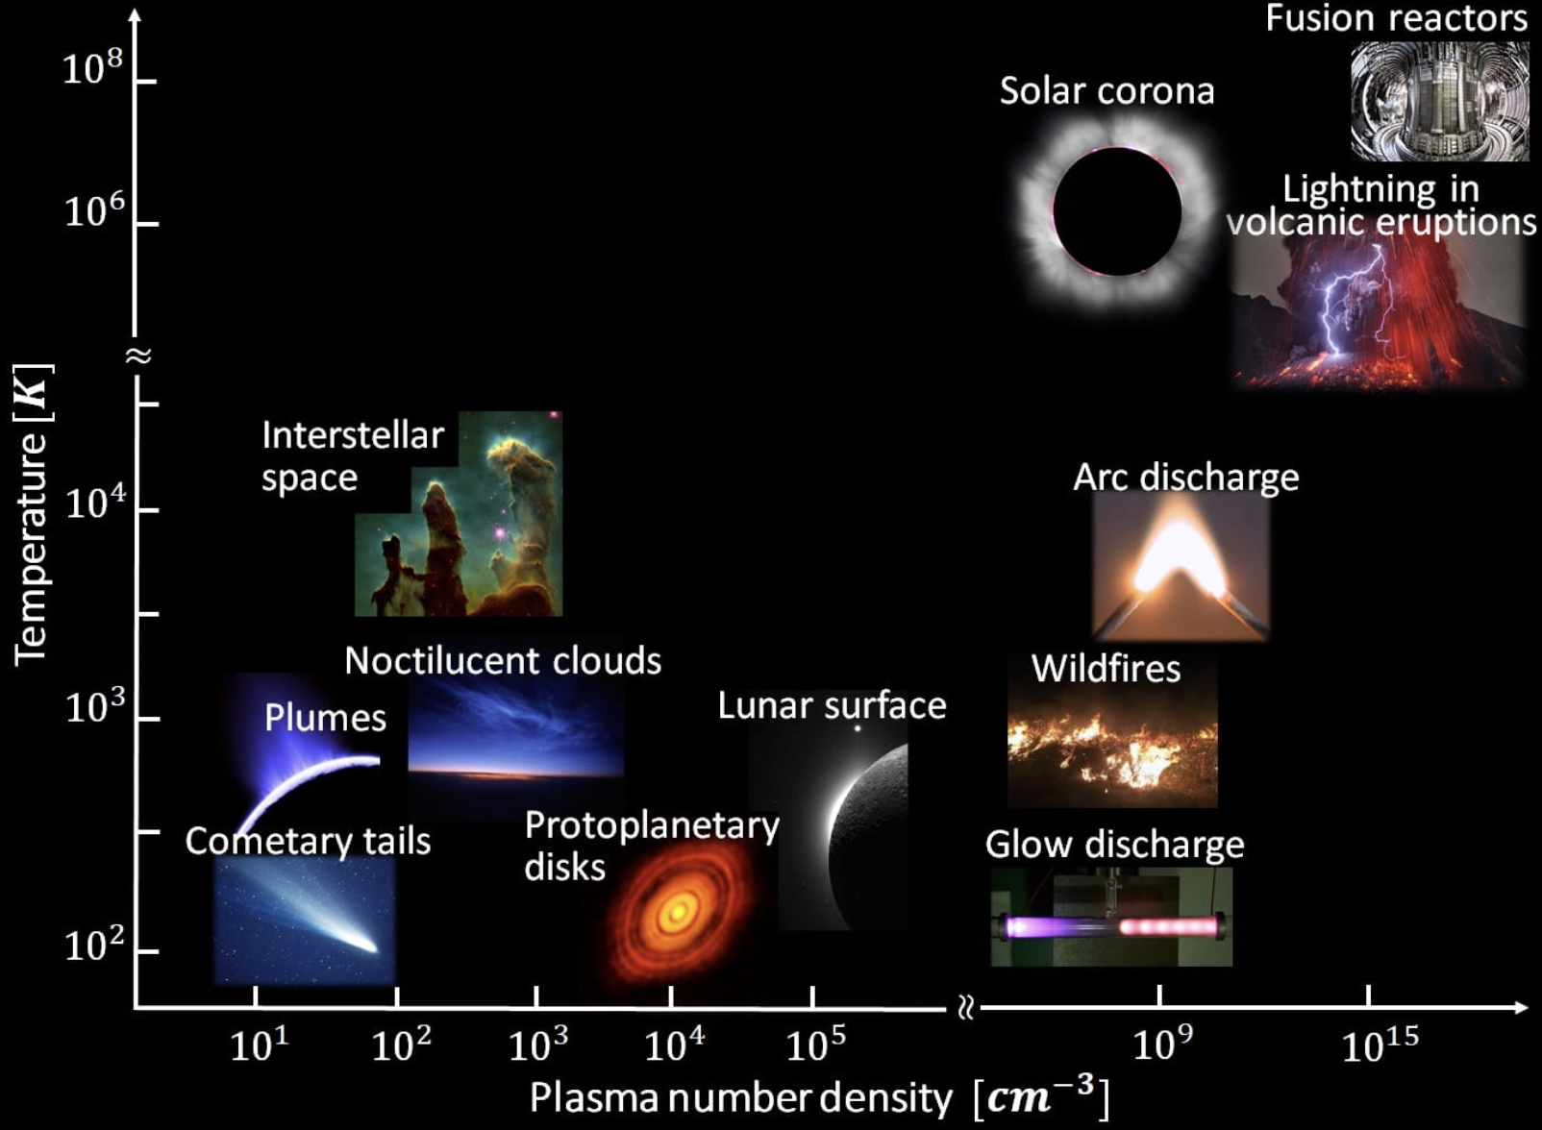
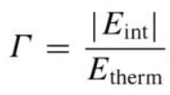
Klasifikace hmoty/plazmatu, kde jsme?
Introduction to complex plasmas – Bonitz et al. 2010
v levém grafu ukazuje čárkovaná modrá čára rozdělení na kvantové a klasické plazma
χ=1 pak značí stupeň degenerace plazmatu chí (χ ~ hustota*rozptyl vlnové funkce), pro větší chí jsou charakteristické vzdálenosti částic srovnatelné s prostorovým rozsahem vlnové funkce a kvantové efekty se stanou stěžejními
kolektivní chování – tedy „korelace v systému“ jsou dány dalekým dosahem Coulombovských sil
toto chování nastává, když energie Coulombovské interakce začne dominovat nad energií kinetickou a charakterizuje se tzv. korelačním parametrem Γ (Coulombův parametr gama), který je určen jako podíl interakční energie (s nejbližším partnerem) a střední tepelné energie systému:
Fermiho plyn
23
Notes:
Pozor je to pro verejnost … jednoduseji, schemata nazorna, ne moc analyz, jen par rovnic

Slide 26
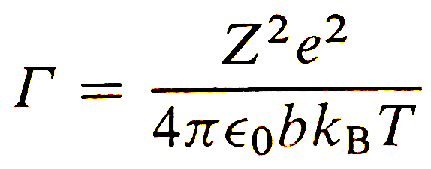
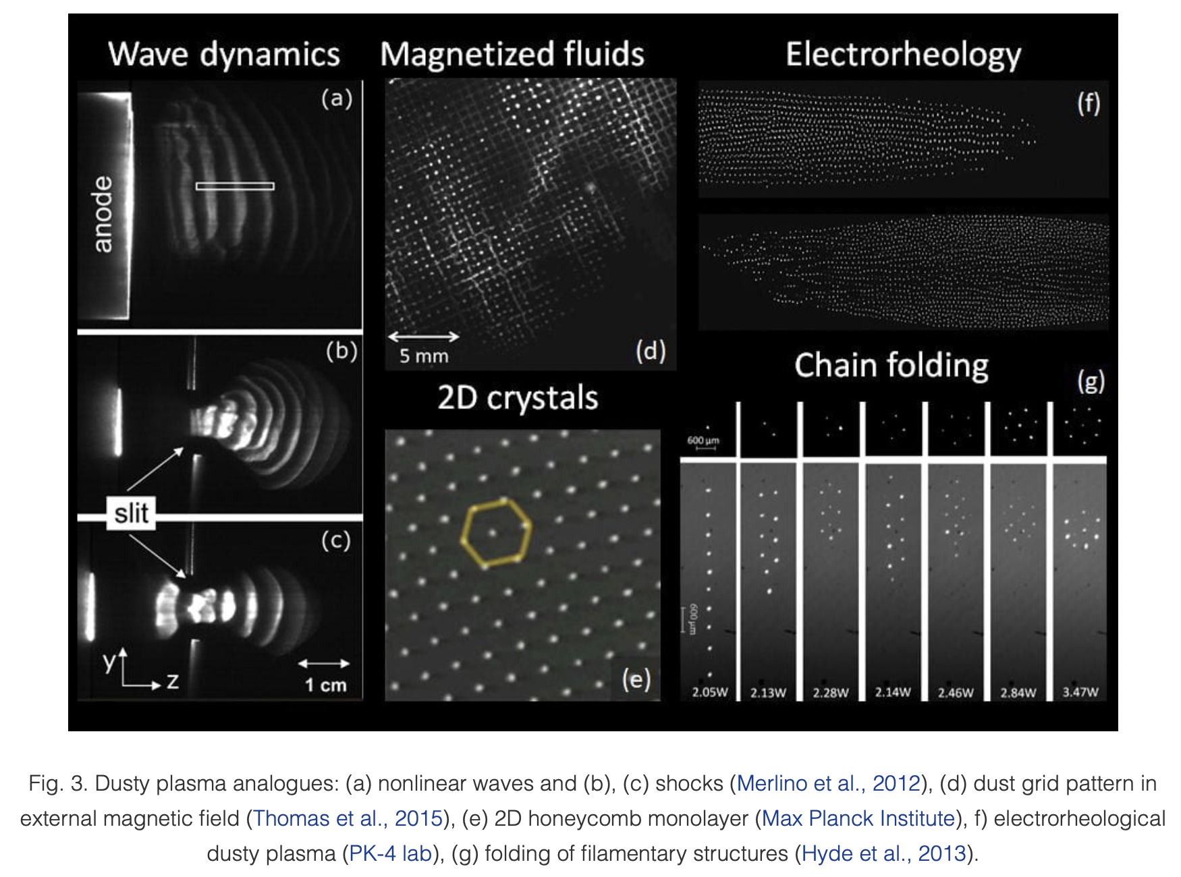
Klasifikace komplexního plazmatu
kolektivní chování – tedy „korelace v systému“ jsou dány dalekým dosahem Coulombovských sil
toto chování nastává, když energie Coulombovské interakce začne dominovat nad energií kinetickou a charakterizuje se tzv. korelačním parametrem Γ, který je určen jako podíl interakční energie (s nejbližším partnerem) a střední tepelné energie systému: tedy
korelační parametr se rozprostírá od:
Γ<<1 pro ideální plyn, přes
Γ>=1 pro silně vázané/korelované systémy (kapalině podobné), až po
Γ>100 krystalickýckých systémů
stručně řečeno, fenomény prostorových korelací/kolektivního chování a vytváření pravidelných struktur vyjadřují tendenci částic k minimalizaci jejich potenciální energie skrze vyhýbání se blízkému sousedství s dalšími částicemi
24
Kostadinova et al. 2019 Baylor Uni
Notes:
Pozor je to pro verejnost … jednoduseji, schemata nazorna, ne moc analyz, jen par rovnic

Slide 27
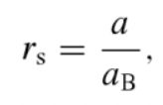








Klasifikace plazmatu
dalším parametrem ke klasifikaci plazmatu je tzv. Bruecknerův parametr:
který popisuje částicovou korelovanost/provázanost v kvantových systémech, kde
je efektivní Bohrův poloměr a a je střední vzdálenost mezi částicemi
je zjevné, že s rostoucím a parametr roste a tedy dalekosažné síly (např. Coulombovské) umožňují kolektivní chování, na úkor prostorově limitovaným kvantovým efektům
tento parametr bere v úvahu růst kvantové kinetické energie při vysokých hustotách a reflektuje tak dopad kvantových efektů z překryvu vlnové funkce na nanoskopických vzdálenostech (dokonce i pro T=0 jsou přítomny kvantové fluktuace, které rostou s hustotou hmoty a teplota tedy není dostatečně výmluvný parametr)
parametr pak popisuje škálu různých systémů od slabě provázaných, ideálních kvantových až po
čistě klasické
je povšimnutí hodné, že i přes obrovskou rozmanitost známých plazmat je vznik kolektivního chování a strukturalizace systému popsatelná pouz výše uvedenými dvěma parametry: korelačním Γ a Bruecknerovým r_{S}
vrátíme-li se k našemu fázovému diagramu, pak krystalické formy
hmoty se nachází pouze v relativně malé oblasti nízkých teplot a
středních hustot, kde 100, a
naopak, druhé dva limitní případy a
jsou kompletně bez struktury
pro silně korelované systémy v iontových pastech, teprve
při 300mK bude elektrostatická energie vzájemných
Coulombovských interakcí mezi jednotlivými ionty dostatečně
větší než tepelná energie, a tedy
ovšem silně provázané systémy jsou známy i při pokojových
teplotách – v tzv. komplexních (prašných - dusty) plazmatech
25
Notes:
Pozor je to pro verejnost … jednoduseji, schemata nazorna, ne moc analyz, jen par rovnic

Slide 28
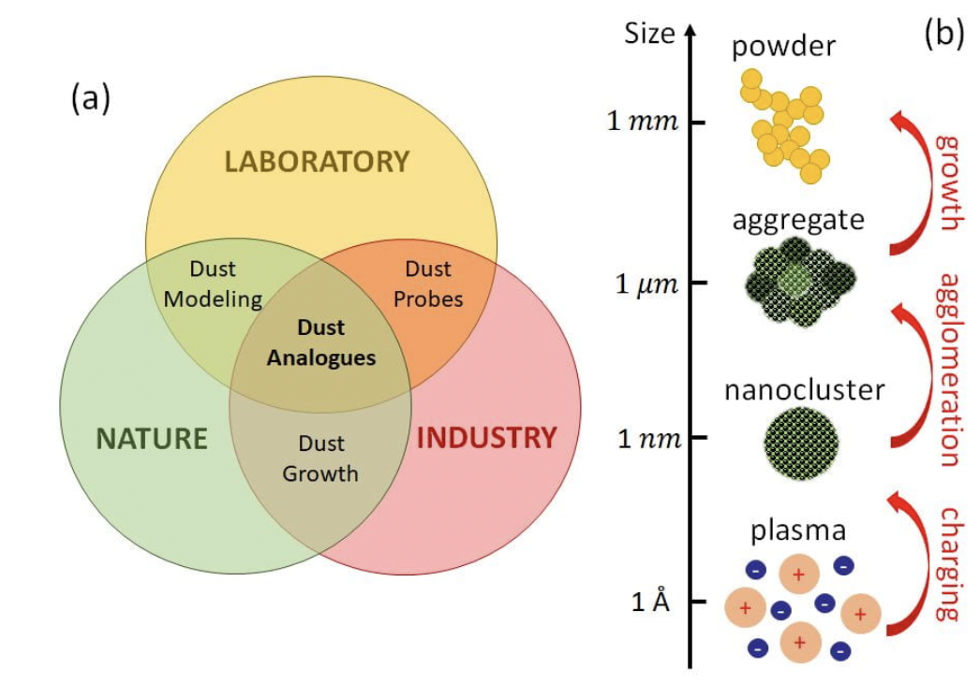
Komplexní plazma – plazma obsahující částice (dusty plasma)
Introduction to complex plasmas – Bonitz et al. 2010
jde o třídu převážně nízkoteplotního plazmatu (alespoň v rozsahu této přednášky) obsahujícího mikroskopické až nanoskopické částice
stěžejními problémy komplexního plazmatu jsou: korelace, dynamika a reaktivita
Korelace (kolektivní chování) – vzájemné působení silně nabitých prachových částic v plazmatických pastech dává vznik silně korelovaným plazmovým stavům
Dynamika – dynamika celého zoo částic vznikajících v plazmatu a interakce plazmatu s povrchem (plasma-surface interaction)
Reaktivita - iniciované chemické procesy v plazmatu a na jeho okrajích/hranicích/rozhraních
26
Kostadinova et al. 2019 Baylor Uni
Notes:
Pozor je to pro verejnost … jednoduseji, schemata nazorna, ne moc analyz, jen par rovnic

Slide 29
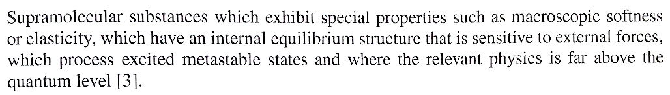
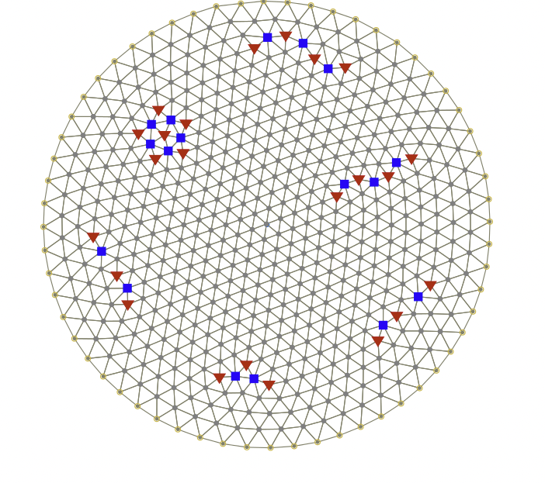
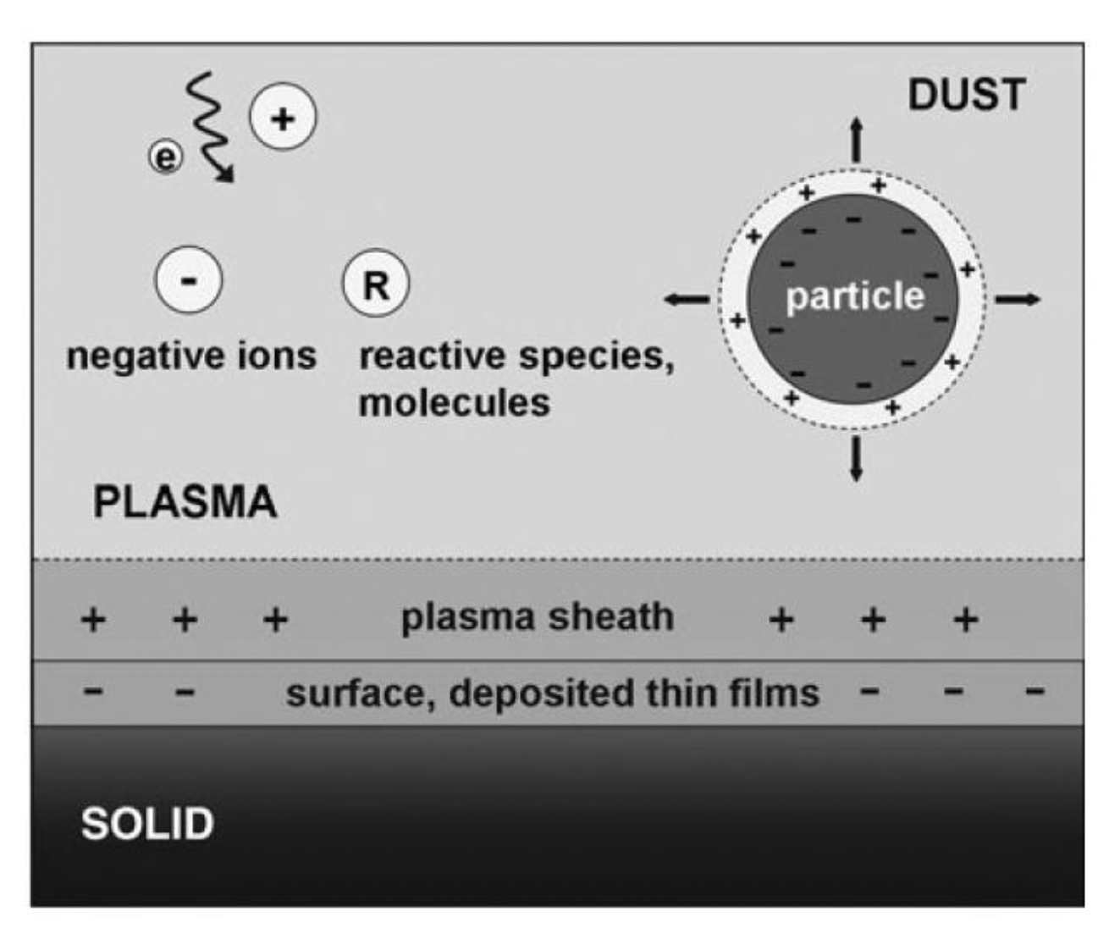
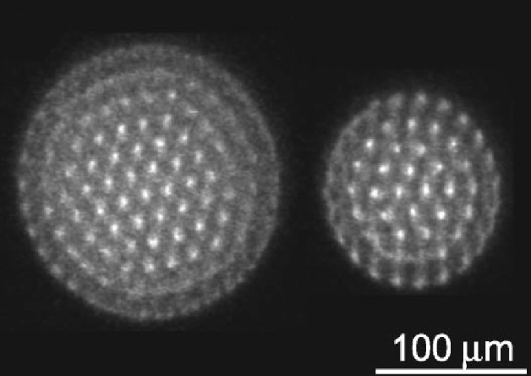
Komplexní plazma – plazma obsahující částice (dusty plasma)
Introduction to complex plazmas – Bonitz et al. 2010
fyzika komplexního plazmatu je poměrně mladé odvětví ve fyzice plazmatu – nejde jen o prašné plazma (dusty plasma) ale spíše obecněji o: několikasložkové nízkoteplotní plazma obsahující vedle elektronů, pozitivních a negativních iontů i nabité nano- či mikročástice a klastry (cluster, shluk částic), ale také reaktivní atomy a molekuly silně reagujícími s povrchy
komplexní plazma je součástí třídy tzv- měkké hmoty (soft matter), kterou můžeme popsat slovy Pierre-Gilles de Gennes:
fyzika komplexního plazmatu se zabývá oblastmi jako nabíjením prašných prstenců Saturnu, elektrickou aktivitou hydrometeorů v bouřkových oblacích, vznik a depozice nanočástic z nanoprášků apod. Dalšími zajímavými příklady jsou tzv.:
Wignerovy krystaly (za nízkých teplot, nízkých hustot
v potenciálových jámách umístěné elektrony)
nebo tzv. Yukawa ball (trojrozměrné krystaly z
nabitých prachových částic v nízkoteplotním plazmatu)
wiki
27
Uni Kiel
Notes:
Pozor je to pro verejnost … jednoduseji, schemata nazorna, ne moc analyz, jen par rovnic

Slide 30
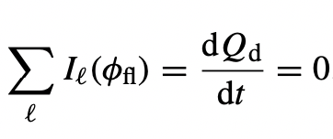



Nabíjení částice v plazmatu
Physics of dusty plasmas – Melzer 2019
zcela zásadním jevem, který je třeba charakterizovat a kvantifikovat je nabíjení částic/klastrů, které jsou vloženy do nebo interagují s plazmatem
projdeme si tedy fundamentální mechanizmy, které ovlivňují nabíjení
základním výchozím bodem bude podmínka pro plovoucí potenciál částice, tedy
kde je plovoucí potenciál částice v plazmatu a ten rozumíme jako potenciál,
při kterém je suma všech proudů na částici nulová, je náboj částice
zajímá nás pro začátek rovnovážný stav (steady-state) a tedy budeme chtít vyjádřit plovoucí potenciál z daných proudů
různé proudy přispívají k celkovému proudu na částici: proud elektronů, iontů, emise sekundárních elektronů a fotoelektronů. Sběr elektronů a iontů dominuje v laboratorních podmínkách, zatímco druhé dva pak v astrofyzikálních plazmatech. Extrakce elektronů vysokým elektrickým polem je také možná, ovšem ne pro námi uvažované (spíše) laboratorní podmínky dále.
začneme diskuzi pro izotropní Maxwellovské rozdělení rychlostí iontů a elektronů. Proudy na částici mohou být popsány pomocí tzv. OML limitu (orbital motion limit), tedy pokud se nabité částice přibližují k prachové částici z nekonečna a interagují pouze Coulombovsky – podobně jako Rutherfordův rozptyl
elektrony díky mnohem nižší hmotnosti mají mnohem vyšší mobility než ionty a tedy bude částice nabita negativně a můžeme tedy uvažovat, že potenciál částice bude záporný vzhledem k potenciálu okolního plazmatu. Nakonec budou tedy pozitivní ionty přitahovány a elektrony odpuzovány.
Výsledné OML proudy vypadají následovně, pro negativní prachovou částici:
(a my si je v následující části odvodíme)
28
Notes:
Pozor je to pro verejnost … jednoduseji, schemata nazorna, ne moc analyz, jen par rovnic

Slide 31

Nabíjení částice v plazmatu
pro kompletnost pak pro pozitivní prachovou částici platí:
Ve všech čtyřech předchozích rovnicích je pak a poloměr prachové částice, e je elementární náboj, k_{B} je Boltzmannova konstanta, n_{i} a n_{e} jsou koncentrace iontů a elektronů, T a m jejich hmotnosti
29
Notes:
Pozor je to pro verejnost … jednoduseji, schemata nazorna, ne moc analyz, jen par rovnic

Slide 32












Odvození OML proudů
jak již bylo uvedeno, budeme vycházet z podmínky, že , začněme iontovou částicí padající na prachovou částici
Kde b je záměrná vzdálenost (jak ji znáte z mikrosvěta), je její kritická hodnota, a pro dopadne iont na prachovou částici a pro větší hodnotu bude pak jen vychýlen
platí změna momentu hybnosti (pro nekonečnou vzdálenost a při interakci):
a … uvažujeme jeho zachování (i když mají částice nenulové rozměry!)
rovnováha energie pro iont v nekonečnu a u nabité částice je dána
a můžeme psát:
z čehož vychází:
a lze odvodit účinný průřez pro připojení iontu na částici jako:
interakční účinný průřez je větší než geometrický průřez částice díky přítomným elektrostatickým silám, platí
30
Notes:
Pozor je to pro verejnost … jednoduseji, schemata nazorna, ne moc analyz, jen par rovnic

Slide 33










Odvození OML proudů
iontový proud je dán:
kde je hustota iontového proudu
iontový proud je třeba pak integrovat přes Maxwellovskou rozdělovací funkci (dle úvodních předpokladů)
a dostáváme:
přitom víme:
a tedy výsledný proud je: tento výsledek lze interpretovat jako modifikaci proudové hustoty iontů s jejich termální rychlostí
31
Notes:
Pozor je to pro verejnost … jednoduseji, schemata nazorna, ne moc analyz, jen par rovnic

Slide 34













Odvození OML proudů
člen pak popisuje zvětšený interakční účinný průřez prachové částice při iontové termální energii
což je blízko klasickému vztahu
pro elektronový proud platí analogicky, pro kritickou záměrnou vzdálenost:
pro rozdělovací funkci a integraci:
spodní mez je dána energií elektronů k překonání odpudivé síly negativní prachové částice
pak podobně jako pro ionty:
a tedy: podobný výsledek lze získat statistickou úvahou, že tepelný tok
elektronů na částici bude redukován Boltzmannovským faktorem
32
Notes:
Pozor je to pro verejnost … jednoduseji, schemata nazorna, ne moc analyz, jen par rovnic

Slide 35
Diskuze OML proudů
odvození bylo provedeno za předpokladu izotropní Maxwellovské rozdělovací funkce a iontových trajektorií bez kolizí
ovšem všechny tyto podmínky jsou v případě plazmatu v elektrických výbojích porušeny…
PROČ?
33
Notes:
Pozor je to pro verejnost … jednoduseji, schemata nazorna, ne moc analyz, jen par rovnic

Slide 36

Diskuze OML proudů
odvození bylo provedeno za předpokladu izotropní Maxwellovské rozdělovací funkce a iontových trajektorií bez kolizí
ovšem všechny tyto podmínky jsou v případě plazmatu v elektrických výbojích porušeny…
34
Notes:
Pozor je to pro verejnost … jednoduseji, schemata nazorna, ne moc analyz, jen par rovnic

Slide 37








Neizotropní proudy iontů
ve stěnové vrstvě (plasma sheath) je drift iontů dán externím elektrickým polem a má dominantní směr, není tedy dán Maxwellovskou rozdělovací funkcí, můžeme psát:
přitom rozdělovací funkce může mít formu:
Kde: a jsou tzv. chybové funkce (error functions)
pro ionty s driftovou rychlostí se pak iontový proud redukuje na
který získáváme nahrazením za a termální rychlost rychlostí driftovou
pro srovnání, původní proud:
35
Notes:
Pozor je to pro verejnost … jednoduseji, schemata nazorna, ne moc analyz, jen par rovnic

Slide 38










Vliv kolizí na nabíjecí proudy
srážky iontů s neutrály signifikantně modifikují iontový proud na prachovou částici
v nízkoteplotním plazmatu ve vzácných plynech pak platí dominantně
uvažujme, jak by tyto kolizní ionty přispěli k proudům na prachovou částici…
uvažujme poloměr R₀ kolem prachové částice, v objemu této koule vede každá výše uvedená kolize ke kolekci iontu na prachovou částici, pravděpodobnost takovéto kolize je asi
kde je střední volná dráha pro kolizi iontu a neutrálu, kde hustota neutrálů a je účinný průřez pro výše uvedenou reakci
termální proud iontů skrze tuto kouli je a tedy platí
totální proud bude tedy po sečtení proudových příspěvků:
zbývá tedy rozumně odhadnout poloměr R₀ , to můžeme udělat tak, že R₀ určíme tam, kde energie interakce iontu a prachové částice je v řádu termální iontové energie, uvažujeme-li Debyeho stínění pak
a ve výsledku
celkový proud bude pak:
36
Notes:
Pozor je to pro verejnost … jednoduseji, schemata nazorna, ne moc analyz, jen par rovnic

Slide 39












Nabíjení částice pomocí jiných mechanizmů
pozitivní nabíjení skrze fotoemisní proud – UV fotony způsobují emisi elektronů, které pak opouští částici
zde je koeficient fotoemise, udává počet uvolněných elektronů po dopadu jednoho fotonu, je tok fotoelektronů
emise sekundárních elektronů po nárazu elektronu, kvantifikována pomocí koeficientu sekundární emise
který je silně závislý od energie příchozího elektronu
pak výsledný proud pro dává:
a pro případ potom:
kde jsou většina proměnných materiálové relativní konstanty a
37
Notes:
Pozor je to pro verejnost … jednoduseji, schemata nazorna, ne moc analyz, jen par rovnic

Slide 40




Vodivostní proudy a potenciál částice
pro laboratorní podmínky můžeme často uvažovat pouze vodivostní proudy – je to dobré přiblížení
z rovnice pro potenciál a OML proudy pak plyne
v tabulce jsou pak uvedené normalizované potenciály v kvazi-
neutrálním plazmatu pro různé poměry teplot
38
Notes:
Pozor je to pro verejnost … jednoduseji, schemata nazorna, ne moc analyz, jen par rovnic

Slide 41



Vodivostní proudy a potenciál částice
pro ne-kvazi-neutrální plazma (sheath, apod.) pak vychází
39
Notes:
Pozor je to pro verejnost … jednoduseji, schemata nazorna, ne moc analyz, jen par rovnic

Slide 42












Kapacitní model prachové částice
po získání potenciálu je dalším cílem získání náboje na prachové částici. Prachovou částici můžeme uvažovat jako sférický kondenzátor: , kde je počet elementárních nábojů na částici
kapacita koule ve vakuu je dána: pokud uvažujeme kouli v plazmatu s Debyovským stíněním pak
která se pak pro redukuje na výraz pro vakuum (mluvíme zde o nízkotlakém plazmatu)
pro náboj na částici pak vychází
což můžeme kvantifikovat jako pro , uvážíme-li přiblížení , tedy , tak aproximativní hodnota náboje prachové částice je
40
Notes:
Pozor je to pro verejnost … jednoduseji, schemata nazorna, ne moc analyz, jen par rovnic

Slide 43









Plovoucí potenciál s driftem iontů
do =1 je potenciál shodný s OML, tedy případ bez driftu
poté klesá cca na polovic, načež roste opět nad původní hodnotu…
částice je tedy na začátku více negativní, aby pak pro vyšší rychlosti
byla pozitivní
minimum je pozorováno pro hodnotu rychlosti kolem tzv. Bohmovy rychlosti
snížení potenciálu je díky snížení účinného průřezu interakce
pro vyšší rychlosti
zvýšení potenciálu je pak díky zvýšení toku iontů
z grafu je také vidno, že aproximativní řešení vede k dobrému přiblížení
již od relativně nízkých driftových rychlostí
41
Notes:
Pozor je to pro verejnost … jednoduseji, schemata nazorna, ne moc analyz, jen par rovnic

Slide 44




Plovoucí potenciál a srážky
použijeme dříve odvozený vztah:
pro zvyšující se střední volnou dráhu pak vidíme
shodu s jednoduchým výsledkem pro OML proudy
pro nižší střední volné dráhy pak částice bude méně
negativní a to díky pozitivnímu příspěvku kolizí k
nabíjení částice pozitivními ionty
Zobnin výsledky numerických simulací pak ukazují
závislost na poloměru částice
42
Notes:
Pozor je to pro verejnost … jednoduseji, schemata nazorna, ne moc analyz, jen par rovnic

Slide 45





Plovoucí potenciál se sekundární elektronovou emisí
pokud se budeme bavit o astrofyzikálním plazmatu a vezmeme v úvahu sekundární elektronovou emisi pak…
z grafu e vidět, že můžeme mít i tři hodnoty potenciálu kdy hodnoty totálního proudu jsou nulové
okrajové hodnoty potenciálu jsou stabilní, ta prostřední není. Pro okrajové platí:
jasně z toho vyplývá důležitá informace: v jednom plazmatu mohou být
takovéto částice i pozitivní i negativní
43
Notes:
Pozor je to pro verejnost … jednoduseji, schemata nazorna, ne moc analyz, jen par rovnic

Slide 46














Časový vývoj náboje na částici
vyjdeme-li z úvodní relace:
pak můžeme psát: , pokud uvažujeme pouze iontový proud
skrze kapacitní model pak dostaneme:
rovnice má následující řešení:
s časovou škálou nabíjení
což v rámci kapacitního modelu můžeme uvažovat jako časovou konstantu pro kondenzátor
s typickým termálním proudem
nebo z a
pro elektronový proud pak podobně kdy (díky mobilitě elektronů)
44
Notes:
Pozor je to pro verejnost … jednoduseji, schemata nazorna, ne moc analyz, jen par rovnic

Slide 47





Nabíjení částice v okrajové vrstvě (sheath) rf plazmatu
v rf výbojích následují pohyb elektrického pole
pouze elektrony, ionty a prachové částice nestíhají
prachová částice pak bude periodicky v iontovém
sheathu nebo v mraku elektronů
pro náboj v elektronovém mraku a sheathu pak
platí:
kdy
rovnováha je dosažena dle relaxačních dob:
rovnovážný stav je dosažen ve tvaru steady-state OML
45
Notes:
Pozor je to pro verejnost … jednoduseji, schemata nazorna, ne moc analyz, jen par rovnic

Slide 48





Stochastické fluktuace
pro plovoucí potenciál platí, že pravděpodobnost dopadu elektronu i iontu je shodná
to zobrazuje graf níže:
pro velikost fluktuací náboje prachové částice vycházi ze simulací a analytických výpočtů vztah:
46
Notes:
Pozor je to pro verejnost … jednoduseji, schemata nazorna, ne moc analyz, jen par rovnic

Slide 49








Systém s více částicemi a odčerpání elektronů
doposud jsme uvažovali o nabíjení jen jedné částice prachu
pro vysokou hustotu prachu je velká část elektronů vázána
na tyto prachové částice, což ovlivní plazma samotné a
samozřejmě taky pak nabíjení částic
uvažujme situaci na obrázku vpravo, pro plazma platí:
a potenciál
předpokládejme, že hustota elektronů v prachovém oblaku
bude škálována skrze změnu plazmového potenciálu v oblaku
přes Boltzmannův faktor
pro plazma elektrických výbojů platí lépe:
kvazineutralita je spoluurčena i prachem:
přitom potenciál prachových zrn je třeba brát ve vztahu k potenciálu plazmatu v prachovém oblaku
přítomnost prachu odsávajícího elektrony se pak může projevit pozitivnějším potenciálem, viz obr. b), anglicky se tomu říká electron depletion
47
Notes:
Pozor je to pro verejnost … jednoduseji, schemata nazorna, ne moc analyz, jen par rovnic

Slide 50









Systém s více částicemi a odčerpání elektronů
odčerpání elektronů (electron depletion) při zvýšeném počtu prachových částic může zredukovat potenciál plazmatu na hodnotu potenciálu plovoucího, viz obr. c)
použijeme-li pro popis normalizované potenciály:
můžeme přepsat podmínku kvazineutrality jako:
kde je normalizovaná hustota elektronů a P vyjadřuje tzv. Havnesův parametr popisující vliv prachu na plazma
z dřívějšího pak víme: a tedy
což znamená degeneraci potenciálů:
a výslednou hustotu volných elektronů blízkou nule
48
Notes:
Pozor je to pro verejnost … jednoduseji, schemata nazorna, ne moc analyz, jen par rovnic

Slide 51
…pro zopakování
Coulombův parametr gama (podíl interakční energie (s nejbližším partnerem) a střední tepelné energie systému):
Fermiho plyn
49
Notes:
Pozor je to pro verejnost … jednoduseji, schemata nazorna, ne moc analyz, jen par rovnic

Slide 52




Interakce v prachovém plazmatu
Krystalizace systému (tedy vytvoření pravidelné periodické struktury) nastává pro gama vyšší než kritické
hlavními silami jsou zde síla gravitační:
síla elektrická:
a síla termoporetická:
dalšími silami mohou být síla vlivem driftujících iontů
kombinací výše uvedených sil pak můžeme popisovat systém chycený v různě-rozměrných pastech
Vzájemná interakce N-částicových systému je pak studována i numerickými počítačovými simulacemi
50
Notes:
Pozor je to pro verejnost … jednoduseji, schemata nazorna, ne moc analyz, jen par rovnic

Slide 53




Různě-rozměrné pasti pro prašné plazma
1D
2D
3D
51
Notes:
Pozor je to pro verejnost … jednoduseji, schemata nazorna, ne moc analyz, jen par rovnic

Slide 54



Studium prašného plazmatu experimentálně
experimentální setupy pro studium interakce prachu a plazmatu a vzájemné interakce částic
zobrazovací techniky pro korektní určení poloh
částic prachu
52
Notes:
Pozor je to pro verejnost … jednoduseji, schemata nazorna, ne moc analyz, jen par rovnic

Slide 55


Studium 3D struktur
Jde o tzv. Yukawovu kouli, která se skládá s nabitých prašných částic o stejných rozměrech
Studovány jsou analogické vlastnosti jako u pevných látek: krystalizace, tání, vliv nečistot na periodickou strukturu, reakce na deformace, apod.
53
Notes:
Pozor je to pro verejnost … jednoduseji, schemata nazorna, ne moc analyz, jen par rovnic

