Slide 1

Uneven Development
Alice Navratilová
OPVK Inovace výuky geografických studijních oborů, CZ.1.07/2.2.00/15.0222

Slide 2
Geographies of Development – the structure of the course
1) Measurements of inequalities and
patterns of development
A) historical dimension of uneven development
B) the nature of inequalities and legitimization of inequalities

Slide 3
Multi-disciplinary approach (besides geography)
Development economics: patterns of uneven development
History of social thought – projects of colonization, modernity, development and globlalization
Development studies – different development paradigms
Antropology: antropology of development
Sociology, political science: civil society, global civil society
Public administration: achieving MDGs and case studies on health policies.

Slide 4
Geographies of Development – the structure of the course I
2 Conceptualising development
Questioning development
Understanding colonialism
Theories and strategies of development
Globalization, development and underdevelopment
OPVK Inovace výuky geografických studijních oborů, CZ.1.07/2.2.00/15.0222

Slide 5
Geographies of Development – the structure of the course II
2) Development in practice
A) methodologies of development – project cycle management
Logical framework analysis
B) participatory development
C) institutions of development
OPVK Inovace výuky geografických studijních oborů, CZ.1.07/2.2.00/15.0222

Slide 6
Geographies of Development – the structure of the course III
3) Spaces of development
A) Local social movements and development
B) Global civil society and development
C) Urban spaces
D) Rural spaces
OPVK Inovace výuky geografických studijních oborů, CZ.1.07/2.2.00/15.0222

Slide 7
World inequalities – development economics
Does world inequality rise or fall?
What is the development over the last two decades?
Why inequality matters?
Are world markets equitable?
Why power matters?

Slide 8
World inequality
Rising inequality at odds with conventional economic wisdom about how income differentials between countries change over time
80s and 90s – giving more space to the global market – would lead to closing of the income gap
However income convergence took place only for a samll number of countries
More successful countries tended to be cautious in pursuing trade and financial reforms.

Slide 9
Why inequality matters
Inequality matters especially within developing countries – injustice, but also unequal opportunities – economic potential stays unutilized
Better education and wealth – allows to take fuller advantage of economic opportunities
Inequality breeds more inequality
Trade-off - equity vs motivation

Slide 10
World inequality
Better endowments enjoyed by rich countries – give them preferential access to capital markets and makes them less vulnerable (Ocampo, Vos, 2008:2)
Markets are not equitable – inverstors prefer less risky countries,
Economy of poorer countries less diversified
Patent protection – intellectual property rights (WTO) – increase costs incurred by poor countries in securing innovation, medicines

Slide 11
World inequality
Economic and political power tend to be reinforcing
The rules governing global markets are likely to be less advantageous for developing countries
Monterrey Consensus mandate to the international community to improve participation of developing countries in international decision-making
Widening global assymetries harm growth and prevent poor countries for reaping the full gains of global development (Ocampo, Vos, 2008:3)

Slide 12
World inequalities – development economics
World inequality is high and rising
The distribution of income across the world´s nations is extraordinarily skewed (Ray, 2007:10).
How to measure inequalities?
GDP – advantages and disadvantages? (to facilitate comparison – local currency into US dollars, problems: a)fluctuating exchange rate; b) intra-state inequalities)

Slide 13
World inequalities
GDP – 1993 – yeardstick, world production 24trillion US$:
20% of production coming from low and middle income countries;
Switzerland enjoyed a per capita income close to 400 times of Tanzania

Slide 14
World inequalities
GNP – ibid.
PPP – purchasing power parity
HDI
CDI
Disparities are enormous, no amout of fine-tuning in measurement methods can get rid of the stark inequalities (Ray, 2007:11).

Slide 15
World inequalities
Average Ethiopian 35times poorer than European or American
Income level (PPP) in 1950 1/16 of American
Now average US citizen 27 times of average Nepalete, up from 19 in 1950
OCAMPO, J.A.; VOS,R.(2006):Uneven Economic Development, London: Zed Books.
(Ocampo, Vos, 2006:1)

Slide 16
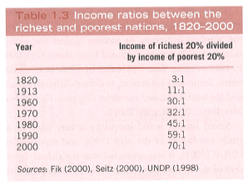
Growth of Inequalities

Slide 17
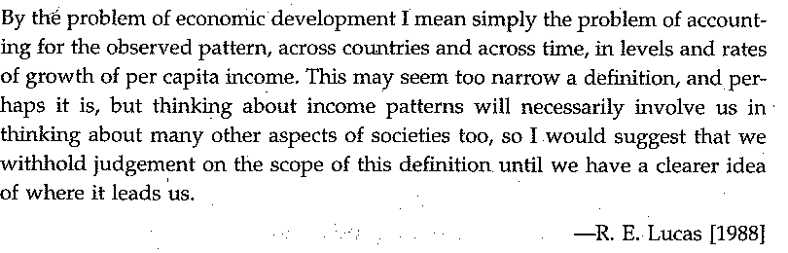
Positive economics

Slide 18
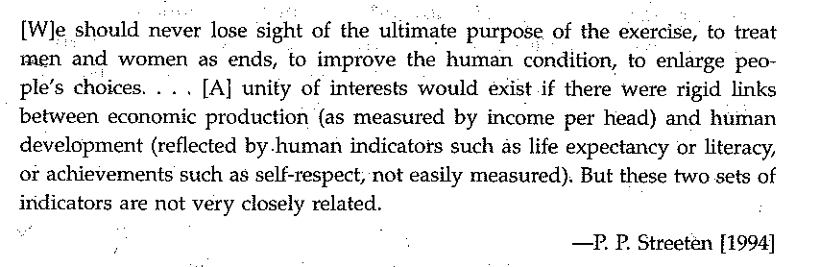
Normative economics

Slide 19
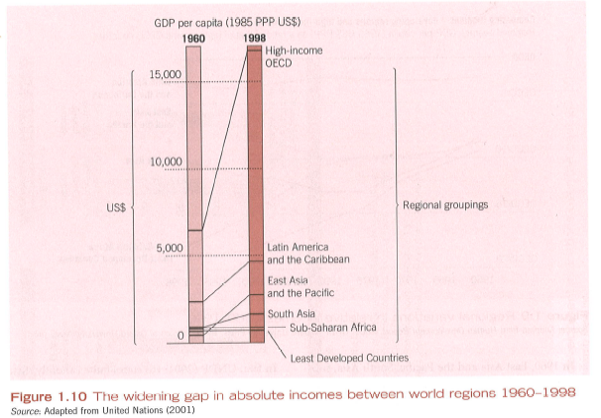

Slide 20
Weaknesses in data available (Ray, 2007:11).
Underreporting of income is not uncommon in developing countries; tax systéms not as efficient as in developed economies - greater incentive to underreport income or output for tax purposes.
National accounts may not be comprehensive as well
The proportion of income that is actually generated fro self-consumption is relatively high in developing countries.

Slide 21
Weaknesses in data available (Ray, 2007:12).
Prices for many goods are not appropriately reflected in exchange rates
Exchange rates are just prices, and the levels of these prices depends only on dommodities (including capital) that cross international borders;
thus goods and services that arenot internationally traded reflected innappropriately
Prices of nontraded goods (infrastructure and many services do not affect exchange rate.
Relatively low prices for nontraded goods – conversion to US dollars underestimates the real incomes of poorer countries.
Attempt at correction – PPP: Heston-Summers data set.

Slide 22
PPP – purchasing power parity
UN International Comparison Program (ICP)
ICP collects data on prices of 400-700 items in ieach of a set of benchmark countries.
150 expenditure categories
PPP for any coutnry is the ratio of its domenstic currency expenditures to the international price value of its output.
International prices are constructed for an enormous basket of goods and services by averaging the prices (expresses in dollars)for each such good and service over all different coutnreis.

Slide 23
PPP, WB indicators
PPP of per capita income go some way toward reducing the astonishing disparities in the world distribution of income (Ray, 2007:15)
World Development Indicators, 2011
http://data.worldbank.org
http://data.worldbank.org/indicator

Slide 24
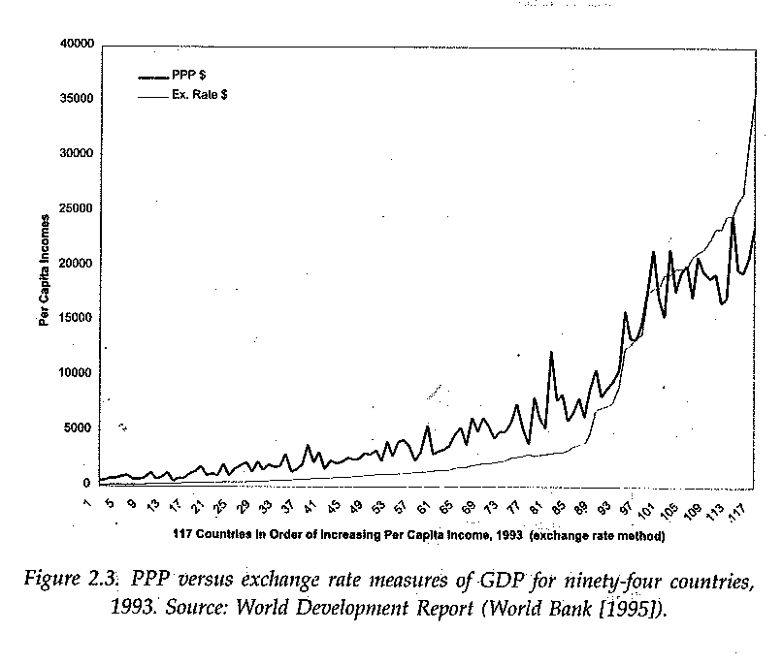

Slide 25
QUESTIONING DEVELOPMENT
Overviews of different ways of defining development
Quantitative vs. qualitative conceptions of development
Focus on socio-economic improvements since 70s, but net increase in inequalities
In the industrialized world the income level has steadily grown for the past five decades
It failed to do so in many developing countries (Ocampo, Vos, 2006:1)

Slide 26
The nature of development
Thomas (2001)
Different usages of ´development´
1) development as fundamental or structural change
Development as intervention and action aimed at improvement
Development as the platform for improvement encompassing changes that will facilitate development in the future

Slide 27
The ´essence´ of development
Different views of development
A) what constitutes development?
B) who participates in development?
C) which institutions promote development?
OPVK Inovace výuky geografických studijních oborů, CZ.1.07/2.2.00/15.0222

Slide 28
Positive interpretation of development
SUPPORTERS OF DEVELOPMENT:
Development brings about economic growth
national progress
modernisation along Western lines
OPVK Inovace výuky geografických studijních oborů, CZ.1.07/2.2.00/15.0222

Slide 29
Positive connotation wt development
Improves the provision of basic needs
Can help create sustainable growth
Improves governance
(Potter et al., 2008:5)

Slide 30
Alternative interpretations of development
Critiques of development :
Development is a dependent and subordinate process
Development creates and deepens spatial inequalities
OPVK Inovace výuky geografických studijních oborů, CZ.1.07/2.2.00/15.0222

Slide 31
Alternative interpretations of development
D. undermines local cultures and values
D. perpetuates poverty and poor working and living conditions

Slide 32
Critiques of development
D. is environmentally unsustainable
D. infringes human rights and undermines democracy (Potter et al., 2008:5)

Slide 33
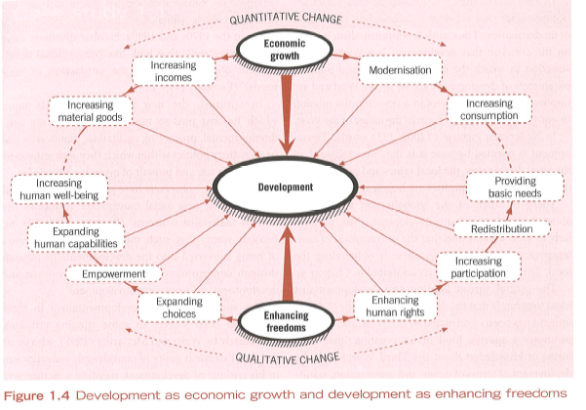

Slide 34
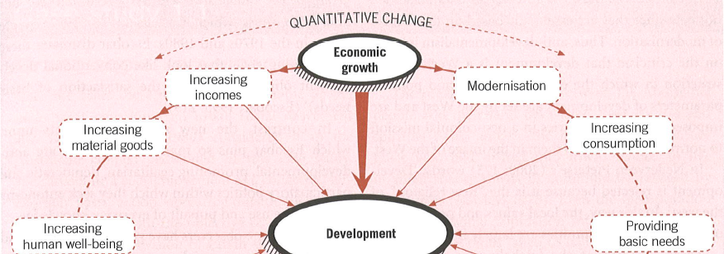

Slide 35
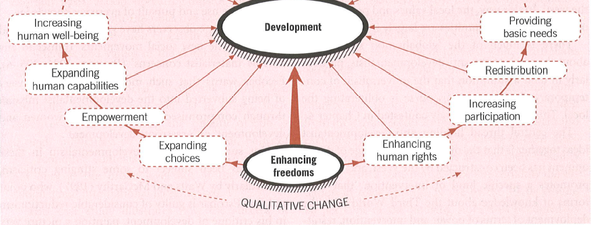

Slide 36
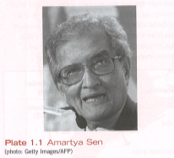
Amartya Sen
Development as Freedom (2000)
Themes – poverty, famine, capabilities, inequality, democracy
Development consists of the removal of various types of unfreedoms that leave people with littel choice and little opportunity for exersicing their reasoned agency

Slide 37
Development as freedom
Human freedom tends to promote freedoms of other kinds: many different interconnections between distinct instrumental freedoms
Economic and political freedoms help to reinforce one another
(Although some argue the opposite)

Slide 38
Development as Freedom
Social opportunites in the fields of heath care and education – which require public action – complement individual opporutinites for economic and political participation.
Thus – intrinsic importance of human freedoms

Slide 39
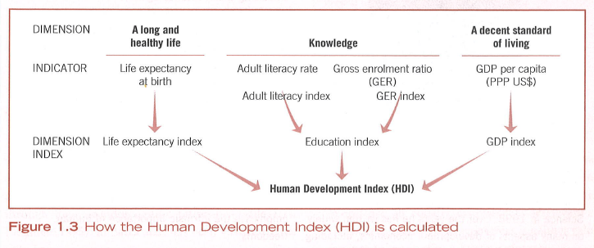

Slide 40
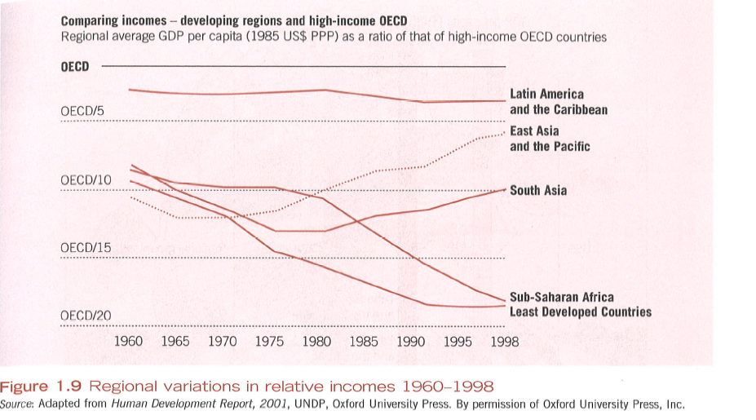

Slide 41
Classification of Development Theory
1) Modernisation School
2) Dependency School
3) Neo-liberalism and current New Institutional Economics
4) human development (basic needs approach, rigths-based approach, development as freedom, MDGs)

Slide 42
Classification of Development Theory
5) alternative development
Alternative to mainstream development
Global civil society
Fluid category – what was in 70s alternative – currently mainstream (sustainable development, WED)
6) Post-development
Said, Escobar, Sachs, post-structuralist discoursive analysis of development

Slide 43
Euro-centricity of development – basic criticism
Ideological biases
Lack of sensitivity to cultural variation
Setting of ethical norms
OPVK Inovace výuky geografických studijních oborů, CZ.1.07/2.2.00/15.0222

Slide 44
Euro-centricity of development – basic criticism
Stereotyping of other people
Tendency towards deterministic formulations
Dominance of ´male´ narratives – vs. subaltern voices
(Potter et al., 2008:5)

Slide 45
Euro-centricity of development – basic criticism
Tendency towards reductionism
Tendency towards the building of grand theories
underlying tones of racial superiority
Unilinearity
Universalism
OPVK Inovace výuky geografických studijních oborů, CZ.1.07/2.2.00/15.0222

Slide 46
Mainstream economics
western economics – logically closed system
Assumptions are substituted for reality
Mainstream economics is neither values-free nor tolerant of non-Western cultures-
OPVK Inovace výuky geografických studijních oborů, CZ.1.07/2.2.00/15.0222

Slide 47
Peet, R.; Hhartwick, H.: Theories of Development , New York: Hulford Press.
Modernity - philosophies that characterize the modern Western world
Positivist through to modernization theorists of teh 20th century
Human reason and rational behavior as the mainspring of social progress
Ideas are strenuously empirically based but also thought to be logical productively between human being and the rest of the natural world .
Reasoned thinking produces science and technology as new

Slide 48
Different histories, diverse narratives, autochton chronologies
China and Japan - over thousand years of self-governance
Thought of themselves as unified people

Slide 49
Commitment fo Development Index (CDI)
Center for Global Development
Ranks OECD DAC countries (22 in total) according to their dedication to policies that help the ´majority´ of the world (5 billion people in poorer countries)
Index looks beyond the standard comparisons of foreign aid flows
Measurement of ´development friendliness´ of 22 countries

Slide 50
Commitment fo Development Index (CDI)
7 dimensions : aid, trade, investment, migration, environment, security, and technology
Operationalization of MDGs no 8, effort to measure not only quantity but also quality of aid.
The Index penalizes countries that give with one hand, for instance through aid or investment, but take away with the other, through trade barriers or pollution.
Closer look at the structure of development aid – tied aid.

Slide 51
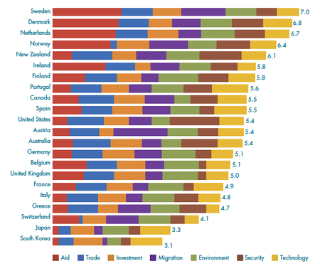
Commitment to Development Index 2010

Slide 52
CDI
Center for Global Development (CGD) - a non-profit think-tank based in Washington, on the initiative of David Roodman
In 2003 CGD first published the Index in Foreign Policy magazine – to provoke discussion, highlight gaps in current knowledge, and encourage policy reform
The Index was published annually in conjunction with Foreign Policy through 2006, and since published by CGD alone.

Slide 53
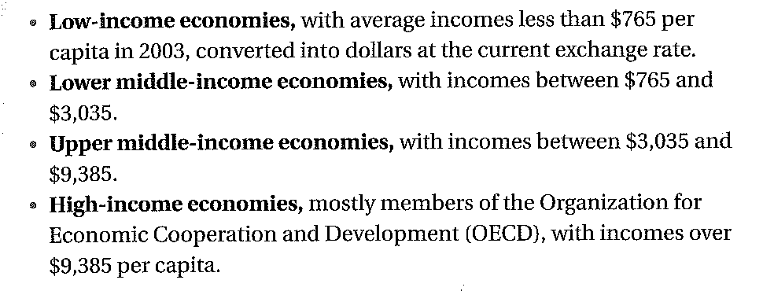
Classifications of countries

Slide 55
Patterns of develpment
PERKINS, D.H., RADELET, S.; LINDAUER, D.L. (1996): Economics of Development, New York: Norton and Company.

Slide 56
On-line data bases and resources
World Bank www.worldbank.org; International Monetary Fund www.imf.org
The United Nations development organizations: www.undp.org; www.who.org, www.milleniumproject.org
(cf Perkins et al. 2006:xxiii)

Slide 57
On-line data bases and resources
Independent Research Organizations : Center for Global Development www.cgdv.org
The Cener for International Development at Harvard University www.cid.harvard.edu
The Earth Institute at Columbia University (www.earthinstitute.columbia.edu
(cf Perkins et al. 2006:xxiv)

Slide 58
On-line data bases and resources
The Overseas Development Institute (www.odi.org.uk)
The World Institute for Development Economics Research (www.wider.unu.edu)
The World Resources Institute www.wri.org
(cf Perkins et al. 2006:xxiv)

Slide 59
Information Gateways
The Development Gateway www.developmentgateway.org
ELDIS: The Electronic Development and Environment Information Systém
The International Development Research Centre www.idrc.ca/library/world
www.Netaid.org
www.Oneworld.net

Slide 60
Data resourses
The Development Assistance Committe of teh OECD (www.oecd.org/dac)
The World Factbook (www.ia.gov/publications/factbook)

Slide 61
NGOs and Advocacy networks
Action Aid (www.actionaid.org)
Debt, AIDS, Trade in Africa (DATA, www.data.org)
The ONE Campaign (www.one.org)
OXFAM (oxfam.org)

