Slide 1
Uneven development - Dependency
DEPENDENCY SCHOOL, THEORY OF INTERNATIONAL TRADE

Slide 2
Post-war mainstream theories- MODERNIZATION SCHOOL AND DEPENDENCY PERSPECTIVE
THEORY OF INTERNATIONAL TRADE, NEOLIBERALISM

Slide 3
Structure of the presentation
1) theories of growth
2) theories of international trade – neoclassical and its criticism
3) structuralist perspective - Prebish
4) new school of dependency studies
5) world system theory - Wallerstein

Slide 4
Production- possibility frontier
PPF shows the maximum amount of alternative combination of goods and services that a society can produce at a given time when there is full utilization of economics resources and technology
The PPF shifts outward over time as more resouces become availabe or technology is improved

Slide 5
PRODUCTION-POSSIBILITY FRONTIER
Economic problem of limited production – explained by PPF
ECONOMIC GROWTH occurs when the economy´s productive capabilites increase
- growth depicted as an outward shift of PPF

Slide 6
PPF and growth
When production is at its maximum, increased output of A requires reduced production of other goods,
there s opportunity cost to the increased production of A
Increasing opportunity costs – continous expansion in the production of A is secured by sacrificing increasing amount of other goods.

Slide 7
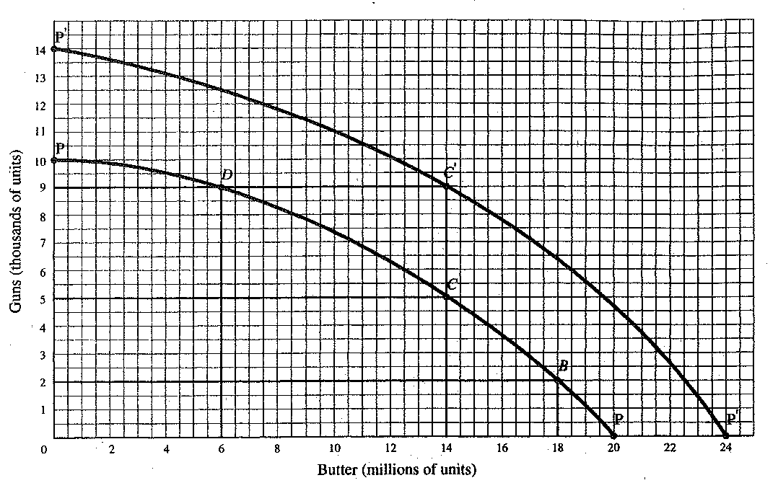

Slide 8
Opportunity cost
= the benefits forgone when a specific decision is made
Of two options - the opportunity cost of the option chosen is the opportunity forgone for the other option
(accounting vs. economic theory OP)

Slide 9
Increasing costs
Recourses are not homogenous - not equally efficient in the production of goods and services
Not equally productive when used to produce alternative good
This imperfect substitutability of recourses – due to differences in the skillds of labour, fertility of soil, specialized funcion of machinery, buildings etc.

Slide 10
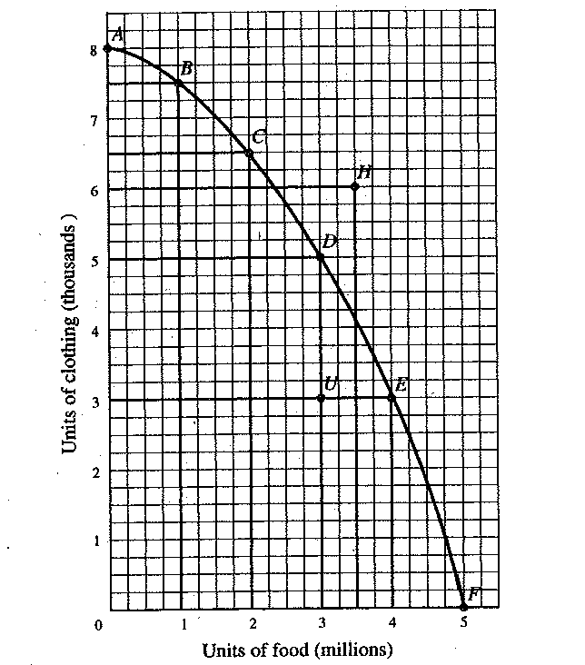

Slide 11
Post-war concepts of development
BINNS, T.: Dualistic and unilinear concepts of development pp. 91-95, in: companion_II.pdf.
Dualism or dichotomous nature of development
Advanced and modern sector of the economy coexisted alongside the traditional and backward sectors (Binns, 2008:82).

Slide 12
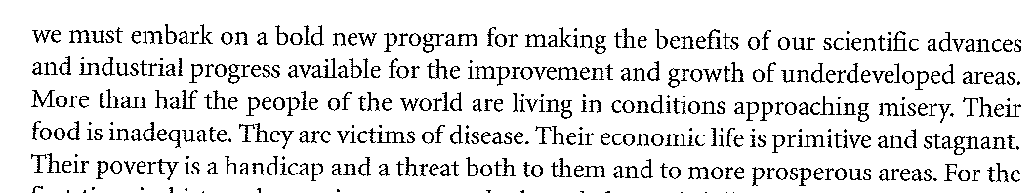
Truman´s presidential address, 1949

Slide 13
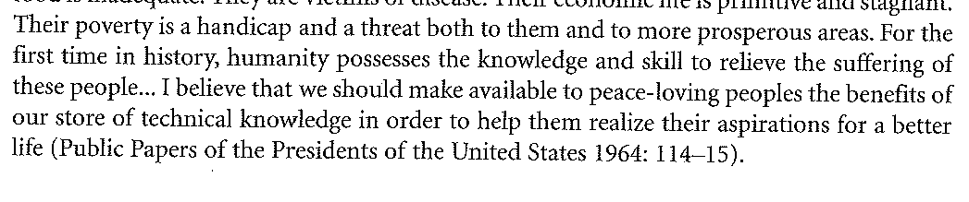
Truman´s presidential address

Slide 14
Arthur Lewis
1954 : Economic Development with unlimited labour
Proponent of dualistic structure of underdeveloped economies
Goal - absorption of underempoyed labour force in susbsistence agriculture
Very influential in the 60s and 70s

Slide 15
Arthur Lewis
Criticism: failed to appreciate the positive role of small agriculture
Some successes of Green revolution – raising productivity in the rural substistence sector - help development process rather then obstacle

Slide 16
Dualism in geographical concepts
Early spation development models
Different qualities and potential of contrasting regions
Initial regional inequalities as a prerequisite for eventual overall development

Slide 17
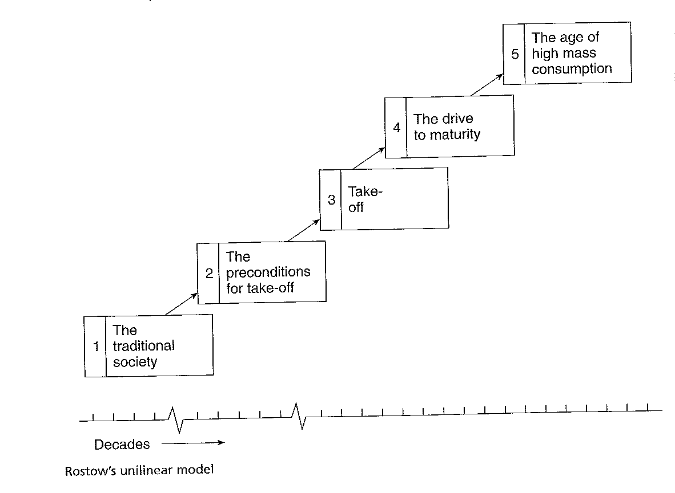
Unilinear models - WW Rostow

Slide 18
Institutionalists - Gunnar Myrdal, Albert Hirschmann
Cumulative causation
Particular regions – by virtue of some initial advantages - moved ahead = new increments of activities and growth will be concentrated in those regions already ahead.

Slide 19
Criticism of Rostow´s model (and similar ones)
1) unilinear development - ´things can only get better´ x cf sub-Saharan countries and LA
Sub-Saharan worse off then at the independence
2) eurocentic model – developing countries will imitate the development path in Europe and America
3) development occurs in stages

Slide 20
Neoliberalism, SAPs
Reading: SIMON, D. : Neoliberalism, stuctural adjustment and poverty reduction strategies, in : companion_II.pdf, pp. 86
Dramatic oil price increases – 1973 and 1979 – triggered a slowdown, severe recession and debt crisis 1981-2

Slide 21
Crisis of Keynesian model
Profound disillusionment - record of the state involvement in economic and social life
Keynesian state involvement - inefficient, bureaucratic, unnecessary drain on public coffers (Binns, 2008:87)

Slide 22
Opportunity cost
= the benefits forgone when a specific decision is made
Of two options - the opportunity cost of the option chosen is the opportunity forgone for the other option
(accounting vs. economic theory OP)

Slide 23
Dependency - readings
Conway, D.; Heynen N.: Dependency theories: from ECLA to André Gunder Frank and beyond, in. Companion_II.pdf
International division of labour
Based on Ricardo´s model of international trade
Factor endowment theory
Specialization on the production of good in which partricular country has comparative advantage

Slide 24
FACTOR ENDOWMENT THEORY
Different countries – different factor endowments
Cf china, South Africa
Heckher Ohlin Hypothesis of international trade
Specialization according to the prevailing factor endowements
USA, UK – focus on what kind of goods?
Sierra Leone?

Slide 25
Raul Prebish, Singer
LA historical marginalization and resultant underdevelopment – perpetuated by such unequal commercial arrangements
LA shoukd benefit from export strategies
Evidence showed oterwise
Structuralist economists – argued that core countries benefited at LA expense

Slide 26
Frank – development of underdevelopment
Metropolis satellite relations occured not only among states bust also on region and sub-regional levels
Dependebcuy – perpetuated through global capitalims
Importance of historical significance and transformative impact of capitalism´s penetrartion into continents structures

Slide 27
ISI
Import substitution industrialization
Prebish - insisted on major structural changes in development policy
Favoured switching to more domestic production under tariff protection
as a means of replacing industrial imports ISI
Capital goods, intermediate product and energy would be purchaised with national income revenue from export of primary commodities (Conway, Heynen, 2008:93)

Slide 28
New forms of dependency
Multinational corporate power and authority over technology transfer anc capital investment emerged as a new form of dependency (Conway, Heynen, 2008:93).

Slide 29
Fernando Cardoso
Associated dependent development
Triple alliance
Domestic elite in cooperation wt transnational corporation
ISI under authoritarian regimes, state policies favoured multinational capital at the expense of labour

Slide 30
Theory of international trade
SAPSFORD, D.: Smith, Ricardo, and the world marketplace 1776-2007: back to the future?

Slide 31
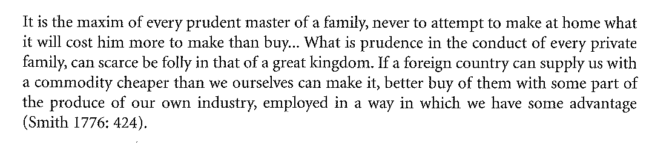
Smith on international trade

Slide 32
Classical depencency school
LA – ECLA , Prebish – head of ECLA
Voices of the periphery
Prebish – criticized outdated international division of labour
LA – asked to produce raw materials for industrial centers

Slide 33
André Gundar Frank
development of underdevelopment
Concepts of modernization school distilled from the categories derived from the Western world
Western categories are unable to guide an understanding of the problems facing 3W

Slide 34
Frank
Modernization school ignores the historical experience of colonialism
Metropolis-satellite relationship explain how underdevelopment works
Replicated within countries
Calcuta

Slide 35
Frank
Satellite flourishes when cut off from the centre
Industrialization during WWI WWII

Slide 36
Social destruction .
Creation of client serving class
Extension of the colonial power
Corruption of local elites
Disintegration of communities, social conflicts

Slide 37
Hegemony
Educational system
Did not enhance knowledge and technological advances
Ubiquous knowledge

Slide 38
Baran – colonialism in India
Politics of de-industrialization
unfavorable terms of trade
Appropriation of 10%
Plus asymetry of power -

Slide 39
Raul Prebish
Structuralist approaches
Critique of Ricardian theory of international trade - empirical evidence – did not prove
LA – growth during both wars
Close links with centers not beneficial to the growth of peripheries

