Slide 1
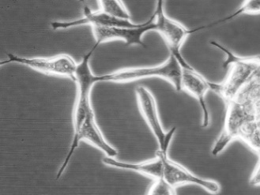


Growth factors in cancer cell signaling
pathological plasticity of epithelial cells
  neuroendocrine differentiation (NED)
    senescence associated secretory phenotype
    cell cycle
  epithelial-mesenchymal transition (EMT)
    cancer stem cells (CSCs)
    role of MDM2
Transforming Growth Factor-β signal transduction
  Growth/differentiation factor – 15
    signal transduction
    role in cancer and damaged hematopoiesis

Slide 2
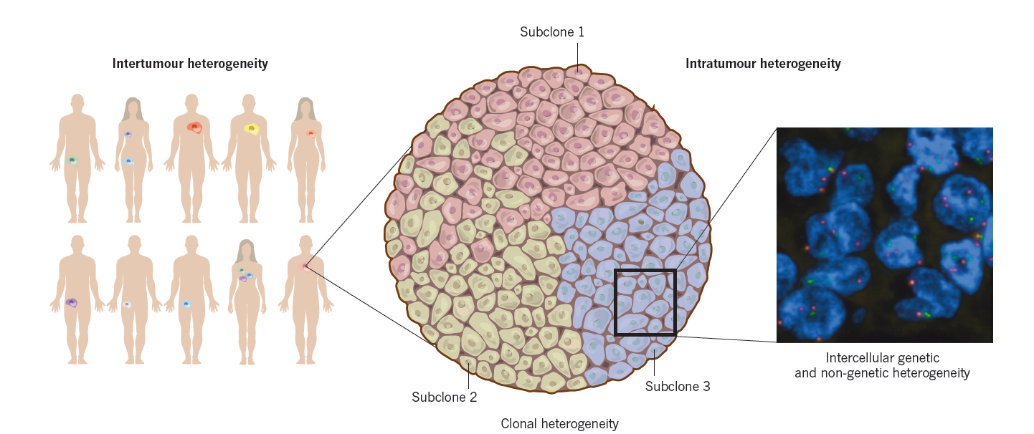
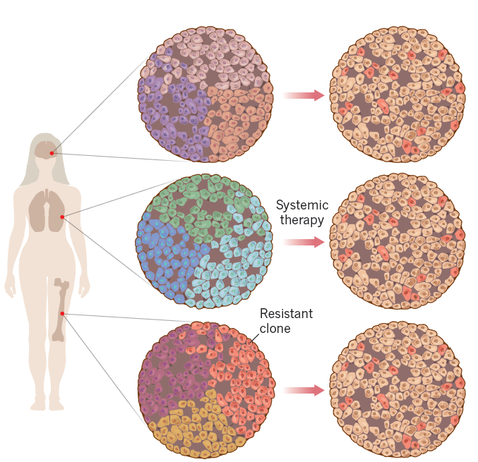
Cancer is heterogeneous …

Slide 3
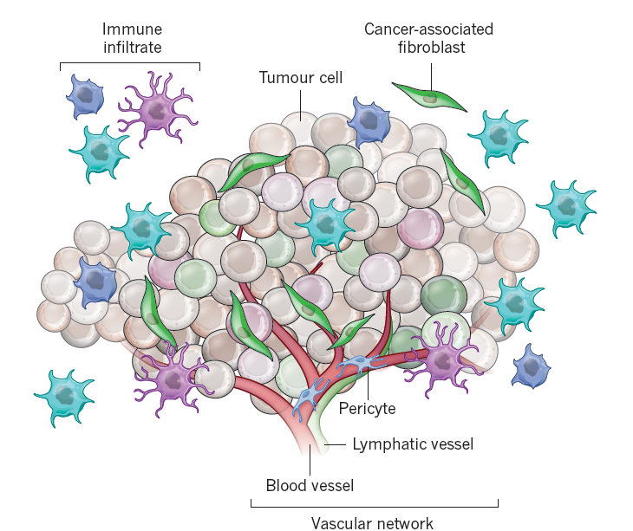
…and not a single cell type disease.

Slide 4
Pathological plasticity of prostate epithelial cells
Neuroendocrine transdiferentiation
Epithelial to mesenchymal transition

Slide 5
Prostate cancer
one of the leading causes of cancer related death in men worldwide
conventional treatment - hormonal therapy
- luminal secretory cells are dependent on androgens
- androgen deprivation therapy (hormonal therapy) –
chirurgical castration or anti-androgen administration
(Casodex (bicalutamide))
patients - positive response at the beginning - tumor regression
- after 1-2 years of treatment - tumor progression,
metastasis - development of androgen independence

Slide 6
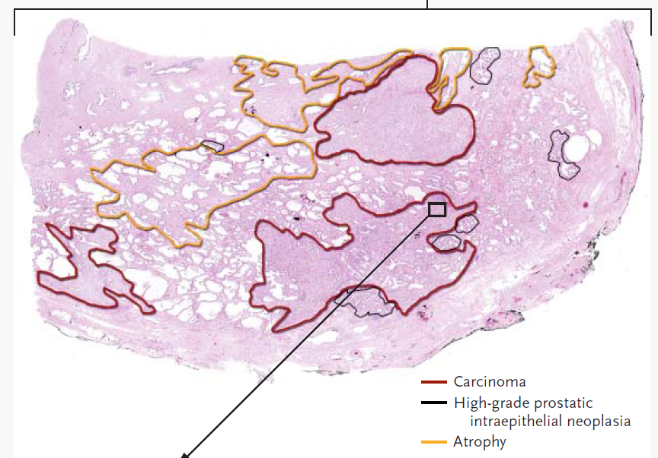
Nelson et al., NEJM 2003, 349(4)
Sun et al., Am J Transl Res 2009, 1(2)

Slide 7
Produced by NE cells
Attar et al., Clin Cancer Res 2009, 15(10)

Slide 8
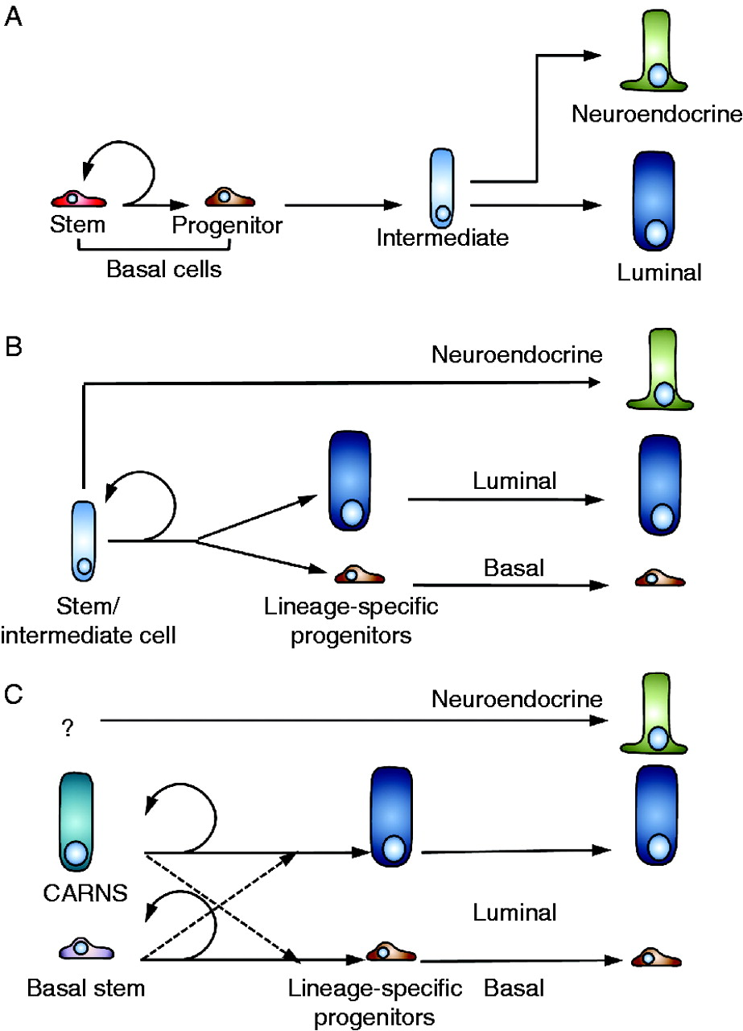
Prostate neuroendocrine cells
Characteristic
  uncertain origin
  scattered in prostatic epithelium
  dendrite-like protrusions
  markers: NSE, TUBB3, CHGA
  quiescent
  do not express AR
  secretion of various factors (bombesin, adrenomedulin, VEGF, serotonin, IL-6, IL-8, etc.)
Function
  growth and differentiation regulation
  modulates function of prostatic gland
  regulation of homeostasis
Taylor R A et al. Endocr Relat Cancer 2010;17:R273-R285

Slide 9
Current research progress
androgen deprivation therapy induces secretory, tumor-promoting senescent cells in prostate tumors;
role of MDM2 in EMT of benign and transformed cells;
CHK1 inhibition & DNA damaging drugs in prostate epithelial cells – preliminary screen
new methods & approaches:
  isolation of normal mouse prostate stem cells
  multicolor protocol for characterization and separation of human prostate cancer stem cells
  new automatic cell cloning assay (ACCA) for determination of clonogenic capacity of cancer stem-like cells

Slide 10
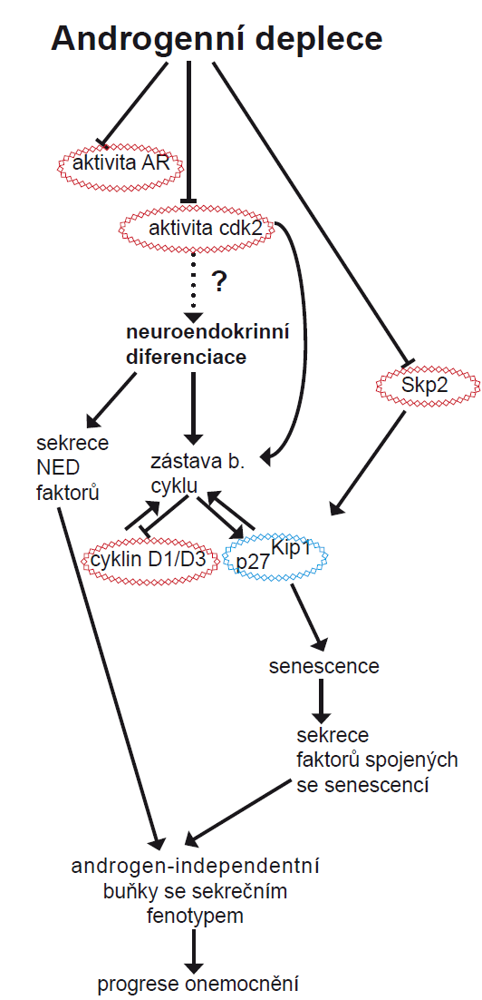
1) androgen deprivation therapy induces secretory, tumor-promoting senescent cells in prostate tumors
We showed link between inhibition of androgen receptor signaling, down-regulation of S-phase kinase-associated protein 2, and the appearance of secretory, tumor-promoting senescent cells in prostate tumors.
We propose that androgen deprivation therapy may contribute to the development of androgen-independent prostate cancer through modulation of the tissue microenvironment by senescent cells.

Slide 11
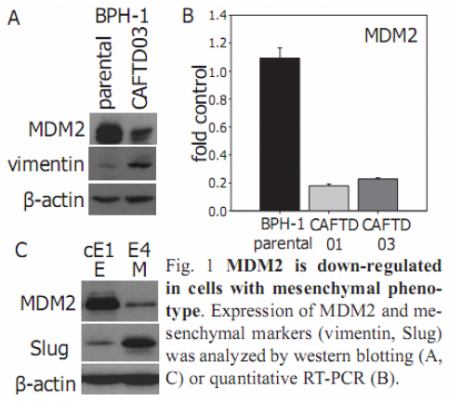
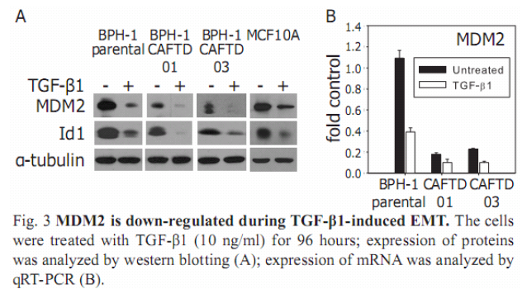
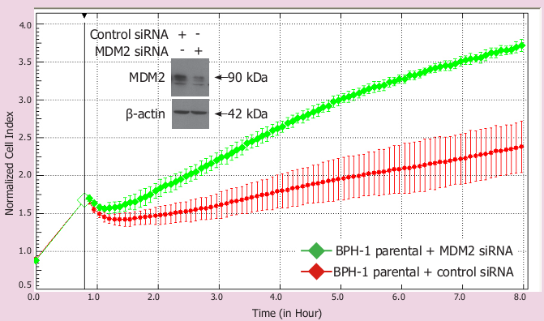
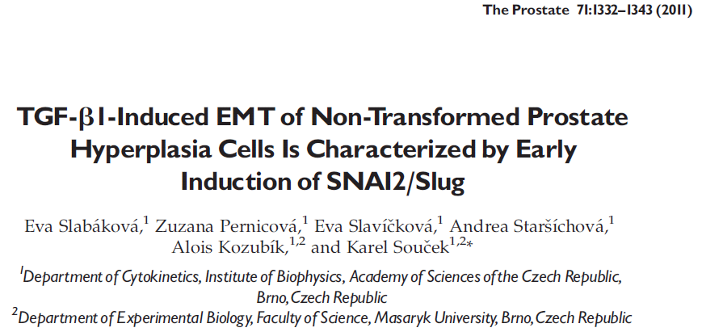
2) The role of MDM2 in epithelial-to-mesenchymal transition: implication for cancer progression

Slide 12
Summary
Slug
MDM2
MDMX
Cancer transformation
EMT
TGF-β
p14Arf
Twist
Cell migration
p53 dependent
p53 independent
EMT dependent
Metastasis

Slide 13
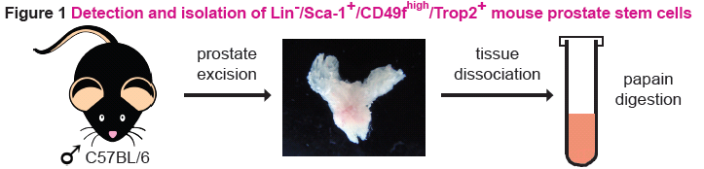
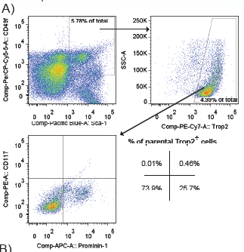
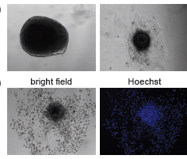
4) new methods & approaches
  a) isolation of normal mouse prostate stem cells

Slide 14
  b) multicolor protocol for characterization and separation of human prostate cancer stem cells
 | primary antibody | conjugate | made in | isotype | source
LIN specific | EpCAM | FITC | mouse | IgG1 | Miltenyi 130-080-301
 | FAP | PE-TexasRed Light-Link | mouse | IgG1 | R&D MAB3715
CSCs-specific | CD49f | PerCP/Cy5.5 | rat | IgG2a kappa | BioLegend 313618
 | CD44 | APC/Cy7 | rat | IgG2b kappa | BioLegend 103028
 | CD24 (SN3) | PB | mouse | IgG1 | Exbio PB-503-T025
 | Trop-2 | PerCP Light-Link | mouse | IgG2A | R&D MAB650
 | CD133/1 (AC133) | Biotin+streptavidin PE/Cy7 | mouse | IgG1 | Miltenyi 130-090-664
 | CD133/2 (AC141) | PE | mouse | IgG1 | Miltenyi 130-080-901
 | CD133/2 (293C3) | APC | mouse | IgG2b | Miltenyi 130-090-854

Slide 15
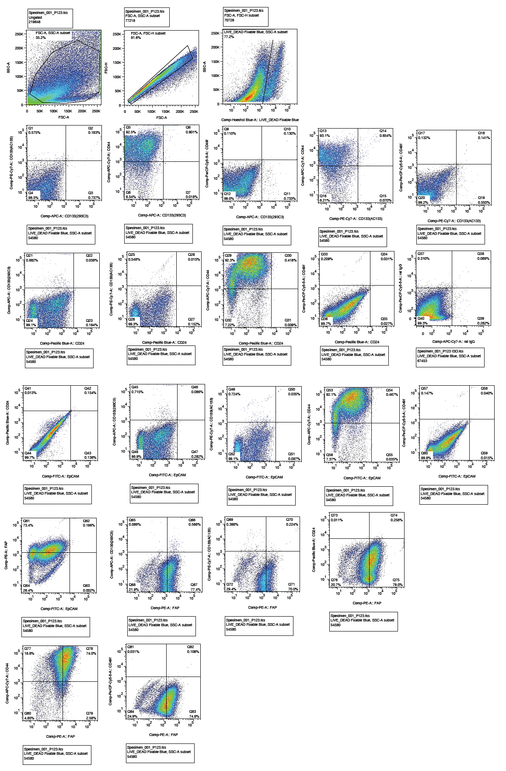
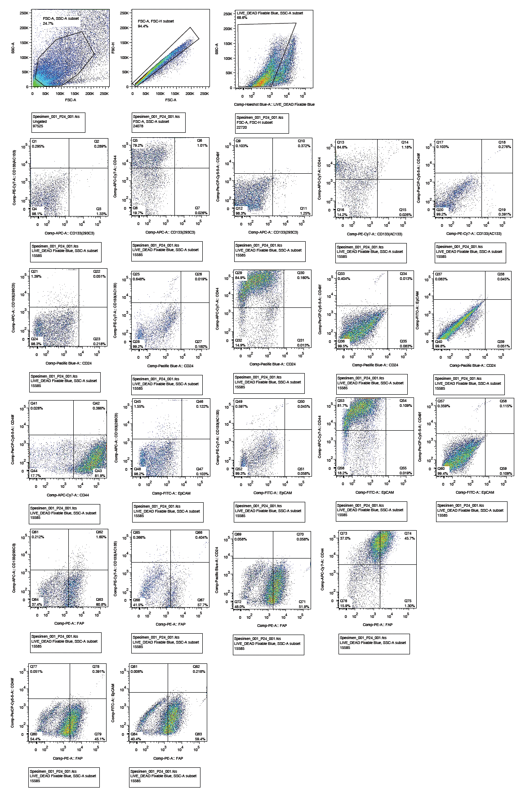
Patient #123
Patient #24

Slide 16
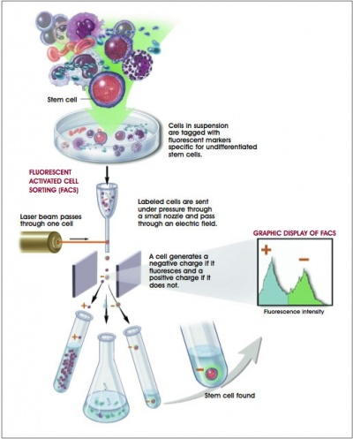
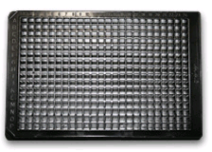
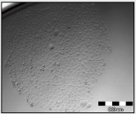
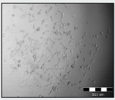
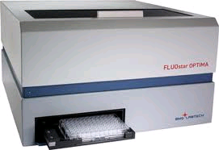
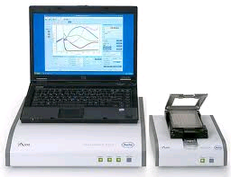
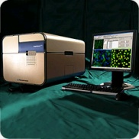
  c) new automatic cell cloning assay (ACCA) for determination of clonogenic capacity of CSCs
single cell/well
up to 384 well plate
re-culture after sorting (2D, 3D)
analysis: CyQuant, ATP, xCelligence, microscopy

Slide 17
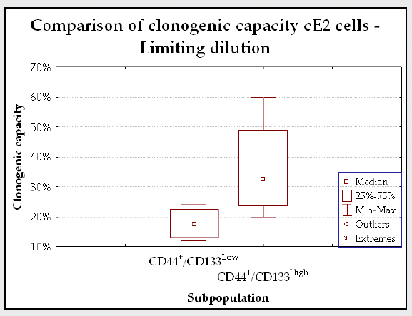
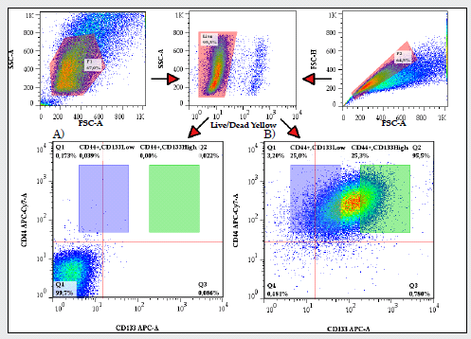
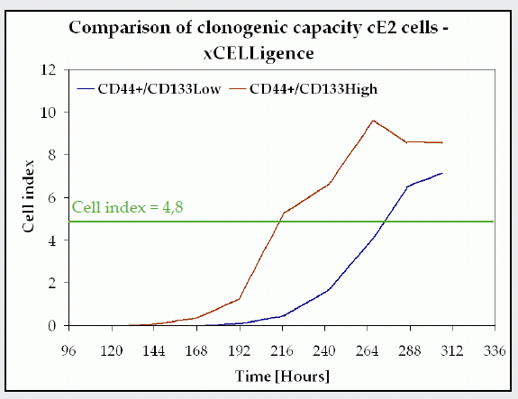
Clonogenic capacity of CD44/CD133^{low} vs. CD44/CD133^{high} cells

Slide 18
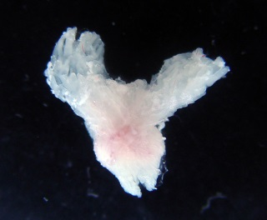
EMT in SCs/CSCs-like subpopulation
Lin⁻/Sca1⁻CD49f⁻
Lin⁻/Sca1⁺CD49f^{high}/Trop2⁺
RNA isolation
cDNA synthesis
RealTime Ready Custom Panel RT-qPCR

Slide 20
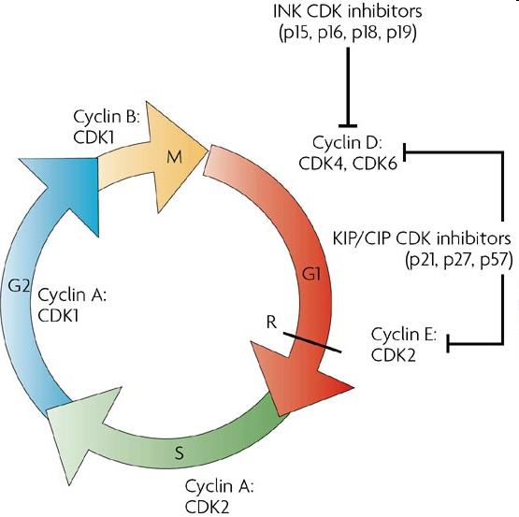
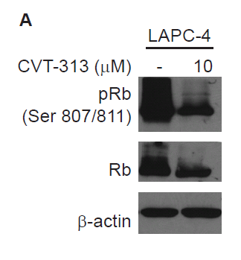
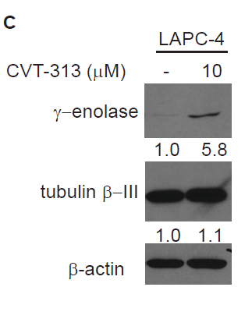
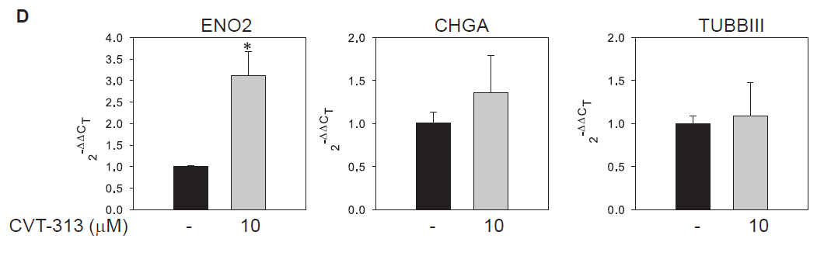
Cdk inhibition induces neuroendocrine differentiation in prostate cancer cells
siRNA
CDKI

Slide 21
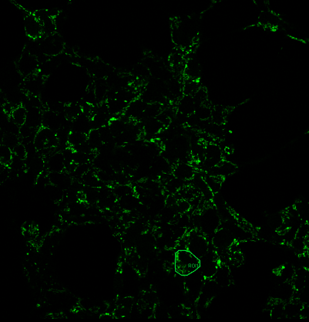
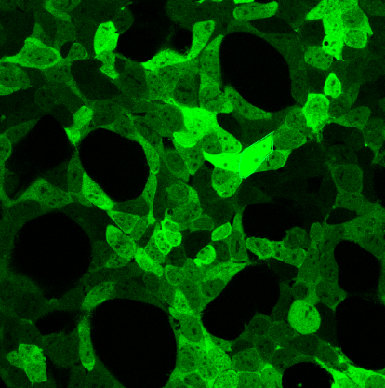
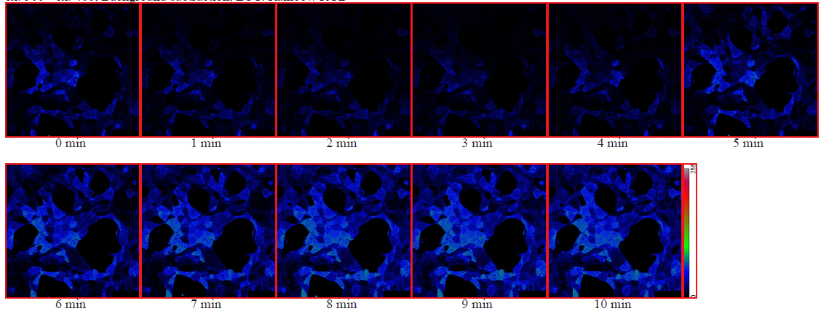
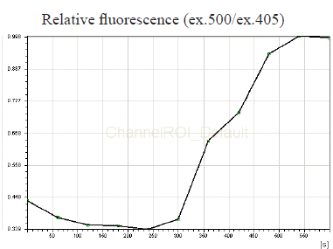
tools for molecular imaging
  hydrogen peroxide sensor HyPer (Evrogen) for ratiometric detection of intracellular H₂O₂ level changes
    HEK293 HyPer-dMito
    HEK293 HyPer-cyto
100 μM H₂O₂
time (s)

Slide 22
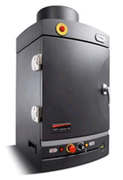
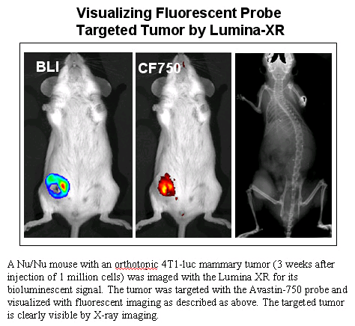
tools for in vivo molecular imaging
  Prostate, Breast, Melanoma, and Colon Carcinoma Models
    for syngeneic immunocompetent strains C57Bl/6 or BALB/c
    stable transfected with lentiviral luc vector
      CT26 luc - mouse colon cancer
      4T1 luc - mouse breast cancer
      B16 F10 luc – mouse melanoma
      TRAMP-C1 – mouse prostate cancer
      RM-1 – mouse prostate cancer

Slide 23
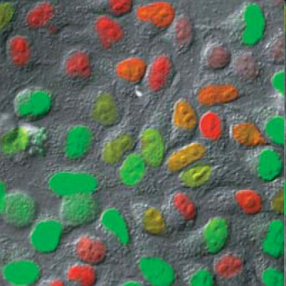
3) CHK1 inhibition & DNA damaging drugs
tested compounds
  CHK1 inhibitor SCH900779
  Ara-C, gemcitabine, HU
tested cell lines
  non-tumorigenic – HPEpiC, BPH-1
  primary cancer – CAFTD-01, -03, LAPC-4
  metastatic cancer – LNCaP, PC3
  other – HeLa Fucci 8
design
  treatment with gem, HU, Ara-C for 24h
  2h treatment with CHK inhibitor, than media exchange
  harvest 48h after treatment
readouts
  CyQuant – concentration screen, synthetic lethality analysis
  xCelligence – real-time analysis (selected concentrations)
Nature Methods - 5, 283 (2008)

Slide 24
pre-screen results
Gemcitabine
  in all tested cell lines very toxic – use lower concentrations
Ara-C + CHKI
  BPH-1 – 5 + 0.25 μM synthetic effect
  LNCaP – 5 + 2 μM synthetic effect
  PC-3 – 5 + 2 μM synthetic effect
HU + CHKI
  all tested cell lines 0.5 + 2 uM synthetic effect

Slide 25
Experimental approaches and models
screening of cytotoxic concentrations of DNA damaging agents and inhibitors
  evaluation by CyQuant® proliferation assay
monitoring of dynamics of cytotoxic effects of DNA damaging drugs
  xCELLigence system
  live microscopic imaging
evaluation of treatment in 3D conditions
  microscopic imaging
  ATP bioluminiscence proliferation assay
 | TISSUE | ORIGIN | p53 STATUS
BPH1 parental | Prostate non – tumorigenic | human | inactivated
BPH1 CAFTD03 | Prostate tumorigenic | human | inactivated
DU-145 | brain metastais of prostate carcinoma | human | mt
PC3 | bone metastatis of prostatic adenocarcinoma | human | null
HCT116 p53 +/+ | colorectal carcinoma | human | +/+
HCT116 p53 -/- | colorectal carcinoma | human | -/-
HCT116 PTEN -/- | colorectal carcinoma | human | +/+
MDCK | kidney tissue non – tumorigenic | dog | wt
B16-F10 | skin melanoma | mouse | wt
TRAMP C1 | prostate adenocarcionma | mouse | wt

Slide 26
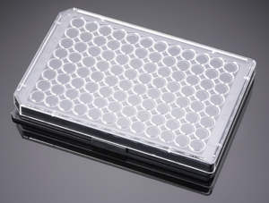
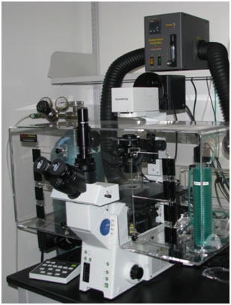
Live microscopic imaging experiment set up
 | BPH1par |  | BPH1 c.03 |  | HCT116 p53+/+ |  | PC-3 |  | DU-145
 | dmso
 | OH209
 | SCH900776
 | GEMCITABINE
 | GEMCITABINE + OH209
 | GEMCITABINE + SCH900776
treatment by
Chk1 inhibitors
media exchange
treatment by DNA-
damaging agents
cells seeding
0 hod
24 hod
48 hod
50 hod
120 hod
microscopic imaging

Slide 27
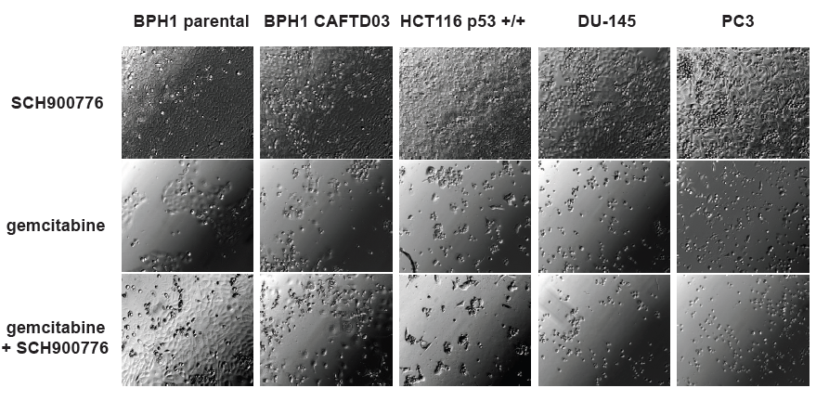
Results
Live microscopic imaging
Cell lines indicated were seeded in microplate wells, treated and then monitored in real time using bright-field microscope and CCD camera. Images obtained at final time (120 hours) are compared for wells treated by gemcitabine (IC50 vaules for selected cell lines), by gemcitabine and SCH900776 (4 μM) and by SCH900776 (4 μM) only

Slide 28
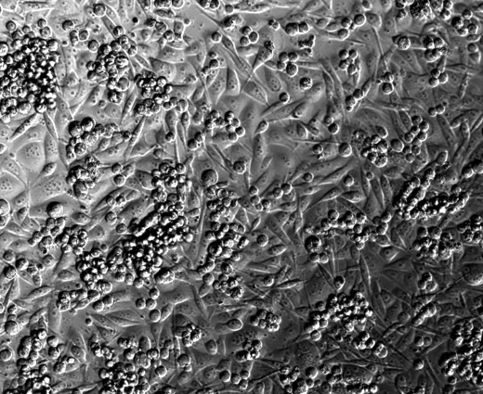
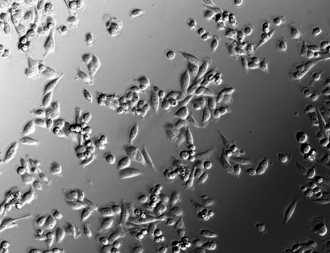
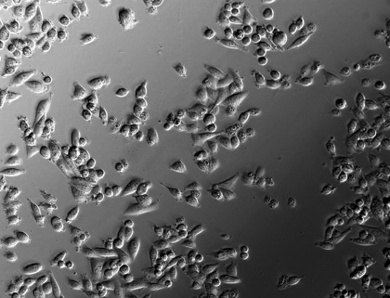
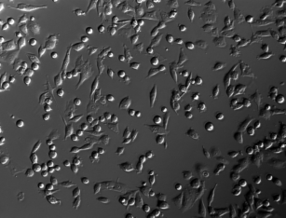
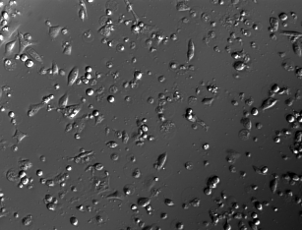
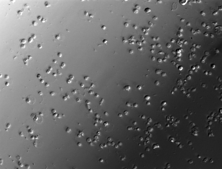
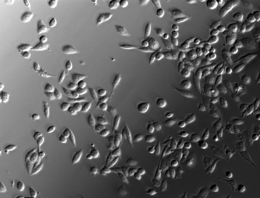
PC3 cell line
media exchange effect (inhibitor only)
inhibitor only
gemcitabine
gemcitabine+ inhibitor

Slide 29
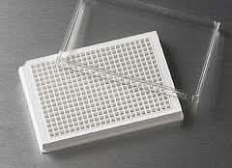
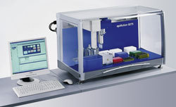
Running experiments - screening for synthetic lethality in panel of cell lines
TYPE | CELL LINE
Colon | SW480
 | SW620
 | HCT-116 p53+/+
 | HCT-116 p53 -/-
 | HT29
Breast | MCF10A
 | MDA-MB-231
 | Sk-Br-3
Lung | H441
 | A549
Ovarian | A2780
 | A2780cis
 | SKOV-3
Prostate | BPH-1
 | BPH-1 CAFTD04
 | PC3
 | DU145
 | LNCaP
 | LAPC-4
Pancreas | MiaPaCa2
 | PANC-1
Kidney | MDCK
6 concentrations of DNA-damage drug (hydroxyurea)
6 concentrations of 2 inhibitors of CHK1 (SCH900776, OH209)
all combinations in quadruplicate and two biological repetition

Slide 30
Cooperations
Aleš Hampl (LF MU) – mGDF15 ICC (cryosections), CSCs, tissue engineering, SCID
Petr Vaňhara (LF MU) – GDF15 in dendritic cells, glioblastoma and ovarian cancer, lentiviral particles
Petr Beneš (PřF MU) – mGDF15 inducible plasmids
Kamil Paruch (PřF MU) – inhibitors
Stjepan Uldrijan (PřF MU) – MDM2 story
Lukáš Kubala (BFÚ) – EMT & ECM, tissue engineering
Jiří Kohoutek (VÚVeL) – gdf15 knock-out colony managment
Michal Hofer (BFÚ)– hematopoiesis study
Jiří Pacherník (PřF MU) – GDF-15 in hypoxia, mES
Pavel Matula, Petr Matula (FI MU) – tube forming assay data analysis
Jiřina Procházková , Jan Vondráček (BFÚ) - GDF15 in cardiomyocytes, interaction of AhR and TGF-β
Miroslav Machala (VÚVeL) - interaction of AhR signaling with TGF-β
Jan Bouchal (UJP Olomouc) – EMT & ECM, prostate cancer clinical samples, CSCs, IHC
Lukas Kenner (Ludwig Boltzman Institute, Vienna) - prostate cancer – mouse model, CSCs,
Giuseppe Valacchi (University of Ferrara) – redox signaling, autophagy

Slide 31
Současná témata studentských prací
Bakalářské
  Úloha SNX9 v epiteliálně mesenchymálním přechodu u epiteliálních buněk prostaty
Diplomové
  Změny v expresi proteinů MDM2 a MDMX v průběhu epiteliálně mesenchymálního přechodu
  Epiteliálně mesenchymální přechod u normálních a nádorových kmenových buněk prostaty
Doktorské
  Úloha Skp2 v cytokinetice nádorových kmenových buněk
  Úloha epitelialně mesenchymálního přechodu v regulaci fenotypu nadorových kmenových buněk

