Slide 1
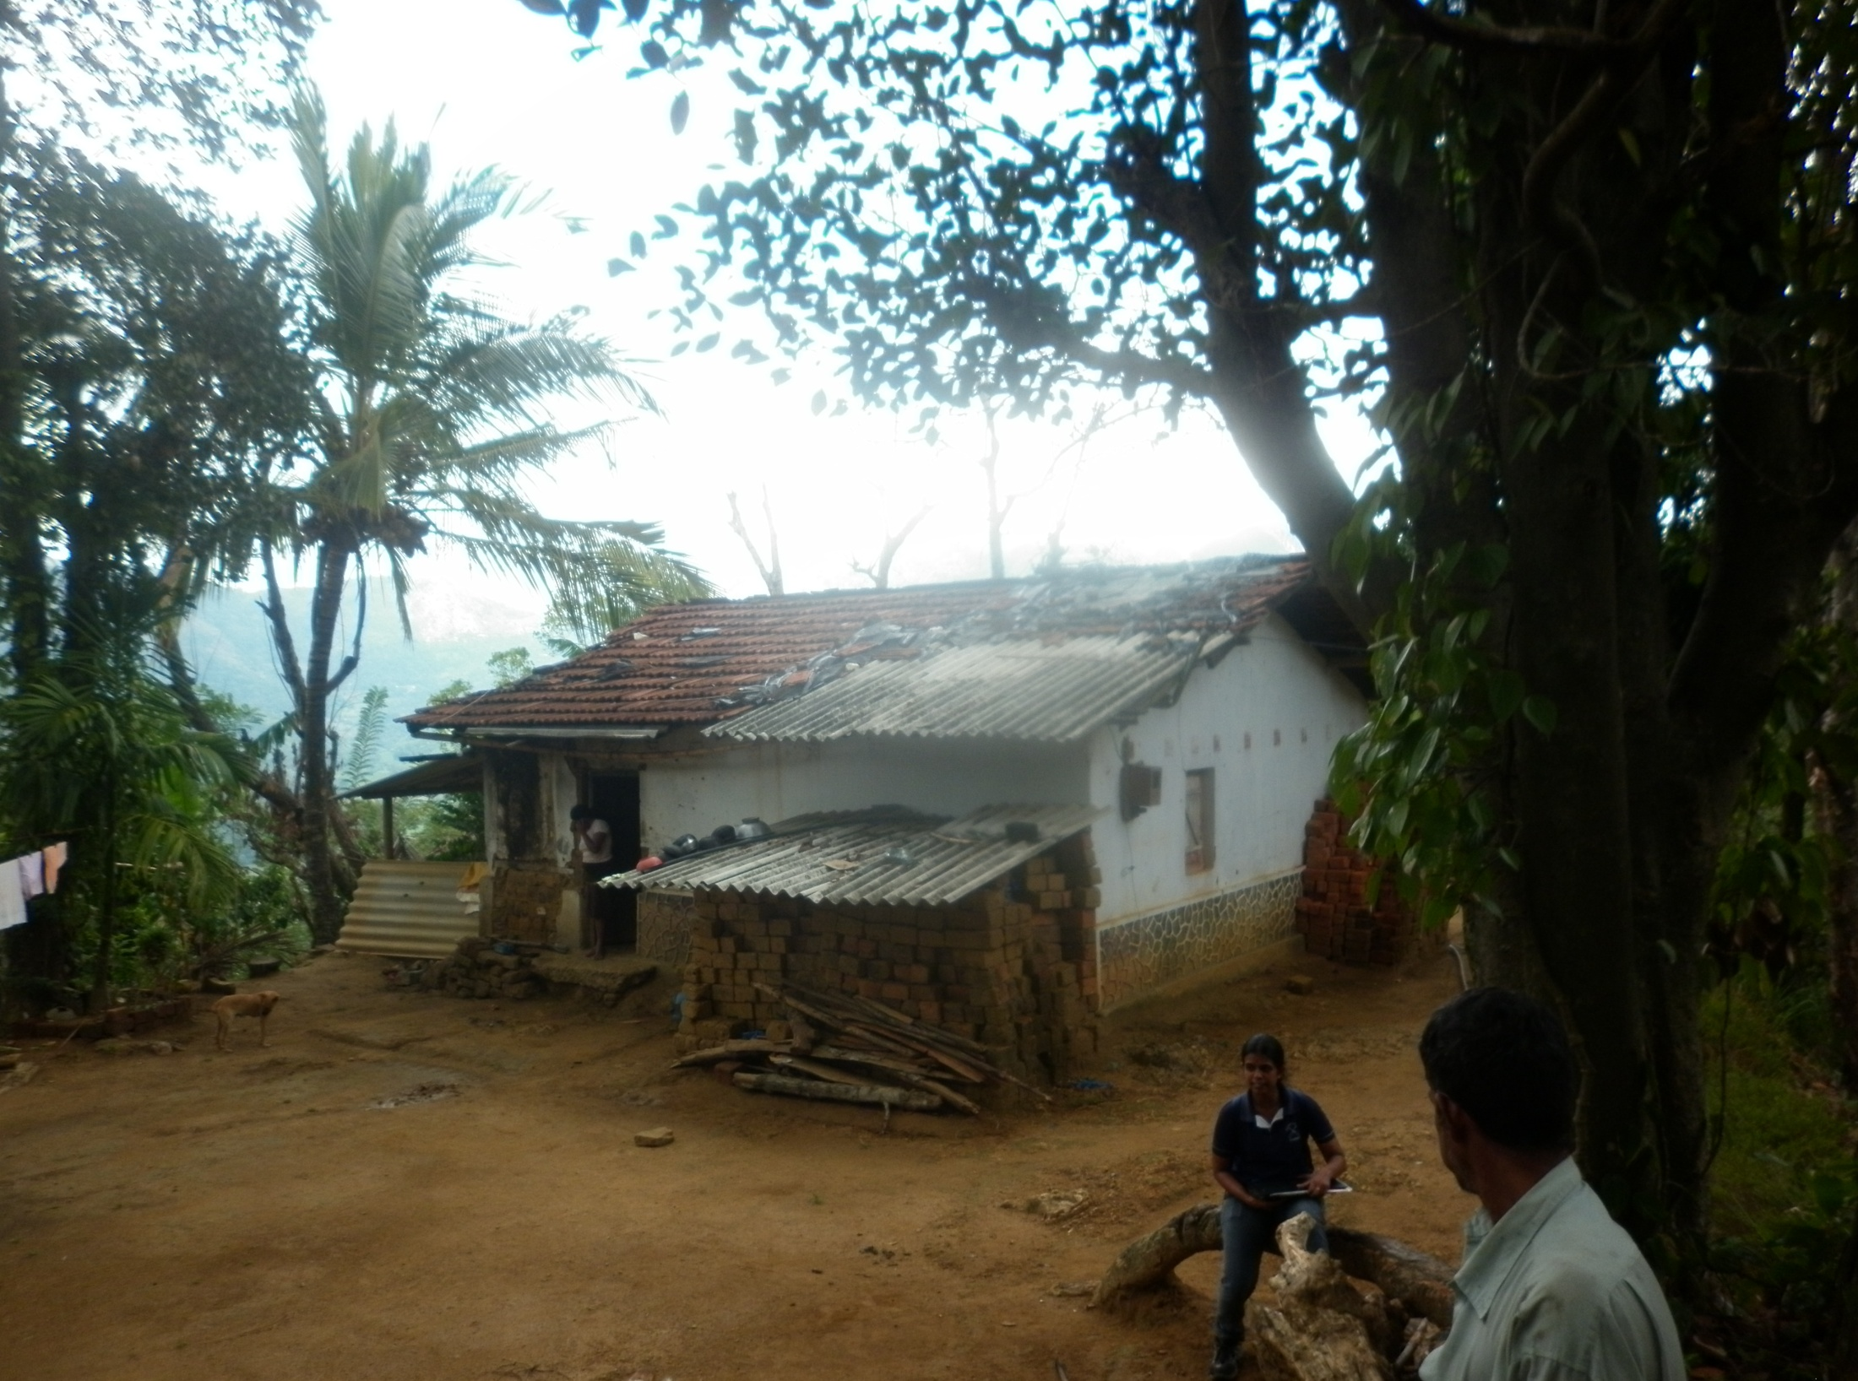
Social Surveys

Slide 2
What is a Social Survey
“systematic collection of facts about people living in a specific geographic, cultural, or administrative area”.
Sociological Dictionary

Slide 3
Nature of Social surveys
Quantitative approach is more popular in the social surveys, particularly the Applied research. Questionnaires used in such surveys take a structured form. Whereas qualitative variant of social surveys are adopted much in academic research they use semi-structured or unstructured questionnaires.
This lecture will focus on quantitative surveys

Slide 4
Types of Surveys
Main tool used in social surveys to collect data is questionnaire. Based on their nature of administration several types of surveys are identified:
Surveys based on face to face interviews
Postal Surveys
Telephone Surveys
Online Surveys (social media any other)

Slide 5
Suitability to Developing Countries
Type | Entire Country | Urban Areas | Segment of Social groups
Face to face interviews | √ | √ | √
Postal Surveys |  |  | √
Telephone Surveys |  |  | √
Online Surveys |  |  | √

Slide 6
Steps of a Social Survey
The social survey method has the ultimate goal of seeking social facts:
Enunciating the object or purpose of the survey;
Definition of the problem under study;
Delimitation of the area or scope of study;
Examination of the available evidences or sources relating to the problem;
Preparation of questionnaire schedule;
Preparation of the analytical plan
Field work to collect data;
Arrangement, tabulation and statistical analysis of the data; interpretation of results; deduction and graphic expression

Slide 7
Successful Survey
Social surveys provide a rich information of society based on individual cases.
However, success of the survey depends largely on:
Questionnaire should be formulated based on the objectives of the survey and to overcome the field level constraints
Selection of the representative sample
Questionnaire Administration: Though it appears to be simple, this is a hard work which take a considerable time.

Slide 8
Possible Errors in Survey Research
Sampling Error
Non-sampling error
  Response error
  Non- response error

Slide 9
Good sources to learn about how to construct questionnaires for developing countries
Paul Glewwe -An overview of questionnaire design
for household surveys in developing Countries
UNESCO (1963) Opinion Surveys in Developing
Countries

Slide 10
Construction of a Questionnaire:
Research Objectives have to be converted to survey objectives and finally to questions:
  Can all research objectives transferred in to survey objectives?
  Should some of them drop in order to keep the questionnaire neat, short ?
  Should additional information like general information collect?
( Think moving forward and backward through objectives and questions)

Slide 11
2. Structure of the Questionnaire
Make it as modules, containing different segment for different components (General Information, Education, Employment, Housing)
Group similar modules which can be answered at a single a stretch by a single person.(expenditure on food children wife can answer more comfortably)
Researcher may need to be familiar to the culture of the area to do this

Slide 12
Box 1: To work as above, a good understanding of the society is essential
“Where we are concerned with
cultures that are as varied and as widely differentiated as is the case in the
underdeveloped countries, it is clear that no research can be undertaken
with any chance of success unless there is previous knowledge of the people
of those countries”.
UNESCO 1963. p.8

Slide 13
3. Possible Question Styles
Filtering questions
Open questions
Closed questions
Rank questions

Slide 14
3. Inappropriate Questions
Not to have any sensitive questions. Particularly questions in the first module requires to be easy)
Double barrel questions
Questions indicating habitual behavior
Leading loaded questions

Slide 15
4. Some strategies to enhance the quality
Cording may reduce the efforts for writing
Should include skip cord
Probe question
Conducting of a pilot survey

Slide 16
Pilot Survey
Pilot survey provides an opportunity to researcher to pretest the questionnaire designed. As a matter of practical fact about 20 questionnaires get completed. If they are free from problems, they can be printed or other wise they have to be corrected. Following design aspects of the questionnaire can be checked by this
Question design and format
Questionnaires length
Questionnaire output
Classification questions
Serialization and other information
(Parfitt, 1997)

