Slide 1
BIOMARKERS AND TOXICITY MECHANISMS
04 – Mechanisms @membranes
Luděk Bláha, PřF MU, RECETOX
www.recetox.cz

Slide 2
Major mechanisms (modes of action) to be discussed in detail
Proteins and inhibition of enzymatic activities
Mitotic poisons & microtubule toxicity
Membrane nonspecific toxicity (narcosis)
Toxicity to membrane gradients
DNA toxicity (genotoxicity)
Complex mechanisms
  Toxicity to signal transduction
  Ligand competition – receptor mediated toxicity
  Oxidative stress – redox toxicity
  Defence processes as toxicity mechanisms and biomarkers - detoxification and stress protein induction

Slide 3
Cell membrane
Key functions for life
Primary barrier / separation of „living“ inside from „abiotic“ outside
Semipermeability for nutrients / signals
Reception of chemical signals & regulatory molecules
Keeping gradients necessary for life
  H+ - ATP synthesis(mitochondria / bacterial emambrane)
  K+/Na+ - neuronal signals
Proteosynthesis (ribosomes) depends on membranes
Many other enzymes bound to membranes (e.g. signaling, detoxification, post-translational modifications)
Etc….

Slide 4
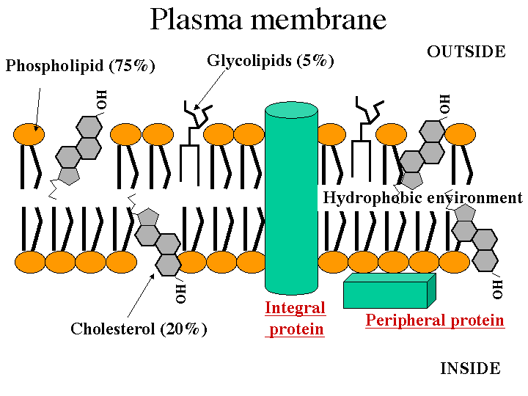
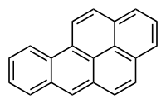
Note: cholesterol – structural/size similarity to toxic
organics e.g. Benzo[a]pyrene

Slide 5
Nonspecific (basal, narcotic) toxicity
- All organic compounds tend to accumulate in membranes, being “narcotic” at relatively "high“ concentrations
- Compounds then affect membranes
→ nonspecific disruption of fluidity
→ and/or disruption of membrane proteins
- Related to lipophilicity (Kow): tendency of compounds to accumulate in body lipids (incl. membranes)
E.g. narcotic toxicity to fish: log (1/LC50) = 0.907 . log Kow - 4.94
- The toxic effects occur at the same "molar volume" of all narcotic compounds (volume of distribution principle)

Slide 6
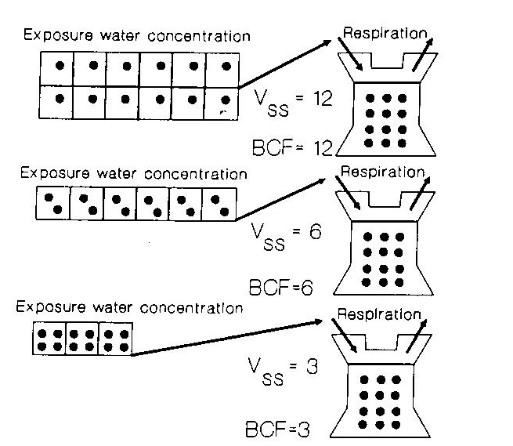
Volume of distribution principle
BCF – bioconcentration factor
* Depends on hydrophobicity
(i.e. Kow)
* Higher BCF
→ lower concentration is
sufficient for bioconcentration
to the same “tissue concentration”
→ lower external concentration
(IC50) will induce toxic effect
* Confirmed by chemical analyses
(same molar concentrations of
different compounds accumulated
in membranes)

Slide 7
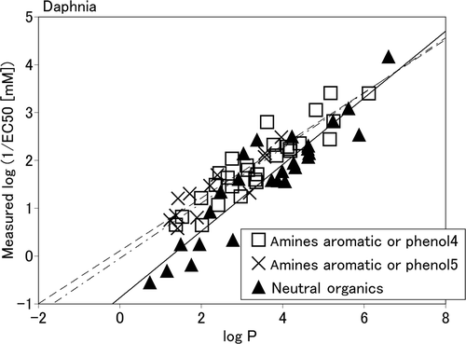
Narcotic toxicity in ecotoxicology
Acute basal toxicity
Direct correlations between logKow (=logP) and EC50 for aquatic organisms (e.g. Daphnia magna)
Example:
Neutral organics
  Nonpolar narcosis
Amines, phenols
  Polar narcosis
  (similar logP → higher toxicity, i.e. higher
  Values of 1/EC50 in comparison to
  neutral organics)
  More specific ... In addition
  to membrane accumulation, direct
  interactions with proteins
  are anticipated

Slide 8
Toxicity to membrane gradients and transport
- Semipermeability of membranes and key functions
- cytoplasmic membrane:
signalling, neural cells Na+/K+ gradient
- mitochondrial membrane:
electrone flow → ATP synthesis
- endoplasmatic reticulum
Ca²⁺ signalling

Slide 9
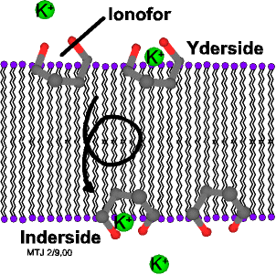
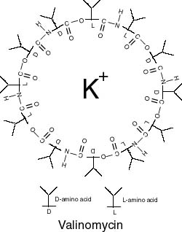
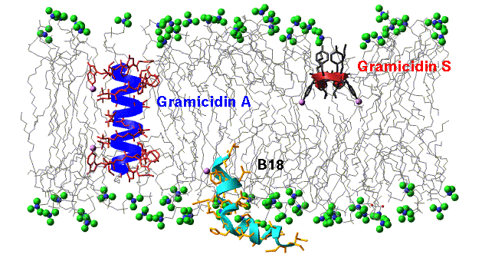
Direct membrane gradient disruption
Ion transfer ("ionofores")
e.g. antibiotics
(K+, Ca2+, Mg2+)

Slide 10
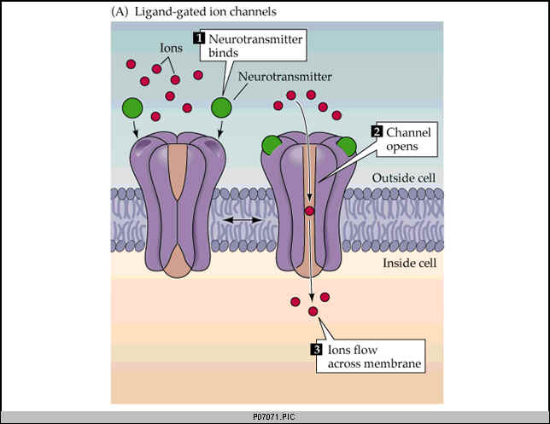
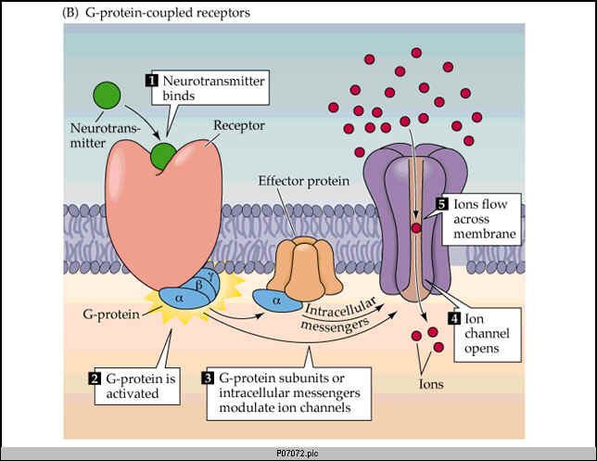
Principal types of channel activation

Slide 11

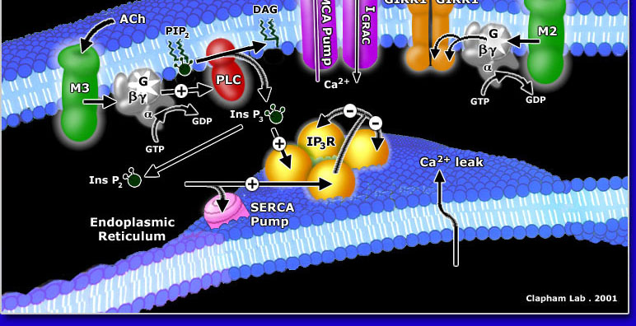
Various membrane channels - examples

Slide 12
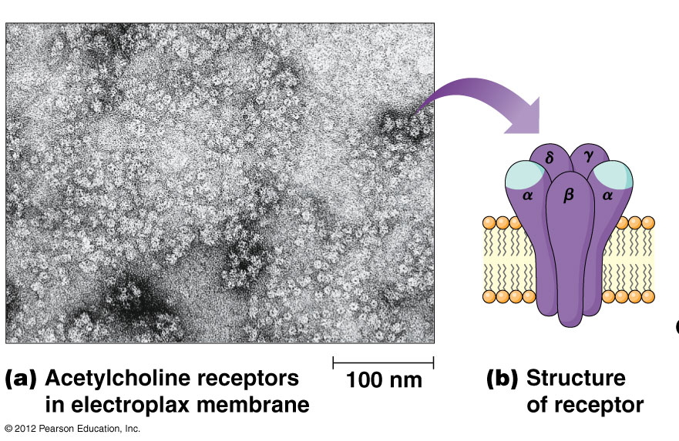
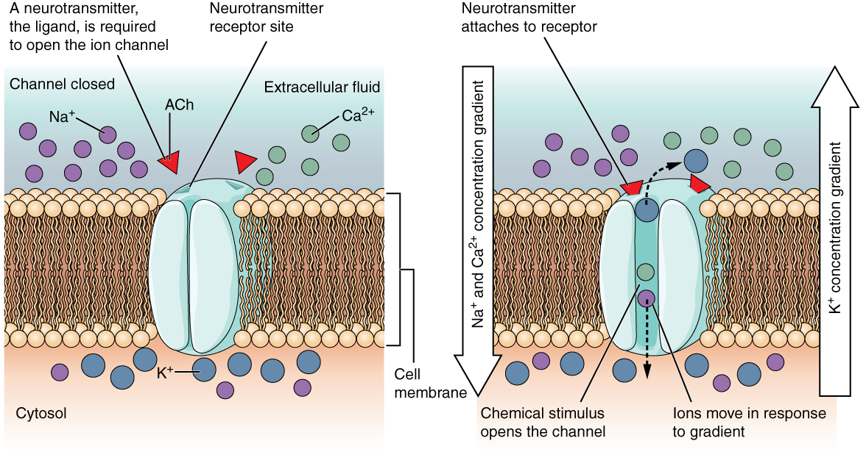
Activation of AcChol
receptors
→ Disruption
of membrane gradients

Slide 13
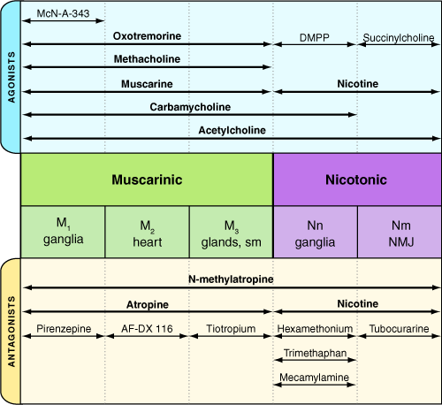
Activation / inhibition of ligand-gated channels
Concentration
-dependent
action

Slide 14
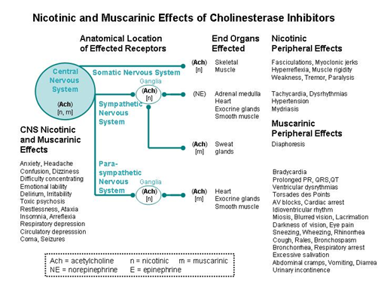
Activation / inhibition of ligand-gated channels

Slide 15
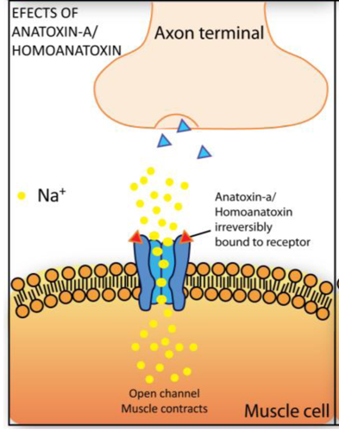
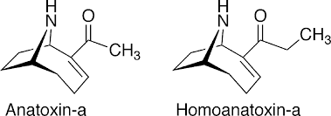
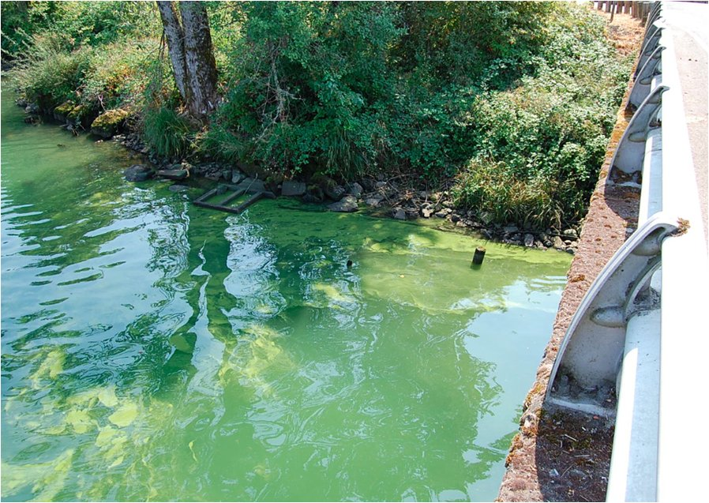
Environmentally relevant ion channel activators
Neurotoxins (cyanobacterial)

Slide 16
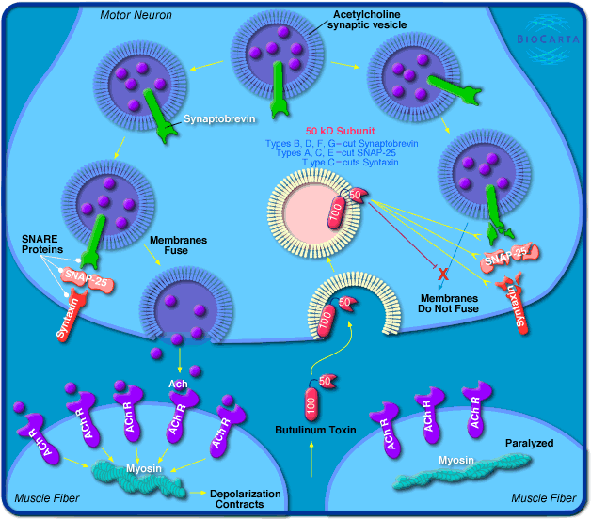
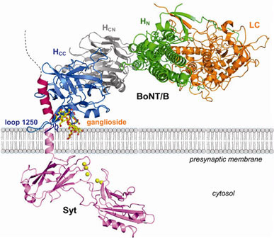
Botulinum and Tetanus toxins
(Clostridium botulinum, Clostridium tetani)
Toxins = enzymes - proteases (!)
- direct cleavage
of proteins involved
in vesicle formation
- selective inhibition of
neutrotransmitter release
BOTULINISM
→ neurotoxicity (paralysis)

Slide 17
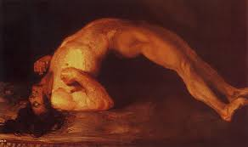
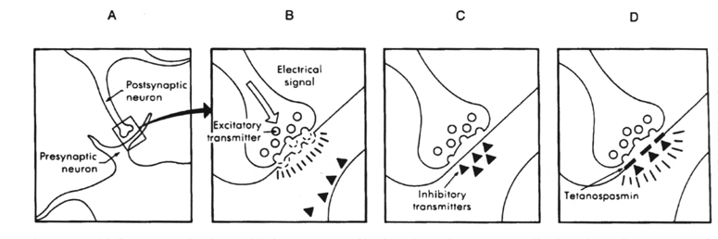
Botulinum and Tetanus toxins
(Clostridium botulinum, Clostridium tetani)
TETANUS TOXIN (tetanospasmin)
blocks release of INHIBITORY NEUROTRANSMITERS
(γ-aminobutyric acid (GABA) in CNS
→ neurotoxicity – permanent contraction

Slide 18
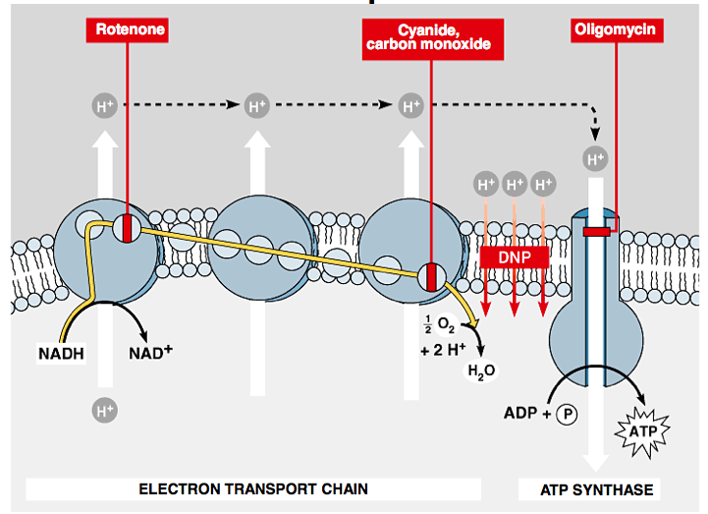
Gradient of H+ → ATP generation & its disruption

