Slide 1
BIOMARKERS AND TOXICITY MECHANISMS
09 – Mechanisms
Nuclear Receptors
Luděk Bláha, PřF MU, RECETOX
www.recetox.cz

Slide 2
NUCLEAR (Intracellular) RECEPTORS in summary
Important physiological functions, and
Important roles in pathologies and chemical toxicity
  Endocrine disruption
  Dioxin-like toxicity,etc.
All NRs share similar structure and mechanisms of action
  Act as direct transcription factors on DNA
Natural ligands are small lipophilic hormones (steroids, thyroids, retinoids)
  Role in toxicity – NR are modulated (activated/inhibited) by structurally close xenobiotics

Slide 3
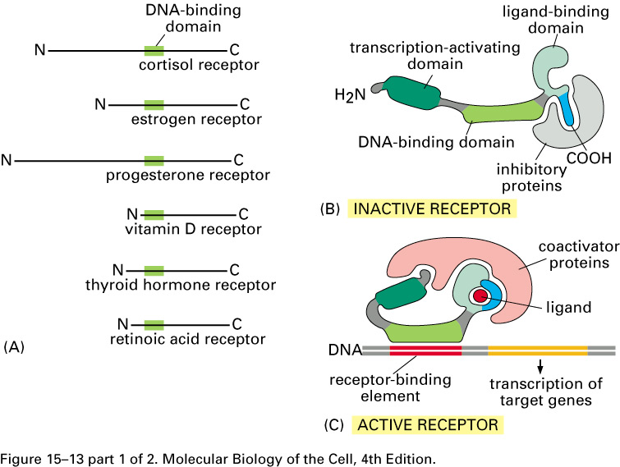
Structure of nuclear receptor proteins

Slide 4
Fate and action of hormones activating NRs
Circulation in the blood bound to transport proteins
Dissociation from carrier at target cells
Passing through cell membrane
Binding to an intracellular receptor (either in the cytoplasm or the nucleus)
Hormone-receptor complex binds to hormone responsive elements in DNA
→ Regulation of gene expression
4
Notes:
4

Slide 5
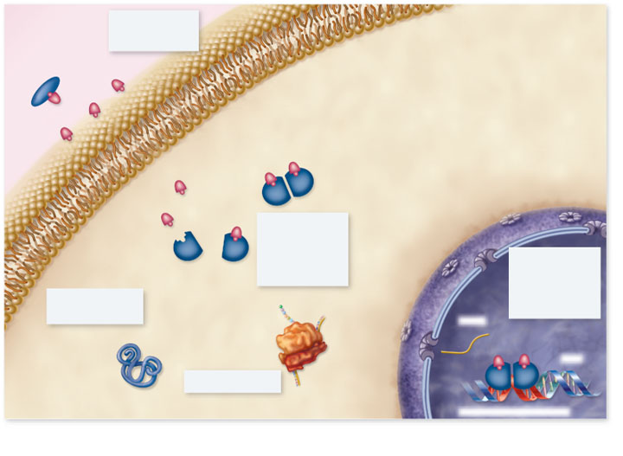
Copyright © The McGraw-Hill Companies, Inc. Permission required for reproduction or display.
Blood
plasma
1. Hormone passes
through plasma
membrane
Lipophilic hormones
Plasma membrane
Cytoplasm
Nucleus
2. Inside target
cell the hormone
binds to a
receptor protein
in the cytoplasm
or nucleus
Receptor
3. Hormone-receptor
complex binds to
hormone response
element on DNA,
regulating gene
transcription
5. Change in protein
synthesis is
cellular response
mRNA
Protein
DNA
4. Protein synthesis
Hormone response element
5
Notes:
5

Slide 6
Further specificities of NRs
Receptor without ligand
  Associated with inhibitory proteins (eg Hsp90)
Regulation of transcription activity - mechanisms may vary
  Steroid receptors often dimerize with a partner to activate gene transcription
  Receptors for vitamin D, retinoic acid and thyroid hormone form heterodimers and then bind to responsive elements on DNA
    Second component of the heterodimer is RXR monomer (i.e, RXR-RAR; RXR-VDR)
NR dimers
  Heterodimeric receptors - exclusively nuclear; without ligand, repress transcription by binding to their cognate sites in DNA
  Homodimeric receptors - mostly cytoplasmic (without ligands) & hormone binding leads to nuclear translocation of receptors

Slide 7
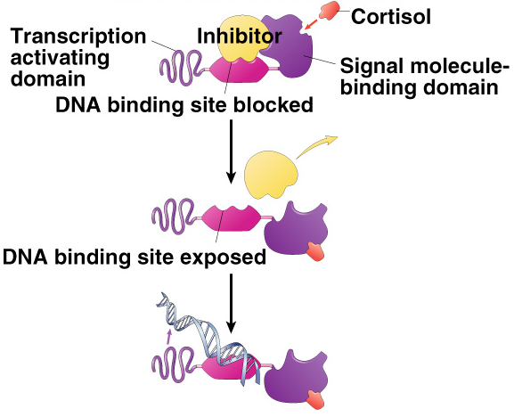
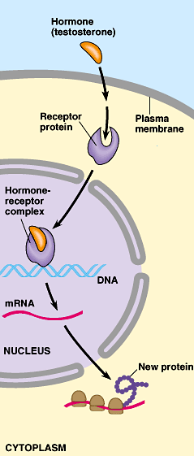
General mechanism of NR action
HYDROPHOBIC:
Non-polar molecules
Gases
Steroids

Slide 8
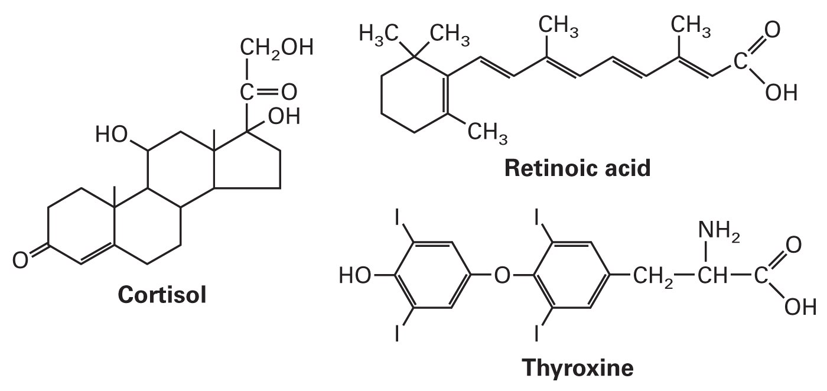
Natural ligands of NR
Small, lipid-soluble molecules
  Diffuse through plasma and nuclear membranes and interact directly with the transcription factors they control.
STEROID HORMONES:
  sex steroids (estrogen, progesterone, testosterone)
  corticosteroids (glucocorticoids and mineralcorticoids)
OTHER HORMONES and ligands
Thyroid hormone, vitamin D3, retinoic acid, ligands of AhR

Slide 9
STEROIDs in more detail

Slide 10
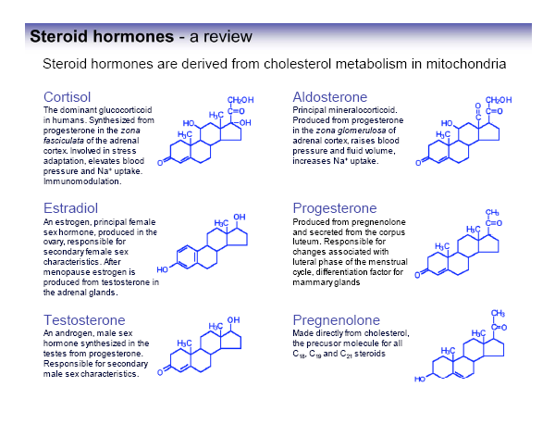

Slide 11
Reminder: STEROID HORMONE biosynthesis

Slide 12
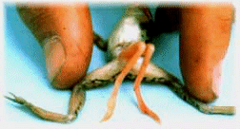
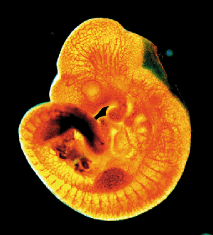
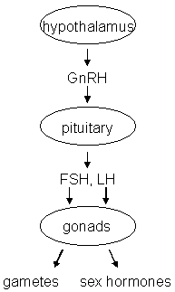
Endocrine disruption
Interference of xenobiotics with normal functioning of hormonal system
Known consequences
→ Disruption of homeostasis, reproduction, development, and/or behavior (and other hormone-controlled processes), such as
  Shift in sex ratio, defective sexual development
  Low fecundity/fertility
  Hypo-immunity, carcinogenesis
  Malformations
  etc.

Slide 13
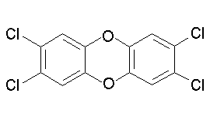
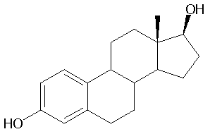
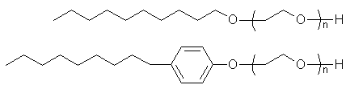
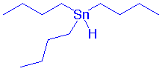
Endocrine disrupters in the environment?
EDCs...
  Persistent Organic Compounds
  (POPs and their metabolites)
  steroid hormones and their
  derivatives from contraception pills
  alkylphenols
  organometallics (butyltins)
  pharmaceuticals
  Pesticides
  + number of unknowns …

Slide 14
Toxicants interact with hormonal system at different levels
Synthesis
Transport
Interaction with receptors
Consequences (both negative!)
Suppression
Metabolization
Stimulation

Slide 15
Toxicant effects
in detail
biosynthesis and release of hormones
e.g. steroidogenesis
e.g. modulation of CYP11A and/or CYP19 activities
binding to plasmatic transport proteins
e.g. down-regulation of receptor levels
binding to nuclear hormonal receptor (HR)
activation of HR
(dissociation of associated heat shock proteins, formation of homodimers)
e.g. modulation of other nuclear receptors
(PPAR/RXR, RXR/TR)
binding of the activated receptor complex to specific DNA motifs - HREs
chromatin rearrangement and transcription of estrogen-inducible genes
effects at the cellular, tissue, organ, organism, and/or population level

Slide 16
Mechanisms of steroid hormones signalling disruption
- Nonphysiological activation of hormone receptor (HR)
Binding to HR without activation
Decrease of HR cellular levels
Disruption of the „master“ hormones (FSH/LH)
Changes in hormone metabolism

Slide 17
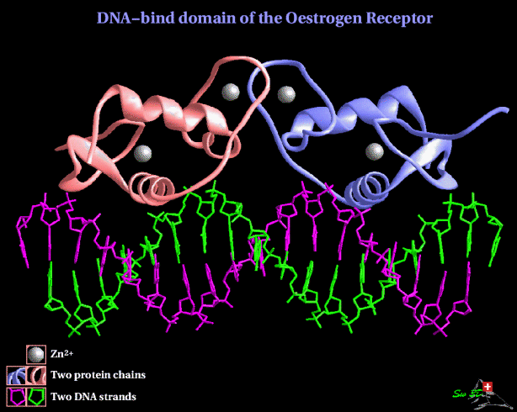
ESTROGEN RECEPTOR – ER the most studied target of EDCs

Slide 18
Estrogens
key roles in female hormone regulation and signalling
responsible for metabolic, behavioural and morphologic changes occurring during stages of reproduction
involved in the growth, development and homeostasis in a number of tissues
control the bone formation, regulation of homeostasis, cardiovascular system and behaviour
regulate production, transport and concentration of testicular liquid and anabolic activity of androgens in males
Synthesis in ovaries
DISRUPTION → many effects known in aquatic biota & laboratory organisms

Slide 19

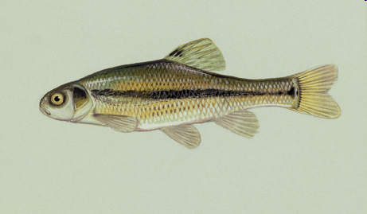
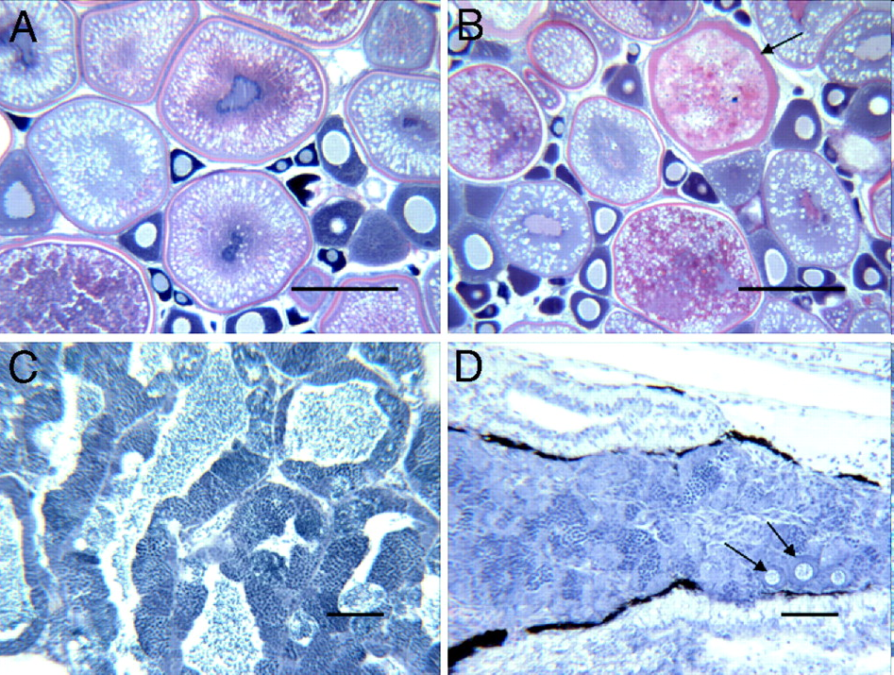
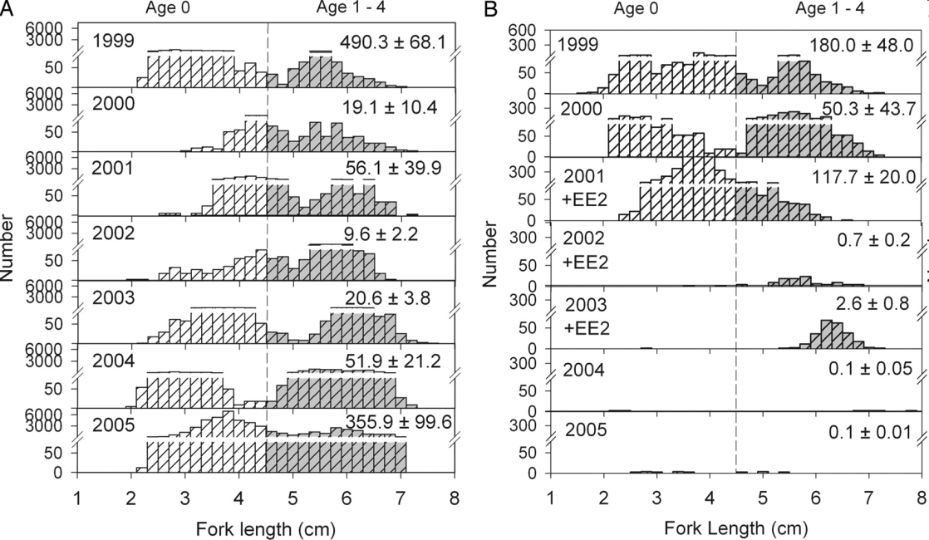
Kidd, K.A. et al. 2007. Collapse of a fish population following exposure to a synthetic estrogen. Proceedings of the National Academy of Sciences 104(21):8897-8901
5 ng/L (!)
7 years
Controls +Ethinylestradiol

Slide 20
ESTROGEN RECEPTORS- subtypes
ER-α (in breast, ovary, brain, liver, bone and cardiovascular system,
adrenals, testis and urogenital tract)
ER-β (in kidneys, prostate and gastrointestinal tract)
(ER-γ in fish)

Slide 21
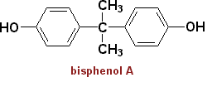

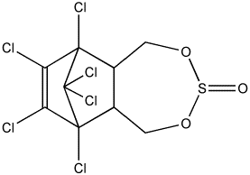
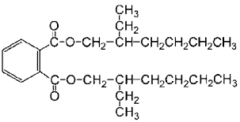
Environmental estrogens (xenoestrogens, exoestrogens)
a diverse group of substances
do not necessarily share structural similarity to the prototypical estrogen 17β-estradiol
may act as AGONISTS and/or ANTAGONISTS (depending on situation and concentration!)
Natural products
genistein
naringenin
coumestrol
zearalenone
Industrial chemicals
Bisphenol A
Nonionic surfactants
Pthalate esters
endosulfan
Various POPs
DDT
kepone
PCBs/OH-PCBs
PAHs and dioxins
DEHP
Pharmaceuticals
Ethinyl estradiol
Diethylstilbestrol
gestodene
norgestrel

Slide 22
Exoestrogens - Relative Potencies to bind to ERa (REPs)
REP – a measure of toxic potency of a compound (similar also at other NRs)

Slide 23
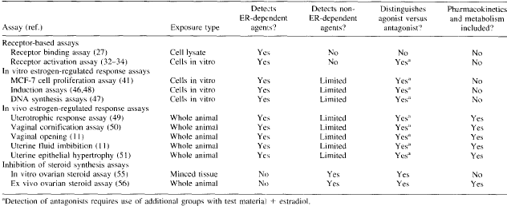
How to assess for ESTROGENICITY?
number of in vivo and in vitro methods available
Janošek, J., Hilscherová, K., Bláha, L., and Holoubek, I. (2006). Environmental xenobiotics and nuclear receptors-Interactions, effects and in vitro assessment. Toxicology in Vitro 20, 18-37.

Slide 24
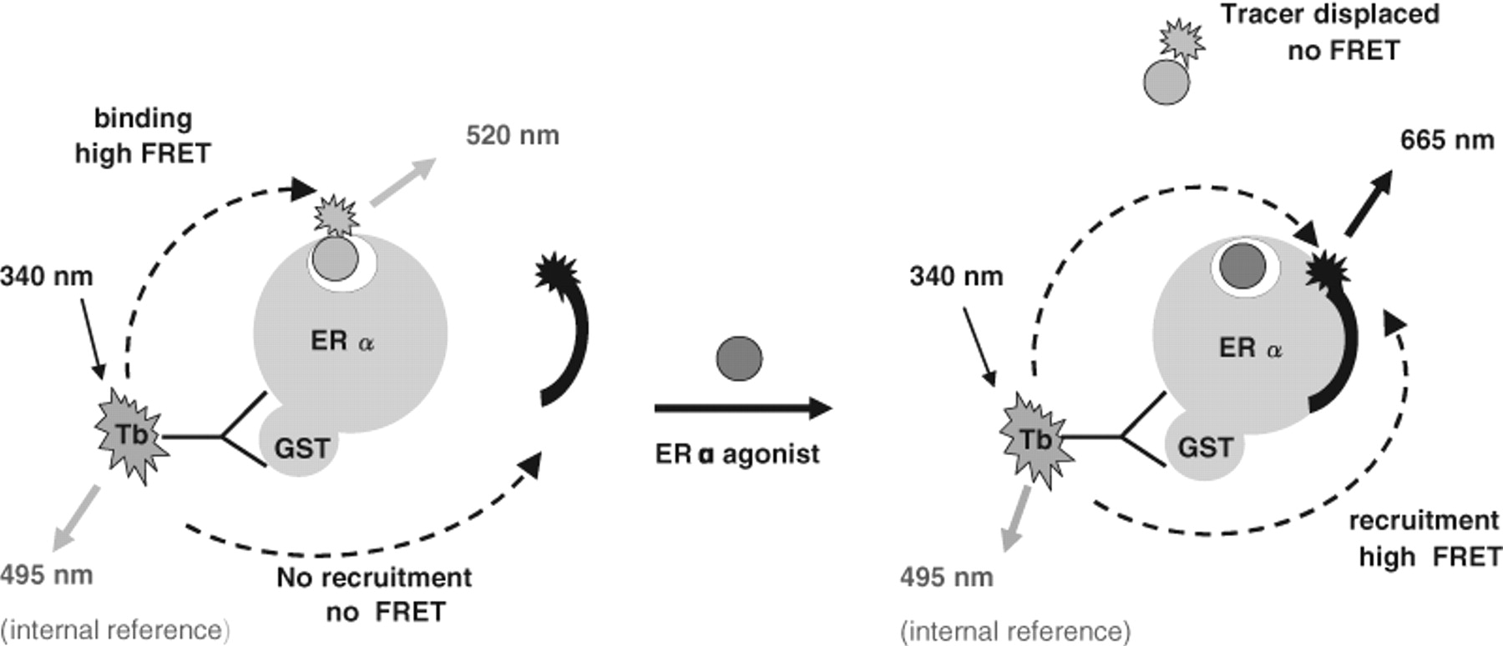
In vitro assays for estrogenicity
INTERACTION (BINDING) to the receptor
  competitive ligand binding assays
    Various variants (e.g. displacement of radioactive substrate, fluorescence resonance energy transfer (FRET) techniques etc.
  information only about “binding potency” but the effect remains unknown (? Activation / suppression / no effect ?)

Slide 25
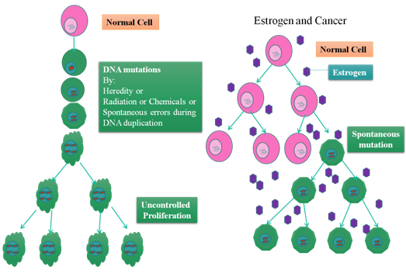
In vitro assays for estrogenicity
Testing the effect at cellular level
  → interference with receptor biological activity
Cell proliferation assays
  Estrogens induce proliferation
Endogenous protein expression (or enzyme activity) assays
  Often reporter gene assays

Slide 26
In vitro ER- mediated effects luciferase reporter assay
Genetically modified cells (e.g. Breast carcinoma – carrying ERs,
stable transfection with firefly luciferase gene)

Slide 27
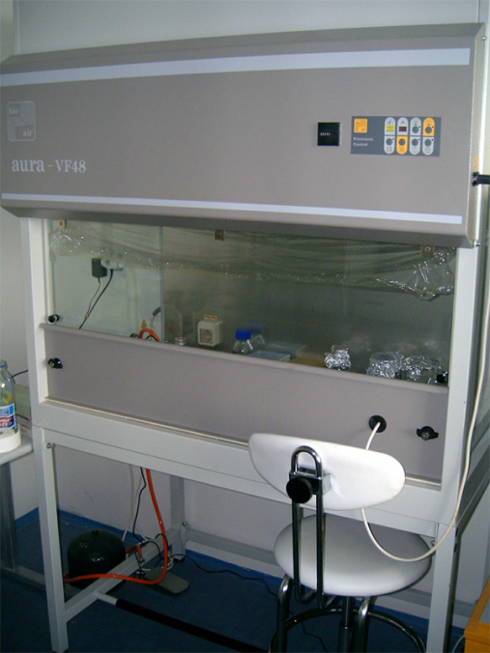
Luciferase reporter assay
Exposure (6 – 24 h)
standards / samples
96 microwell plate
cultivation of transgenic cell lines
ER: breast carcinoma MVLN cells
SIMILAR DESIGN FOR
OTHER NRs
(discussed below):
AhR (H4IIE.luc cells)
AR (MDA cells)
RAR/RXR (P19 cells)
Cell lysis
-> extraction of induced luciferase
Luminescence determination
(microplate luminescence reader)
Lumino

Slide 28
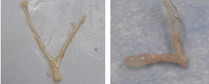
IN VIVO ASSAYS FOR ESTROGENICITY
Rat uterus
Control Estrogen exposure
uterotropic assay
vaginal cornification assay
production of estrogen-inducible proteins
(e.g. vittelogenin and zona radiata protein)
→ also discussed at “biomarkers” part
standard test procedures for reproductive and developmental toxicity
  using mice, rats, fish, amphibians etc.

Slide 29
ANDROGEN RECEPTOR (AR) role in toxicity confirmed ... but less explored than ER

Slide 30
Androgens
Role in males similar to the of estrogens in females
  development of male sexual characteristics
  stimulating protein synthesis, growth of bones
  cell differenciation, spermatogenesis
  male type of behaviour

Slide 31
Androgens
Endogenous ligands – androgen hormones
  Two key androgens
    testosterone (T)
    dihydrotestosterone (DHT)
  Other androgens – androstanediol,
  dehydroepiandrosterone, androstenedione
T: synthesis in testis (Leydig cells)
  in lesser extent in adrenals
DHT: Formed extratesticulary from T
  In several tissues (seminal vesicles, prostate, skin)
  higher affinity to androgen receptor than T
  Daily production 5-10% of testosterone
Testosterone

Slide 32
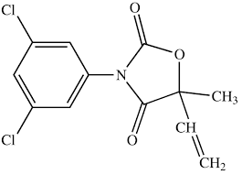
Mechanisms of androgen signalling disruption
1) Binding to AR
  Mostly competitive inhibition
  xenobiotics mostly DO NOT activate AR-dependent transcription
Only few compounds able to activate AR in the absence of androgen hormones but they are anti-androgenic in the presence of strong androgens like T or DHT
- metabolites of fungicide vinclozoline, some PAHs
2) FSH/LH (gonadotropins) signalling disruption – less explored
  FSH/LH expression - regulation via negative feedback by testosterone
  Suppression → alterations of spermatogenesis
vinclozoline

Slide 33
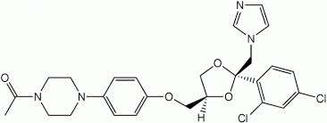
Mechanisms of androgen signalling disruption
3) Alterations of testosterone synthesis
  Inhibition of P450scc needed for side chain cleavage of cholesterol or inhibitions of 17-beta-hydroxylase and other CYPs
    fungicide ketoconazol
4) Testosterone metabolic clearance
  Induction of detoxification enzymes (UDP-glucuronosyltransferase or monooxygenases CYP1A, 1B)
    Pesticides endosulfan, mirex, o-p´-DDT

Slide 34
Effects of male exposure to antiandrogens
Exposure during prenatal development:
  malformations of the reproductive tract
    reduced anogenital distance
    hypospadias (abnormal position of the urethral opening on the penis)
    vagina development
    undescendent ectopic testes
    atrophy of seminal vesicles and prostate gland
Exposure in prepubertal age:
  delayed puberty
  reduced seminal vesicles
  reduced prostate
Exposure in adult age:
  oligospermia
  azoospermia
  loss of sexual libido
Seek google for
illustrations

Slide 35
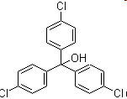
Antiandrogenic compound
tris-(4-chlorophenyl)-methanol
  Ubiquitous contaminant of uncertain origin
  Probable metabolite of DDT-mixturec
  Levels in human blood serum cca. 50nM
  antiAR - EC50 – cca. 200nM

Slide 36
AR-binding – potencies (Reference DHT: EC50 ~ 0.1 uM)
Compound
IC₅₀ (µM)
Benz[a]anthracene
3.2
Benzo[a]pyrene
3.9
Dimethylbenz[a]anthracene
10.4
Chrysene
10.3
Dibenzo[a,h]anthracene
activation in range 0.1-10µM
Bisphenol A
5
vinclozolin metabolites
9.7
hydroxyflutamide
5
Aroclor typical values
0.25-1.11
Individual PCBs typical values
64 - 87
tris-(4-chlorophenyl)-methanol
0.2

Slide 37
(Anti)androgenicity assessment
In vivo Hershberger assay
  castrated rats treated with examined substance
  Endpoint – after 4-7 days – seminal vesicles and ventral prostate weight
In vivo measurement of testosterone blood levels
In vitro cell proliferation assays
  cell lines with androgen-dependent growth: mammary carcinoma cell lines
  prostatic carcinoma cell lines
Receptor-reporter assays
  Gene for luciferase (or GFP) under control of AR
    AR-CALUX (human breast carcinoma T47D)
    PALM (human prostatic carcinoma PC-3)
    CHO515 (Chinese hamster ovary CHO)
  Yeast transfected cells
    beta-galactosidase reporter

Slide 38
THYROID SIGNALLING

Slide 39


THYROID HORMONES
Play crucial roles in stimulating metabolism, development and maturation
  Regulation of metabolism
    increasing oxygen consumption
    modulating levels of other hormones (insulin, glucagon, somatotropin, adrenalin)
  Important in cell differenciation
  Crucial role in development of CNS, gonads and bones
EDC compounds interfering with thyroid signalling
  “GOITROGENS”
HYPOTHYROIDISM
HYPERTHYROIDISM

Slide 40
Thyroid hormones
Thyroxine (T4)
Triiodothyronine (T3)
Contains 3 iodide ions
Most T3 produced
by deiodination
in target tissues (deiodinases)
Also called tetraiodothyronine
Contains 4 iodide ions
T4 – prohormone
5´-deiodination → active form, T3

Slide 41
Enzymes involved in Thyroid hormone metabolism
Thyroid peroxidases
  iodination of tyrosyl residues
  coupling of iodinated tyrosyl residues
Thyroid deiodinases
  D1, D2 - activation of T4 into T3 via deiodination on „outer“ ring
  D3 - deactivation into rT3 via deiodination on „inner“ ring
Many goitrogens affect expression, activities and outcomes of these key enzymes
E.g. Thiocyanate ([SCN]⁻) or perchlorate (NaClO₄)
  →effect on iodine uptake
„outer“
„inner“

Slide 42
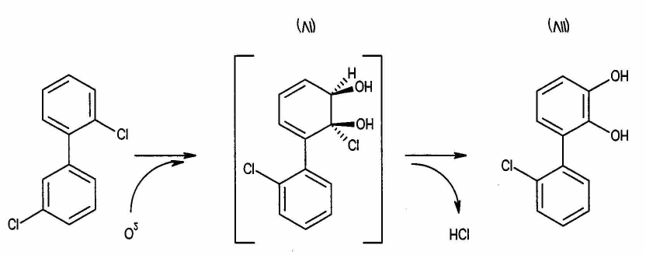
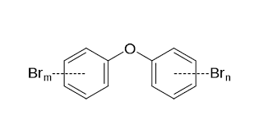
Transport of thyroid hormones in blood
SPECIFIC TRANSPORTERS in blood
  regulating free T4 and T3 levels
  3 types :
    Thyroid-binding prealbunin (transthyretin) (20-25%)
    Albumin (5-10%)
    Thyroid binding globulin (TBP, 75%)
NUMBER OF EDCs → act on transport proteins
  OH-PCBs, brominated and chlorinated flame retardants, DDT, dieldrin
  OH-PCBs – equal affinity to TBP as T4 and T3 (!!!)
Increased levels of “free T4” in blood
  negative feedback to TSH release
  → increased depletion
  → increased weight,
  histological changes in thyroid gland
  Documented after exposures to POPs in mammals, birds, fish
Hydroxylated PCB formation
Polybrominated diphenyl ethers
(PBDEs) – flame retardants

Slide 43
Other mechanisms of goitrogens’ toxicity
Competitive binding to TR
  Probably less important than binding to TBP
    Chemicals that affect thyroid signalling in vivo mostly don´t bind to TR (DDT, PCBs) or bind with much lesser affinity than T3 (OH-PCBs – 10000x)
Accelerated depletion of hormones
  UDP-glucuronosyltransferase – detoxification enzyme (II.biotransformation phase)
  Induced by PCBs and dioxins
  → indirect goitrogens

Slide 44
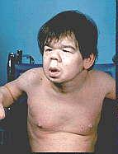
Effects of thyroid disruption
Exposures during prenatal stages
  severe damage of CNS (cretenism, delayed eye opening, cognition)
  Megalotestis
  Histological changes in thyroid gland (goitre)
Exposures during development
  nervous system fails to develop normally
  mental retardation
  skeletal development

Slide 45
Assessment of goitrogen effects
(For information only)
In vivo approaches
  TH serum levels – simple, nondestructive x variation within time of day, age, sensitive to other than biochemical stresses
  Thyroid gland weight and folicular cells number
  Developmental toxicity assays - delayed eye opening, abnormalities in brain development and cognition, increased testis weight and sperm counts
  Perchlorate discharge test (TH synthesis)
  Hepatic UDP-glucuronosyltransferase activity (marker of enhanced TH clearance from serum)
In vitro
  Enzyme inhibition assays (thyroid peroxidase, deiodinases) – assessment of thyroid metabolism
  Competitive binding assays with TBP
  TH- dependent proliferation assay (pituitary tumor GH3, thyroid tumors like FRTL-5 cell line) or TSH-dependent proliferation assay (thyroid tumors)
  Receptor-reporter gene assays with luciferase (monkey kidney CV-1, chinese hamster ovary CHO or insect Sf9 cell lines)

Slide 46
Vitamin A and its derivatives
RETINOIDS
(role in toxicity - still in the research phase)

Slide 47
RETINOIDS
Sources: from diet - dietary hormones
Retinyl esters – animal sources
Plant carotenoids
β-karoten
Bond cleavage
Retinol (vitamin A)
Retinoic Acid

Slide 48
Retinoids and their functions
Regulation of development and homeostasis in tissues of vertebrates and invertebrates
Development of embryonic, epithelial cells (gastrointestinal tract, skin, bones)
Necessary for vision
Suppressive effects in cancer development
Important for cell growth, apoptosis and differenciation
Antioxidative agent
Affect nervous and immune function

Slide 49
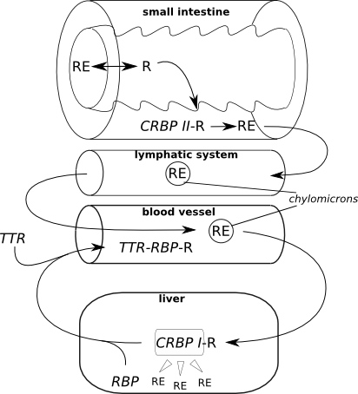
Retinoid transport
RE: Retinol-Ester
R: Retinol
RBP: Retinol Binding
Protein (LMW)
TTR: Transthyrethin
(HMW)

Slide 50
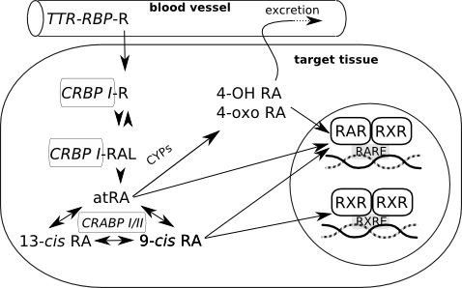
Retinoid fate in the cells
Gene expression
Retinoid binding proteins
CRBP – cellular retinol binding protein
- binding of retinol, immediate decrease of retinol concentration
CRBAP – cellular retinoic acid binding protein
- Controlling the ratio free retinol/free retinoic acid

Slide 51
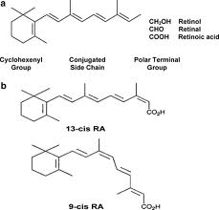
RAR/RXR and RA
Isoforms of RAR a RXR
  Formation of homo- and heterodimers
  48 possible RAR-RXR heterodimers
  → sensitive regulation of gene expression
RXR – heterodimers with other receptors
  VDR, TR, PPAR ... → see crosstalk
RETINOIC ACID (RA)
3 basic subtypes
  all-trans- (ATRA)
  9-cis- and 13-cis-retinoic acid
All-trans RA (ATRA) binds selectively to RAR
Cis RA bind to both receptor types

Slide 52
Disruption of retinoid signalling by xenobiotics
Relatively little known - possible modes of action:
  Metabolization of retinoids by detoxication enzymes
  Disruption of binding retinoids to retinoid binding proteins
  Retinoids as antioxidants may be consumed cause of oxidative stress caused by xenobiotics
  Interference of chemicals (binding to RAR/RXR)
Decreased retinoid levels in organisms
  Downregulation of growth factors
  Xerophtalmia, night blindness
  Embryotoxicity, developmental abnormalities
Increased ATRA concentration
  teratogenic effects

Slide 53
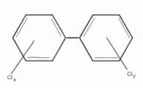
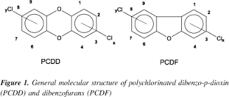
Disruption of retinoid signalling by xenobiotics
Polluted areas
  mostly decrease of retinoid levels
    Documented in aquatic birds, mammals and fish
Disruption of retinoid transport: PCBs
Effects on retinoid receptors:
  RAR, RXR binding and/or transactivation
    pesticides (chlordane, dieldrin, methoprene, tributyltin…)
    Effect on ATRA mediated response – TCDD, PAHs
Disruption of retinoid metabolism:
  PCDD/Fs, PAHs, PCBs, pesticides
  changes of serum concentrations of retinol and RA
  mobilization of hepatic storage forms

Slide 54
AhR (Arylhydrocarbon receptor)
AhR structure

Slide 55
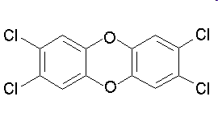
AhR
ligand-activated transcription factor
  Similar to all NRs
activation of many different genes
important mediator of toxicity of POPs – primary target of coplanar aromatic substances
regulator of xenobiotic metabolism and activation of promutagens
crossactivation/crosstalk with other NRs
strongest known ligand - TCDD
  (not endogeneous !)

Slide 56
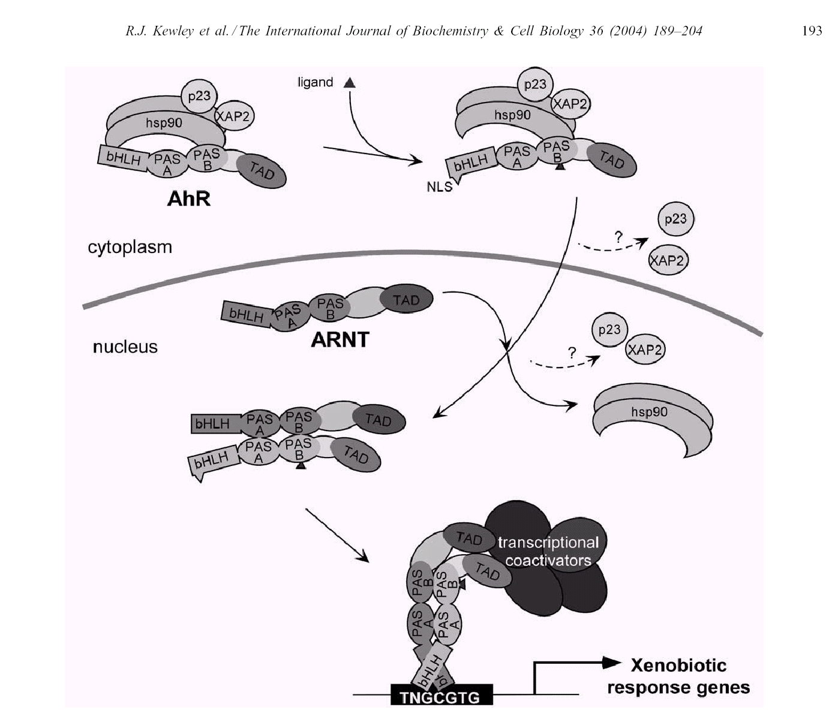
AhR activation

Slide 57
AhR regulated genes
Many genes contain xenobiotic response elements (XRE) or dioxin responsive elements (DRE) in their promoter region:
  phase I enzymes - CYP 1A1, CYP 1A2, CYP 1B1;
  phase II enzymes - UDP-glucuronosyltransferase, GST-Ya, NADP(H):oxidoreductase;
  other genes - regulation of cell cycle and apoptosis
    Bax (apoptosis), p27Kip1, Jun B (MAP-kinase), TGF-b

Slide 58
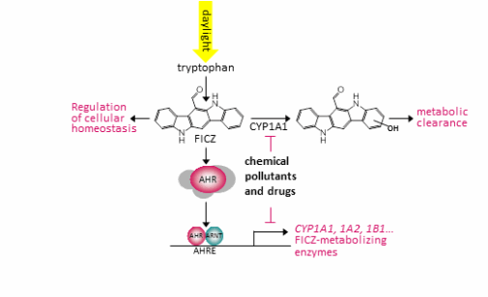
6-formylindolo[3,2-b]carbazole (FICZ) potent endogenous physiological ligand of AhR

Slide 59
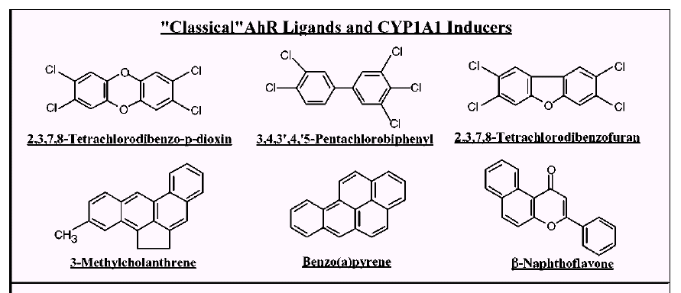
Classical and “non-classical” AhR ligands
Classical = planar structures → direct binding to AhR
Denison & Nagy, Annu. Rev. Pharmacol. Toxicol. 43:309

Slide 60
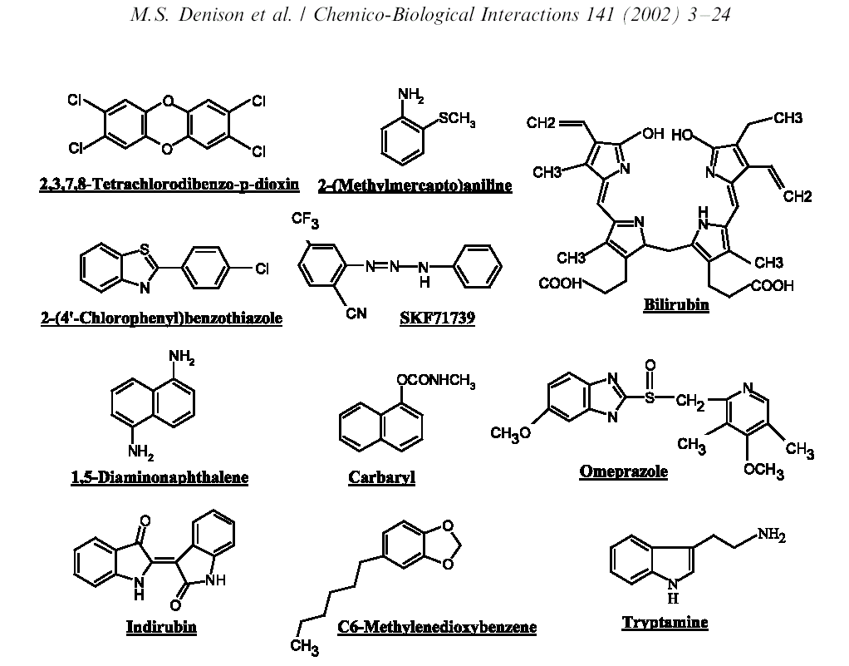
„Non-classical“ AhR ligands – various structures
“Classical” ligand

Slide 61
Physiological role of AhR
Physiological role for AhR still not known (?)
  Most likely – “protection” against toxicants → induction of detoxification
Many adverse effects in AhR-deficient mice:
  significant growth retardation;
  defective development of liver and immune system;
  retinoid accumulation in liver;
  abnormal kidney and hepatic vascular structures.
  resistant to BaP-induced carcinogenesis and TCDD-induced teratogenesis;
  no inducible expression of CYP 1A1 and 2.

Slide 62
Biological responses to TCDD
Schmidt & Bradfield, Annu. Rev. Cell Dev. Biol. 12:55

Slide 63
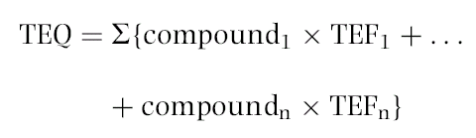
Toxic equivalency factors (TEF)/TEQ concept
Toxicity of compounds with similar toxicological properties as TCDD (activating AhR) may be evaluated by TEF/TEQ concept
  TEF = Toxic Equivalency Factor (“characteristic” of the Chemical)
  TEQ = Toxic Equivalent (sum of TEFs x concentrations)
TEFs are consensus values based on REPs (relative potencies) across multiple species and/or endpoints.
  TEFs are based upon a number of endpoints, from chronic in vivo toxicity to in vitro toxicity with the former having the greatest importance in determining overall TEF.
TEQs provide a simple, single number that is indicative of overall toxicity of a sample (water, sediment, food) containing a mixture of dioxins and dioxin-like compounds.
The total potency of a mixture can be expressed in TCDD TEQ concentration
  i.e. TEQ = concentration corresponding to the effect that would be induced by TCDD

Slide 64
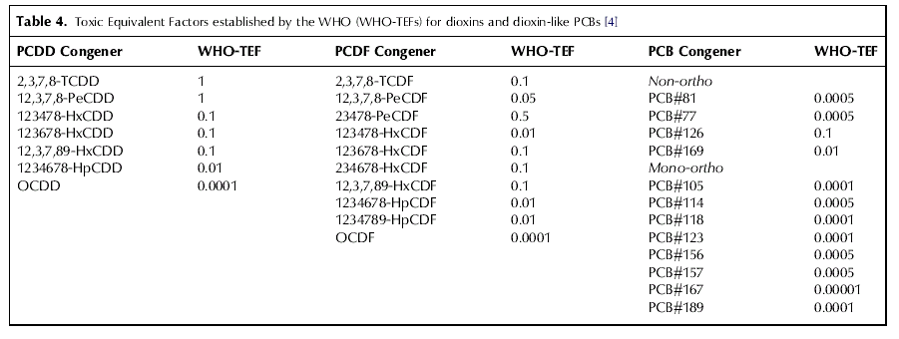
Toxic equivalency factors for PCDDs, PCDFs and PCBs:
Eljarrat & Barceló, Trends Anal. Chem.22: 655
Final concentration is expressed as „Equivalents of TCDD“
(e.g. ng TEQ / kg = ng TCDD / kg)

Slide 65
Biomarkers/bioanalytical methods for AhR toxicity
In vivo studies
  liver enlargement, reduction of thymus weight, wasting syndrome, reproductive and developmental disorders
In vivo biomarkers
  EROD activity, CYP 1A1 and 1B1 expression
in vitro assessment of chemical potencies
  EROD (ethoxyresorufin-O-deethylase activity) in cell cultures;
  CALUX/CAFLUX assays;
  GRAB assay (AhR-DNA binding)
  yeast bioassay;
  immunoassays;
  detection of CYP1A mRNA (qPCR) or AhR protein (western blotting)

Slide 66
In vitro CALUX/CAFLUX assays
CALUX – Chemical Assisted Luciferase Expression
DR-CALUX (Dioxin Responsive CALUX)
(i.e. Luciferase Reporter Gene Assay with H4IIE.luc cells)

Slide 67
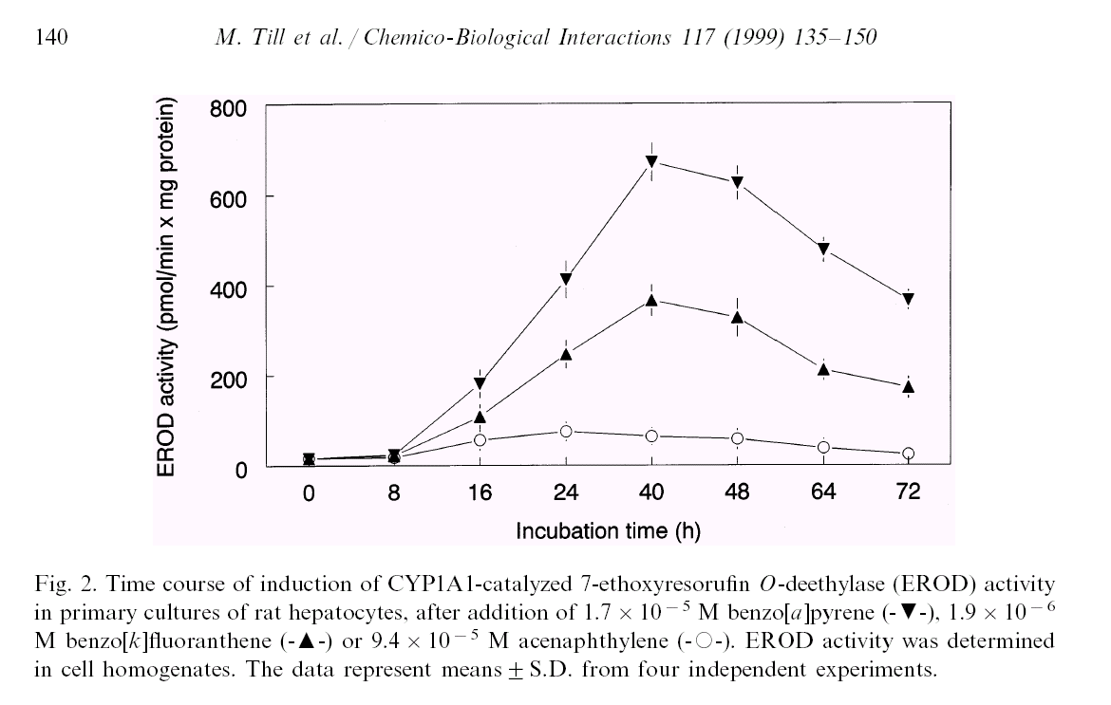
DETECTION of EROD activity - example

Slide 68
Comparing toxicity of compounds
→ Application in Risk Assessment
Quantification of effects (EC₅₀)
Comparison with the effect of reference toxicant (2,3,7,8-TCDD)
  → relative potencies (REPs) to TCDD
    (= in vitro “Toxic Equivalency Factors” ~ TEFs)
TCDD: IC₅₀
PAH: IEC₅₀
Relative Potency (REP)
= Induction Equivalency Factor
IEF = IC₅₀ / IEC₅₀
REP interpretation: How many times is the compound "weaker" inducer than TCDD ?
120
TCDD
B[a]P
B[e]P
4´-OH-PCB 79
4´-OH-PCB 3
100
80
AhR-mediated activity (%TCDD-max)
60
40
IEC50 = 2
m
M
20
IC50 = 10 pM
0
1.E-07
1.E-04
1.E-01
1.E+02
concentration (
m
M)

Slide 69
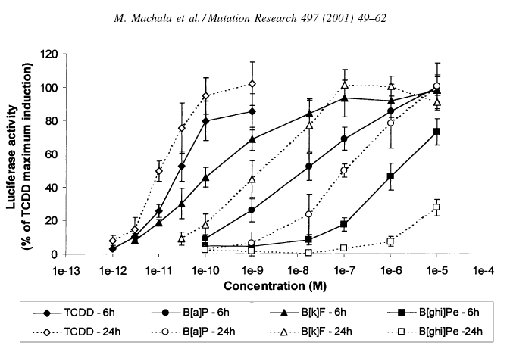
Example - relative potencies of PAHs (two exposure periods)

Slide 70
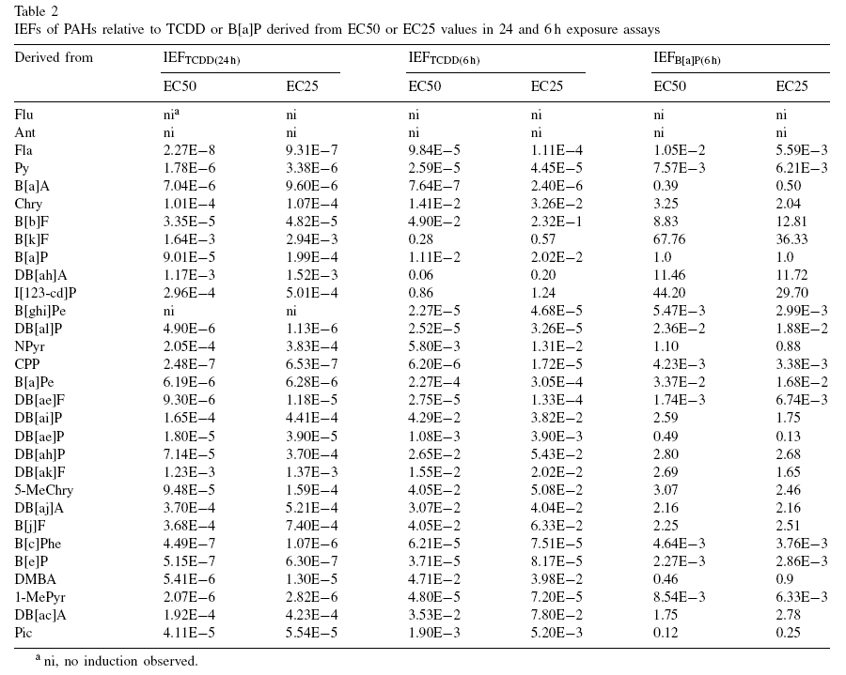

Slide 71
Crosstalk in signalling of nuclear receptors

Slide 72
“Cross talk” of various NR → diverse toxic outcomes
Crosstalk effects documented but still less explored, e.g.
  “antiestrogenicity” of AhR ligands
  fast clearance of retinoids after AhR activation
  Immunosuprresions after ER activations
RAR
?
ER
AhR
P
P
P
hsp90
hsp90
ER
RAR
P
AhR
hsp90
hsp90
ER
AhR
AhR
RAR
ER
RAR

Slide 73
Summary – Nuclear receptors
Important physiological functions,
Important roles in pathologies and chemical toxicity (ENDOCRINE DISRUPTION)
NRs with well studied roles in toxicity: ER and AhR
  Other NRs (AR, RAR/RXR, ThR) – important but less explored
All NRs share similar structure and mechanisms of action
  Act as direct transcription factors on DNA
Natural ligands of NRs are small lipophilic hormones
  steroids, thyroids, retinoids
  Various regulatory functions
  Role in toxicity: NR interact with structurally similar xenobiotics
Various mechanisms beyond the toxicity
  Adverse are both STIMULATIONS and INHIBITIONS directly at the receptor site (e.g. “anti-androgenicity)
  Additional mechanisms – transport of hormones in blood (Thyroids), metabolism (Thyroids) clearance (Retinoids), heterodimerization and “crosstalk”
Other key information to remember
  REPORTER GENE ASSAYS (principle, use, what is CALUX?)
  Characterization of chemical “toxic potentials”
    General concept of “REPs” (valid for activation of all NRs)
    Specifically for AhR - concept of TEFs / TEQs

