Slide 1
BIOMARKERS AND TOXICITY MECHANISMS
13 – BIOMARKERS
Summary and final notes
Luděk Bláha, PřF MU, RECETOX
www.recetox.cz

Slide 2
Topics covered in the final presentation
Biomarkers at different levels
  Omics
  ... and beyond
Biomarkers in human medicine and drug development
  Strategy and steps in development
  Application examples

Slide 3
Biomarkers at various levels
“omics”

Slide 4
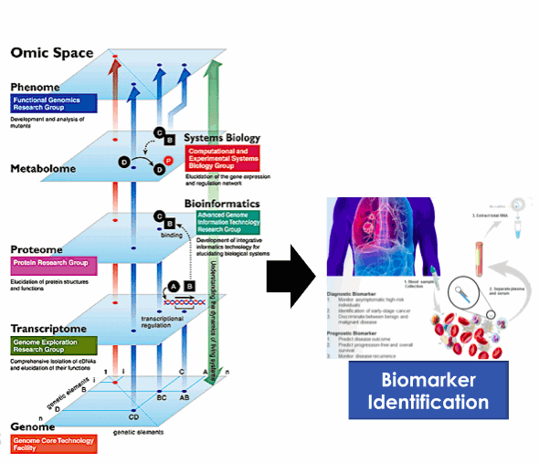
Biomarkers at different biological levels – „omics“ approach

Slide 5
Biomarkers at different biological levels
“Omics” techniques
  Systems biology research
  Screenings of responses (differences) at all levels of biological organization
GENOMICS
  Relatively stable
    not responding to environmental changes (e.g. Toxicants)
  Can be used as “biomarkers of susceptibility” (SNPs and personalized medicine)
OTHER “OMICS” (Transcripts, Proteins, Metabolites...)
  Resposive to environmental stress (including toxicants, therapy etc.)

Slide 6
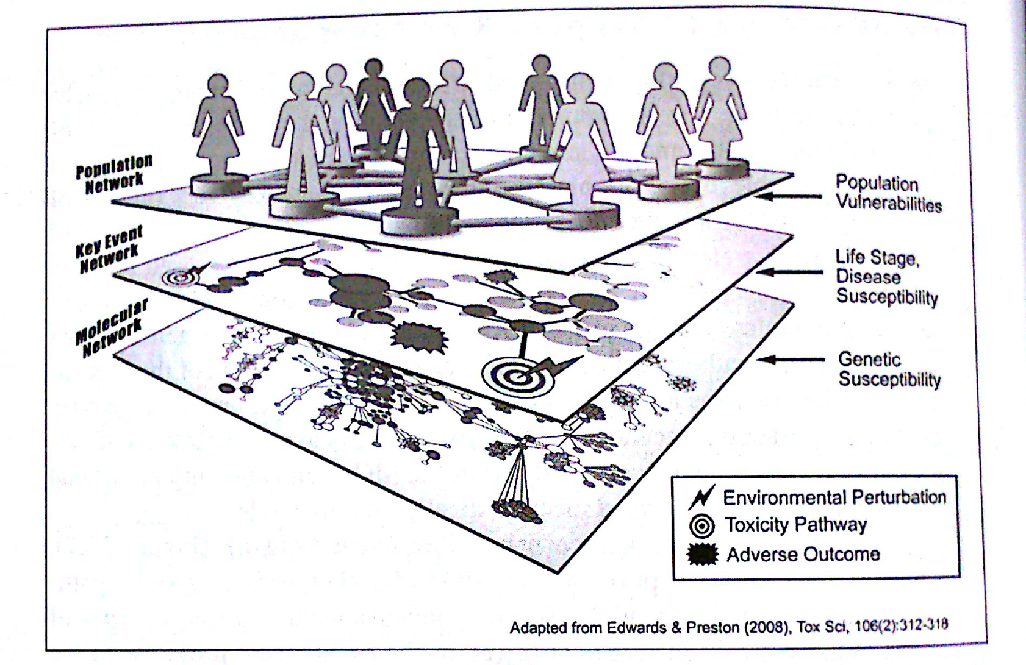
Biomarkers at different biological levels

Slide 7
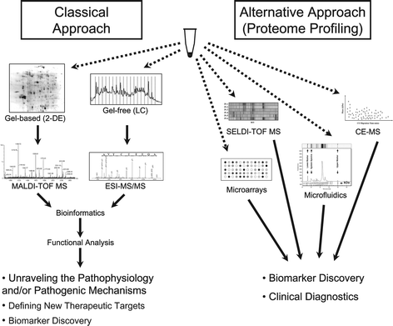
Hypothesis driven research Data driven research
(focus on pathways) (omics & profiling)

Slide 8
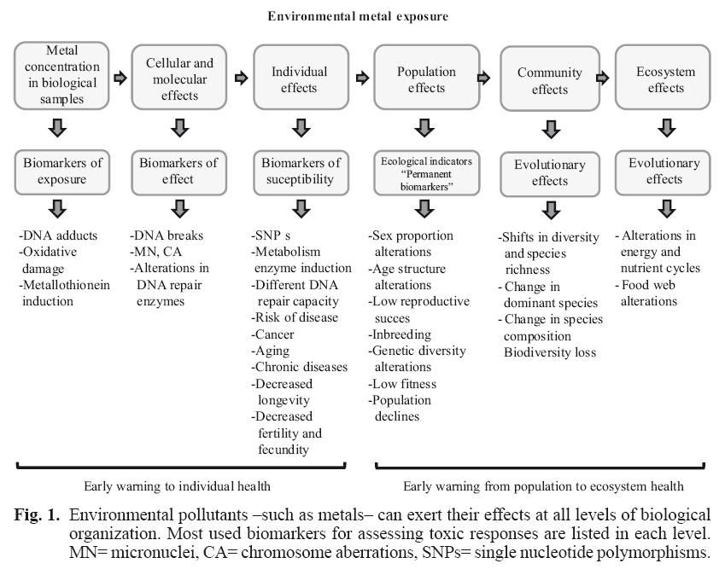
Biomarkers at even higher levels – example: toxic metals

Slide 9
Developments and applications of biomarkers

Slide 10
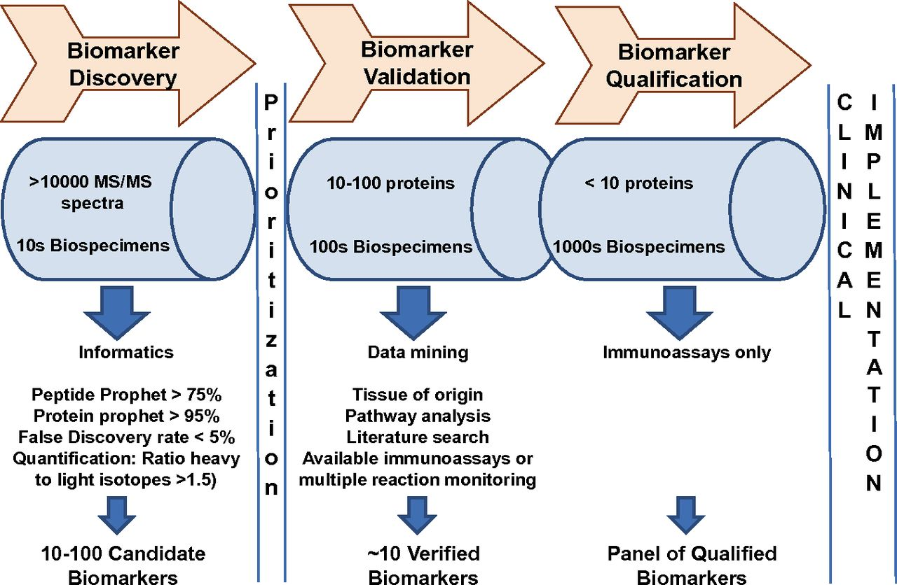
3 key steps towards the biomarker establishment
An example of protein-based biomarkers

Slide 11
3 key steps towards the biomarker establishment
Biomarker development
  High numbers of endpoints (e.g. proteins)
  Low numbers of samples compared (e.g. 10 controls vs 10 “treatments”)
Biomarker validation
  Decreasing number of markers
  Increasing numbers of specimens (biological samples)
Biomarker qualification and approval
  Individual markers
  Analytical methods validated and well established

Slide 12
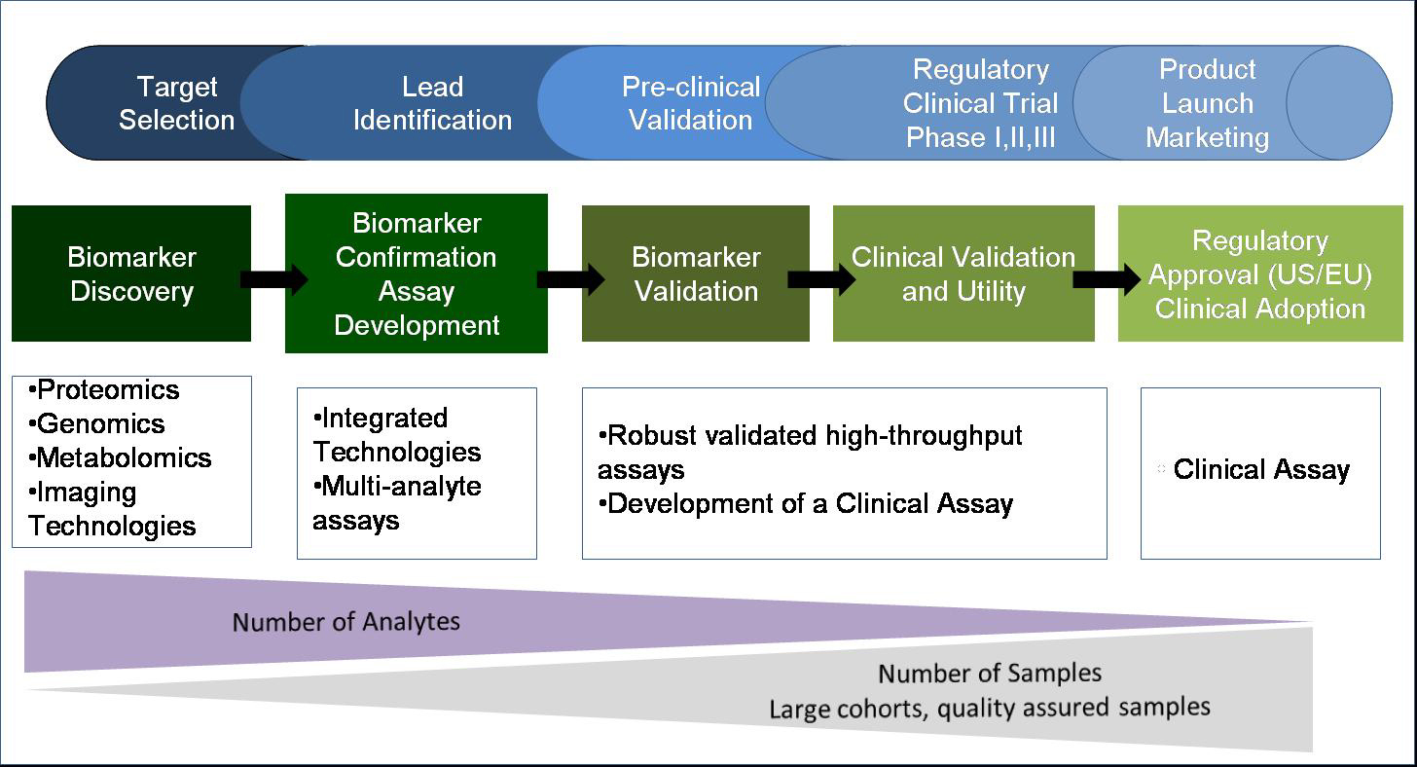
More detailed view: 5 steps leading to biomarker use in practice
DISCOVERY → VALIDATION STEPS → APPROVAL

Slide 13
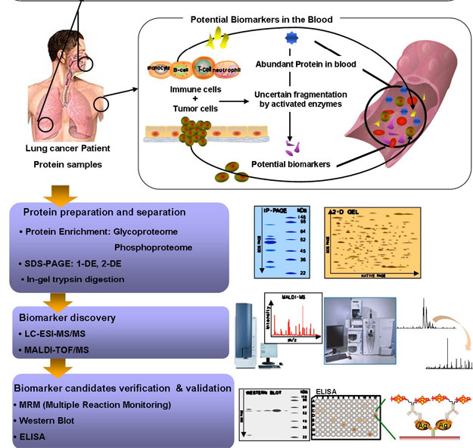
EXAMPLE process of biomarker establishment – lung cancer diagnosis
Which of the
many changes
are “significant” ?
→ Use quantitative
metrics
(see Following slide)

Slide 14
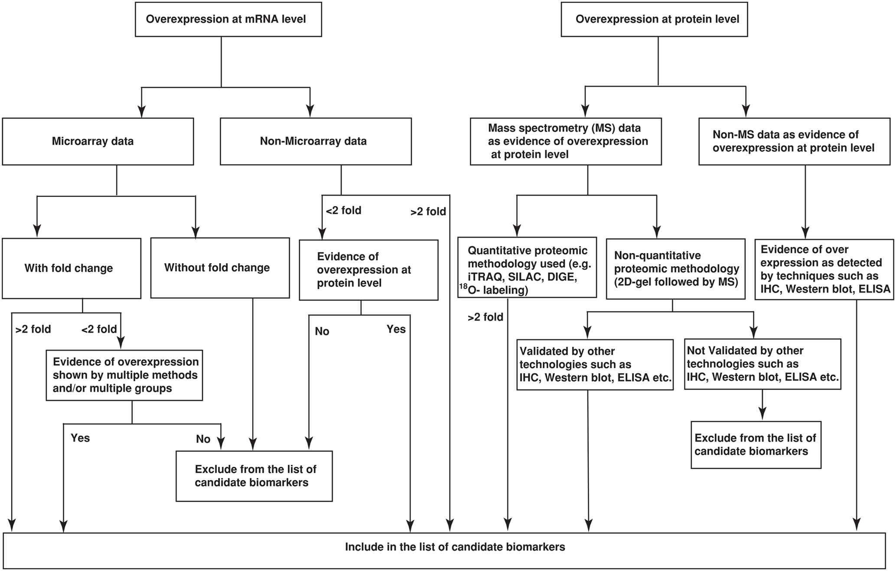
What is (what is not) a candidate biomarker: example flowchart
Use of quantitative metrics during development

Slide 15
Biomarkers have MANY APPLICATIONS ... such as:
Biomarkers in research
  Search of “potential” therapies/drugs
    Changes in biochemical responses provide information on efficiency and mechanism of action
  Identification of “early markers” of chronic diseases
    Early diagnosis (e.g. identification of developing cancer, coronary disease...)
Biomarkers in medicine
  Identification of status of an individual
    Healthy vs Disease
  Assessment of therapy/treatment
    Efficiency – Did treatment improved situation? (improvements in biomarker responses)
    Adverse or side effects of therapy
Biomarkers in toxicology
  Identification of status
    Intoxicated (exposed) vs Controls
    Forensic toxicology (e.g. consumption of drugs of abuse, alcohol etc)
  Early warnings of future health consequences
    Biochemical changes are detectable before the actual health problems

Slide 16
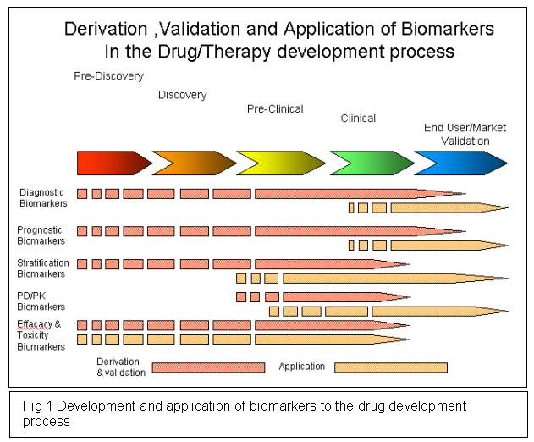

Slide 17
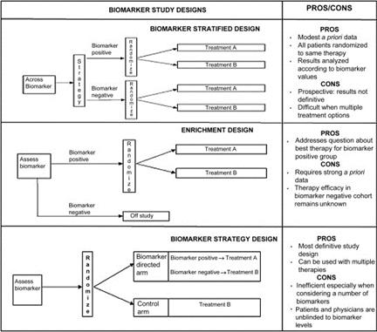
Various designs to search for biomarkers of different therapies

Slide 18
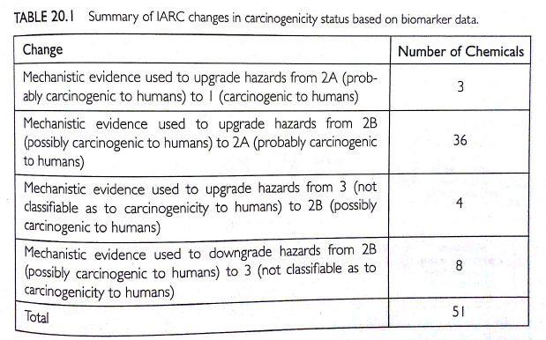
Biomarker applications in CLASSIFICATION OF CARCINOGENS
IARC – International Agency for Research of Cancer

Slide 19
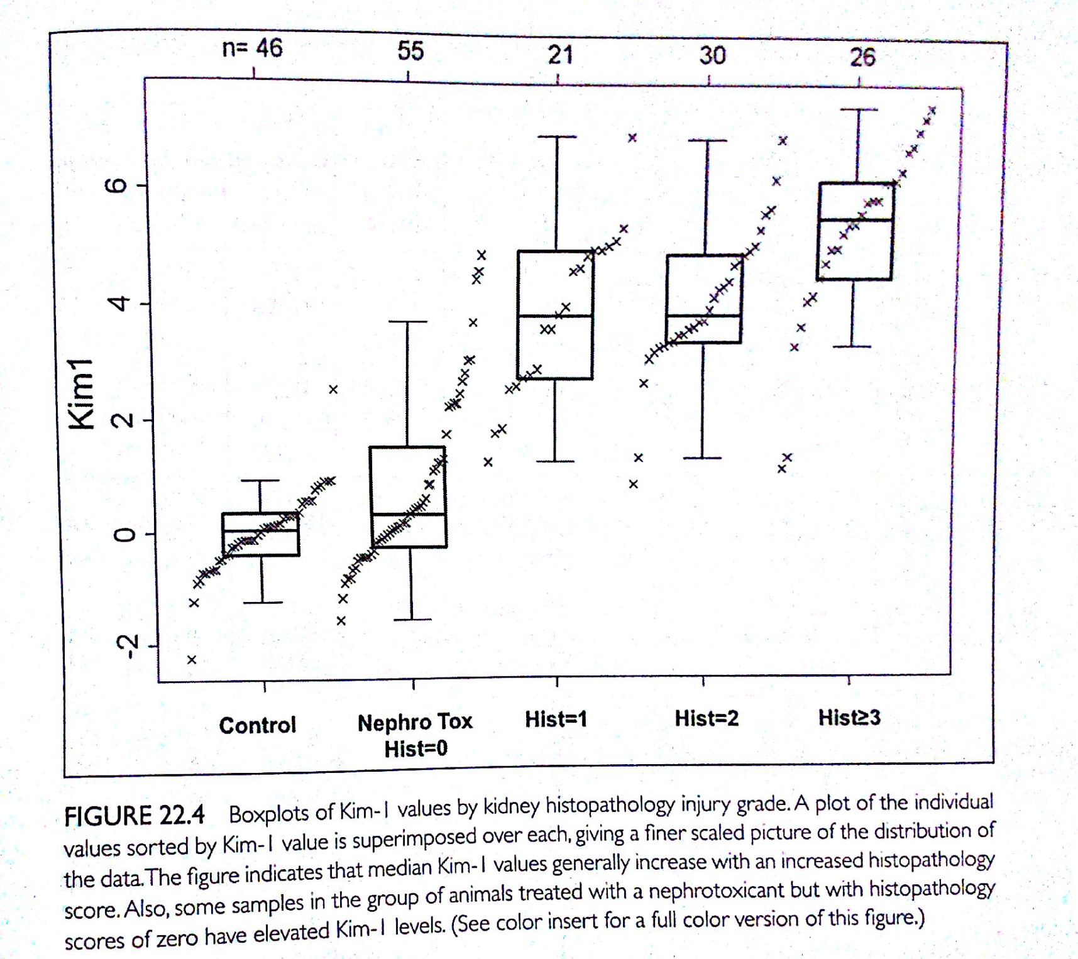
Biomarker validation EXAMPLE
Kim-1 protein levels and kidney clinical signs (histopathology grades 0-3)

Slide 20
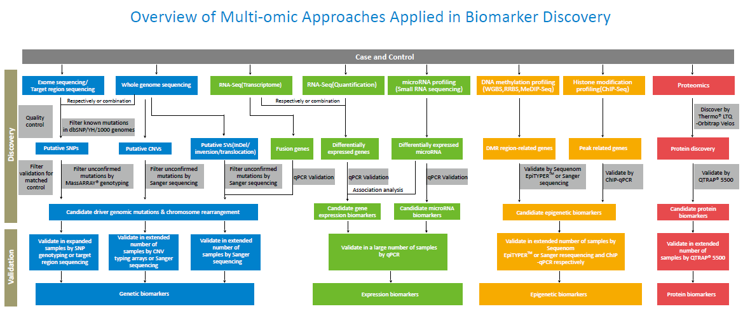
OMICS biomarkers in discovery and validation

Slide 21
toxicity mechanisms (MoA) and biomarkers overall summary

Slide 22
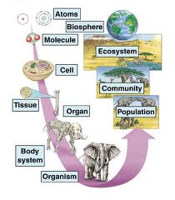
Molecular effects of toxicants (1)
  Propagate to higher levels (2),
    here they induce various “responses” detectable as (3) biomarkers
1
3
Biomarkers
- types
- examples
- methods
MoAs
* Molecular interactions
* Key targets ...:
- DNA, RNAs
- proteins (and their functions)
- membranes
* Complex mechanisms
- Oxidative stress
- Signalling and hormones
- Detoxification
1
2
Biological
organization

