Slide 1
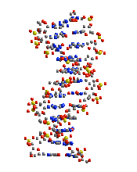
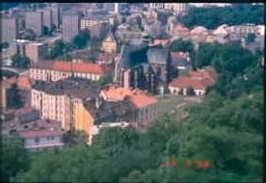
1. PŘEDNÁŠKA
2012-13
Nucleic acids
Historical view
Emil Paleček
Institute of Biophysics, Acad. Sci. CR v.v.i., 612 65 Brno
Czech Republic
The Road to DNA started in Brno
G.J. Mendel
1866
F. Miescher
Tübingen 1871

Slide 2
NUCLEIC ACIDS
Chemical nature and spatial organization Biological function
STRUCTURE
F. MIESCHER, TÜBINGEN G. J. MENDEL, BRNO
1871 1866

Slide 3
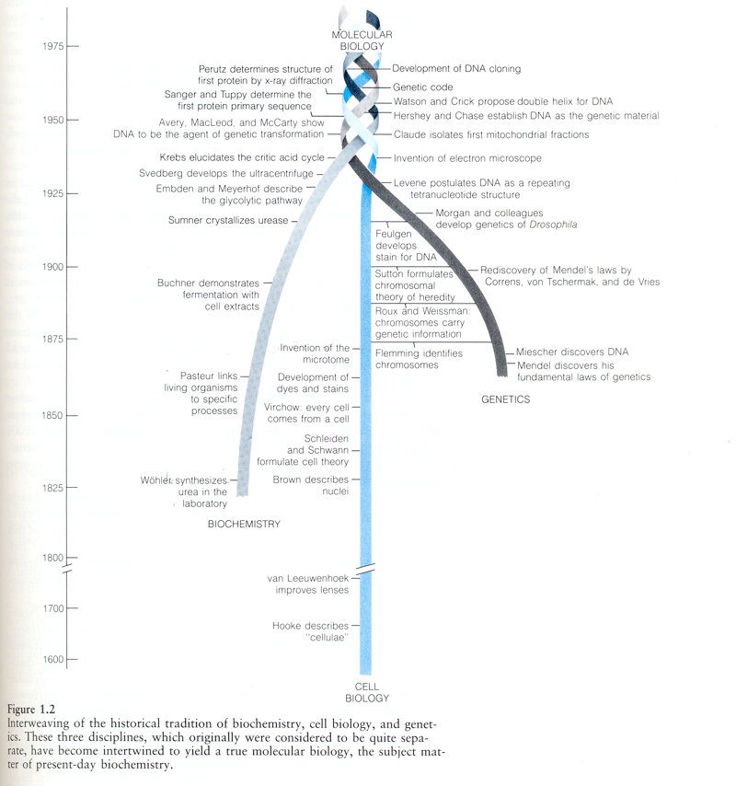
MIESCHER
MENDEL
C K MATHEWS , K E van HOLDE, BIOCHEMISTRY, 1990

Slide 4
Timeline of DNA
1865: Gregor Mendel discovers through breeding experiments with peas that traits are inherited based on specific laws (later to be termed “Mendel’s laws”). By mentioning Elements of Heredity he predicts DNA and genes (published 1866)
1866: Ernst Haeckel proposes that the nucleus contains the factors responsible for the transmission of hereditary traits.
1869: Friedrich Miescher isolates DNA/NUCLEIN for the first time.
1871: The first publications describing DNA (nuclein) by F Miescher, Felix Hoppe-Seyler, and P. Plosz are printed.
1882: Walther Flemming describes chromosomes and examines their behavior during cell division.
1884–1885: Oscar Hertwig, Albrecht von Kölliker, Eduard Strasburger, and August Weismann independently provide evidence that the cell’s nucleus contains the basis for inheritance.
1889: Richard Altmann renames nuclein to nucleic acid.
1900: Carl Correns, Hugo de Vries, and Erich von Tschermak rediscover Mendel’s Laws.
1902: T Boveri and W Sutton postulate that the heredity units (called genes as of 1909) are located on chromosomes.
1902–1909: A Garrod proposes that genetic defects result in the loss of enzymes and hereditary metabolic diseases.
1909: Wilhelm Johannsen uses the word gene to describe units of heredity.
1910: T H Morgan uses fruit flies (Drosophila) as a model to study heredity and finds the first mutant with white eyes.
1913: Alfred Sturtevant and Thomas Hunt Morgan produce the first genetic linkage map (for the fruit fly Drosophila).
1928: Frederick Griffith postulates that a transforming principle permits properties from one type of bacteria (heat-inactivated virulent Streptococcus pneumoniae) to be transferred to another (live nonvirulent Streptococcus pneumoniae).
1929: P Levene identifies the building blocks of DNA, incl. four bases adenine (A), cytosine (C), guanine (G), thymine (T) .
1941: George Beadle and Edward Tatum demonstrate that every gene is responsible for the production of an enzyme.
1944: Oswald T. Avery, Colin MacLeod, and Maclyn McCarty demonstrate that Griffith’s transforming principle is not a protein, but rather DNA, suggesting that DNA may function as the genetic material

Slide 5
1949: Colette and Roger Vendrely and A Boivin discover that the nuclei of germ cells contain half the amount of DNA that is found in somatic cells. This parallels the reduction in the number of chromosomes during gametogenesis and provides further evidence for the fact that DNA is the genetic material.
1949–1950: Erwin Chargaff finds that the DNA base composition varies between species but determines that the bases in DNA are always present in fixed ratios: the same number of A’s as T’s and the same number of C’s as G’s.
1952: Alfred Hershey and Martha Chase use viruses (bacteriophage T2) to confirm DNA as the genetic material by demonstrating that during infection viral DNA enters the bacteria while the viral proteins do not and that this DNA can be found in progeny virus particles.
1953: Rosalind Franklin and Maurice Wilkins use X-ray analyses to demonstrate that DNA has a regularly repeating helical structure.
1953: James Watson and Francis Crick discover the molecular structure of DNA: a double helix in which A always pairs with T, and C always with G.
1956: Arthur Kornberg discovers DNA polymerase, an enzyme that replicates DNA.
1957: Francis Crick proposes the central dogma (information in the DNA is translated into proteins through RNA) 1958: Matthew Meselson and Franklin Stahl describe how DNA replicates (semiconservative replication).
1960-63: Julius Marmur and Paul Doty show separation of DNA strands and reformation of DNA double-helical structure – DNA renaturation/hybridization
1961–1966: Robert W. Holley, Har Gobind Khorana, Heinrich Matthaei, Marshall W. Nirenberg, and colleagues crack the genetic code.
1968–1970: Werner Arber, Hamilton Smith, and Daniel Nathans use restriction enzymes to cut DNA in specific places for the first time.
1972: Paul Berg uses restriction enzymes to create the first piece of recombinant DNA.
1977: Frederick Sanger, Allan Maxam, and Walter Gilbert develop methods to sequence DNA.

Slide 6
1982: The first drug (human insulin), based on recombinant DNA, on the market.
1983: Kary Mullis invents PCR as a method for amplifying DNA in vitro.
1990: Sequencing of the human genome begins.
1995: First complete sequence of the genome of a free-living organism (the bacterium Haemophilus influenzae) is published.
1996: The complete genome sequence of the first eukaryotic organism—the yeast S. cerevisiae—is published.
1998: Complete genome sequence of the first multicellular organism—the nematode worm Caenorhabditis elegans—is published.
1999: Sequence of the first human chromosome (22) is published.
2000: The complete sequences of the genomes of the fruit fly Drosophila and the first plant—Arabidopsis—are published.
2001: The complete sequence of the human genome is published.
2002: The complete genome sequence of the first mammalian model organism—the mouse—is published.

Slide 7
Darwin C. 1859: Book - On the Origin of Species by Means of Natural Selection
Mendel G. 1866
Miescher F. 1871
papers
Charles Darwin - Important claims:
A. Universal Common Descent - Tree of Life - the first one-celled organism, representing the root or trunk of the Tree, gradually developed and changed over many generations into new and more complex forms, representing the branches
B. Natural Selection as a mechanism responsible for the branching pattern
Variations in living forms arise at random
Nature selects the adaptive ones
Adaptive organism survive and reproduce
Inherited adaptations may cause population changes
Darwin understand neither how genetic traits were passed to the progeny nor how the variations arose. He is a founder of Evolution Biology
At present: - Natural Selection as a mechanism for relatively simple processes is fully confirmed but also cooperation played a significant role
- Universal Common Descent - Tree of Life and the role of natural selection in the origin of species are questioned

Slide 8
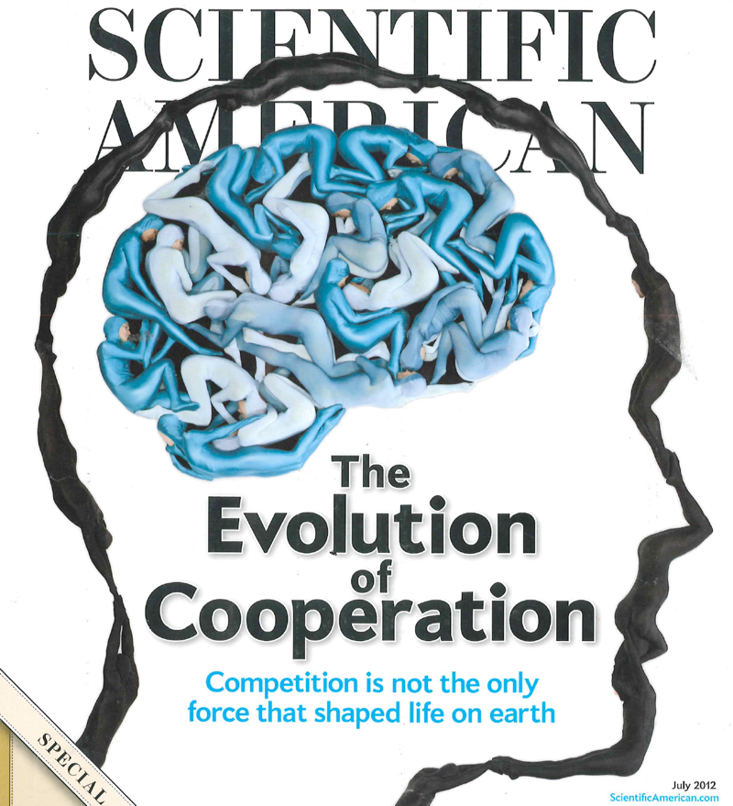
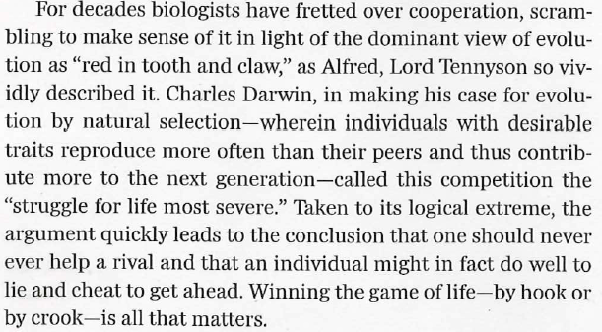
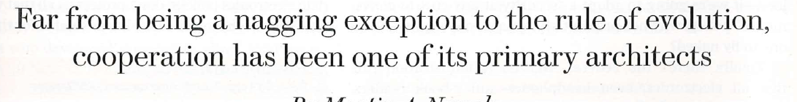

Slide 9
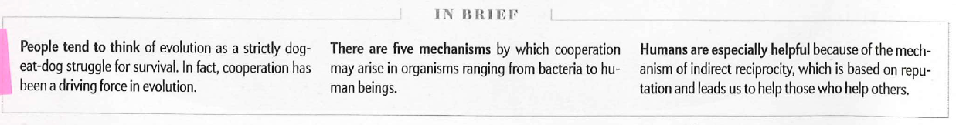
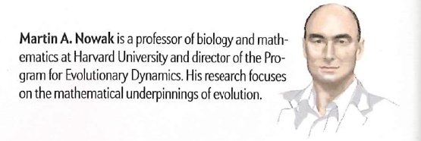
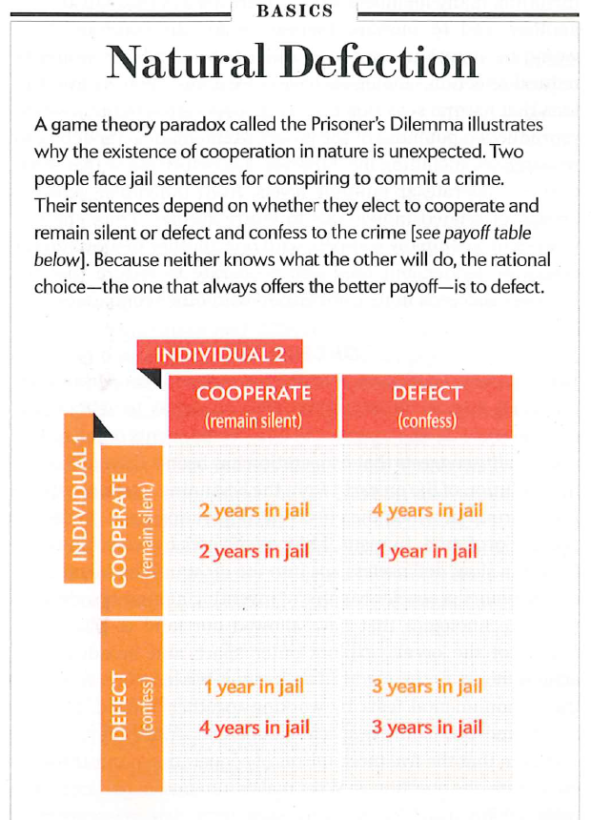
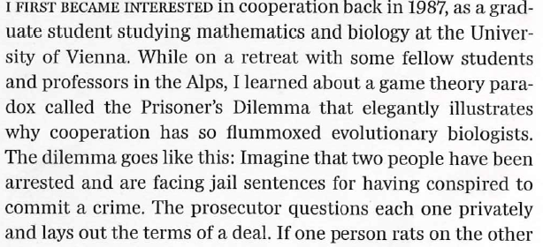
Math & Biology, Vienna Univ.

Slide 10
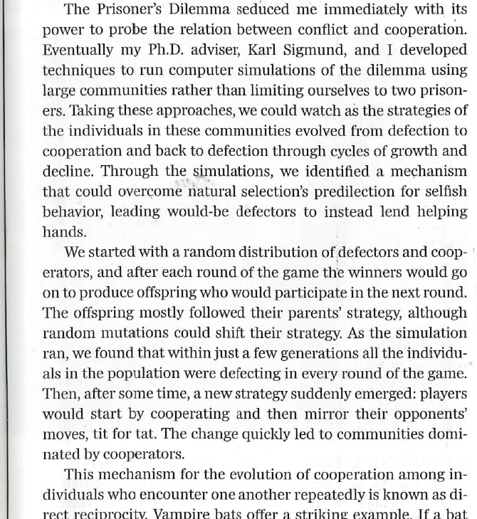
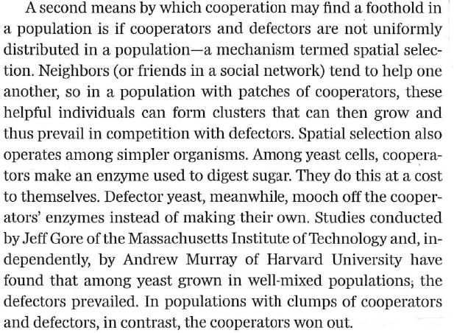
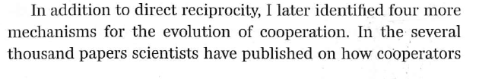
DIRECT RECIPROCITY
Random distribution vs. non-uniform distribution
of defectors and cooperators

Slide 11
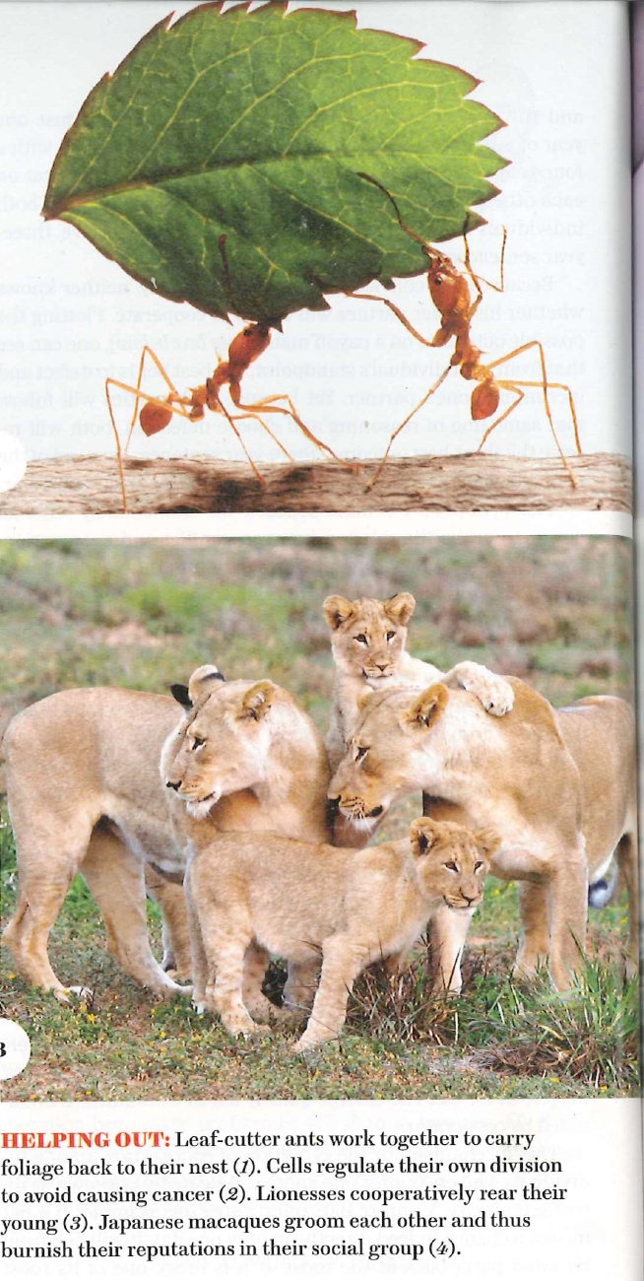
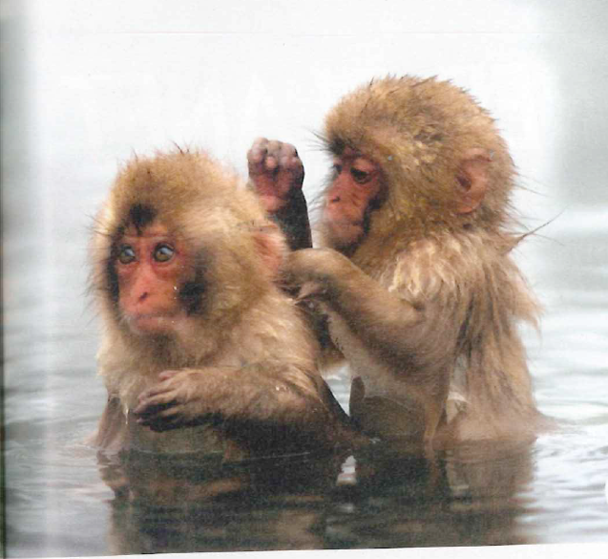
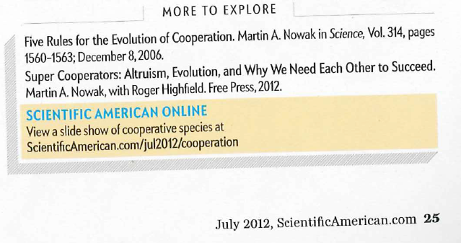

Slide 12
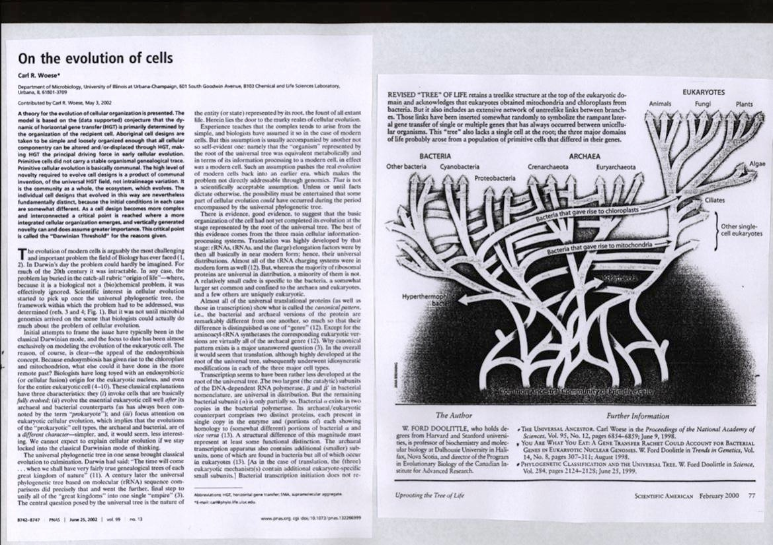
Horizontal gene transfer - cell conglomerate
instead of single cell ancestor

Slide 13
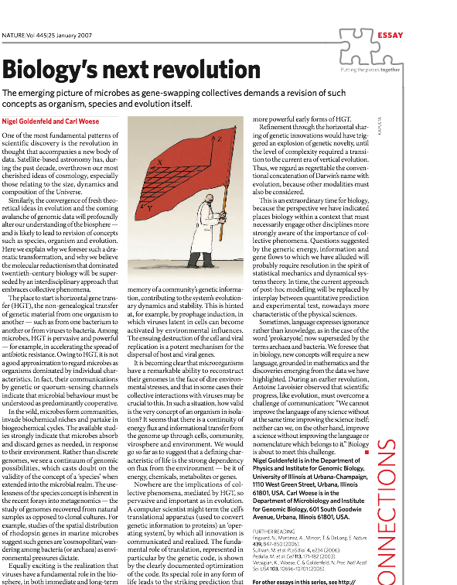
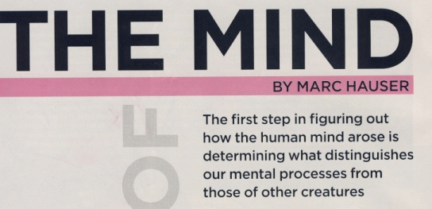
Thus we regard as regrettable the conventional concatenation of Darwin’s name with evolution, because other modalities must also be considered

Slide 14
EVOLUČNÍ BIOLOGIE
- rychle se vyvíjející vědecká disciplina
vedle ní existuje IDEOLOGIE EVOLUCIONISMU
PODLE DARWINISTY M. RUSE NENÍ
BOJ EVOLUCIONISMU S KREACIONISMEM
BOJEM VĚDY S NÁBOŽENSTVÍM ALE
BOJEM NÁBOŽENSTVÍ S NÁBOŽENSTVÍM
M. Ruse, The Evolution-Creation Struggle
HARVARD UNIVERSITY PRESS , 2005

Slide 15
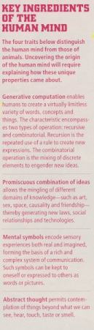
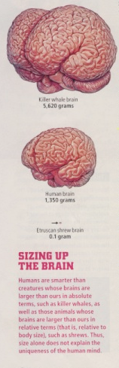
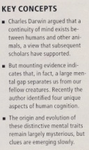
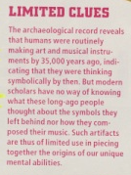
Text
JEDINEČNOST LIDSKÉHO MOZKU NELZE VYSVĚTLIT jeho VELIKOSTÍ
Sci. Amer. , Sept. 2009

Slide 16
JOHANN GREGOR MENDEL
* 1822 in Hynčice (Moravia, Austro-Hungarian Empire)
+ 1884 in Brno (buried at Central Cemetery in Brno)
In the 1950´s Mendelism declared to be a reactionary teaching (LYSENKO, LEPESHINSKAYA)
Mendel statue removed and its destruction ordered
Brno geneticist J. Kříženecký jailed
His pupil V. Orel forced to work manually in industry
1964 attempts to rehabilitate Mendel
Academicians B. Němec (biologist) and F. ŠORM (biochemist, President of the Czechoslovak Academy of Sciences) backed by Soviet Academicians. Dealing between N. Khrushtchov, A. Novotný (President of Czechoslovakia), F. Šorm and biologist J. Pospíšil (later the Party Secretary) resulted in the decision to organize an international conference in 1968 (100 anniversary of publication of Mendel´s paper) in Brno (F. Šorm warned by Novotný that his attempts may result in the end of his career if the action will get out of control). Beginning of Mendel´s Museum in Brno
A milestone not only in the approach of Party and State to Mendel but also a beginning of rehabilitation of SCIENCE against the COMMUNIST IDEOLOGY
discovered through breeding experiments with peas that traits are inherited based on specific laws (later to be termed “Mendel’s laws”). By mentioning Elements of Heredity he predicted DNA and genes (published 1866, lecture in Brno 1965)

Slide 17
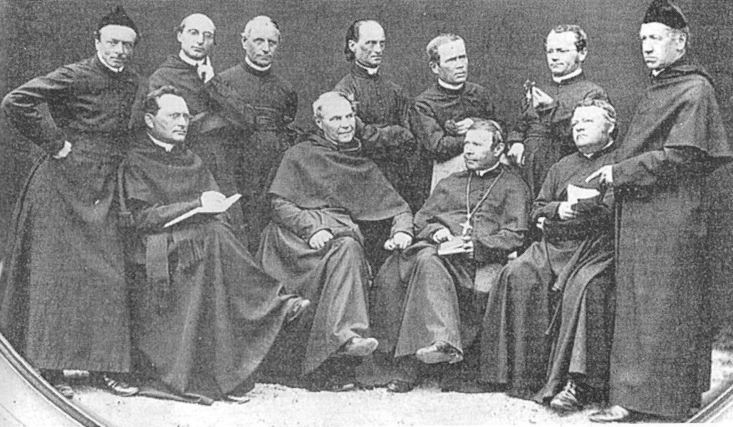
Brno Augustinians 1860-62 Abbot C. Napp

Slide 18
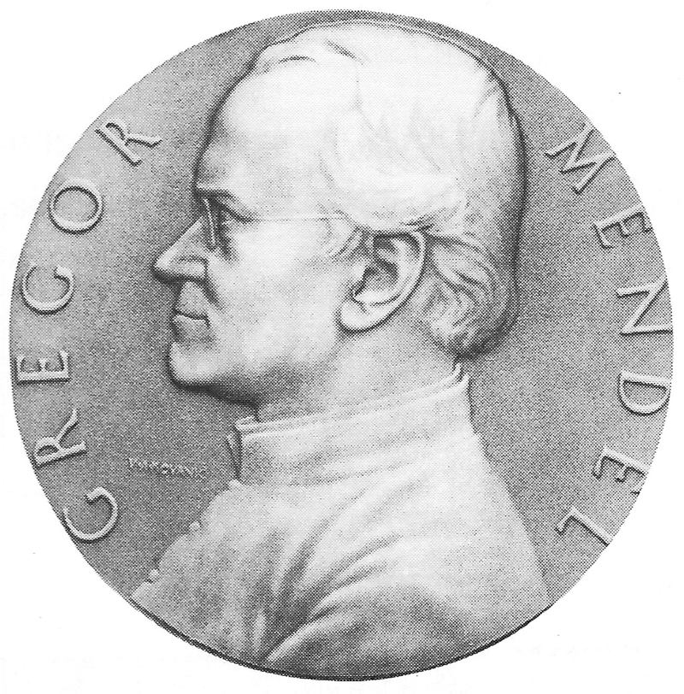
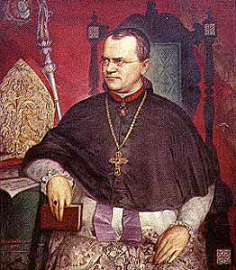
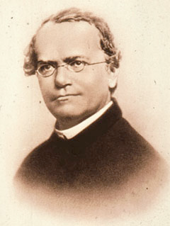
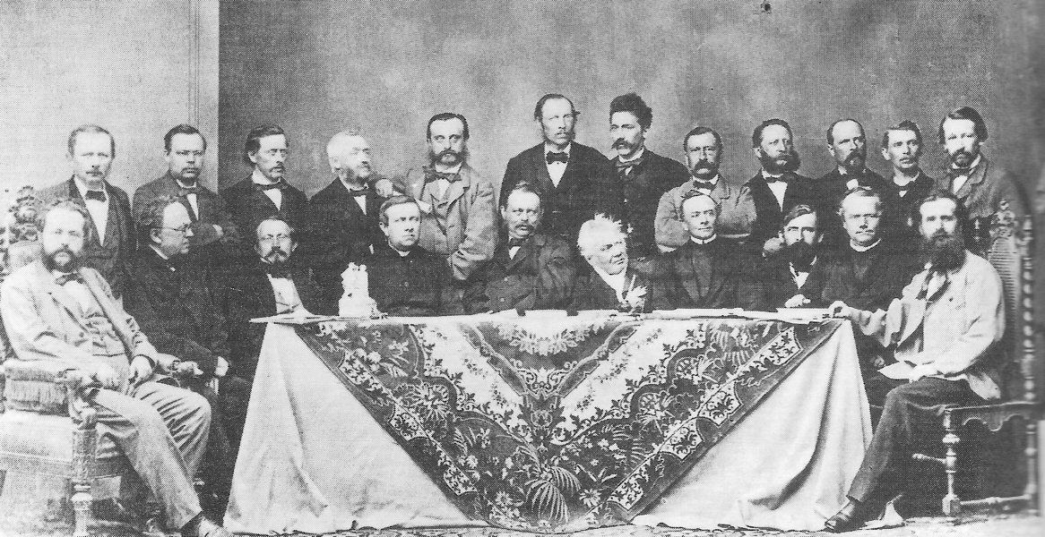
Mendel’s Medal,
Moravian Museum, Brno
Abbot G. Mendel
G J MENDEL, priest, teacher, scientist and abbot
in BRNO
Teachers of Brno gymnasium (High School)

Slide 19
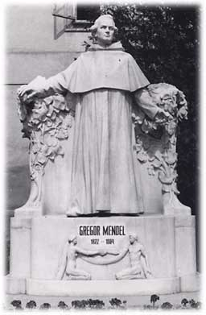
THE STATUE STORY
In 1906 Dr. Hugo Iltis, the gymnasium professor in Brno organized an international
collection to build the Mendel‘s Statue in Brno. Created by a French sculpturer
T. Charlemont the Statue was errected at the Mendel Square in 1910
In 1956 Mendel‘s Statue was ordered by the Regional Authorities to be destroyed.
The workers who were supposed to the job decided not to do it because they believed
that the statue was nice. Moreover it would be difficult to destroy it.
After February 1948 Soviet „Lysenkism“ (T. D. Lysenko 1896-1974) strongly
affected biology in Czechoslovakia. After Stalin death (1953) attempts were made
by soviet scientists (particularly by physists and chemists) to substitute Lysenko‘s
„materialistic biology“ for normal science and by the end of 1950’s plans were made to organize in Brno International Mendel Memorial Symposium. In 1962 Lysenko‘s work was criticized by the Soviet Academy but
still in September 1964 N.S. Khrushtchov raised objections against the Mendel Symposium in 1965 in Brno. During his visit in Prague he dealt with the President A. Novotny who finally agreed with the meeting organization after the President of the Academy F. Sorm personally guaranteed that the Symposium will not be politically misused. (F. Sorm was well informed about the activities of the influential Soviet scientist to rehabilitate fully the genetics - Soon after his visit of this country N.S. Khrushtchov was removed from his position).
Before the Symposium the Director of the Institute of Biophysics prof. F. Hercik was entrusted by the Academy
to help with the organization of the Mendel International Meeting in Brno. To fulfill his duties he turned
to the City Authorities asking to move the Mendel‘s Statue to the Abbey garden. As his request was ignored
he asked his graduate students J. Koudelka and B. Janík to move the Statue from the Abbey yard to the garden.
Both fellows were quite strong young men but they found the marble Statue too heavy.

Slide 20
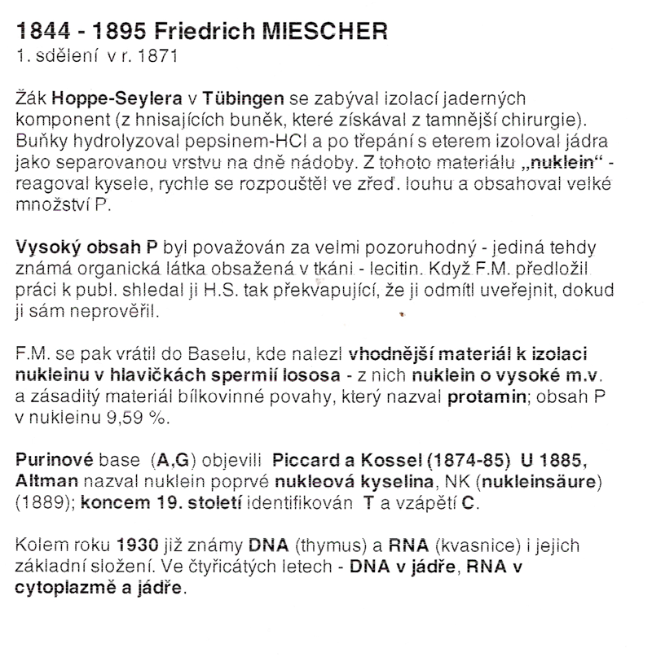

Slide 21
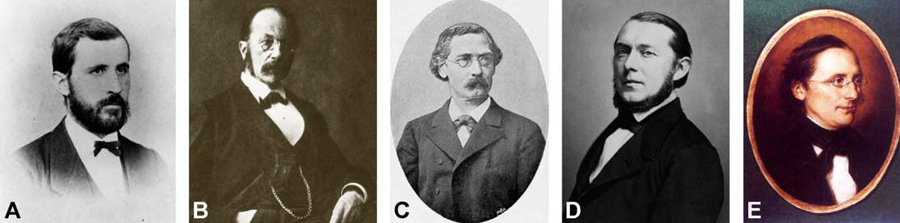
F. Miescher
W. His
F. Hoppe-Seyler
A. STRECKER
Fig. 1. Friedrich Miescher and his mentors. (A) Friedrich Miescher (1844–1895) as a young man. (B) Wilhelm His (1831–1904), Miescher’s uncle. His still is
famous for his work on the fate of cells and tissues during embryonic development and for his insights into neuroembryology. He, for example, discovered
neuroblasts and coined the term bdendriteQ (Finger, 1994; Shepherd, 1991). (C) Felix Hoppe-Seyler (1825–1895), one of the pioneers of physiological
chemistry (now biochemistry). Hoppe-Seyler performed seminal work on the properties of proteins, most notably hemoglobin (which he named), introduced
the term bproteidQ (which later became bproteinQ), and worked extensively on fermentation and oxidation processes as well as lipid metabolism (Perutz, 1995).
He was instrumental in founding Germany’s first independent institute for physiological chemistry (in 1884) and in 1877 founded and edited the first journal of
biochemistry, the Zeitschrift fu¬r Physiologische Chemie, which still exists today as Biological Chemistry. (D) Adolf Strecker (1822–1871), a leading figure in
chemistry in the mid-19th century and professor at the University of Tubingen from 1860 to 1870. Among other achievements, he was the first to synthesize aamino acid (alanine from acetaldehyde via its condensation product with ammonia and hydrogen cyanide) in a reaction known today as Strecker synthesis
(Strecker, 1850). (E) Carl Ludwig (1816–1895), a protagonist in the field of physiology in the second half of the 19th century. His focus was the physiology of
the nervous system and its sensory organs. In 1869, he founded Leipzig’s Physiological Institute.

Slide 22
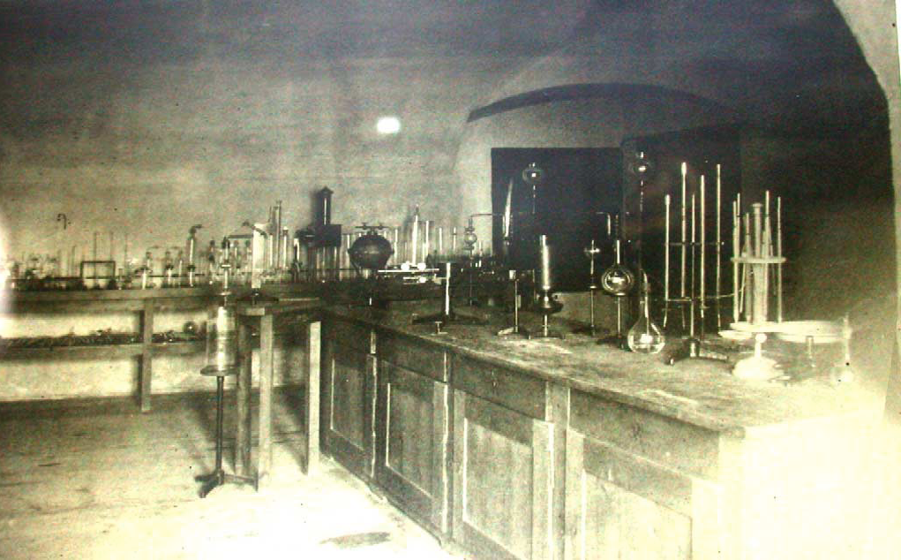
Hoppe-Seyler’s laboratory around 1879

Slide 23
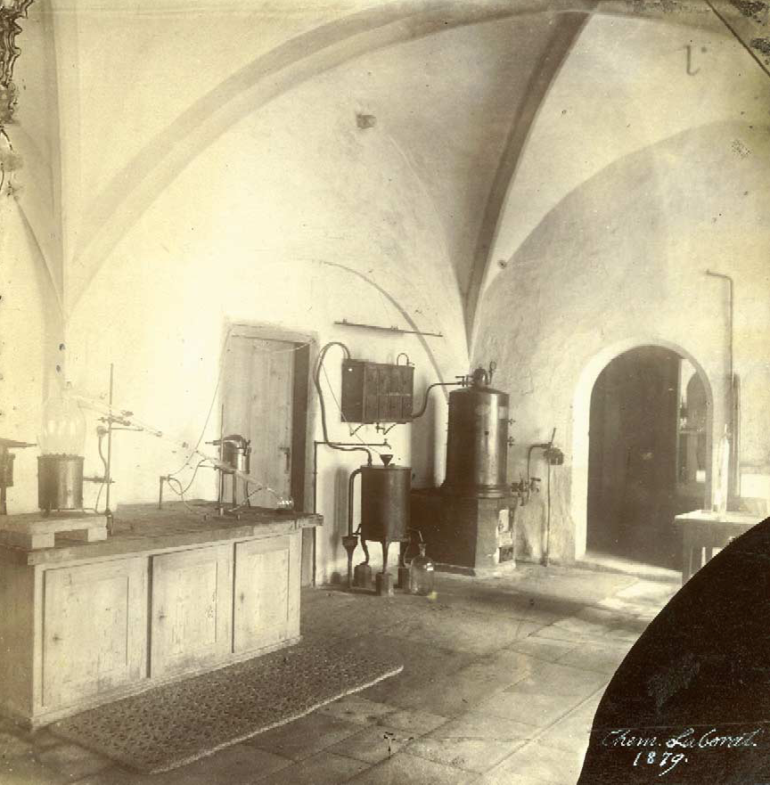
F. Miescher’s laboratory

Slide 24
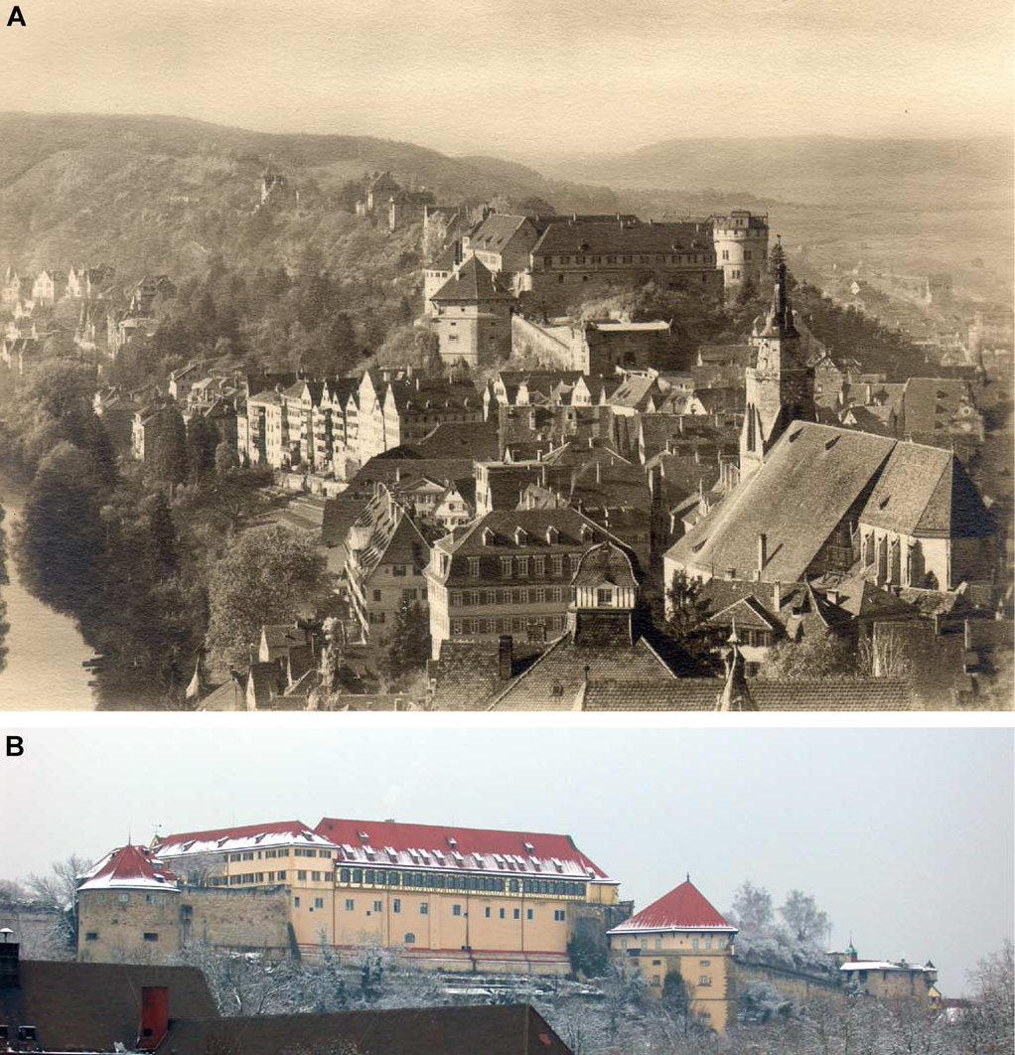
Tübingen castle
A, in Miescher’s time
Text
B, at present

Slide 25
FIRST PROTOCOL
Before attempting the isolation of cells from the pus on surgical bandages, Miescher took great care to ensure that his
source material was fresh and not contaminated. He painstakingly examined it and discarded everything that showed signs
of decomposition, either in terms of smell, appearance under the microscope, or by having turned acidic. A great deal of the
material he could obtain did not meet these strict requirements (Miescher, 1871d). Those samples that did were
subsequently used to isolate leucocytes.
In a first step, Miescher separated the leucocytes from the bandaging material and the serum (Miescher, 1869a,
1871d). This separation posed a problem for Miescher. Solutions of NaCl or a variety of alkaline or alkaline earth salt
solutions used to wash the pus resulted in a “slimy swelling” of the cells, which was impossible to process further
(His, 1897b). (This “slimy swelling” of the cells was presumably due to high-molecular-weight DNA, which had been
extracted from cells that had been damaged.) Only when Miescher tried a dilute solution of sodium sulfate [a mixture
of one part cold saturated Glauber’s salt (Na2SO4d 10 H2O) solution and nine parts water] to wash the bandages did he
manage to successfully isolate distinct leucocytes, which could be filtered out through a sheet to remove the cotton
fibers of the bandaging. Miescher subsequently let the washing solution stand for 1–2 h to allow the cells to sediment
and inspected the leucocytes microscopically to confirm that they did not show any signs of damage.
Having isolated the cells, Miescher next had to separate the nuclei from the cytoplasm. This had never been
achieved before and Miescher had to develop new protocols. He washed the cells by rinsing them several (6–10) times
with fresh solutions of diluted (1:1000) hydrochloric acid over a period of several weeks at “wintry temperatures”
(which were important to avoid degradation). This procedure removed most of the cells’ bprotoplasm,Q leaving behind
the nuclei. The residue from this treatment consisted in part of isolated nuclei and of nuclei with only little fragments of
cytoplasm left attached. Miescher showed that these nuclei could no longer be stained yellow by iodine solutions, a
method commonly used at the time for detecting cytoplasm (Arnold, 1898; Kiernan, 2001).
He then vigorously shook the nuclei for an extended period of time with a mixture of water and ether. This caused
the lipids to dissolve in the ether while those nuclei, still attached to cytoplasm, collected at the water/ether interface.
By contrast, the clean nuclei without contaminating cytoplasm were retained in the water phase. Miescher filtered these
nuclei and examined them under a microscope. He noticed that in this way he could obtain completely pure nuclei
with a smooth contour, homogeneous content, sharply defined nucleolus, somewhat smaller in comparison to their
original volumes (Miescher, 1871d).
Miescher subsequently extracted the isolated nuclei with alkaline solutions. When adding highly diluted (1:100,000)
sodium carbonate to the nuclei, he noticed that they would swell significantly and become translucent. Miescher then
isolated a yellow solution of a substance from these nuclei. By adding acetic acid or hydrochloric acid in excess, he
could obtain an insoluble, flocculent precipitate (DNA). Miescher noted that he could dissolve the precipitate again by
adding alkaline solutions.
Although this protocol allowed Miescher for the first time to isolate nuclein in appreciable purity and quantities, it was
still too little and not pure enough for his subsequent analyses. He consequently improved on this protocol until he
established the protocol detailed in Box 2, which enabled him to purify sufficient amounts of nuclein for his first set of
experiments on its elementary composition.
Box 1

Slide 26
M. SECOND PROTOCOL TO ISOLATE DNA
A key concern of Miescher’s was to get rid of contaminating proteins, which would have skewed his analyses of the novel substance. “I therefore turned to an agent that was already being used in chemistry with albumin molecules on account of its strong protein-dissolving action, namely, pepsin solutions (Miescher, 1871d). Pepsin is a proteolytic enzyme present in the stomach for digesting proteins. Miescher used it to separate the DNA from the proteins of the cells’ cytoplasm. He extracted the pepsin for his experiments from pig stomachs by washing the stomachs with a mixture of 10 cc of fuming hydrochloric acid and one liter of water and filtering the resulting solution until it was clear. In contrast to his earlier protocol, Miescher first washed the pus cells (leucocytes) three or four times with warm alcohol to remove lipids. He then let the residual material digest with the pepsin solution between 18 and 24 h at 37–45 C. After only a few hours, a fine gray powdery sediment of isolated nuclei separated from a yellow liquid. Miescher continued the digestion process, changing the pepsin solution twice. After this procedure, a precipitate of nuclei without any attached cytoplasm formed. He shook the sediment several times with ether in order to remove the remaining lipids. Afterwards, he filtered the nuclei and washed them with water until there was no longer any trace of proteins. He described the nuclei isolated in this way as naked. The contours were smooth in some cases or slightly eaten away in others (Miescher, 1871d). Miescher washed the nuclei again several times with warm alcohol and noted that the nuclear mass cleaned in this way exhibited the same chemical behavior as the nuclei isolated with hydrochloric acid. Miescher subsequently extracted the isolated nuclei using the same alkaline extraction protocol he had previously employed on the intact cells (see Box 1) and, when adding an excess of acetic acid or hydrochloric acid to the solution, again obtained a precipitate of nuclein.

Slide 27
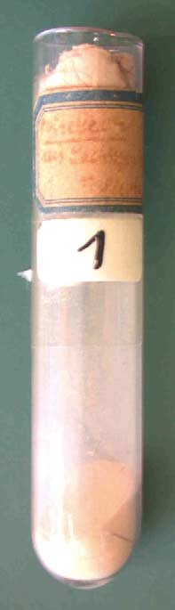
Fig. 5. Glass vial containing nuclein isolated from salmon sperm by
Friedrich Miescher while working at the University of Basel. The faded
label reads Nuclein aus Lachssperma, F. Miescher (Nuclein from salmon
sperm, F. Miescher). Possession of the Interfakult-res Institut fqr
Biochemie (Interfacultary Institute for Biochemistry), University of
Tubingen, Germany; photography by Alfons Renz, University of Tubingen.

Slide 29
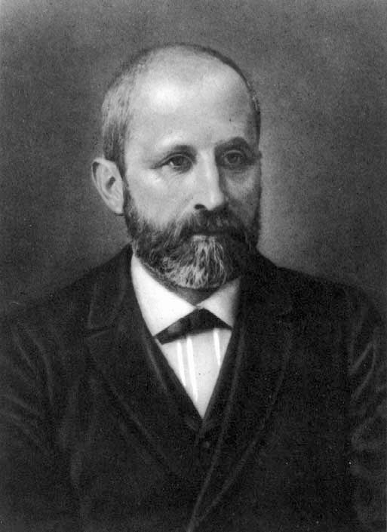
Fig. 6. This picture of Friedrich Miescher in his later years is the
frontispiece on the inside cover of the two volume collection of Miescher’s
scientific publications, his letters, lecture manuscripts, and papers published
posthumously by Wilhelm His and others (His et al., 1897a,b).

Slide 30
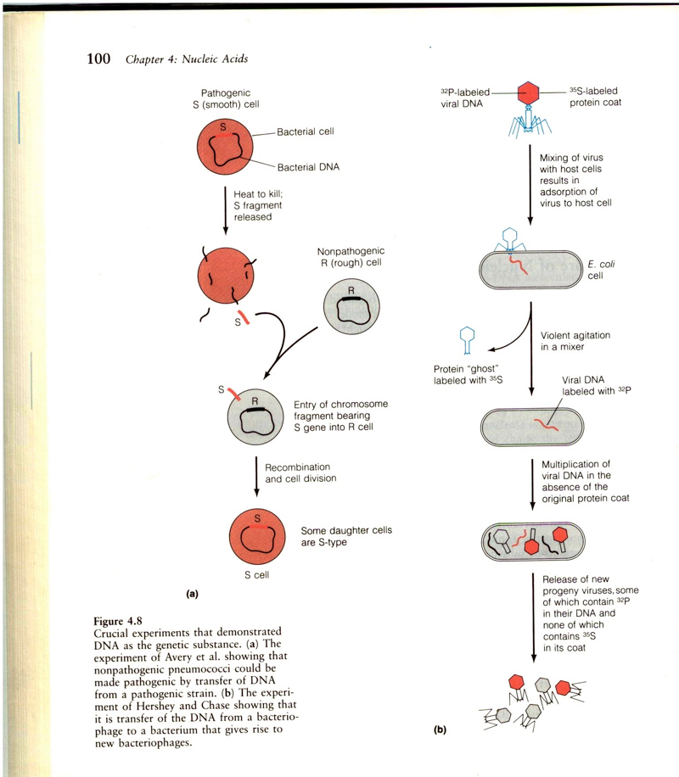
(a) 1944: Oswald T. Avery, Colin MacLeod, and Maclyn McCarty demonstrate that Griffith’s transforming principle is not a protein, but rather DNA, suggesting that DNA may function as the genetic material
(b) 1952: Alfred Hershey and Martha Chase use viruses (bacteriophage T2) to confirm DNA as the genetic material by demonstrating that during infection viral DNA enters the bacteria while the viral proteins do not and that this DNA can be found in progeny virus particles.

Slide 31
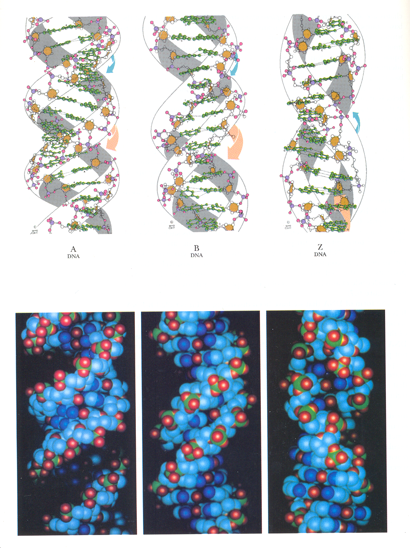
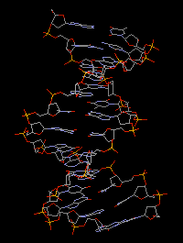
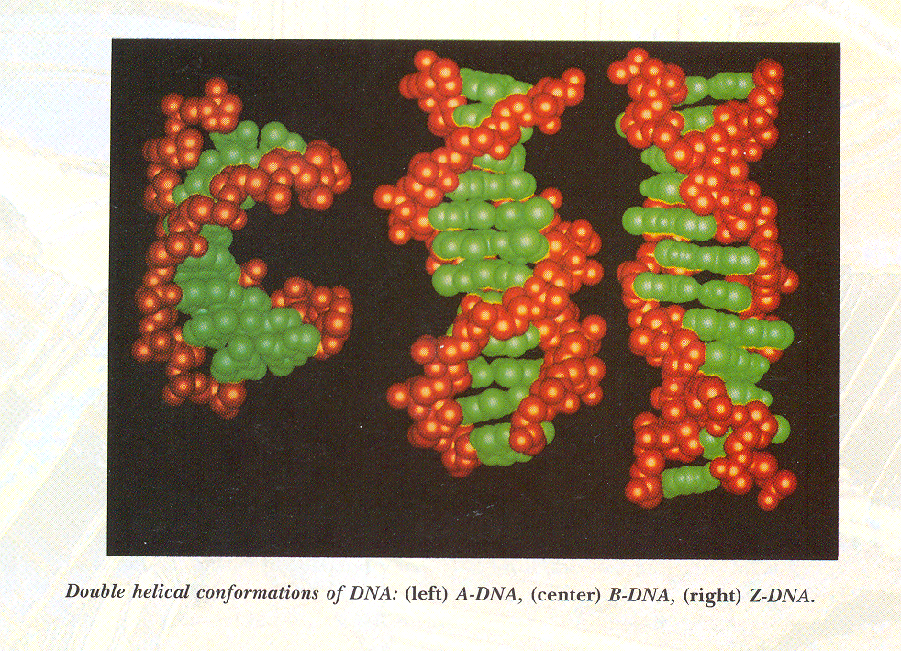
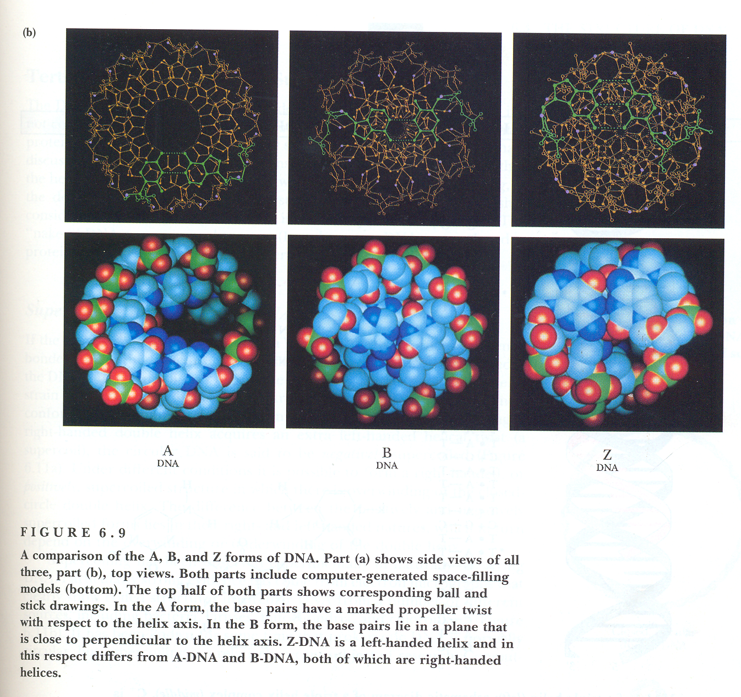
A, B and left-handed Z-DNA
as we know them now
How did we arrive to them ?

Slide 32
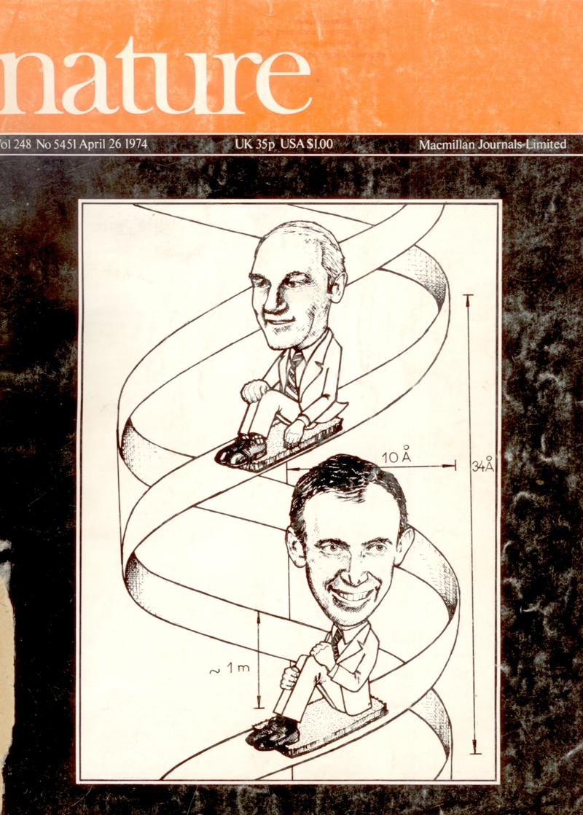
21st Anniversary:
The DNA Double Helix
Comes of Age

Slide 33
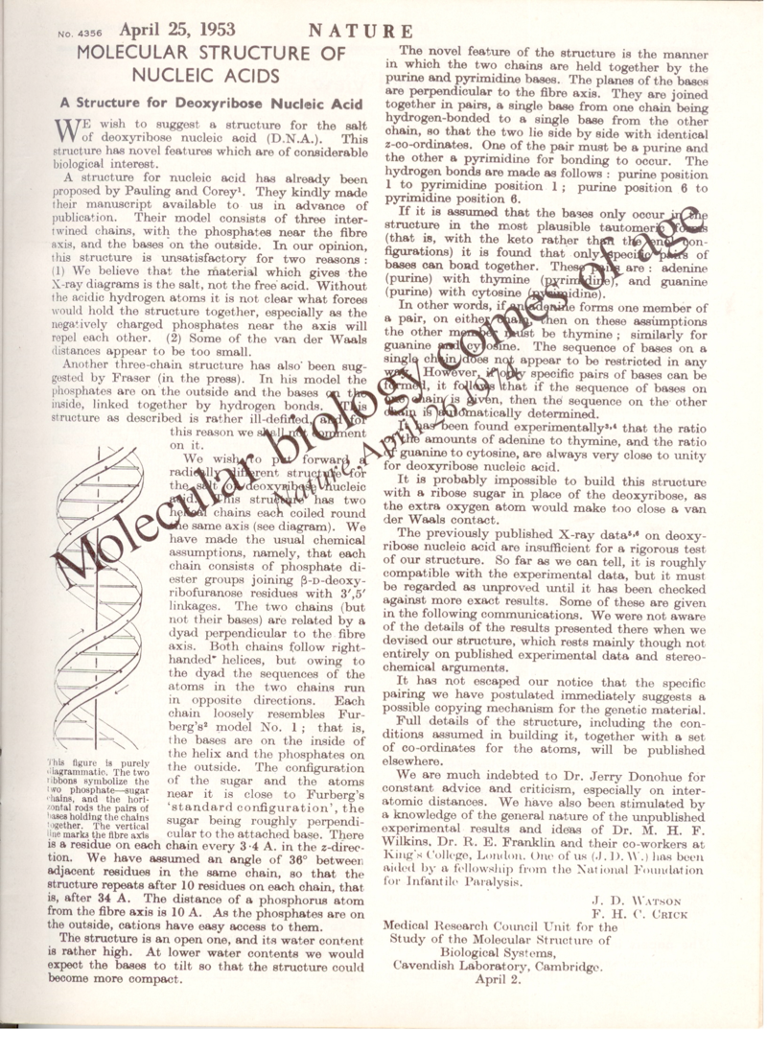

Slide 34
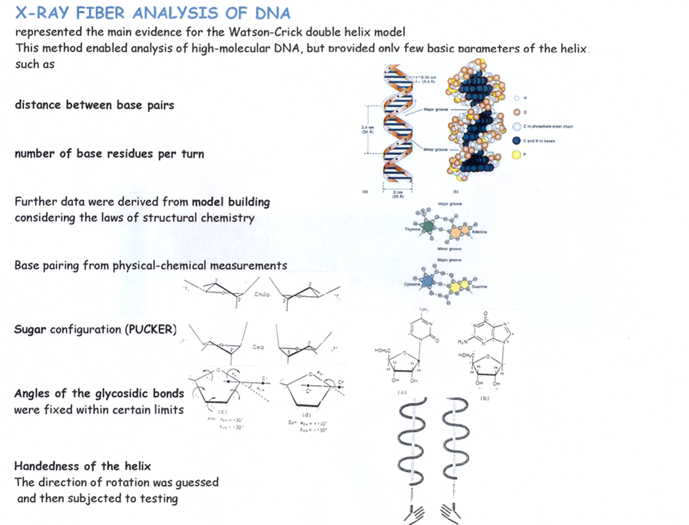
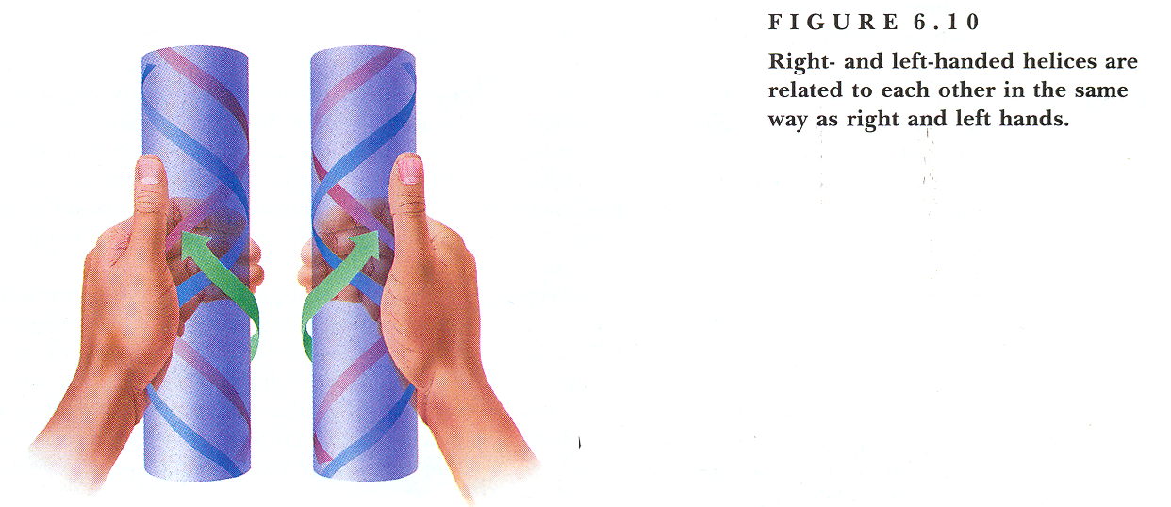

Slide 35
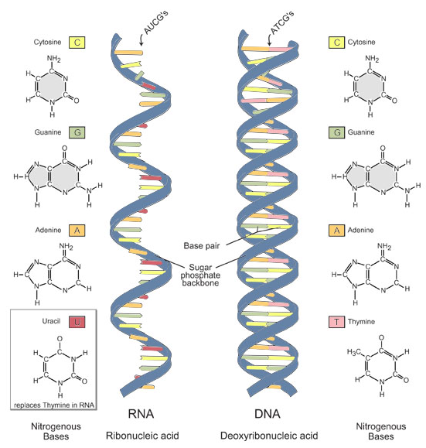
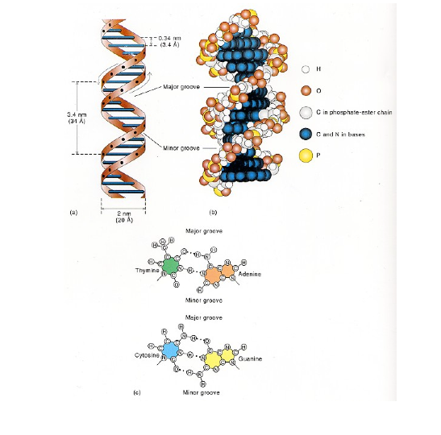
DNA is a polyanionic biomacromolecule with bases in its interior and sugar-phosphate backbone on the surface. At neutral pH it carries one negative charge per nucleotide. Below pH 5 and and above pH 9 ionization of bases become important

Slide 36
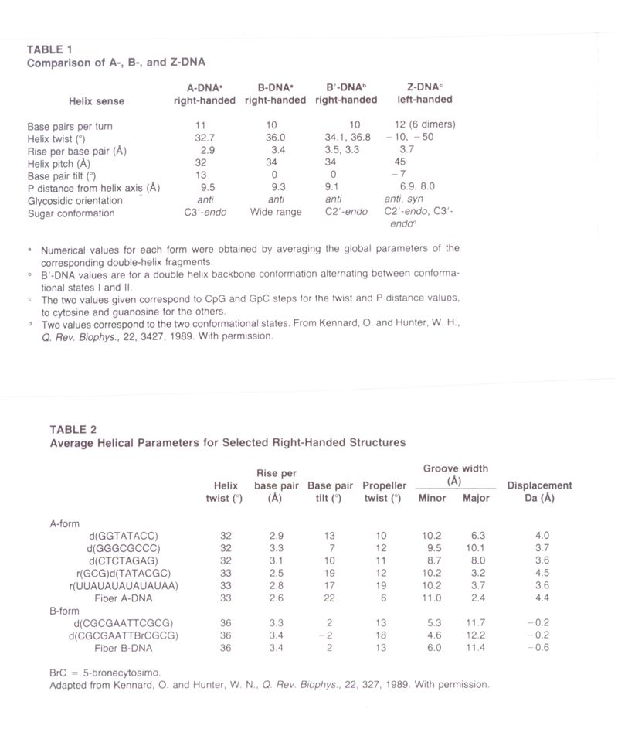
Parameters of DNA structures
A B Z
DNA structures from X-ray crystal analysis
DNA double helix is polymorphic
depending on the nucleotide sequence

Slide 37
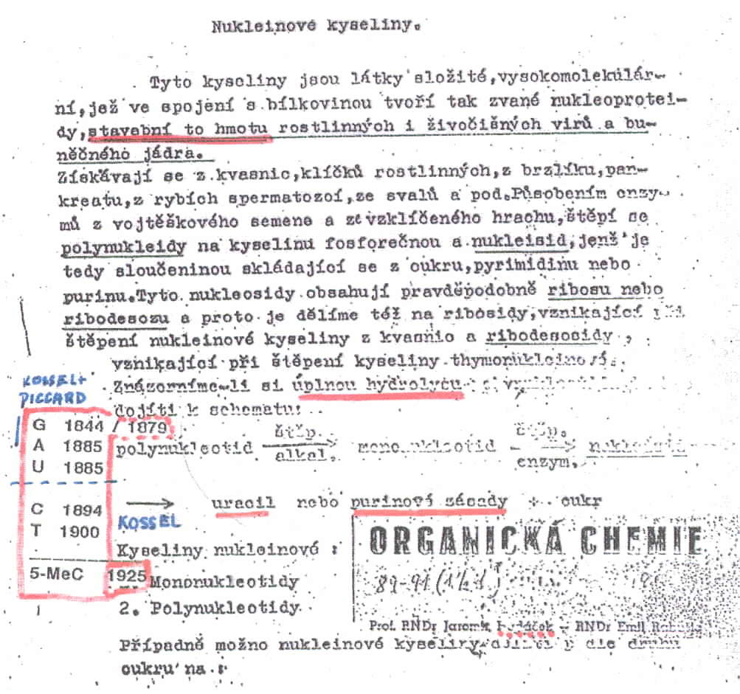
1953
A paragraph dealing with nucleic acids
from a text book of Organic Chemistry (in Czech) is shown.
Briefly, it says nucleic acids (NA‘s) form complexes with
proteins which are the building blocks of plant and animal
viruses and of cell nucleus. Total hydrolysis of NA‘s proceeds
according to the following scheme:
alkaline hydrolysis enzym. digestion
Polynucleotide mononucleotide uracil or purine bases
Considering that uracil and adenine were discovered in 1885 and G in 1844
while C in 1894 and T in 1900, our lectures on NA‘s were up-todate in 1885
but not in 1894
In courses of Marxism-Leninism (obligatory to all students)
we were tought that G. Mendel was a burgeois reactionary pseudoscientist.
Interestingly there was not a single chemist among us who believed it.
To my surprise there were some biologists who took this nonsense seriously

Slide 38
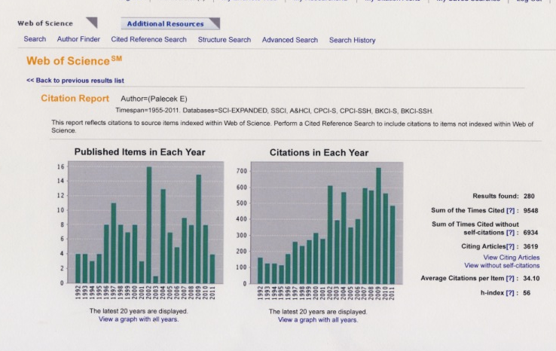
Text
280
9548
56

Slide 39

2009
264
8280
31.36
52
Chemická reaktivita a struktura nukleových kyselin. Lokální struktury DNA stabilizované superhelikálním vinutím; Interakce DNA a bílkovin s povrchy; Interakce DNA-protein
Elektrochemie nukleových kyselin a bílkovin;
Nádorové supresory, zejména protein p53; Agregace bílkovin v neurodegenerativních chorobách (zejména agregace α-synucleinu v Parkinsonově chorobě)

Slide 40


WEB OF SCIENCE
311 Počet publikací
11 840 počet citací
38.07 citace/publikace
62 h-index
Když si budete vybírat téma své dizertace snažte se zjistit nejen zda vám téma vyhovuje ale také, jak je váš budoucí školitel ve vědě úspěšný
Společné a vlastní a publikace
ÚLOHA JEDNOTLIVCE

Slide 41



Slide 42
Vědecká rada navrhla na cenu Česká hlava biochemika Emila Palečka
16. září 2014 v 18:18
Biochemik Emil Paleček (na snímku z 12. února 2014)
Foto: ČTK
Prestižní Národní cenu vlády Česká hlava 2014 dostane biochemik Emil Paleček z Biofyzikálního ústavu Akademie věd ČR. Rozhodla o tom Rada pro výzkum, vývoj a inovace. Palečkovo ocenění ještě musí schválit vláda.
„Musím říct, že mě to velmi překvapilo, ba přímo šokovalo. Já jsem to nečekal. Samozřejmě mám z toho radost,“ reagoval Emil Paleček na zprávu o svém ocenění.
Členové Rady pro výzkum, vývoj a inovace jednomyslně vybrali profesora Palečka z celkem devíti kandidátů, které nominovaly instituce na základě výzvy projektu Česká hlava.
Vědecká
00:00
Vědecká rada navrhla na cenu Česká hlava biochemika Emila Palečka. Rozhovor s ním přinesl Radiožurnál
Vložit na svůj web

Slide 43


2010 + elektrochemie poly- a oligosacharidů, glykoproteiny
273
8.836
32,37
54
Společné a vlastní a publikace
ÚLOHA JEDNOTLIVCE
Elektrochemie biomakromolekul
bílkoviny, glykoproteiny
DNA, RNA

Slide 44






90 years of polarography and ~55 years of nucleic acid electrochemistry
This year we commemorate the 90th Anniversary of the invention of polarography by J. Heyrovsky. In 1941 he invented oscillographic polarography with controlled a.c. (cyclic a.c. chronopotentiometry). By the end of the 1950‘s oscillographic polarography was the method of choice for the DNA electrochemical analysis:
1958: Nucleic acid bases, DNA and RNA are electroactive
1960: Relations between the DNA structure and electrochemical responses
E. Palecek, Naturwiss. 45, 186-187
Electrochemistry of nucleic acids is now a booming field
112 (2012) 3427-3481
IF 33
WHY?
progress in GENOMICS
increasing importance
of parallel nucleotide
sequencing
electrochemistry can
complement optical
detection in arrays
and particularly in chips
for decentralized
analysis
E. Palecek, Nature 188 (1960) 656-657
1960-66 Relation between the DNA structure and electrochemical responses
1974 DNA unwinding at negatively charged surfaces
1981-83 Electroactive markers covalently bound to DNA
1986-88 DNA-modified electrodes

Slide 45


H. BERG
Bchem Z. 1957:
DNA and RNA are INACTIVE
50 years of nucleic acid electrochemistry
1958: Nucleic acid bases, DNA and RNA are electroactive
...part of the guanine ring important for the anodic signal is near to the surface
whereas the the analogous part of cytosine is hidden inside the DNA double helix
participating in the hydrogen bonding.... (showing a cathodic signal in ssDNA
but not in dsDNA)
E. Palecek, Nature 188 (1960) 656-657
E. Palecek, Fifty years of nucleic acid electrochemistry, Electroanalysis 2009

Slide 46


Paleček Emil
Chemická reaktivita a struktura nukleových kyselin. Lokální struktury DNA stabilizované superhelikálním vinutím; Interakce DNA a bílkovin s povrchy; Interakce DNA-protein;
248
7 524
50
Elektrochemie nukleových kyselin a bílkovin;
Nádorové supresory, zejména protein p53; Agregace bílkovin v neurodegenerativních chorobách (zejména agregace α-synucleinu v Parkinsonově chorobě)

Slide 47



Electrochemical analysis of proteins and peptides at Hg electrodes in the presence of large excess of thiols was difficult or impossible.
Recently we have found that peak H is produced by proteins adsorbed at mercury and solid amalgam electrodes modified by different kinds of thiol self-assembled monolayers (SAMs). For practical reasons we were primarily interested in DTT SAMs.
V. Ostatná, H. Cernocká, E. Palecek (2010) J.Am. Chem. Soc., 132, 9408-9413
Thiol SAM
protein-modified
electrode
Temperature, at which the electrode process is taking place, greatly influences the electrochemical behavior of the surface-immobilized proteins.

Slide 48

Tumor suppressor protein p53
declared „The Molecule of the Year“ by Science magazine in 1993 perhaps the most important protein in the development of cancer. This protein p53 plays a critical role in the cellular response to DNA damage by regulating the expression of genes involved in controlling cell proliferation, DNA repair, and apoptosis. P53 protein is inactivated by mutation in about 50 % of human malignancies. Most mutations are located in the DNA-binding core domain of the protein. p53 protein is biologically active in its reduced state and is usually stored with mM concentrations of reducing agent - dithiothreitol (DTT).
EU 6th FP: Mutant p53 as target
for improved cancer therapy

Slide 49

8.6 11.1 13.9 °C
p53 core domain
Mutation in R175H induces structural perturbation at the zinc-binding site, destabilizes the core domain by 3 kcal/mol and eliminates p53 sequence specific DNA binding. The same effect can be observed in the wt core domain upon removal of the zinc ion.
We tested other mutants such as V145A, F270L, R273H and Y220C and we always observed CPS responses different from
the wt protein
    15.9 17.9 20.3 °C
H1
H2
E. Palecek et al. JACS 2011, 133, 7190–7196

Slide 50

The Protein Group
Hana Cernocka
Mojmir Trefulka
Petra Mittnerova
Emil Palecek
Lida Rimankova
Martin Bartosik
Veronika Ostatna
Veronika Vargová

Slide 51
2. přednáška 7.10.

Slide 52

Negative SUPERCOILING stabilizes
local DNA structures
CRUCIFORM
inverted repeat
LEFT-HANDED Z-DNA
alternating pu-py
SUPERCOIL
TRIPLEX structure
homopu.homopy
Text
CURVATURE
4-6 A’s in phase with the helix turns
HAIRPIN
SINGLE-STRANDED region
AT-rich
Physical methods such as NMR and X-ray analysis indispensable in the research of
linear DNA structures are of limited use in studies of local structures stabilized by supercoiling

Slide 53
Problems of life origin
What was first - DNA, RNA or protein?
Well-known Oxford zoologist Professor Richard Dawkins (who declares himself to be passionate fighter for the truth) writes in his book River out of Eden:
“At the beginning of Life Explosion there was no mind, no creativity, no intent, there was only chemistry”
Let us try to summarize what chemistry it was

Slide 54



Slide 55



Slide 56


PROBLEMS OF LIFE ORIGINS
S. Miller and H. Urey subjected mixture of methane, ammonia and hydrogen to an electric discharge and led the product into water ...
The Miller-Urey experiment attempted to recreate the chemical conditions of the primitive Earth in the laboratory, and synthesized some of the building blocks of life
but geologists showed that prebiotic atmosphere
was not strongly reducing and not oxygen-free, differring from that expected by Miller and Urey

Slide 57

Cytosine synthesis would not be possible even strongly in reducing
prebiotic atmosphere.
Similar problems arise with the abiotic synthesis of nucleotides
Abiotic synthesis of a complicated molecule such as RNA is highly improbable

Slide 58


Slide 59


NOBEL laureate Christian de Duve has called for “a rejection of improbablities so incomensurably high that they only can be called miracles, phenomena that fall outside the scope of scientific inquiry”. DNA, RNA and PROTEINS must then be set aside as participants in the origin of life.

Slide 60



Slide 61



Slide 62

Peptide Nucleic Acid (PNA)

Slide 63

Panspermia
Or did life come from another world?
The hypothesis of F. Crick is discussed in November issue of Scientific American 2005.
It is concluded that microorganism could have survived a journey from Mars to Earth
Recent finding of glycine in the comet tail might be considered as
support for this alternative
RNA First
Metabolism first (2007)
PNA First (2008)
RNA First (again/2009)
Panspermia again and again
The actual nature of the first organism and the exact circumstances of the origin of life may be forever lost for science.
But research can at least help to understand what is possible
Sci. Amer., September 2009

Slide 64


Slide 65



Slide 66


Slide 67

Or did life come from another world?
The hypothesis of F. Crick is discussed in November issue of Scientific American 2005.
It is concluded that microorganism could have survived a journey from Mars to Earth

Slide 68




DNA DENATURATION and RENATURATION/HYBRIDIZATION
Native dsDNA
Melted ssDNA
J. Marmur and P. Doty

Slide 69


Slide 70

Microbiologist, biochemist and molecular biologist
Julius Marmur – dicovered renaturation of DNA
22 March, 1926 Bialystok (Poland) – 20 May, 1996 New York, NY
Oswald Avery 1944 - DNA is a genetic material
(Rockefeller Institute, New York, NY)
Rollin D. Hotchkiss
1993
Julius Marmur

Slide 71




Francis Crick 21 years after invention of the DNA double helix structure about the discovery of DNA renaturation
Nature 248(1974) 766

Slide 72

  KEY CONCEPTS
• Scientists long assumed that any DNA mutation that does not change the final protein encoded by a gene is effectively “silent”.
• Mysterious exceptions to the rule, in which silent changes seemed to be exerting a powerful effect on proteins, have revealed that such mutations can affect health through a variety of mechanisms.
• Understanding the subtler dynamics of how genes work and evolve may reveal further insights into causes and cures for disease.

Slide 73


Slide 74

MUFFLED MESSAGE
A synonymous mutation was found to affect pain sensitivity by changing the amount of an important enzyme that cells produced. The difference results from alteration in the shape of mRNA that can influence how easily ribosomes are able to unpackage and read the strand. The folded shape is caused by base-pairing of the mRNA´s nucleotides; therefore, a synonymous mutation can alter the way nucleotides match up.

