Slide 1

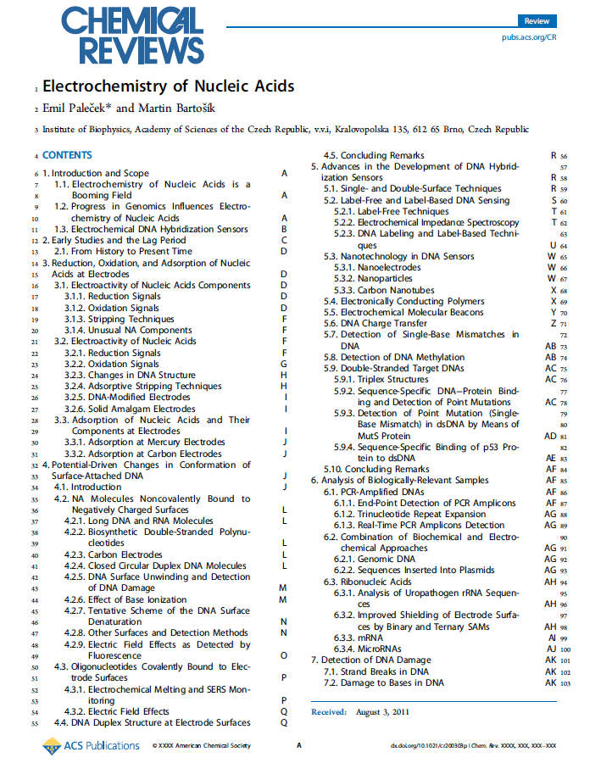
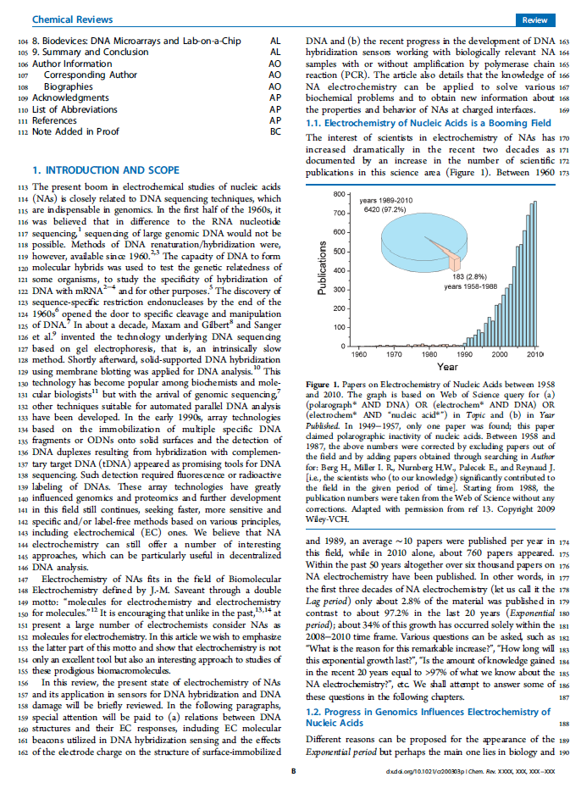


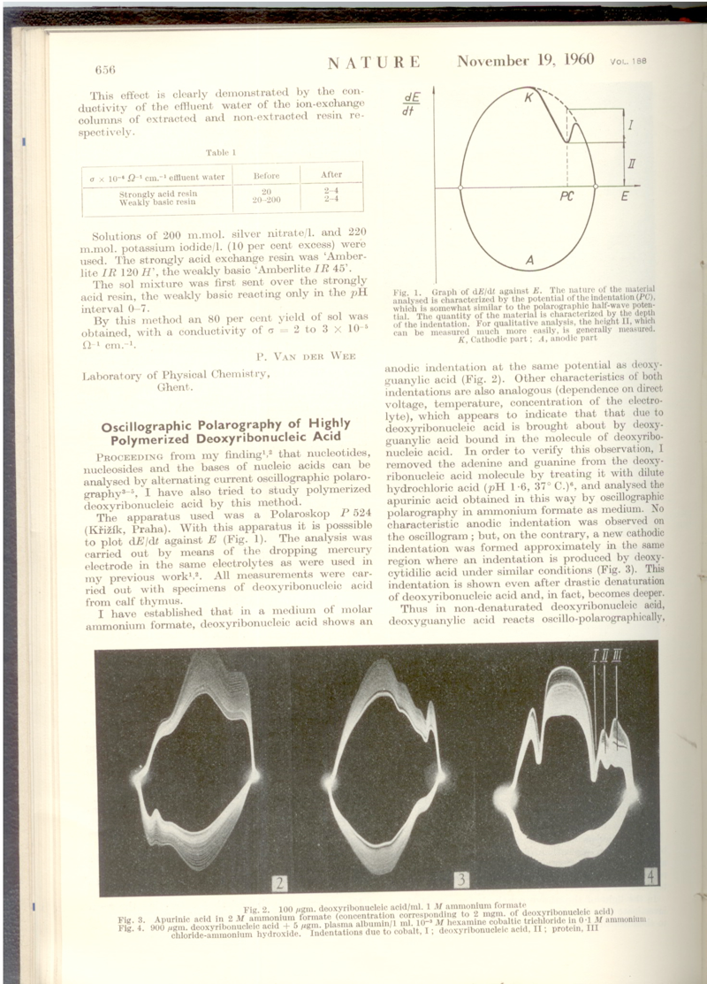
90 years of polarography and ~55 years of nucleic acid electrochemistry
This year we commemorate the 90th Anniversary of the invention of polarography by J. Heyrovsky. In 1941 he invented oscillographic polarography with controlled a.c. (cyclic a.c. chronopotentiometry). By the end of the 1950‘s oscillographic polarography was the method of choice for the DNA electrochemical analysis:
1958: Nucleic acid bases, DNA and RNA are electroactive
1960: Relations between the DNA structure and electrochemical responses
2. PŘEDNÁŠKA 25.9. 2014
E. Palecek, Naturwiss. 45, 186-187
Electrochemistry of nucleic acids is now a booming field
112 (2012) 3427-3481
IF 33
WHY?
progress in GENOMICS
increasing importance
of parallel nucleotide
sequencing
electrochemistry can
complement optical
detection in arrays
and particularly in chips
for decentralized
analysis
E. Palecek, Nature 188 (1960) 656-657
1960-66 Relation between the DNA structure and electrochemical responses
1974 DNA unwinding at negatively charged surfaces
1981-83 Electroactive markers covalently bound to DNA
1986-88 DNA-modified electrodes

Slide 2
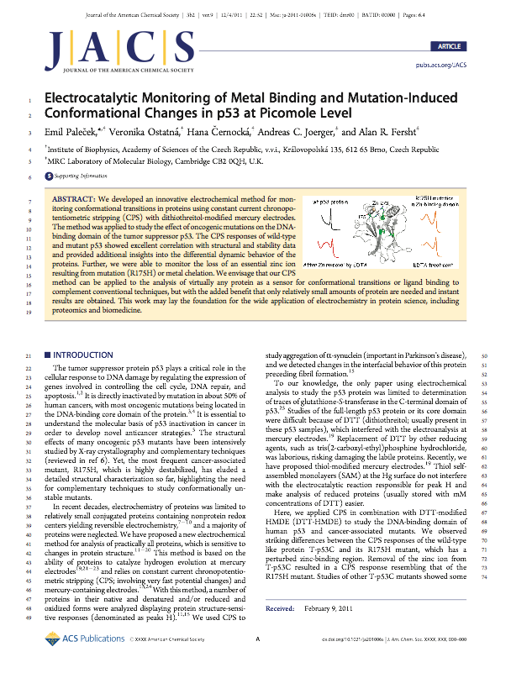
Tumor suppressor protein p53
declared „The Molecule of the Year“ by Science magazine in 1993 perhaps the most important protein in the development of cancer. This protein p53 plays a critical role in the cellular response to DNA damage by regulating the expression of genes involved in controlling cell proliferation, DNA repair, and apoptosis. P53 protein is inactivated by mutation in about 50 % of human malignancies. Most mutations are located in the DNA-binding core domain of the protein. p53 protein is biologically active in its reduced state and is usually stored with mM concentrations of reducing agent - dithiothreitol (DTT).
EU 6th FP: Mutant p53 as target
for improved cancer therapy

Slide 3
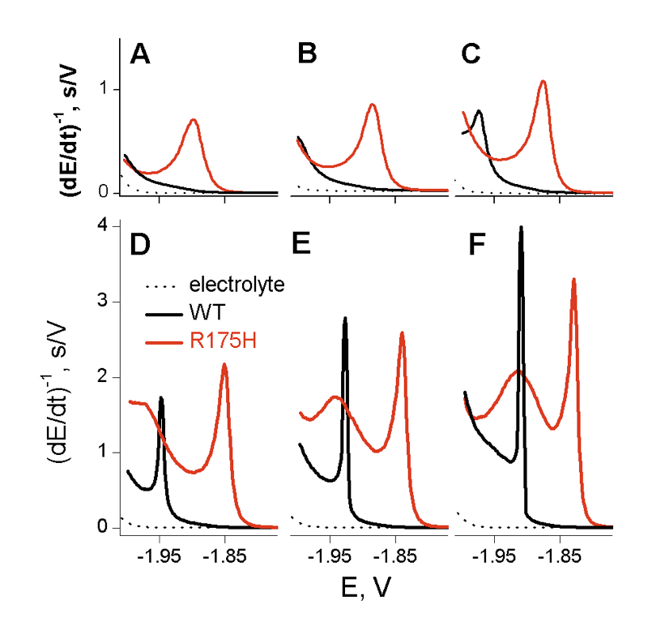
8.6 11.1 13.9 °C
p53 core domain
Mutation in R175H induces structural perturbation at the zinc-binding site, destabilizes the core domain by 3 kcal/mol and eliminates p53 sequence specific DNA binding. The same effect can be observed in the wt core domain upon removal of the zinc ion.
We tested other mutants such as V145A, F270L, R273H and Y220C and we always observed CPS responses different from
the wt protein
    15.9 17.9 20.3 °C
H1
H2
E. Palecek et al. JACS 2011, 133, 7190–7196

Slide 4
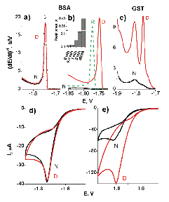
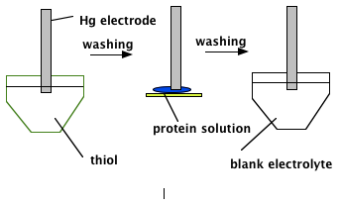

Electrochemical analysis of proteins and peptides at Hg electrodes in the presence of large excess of thiols was difficult or impossible.
Recently we have found that peak H is produced by proteins adsorbed at mercury and solid amalgam electrodes modified by different kinds of thiol self-assembled monolayers (SAMs). For practical reasons we were primarily interested in DTT SAMs.
V. Ostatná, H. Cernocká, E. Palecek (2010) J.Am. Chem. Soc., 132, 9408-9413
Thiol SAM
protein-modified
electrode
Temperature, at which the electrode process is taking place, greatly influences the electrochemical behavior of the surface-immobilized proteins.

Slide 5
Glycoproteins
V přírodě polysacharidy (PS) a oligosacharidy (OLS) vytvářejí velké a dosti odlišné třídy látek vyskytujících se buď volně, nebo vázané na proteiny či lipidy [66]. Díky jejich strukturní flexibilitě, která jim umožňuje nepřeberné množství kombinací vzájemného propojení, jsou bezpochyby ideálními „identifikátory“ v mezimolekulové a mezibuněčné komunikaci. V poslední době se ukazuje, že většina bílkovin v buňkách savců se vyskytuje právě ve formě glykoproteinů a že jejich glykosylace často hraje důležitou roli ve zdraví i nemoci člověka, a to včetně rakoviny, u které bývá např. pozorována abnormální glykosylace bílkovin na povrchu nádorových buněk.
V současné době lze pozorovat zvýšený zájem o nové metody analýzy PS, OLS a glykoproteinů. PS neobsahují redoxní skupiny a byly proto do nedávna považovány za elektrochemicky inaktivní látky. Teprve v r. 2009 bylo zjištěno, že některé sulfátované PS katalyzují vylučování vodíku a poskytují CPS signály na rtuťových elektrodách. Zcela nedávno bylo zjištěno, daleko intenzivnější signály tohoto typu poskytuji některé PS a OLS, obsahující glukosamin . Vedle toho se ukázalo, že PS a OLS lze snadno modifikovat komplexy šestimocného osmia s dusíkatými ligandy (Os(VI)L), přičemž vzniklé adukty jsou elektrochemicky aktivní (podobně jako výše zmíněné značení mikroRNA). Použití některých ligandů (např. bipyridinu) umožňuje i vznik aduktů, které mohou navíc poskytnout citlivější signály, podmíněné katalytickým vylučováním vodíku. U jiných ligandů (temed) je zase možné stanovení PS a OLS přímo v reakční směsi. Proti některým aduktům PS-Os(VI)L byly generovány vysoce specifické monoklonální protilátky, které je možno použít k analýze Os(VI)L-modifikovaných glykanů přímo v glykoproteinech.

Slide 6
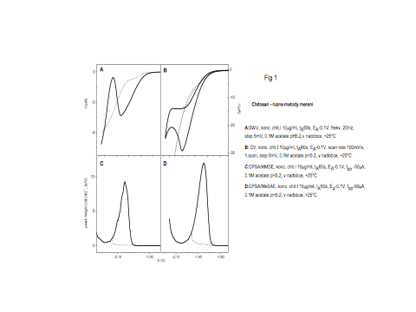
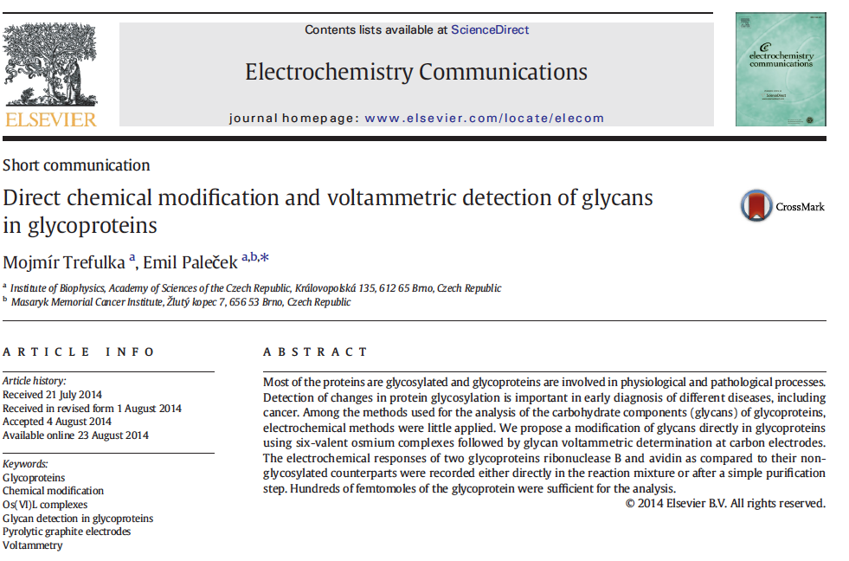
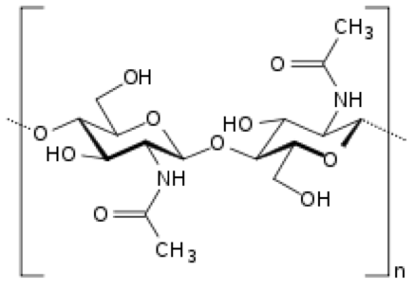
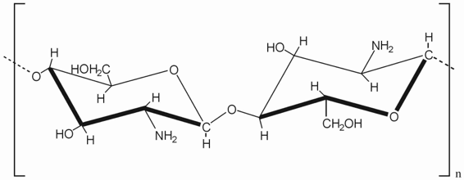
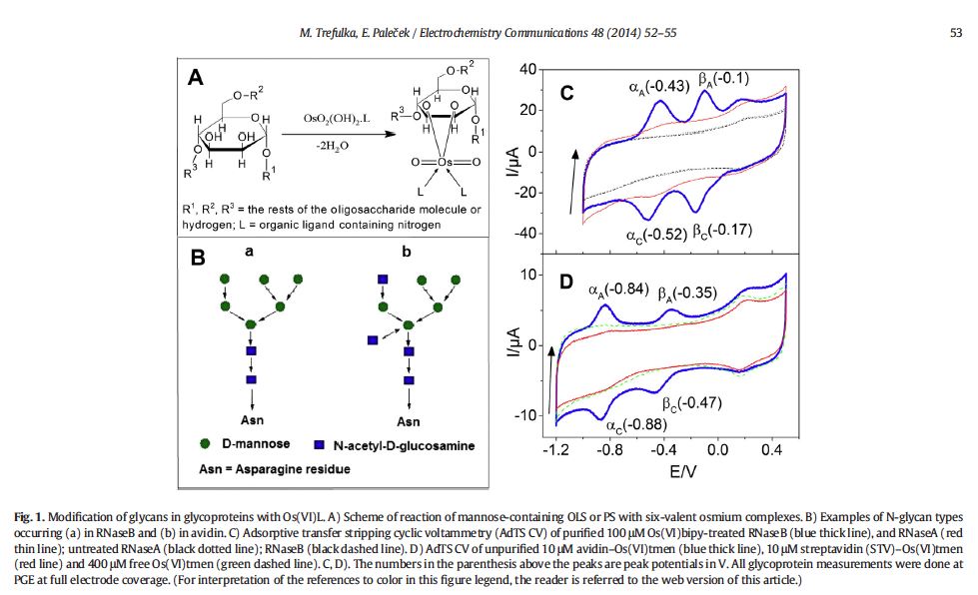
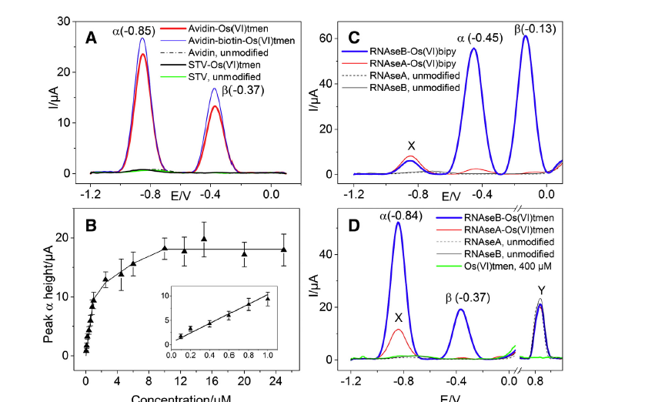
Chitin
Chitosan

Slide 7
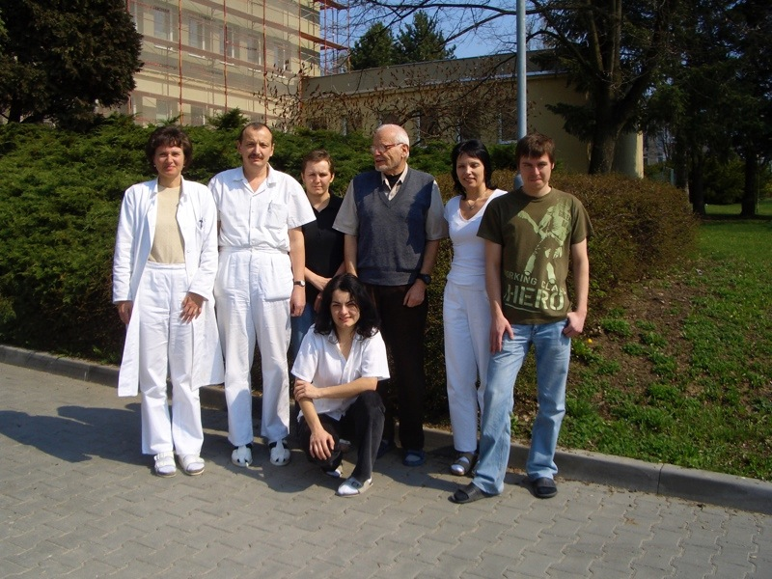
The Protein Group
Hana Cernocka
Mojmir Trefulka
Petra Mittnerova
Emil Palecek
Lida Rimankova
Martin Bartosik
Veronika Ostatna
Veronika Vargová
Vlasto Dorčák

Slide 8
....ještě doplněk scientometrie

Slide 9


Index h
Index h navrhl Jorge Hirsch, University of California, San Diego
(Nature 436 (2005) 900)
je to číslo, ktere udává počet n prací (určitého autora, instituce, apod.) které byly citovány nejméně n-krát
18.
h-index
22
21
22.
22.
21.

Slide 10
Impact Factor (IF) charakterizuje průměrnou citovanost prací publikovaných v daném časopise
The journal impact factor is a measure of the frequency with which the "average article" in a journal has been cited in a particular year. The impact factor will help you evaluate a journal's relative importance, especially when you compare it to others in the same field.
NOTE: Title changes and coverage changes may result in no impact factor for one or more years.
Impact factor 2011
Cites in 2011 to articles published in: 2010 = 100 2009 = 132 Sum: 232
Number of articles published in: 2010 = 31 2009 = 22 Sum: 53
Calculation:
Cites to recent articles: 232 IF = 4.377
Number of recent articles: 53

Slide 11
Problémy časopisů s nízkým IF
1. Nedostatek vysoce kvalifikovaných recenzentů a vyšší pravděpodobnost publikace nekvalitních prací (záleží na šíři problematiky/scope of the journal)
2. Slabé ocenění publikovaných prací při evaluacích a financování výzkumu
3. Menší zájem čtenářů
4. Nestabilita IF atd.
Hrátky s IF
Vybráno z Nature:
The Swiss journal Folia Phoniatrica et Logopaedica has a good
reputation among voice researchers but, with an impact factor of 0.655 in 2007,
publication in it was unlikely to bring honour or grant money to the authors' institutions.
Now two investigators, one Dutch and one Czech, have taken on the system and fought back.
They published a paper called:
'Reaction of Folia Phoniatrica et Logopaedica on the current trend of impact factor measures'
(H. K. Schutte and J. G. Švec Folia Phoniatr. Logo. 59, 281-285; 2007).
This cited all the papers published in the journal in the previous two years. As 'impact factor' is defined as the number of citations to articles in a journal in the past two years, divided by the total number of papers published in that journal over the same period, their strategy dramatically increased Folia's impact factor this year to 1.439.
ALE

Slide 12
San Francisco Declaration on Research Assessment
Putting science into the assessment of research
There is a pressing need to improve the ways in which the output of scientific research is evaluated by funding agencies, academic institutions, and other parties.
To address this issue, the group of editors and publishers of scholarly journals listed below met during the Annual Meeting of The American Society for Cell Biology (ASCB) in San Francisco, CA, on December 16, 2012. The group developed a set of recommendations, referred to as the San Francisco Declaration on Research Assessment. We invite interested parties across all scientific disciplines to indicate their support by adding their names to this declaration.
The Journal Impact Factor is frequently used as the primary parameter with which to compare the scientific output of individuals and institutions. The Journal Impact Factor, as calculated by Thomson Reuters, was originally created as a tool to help librarians identify journals to purchase, not as a measure of the scientific quality of research in an article. With that in mind, it is critical to understand that the Journal Impact Factor has a number of well-documented deficiencies as a tool for research assessment. These limitations include: A) citation distributions within journals are highly skewed [1-3]; B) the properties of the Journal Impact Factor are field-specific: it is a composite of multiple, highly diverse article types, including primary research papers and reviews [1, 4]; C) Impact Factors can be manipulated (or “gamed”) by editorial policy [5]; and D) data used to calculate the Journal Impact Factors are neither transparent nor openly available to the public [4, 6, 7].
IF je pouze předběžný údaj
o významu určité práce
DŮLEŽITĚJŠÍ je CITOVANOST DANÉ
PRÁCE v určitém OBORU
Nověji:
Eigenfactor Article Influence
Score Score

Slide 13
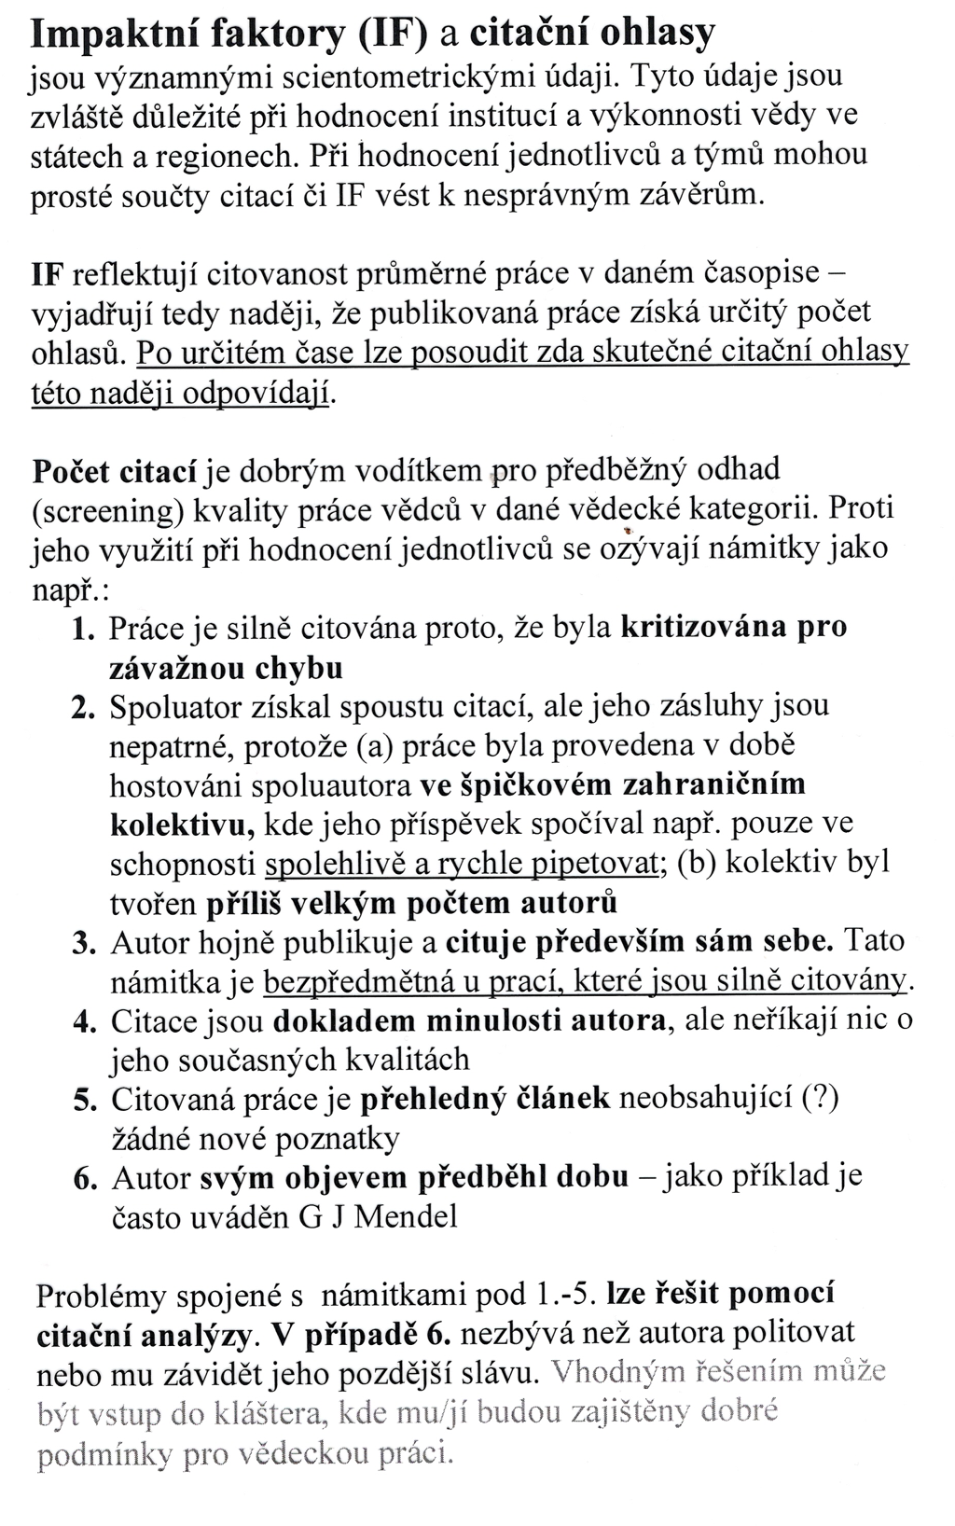
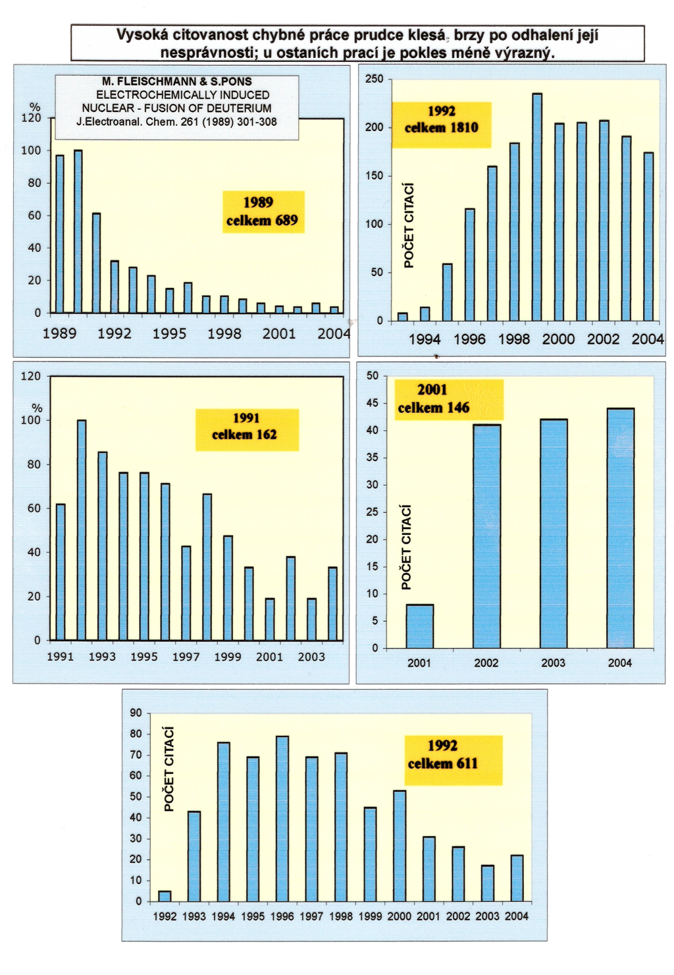

Slide 14
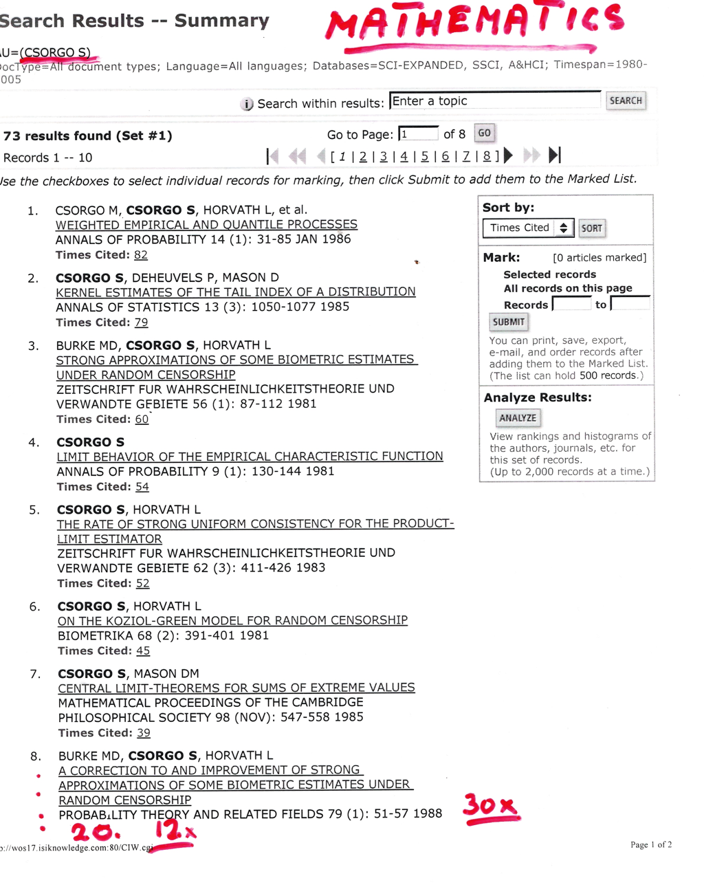
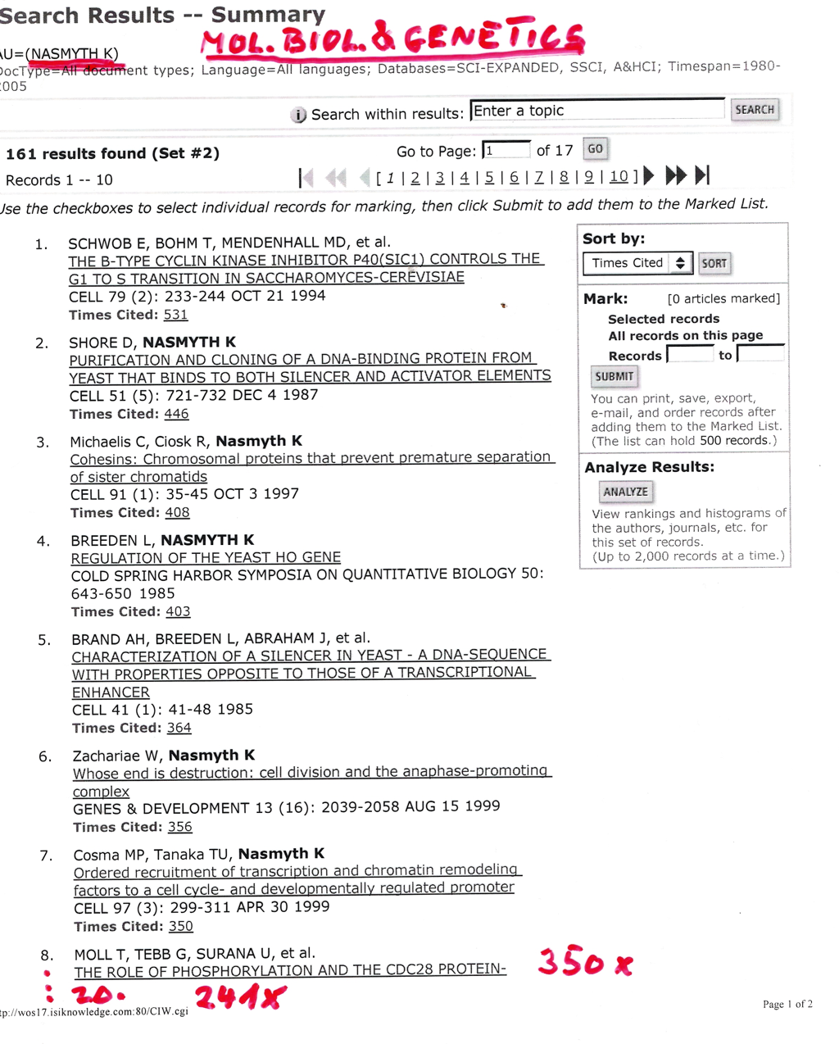
IF, počty citací a další scientometrické údaje by neměly být využívany ke srovnávání úspěšnosti vědců z různých oborů

Slide 15
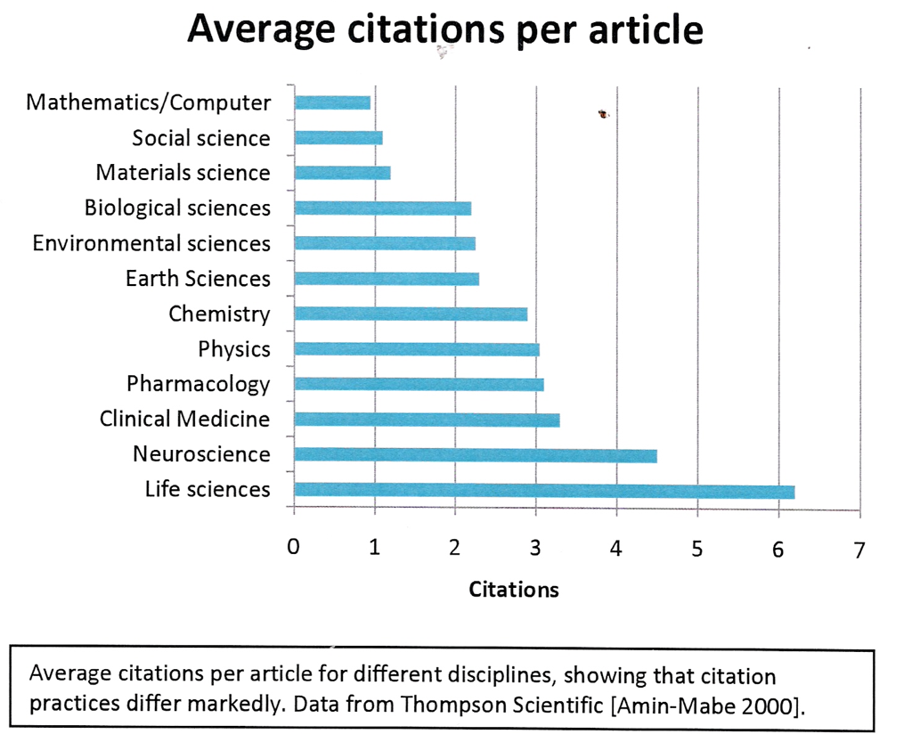

Slide 16
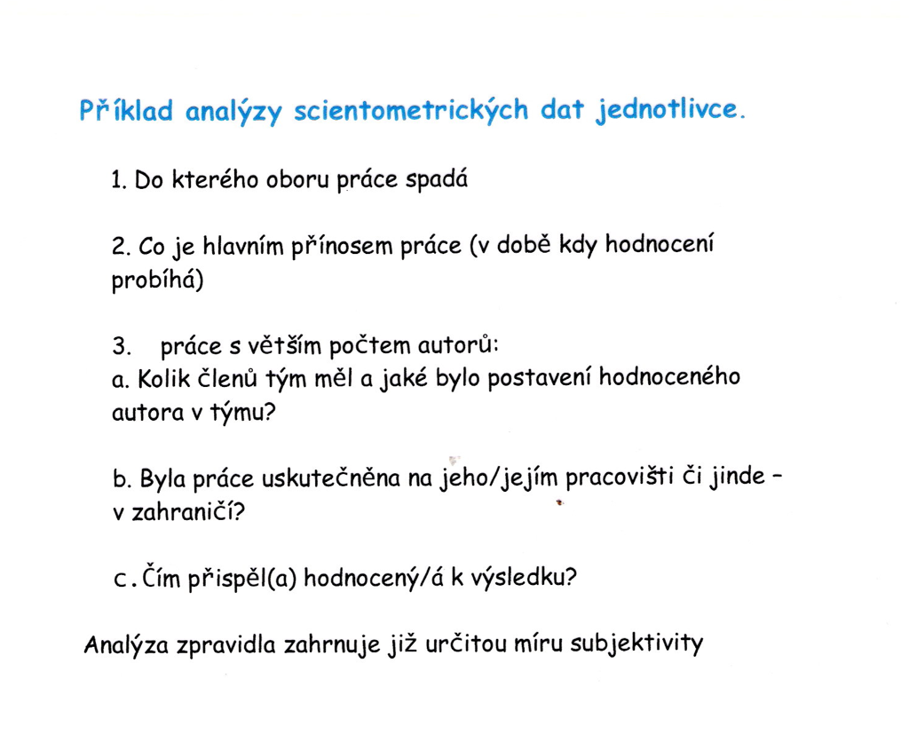
Citace jinými autory x autocitace

Slide 17
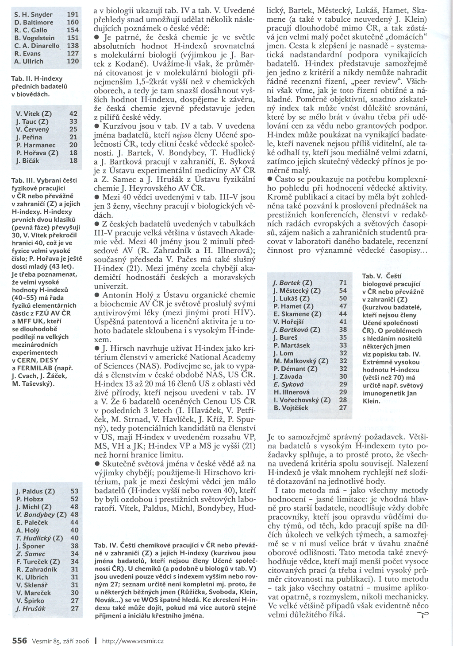
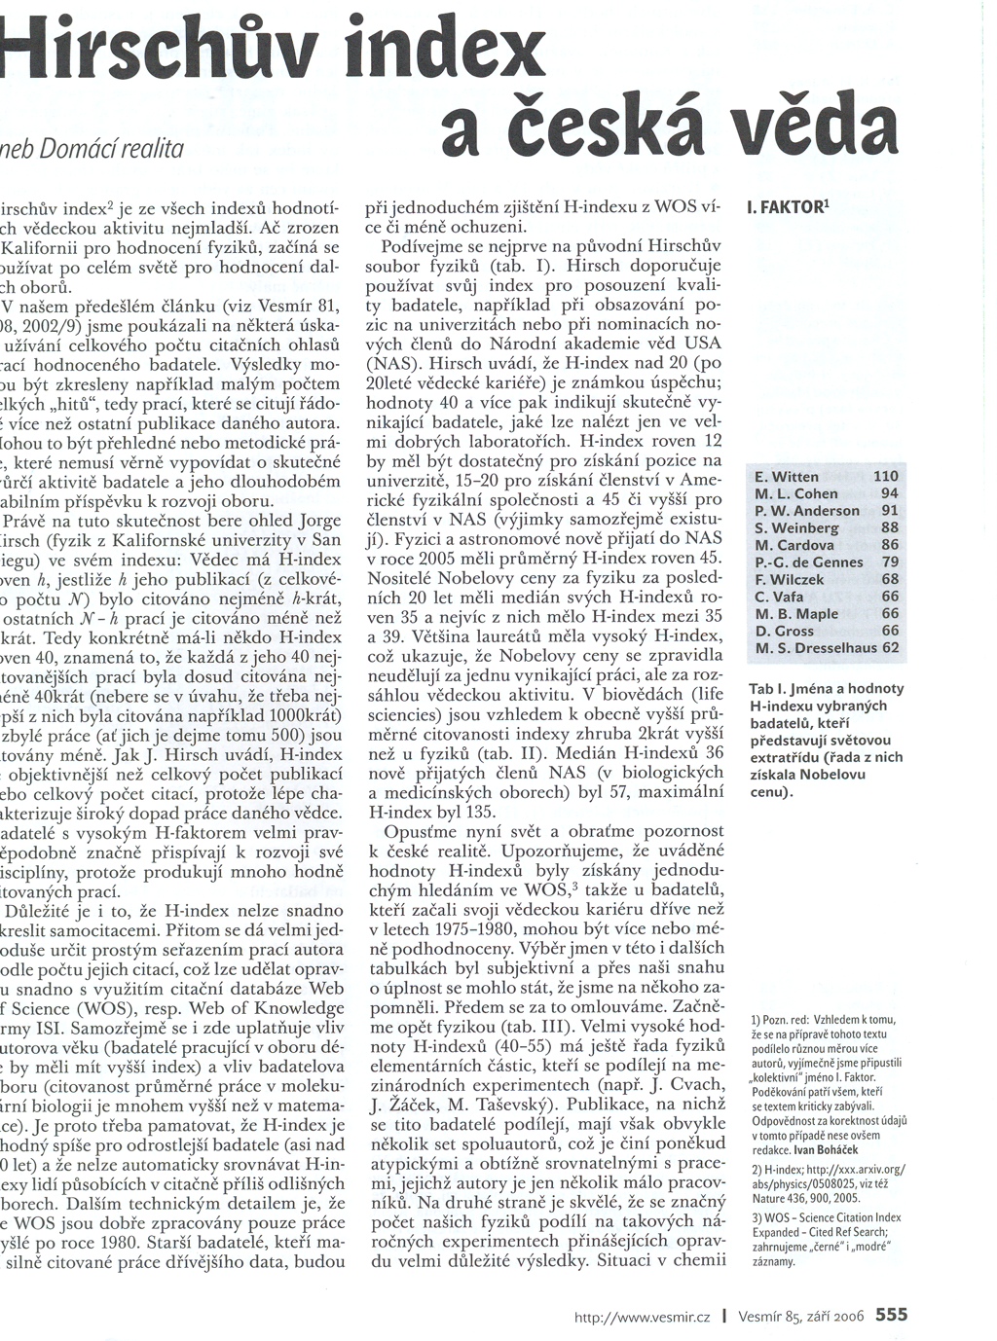
Vesmír, září 2006
Extra třída
bio
ČEŠI
a. Fyzici
Nobel
c.Bio
b.Chemici

Slide 18
Vědecké týmy, vědecká spolupráce
Společné a vlastní publikace
ÚLOHA JEDNOTLIVCE
V současné době je připravován systém hodnocení výsledků vědy v AV ČR i na MŠMT,
zahrnující scientometriké/bibliometrické hodnocení x kafemelejnek
Když si budete vybírat téma své diplomky/dizertace snažte se zjistit jak je váš budoucí školitel ve vědě úspěšný a jak aktuální a zajímavé jsou problémy, které řeší
Již během svého studia můžete dělat vědecké objevy!

Slide 19
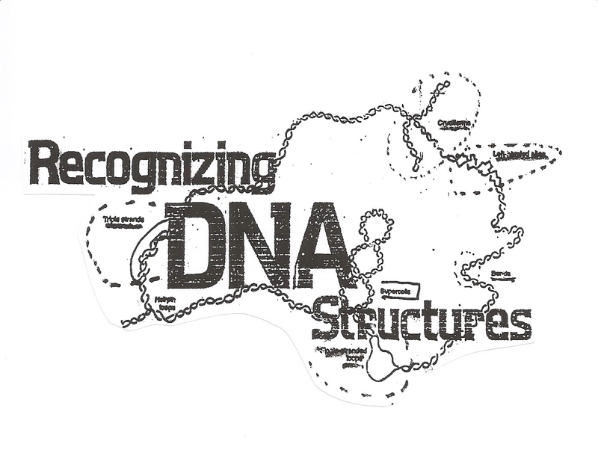
Negative SUPERCOILING stabilizes
local DNA structures
CRUCIFORM
inverted repeat
LEFT-HANDED Z-DNA
alternating pu-py
SUPERCOIL
TRIPLEX structure
homopu.homopy
Text
CURVATURE
4-6 A’s in phase with the helix turns
HAIRPIN
SINGLE-STRANDED region
AT-rich
Physical methods such as NMR and X-ray analysis indispensable in the research of
linear DNA structures are of limited use in studies of local structures stabilized by supercoiling

Slide 20
Problems of life origin
What was first - DNA, RNA or protein?
Well-known Oxford zoologist Professor Richard Dawkins (who declares himself to be passionate fighter for the truth) writes in his book River out of Eden:
“At the beginning of Life Explosion there was no mind, no creativity, no intent, there was only chemistry”
Let us try to summarize what chemistry it was

Slide 21
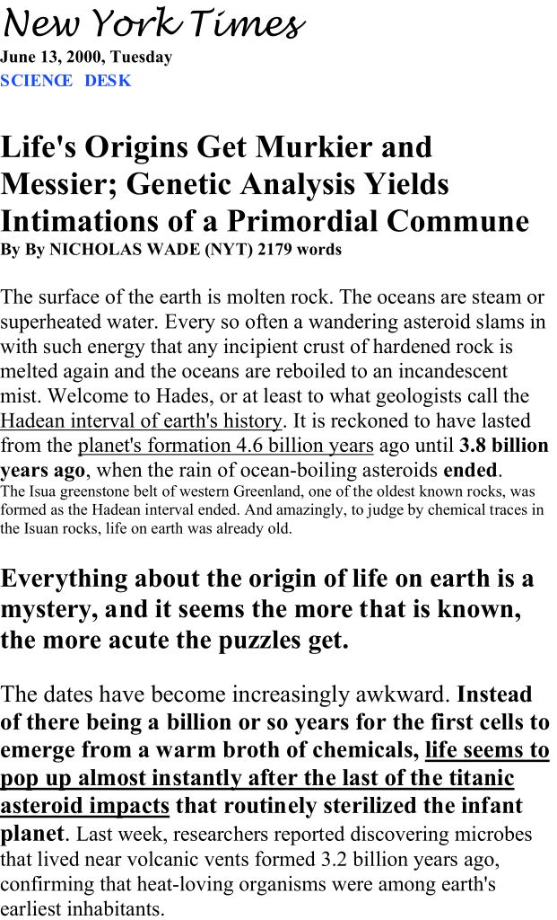
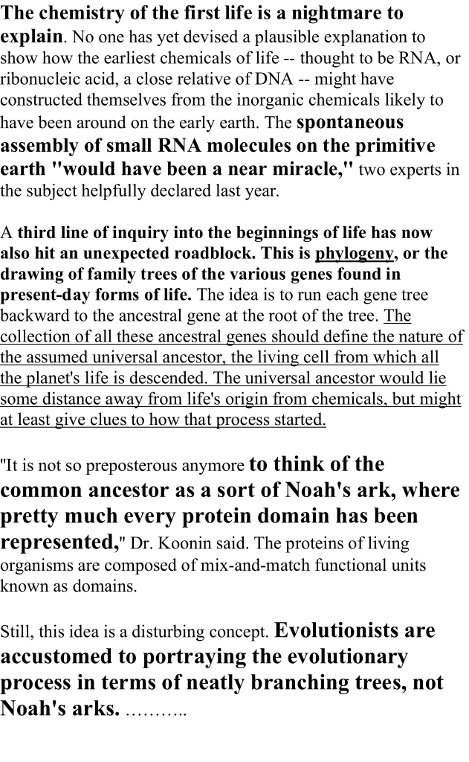

Slide 22
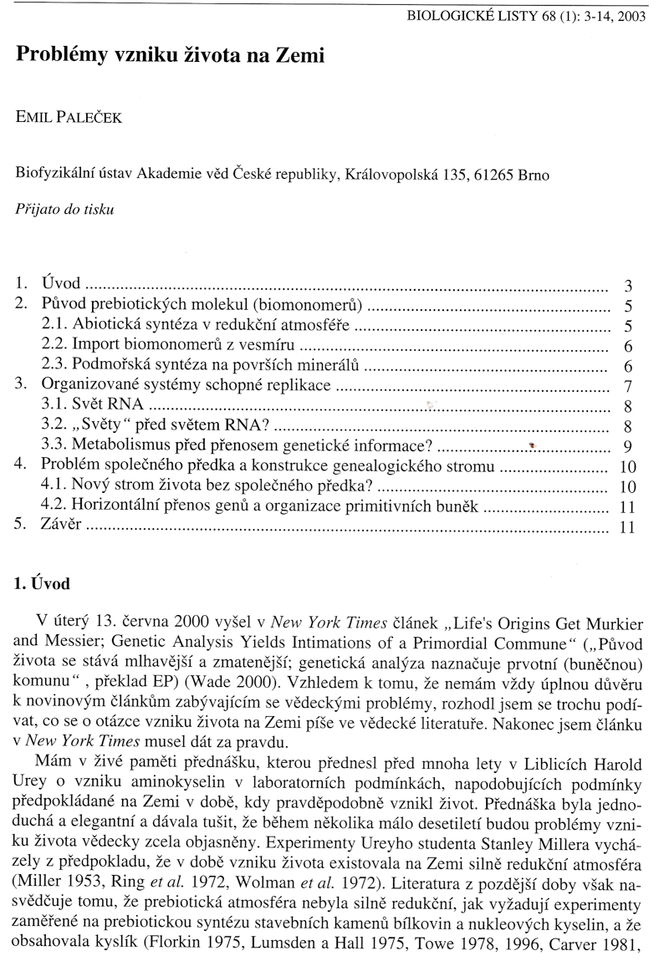
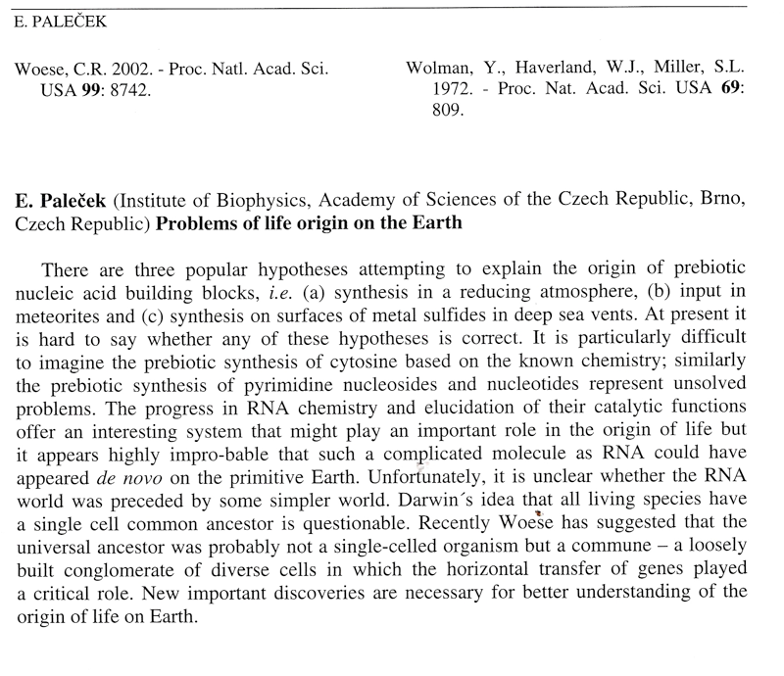

Slide 23
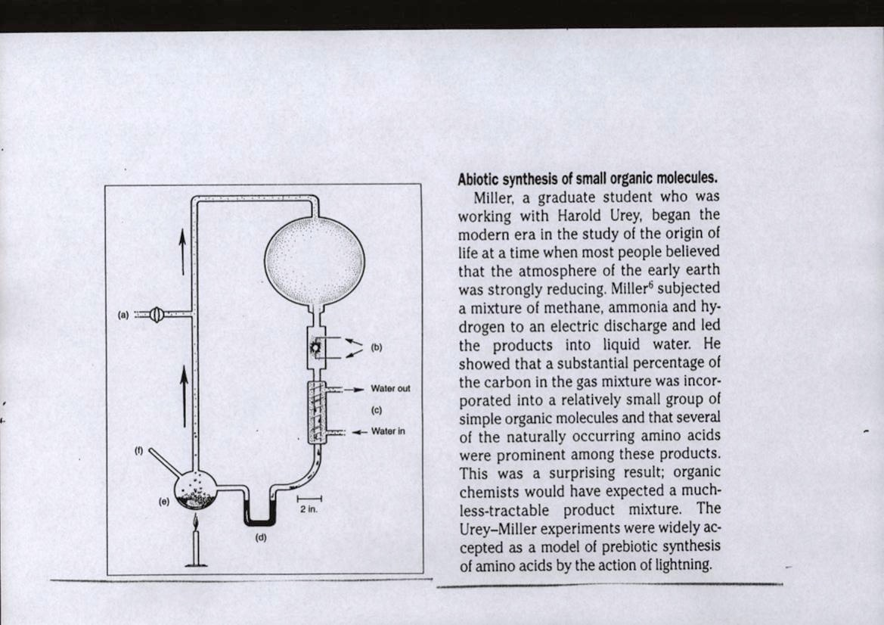
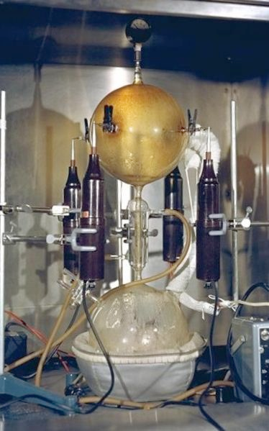
PROBLEMS OF LIFE ORIGINS
S. Miller and H. Urey subjected mixture of methane, ammonia and hydrogen to an electric discharge and led the product into water ...
The Miller-Urey experiment attempted to recreate the chemical conditions of the primitive Earth in the laboratory, and synthesized some of the building blocks of life
but geologists showed that prebiotic atmosphere
was not strongly reducing and not oxygen-free, differring from that expected by Miller and Urey

Slide 24
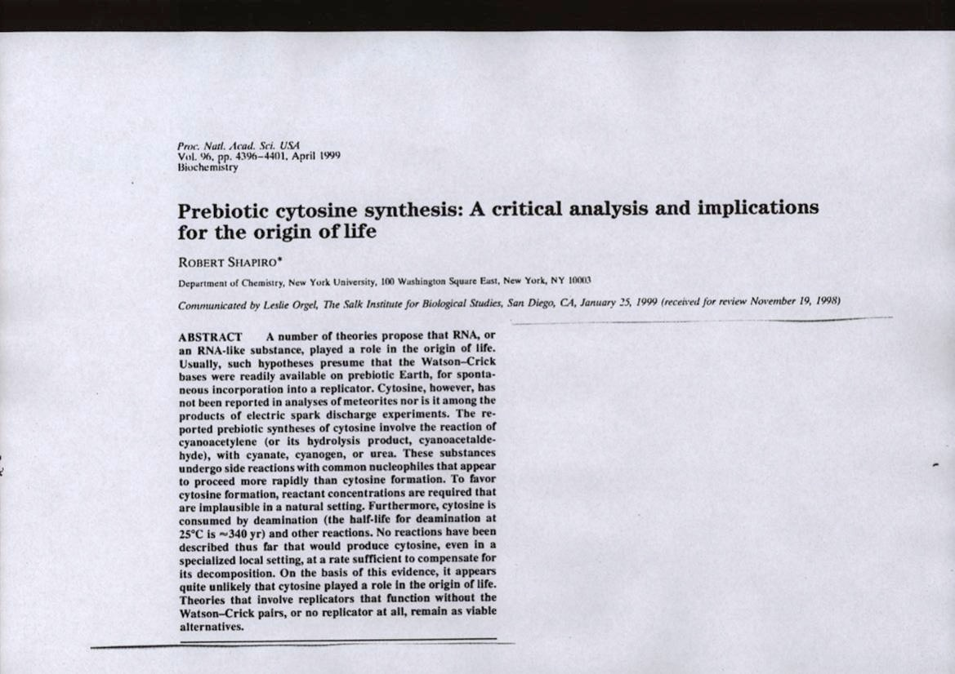
Cytosine synthesis would not be possible even strongly in reducing
prebiotic atmosphere.
Similar problems arise with the abiotic synthesis of nucleotides
Abiotic synthesis of a complicated molecule such as RNA is highly improbable

Slide 25
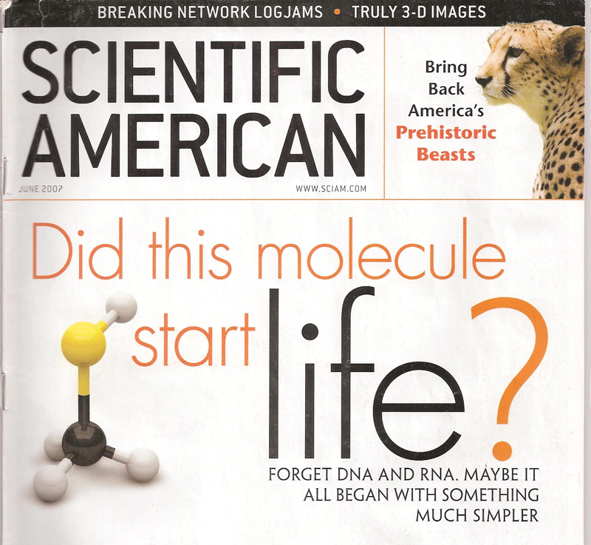

Slide 26
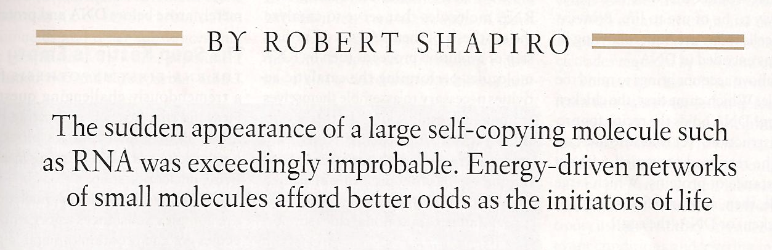
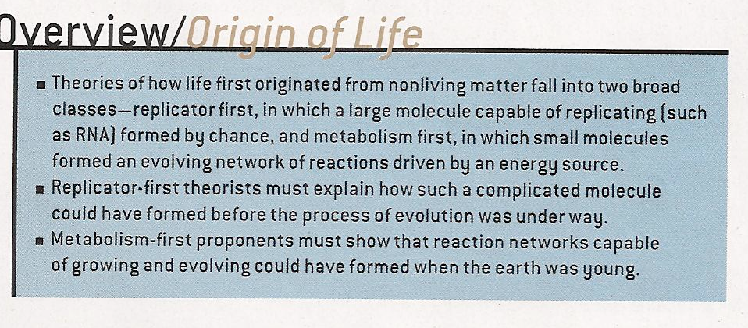
NOBEL laureate Christian de Duve has called for “a rejection of improbablities so incomensurably high that they only can be called miracles, phenomena that fall outside the scope of scientific inquiry”. DNA, RNA and PROTEINS must then be set aside as participants in the origin of life.

Slide 27
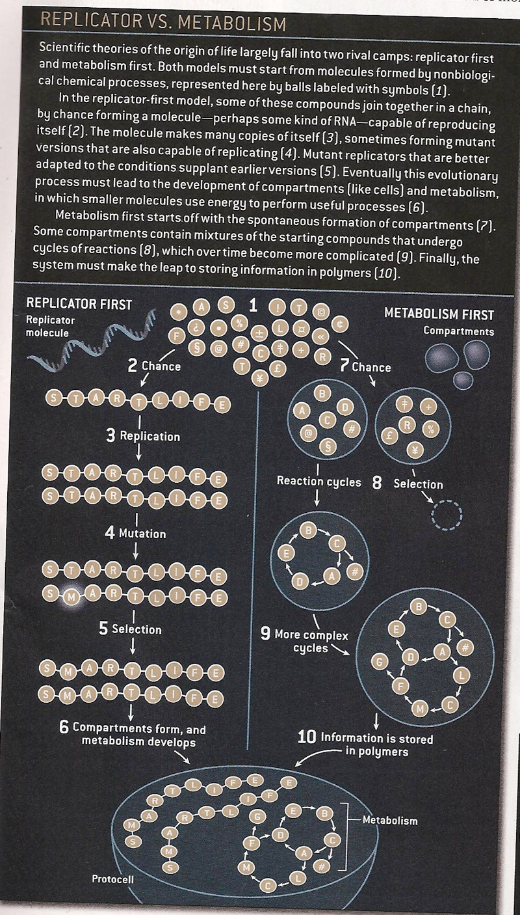
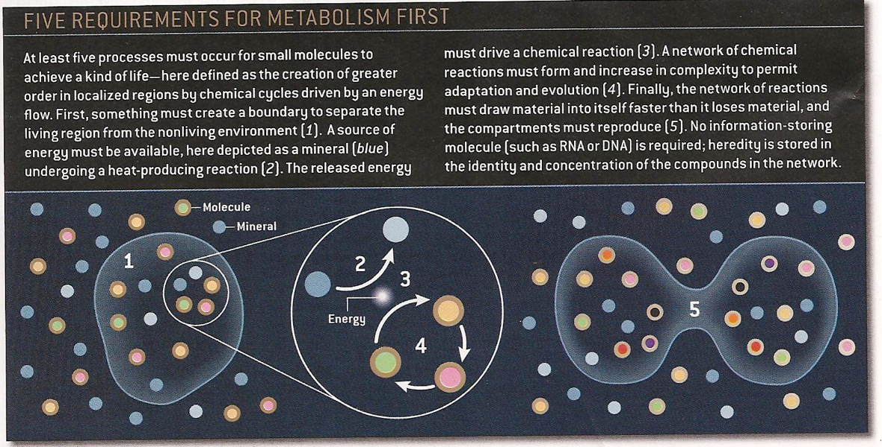

Slide 28
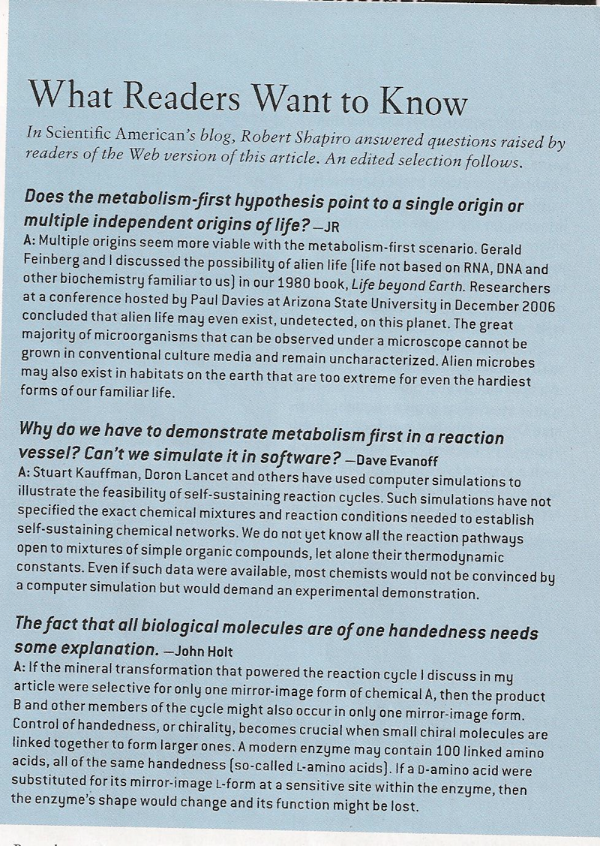
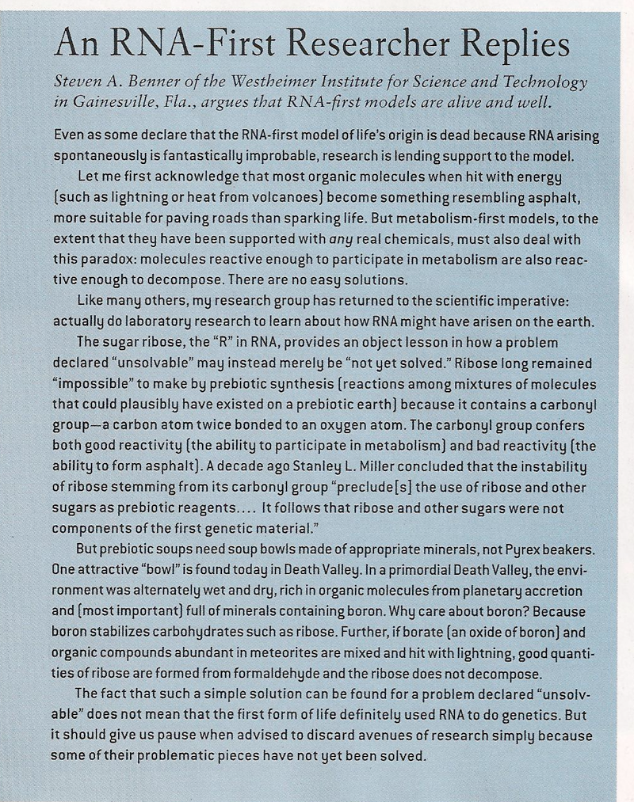

Slide 29
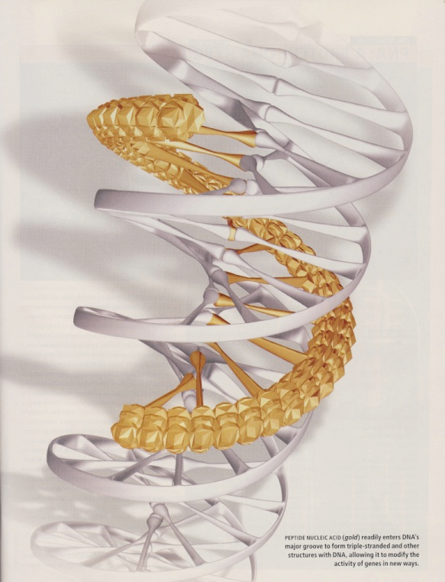
Peptide Nucleic Acid (PNA)

Slide 30

Panspermia
Or did life come from another world?
The hypothesis of F. Crick is discussed in November issue of Scientific American 2005.
It is concluded that microorganism could have survived a journey from Mars to Earth
Recent finding of glycine in the comet tail might be considered as
support for this alternative
RNA First
Metabolism first (2007)
PNA First (2008)
RNA First (again/2009)
Panspermia again and again
The actual nature of the first organism and the exact circumstances of the origin of life may be forever lost for science.
But research can at least help to understand what is possible
Sci. Amer., September 2009

Slide 31
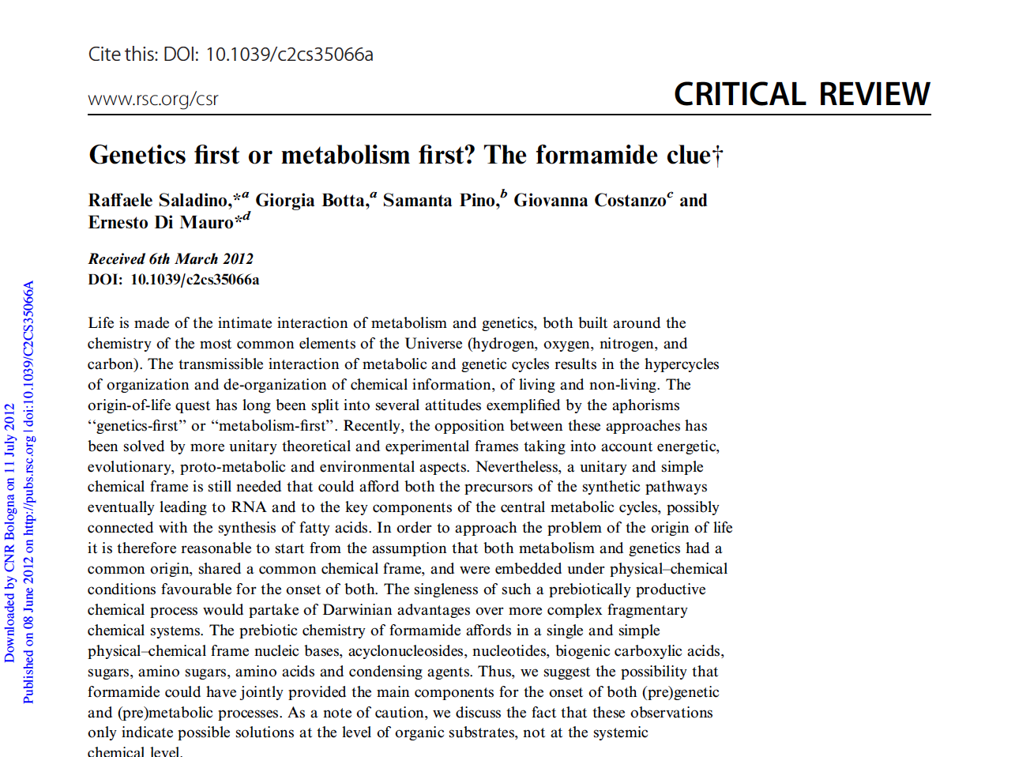

Slide 32
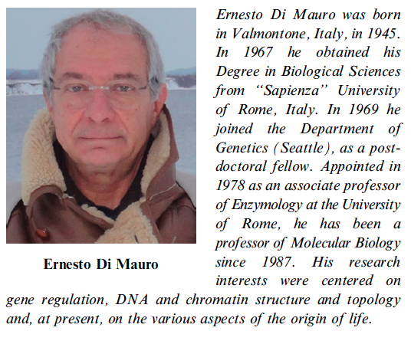
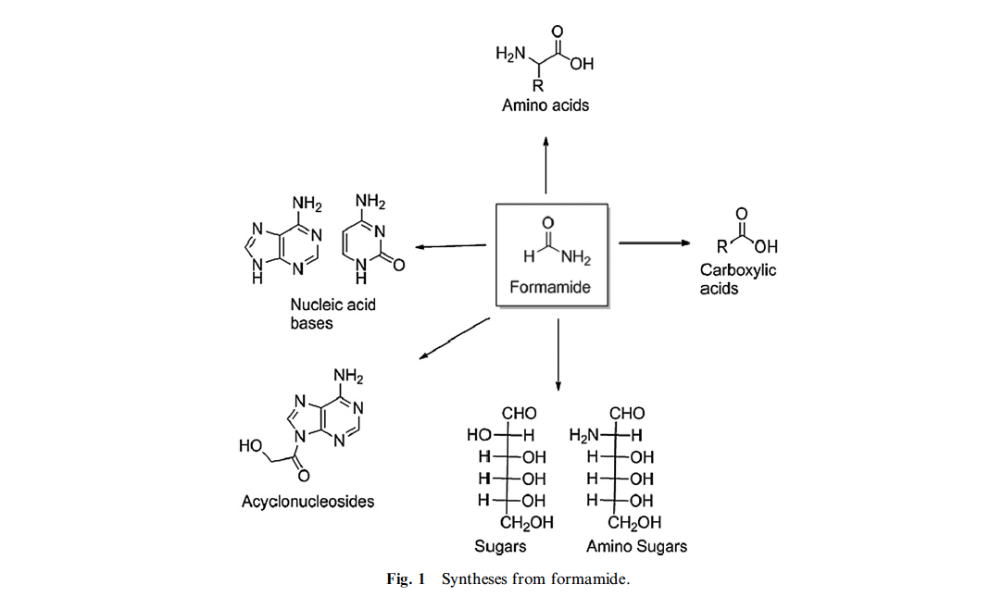

Slide 33
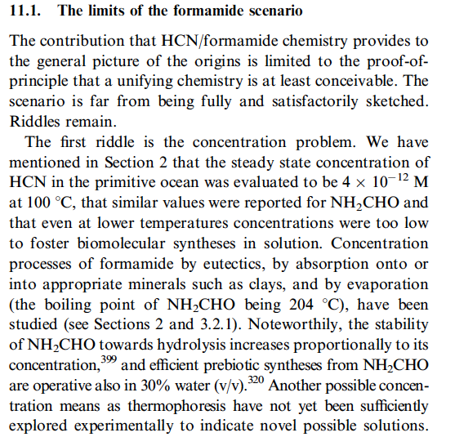

Riddles remain
_____________________
_____________________
Riddles remain

Slide 34
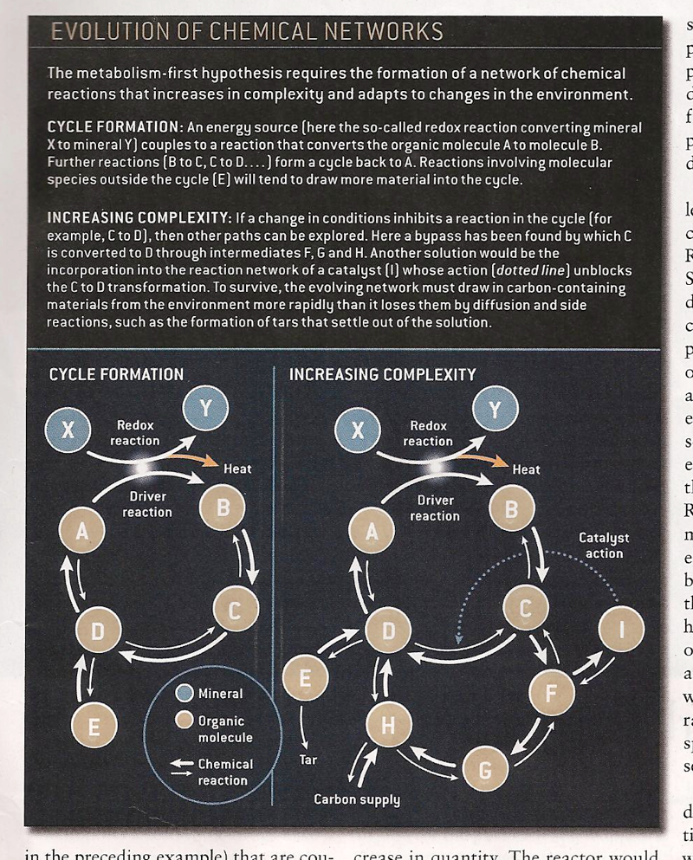
Or did life come from another world?
The hypothesis of F. Crick is discussed in November issue of Scientific American 2005.
It is concluded that microorganism could have survived a journey from Mars to Earth

Slide 35
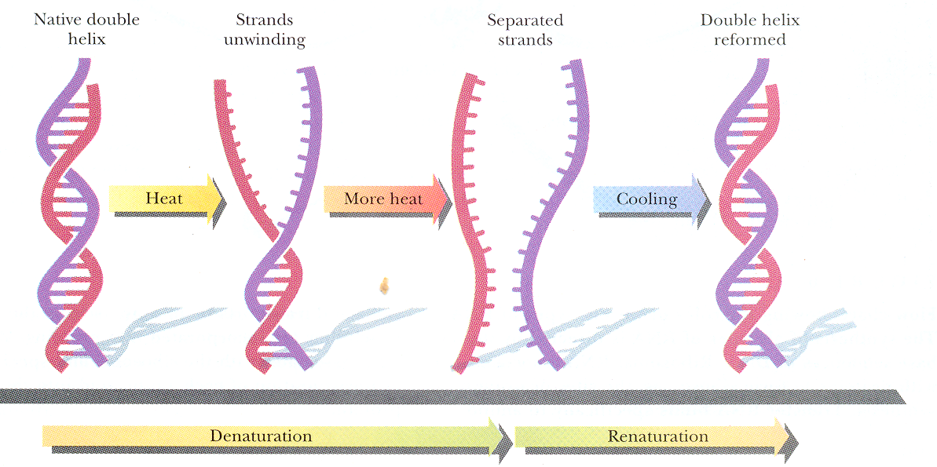

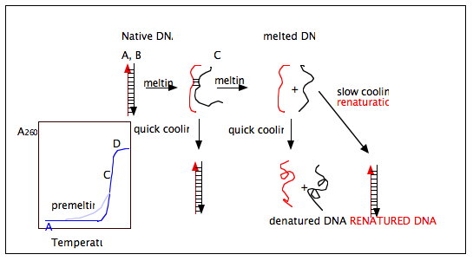
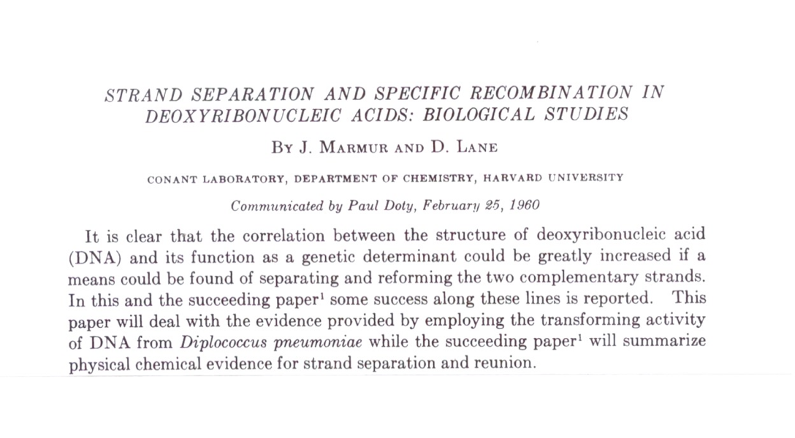
DNA DENATURATION and RENATURATION/HYBRIDIZATION
Native dsDNA
Melted ssDNA
J. Marmur and P. Doty

Slide 36
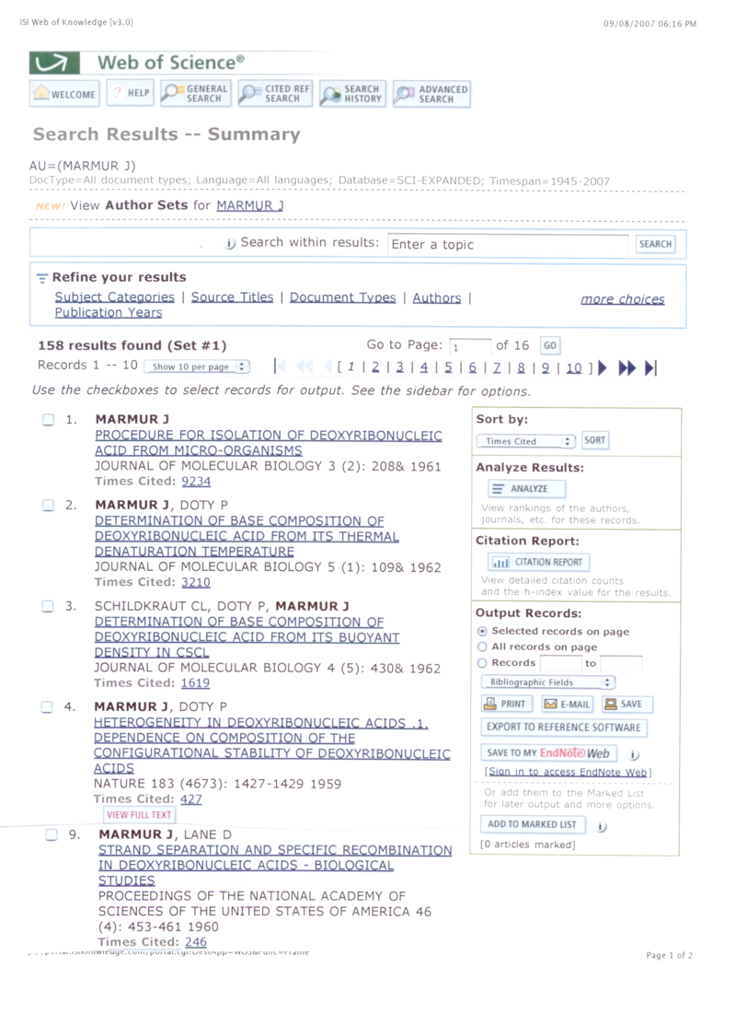

Slide 37
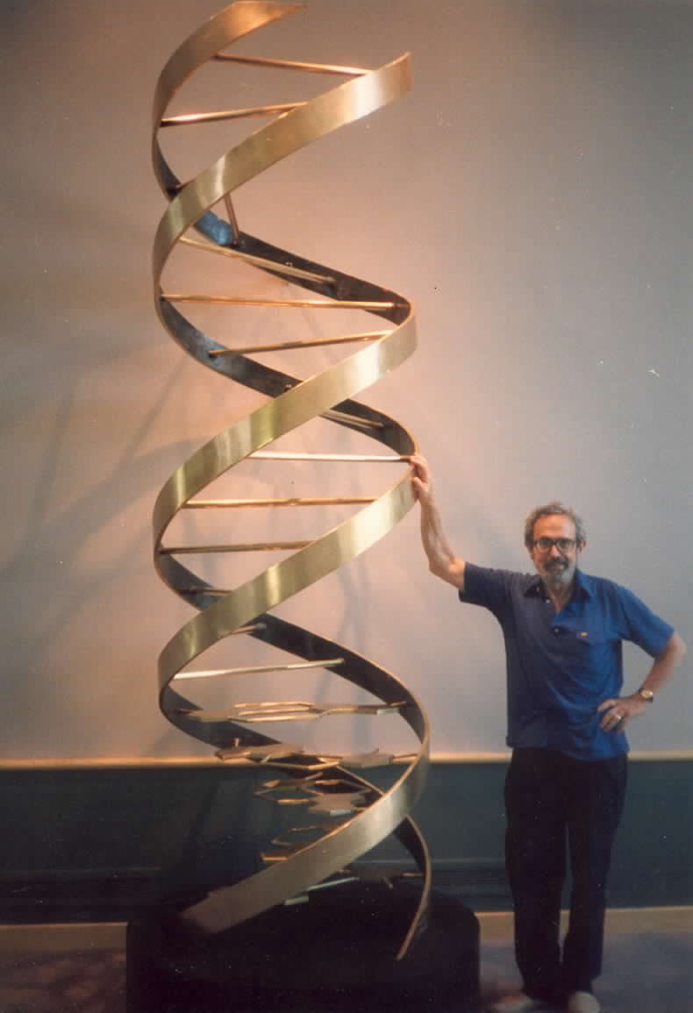
Microbiologist, biochemist and molecular biologist
Julius Marmur – discovered renaturation of DNA
22 March, 1926 Bialystok (Poland) – 20 May, 1996 New York, NY
Oswald Avery 1944 - DNA is a genetic material
(Rockefeller Institute, New York, NY)
Rollin D. Hotchkiss
1993
Julius Marmur

Slide 38
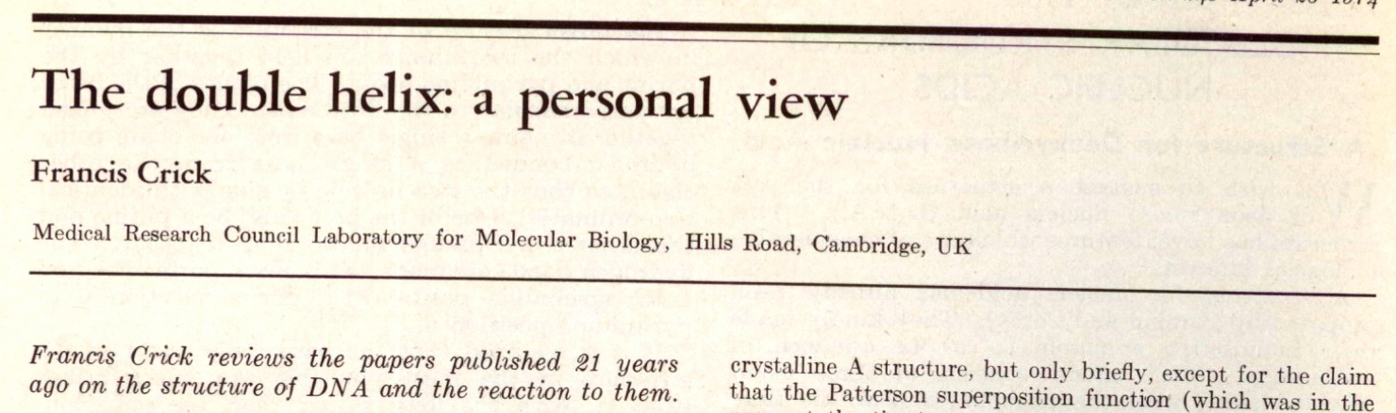
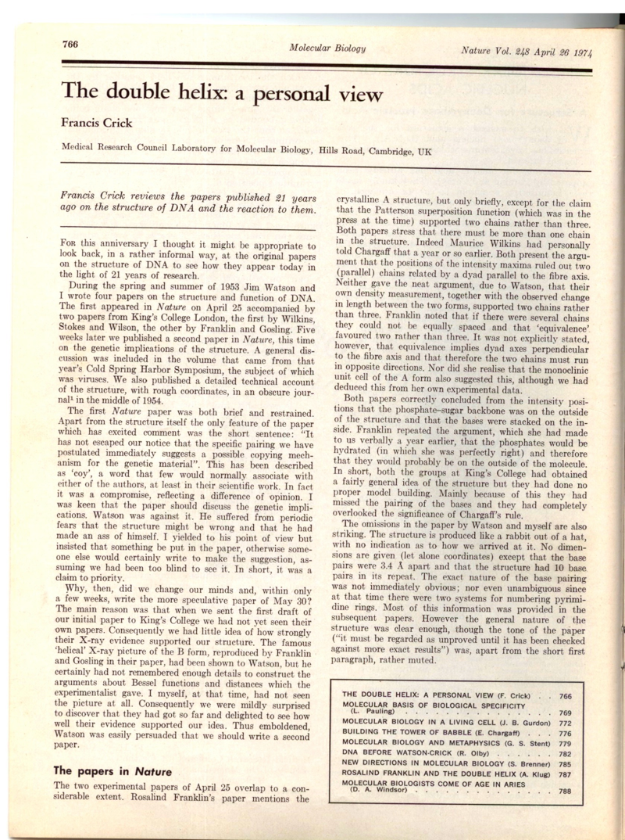


Francis Crick 21 years after invention of the DNA double helix structure about the discovery of DNA renaturation
Nature 248(1974) 766

Slide 39

  KEY CONCEPTS
• Scientists long assumed that any DNA mutation that does not change the final protein encoded by a gene is effectively “silent”.
• Mysterious exceptions to the rule, in which silent changes seemed to be exerting a powerful effect on proteins, have revealed that such mutations can affect health through a variety of mechanisms.
• Understanding the subtler dynamics of how genes work and evolve may reveal further insights into causes and cures for disease.

Slide 40

MUFFLED MESSAGE
A synonymous mutation was found to affect pain sensitivity by changing the amount of an important enzyme that cells produced. The difference results from alteration in the shape of mRNA that can influence how easily ribosomes are able to unpackage and read the strand. The folded shape is caused by base-pairing of the mRNA´s nucleotides; therefore, a synonymous mutation can alter the way nucleotides match up.

Slide 41


Slide 42

Electrochemistry of Nucleic Acids is a Booming Field
DNA and RNA are Electroactive Species
producing faradaic and other signals on interaction with electrodes
Cytosine (C)
Adenine (A) A, C, G are reduced at MERCURY electrodes
Guanine (G) reduction product of guanine is oxidized back to G
All bases (A, C, G, T, U) yield sparingly soluble compounds with
mercury and can be determined at concentration down to 10⁻¹¹M.
Solid amalgam electrodes can be used instead of the mercury drop electrodes.
____________
A and G as well as C and T are oxidized at CARBON electrodes
_________________________________________________________
PEPTIDE NUCLEIC ACID (PNA) BEHAVES SIMILARLY TO DNA AND RNA
_________________________________________________________________________________________________
Microliter volumes of the analyte are sufficient for analysis
_____________________________________________________________
Electroactive Labels can be Introduced in DNA
Fojta, M., et al.. (2007): „Multicolor“ electrochemical labeling of DNA hybridization probes with osmium tetroxide complexes. Anal. Chem. 79, 1022-1029
Trefulka, M., et al. (2007): Covalent labeling nucleosides, RNA and DNA with VIII- and VI-valent osmium complexes. Electroanal. 19, 1281-1287

Slide 43








Jaroslav Heyrovský 1890-1967
invented POLAROGRAPHY in 1922
Present electrochemical analysis stems from Heyrovský’s polarography
Oscillographic polarography at controlled a.c
(cyclic a.c. chronopotentiometry)
complete analyses on a single mercury drop 1941
J Heyrovsky S Ochoa A Kornberg
Nobel Prize 1959

Slide 44
Electrodes
Heyrovsky’s polarography was based on mercury electrodes. At present a number of different electrodes is used in electrochemical analysis, incl. bimacromolecule studies, such as liquid mercury and solid mercury-containing electrodes (such as film and solid amalgam, incl. dental amalgam electrodes), carbon, gold, indium-tin oxide, silver, etc. Only with mercury-containing and carbon electrodes well-behaved NA electroactivity has been observed. Mercury electrodes and most of the solid electrodes greatly differ in their potential windows
-2 V Hg 0 V
-1 V
Carbon, Au, Ag, Pt….
+1 V
Hg electrodes thus suits better for reductions while solid electrodes (e.g. carbon, Au,,,) are better for oxidation processes. Material of the electrode is also very important. Hydrophobicity/hydrophilicity as well reactive functional groups may greatly affect adsorption of DNA and proteins

Slide 45



90 years of polarography and ~55 years of nucleic acid electrochemistry
This year we commemorate the 90th Anniversary of the invention of polarography by J. Heyrovsky. In 1941 he invented oscillographic polarography with controlled a.c. (cyclic a.c. chronopotentiometry). By the end of the 1950‘s oscillographic polarography was the method of choice for the DNA electrochemical analysis:
1958: Nucleic acid bases, DNA and RNA are electroactive
1960: Relations between the DNA structure and electrochemical responses
1955 :Adenine is polarographically reducible at strongly acid pH while other NA bases are inactive. J.N.Davidson and E.Chargraff: The Nucleic Acids, Vol.1, Academic Press, New York 1955
1957: NO response of RNA
and DNA on oscillopolarograms
H. BERG, Biochem. Z. 329 (1957) 274
dsDNA
ssDNA
Using these techniques in the 1960‘s and and 1970‘s DNA denaturation and renaturation was followed and early evidence of DNA premelting and POLYMORPHY OF THE DNA DOUBLE HELIX was obtained

Slide 46

D.c. polarography vs. oscillopolarography (OP)
Why d.c. polarography was rather poor in DNA analysis?
(a) no DNA accumulation at the electrode
(b) DNA adsorption at negatively charged DME (~-1.4V) compared to open current potential in OP

Slide 47



DNA and RNA are polarographically inactive. H. Berg, Biochem. Z. (1957)
E. Palecek,Naturwiss. 45, 186-187

Slide 48
OSCILLOGRAPHIC POLAROGRAPHY
At controlled alternating current (constant current chronopotentiometry)
dE/dt
dsDNA
ssDNA
cathodic
CA
sparingly soluble compounds with Hg
G
anodic
E
LITERATURE in 1958: Adenine is polarographically reducible at strongly acid pH while other NA bases as well as DNA are inactive
J.N.Davidson and E.Chargraff: The Nucleic Acids, Vol. 1, Academic Press, New York 1955
Palecek E.: Oszillographiche Polarographie der Nucleinsauren und ihrer Bestandteile; Naturwiss. 45 (1958), 186
Palecek E.: Oscillographic polarography of highly polymerized deoxyribonucleic acid; Nature 188 (1960), 656

Slide 49

RENATURATION OF RNA
AS DETECTED BY DPP
Time dependence

Slide 50
IFFY stories
On this day 50 years ago, Watson and Crick published their double-helix theory. But, what if...
By Steve Mirsky (2003)
“I am now astonished that I began work on the triple helix structure, rather than on the double helix,” wrote Linus Pauling in the April 26, 1974 issue of Nature.
In February 1953, Pauling proposed a triple helix structure for DNA in the Proceedings of the National Academy of Sciences (PNAS). He had been working with only a few blurry X-ray crystallographic images from the 1930s and one from 1947.
If history´s helix had turned slightly differently, however, perhaps the following timeline might be more than mere musing...
August 15, 1952: Linus Pauling (finally allowed to travel to England by a US State Department that thinks the words “chemist” and “communist” are too close for comfort) visits King´s College London and sees Rosalind Franklin´s X-ray crystallographs. He immediately rules out a triple helical structure for DNA and concentrates on determining the nature of what is undoubtedly a double helix.
February 1953: Pauling and Corey describes the DNA double helix structure in PNAS .....

Slide 51



Triple helix
with bases on the outside and
sugar-phosphate backbone in the interior of the molecule
My IFFY story:
If L. PAULING had in his lab an oscillopolarograph in 1952 he would never proposed this structure. Polarography clearly showed that bases must be hidden in the interior of native DNA molecule and become accessible when DNA is denatured

Slide 52

In 1960 when I published my NATURE paper
on electrochemistry of DNA I obtained invitations
from 3 emminent US scientists:
J. Marmur - Harvard Univ.
L. Grossman - Brandeis Univ.
J. Fresco - Princeton Univ.
To work in their laboratories as a postdoc
In 1960 new techniques were sought to study DNA
Denaturation and Renaturation. To those working with
DNA Oscillographic Polarography (OP) appeared as a
very attractive tool. Invented by J. Heyrovsky, it was fast
and simple, showing large differences between the signals
of native and denatured DNA. The instrument for OP was
produced only in Czechoslovakia.
I accepted the invitation by Julius Marmur but for more
than two years I was not allowed to leave Czechoslovakia.
In the meantime JM moved from Harvard to Brandeis Univ.
By the end of November 1962 I finally got my exit visa and
with Heyrovsky Letter of Reccommendation in my pocket
I went to the plane just 24 hours before expiration of my
US visa. Before my departure I sent my OP instrument by
air to Boston. It arrived after 9 months completely broken.
Instead of OP I had to use ultracentrifuges and microbiological methods.
Julius Marmur discovered DNA
Renaturation/Hybridization and
proposed (in JMB) a new method of
DNA isolation which was widely applied.
His paper was quoted > 9000x.
oscilak
J M at the 40th Anniversary of the
Discovery of the DNA Double Helix
At the end of my stay at Brandeis I did some
OP experiments which I finished in Brno
and published in J. Mol. Biol. in 1965 and 1966.

Slide 54





Early evidence of DNA Premelting and Polymorphy of the DNA Double Helix
1976
B. sublilis and B. brevis DNAs have the same
G+C content and different nucleotide sequence
Before my departure to the US I observed
Changes in the polarographic behavior of
DNA far below the denaturation
temperature. These changes were
later called DNA Premelting
B. brevis
B. subtilis
J. Mol. Biol.
20 (1966) 263-281
Meeting F. Crick in Copenhagen
and Arhus, 1977 (B. Clark)
POLAROGRAPHIC BEHAVIOR OF dsDNA
At roomand premeltig temperaturse depended on
DNA nucleotide SEQUENCE
What the people said
What the people said:
Before 1980
No doubt that this electrochemistry
must produce artifacts because we know
well that the DNA double helix has
a unique structure INDEPENDENT
of the nucleotide SEQUENCE
After 1980
Is not it strange that such an obscure technique can recognize POLYMORPHY
OF THE DNA DOUBLE HELIX?

Slide 55


Slide 56




Electroactive labels can be introduced in nucleic acids
Os(VIII)L complexes are sensitive to the DNA structure (CHEMICAL PROBES OF THE DNA STRUCTURE)
they react with single-stranded and distorted but NOT with intact double-stranded DNA in vitro and in cells
We developed methods of chemical probing of the DNA structure based on osmium tetroxide complexes (Os,L). Some of the Os,L complexes react with single-stranded DNA but not with the double-stranded B-DNA.
In the beginning of the 1980‘s Os,L complexes
were the first electroactive labels covalently
bound to DNA. These complexes produced
catalytic signals at Hg electrodes allowing
determination of DNA at subnanomolar
concentrations
These methods yielded information about the distorted and single-stranded regions in the DNA double helix at single-nucleotide resolution. DNA probed both in vitro and directly in cells.

Slide 57


ADSORPTIVE STRIPPING
ADSORPTIVE TRANSFER STRIPPING
NA is in the electrolytic cell and accumulates at the electrode surface during waiting
NA is attached to the electrode from a small drop of solution (3-10 μl)
NA is at the electrode but the electrolytic cell contains only blank electrolyte
In 1986 we proposed Adsorptive Transfer Stripping Voltammetry (AdTSV) based on easy preparation of DNA-modified electrodes
AdTSV has many advatages over conventional voltammetry of NAs:
1) Volumes of the analyte can be reduced to few microliters
2) NAs can be immobilized at the electrode surface from media not suitable for the voltammetric analysis
3) Low m.w. compounds (interfering with conventional electrochemical analysis of NAs) can be washed away
4) Interactions of NAs immobilized at the surface with proteins and other substances in solution and influence of the surface charge on NA properties and interactions can be studied, etc.

