Slide 1
Bi9393 Analytická cytometrie
Lekce 3
Karel Souček, Ph.D.
Oddělení cytokinetiky
Biofyzikální ústav AV ČR, v.v.i.
Královopolská 135
612 65 Brno
e-mail: ksoucek@ibp.cz
tel.: 541 517 166
K. Souček Bi9393 Analytická cytometrie

Slide 12
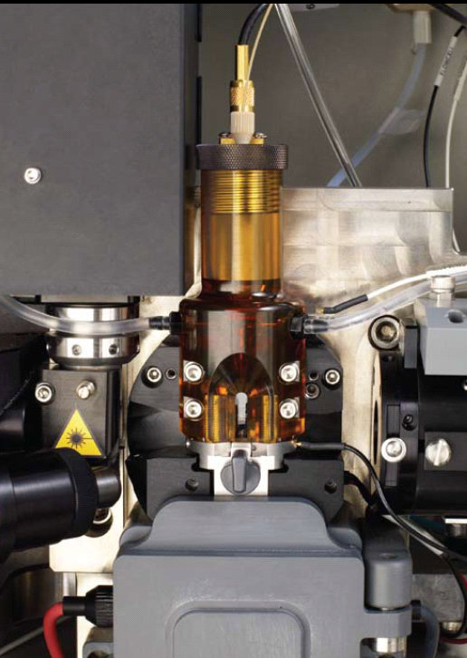

Slide 14
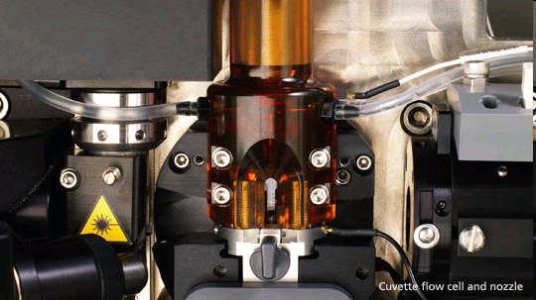


Slide 16

Particle Delivery: Hydrodynamic Focusing
Conventional Instrumentation: Low Flow Rates (12µL/min)
Hydrodynamic core
Narrow particle focus = Narrow distribution
Laser Cross Sectional Area
Count
Intensity
Sample core is ‘pinched’ by fast flowing sheath
Sample volume ratios of 100 – 1000
Large ratios => low sample inputs
Resolution of particle populations
sheath
sheath
Notes:
To really understand what is different and unique about acoustic focusing, one first needs to understand the current most commonly used method for focusing, called hydrodynamic focusing.
In this method, the sample is injected into a stream of sheath fluid where it is completely surrounded by sheath, the sample core is then centered in the sheath fluid where the laser beam will then interact with the particles. Based on principles relating to laminar flow, the sample core remains separate but coaxial within the sheath fluid. The flow of sheath fluid accelerates the particles and restricts them to the center of the sample core. This process is known as hydrodynamic focusing. Where the sample core is narrow, the particles interact with the laser beam optimally and a narrow distribution results as seen in the histogram above.

Slide 17
Particle Delivery: Hydrodynamic Focusing
Conventional Instrumentation: High Flow Rate (60µL/min)
Hydrodynamic core
Broad particle focus = Broad distribution
Count
Laser Cross Sectional Area
Intensity
Increased sample input = increase core size
Particle distributions broadened, CVs increase
Instrument resolution decreased
Historically, low volumetric sample rates used (25 μl/min – 150 μl/min)
sheath
sheath

Slide 18
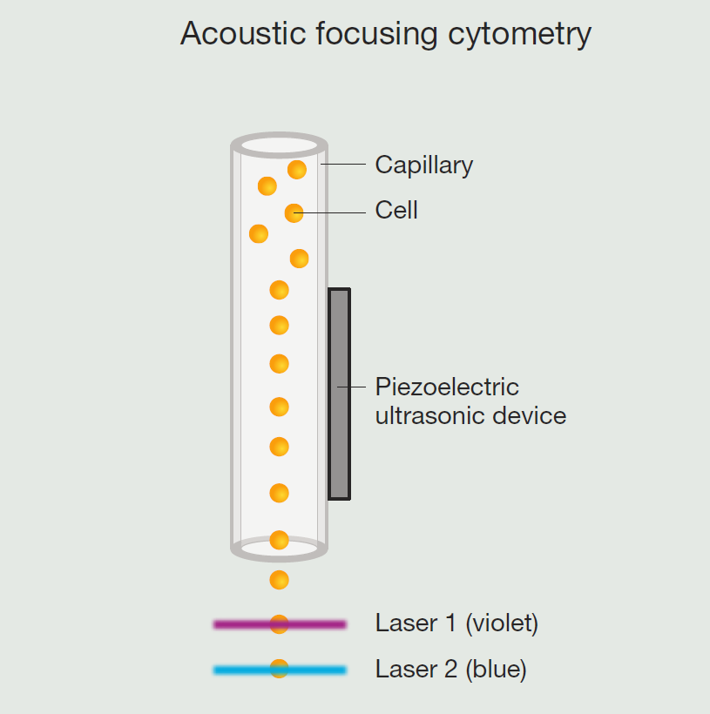
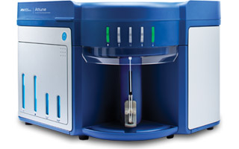
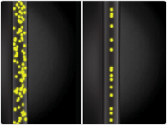

Attune® Acoustic Focusing Cytometer

Slide 19
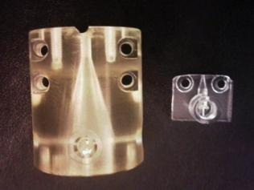
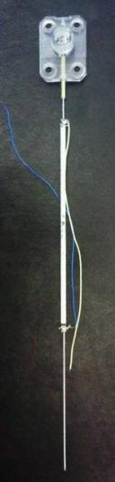
Acoustic Focusing = Better Precision
12 µL/min
Narrow particle focus = Narrow distribution
1000 µL/min
sheath
sheath
Acoustic focusing of particles occurs prior to mixing with sheath fluid
sheath
sheath
Acoustic focusing Module
Notes:
Fundamentals of acoustic focusing in flow cytometry:
Picture in the middle is a comparison of a manifold taken from a traditional hydrodynamic focusing cytometer (left) compared to a manifold taken from the Attune Cytometer and represented “in action” by the cartoons directly to the left and right of the photograph. The picture on the far right shows a full acoustic device as well as the manifold at the top.
Here, regardless of the sample volume that is moved through the flow cell, cells are focused by the acoustic device prior to entering the manifold and, ultimately, the flow cell.
So, at low sample volumes (left) and high sample volumes (right), focus is maintained.
This also means that very little sheath is needed. It is only used to allow for varying the amount of sample while maintaining the correct flow rate; and, is used to prevent reagent from staining the inside of the cuvette.

Slide 20
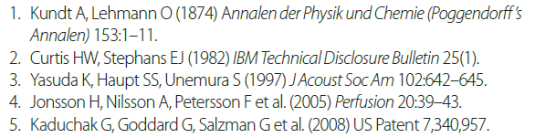
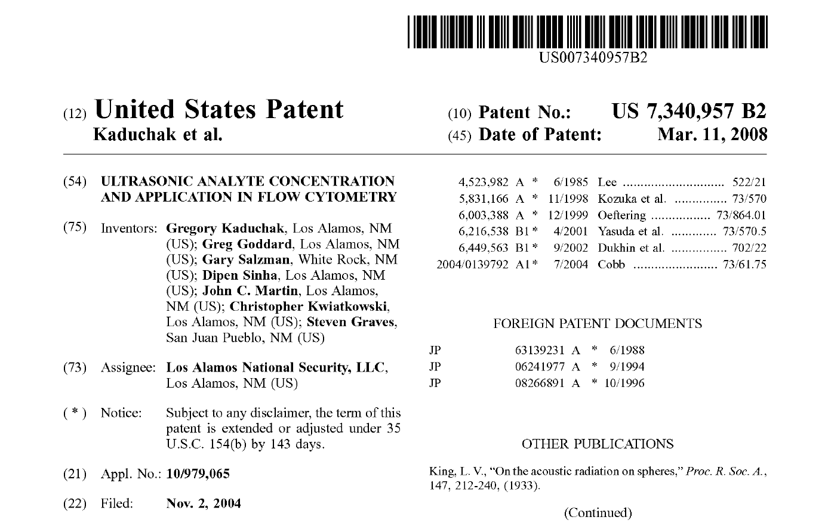
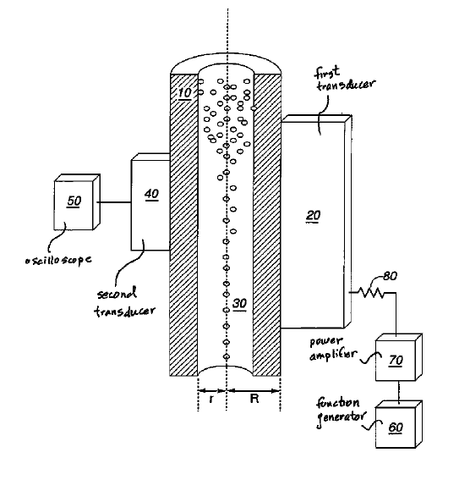

Slide 21


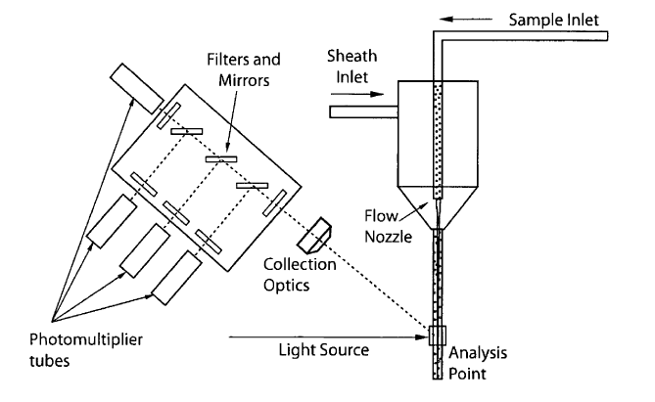
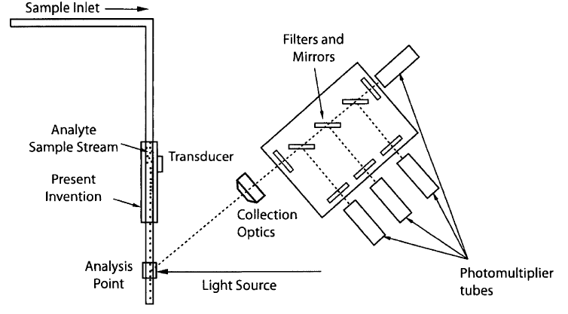

Slide 22
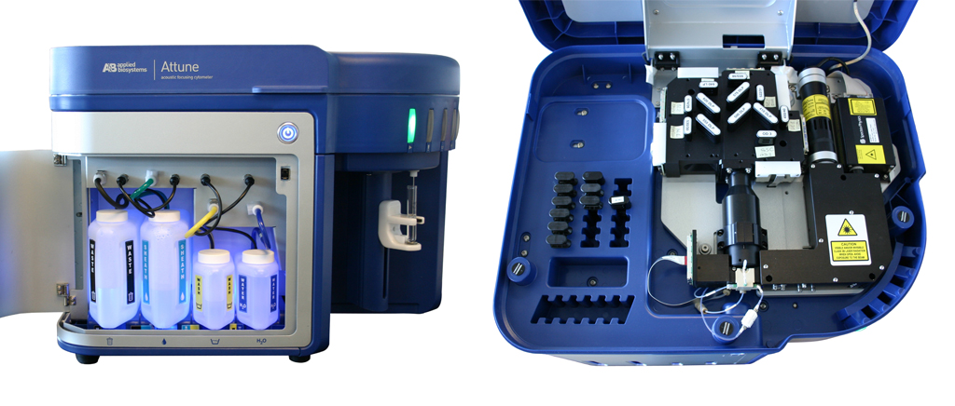
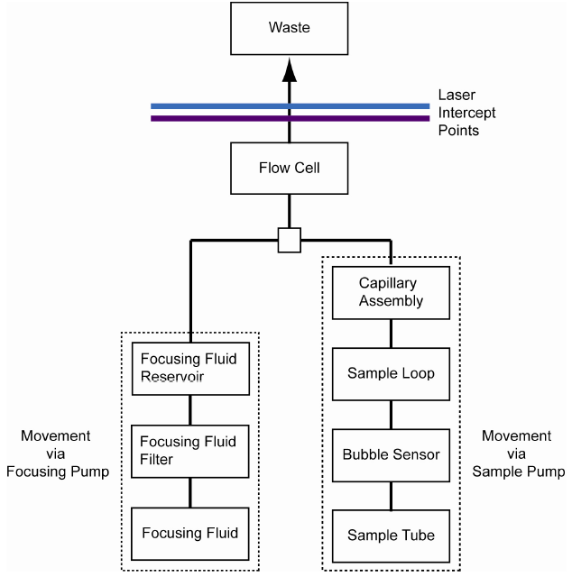
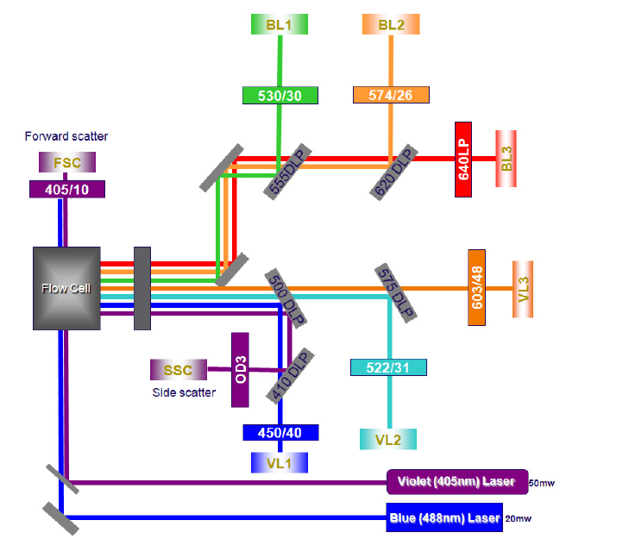

Slide 23
Attune (2 lasers, 6 detectors setup)
laser | detector |  | fluorochrome
405
 | VL1 | 450/50 | Pacific Blue, Alexa Fluor 405, Brilliant Violet 421
 | VL2 | 522/31 | Horizon V500, LIVE/DEAD Aqua
 | VL3 | 603/48 | LIVE/DEAD Yellow, Qdot 605
488
 | BL1 | 530/30 | FITC, GFP, Alexa Fluor 488, Calcein, LIVE/DEAD Green, ALDEFLUOR, HiLyte 488
 | BL2 | 574/26 | PE, propidium iodide, Hilyte 555
 | BL3 | 640 LP | PerCP, Pe-Cy7, PerCP-eFluor 710, LIVE/DEAD Red, 7-AAD

Slide 24
Attune - Key performance features include:
Breakthrough acoustic technology that focuses cells or particles
Highest sample delivery rates commercially available (up to 1,000 μL/minute)
User-selectable collection rates
Equipped with: Blue/Violet: 488 nm (20 mW) and 405 nm (50 mW) lasers
8 parameters—6-color detection plus side scatter and forward scatter
User-changeable bandpass and dichroic filters
Simplified fluorescence compensation
Manual and automated compensation
Adjustable PMT voltage settings
Detection of up to 20,000 events/sec and 20 million events/file
Calibrated delivery volumes for volumetric analysis and absolute cell counts
Electronic resolution of 6 decades
Low fluid consumption (about 1 L/day); self-contained fluids
Countertop instrument—fits on standard lab bench or in laminar
Software:
No software licensing fees
Output file format: FCS 3.0
Live gating with automatic saving
User and administrator log-in

Slide 25
Cancer
The Attune® Acoustic Focusing Cytometer, with its fast acquisition times and increased precision, overcomes the technological hurdles involved in analyzing CECs.
Stem Cells
Side Population Analysis
In this study, we demonstrate the ability of the Attune® Acoustic Focusing Cytometer with the blue/ violet laser configuration to quickly analyze a large number of events in search of very rare populations of stem cells.
Human Mesenchymal Stem Cells (hMSCs)
Adult human mesenchymal stem cells (hMSCs) are rare fibroblast-like cells capable of differentiating into a variety of cell tissues, including bone, cartilage, muscle, ligament, tendon, and adipose.
Cell Cycle Analysis
Cell cycle analysis is just one example of an application in which precise detection of differences in fluorescence intensity between multiple cell populations is critical...
Cell Proliferation
Successful proliferation analysis by dye dilution requires sensitive instrumentation and an extremely bright dye to accurately distinguish fluorescently labeled cells from autofluorescence after several cell divisions...
Marine Sample Analysis
Flow cytometry is a powerful tool for studying the biology, ecology, and biogeochemistry of marine photosynthetic picoplankton...
Immunophenotyping
The Attune® Acoustic Focusing Cytometer exhibits excellent segregation of populations in immunophenotyping experiments (with up to 6 colors)...
Apoptosis
The Attune® Acoustic Focusing Cytometer is compatible with a broad offering of reagents and kits for flow cytometric apoptosis testing...
GFP & RFP Detection
Data for GRP and RFP detection were collected from the Attune® Acoustic Focusing Cytometer using human osteosarcoma cells (U2OS) and BacMam CellLight® reagents...
Microbiological Applications
In recent years the application of flow cytometry to the study of various microbiological phenomena has increased, finding utility in studies that include detection and quantification...

Slide 26
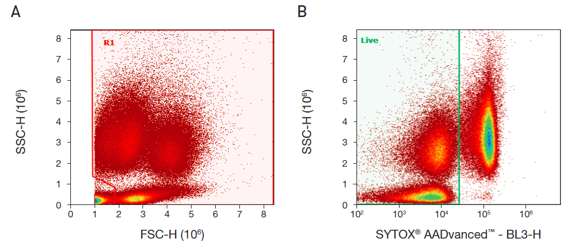
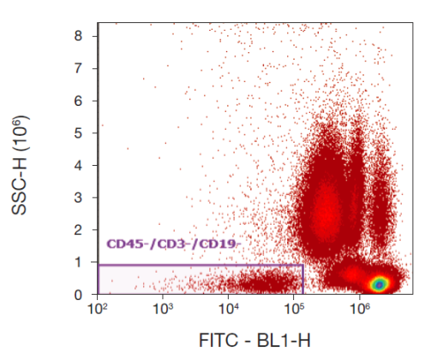
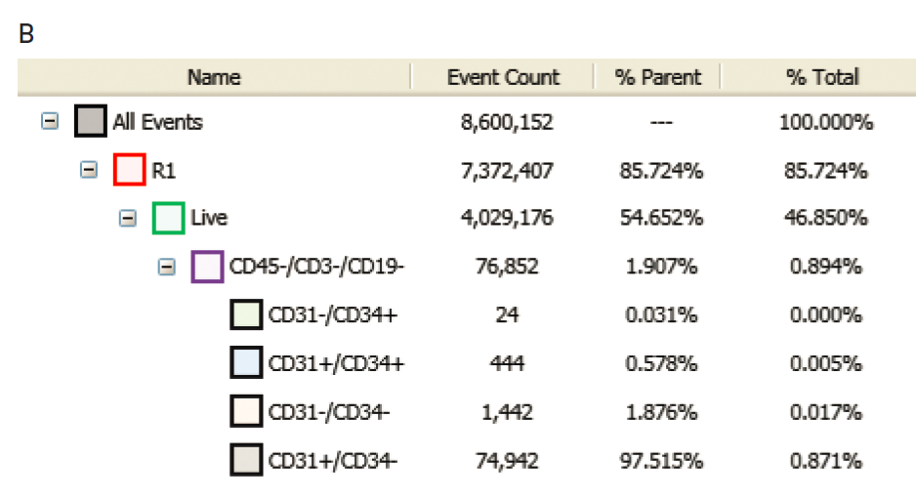
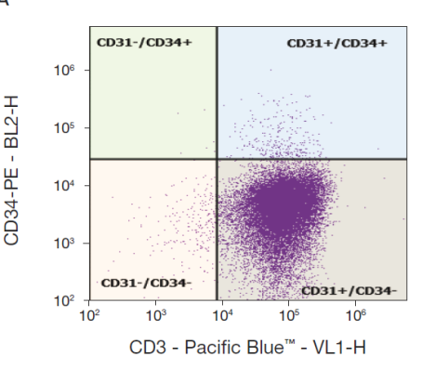
Example: Detecting human circulating endothelial cells
using the Attune® Acoustic Focusing Cytometer
Circulating endothelial cells (CECs) are mature cells shed from blood vessel
walls during the natural process of endothelial cell turnover.
Elevated levels of CECs have been reported in a host of pathological conditions including cardiovascular disorders, infectious diseases, immune disorders, post transplantation analysis, and cancer.
CECs are reported to be present in very low numbers: 0.01%–0.0001% of all peripheral blood mononuclear cells

Slide 27

Attune® Throughput Compared to Hydrodynamic Focused Instruments
Maximum Sample Input Rate (μl/min)
100
200
300
400
500
600
700
800
900
1000
Instrument 1
Instrument 2
Hydrodynamic Focused Instruments
Instrument 3
Instrument 4
Instrument 5
Instrument 6
Attune®
Attune® can analyze at sample rates from 25µL/min to 1000µL/min without losing accuracy
Traditional Flow Cytometers can only run at most 150µL/min and will sacrifice data quality
Higher sample rates enable dilution of limited samples and analysis of Rare Events Faster
Notes:
With Precious and Rare samples, the problem is that certain cells may not have enough volume of the original sample or cells may be fragile and can not withstand the centrifugation required to concentrate enough to run at low sample input rates. With the Attune® cytometer, being able to increase the sample rate up to 10x that of a traditional flow cytometer enables these customers to run rare or dilute samples. Also, because you can dilute your sample prior to running it on the Attune, customers with limited sample can save some of their sample for other analyses i.e. PCR, western, imaging etc.

Slide 28
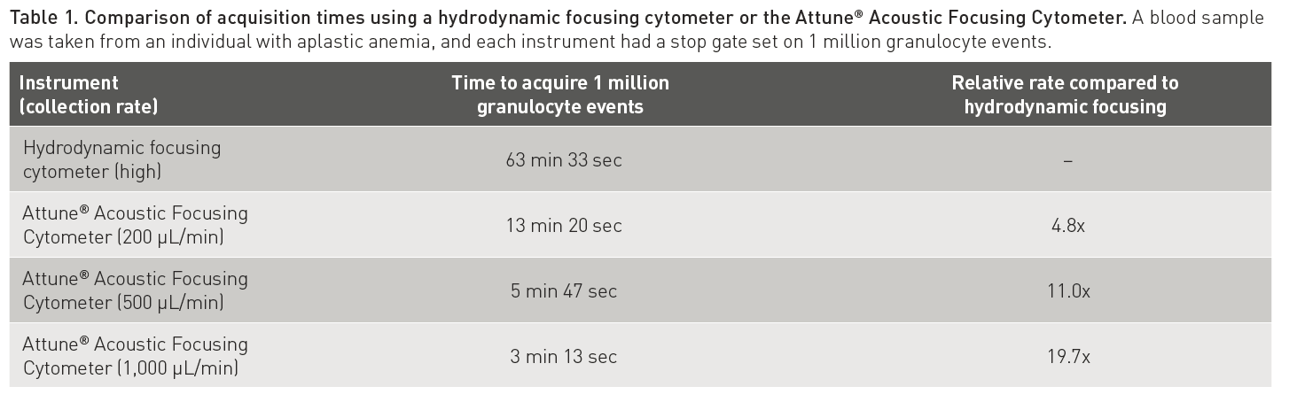

Slide 29

Attune souhrn
Výhody:
rychlost měření
jednoduché ovládání
sw licence bez omezení
snadná výměna emisních filtrů
nízká spotřeba nosné kapaliny (cca 1L denně)
Limitace:
jen dva lasery (6 barev)
pouze originální roztoky
dlouhý (i když automatický) shutdown
sw nedokáže importovat FCS data
nutnost nastavit určitý akviziční objem vzorku

Slide 31
Fluidika – shrnutí 2
tlak nosné (oplašťující) kapaliny vede pufr kyvetou a vyšší tlak ve zkumavce se vzorkem zavádí vzorek do kyvety.
Princip hydrodynamického zaostření zarovná buňky v kyvetě „jako perly na šňůrce“ předtím než dojdou do bodu kde protnout paprsek laseru.
Hydrodynamické zaostření nemůže oddělit buněčné agregáty. Průtoková cytometrie vyžaduje suspenzi jednotlivých buněk!

Slide 32
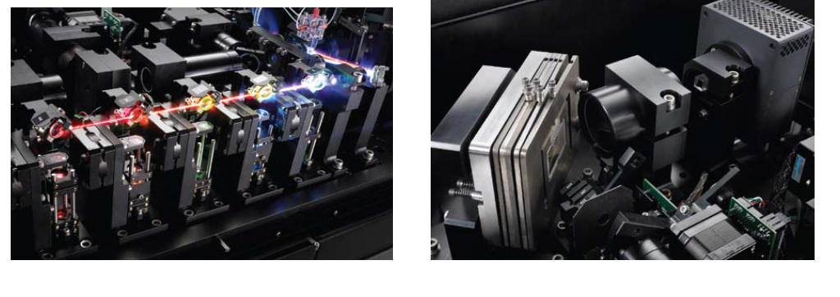
Image Stream & Flowsight Amnis – kombinace průtokové cytometrie a analýzy obrazu

Slide 34
Amnis - aplikace

Slide 35
Principy průtokové cytometrie a sortrování
sorting
zpracování signálu
analýza dat
kompenzace signálu
K. Souček Bi9393 Analytická cytometrie

Slide 36
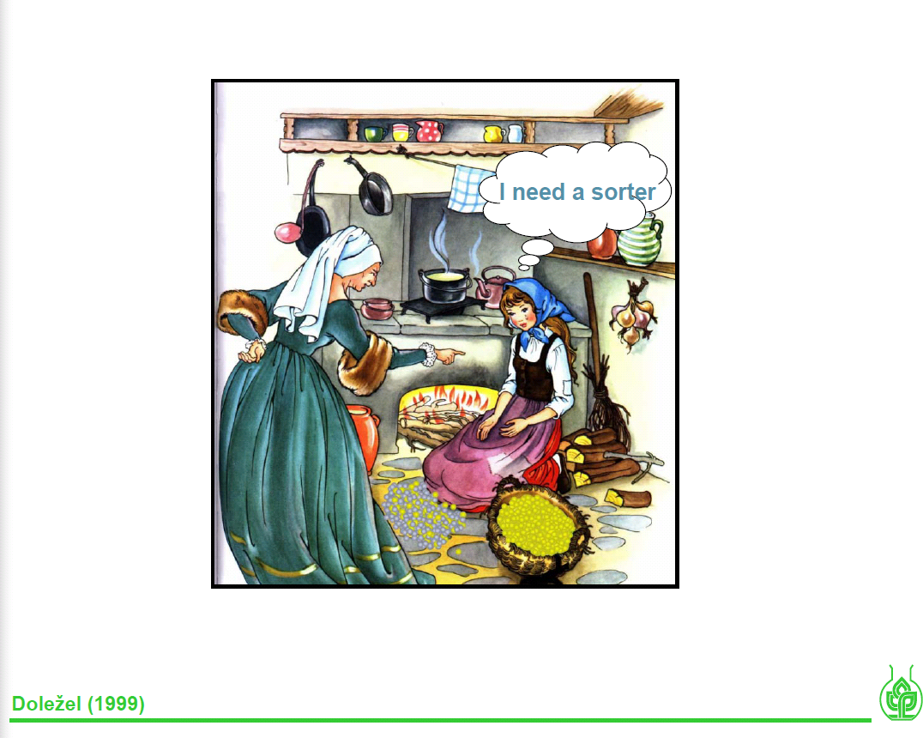

Slide 37
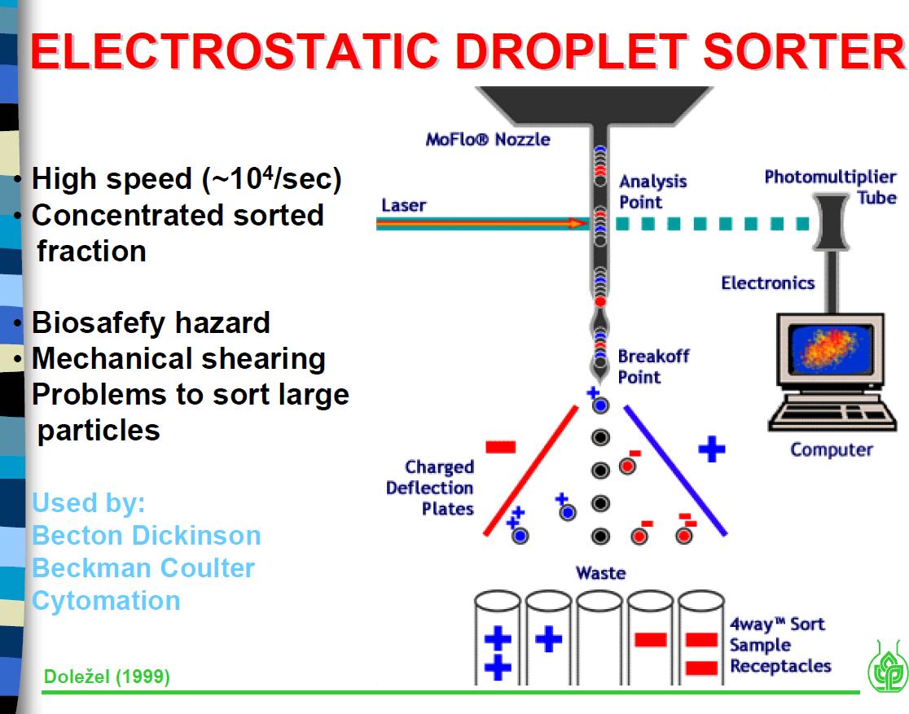

Slide 38


-----
+++++

Slide 39
-----
+++++

Slide 40
-----
+++++

Slide 41
+++++
+++++
-----
+++++

Slide 42
++
++
+++++
+++++
-----
+++++

Slide 43
+
+
+++++
+++++
-----
+++++

Slide 44
-----
+++++
+++++
-----
+++++

Slide 45
-----
-----
-----
+++++
+++++
+++++

Slide 46
- -
- -
- - - - -
- - - - -
-----
+++++

Slide 47
-
-
- - - - -
- - - - -
-----
+++++

Slide 48
-
- - - - -
- - - - -
-----
+++++

Slide 49
-
- - - - -
- - - - -
-----
+++++

Slide 50
-
-----
+++++
- - - - -
- - - - -

Slide 51
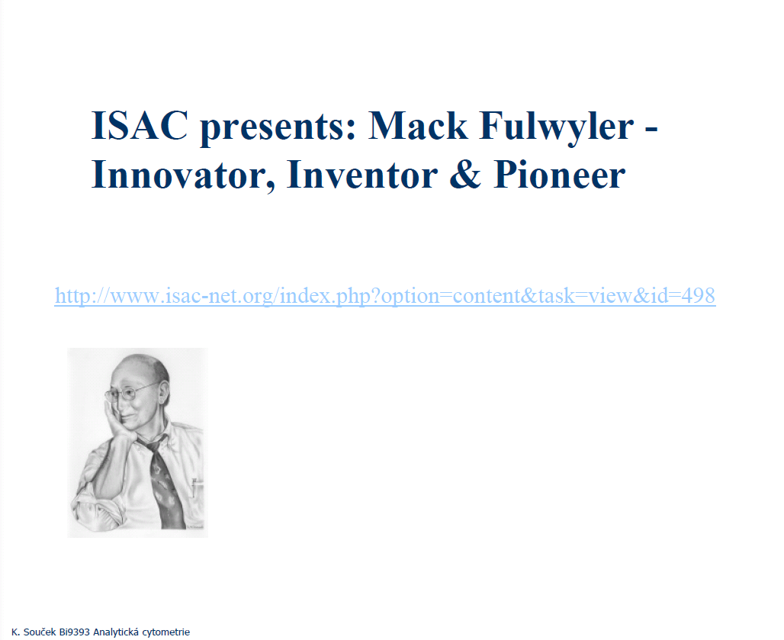
http://www.cyto.purdue.edu/cdroms/cyto10a/seminalcontributions/fulwyler.html

Slide 54

SORTING

Slide 55

SORTING
Frequency
Charge
Drop Delay
Amplitude

Slide 56
SORTING
Sheath Pressure
Frequency
Nozzle Size
Amplitude

Slide 57
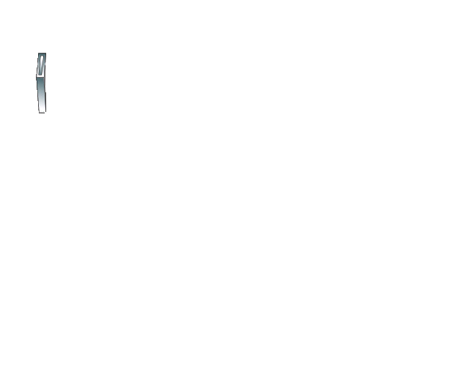
SORTING
Interrogation point
Drop delay
Breakoff

Slide 58
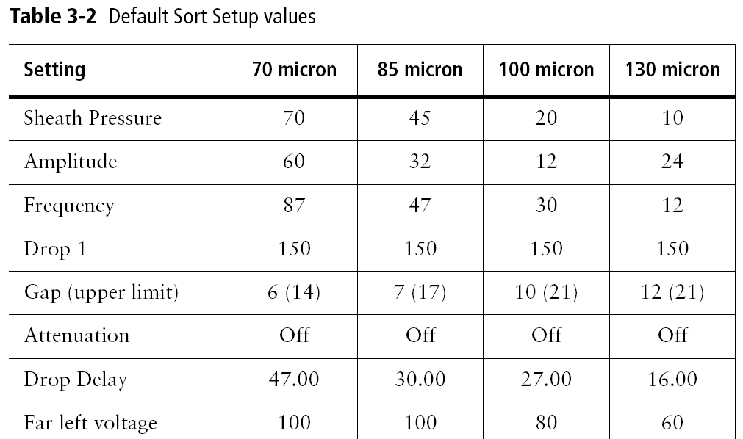
SORTING
Each sort setup includes:
Sheath pressure
Breakoff window values
Side Stream window values
Instrument window > Laser tab values

Slide 59
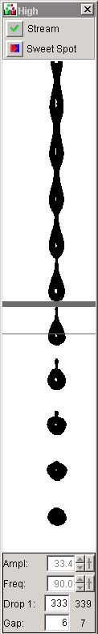
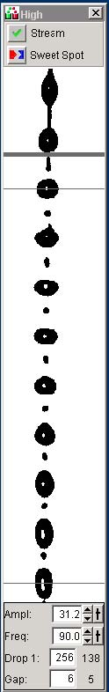
SORTING - Streams
Good
Bad

Slide 60
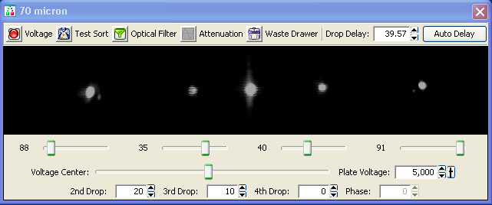
SORTING – Setup Side Streams

Slide 61
Drop Delay
interrogation point
drop delay
BD FACS™ Accudrop technology
Accudrop beads
Diode laser
Camera
Optical filter
breakoff
Waste
Notes:
Before sorting, you need to make sure that you have an accurate drop delay setting. The Aria has integrated Accudrop technology which provides a simple way to adjust the drop delay.
The components used for Accudrop:
Diode laser: A low-power red laser which illuminates the lower portion of the stream when the sort block door is closed (there’s a safety interlock).
Camera: Provides an image of the side streams visible in this window. (located behind the round window in the sort block)
Optical filter: Used for viewing the fluorescence from the droplets containing Accudrop beads. (point out the button on this image that moves the filter into place)
Accudrop beads: Beads that are excited by the diode laser and emit within the range of the optical filter.
The drop delay is the distance between the laser intercept and the last connected drop, measured in time. The system needs to know when to charge the stream so that the intended droplet is charged before it is detached from the stream.
This diagram shows the diode laser and the lower camera window. When setting the drop delay, the waste aspirator drawer is blocking the collection tubes, so all beads will go to waste. Essentially, Accudrop allows us to view the accuracy of our sort in real-time, without having to do a post-sort analysis.

Slide 62
Sorting - Sort Masks
Cells are randomized distributed over the stream

Slide 63
Sorting - Sort Masks
Trailing
Interrogated
Leading

Slide 64
Mask
A region of the stream monitored for the presence of cells
Determines how drops will be deflected if a sorting conflict occurs
Measured in 1/32 drop increments
4
8
16
4
8
16
Mask = 0
Mask = 8
Mask = 16
Mask = 32
Notes:
At the laser intercept particles are defined as wanted or not based on the gates you created in the software. However, while the particle is traveling down the stream another decision is made on whether or not the particle will be sorted based upon the Sort Precision mode.
A sort precision mode is made up of a combination of masks. A mask is a region of the stream that will be considered to make a decision if there’s a sorting conflict. Each mask is measured in 1/32 drop increments.
The next few slides will discuss each individual mask, then we’ll look at how those three masks are combined into precision modes.
Note to instructor: Encourage customers to hold questions about putting the masks together until after you’ve discuss the basic definitions of all three.

Slide 65
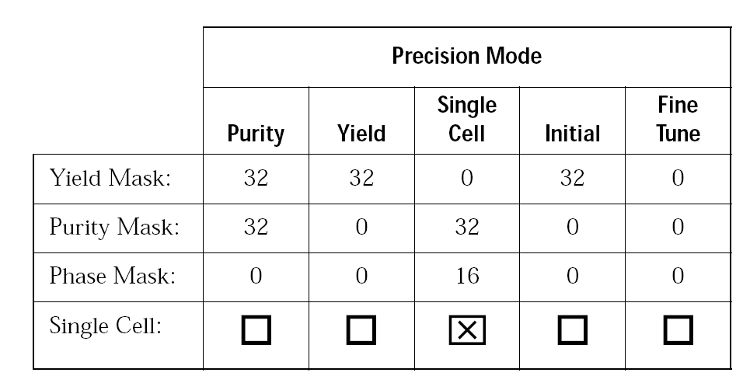
Conflict Resolution
Precision modes include three types of masks
  Yield
  Purity
  Phase
Notes:
At the laser intercept particles are defined as wanted or not based on the gates you created in the software. However, while the particle is traveling down the stream another decision is made on whether or not the particle will be sorted based upon the Sort Precision mode.
A sort precision mode is made up of a combination of masks. A mask is a region of the stream that will be considered to make a decision if there’s a sorting conflict. Each mask is measured in 1/32 drop increments.
The next few slides will discuss each individual mask, then we’ll look at how those three masks are combined into precision modes.
Note to instructor: Encourage customers to hold questions about putting the masks together until after you’ve discuss the basic definitions of all three.

Slide 66
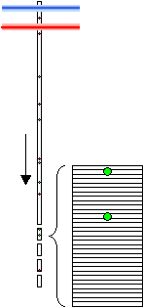
Sorting - Sort Masks
Sort decisions are determined by sort masks
Target particles in a drop with 1/32-drop resolution

Slide 67
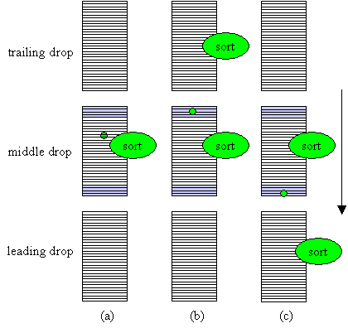
Sorting - Yield Mask
The yield mask defines how many drops will be sorted Yield mask of 8/32 indicated in blue; target particle shown in green
Yield Mask

Slide 68
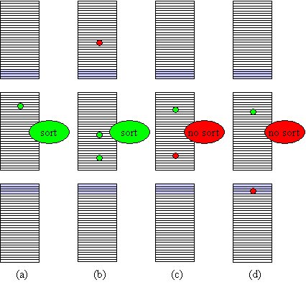
Sorting - Purity Mask
Purity mask of 8/32 in blue, 4/32 in each adjacent drop; target particles in green, non-target particles in red
Purity Mask
Purity Mask

Slide 69
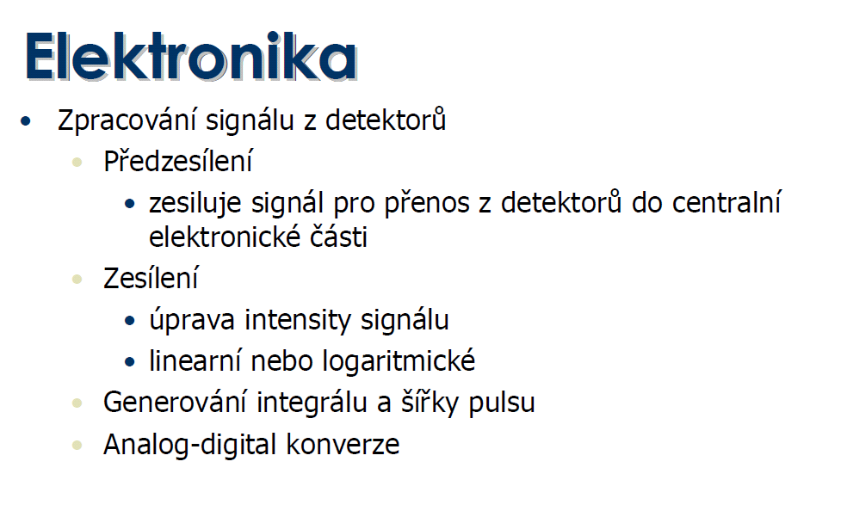

Slide 71
Creation of a Voltage Pulse
1
Laser
Voltage
Time
2
Laser
Voltage
Time
3
Laser
Voltage
Time

Slide 72
Height, Area, and Width
Pulse area(A)
Pulse Height (H)
Voltage
0
Pulse Width (W)
Time (µs)

Slide 73
Signal processing
dot plot
1000
FL-1 (H)
Zesílení signálu (!)
lin nebo log
0
1000
FL-2 (H)
Analog/digital
conversion
FSC ~ cell size
FL-1 (530/30nm) ~ green fluo.
FL- (H, W, A)
analog signal intesity
VOLTAGE
Height
FL-2 (585/42nm) ~ red fluo.
Width
Area ( ∫ )
time
K. Souček Bi9393 Analytická cytometrie

Slide 74
Analog to Digital Converter
16, 364
12420
7650
1985
340
baseline
Time

Slide 75
Analog to Digital Converter
Analog to Digital
Conversion
Signal
Out
Digital data to memory
Photon
In
Voltage In
PMT
Power Supply
Digitize
the pulse
16,384 levels
Sample
the pulse
10 MHz
Levels 0–1000 Volts

Slide 76
Parameters
14524
9568
10270
4004
3060
358
282
Area: Sum of all height values
Height: Maximum digitized value X 16
Width: Area/Height X 64K
Data is displayed on 262,144 scale

Slide 77
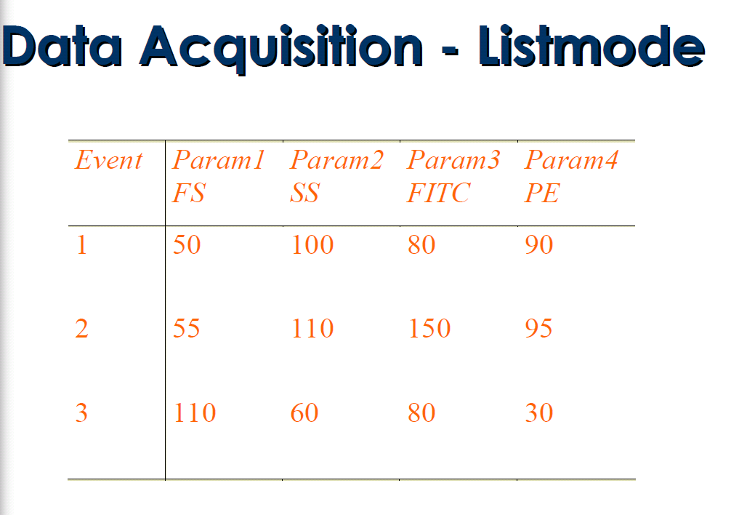

Slide 78
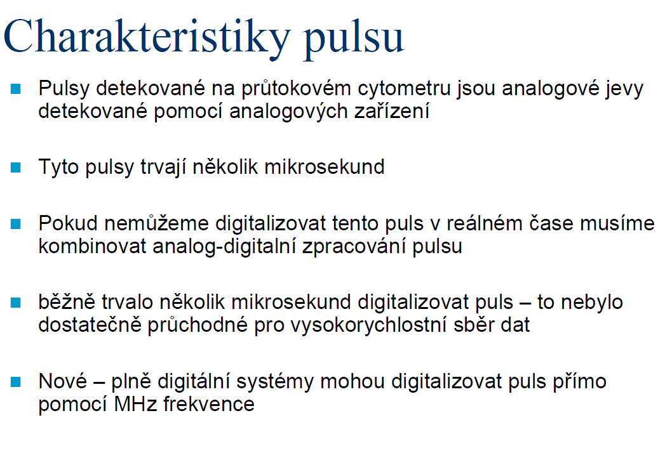

Slide 80
2⁴=16

Slide 81
Lineární a logaritmický obvod
lineární
logaritmický
kompenzace fluorescenčního signálu

Slide 82
AD převodníky
2⁸ = 256
2¹⁰ = 1024
.
.
.
Počet bitů | # kanálů | rozlišení
8 | 256 | 39.1 mV
10 | 1024 | 9.77 mV
12 | 4096 | 2.44 mV
14 | 16384 | 610 μV
16 | 65536 | 153 μV
18 | 262144 | 38.1 μV
20 | 1048576 | 9.54 μV
22 | 4194304 | 2.38 μV
24 | 16777216 | 596 nV
Full scale measurement range = 0 to 10 volts
ADC resolution is 12 bits: 212 = 4096 quantization levels
ADC voltage resolution is: (10-0)/4096 = 0.00244 volts = 2.44 mV
K. Souček Bi9393 Analytická cytometrie

Slide 83
Kolik bitů?
Pokud konvertujeme analogový signál pomocí 8 bitového ADC – máme 256 kanálů (2⁸=256) odpovídajících rozsahu 0-10 V
Rozdíl mezi kanály je 10/256=~40mV
1V
10V
100mV
0 50 100 150 200 250
Channels
upraveno podle J.P.Robinson

Slide 84
Ideální logaritmický zesilovač
1 V
10 V
100 mV
Linearní
0 50 100 150 200 250
Log amp
1 mV
10 mV
100 mV
1 V
10 V
Log
0 50 100 150 200 250
Channels
upraveno podle J.P.Robinson

Slide 85
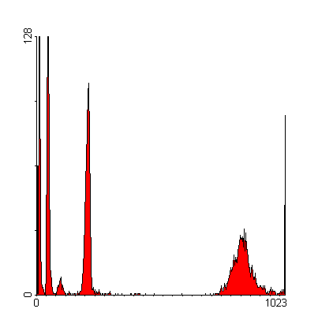
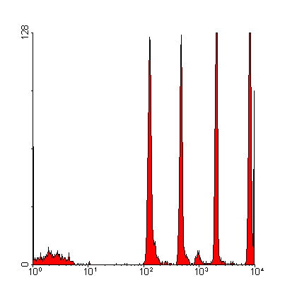
Logaritmické zesílení & dynamický rozsah
lin
log
upraveno podle J.P.Robinson

Slide 86
Kompenzace fluorescenčního signálu
…později

Slide 87
Analýza dat
Zobrazení dat
  histogram
  dot plot
  isometric display
  contour plot
  chromatic (color) plots
  3 D projection
Gating

Slide 88
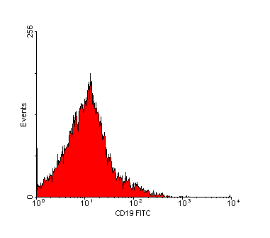
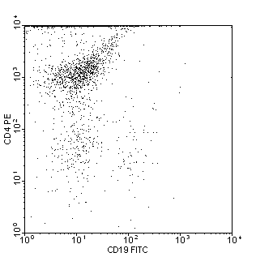
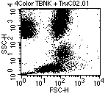
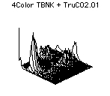
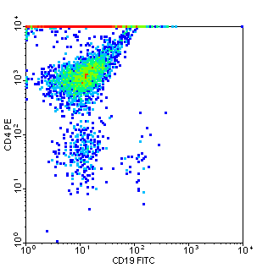
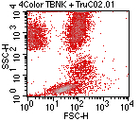
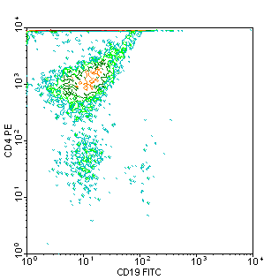
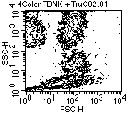
Způsoby pro zobrazení dat
K. Souček Bi9393 Analytická cytometrie

Slide 89
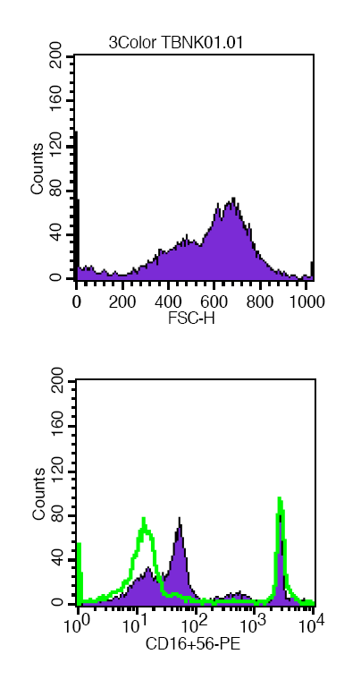
Histogram distribuce četnosti
Histogram zobrazuje četnost částic pro jeden parametr
Jednoduchý výstup
Nekorelujeme s dalším parametrem
Problém s identifikací populací
K. Souček Bi9393 Analytická cytometrie

Slide 90
Dot plot
Zobrazuje korelaci dvou libovolných parametrů
Jednotlivé tečky představují konkrétní změřené buňky (částice)
Hodnoty pro řadu částic mohou ležet ve stejném místě
Nemáme informaci o relativní denzitě částic
Problémy s vykreslením v případě velkých objemů dat
K. Souček Bi9393 Analytická cytometrie

Slide 91
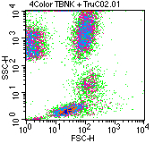
Density & contour plot
Density plot:
Zobrazuje dva parametry jako frekvenci četnosti
barva a nebo její odstín odpovídá četnosti částic
Contour plot:
spojnice spojuje body (částice) se stejnou hodnotou signálu
V podstatě simulujeme 3D graf – třetí rozměr je frekvence
K. Souček Bi9393 Analytická cytometrie

Slide 92
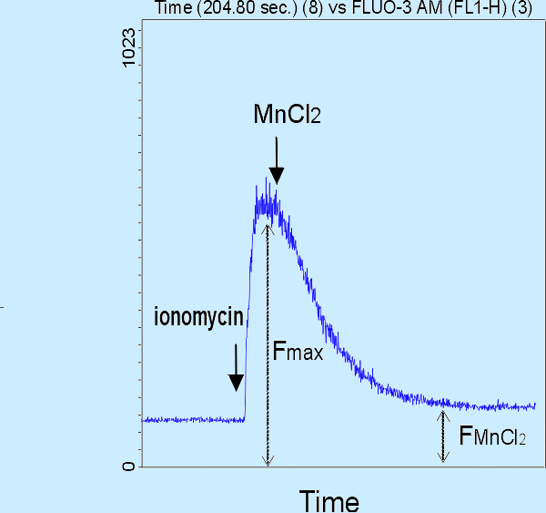
Čas jako jeden z parametrů
K. Souček Bi9393 Analytická cytometrie

Slide 93
3D zobrazení
2 parametry + četnost
3 parametry společně
K. Souček Bi9393 Analytická cytometrie

Slide 94
3 Color Combinations
APC
4+4+4=12
Positives
PE
4+4=8
FITC
Negatives
upraveno podle J.P.Robinson

Slide 95
3 Color Combinations
1000
PE-FITC Pattern
1000
TR-FITC Pattern
1000
TR-PE Pattern
APC
4+4+4=12
100
100
100
CD38
CD20
CD8
CD5
CD3
CD8
Phycoerytherin
CD3
CD20
10
CD4
10
CD8
10
IgM
K/L
Texas Red
Texas Red
CD3
CD20
IgG
CD20
CD7
CD8 (dim)
IgG
1
1
HLA-DR
CD2
1
CD2
CD10
L
K
.1
Negative
CD3
.1
CD3
.1
Negative
CD4
CD45
Negative
CD45
1
CD5
.1
1
10
100
1000
.1
1
10
100
1000
.1
10
100
1000
FITC
FITC
Phycoerytherin
PE
FITC
upraveno podle J.P.Robinson

Slide 96
„Gating“
Real-time gating vs. softwarový „gating“
Určení regionů
Strategie „gatingu“
Analýza kvadrantů
Boolean „gating“
zpětný „gating“

Slide 97
Real-Time vs. Software Gating
Real-time (live) gating:
-omezuje akceptovaná data během měření
Software (analysis) gating:
-vyřazuje určitá data během následné analýzy
upraveno podle J.P.Robinson

Slide 98

Určení regionů
Objektivní nebo subjektivní?
  -školení/schopnosti/trénink
Možné tvary:
  -obdelník
  -elipsa
  -“free-hand“ (polygon)
  -kvadrant
Statistika
- počet
- podíl (%)
- průměr, medián, S.D., CV, ….

Slide 99
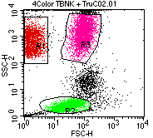
Region vs. gate
Region
oblast (plocha) v grafu definovaná uživatelem
mnoho regionů v jednou grafu
ohraničujeme pomocí nich populace našeho zájmu
je možné je barevně odlišit
je definován stejně pro všechny vzorky v analýze
Gate
je definován jako jeden a nebo více regionů zkombinovaných pomocí logických operátorů (AND, OR, NOT; Booleova logika)
K. Souček Bi9393 Analytická cytometrie

Slide 100

Using Gates
log PE
Region 1 established
Gated on Region 1
upraveno podle J.P.Robinson

Slide 101




Statistika
Aritmerický průměr
Geometrický průměr
Medián
– odhad střední hodnoty
– není ovlivněn extrémními hodnotami
Směrodatná odchylka
Koeficient variance
Modus – nejčastější hodnota
K. Souček Bi9393 Analytická cytometrie

Slide 102

Statistika pro histogram
K. Souček Bi9393 Analytická cytometrie

Slide 103
Analýza kvadrantů
( - +)
(+ +)
(- -)
(+ -)
K. Souček Bi9393 Analytická cytometrie

Slide 104

Logický „Gating“ (Booleova logika)
S překrývajícími se oblastmi máme mnoho možností:
upraveno podle J.P.Robinson

Slide 105

Boolean Gating
Not Region 1:
upraveno podle J.P.Robinson

Slide 106

Boolean Gating
Not Region 2:
upraveno podle J.P.Robinson

Slide 107

Boolean Gating
Region 1 or Region 2:
upraveno podle J.P.Robinson

Slide 108

Boolean Gating
Region 1 and Region 2:
upraveno podle J.P.Robinson

Slide 109

Boolean Gating
Not (Region1 and Region 2):
upraveno podle J.P.Robinson

Slide 110
Light Scatter Gating
Side Scatter Projection
Neutrophils
Scale
1000
200
100
50
40
Monocytes
30
20
15
Lymphocytes
8
0
200
400
600
800
1000
90 Degree Scatter
upraveno podle J.P.Robinson

Slide 111


Back Gating
Back gate
log PE
Region 4 established
Back-gating using Region 4
upraveno podle J.P.Robinson

Slide 112

Back Gating
K. Souček Bi9393 Analytická cytometrie

Slide 113





3 Parameter Data Display
FITC+
APC+
PE +
APC+
FITC+
PE+
upraveno podle J.P.Robinson

Slide 114

Vícebarevné analýzy generují mnoho dat…
5 color
4 color
3 color
1 2 3 4 5 6 7 8 9 10
QUADSTATS
QUADSTATS
QUADSTATS
QUADSTATS
QUADSTATS
QUADSTATS
QUADSTATS
QUADSTATS
QUADSTATS
QUADSTATS
-+
++
-+
++
-+
++
-+
++
-+
++
-+
++
-+
++
-+
++
-+
++
-+
++
Log Fluorescence
Log Fluorescence
Log Fluorescence
Log Fluorescence
Log Fluorescence
Log Fluorescence
Log Fluorescence
Log Fluorescence
Log Fluorescence
Log Fluorescence
--
+-
--
+-
--
+-
--
+-
--
+-
--
+-
--
+-
--
+-
--
+-
--
+-
Log Fluorescence
Log Fluorescence
Log Fluorescence
Log Fluorescence
Log Fluorescence
Log Fluorescence
Log Fluorescence
Log Fluorescence
Log Fluorescence
Log Fluorescence
QUADSTATS
QUADSTATS
QUADSTATS
QUADSTATS
QUADSTATS
QUADSTATS
QUADSTATS
QUADSTATS
QUADSTATS
QUADSTATS
-+
++
-+
++
-+
++
-+
++
-+
++
-+
++
-+
++
-+
++
-+
++
-+
++
Log Fluorescence
Log Fluorescence
Log Fluorescence
Log Fluorescence
Log Fluorescence
Log Fluorescence
Log Fluorescence
Log Fluorescence
Log Fluorescence
Log Fluorescence
--
+-
--
+-
--
+-
--
+-
--
+-
--
+-
--
+-
--
+-
--
+-
--
+-
Log Fluorescence
Log Fluorescence
Log Fluorescence
Log Fluorescence
Log Fluorescence
Log Fluorescence
Log Fluorescence
Log Fluorescence
Log Fluorescence
Log Fluorescence
QUADSTATS
QUADSTATS
QUADSTATS
QUADSTATS
QUADSTATS
QUADSTATS
QUADSTATS
QUADSTATS
QUADSTATS
QUADSTATS
-+
++
-+
++
-+
++
-+
++
-+
++
-+
++
-+
++
-+
++
-+
++
-+
++
Log Fluorescence
Log Fluorescence
Log Fluorescence
Log Fluorescence
Log Fluorescence
Log Fluorescence
Log Fluorescence
Log Fluorescence
Log Fluorescence
Log Fluorescence
--
+-
--
+-
--
+-
--
+-
--
+-
--
+-
--
+-
--
+-
--
+-
--
+-
Log Fluorescence
Log Fluorescence
Log Fluorescence
Log Fluorescence
Log Fluorescence
Log Fluorescence
Log Fluorescence
Log Fluorescence
Log Fluorescence
Log Fluorescence
upraveno podle J.P.Robinson

Slide 115





Slide 116

Detection and monitoring of normal and leukemic cell populations with hierarchical clustering of flow cytometry data
Cytometry Part A
Volume 81A, Issue 1, pages 25-34, 11 OCT 2011 DOI: 10.1002/cyto.a.21148
http://onlinelibrary.wiley.com/doi/10.1002/cyto.a.21148/full#fig1
Notes:
HCA‐Main hematopoietic populations in normal BM. A: Dendrogram with heatmap‐HCA of 10⁴ ungated events acquired from normal BM. Heatmap shows relative levels of all eight parameters (columns) in all 10⁴ events (rows) in color coding (blue, low expression; red, high expression). Dendrogram shows the hierarchy of cells based on their similarity in all parameters measured. The x‐axis under the dendrogram represents similarity distance. Colored branches of the dendrogram are selected clusters, as displayed in B. B: The main populations (as identified by HCA) are displayed on a conventional forward versus side scatter dot plot. C: All two‐parameter combination plots of a defined cluster (marked by red rectangle in A). This population is negative for most of the antibodies from the B cell panel and may be difficult to detect by standard gating as it overlaps with other populations in all 28 two‐parameter plots. Nevertheless it is a compact, homogenous population most likely of T cell origin. This red population was drawn on top of the remaining cells (gray). D: Mirror image to C. The gray population was drawn on top of the red population. Fluorescent dyes used were: CD10‐FITC, CD22‐PE, CD117‐PerCP‐Cy5.5, CD38‐PE‐Cy7, CD34‐APC, CD19‐APC‐Cy7, and in all cases pulse height was used.
© This slide is made available for non-commercial use only. Please note that permission may be required for re-use of images in which the copyright is owned by a third party.

Slide 117





Slide 118


The Flow Cytometry: Critical Assessment of Population Identification Methods (FlowCAP)
The goal of FlowCAP is to advance the development of computational methods for the identification of cell populations of interest in flow cytometry data. FlowCAP will provide the means to objectively test these methods, first by comparison to manual analysis by experts using common datasets, and second by prediction of a clinical/biological outcome.

Slide 119
Způsoby pomocí kterých lze upravit výsledky:
1. Odstranění „doublets“
2. Čas jako parametr pro kontrolu kvality
Příklad - pro DNA analýzu je třeba:
- odstranit „debris“ a shluky
- odstranit „doublets“
- udržovat konstantní průtok
K. Souček Bi9393 Analytická cytometrie

Slide 120
DNA Histogram
G₀-G₁
G₂-M
S
# of Events
Fluorescence Intensity

Slide 121

Co je problém při vícebarevné detekci?
K. Souček Bi9393 Analytická cytometrie

Slide 122

Emission Spectra–Spectral Overlap

Slide 123
Kompenzace fluorescenčního signálu při vícebarevné detekci
Proces při kterém dochází k eliminaci všech fluorescenčních signálů kromě signálu z fluorochromu který má být na příslušném detektoru detekován
Nastavení pomocí mixu mikročástic či buněk označených/neoznačených příslušnými fluorochromy.
K. Souček Bi9393 Analytická cytometrie

Slide 124
Co je problém při vícebarevné detekci?
K. Souček Bi9393 Analytická cytometrie

Slide 125

Kompenzace fluorescenčního signálu při vícebarevné detekci
K. Souček Bi9393 Analytická cytometrie

Slide 126

“Bright” = good resolution sensitivity

Slide 127

Various fluorochromes-stain index

Slide 128

Choices for 6,- 8,- 10,- and more colors

Slide 129

Fluorochrome selection considerations

Slide 130

FITC Spillover
FITC
PE
585/42
PerCP-Cy5.5
695/40
530/30
Relative Intensity
500nm
550nm
600nm
650nm
700nm
750nm
800nm
Wavelength (nm)

Slide 131


FITC Compensation
FITC
530/30
PE
585/42
PerCP-Cy5.5
695/40
Relative Intensity
500nm
550nm
600nm
650nm
700nm
Wavelength (nm)

Slide 132


FITC Compensation
FITC
530/30
PE
585/42
PerCP-Cy5.5
695/40
Relative Intensity
500nm
550nm
600nm
650nm
700nm
Wavelength (nm)

Slide 133



FITC Compensation
Dot plot showing uncompensated FITC data
Dot plot showing compensated FITC data
Biexponential dot plot showing compensated FITC data

Slide 134


FITC Spillover
FITC
PE
585/42
530/30
Relative Intensity
500nm
550nm
600nm
Wavelength (nm)

Slide 135



Slide 136


Slide 137


Slide 138
Kompenzace fluorescenčního signálu
FITC positive & negative
PE negative beads
#2
K. Souček Bi9393 Analytická cytometrie

Slide 139
Kompenzace fluorescenčního signálu
FITC positive & negative
PE negative beads
NONE!
K. Souček Bi9393 Analytická cytometrie

Slide 140
Kompenzace fluorescenčního signálu

Slide 141

Nastavení kompenzací
značené mikročástice – pro běžně konjugované fluorochromy
značené buňky – pro vitální značení
parametr - detektor amp.
FL1 - 544
FL2 - 434
kompenzace
FL1 - 1.1%FL2
FL2 - 17.5%FL1

Slide 142





Effects of Changing PMT Values
Correct Compensation
FITC Voltage Decreased by 5 V
FITC Voltage Increased by 5 V

Slide 143
Which marker for compensation?
Small errors in compensation of a dim control (A) can result in large compensation errors with bright reagents (B & C).
Use bright markers to setup proper compensation.

Slide 144

BD Comp Beads
Always positive
Bright staining
Save sample (HIV patients)
Use the same antibody for compensation and the real experiment

Slide 145





BD Comp Beads

Slide 146

Fluorescence Minus One
PBMC were stained as shown in a 3-color experiment. Compensation was properly set for all spillovers
Courtesy Mario Roederer

Slide 147

Tandemové značky

Slide 148


Tandemové značky - příklad

Slide 149
Tandems are light sensitive
CD8
CD3
PE-Cy7
PE-Cy5
Time Sample Left in Light
0 hours
PE
(FL2)
2 hours
22.5 hours

Slide 150
Kompenzace - literatura
Mario Roederer - Compensation in Flow Cytometry
Current Protocols in Cytometry (2002) 1.14.1-1.14.20 John Wiley & Sons, Inc.
M. Loken, D. R. Parks, & L. A. Herzenberg (1977). Two-color immunofluorescence using a fluorescence-activated cell sorter. J. Histochem. Cytochem. 25:899-907.
M. Roederer & R. F. Murphy (1986). Cell-by-cell autofluorescence correction for low signal-to-noise systems: application to EGF endocytosis by 3T3 fibroblasts. Cytometry 7:558-565.
S. Alberti, D. R. Parks, & L. A. Herzenberg (1987). A single laser method for subtraction of cell autofluorescence in flow cytometry. Cytometry 8:114-119.
C. B. Bagwell & E. G. Adams (1993). Fluorescence spectral overlap compensation for any number of flow cytometry parameters. in: Annals of the New York Academy of Sciences, 677:167-184.
K. Souček Bi9393 Analytická cytometrie

Slide 151

No Data Analysis Technique Can Make Good Data Out of Bad Data!
Shapiro’s 7th Law of Flow Cytometry

Slide 152
Shrnutí přednášky
sorting
zpracování signálu
vizualizace dat a „gating“
kompenzace
Na konci dnešní přednášky byste měli:
Znát základní principu sortování,
popsat způsob zpracování signálu,
rozumět lin / log zesílení signálu,
rozeznat jednotlivé způsoby vizualizace dat,
chápat základní principy „gatingu“,
znát princip kompenzace signálu při vícebarevné detekci.
K. Souček Bi9393 Analytická cytometrie

