Slide 1
Identifikovanie a mapovanie povodňového rizika
Identifikovanie a mapovanie povodňového rizika
hlavný cieľ:
v prostredí GIS realizovať hodnotenie povodňového rizika s využitím metód multikriteriálnej priestorovej analýzy a porovnať získané výsledky hodnotenia, pri rôznych „zostavách“ analýzy
(váhy, kritériá, rozhodovacie pravidlá,...)
vedľajšie (čiastkové) ciele:
pri hodnotení povodňového rizika vychádzať z:
povodňovej hrozby (F-G parametre, N-ročné prietoky..)
zraniteľnosti (sociálna, environmentálna, ekonomická)
pokus o čiastočnú „automatizáciu“ hodnotenia (?ArcGIS toolbox? ; ?skript? ; ?celuárny automat? ...)
kompatibilita s legislatívnou SR/EU (2007/60/ES ; z. č. 7/2010), príp. iné nadväzujúce projekty a iniciatívy

Slide 2
OCHRANA PRED POVODŇAMI
tzv. „tradičný prístup“ vs. manažment povodňového rizika
tradičný prístup:
rôzne technické riešenia zamerané hlavne na redukciu rozsahu potenciálne zaplaveného územia:
budovanie hrádzí, vodných nádrží, suchých / vlhkých poldrov, prehlbovanie koryta, stabilizácia a čistenie brehov, regulácia vodných tokov, napriamovanie vodných tokov, prerezávanie meandrov...
kritika tohto prístupu :
nekomplexnosť, relatívnosť ochrany, nezohľadňovanie zraniteľnosti ohrozených objektov (ich vlastností) ...

Slide 3
OCHRANA PRED POVDŇAMI
manažment povodňového rizika:
okrem zmenšovania rozsahu potenciálne zaplaveného územia aj znižovanie zraniteľnosti a negatívnych dôsledkov
„Integrácia technických a netechnický opatrení (zmenšenie rozsahu zaplavenia a zníženie zraniteľnosti), vedie k oveľa efektívnejšej a optimálnejšej redukcií potenciálnych negatívnych dôsledkov povodne a tým aj robustnejšej ochrane.“
TRADIČNÝ (TECHNOKRATICKÝ) PRÍSTUP
MANAŽMENT POVODŇOVÉHO RIZIKA
LEN redukcia rozsahu potenciálne zaplaveného územia
technické + netechnické opatrenia (zraniteľnosť, pripravenosť, informovanosť..)

Slide 4
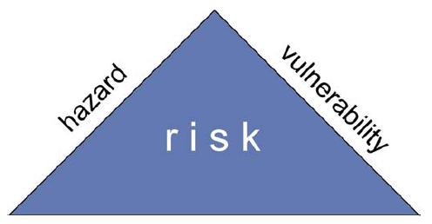
POVODŇOVÉ RIZIKO
povodňové riziko = hazard (pravepodobnosť) * konkrétne negatívne dopady
„Riziko je kvantifikovateľná pravdepodobnosť toho, že nejaký sledovaný ohrozený objekt utrpí stratu (na kvantite alebo kvalite) v dôsledku pôsobenia konkrétneho hazardu. Hazard je fenomén – prírodný živel – ktorý má potenciál spôsobiť tieto negatívne dopady, avšak záleží hlavne na zraniteľnosti ohrozených objektov, či a do akej miery tieto dopady budú naozaj realitou.“
exposure / status
Crichton (1996) ; Thywissen (2006) ; Schneiderbauer & Ehrlich (2004)
Notes:
Jednorozmerná koncepcia chápe riziko spravidla len ako
pravdepodobnost – v našom prípade pravdepodobnost výskytu povodne. Príkladom takýchto definícií môžu
byt napr. Alwang et al. (2001) podla ktorého, je riziko charakterizované známymi alebo neznámymi
hodnotami pravdepodobnosti, urcujúcej že dôjde k nejakej udalosti realizácií hazardu. Schneiderbauer a
Ehrlich (2004) definujú riziko ako pravdepodobnost negatívnych dopadov alebo ocakávaných strát
vyplývajúcich z pôsobenia hazardu na konkrétne objekty vystavené hazardu v konkrétnom case. Ako
poslednú z tejto skupiny uvádzame definíciu z Journal of Prehospital and Disaster Medicine (2004): Riziko je
objektívna (matematicky vyjadrená) alebo subjektívna (induktívne urcená) pravdepodobnost, že dôjde k
pôsobeniu hazardu (hazard sa stane eventom). Je možné identifikovat faktory, ktoré túto pravdepodobnost
modifikujú. V súvislosti s povodnovým rizikom je teda jednorozmernú definíciu rizika možné chápat ako
pravdepodobnost výskytu konkrétneho N-rocného prietoku spôsobujúceho povoden. Viacrozmerná skupina
definícií rizika popri pravdepodobnosti výskytu povodnovej udalosti zahrna aj potenciálne negatívne dopady,
ktoré vznikajú pri pôsobení hazardu (povodne). V tejto skupine definícií je to už pestrejšie, nakolko autori sa
odlišujú hlavne v tom, co všetko a do akej miery podla nich determinuje negatívne dopady.

Slide 5
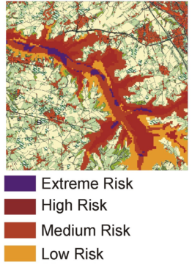
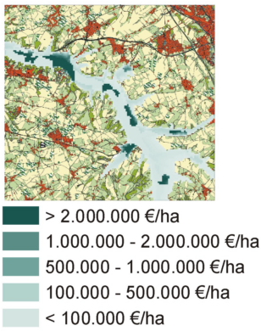
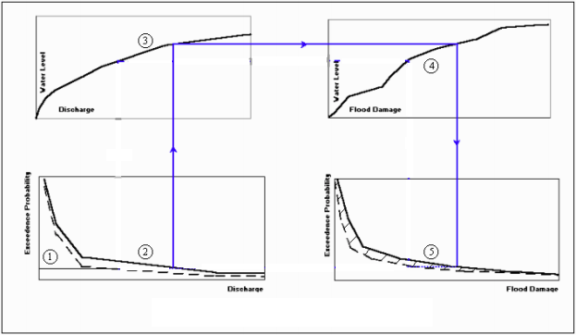
VYJADRENIE POVODŇOVÉHO RIZIKO
kvalitatívne
kvantitatívne
zdroj obrázku: Biza P. et al. (2001): The Use of GIS Software Tool for Benefit-Cost Analysis of Flood Mitigation Measures in CR
Notes:
OPÝTAŤ SA !!!

Slide 6
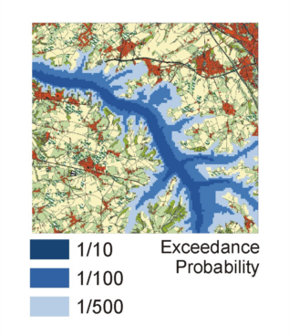
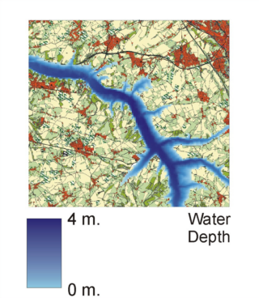
HAZARD
potenciálna škodlivá alebo škodu vytvárajúcu udalosť, prírodný živel, jav, fenomén alebo ľudská
aktivita, ktorá môže spôsobiť stratu na životoch, zranenia, škody na majetku, prerušenia
sociálnych alebo ekonomických sietí a aktivít, príp. environmentálnu degradáciu
v súvislosti s povodňami hazard vnímame ako konkrétnu N-ročnú povodeň(kde N=5, 10, 20, 50, 100, 1000)
resp. povodeň, ktorá sa vyskytne s pravdepodobnosťou P(kde P=0.2, 0.1, 0.05, 0.02, 0.01, 0.001)
atribúty hazardu (povodne):
výška vodnej hladiny
rýchlosť prúdenia
doba zaplavenia
...
zdroj obrázku : de Moel, H. et al (2009): Flood maps in Europe – methods, availability and use
Notes:
When assessing the flood hazard, a first indication can be obtained
by looking at how often floods occurred historically
and the magnitude of them. These can be mapped as point
events (as in Ireland, similar to Fig. 2a), or extents of historical
floods can be depicted on a flood extent map
The use
of historical flood maps is in this respect restricted since it is
impossible to compare them as return periods are not equal
and boundary conditions (streambed, land cover, etc.) may
have changed significantly over time.
The calculation of the flood hazard can be done using
methods of varying complexity (Buchele et al., 2006), depending
on the amount of data, resources, and time available.
While there are different approaches the conceptual framework
behind the calculation of flood hazards is quite general
(Fig. 1) and consists broadly of three steps:
The first step is to estimate discharges for specific return
periods. This can be done by using frequency analyses
on discharge records and fitting extreme value distributions.
Flood information (e.g. discharge, precipitation, or flood
moments) can be extrapolated to ungauged parts using
regionalisation techniques (see e.g. Merz and Bloschl,
2005). More often however, hydrological models are
used to calculate discharges.
Second. When discharges and their return periods have been derived
using the above mentioned approaches, a subsequent
step towards developing a flood map is to translate
discharges into water levels. This is usually done
with rating (stage-discharge) curves. Alternatively, 1-
D or 2-D hydrodynamic models can be used to determine
water levels.
In the third step the flooded area (and possibly flood
depth) is determined by combining water levels with
a digital elevation model (DEM), thus creating a flood
map showing flood extent or depth.

Slide 7
VYJADRENIE HAZARDU
záleží od veľkosti územia (mierky spracovania)
priestorové rozšírenie => hodnotené územie
kvalitatívne vyjadrenie
hydrologické modelovanie v prostredí HecRAS 4.1 (príprava dát a vizualizácia Hec-GeoRAS 10)
dáta:
prietoky - Q (GúSAV)
digitálny model reliéfu (DMR-3 10m ; GKU)
landcover (Corine ’06 ; SAŽP) ; CPD ZB GIS (GKU)
letecké snímky (2003 – 2004 ; GúSAV) / Google Earth – aktuálnejší stav
verifikácia – spoločnosť DHI
Notes:
When assessing the flood hazard, a first indication can be obtained
by looking at how often floods occurred historically
and the magnitude of them. These can be mapped as point
events (as in Ireland, similar to Fig. 2a), or extents of historical
floods can be depicted on a flood extent map
The use
of historical flood maps is in this respect restricted since it is
impossible to compare them as return periods are not equal
and boundary conditions (streambed, land cover, etc.) may
have changed significantly over time.
The calculation of the flood hazard can be done using
methods of varying complexity (Buchele et al., 2006), depending
on the amount of data, resources, and time available.
While there are different approaches the conceptual framework
behind the calculation of flood hazards is quite general
(Fig. 1) and consists broadly of three steps:
The first step is to estimate discharges for specific return
periods. This can be done by using frequency analyses
on discharge records and fitting extreme value distributions.
Flood information (e.g. discharge, precipitation, or flood
moments) can be extrapolated to ungauged parts using
regionalisation techniques (see e.g. Merz and Bloschl,
2005). More often however, hydrological models are
used to calculate discharges.
Second. When discharges and their return periods have been derived
using the above mentioned approaches, a subsequent
step towards developing a flood map is to translate
discharges into water levels. This is usually done
with rating (stage-discharge) curves. Alternatively, 1-
D or 2-D hydrodynamic models can be used to determine
water levels.
In the third step the flooded area (and possibly flood
depth) is determined by combining water levels with
a digital elevation model (DEM), thus creating a flood
map showing flood extent or depth.

Slide 8
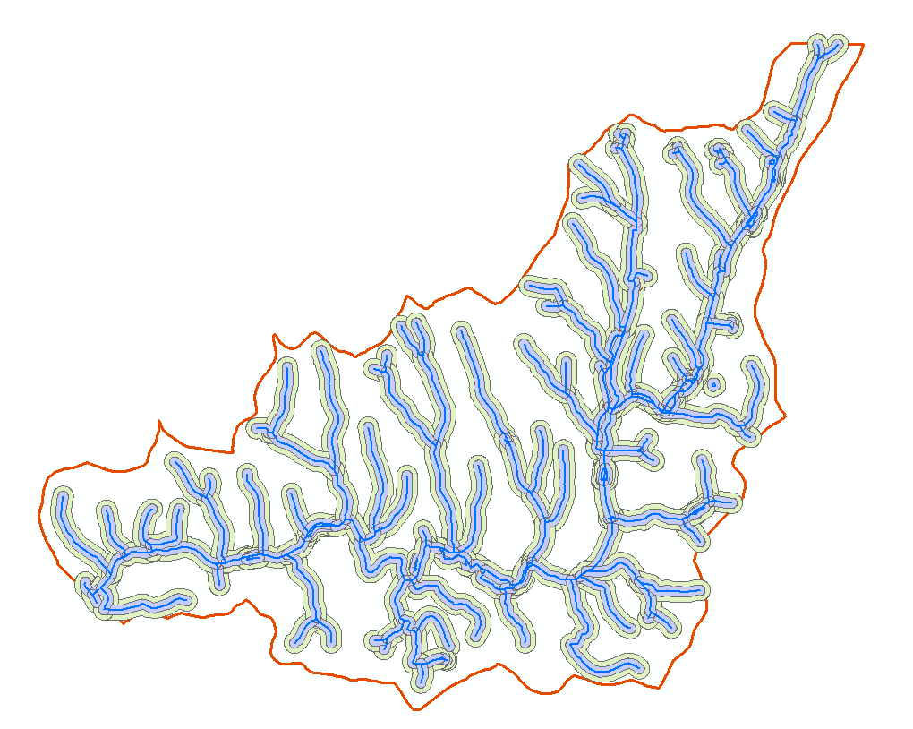
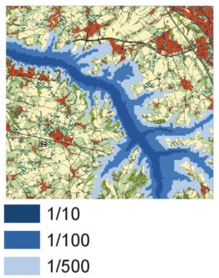
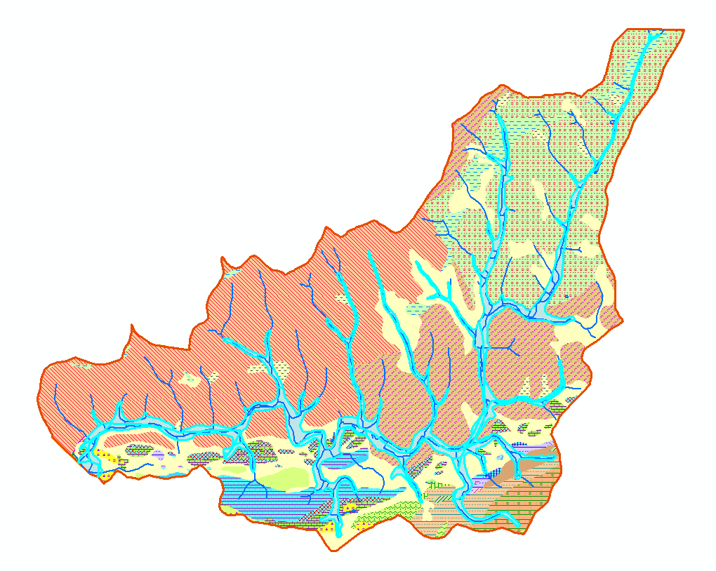
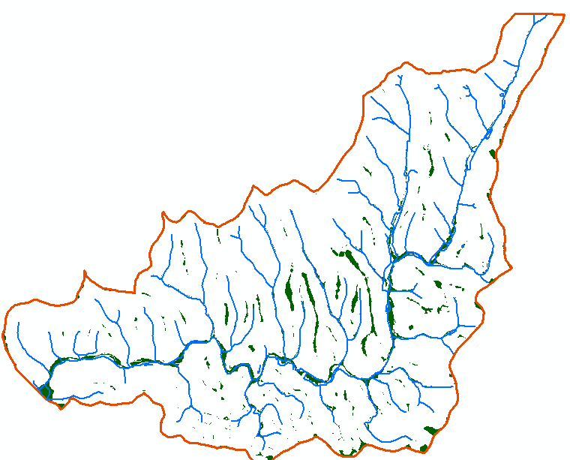
ALTERNATÍVNE MOŽNOSTI VYMEDZENIA HODNOTENÉHO ÚZEMIA RESP. HAZARDU
viacero alternatív:
hydrologické modelovanie (1D)
buffer (50, 100, 150, 200 m .. viac)
selektívny buffer podľa rádu/veľkosti/významnosti
geologická mapa (nivy vodných tokov)
– fluviálne sedimenty
– fluviálne sedimenty súčasných nív
sklon reliéfu
rôzne kombinácie uvedených...
„suché doliny“ ?
Notes:
When assessing the flood hazard, a first indication can be obtained
by looking at how often floods occurred historically
and the magnitude of them. These can be mapped as point
events (as in Ireland, similar to Fig. 2a), or extents of historical
floods can be depicted on a flood extent map
The use
of historical flood maps is in this respect restricted since it is
impossible to compare them as return periods are not equal
and boundary conditions (streambed, land cover, etc.) may
have changed significantly over time.
The calculation of the flood hazard can be done using
methods of varying complexity (Buchele et al., 2006), depending
on the amount of data, resources, and time available.
While there are different approaches the conceptual framework
behind the calculation of flood hazards is quite general
(Fig. 1) and consists broadly of three steps:
The first step is to estimate discharges for specific return
periods. This can be done by using frequency analyses
on discharge records and fitting extreme value distributions.
Flood information (e.g. discharge, precipitation, or flood
moments) can be extrapolated to ungauged parts using
regionalisation techniques (see e.g. Merz and Bloschl,
2005). More often however, hydrological models are
used to calculate discharges.
Second. When discharges and their return periods have been derived
using the above mentioned approaches, a subsequent
step towards developing a flood map is to translate
discharges into water levels. This is usually done
with rating (stage-discharge) curves. Alternatively, 1-
D or 2-D hydrodynamic models can be used to determine
water levels.
In the third step the flooded area (and possibly flood
depth) is determined by combining water levels with
a digital elevation model (DEM), thus creating a flood
map showing flood extent or depth.

Slide 9
ZRANITEĽNOSŤ
vnútorná (inherentná) vlastnosť objektu (sytému), ktorá definuje jeho potenciál utrpieť škodu, ale ktorá aj hovorí o tom, ako je tento objekt (systém) schopný očakávať, vyrovnať sa s a
zotaviť z, negatívnych dopadov pôsobenia hazardu
zraniteľnosť v kontexte našej práce vnímame ako tzv. hazard-independent – t.j. nezávislú od pravdepodobnosti výskytu povodne
Notes:
When assessing the flood hazard, a first indication can be obtained
by looking at how often floods occurred historically
and the magnitude of them. These can be mapped as point
events (as in Ireland, similar to Fig. 2a), or extents of historical
floods can be depicted on a flood extent map
The use
of historical flood maps is in this respect restricted since it is
impossible to compare them as return periods are not equal
and boundary conditions (streambed, land cover, etc.) may
have changed significantly over time.
The calculation of the flood hazard can be done using
methods of varying complexity (Buchele et al., 2006), depending
on the amount of data, resources, and time available.
While there are different approaches the conceptual framework
behind the calculation of flood hazards is quite general
(Fig. 1) and consists broadly of three steps:
The first step is to estimate discharges for specific return
periods. This can be done by using frequency analyses
on discharge records and fitting extreme value distributions.
Flood information (e.g. discharge, precipitation, or flood
moments) can be extrapolated to ungauged parts using
regionalisation techniques (see e.g. Merz and Bloschl,
2005). More often however, hydrological models are
used to calculate discharges.
Second. When discharges and their return periods have been derived
using the above mentioned approaches, a subsequent
step towards developing a flood map is to translate
discharges into water levels. This is usually done
with rating (stage-discharge) curves. Alternatively, 1-
D or 2-D hydrodynamic models can be used to determine
water levels.
In the third step the flooded area (and possibly flood
depth) is determined by combining water levels with
a digital elevation model (DEM), thus creating a flood
map showing flood extent or depth.

Slide 10
KONCEPT ZRANITEĽNOSTI
expozícia („vystavenie“):
vystavenie alebo blízkosť objektu voči hazardu
so zvyšujúcou expozíciou voči hazardu, sa zvyšuje aj celková zraniteľnosť
susceptibilita („citlivosť“):
hovorí o predispozícii utrpieť škodu, resp. stratu
je definovaná hlavne vnútornými (fyzickými) atribútmi ohrozených objektov
pasívna zložka zraniteľnosti
napr. pri obytných budovách: materiál, z ktorého sú postavené ; počet podlaží...
Notes:
zvyšovanie rezistenice alebo resiliencie – dva spôsoby ako dospieť k robustnému resp. trvalo-udržateľnému systému

Slide 11
KONCEPT ZRANITEĽNOSTI
rezistenica („odolnosť“): [coping capacity]
hovorí o schopnosti objektu (systému) odolávať nepriaznivým účinkom povodne v čase jej pôsobenia
ako dlho dokáže postihnutý systém odolávať priamym následkom povodne a zachovať tak svoju funkčnosť bez výrazných zmien
aktívna zložka zraniteľnosti
napr. protipovodňové úpravy budov, zásoby ..
resiliencia („pružnosť“): [adaptive capacity]
hovorí o schopnostiach obnovy postihnutého systému (objektu), po odznení povodne do pôvodného stavu
alebo prispôsobenie sa zmeneným podmienkam - zachovanie funkčnosti
aktívna zložka zraniteľnosti
Notes:
zvyšovanie rezistenice alebo resiliencie – dva spôsoby ako dospieť k robustnému resp. trvalo-udržateľnému systému

Slide 12
VYJADRENIE ZRANITEĽNOSTI
zraniteľnosť nie je možné merať priamo
nutnosť použiť tzv. proxy premenné
voľba, resp. vhodnosť zdrojov údajov zvyčajne závisí od mierky v akej pracujeme
výber konkrétnych premenných sa realizuje buď tzv. induktívnym alebo deduktívnym spôsobom
INDUKTÍVNY – využitie štatistických metód na redukciu väčšieho počtu premenných (PCA)
DEDUKTÍVNY – kombinácie premenných na základe znalostí a logických väzieb (MCDA)
Notes:
When assessing the flood hazard, a first indication can be obtained
by looking at how often floods occurred historically
and the magnitude of them. These can be mapped as point
events (as in Ireland, similar to Fig. 2a), or extents of historical
floods can be depicted on a flood extent map
The use
of historical flood maps is in this respect restricted since it is
impossible to compare them as return periods are not equal
and boundary conditions (streambed, land cover, etc.) may
have changed significantly over time.
The calculation of the flood hazard can be done using
methods of varying complexity (Buchele et al., 2006), depending
on the amount of data, resources, and time available.
While there are different approaches the conceptual framework
behind the calculation of flood hazards is quite general
(Fig. 1) and consists broadly of three steps:
The first step is to estimate discharges for specific return
periods. This can be done by using frequency analyses
on discharge records and fitting extreme value distributions.
Flood information (e.g. discharge, precipitation, or flood
moments) can be extrapolated to ungauged parts using
regionalisation techniques (see e.g. Merz and Bloschl,
2005). More often however, hydrological models are
used to calculate discharges.
Second. When discharges and their return periods have been derived
using the above mentioned approaches, a subsequent
step towards developing a flood map is to translate
discharges into water levels. This is usually done
with rating (stage-discharge) curves. Alternatively, 1-
D or 2-D hydrodynamic models can be used to determine
water levels.
In the third step the flooded area (and possibly flood
depth) is determined by combining water levels with
a digital elevation model (DEM), thus creating a flood
map showing flood extent or depth.

Slide 13
DÁTA PRE ZRANITEĽNOSŤ
sociálna zraniteľnosť:
sčítanie obyvateľstva, národné štatistiky, CLC, LandUse..
environmentálna:
CLC, Natura 2000, potenciálne zdroje znečistenia, brownfields, zdroje pitnej vody..
ekonomická:
škody na bytovom fonde, nebytovom fonde, na ornej pôde, technickej infraštruktúre ..
ceny pozemkov, ceny prenájmov, výška zástavby; doba výstavby RD
ale aj: negatívne dopady na podnikanie a služby v oblasti (nedostatok dát, prakticky nezistiteľné.. )
indexy zraniteľnosti
ustálené, často používané kombinácie premenných
napr.: SoVI (Social Vulnerability Index) ; SFVI (Social Flood VI)
BEVI (Built Environment VI) ; HazVI (Hazard VI) ; ...
uľahčujú interpretáciu výsledkov, porovnávanie štúdií, spoluprácu...
vážené kombinácie, MCA, faktorová analýza, PCA...
Notes:
When assessing the flood hazard, a first indication can be obtained
by looking at how often floods occurred historically
and the magnitude of them. These can be mapped as point
events (as in Ireland, similar to Fig. 2a), or extents of historical
floods can be depicted on a flood extent map
The use
of historical flood maps is in this respect restricted since it is
impossible to compare them as return periods are not equal
and boundary conditions (streambed, land cover, etc.) may
have changed significantly over time.
The calculation of the flood hazard can be done using
methods of varying complexity (Buchele et al., 2006), depending
on the amount of data, resources, and time available.
While there are different approaches the conceptual framework
behind the calculation of flood hazards is quite general
(Fig. 1) and consists broadly of three steps:
The first step is to estimate discharges for specific return
periods. This can be done by using frequency analyses
on discharge records and fitting extreme value distributions.
Flood information (e.g. discharge, precipitation, or flood
moments) can be extrapolated to ungauged parts using
regionalisation techniques (see e.g. Merz and Bloschl,
2005). More often however, hydrological models are
used to calculate discharges.
Second. When discharges and their return periods have been derived
using the above mentioned approaches, a subsequent
step towards developing a flood map is to translate
discharges into water levels. This is usually done
with rating (stage-discharge) curves. Alternatively, 1-
D or 2-D hydrodynamic models can be used to determine
water levels.
In the third step the flooded area (and possibly flood
depth) is determined by combining water levels with
a digital elevation model (DEM), thus creating a flood
map showing flood extent or depth.

Slide 14
DÁTA PRE ZRANITEĽNOSŤ
sociálna zraniteľnosť (zraniteľnosť sociálneho systému):
zdroj údajov hlavne „Sčítanie obyvateľstva SR 2001“ – údaje za ZSJ
atribúty, ktoré považujeme za kľúčové, pre hodnotenie sociálnej zraniteľnosti:
veková štruktúra – predpoklad: čím väčšie zastúpenie starších ľudí (65+) a „nezaopatrených“ detí (15-) tým je ZSJ zraniteľnejšia ; starší ľudia – obmedzený pohyb, žijú sami, choroby ; nezaopatrený – potreba „rodiča“
deti a žiaci navštevujúci ZŠ – predpoklad: čím väčšie zastúpenie, tým zraniteľnejšia ZSJ – nezaopatrené deti
ekonomicky aktívny – predpoklad: čím väčšie zastúpenie, tým menej zraniteľnejšia ZSJ je
nezamestnaní – predpoklad: čím väčšie zastúpenie, tým zraniteľnejšia ZSJ ; resp. pomer k ekonomicky aktívnym
na materskej dovolenke – predpoklad: čím väčšie zastúpenie, tým zraniteľnejšia ZSJ ; resp. pomer k e. aktívnym
Notes:
When assessing the flood hazard, a first indication can be obtained
by looking at how often floods occurred historically
and the magnitude of them. These can be mapped as point
events (as in Ireland, similar to Fig. 2a), or extents of historical
floods can be depicted on a flood extent map
The use
of historical flood maps is in this respect restricted since it is
impossible to compare them as return periods are not equal
and boundary conditions (streambed, land cover, etc.) may
have changed significantly over time.
The calculation of the flood hazard can be done using
methods of varying complexity (Buchele et al., 2006), depending
on the amount of data, resources, and time available.
While there are different approaches the conceptual framework
behind the calculation of flood hazards is quite general
(Fig. 1) and consists broadly of three steps:
The first step is to estimate discharges for specific return
periods. This can be done by using frequency analyses
on discharge records and fitting extreme value distributions.
Flood information (e.g. discharge, precipitation, or flood
moments) can be extrapolated to ungauged parts using
regionalisation techniques (see e.g. Merz and Bloschl,
2005). More often however, hydrological models are
used to calculate discharges.
Second. When discharges and their return periods have been derived
using the above mentioned approaches, a subsequent
step towards developing a flood map is to translate
discharges into water levels. This is usually done
with rating (stage-discharge) curves. Alternatively, 1-
D or 2-D hydrodynamic models can be used to determine
water levels.
In the third step the flooded area (and possibly flood
depth) is determined by combining water levels with
a digital elevation model (DEM), thus creating a flood
map showing flood extent or depth.

Slide 15
DÁTA PRE ZRANITEĽNOSŤ
sociálna zraniteľnosť (zraniteľnosť sociálneho systému):
najvyššie dosiahnuté vzdelanie – predpoklad: čím väčšie zastúpenie, ľudí s VŠ titulom, tým je predpoklad, že ZSJ bude menej zraniteľná (lepšie znalosti (skúsenosti), lepšie zamestnanie, vyššia životná úroveň, potenciál úspor..) ; obdobne pre SŠ, len v nižších relatívnych impaktoch ; naopak obrátene so ZŠ – pomer VŠ-ZŠ a VŠ-SŠ
nekompletné rodiny – predpoklad: vyšší stres, náročnejšie v prípade evakuácie, fatálnejšie v prípade straty domova...
obyvateľstvo inej národnosti než väčšinovej – predpoklad: čím väčšie zastúpenie, tým zraniteľnejšia ZSJ
obyvateľstvo s iným materinským jazykom než slovenským – predpoklad: čím väčšie zastúpenie, tým zraniteľnejšia ZSJ
otázne atribúty: počet závislých detí (4+) ; dočasne prítomné obyvateľstvo ; vybavenie bytov/domov (kategórie); priemerný počet podlaží domov/bytov; odvetvia hospodárskych činností ekonomicky aktívnych obyvateľov....
rozlišovať pohlavie?!?
Notes:
When assessing the flood hazard, a first indication can be obtained
by looking at how often floods occurred historically
and the magnitude of them. These can be mapped as point
events (as in Ireland, similar to Fig. 2a), or extents of historical
floods can be depicted on a flood extent map
The use
of historical flood maps is in this respect restricted since it is
impossible to compare them as return periods are not equal
and boundary conditions (streambed, land cover, etc.) may
have changed significantly over time.
The calculation of the flood hazard can be done using
methods of varying complexity (Buchele et al., 2006), depending
on the amount of data, resources, and time available.
While there are different approaches the conceptual framework
behind the calculation of flood hazards is quite general
(Fig. 1) and consists broadly of three steps:
The first step is to estimate discharges for specific return
periods. This can be done by using frequency analyses
on discharge records and fitting extreme value distributions.
Flood information (e.g. discharge, precipitation, or flood
moments) can be extrapolated to ungauged parts using
regionalisation techniques (see e.g. Merz and Bloschl,
2005). More often however, hydrological models are
used to calculate discharges.
Second. When discharges and their return periods have been derived
using the above mentioned approaches, a subsequent
step towards developing a flood map is to translate
discharges into water levels. This is usually done
with rating (stage-discharge) curves. Alternatively, 1-
D or 2-D hydrodynamic models can be used to determine
water levels.
In the third step the flooded area (and possibly flood
depth) is determined by combining water levels with
a digital elevation model (DEM), thus creating a flood
map showing flood extent or depth.

Slide 16
DÁTA PRE ZRANITEĽNOSŤ
ekonomická zraniteľnosť (zraniteľnosť ekonomického systému):
zdroj údajov hlavne „Sčítanie obyvateľstva SR 2001“ – údaje za ZSJ + iné..
atribúty, ktoré považujeme za kľúčové, pre hodnotenie ekonomickej zraniteľnosti:
éra výstavby domu – (pred 1900 ; 1900-1945 ; 1945-1990 ; 1990-súčastnosť) predpoklad: zvyklosti výstavby (napr. výška nad terénom), používané materiály, stavebné technológie
materiál nosných múrov – (drevo ; nepálené tehly ; kameň/tehly ; ostatné) predpoklad: odolnosť voči pôsobeniu vody
počet nadzemných podlaží – predpoklad: čím viac tým lepši – možnosť odloženia majetku, či dokonca „evakuácie“
vybavenosť – predpoklad: čím „kompletnejšie“ vybavenie tým vyššia potenciálna škoda ; PC + internet!
kategórie bytových domov
priemerná cena pozemkov – realitné kancelárie
Notes:
When assessing the flood hazard, a first indication can be obtained
by looking at how often floods occurred historically
and the magnitude of them. These can be mapped as point
events (as in Ireland, similar to Fig. 2a), or extents of historical
floods can be depicted on a flood extent map
The use
of historical flood maps is in this respect restricted since it is
impossible to compare them as return periods are not equal
and boundary conditions (streambed, land cover, etc.) may
have changed significantly over time.
The calculation of the flood hazard can be done using
methods of varying complexity (Buchele et al., 2006), depending
on the amount of data, resources, and time available.
While there are different approaches the conceptual framework
behind the calculation of flood hazards is quite general
(Fig. 1) and consists broadly of three steps:
The first step is to estimate discharges for specific return
periods. This can be done by using frequency analyses
on discharge records and fitting extreme value distributions.
Flood information (e.g. discharge, precipitation, or flood
moments) can be extrapolated to ungauged parts using
regionalisation techniques (see e.g. Merz and Bloschl,
2005). More often however, hydrological models are
used to calculate discharges.
Second. When discharges and their return periods have been derived
using the above mentioned approaches, a subsequent
step towards developing a flood map is to translate
discharges into water levels. This is usually done
with rating (stage-discharge) curves. Alternatively, 1-
D or 2-D hydrodynamic models can be used to determine
water levels.
In the third step the flooded area (and possibly flood
depth) is determined by combining water levels with
a digital elevation model (DEM), thus creating a flood
map showing flood extent or depth.

Slide 17
DÁTA PRE ZRANITEĽNOSŤ
environmentálna zraniteľnosť (zraniteľnosť environmentálneho systému):
zdroj údajov hlavne Corine Land Cover, NATURA2000, iné projekty, iné
atribúty, ktoré považujeme za kľúčové, pre hodnotenie environmentálnej zraniteľnosti:
výskyt chránených území , rezervácií, CHKO, príp. národných parkov v rámci ZSJ
brownfields ako potenciálne zdroje znečistenia
zdroje pitnej vody, pramene
priepustnosť / nepriepustnosť pôdy a podložia
erózny potenciál
...
Notes:
When assessing the flood hazard, a first indication can be obtained
by looking at how often floods occurred historically
and the magnitude of them. These can be mapped as point
events (as in Ireland, similar to Fig. 2a), or extents of historical
floods can be depicted on a flood extent map
The use
of historical flood maps is in this respect restricted since it is
impossible to compare them as return periods are not equal
and boundary conditions (streambed, land cover, etc.) may
have changed significantly over time.
The calculation of the flood hazard can be done using
methods of varying complexity (Buchele et al., 2006), depending
on the amount of data, resources, and time available.
While there are different approaches the conceptual framework
behind the calculation of flood hazards is quite general
(Fig. 1) and consists broadly of three steps:
The first step is to estimate discharges for specific return
periods. This can be done by using frequency analyses
on discharge records and fitting extreme value distributions.
Flood information (e.g. discharge, precipitation, or flood
moments) can be extrapolated to ungauged parts using
regionalisation techniques (see e.g. Merz and Bloschl,
2005). More often however, hydrological models are
used to calculate discharges.
Second. When discharges and their return periods have been derived
using the above mentioned approaches, a subsequent
step towards developing a flood map is to translate
discharges into water levels. This is usually done
with rating (stage-discharge) curves. Alternatively, 1-
D or 2-D hydrodynamic models can be used to determine
water levels.
In the third step the flooded area (and possibly flood
depth) is determined by combining water levels with
a digital elevation model (DEM), thus creating a flood
map showing flood extent or depth.

Slide 18
DÁTA PRE ZRANITEĽNOSŤ
hlavný problém:
tzv. place-based prístup k hodnoteniu zraniteľnosti
takmer všetky dáta sú vztiahnuté k priestorovej jednotke inej, než bude MMU našej analýzy
pre zvýšenie relevantnosti – nutná aspoň jednoduchá „deagregácia“ údajov
transformácia geografických dát istej priestorovej štruktúry do inej štruktúry – existuje niekoľko (aj jednoduchších) metód:
nutnosť využitia podporných dát (CLC resp. cestná sieť, zástavba...) – presnosť týchto dát je dôležitejšia než zvolená metóda
Notes:
When assessing the flood hazard, a first indication can be obtained
by looking at how often floods occurred historically
and the magnitude of them. These can be mapped as point
events (as in Ireland, similar to Fig. 2a), or extents of historical
floods can be depicted on a flood extent map
The use
of historical flood maps is in this respect restricted since it is
impossible to compare them as return periods are not equal
and boundary conditions (streambed, land cover, etc.) may
have changed significantly over time.
The calculation of the flood hazard can be done using
methods of varying complexity (Buchele et al., 2006), depending
on the amount of data, resources, and time available.
While there are different approaches the conceptual framework
behind the calculation of flood hazards is quite general
(Fig. 1) and consists broadly of three steps:
The first step is to estimate discharges for specific return
periods. This can be done by using frequency analyses
on discharge records and fitting extreme value distributions.
Flood information (e.g. discharge, precipitation, or flood
moments) can be extrapolated to ungauged parts using
regionalisation techniques (see e.g. Merz and Bloschl,
2005). More often however, hydrological models are
used to calculate discharges.
Second. When discharges and their return periods have been derived
using the above mentioned approaches, a subsequent
step towards developing a flood map is to translate
discharges into water levels. This is usually done
with rating (stage-discharge) curves. Alternatively, 1-
D or 2-D hydrodynamic models can be used to determine
water levels.
In the third step the flooded area (and possibly flood
depth) is determined by combining water levels with
a digital elevation model (DEM), thus creating a flood
map showing flood extent or depth.

Slide 19
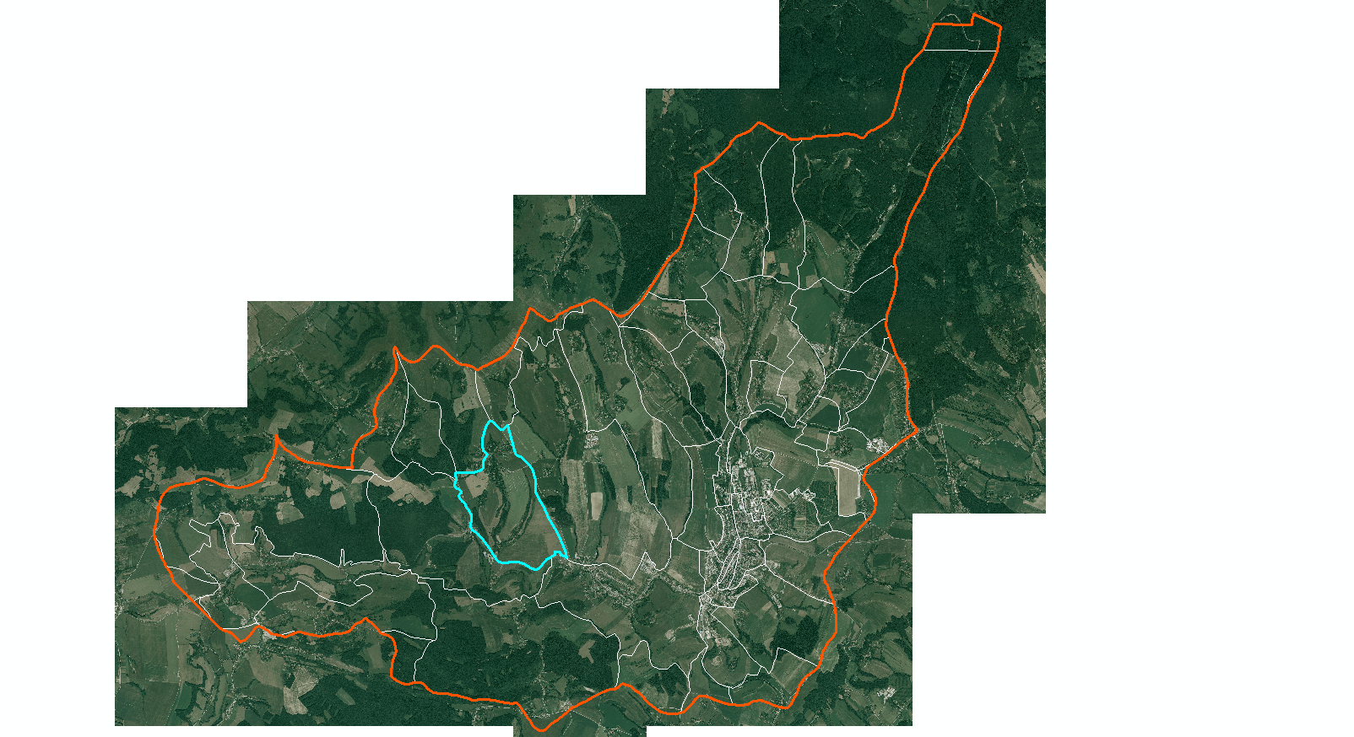
DÁTA PRE ZRANITEĽNOSŤ
Notes:
When assessing the flood hazard, a first indication can be obtained
by looking at how often floods occurred historically
and the magnitude of them. These can be mapped as point
events (as in Ireland, similar to Fig. 2a), or extents of historical
floods can be depicted on a flood extent map
The use
of historical flood maps is in this respect restricted since it is
impossible to compare them as return periods are not equal
and boundary conditions (streambed, land cover, etc.) may
have changed significantly over time.
The calculation of the flood hazard can be done using
methods of varying complexity (Buchele et al., 2006), depending
on the amount of data, resources, and time available.
While there are different approaches the conceptual framework
behind the calculation of flood hazards is quite general
(Fig. 1) and consists broadly of three steps:
The first step is to estimate discharges for specific return
periods. This can be done by using frequency analyses
on discharge records and fitting extreme value distributions.
Flood information (e.g. discharge, precipitation, or flood
moments) can be extrapolated to ungauged parts using
regionalisation techniques (see e.g. Merz and Bloschl,
2005). More often however, hydrological models are
used to calculate discharges.
Second. When discharges and their return periods have been derived
using the above mentioned approaches, a subsequent
step towards developing a flood map is to translate
discharges into water levels. This is usually done
with rating (stage-discharge) curves. Alternatively, 1-
D or 2-D hydrodynamic models can be used to determine
water levels.
In the third step the flooded area (and possibly flood
depth) is determined by combining water levels with
a digital elevation model (DEM), thus creating a flood
map showing flood extent or depth.

Slide 20
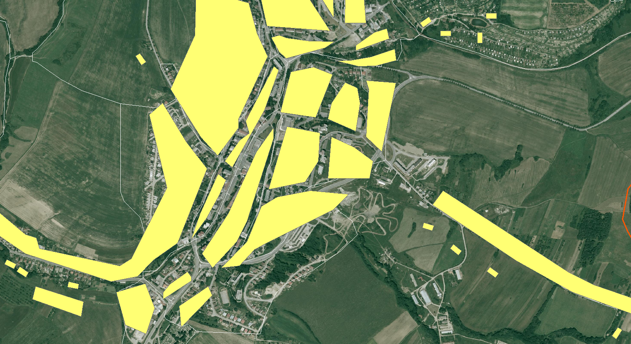
CPD ZB GIS vs. SVM 50
ZASTAVANÁ PLOCHA
Notes:
When assessing the flood hazard, a first indication can be obtained
by looking at how often floods occurred historically
and the magnitude of them. These can be mapped as point
events (as in Ireland, similar to Fig. 2a), or extents of historical
floods can be depicted on a flood extent map
The use
of historical flood maps is in this respect restricted since it is
impossible to compare them as return periods are not equal
and boundary conditions (streambed, land cover, etc.) may
have changed significantly over time.
The calculation of the flood hazard can be done using
methods of varying complexity (Buchele et al., 2006), depending
on the amount of data, resources, and time available.
While there are different approaches the conceptual framework
behind the calculation of flood hazards is quite general
(Fig. 1) and consists broadly of three steps:
The first step is to estimate discharges for specific return
periods. This can be done by using frequency analyses
on discharge records and fitting extreme value distributions.
Flood information (e.g. discharge, precipitation, or flood
moments) can be extrapolated to ungauged parts using
regionalisation techniques (see e.g. Merz and Bloschl,
2005). More often however, hydrological models are
used to calculate discharges.
Second. When discharges and their return periods have been derived
using the above mentioned approaches, a subsequent
step towards developing a flood map is to translate
discharges into water levels. This is usually done
with rating (stage-discharge) curves. Alternatively, 1-
D or 2-D hydrodynamic models can be used to determine
water levels.
In the third step the flooded area (and possibly flood
depth) is determined by combining water levels with
a digital elevation model (DEM), thus creating a flood
map showing flood extent or depth.

Slide 21
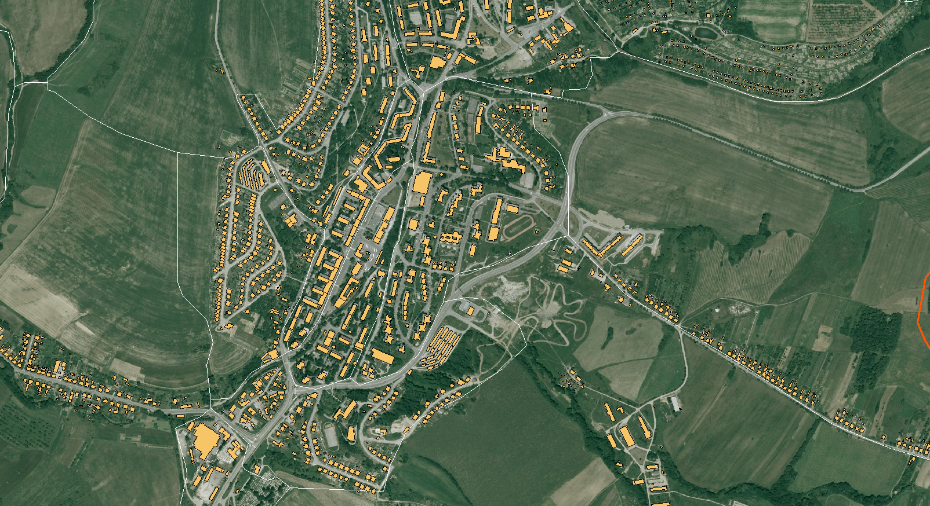
CPD ZB GIS vs. SVM 50
ZASTAVANÁ PLOCHA
Notes:
When assessing the flood hazard, a first indication can be obtained
by looking at how often floods occurred historically
and the magnitude of them. These can be mapped as point
events (as in Ireland, similar to Fig. 2a), or extents of historical
floods can be depicted on a flood extent map
The use
of historical flood maps is in this respect restricted since it is
impossible to compare them as return periods are not equal
and boundary conditions (streambed, land cover, etc.) may
have changed significantly over time.
The calculation of the flood hazard can be done using
methods of varying complexity (Buchele et al., 2006), depending
on the amount of data, resources, and time available.
While there are different approaches the conceptual framework
behind the calculation of flood hazards is quite general
(Fig. 1) and consists broadly of three steps:
The first step is to estimate discharges for specific return
periods. This can be done by using frequency analyses
on discharge records and fitting extreme value distributions.
Flood information (e.g. discharge, precipitation, or flood
moments) can be extrapolated to ungauged parts using
regionalisation techniques (see e.g. Merz and Bloschl,
2005). More often however, hydrological models are
used to calculate discharges.
Second. When discharges and their return periods have been derived
using the above mentioned approaches, a subsequent
step towards developing a flood map is to translate
discharges into water levels. This is usually done
with rating (stage-discharge) curves. Alternatively, 1-
D or 2-D hydrodynamic models can be used to determine
water levels.
In the third step the flooded area (and possibly flood
depth) is determined by combining water levels with
a digital elevation model (DEM), thus creating a flood
map showing flood extent or depth.

Slide 22
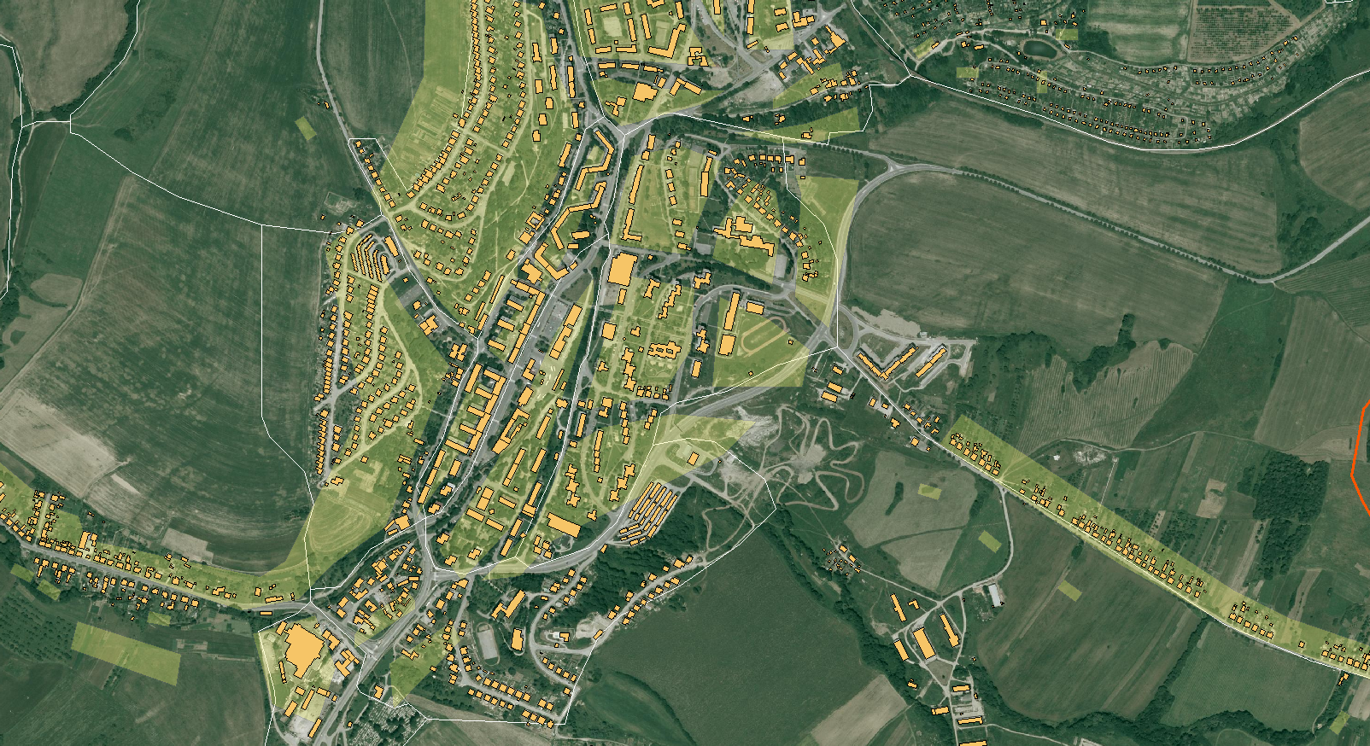
CPD ZB GIS vs. SVM 50
ZASTAVANÁ PLOCHA
Notes:
When assessing the flood hazard, a first indication can be obtained
by looking at how often floods occurred historically
and the magnitude of them. These can be mapped as point
events (as in Ireland, similar to Fig. 2a), or extents of historical
floods can be depicted on a flood extent map
The use
of historical flood maps is in this respect restricted since it is
impossible to compare them as return periods are not equal
and boundary conditions (streambed, land cover, etc.) may
have changed significantly over time.
The calculation of the flood hazard can be done using
methods of varying complexity (Buchele et al., 2006), depending
on the amount of data, resources, and time available.
While there are different approaches the conceptual framework
behind the calculation of flood hazards is quite general
(Fig. 1) and consists broadly of three steps:
The first step is to estimate discharges for specific return
periods. This can be done by using frequency analyses
on discharge records and fitting extreme value distributions.
Flood information (e.g. discharge, precipitation, or flood
moments) can be extrapolated to ungauged parts using
regionalisation techniques (see e.g. Merz and Bloschl,
2005). More often however, hydrological models are
used to calculate discharges.
Second. When discharges and their return periods have been derived
using the above mentioned approaches, a subsequent
step towards developing a flood map is to translate
discharges into water levels. This is usually done
with rating (stage-discharge) curves. Alternatively, 1-
D or 2-D hydrodynamic models can be used to determine
water levels.
In the third step the flooded area (and possibly flood
depth) is determined by combining water levels with
a digital elevation model (DEM), thus creating a flood
map showing flood extent or depth.

Slide 23
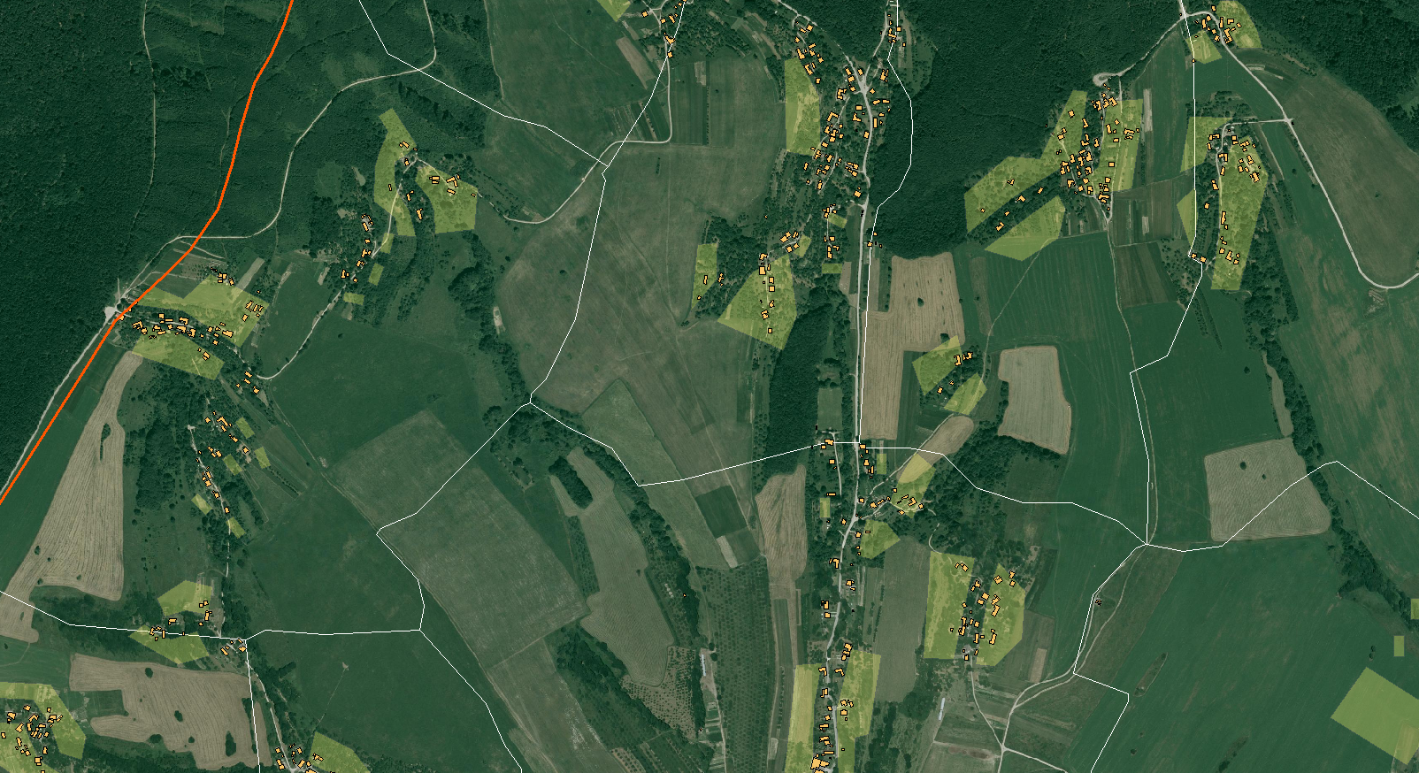
CPD ZB GIS vs. SVM 50
ZASTAVANÁ PLOCHA
Notes:
When assessing the flood hazard, a first indication can be obtained
by looking at how often floods occurred historically
and the magnitude of them. These can be mapped as point
events (as in Ireland, similar to Fig. 2a), or extents of historical
floods can be depicted on a flood extent map
The use
of historical flood maps is in this respect restricted since it is
impossible to compare them as return periods are not equal
and boundary conditions (streambed, land cover, etc.) may
have changed significantly over time.
The calculation of the flood hazard can be done using
methods of varying complexity (Buchele et al., 2006), depending
on the amount of data, resources, and time available.
While there are different approaches the conceptual framework
behind the calculation of flood hazards is quite general
(Fig. 1) and consists broadly of three steps:
The first step is to estimate discharges for specific return
periods. This can be done by using frequency analyses
on discharge records and fitting extreme value distributions.
Flood information (e.g. discharge, precipitation, or flood
moments) can be extrapolated to ungauged parts using
regionalisation techniques (see e.g. Merz and Bloschl,
2005). More often however, hydrological models are
used to calculate discharges.
Second. When discharges and their return periods have been derived
using the above mentioned approaches, a subsequent
step towards developing a flood map is to translate
discharges into water levels. This is usually done
with rating (stage-discharge) curves. Alternatively, 1-
D or 2-D hydrodynamic models can be used to determine
water levels.
In the third step the flooded area (and possibly flood
depth) is determined by combining water levels with
a digital elevation model (DEM), thus creating a flood
map showing flood extent or depth.

Slide 24
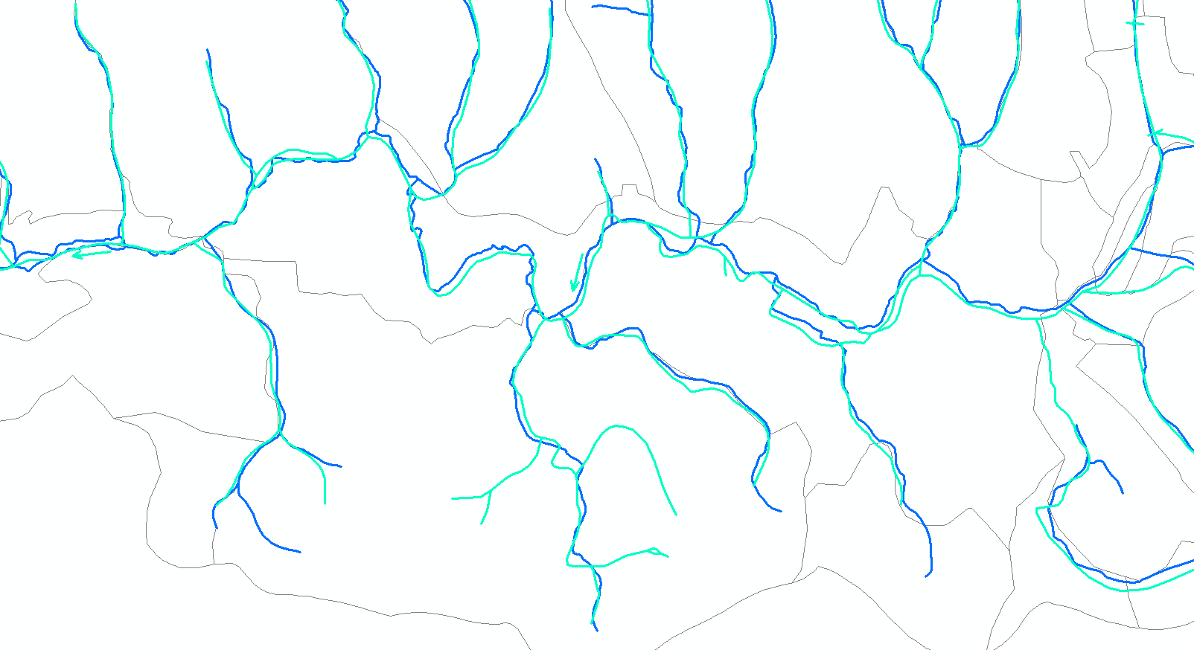
CPD ZB GIS vs. SVM 50
VODNÉ TOKY
Notes:
When assessing the flood hazard, a first indication can be obtained
by looking at how often floods occurred historically
and the magnitude of them. These can be mapped as point
events (as in Ireland, similar to Fig. 2a), or extents of historical
floods can be depicted on a flood extent map
The use
of historical flood maps is in this respect restricted since it is
impossible to compare them as return periods are not equal
and boundary conditions (streambed, land cover, etc.) may
have changed significantly over time.
The calculation of the flood hazard can be done using
methods of varying complexity (Buchele et al., 2006), depending
on the amount of data, resources, and time available.
While there are different approaches the conceptual framework
behind the calculation of flood hazards is quite general
(Fig. 1) and consists broadly of three steps:
The first step is to estimate discharges for specific return
periods. This can be done by using frequency analyses
on discharge records and fitting extreme value distributions.
Flood information (e.g. discharge, precipitation, or flood
moments) can be extrapolated to ungauged parts using
regionalisation techniques (see e.g. Merz and Bloschl,
2005). More often however, hydrological models are
used to calculate discharges.
Second. When discharges and their return periods have been derived
using the above mentioned approaches, a subsequent
step towards developing a flood map is to translate
discharges into water levels. This is usually done
with rating (stage-discharge) curves. Alternatively, 1-
D or 2-D hydrodynamic models can be used to determine
water levels.
In the third step the flooded area (and possibly flood
depth) is determined by combining water levels with
a digital elevation model (DEM), thus creating a flood
map showing flood extent or depth.

Slide 25
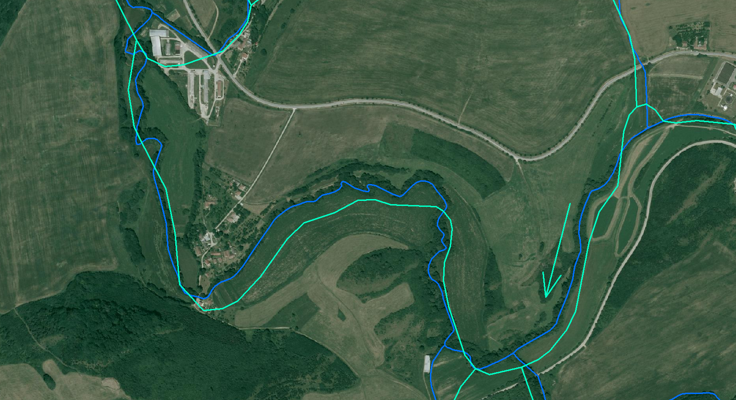
CPD ZB GIS vs. SVM 50
VODNÉ TOKY
Notes:
When assessing the flood hazard, a first indication can be obtained
by looking at how often floods occurred historically
and the magnitude of them. These can be mapped as point
events (as in Ireland, similar to Fig. 2a), or extents of historical
floods can be depicted on a flood extent map
The use
of historical flood maps is in this respect restricted since it is
impossible to compare them as return periods are not equal
and boundary conditions (streambed, land cover, etc.) may
have changed significantly over time.
The calculation of the flood hazard can be done using
methods of varying complexity (Buchele et al., 2006), depending
on the amount of data, resources, and time available.
While there are different approaches the conceptual framework
behind the calculation of flood hazards is quite general
(Fig. 1) and consists broadly of three steps:
The first step is to estimate discharges for specific return
periods. This can be done by using frequency analyses
on discharge records and fitting extreme value distributions.
Flood information (e.g. discharge, precipitation, or flood
moments) can be extrapolated to ungauged parts using
regionalisation techniques (see e.g. Merz and Bloschl,
2005). More often however, hydrological models are
used to calculate discharges.
Second. When discharges and their return periods have been derived
using the above mentioned approaches, a subsequent
step towards developing a flood map is to translate
discharges into water levels. This is usually done
with rating (stage-discharge) curves. Alternatively, 1-
D or 2-D hydrodynamic models can be used to determine
water levels.
In the third step the flooded area (and possibly flood
depth) is determined by combining water levels with
a digital elevation model (DEM), thus creating a flood
map showing flood extent or depth.

Slide 26
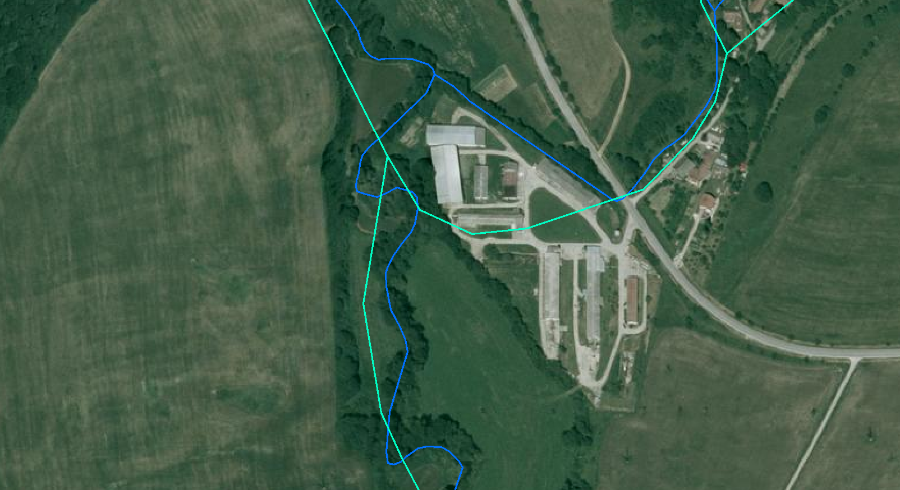
CPD ZB GIS vs. SVM 50
VODNÉ TOKY
Notes:
When assessing the flood hazard, a first indication can be obtained
by looking at how often floods occurred historically
and the magnitude of them. These can be mapped as point
events (as in Ireland, similar to Fig. 2a), or extents of historical
floods can be depicted on a flood extent map
The use
of historical flood maps is in this respect restricted since it is
impossible to compare them as return periods are not equal
and boundary conditions (streambed, land cover, etc.) may
have changed significantly over time.
The calculation of the flood hazard can be done using
methods of varying complexity (Buchele et al., 2006), depending
on the amount of data, resources, and time available.
While there are different approaches the conceptual framework
behind the calculation of flood hazards is quite general
(Fig. 1) and consists broadly of three steps:
The first step is to estimate discharges for specific return
periods. This can be done by using frequency analyses
on discharge records and fitting extreme value distributions.
Flood information (e.g. discharge, precipitation, or flood
moments) can be extrapolated to ungauged parts using
regionalisation techniques (see e.g. Merz and Bloschl,
2005). More often however, hydrological models are
used to calculate discharges.
Second. When discharges and their return periods have been derived
using the above mentioned approaches, a subsequent
step towards developing a flood map is to translate
discharges into water levels. This is usually done
with rating (stage-discharge) curves. Alternatively, 1-
D or 2-D hydrodynamic models can be used to determine
water levels.
In the third step the flooded area (and possibly flood
depth) is determined by combining water levels with
a digital elevation model (DEM), thus creating a flood
map showing flood extent or depth.

Slide 27
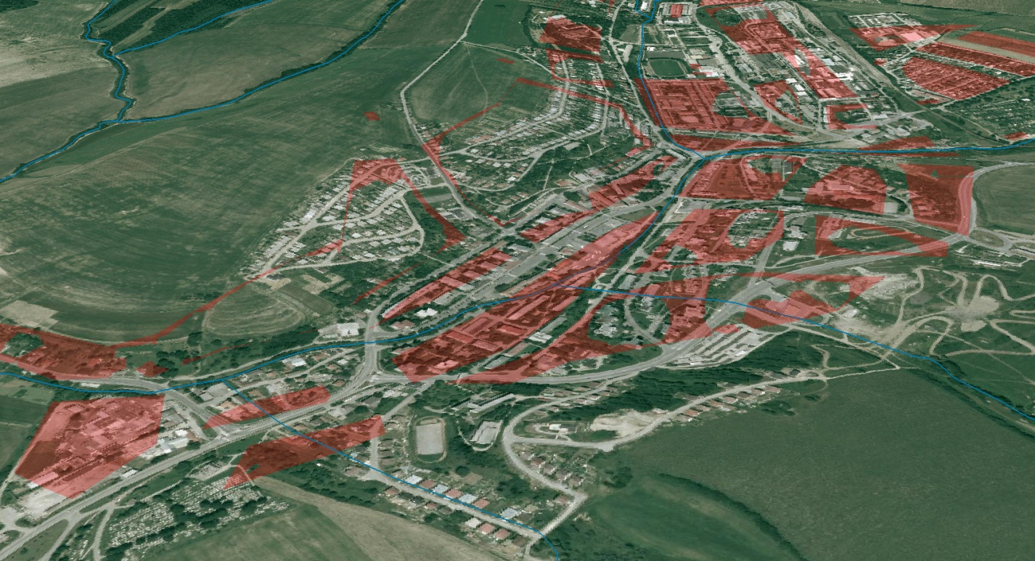
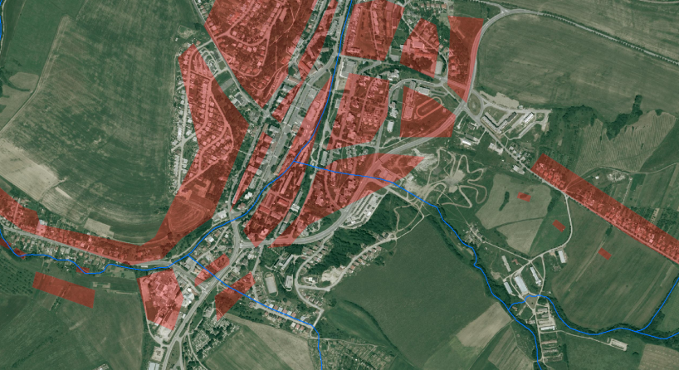
DÁTA PRE ZRANITEĽNOSŤ
Notes:
When assessing the flood hazard, a first indication can be obtained
by looking at how often floods occurred historically
and the magnitude of them. These can be mapped as point
events (as in Ireland, similar to Fig. 2a), or extents of historical
floods can be depicted on a flood extent map
The use
of historical flood maps is in this respect restricted since it is
impossible to compare them as return periods are not equal
and boundary conditions (streambed, land cover, etc.) may
have changed significantly over time.
The calculation of the flood hazard can be done using
methods of varying complexity (Buchele et al., 2006), depending
on the amount of data, resources, and time available.
While there are different approaches the conceptual framework
behind the calculation of flood hazards is quite general
(Fig. 1) and consists broadly of three steps:
The first step is to estimate discharges for specific return
periods. This can be done by using frequency analyses
on discharge records and fitting extreme value distributions.
Flood information (e.g. discharge, precipitation, or flood
moments) can be extrapolated to ungauged parts using
regionalisation techniques (see e.g. Merz and Bloschl,
2005). More often however, hydrological models are
used to calculate discharges.
Second. When discharges and their return periods have been derived
using the above mentioned approaches, a subsequent
step towards developing a flood map is to translate
discharges into water levels. This is usually done
with rating (stage-discharge) curves. Alternatively, 1-
D or 2-D hydrodynamic models can be used to determine
water levels.
In the third step the flooded area (and possibly flood
depth) is determined by combining water levels with
a digital elevation model (DEM), thus creating a flood
map showing flood extent or depth.

Slide 28
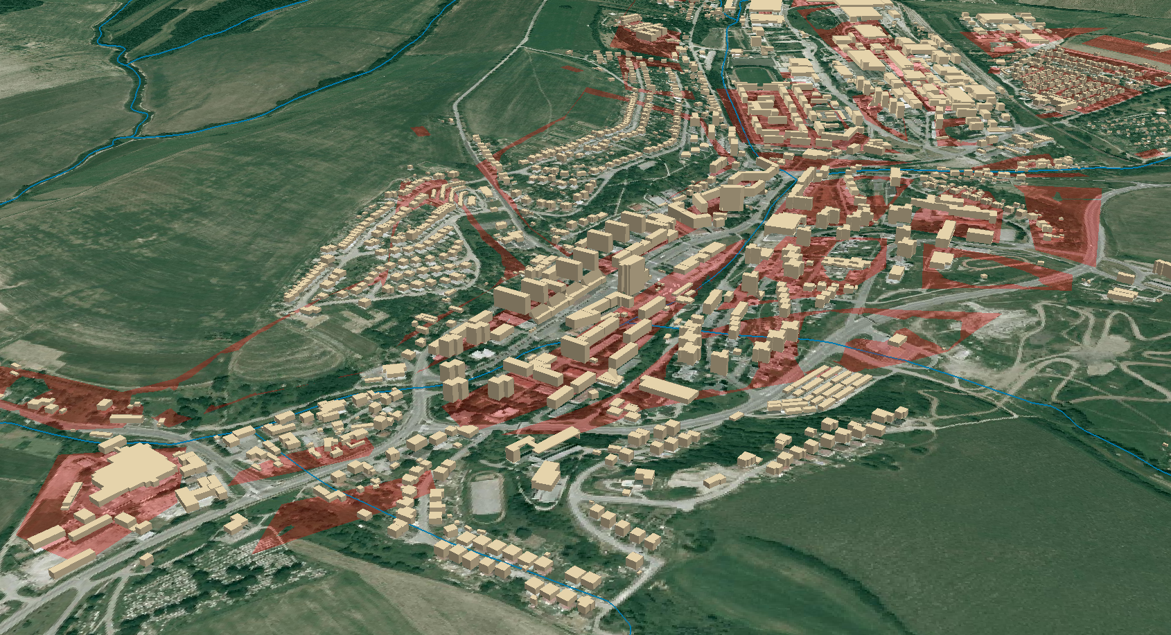
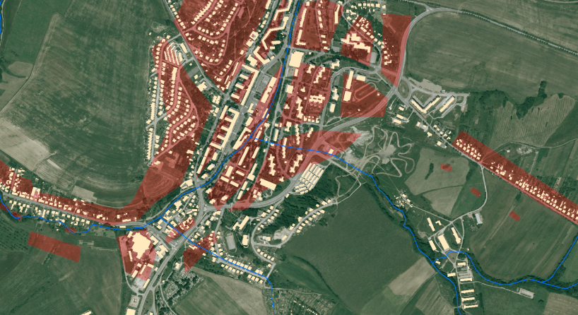
DÁTA PRE ZRANITEĽNOSŤ
Notes:
When assessing the flood hazard, a first indication can be obtained
by looking at how often floods occurred historically
and the magnitude of them. These can be mapped as point
events (as in Ireland, similar to Fig. 2a), or extents of historical
floods can be depicted on a flood extent map
The use
of historical flood maps is in this respect restricted since it is
impossible to compare them as return periods are not equal
and boundary conditions (streambed, land cover, etc.) may
have changed significantly over time.
The calculation of the flood hazard can be done using
methods of varying complexity (Buchele et al., 2006), depending
on the amount of data, resources, and time available.
While there are different approaches the conceptual framework
behind the calculation of flood hazards is quite general
(Fig. 1) and consists broadly of three steps:
The first step is to estimate discharges for specific return
periods. This can be done by using frequency analyses
on discharge records and fitting extreme value distributions.
Flood information (e.g. discharge, precipitation, or flood
moments) can be extrapolated to ungauged parts using
regionalisation techniques (see e.g. Merz and Bloschl,
2005). More often however, hydrological models are
used to calculate discharges.
Second. When discharges and their return periods have been derived
using the above mentioned approaches, a subsequent
step towards developing a flood map is to translate
discharges into water levels. This is usually done
with rating (stage-discharge) curves. Alternatively, 1-
D or 2-D hydrodynamic models can be used to determine
water levels.
In the third step the flooded area (and possibly flood
depth) is determined by combining water levels with
a digital elevation model (DEM), thus creating a flood
map showing flood extent or depth.

Slide 29
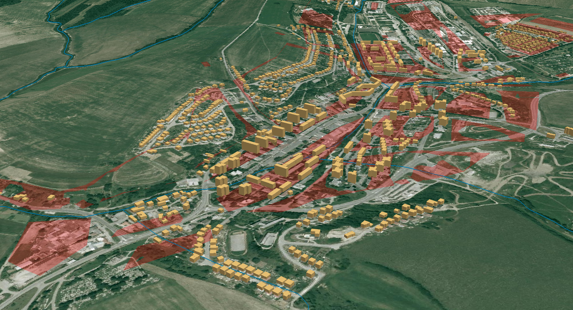
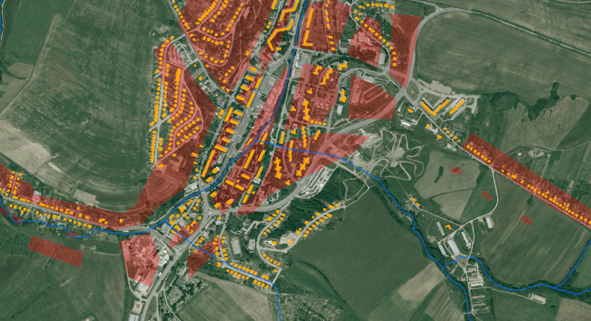
OBYTNÉ BUDOVY (2895 z 8630)
Notes:
When assessing the flood hazard, a first indication can be obtained
by looking at how often floods occurred historically
and the magnitude of them. These can be mapped as point
events (as in Ireland, similar to Fig. 2a), or extents of historical
floods can be depicted on a flood extent map
The use
of historical flood maps is in this respect restricted since it is
impossible to compare them as return periods are not equal
and boundary conditions (streambed, land cover, etc.) may
have changed significantly over time.
The calculation of the flood hazard can be done using
methods of varying complexity (Buchele et al., 2006), depending
on the amount of data, resources, and time available.
While there are different approaches the conceptual framework
behind the calculation of flood hazards is quite general
(Fig. 1) and consists broadly of three steps:
The first step is to estimate discharges for specific return
periods. This can be done by using frequency analyses
on discharge records and fitting extreme value distributions.
Flood information (e.g. discharge, precipitation, or flood
moments) can be extrapolated to ungauged parts using
regionalisation techniques (see e.g. Merz and Bloschl,
2005). More often however, hydrological models are
used to calculate discharges.
Second. When discharges and their return periods have been derived
using the above mentioned approaches, a subsequent
step towards developing a flood map is to translate
discharges into water levels. This is usually done
with rating (stage-discharge) curves. Alternatively, 1-
D or 2-D hydrodynamic models can be used to determine
water levels.
In the third step the flooded area (and possibly flood
depth) is determined by combining water levels with
a digital elevation model (DEM), thus creating a flood
map showing flood extent or depth.

Slide 30
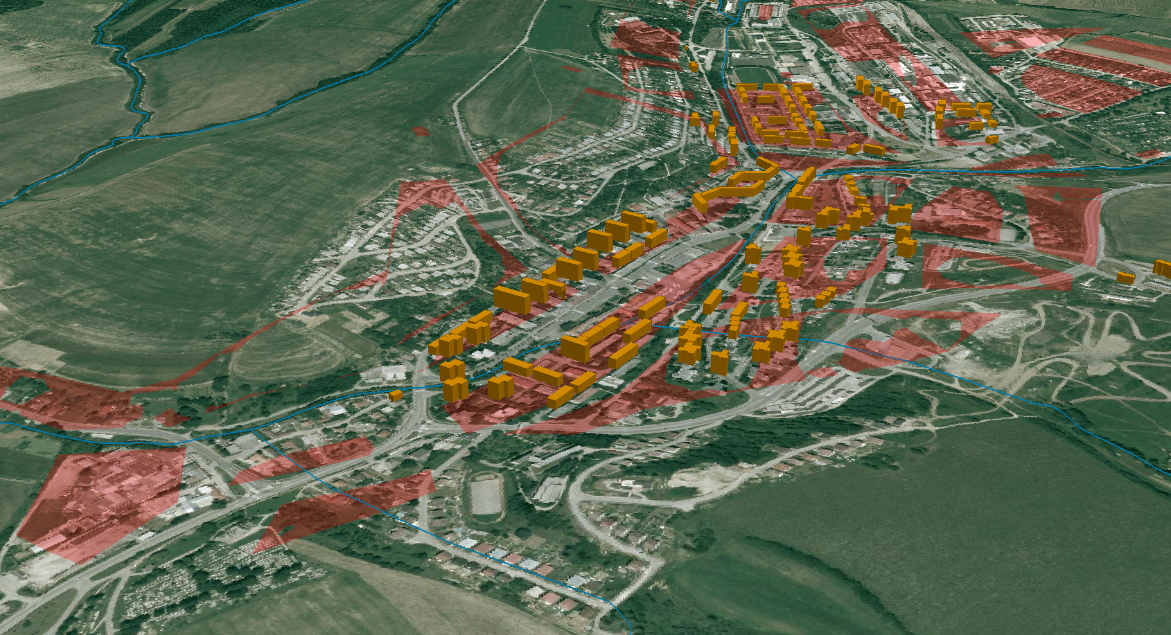
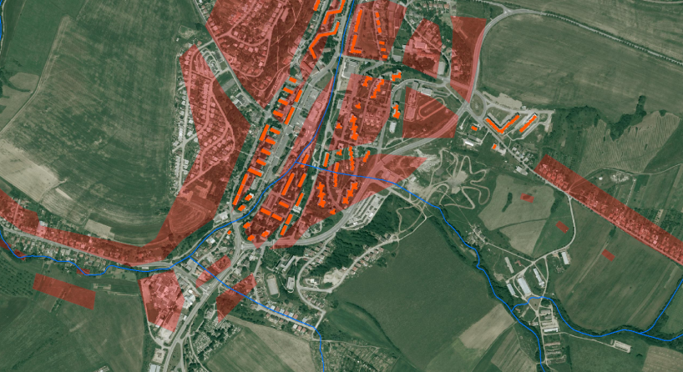
BYTOVÉ DOMY
Notes:
When assessing the flood hazard, a first indication can be obtained
by looking at how often floods occurred historically
and the magnitude of them. These can be mapped as point
events (as in Ireland, similar to Fig. 2a), or extents of historical
floods can be depicted on a flood extent map
The use
of historical flood maps is in this respect restricted since it is
impossible to compare them as return periods are not equal
and boundary conditions (streambed, land cover, etc.) may
have changed significantly over time.
The calculation of the flood hazard can be done using
methods of varying complexity (Buchele et al., 2006), depending
on the amount of data, resources, and time available.
While there are different approaches the conceptual framework
behind the calculation of flood hazards is quite general
(Fig. 1) and consists broadly of three steps:
The first step is to estimate discharges for specific return
periods. This can be done by using frequency analyses
on discharge records and fitting extreme value distributions.
Flood information (e.g. discharge, precipitation, or flood
moments) can be extrapolated to ungauged parts using
regionalisation techniques (see e.g. Merz and Bloschl,
2005). More often however, hydrological models are
used to calculate discharges.
Second. When discharges and their return periods have been derived
using the above mentioned approaches, a subsequent
step towards developing a flood map is to translate
discharges into water levels. This is usually done
with rating (stage-discharge) curves. Alternatively, 1-
D or 2-D hydrodynamic models can be used to determine
water levels.
In the third step the flooded area (and possibly flood
depth) is determined by combining water levels with
a digital elevation model (DEM), thus creating a flood
map showing flood extent or depth.

Slide 31
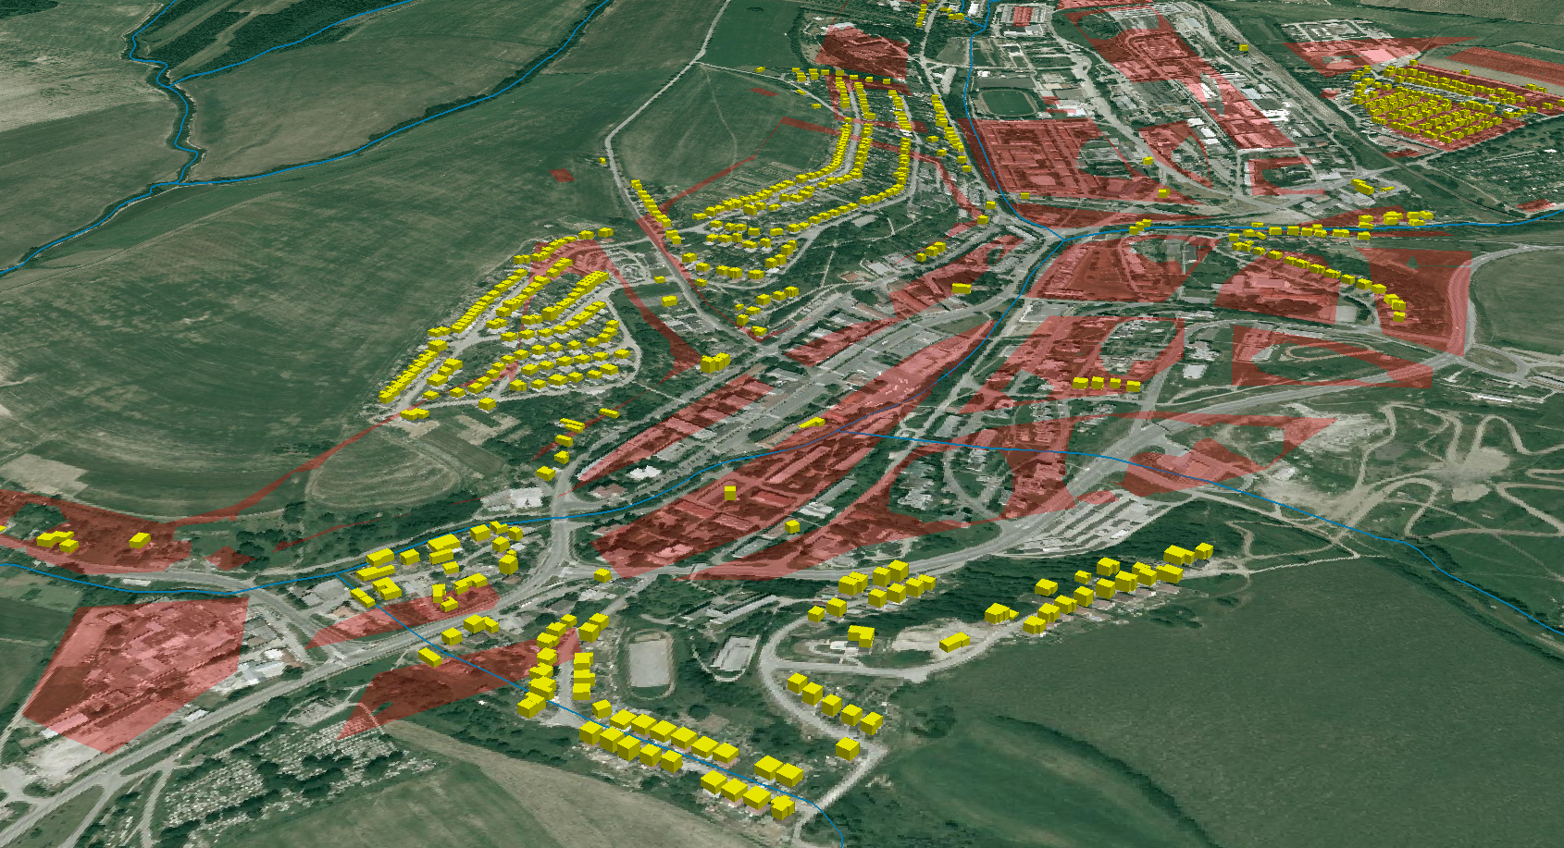
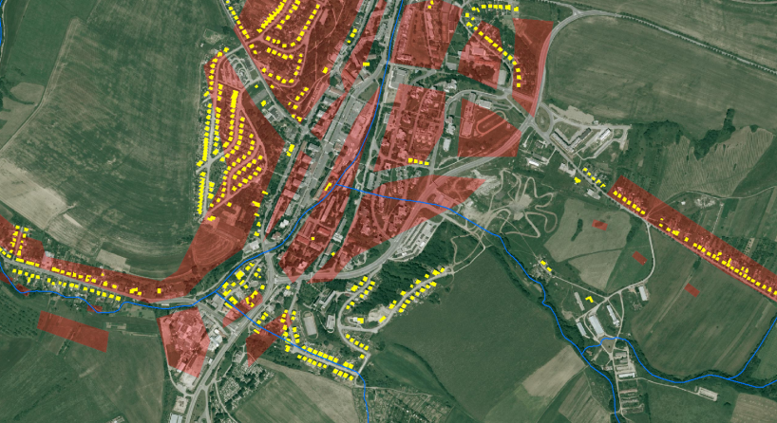
RODINNÉ DOMY
Notes:
When assessing the flood hazard, a first indication can be obtained
by looking at how often floods occurred historically
and the magnitude of them. These can be mapped as point
events (as in Ireland, similar to Fig. 2a), or extents of historical
floods can be depicted on a flood extent map
The use
of historical flood maps is in this respect restricted since it is
impossible to compare them as return periods are not equal
and boundary conditions (streambed, land cover, etc.) may
have changed significantly over time.
The calculation of the flood hazard can be done using
methods of varying complexity (Buchele et al., 2006), depending
on the amount of data, resources, and time available.
While there are different approaches the conceptual framework
behind the calculation of flood hazards is quite general
(Fig. 1) and consists broadly of three steps:
The first step is to estimate discharges for specific return
periods. This can be done by using frequency analyses
on discharge records and fitting extreme value distributions.
Flood information (e.g. discharge, precipitation, or flood
moments) can be extrapolated to ungauged parts using
regionalisation techniques (see e.g. Merz and Bloschl,
2005). More often however, hydrological models are
used to calculate discharges.
Second. When discharges and their return periods have been derived
using the above mentioned approaches, a subsequent
step towards developing a flood map is to translate
discharges into water levels. This is usually done
with rating (stage-discharge) curves. Alternatively, 1-
D or 2-D hydrodynamic models can be used to determine
water levels.
In the third step the flooded area (and possibly flood
depth) is determined by combining water levels with
a digital elevation model (DEM), thus creating a flood
map showing flood extent or depth.

Slide 32
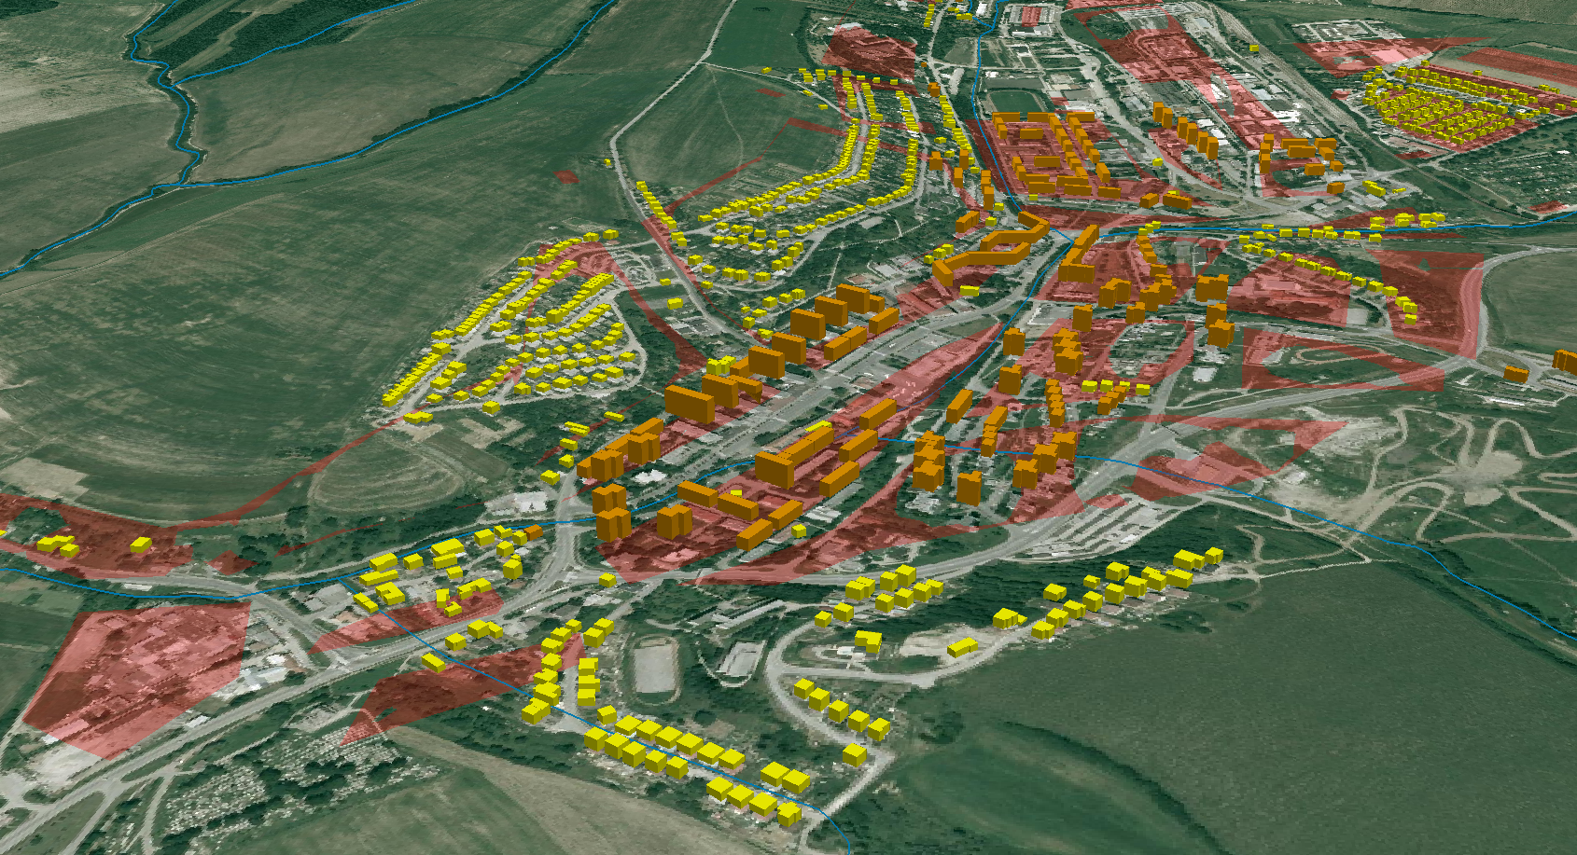
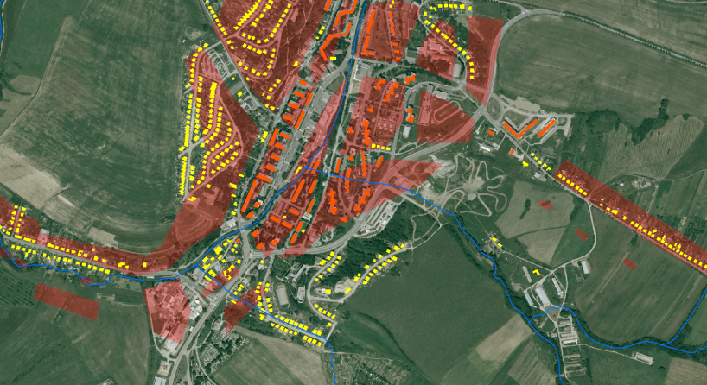
BYTOVÉ A RODINNÉ DOMY SPOLU
Notes:
When assessing the flood hazard, a first indication can be obtained
by looking at how often floods occurred historically
and the magnitude of them. These can be mapped as point
events (as in Ireland, similar to Fig. 2a), or extents of historical
floods can be depicted on a flood extent map
The use
of historical flood maps is in this respect restricted since it is
impossible to compare them as return periods are not equal
and boundary conditions (streambed, land cover, etc.) may
have changed significantly over time.
The calculation of the flood hazard can be done using
methods of varying complexity (Buchele et al., 2006), depending
on the amount of data, resources, and time available.
While there are different approaches the conceptual framework
behind the calculation of flood hazards is quite general
(Fig. 1) and consists broadly of three steps:
The first step is to estimate discharges for specific return
periods. This can be done by using frequency analyses
on discharge records and fitting extreme value distributions.
Flood information (e.g. discharge, precipitation, or flood
moments) can be extrapolated to ungauged parts using
regionalisation techniques (see e.g. Merz and Bloschl,
2005). More often however, hydrological models are
used to calculate discharges.
Second. When discharges and their return periods have been derived
using the above mentioned approaches, a subsequent
step towards developing a flood map is to translate
discharges into water levels. This is usually done
with rating (stage-discharge) curves. Alternatively, 1-
D or 2-D hydrodynamic models can be used to determine
water levels.
In the third step the flooded area (and possibly flood
depth) is determined by combining water levels with
a digital elevation model (DEM), thus creating a flood
map showing flood extent or depth.

Slide 33
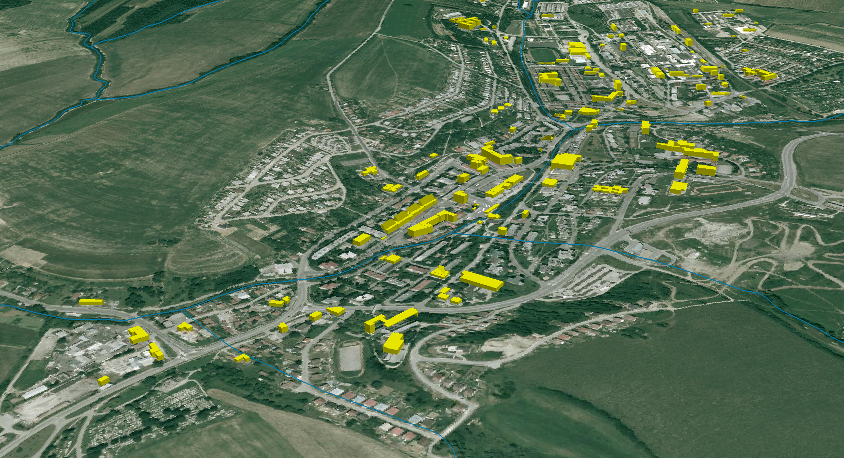
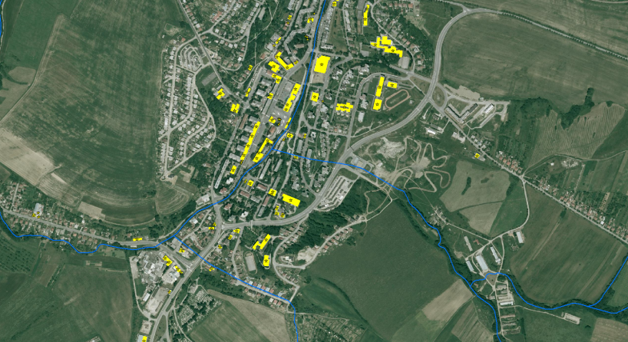
SOCIÁLNE HOTSPOTY – „DEŇ“
Notes:
When assessing the flood hazard, a first indication can be obtained
by looking at how often floods occurred historically
and the magnitude of them. These can be mapped as point
events (as in Ireland, similar to Fig. 2a), or extents of historical
floods can be depicted on a flood extent map
The use
of historical flood maps is in this respect restricted since it is
impossible to compare them as return periods are not equal
and boundary conditions (streambed, land cover, etc.) may
have changed significantly over time.
The calculation of the flood hazard can be done using
methods of varying complexity (Buchele et al., 2006), depending
on the amount of data, resources, and time available.
While there are different approaches the conceptual framework
behind the calculation of flood hazards is quite general
(Fig. 1) and consists broadly of three steps:
The first step is to estimate discharges for specific return
periods. This can be done by using frequency analyses
on discharge records and fitting extreme value distributions.
Flood information (e.g. discharge, precipitation, or flood
moments) can be extrapolated to ungauged parts using
regionalisation techniques (see e.g. Merz and Bloschl,
2005). More often however, hydrological models are
used to calculate discharges.
Second. When discharges and their return periods have been derived
using the above mentioned approaches, a subsequent
step towards developing a flood map is to translate
discharges into water levels. This is usually done
with rating (stage-discharge) curves. Alternatively, 1-
D or 2-D hydrodynamic models can be used to determine
water levels.
In the third step the flooded area (and possibly flood
depth) is determined by combining water levels with
a digital elevation model (DEM), thus creating a flood
map showing flood extent or depth.

Slide 34
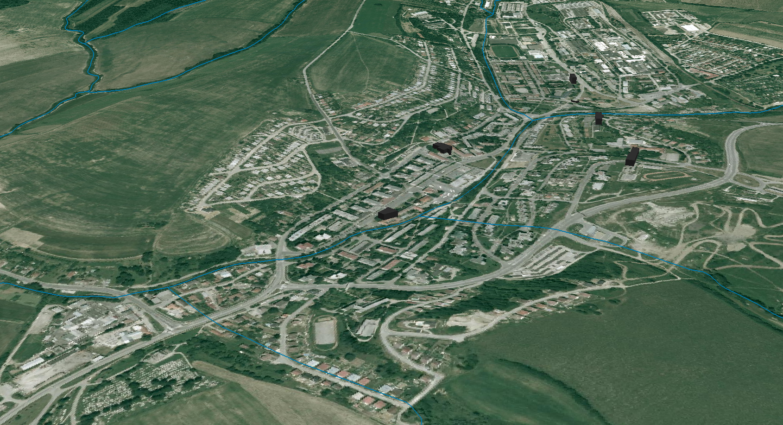
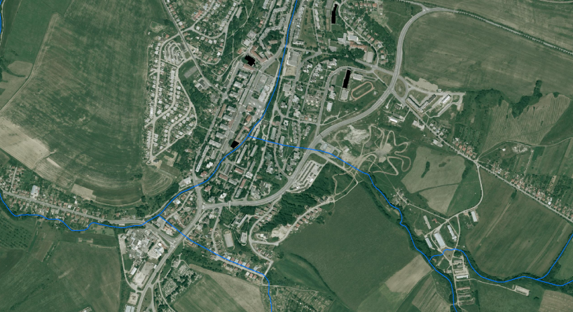
SOCIÁLNE HOTSPOTY – „NOC“
Notes:
When assessing the flood hazard, a first indication can be obtained
by looking at how often floods occurred historically
and the magnitude of them. These can be mapped as point
events (as in Ireland, similar to Fig. 2a), or extents of historical
floods can be depicted on a flood extent map
The use
of historical flood maps is in this respect restricted since it is
impossible to compare them as return periods are not equal
and boundary conditions (streambed, land cover, etc.) may
have changed significantly over time.
The calculation of the flood hazard can be done using
methods of varying complexity (Buchele et al., 2006), depending
on the amount of data, resources, and time available.
While there are different approaches the conceptual framework
behind the calculation of flood hazards is quite general
(Fig. 1) and consists broadly of three steps:
The first step is to estimate discharges for specific return
periods. This can be done by using frequency analyses
on discharge records and fitting extreme value distributions.
Flood information (e.g. discharge, precipitation, or flood
moments) can be extrapolated to ungauged parts using
regionalisation techniques (see e.g. Merz and Bloschl,
2005). More often however, hydrological models are
used to calculate discharges.
Second. When discharges and their return periods have been derived
using the above mentioned approaches, a subsequent
step towards developing a flood map is to translate
discharges into water levels. This is usually done
with rating (stage-discharge) curves. Alternatively, 1-
D or 2-D hydrodynamic models can be used to determine
water levels.
In the third step the flooded area (and possibly flood
depth) is determined by combining water levels with
a digital elevation model (DEM), thus creating a flood
map showing flood extent or depth.

Slide 35
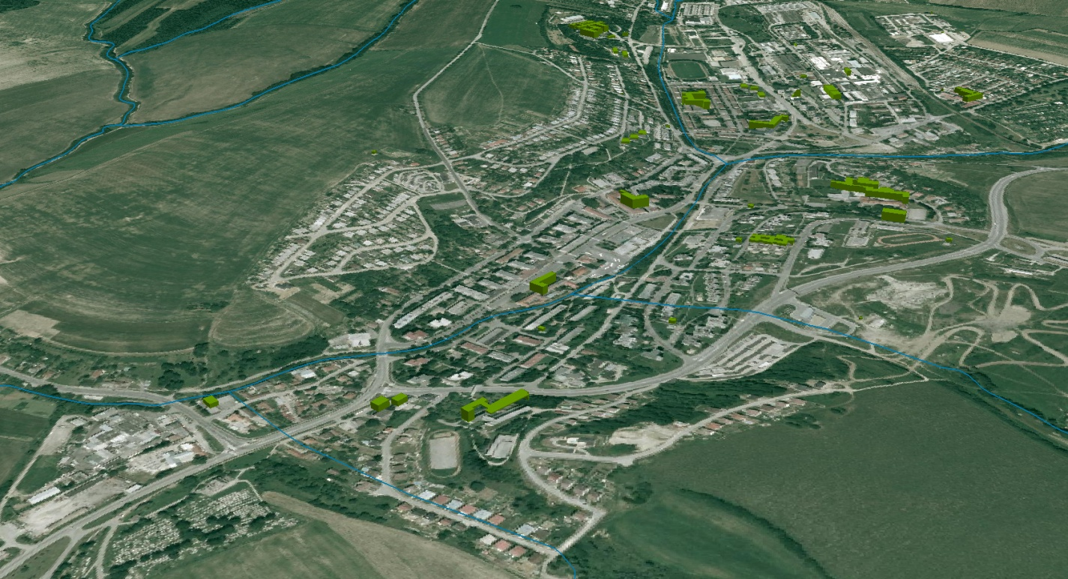
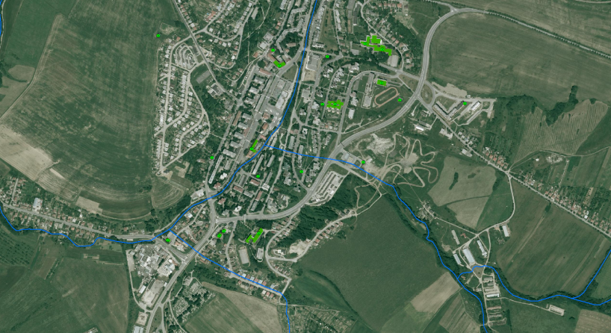
BUDOVY VŠEOBECNÉHO VÝZNAMU
Notes:
When assessing the flood hazard, a first indication can be obtained
by looking at how often floods occurred historically
and the magnitude of them. These can be mapped as point
events (as in Ireland, similar to Fig. 2a), or extents of historical
floods can be depicted on a flood extent map
The use
of historical flood maps is in this respect restricted since it is
impossible to compare them as return periods are not equal
and boundary conditions (streambed, land cover, etc.) may
have changed significantly over time.
The calculation of the flood hazard can be done using
methods of varying complexity (Buchele et al., 2006), depending
on the amount of data, resources, and time available.
While there are different approaches the conceptual framework
behind the calculation of flood hazards is quite general
(Fig. 1) and consists broadly of three steps:
The first step is to estimate discharges for specific return
periods. This can be done by using frequency analyses
on discharge records and fitting extreme value distributions.
Flood information (e.g. discharge, precipitation, or flood
moments) can be extrapolated to ungauged parts using
regionalisation techniques (see e.g. Merz and Bloschl,
2005). More often however, hydrological models are
used to calculate discharges.
Second. When discharges and their return periods have been derived
using the above mentioned approaches, a subsequent
step towards developing a flood map is to translate
discharges into water levels. This is usually done
with rating (stage-discharge) curves. Alternatively, 1-
D or 2-D hydrodynamic models can be used to determine
water levels.
In the third step the flooded area (and possibly flood
depth) is determined by combining water levels with
a digital elevation model (DEM), thus creating a flood
map showing flood extent or depth.

Slide 36
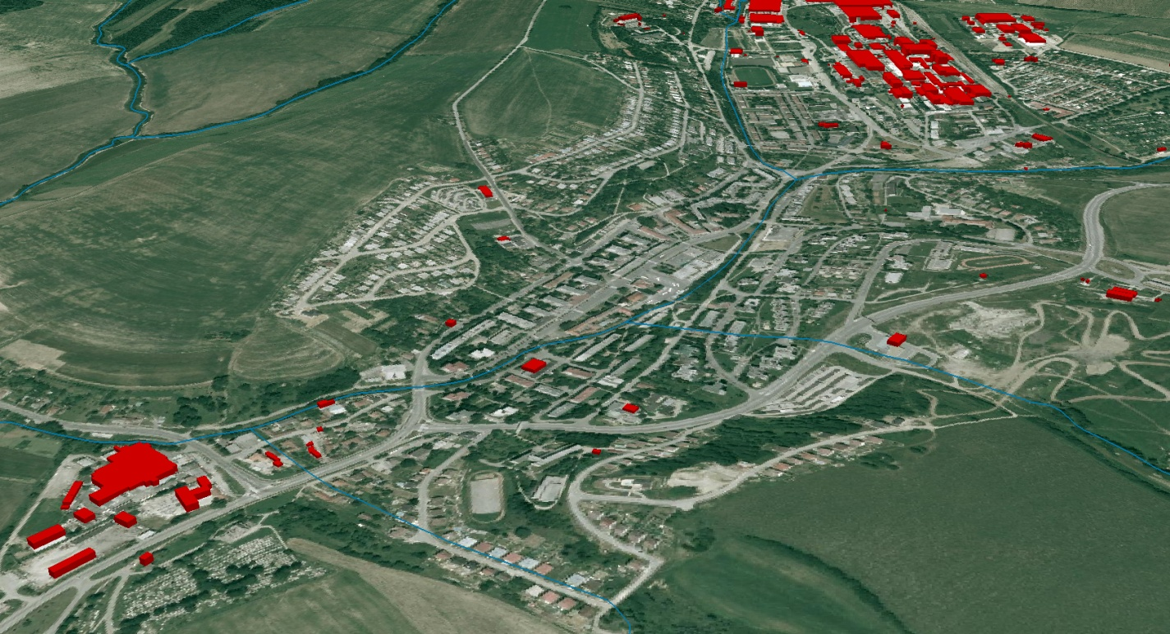
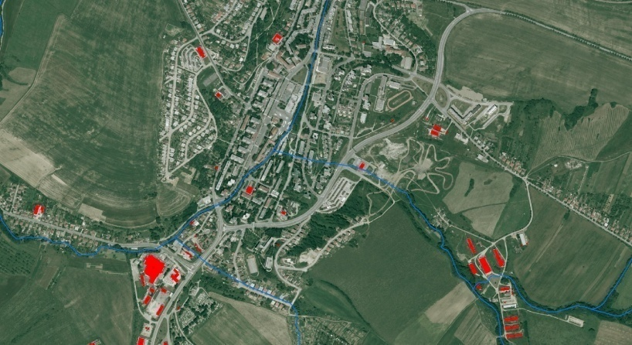
POTENCIÁLNE ZDROJE ZNEČISTENIA
Notes:
When assessing the flood hazard, a first indication can be obtained
by looking at how often floods occurred historically
and the magnitude of them. These can be mapped as point
events (as in Ireland, similar to Fig. 2a), or extents of historical
floods can be depicted on a flood extent map
The use
of historical flood maps is in this respect restricted since it is
impossible to compare them as return periods are not equal
and boundary conditions (streambed, land cover, etc.) may
have changed significantly over time.
The calculation of the flood hazard can be done using
methods of varying complexity (Buchele et al., 2006), depending
on the amount of data, resources, and time available.
While there are different approaches the conceptual framework
behind the calculation of flood hazards is quite general
(Fig. 1) and consists broadly of three steps:
The first step is to estimate discharges for specific return
periods. This can be done by using frequency analyses
on discharge records and fitting extreme value distributions.
Flood information (e.g. discharge, precipitation, or flood
moments) can be extrapolated to ungauged parts using
regionalisation techniques (see e.g. Merz and Bloschl,
2005). More often however, hydrological models are
used to calculate discharges.
Second. When discharges and their return periods have been derived
using the above mentioned approaches, a subsequent
step towards developing a flood map is to translate
discharges into water levels. This is usually done
with rating (stage-discharge) curves. Alternatively, 1-
D or 2-D hydrodynamic models can be used to determine
water levels.
In the third step the flooded area (and possibly flood
depth) is determined by combining water levels with
a digital elevation model (DEM), thus creating a flood
map showing flood extent or depth.

Slide 37
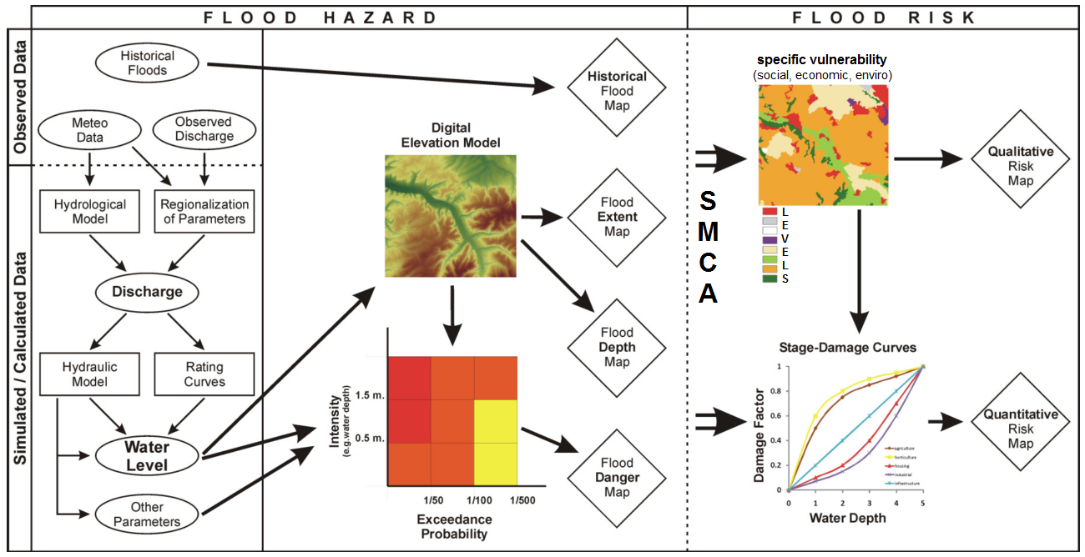
KONCEPT RIEŠENIA - STAV ROZPRACOVANIA
zdroj obrázku : de Moel, H. et al (2009): Flood maps in Europe – methods, availability and use
Notes:
Mapy zobrazujúce povodnový hazard zvycajne obsahujú informáciu
o pravdepodobnosti výskytu konkrétnej N-rocnej povodne a jej plošnom rozsahu. Velmi zriedkavo sa
uvádzajú informácie o rýchlosti prúdenia, dobe zaplavenia, ci rýchlosti stúpania hladiny. Mapy povodnového
rizika na druhej strane obsahujú informácie o negatívnych dopadoch podvodne, ako napríklad: pocet
postihnutých obyvatelov, kvantifikované škody, environmentálna zátaž a pod. (de Moel et al. 2009). Aj
spomínaná európska smernica 2007/60/EC „O hodnotení a manažmente povodnových rizík“ presne
stanovuje, co pripravované mapy musia obsahovat. Mapy povodnového hazardu musia byt vytvorené pre
všetky riecne úseky s malou a strednou pravdepodobnostou výskytu povodne (N 100) a kde je to nutné, aj
pre úseky s vysokou pravdepodobnostou výskytu povodne (N 10). Mapy povodnové rizika pre tieto kritické
úseky musia obsahovat informáciu o orientacnom pocte potenciálne postihnutých obyvatelov, druhu
hospodárskej cinnosti a potenciálnych zdrojoch znecistenia

Slide 38
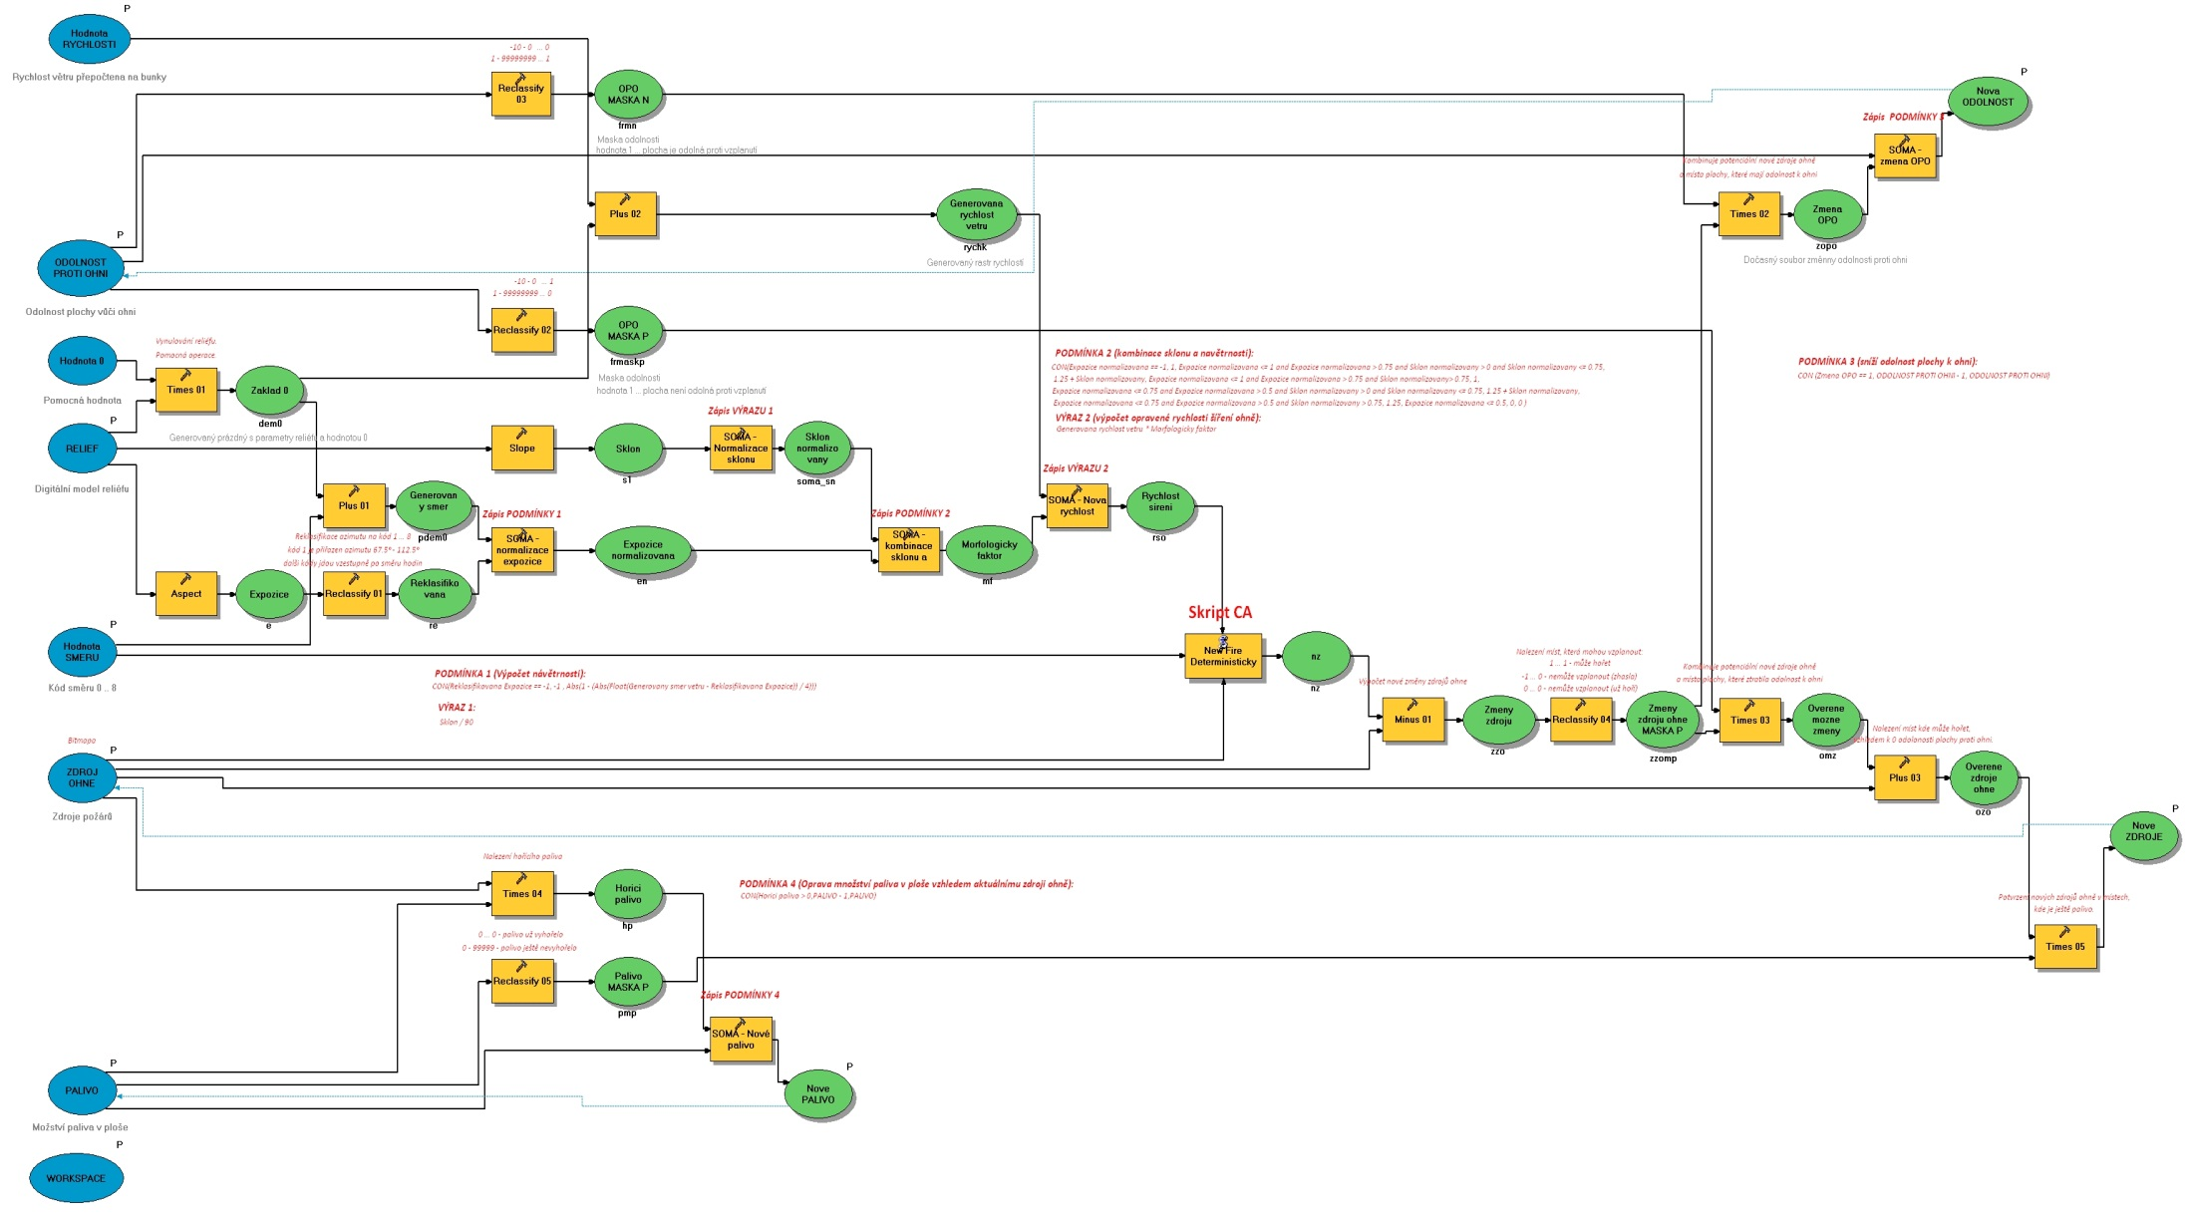
AUTOMATIZÁCIA PROCESU HODNOTENIA „ArcGIS MODEL BUILDER“
Notes:
When assessing the flood hazard, a first indication can be obtained
by looking at how often floods occurred historically
and the magnitude of them. These can be mapped as point
events (as in Ireland, similar to Fig. 2a), or extents of historical
floods can be depicted on a flood extent map
The use
of historical flood maps is in this respect restricted since it is
impossible to compare them as return periods are not equal
and boundary conditions (streambed, land cover, etc.) may
have changed significantly over time.
The calculation of the flood hazard can be done using
methods of varying complexity (Buchele et al., 2006), depending
on the amount of data, resources, and time available.
While there are different approaches the conceptual framework
behind the calculation of flood hazards is quite general
(Fig. 1) and consists broadly of three steps:
The first step is to estimate discharges for specific return
periods. This can be done by using frequency analyses
on discharge records and fitting extreme value distributions.
Flood information (e.g. discharge, precipitation, or flood
moments) can be extrapolated to ungauged parts using
regionalisation techniques (see e.g. Merz and Bloschl,
2005). More often however, hydrological models are
used to calculate discharges.
Second. When discharges and their return periods have been derived
using the above mentioned approaches, a subsequent
step towards developing a flood map is to translate
discharges into water levels. This is usually done
with rating (stage-discharge) curves. Alternatively, 1-
D or 2-D hydrodynamic models can be used to determine
water levels.
In the third step the flooded area (and possibly flood
depth) is determined by combining water levels with
a digital elevation model (DEM), thus creating a flood
map showing flood extent or depth.

