Slide 1
The Secondary Data Collection
Lesson 4- 15.10.2013

Slide 2
What are Secondary Data
‘Secondary data’ means the information which has already been collected by someone else (researchers, institutions or NGOs), for other purposes than the one currently being considered (Cnossen, 1997) . They include
Official data collected by public bodies by spending public money.
Data collected by firms NGOs or individuals.

Slide 3
Sources of Secondary Data
Government and their various agencies, bureaus, departments (Census of population, agriculture or industries.
Administrative Records
Technical reports: account of work done on development projects (feasibility studies)
Diaries
Planning documents (EIA reports)
Maps
Areal photographs
Sound recordings (Radio and TV Programmes)

Slide 4
National Level Secondary Data
Demographic data (population, rural/urban, ethnic group)
Economic data (income, poverty, subsidies
Social data (employment, local institutions,
Cultural data (religion, ethnicity,
Infrastructure
Most of such data could be at aggregate level, however, depending on the country you can go for lower levels(in Sri Lanka, the lowest unit is GN level.
How much the data are realistic? (National pride,
Data could be old, as it is taken once after a regular interval).

Slide 5
Sources of selected official statistical data in Developing Countries
Country | Source | Remarks
India | http://www.censusindia.net | Office of the Registrar General and Census Commissioner of India
Sri Lanka | www.statistics.gov.lk | Department of Census and Statistics of Sri Lanka
Nepal | cbs.gov.np | Government of Nepal Central Bureau of Statistics
Bangladesh | www.bbs.gov.bd | Bangladesh Bureau of Statistics

Slide 6
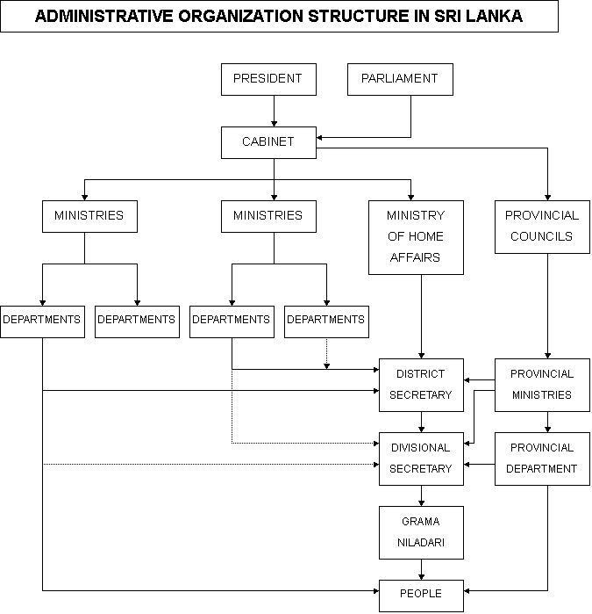
General Administrative Structure: Secondary Data Collection Point

Slide 7
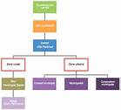
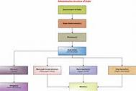
Administrative Structure
India
Nepal

Slide 8
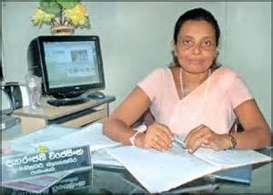
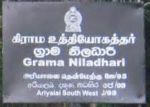
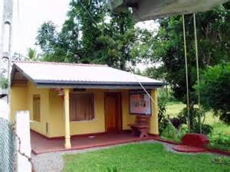
Data Available at GND Level in Sri Lanka
Grama Niladari Division(GND) is the lowest Administrative Division
A Grama Niladari
Grama Niladari Office

Slide 9
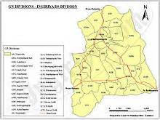
GND Map
-Crude map of the village, most occasions no scale. But such maps can also contain some village specific additional information which are not available in the other large scale maps.

Slide 10
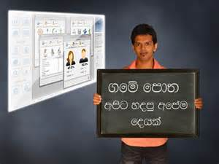
Lists pasted on the walls of the GN’s office

Slide 11
Resource profile of the GND

Slide 12
Household name list in the GND

Slide 13
Agricultural land use in the GND

Slide 14
Advantages of Secondary Data
Easy to build up the background of the research area. This is very important particularly for an outside researcher
Easy to collect
Researcher can save time and money
Can easily be used for trend analysis as long term data is available

Slide 15
Disadvantages of Secondary Data
It is not often possible to judge on quality of secondary data
Sources may conflict with each other
Secondary data can not reveal individual or group values, beliefs or reasons that may be underlining the currant trends (Beaulieu, 1992)
Unit of secondary data collection (income you can have gross income, if you want disposable income, you can not get)

Slide 16
Quality of Secondary Data in Developing Countries
Government official data- comprehensive, available for a long term, and generally trustable
But, at certain occasions they may characterize following problems owing to under-skilled enumerators used and lack of supervision
Unreliability
Data gaps
Inaccuracies
Mutual inconsistencies (Gill, 1993)

Slide 17
Evaluation of secondary data
Availability
Relevance (units of measurement and concepts used must be the same)
Accuracy
Sufficiency

Slide 18
Towards resolving problems
Make use of local Experts: regarding quality of data seek advice from sector specialists, country offices, colleagues in the universities and research stations
Yourself determine the original purpose of the data collected (Novak, 1996)
Attempt to ascertain the credentials of the source or author (education backgrounds, past works
Pay skeptical attention of employment data. “It is very difficult to count on the employment data accurately, especially in developing countries” (Katherine, 2005)- Informal or unrecorded activities, such as seasonal agricultural workers, women’s agricultural labor, Child labor, primary employment, secondary or other

Slide 19
For the discussion on 22.10.2014
Make a list of secondary data available at the lowest level administrative unit where you live preferably with a map
Taking into account a developing country construct a research topic for you to study a geographical problem

