Slide 1
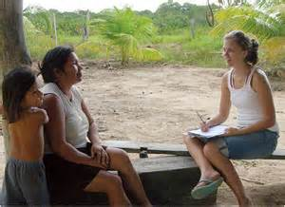
Administration of Questionnaires
Lesson 7
29.10.2013

Slide 2
Possible choices
Surveys based on face to face interviews
Postal Surveys
Telephone Surveys
Online Surveys (social media or any other)
Can we assume face to face interviews as most feasible way to collect data from developing countries ?

Slide 3
Sampling Methods for DC: Considerations
The geographical,
ethnic
linguistic situation and,
The existing sociological structures
UNESCO 1963. P.8

Slide 4
Sampling related matters
What types
Simple random sampling
Stratified sampling
Multi- Stage sampling
Do we have enough information to select samples from developing countries?
Name lists
Maps showing geographical boundaries
Some micro-features not available in maps

Slide 5
Towards some solutions
Field familiarization visits
Topo maps, Google map
Taking the help from village headman or any other knowledgeable persons to manage the survey
Boundaries of village, communities etc., initiatives to take samples

Slide 6
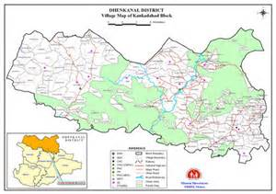
Village map showing different segments

Slide 7
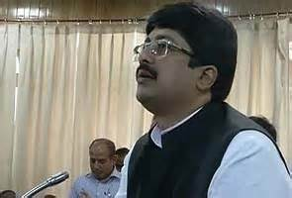
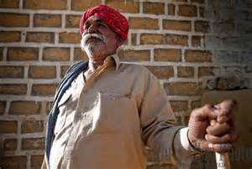
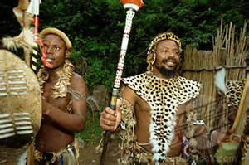
Range of socio-economic background of village leaders
Village Headman in Rajasthan
Village Headman in Uttar Predesh
Simunaya village headman (S. Africa)

Slide 8
Local Headmen’s in Managing Surveys
They have an intimate knowledge of their culture
Knowledgeable local peoples’ support to plan the survey and to know where about for more logistical things can be used.
Be informed heads/chiefs of the tribe in advance
Fink notes this for Laos and
Hoffmann for Africa. (p.13)

Slide 9
Determining the respondents and responses
Doubts | Options | Remarks
Who will be the respondents? | Chief household- Husband/wife | Is it possible to make a prior appointment? Is it possible to pay attention to their free times (ethics?)
Will they be available? | Any other matured family member Visiting later Collecting data from next house
Nature of responses | Personal Collective | Taboos, bound by family and community (individual Quest. May not be ideal)

Slide 10
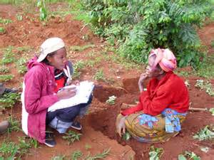
Interviewers
Ideal to have interviewers from the same ethnic group
Same social status to avoid inferiority
A prior training may be important
Supervisor for a several enumerators

Slide 11
Box 1: interviewer training in Laos social Survey (thee and half day training)
1st, day morning- Training of ‘do’s and ‘don’t s
1st, day afternoon- Explanation of questionnaire
2nd’ day morning- Mock interviews with friends
2nd’ day afternoon Discussion & review of m. interviews
3rd’ day morning Interview with a stranger
3rd’ day afternoon Review interviews and exp. sampling
Fink, R. (1963)

Slide 12

Afternoon reviewing and debriefing of interviewers works
Editing errors
Completing incomplete parts

Slide 13
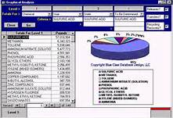
At last you will have duly completed required number of questionnaires. Out of them now you can develop data bases and start analysis.

Slide 14
For Next Week Discussion (05.11.2014)
1. Study the following article
Preliminary Investigation and Interview Guide Development or Studying how Malaysian Farmers’ Form their Mental
Models of Farming
Steven Eric Krauss, Azimi Hamzah, Zoharah Omar, Turiman Suandi, Ismi Arif Ismail and Mohd Zaidan Zahari
2. Write the introduction and elaborate your research objectives (Maximum 2 pages)

